Slide 1
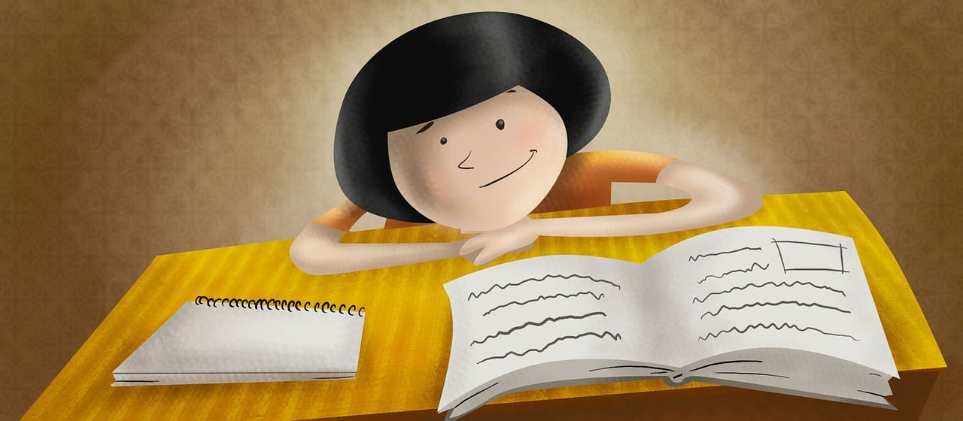
Asking and answering questions: what you’re like at the moment and in general
Repaso (revision) SER & ESTAR [revisited] SSCs [ge], [gi], [j] [revisited]
Y7 Spanish Term 2.1 - Week 5 - Lesson 37 Amanda Izquierdo / Nick Avery / Rachel Hawkes Artwork: Mark Davies Date updated: 16.01.24
Notes:
All pictures selected are available under a Creative Commons license, no attribution required.
Note: all words (new and revisited) in this week of the SOW appear on all three GCSE wordlists, with the following exception:
i) AQA and Edexcel lists do not have feo. Learning outcomes (lesson 1):
Consolidation of the following features:
SER – 1st and 2nd person singular (soy, eres)
ESTAR – 1st and 2nd persons singular (estoy, estás)
Gender agreement on adjectives
Consolidation of SSCs [ge], [gi] & [j]
Note: a little space is left in lesson 1 to allow time for instructions regarding next week’s (7.2.1.6) assessments and/or to do peer revision, as appropriate.
Word frequency (1 is the most frequent word in Spanish):
2.1.2 (revisit) tenemos [tener-19]; tienen [19]; perro [888]; abuelo [4796]; abuela [717]; trabajo²; [152] primo [1451]; prima [3051]; bastante [308]; hermoso [980]; activo [1278]; fuerte [435]
1.2.4 (revisit) son [ser-7]; pequeño [202]; bueno [98]; malo [368]; famoso [997]; bonito [891]; feo [2373]; rico¹ [398]; caro [2179]; barato [2164]; antiguo [446] ¿cómo es? [cómo-151]
Source: Davies, M. & Davies, K. (2018). A frequency dictionary of Spanish: Core vocabulary for learners (2nd ed.). Routledge: London
The frequency rankings for words that occur in this PowerPoint which have been previously introduced in NCELP resources are given in the NCELP SOW and in the resources that first introduced and formally re-visited those words.
For any other words that occur incidentally in this PowerPoint, frequency rankings will be provided in the notes field wherever possible.

Slide 2
j
ge
gi
ojo
gente
imaginar
Notes:
Timing: 1 minute
Aim: for students to revisit the individual SSC [j], [ge] and [gi] with their source words.
Procedure:
1. Recap and elicit the pronunciation of the individual SSC [j]’ and then the source word again (with gesture, if using).
2. Repeat with [ge] and [gi].

Slide 3
Fonética
escuchar / escribir
Escucha y escribe la palabra. ¿Es [ge], [gi] o [j]? Luego, escribe la frase en inglés.
La ______ está _____ de la ______.
The woman is far from the people.
1
mujer
lejos
gente
El chico es _____ .
The boy is short.
2
bajo
3
Es un ______ muy _______ .
The drawing is very original.
dibujo
original
4
El _______ en _______ es ______.
(The) work in pairs is better.
trabajo
parejas
mejor
¿Puedes _________ un _______ ____?
5
imaginar
pájaro
rojo
Can you imagine a red bird?
6
argentino
El chico __________ está en el _______.
colegio
The Argentinian boy is in the school.
Notes:
Timing: 9 minutes
Aim: for students to consolidate their spelling of words that begin with soft ‘g’ and ‘j’.
Procedure:
1. Teachers play the audio once by clicking the number button and students write the missing words.
2. Teachers show the answers by clicking for each sentence, one by one.
3. Teachers play the audio again each time so students can listen and read at the same time.
Transcript:
La mujer está lejos de la gente.
El chico es bajo.
Es un dibujo muy orginal.
El trabajo en parejas es mejor.
¿Puedes imaginar un pájaro rojo?
El chico argentino está en el colegio.
Notes:
As these sound the same, the activity tests individual word knowledge, rather than SSC knowledge. Audio is provided to reinforce the sound of the SSC, rather than to give a cue for correct spelling.

Slide 4
Vocabulario
escuchar
español
inglés
1
caro
expensive
2
barato
cheap
3
activo
active
4
pequeño
small
5
fuerte
strong
6
bueno
good
7
malo
bad
8
famoso
famous
9
bonito
beautiful
10
feo
ugly
Notes:
Timing: 8 minutes
Aim: Vocabulary exercise to revisit previously taught adjectives in the oral and written modalities. In later activities, students will be using these words in production.
Procedure: 1. Teachers click the number button to hear the word in Spanish. 2. Students should write down the word in Spanish and then the meaning in English. 3. Teachers click to check answers for each question.
Transcript: 1. caro
2. barato
3. activo
4. pequeño
5. fuerte
6. bueno
7. malo
8. famoso
9. bonito
10. feo

Slide 5
SER and ESTAR
gramática
In Spanish, there are two ways to say ‘I am’: ________ and _______
estoy
soy
estoy
Use ‘______’ for temporary state/mood.
With ‘estar’, English often uses a verb with –ing: e.g. ‘I’m feeling nervous’.
Use ‘______’ for permanent traits.
soy
I am active (trait).
Soy activo/a.
I am nervous (state).
Estoy nervioso/a.
Notes:
Timing: 1 minute
Aim: This revision slide can be used for interactive elicitation of the previously taught verbs ‘estoy’ and ‘soy’ and their respective functions before the subsequent activity.
Procedure:
Teachers click to show the sentence and ask students what the two ways of saying ‘I am’ are. Answers are then shown by clicking.
Definitions of why ‘estoy’ and ‘soy’ are used, again with the answers blanked out to elicit answers from students.
Teachers click again to show examples and then a call out bubble for explaining how ‘estar’ could be translated in English.

Slide 6
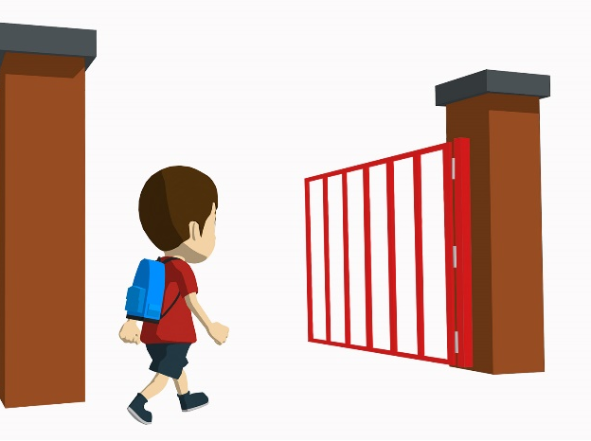
leer
Hoy, Daniel está en clase. Lucía también.
Lee la frase. ¿Es ‘hoy’ [temporary state] o ‘en general’ [trait]?
¿Y quién habla?
 |  | Hoy | En general | Daniel, Lucia or could be either? | En inglés
1. | Estoy tranquila. |  |  | Lucía | I am calm / I am feeling calm.
2. | Soy fuerte. |  |  | either | I am strong.
3. | Soy activa. |  |  | Lucía | I am active.
4. | Estoy tonta. |  |  | Lucía | I am silly / I am acting silly.
5. | Estoy guapo. |  |  | Daniel | I am looking good.
6. | Soy alegre. |  |  | either | I am cheerful.
Notes:
Timing: 5 minutes
Aim: to practise differentiating between ‘estoy’ for temporary state and ‘soy’ for trait. Adjective agreement is also practised here
Procedure:
Students read the sentences and decide if the speaker refers to ’hoy’ (today) or ‘en general’ (in general).
The teacher then clicks to go through these answers.
Students then fill out the ‘Daniel, Lucia, or either’ column answers by looking at the ending of the adjective? Teacher clicks to go through the answers.
The students should then write the sentence in English, and then the answers are checked.

Slide 7
SER and ESTAR
gramática
In Spanish, there are two ways to say ‘you are’: ________ and _______
estás
eres
Use ‘______’ for temporary state/mood.
estás
Use ‘______’ for permanent traits.
eres
¿Cómo se dice en inglés?
You are famous (trait).
Eres famoso/a.
¿Cómo estás?
How are you?
¿Cómo eres?
What are you like?
You are looking serious (state).
Estás serio/a.
Notes:
Timing: 2 minutes
Aim: to revise the target grammar forms ‘estás’ and ‘eres’ and their respective functions before the subsequent activity.
Procedure:
The procedure here is the same as the ‘soy/estoy’ slide. Teachers click to show the first sentence with the answers missing to enable students to be asked to recall the words. These are then shown by clicking.
The explanations of when ‘estás’ and ‘eres’ are used are then shown with the answers missing, which are then shown by clicking after students have answered.
Teachers then click to show example sentences, and then a callout button asking what ‘¿cómo estás? and ¿cómo eres?’ mean, followed by their translations.

Slide 8
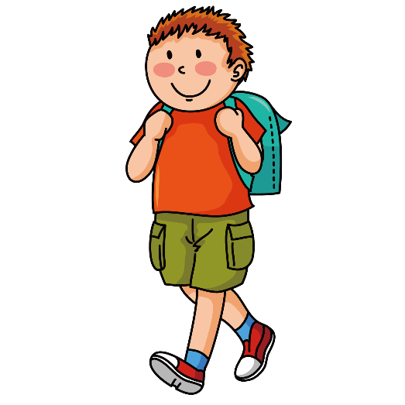
escuchar
Some new students in class are introducing themselves.
escuchar
Escuchas unas respuestas. ¿Cuál es la pregunta?
 | Says how s/he is (today) | Says what s/he is like (in general) | ¿Chico, chica o los dos? | ¿Cómo eres? o ¿Cómo estás?
1. |  |  | chico | ¿Cómo estás?
2. |  |  | chica | ¿Cómo eres?
3. |  |  | chico | ¿Cómo estás?
4. |  |  | chico | ¿Cómo eres?
5. |  |  | los dos | ¿Cómo eres?
6. |  |  | chica | ¿Cómo estás?
1
2
3
4
5
6
Notes:
Timing: 6 minutes
Aim: to practise distinguishing between the meanings of ‘estoy ‘ and ‘soy’ and to further consolidate knowledge of adjectival agreement.
Procedure:
Students copy out the grid and will listen to these responses and tick if the person speaking is referring to ‘today’ or ‘in general’. Teachers click the number button to play the recording.
Students listen again and decide if it’s a boy or a girl speaking. It could also be either. They will need to pay attention to the ending of the adjective.
Lastly, students write the original question for each answer. Was the question ‘¿Cómo eres?’ o ‘¿Cómo estás?’?
Teachers click to go through each individual answer for each question.
Transcript:
Estoy nervioso.
Soy simpática.
Estoy raro.
Soy bueno.
Soy interesante.
Estoy seria.

Slide 9
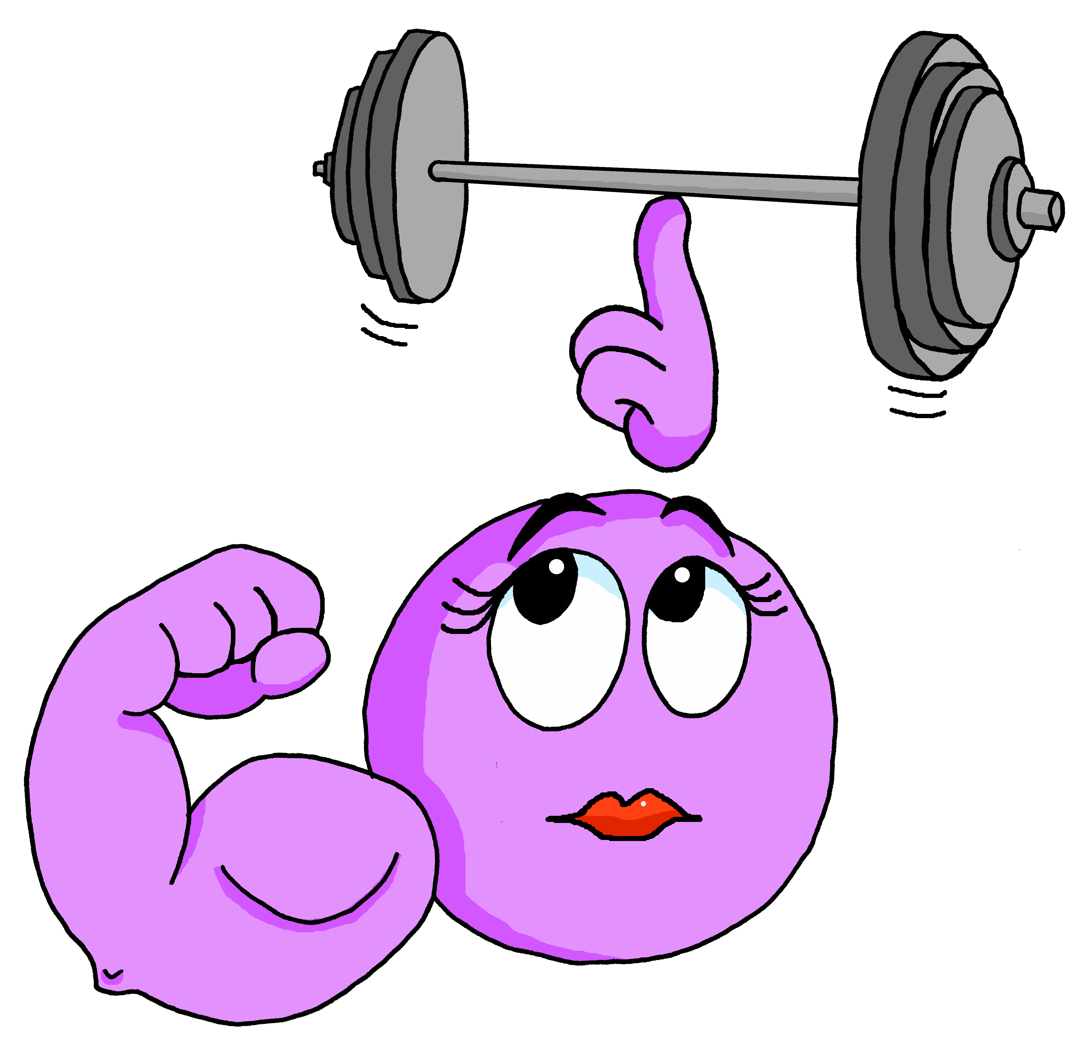
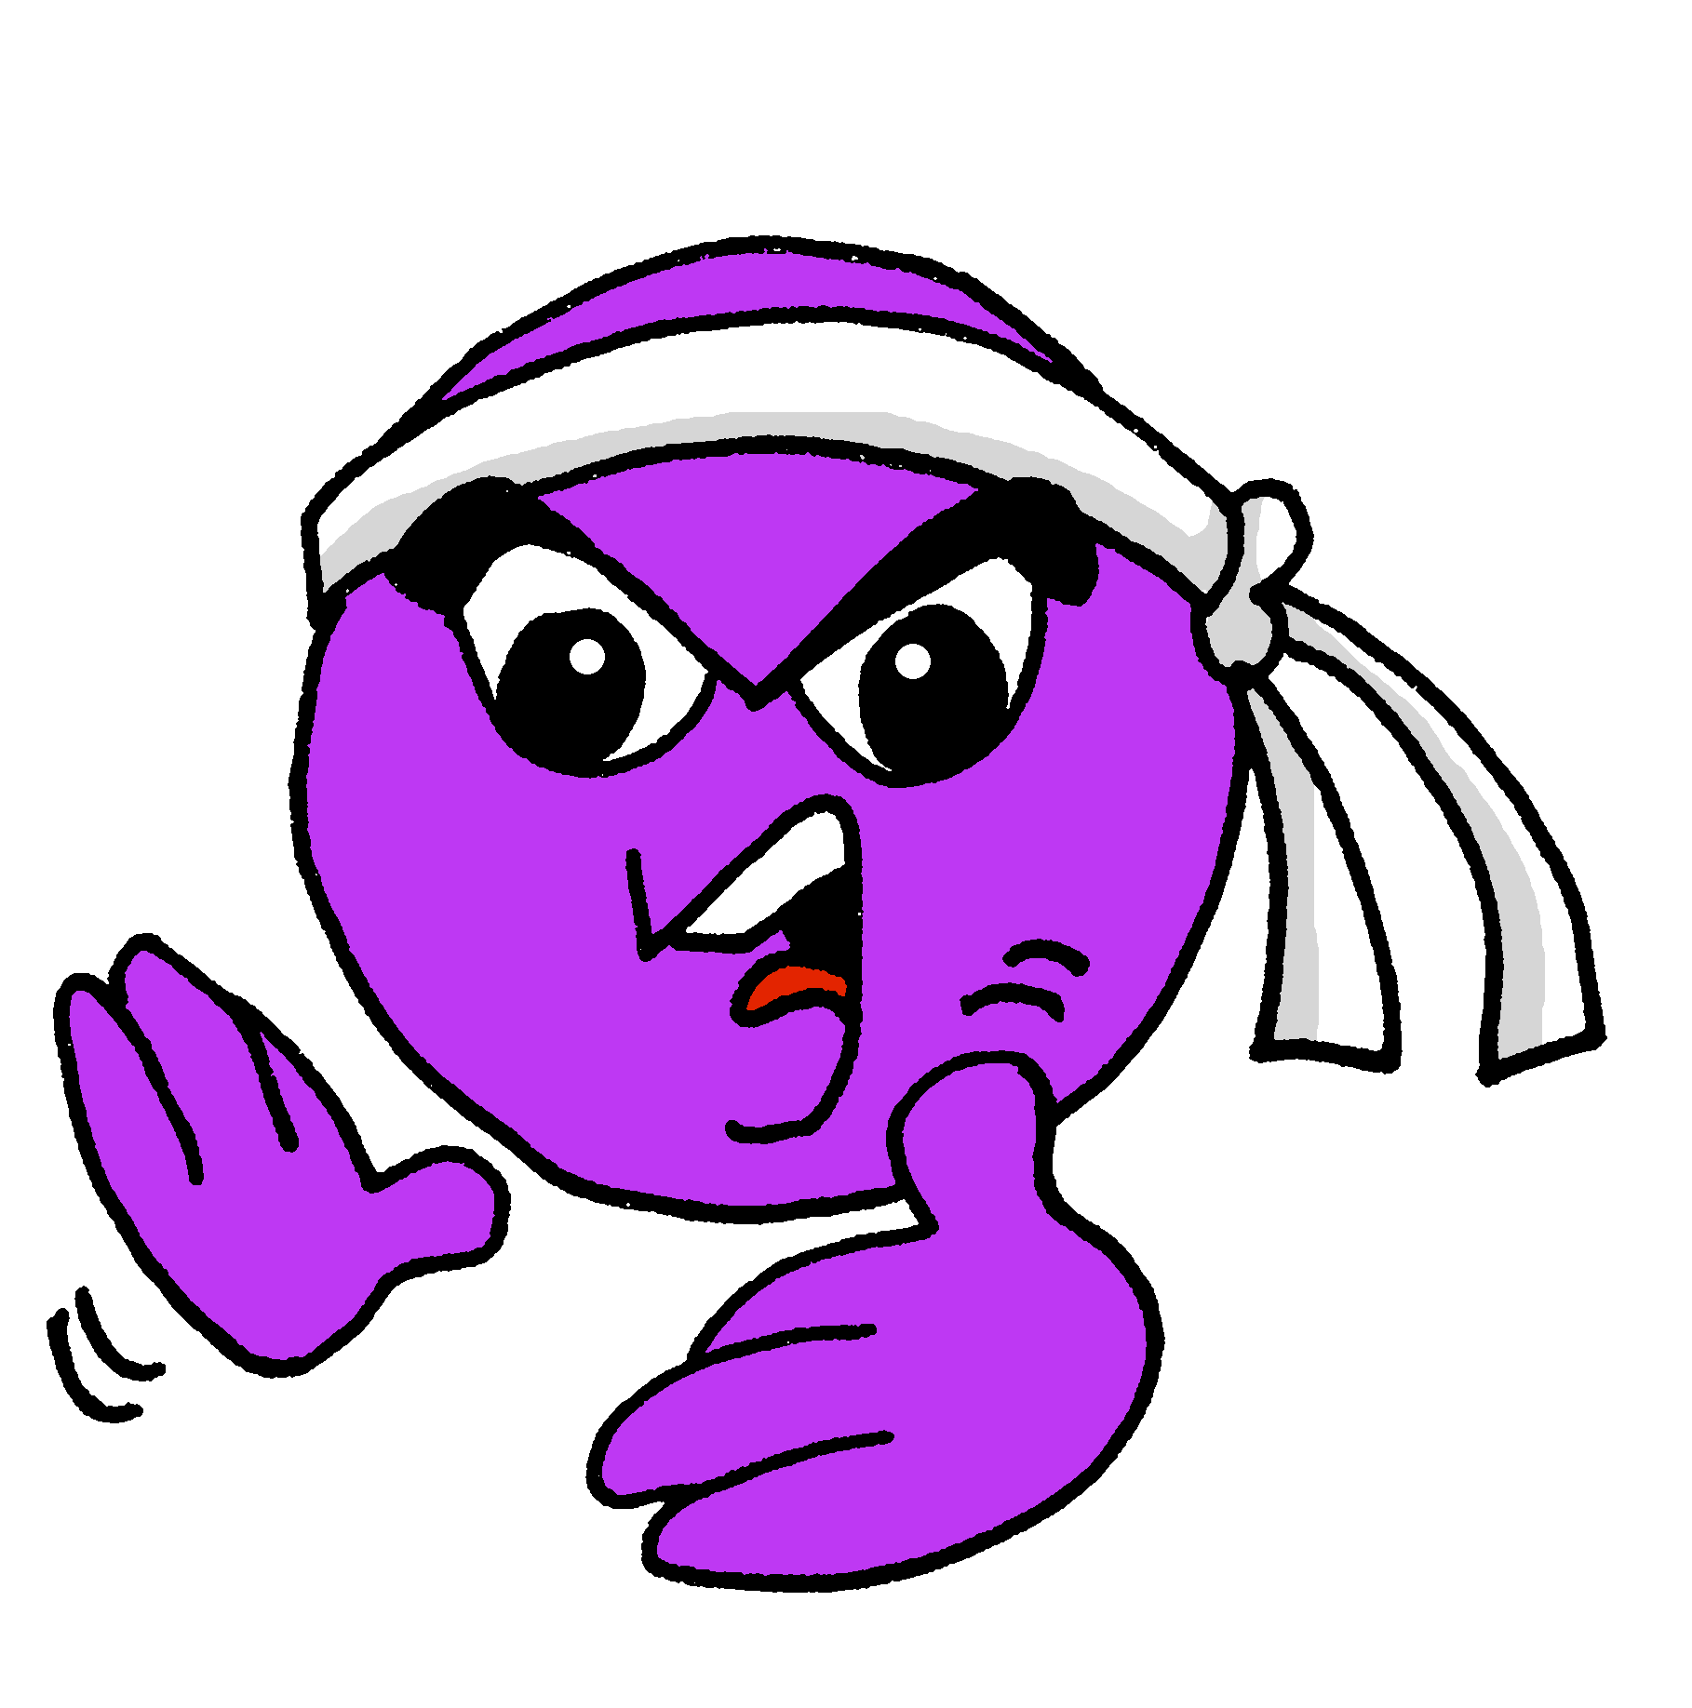
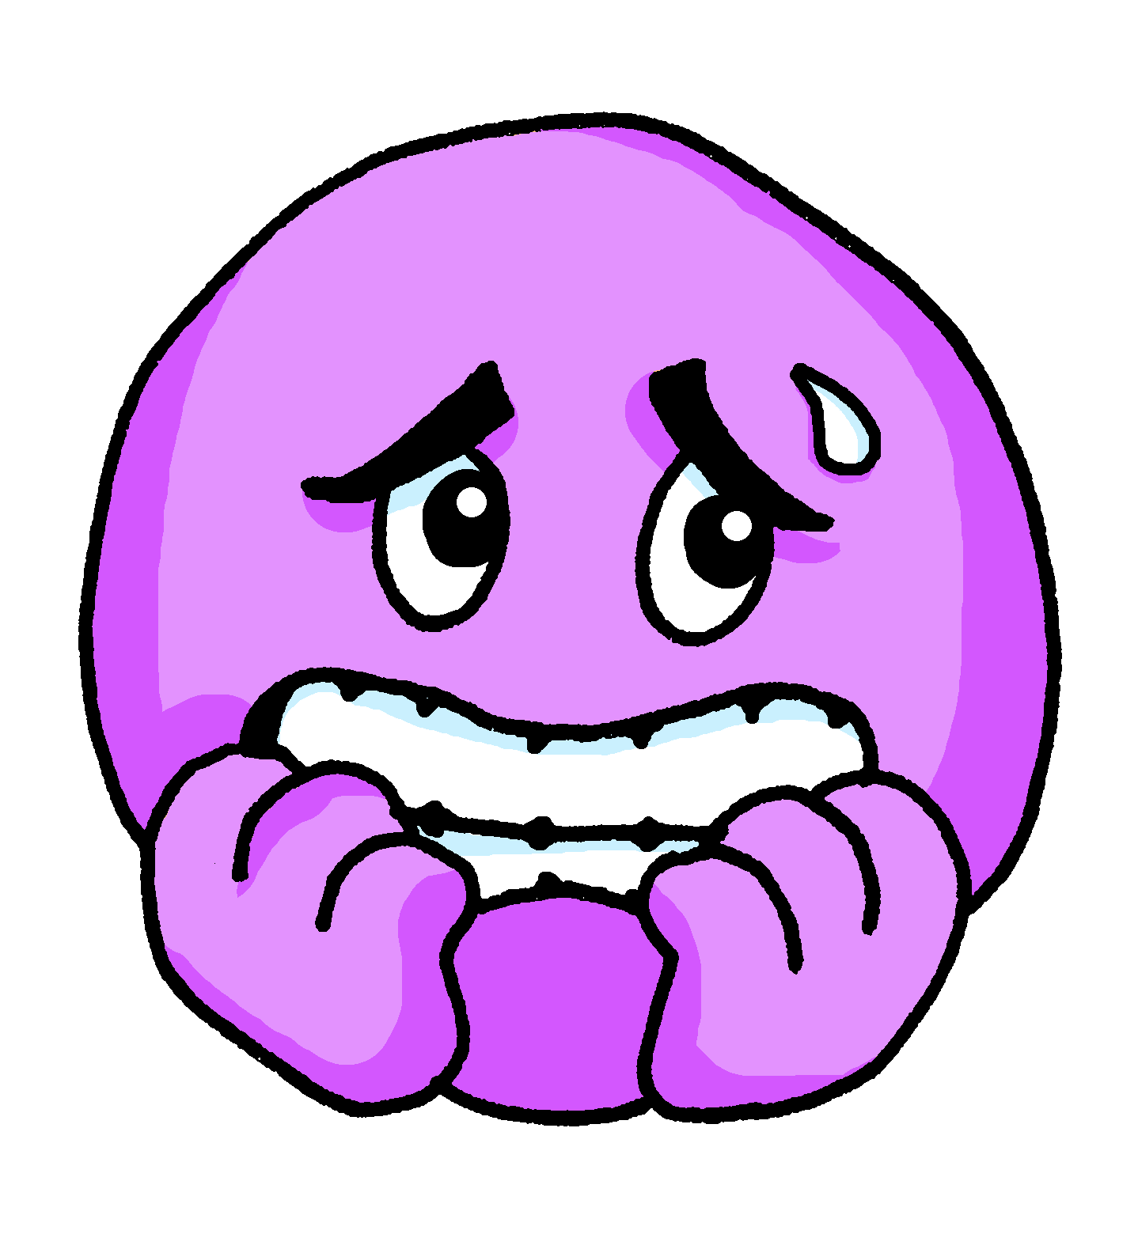
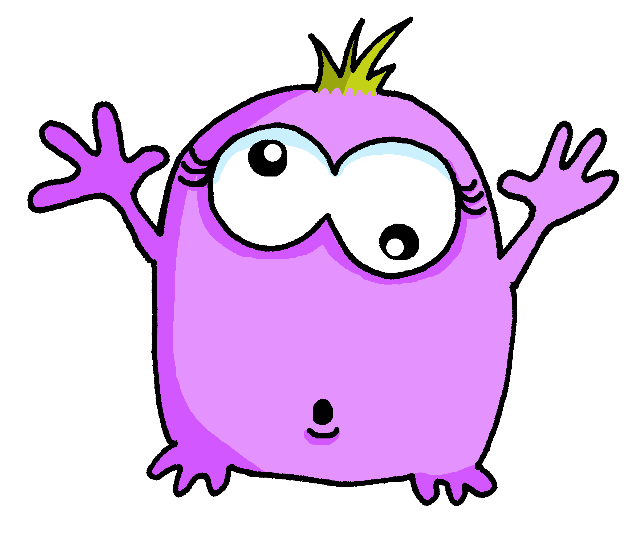
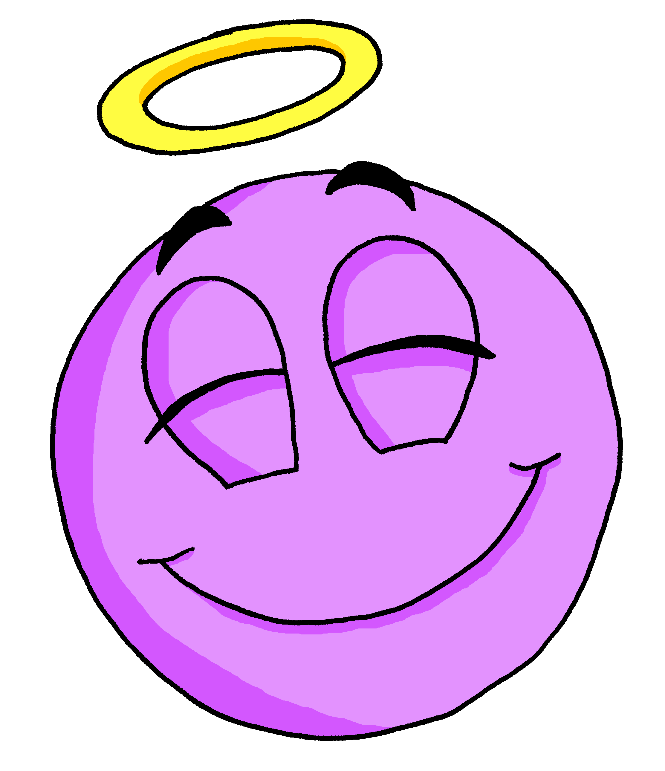
En clase
hablar
today
in general
today
in general
today
in general
1
2
3
serious
nervous
looking good
strong
calm
active
4
5
6
today
in general
today
in general
today
in general
strange
cheerful
active
famous
not looking good
good
Notes:
Timing: 8 minutes Aim: to practise spoken production and comprehension of questions with ser/estar in 2nd person singular and their replies.
Procedure:
Student As and Bs decide (in secret) which answers they want their partner to give, and therefore which question they will ask: ¿Cómo estás? for the ‘today’ answers and ¿Cómo eres? for the ‘in general’ answers.
Bs face the board. As ask either ¿Cómo estás? or ¿Cómo eres?
Bs respond in Spanish, giving the adjective (in the correctly gendered form for them).
As check that Bs have answered correctly (and correct their partner, if not).
Interactions continue until all 6 questions have been asked and answered.
Students swap roles and repeat the task.

Slide 10
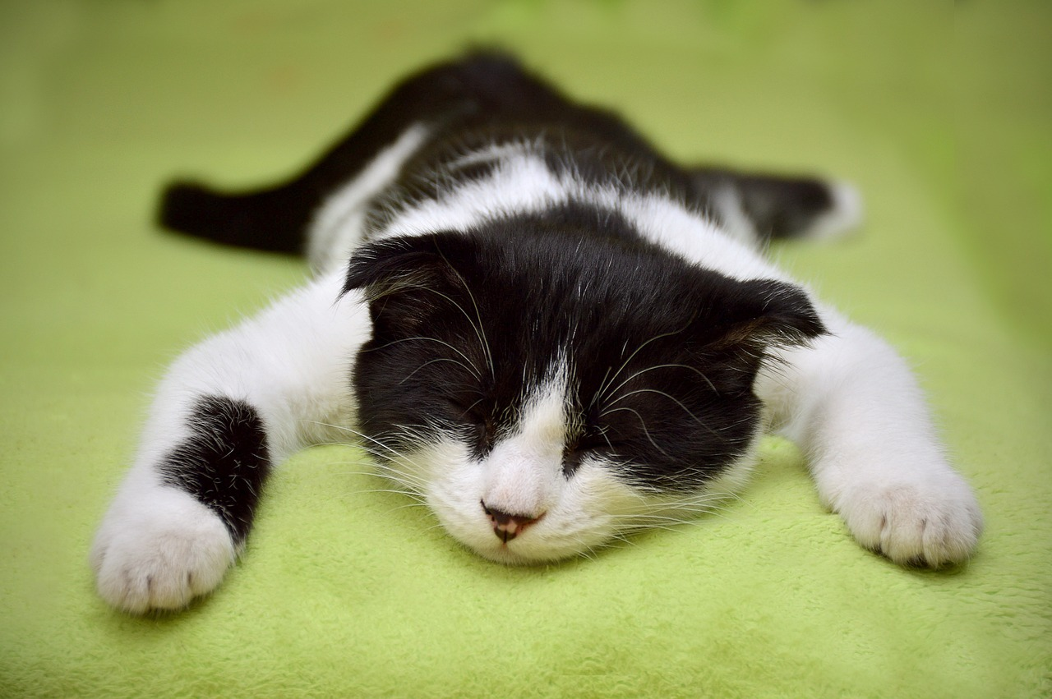
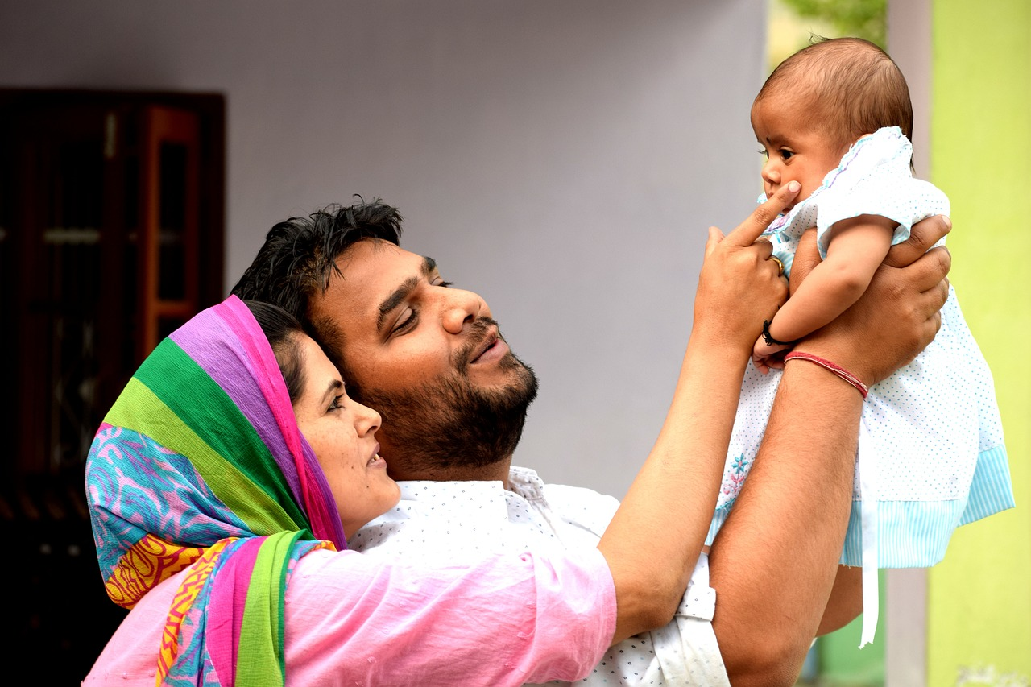
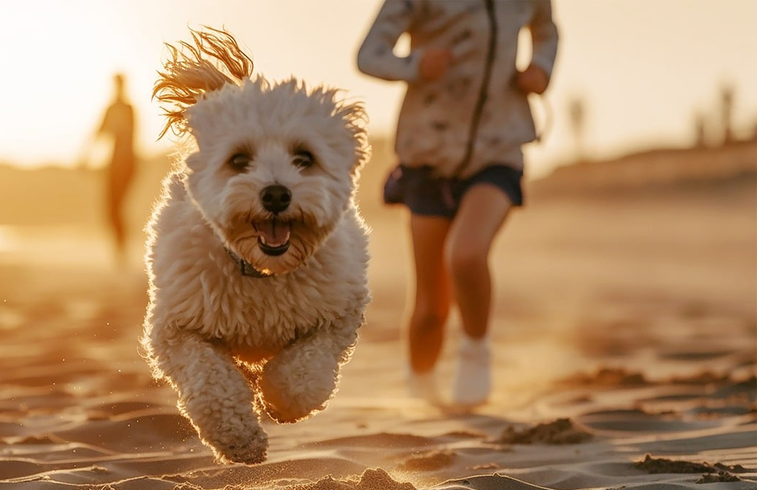
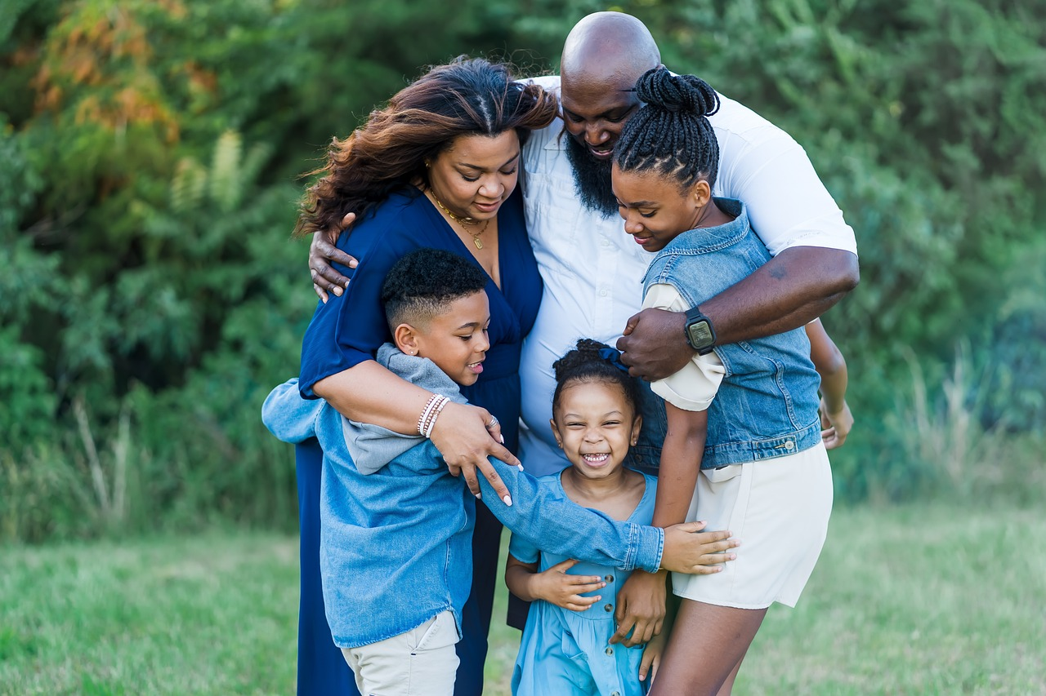
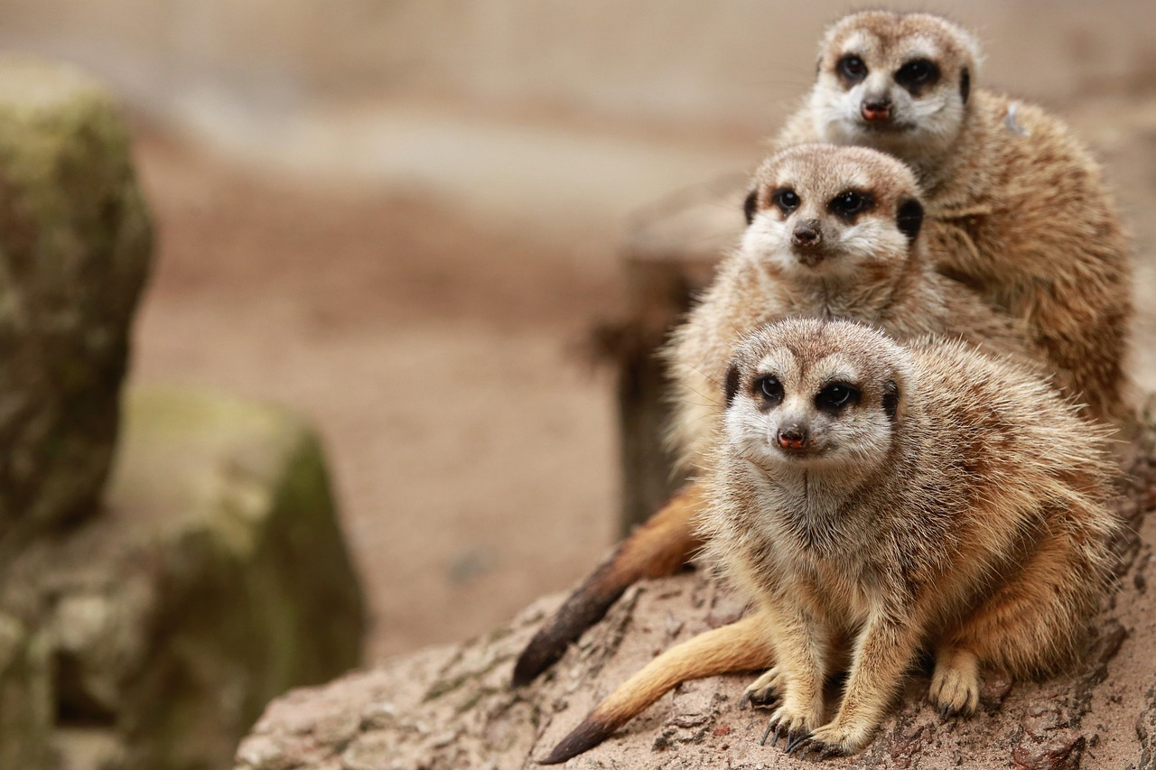
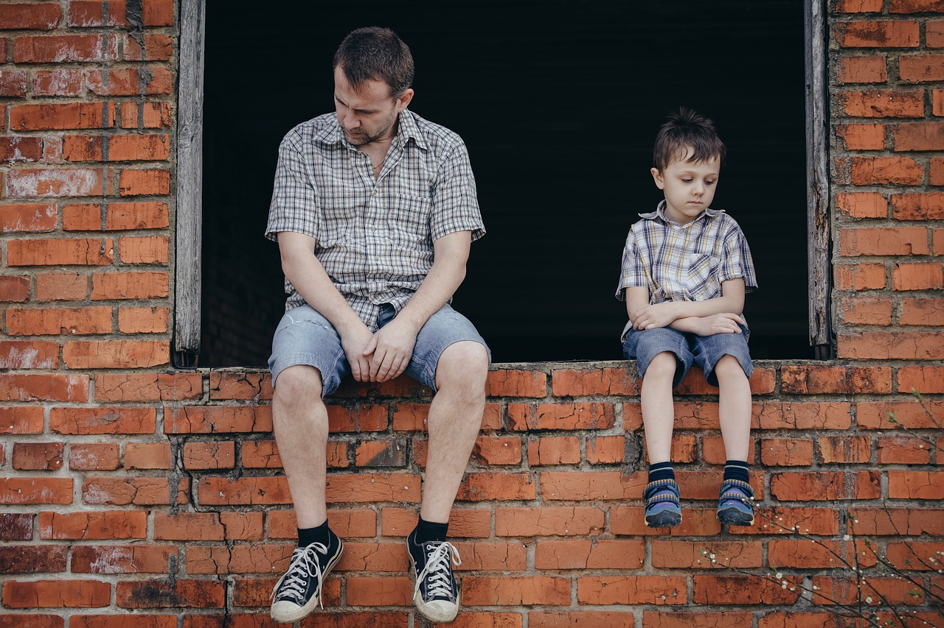
Escribe en español
escribir
Écris en français !
I am feeling quite calm.
She is small and beautiful.
You are strong and active today.
Estoy bastante tranquilo.
Es pequeña y hermosa.
Estás fuerte y activo hoy.
They are a family.
They are not dogs but they are cousins.
You are sad today.
No son perros pero son primos.
Son una familia.
Estás triste hoy.
Notes:
Timing: 10 minutes
Aim: to practise written production of the revisited structures and vocabulary.
Procedure:
Students translate the sentences.
The answers to this translation task appear upon successive clicks of the mouse.
Note: Teachers will differentiate according to the needs of their students, perhaps providing access to the language guide or KO, but encouraging production from memory wherever possible first (and subsequent access to support for checking/improving answers).

Slide 11
Asking and answering questions about doing and making
Repaso (revision) HACER in singular persons [revisited]
SSCs [ge], [gi], [j] [revisited]
Y7 Spanish Term 2.1 - Week 5 - Lesson 38 Amanda Izquierdo / Nick Avery / Rachel Hawkes Artwork: Mark Davies Date updated: 17.01.24
Notes:
All pictures selected are available under a Creative Commons license, no attribution required.
Note: all words (new and revisited) in this week of the SOW appear on all three GCSE wordlists, with the following exception:
i) AQA and Edexcel lists do not have feo. Learning outcomes (lesson 2):
Consolidation of HACER in singular persons (hago/haces/hace)
Consolidation of question words
Consolidation of SSCs [ge], [gi] & [j]
Note: a little space is left in lesson 1 to allow time for instructions regarding next week’s (7.2.1.6) assessments and/or to do peer revision, as appropriate.
Word frequency (1 is the most frequent word in Spanish):
2.1.2 (revisit) tenemos [tener-19]; tienen [19]; perro [888]; abuelo [4796]; abuela [717]; trabajo²; [152] primo [1451]; prima [3051]; bastante [308]; hermoso [980]; activo [1278]; fuerte [435]
1.2.4 (revisit) son [ser-7]; pequeño [202]; bueno [98]; malo [368]; famoso [997]; bonito [891]; feo [2373]; rico¹ [398]; caro [2179]; barato [2164]; antiguo [446] ¿cómo es? [cómo-151]
Source: Davies, M. & Davies, K. (2018). A frequency dictionary of Spanish: Core vocabulary for learners (2nd ed.). Routledge: London
The frequency rankings for words that occur in this PowerPoint which have been previously introduced in NCELP resources are given in the NCELP SOW and in the resources that first introduced and formally re-visited those words.
For any other words that occur incidentally in this PowerPoint, frequency rankings will be provided in the notes field wherever possible.

Slide 12
Fonética
escuchar / escribir
Remember that [soft g] and [j] sound the same, so the spelling will depend on the word!
Escucha y marca. ¿Escuchas [ge], [gi] o [j]?
 | ge | gi | j
1. |  |  |  | generalmente | Generally dogs are good.
2. |  |  |  | hijo | S/he speaks with the son.
3. |  |  |  | julio | Where are you in July?
4. |  |  |  | páginas | The homework is many pages long.
5. |  |  |  | elegir | It’s normal to choose a cheap product.
6. |  |  |  | imágenes | The books have quite beautiful images.
7. |  |  |  | religion | It’s an old religion.
8. |  |  |  | jugar | It’s good to play with the grandmother.
la palabra
la frase en inglés
1
2
(literally, ‘has a lot of pages’).
3
4
5
6
7
8
Notes:
Timing: 8 minutes
Aim: to revisit knowledge of SSC [ge], [gi] and [j] and to practise aural comprehension of previously taught vocabulary.
Note: As the ‘soft’ G and J sound the same, students will need to learn that spelling here is word knowledge and not SSC knowledge. In this case, the audio is provided to reinforce the sound of the SSC, rather than to give a cue for correct spelling. All of these words have been previously taught.
Procedure:
Students should number 1-8 and prepare to write [ge], [gi] or [ji], then the target Spanish word and finally, the phrase in English.
Teachers play the audio once by clicking on the number button. Students need to tick the SSC and write the missing word in Spanish.
Teachers play it again and students write the sentence in English.
Answers are shown for each sentence, one by one, by clicking. The answers for the SSC are shown first for 1-8, then the words, and finally the English translations.
Teachers can play the audio again each time so students can listen and read at the same time.
Transcript:
Generalmente los perros son buenos.
Habla con el hijo.
¿Dónde estás en julio?
Los deberes tienen muchas páginas.
Es normal elegir un producto barato.
Los libros tienen imágenes bastante bonitas.
Es una religión antigua.
Es bueno jugar con la abuela.

Slide 13
Vocabulario
hablar
cousin (female)
cousin (male)
they are (for traits)
small
quite
cheap
beautiful
rich
grandfather
we have
they have
expensive
tenemos
prima
tienen
t_ _ _ _ _ _ _
p_ _ _ _
t_ _ _ _ _ _
abuelo
son
pequeño
a_ _ _ _ _
s_ _ _
p_ _ _ _ _ _ _
primo
rico
barato
p_ _ _ _
r_ _ _
b_ _ _ _ _
hermoso
caro
bastante
h_ _ _ _ _ _
c_ _ _
b_ _ _ _ _ _ _
Notes:
Timing: 3 minutes
Aim: to revise items of vocabulary from one of this week’s revisited vocabulary sets.
Procedure:
The teacher clicks to show the English word. Students say the word in Spanish in choral response to match the English. Only the first letter is provided so that students have to recall the noun.
The teacher then clicks to bring up the Spanish word.

Slide 14
Hacer
gramática
hago
In Spanish, to say ‘I do’ or ‘I make’ say: _________.
To say ’you do’ or ‘you make’ say: _________.
haces
hace
To say ‘s/he or it does’ or ‘s/he or it makes’ say: _________.
Hago los deberes.
I do the homework.
Haces amigos.
You make friends.
Hace dibujos.
S/he or it does drawings.
Notes:
Timing: 2 minutes
Aim: to revise the target grammar forms ‘hago’, ‘haces’ and ‘hace’ and their respective functions before the subsequent activity.
Procedure:
Teachers click to show the sentences with the answers missed out, in order to elicit the answer from the students.
Click again to show examples of ‘hago / haces / haces’ in a short sentence with translation.
It is worth reminding students of the dual possible meanings of hacer (to do/make).

Slide 15
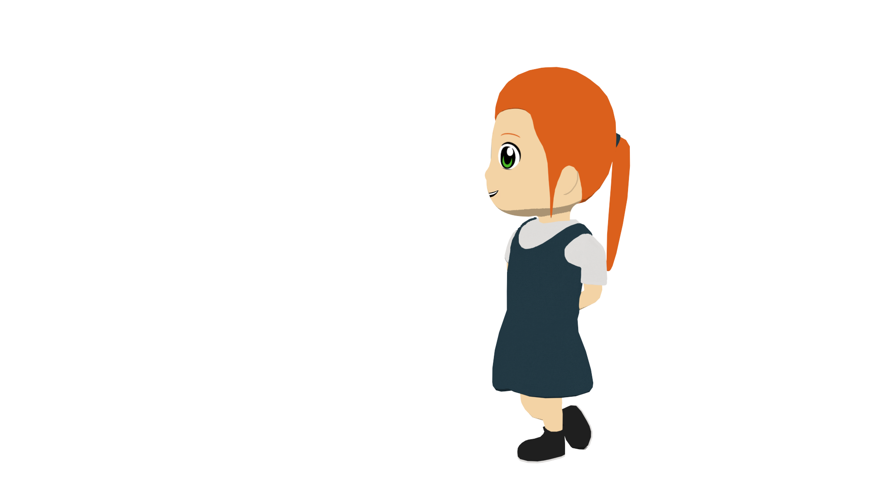
leer
¿Quién hace la actividad? ¿Es Lucía (I), Daniel (you) o Nadia (she)? Marca la opción correcta. Luego marca el verbo correcto en inglés.
leer
leer
 | ‘I’ | ‘you’ | ‘s/he’ | verbo inglés | ¿Qué? En inglés
1. Hago un dibujo bonito. |  |  |  | make/makes
 |  |  |  | do/does
2. Haces trabajo en equipo. |  |  |  | make/makes
 |  |  |  | do/does
3. Hago una película con el primo. |  |  |  | make/makes
 |  |  |  | do/does
4. Hace una camisa pequeña. |  |  |  | make/makes
 |  |  |  | do/does
5. Haces un plato español. |  |  |  | make/makes
 |  |  |  | do/does
6. Hace mucho deporte. |  |  |  | make/makes
 |  |  |  | do/does
a beautiful drawing
work in a team
a film with the cousin
a small shirt
a Spanish dish
a lot of sport
Notes:
Timing: 8 minutes
Aim: to consolidate verb endings and understanding of the different translations of ‘hacer’.
Procedure:
Students copy the grid and read each phrase and decide who performs the action, putting a tick in the relevant column.
Students then decide whether the verb means ’make’, ‘makes’, ’do’ or ‘does’, and either writes their answer or circles the correct one.
Students then write what each person does or makes in English.
The teacher goes through the answers. The ‘I/you/he/she’ answers are shown for questions 1-6 first, then the translation of hacer column 1-6 and finally the English translation column.

Slide 16
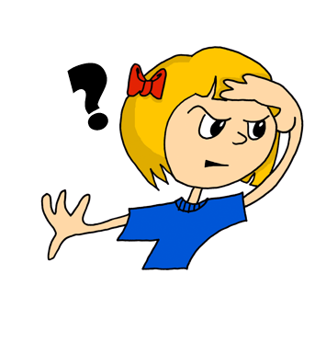
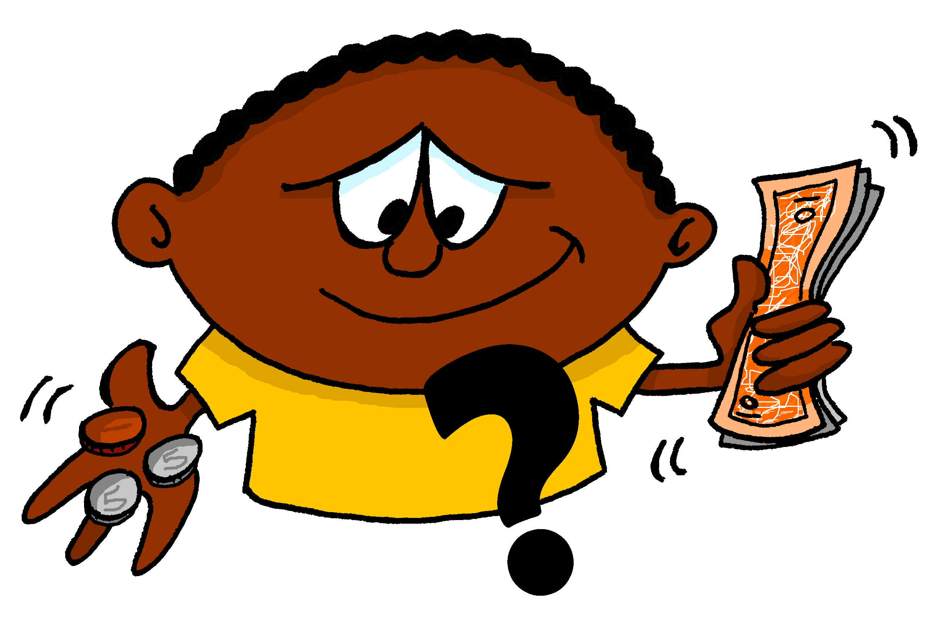
¿Cómo se dice en español?
leer / hablar
1.
2.
3.
4.
Where?
Which?
How?
Who?
¿cómo?
¿quién(es)?
¿dónde?
¿cuál(es)?
5.
6.
7.
8.
What?
When?
How many?
How much?
¿qué?
¿cuándo?
¿cuántos?
¿cuánto?
¿cuánto?
¿cuál(es)?
¿cuántos?
¿quién(es)?
¿dónde?
¿cuándo?
¿cómo?
¿qué?
Notes:
Timing: 2 minutes
Aim: to refresh understanding of eight previously taught question words ahead of the next activity.
Procedure:
1. Teachers ask students to volunteer answers orally, in chorus.
2. Click for the Spanish word to float to the correct English word.

Slide 17
escuchar
La profesora hace preguntas en clase. Who is she referring to?
escuchar
What’s the question word in English?
 | ‘I’ | ‘You’ | 'S/he’
1.
2.
3.
4.
5.
6.
7.
8.
question word in English
‘do’, ‘make’ o los dos?
1
what?
los dos
2
when?
do
3
who?
make
4
how?
do
5
where?
do
6
what?
los dos
7
how many?
make
8
which?
do
Notes:
Timing: 8 minutes
Aim: to increase aural awareness of three verb endings of the verb ‘hacer’ and understanding of the person that each refers to. To also reinforce knowledge of question words.
Procedure:
Students copy the grid and listen to each recording and decide whether the question refers to ‘I’, ‘you’ or ‘s/he’. Teachers play the recording by clicking the number button.
Teachers click to go through these answers, and then click to show the next table.
On the second listen through students then write each question word in English.
Additional option: the teacher could also play the audio again and ask whether, in context, ‘hacer’ refers to ‘do’ or ‘make’. This table is revealed and the answers by clicking.
Transcript:
1. ¿Qué haces por la tarde?
2. ¿Cuándo hace los deberes?
3. ¿Quién hace la cama?
4. ¿Cómo hago la tarea?
5. ¿Dónde haces deporte?
6. ¿Qué hago en la escuela?
7. ¿Cuántos regalos haces?
8. Hay dos actividades. ¿Cuál haces?

Slide 18
¿Cómo se dice en espanol?
In English, we also sometimes use ‘do’ as an auxiliary verb in questions. In Spanish, you only need one verb here!
escribir
escribir
What When Who How | do I do/make do you do/make does he do/make does/makes | Spanish dishes?
When | do you do/make | films?
Who | does he do/make | sport?
How | does/makes | friends?
 |  | the homework?
 |  | the bed?
 |  | in the afternoon?
¿Cómo haces amigos?
¿Quién hace películas?
¿Cuándo hago la cama?
¿Cuándo haces deporte?
¿Qué hace por la tarde?
¿Cómo hace platos españoles?
¿Quién hace los deberes?
Notes:
Timing: 8 minutes
Aim: to create seven questions with ‘hacer’, based on the prompts. This will help to prepare students for the next activity.
Procedure:
Teachers click to bring up each combination of sentence parts.
Teachers ask students to write the Spanish on mini-whiteboards or in their books, then volunteer the answer orally.
The answer is shown by clicking, and then the process is repeated. There are seven questions.

Slide 19
escribir
You’re helping a friend write messages to a Spanish friend.
Escribe en español.
escribir
What do you do in the afternoons?
I make films! It’s great.
Do you do sport ?
¿Qué haces por las tardes?
Hago películas. ¡Es genial! ¿Haces deporte?




Yes, and I also do drawings.
What does Tomás do and where?
He does karate in the square and he makes Spanish dishes.
Hace kárate en la plaza y hace platos españoles.
Sí, y tambien hago dibujos. ¿Qué hace Tomás, y dónde?


Notes:
Timing: 10 minutes
Aim: This mini-Whatsapp exchange is a chance to bring together some of the different features practised this lesson in writing practice.
question words
hago/haces/hace
vocabulary used with ‘hacer’
Procedure: 1. Students translate the four messages into Spanish, if possible without using reference resources. 2. When the students are finished, teachers click to show the answers, and go through any potential issues.

Slide 20
Deberes
No new vocabulary for 7.2.1.6 but revisit Term 1 and Term 2.1 vocabulary for the assessment next week.
Notes:
Use this slide to set the homework and give any instructions about next week’s assessment.
This week there is no new vocabulary but quite a lot of previously taught vocabulary to revisit.
Notes:
i) Teachers may want to recommend use of a particular online app for the revision of these words. ii) Quizlet now requires parental involvement / registration / permissions for users below the age of 13, so it is perhaps most suitable for Y9 – 11 students. This is the mash up of all the Y7 words taught so far: https://quizlet.com/gb/482078646/spanish-y7-vocabulary-mash-up-terms-11-12-and-21-flash-cards/ iii) Language Nut hosts LDP vocabulary lists and these are free for schools to use, though there is a registration process. One benefit is that all of the student tracking data that Language Nut offers are also available to schools that use the LDP lists for practice. Perhaps this makes it a good option for Y7/8.
iv) There are other free apps, and new ones are always appearing. Teachers have told us that they are currently using: Flippity, Wordwall (where using previously-created activities is free).

