Slide 1
Asking and answering questions
HACER in singular persons SSCs [a], [o] revisited
¿cuándo?
Y7 Spanish Term 2.1 - Week 4 - Lesson 35 Victoria Hobson / Nick Avery / Rachel Hawkes Artwork: Mark Davies Date updated: 15.01.24
Notes:
All pictures selected are available under a Creative Commons license, no attribution required.
Note: all words (new and revisited) in this week of the SOW appear on all three GCSE wordlists, with the following exceptions: i) AQA, Edexcel, Eduqas lists do not have balcón, caballero, dama ii) In addition, Eduqas list does not have flor.
Learning outcomes (lesson 1):
Introduction of HACER in the singular persons (hago, hace, haces)
Introduction of question word ‘cuándo’
Consolidation of question words ‘quién’, ‘cómo’, ‘dónde’, ‘qué’
Consolidation of SSCs [a], [o]
Word frequency (1 is the most frequent word in Spanish):
7.2.1.4 (introduce) ¿cuándo? [57]; ¿cuánto? [580]; ¿cuál? [445]; hacer [26]; hago; haces; hace; deporte [1489]; deberes [2187]; actividad [344]; dibujo [1726]; noche [164]; tarde [392]; mañana [402]; para [16]
7.1.2.3 (revisit) hay [13]; mirar [125]; mesa [525]; silla [1271]; ventana [752]; puerta [274]; chica [1129]; persona [108]; chico [727]; aquí [130]; allí [197]; clase [320]
7.2.1.1 (revisit) balcón [3133]; dama [2062]; torre [2138]; caballero [2056]; saber [44]; pasar [68]; blanco [372]; flor [739]; plaza [806]; llevar [101]
Source: Davies, M. & Davies, K. (2018). A frequency dictionary of Spanish: Core vocabulary for learners (2nd ed.). Routledge: London
The frequency rankings for words that occur in this PowerPoint which have been previously introduced in NCELP resources are given in the NCELP SOW and in the resources that first introduced and formally re-visited those words.
For any other words that occur incidentally in this PowerPoint, frequency rankings will be provided in the notes field wherever possible.

Slide 2
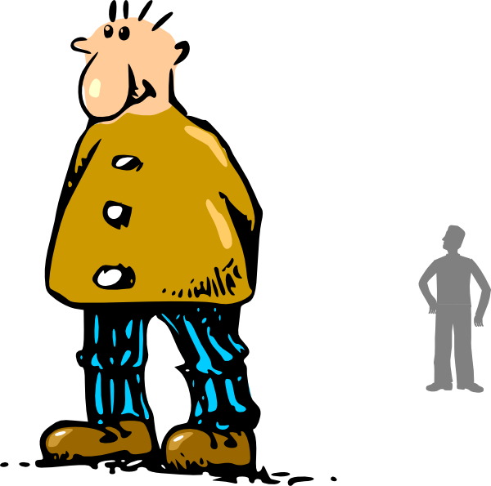
a
alto
Notes:
Timing: 4 minutes (8 slides) Aim: to revisit SSC [a] and [o]. Procedure: 1. Recap and elicit the pronunciation of the individual SSC ‘a’ and then present and practise the pronunciation of the source word ‘alto’.
A possible gesture for this source word would be to stretch up one hand high above your head, fingers bent at right angle to show act of ‘measuring’
2. Say and repeat the word. 3. Ensure pupils know the meaning (use usual routine for this – e.g. ¿Qué significa’? ‘tall’, sí, es correcto.

Slide 3
a
alto
Notes:
Repeat the sound and elicit the source word.

Slide 4
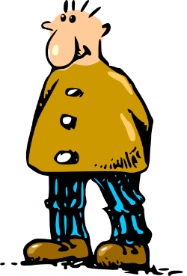
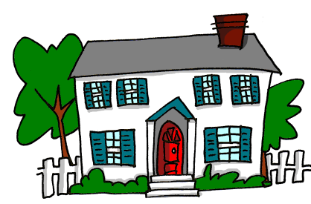
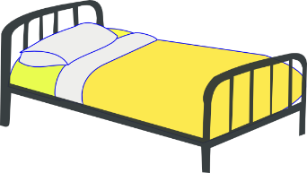
a
nada
amar
∅
casa
alto
agosto
cama
Notes:
Recap individual SSC ‘A’ and then the source word again (with gesture, if using). Then present and elicit the pronunciation of the five cluster words. The cluster words have been chosen for their high-frequency, from a range of word classes, with the SSC (where possible) positioned within a variety of syllables within the words(e.g. initial, 2nd, final etc..) and additionally, we have tried to use words that build cumulatively on previously taught SSCs (see the Phonics Teaching Sequence document) and do not include new SSCs. Where new SSCs are used, they are often consonants which have a similar symbol-sound correspondence in English. Word frequency rankings: alto [231]; nada [87]; casa [106] cama [609]; amar [700]; agosto [931] Source: Davies, M. & Davies, K. (2018). A Frequency Dictionary of Spanish: Core vocabulary for learners (2nd ed.) London: Routledge.
A note on L1:L2 word translations: these are supported in the research literature on vocabulary learning, and should only be avoided where meanings are transparent. If at any point in teaching, pupils are not clear about a meaning, teachers should not hesitate in giving the English meaning.

Slide 5
a
nada
amar
casa
alto
agosto
cama
Notes:
Without the images or sound, students have to pronounce the words themselves.

Slide 6
o
yo
Notes:
Recap and elicit the pronunciation of the individual SSC ‘O’ and then present and practise the pronunciation of the source word ‘yo’.
A possible gesture for this source word would be to use the index fingers on both hands to point towards yourself

Slide 7
o
yo
Notes:
Repeat the sound and elicit the source word.

Slide 8
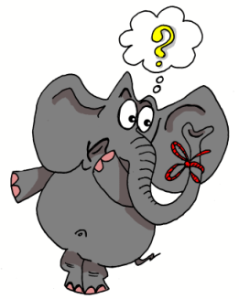
o
olvidar
dos
solo
yo
con
Con ketchup
poco
[little]
Notes:
Recap and elicit the pronunciation of the individual SSC ‘o’ and then the source word again (with gesture, if using). Then present and elicit the pronunciation of the five cluster words.
The cluster words have been chosen for their high-frequency, from a range of word classes, with the SSC (where possible) positioned within a variety of syllables within the words(e.g. initial, 2nd, final etc..) and additionally, we have tried to use words that build cumulatively on previously taught SSCs (see the Phonics Teaching Sequence document) and do not include new SSCs. Where new SSCs are used, they are often consonants which have a similar symbol-sound correspondence in English.

Slide 9
o
olvidar
dos
solo
yo
con
poco
Notes:
Without the images or sound, students have to pronounce the words themselves.

Slide 10
Escucha. Escribe la letra correcta y la palabra en inglés.
escuchar / escribir
escuchar / escribir
 | Palabra | Traducción
 | flor | flower
 | saber | to know
 | torre | tower
1
_
2
_
3
_
 | Palabra | Traducción
 | blanco | white
 | plaza | square
 | llevar | to carry/wear
4
_
_
5
_
_
6
_
Notes:
Timing: 5 minutes
Aim: listening activity pairing the [a] and [o] SSCs, practising sound recognition, then vocabulary recognition
Procedure:
Students copy the grid into their exercise books. They will need to complete the word with either ‘a’ or ‘o’, and then write the translation.
The teacher clicks the number button to play the word.
Answers are revealed individually for each question by clicking to enable teachers to elicit answers for the missing letter and the translation.
Transcript
flor
saber
torre
blanco
plaza
llevar

Slide 11
Vocabulario
leer / hablar
Segundos
 | Español | Inglés
1 | ¿cuándo? | when?
2 | el deporte | sport
3 | los deberes | homework
4 | la actividad | activity
5 | el dibujo | drawing
6 | la noche | night
7 | la tarde | afternoon/evening
8 | la mañana | morning
9 | para | for
60
To say ‘in the morning/afternoon’ or ‘at night’, Spanish often uses the word ‘por’.
E.g. ‘Estudio por la mañana’ =
I study in the morning.
It is also correct to say ‘en la mañana/tarde/noche’ in some Spanish-speaking countries.
0
INICIO
Notes:
Timing: 6 minutes
Aims: vocabulary practice of this week’s set.
Procedure:
Pupils either work by themselves or in pairs, reading out the words and recapping their English meaning (1 minute).
The teacher clicks to remove the English meanings and the students try to recall them by looking at the Spanish. The teacher can click on ‘inicio’ to start a 1 minute timer, or keep time in their own way.
When done, the teacher clicks again to remove the Spanish words, and the process is repeated.
Further rounds of learning can be facilitated by one pupil turning away from the board, and his/her partner asking him/her the meanings. This activity can work from L2 → L1 or L1 → L2.
The teacher clicks to show an explanation of how to say ‘in the morning / afternoon / evening’
Note: The following items are taught explicitly as part of the grammar foci for this sequence and hence not included here:
¿cuánto?; ¿cuál?; hacer; hago; haces; hace

Slide 12
¿Cómo se dice en español?
leer / hablar
1.
2.
3.
How?
Where?
Who?
¿cómo?
¿quién?
¿dónde?
4.
5.
What?
When?
¿qué?
¿cuándo?
¿dónde?
¿quién?
¿cuándo?
¿cómo?
¿qué?
Notes:
Timing: 3 minutes
Aim: revisit 4 question words and introduce ‘¿cuándo?’
Procedure:
Teachers elicit the Spanish for each question word.
Answers are revealed by clicking and the Spanish word will float to the correct translation in English.
‘¿Cuándo?’ is discovered by a process of elimination
Teachers may want to lead additional consolidation activities to ensure that the question words are securely embedded.
This activity will help the next activity using ‘hacer’.

Slide 13
Escribe la pregunta correcta.
leer / escribir
¿Qué hay en la mesa?
¿Quién es la chica? ¡Es Sara!
¿Cuándo es la clase de español?
¡Es hoy!
4. ¿Cómo se escribe ‘silla’?
5. ¿Dónde está la puerta? Allí, entre el profesor y la mesa.
6. ¿Quién es la persona? Es Ana.
7. ¿Qué quieres mirar?
8. ¿Cómo se dice ‘aquí’ en inglés?
9. ¿Dónde está el chico? ¡Aquí!
10. ¿Cuándo hay una clase de arte? En diciembre.
Notes:
Timing: 5 minutes
Aim: to consolidate comprehension in context and written production of the five question words.
Procedure:
Teachers can decide if students should just write out the missing question word or the whole sentence.
The missing question words are revealed by clicking.
Sentences can be translated into English as well, either as part of the exercise itself, or translated when going through the answers.
Notes:
The vocabulary used in these sentences is from 1.2 week 3, the second set of words to be revisited this week, as part of students’ vocabulary learning homework.

Slide 14
hacer
[to do, make | doing, making]
hace
[does, makes | is doing, making]
Notes:
Timing: 3 minutes for sequence of six verbs
Aim: to introduce the verb ‘hacer’ more explicitly.
Procedure
Teacher click to bring up the word ‘hacer’ on its own, say it, students repeat it, and remind them of the phonics. Teachers can draw attention to the SSC [a]
Teachers try to elicit the meaning from the students.
Bring up the picture, and potential use an appropriate gesture to help.
Teachers then click to bring up the English translations. Emphasise the two meanings for the infinitive.
Teachers click again to bring up the short form ‘hace’, say it, students repeat it. Draw attention to the phonics feature
Try to elicit the meaning from the students. Emphasise the two meanings for the short form.
Notes:
‘Hacer’ is one of the 25 most frequently used verbs in Spanish. All 25 most frequent verbs will be introduced early on using the same format. Both long form (infinitive) and short form (3rd person singular) are introduced in order to familiarise students with various forms of the same verb.

Slide 15
hacer
[to do, make | doing, making]
hace
[does, makes | is doing, making]
Notes:
Procedure:
1. Teachers cycle through the long and short form again to consolidate meaning and pronunciation.

Slide 16
hace
[does, makes | is doing, making]
Hace un examen.
[S/he does | is doing an exam.]
Notes:
Aim: Introduce the short form in a sentence.
Procedure:
Same process as the previous slides, teachers click to show ‘hace’ and then again to show the meaning.
Teachers click again to show ‘hace’ in a short sentence’, and then again to translate this sentence.

Slide 17
hacer
[to do, make | doing, making]
No quiere hacer un examen.
[S/he doesn't want to do an exam.]
Notes:
Aim: Introduce the long form of ‘hacer’ in a sentence.
Procedure:
Same as the previous slides, this time consolidating the meaning of the infinitive and how it could be used in a sentence.

Slide 18
hace
[does, makes | is doing, making]
______
Hace un examen.
[S/he does | is doing an exam.]
Notes:
Procedure
1. Teachers cycle through the short form in context again, and elicit meanings from students.

Slide 19
hacer
[to do, make | doing, making]
______
No quiere hacer un examen.
[S/he doesn't want to do an exam.]
Notes:
Procedure:
1. Teachers cycle through the long form in context again.

Slide 20
hago
[I do | make]
Notes:
Timing: 1 minute (for two slides)
Aim: introduce the ‘I’ form of ‘hacer’ and its dual meaning (do / make)
Procedure:
Teachers click to show and hear ‘hago’ and then its meaning

Slide 21
hago
[I do | make]
Hago deporte.
[I do sport.]
Hago dinero.
[I make money.]
Notes:
Aim: to introduce the 1st person singular in a sentence.
Procedure:
1. Teachers repeat the process to show ‘and hear ‘hago’ and elicit its meaning, and then to see it used in two short sentences where it can mean ‘I do’ and ‘I make.’

Slide 22
escuchar
Escucha. ¿Quién hace la actividad? Marca la opción correcta. Luego marca la traducción del verbo en inglés.
escuchar
 | ‘I’ | ‘S/he’ | Traducción
 |  |  | make/makes
 |  |  | do/does
 |  |  | make/makes
 |  |  | do/does
 |  |  | make/makes
 |  |  | do/does
 |  |  | make/makes
 |  |  | do/does
 | ‘I’ | ‘S/he’ | Traducción
 |  |  | make/makes
 |  |  | do/does
 |  |  | make/makes
 |  |  | do/does
 |  |  | make/makes
 |  |  | do/does
 |  |  | make/makes
 |  |  | do/does
1
5
2
6
3
7
4
8
Notes:
Timing: 6 minutes
Aim: listening exercise pairing ‘hago’ and ‘hace’ and consolidating two possible meanings of the verb ‘hacer’
Procedure:
Students should copy the grid into their books. They will need to tick either the ‘I’ or the ‘he/she’ column, and then circle the best translation of the verb form of ‘hacer’ depending on the meaning. Alternatively, students could just write the correct meaning as their answer.
Teachers click the number button to play the recording.
Teachers click to show each individual answer for each question. After going through the answer it could be worth playing again to elicit full meaning of the sentence.
Transcript:
Hace la cama
Hago deporte.
Hago una silla.
Hace karate .
Hace los deberes.
Hago un examen.
Hago dibujo.
Hace dinero.

Slide 23
haces
[you do | make]
Notes:
Timing: 2 minutes (for two slides)
Aim: to introduce the 2nd person singular form of hacer.
Procedure:
Teachers click to show and hear ‘haces’, and then its meaning (both ‘you do’ and ‘you make’)
On the next slide, teachers click to show the verb and hear the verb again, and then see it in two short sentences, with its different possible meanings.

Slide 24
haces
[you do |make]
Haces una actividad.
[You do an activity.]
Haces la cama.
[You make the bed.]

Slide 25
leer y escribir
leer / escribir
Lee las frases. ¿Quién hace las actividades? Marca la opción correcta. Luego escibe el verbo correcto en español para completar la respuesta.
 | Pregunta | You | S/he | Respuesta
1 | ¿Quién hace la cama? |  |  | Mi madre hace la cama.
2 | ¿Cuándo haces deporte? |  |  | Hago deporte por la tarde.
3 | ¿Qué actividad haces por la mañana? |  |  | Hago taekwondo por la mañana.
4 | ¿Cómo haces los deberes? |  |  | Hago los deberes en el ordenador.
5 | ¿Dónde hace el examen? |  |  | Hace el examen en la escuela.
6 | ¿Cuándo hace dibujo? |  |  | Hace dibujo por la noche.
Notes:
Version 1 – more supported Timing: 7 minutes
Notes:
Either do the activity on this slide, or the next one. The difference is that on the next slide, the question word is obscured to add more difficulty and an extra answer needed.
Aim: Reading and writing exercise practising use and understanding of the 1st, 2nd and 3rd person singular forms of the verb ‘hacer’
Procedure
1. Students copy out the grid. They will need to tick either the ‘you’ or ‘he/she’ column for the question, and then either write ‘hago’ or ‘hace’ for the answer column.
2. Teachers click to go through the individual answers for each question. After eliciting the answers, both the question and answer can be translated.

Slide 26
leer y escribir
Lee las frases. ¿Quién hace las actividades? Marca la opción correcta. Luego escibe el verbo correcto en español para completar la respuesta y escribe la pregunta correcta.
leer / escribir
 | Pregunta | You | S/he | Respuesta
1 | ¿Quién hace la cama? |  |  | Mi madre hace la cama.
2 | ¿Cuándo haces deporte? |  |  | Hago deporte por la tarde.
3 | ¿Qué actividad haces por la mañana? |  |  | Hago taekwondo por la mañana.
4 | ¿Cómo haces los deberes? |  |  | Hago los deberes en el ordenador.
5 | ¿Dónde hace el examen? |  |  | Hace el examen en la escuela.
6 | ¿Cuándo hace dibujo? |  |  | Hace dibujo por la noche.
?
?
?
?
?
?
Notes:
Version 2 – more challenging Timing 7 minutes
Notes:
Either do this activity or the preceding one.
Aim: Same as the last activity but also practising question words
Procedure:
Same as the last activity but students will also need to write out what the missing question word is.
When going through the answers, the missing question word is revealed with the second click, after the answer for the ‘you’ or ‘he/she’ columns.

Slide 27
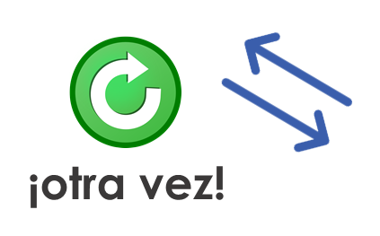
En pareja
hablar
Practica el diálogo con una pareja.
Habla de un amigo/una amiga o de tu hermano/hermana.
1 | Hello!
2 | Who is s/he?
3 | What is s/he like ?
4 | Where is s/he today?
5 | What is s/he studying?
6 | When does s/he do sport?
7 | When does s/he do homework?
8 | Bye!
1 | Hello!
2 | S/he is ________.
3 | S/he is ________.
4 | Today S/he is ________.
5 | S/he is studying _______
6 | In the morning
7 | In the evening
8 | Bye!
Notes:
Timing: 8 minutes
Aim: to practise oral recall of these key verbs in questions and verbs and vocabulary in the responses.
Procedure:
Students practise the dialogue in pairs, supplying the verb forms and vocabulary from memory. They then swap roles so each has a turn asking the questions.

Slide 28
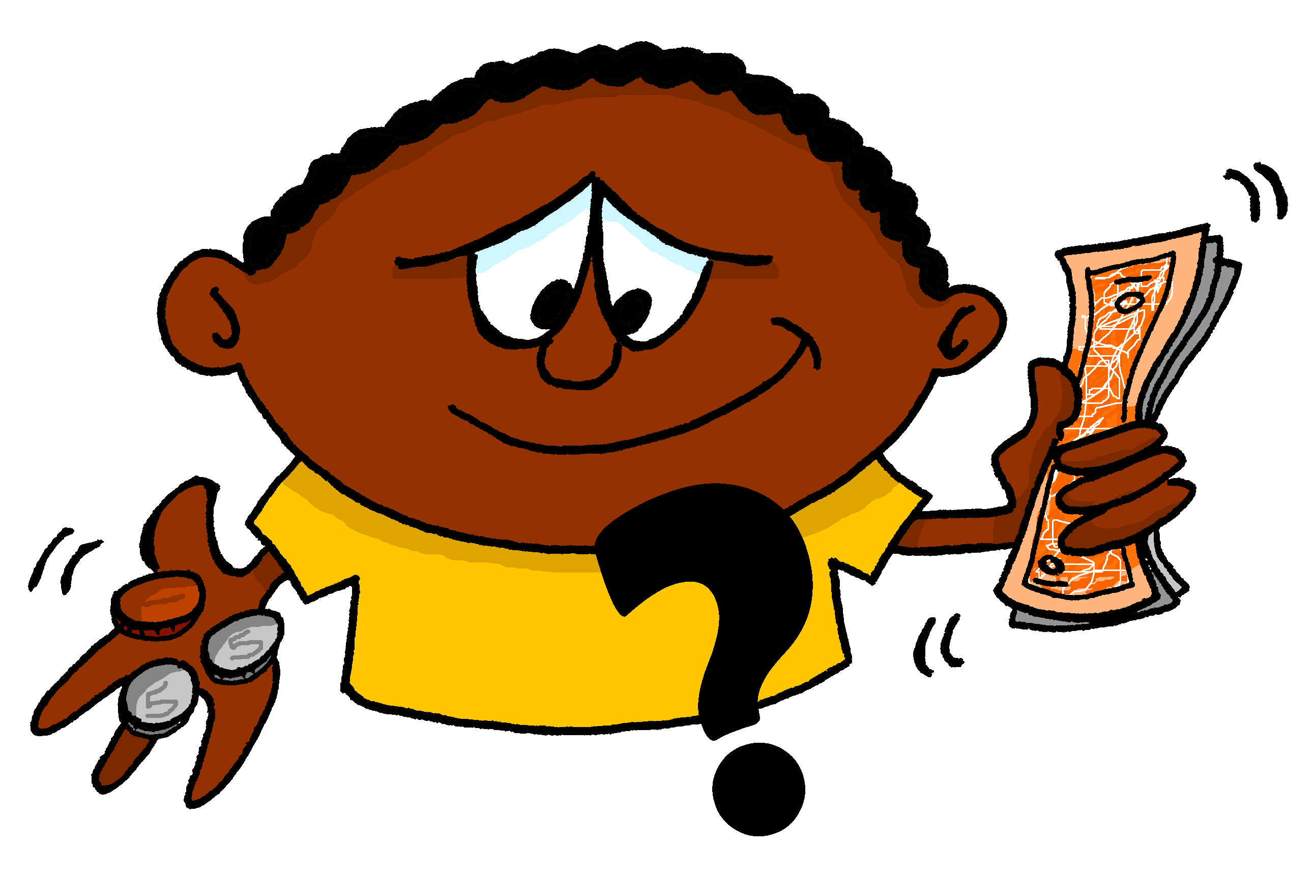
Asking and answering questions
Question words: cuánto(s), cuál(es),quién(es)
¿cuál(es)?
¿cuánto?
¿cuántos?
Y7 Spanish Term 2.1 - Week 4 - Lesson 36 Victoria Hobson / Nick Avery / Rachel Hawkes Artwork: Mark Davies Date updated: 16.01.24
¿quién(es)?
Notes:
All pictures selected are available under a Creative Commons license, no attribution required.
Note: all words (new and revisited) in this week of the SOW appear on all three GCSE wordlists, with the following exceptions: i) AQA, Edexcel, Eduqas lists do not have balcón, caballero, dama ii) In addition, Eduqas list does not have flor.
Learning outcomes (lesson 2):
Introduction of question words ‘cuánto(s)’, ‘cuál(es)’, ‘quién(es)’
Consolidation of ‘es’ and ‘son’
Word frequency (1 is the most frequent word in Spanish):
7.2.1.4 (introduce) ¿cuándo? [57]; ¿cuánto? [580]; ¿cuál? [445]; hacer [26]; hago; haces; hace; deporte [1489]; deberes [2187]; actividad [344]; dibujo [1726]; noche [164]; tarde [392]; mañana [402]; para [16]
7.1.2.3 (revisit) hay [13]; mirar [125]; mesa [525]; silla [1271]; ventana [752]; puerta [274]; chica [1129]; persona [108]; chico [727]; aquí [130]; allí [197]; clase [320]
7.2.1.1 (revisit) balcón [3133]; dama [2062]; torre [2138]; caballero [2056]; saber [44]; pasar [68]; blanco [372]; flor [739]; plaza [806]; llevar [101]
Source: Davies, M. & Davies, K. (2018). A frequency dictionary of Spanish: Core vocabulary for learners (2nd ed.). Routledge: London
The frequency rankings for words that occur in this PowerPoint which have been previously introduced in NCELP resources are given in the NCELP SOW and in the resources that first introduced and formally re-visited those words.
For any other words that occur incidentally in this PowerPoint, frequency rankings will be provided in the notes field wherever possible.

Slide 29
¿cuánto?
how much?
Notes:
Timing: 5 minutes (for 6 slides)
Aim: to introduce ‘¿cuánto/s’ and show its use in singular and plural versions
Procedure
Teachers click to show ‘¿cuánto?’ and its translation
It is worth reminding students that all question words in Spanish have an accent, and also to use the upside down question mark.
The same procedure is repeated on the next few slides

Slide 30
¿cuánto?
how much?
Notes:
Procedure:
Same as the previous slide

Slide 31
¿cuánto?
how much?
¿Cuánto dinero tienes?
[How much money do you have?]
Notes:
Procedure
1. Same as the previous slides, but after the translation of ‘¿cuánto?’ students will see an example of a short sentence, and then its translation after the click

Slide 32
¿cuántos?
how many?
Notes:
Procedure:
1. This slide introduces the plural form. Teachers follow the same procedure of previous slides, clicking to show the word and then the meaning.

Slide 33
¿cuántos?
how many?
Notes:
Procedure:
1. Same as the previous slide.

Slide 34
¿cuántos?
how many?
¿Cuántos libros tienes?
[How many books do you have?]
Notes:
Procedure:
1. Same as the previous slide, but after the translation of ‘¿cuántos’, students will see an example of a short sentence and then its translation.

Slide 35
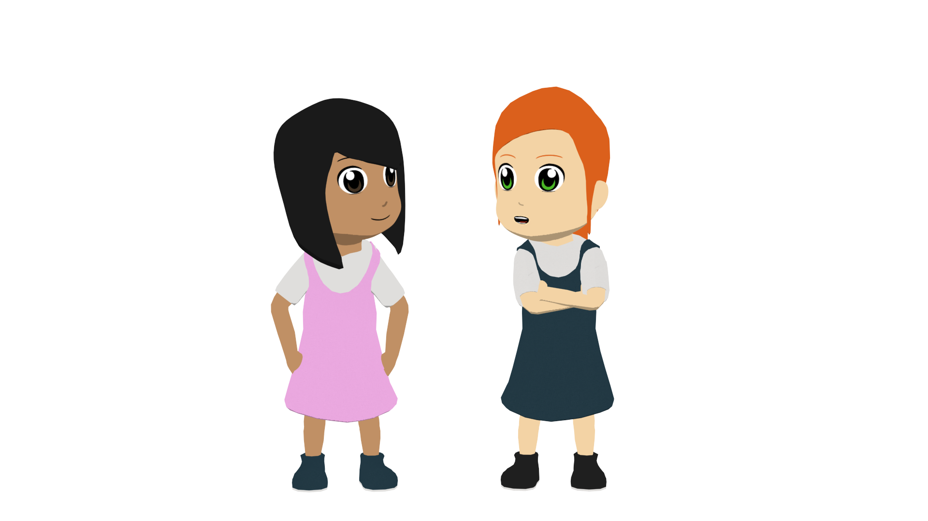
La mamá de Lucía
Ana, la mama de Lucía tiene preguntas para Lucía y Nadia.
leer
Lee las frases. ¿Es singular (how much?) o plural (how many)? Marca la palabra correcta.
 |  | ¿Singular o plural?
1 | ¿Cuántos | regalos | compras?
 |  | chocolate
2 | ¿Cuánto | bolígrafos | tienes?
 |  | papel
3 | ¿Cuánto | tiempo | necesitas?
 |  | libros
 |  | ¿Singular o plural?
4 | ¿Cuántos | libros | quieres?
 |  | dinero
5 | ¿Cuántos | ejercicio | haces?
 |  | deportes
6 | ¿Cuánto | inglés | hablas?
 |  | idiomas
el ejercicio – exercise | el idioma – language | el tiempo – time
Notes:
Timing: 5 minutes
Aim: reading exercise practising recognition of number agreement between the question word ‘¿cuánto(s)?’ and the noun (singular vs plural)
Procedure:
Students should look at the question word and decide if the singular or plural noun is needed.
The answers are shown by clicking.
The teacher clicks again to show a vocabulary box with the new words in the exercise. Students then can be asked to translate the sentences. It may be necessary to first bring up the box with glosses for unknown vocabulary.
Notes:
In this activity, in order to exemplify this grammatical feature within a sentence, it has been necessary to use some nouns that students do not yet know. However, students do not have to understand the noun; their focus is only on understanding the grammatical feature. All the verbs used are known to students.
Unknown Words
ejercicio [1162]; idioma [1159]; tiempo [80] (all to be covered in Y7 SoW)
chocolate [3408] (cognate)

Slide 36
¿quién?
¿quiénes?
who?
Notes:
Timing: 2 minutes (for slides 32 and 33)
Aim: to consolidate ‘¿quién?’ and introduce the plural form ‘¿quiénes?’ and its usage
Procedure:
1. Teachers click to show the singular form and then the plural form for ‘who’. Teachers should explain usage at this time, benefitting from ‘¿cuánto/s?’ working in the same way.

Slide 37
exercise
¿Quién es la persona con el libro?
[Who is the person with the book?]
¿Quiénes son las personas con los libros?
[Who are the people with the books?]
Notes:
Procedure:
Teachers click to show an example of a sentence using ‘¿quién?’ and should ask students to translate. They should draw attention to the verb and the noun in this example. Clicking shows the translation.
Teachers click to show an example of a sentence using ‘¿quiénes?’. Follow the same procedure pointing out the verb and noun, and then show the translated sentence in English.

Slide 38
Nadia hace preguntas también
leer / escribir
Lee las frases. ¿Es singular o plural? Marca el verbo correcto y la imagen correcta. Luego escribe la palabra correcta en español.
Una opción: escribe la frase completa en español y también en inglés.
 |  | ☑ | ¿Singular o plural? | Palabra en español
1 | ¿Quiénes | es |  |  | ?
 |  | son
2 | ¿Quién | son |  |  | ?
 |  | es
3 | ¿Quién | es |  |  | ?
 |  | son
4 | ¿Quiénes | son |  |  | ?
 |  | es
las chicas
el profesor
la familia
los chicos
Notes:
Timing: 6 minutes (+3 minutes if the optional writing out is done)
Aim: to practise differentiating between ‘¿quién?’ and ‘quiénes’, and necessary changes in verb and noun plurality
Procedure:
Students should copy the grid, a column/2 columns for ‘es’ or ‘son’ (one column if students write the verb, two if they tick the correct verb), a column for singular or plural and then a column to write the translated word in Spanish shown by the picture. (Alternatively students could just write out the full sentence).
Teachers click to go through the answers individually for each question.
Once the answers have been done, the sentences can be translated into English.
For added practice, teachers could ask students to switch the completed sentence back to the singular / plural form in Spanish.

Slide 39
¿cuál?
¿cuáles?
‘Cuál(es)’ is never followed directly by a noun.
Use ‘qué’ to say ‘which + noun’.
Compare:
¿Qué libro tienes? (Which book do you have?)
¿Cuál es la persona con el libro? (Which is the person with the book?)
which?
Notes:
Timing: 2 minutes (for slides 45 and 46)
Aim: to introduce ‘¿cuál?’ and ‘¿cuáles?’
Procedure:
Teachers click to show ¿cuál?’ say that this also has a plural form, and ask students to guess what it will be based on forming plurals rules.
Teachers click to show the plural form, and again to show the meaning.
An explanation bubble is then shown on the next click about how this question word is used, in comparison to ‘¿qué?.

Slide 40
exercise
¿Cuál es la respuesta correcta?
[Which is the correct answer?]
¿Cuáles son las respuestas correctas?
[Which are the correct answers?]
Notes:
Aim: Show how the singular and plural form of ‘¿cuál(es)?’ is used
Procedure:
Teachers click to show an example sentence, drawing attention to the singular verb, noun and adjective agreement. The translation can be asked for, which will then be shown on the next click.
The same procedure is followed to show an example of ‘¿cuáles?’ use.

Slide 41
escuchar y escribir
escuchar / escribir
Escucha las frases. Escribe la pregunta en español. Marca el
verbo correcto. Luego escribe las palabras correctas en español para completar la frase.
 | Pregunta | ☑ | Cosa | Adjetivo
 |  | es |  |  | ?
 |  | son
 |  | son |  |  | ?
 |  | es
 |  | es |  |  | ?
 |  | son
 |  | son |  |  | ?
 |  | es
1
¿Cuál
la plaza
antigua
2
¿Cuáles
las torres
grandes
3
¿Cuáles
las flores
blancas
¿Cuál
el balcón
famoso
4
Notes:
Version 1 – more supported Timing: 6 minutes
Aim: listening exercise pairing up the singular and plural forms of ‘¿cuál/es’ and practising subsequent changes in verb and noun
Notes:
Either do this exercise, or the activity on the next slide which also blanks out the question word.
Procedure:
Students copy out the grid. They will need to tick either ‘es’ or ‘son’ and then write the object and adjective in Spanish.
Teacher click the number button to play the recording. The ‘es/son’ is bleeped out, so students need to pay attention to the question word that they will hear.
Answers are revealed by clicking to show each one individually. The completed sentences can then be translated into English.
Transcript
¿Cuál [es] la plaza antigua?
¿Cuáles [son] las torres grandes?
¿Cuáles [son] las flores blancas?
¿Cuál [es] el balcón famoso?

Slide 42
escuchar y escribir
escuchar / escribir
Escucha las frases. Escribe la pregunta en español. Marca el
verbo correcto. Luego escribe las palabras correctas en español para completar la frase.
 | Pregunta | ☑ | Cosa | Adjectivo
 | ¿Cuál | es | la plaza | antigua | ?
 |  | son
 | ¿Cuáles | son | las torres | grandes | ?
 |  | es
 | ¿Cuáles | es | las flores | blancas | ?
 |  | son
 | ¿Cuál | son | el balcón | famoso | ?
 |  | es
1
2
3
4
Notes:
Version 2 – more challenging OPTIONAL
Either do the activity on the previous slide or this one
Procedure
1. Same as the previous activity, but also requiring students to write the correct form of ¿cuál/es?’
Transcript
¿Cuál [es] la plaza antigua?
¿Cuáles [son] las torres grandes?
¿Cuáles [son] las flores blancas?
¿Cuál [es] el balcón famoso?

Slide 43
Un texto
Escribe un texto.
Add words you want to your repertoire!
escribir
Write a short text about your life. Include:
vocabulario
Introduce yourself (I am … from …in …)
What you are like (I am quite/very… but today I am (feeling)..)
How many there are in your family (There are … people: my…, my… and me*)
Something about 1 or 2 of your family (My sister is… and/but my..)
Two activities you do at home (E.g., I do my homework and I sometimes listen to music)
Two relevant questions (E.g., Do you have brothers and sisters? What is s/he like? What are they like?)
my – mi (familia, hermano)
usually – normalmente
sometimes – a veces
favourite – favorito/a
Write 6 sentences Use at least 4 different verb forms Use 1 conjunction (and, or, but, also) Ask 2 questions | Write 7-9 sentences Use at least 6 different verb forms Use 2 conjunctions (and, or, but, also) Ask 2 questions
* and me = y yo (literally, ‘and I’).
Notes:
Timing: 20 minutes Aim: to revisit previously taught vocabulary and grammar in the context of a short piece of writing, bringing together some language from Y7 Term 1 and Term 2.1.
Procedure: 1. Clarify the activity with students.
2. Suggest they build their text by writing one sentence for each bullet first, and if they have time they could add another one.
3. Suggest that students take 7-10 minutes to plan the task out, and the rest of the time (10-13 minutes) to write.
Teachers may want to differentiate the level of challenge for different students within their classes. Perhaps allow students to use their KO as it will have individual words for them to check, but they won’t fall into the habit of memorising a full set of sentences. All levels of adaption are possible, here, including for example just asking pupils to make a list of words that they would need to do this task, but not asking them to do it.
4. Tell students that: “we are all individuals and our language repertoire (the words we learn, store and use) will be individual, too. Whilst there are lots of essential words that everyone will need (and those are the ones I’m teaching you), you will also want to add in words that are important to you to express your meanings, so start on that repertoire-building now. Look up words you need to describe your friend or you and record them in the space we’ve left for that in your exercise book.” (e.g., back pages).
Note: a few useful words/phrases are given, here. All of these appear on all 3 GCSE wordlists (with the exception of favorito – LDP list allows for preferido instead).

Slide 44
Deberes
No new vocabulary for 7.2.1.5 but revisit:
Term 2.1.2 Term 1.2.4
Notes:
Use this slide to set the homework.
For Y7, the typical homework will be to pre-learn vocabulary for the next lesson. There is an audio file to accompany the student worksheet.
Notes:
i) Teachers may, in addition, want to recommend use of a particular online app for the pre-learning of each week’s words. ii) Quizlet now requires parental involvement / registration / permissions for users below the age of 13, so it is perhaps most suitable for Y9 – 11 students. iii) Language Nut hosts LDP vocabulary lists and these are free for schools to use, though there is a registration process. One benefit is that all of the student tracking data that Language Nut offers are also available to schools that use the LDP lists for practice. Perhaps this makes it a good option for Y7/8.
iv) There are other free apps, and new ones are always appearing. Teachers have told us that they are currently using: Flippity, Wordwall (where using previously-created activities is free).
v) Gaming Grammar has been acquired by Language Nut. Its original content should still be available to teachers and much of it is appropriate for Y7 learners. Adjective: number in the ‘Adjective agreement’ menu

