Slide 1
Talking about family
Using the verb ‘tener’ (‘I’ and ‘we’) SSCs [rr], [r]
Y7 Spanish Term 2.1 - Week 2 - Lesson 31 Victoria Hobson / Rachel Hawkes / Nick Avery Artwork: Mark Davies Date updated: 15.01.24
Notes:
All pictures selected are available under a Creative Commons license, no attribution required.
Note: all words (new and revisited) in this week of the SOW appear on all three GCSE wordlists, with no exceptions.
Learning outcomes (lesson 1):
Introduction of SSCs [r] and [rr]
Consolidation of ‘tengo’ Introduction of ‘tenemos’
Word frequency (1 is the most frequent word in Spanish):
7.2.1.2 (introduce) tenemos [tener-19]; tienen [tener-19]; perro [888]; abuelo [4796]; abuela [717]; primo [1451]; prima [3051]; bastante [308]; hermoso [980]; activo [1278]; fuerte [435]; trabajo² [152]
7.1.2.6 (revisit) necesitar [276]; usar [317]; llevar [75]; zapato [1477]; vaso [1609]; producto [394]; bolsa [1581]; camisa [1873]; cosa [69]
7.1.2.1 (revisit) no [11]; caminar [514]; estudiar [281]; español¹ [262]; inglés¹ [583]; arte [208]; ciencia(s) [738]; señor¹ [201]; señora¹ [509]; mucho (as adverb only) [41]; pero [30]; verdadero [558]; o [29]; falso [1599]; entiendo [entender-229]; silencio [518]; grupo [200]; perdón [1729]
Source: Davies, M. & Davies, K. (2018). A frequency dictionary of Spanish: Core vocabulary for learners (2nd ed.). Routledge: London
The frequency rankings for words that occur in this PowerPoint which have been previously introduced in LDP resources are given in the LDP SOW and in the resources that first introduced and formally re-visited those words.
For any other words that occur incidentally in this PowerPoint, frequency rankings will be provided in the notes field wherever possible.

Slide 2
rr
perro
Notes:
Introduce and elicit the pronunciation of the individual SSC ‘rr’ and then present and practise the pronunciation of the source word ‘perro’.
A possible gesture for this source word would be pretend to sniff around or to bark, or to hold up two hands as ‘paws’ with fingers bent over and make two, quick dipping motions on each of the two syllables pe-rro.

Slide 3
rr
perro
Notes:
Repeat the sound and elicit the source word.

Slide 4
rr
perro
Notes:
Repeat the sound and elicit the source word.

Slide 5
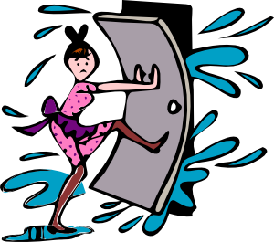
rr
correr
barrio
cerrar
perro
correcto
correo
@
Notes:
Introduce and elicit the pronunciation of the individual SSC ‘rr’ and then the source word again (with gesture, if using). Then present and elicit the pronunciation of the five cluster words.
The cluster words have been chosen for their high-frequency, from a range of word classes, with the SSC (where possible) positioned within a variety of syllables within the words (e.g. initial, 2nd, final etc.). Additionally, we have tried to use words that build cumulatively on previously taught SSCs (see the Phonics Teaching Sequence document) and do not include new SSCs. Where new SSCs are used, they are often consonants which have a similar symbol-sound correspondence in English.
Word frequency rankings: perro [888]; correr [343]; cerrar [521]; correo [1638]; barrio [940]; correcto [1467] Source: Davies, M. & Davies, K. (2018). A Frequency Dictionary of Spanish: Core vocabulary for learners (2nd ed.) London: Routledge.

Slide 6
rr
correr
barrio
cerrar
perro
correcto
correo
Notes:
Without the images, students focus this time again closely on the SSC and the cluster words.

Slide 7
rr
correr
barrio
cerrar
perro
correcto
correo
Notes:
Without the images or sound, students have to pronounce the words themselves.

Slide 8
r
pero
Notes:
Introduce and elicit the pronunciation of the individual SSC ‘r’ and then present and practise the pronunciation of the source word ‘pero’.
A possible gesture for this source word would be hold up your right hand, palm facing away, as if raising an objection or rejecting something. NB: Picture and gesture are abstract and pupils need to be told that ‘pero’ means ‘but’.

Slide 9
r
pero
Notes:
Repeat the sound and elicit the source word.

Slide 10
r
pero
Notes:
Repeat the sound and elicit the source word.

Slide 11
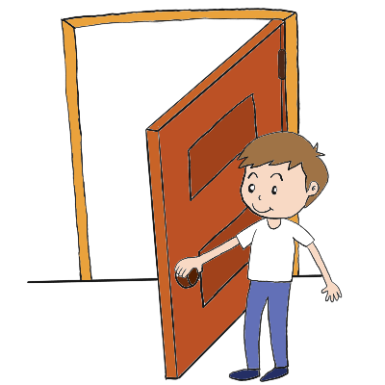
r
caro
abro
seria
pero
Francia
sobre
[about; on top of]
Notes:
Introduce and elicit the pronunciation of the individual SSC ‘r’ and then the source word again (with gesture, if using). Then present and elicit the pronunciation of the five cluster words.
The cluster words have been chosen for their high-frequency, from a range of word classes, with the SSC (where possible) positioned within a variety of syllables within the words (e.g. initial, 2nd, final etc.). Additionally, we have tried to use words that build cumulatively on previously taught SSCs (see the Phonics Teaching Sequence document) and do not include new SSCs. Where new SSCs are used, they are often consonants which have a similar symbol-sound correspondence in English.
Word frequency rankings: pero [30]; caro [2179]; Francia [939]; sobre [62]; abrir [246]; rico[398] Source: Davies, M. & Davies, K. (2018). A Frequency Dictionary of Spanish: Core vocabulary for learners (2nd ed.) London: Routledge.

Slide 12
r
caro
abro
seria
pero
Francia
sobre
Notes:
Without the images, students focus this time again closely on the SSC and the cluster words.

Slide 13
r
caro
abro
seria
pero
Francia
sobre
Notes:
Without the images or sound, students have to pronounce the words themselves.

Slide 14
¿r o rr?
escuchar
Escucha y escribe la letra. ¿Es ‘r’ o ‘rr’?
Escucha otra vez. Escribe la palabra en español.
r
pero
rr
correo
1
4
rr
perro
5
r
caro
2
rr
correcto
r
abrir
3
6
Notes:
Timing: 4 minutes
Aim: to distinguish between the [r] and [rr] SSC when listening
Procedure:
Students should write 1 to 6 in their exercise book.
Teacher clicks on the number button to play the word. On the first listen students should aim to write either ‘r’ or ‘rr’. On the second listen they can check and then write the whole word.
Teacher then clicks to reveal the ‘r’ ‘or ‘rr’ and then clicks again to show the full word, allowing the teacher to elicit individual answers from students.
TRANSCRIPT
pero
perro
correcto
correo
caro
abrir

Slide 15
Vocabulario
leer / hablar
60
 | Español | Inglés
1 | el perro | dog
2 | el abuelo | grandad
3 | la abuela | grandma
4 | bastante | quite, fairly
5 | el primo | male cousin
6 | la prima | female cousin
7 | hermoso | beautiful, handsome
8 | activo | active
9 | fuerte | strong
10 | el trabajo | job, work
Segundos
0
INICIO
Notes:
Timing: 5 minutes
Aim: to learn or recap vocabulary
Procedure:
Pupils either work by themselves or in pairs, reading out the words and recapping their English meaning (1 minute).
The teacher clicks to remove the English meanings and pupils have one minute to try to recall them by looking at the Spanish. The teacher can click on the ‘inicio’ button’ to run the time or keep time themselves.
The teacher then clicks and the Spanish meanings are removed. The pupils try to recall them, looking at the English (1 minute). The teacher can start the timer again in the same way as before.
Notes:
Further rounds of learning can be facilitated by one pupil turning away from the board, and his/her partner asking him/her the meanings. This activity can work from L2 → L1 or L1 → L2.
Vocabulary frequency rankings (1 is the most common word in Spanish):
tenemos [tener-19]; tienen [tener-19]; perro [888]; abuelo [4796]; abuela [717]; primo [1451]; prima [3051]; bastante [308]; hermoso [980]; activo [1278]; fuerte [435]; trabajo² [152]

Slide 16
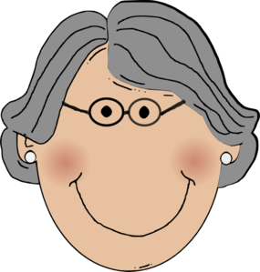
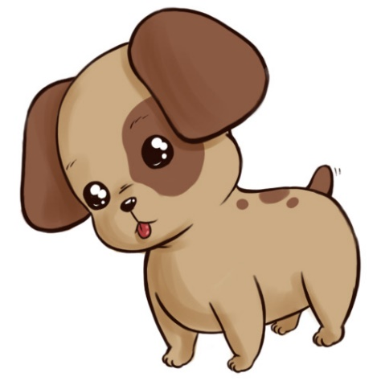
Soy Isobel, hablo de mi familia.
leer / hablar
el tío = uncle
la tía = aunt
el abuelo
Paco
la abuela
Sofia
Carlos
la tía
el tío
Ana
Emilia
Martín
el perro
Chu-chu
el primo
la prima
Luca
Lorena
Isobel
Notes:
Timing: 6 minutes (for 7 slides)
Aim: to recap and embed family member vocabulary and revise adjective agreements.
Procedure:
1. Teachers could begin by clarifying who is who to revise the family members. Students could be asked to write the name of the person, with the correct word in Spanish e.g Paco = el abuelo etc. Or this could be done orally – in pairs give the Spanish and then the teacher takes feedback by asking ¿Quién es Paco? etc.
2. The teacher then clicks to reveal the word for each family member which will cover the name. The order is abuelo; abuela; tío; tía; (the gloss will be revealed for these two new words at the same time); primo; prima. This allows the teacher to ask for individual pupils to answer each question. If the teacher has asked ‘¿Quién es Paco?’, then the answer can simply be ‘el abuelo’. Later in the scheme of work, the use of ‘de’ for possession will be taught explicitly (e.g. ‘Paco es el abuelo de Isobel’).
Note:
‘tío’ and ‘tía’ are included in this activity to support the recycling of adjectives. Since they aren’t vocabulary items this week, a gloss is provided.

Slide 17
Isobel
El perro es bonito.
Es bonito… ¿la abuela, la prima o el perro?
leer / hablar
Paco
Sofia
Carlos
Ana
Emilia
Martín
Chu-chu
Luca
Lorena
Isobel
Notes:
Procedure: (for this and the next 6 slides)
The teacher clicks and a sentence appears to describe a member of the family with three potential answers circled. Students use the clue by looking at the adjective ending to give their answer. Students can either write the response in their exercise books / on mini-whiteboards or say the answer out loud as a choral response.
The teacher clicks again to reveal the answer in Spanish, and the chance to explain why it is correct. This offers an opportunity for teachers to check understanding by asking for the English translation.
Repeat the process for the following slides.
The last slide in this sequence uses the adjective ‘fuerte’ which will lead to all answers being correct.

Slide 18
Isobel
Es activa… ¿el abuelo, la tía o el perro?
La tía es activa.
leer / hablar
Paco
Sofia
Carlos
Ana
Emilia
Martín
Chu-chu
Luca
Lorena
Isobel

Slide 19
Isobel
Es hermosa… ¿el abuelo, la abuela o el tío?
La abuela es hermosa.
leer / hablar
Paco
Sofia
Carlos
Ana
Emilia
Martín
Chu-chu
Luca
Lorena
Isobel

Slide 20
Isobel
El primo es simpático.
Es simpático… ¿la prima, el primo o la tía?
leer / hablar
Paco
Sofia
Carlos
Ana
Emilia
Martín
Chu-chu
Luca
Lorena
Isobel

Slide 21
Isobel
Es hermoso… ¿la prima, el tío o la tía?
El tío es hermoso.
leer / hablar
Paco
Sofia
Carlos
Ana
Emilia
Martín
Chu-chu
Luca
Lorena
Isobel

Slide 22
Isobel
La prima es famosa.
Es famosa… ¿la prima, el abuelo o el tío?
leer / hablar
Paco
Sofia
Carlos
Ana
Emilia
Martín
Chu-chu
Luca
Lorena
Isobel

Slide 23
Isobel
El abuelo / la abuela / la prima es fuerte.
Es fuerte… ¿la abuela, el abuelo o la prima?
leer / hablar
Paco
Sofia
Carlos
Ana
Emilia
Martín
Chu-chu
Luca
Lorena
Isobel
Notes:
Note:
Remind students that ‘fuerte’ can refer to any of them (in the same way as other adjectives they have seen, like ‘alegre’, ‘interesante’).

Slide 24
tener
gramática
[to have | having]
tengo
[ I have ]
Notes:
Timing: 1 minute (slides 18 and 19)
Aim: to recap the verb ‘tener’ and the I form ‘tengo’, and then introduce the ‘tenemos’ form.
Procedure:
The teacher clicks to show ‘tener’, then clicks again to show a question button ask for the meaning. The next click reveals the meaning in English.
The teacher clicks to show ‘tengo’, and follows the same procedure to ask for the meaning and then to reveal it.

Slide 25
tenemos
gramática
[we have]
Tenemos un abuelo. Es famoso.
[We have a grandad. He is famous.]
Notes:
Aim: to introduce ‘tenemos’ form of tener
Procedure:
1. The teacher clicks to show ‘tenemos’ and the meaning at the same time.
2. The teacher clicks again to show ‘tenemos’ used in a short sentence. The teacher can ask for the meaning before clicking to reveal the translation.

Slide 26
leer
Lee las descripciones. Escribe en inglés. ¿Cómo son las familias?
leer
Tenemos una familia. Es grande.
Tengo una familia. Es interesante.
Tengo un abuelo. Es activo.
Tenemos dos primos en Inglaterra.
el tío = uncle
la tía = aunt
Tengo un tío y una tía.
Tenemos una abuela. Es alegre.
Tenemos un perro. Es bastante tonto.
Tengo una prima. Es simpática.
Isobel (“I have”)
Los primos (“we have”)
an interesting family
a big family
an active grandad
two cousins in England
an aunt and uncle
a cheerful grandma
Isobel
Los primos
a nice cousin
a quite silly dog
Notes:
Timing: 8 minutes
Aim: reading activity pairing up and contrasting the meaning of ‘tengo’ and ‘tenemos’, recapping family members and adjective meanings
Procedure:
The teacher tells students to copy the grid into their exercise books, drawing attention to the ‘I have’ column on the left, and the ‘we have’ column on the right.
Students write their answers in English in the correct columns, focusing on the ‘tengo’ and ‘tenemos’ verbs in each sentence.
The teacher clicks to go through the answers, first those in the ‘Isobel’ column (one click to show each answer), and then followed by those in the ‘los primos’ column.

Slide 27
escuchar
La familia visita una isla. ¿Qué tiene la familia?
escuchar
Marca ‘tengo’ o ‘tenemos’.
I have
We have
 |  | Escribe las cosas. | ¿Cómo es/son? Marca el adjetivo correcto
 |  |  | interesantes / interesante
 |  |  | grande / grandes
 |  |  | importante / importantes
 |  |  | bonito / bonita / bonitos / bonitas
 |  |  | raro / rara / raros / raras
 |  |  | pequeño / pequeña / pequeños / pequeñas
A
una vista
B
unos productos
C
unas bolsas
D
una camisa
unas cosas
E
un vaso
F
Notes:
Timing: 8 minutes
Aim: listening exercise pairing up and contrasting ‘tengo’ and ‘tenemos’, revisiting vocabulary from 1.1.7/ 1.2.6 and practising adjective agreements
Procedure:
The pupils should copy the grid into their exercise books. The teacher clicks to reveal the instructions one by one to fill in the table. The teacher should tell the pupils to put a tick in either the ‘I have or ‘we have’ column, then write the object in Spanish, using the indefinite article (un, una, unos, unas), and then either to write the correct adjective from the 2/4 options, or write each adjective down and then circle the correct one.
The teacher clicks on the letter button to play the recording. The adjective will be ‘beeped out’ in the recording so pupils need to decide what the correct adjective agreement will be based on the product heard.
When finished the teacher clicks to reveal the individual answers for each question, one click to show each answer, allowing pupils to answer each one.
If required, the teacher can ask the pupils what the complete sentence means in English.
Transcript
Tenemos una vista [beep]
Tengo unos productos [beep]
Tengo unas bolsas [beep]
d) Tenemos una camisa [beep]
e) Tengo unas cosas [beep]
f) Tenemos un vaso [beep]
Notes
Vocabulary from 1.2.6 revisited here

Slide 28
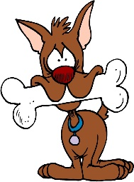
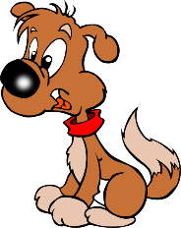
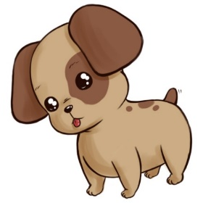
escribir / hablar / escuchar
Persona A
a grandma
escribir / hablar / escuchar
Sentence with tenemos
Sentence with tengo
Tenemos una abuela.
Tengo una abuela.
Paco
Sofía
¿Quién?
Carlos
Ana
Raúl
Emilia
Martín
Isobel 
Luca
Lorena
Isobel

Luca y Lorena
Notes:
Timing: 10-12 minutes (for 4 slides)
Aim: writing, speaking and listening practice with ‘tengo’ and ‘tenemos’, using family members
Procedure:
1. Use this slide to model the instructions of this next activity to students.
2. Teachers should hand out the blank grids first to help the students understand the exercise.
3. The teacher explains to students they are going to write three sentences using I have and three using we have for the words they are given. Use the animation on this slide to model the instructions.
4. The teacher clicks to show ‘a sentence with tengo, then clicks again to show ‘tengo una abuela’, and then who that would refer to (Isobel). The teacher then clicks again to show an example with ‘tenemos’, (tenemos una abuela), and then clicks to show that the answer would be Luca y Lorena.
4. Students need to use the image of the family tree, their knowledge of family members from this lesson together with other family member words (brother and sister from Y7 Term 1.2 Week 7). Students also need the word for cat which is from 1.1 wk4. Teachers could do a quick knowledge check by eliciting these three words from students and writing them up on the board if they think that would help.
5. Students write their three sentences starting with tengo and three starting with tenemos for the family members they have been given (for prompts, see slide 24). Students must also write the answer– this is so they have already thought through the response to be able to check it against what their partner will say.
6. Partner A will say one of their sentences to partner B, who has to identify the correct name. The family tree will need displaying on the board throughout this activity. Partners take it in turns thereafter.
7. Students will need to think carefully about the meanings of tengo and tenemos to arrive at their answers given that the vocabulary items do not yield the response alone.
8. When the teacher has explained the activity, click to move on to the next family tree slide which should be left visible for the duration of the activity.

Slide 29
escribir / hablar / escuchar
escribir / hablar / escuchar
Paco
Sofía
Carlos
Ana
Raúl
Emilia
Martín
Luca
Lorena
Isobel
Notes:
Procedure:
Teachers leave this slide up for the duration of the activity for students to refer to when writing their sentences and for them to check their answers when listening to their partner’s sentences.

Slide 30
Persona A
a grandad & grandma
a cat
a brother
Write three sentences starting with tengo and three with tenemos for the family members you have been given. Use the family tree to work out the answer. Take it in turns to say them to your partner who has to work out the answer.
Persona B
two dogs
a female cousin
a dog
Write three sentences starting with tengo and three with tenemos for the family members you have been given. Use the family tree to work out the answer. Take it in turns to say them to your partner who has to work out the answer.
……………………………………………………………………………………………..............................................................
Frase | ¿Quién?
1
2
3
4
5
6
Frase | ¿Quién?
1
2
3
4
5
6

Notes:
Worksheet for printing for writing/speaking/listening exercise
Notes
1. Blank copy for printing should teachers wish to use this as a worksheet. Cut down the middle to give out the correct parts to each pair.
2. Partners should not have sight of each others’ sheets.
3. English instructions are given on this student worksheet. Teachers could delete the text box should it not be needed. NB font size is 12 given that this is a slide to be printed and not intended to be projected.

Slide 31
escribir / hablar / escuchar
Persona A
1) a grandad & grandma
2) a brother
3) a dog
Persona B
1) two dogs
2) a female cousin
3) a cat
escribir / hablar / escuchar
Frase | ¿Quién? | Frase | ¿Quién?
1)
Tengo un abuelo y una abuela.
1)
Tengo dos perros.
Isobel.
Lorena.
2)
Tengo un hermano.
Lorena.
2)
Tengo una prima.
Isobel.
3)
Tengo un perro.
Isobel.
3)
Tengo un gato.
Luca.
1)
Tenemos un abuelo y una abuela.
Luca y Lorena.
1)
Tenemos dos perros.
Carlos y Ana.
2)
Tenemos un perro.
Paco y Sofía.
2)
Tenemos una prima.
Luca y Lorena.
3)
Tenemos un hermano.
3)
Tenemos un gato.
Carlos y Martín.
Emilia y Martín.
Notes:
Answer slide for writing/speaking/listening activity
Procedure
Teachers could choose to use this slide to check through students’ answers.
Teachers should either use the custom animation to go through answers individually (first Persona A, then Persona B) or showing the answers all at once so students can quickly check their sentences as the final bringing together of this activity.

Slide 32
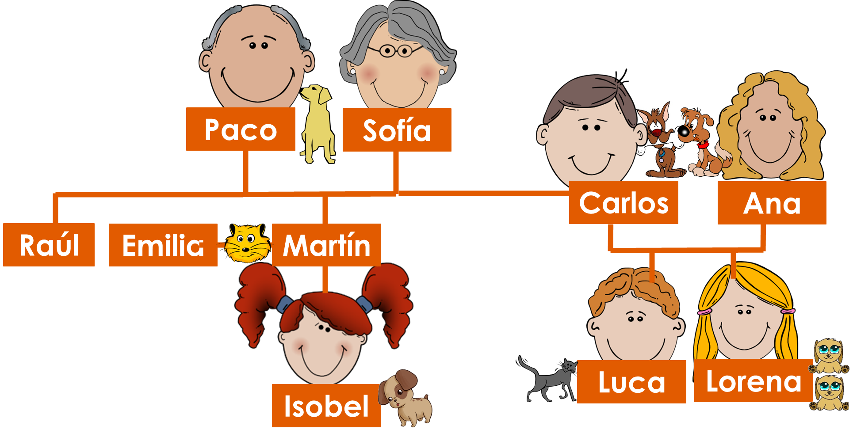
Talking about family
Using the verb ‘tener’ (‘s/he’ and ‘they’)
Y7 Spanish Term 2.1 - Week 2 - Lesson 32 Victoria Hobson / Rachel Hawkes / Nick Avery Artwork: Mark Davies Date updated: 15.01.24
Notes:
All pictures selected are available under a Creative Commons license, no attribution required.
Note: all words (new and revisited) in this week of the SOW appear on all three GCSE wordlists, with no exceptions.
Learning outcomes (lesson 2):
Consolidation of ‘tiene’
Introduction of ‘tienen’
Word frequency (1 is the most frequent word in Spanish):
7.2.1.2 (introduce) tenemos [tener-19]; tienen [tener-19]; perro [888]; abuelo [4796]; abuela [717]; primo [1451]; prima [3051]; bastante [308]; hermoso [980]; activo [1278]; fuerte [435]; trabajo² [152]
7.1.2.6 (revisit) necesitar [276]; usar [317]; llevar [75]; zapato [1477]; vaso [1609]; producto [394]; bolsa [1581]; camisa [1873]; cosa [69]
7.1.2.1 (revisit) no [11]; caminar [514]; estudiar [281]; español¹ [262]; inglés¹ [583]; arte [208]; ciencia(s) [738]; señor¹ [201]; señora¹ [509]; mucho (as adverb only) [41]; pero [30]; verdadero [558]; o [29]; falso [1599]; entiendo [entender-229]; silencio [518]; grupo [200]; perdón [1729]
Source: Davies, M. & Davies, K. (2018). A frequency dictionary of Spanish: Core vocabulary for learners (2nd ed.). Routledge: London
The frequency rankings for words that occur in this PowerPoint which have been previously introduced in LDP resources are given in the LDP SOW and in the resources that first introduced and formally re-visited those words.
For any other words that occur incidentally in this PowerPoint, frequency rankings will be provided in the notes field wherever possible.

Slide 33
Organiza los adjetivos. Hay dos opciones.
1)
-o
-a
2)
-os
-as
-s
blanco feo interesante rico caro importante antiguo guapo artístico alegre bonito bueno bajo tonto fuerte serio nervioso tranquilo alto grande raro pequeño famoso hermoso activo barato
Notes:
Timing: 5 minutes
Aim: to recap adjective agreements
Procedure:
The teacher can either use the adjective on the previous slide ‘es hermoso’ to lead in to a reminder of questions eliciting answers about how adjectives agree in gender and number. Both patterns covered so far in the SoW are practised here, and this activity will be useful for the forthcoming activities in this lesson
Teachers ask students to write the adjectives down in two columns depending on whether the ending will change ‘o/a/os/as’ or ‘e/es’. As an alternative, this exercise could be done orally.
Notes:
The shapes offer a visual representation of the possible endings. Elicit the responses from the students as to when to use the different endings and therefore which type of adjective will go in each box.

Slide 34
Respuestas
o
blanco
feo
rico
caro
antiguo
guapo
artístico
bonito
bueno
bajo
tonto
serio
nervioso
tranquilo
alto
raro
pequeño
famoso
hermoso
activo
barato
a
interesante
importante
alegre
fuerte
grande
os
as
s
Notes:
Answer slide for the previous activity
Notes:
Teachers should take this opportunity to revisit the meaning of these adjectives. This could either be done by going through each word one by one or by saying ‘white, masculine plural’ and asking students to say ‘blancos’, or doing it from L2 to L1, saying ‘blancos’ and asking for the answer ‘white, masculine plural’.

Slide 35
tener
[to have | having]
tiene
[s/he has | it has]
Notes:
Timing: 1 minute (slides 28 and 29).
Aim: to recap meanings of ‘tiene’ and introduce ‘tienen’
Procedure:
1. The teacher clicks to show ‘tener’ and asks for the meaning. Clicking again shows the translation
2. The teacher clicks to show ‘tiene’ and asks for the meanings. Clicking again show the answer.

Slide 36
tienen
[they have]
Tienen un gato. Es hermoso.
[They have a cat. It’s beautiful]
Notes:
Aim: to introduce ‘tienen’ and show use
Procedure:
The teacher clicks to show ‘tienen’ and its meaning.
Clicking again shows an example of a sentence using ‘tienen’. A student could be asked for the meaning of the sentence before another click will show the translation.

Slide 37
leer
leer
La familia visita un pueblo en las islas. Lee las descripciones ¿Qué tiene el pueblo? ¿Qué tienen las islas? Marca la opción correcta y escribe el inglés.
 |  | it has | they have
1 | Tienen unas vistas. Son hermosas.
2 | Tiene unos edificios. Son grandes.
3 | Tiene un equipo de fútbol. Es famoso.
4 | Tienen unos platos. Son baratos.
5 | Tiene trabajo. Es interesante.
6 | Tienen unas películas de cultura española.
beautiful views
big buildings
a famous football team
cheap dishes
interesting work
films of Spanish culture
Notes:
Timing: 5 minutes
Aim: reading exercise pairing up ‘tiene’ and ‘tienen’ to practise understanding their different meanings.
Procedure:
Teachers can decide here how much of the grid students copy into their exercise book, whether they write the sentence or not.
The key element for students is to recognise ‘tiene’ or ‘tienen’ and tick the correct column. They then also translate what the town has into English.
When finished the teacher clicks to show each answer individually, first the ‘it has’ or ‘they have’, and then the English translation, allowing students to answer.
It is worth teachers drawing attention to the adjective agreements in action in each sentence.
Notes:
Vocabulary in this activity is revisited from 1.2.6 – vista/edificio/equipo/plato/trabajo/familia/película/intersante/grande (plus isla and pueblo in the rubric).

Slide 38
escuchar y escribir
escuchar / escribir
¿Qué tiene la abuela? ¿Qué tienen los primos? Escucha y marca la opción correcta. Completa la segunda frase con un adjetivo.
 |  |  | una bolsa
 |  |  | unas películas
 |  |  | unos zapatos
 |  |  | unas cosas
 |  |  | una tía
 |  |  | unos amigos
¿Cómo es/son?
she has
they have
1
e.g. Es cara.
(It’s expensive)
2
3
4
5
6
Notes:
Timing: 8 minutes
Aim: listening activity pairing up ‘tiene’ with ‘tienen’, and practice with adjective agreements
Procedure:
1. Students copy out the grid. They will need to tick the correct column depending on whether they hear ‘tiene’ or ‘tienen’
2. The teacher clicks the number button to play the short phrase. The adjective is beeped out.
3. The answers are shown by clicking one after another
4. After showing the answer to number 8, the teacher asks students to write a possible adjective that could fill in the bleep in the recording, ensuring that the adjective agrees with the noun. The teacher can then listen to various answers from students and ask them for the meaning in English. One possible answer is given for number one, but there are no other answers on this slide.
Transcript:
Tiene una bolsa. Es [beep]
Tienen unas películas. Son [beep]
Tiene unos zapatos. Son [beep]
Tienen unas cosas. Son [beep]
Tienen una tía. Es [beep]
Tiene unos amigos. Son [beep]

Slide 39
¡A hablar!
escribir / hablar / escuchar
A & B. First, write your sentences in Spanish.
Round 1 Persona A. Say your sentences in Spanish to your partner in any order.
Round 1 Persona B. Listen to your partner. Write the sentences in English.
Round 2 Persona B. Say your sentences in Spanish to your partner in any order.
Round 2 Persona B. Listen to your partner. Write the sentences in English.
Notes:
Timing: 10 minutes
Notes
The next slides are the Person A and Person B sheets for the writing, speaking and listening activity, do not show these in class.
Aim: writing, speaking and listening activity practising using ‘tiene’ and tienen’, this week’s vocabulary and adjective agreements.
Procedure:
The teacher gives different sheets to partner A and partner B.
Each partner must first write their own set of sentences in Spanish. They then take it in turns to say a sentence to their partner who must listen to find out the information about the person/s being described and write the details under the correct picture in English. Students need to listen carefully for tiene/tienen to determine a) who is being described, then listen to the details to determine b) the exact description.
At the end of the activity partners compare their answers to the original sentences to see if the have understood the information correctly. There are answer slides to check.

Slide 40
escribir / hablar /escuchar
Round 1 Persona A. Write these sentences in Spanish. Say them in Spanish to your partner in any order.
Round 2 Persona A. Listen to your partner. Write the sentences in English.
She has a grandma. She is cheerful
……………………………………………………….
She has work. It is important.
……………………………………………………….
She has some shoes. They are expensive.
……………………………………………………….
They have three dogs. They are strong.
……………………………………………………….
They have a family. It is big.
……………………………………………………….
They have some films. They are old.
……………………………………………………….
1
2
3
1
2
3
Notes:
This is the Person A sheet for both rounds.

Slide 41
escribir / hablar /escuchar
Round 1 Persona B. Listen to your partner. Write the sentences in English.
Round 2 Persona B. Write these sentences in Spanish. Say them in Spanish to your partner in any order.
They have a cousin. She is nice.
……………………………………………………….
They have two cats. They are small.
……………………………………………………….
They have some things. They are interesting.
……………………………………………………….
She has a brother. He is active.
……………………………………………………….
She has some shoes. They are pretty.
……………………………………………………….
She has an island. It is beautiful.
……………………………………………………….
1
2
3
1
2
3
Notes:
This is the person B sheet for both rounds.

Slide 42
escribir / hablar /escuchar
Round 1 respuestas
escribir / hablar / escuchar
Persona A
She has a grandma. She is cheerful.
Tiene una abuela. Es alegre.
She has work. It is important.
Tiene trabajo. Es importante.
She has some shoes. They are expensive.
Tiene unos zapatos. Son caros.
They have three dogs. They are strong.
Tienen tres perros. Son fuertes.
They have a family. It is big.
Tienen una familia Es grande.
They have some films. They are old.
Tienen unas películas. Son antiguas.
Persona B
They have a cousin. She is nice.
They have two cats. They are small.
They have some things. They are interesting.
She has a brother. He is active.
She has some shoes. They are pretty
She has an island. It is beautiful.
She has a grandma. She is cheerful.
She has work. It is important.
She has some shoes. They are expensive.
They have three dogs. They are strong.
They have a family. It is big.
They have some films. They are old.
Notes:
Answer slide 1 for Round 1
Procedure
Display this slide to allow As to check their writing and Bs to check their understanding.

Slide 43
escribir / hablar /escuchar
Round 2 respuestas
escribir / hablar / escuchar
They have an cousin. She is nice.
Tienen una prima. Es simpática.
They have two cats. They are small.
Tienen dos gatos. Son pequeños.
They have some things. They are interesting. Tienen unas cosas. Son interesantes.
She has a brother. He is active.
Tiene un hermano. Es activo.
She has some shoes. They are pretty.
Tiene unos zapatos. Son bonitos.
She has an island. It is beautiful.
Tiene una isla. Es hermosa.
Persona B
Persona A
They have a cousin. She is nice.
They have two cats. They are small.
They have some things. They are interesting.
She has a brother. He is active.
She has some shoes. They are pretty.
She has an island. It is beautiful.
Notes:
Answer slide 2 for Round 2
Procedure
Display this slide to allow Bs to check their writing and As to check their understanding.

Slide 44
Mi familia
hablar
Practica el diálogo con una pareja.
1 | Hello!
2 | How are you?
3 | What is your family like?
4 | Who do you have in your family?
5 | What is s/he like?
6 | Does s/he study (…)?
7 | Ah, I understand. Bye!
¡otra vez!
1 | Hello!
2 | I’m fine, thanks.
3 | It is big.
4 | I have (…)
5 | S/he is (…)
6 | No, but s/he studies (…)
7 | Yes, bye!
Perdón, señor XXX / señora XXX.
¿Cómo se dice XXX en español?
Notes:
Timing: 5-10 minutes
Aim: to practise oral recall of key new and revisited vocabulary and structures in spoken interaction.
Procedure:
1. Students practise the dialogue in pairs. 2. They then swap roles so each has a turn asking the questions.
Note: this dialogue also revisits some vocabulary from 7.1.2.1: no [11]; estudiar [281]; español¹ [262]; inglés¹ [583]; arte [208]; ciencia(s) [738]; señor¹ [201]; señora¹ [509]; pero [30]; entiendo [entender-229]; perdón [1729]
Differentiation: For students who need more support leading up to this activity, teachers can modify the slide with first letters of each word, and model the whole dialogue first, eliciting the Spanish from students, perhaps writing up (on a separate whiteboard or annotating this slide) vocabulary that students are less sure about. The pink prompt box at the bottom is to remind students that they already know how to ask for help with specific items of vocabulary from their teacher.

Slide 45
escribir
We have a grandma. She’s quite kind.
They have two cousins. They’re famous.
He has an job. It’s very interesting.
I have some products. They’re important.
She has a family. It’s small.
The family has an aunt. She’s rich.
The islands have some views. They’re beautiful.
escribir
Tenemos una abuela. Es bastante simpática.
Tienen dos primos. Son famosos.
Tiene un trabajo. Es muy interesante.
Tengo unos productos. Son importantes.
Tiene una familia. Es pequeña.
La familia tiene una tía. Es rica.
Las islas tienen unas vistas. Son hermosas.
Notes:
Timing: 10 minutes Note: if time is short, this activity can be shortened or set for homework, or omitted entirely.
Aim: to practise writing the different forms of ‘tener’ learned this week (tengo/tiene/tenemos /tienen) and adjective agreements.
Procedure:
Students need to translate the sentences into Spanish. Teachers should ask students to focus on using the correct form of ‘tener’ and remind them to check adjective agreements in each sentence.
Teacher clicks to show the correct sentences one after another.
Notes
This activity presents a challenge in terms of accuracy of verb and adjective agreement. This will allow the teacher to gauge the students’ competency with these grammatical features.
Numbers 6 & 7 may lead to some discussion. This presents an opportunity to clarify and exemplify the meanings of tiene / tienen as has/have i.e not he/she/it has & they have.

Slide 46
Deberes
New vocabulary for 7.2.1.3:
Audio file
Student worksheet
In addition, revisit: Term 1.2.7 Term 1.2.2
Notes:
Use this slide to set the homework.
For Y7, the typical homework will be to pre-learn vocabulary for the next lesson. There is an audio file to accompany the student worksheet.
Notes:
i) Teachers may, in addition, want to recommend use of a particular online app for the pre-learning of each week’s words. ii) Quizlet now requires parental involvement / registration / permissions for users below the age of 13, so it is perhaps most suitable for Y9 – 11 students. iii) Language Nut hosts LDP vocabulary lists and these are free for schools to use, though there is a registration process. One benefit is that all of the student tracking data that Language Nut offers are also available to schools that use the LDP lists for practice. Perhaps this makes it a good option for Y7/8.
iv) There are other free apps, and new ones are always appearing. Teachers have told us that they are currently using: Flippity, Wordwall (where using previously-created activities is free).
v) Gaming Grammar has been acquired by Language Nut. Its original content should still be available to teachers and much of it is appropriate for Y7 learners.
For this week: Adjective: number in the ‘Adjective agreement’ menu

