Slide 1
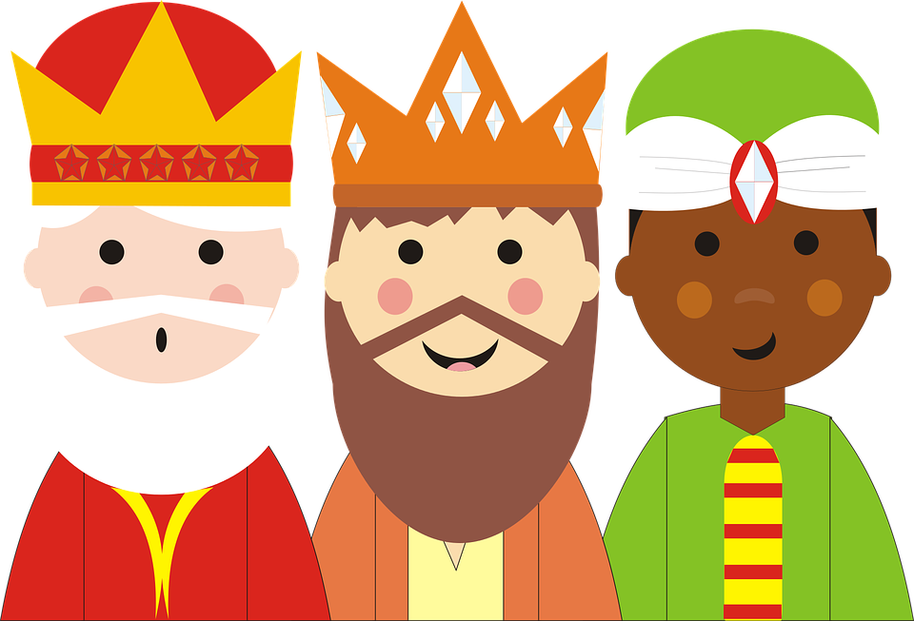
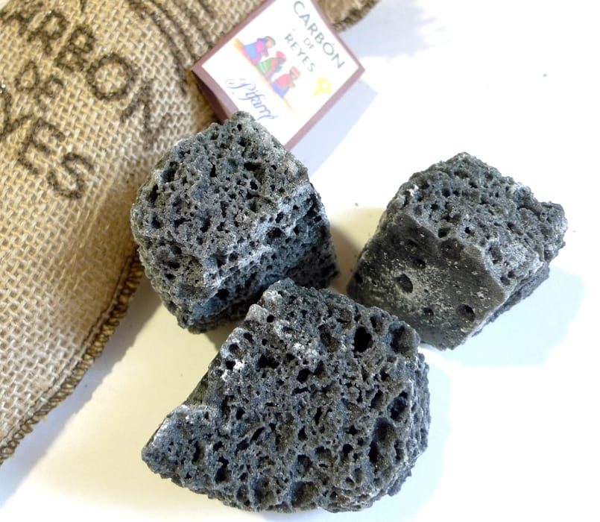
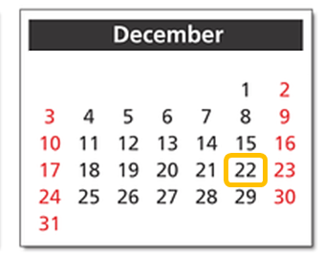
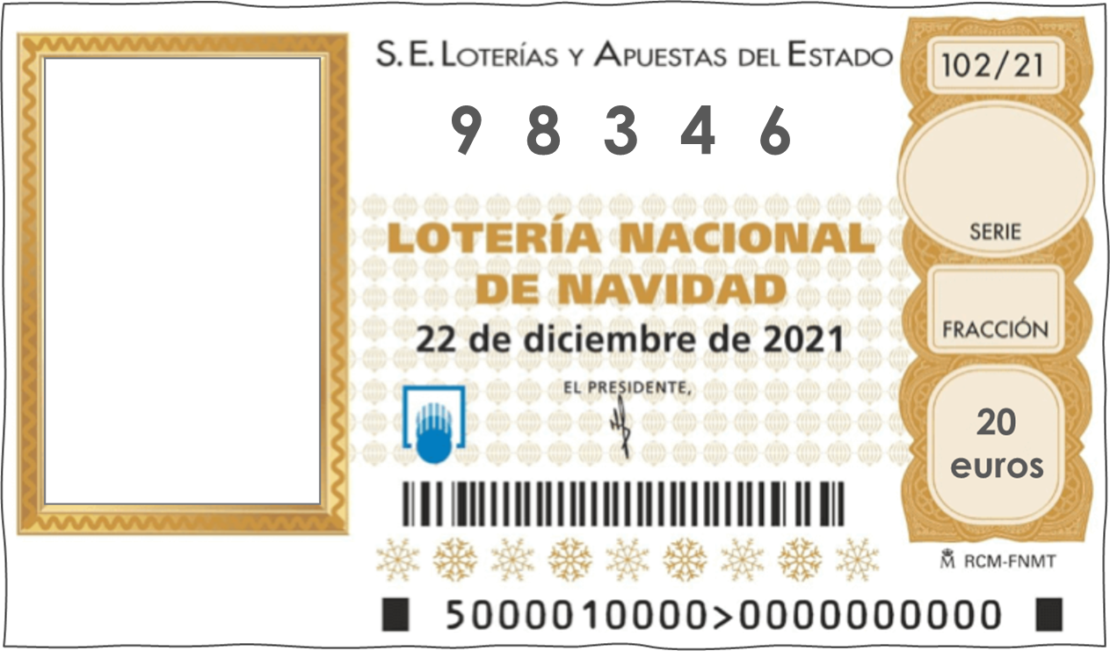
Talking about festive seasons: wanting and giving
QUERER - quiero/quieres/quiere + noun
Y7 Spanish Term 1.2 – Week 7 – Lesson 27 Nick Avery / Rachel Hawkes Artwork: Mark Davies Date updated: 04.08.23
Notes:
Note: all words (new and revisited) in this week of the SOW appear on all three GCSE wordlists.
Learning outcomes:
Introduction of SSC [n], [ñ]
Introduction of querer - quiero/quieres/quiere + noun
Consolidation of indefinite articles
Note: this week we introduce two verbs: querer and dar. We practise them both in singular persons in receptive activities, with one production activity at the end of lesson 2. The verbs will be incorporated into more production activities in the first lesson of Term 2.1.
Word frequency (1 is the most frequent word in Spanish):
7.1.2.7 (introduce) dar [42]; doy; das; da; querer [58]; quiero; quieres; quiere; regalo [1986]; padre [162]; madre [226]; hermano [333]; hermana [3409]; dinero [364]; a [8]
7.1.2.4 (revisit) son [ser-7]; pequeño [202]; bueno [98]; malo [368]; famoso [997]; bonito [891]; feo [2373]; rico¹ [398]; caro [2179]; barato [2164]; antiguo [446] ¿cómo es? [cómo-151]
7.1.1.6 (revisit) ¿quién? [289]; hablar [90]; comprar [361]; bailar [1323]; llegar [75]; escuchar [281]; amiga [1172]; música [340]; tarde¹ [392]; temprano [1578]; importante [171]; bien [78]; con [14]; otra vez [59-vez]; pareja¹ [892]
Source: Davies, M. & Davies, K. (2018). A frequency dictionary of Spanish: Core vocabulary for learners (2nd ed.). Routledge: London

Slide 2
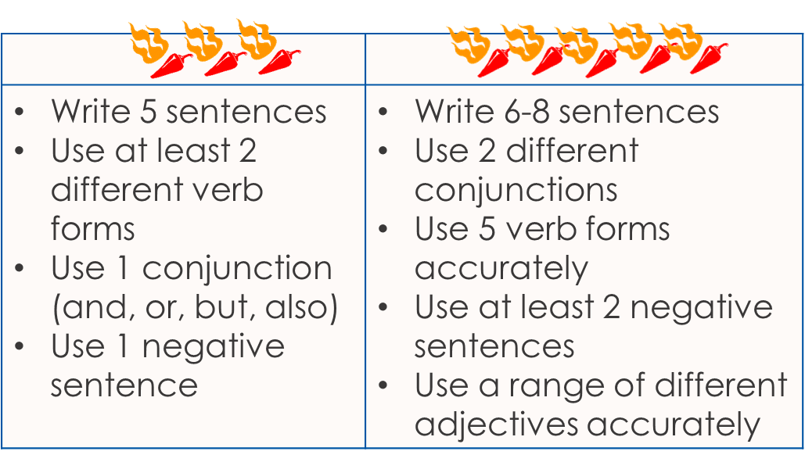
Un texto
Escribe un texto.
escribir
Write a short text about your town/village. Include:
vocabulario
Introduce yourself (I am … from …in …)
What there is there (In the town/city there is/are… and …)
What two places are like (The … is/are… and/but the … is/are…)
If your school is near or far (The school is …)
Three questions (e.g., Where are you? What is the town/city like? What is there there? Does it have a …?)
my – mi (familia, pueblo)
sometimes – a veces
often – a menudo
always - siempre
Notes:
Note: if teachers are not completing a piece of assessed writing this week in class time, they can start this lesson from slide 3. Timing: 10-15 minutes Aim: to revisit previously taught vocabulary and grammar in the context of a short piece of writing, bringing together language from Y7 Term 1 so far.
Procedure: Students write the short text they prepared last week. Teachers will decide on the level of support, though students will build from individual words, manipulating the language they have been taught to build their own sentences.

Slide 3
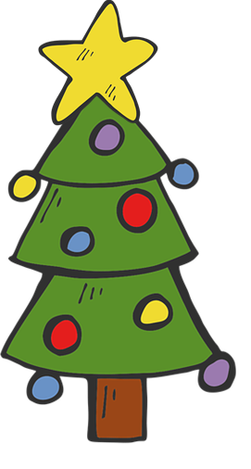
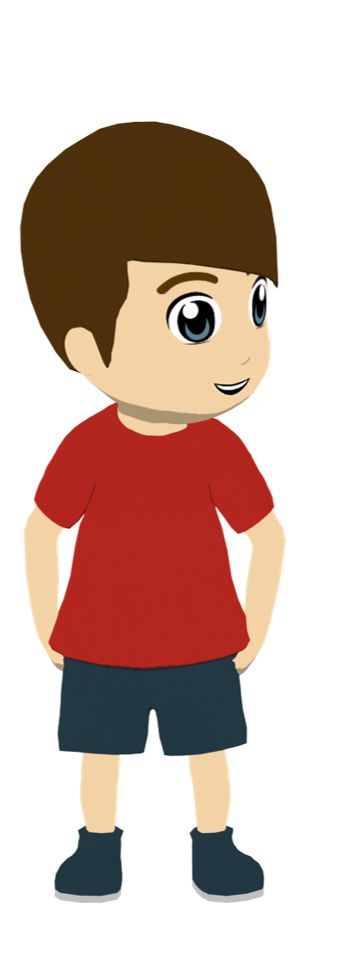
Navidad
Es diciembre. Daniel describe la Navidad en casa.
escuchar / escribir
Lee. ¿Cómo se dice…en inglés?
La familia es muy importante en Navidad. Es bueno estar con familia, bailar, mirar películas y dar regalos. Siempre* doy regalos a la familia y a los amigos. Mi hermana quiere una bicicleta y unos bolígrafos. Papá da la bici a Lucía y yo compro los bolígrafos! Mi madre siempre llega tarde – necesita un teléfono o un reloj*! Mi padre escucha música en el trabajo y quiere unos auriculares*. Quiero unos juegos. Y tú, qué quieres? Y qué das a tu hermano?
siempre – always | mi – my | el reloj – watch | los auriculares – headphones/earbuds
Notes:
Timing: 10 minutes
Aim: to practise comprehension of previously taught and all of this week’s new vocabulary in context. Note: i) this week’s new words are in bold. All other words have been previously taught or are glossed (with the exception of ‘juego’ which is a phonics cluster word from last week). Note that all words from this text appear on the GCSE wordlists (with the exception of ‘auriculares’ which are only on the Edexcel Spanish list). ii) if teachers prefer they can (as always) present and practise the vocabulary for this week using any of their usual repertoire of activities.
Procedure: 1. Elicit or explain the meaning of the word ‘Navidad’.
2. Give students 1 minute to read the text aloud in pairs, taking turns.
3. Move to the next slide.

Slide 4
Navidad
leer
Es diciembre. Daniel describe la Navidad en casa.
dar
doy
das
da
querer
quiero
quieres
quiere
el regalo
el padre
la madre
el hermano
la hermana
el dinero
a
to give
Lee. ¿Cómo se dice…en inglés?
I give
you give
La familia es muy importante en Navidad. Es bueno estar con familia, bailar, mirar películas y dar regalos. Siempre* doy regalos a la familia y a los amigos. Mi hermana quiere una bicicleta y unos bolígrafos. Papá da la bici a Lucía y yo compro los bolígrafos! Mi madre siempre llega tarde – necesita un teléfono o un reloj*! Mi padre escucha música en el trabajo y quiere unos auriculares*. Quiero unos juegos. Y tú, ¿qué quieres? ¿dinero? Y ¿qué das a tu hermano?
s/he gives
to want
I want
you want
s/he wants
present
father
mother
brother
sister
siempre – always | mi – my | el reloj – watch | los auriculares – headphones/earbuds
money
to
Notes:
Procedure: 1. Click to bring up the vocabulary prompts for the new words, and elicit the words from students.
2. Clarify any unknown words, encouraging students to ask for words they don’t recognise/remember, using ‘¿Cómo se dice…en inglés?’

Slide 5
querer
[to want| wanting]
quiere
[wants | s/he wants]
Notes:
Timing: 3 minutes for sequence of six slides
Aim: to introduce the verb ‘querer’ more explicitly. Querer is one of the 25 most frequently used verbs in Spanish. All 25 most frequent verbs will be introduced early on using the same format. Both long form (infinitive) and short form (3rd person singular) are introduced in order to familiarise students with various forms of the same verb. Note that quiero was also introduced as a phonics word in 7.1.2.3.
Procedure
Bring up the word ‘querer’ on its own, say it, students repeat it, and remind them of the phonics. Draw attention to ‘que’.
Try to elicit the meaning from the students.
Bring up the picture, and, if using gestures, a possible gesture would be to outstretch your arm and grasp your fingers.
Then bring up the English translations. Emphasise the two meanings for the infinitive.
Bring up the short form ‘quiere’, say it, students repeat it. Draw attention to ‘que’.
Try to elicit the meaning from the students. Emphasise the two meanings for the short form.

Slide 6
querer
[to want| wanting]
quiere
[wants | s/he wants]
Notes:
Cycle through the long and short form again.

Slide 7
quiere
[wants]
Emilia quiere una casa.
[Emilia wants a house.]
Notes:
Introduce the short form in a sentence.

Slide 8
querer
[to want| wanting]
Querer una casa es normal.
[Wanting a house is normal.]
Notes:
Introduce the long form in a sentence.

Slide 9
quiere
[wants]
Emilia ______ una casa.
quiere
[Emilia wants a house.]
Notes:
Cycle through the short form in context again.

Slide 10
querer
[to want| wanting]
______ una casa es normal.
Querer
[Wanting a house is normal.]
Notes:
Cycle through the long form in context again.

Slide 11
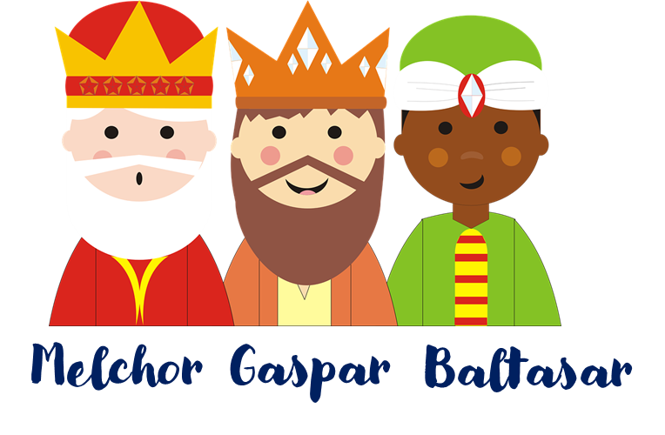
Carta a los Reyes Magos
In English, we call ‘los Reyes Magos’ ‘the three Wise Men’ or ‘the three Kings’.
leer
Lucía escribe una carta* a los Reyes Magos*: Melchor, Gaspar y Baltasar. Es una tradición.
Oh no! Someone put her ideas for her Christmas letter through the shredder.
querer un amigo
quiere un teléfono
querer un caballo
quiere una revista en español
quiere una botella de Pepsi
querer una tarea
quiere dinero
la carta – letter
Notes:
Timing: 2 minutes
Aim: to introduce the context for the reading activity that follows; to introduce one element of Christmas culture in Spain – the writing of a Christmas letter to the Reyes Magos. English children write to Father Christmas.
Procedure:
Read the Spanish introduction to this activity.
Click to bring up the callout explaining the Reyes Magos.
Explain the cultural difference in Christmas letter writing.
Click to bring up the 2nd part of the scenario.
Move to the next slide.

Slide 12
Carta a los Reyes Magos
Lee las frases. Marca la opción correcta. ¿Qué significa?
leer
‘to want’, ‘wanting’ (the action in general) | someone wants
¿Qué cosa? (en inglés)
1
querer un amigo
a (male) friend
2
quiere un teléfono
a phone
3
quiere una revista en español
a magazine in Spanish
4
querer un caballo
a horse
5
quiere una botella de Pepsi
a bottle of Pepsi
6
querer una tarea
a task
7
quiere dinero
money
Notes:
Timing: 6 minutes
Aim: to understand the difference in meaning between ‘quiere’ and ‘querer’; to consolidate understanding of the previously taught nouns.
Procedure:
Students write 1-7.
They read the Spanish phrases. For each one, they write the answer (or tick it, if they have copied the column headers at the top).
3. They also translate the nouns into Spanish.
Notes: This is the first time that students following the SoW have encountered ‘¿Qué significa?’ so ensure that the meaning is clear

Slide 13
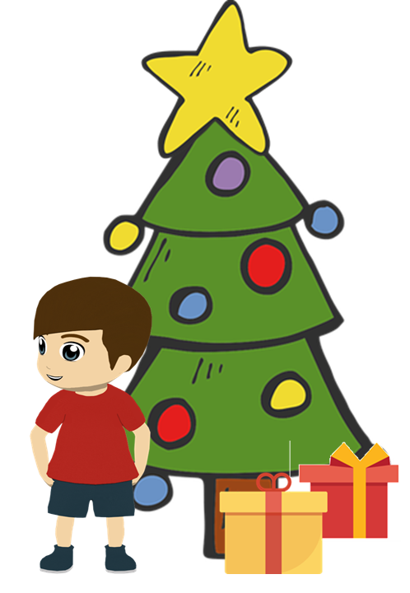
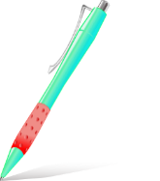
Regalos
Escucha. ¿Es ‘quiero’ o ‘quiere’? ¿Es ‘A’ o ‘B’?
escuchar
Yo (I want)
Mi padre (he wants)
A
B
1
2
3
4
5
6
Notes:
Timing: 8 minutes
Aim: to understand the difference between ‘quiero’ and ‘quiere’ in listening; to understand the difference between singular and plural nouns; to revisit previously taught vocabulary.
Procedure:
Students write 1-6.
They listen and write ‘I’ or ‘he’.
They listen again and write ‘A’ or ‘B’ depending on whether they hear a singular or plural noun.
Click to elicit and give feedback.
Notes: Mi’ hasn’t yet been taught in the LDP Y7 Spanish, so make sure that the meaning of this word is clear (it can be mistakenly understood to be the English ‘me’).
Transcript:
Quiere unas plantas.
Quiere una moneda.
Quiero un libro.
Quiere una camisa.
Quiero una revista.
Quiero unos bolígrafos.

Slide 14
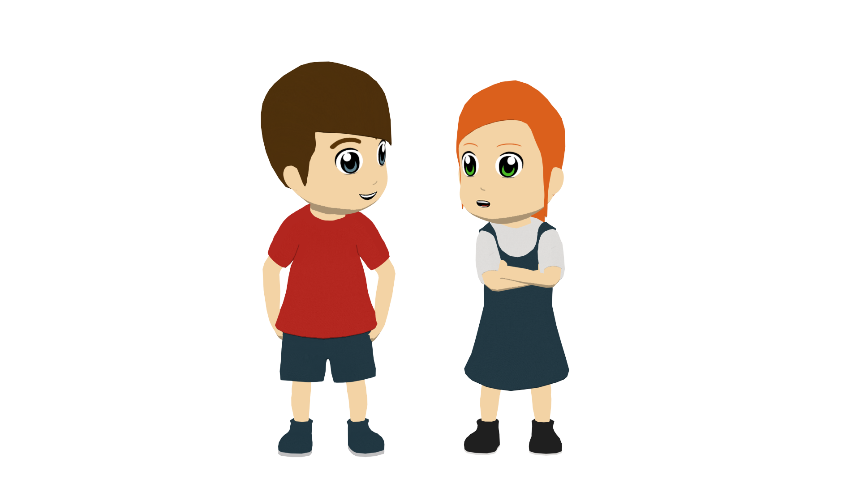
Regalos
Lee y completa la table en inglés.
leer
Lucía habla con Daniel.
Yo (“I want”)
Mi hermano (“you want”)
“Quiero una película y quieres un teléfono.”
“Quieres una camisa y unos zapatos.”
“Quiero unas flores y una planta.”
“Quieres dinero.”
“Quiero un gato y ¡quieres un caballo!”
“Quiero cuatro regalos.”
a film
a phone
some flowers
a shirt
a plant
some shoes
a cat
money
four presents
a horse!?
Notes:
If teachers started this lesson with the writing task on town, they will either finish the lesson here, or with the previous slide.
Timing: 6 minutes
Aim: to understand the difference between ‘quiero’ and ‘quieres’; to understand ten previously taught nouns and differentiate singular/plural nouns.
Procedure:
1. Students write 1-5 and two columns in their books: ‘I want’ and ‘you wants’
2. They complete the table, writing the nouns in English in the correct column.
3. Click to correct.
Notes: ‘Mi’ hasn’t yet been taught in the LDP Y7 Spanish SOW, so make sure that the meaning of this word is clear (it can be mistakenly understood to be the English ‘me’).

Slide 15
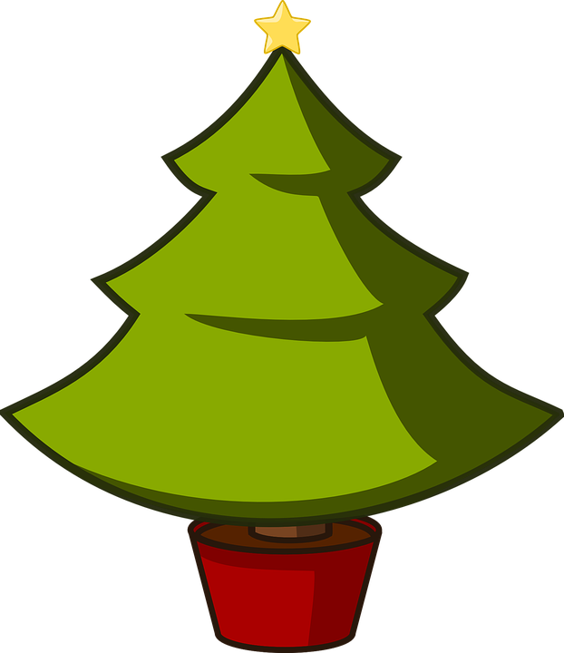
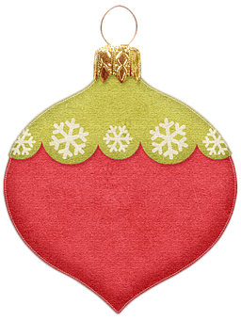
En pareja
Escribe 5 frases en inglés. Habla en español.
leer/hablar
¿quién?
¿qué?
¿cómo es?
¡otra vez!
quiero quieres quiere doy das da uso usa compro compra necesito necesita | un una unos unas | vaso. gato. teléfono. árbol. bici. camisa. bolsa. zapatos. libros. monedas de chocolate bolas de Navidad cosas. | Es Son | pequeño buenos malo famoso bonita fea ricas cara baratos antiguas
rico (rich) can also mean ‘tasty’.
el árbol – tree | la bola de Navidad – Christmas bauble
Notes:
Additional vocabulary practice activity, incorporating all of the remaining vocabulary to be revisited this week.
Timing: 8 minutes
Aim: to practise comprehension and read aloud of new and revisited language and grammar from this and previous weeks.
Procedure:
Explain the task (students did a similar task in 7.1.1.7).
Click to bring up the callout about ‘rico’ – this meaning is introduced here so that the word can be revisited in the task. The 2nd meaning very appropriate to the season, too! This is not a formal introduction of the 2nd meaning of this word which is in 7.3.1.4.
Both pupils write 5 sentences (in English) made up of words from the table. They swap sentences.
Partner A tries to say all B’s sentences in Spanish as quickly as possible.
Then Partner B tries to say all A’s sentences in Spanish.
Note: the nouns are singular/plural, the adjectives are singular/plural, masculine/feminine. As it stands, students are guided to select adjectives with the appropriate ending, so only certain combinations are possible. This is useful support and preparation for the less structured writing that follows, which directs students to adapt the adjectives themselves. Depending on the class, teachers may decided to increase the challenge here by putting all adjectives in singular, masculine form OR reduce the challenge by reducing the number of items/options in terms of verb, noun and/or adjective.

Slide 16
Navidad
¿Cómo se escribe…? Escribe frases en español.
escribir
Change the adjectives to match the gender and number of the noun.
I want You want She/He wants I use She/He uses I buy You buy You need She/He needs | a phone a cat a bike a shirt a bag (some) shoes (some) books (some) chocolate coins (some) things | It is They are | small. good. bad. famous. pretty. ugly. rich.|tasty. expensive. cheap. old.
Quiero unas monedas de chocolate. Son famosas y ricas.
Necesita unos libros. Son antiguos.
Quiere una bolsa. ¡Es fea!
Compras unas cosas. Son buenas y baratas.
Notes:
Additional vocabulary practice activity, incorporating all of the remaining vocabulary to be revisited this week.
Timing: 5 -10 minutes
Aim: to practise written production of new and revisited language and grammar from this and previous weeks.
Procedure:
Teacher clicks to bring up prompt 1.
Students write the sentence in Spanish.
Teacher clicks to provide feedback.
Continue with items 2-4.
Notes:
1) If there is more time, students can continue the activity in pairs OR the teacher can continue to give prompts for further sentences. 2) If more support is needed, students could use the Knowledge Organiser or their Language Guide, but encourage most students to work from memory. Tell them it is not a test and they will learn more by trying to remember the words, than by copying them across from a written source. 3) This activity could also be completed as a speaking activity.

Slide 17
Talking about festive seasons: wanting and giving [2]
DAR – doy/das/da + noun
SSC [ñ] [n]
Y7 Spanish Term 1.2 – Week 7 – Lesson 28 Nick Avery / Rachel Hawkes Artwork: Mark Davies Date updated: 04.08.23
Notes:
Learning outcomes:
Introduction of SSC [n], [ñ]
Introduction of querer - quiero/quieres/quiere + noun
Consolidation of indefinite articles
Note: this week we introduce two verbs: querer and dar. We practise them both in singular persons in receptive activities, with one production activity at the end of lesson 2. The verbs will be incorporated into more production activities in the first lesson of Term 2.1.
Word frequency (1 is the most frequent word in Spanish):
7.1.2.7 (introduce) dar [42]; doy; das; da; querer [58]; quiero; quieres; quiere; regalo [1986]; padre [162]; madre [226]; hermano [333]; hermana [3409]; dinero [364]; a [8]
7.1.2.4 (revisit) son [ser-7]; pequeño [202]; bueno [98]; malo [368]; famoso [997]; bonito [891]; feo [2373]; rico¹ [398]; caro [2179]; barato [2164]; antiguo [446] ¿cómo es? [cómo-151]
7.1.1.6 (revisit) ¿quién? [289]; hablar [90]; comprar [361]; bailar [1323]; llegar [75]; escuchar [281]; amiga [1172]; música [340]; tarde¹ [392]; temprano [1578]; importante [171]; bien [78]; con [14]; otra vez [59-vez]; pareja¹ [892]
Source: Davies, M. & Davies, K. (2018). A frequency dictionary of Spanish: Core vocabulary for learners (2nd ed.). Routledge: London

Slide 18
ñ
español
Notes:
Timing: 3 minutes (5 slides)
Aim: To introduce SSC [ñ] and source word ‘España’ and the five cluster words.
Procedure:
1. Introduce and elicit the pronunciation of the individual SSC ‘ñ’ and then present and practise the pronunciation of the source word ‘España’.
2. Move to the next slide. Note: A possible gesture for this source word would be to raise the right hand high above the head, and lower the left, putting middle finger and thumb together to simulate a ‘flamenco’ dance posture. Reverse the position of the hands (left hand up / right hand down) on the <ñ> syllable.
Word frequency (1 is the most frequent word in Spanish): español [262]
Source: Davies, M. & Davies, K. (2018). A frequency dictionary of Spanish: Core vocabulary for learners (2nd ed.). Routledge: London

Slide 19
ñ
español
Notes:
Repeat the sound and elicit the source word.

Slide 20
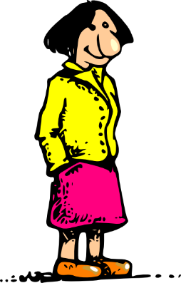
ñ
año
montaña
2019
señora
niña
español
mañana
[morning; tomorrow]
Notes:
Procedure:
1. Introduce and elicit the pronunciation of the individual SSC [ñ]and then the source word again (with gesture, if using). 2. Then present and elicit the pronunciation of the five cluster words.
The cluster words have been chosen for their high-frequency, from a range of word classes, with the SSC (where possible) positioned within a variety of syllables within the words (e.g. initial, 2nd, final etc.). Additionally, we have tried to use words that build cumulatively on previously taught SSCs (see the Phonics Teaching Sequence document) and do not include new SSCs. Where new SSCs are used, they are often consonants which have a similar symbol-sound correspondence in English. Word frequency (1 is the most frequent word in Spanish): año [46] español [262] mañana [402] montaña [1464] niña [622] señora [509]
Source: Davies, M. & Davies, K. (2018). A frequency dictionary of Spanish: Core vocabulary for learners (2nd ed.). Routledge: London

Slide 21
ñ
año
montaña
señora
niña
español
mañana
Notes:
Without the images, students focus this time again closely on the SSC and the cluster words.

Slide 22
ñ
año
montaña
señora
niña
español
mañana
Notes:
Without the images or sound, students have to pronounce the words themselves.

Slide 23
n
mano
Notes:
Timing: 3 minutes (5 slides)
Aim: To introduce SSC [n] and source word ‘mano’ and the five cluster words.
Procedure:
1. Introduce and elicit the pronunciation of the individual SSC ‘n’ and then present and practise the pronunciation of the source word ‘mano’.
2. Move to the next slide. Note: A possible gesture for this source word would be to open the palm of both your hands, one after the other on each syllable, ma-no.
Word frequency (1 is the most frequent word in Spanish): mano [135]
Source: Davies, M. & Davies, K. (2018). A frequency dictionary of Spanish: Core vocabulary for learners (2nd ed.). Routledge: London

Slide 24
n
mano
Notes:
Repeat the sound and elicit the source word.

Slide 25
n
noche
poner
mano
nada
nosotros
tener
[to have]
Notes:
Procedure:
1. Introduce and elicit the pronunciation of the individual SSC [n]and then the source word again (with gesture, if using). 2. Then present and elicit the pronunciation of the five cluster words.
The cluster words have been chosen for their high-frequency, from a range of word classes, with the SSC (where possible) positioned within a variety of syllables within the words (e.g. initial, 2nd, final etc.). Additionally, we have tried to use words that build cumulatively on previously taught SSCs (see the Phonics Teaching Sequence document) and do not include new SSCs. Where new SSCs are used, they are often consonants which have a similar symbol-sound correspondence in English. Word frequency (1 is the most frequent word in Spanish): mano [135] nada [87] noche [164] nosotros [165] poner [91] tener [19]
Source: Davies, M. & Davies, K. (2018). A frequency dictionary of Spanish: Core vocabulary for learners (2nd ed.). Routledge: London

Slide 26
n
noche
poner
mano
nada
nosotros
tener
Notes:
Without the images, students focus this time again closely on the SSC and the cluster words.

Slide 27
n
noche
poner
mano
nada
nosotros
tener
Notes:
Without the images or sound, students have to pronounce the words themselves.

Slide 28
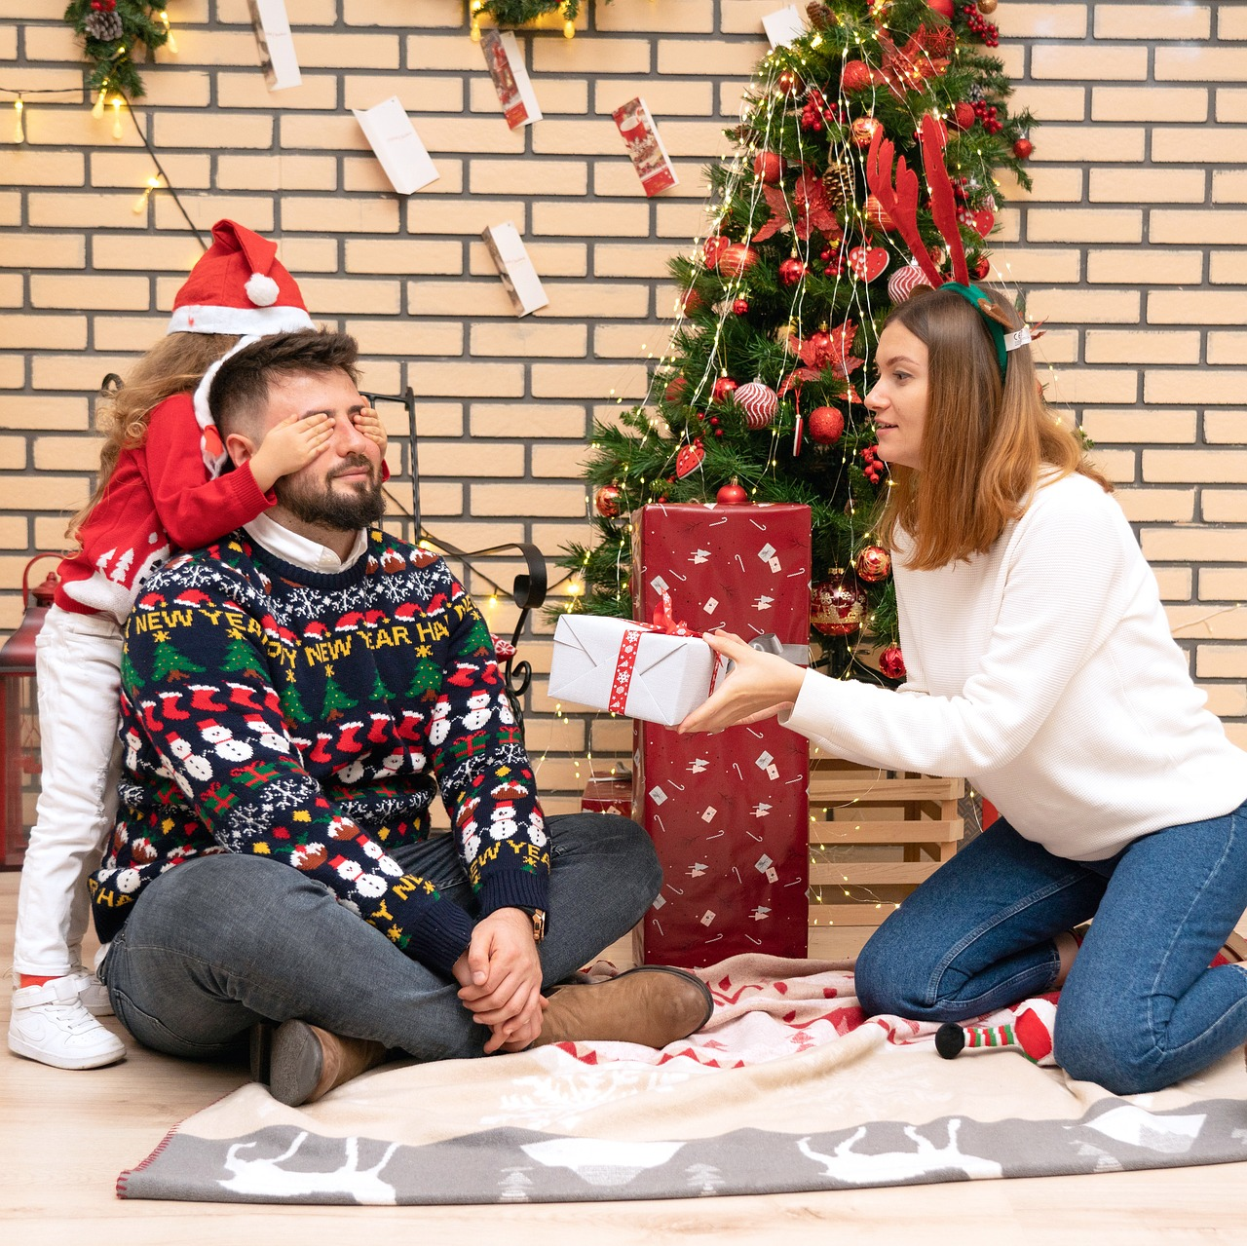
Fonética
Navidad en mi casa
escuchar / escribir
ñ
Hola, soy Daniel. Es la ma__ana de Navidad, y estoy con mi herma__a, Camila. Mi herma__o, Martín, está aquí también. Mi padre hoy tiene trabajo, pero mi madre está con nosotros. Está super alegre. Canta con mi ni__a en espa__ol ¡y en inglés!
La casa está muy bo__ita porque mi madre po__e luces en las ventanas. Hay muchos regalos también. Unos son gra__des; otros son peque__os. Martín está impaciente. ¡Quiere un regalo!
n
n
ñ
ñ
n
n
n
ñ
Notes:
Timing: 6 minutes Aim: to practise aural recognition of the difference between [ñ] and [n]; to recognise familiar vocabulary; to practise parts of querer, new this week.
Procedure: 1. Students listen and write [ñ] or [n] for the 1-9 gaps. 2. Click to correct. 3. Teachers elicit the meanings of vocabulary (see notes below) and grammar. Notes: This text can be exploited for phonics, vocabulary and grammar:
Phonics: Students listen and complete the gaps in the words with ‘n’ or ‘ñ’ (practising the phonics SSCs taught this week). The text could be adapted so that higher-achieving groups have to write the whole of a missing word, rather than just the letter.
Vocabulary: Students are asked to translate the five nouns taught this week: hermano, hermana, madre, padre, regalo. The teacher could also challenge students to also translate the phonics practice words (luces, porque, nosotros).
Grammar: Ask students what ‘quiere un regalo’ means (NB ‘he wants’ in the context of this text, but can also be ‘she wants’). Then ask them how you would say ‘I want a present’ or ‘You want a present’ to revise the singular person forms of querer from last lesson.
Notes:
1. Mi’ hasn’t yet been taught in the LDP Y7 Spanish, so make sure that the meaning of this word is clear (it can be mistakenly understood to be the English ‘me’).
2. A number of words that students have just revisited for homework are included here: ‘también’, ‘tarea’, ‘bonita’, ‘pequeño’, ‘son’.
3. ‘Impaciente’ hasn’t yet been taught but is a near-cognate.
Transcript:
Hola, soy Daniel. Es la mañana de Navidad, y estoy con mi hermana, Camila. Mi hermano, Martín, está aquí también. Mi padre hoy tiene trabajo, pero mi madre está con nosotros. Está super alegre. Canta con mi niña en español ¡y en inglés!
La casa está muy bonita porque mi madre pone luces en las ventanas. Hay muchos regalos también. Unos son grandes; otros son pequeños. Martín está impaciente. ¡Quiere un regalo!

Slide 29
dar
[to give | giving]
da
[gives | s/he gives]
Notes:
Timing: 3 minutes for sequence of six slides
Aim: to introduce the verb ‘dar’ more explicitly. ‘Dar’ is one of the 25 most frequently used verbs in Spanish. All 25 most frequent verbs will be introduced early on using the same format. Both long form (infinitive) and short form (3rd person singular) are introduced in order to familiarise students with various forms of the same verb.
Procedure
Bring up the word [dar] on its own, say it, students repeat it, and remind them of the phonics. Draw attention to [a].
Try to elicit the meaning from the students.
Bring up the picture, and, if using gestures, a possible gesture would be [to mime passing something to someone].
Then bring up the English translations. Emphasise the two meanings for the infinitive.
Bring up the short form [da], say it, students repeat it. Draw attention to [a].
Try to elicit the meaning from the students. Emphasise the two meanings for the short form.

Slide 30
dar
[to give | giving]
da
[gives | s/he gives]
Notes:
Cycle through the long and short form again.

Slide 31
da
[gives]
Da mucho a un amigo.
[S/he gives a lot to a friend.]
Notes:
Introduce the short form in a sentence.

Slide 32
dar
[to give | giving]
Dar mucho es bueno.
[Giving a lot is good.]
Notes:
Introduce the long form in a sentence.

Slide 33
da
[gives]
Da
___ mucho a un amigo.
[S/he gives a lot to a friend.]
Notes:
Cycle through the short form in context again.

Slide 34
dar
[to give | giving]
____ mucho es bueno.
Dar
[Giving a lot is good.]
Notes:
Cycle through the long form in context again.

Slide 35
Regalos
These sentences are from an article about what to give at Christmas.
leer
Lee y completa la frase con la opción correcta.
…arte a un amigo es una buena idea.
1
Dar
…arte a un amigo.
…mucho no es necesario.
2
Da
…mucho.
…flores.
3
Da
…flores es romántico.
…una película es una mala idea.
Dar
4
…una película a un amigo.
…tres regalos es normal.
Da
5
…tres regalos.
Dar
…vasos.
6
…vasos es una opción.
Notes:
Timing: 7 minutes
Aim: to understand the difference between ‘dar’ and ‘da’.
Procedure:
Students are provided with ‘dar’ or ‘da’ and have to finish the sentence with the correct ending. They can write 1-6, A or B.
Sentences beginning with ‘dar’ make a verb phrase, e.g. ‘giving arte’, which then needs a complement (e.g. is a good idea, is normal).
Elicit the English meanings of the sentences orally, during feedback.

Slide 36
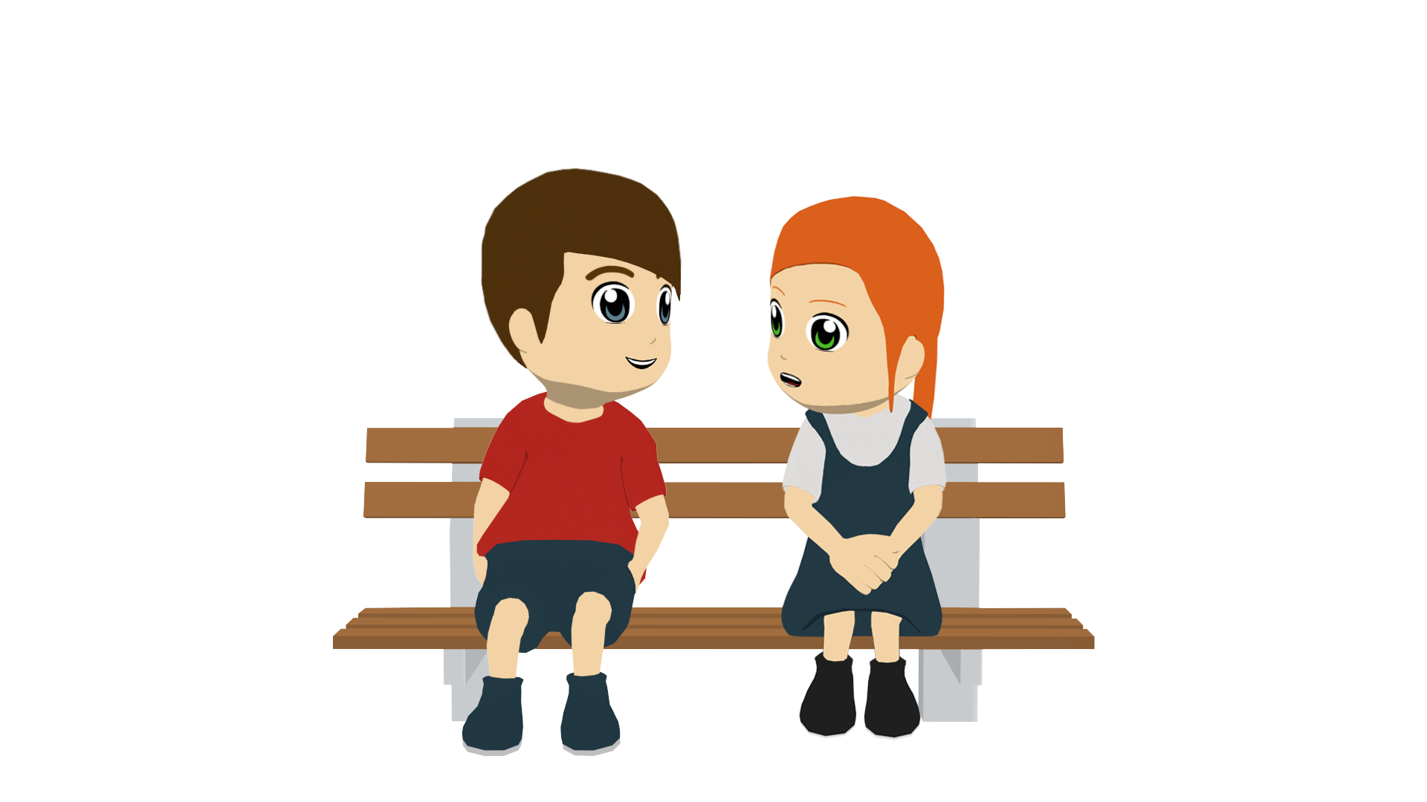
Dar regalos
Escucha. ¿Es doy o das?
escuchar
Escucha otra vez. Escribe el artículo.
‘I give’
‘You give’
un/una/unos/unas
1
una
Un ejemplo: ‘mesa’
(Es feminino y singular.)
2
unos
Un ejemplo: ‘zapatos’
(Es masculino y plural.)
3
unas
4
un
5
unos
6
una
¡Inventa el regalo! Completa la frase.
Make sure the noun agrees in gender and number with the article (‘un’, ‘una’ etc.).
Notes:
Timing: 7 minutes
Aim: to practise distinguishing between the meanings of ‘doy’ and ‘das’; to revisit indefinite articles
Procedure:
1. Students first listen to see if they can hear ‘doy’ or ‘das’.
2. They then listen again and write down the indefinite article that they hear. [Note: some classes may complete both steps in one listening.]
3. Finally, they think of a noun to complete the sentence. Encourage students to pay attention to the preceding article here, which determines the gender and number of the noun.
4. Students could then practise saying these aloud to each other in pairs. Depending on the class, the students could complete this orally as a quick think-pair-share.
Transcript:
Doy una [beep]
Das unos [beep]
Das unas [beep]
Doy un [beep]
Doy unos [beep]
Das una [beep]
Word frequency (1 is the most frequent word in Spanish): dar [42]; doy; das
Source: Davies, M. & Davies, K. (2018). A frequency dictionary of Spanish: Core vocabulary for learners (2nd ed.). Routledge: London

Slide 37
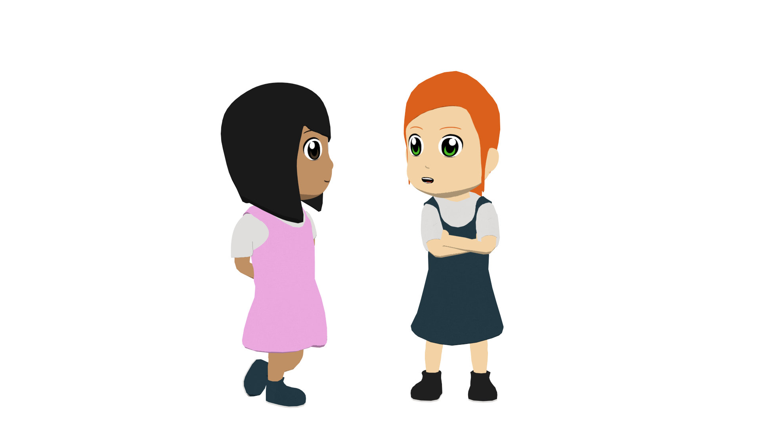
Regalos
Lucía habla con Nadia. ¿Qué da a quién? . ¿Qué da mamá a quién?
leer
Lee y completa la tabla en español.
Doy unos bolígrafos a mi hermano.
Doy una camisa a un amigo.
Da unas camisas a mi padre.
Da dinero a mi hermano.
Da una revista de música a una amiga.
Doy un libro a mi profesor de inglés.
Luego contesta las preguntas en inglés.
Lucía (‘I give’)
la madre (‘she gives’)
Who receives…
unos bolígrafos
unas camisas
the money?
brother
una camisa
dinero
the book?
English teacher
un libro
una revista de música
the shirts?
father
Notes:
Timing: 8 minutes
Aim: to recognise the difference between the verbs ‘doy’ and ‘da’ and their meanings
Procedure:
1. Students copy the blank grid on the LHS into their books.
2. They read the sentences in the speech bubble and complete it with the information in English.
3. They then answer the questions on the RHS, which prompt them to think about the meaning of the vocabulary items for family members
Notes:
1. The ‘who receives’ table requires students to pay attention to the meaning of the nouns taught this week and others that are revisited.
2. Mi’ hasn’t yet been taught in NCELP Y7 Spanish SoW, so make sure that the meaning of this word is clear (it can be mistakenly understood to be the English ‘me’).
Transcript:
Word frequency (1 is the most frequent word in Spanish): dar [42]; doy; da; padre [162]; madre [226]; hermano [333]; hermana [3409]; dinero [364]; a [8]; bolígrafo [>5000]; moneda [1577]; bicicleta [3684]; libro [230]; revista [920]; producto [394]; camisa [1873];
Source: Davies, M. & Davies, K. (2018). A frequency dictionary of Spanish: Core vocabulary for learners (2nd ed.). Routledge: London

Slide 38
Una tarea escrita
Escribes una carta a los Reyes Magos.
escribir
You decide to include:
Usa la forma correcta de ‘dar’ o ‘querer’.
a) what you want for Christmas.
b) what you give for Christmas.
c) what a friend / family member wants for Christmas.
d) what a friend / family member gives for Christmas.
my - mi
Notes:
OPTIONAL
Timing: 10-15 minutes
Aim: to use ‘dar’ and ‘querer’ in written production (singular persons only)
Procedure:
Students respond to the prompts, writing a letter to the wise men about wanting and giving presents.
Note:
1. Dictionaries would be useful for this task, since students may wish to use previously untaught vocabulary.
2. Students could also say who they give to, using ‘a’. This could either require use of indefinite article (…a un amigo) or the use of ‘mi’ (…a mi madre). ‘Mi’ isn’t formally taught until Term 3, but students will naturally want to use it to refer to family members.
3. This activity could also be given for homework.

Slide 39
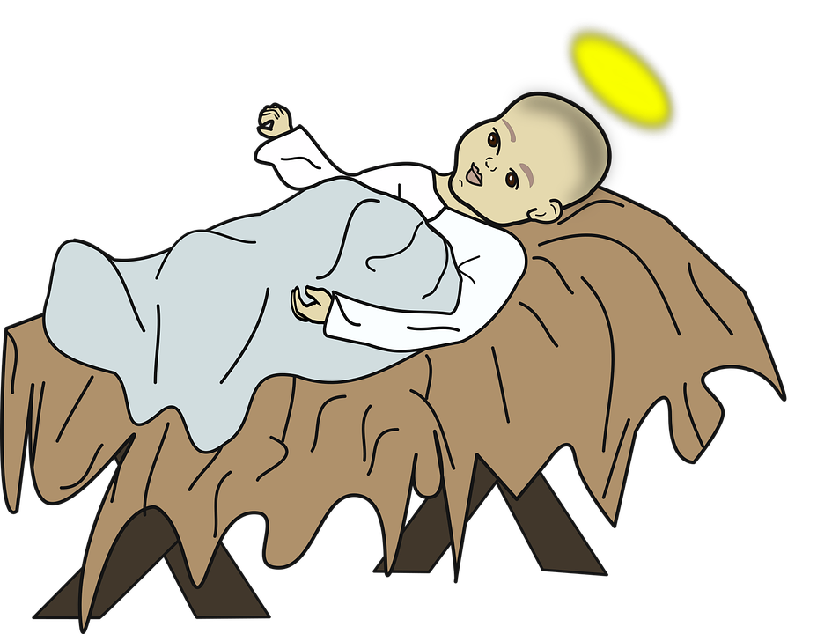
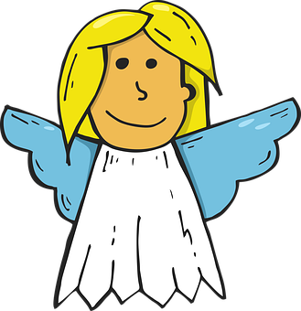
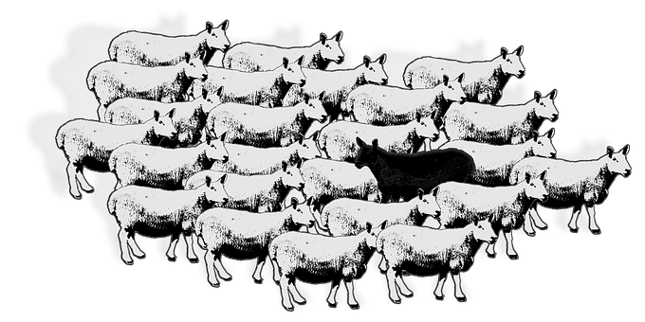
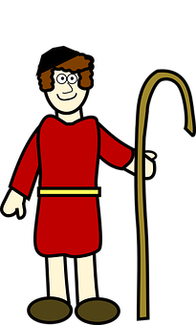
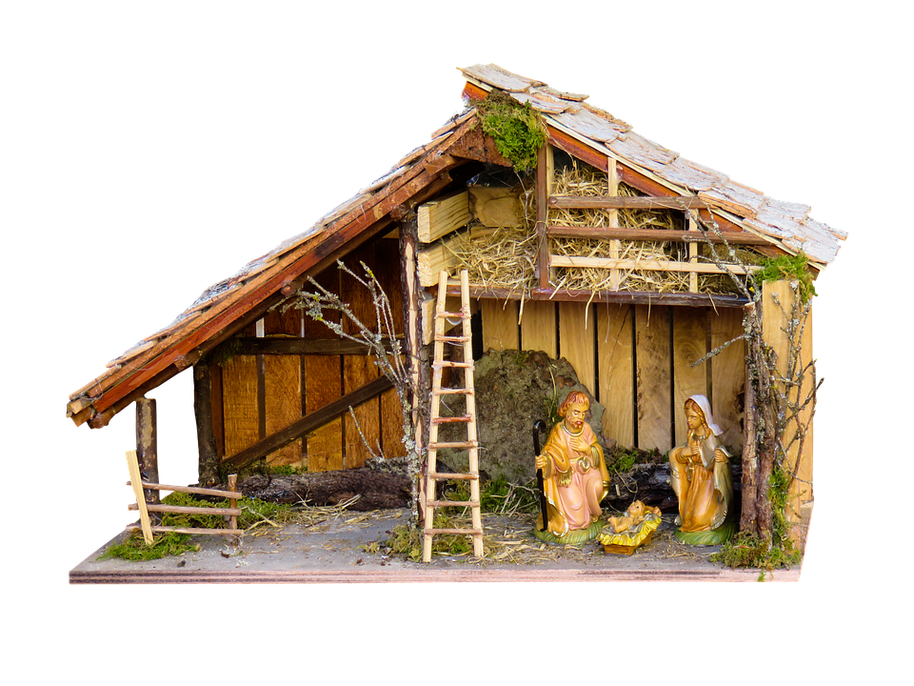
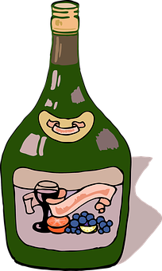
Un villancico
________ sobre _________
escuchar
Campana
campana
¡Escucha y completa el villancico!
¿Qué título tiene el villancico?
[estribillo] (chorus) 1
_____________ (1) sobre _____________ (2) y sobre campana ________ (3)
asómate a la _____________ (4)
verás al __________ (5) en la cuna.
Belén, campanas de Belén Que los ángeles __________ (6) ¿Qué nuevas nos traéis?
[estribillo] (chorus) 2
_____________ (7) sobre _____________ (8) y sobre campana ________ (9)
asómate a la _____________ (10)
porque _________ (11) naciendo Dios.
Belén, campanas de Belén Que los ángeles __________ (12) ¿Qué nuevas nos traéis?
campana
campana
campana
campana
una
dos
ventana
ventana
niño
está
tocan
tocan
Recogido tu rebaño
¿A dónde vas pastorcito?
Voy a llevar al portal
Requesón, manteca y vino
[estribillo] (chorus) 1
el villancico - Christmas carol
tocar – to play (instrument)
Notes:
OPTIONAL
Tune:
https://www.youtube.com/watch?v=c1QVf4ywHrY&ab_channel=MundoCanticuentos
Timing: 10 – 15 minutes
Aim: to enjoy a traditional Spanish carol; to practise read aloud and pronunciation, including of some unknown words.
Procedure: 1. Listen to the song and fill in the gaps.
2. Click to reveal the missing words.
Transcript: Campana sobre campana Y sobre campana una Asómate a la ventana Verás al Niño en la cuna
Belén, campanas de Belén Que los ángeles tocan ¿Qué nuevas me traéis?
Recogido tu rebaño ¿A dónde vas pastorcito? Voy a llevar al portal Requesón, manteca y vino
Campana sobre campana Y sobre campana dos Asómate a la ventana Porque está naciendo Dios
Belén, campanas de Belén Que los ángeles tocan ¿Qué nuevas nos traéis?

Slide 40
Campana sobre campana
¡Canta el villancico!
escuchar / cantar
el villancico = Christmas carol
Campana
campana
Campana
campana
____________ sobre _____________ y sobre campana ________
asómate a la _____________
verás al __________ en la cuna.
Belén, campanas de Belén Que los ángeles __________ ¿Qué nuevas nos traéis?
_____________ sobre _____________ y sobre campana ________
asómate a la _____________
porque _________ naciendo Dios.
Belén, campanas de Belén Que los ángeles __________ ¿Qué nuevas nos traéis?
una
dos
ventana
ventana
niño
está
tocan
tocan
Recogido tu rebaño
¿A dónde vas pastorcito?
Voy a llevar al portal
Requesón, manteca y vino
asómate – lean out nuevas = news
verás - you will see nos traéis = you all bring us
(la) cuna - crib porque = because
tocan - they play naciendo = being born
Notes:
[2/2]
Procedure: 3. Listen again and sing along with the song version.
Transcript: Campana sobre campana Y sobre campana una Asómate a la ventana Verás al Niño en la cuna
Belén, campanas de Belén Que los ángeles tocan ¿Qué nuevas me traéis?
Recogido tu rebaño ¿A dónde vas pastorcito? Voy a llevar al portal Requesón, manteca y vino
Campana sobre campana Y sobre campana dos Asómate a la ventana Porque está naciendo Dios
Belén, campanas de Belén Que los ángeles tocan ¿Qué nuevas nos traéis?

Slide 41
Deberes
New vocabulary for 7.2.1.1:
In addition, revisit: Term 1.2.5 Term 1.1.7
Notes:
For Y7, the typical homework will be to pre-learn vocabulary for the next lesson. There is no audio homework for this week. It’s an opportunity to NOT set any. However, If teachers want to set the pre-learning of vocabulary, they can direct pupils to the new vocabulary for 7.2.1.1 and to revisit 7.1.2.5 and 7.1.1.7. The lists still exist on Quizlet (https://quizlet.com/gb/474553189/y7-spanish-term-21-week-1-challenging-text-week-flash-cards/) but teachers may, as explained below, want to use an alternative app.
Notes:
i) Teachers may, in addition, want to recommend use of a particular online app for the pre-learning of each week’s words. ii) Quizlet now requires parental involvement / registration / permissions for users below the age of 13, so it is perhaps most suitable for Y9 – 11 students. iii) Language Nut hosts LDP vocabulary lists and these are free for schools to use, though there is a registration process. One benefit is that all of the student tracking data that Language Nut offers are also available to schools that use the LDP lists for practice. Perhaps this makes it a good option for Y7/8.
iv) There are other free apps, and new ones are always appearing. Teachers have told us that they are currently using: Flippity, Wordwall (where using previously-created activities is free).
v) Gaming Grammar has been acquired by Language Nut. Its original content should still be available to teachers and much of it is appropriate for Y7 learners.

Slide 42
leer / escribir
Lucía finds six more pieces in the shredder!
Escribe seis frases completas en español.
Usa una frase de ‘A’ y una frase de ‘B’.
B
querer una tarea
A
es importante
mi hermana
querer un caballo
es normal
es raro
quiere una botella de Pepsi
mi hermano
mi padre
quiere un teléfono
querer un periódico
Escribe las frases en inglés.
Un ejemplo:
quiere una revista
“It’s strange to want a cat.”
Notes:
OPTIONAL Sentence matching task from lesson 1
Timing: 7 minutes
Aim: to understand the difference between ‘quiere’ and ‘querer’; to consolidate understanding of vocabulary
Procedure:
Students read the 12 sentence fragments (those in box ‘B’ were on the previous slide).
The fragments can be combined to make 6 sentences. A number of combinations are grammatically possible. Students have to make sure that they use a sentence starter that is compatible with ‘querer’ or ‘quiere’.
Encourage students to think about the meaning of the sentences (the translation into English will facilitate this).
They will come up with different sentence combinations, so when checking the answers, ask which seem most and least likely.

Slide 43
Vocabulario
hablar
60
 | Español | Inglés
1 | querer | to want, wanting
2 | quiero | I want
3 | quieres | you want
4 | quiere | s/he wants, it wants
5 | el regalo | present
6 | el padre | father
7 | la madre | mother
8 | el hermano | brother
9 | la hermana | sister
10 | el dinero | money
11 | a | to
Segundos
0
INICIO
Notes:
OPTIONAL Vocabulary practice slide Pupils either work by themselves or in pairs, reading out the words and recapping their English meaning (1 minute). Then the English meanings are removed and they try to recall them, looking at the Spanish (1 minute). Then the Spanish meanings are removed and they to recall them, looking at the English (1 minute) Further rounds of learning can be facilitated by one pupil turning away from the board, and his/her partner asking him/her the meanings. This activity can work from L2 → L1 or L1 → L2.
Word frequency (1 is the most frequent word in Spanish): querer [58]; quiero; quieres; quiere; regalo [1986]; padre [162]; madre [226]; hermano [333]; hermana [3409]; dinero [364]; a [8]
NB Lesson 2 will present dar [42]; doy; das; da
Source: Davies, M. & Davies, K. (2018). A frequency dictionary of Spanish: Core vocabulary for learners (2nd ed.). Routledge: London

