Slide 1
Describing a place
Plural definite articles (los/las)
Singular definite article (el/la) [revisited]
SSC [j]
Y7 Spanish Term 1.2 – Week 6 – Lesson 25 Victoria Hobson / Nick Avery Artwork: Mark Davies Date updated: 04.08.23
Notes:
Note: all words (new and revisited) in this week of the SOW appear on all three GCSE wordlists.
Learning outcomes:
Introduction of SSC [j]
Introduction of plural definite article
Consolidation of singular definite article
Consolidation of es, son and adjectival agreement
Word frequency (1 is the most frequent word in Spanish):
7.1.2.6 (introduce) pueblo [244]; equipo [373]; trabajo¹ [152]; edificio [857]; plato [1808]; familia [233]; película [543]; vista [408]; isla [810]; grande [66]; interesante [616]; de¹ [2]
7.1.2.3 (revisit) hay [13]; mirar [125]; mesa [525]; silla [1271]; ventana [752]; puerta [274]; chica [1129]; persona [108]; chico [727]; aquí [130]; allí [197]; clase [320]; señor² [201]; señora² [509]
7.1.1.5 (revisit) amigo [210]; periódico [1026]; caballo [907]; teléfono [866]; planta [768]; botella [1878]; revista [920]; pregunta [507]; palabra [192]; tarea [995]; también [49]
Source: Davies, M. & Davies, K. (2018). A frequency dictionary of Spanish: Core vocabulary for learners (2nd ed.). Routledge: London

Slide 2
j
ojo
Notes:
Timing: 3 minutes (5 slides)
Aim: To introduce SSC [j] and source word ‘ojo’ and the five cluster words.
Procedure:
1. Introduce and elicit the pronunciation of the individual SSC ‘j’ and then present and practise the pronunciation of the source word ‘ojo’.
2. Move to the next slide. Note: A possible gesture for this source word would be to point towards your eye.
Word frequency (1 is the most frequent word in Spanish): ojo [169]
Source: Davies, M. & Davies, K. (2018). A frequency dictionary of Spanish: Core vocabulary for learners (2nd ed.). Routledge: London

Slide 3
j
ojo
Notes:
Repeat the sound and elicit the source word.

Slide 4
j
julio
mejor
rojo
ojo
mujer
dejar
[to leave]
Notes:
Procedure:
1. Introduce and elicit the pronunciation of the individual SSC ‘j’ and then the source word again (with gesture, if using). 2. Then present and elicit the pronunciation of the five cluster words.
The cluster words have been chosen for their high-frequency, from a range of word classes, with the SSC (where possible) positioned within a variety of syllables within the words (e.g. initial, 2nd, final etc.). Additionally, we have tried to use words that build cumulatively on previously taught SSCs (see the Phonics Teaching Sequence document) and do not include new SSCs. Where new SSCs are used, they are often consonants which have a similar symbol-sound correspondence in English. Word frequency (1 is the most frequent word in Spanish): ojo [169] dejar [86] julio [659] mejor [116] mujer [120] rojo [534]
Source: Davies, M. & Davies, K. (2018). A frequency dictionary of Spanish: Core vocabulary for learners (2nd ed.). Routledge: London

Slide 5
j
julio
mejor
rojo
ojo
mujer
dejar
Notes:
Without the images, students focus this time again closely on the SSC and the cluster words.

Slide 6
j
julio
mejor
rojo
ojo
mujer
dejar
Notes:
Without the images or sound, students have to pronounce the words themselves.

Slide 7
Fonética
escuchar / escribir
Escucha. Escribe la frase en español.
¿Cómo se dice en inglés?
1
No hay clase en julio.
There isn’t class in July.
2
La cámara es roja.
The camera is red.
3
Quiero un ejemplo.
I want an example.
4
¿Inglaterra o España? España es mejor.
England or Spain? Spain is better!
5
Es mejor dejar la bolsa en casa.
It’s better to leave the bag at home.
6
Tienes dos ojos.
You have two eyes.
Notes:
Note: depending on the class, teachers may want to shorten the activity and omit items 4-6. Timing: 7 minutes
Aim: to practise mapping sound to spelling with SSC [j]
Procedure:
1. Click on the blue action button to play the audio.
2. Students write each sentence in Spanish.
3. Students translate each sentence into English (in writing or orally) – these are all previously taught words or from this week.
Transcript:
No hay clase en julio.
La cámara es roja.
Quiero un ejemplo.
¿Inglaterra o España? España es mejor.
Es mejor dejar la bolsa en casa.
Tienes dos ojos.

Slide 8
Vocabulario
hablar
 | Español | Inglés
1 | el pueblo | town, village
2 | el equipo | team
3 | el trabajo | job
4 | el edificio | building
5 | el plato | plate, dish
6 | la familia | family
7 | la película | film
8 | la vista | view
9 | la isla | island
10 | grande | big
11 | interesante | interesting
12 | de | of
60
Segundos
0
INICIO
Notes:
Timing: 4 minutes Aim: To reactivate and strengthen vocabulary knowledge. Note: students will move from this slide into oral recall, so teachers may want to circulate to ascertain how well students know the vocabulary.
Procedure: Round 1: Look at the Spanish, recall the English meanings, saying them aloud. [1 minute] Round 2: Look at the English, recall the Spanish meanings, saying them aloud. [1 minute] Repeat for two further minutes, to speed up recall.
Word frequency (1 is the most frequent word in Spanish): pueblo [244]; equipo [373]; trabajo [152]; edificio [857]; plato [1808]; familia [233]; película [543]; vista [408]; isla [810]; grande [66]; interesante [616]; de [2]
Source: Davies, M. & Davies, K. (2018). A frequency dictionary of Spanish: Core vocabulary for learners (2nd ed.). Routledge: London

Slide 9
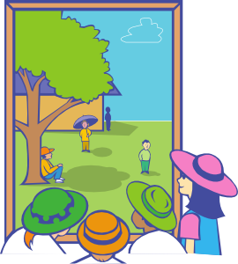
Vocabulario
el plato
el trabajo
el pueblo
el edificio
el equipo
la familia
la vista
la película
la isla
big
interesting
grande
interesante
Notes:
Timing: 2 minutes Aim: to practise oral recall of this week’s vocabulary.
Procedure: 1. Elicit (or provide, where students are not yet able to recall) the Spanish for each word.
2. If needed, rewind the animations and repeat the elicitation for further practice.

Slide 10
Plural definite article
el
la
To say ‘the’ before a singular noun, use _____ or _____.
To say ‘the’ before a plural noun (more than one), use ‘los’ or ‘las’.
Masculine nouns
Feminine nouns
los
the
el
pueblo
s
village
s
las
the
la
s
película
film
s
los
s
equipo
el
the
team
s
vista
las
s
the
la
view
s
los
s
el
edificio
s
las
isla
the
la
building
s
s
the
island
Notes:
Timing: 2 minutes Aim: to introduce plural forms of ‘the’ (definite articiles ‘los/las’).
Procedure: 1. Click to present the information.
2. Elicit English meanings for Spanish examples, where appropriate.

Slide 11
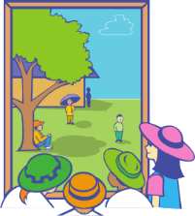
¿Qué es? ¿Cómo son?
Nadia visita Barcelona y describe unas cosas allí.
escuchar
Escucha. ¿Es ‘los’ o ‘las’? Marca la opción correcta (A o B).
A
B
A
B
1
4
2
5
3
6
Notes:
Timing: 8 minutes
Aim: to practise ‘listening out’ for the gender of the definite article and connecting it to the noun
Procedure:
Students listen and decide if the noun that is ‘beeped out’ is ‘A’ or ‘B’.
Teachers may want to break the listening down into two stages, noting the gender of the noun they hear first, then going back to work out which noun it must be (they won’t need to listen again for that stage). Other classes will be able to manage to identify the gender and match it to the correct noun picture in one stage.
Transcript:
1) Las [películas] son buenas.
2) Los [edificios] son grandes.
3) Las [familias] son alegres.
4) Los [trabajos] son importantes.
5) Los [pueblos] son caros.
6) Los [equipos] son famosos.

Slide 12
¿Cómo es? ¿Cómo son?
Nadia describe más.
leer
1 | La | familia / familias | son / es | grandes / grande
2 | La | isla / islas | es / son | pequeña / pequeñas
3 | Las | películas / película | son / es | diferente / diferentes
4 | Las | vistas / vista | son / es | bonita / bonitas
5 | Los | equipo / equipos | es / son | genial / geniales
6 | El | pueblos / pueblo | son / es | famoso / famosos
Lee las descripciones y completa la frase con las opciones correctas.
Notes:
Timing: 7 minutes
Aim: to practise attending to the form of the noun (singular, plural) to decide what the definite article must be; to consolidate understanding of ‘es’ vs ‘son’ and adjectival agreement
Procedure:
1. Students write 1-6 and the correct words (or the full sentence).
2. Students could also be asked to give the English translation to check that they have understood the sentence.
Note: ‘Genial’ in Term 2.1, Week 2 vocabulary set. It is included here to vary the adjectives. ‘Genial’ appears in AQA and Eduqas GCSE word lists.

Slide 13
¿Cómo es? ¿Cómo son?
escribir
Los
____ edificios
son randes.
____ g_______
Notes:
Timing: 5 minutes (6 slides)
Aim: to practise all four words for ‘the’; to produce the correct verb (es/son); and to apply correct adjective agreement of adjectives ending in-e.
Procedure:
Teachers can use this first slide to model the instructions to the students. Explain that students need to choose between es/son, then one of grande/interesante/alegre/importante with correct number marking on the adjective.
On each slide, elicit the missing Spanish words/letters, either in chorus or as responses (e.g. using mini whiteboard)
Check understanding by asking for the English translation too.

Slide 14
____ vista
La
es teresante.
__ in__________

Slide 15
____ islas
Las
____ g________
son randes.

Slide 16
____ trabajos
Los
son portantes.
___ im__________

Slide 17
____ platos
Los
son teresantes.
____ in__________

Slide 18
____ equipo
El
es portante.
__ im________

Slide 19
¿Cómo es? ¿Cómo son?
Un ejemplo
hablar
Persona A (habla)
Persona B (escucha y escribe en español.
Look at the 6 pictures. Decide what to say for each picture. Say your 6 sentences in any order in Spanish.
Use Spanish adjectives for: big, interesting, cheerful, important.
 la isla es grande.
La isla es grande.
Notes:
NO NEED FOR HANDOUTS Timing: 12 minutes (3 slides)
Aim: to practise teaching points from the previous sequence, now in a paired speaking/listening task.
Procedure:
Teachers use this slide to give instructions and the following slide to show a worked example / model the interaction.
See the next slides for instructions for the activity itself
Notes: The meaning of the near-cognate ‘identifica’ should be clear to students, even though this hasn’t yet appeared in the LDP SoW.

Slide 20
Persona A (habla)
Persona B (escucha y escribe)
1
2
1. Say your six sentences in any order.
2. Use ‘es’ or ‘son’ and the correct form of Spanish adjectives for: big, interesting, cheerful, important.
3
4
5
6
Notes:
ROUND 1: DISPLAY THIS SLIDE
Partner A says six sentences, one to describe each picture. S/he must choose from the adjectives: big (grande), interesting (interesante), cheerful (alegre), or important (importante).
E.g
Partner A says: ‘El pueblo es grande.’
Partner B finds the number of the picture of one village (singular) and writes the sentence in Spanish in his/her book, next to that number.

Slide 21
Persona A (escucha y escribe)
Persona B (habla)
1
2
1. Say your six sentences in any order.
2. Use ‘es’ or ‘son’ and the correct form of Spanish adjectives for: big, interesting, cheerful, important.
3
4
5
6
Notes:
ROUND 2: DISPLAY THIS SLIDE Students swap roles.

Slide 22
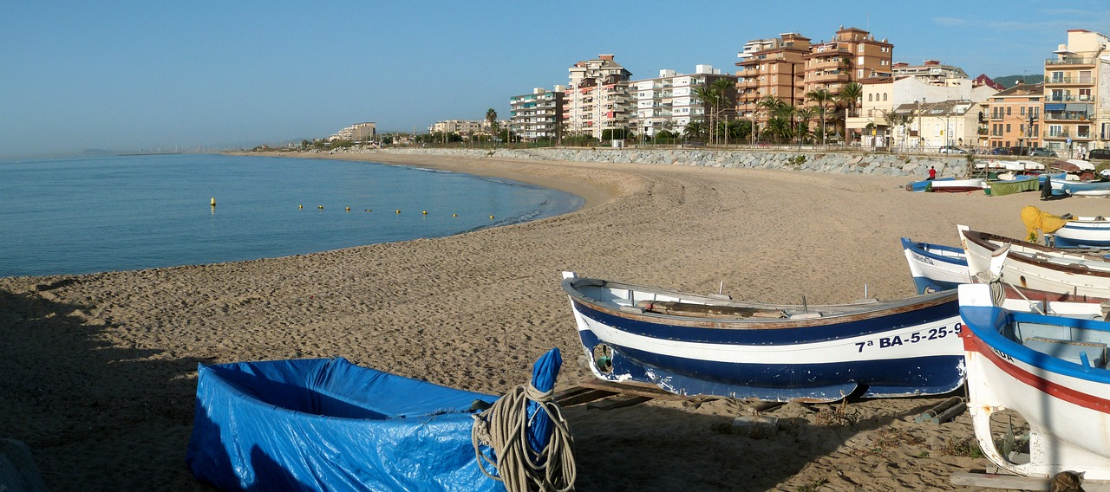
Describing a place [2]
Plural definite articles (los/las)
Singular definite article (el/la) [revisited]
SSC [j]
Y7 Spanish Term 1.2 – Week 6 – Lesson 26 Victoria Hobson / Nick Avery Artwork: Mark Davies Date updated: 04.08.23
Notes:
Learning outcomes:
Consolidation of plural definite article
Consolidation of singular definite article
Consolidation of es, son, number agreement & gender agreement on adjectives
Word frequency (1 is the most frequent word in Spanish):
7.1.2.6 (introduce) pueblo [244]; equipo [373]; trabajo¹ [152]; edificio [857]; plato [1808]; familia [233]; película [543]; vista [408]; isla [810]; grande [66]; interesante [616]; de¹ [2]
7.1.2.3 (revisit) hay [13]; mirar [125]; mesa [525]; silla [1271]; ventana [752]; puerta [274]; chica [1129]; persona [108]; chico [727]; aquí [130]; allí [197]; clase [320]; señor² [201]; señora² [509]
7.1.1.5 (revisit) amigo [210]; periódico [1026]; caballo [907]; teléfono [866]; planta [768]; botella [1878]; revista [920]; pregunta [507]; palabra [192]; tarea [995]; también [49]
Source: Davies, M. & Davies, K. (2018). A frequency dictionary of Spanish: Core vocabulary for learners (2nd ed.). Routledge: London

Slide 23
Vocabulario
leer / hablar
 |  |  | el | la | los | las
1 | películas
2 | equipos
3 | platos
4 | edificio
5 | isla
6 | trabajo
films
teams
plates, dishes
building
island
job
Notes:
Timing: 3 minutes
Aim: to identify the four words for the to reconnect with the previous lesson’s teaching point before picking up again with the definite article.
Procedure:
Give students 1-2 minutes to think-pair-share and decide which article goes with the word, and what the word means.
Teacher elicits i) the Spanish word + article (e.g., las películas) and ii) the English meaning.

Slide 24
¿Cómo es…?
escribir
big
interesting
interesting
big
big
El plato es grande.
El trabajo es interesante.
El pueblo es interesante.
El edificio es grande.
El equipo es grande.
big
interesting
interesting
big
La familia es grande.
La vista es interesante.
La película es interesante.
La isla es grande.
Notes:
Timing: 5 minutes
Aim: to practise the new vocabulary introduced this week in short sentences.
Procedure:
There are various ways to use this activity:
Students write (either in ex. books or mini whiteboards) the correct sentence.
Pairs turn to each other to say the sentence.
Students all say the sentence out loud as a choral response
4) Pairs take it in turns to translate the sentence to their partner. Partner A gives the Spanish and partner B then translates. (Partner B looks away from the board). After all 9 partners swap roles. Players can keep a tally of how many sentences they translate correctly.

Slide 25
Una familia en España
escuchar
España tiene 179 islas. ¿Gran Bretaña tiene más* islas? ¿Qué opinas?
Escucha. Marca la opción correcta. Luego complete la frase en español.
la / las | familia / familias
las / la | isla / islas
la / las | vistas / vista
el / los | pueblos / pueblo
los / el | plato / platos
los / el | trabajos / trabajo
1
habla mucho de España.
2
son muy tranquilas.
3
son bonitas.
4
está lejos.
5
no son caros.
6
no son malos.
más - more
Notes:
Timing: 8 minutes
Aim: to connect the definite article form to the noun (both need to be singular or plural); to consolidate understanding of previously taught vocabulary
Procedure:
1. Students first listen out for the definite article to decide whether the noun is singular or plural.
2. Then, they listen again and write the Spanish (i.e., transcription). This should help them to begin to associate singular definite article and plural definite article with the singular and plural forms of the verb (ser) and adjective.
Notes: The culture note includes inhabited and uninhabited islands in Spain’s possession, according to:
https://en.wikipedia.org/wiki/List_of_islands_of_Spain#:~:text=This%20list%20of%20islands%20in,number%20of%20islands%20is%20179. GB has between 6000-7000 islands so substantially more.
Transcript:
La [familia] habla mucho de España
Las [islas] son muy tranquilas.
Las [vistas] son bonitas.
El [pueblo] está lejos.
Los [platos] no son caros.
Los [trabajos] no son malos.

Slide 26
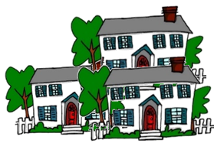
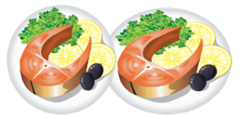
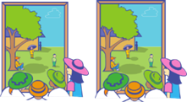
¿Cómo es? ¿Cómo son?
7.1.2.3 (revisit) hay [13]; mirar [125]; mesa [525]; silla [1271]; ventana [752]; puerta [274]; chica [1129]; persona [108]; chico [727]; aquí [130]; allí [197]; clase [320]; señor² [201]; señora² [509]
7.1.1.5 (revisit) amigo [210]; periódico [1026]; caballo [907]; teléfono [866]; planta [768]; botella [1878]; revista [920]; pregunta [507]; palabra [192]; tarea [995]; también [49]
Habla en español.
hablar
… buena.
… feas.
…simpática.
…pequeño.
…tranquilo.
…blancos.
…bonita.
… caros.
Notes:
Timing: 5 minutes Aim: to practise spoken recall of es/son and this week’s 9 new nouns; to apply knowledge of adjective agreement in the construction of sentences. Procedure: 1. Explain that there may be more than one possible answer but that students must keep the adjective ending the same as here, and then ensure that the rest of the sentence works.
2. E.g. … Buena could be the end of: la familia esb, la película es buena, la isla es buena. All are possible but teachers must also weigh up the other options for ending the sentences with singular, feminine nouns (i.e., simpática, bonita) and select the more appropriate.
Note: there are no animated answers, to allow for different options.

Slide 27
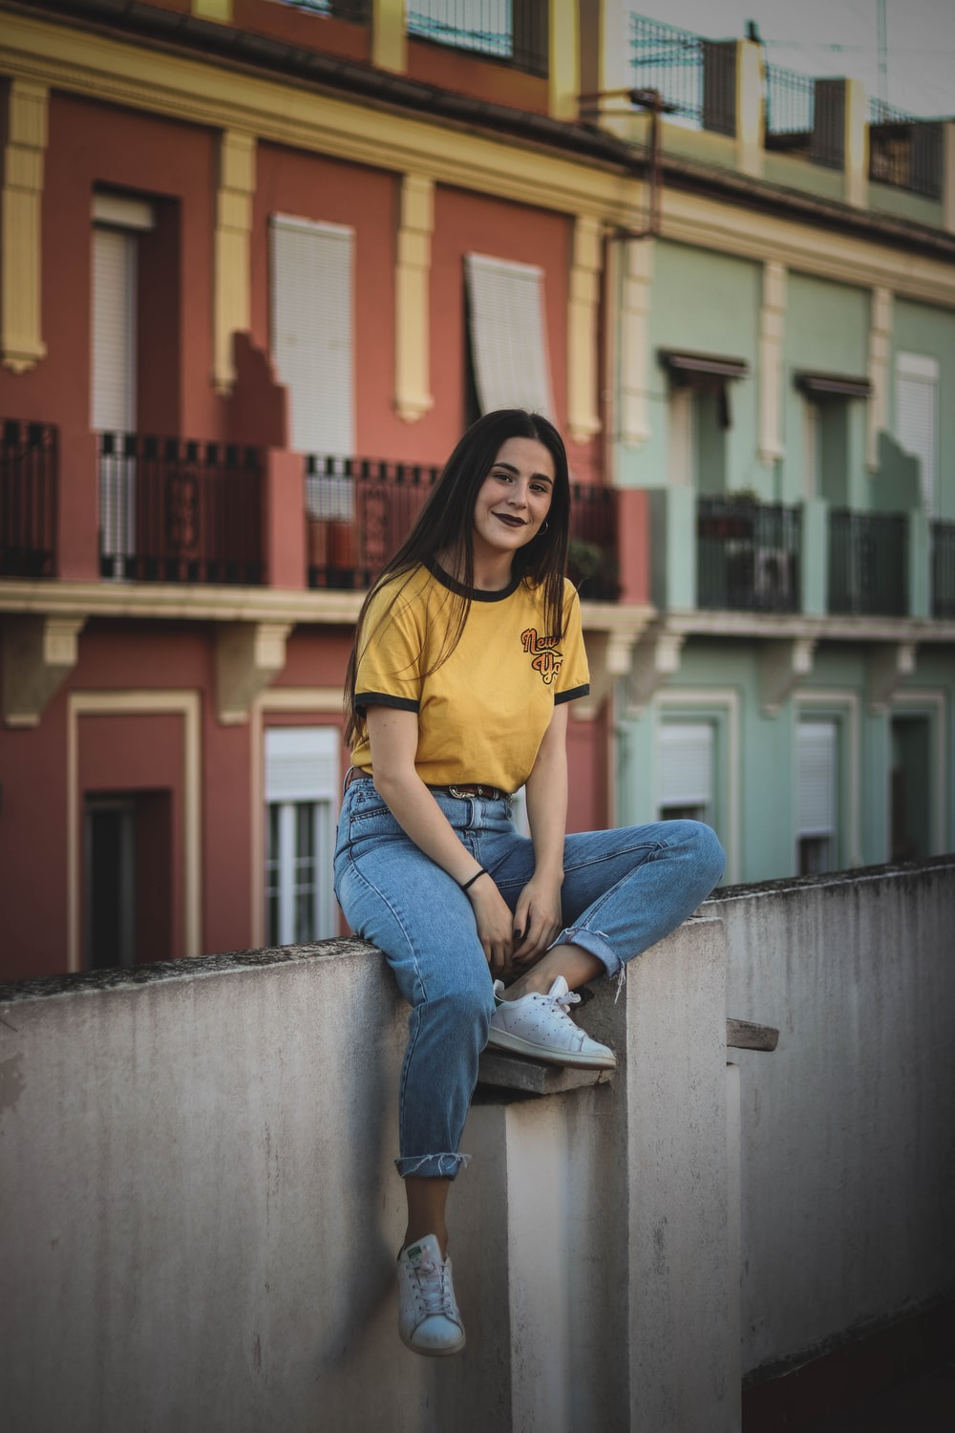
Sara
escuchar
Hola, soy Sara, de Vilassar de Mar, un pueblo cerca de Barcelona.
Notes:
Timing: 15 minutes (two slides)
Aim: to consolidate vocabulary from weeks 1.1.4, 1.1.5 and 1.2.3, while also recycling a number of previously taught high-frequency verbs: ‘hay’, ‘tengo’, ‘tiene’, ‘soy’, ‘es’, ‘son’ and ‘está’.
Procedure:
Use this slide to introduce the context. The speech bubble is the first sentence of the listening passage that students are going to listen to and translate.
Elicit an oral translation of this sentence now, to get students start.
Move to the next slide.

Slide 28
Sara
Escucha. Luego, escribe en inglés.
escuchar
Hello, I’m Sarah from Villassar de Mar, a town near Barcelona.
My family has a house and a boat here. The boat is yellow and the doors, tables, beds and windows of the house are also yellow.
My best friends are Pilar, a girl, and Luis and Ángel, two boys. Pilar is in my Taekwondo class.
I collect a lot of things. For example, I have a collection of coins. They’re different: some are small, others are big. Some are new, others are old. Pilar has a collection of pens.
amarillo – yellow coleccionar – to collect la colección – collection ¿Qué más? – what else?
siempre - always
I also study Mandarin. I have a book with some phrases. In Mandarin there are no letters, but there are characters.
What else? Yes, my cat, Misti. She’s always in bed!
Notes:
Procedure:
Students listen and translate.
The audio here allows the student or teacher to pause and go back to certain points in the recording. We have grouped the text into individual sentences or small paragraphs so that it can be done one part at a time.
Transcript: Hola. Soy Sara de Vilasar de Mar, un pueblo cerca de Barcelona.
Mi familia tiene una casa y un barco aquí. El barco es amarillo y las puertas, mesas, camas y ventanas de las casa también son amarillas. Mis mejores amigos son Pilar, una chica y Luis y Ángel, dos chicos. Pilar está en mi clase de Taekwondo. Colecciono muchas cosas. Por ejemplo, tengo una colección de monedas. Son diferentes: unas son pequeñas, otras son grandes. Unas son nuevas, otras son antiguas. Pilar tiene una colección de bolígrafos. También estudio mandarín. Tengo un libro con unas frases. En mandarín no hay letras, pero hay caracteres. ¿Qué más? Sí, mi gato, Misti. ¡Siempre está en la cama!
Notes:
1. You may find that there isn’t time to also do this translation activity in class. If so, we recommend setting it for homework.
2. We also provide a link to the file online, in case you wish to send it to students by email (and so that they don’t see the translation provided here): https://ncelp.org/audio/SY7T2-1W6_lesson_audio
Image of Sara free to use and available on www.unsplash.com

Slide 29
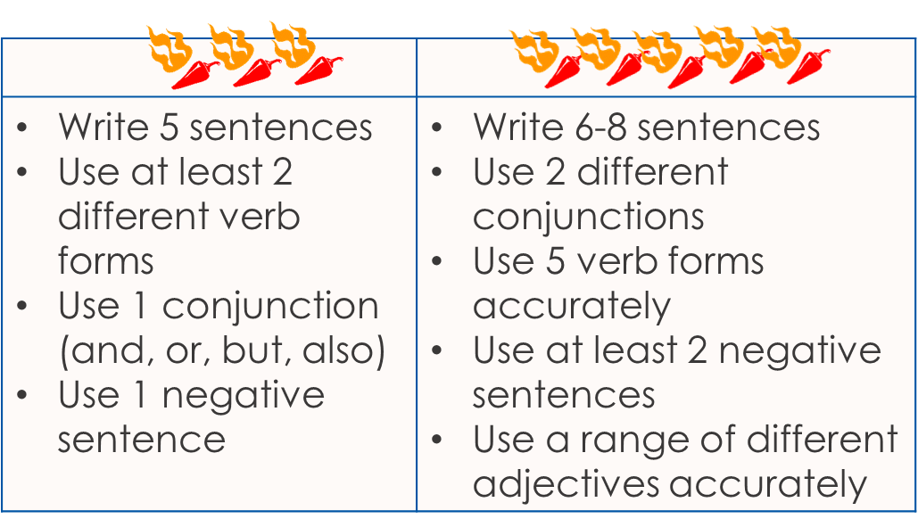
Un texto
Escribe un texto.
Add words you want to your repertoire!
escribir
Write a short text about your town/village. Include:
vocabulario
Introduce yourself (I am … from …in …)
What there is there (In the town/city there is/are… and …)
What two places are like (The … is/are… and/but the … is/are…)
If your school is near or far (The school is …)
Three questions (e.g., Where are you? What is the town/city like? What is there there? Does it have a …?)
my – mi (familia, pueblo)
sometimes – a veces
often – a menudo
always - siempre
Notes:
Timing: 20 minutes (10 minutes in class to plan, they will write it in class next week), with their notes in front of them (but not Language Guides or Kos) Aim: to revisit previously taught vocabulary and grammar in the context of a short piece of writing, bringing together some language from Y7 Term 1 so far.
Procedure: 1. Clarify the activity with students.
2. Suggest they build their text by writing one sentence for each bullet first, and if they have time they could add another one.
3. Suggest that students have 10 minutes (the rest of the lesson) to plan the task out, and then tell them they will write the text without referring next lesson. Clearly teachers may want to differentiate the level of challenge for different students within their classes. Perhaps allow students to use their KO as it will have individual words for them to check, but they won’t fall into the habit of memorising a full set of sentences. All levels of adaption are possible, here, including for example just asking pupils to make a list of words that they would need to do this task, but not asking them to do it.
5. Tell students that: “we are all individuals and our language repertoire (the words we learn, store and use) will be individual, too. Whilst there are lots of essential words that everyone will need (and those are the ones I’m teaching you), you will also want to add in words that are important to you to express your meanings, so start on that repertoire-building now. Look up words you need to describe your friend or you and record them in the space we’ve left for that in your exercise book.” (e.g., back pages).

Slide 30
Deberes
Vocabulary Learning Homework (Y7, Term 1.2, Week 7)
Audio file
Student worksheet
In addition, revisit: Term 1.2 Week 4 Term 1.1 Week 6
Notes:
Use this slide to set the homework.
For Y7, the typical homework will be to pre-learn vocabulary for the next lesson. There is an audio file to accompany the student worksheet.
Notes:
i) Teachers may, in addition, want to recommend use of a particular online app for the pre-learning of each week’s words. ii) Quizlet now requires parental involvement / registration / permissions for users below the age of 13, so it is perhaps most suitable for Y9 – 11 students. iii) Language Nut hosts LDP vocabulary lists and these are free for schools to use, though there is a registration process. One benefit is that all of the student tracking data that Language Nut offers are also available to schools that use the LDP lists for practice. Perhaps this makes it a good option for Y7/8.
iv) There are other free apps, and new ones are always appearing. Teachers have told us that they are currently using: Flippity, Wordwall (where using previously-created activities is free).
v) Gaming Grammar has been acquired by Language Nut. Its original content should still be available to teachers and much of it is appropriate for Y7 learners. From this lesson, for example, learners could practise Definite articles: gender and Articles: number

Slide 31
¿Cómo es? ¿Cómo son?
escribir
Escribe frases (de memoria).
1 |  | 4
2 |  | 5
3 |  | 6
Las familias son alegres.
Los pueblos son interesantes.
are interesting
are cheerful
Los platos son grandes.
La película es interesante.
are big
is interesting
El equipo es importante.
Los edificios son grandes.
is important
are big
Notes:
OPTIONAL
Timing: 8 minutes
Aim: to practise key language in written sentences.
Procedure:
Students write full sentences.
Click to provide feedback and clarify any misunderstandings.

Slide 32
hablar
En parejas
Persona A: Describe las cosas.
Usa ‘el/la/los/las’ + ‘es’ o ‘son’ + adjetivo.
İImportante! Add –s to the adjective when you talk about a plural noun.
Persona B: Escucha.
¿Es una cosa o son unas cosas?
Identifica la imagen correcta. Escribe ‘is’ o ‘are’ y el adjetivo en inglés.
Notes:
LESSON 1: ALTERNATIVE VERSION OF THE SPEAKING ACTIVITY REQUIRING HANDOUTS.
Timing: 10 minutes
Aim: to practise teaching points from the previous sequence, now in a paired speaking/listening task.
Procedure:
Teachers use this slide to give instructions and the following slide to show a worked example / model the interaction.
See the next slides for instructions for the activity itself
Notes: The meaning of the near-cognate ‘identifica’ should be clear to students, even though this hasn’t yet appeared in the LDP SoW.
Word frequency (1 is the most frequent word in Spanish): pueblo [244]; equipo [373]; edificio [857]; plato [1808]; familia [233]; película [543]; grande [66]; interesante [616]; importante [171]; alegre [2081]
Source: Davies, M. & Davies, K. (2018). A frequency dictionary of Spanish: Core vocabulary for learners (2nd ed.). Routledge: London

Slide 33
hablar
Un ejemplo
Persona A (habla)
Persona B (escucha y escribe en inglés)
The island is big.
La isla es grande.
The islands are important.
is big
are important
Las islas son importantes.
Notes:
This slide can be used to model the instructions of the pair work. It shows how the students need to think carefully about the definite article (singular/plural). They will also need to think about the verb (es/son) and adjective agreement.
In order that students focus as much as possible on the definite article, the sentences have been pared down in complexity. The verb choice is only between es/son and the adjective agreement has been kept simple by only including adjectives ending in –e.
Use this slide to model these features with the students, to help them to think about all the parts of the sentence. In-class teacher circulation will be necessary to listen to students and correct as necessary, keeping in mind that accuracy of the definite article is the main goal.

Slide 34
Persona A (habla)
✄
Persona B (escucha)
The village is big.
The films are cheerful.
The buildings are important.
The film is interesting.
The villages are interesting.
The building is big.
[town]
- - - - - - - - - - - - - - - - - - - - - - - - - - - - - - - - - - - - - - - - - -
Notes:
Do not display during the activity. Refer to the Word doc uploaded with this resource for printable speaking cards and listening grids.
Partner A translates their sentences 1- 6 into Spanish whilst Partner B listens and writes down in English what their partner has told them, below the correct image.
E.g
Partner A says: ‘El pueblo es grande.’
Partner B finds the picture of one village (singular) and writes in English below the picture ‘is big’.

Slide 35
Persona A (escucha)
✄
Persona B (habla)
The family is big.
The dishes are big.
The teams are important.
The families are cheerful.
The team is big.
The dish is interesting.
- - - - - - - - - - - - - - - - - - - - - - - - - - - - - - - - - - - - - - - - - -
[team]
Notes:
Do not display during the activity. Refer to the Word doc uploaded with this resource for printable speaking cards and listening grids.
Partner B translates their sentences 1- 6 into Spanish whilst Partner A listens and writes down in English what their partner has told them, below the correct image.
E.g
Partner B says: ‘La familia es grande.’
Partner A finds the picture of one family (singular) and writes in English below the picture ‘is big’.

Slide 36
Persona A
Persona B
is big
are cheerful
are interesting
is big
Las familias son alegres.
Los pueblos son interesantes.
La familia es grande.
El pueblo es grande.
are big
is interesting
is interesting
are
cheerful
Los platos son grandes.
El plato es interesante.
La película es interesante.
Las películas son alegres.
are important
are important
is big
is big
El equipo es grande.
Los equipos son importantes.
Los edificios son importantes.
El edificio es grande.
Notes:
ANSWER SLIDE
At the end, both partners can use their English notes to write full Spanish sentences. They should compare with their partner’s original prompt cards to check that they are correct.
Students can just write these sentences in their exercise books (the completed grids with Spanish sentences here as just for illustrative purposes).

