Slide 1
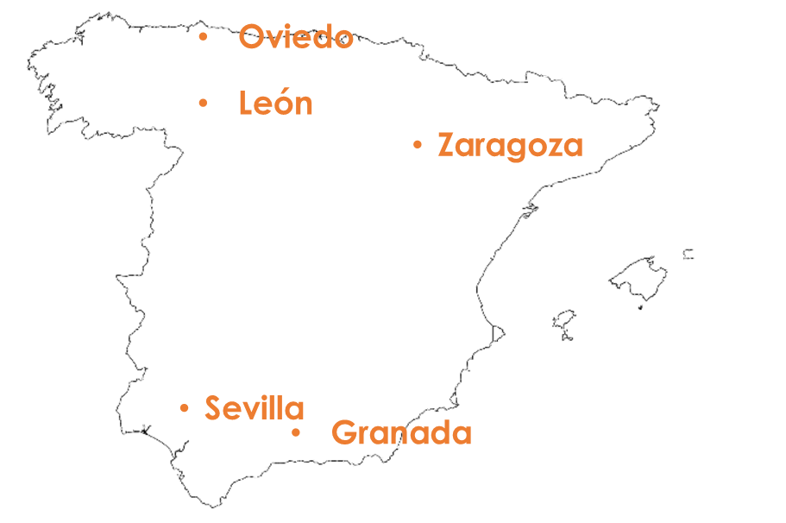
Saying what places there are around you and describing them
SER – ‘es’ [revisited] and ‘son’ (they are)
‘Hay’ vs ‘tiene’ [revisited]
SSC [ga] [go] [gu]
Y7 Spanish Term 1.2 – Week 4 – Lesson 21 Nick Avery / Rachel Hawkes Artwork: Mark Davies Date updated: 02.08.23
Notes:
Note: all words (new and revisited) in this week of the SOW appear on all three GCSE wordlists, with the following exceptions:
i) AQA list does not have marcar.
ii) Edexcel list does not have correcto, guapo, marcar.
Learning outcomes:
Introduction of ‘son’
Consolidation of ‘es’, ‘hay’ and ‘tiene’
Introduction of SSC [ga], [go], [gu]
Word frequency (1 is the most frequent word in Spanish):
7.1.2.4 (introduce) son [ser-7]; pequeño [202]; bueno [98]; malo [368]; famoso [997]; bonito [891]; feo [2373]; rico¹ [398]; caro [2179]; barato [2164]; antiguo [446] ¿cómo es? [cómo-151]
7.1.2.1 (revisit) no [11]; caminar [514]; estudiar [281]; español¹ [262]; inglés¹ [583]; arte [208]; ciencia(s) [738]; señor¹ [201]; señora¹ [509]; mucho (as adverb only) [41]; pero [30]; verdadero [558]; o [29]; falso [1599]; entiendo [entender-229]; silencio [518]; grupo [200]; perdón [1729]
7.1.1.3 (revisit) ser [7]; soy; eres; es; alegre [2081]; simpático [3349]; guapo [4192]; alto¹ [231]; bajo¹ [236]; y [4]; marca [marcar-993]; correcto [1467]; opción [1175]
Source: Davies, M. & Davies, K. (2018). A frequency dictionary of Spanish: Core vocabulary for learners (2nd ed.). Routledge: London

Slide 2
ga
regalo
jugar
gato
ganar
amiga
lugar
[place]
Notes:
Timing: 2 minutes (3 slides)
Aim: to introduce SSC [ga] and source word ‘ganar’ and the five cluster words.
Procedure:
1. Introduce and elicit the pronunciation of the individual SSC and then the source word (with gesture, if using). Note: A possible gesture for this source word would be do a ‘fist pump’.
2. Then present and elicit the pronunciation of the five cluster words.
Word frequency (1 is the most frequent word in Spanish): amigo/a [210] ganar [295] gato [1728] jugar [356] lugar [144] regalo [1986]
Source: Davies, M. & Davies, K. (2018). A frequency dictionary of Spanish: Core vocabulary for learners (2nd ed.). Routledge: London
The cluster words have been chosen for their high-frequency, from a range of word classes, with the SSC (where possible) positioned within a variety of syllables within the words (e.g. initial, 2nd, final etc.). Additionally, we have tried to use words that build cumulatively on previously taught SSCs (see the Phonics Teaching Sequence document) and do not include new SSCs. Where new SSCs are used, they are often consonants which have a similar symbol-sound correspondence in English.

Slide 3
ga
regalo
jugar
gato
ganar
amiga
lugar
Notes:
Without the images, students focus this time again closely on the SSC and the cluster words.

Slide 4
ga
regalo
jugar
gato
ganar
amiga
lugar
Notes:
Without the images or sound, students have to pronounce the words themselves.

Slide 5
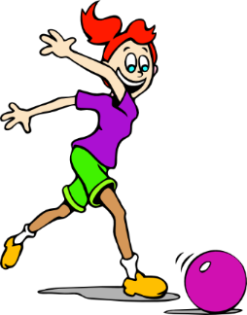
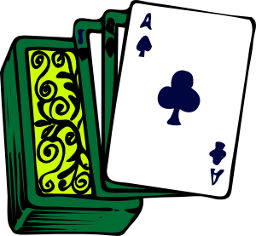
go
domingo
largo
SUNDAY
gol
juego (n)
conmigo
[with me]
algo
[something]
Notes:
Timing: 2 minutes (3 slides)
Aim: To introduce SSC [go] and source word ‘gol’ and the five cluster words.
Procedure:
1. Introduce and elicit the pronunciation of the individual SSC and then the source word (with gesture, if using). Note: A possible gesture for this source word would simply be to mime scoring a goal or doing a goal celebration – you could take a few seconds to take suggestions from students for the gesture.
2. Then present and elicit the pronunciation of the five cluster words.
Word frequency (1 is the most frequent word in Spanish): algo [110] conmigo [1256] domingo [693] gol [2069] juego [356] largo[300]
Source: Davies, M. & Davies, K. (2018). A frequency dictionary of Spanish: Core vocabulary for learners (2nd ed.). Routledge: London
The cluster words have been chosen for their high-frequency, from a range of word classes, with the SSC (where possible) positioned within a variety of syllables within the words (e.g. initial, 2nd, final etc.). Additionally, we have tried to use words that build cumulatively on previously taught SSCs (see the Phonics Teaching Sequence document) and do not include new SSCs. Where new SSCs are used, they are often consonants which have a similar symbol-sound correspondence in English.

Slide 6
go
domingo
largo
gol
juego (n)
conmigo
algo
Notes:
Without the images, students focus this time again closely on the SSC and the cluster words.

Slide 7
go
domingo
largo
gol
juego (n)
conmigo
algo
Notes:
Without the images or sound, students have to pronounce the words themselves.

Slide 8
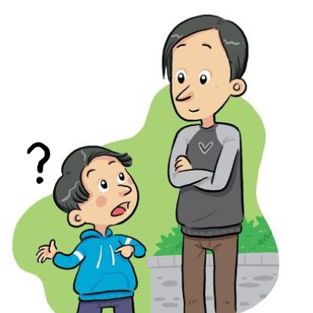
gu
¡mucho gusto!
segundo
preguntar
Notes:
Introduce and elicit the pronunciation of the individual SSC ‘gu’ and then the source word again (with gesture, if using). Then present and elicit the pronunciation of the five cluster words.
The cluster words have been chosen for their high-frequency, from a range of word classes, with the SSC (where possible) positioned within a variety of syllables within the words (e.g. initial, 2nd, final etc.). Additionally, we have tried to use words that build cumulatively on previously taught SSCs (see the Phonics Teaching Sequence document) and do not include new SSCs. Where new SSCs are used, they are often consonants which have a similar symbol-sound correspondence in English.
Timing: 2 minutes (3 slides)
Aim: To introduce SSC [gu] and source word ‘preguntar’ and the five cluster words.
Procedure:
1. Introduce and elicit the pronunciation of the individual SSC and then the source word (with gesture, if using). Note: A possible gesture for this source word would simply be to mime scoring a goal or doing a goal celebration – you could take a few seconds to take suggestions from students for the gesture.
2. Then present and elicit the pronunciation of the five cluster words.
Word frequency (1 is the most frequent word in Spanish): preguntar [219] segundo [223] ¡mucho gusto! [n/a] (gusto [890] mucho [41])
Source: Davies, M. & Davies, K. (2018). A frequency dictionary of Spanish: Core vocabulary for learners (2nd ed.). Routledge: London
The cluster words have been chosen for their high-frequency, from a range of word classes, with the SSC (where possible) positioned within a variety of syllables within the words (e.g. initial, 2nd, final etc.). Additionally, we have tried to use words that build cumulatively on previously taught SSCs (see the Phonics Teaching Sequence document) and do not include new SSCs. Where new SSCs are used, they are often consonants which have a similar symbol-sound correspondence in English.

Slide 9
gu
¡mucho gusto!
segundo
preguntar
Notes:
Without the images, students focus this time again closely on the SSC and the cluster words.

Slide 10
gu
¡mucho gusto!
segundo
preguntar
Notes:
Without the images or sound, students have to pronounce the words themselves.

Slide 11
Fonética
escuchar / leer
Qué escuchas? [ga], [go] o/y [gu]?
GA | GO | GU | en español / en inglés
Pregunta mucho en clase.
1
S/he asks a lot in class.
No quiero un gato. Estoy seguro.
2
I don’t want a cat. I’m sure.
Una amiga estudia conmigo.
3
A (female) friend studies with me.
¡Gol! Gana el Real Madrid.
4
Goal! Real Madrid wins.
‘B’ es la segunda letra.
5
‘B’ is the second letter.
Notes:
Timing: 5 minutes
Aim: to practise ‘listening out’ for the target SSC and understanding the source/cluster word in context
Procedure:
Students first listen and decide which target SSC(s) they hear. Ensure that students know they might hear more than one SSC in each phrase.
Click to correct and bring up the Spanish sentence.
Students do ‘think-pair-share’ to i) pronounce the sentence and ii) translate it orally into English.
Elicit students’ English translations.
Complete steps 1-4 with items 2 – 5.
Word frequency (1 is the most frequent word in Spanish): ganar [295]; gato [1728]; amiga [1172]; gol [2069]; conmigo [1256]; preguntar [219]; segundo [223]; seguro [407]
Source: Davies, M. & Davies, K. (2018). A frequency dictionary of Spanish: Core vocabulary for learners (2nd ed.). Routledge: London

Slide 12
Vocabulario
hablar
 | Español | Inglés
1 | son | they are (permanent)
2 | pequeño | small, little
3 | bueno | good
4 | malo | bad
5 | famoso | famous
6 | bonito | pretty
7 | feo | ugly
8 | rico | rich
9 | caro | expensive
10 | barato | cheap
11 | antiguo | old, ancient
12 | ¿Cómo es? | What is s/he like? What is it like?
60
Segundos
All of these adjectives also have a feminine form, ending in –a.
0
INICIO
Notes:
Timing: 1-4 minutes Aim: to reactivate and strengthen vocabulary knowledge. Procedure: Round 1: Look at the Spanish, recall the English meanings, saying them aloud. [1 minute] Round 2: Look at the English, recall the Spanish meanings, saying them aloud. [1 minute] Repeat for two further minutes, to speed up recall.
Word frequency (1 is the most frequent word in Spanish): son [7 – ser]; pequeño [202]; bueno [98]; malo [368]; famoso [997]; bonito [891]; feo [2373]; rico [398]; caro [2179]; barato [2164]; antiguo [446] ¿cómo es? [cómo - 151]
Source: Davies, M. & Davies, K. (2018). A frequency dictionary of Spanish: Core vocabulary for learners (2nd ed.). Routledge: London

Slide 13
Palabra antónima
Say the Spanish word with the opposite meaning.
leer/hablar
antiguo
tarde
barato
hablar
malo
feo
temprano
alto
aquí
nuevo
es
bonito
escuchar
verdadero
señora
caro
enorme
bueno
pequeño
señor
son
falso
bajo
allí
Notes:
Timing: 2 minutes
Aim: to deepen vocabulary knowledge of 24 of this week’s new and revisited words.
Procedure:
Click for an English prompt.
Students select and read aloud the correct Spanish meaning, chorally.
Continue for all 12 items.
Note: enorme [631] hasn’t been taught but is a cognate and appears on all new GCSE vocabulary lists.

Slide 14
Describing what there is around you: Using ‘es’ and ‘son’
To describe someone or something, Spanish often uses ‘es’:
Hay una casa. Es cara.
→ There is a house. It is expensive.
To describe two or more people or things, often use ‘son’:
Hay unas casas. Son caras.
→ There are some houses. They are expensive.
¡Importante! ‘Es’ (is) and ‘son’ (are) both refer to permanent traits.
Notes:
Timing: 2 minutes
Aim: to recap the use of ‘es’ (is/s/he,it is) and introduce the plural form ‘son’ (are/they are). Procedure: 1. Click through to present the information.
2. Elicit English meanings of the Spanish examples.
Note: In learning ‘son’, students also begin to encounter adjectives with plural number marking, e.g. altas. This grammar feature will be fully explained and practised in lesson 2. For now, to avoid overload, students are only expected to understand when to use ‘es’ and ‘son’ correctly, and to understand the meanings of the new adjectives.

Slide 15
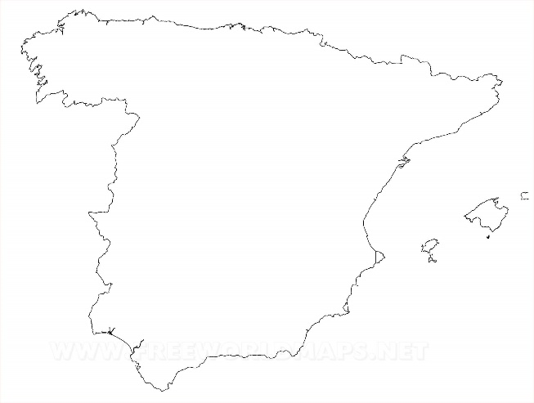
Lucía describe tres ciudades
escuchar
Lucía describe Toledo, Oviedo y León. Escucha. Marca la opción correcta.
Escucha otra vez. Escribe el adjetivo en inglés.
 | Toledo (‘it is’) | Oviedo y León (‘they are’)
1
pretty
2
small, little
expensive
Oviedo
3
León
4
ugly
Toledo
5
old, ancient
6
cheap
Notes:
Timing: 7 minutes
Aim: to practise distinguishing between ‘es’ and ‘son’; to consolidate understanding of the new adjectives
Procedure:
1. Students write 1-6.
2. They listen to each item and write ‘it is’ or ‘they are’.
3. They listen again. This time, they write the adjective in English.
4. Teacher checks answers.
Notes:
Ciudad’ has been practised as a phonics word (T1.1, Week 7).
Transcript:
Es bonito.
Es pequeño.
Son caros.
Son feos.
Es antiguo.
Son baratos.
Image free to use. Retrieved from https://www.freeworldmaps.net/europe/spain/political.html

Slide 16
Daniel describe también
leer
Lee la frase. Marca la opción correcta.
Lee la segunda frase. Marca la opción correcta.
1 |  | A
 |  | B
2 |  | A
 |  | B
3 |  | A
 |  | B
4 |  | A
 |  | B
5 |  | A
 |  | B
Es muy antiguo.
Son muy antiguos.
No son muy bonitos.
No es muy bonito.
Son muy pequeñas.
Es muy pequeña.
Es cara.
Son caras.
Es famosa.
Son famosas.
Madrid
En Madrid
hay un monumento.
Málaga
En Málaga
tiene unos parques.
En Mallorca
Mallorca
hay una escuelas.
San Sebastián
En San Sebastián
hay unas casas.
Santiago de Compostela
En Santiago de Compostela
tiene una cathedral.
Notes:
Timing: 8 minutes
Aim: to consolidate understanding of the difference between ‘hay’ and ‘tiene’; to continue distinguishing between the meanings of ‘es’ and ‘son’.
Procedure:
Students first decide which sentence starter is correct, based on whether the ending includes ‘hay’ or ‘tiene’.
Click to provide feedback.
2. They then decide if the following sentence uses ‘es’ or ‘son’, based on the noun in the preceding sentence.
3. Click to provide feedback.
Notes:
1. Check that ‘segunda’ is clear – this was introduced as a phonics practice word earlier in the lesson.
2. Differentiation: higher-achieving groups may be able to complete both parts of the task as they read each item.
Word frequency of unknown words and cognates (1 is the most frequent word in Spanish): catedral [2679] monumento [3149]
Source: Davies, M. & Davies, K. (2018). A frequency dictionary of Spanish: Core vocabulary for learners (2nd ed.). Routledge: London

Slide 17
¿Cómo se dice en inglés?
leer
1. León has some parks. They’re very good.
León tiene unos parques. Son muy buenos.
Oviedo
León
2. In Oviedo there are some people. They’re rich.
Zaragoza
En Oviedo hay unas personas. Son ricas.
3. Granada has a bar. It’s ugly.
Granada tiene un bar. Es feo.
Sevilla
4. Seville has some houses. They’re old.
Granada
Sevilla tiene unas casas. Son antiguas.
5. In Zaragoza there are some restaurants. They are very cheap.
En Zaragoza hay unos restaurantes. Son muy baratos.
Notes:
OPTIONAL EXTENSION SLIDE
Procedure:
Students translate the Spanish sentences into English, orally.

Slide 18
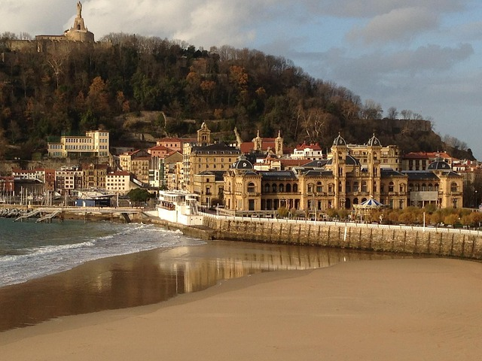
¿Cómo es España?
old
cheap
strange
Completa las frases.
escribr
beautiful
calm
small
famous
old
expensive
beautiful
San Sebastián
Barcelona y San Sebastián son
1) _______________________________ bonitos.
Bilbao es
2) ____________________ barato.
Bilbao y Barcelona son
3) __________________________ antiguos.
famous
calm
strange
San Sebastián es
4) ________________________ pequeño.
Zaragoza y San Sebastián son
5) ______________________________ tranquilos.
Bilbao y Zaragoza son
6) ________________________ raros.
Notes:
Timing: 5 minutes
Aim: to practise identifying the meanings of adjectives and using ‘es’ and ‘son’ in written production
Procedure:
1. Teacher asks students to translate the title as it contains core vocabulary introduced this week (¿Cómo es?)
2. Students look at the pictures and decide which city to write and whether to use ‘es’ or ‘son’.
Notes:
1. Notice that the Spanish adjectives are already provided. In lesson 1 we want students to focus on the correct use of es/son and the meaning of the new adjectives. In lesson 2, students will focus on manipulating their endings to reflect number (and gender) agreement.
Map courtesy www.pinterest.com (no author found).

Slide 19
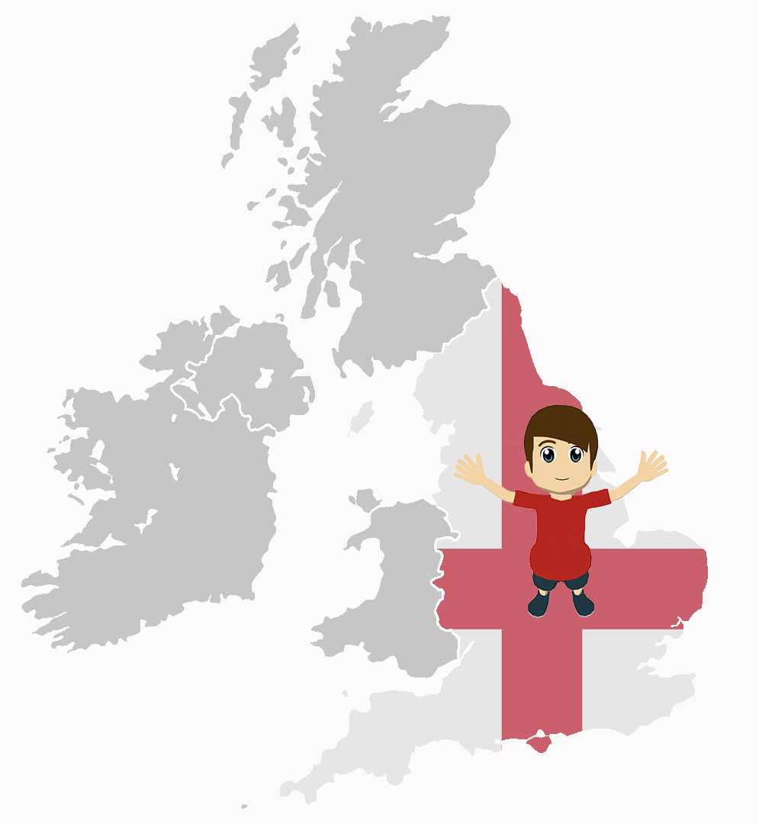
¿Cómo es Inglaterra?
escribir
Write about any places you know in England. You
can add or change the adjectives, too.
Un ejemplo:
Sheffield es barato.
Bristol y Oxford son caros.
Completa las frases.
1) ____________________ bonitos.
2) ____________________ barato.
3) ____________________ antiguos.
4) ____________________ pequeño.
5) ____________________ tranquilos.
6) _____________________feo.
7) _____________________raro.
8) _____________________caros.
Notes:
Timing: 8 minutes
Aim: to use ‘es’ and ‘son’ in written production in a freer context.
Procedure:
1. Students need to pay attention to the adjective ending (whether it ends with –s or not) as a cue for writing about one or more than one city. They are using this receptively to direct their production of ‘es’ and ‘son’.

Slide 20
Saying who there is around you and describing them
SER – ‘es’ [revisited] and ‘son’ (they are)
Adjective number agreement
Y7 Spanish Term 1.2 – Week 4 – Lesson 22 Nick Avery / Rachel Hawkes Artwork: Mark Davies Date updated: 02.08.23
profesores
amigos
Notes:
Learning outcomes:
Introduction of adjective number agreement -s (as complement to verb) Consolidation of adjective gender agreement -o, -a (now including abstract gender)
Word frequency (1 is the most frequent word in Spanish):
7.1.2.4 (introduce) son [ser-7]; pequeño [202]; bueno [98]; malo [368]; famoso [997]; bonito [891]; feo [2373]; rico¹ [398]; caro [2179]; barato [2164]; antiguo [446] ¿cómo es? [cómo-151]
7.1.2.1 (revisit) no [11]; caminar [514]; estudiar [281]; español¹ [262]; inglés¹ [583]; arte [208]; ciencia(s) [738]; señor¹ [201]; señora¹ [509]; mucho (as adverb only) [41]; pero [30]; verdadero [558]; o [29]; falso [1599]; entiendo [entender-229]; silencio [518]; grupo [200]; perdón [1729]
7.1.1.3 (revisit) ser [7]; soy; eres; es; alegre [2081]; simpático [3349]; guapo [4192]; alto¹ [231]; bajo¹ [236]; y [4]; marca [marcar-993]; correcto [1467]; opción [1175]
Source: Davies, M. & Davies, K. (2018). A frequency dictionary of Spanish: Core vocabulary for learners (2nd ed.). Routledge: London

Slide 21
Vocabulario
hablar
c_ _ _
a_ _ _ _ _ _
¿C_ _ _ e_?
b_ _ _ _ _
f_ _
p_ _ _ _ _ _
f_ _ _ _ _
m_ _ _
r_ _ _
b_ _ _ _
s_ _
b_ _ _ _ _
pequeño
small, little
Notes:
Timing: 6 minutes (11 slides)
Aim: to retrieve the new words from memory, with first letter prompts.
Procedure:
Teacher elicits the Spanish word from students.
Click to reveal the answer.
Continue with items 2-11.
Note: If classes are not yet able to retrieve the word from memory, additional letters could be added to offer additional support.

Slide 22
cheap
c_ _ _
a _ _ _ _ _ _
¿C_ _ _ e_?
b_ _ _ _ _
f _ _
p _ _ _ _ _ _
f _ _ _ _ _
m_ _ _
r _ _ _
b _ _ _ _
s_ _
b _ _ _ _ _
barato
Notes:
[2/11]

Slide 23
old, ancient
c_ _ _
a_ _ _ _ _ _
¿C_ _ _ e_?
b_ _ _ _ _
f_ _
p_ _ _ _ _ _
f_ _ _ _ _
m_ _ _
r_ _ _
b_ _ _ _
s_ _
b_ _ _ _ _
antiguo
Notes:
[3/11]

Slide 24
famous
c_ _ _
a_ _ _ _ _ _
¿C_ _ _ e_?
b_ _ _ _ _
f_ _
p_ _ _ _ _ _
f_ _ _ _ _
m_ _ _
r_ _ _
b_ _ _ _
s_ _
b_ _ _ _ _
famoso
Notes:
[4/11]

Slide 25
ugly
c_ _ _
a_ _ _ _ _ _
¿C_ _ _ e_?
b_ _ _ _ _
f_ _
p_ _ _ _ _ _
f_ _ _ _ _
m_ _ _
r_ _ _
b_ _ _ _
s_ _
b_ _ _ _ _
feo
Notes:
[5/11]

Slide 26
rich
c_ _ _
a_ _ _ _ _ _
¿C_ _ _ e_?
b_ _ _ _ _
f_ _
p_ _ _ _ _ _
f_ _ _ _ _
m_ _ _
r_ _ _
b_ _ _ _
s_ _
b_ _ _ _ _
rico
Notes:
[6/11]

Slide 27
What is s/he like?
What is it like?
c_ _ _
a_ _ _ _ _ _
¿C_ _ _ e_?
b_ _ _ _ _
f_ _
p_ _ _ _ _ _
f_ _ _ _ _
m_ _ _
r_ _ _
b_ _ _ _
s_ _
b_ _ _ _ _
¿Cómo es?
Notes:
[7/11]

Slide 28
they are (trait)
c_ _ _
a_ _ _ _ _ _
¿C_ _ _ e_?
b_ _ _ _ _
f_ _
p_ _ _ _ _ _
f_ _ _ _ _
m_ _ _
r_ _ _
b_ _ _ _
s_ _
b_ _ _ _ _
son
Notes:
[8/11]

Slide 29
bad
c_ _ _
a_ _ _ _ _ _
¿C_ _ _ e_?
b_ _ _ _ _
f_ _
p_ _ _ _ _ _
f_ _ _ _ _
m_ _ _
r_ _ _
b_ _ _ _
s_ _
b_ _ _ _ _
malo
Notes:
[9/11]

Slide 30
good
c_ _ _
a_ _ _ _ _ _
¿C_ _ _ e_?
b_ _ _ _ _
f_ _
p_ _ _ _ _ _
f_ _ _ _ _
m_ _ _
r_ _ _
b_ _ _ _
s_ _
b_ _ _ _ _
bueno
Notes:
[10/11]

Slide 31
pretty
c_ _ _
a_ _ _ _ _ _
¿C_ _ _ e_?
b_ _ _ _ _
f_ _
p_ _ _ _ _ _
f_ _ _ _ _
m_ _ _
r_ _ _
b_ _ _ _
s_ _
b_ _ _ _ _
bonito
Notes:
[11/11]

Slide 32
Describing what there is around you: Using ‘es’ and ‘son’
Spanish adjectives change depending on whether the noun is singular (one) or plural (more than one).
Compare:
Hay una casa. Es cara.
→ There is a house. It is expensive.
Hay unas casas. Son caras.
→ There are some houses. They are expensive.
So, if the adjective refers to a plural noun, add an -s.
Notes:
Timing: 2 minutes
Aim: to present the most common pattern of Spanish plural adjective agreement.
Procedure: 1. Click to present the new information.
2. Elicit English meanings for each Spanish example.
Note:
1. Students haven’t yet learnt any adjectives that end in a consonant (e.g. azul), which require –es to form a plural adjective. We therefore don’t teach this rule here. The aim here is to get them to learn a ‘default’, main pattern. We can introduce the complexities and exceptions to the rule later.

Slide 33
¿Cómo es? ¿Cómo son?
Lucía describe a un profesor y a unos amigos.
escuchar
Escucha otra vez. Escribe las palabras en español.
Escucha. Marca la opción correcta.
 | El profesor (‘he is’) | Los amigos (‘they are’)
1
Es alto.
2
Son tontos.
3
Es tranquilo.
4
No es feo.
5
No son famosos.
6
Son bajos.
Notes:
Timing: 8 minutes
Aim: to practise listening out for ‘es’ and ‘son’ and understanding their meaning.
Procedure:
1. Students first listen out for ‘es’ and ‘son’ to decide whether the subject is singular ‘he’ or plural ‘they’.
2. Then, they listen again and write the Spanish (i.e., transcription). This should help them to begin to associate ‘es’ and ‘son’ with the singular and plural forms of the adjective.
Notes:
Adjectives taught this week: famoso, feo;
Adjectives recently re-visited in Quizlet: tonto, tranquilo.
Adjectives taught in other weeks: alto, bajo Definite articles (el, la, los, las) have not been formally taught yet (el,la are taught next week) but in pre-learning of vocabulary, students have encountered the articles connected to nouns.
Transcript:
Es alto
Son tontos
No son famosos
Es tranquilo
No es feo
Son bajos

Slide 34
¿Cómo es? ¿Cómo son?
Lee y decide. ¿Es positivo, negativo o depende?
leer
Es alto.
Son tontos.
Es positivo ☺
Es negativo ☹
Es tranquilo.
Es tranquilo.
Son tontos.
No es feo.
No es feo.
No son famosos.
Son bajos.
Depende ☺ / ☹
Es alto.
No son famosos.
Son bajos.
Notes:
Timing: 5 minutes
Aim: for students to engage with the meaning of the words that they just heard and transcribed.
Procedure:
Students decide if the statements are positive, negative or whether it depends (ensure that ‘depende’ is clear when introducing the task) and write P, N o D next to each of their transcribed phrases.
Elicit responses from students in Spanish (top to bottom, starting with ‘es alto’).
Note: A number of these are of course open to interpretation. The idea is that students engage with the meaning of the words that they just heard and transcribed.

Slide 35
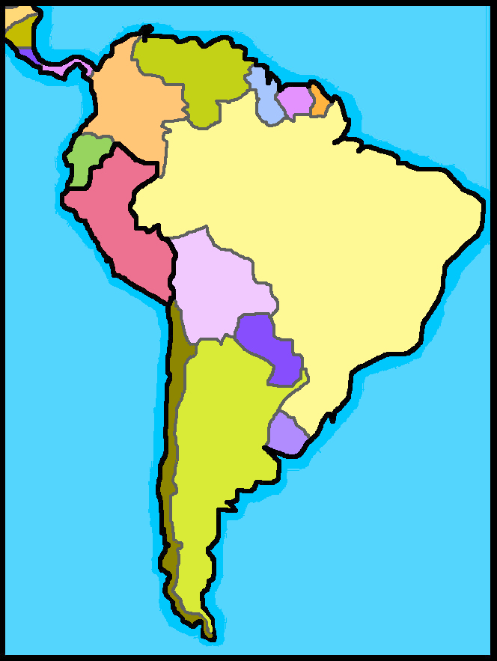
Día del profesor*
México
leer
En España el Día del Maestro es el 27 de noviembre.
El Día del Profesor (o Día del Maestro) es una festividad para celebrar la profesión del profesor.
¿Y en Inglaterra? Oficialmente es el 5 de octubre pero ¡no es una festividad famosa aquí!
Perú
Es muy importante en Sudamérica y no hay clases pero hay muchos regalos para los profesores.
Words you have met before
En Perú es el 6 de julio, en México es en mayo, en Argentina septiembre.
Argentina
Cognates
Notes:
Timing: 5 minutes
Aim: to introduce students to a celebration day celebrated in all Spanish-speaking countries; to practise comprehension of a longer text and identification and recognition of many cognates.
Procedure:
Read the text aloud with students. Ask them to follow along. Pause every now and then and ask students to say the next word.
After the first paragraph, ask students to tell you what the ‘día del profesor’ is/is celebrating.
3. Continue reading the other short paragraphs.
4. Ask students to tell you what else they have understood.
5. Click to bring up the callout ‘Words you have met before’ and click again to reveal these in the text.
6. Then, click to bring up the ‘cognates’ callout and go through and ask students to tell you any words that they understand from the text because of their similarity to English (i.e., identify the cognates). This will also practise read aloud of unknown words.
7. Click to reveal all the cognates in one go.
8. If necessary, clarify the meanings of any remaining words.
Notes: i) Students have met mucho as an adverb and regalo as a phonics cluster word. They may be able to infer the meaning of para from the surrounding words in the sentences. Singular definite articles (el,la) are taught formally next week. Students may ask about these (may have already asked) and teachers may find it helpful to tell students their meanings now, ahead of the formal teaching and practice of them (which is imminent).
Students (and teachers!) may be surprised to learn that we have a Day of the Teacher in the UK. The 5 October is the official UNESCO world Day of the Teacher, but as we know, it’s not really recognised or celebrated here! Stress that in Latin America and other parts of the world, including the US, Canada, Australia it is much more enthusiastically celebrated.

Slide 36
¿Cómo es? ¿Cómo son?
Daniel describe a unos profesores, también.
leer
Lee y marca A o B. Luego, escribe ‘es’ o ‘son’ para completar la frase.
El profesor de arte ___
Los profesores de historia ___
1
2
3
4
5
6
es
bueno, pero nervioso.
Los profesores de ciencias no ___
El profesor de matemáticas no ___
son
ricos.
la profesora de ciencias
La profesora de música ___
Las profesoras de español ___
es
rara.
Los profesores de historia no ___
El profesor de inglés no ___
son
malos.
el profesor de arte
La profesora de ciencias ___
Las profesoras de arte ___
son
simpáticas.
El profesor de español __
Los profesores de matemáticas ___
es
nuevo.
las profesoras de español
Notes:
Timing: 8 minutes
Aim: to practise attending to adjective number agreement as a cue for understanding the subject of the sentence; to consolidate understanding and production of ‘es’ and ‘son’
Procedure:
1. Teacher runs through the instructions. Elicit the meaning of ‘cómo son’ in the title.
2. Students use the adjective at the end of the sentence to decide which sentence starter is correct.
3. They then complete the sentence with ‘es’ or ‘son’.
4. Elicit English meanings of each sentence orally, to reinforce understanding.
Notes:
Adjectives taught this week: bueno, malo
Adjectives recently re-visited in Quizlet: nervioso, raro
Adjectives taught in other weeks: simpatico, nuevo

Slide 37
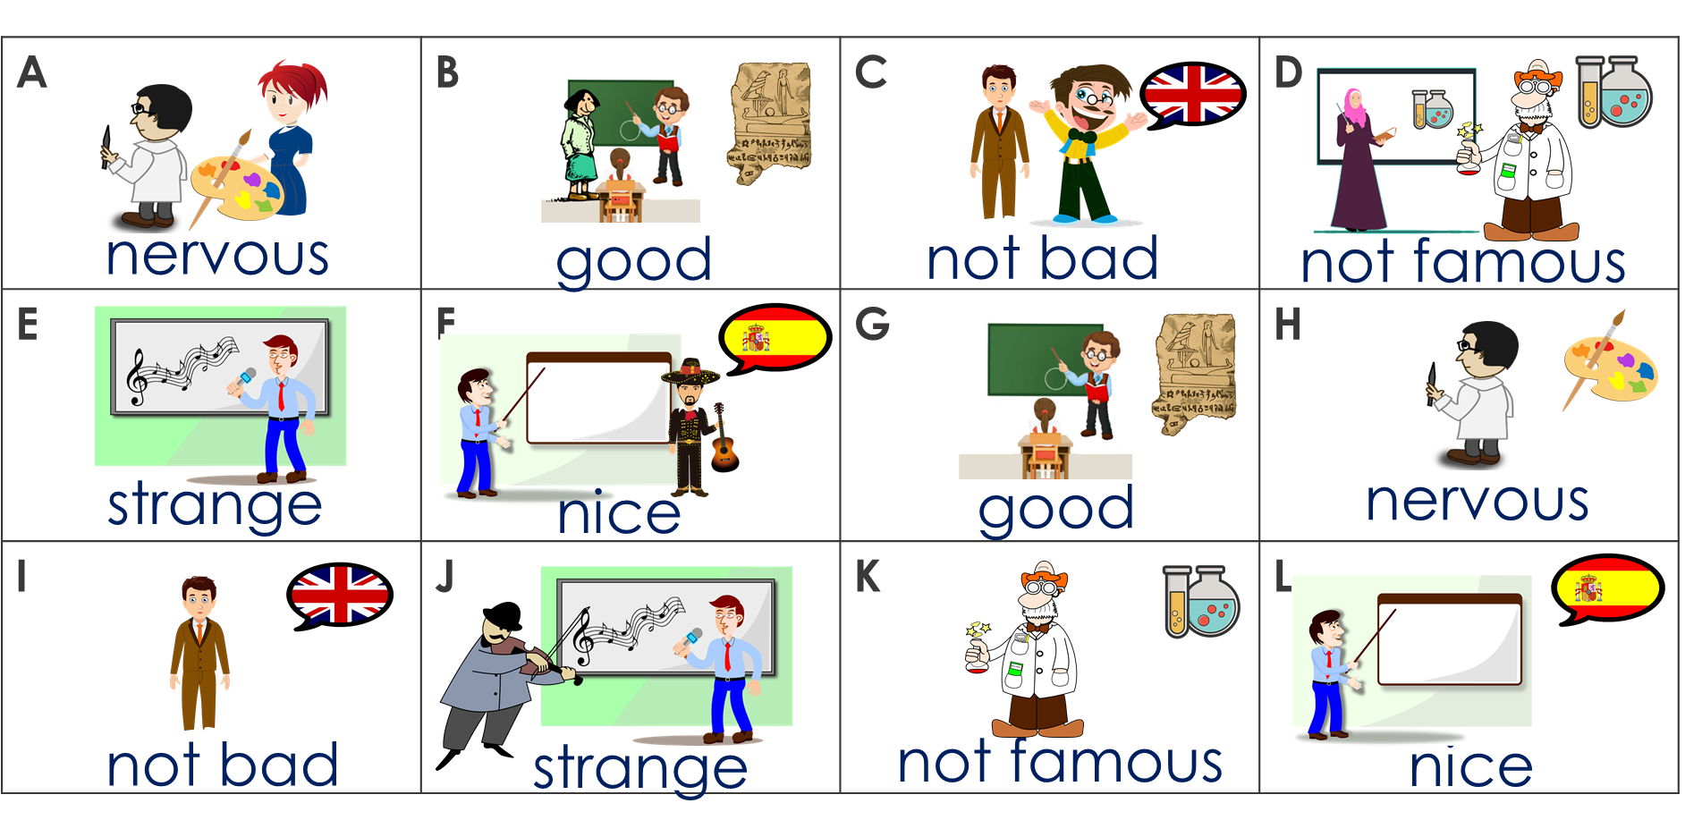
¿Cómo es? ¿Cómo son?
Escribe 4 letras. En parejas, describe. Take turns. The partner who says all 4 of their partner’s choices first, wins.
hablar
A | E | F | H
No es famoso.
Son simpáticos.
Ejemplo. Persona A (habla):
¡Sí!
No.
Persona B:
B | D | I | J
There are two pictures for each type of teacher. Remember to use ‘es’ for ‘is’ and ‘son’ for ‘are’, and to use the right adjective ending: -o, -os. es rico | son ricos |
Notes:
Timing: 10 minutes
Aim: to practise using ‘es’ and ‘son’ to refer to singular and plural subjects; to practise using gender and number agreement in the oral modality
Procedure:
Teacher elicits meaning of ‘parejas’. They have encountered ‘pareja’ as partner. Ensure they understand the meaning ‘in pairs’.
Teacher uses this slide to model the activity.
Students secretly write 6 letters – they need to think for themselves what the phrase will be for those items.
Partner A starts – s/he is trying to guess the letters that B has chosen by saying the phrase that describes the teachers.
Draw students’ attention (using the callout) to the fact that the pictures are either singular or plural and they must take care to get the correct verb and adjective. There are two rounds of activity – the first round has single and plural male teachers, the second round has single and multiple female teachers. This avoids students having to juggle all four endings at once when they speak.
5. After 5 minutes, swap to Round 2. If students have finished Round 1 quickly, they can always repeat the activity.

Slide 38
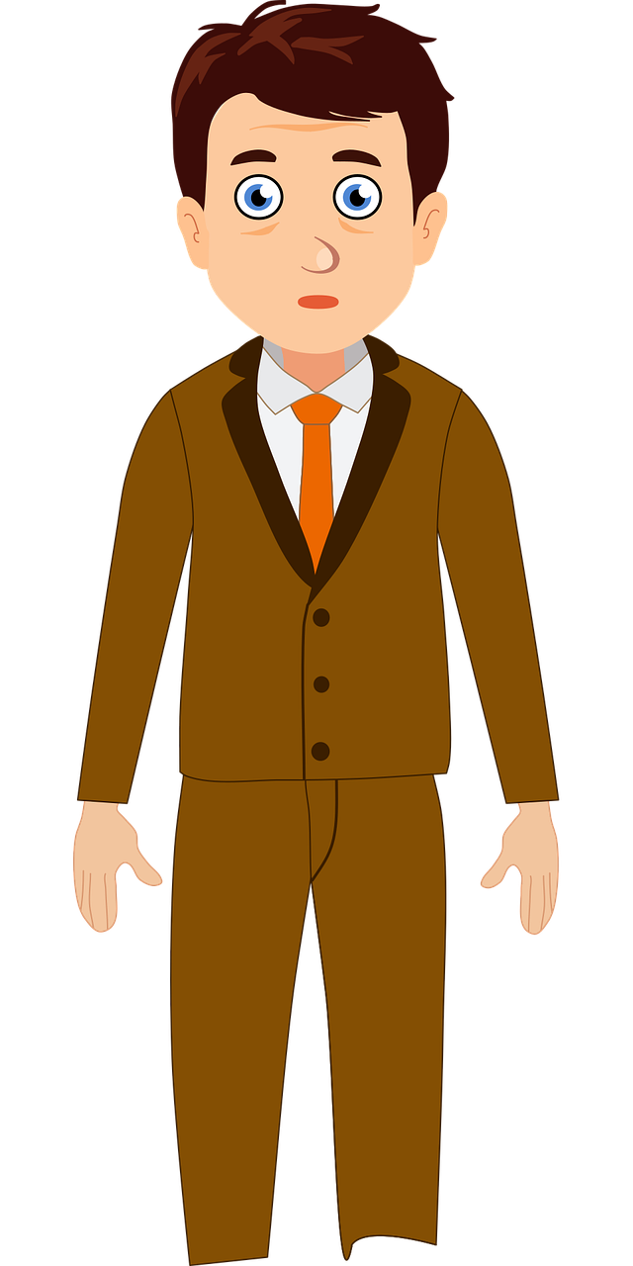
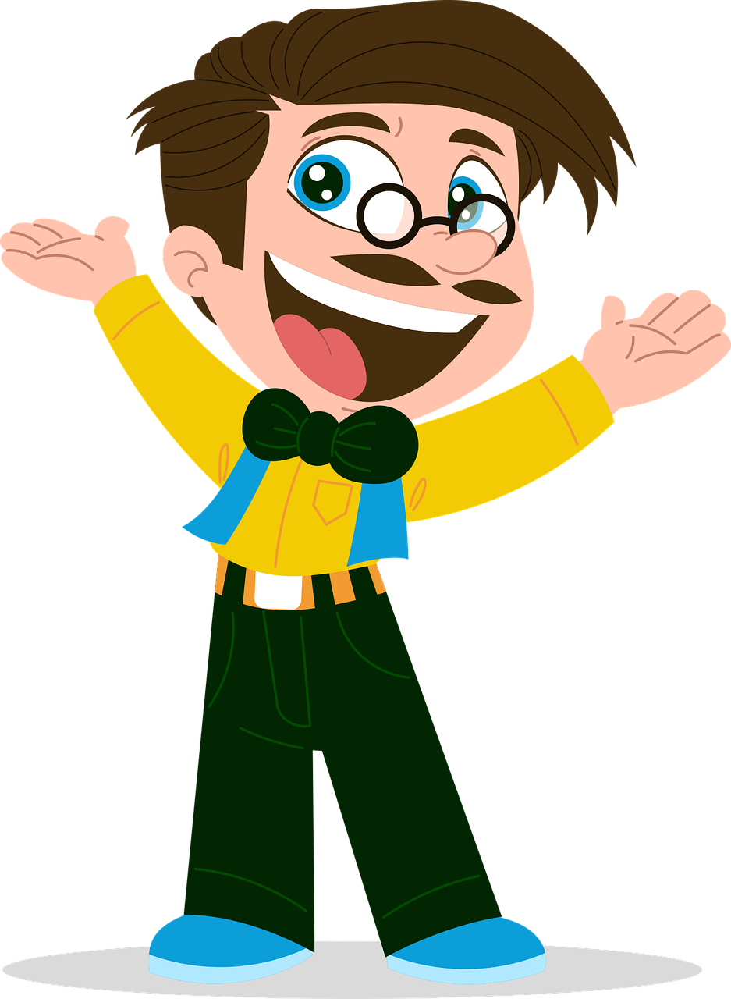
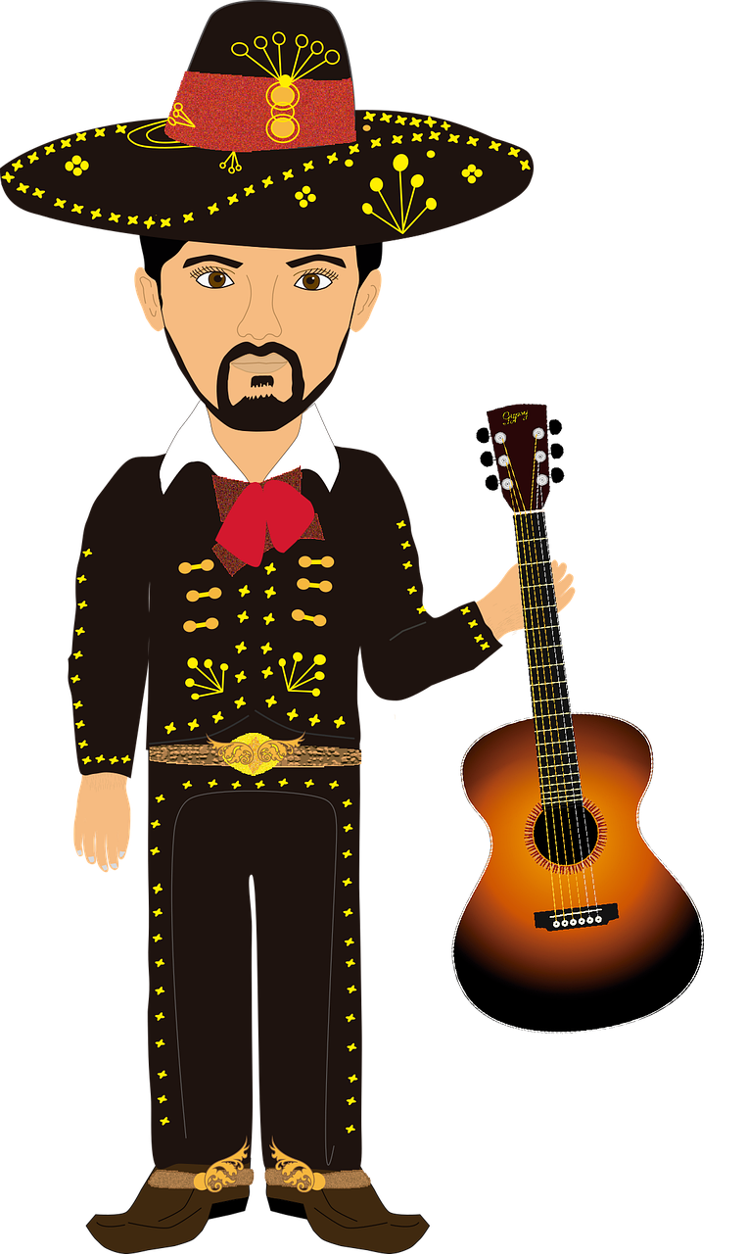
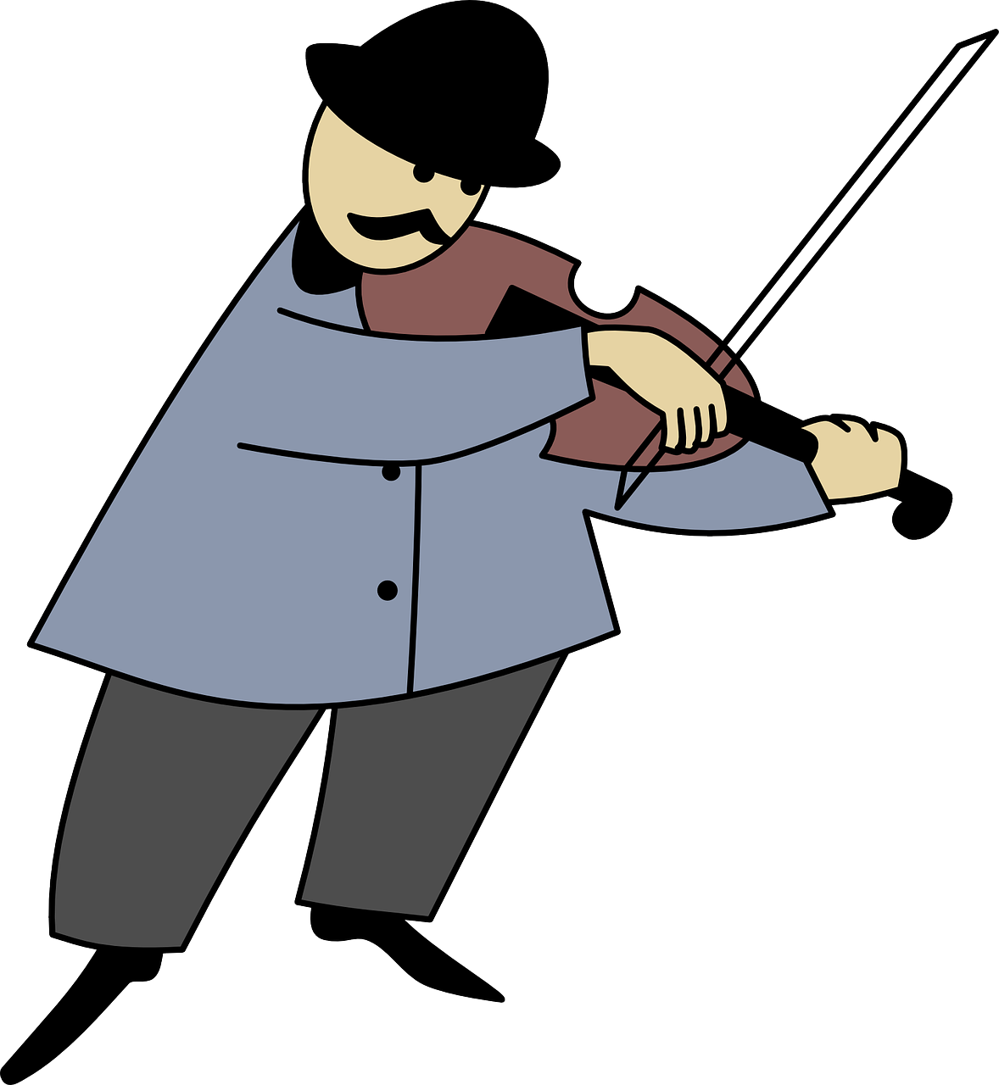
¿Cómo es? ¿Cómo son?
hablar
c
A | B | C | D
E | F | G | H
I | J | K | L
nervous
good
not bad
not famous
strange
nice
good
nervous
not bad
strange
not famous
nice
Notes:
Round 1 Masculine singular / plural

Slide 39
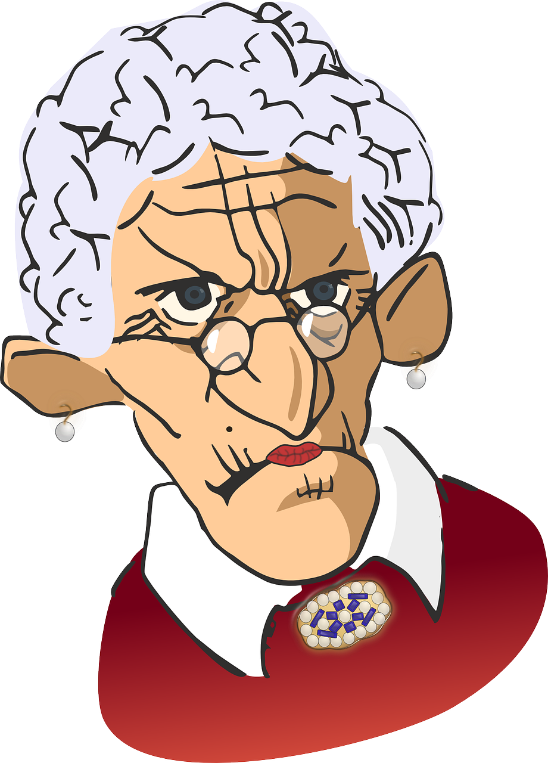
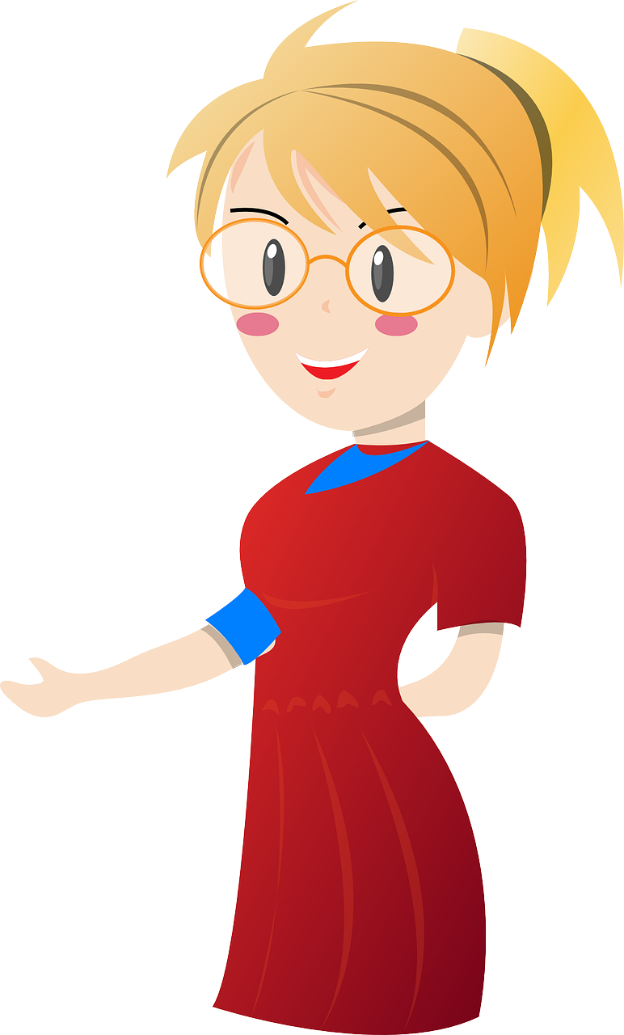
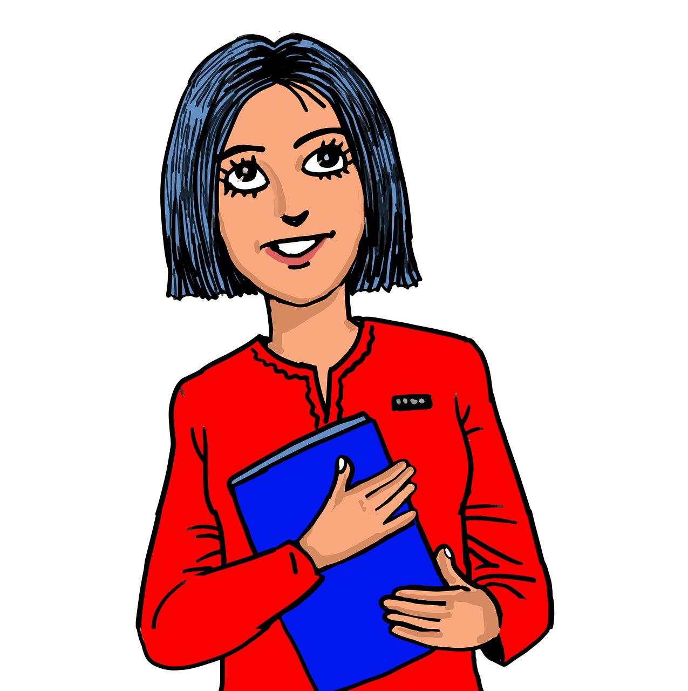
¿Cómo es? ¿Cómo son?
hablar
This time you are describing female teachers. Use the right adjective endings: e.g., es alta | son altas |
A | B | C | D
E | F | G | H
I | J | K | L
not rich
new
not bad
serious
strange
nice
not bad
new
strange
serious
not rich
nice
Notes:
Round 2 Feminine singular / plural

Slide 40
Vocabulario
escribir / hablar
rico
famoso
es
son
rich
famous
(s/he, it) is_{[trait]}
(they) are_{[trait]}
y
soy
eres
perdón
and
I am_{[trait]}
you are_{[trait]}
sorry
¿cómo es?
estudiar
o
entiendo
what is … like?
to study
or
I understand
caminar
ser
mucho
pero
to walk
to be_{[trait]}
a lot
but
arte
guapa
simpático
ciencia(s)
good-looking (f)
art
nice (m)
science(s)
Notes:
OPTIONAL ADDITIONAL VOCABULARY PRACTICE Timing: 3 minutes
Aim: to practise spoken OR written production of 20 new and revisited words, in a low stakes but time-limited activity.
Procedure:
Work from left to right, top to bottom on the word wall. Ask ‘¿Cómo se dice ‘to dance’ en español?
Click to start the 5-second animation. Pupils say the Spanish word before the animation finishes and reveals the word.
Continue with all words.
Note: this activity would work as speaking or writing (e.g., on mini whiteboards)

Slide 41
Deberes
Vocabulary Learning Homework (Y7, Term 1.2, Week 5)
Audio file
Student worksheet
In addition, revisit: Term 1.2 Week 2 Term 1.1 Week 4
Notes:
Use this slide to set the homework.
For Y7, the typical homework will be to pre-learn vocabulary for the next lesson. There is an audio file to accompany the student worksheet.
Notes:
i) Teachers may, in addition, want to recommend use of a particular online app for the pre-learning of each week’s words. ii) Quizlet now requires parental involvement / registration / permissions for users below the age of 13, so it is perhaps most suitable for Y9 – 11 students. iii) Language Nut hosts LDP vocabulary lists and these are free for schools to use, though there is a registration process. One benefit is that all of the student tracking data that Language Nut offers are also available to schools that use the LDP lists for practice. Perhaps this makes it a good option for Y7/8.
iv) There are other free apps, and new ones are always appearing. Teachers have told us that they are currently using: Flippity, Wordwall (where using previously-created activities is free).
v) Gaming Grammar has been acquired by Language Nut. Its original content should still be available to teachers and much of it is appropriate for Y7 learners. From this lesson, for example, learners could practise Adjectives: number

