Slide 1
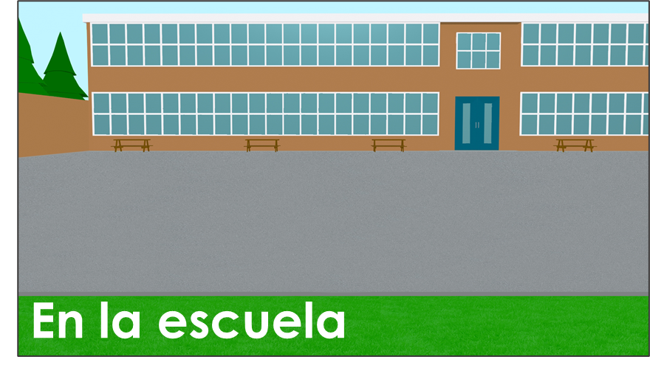
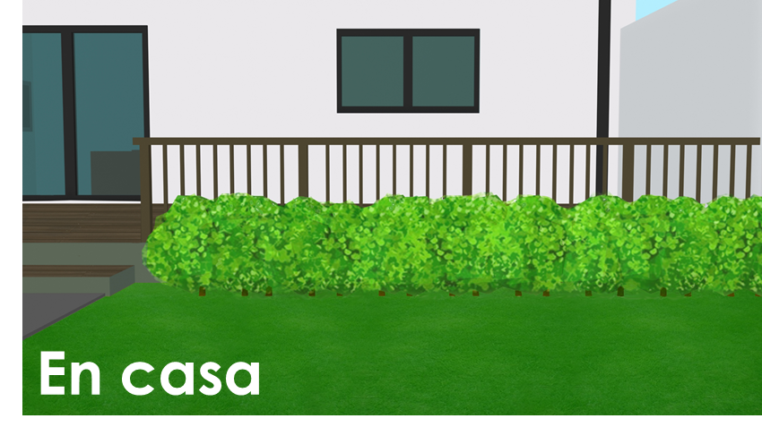
Saying what there is around you
Using ‘hay’ Indefinite articles [revisited]
SSC [qui]
Y7 Spanish Term 1.2 – Week 3 – Lesson 19 Nick Avery / Rachel Hawkes Artwork: Mark Davies Date updated: 02.08.23
Notes:
Note: all words (new and revisited) in this week of the SOW appear on all three GCSE wordlists, with the following exceptions:
i) AQA list does not have voluntario (though as a cognate it could be used in reading assessments).
ii) Edexcel list does not have raro, tonto, voluntario.
Learning outcomes:
Introduction of SSC [qui]
Introduction of hay
Consolidation of indefinite articles
Word frequency (1 is the most frequent word in Spanish):
7.1.2.3 (introduce) hay [13]; mirar [125]; mesa [525]; silla [1271]; ventana [752]; puerta [274]; chica [1129]; persona [108]; chico [727]; aquí [130]; allí [197]; clase [320]; señor² [201]; señora² [509]
7.1.1.7 (revisit) necesitar [276]; usar [317]; llevar¹ [75]; zapato [1477]; vaso [1609]; producto [394]; bolsa [1581]; camisa [1873]; cosa [69]; ayuda [784]; voluntario¹ [2732]; gracias [275]; de nada [nada-87]; luego¹ [150]
7.1.1.2 (revisit) nervioso [1521]; tranquilo [1073]; serio [856]; raro¹ [1005]; tonto [2379]; blanco [372]; ¿cómo? [151]; muy [43]; hoy [167]; ¿Cómo se dice […] en inglés/español?; ¿Cómo se escribe?; seguro [407]; listo [1684]; sí [45]; no [11]
Source: Davies, M. & Davies, K. (2018). A frequency dictionary of Spanish: Core vocabulary for learners (2nd ed.). Routledge: London

Slide 2
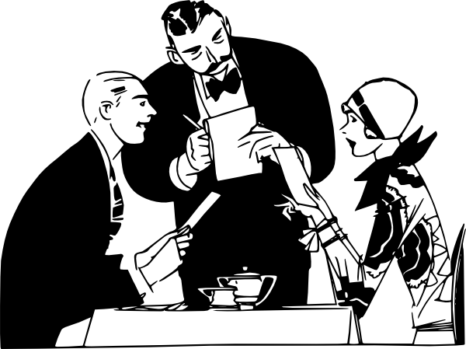
qui
quiero
Nick Avery
Notes:
Timing: 3 minutes (five slides)
Aim: To introduce SSC [qui] and source word ‘quiero’.
Procedure:
Introduce and elicit the pronunciation of the individual SSC and then the source word (with gesture, if using).
Note: A possible gesture for this source word would be to fold hands over your heart, and then move the right hand away from the body.
Word frequency (1 is the most frequent word in Spanish): quiero (querer) [58]
Source: Davies, M. & Davies, K. (2018). A frequency dictionary of Spanish: Core vocabulary for learners (2nd ed.). Routledge: London

Slide 3
qui
quiero
Nick Avery
Notes:
Repeat the sound and elicit the source word.

Slide 4
qui
izquierda
tranquilo
[calm]
quiero
[I want]
quince
¿quién?
equipo
[team]
Notes:
Aim: To introduce/consolidate SSC [qui]
Procedure:
Introduce and elicit the pronunciation of the individual SSC [qui] and then the source word again ‘quiero’ (with gesture, if using).
Then present and elicit the pronunciation of the five cluster words.
The cluster words have been chosen for their high-frequency, from a range of word classes, with the SSC (where possible) positioned within a variety of syllables within the words (e.g. initial, 2nd, final etc.). Additionally, we have tried to use words that build cumulatively on previously taught SSCs (see the Phonics Teaching Sequence document) and do not include new SSCs. Where new SSCs are used, they are often consonants which have a similar symbol-sound correspondence in English.
Word frequency (1 is the most frequent word in Spanish): quiero [>5000]; izquierda [1352]; quince [1215]; equipo [373]; tranquilo [1073]; ¿quién? [289] Source: Davies, M. & Davies, K. (2018). A frequency dictionary of Spanish: Core vocabulary for learners (2nd ed.). Routledge: London

Slide 5
qui
izquierda
tranquilo
quiero
[I want…]
quince
¿quién?
equipo
Notes:
Without the images, students focus this time again closely on the SSC and the cluster words.

Slide 6
qui
izquierda
tranquilo
quiero
[I want…]
quince
¿quién?
equipo
Notes:
Without the images or sound, students have to pronounce the words themselves.

Slide 7
¿Es [que] o [qui]?
escuchar / escribir
Escucha. Marca ‘que’ o ‘qui’.
Escucha otra vez. Escribe la palabra.
 | QUE | QUI
palabra
¿Cómo se dice en inglés?
por____
1
que
because
qui
2
tran___lo
calm, tranquil
¿___én?
3
qui
who?
4
parque
park
5
quince
fifteen
6
quiero
I want
7
¿qué?
what?
Notes:
Timing: 7 minutes
Aim: to practise mapping sound to spelling for SSCs [que] and [qui]
Procedure:
1. Students listen to audio.
2. Students tick ‘que’ or ‘qui’.
3. They then listen again, write the missing letters themselves.
4. Correct the answers and elicit the English translations, orally.
Note: Make sure that students remember the accent when writing ‘¿qué?’.
These are high-frequency words that some students will acquire incidentally, but are not counted within the core expected learning of 360 words in Y7. Students should therefore not think of the additional challenge of translating into English as a test, but as an additional opportunity.
Transcript:
Porque
Tranquilo
Quién
Parque
Quince
Quiero
Qué
Word frequency (1 is the most frequent word in Spanish): querer [58]; quince [1215]; quién [289]; tranquilo [1073]; qué [50]; porque [40]; parque [1354]
Source: Davies, M. & Davies, K. (2018). A frequency dictionary of Spanish: Core vocabulary for learners (2nd ed.). Routledge: London

Slide 8
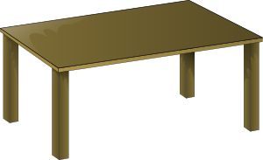
Vocabulario [1/2]
leer / hablar
la clase
la puerta
aquí
la ventana
allí
la mesa
there
here
class
1
2
3
4
5
6
Notes:
NOTE: Teachers to adapt the activities for practising the new vocabulary to suit their class. There is a pairwork vocabulary reactivation slide at the end of this presentation, if desired. Timings: 4 minutes (two slides)
Aim: to practise identifying and pronouncing the new vocabulary items.
Procedure:
1. Teacher elicits the vocabulary from students. Suggested routine:
Teacher: ¿Qué es el número 1’? Students: allí Teacher: ¿Qué es el número 2’? Students: aquí. 2. Teacher attends to and supports pronunciation, as needed (e.g., students have not yet learnt the SSC [ll]) and [qui] is new this week. 3. Teacher elicits a 2nd round of production, using this routine: Teacher: ¿Cómo se dice ‘table’ en español’? Students: la mesa. Option to include some alphabet practice as we revisit both these two phrases this week: Teacher: ¿Cómo se escribe ‘puerta’ Students: P-U-E-R-T-A.
Pictures retrieved from www.clker.com (free to use)

Slide 9
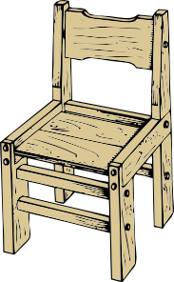
Vocabulario [2/2]
leer / hablar
el chico
la silla
hay
la persona
la chica
there is there are
7
8
person
9
10
11
Notes:
Vocabulary practice activity [2/2]
Pictures retrieved from www.clker.com (free to use)

Slide 10
Saying what there is around you: The use of ‘hay’
To say ‘there is’ or ‘there are’, Spanish uses the word ‘hay’.
Hay unos señores.
→ There are some men.
Sentences with ‘hay’ often start with ‘en’.
En clase hay una señora.
→ In class there is a woman.
Sentences with ‘tiene’ don’t normally start with ‘en’.
La clase tiene un profesor.
→ The class has a teacher.
Notes:
Timing: 2 minutes
Note:
1. Students haven’t yet practised the silent ‘H’ in Spanish phonics (although they have met ‘hablar’ and ‘hoy’), so practise the pronunciation of ‘hay’ here. It might help students to know that it sounds similar to the English letter ‘I’!
2. Emphasise that ‘hay’ means ‘there is’ and ‘there are’ and goes with singular AND plural nouns.
3. Students will be practising hay vs tiene in several activities this week.
4. Señor and Señora are reintroduced on this slide with the new meaning ‘man’ and ‘woman’.

Slide 11
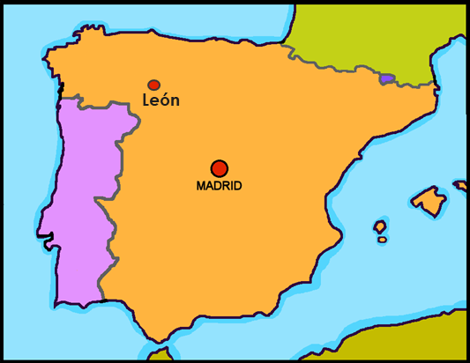
Lucía describe la escuela
leer
Lee la frase. Marca la opción correcta: hay o tiene.
¿un o una?
León | tiene | hay |  | monumento. Está aquí, cerca de* la escuela. Es muy importante.
La escuela | hay | tiene |  | directora. Es muy seria pero habla mucho.
En la escuela | hay | tiene |  | señor. Es un voluntario y hoy está en clase.
En la clase | tiene | hay |  | profesor. Es listo pero es nuevo y necesita ayuda con unas cosas.
El profesor | hay | tiene |  | mesa. Es blanca y es un producto de Inglaterra.
En clase | tiene | hay |  | chica. Lleva una camisa, pero hoy no lleva zapatos. ¡Qué raro!
un
una
un
un
una
una
cerca (de) – near (to)
Notes:
Timing: 10 minutes (2 slides)
Aim: to work out whether ‘hay’ or ‘tiene’ is right (paying attention to whether the sentence begins with ‘en’ or with ‘el’ / ‘la’); to consolidate understanding of indefinite articles; to practise comprehension (in the written modality) of new and revisited vocabulary.
Procedure:
1. Students write 1-6.
2. They read each sentence and write ‘hay’ or ‘tiene’.
3. They then provide the singular indefinite article (un/una) to complete the fist sentence. 4. Click to reveal, then elicit oral translation of the second/third sentences. The next slide can be used to check answers, if required.

Slide 12
¿Cómo se dice en inglés?
leer
1. León tiene un monumento. Está aquí, cerca de la escuela.
León has a monument. It’s here, near to the school.
2. La escuela tiene una directora. Es muy seria pero habla mucho.
The school has a head teacher. She is very serious but she talks a lot.
3. En la escuela hay un señor. Es un voluntario y hoy está en clase.
In the school there is a man. He’s a volunteer and today he is in class.
4. En la clase hay un profesor. Es listo pero es nuevo y necesita ayuda.
In class there is a teacher. He is clever but he is new and needs help.
5. El profesor tiene una mesa. Es blanca y es un producto de Inglaterra.
The teacher has a table. It is white and it is a product of/from England.
6. En clase hay una chica. Lleva una camisa pero hoy no lleva zapatos. ¡Qué raro!
In class there is a girl. She’s wearing a shirt but today she’s not wearing shows. How strange!
Notes:
Use this slide to elicit oral English tranlsations.

Slide 13
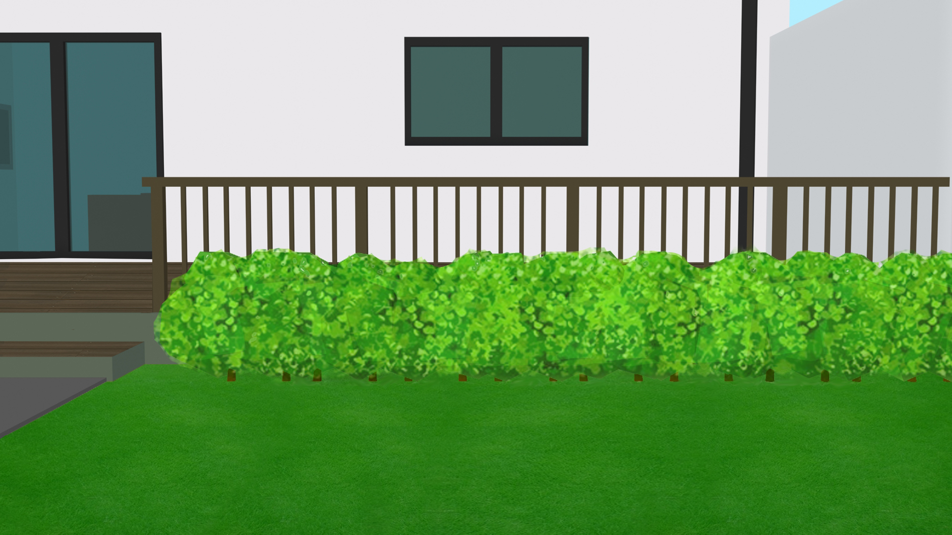
Lucía está en casa
The start of each sentence is missing. How must it begin?
escuchar
En la casa…
La casa…
1
2
3
4
5
6
Notes:
Timing: 10 minutes (two slides)
Aim: to practise connecting ‘hay’ and ‘tiene’ to the correct sentence starter (in the oral modality).
Procedure:
Students write 1-6.
They listen out for ‘tiene’ or ‘hay’ and decide how the sentence must begin.
Then, on the next slide, they listen again – this time for the number and noun mentioned.
Transcript:
[beep] tiene unas ventanas.
[beep] tiene una puerta.
[beep] hay unos chicos.
[beep] hay unas personas.
[beep] tiene unos vasos.
[beep] hay unas sillas
Pictures retrieved from www.clker.com (free to use).

Slide 14
Lucía está en casa
escuchar
Escucha otra vez. Escribe la letra correcta.
B
C
A
¿Qué tiene? / ¿Qué hay?
¿un, una, unos o unas?
G
1
I
unas
F
D
E
2
G
una
3
H
unos
4
J
unas
H
5
unos
J
D
I
person
6
E
unas
Notes:
[2/2]
Procedure:
Listen again – this time write the correct letter (for the picture of the noun) and the correct indefinite article.
Note: there are four items too many (distractors). Teachers could remove some or all of these to make the task more straightforward, adjusting the letter answers accordingly.
Transcript:
[beep] tiene unas ventanas.
[beep] tiene una puerta.
[beep] hay unos chicos.
[beep] hay unas personas.
[beep] tiene unos vasos.
[beep] hay unas sillas.

Slide 15
¿Qué hay en la casa? ¿Dónde?
hablar / escuchar
Student A: Your partner has a house in England and a house in Spain!
Find out which picture card your partner has chosen.
Look at the cards and ask him/her questions about what there is. Use hay.
If your partner says ‘yes’, ask where - here (England) or there (Spain)?
Student B:
Respond to your partner’s questions about your two houses.
Choose a card (don’t tell your partner which one!)
Remember!
‘Here’ is ‘aquí’.
‘There’ is ‘allí’
Answer your partner’s questions – use hay or no hay.
If your answer is ‘yes’, say where: here (in England) or there (in Spain).
Then swap roles.
Notes:
Timing: 10 minutes (3 slides) Aim: to complete an information gap spoken interaction about the contents and location of houses, using the ‘hay’ and ‘está’ and vocabulary from this and previous weeks’ learning. Procedure: 1. Use this slide to clarify the task. 2. Move to the next slide, to model an example.

Slide 16
Un ejemplo
here
there
¡Importante! Usa una frase completa. ☺
casa 5
¿Hay unos gatos?
Sí, hay unos gatos.
Persona A
Persona B
¿Dónde?
Aquí, en Inglaterra.
Hmm… ¿es el número 5?
Sí, es el número 5!
Notes:
Use this slide to model the task.

Slide 17
here
there
here
there
here
there
casa 1
casa 2
casa 3
here
there
here
there
here
there
casa 4
casa 5
casa 6
Notes:
DISPLAY DURING ACTIVITY
Students A and B will both see this set of cards. The slide can be projected for the whole group (no printing needed).
Procedure:
Students work in pairs. Student B chooses ONE of the six pictures, but does not tell Student A which it is.
Student A has to find out which house they are in. They ask, e.g., ¿Hay unas mesas?. Student B then responds in the affirmative or negative (hay / no hay).
If the answer is negative, Student A asks again.
If it is affirmative, Student A asks ¿Dónde? and Student B must reply with Aquí or Allí. After several rounds of this, Student A should be able to ask ‘¿Estás en casa 4?. Once s/he gets the right answer, students swap roles.
Note: Encourage full sentences
Pictures retrieved from www.clker.com (free to use)

Slide 18
Saying what there is around you [2]
‘Hay’ [cont’d] Types of plural noun [revisited]
Y7 Spanish Term 1.2 – Week 3 – Lesson 20 Nick Avery / Rachel Hawkes Artwork: Mark Davies Date updated: 02.08.23
Notes:
NOTE: there is no new grammar in this lesson, so as long as teachers thoroughly revisit vocabulary, they have even more flexibility to adapt than usual.
Notice that a substantial portion of the lesson is given to written and spoken production activities that bring together previously taught language.
Learning outcomes:
Consolidation of hay
Consolidation of plural nouns (-s and –es)
Consolidation of es vs está
Word frequency (1 is the most frequent word in Spanish):
7.1.2.3 (introduce) hay [13]; mirar [125]; mesa [525]; silla [1271]; ventana [752]; puerta [274]; chica [1129]; persona [108]; chico [727]; aquí [130]; allí [197]; clase [320]; señor² [201]; señora² [509]
7.1.1.7 (revisit) necesitar [276]; usar [317]; llevar¹ [75]; zapato [1477]; vaso [1609]; producto [394]; bolsa [1581]; camisa [1873]; cosa [69]; ayuda [784]; voluntario¹ [2732]; gracias [275]; de nada [nada-87]; luego¹ [150]
7.1.1.2 (revisit) nervioso [1521]; tranquilo [1073]; serio [856]; raro¹ [1005]; tonto [2379]; blanco [372]; ¿cómo? [151]; muy [43]; hoy [167]; ¿Cómo se dice […] en inglés/español?; ¿Cómo se escribe?; seguro [407]; listo [1684]; sí [45]; no [11]
Source: Davies, M. & Davies, K. (2018). A frequency dictionary of Spanish: Core vocabulary for learners (2nd ed.). Routledge: London

Slide 19
En clase
Champion translator! Escribe en inglés y español.
escribir
español
A: ¡[Hello]!
B: ¡[Hello]!
A: ¿[How] estás?
B: No estoy [fine].
A: [No? What] necesitas? B: [I don’t have] papel. ¿[Do you have (a sheet of) paper], por favor?
A: [Yes], aquí tienes.
B: ¡Gracias!
A: De nada. [Are you ok/fine]? B: [Yes, I am fine.]
A: [Are you] seguro/a? B: [Yes, thanks. Bye]. A: [Bye ].
inglés
A: ¡Hola! B: ¡Hola! A: ¿Cómo estás? B: No estoy bien. ☹ A: ¿No? ¿Qué necesitas? B: No tengo papel. ¿Tienes un papel, por favor? A: Sí, aquí tienes. B: Gracias. A: De nada. ¿Estás bien? B: Sí, estoy bien. A: ¿Estás seguro/a? B: Sí, gracias. ¡Hasta luego! A: ¡Hasta luego!
A: Hello!
B: Hello!
A: How are you? B. I’m not fine.
A: No? What do you need? B: I don’t have paper. Do you have a sheet of paper, please?
A: Yes, here you go. B: Thank you.
A: You’re welcome. Are you ok?
B: Yes, I am fine. A: Are you sure? B: Yes, thanks. Bye! A: Bye!
Notes:
Timing: 10 minutes Aim: to bring together previously taught language in the context of a spoken classroom interaction.
Procedure: 1. Ask students to read and translate the conversation into Spanish and English.
2. There is one new phrase ‘please (por favor)’. This gives students the need to ask: ¿Cómo se dice ‘please’ en español?
Prompt them to ask you any words they don’t know/can’t remember in this way. 3. Click to reveal both texts. Clarify any misunderstandings.
4. Move to the next slide to challenge students to carry out the conversation with English only prompts. Note: i) this dialogue revisits most of the rest of the vocabulary from this week, which didn’t already appear in lesson 1. Remaining words are: luego, tonto, nervioso. ii) this activity and the following one should be adapted by teachers to suit their classes, aiming to challenge recall but situate the task within reach of students. This may involve some students completing part of the dialogue (e.g., up to ‘aquí tienes’). It may involve students referring to their KO or language guide.
iii) note that ‘por favor’ is not formally taught until later but it is anticipated that students will need it for classroom interaction so teachers should recycle it frequently from now on, as they do all other classroom interaction language.

Slide 20
En clase
hablar
Practica el diálogo con una pareja.
1 | Hello!
2 | How are you?
3 | No? What do you need?
4 | Yes. Here you go. (Here you have)
5 | You’re welcome. Are you ok?
6 | ¿Are you sure?
7 | Bye!
¡otra vez!
1 | Hello!
2 | I am not fine.
3 | I don’t have paper. Do you have a (sheet of) paper, please?
4 | Thank you!
5 | Yes! I’m fine.
6 | Yes, thanks. Bye!
necesitar – to need
por favor - please
estar – to be (state)
gracias – thank you de nada – you’re welcome
tener – to have (tengo, tienes)
seguro/a - sure
Notes:
Timing: 5 minutes
Aim: to practise oral recall of key new and revisited vocabulary and structures in spoken interaction.
Procedure:
1. Students practise the dialogue in pairs. 2. They then swap roles so each has a turn asking the questions.
Note: this dialogue revisits most of the rest of the vocabulary from this week, which didn’t already appear in lesson 1. Remaining words are: luego, tonto, nervioso.

Slide 21
Vocabulario
leer
Mira la palabra. ¿Qué es en inglés?
[there is, there are]
[to look at]
[Mr., Sir, man]
mirar
la chica
el señor
hay
[here]
[there]
[Mrs., woman]
aquí
la silla
la señora
allí
el chico
la mesa
la puerta
la ventana
Notes:
Timing: 10 minutes (two slides)
Aim: to practise written recognition of this week’s new vocabulary.
Procedure:
Teacher asks: ¿cómo se dice ‘mirar’ en inglés?
Students volunteer the English translation for each item.
Click to confirm after each item.
Note: although ‘mirar’ was in the pre-learning hw and is part of this week’s vocabulary set, it hasn’t featured in the learning so far this week. However, it is in the TL instruction for this task. Teachers may want to draw attention to it, and use a gesture to support understanding, before then focusing attention on ‘mirar’ the infinitive.

Slide 22
Vocabulario
hablar
Mira la imagen. ¿Qué palabra es?
[there is, there are]
[to look at]
[Mr., Sir, man]
mirar
la chica
el señor
hay
[here]
[there]
[Mrs., woman]
aquí
la silla
la señora
allí
el chico
la mesa
la puerta
la ventana
Notes:
Aim: to practise oral production of this week’s new vocabulary.
Procedure:
Click to bring up the star icon.
Students volunteer the Spanish word for each item.
Click to confirm.

Slide 23
Daniel describe la escuela
Lee. Escribe ‘hay’ o ‘tiene’. Escribe A o B.
leer
A | B
¿hay o tiene?
¿chica o autor?
1
chica
autor
1. En la escuela hay siete autores.
2
director
directora
2. La escuela tiene dos directoras.
3
flor
silla
3. En la escuela hay doce sillas.
4. En la escuela hay once profesores de español.
4
profesora
profesor
5
plan
puerta
5. La escuela tiene tres planes.
6
chico
color
6. En la escuela hay ocho chicos.
Notes:
Timing: 8 minutes (two slides)
Aim: to correctly identify hay or tiene as the missing word, based on the sentence starter; to consolidate understanding of plural nouns (building on last week’s lesson)
Procedure:
Students write 1-6
Students read the sentence and write ‘hay’ or ‘tiene’ for each item.
They then decide if the second gap is in the word in column ‘A’ or ‘B’, according to whether the noun ends in a vowel (requiring –s) or consonant (requiring –es)
Notes:
1. The task instructions are increasingly in Spanish and they purposefully re-visit previously taught language in new combinations, with the occasional moment of ‘acceptable difficulty’ e.g. ‘describe’. Teachers will want to know that students are clear about the meaning of all instructions. This may or may not involve prompting them to give their English meaning.
2. Plurals: Teachers will need to make clear the basis on which students select the correct missing word: all the plurals end in –s, but the question is whether it is just –s, OR –es.
NB Some gaps may appear between words. It was necessary to keep the box size the same for ‘hay’ and ‘tiene’ to avoid giving the answer away.

Slide 24
leer
Lee otra vez. ¿Qué opción es correcta?
“La escuela tiene dos directoras.”
The headteachers…
are women only
could be men only OR men and women
“En la escuela hay once profesores de español.”
The Spanish teachers…
are women only
could be men only OR men and women
“En la escuela hay siete autores.”
The Spanish teachers…
are women only
could be men only OR men and women
Notes:
Procedure:
1. Students re-read 3 sentences from the last task and decide on the biological gender of plural nouns.
2. Teachers give feedback.

Slide 25
Describing a location vs permanent trait
Using ‘es’ and ‘está’ to mean ‘is’
‘está’
To say where something or someone is, Spanish uses _______.
Hay un chico. Está en Paris.
→ There is a boy. He is in Paris.
Hay una chica. Está aquí.
→ There is a girl. She is here.
‘es’
To talk about permanent characteristics, Spanish uses _____.
Hay un chico. Es alto.
→ There is a boy. He is tall.
Hay una chica. Es seria.
→ There is a girl. She is serious.
Hay una mesa. Es blanca.
→ There is a table. It is white.
Notes:
Timing: 1 minute Aim: To revisit the meaning and one use of ‘está’ and the meaning/use of ‘es’. Procedure: 1. Click to present the information.
2. Elicit the English for each Spanish example.
Note: Students are about to do an activity focusing on ‘es’ vs ‘está, which were taught separately during weeks 1-3 of NCELP Y7 Spanish SoW. This is the first time that ‘es’ and ‘está’ are revisited together. This slide can therefore be used for an initial ‘knowledge check’.
Three adjectives to be used in the next activity are also included in the examples. Elicit the meaning of ‘blanco’, ‘alto’ and ‘serio’.

Slide 26
Lucía describe un libro
Escucha. ¿Usa ‘es’ o ‘está’?
escuchar
es
está
1
2
3
4
5
6
Notes:
Timing: 5 minutes
Aim: to ‘listen out’ for the verb (es or está); to prepare students for the next activity, which requires production of these two verbs.
Procedure:
Students write 1-6.
They listen and write ‘es’ or ‘está’
Transcript:
Hay una profesora. Es seria.
Hay una mesa. Es blanca.
Hay una ventana. Está aquí.
Hay un chico. Está en Granada.
Hay una directora. Es simpática.
Hay una puerta. Está allí.
Note: although this is a form-spotting activity (rather than an activity that requires form-meaning connections), there is research to suggest that it is also effective in helping to develop receptive grammatical knowledge (see Kasprowicz and Marsden, 2018, in Applied Linguistics).
Picture retrieved from www.unsplash.com (free to use).

Slide 27
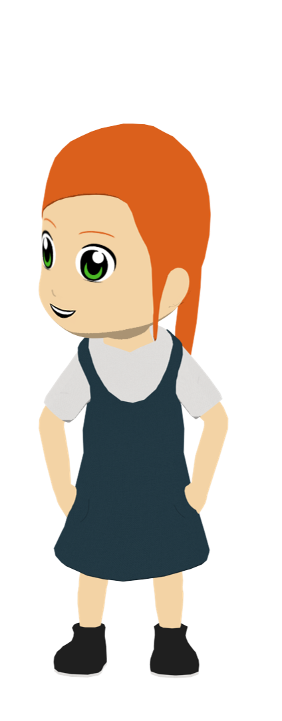
Lucía describe un libro
Lee el inglés. Escribe en español.
escribir
1 | There’s a boy. He’s in Madrid.
 | Hay ___________. ________ en Madrid.
2 | There’s a table. It’s white.
 | Hay ___________________. __________.
3 | There’s a door. It’s there.
 | Hay _____________. __________.
4 | There’s a window. It’s here.
 | Hay ________________. ____________.
5 | There’s a female teacher. She’s serious (trait).
 | Hay ___________________. __________.
6 | There’s a female head teacher. She’s nice (trait)
 | Hay ___________________. _______________.
un chico
Está
una mesa
Es blanca.
una puerta
Está allí
una ventana
Está aquí
una profesora
Es seria.
una directora
Es simpática.
Notes:
Timing: 10 minutes
Aim: to practise producing, in writing, the new vocabulary and revisited grammar (es, está)
Procedure:
Students translate the 6 English sentences into Spanish.
Note:
1. The target sentences are from the previous activity, but appear in jumbled order (the order of es, está isn’t the same as students have just heard). This means they will have to think about whether to use es/está in their translations. 2. For students who require more support, provide all of the Spanish except ‘es’ / ‘está’ to reduce the cognitive load.

Slide 28
Deberes
Vocabulary Learning Homework (Y7, Term 1.2, Week 4)
Audio file
Student worksheet
In addition, revisit: Term 1.2 Week 1 Term 1.1 Week 3
Notes:
Use this slide to set the homework.
For Y7, the typical homework will be to pre-learn vocabulary for the next lesson. There is an audio file to accompany the student worksheet.
Notes:
i) Teachers may, in addition, want to recommend use of a particular online app for the pre-learning of each week’s words. ii) Quizlet now requires parental involvement / registration / permissions for users below the age of 13, so it is perhaps most suitable for Y9 – 11 students. iii) Language Nut hosts LDP vocabulary lists and these are free for schools to use, though there is a registration process. One benefit is that all of the student tracking data that Language Nut offers are also available to schools that use the LDP lists for practice. Perhaps this makes it a good option for Y7/8.
iv) There are other free apps, and new ones are always appearing. Teachers have told us that they are currently using: Flippity, Wordwall (where using previously-created activities is free).
v) Gaming Grammar has been acquired by Language Nut. Its original content should still be available to teachers and much of it is appropriate for Y7 learners.

Slide 29
Vocabulario
 | Español | Inglés
1 | hay | there is, there are
2 | una mesa | table
3 | una silla | chair
4 | una ventana | window
5 | una puerta | door
6 | una chica | girl
7 | un chico | boy
8 | aquí | here
9 | allí | there
10 | una persona | person
11 | una clase | class
12 | mirar | to look, to look at
60
Segundos
0
INICIO
Notes:
Vocabulario
Timing: 1-4 minutes Aim: To reactivate and strengthen vocabulary knowledge.
Procedure: Round 1: Look at the Spanish, recall the English meanings, saying them aloud. [1 minute] Round 2: Look at the English, recall the Spanish meanings, saying them aloud. [1 minute] Repeat for two further minutes, to speed up recall.
Transcript:
Word frequency (1 is the most frequent word in Spanish): hay [13]; mesa [525]; silla [1271]; ventana [752]; puerta [274]; chica [1129]; persona [108]; chico [727]; aquí [130]; allí [197]; clase [320]; mirar; el señor²/la señora²
Source: Davies, M. & Davies, K. (2018). A frequency dictionary of Spanish: Core vocabulary for learners (2nd ed.). Routledge: London

