Slide 1
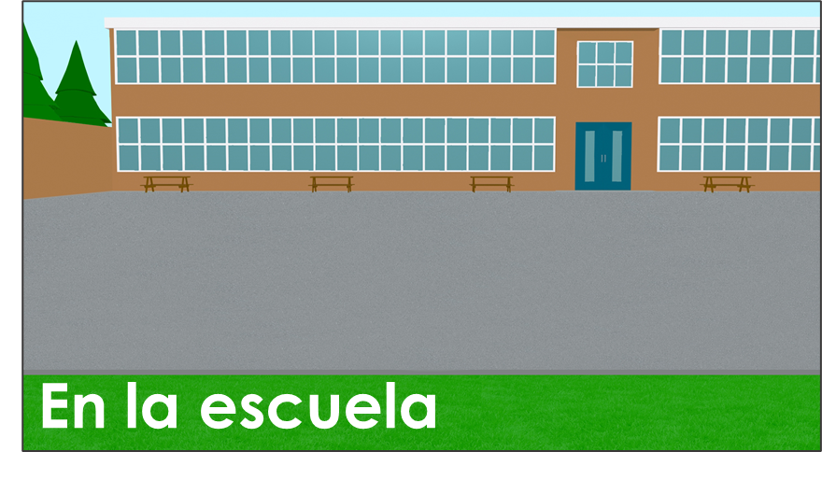
Talking about more than one thing
Plural nouns with –es Plural nouns with –s (revisited)
SSC [que]
Y7 Spanish Term 1.2 – Week 2 – Lesson 17 Nick Avery / Rachel Hawkes Artwork: Mark Davies Date updated: 31.07.23
Notes:
Note: all words (new and revisited) in this week of the SOW appear on all three GCSE wordlists, with the following exceptions:
i) AQA list does not have Inglaterra.
ii) Edexcel list does not have autor. (This is a cognate that could be used in reading assessments). iii) Eduqas list does not have flor.
Learning outcomes:
Introduction of SSC [que]
Introduction of plural nouns with -es
Consolidation of plural nouns with –s
Consolidation of TENER
Word frequency (1 is the most frequent word in Spanish):
7.1.2.2 (introduce) uno [425]; dos [64]; tres [134]; cuatro [241]; cinco [284]; seis [438]; siete [603]; ocho [641]; nueve [991]; diez [449]; once [1700]; doce [1138]; color [358]; plan [625]; flor [739]; autor/a [513]; profesor/a [501]; director/a [592]; número [324]
7.1.1.6 (revisit) ¿quién? [289]; hablar [90]; comprar [361]; bailar [1323]; llegar [75]; escuchar [281]; amiga [1172]; música [340]; tarde¹ [392]; temprano [1578]; importante [171]; bien [78]; con [14]; otra vez [59-vez]; pareja¹ [892]
7.1.1.1 (revisit) estar [21]; estoy; estás; está; norte [624]; sur [661]; Inglaterra [N/A]; España [N/A]; ¿dónde? [161] en [5]; hola [1245]; hasta luego [luego-150]
Source: Davies, M. & Davies, K. (2018). A frequency dictionary of Spanish: Core vocabulary for learners (2nd ed.). Routledge: London

Slide 2
En pareja
hablar
Practica el diálogo con una pareja.
1 | Hello!
2 | ¿Quién [are you – trait.]?
3 | ¿Cómo [are you – trait.]?
4 | ¿Cómo [are you – state.]?
5 | ¿Cómo [is – trait.] tu amiga?
6 | ¿Qué [do you have] en tu mochila?
7 | ¿Dónde [is – location] Zaragoza?
8 | Bye!
1 | Hello!
2 | I am ________.
3 | I am ________.
4 | Today I am ______________.
5 | My friend is _____________.
6 | In my school bag I have _______.
7 | Zaragoza is (location) in _______.
8 | Bye!
¡otra vez!
Notes:
Timing: 5 minutes
Aim: to practise oral recall of these key verbs in questions and verbs and vocabulary in the responses.
Procedure:
Students practise the dialogue in pairs, supplying the verb forms and vocabulary from memory. They then swap roles so each has a turn asking the questions.
Note: this dialogue revisits 8 of the words from this week’s revisited vocabulary, including ‘otra vez’ ‘con’ and ‘pareja’. Ensure students engage with the meaning of all these words.

Slide 3
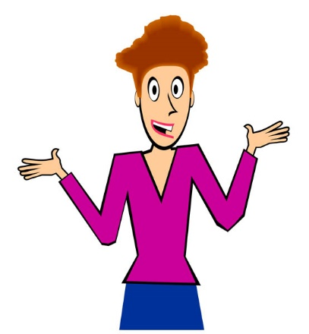
que
porque
Notes:
Timing: 3 minutes (five slides)
Aim: To introduce SSC [que] and source word ‘porque’.
Procedure:
Introduce and elicit the pronunciation of the individual SSC and then the source word (with gesture, if using).
Note: A possible gesture for this source word would be to rotate your index fingers in a clockwise direction, akin to miming a wheel in forward motion.
Whilst abstract, this is a gesture often used in the classroom to encourage learners to justify their opinions with reasons. NB: The English meaning ‘because’ should be clearly given to ensure secure word-meaning mapping.
Word frequency (1 is the most frequent word in Spanish): zona [359]
Source: Davies, M. & Davies, K. (2018). A frequency dictionary of Spanish: Core vocabulary for learners (2nd ed.). Routledge: London

Slide 4
que
porque
Notes:
Repeat the sound and elicit the source word.

Slide 5
que
parque
pequeño
porque
¿qué?
querer
[because]
[to want]
quedar
[to meet up; stay; suit]
Notes:
Procedure:
1. Introduce and elicit the pronunciation of the individual SSC ‘que’ and then the source word again (with gesture, if using). 2. Then present and elicit the pronunciation of the five cluster words.
The cluster words have been chosen for their high-frequency, from a range of word classes, with the SSC (where possible) positioned within a variety of syllables within the words (e.g. initial, 2nd, final etc.). Additionally, we have tried to use words that build cumulatively on previously taught SSCs (see the Phonics Teaching Sequence document) and do not include new SSCs. Where new SSCs are used, they are often consonants which have a similar symbol-sound correspondence in English.
Word frequency (1 is the most frequent word in Spanish):
porque [40] parque [1354] pequeño [202] qué [50] quedar [100] querer [58]
Source: Davies, M. & Davies, K. (2018). A frequency dictionary of Spanish: Core vocabulary for learners (2nd ed.). Routledge: London

Slide 6
que
parque
pequeño
porque
¿qué?
querer
quedar
Notes:
Without the images, students focus this time again closely on the SSC and the cluster words.

Slide 7
que
parque
pequeño
porque
¿qué?
querer
quedar
Notes:
Without the images or sound, students have to pronounce the words themselves.

Slide 8
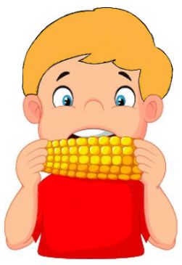
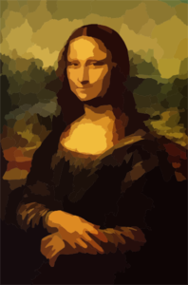
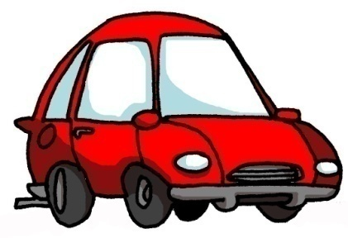
QUE|CO |CU
escuchar / escribir
C
D
[to want]
A
B
es cu char
querer
comer
pequeño
E
F
G
[with]
H
con
cultura
coche
parque
Notes:
Timing: 5 minutes
Aim: to recall the missing the SSCs (and to successfully map their sound to spelling)
Procedure:
1. Teachers ask students to write A-I the missing SSC (obscured by scribble) for each word.
2. Teachers click on the pictures to play the word.
3. Click to reveal the answers in order.

Slide 9
Cómo se dice en español?
leer
two
six
plan
flower
three
dos
seis
el plan
la flor
tres
five
colour
four
male author
one
cinco
el color
cuatro
uno
el autor
male teacher
el autor | cinco | uno | el color | seis | el profesor
cuatro | el plan | tres | dos | la flor
el profesor
Notes:
Timing: 3 minutes
Aim: to practise recognising the meanings of the new Spanish words.
Procedure:
1. Click to bring up the English word.
2. Students choose the correct Spanish word from those in the grid.
3. Teachers may wish to remove the option grid to challenge a higher-achieving group, on a repeat of the activity.
Note: we anticipate that students will have done pre-learning, and that this week’s words are short, several are cognates, and students may already know numbers from primary. However, if students need more vocabulary practice at this stage, teachers could you the additional slide from the end of this slide deck.

Slide 10
Talking about more than one thing: Plural nouns with -es
Many Spanish nouns end in a vowel (like ‘o’ and ‘a’)
To talk about these in the plural (more than one), add –s to the end of the noun.
Tengo plantas.
→ I have plants.
If the noun ends in a consonant (like ‘n’ or ‘r’), add –es to the end.
For example:
Tengo planes.
→ I have plans.
Tengo flores.
→ I have flowers.
Notes:
Timing: 2 minutes
Aim: to introduce the 2nd plural rule for Spanish nouns.
Procedure: 1. Click to present the information.
2. Elicit the English meanings for the Spanish examples.
Note:
1. Students following the SoW should be familiar with the first half of the explanation. After ‘tengo plantas’, the teacher can elicit more examples of nouns that pluralise by adding –s to the singular form (e.g. bicicleta, teléfono, cámara, cama, casa, pregunta).
2. For now, we simply treat ‘autores’ and ‘profesores’ in their plural form as masculine (i.e. male teachers, male authors). In lesson 2, we will introduce rules regarding the biological gender marking on plural nouns.

Slide 11
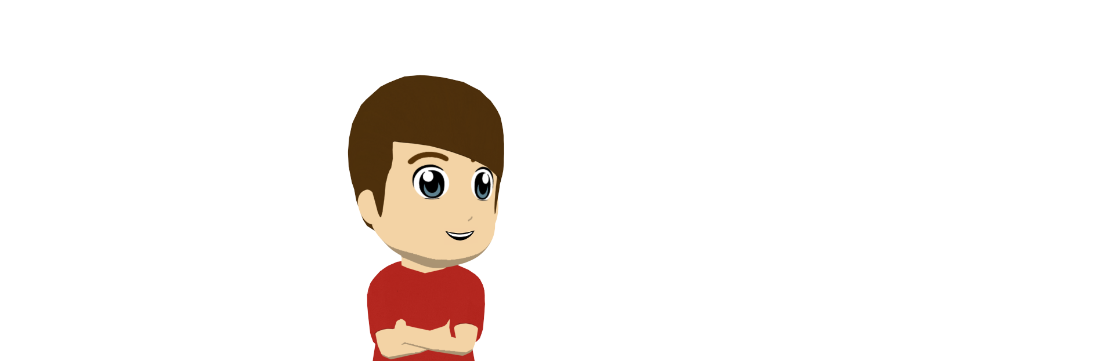
Daniel describe a Hugo
Lee el español. ¿Qué palabra es?
leer
Marca la letra correcta (A o B).
A | B
1
amigo
autor
1. Hugo estudia con seis
s.
2
profesor
amiga
2. Habla con con cinco
es.
3
cama
color
3. Compra un barco de tres
es.
4
camisa
flor
4. No lleva
es.
5
directores
parejas
5. La clase necesita dos s.
‘Señor’ means ‘Mr.’.
It can also mean ‘Sir’ and ‘man’.
6
señor
gatos
6. Llega con cuatro
s.
Notes:
Timing: 8 minutes
Aim: to practise distinguishing between nouns that pluralise with –s and -es
Procedure:
1. Students write 1-6.
2. They read each sentence and decide what the missing noun must be (see right hand side).
3. They write ‘A’ or ‘B’.
4. Teacher checks answers, eliciting the meanings of the sentences.

Slide 12
Cosas en la escuela
Escucha. Marca la opción correcta.
escuchar / escribir
Escucha otra vez. Escribe las palabras.
noun ends in -s | noun ends in -es
1
1.tres tareas
2
2. seis profesores
3
3. cinco cosas
4
4. dos colores
5
5. cuatro planes
6
6. unos periódicos
Notes:
Timing: 8 minutes Aim: to practise ‘listening out’ for noun endings and to practise writing the new words (transcription)
Procedure:
1. Play the audio. Decide if the noun ends in –s or –es (this is a simple ‘listening out’ for the form).
2. Students listen again and write what they hear (transcribing both the number and plural noun).
Note: Higher-achieving groups may be able to complete both parts as they listen.
Transcript:
1.tres tareas
2. seis profesores
3. cinco cosas
4. dos colores
5. cuatro planes
6. unos periódicos

Slide 13
Student A – I have…
Student B – I have…
Tengo seis revistas.
Tengo cinco revistas.
more… | me | my partner
magazines
Notes:
Timing: 10 minutes Aim: to practise producing and understanding numbers 2-6 and a variety of plural nouns. Procedure: 1. Model the task using this slide.
2. Click to model A’s sentence.
3. Click to model B’s sentence.
4. Model how A would fill in a table with the item in English and who has more. (B would also do this, but would tick ‘my partner’ for this item.
5. Move to the next slide for the first round of 5 x items. A following slide has a 2nd round. Note: in response to teacher feedback we have tried to make all the speaking activities possible without handouts. In this case, we have had to compromise. Students will be able to see their partner’s items as well as their own, if they choose to look. If they do, it takes away the need to listen to understand. We suggest students sit back to back and just glance right (As) or left (Bs) at the board and just look for their item in response to what their partner says, meaning they will listen to understand. If this is not going to work well for your class, there is a version of the task, with handouts, on slides at the end of this slide deck.

Slide 14
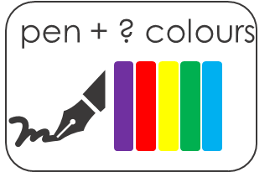
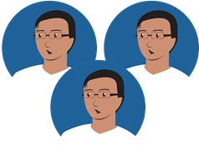
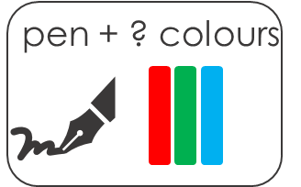
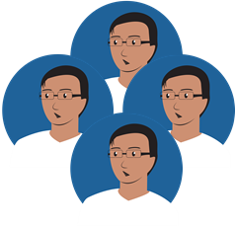
Student A – I have…
Student B – I have…
teachers
teachers
Notes:
ROUND 1: DISPLAY DURING THE SPEAKING ACTIVITY Procedure: 1. Ensure students sit back to back but so that each can glance at the board. 2. Give students 4 minutes to complete Round 1.

Slide 15
Student A – I have…
Student B – I have…
head teachers
head teachers
Notes:
ROUND 2: DISPLAY DURING THE SPEAKING ACTIVITY

Slide 16
Talking about more than one thing [2]
Gender of plural nouns Plural nouns with –es (cont’d.)
Y7 Spanish Term 1.2 – Week 2 – Lesson 18 Nick Avery / Rachel Hawkes Artwork: Mark Davies Date updated: 31.07.23
Notes:
Learning outcomes: Consolidation of plural nouns with –s and -es
Consolidation of TENER
Word frequency (1 is the most frequent word in French):
7.1.2.2 (introduce) uno [425]; dos [64]; tres [134]; cuatro [241]; cinco [284]; seis [438]; siete [603]; ocho [641]; nueve [991]; diez [449]; once [1700]; doce [1138]; color [358]; plan [625]; flor [739]; autor/a [513]; profesor/a [501]; director/a [592]; número [324]
7.1.1.6 (revisit) ¿quién? [289]; hablar [90]; comprar [361]; bailar [1323]; llegar [75]; escuchar [281]; amiga [1172]; música [340]; tarde¹ [392]; temprano [1578]; importante [171]; bien [78]; con [14]; otra vez [59-vez]; pareja¹ [892]
7.1.1.1 (revisit) estar [21]; estoy; estás; está; norte [624]; sur [661]; Inglaterra [N/A]; España [N/A]; ¿dónde? [161] en [5]; hola [1245]; hasta luego [luego-150]
Source: Davies, M. & Davies, K. (2018). A frequency dictionary of Spanish: Core vocabulary for learners (2nd ed.). Routledge: London

Slide 17
Vocabulario 1/10
uno
cuatro
la flor
el plan
tres
el profesor
cinco
el autor
el color
seis
dos
Notes:
Timing: 5 minutes (10 slides)
Aim: to identify the Spanish word with the same meaning as the English in the centre; to practise accurate read aloud of this week’s new vocabulary. Procedure: 1. Click to bring up the English prompt.
2. Elicit the Spanish word chorally from the class.
3. Click to confirm.
4. Repeat for items 2-10 on the next slides.

Slide 18
Vocabulario 2/10
uno
cuatro
la flor
el plan
tres
el profesor
cinco
el autor
el color
seis
dos

Slide 19
Vocabulario 3/10
uno
cuatro
la flor
el plan
tres
el profesor
cinco
el autor
el color
seis
dos

Slide 20
Vocabulario 4/10
uno
cuatro
la flor
el plan
tres
el profesor
cinco
el autor
el color
seis
dos

Slide 21
Vocabulario 5/10
uno
cuatro
la flor
el plan
tres
el profesor
cinco
el autor
el color
seis
dos

Slide 22
Vocabulario 6/10
uno
cuatro
la flor
el plan
tres
el profesor
cinco
el autor
el color
seis
dos

Slide 23
Vocabulario 7/10
uno
cuatro
la flor
el plan
tres
el profesor
cinco
el autor
el color
seis
dos

Slide 24
Vocabulario 8/10
uno
la flor
el plan
cuatro
tres
el profesor
cinco
el autor
el color
seis
dos

Slide 25
Vocabulario 9/10
uno
cuatro
la flor
el plan
tres
el profesor
cinco
el autor
el color
seis
dos

Slide 26
Vocabulario 10/10
uno
cuatro
la flor
el plan
tres
el profesor
cinco
el autor
el color
seis
dos

Slide 27
Vocabulario
hablar
 | Español | Inglés
1 | siete | seven
2 | ocho | eight
3 | nueve | nine
4 | diez | ten
5 | once | eleven
6 | doce | twelve
7 | una autora | female author
8 | una profesora | female teacher
9 | un director | male director, headteacher
10 | una directora | female director, headteacher
60
Segundos
0
INICIO
Notes:
Timing: 1-4 minutes Aim: To reactivate and strengthen vocabulary knowledge.
Procedure: Round 1: Look at the Spanish, recall the English meanings, saying them aloud. [1 minute] Round 2: Look at the English, recall the Spanish meanings, saying them aloud. [1 minute] Repeat for two further minutes, to speed up recall.
Note: the introduction of new vocabulary this week is staggered over the two lessons.
Word frequency (1 is the most frequent word in Spanish): siete [603]; ocho [641]; nueve [991]; diez [449]; once [1700]; doce [1138]; la autora [513]; la profesora [501]; el director [592]; la directora [592]
Source: Davies, M. & Davies, K. (2018). A frequency dictionary of Spanish: Core vocabulary for learners (2nd ed.). Routledge: London

Slide 28
Talking about more than one thing: Gender and plural nouns
To talk about male and female people together, Spanish often uses the masculine form of the noun.
In English, we don’t always make this clear either!
We often refer to ‘friends’ without saying if they are boys or girls.
“Tengo tres amigos.” can mean:
I have 3 (male) friends.
OR
I have 3 (male and female) friends.
To refer to two or more females, use the feminine form in the plural.
“Tengo tres amigas.”
I have 3 (female) friends.
Notes:
Timing: 2 minutes
Aim: to explain to students how to refer to mixed gender groups in Spanish.
Procedure: Click to present the new information.
Note: Students will later also learn that
some nouns don’t pluralise in the two ways they have learnt so far (e.g. actriz -> actrices)
some nouns don’t have different forms for masculine and feminine (asistente, estudiante, ayudante, cantante etc.)

Slide 29
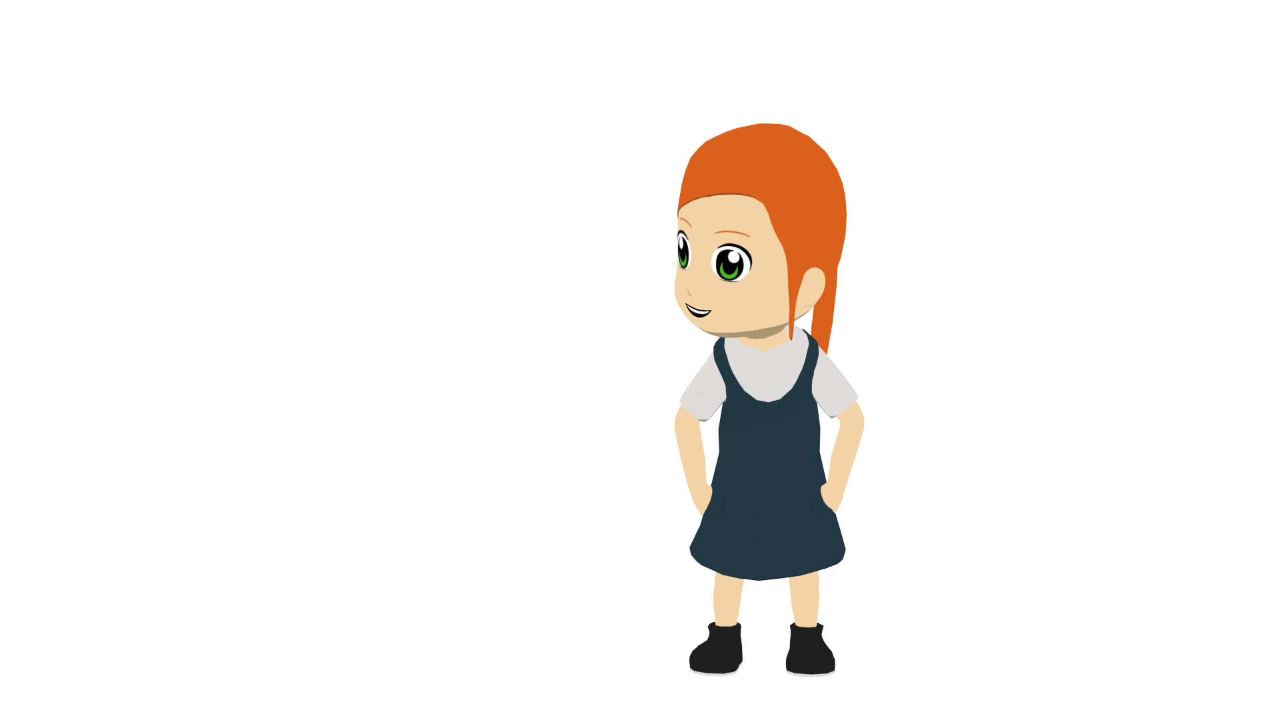
Lucía describe la escuela
Lee el texto. Marca la opción correcta.
leer
Estudio en una escuela. Está en León, España y ¡es enorme! Tiene dos directoras y once profesores de español también. La clase de español es excelente, pero no estudio mucho porque tengo doce amigas y ¡hablo mucho en clase!
Hoy tengo historia. Estudio con seis amigos de Inglaterra. Es importante llevar un libro a clase, pero no es un libro pequeño - ¡tiene nueve autores!
 | Female | Male / male & female
headteachers
Spanish teachers
friends in Spanish class
friends in history class
authors of history book
How many?
1
2
2
11
3
12
4
6
5
9
pequeño - small
Notes:
Timing: 10 minutes
Aim: to begin to read Spanish beyond the sentence level; to practise working out the biological gender of plural nouns
Procedure:
1. Students write 1-5.
2. Students read the text and decide on the biological gender of the nouns.
3. They look again and decide how many of each noun there are.
4. Teachers check answers. 5. Teacher then asks students to identify cognates in the text (words they have not yet been taught formally, but recognise because of their similarity to English words with the same meaning) – click to highlight these after eliciting suggestions from students.
6. Finally click to highlight porque – it was introduced last lesson as a phonics source word. Ensure students recognize the meaning. And pequeño – also a phonics word this week – it is glossed on the slide, but worth highlighting it with students as it is such a high frequency word and will be taught in two weeks’ time.
Notes:
This text, or part of it, could also be used for dictation.
Frequency of unknown words and cognates (1 is the most frequent word in Spanish):
clase [320] enorme [631] escuela [424] historia [186] pequeño [202] porque [40]
Source: Davies, M. & Davies, K. (2018). A frequency dictionary of Spanish: Core vocabulary for learners (2nd ed.). Routledge: London

Slide 30
escuchar
Escucha. Marca la opción correcta.
Escucha otra vez. Escribe el número.
Female only | Male only / male & female
How many?
2
3
10
1
8
12
10
3
9
11
2
8
7
3
4
9
5
2
6
7
7
12
8
11
Notes:
Timing: 8 minutes
Aim: to practise understanding biological gender of plural nouns; to practise understanding numbers in the oral modality
Procedure:
1. Students write 1-8.
2. Students listen. For each item, they note if it’s ‘female only’ or ‘male only / male & female’
3. Students listen again. This time, they note the number.
Note: Remove the box with the number options if your class does not need this additional support.
Transcript:
tres profesoras
once autores
ocho directores
siete amigas
dos amigos
nueve directoras
doce autoras
diez profesores

Slide 31
Poema: una persona extraordinaria
Escucha. Escribe la letra correcta.
escuchar
A
Llega con tres directores.
Compra libros de doce autores.
Estudia inglés con nueve profesores.
Pero, ¡no es todo!
Lleva una camisa de ocho colores.
Compra un bouquet de siete flores.
Y habla con seis actores.
1
D
B
G
2
C
3
A
4
B
D
5
F
E
6
C
F
7
E
Full poem
G
todo – all, everything | de – of (by)
Notes:
Timing: 8 minutes
Aim: to identify the line of the poem heard in the audio; to understand the meaning of each line
Procedure:
1. Students first listen and decide which sentence of the poem they hear (these are in jumbled order).
2. The teacher then clicks on ‘full poem’ to hear it in order (answers can be checked).
3. Then, line by line, ask students for a translation of the poem. Draw students’ attention to the word ‘de’ in sentences B, E, F. They will learn this very high frequency word in 7.1.2.6 in a few weeks’ time. In sentence B we would translate ‘de’ as ‘by’, in E and F we could say ‘of’.
Note.
1. The vocabulary has been previously been taught, except for ‘todo’. This will be introduced in Y7 Term 3.2. Students won’t be expected to produce it on their own here (see next slide).
2. The noun ‘actor’ wasn’t used for preceding grammar-focused activities, but was chosen here as it is frequent [1533] and also a cognate. Bouquet is also a cognate / loan word that is common in English.
Frequency of unknown words and cognates (1 is the most frequent word in Spanish):
actor [320] bouquet [>5000]
Source: Davies, M. & Davies, K. (2018). A frequency dictionary of Spanish: Core vocabulary for learners (2nd ed.). Routledge: London
Photos by Shubham Bochiwal & Uljana Maljutina on Unsplash

Slide 32
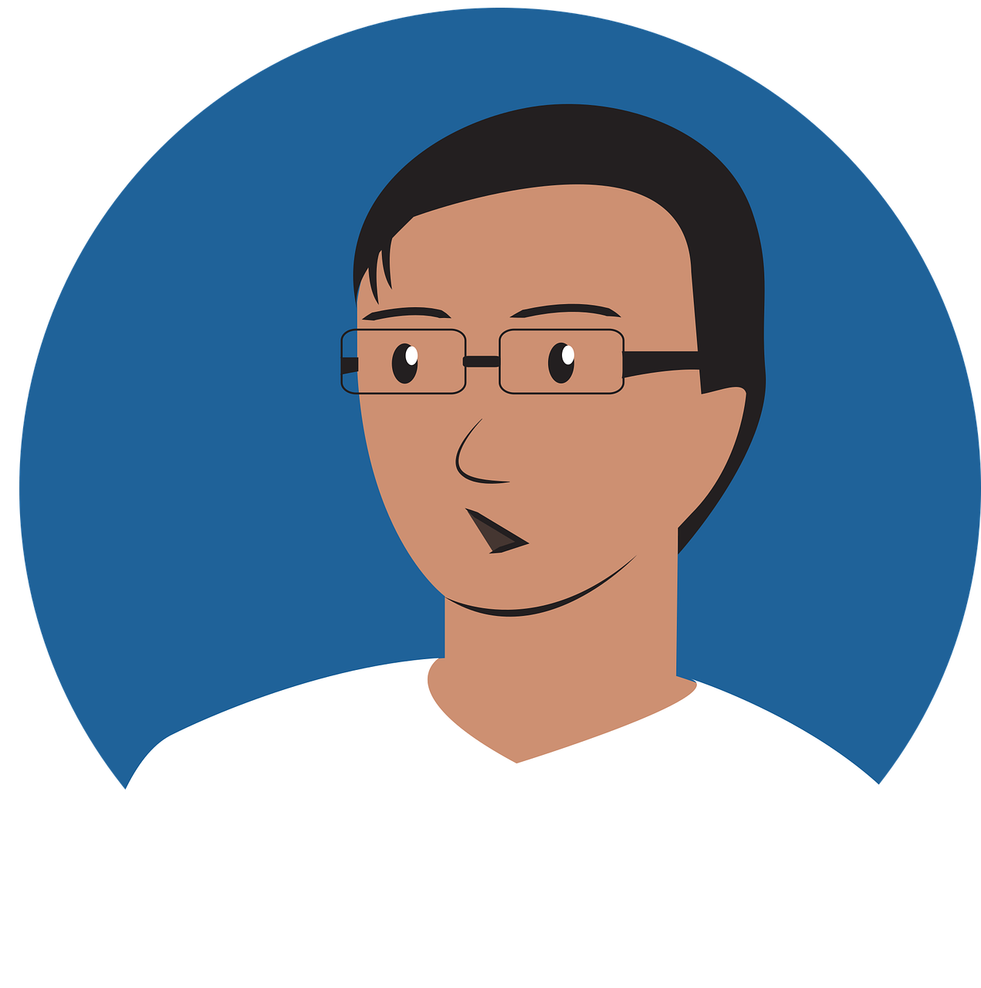
Escribe un poema
hablar
Write 5-7 lines. Use the ideas below in any order or combination, or add your own ideas.
arrives with…
authors
buys books by…
studies English with…
speaks with…
wears a shirt of…
buys a bouquet of…
…
But that’s not all*!
*all = todo
Notes:
Timing: 10 minutes
Aim: to practise written production of this week’s language and previously taught verbs.; to allow scope for personalisation in a more open-ended written task. Procedure: 1. Explain the task.
2. Students create their poem. Make reference resources materials available to students who are keen to personalise their writing.

Slide 33
Deberes
Vocabulary Learning Homework (Y7, Term 1.2, Week 3)
Audio file
Student worksheet
In addition, revisit: Term 1.1 Week 7
Term 1.1 Week 2
Notes:
Use this slide to set the homework.
For Y7, the typical homework will be to pre-learn vocabulary for the next lesson. There is an audio file to accompany the student worksheet.
Notes:
i) Teachers may, in addition, want to recommend use of a particular online app for the pre-learning of each week’s words. ii) Quizlet now requires parental involvement / registration / permissions for users below the age of 13, so it is perhaps most suitable for Y9 – 11 students. iii) Language Nut hosts LDP vocabulary lists and these are free for schools to use, though there is a registration process. One benefit is that all of the student tracking data that Language Nut offers are also available to schools that use the LDP lists for practice. Perhaps this makes it a good option for Y7/8.
iv) There are other free apps, and new ones are always appearing. Teachers have told us that they are currently using: Flippity, Wordwall (where using previously-created activities is free).
v) Gaming Grammar has been acquired by Language Nut. Its original content should still be available to teachers and much of it is appropriate for Y7 learners.

Slide 34
Vocabulario
leer / hablar
 | Español | Inglés
1 | uno | one
2 | dos | two
3 | tres | three
4 | cuatro | four
5 | cinco | five
6 | seis | six
7 | un color | colour
8 | un plan | plan
9 | una flor | flower
10 | un autor | male author
11 | un profesor | male teacher
60
Segundos
0
INICIO
Notes:
ADDITIONAL OPTIONAL VOCABULARY SLIDE FOR LESSON 1
Timing: 1-4 minutes Aim: To reactivate and strengthen vocabulary knowledge. Procedure: Round 1: Look at the Spanish, recall the English meanings, saying them aloud. [1 minute] Round 2: Look at the English, recall the Spanish meanings, saying them aloud. [1 minute] Repeat for two further minutes, to speed up recall.
Note: the introduction of new vocabulary this week is staggered over the two lessons. This includes feminine forms of nouns (profesora, autora).
Word frequency (1 is the most frequent word in Spanish): uno [425]; dos [64]; tres [134]; cuatro [241]; cinco [284]; seis [438]; color [358]; plan [625[; flor [739]; autor [513]; profesor [501]
Source: Davies, M. & Davies, K. (2018). A frequency dictionary of Spanish: Core vocabulary for learners (2nd ed.). Routledge: London

Slide 35
Using your prompt cards, take turns to tell your partner how many of each thing you have.
escuchar / hablar
Tengo tres bolsas.
Persona A
Tengo dos bolsas.
Persona B
Complete your response grid after each exchange.
Me
My partner
Example (Persona A):
Who has more bags?
Notes:
ALTERNATIVE VERSION OF LESSON 1 SPEAKING
Instruction slide
Note:
Teachers can use this to model the interaction in the activity
Note that the final two prompt cards elicits ‘tiene’ (e.g. Tengo un libro. Tiene cuatro autores). It may be useful to tell students that they will use this previously taught verb in the task, in addition to ‘tengo’.

Slide 36
Student A – I have…
Student B – I have…
four tasks.
two (male) teachers.
three shirts.
five plans today.
six flowers.
four newspapers in Spanish.
a book – it has two (male) authors.
a pen – it has five colours.
three tasks.
four (male) teachers.
two shirts.
six plans today.
three flowers.
five newspapers in Spanish.
a book – it has six (male) authors.
a pen – it has two colours.
Notes:
DO NOT DISPLAY THIS SLIDE A printer-friendly version of these prompt cards is available in Word format.

Slide 37
ANSWERS
Student A
Student B
Who… | me | my partner
me | my partner
has more tasks?
has more (male) teachers?
has more shirts?
has more plans today?
has more flowers?
has more newspapers in Spanish?
has the book with more authors?
has the pen with more colours?
Notes:
ANSWERS

