Slide 1
Saying what people do & don't do
negative 'no'
present tense -ar verbs [revisited]
SSC [z]
En la escuela
Y7 Spanish Term 1.2 – Week 1 – Lesson 15 Nick Avery Artwork: Mark Davies Date updated: 30.07.23
Notes:
Note: all words (new and revisited) in this week of the SOW appear on all three GCSE wordlists.
Learning outcomes:
Introduction of SSC [z]
Introduction of negative 'no’
Consolidation of present tense -ar verbs: 1st person singular (-o), 2nd person singular (-as), 3rd person singular (-a)
Word frequency (1 is the most frequent word in Spanish):
7.1.2.1 (introduce) no [11]; caminar [514]; estudiar [281]; español¹ [262]; inglés¹ [583]; arte [208]; ciencia(s) [738]; señor¹ [201]; señora¹ [509]; mucho (as adverb only) [41]; pero [30]; verdadero [558]; o [29]; falso [1599]; entiendo [entender-229]; silencio [518]; grupo [200]; perdón [1729]
7.1.1.5 (revisit) amigo [210]; periódico [1026]; caballo [907]; teléfono [866]; planta [768]; botella [1878]; revista [920]; pregunta [507]; palabra [192]; tarea [995]; también [49]
Source: Davies, M. & Davies, K. (2018). A frequency dictionary of Spanish: Core vocabulary for learners (2nd ed.). Routledge: London

Slide 2
z
zona
Nick Avery
Notes:
Timing: 3 minutes (five slides)
Aim: To introduce SSC [z] and source word ‘zona’.
Procedure:
Introduce and elicit the pronunciation of the individual SSC and then the source word (with gesture, if using). A possible gesture for this source word would be to use your hands to draw an imaginary space around you.
Word frequency (1 is the most frequent word in Spanish): zona [359]
Source: Davies, M. & Davies, K. (2018). A frequency dictionary of Spanish: Core vocabulary for learners (2nd ed.). Routledge: London

Slide 3
z
zona
Nick Avery
Notes:
Repeat the sound and elicit the source word.

Slide 4
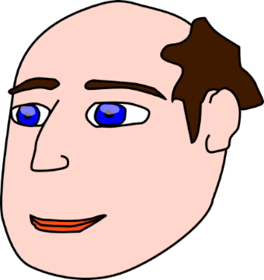
z
voz
diez
cabeza
zapato
zona
empezar
[to start]
Nick Avery
Notes:
Procedure:
1. Introduce and elicit the pronunciation of the individual SSC ‘z’ and then the source word again (with gesture, if using). 2. Then present and elicit the pronunciation of the five cluster words.
The cluster words have been chosen for their high-frequency, from a range of word classes, with the SSC (where possible) positioned within a variety of syllables within the words (e.g. initial, 2nd, final etc.). Additionally, we have tried to use words that build cumulatively on previously taught SSCs (see the Phonics Teaching Sequence document) and do not include new SSCs. Where new SSCs are used, they are often consonants which have a similar symbol-sound correspondence in English.
Word frequency (1 is the most frequent word in Spanish):
zona [359] cabeza [265] diez [449] empezar [175] voz [252] zapato [1477] Source: Davies, M. & Davies, K. (2018). A frequency dictionary of Spanish: Core vocabulary for learners (2nd ed.). Routledge: London

Slide 5
z
voz
diez
cabeza
zapato
zona
empezar
Nick Avery
Notes:
Without the images, students focus this time again closely on the SSC and the cluster words.

Slide 6
z
voz
diez
cabeza
zapato
zona
empezar
Nick Avery
Notes:
Without the images or sound, students have to pronounce the words themselves.

Slide 7
Fonética
There are different ways to pronounce ‘z’.
In most of Spain, ‘z’ is pronounced like the ‘th’ in English (as you just heard).
In the Canary Islands and Latin America, this ‘z’ is often pronounced like an ‘s’.
Compare:
zapato
(mainland Spain)
1
zapato
(Canaries & Latin America)
2
Notes:
Timing: 2 minutes
Aim: to introduce two ways in which [z] may be pronounced.
Procedure:
Click to present the information.
Click on the orange numbers to hear the word.
Notes:
Teachers may find it useful to consider the information from the new GCSE AO Spanish specifications below:
AQA: Passages in the Listening and Reading assessments will be set in the context of the target language countries and communities.
The test will be studio recorded using native speakers speaking in clearly articulated, standard speech.
Learn and apply the principles by which spelling represents sounds in standard or widely used forms of the language, and use clear and comprehensible pronunciation when speaking the language.
Edexcel: Students are assessed on their understanding of standard spoken Spanish by one or more speakers, across a range of formal and informal contexts, and in familiar and unfamiliar settings.
Students will need to: • apply the principles by which spelling represents sounds in standard or widely used forms of Spanish
Eduqas:

Slide 8
Fonética
Escribe 1-6.
escuchar / escribir
Escucha.
¿Dónde está la persona?
Escribe ‘España’ o ‘Latinoamérica / Canarias’.
1
España
2
Latinoamérica / Canarias
3
España
4
Latinoamérica / Canarias
5
Latinoamérica / Canarias
6
España
Notes:
Timing: 5 minutes
Aim: to practise recognising pronunciation of [z] and the geographical area in which it is typically used.
Procedure:
1. Students write 1-8.
2. Click on the orange box to play the audio.
3. Students listen and write down where they think it is more likely to be Sp or LA.
Transcript:
zona
voz
cabeza
diez
empezar
zapato
Image with creative commons public domain licence
https://mycsres.com/freesheet/spanish-speaking-world-map-18.html.html

Slide 9
Vocabulario
Escucha.
Escribe la letra correcta.
escuchar
R
There are two letters you don’t need.
K
L
M
1
English
much, a lot
science(s)
2
S
inglés
mucho
ciencia(s)
3
K
4
L
N
Ñ
O
P
5
T
Mrs.
also, too
to walk
but
P
señora
también
caminar
pero
6
7
O
Q
Q
R
S
T
8
to study
art
Mr.
Spanish
9
N
estudiar
arte
señor
español
Notes:
Timing: 5 minutes Aim: to reactivate and strengthen vocabulary knowledge of this week’s new vocabulary. Procedure:
1. Students listen to each Spanish word (in the order below) and write the letter of the box that has its English translation.
2. Click to do whole class feedback.
3. Ask students to tell you the Spanish for the two missing items, if they can. Click to reveal them.
Notes:
1. If the teacher is already confident that students know the alphabet well, and the class is higher achieving, the English and lettered boxes could be removed entirely, and the listening done ‘blind’ with students writing the English meanings of the words 1-10.
2. Variation (pair work): students take turns to say the letter corresponding to an English word (chosen randomly). The partner listens to the letter and has to give the translation in Spanish.
Transcript:
The answers are animated and appear in the order below.
1. arte – R
2. señor – S
3. inglés – K
4. mucho – L
5. español – T
6. pero – P
7. caminar – M;
8. estudiar – Q;
9. señora – N

Slide 10
Vocabulario
leer
A
B
C
D
E
F
G | H | I | J | K
señora | pero | estudiar | arte | ciencia(s)
falso | o | silencio | perdón | no
entiendo | caminar | español | mucho | tarea
señor | amigo | palabra | caballo | planta
grupo | inglés | revista | teléfono | también
pregunta | periódico | botella | y | verdadero
Notes:
Timing: 5 minutes Aim: to reactivate and strengthen vocabulary knowledge of this week’s new and revisited vocabulary. Procedure: 1. Teacher gives co-ordinates using Spanish alphabet letters. E.g., DJ – ¿qué palabra es?
2. Students respond by reading aloud the Spanish word and then giving the English meaning. E.g., caballo – horse. 3. The teacher can also develop depth of vocabulary knowledge by giving word prompts to trigger word associations.
For example, the teachers says ‘hablar’ and students volunteer any words that have an association with this verb (e.g., inglés, español, palabra, pregunta, teléfono).
Other words the teacher could give are: i) la escuela (estudiar, arte, ciencia(s), español, inglés, tarea, señora, señor, amigo, grupo, verdadero, falso) ii) persona (amigo, señora, señor) iii) leer (revista, periódico, palabra, estudiar) iv) animal (caballo) v) conjunciones (o, pero, y, también) vi) ciencias (caballo, planta, botella, grupo, pregunta) There are no 100% correct / incorrect answers here; it is a matter of students reflecting on the meaning of the words and the contexts in which they could be used.

Slide 11
Saying what I and others don’t do: Using the negative ‘no’
In Spanish, to say what you or others don’t do, put ‘no’ before the verb. This makes a negative.
Compare:
Entiendo el inglés.
No entiendo el inglés.
→ I understand English.
→ I don’t understand English.
This works for any verb and any person (e.g., I, you, s/he).
Notes:
Timing: 1 minute
Aim: to introduce negation in Spanish.
Procedure: 1. Click to the present the new information. 2. Elicit the English meanings of the Spanish examples.
Note: Negative ‘no’ will be practised with a range of previously introduced regular and irregular verbs.

Slide 12
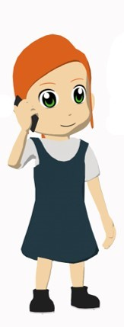
Lucía habla con una amiga
¿Qué tiene Lucía?
¿Qué no tiene?
leer
¡No! No tengo caballos, pero tengo un amigo. Es muy alegre.
En casa no tengo tareas. ¡Es perfecto!
En clase tengo preguntas. ¡No entiendo! No tengo un teléfono o una cámara.
Tengo un periódico, y tengo una revista de arte también. Tengo libros en español, pero no tengo libros en inglés.
Lucía tiene… (5 cosas)
un amigo
un periódico
una revista
preguntas en clase
libros en español
Lucía no tiene… (5 cosas)
caballos
un teléfono en clase
una cámara en clase
tareas en casa
libros en inglés
Notes:
Timing: 8 minutes Aim: to identify the presence/absence of negation and associate this with affirmative and negative meaning
Procedure:
1. Students first have to read and decide what Elena has and doesn’t have.
2. If time allows, elicit English translations of each full sentence, too.
Note: some of the vocabulary in this activity and the last is recycled from week 5 (pregunta, también, tarea, caballo, periódico, revista, teléfono), while some is new this week (español, inglés, arte, pero).

Slide 13
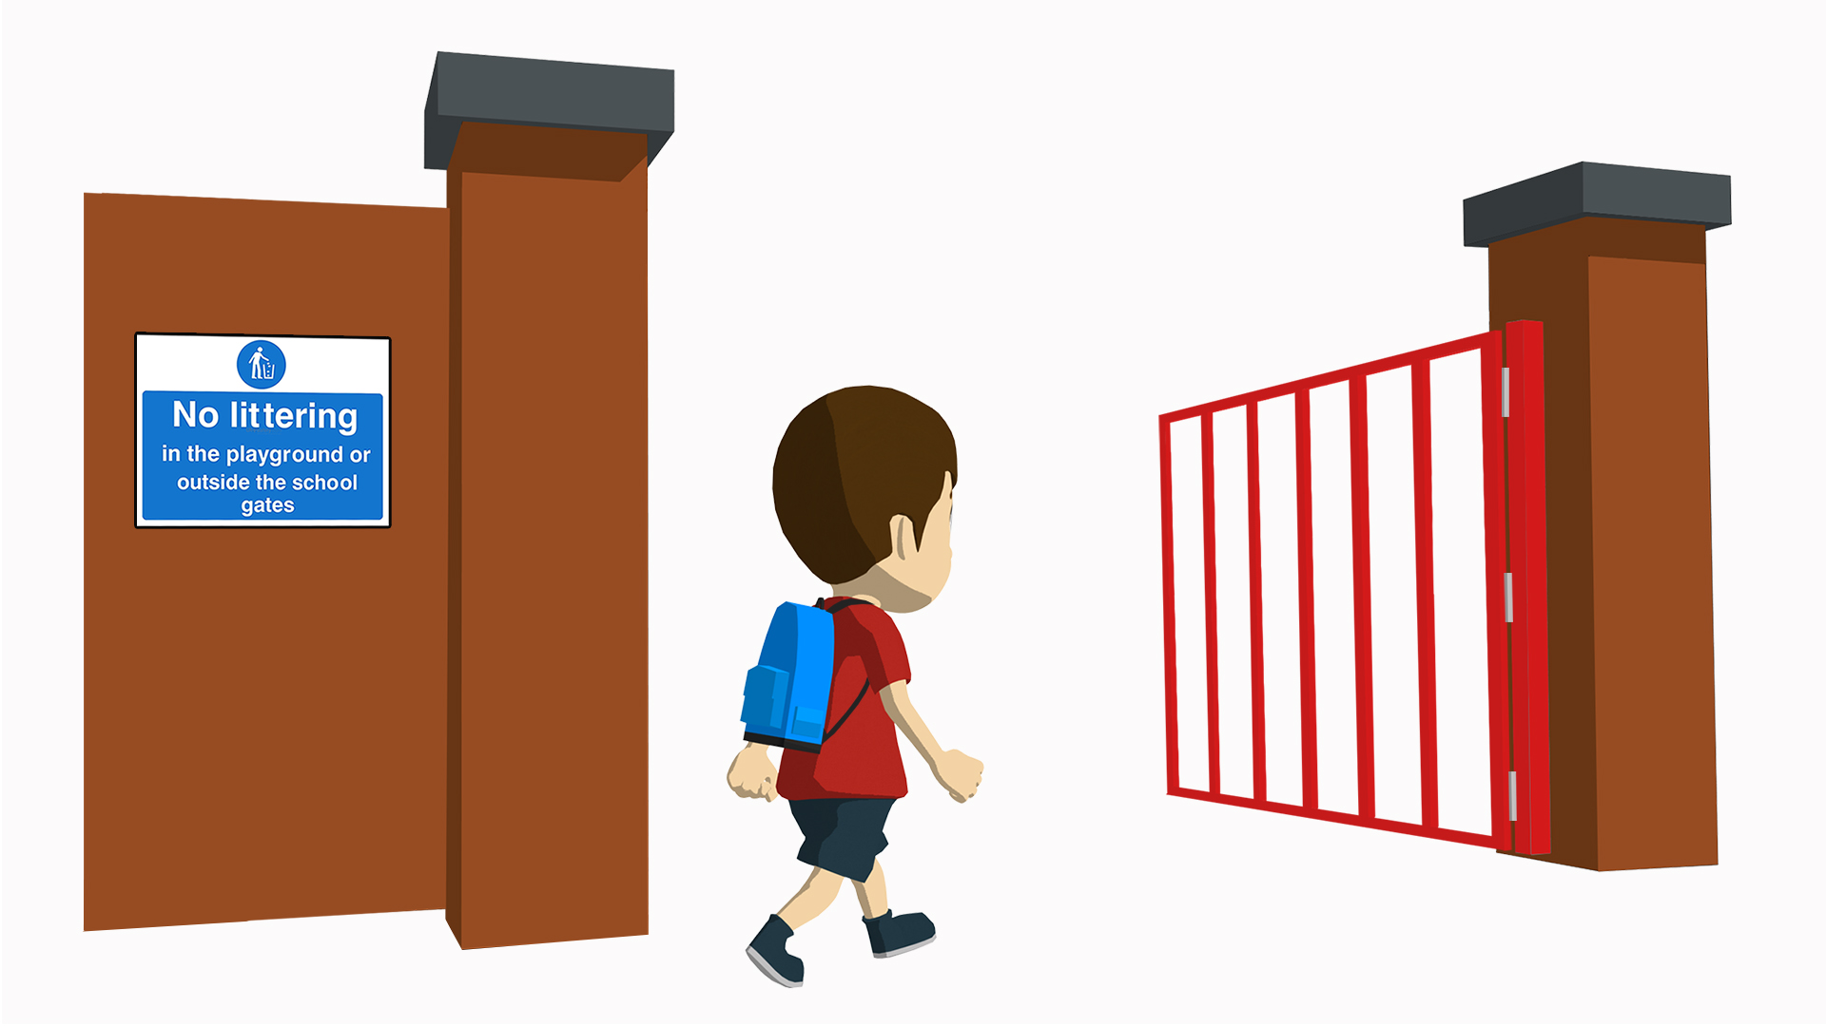
Lucía describe a Daniel
Escribe 1-6.
Escucha.
escuchar
Marca ‘afirmativo’ o ‘negativo’.
afirmativo | negativo
1
2
3
4
5
6
Notes:
Timing: 9 minutes (2 slides)
Aim: to practise listening for whether sentences are affirmative or negative
Procedure:
1. Students write 1-6.
2. They write ‘afirmativo’ (or +) or ‘negativo’ (or -) after listening to each sentence.
Transcript:
Estudia mucho en casa.
Habla español con Señor López.
No habla inglés.
Tiene preguntas en clase.
No escucha música.
No camina mucho.
Word frequency (1 is the most frequent word in Spanish): no [11]; caminar [514]; estudiar [281]; español¹ [262]; inglés¹ [583]; señor¹ [201]; mucho [41]; amigo [210]; [1878]; pregunta [507]; casa [106]; clase [320]; historia [186]; escuchar [281], música [340]
Source: Davies, M. & Davies, K. (2018). A frequency dictionary of Spanish: Core vocabulary for learners (2nd ed.). Routledge: London

Slide 14
escuchar
Escucha otra vez.
Marca ‘verdadero’ o ‘falso’.
 | verdadero | falso
1
He studies a lot at home.
2
He speaks Spanish with Mr. Lopez.
3
He doesn’t speak English.
4
He doesn’t have questions in class.
He listens to music.
5
6
He doesn’t walk much.
Notes:
[2/2]
Procedure:
Students listen again and decide if the statements are true or false
Elicit answers and provide feedback.
Transcript:
Estudia mucho en casa.
Habla español con Señor López.
No habla inglés.
Tiene preguntas en clase.
No escucha música.
No camina mucho.

Slide 15
Yes/no questions
In Spanish, change a statement into a question
by raising your voice at the end:
Statement
Llevas una mochila.
You carry a rucksack.
Question
¿Llevas una mochila?
Do you carry a rucksack?
Notes:
Timing: 1 minute
Aim: to remind students of yes-no question formation (from 1.1.3 of the SOW) before starting the next activity.
Procedure: 1. Click to present the information.
2. Elicit the English for the Spanish examples.
Note: la mochila is on the AQA new GCSE vocabulary list (though not Edexcel or Eduqas). It seems a useful word for students in Y7 to use, and some will have encountered it at primary.

Slide 16
Preguntas en español
escribir
Escribe en español.
¿ayuda? 🆘
estudiar | escuchar
hablar | caminar
llegar | llevar
Remember! There is no Spanish word for ‘do’ in questions. Just use the same verb form in questions and statements.
1. Do you study art?
4. Do you walk much?
¿Estudias arte?
¿Caminas mucho?
2. You don’t listen to music in class.
5. You don’t arrive late.
No escuchas música en clase.
No llegas tarde.
3. Do you speak with Mr. López?
6. You don’t carry a bag.
¿Hablas con Señor López?
No llevas una bolsa.
Notes:
Timing: 9 minutes Aim: to produce yes-no questions, and negative/affirmative statements in Spanish
Procedure:
Students read the English and write the Spanish.
Click the SOS if students need help remembering the infinitive verbs.
Elicit responses orally and click to check.

Slide 17
Saying what people do & don't do (cont.)
negative 'no'
present tense -ar verbs [revisited]
En la escuela
Y7 Spanish Term 1.2 – Week 1 – Lesson 16 Nick Avery Artwork: Mark Davies Date updated: 30.07.23
Notes:
Learning outcomes:
Consolidation of negative 'no’
Consolidation of present tense -ar verbs: 1st person singular (-o), 2nd person singular (-as), 3rd person singular (-a)
Word frequency (1 is the most frequent word in Spanish):
7.1.2.1 (introduce) no [11]; caminar [514]; estudiar [281]; español¹ [262]; inglés¹ [583]; arte [208]; ciencia(s) [738]; señor¹ [201]; señora¹ [509]; mucho (as adverb only) [41]; pero [30]; verdadero [558]; o [29]; falso [1599]; entiendo [entender-229]; silencio [518]; grupo [200]; perdón [1729]
7.1.1.5 (revisit) amigo [210]; periódico [1026]; caballo [907]; teléfono [866]; planta [768]; botella [1878]; revista [920]; pregunta [507]; palabra [192]; tarea [995]; también [49]
Source: Davies, M. & Davies, K. (2018). A frequency dictionary of Spanish: Core vocabulary for learners (2nd ed.). Routledge: London

Slide 18
Vocabulario
hablar
60
 | Español | Inglés
1 | caminar | to walk, walking
2 | estudiar | to study studying
3 | español | Spanish
4 | inglés | English
5 | arte | art
6 | historia | history
7 | señor | Mr.
8 | señora | Mrs.
9 | mucho | much, a lot
10 | pero | but
Segundos
0
INICIO
Notes:
Timing: 1-4 minutes Aim: To reactivate and strengthen vocabulary knowledge. Procedure: Round 1: Look at the Spanish, recall the English meanings, saying them aloud. [1 minute] Round 2: Look at the English, recall the Spanish meanings, saying them aloud. [1 minute] Repeat for two further minutes, to speed up recall.
Word frequency (1 is the most frequent word in Spanish): caminar [514]; estudiar [281]; español [262]; inglés [583]; arte [208]; historia [186]; señor [201]; señora [509]; mucho [41]; pero [30].
Source: Davies, M. & Davies, K. (2018). A frequency dictionary of Spanish: Core vocabulary for learners (2nd ed.). Routledge: London

Slide 19
Vocabulario
hablar
L
M
N
Ñ
O
P
Q | R | S | T | U
Mrs./Ms | but
false | or |  |  | no, not
I understand |  |  | a lot
Mr. | friend | word
group |  |  |  | also, too
 |  |  | and | true
Notes:
Timing: 5 minutes Aim: to reactivate and strengthen vocabulary knowledge of this week’s new and revisited vocabulary; to revisit letters of the alphabet Procedure: 1. Teacher gives co-ordinates using Spanish alphabet letters. E.g., NR – ¿qué palabra es?
2. Students respond by producing the Spanish word. E.g., caminar
If not done in the parallel activity last lesson, the teacher can also develop depth of vocabulary knowledge by giving word prompts to trigger word associations.
For example, the teachers says ‘hablar’ and students volunteer any words that have an association with this verb (e.g., inglés, español, palabra, pregunta, teléfono).
Other words the teacher could give are: i) la escuela (estudiar, arte, ciencia(s), español, inglés, tarea, señora, señor, amigo, grupo, verdadero, falso) ii) persona (amigo, señora, señor) iii) leer (revista, periódico, palabra, estudiar) iv) animal (caballo) v) conjunciones (o, pero, y, también) vi) ciencias (caballo, planta, botella, grupo, pregunta) There are no 100% correct / incorrect answers here; it is a matter of students reflecting on the meaning of the words and the contexts in which they could be used.

Slide 20
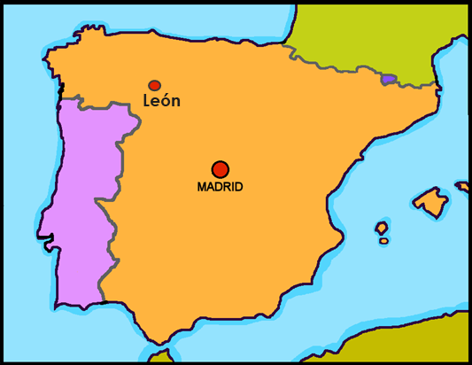
Un email de Lucía
leer
¡Hola, soy Lucía! Soy baja y alegre.
Hoy estoy en la escuela* en León, España.
Tengo una amiga, Nadia. Es muy tranquila pero hoy está nerviosa porque tiene un examen. En la escuela estudio español, inglés, arte y ciencias. Señora Jones es muy simpática pero ¡no entiendo bien el inglés! ¡Perdón! ☹
Llego a la escuela en bici y llego temprano a clase. Nadia camina con amigos a la escuela pero llega tarde. Estudia mucho pero no estudia en silencio, habla mucho en clase.
Words you have met before
Cognates
Words to work out
school
“Today I am in (the) _________ .”
because
“Today she is nervous ________ she has an exam.”
¿Dónde estás hoy? ¿Cómo eres? ¿Estudias español? ¿Qué estudias? ¿Tienes un amigo o una amiga en clase? ¿Cómo es?
Notes:
Timing: 10 minutes Aim: to understand this week’s new and revisited vocabulary in the context of a longer text about school life.
Procedure:
If possible give students a copy of the text to work with.
Ask them to highlight (or underline) any words they already know. Tell them they have been taught 90% of these words already, if we include two untaught cognates (words that they haven’t been taught but look very much like English words with the same meaning. Celebrate this!
Click several times to highlight all the words they have learnt so far this term (in green).
Ask them to highlight in a different colour (or circle) any cognates they find. Hopefully they will identify ‘examen’ and ‘clase’.
Elicit / provide the meanings of two new words: la escuela (school) and porque (because). Do this by prompting them to use the surrounding words, which they do know. Tell students that sometimes when we know all of most of the rest of the words in a sentence, we can work out a plausible meaning of an unknown word.
Click to bring up the prompts to help them work out the meanings.
Suggest they share a ‘working spoken/oral translation of the two sentences with unknown words and try to work out what could usefully fill the gap.
When meanings are clear, suggest students annotate their text. This makes 100% coverage.
Students then work in pairs to do an oral, working translation of the text. (Alternatively, they could write it down).
Frequency of unknown words and cogates:
escuela [424] (phonics word 7.1.1.6, will be introduced as vocabulary 7.1.2.5) porque [40] (phonics word next week 7.1.2.1, and as vocabulary in 7.3.2.5) examen [2005] (cognate, and introduced in 9.3.1.6) clase [320] (cognate and introduced as vocabulary 7.1.2.3)

Slide 21
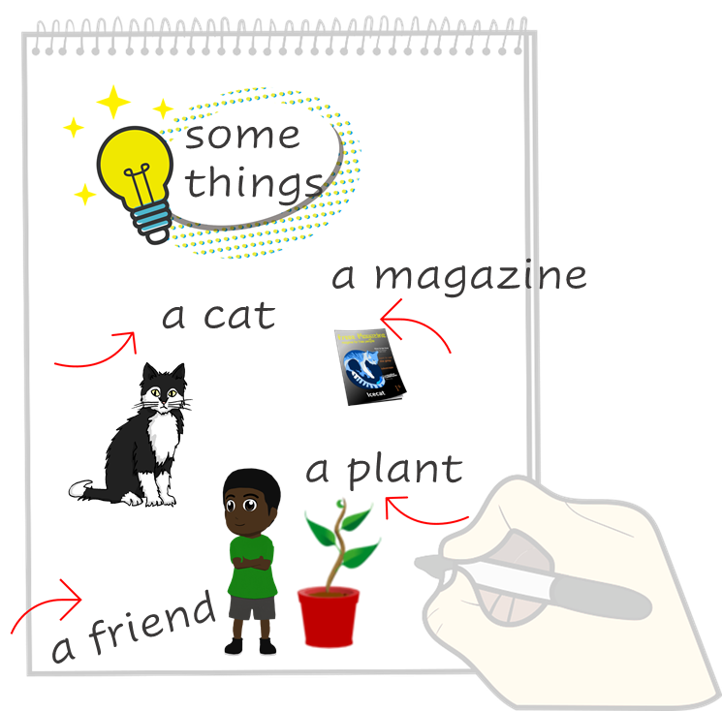
Un email de Daniel
Daniel writes to you in English. Can you write a message back in Spanish.
leer
Escribe un mensaje.
Just have a go! Write any of these English words or sentences in Spanish. You
can add different words, too.
Hello, I’m Daniel.
Today I’m at school (in León, Spain).
I have a friend, Hugo. He is tall and very friendly.
In school I study music, sciences, Spanish and English.
English is important. Mr Dickens is cheerful but also strange!
I arrive late to school because I walk with my friends and I talk a lot!
Where are you today? What are you like? What do you study? Do you have a friend (male or female) in class?
la escuela – school |
porque – because
Notes:
Timing: up to 30 minutes
Aim: to practise written production of vocabulary and structures from this week and the previous half-term.
Note: Students can be steered to respond to the prompts in a differentiated way – they could simply write ‘Hello, I am XXX’ and then write any Spanish nouns or verbs they remember (poster style) as shown here. Or they could try to write a full message, using Daniel’s English message as a guide for ideas, but they should be encouraged to vary the content and can personalise their writing, including looking up words in a dictionary, as appropriate to the ability and knowledge of the students.
Procedure:
Students read the message from Daniel in the blue text box.
Students use Daniel’s message and the words and pictures on the notebook to the right as inspiration. They write any words or sentences in Spanish to reply to Daniel.
3. Encourage students wherever possible to write from memory. It could be useful, however for them to have this English content in view and to give them 10 minutes planning time using their KO or Language Guide or dictionaries to look up words they will need.
Frequency of unknown words and cogates:
escuela [424] (phonics word 7.1.1.6, will be introduced as vocabulary 7.1.2.5) porque [40] (phonics word next week 7.1.2.1, and as vocabulary in 7.3.2.5)

Slide 22
Deberes
Vocabulary Learning Homework (Term 1.2, Week 2)
Audio file
Student worksheet
In addition, revisit: Term 1.1 Week 6
Notes:
Use this slide to set the homework.
For Y7, the typical homework will be to pre-learn vocabulary for the next lesson. There is an audio file to accompany the student worksheet.
Notes:
i) Teachers may, in addition, want to recommend use of a particular online app for the pre-learning of each week’s words. ii) Quizlet now requires parental involvement / registration / permissions for users below the age of 13, so it is perhaps most suitable for Y9 – 11 students. iii) Language Nut hosts LDP vocabulary lists and these are free for schools to use, though there is a registration process. One benefit is that all of the student tracking data that Language Nut offers are also available to schools that use the LDP lists for practice. Perhaps this makes it a good option for Y7/8.
iv) There are other free apps, and new ones are always appearing. Teachers have told us that they are currently using: Flippity, Wordwall (where using previously-created activities is free).
v) Gaming Grammar has been acquired by Language Nut. Its original content should still be available to teachers and much of it is appropriate for Y7 learners.

Slide 23
Daniel tiene una tarea en inglés y español
leer
Read the English. Which 5 phrases have a ‘no’ in them? Write 5 letters.
Careful! The English and Spanish sentences aren’t in the same order.
A
B
I don’t use a phone.
He uses a phone.
I understand ENglish.
He doesn’t understand English.
He doesn’t arrive by bike.
I arrive by bike.
I don’t carry a bag
He carries a bag.
I don’t dance well.
He dances well.
usa un telefóno.
No uso un teléfono.
C
D
entiendo el inglés.
No entiende el inglés.
E
F
llego en bici.
No llega en bici.
G
H
lleva una bolsa.
No llevo una bolsa.
I
J
No bailo bien.
baila bien.
Notes:
OPTIONAL ADDITONAL HOMEWORK ACTIVITY
Timing: 7 minutes
Aim: to pay attention to ‘no’ and its function in Spanish negation.
Procedure:
The first pair of sentences can be done as an example with students. The teacher can lead students through the process of reading the first two English phrases aloud, then the two Spanish phrases A and B, and ask “Frase A. ¿Es ‘no usa’ o ‘usa’? Frase B. ¿Es ‘no uso’ o ‘uso’’?
Students continue for homework. They look at the English sentences, then then look at the Spanish sentences and decide which grey letters must have a ‘no’ behind them
Teachers ask for oral feedback to practise letters of the alphabet.
Clicking on a letter will reveal whether anything is behind it!
Answers: B, D, E, H, I
Notes:
1. Try to elicit the meaning of ‘Andrés tiene una tarea en inglés y español’ before displaying the rest of the instructions.
2. The pairs of sentences are identical, so the only way to complete the activity is to pay attention to the verb ending and connect it with the affirmative/negative meaning of the English.

