Slide 1
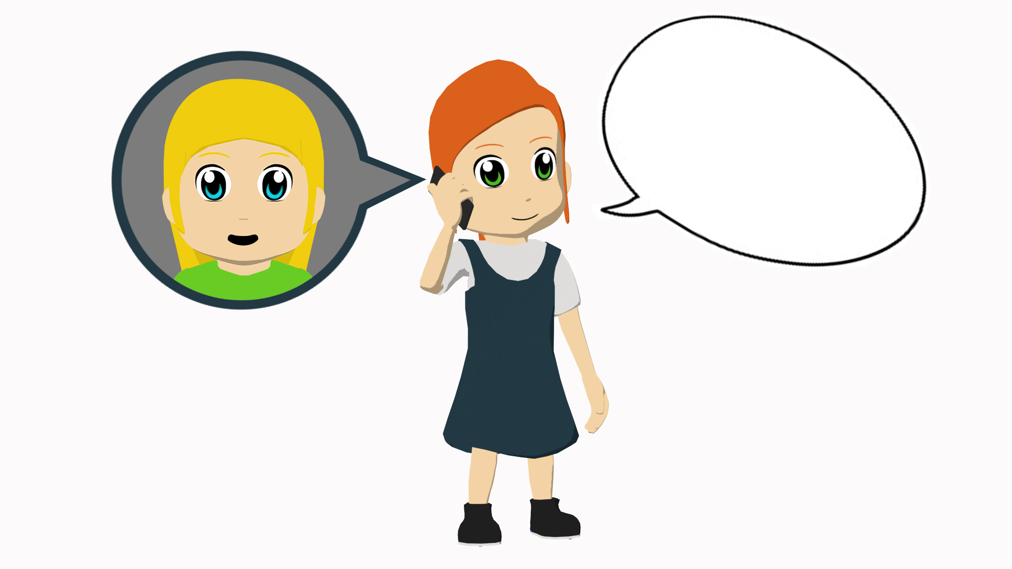
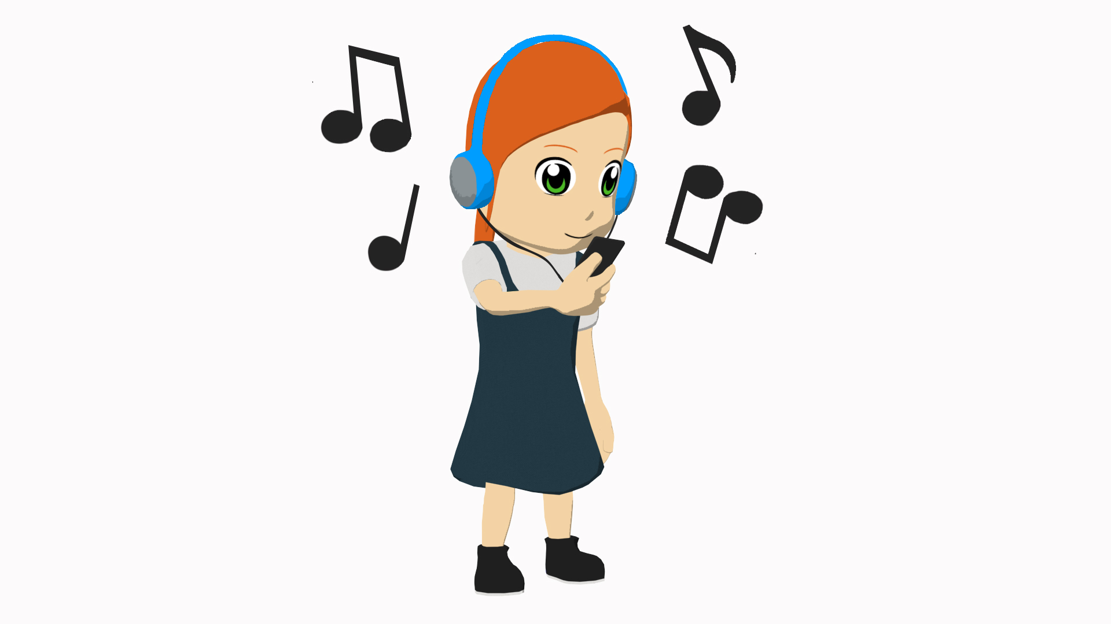
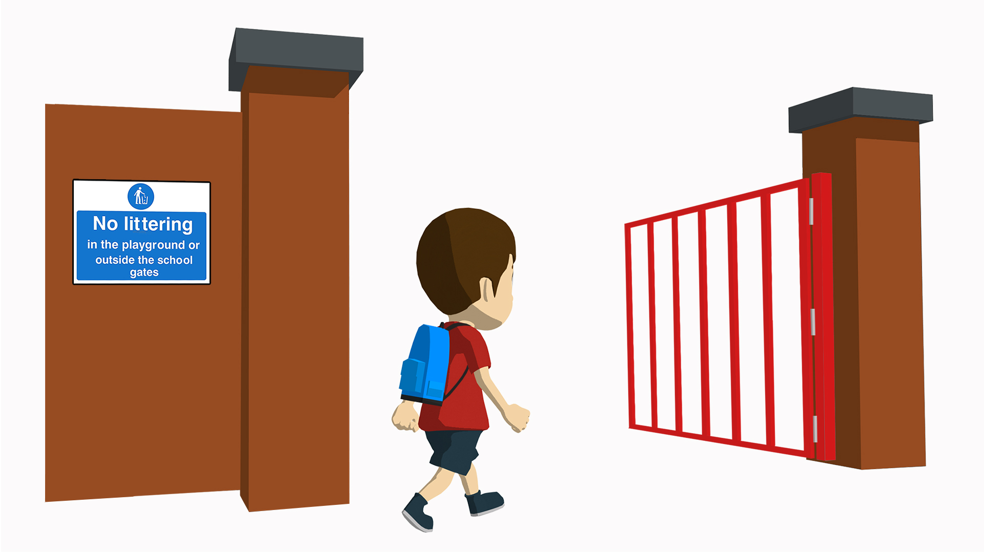
Saying what people do
-ar verbs: infinitive & 3rd person singular (-a)
singular indefinite articles [revisited]
SSC [cu] + vowel
Y7 Spanish Term 1.1 – Week 6 – Lesson 11 Nick Avery / Rachel Hawkes Artwork: Mark Davies Date updated: 28.07.23
Notes:
Note: all words (new and revisited) in this week of the SOW appear on all three GCSE wordlists, with the following exceptions:
AQA list does not have marcar.
Edexcel list does not have correcto, guapo, marcar.
Learning outcomes:
Introduction of SSC [cu] + vowel (cue/cua/cui)
Introduction of -ar verbs; infinitive & 3rd singular (-a)
Consolidation of singular indefinite article (un/una)
Word frequency (1 is the most frequent word in Spanish):
7.1.1.6 (introduce) ¿quién? [289]; hablar [90]; comprar [361]; bailar [1323]; llegar [75]; escuchar [281]; amiga [1172]; música [340]; tarde¹ [392]; temprano [1578]; importante [171]; bien [78]; con [14]; otra vez [59-vez]; pareja¹ [892]
7.1.1.3 (revisit) ser [7]; soy; eres; es; alegre [2081]; simpático [3349]; guapo [4192]; alto¹ [231]; bajo¹ [236]; y [4]; marca [marcar-993]; correcto [1467]; opción [1175]
Source: Davies, M. & Davies, K. (2018). A frequency dictionary of Spanish: Core vocabulary for learners (2nd ed.). Routledge: London

Slide 2
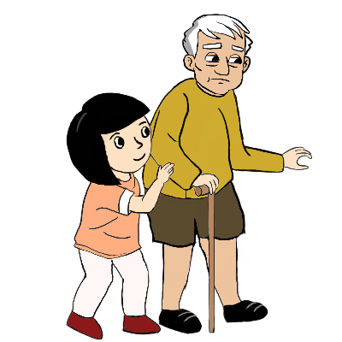
cue
escuela
CUE
cuerpo
[body]
cuadro
CUA
cuatro
to look after;
take care of
¡cuidado!
CUI
cuidar
[careful!]
Notes:
Timing: 2 minutes
Aim: To introduce SSCs [cue], [cua], [cui]
Procedure:
Introduce and elicit the pronunciation of the individual SSCs and then the source words (with gesture, if using).
Then present and elicit the pronunciation of the cluster word.
The cluster words have been chosen for their high-frequency, from a range of word classes, with the SSC (where possible) positioned within a variety of syllables within the words (e.g. initial, 2nd, final etc.). Additionally, we have tried to use words that build cumulatively on previously taught SSCs (see the Phonics Teaching Sequence document) and do not include new SSCs. Where new SSCs are used, they are often consonants which have a similar symbol-sound correspondence in English.
Word frequency (1 is the most frequent word in Spanish): cuerpo [232], escuela [424]; cuatro [241], cuadro [1017]; cuidar [751], cuidado [1822] Source: Davies, M. & Davies, K. (2018). A frequency dictionary of Spanish: Core vocabulary for learners (2nd ed.). Routledge: London

Slide 3
¿CUE, CUA o CUI?
escuchar / escribir
¡cui
[to look after; take care of]
___dado!
1
3
5
es____la
cue
cui
___dar
2
4
6
cue
____tro
___rpo
cua
cua
___dro
Notes:
Timing: 4 minutes (1 slide)
Aim: to practise mapping from sound to spelling
Procedure:
1. Click on the orange number next to each picture to hear the corresponding word.
2. Learners then write down the missing letters in the word
Transcript:
escuela
cuatro
cuidar
cuadro
cuidado
cuerpo
Word frequency (1 is the most frequent word in Spanish): cuerpo [232], escuela [424], cuatro [241], cuadro [1017], cuidar [751], cuidado [1822]
Source: Davies, M. & Davies, K. (2018). A frequency dictionary of Spanish: Core vocabulary for learners (2nd ed.). Routledge: London

Slide 4
¿CUE, CUA o CUI?
escuchar / escribir
1
¡cuidado!
3
[to look after; take care of]
5
escuela
cuidar
6
2
4
cuatro
cuadro
cuerpo
Notes:
Variation: same task as on the previous slide, but students have to write the whole word.

Slide 5
¿Qué es?
hablar
revista
un
una
un
una
barco
libro
un
una
Notes:
Timing: 2 minutes
Aim: to recall the 6 words in the images and their gender
Procedure:
Bring up the image
Elicit the Spanish word.
Click to reveal it.
Click again to reveal the correct indefinite article
Note: These words will be needed in the listening / speaking activity later in lesson 1, so it’s worth re-visiting them here.
Images retrieved from https://unsplash.com/ (freely usable images)

Slide 6
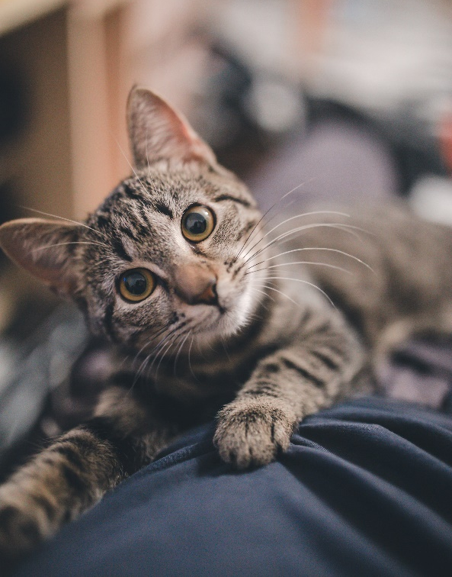
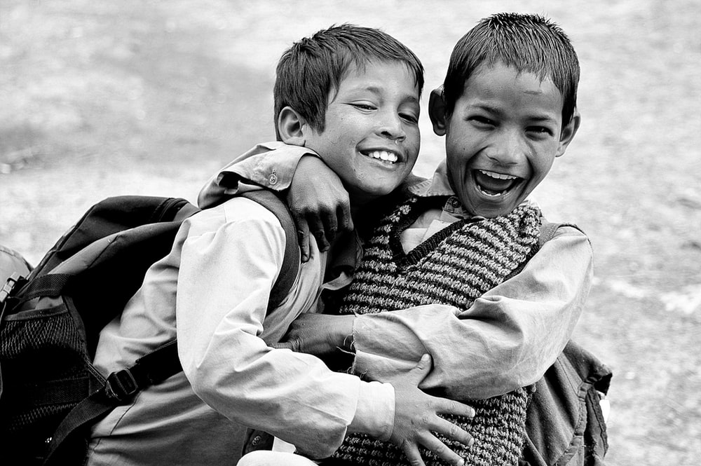
¿Qué es?
at home = en casa
hablar
casa
un
una
gato
un
una
amigo
un
una

Slide 7
Vocabulario
 | Word | English meaning
1 | ¿quién? | who?
2 | hablar | to speak, speaking
3 | comprar | to buy, buying
4 | bailar | to dance, dancing
5 | llegar | to arrive, arriving
6 | escuchar | to listen, listening
7 | una amiga | a friend (female)
8 | música | music
9 | tarde | late
10 | temprano | early
11 | bien | well
12 | con | with
60
Want to say where you arrive?
Use llegar + a + place
0
INICIO
Notes:
Timing: 1-4 minutes Aim: To reactivate and strengthen vocabulary knowledge. Procedure: Round 1: Look at the Spanish, recall the English meanings, saying them aloud. [1 minute] Round 2: Look at the English, recall the Spanish meanings, saying them aloud. [1 minute] Repeat for two further minutes, to speed up recall.
Note: here we draw attention to construction ‘llegar a’, which will appear later in the second lesson

Slide 8
comprar
comprar
[to buy | buying]
compra
[buys | s/he buys]
Notes:
Timing: 3 minutes (six slides)
Aim: To introduce the verb comprar more explicitly. Comprar is one of the NCELP 15 prototypical verbs in Spanish. Prototypical verbs are common verbs that illustrate the typical characteristics of a class of verb – the Spanish prototypical verbs contain examples of regular/weak verbs, but also common examples of changes to the stem. All 15 prototypical verbs will be introduced early on using the same format. Both long form (infinitive) and short form (3rd person singular) are introduced in order to familiarise students with various forms of the same verb.
Procedure
Bring up the word comprar on its own, say it, students repeat it, and remind them of the phonics. Draw attention to SSC [co]
Try to elicit the meaning from the students.
Bring up the picture, and, if using gestures, a possible gesture would be to hold out your hand, as if you were buying something.
Then bring up the English translations. Emphasise the two meanings for the infinitive.
Bring up the short form compra, say it, students repeat it. Draw attention to SSC [co]
Try to elicit the meaning from the students. Emphasise the two meanings for the short form.

Slide 9
comprar
comprar
[to buy | buying]
compra
[buys | s/he buys]
Notes:
Cycle through the long and short form again.

Slide 10
compra
compra
[buys | s/he buys]
Lucía compra una revista.
[Lucía buys a magazine.]
Notes:
Introduce the short form in a sentence.

Slide 11
comprar
comprar
[to buy | buying]
Es normal comprar una revista.
[It’s normal to buy a magazine.]
Notes:
Introduce the long form in a sentence.

Slide 12
compra
compra
[buys | s/he buys]
compra
Lucía ________ una revista.
[Lucía buys a magazine.]
Notes:
Cycle through the short form in context again.

Slide 13
comprar
comprar
[to buy | buying]
comprar
Es normal _________ una revista.
[It’s normal to buy a magazine.]
Notes:
Cycle through the long form in context again.

Slide 14
Saying what people do
-ar verbs - infinitive and 3rd person singular
The infinitive form of a verb is the form you see in a dictionary.
In English, this is often written ‘to + verb’.
In Spanish, the infinitive of the verb often ends in –ar.
For example:
Es importante escuchar.
It’s important to listen.
You can also begin a sentence with the infinitive:
Escuchar es importante.
Listening is important.
So, the infinitive often describes the general meaning of the verb.
Notes:
Timing: 2 minutes (two slides)
Aim: to introduce –AR infinitives. Procedure: 1. Click to present the information.
2. Elicit English meanings for the Spanish example sentences.
Note: Escuchar is included here as it was previously practised in 1.1.5 with phonics words.

Slide 15
Saying what people do -ar verbs - infinitive and 3rd person singular
To mean ‘s/he’ or ‘it’ with a verb, the verb ending changes to –a.
For example:
Escucha música.
S/he listens to music.
In English, we say ‘he’ or ‘she’ to say who does the action.
In Spanish, the verb ending tells us this. There is often no need for the word for ‘s/he’.
Notes:
Grammar presentation slide [2/2]

Slide 16
¡Un desastre!
The dog ate Lucía’s Spanish homework! What do the text pieces talk about?
leer
the action in general | someone does the action
1
habla con un amigo
2
llega temprano
3
bailar salsa
compra un libro
4
5
escuchar en clase
6
comprar una casa
Notes:
Timing: 7 minutes
Aim: to practise attending to the meanings of infinitives and 3rd person singular forms of verbs.
Procedure:
1. Students write 1-6 on the LHS of books and copy the two column headers
2. They then tick the correct column, depending on the verb form.
3. Elicit the meanings of the sentence fragments during feedback.

Slide 17
escribir
Lucía finds four more pieces!
Which of the text fragments could these have gone with?
1
habla con un amigo
es importante
es excelente
2
llega temprano
es fantástico
es normal
3
bailar salsa
4
compra un libro
Write four sentences combining the new pieces with three of the old ones!
Then translate them into English.
5
escuchar en clase
6
comprar un barco
Notes:
Timing: 8 minutes
Aim: to practise attending to the meanings of infinitives and 3rd person singular verb forms
Procedure:
Ask students to look at the sentence fragments on the LHS and decide which of them could be used with those on the RHS.
Students write the full sentence (and could also write the English translation, if there is time).
To make students think about meaning of the infinitives and the adjectives, ask them which combinations seem most and least likely. They could be asked to write two sensible ones and two silly ones!
Notes:
The four adjectives were chosen as they are all frequent and are near-cognates.
The sentences could either start or finish with ‘es importante’ etc. This is important to bear in mind because the English translation is affected by the position of the verb. For example:
Hablar con José es importante. Speaking/talking with José is important.
Es importante hablar con José. It’s important to talk/to speak with José.
Word frequency (1 is the most frequent word in Spanish): importante [171], excelente [1546], fantástico [2501], normal [1000]
Source: Davies, M. & Davies, K. (2018). A frequency dictionary of Spanish: Core vocabulary for learners (2nd ed.). Routledge: London

Slide 18
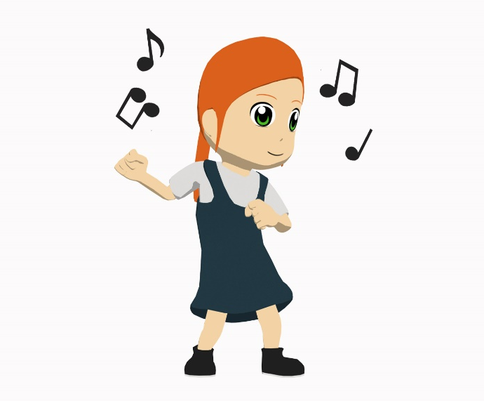
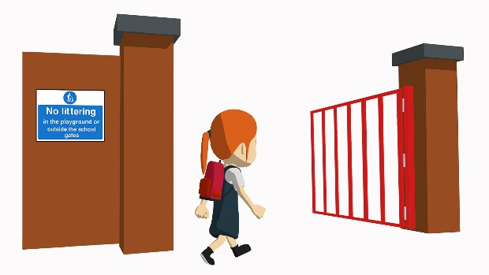
¿Qué actividad es?
escuchar
Listen to what Lucía does. Write 1 – 5.
Listen and match the action verb you hear to the picture.
C
B
A
1
A
2
C
3
D
E
D
E
4
[arrives]
¡Hola!
5
B
Notes:
Timing: 12 minutes (two slides)
Aim: to focus students on the meanings of the lexical verbs, both in isolation (this slide) and then in sentence constructions (next slide)
Procedure:
1. On this slide, students listen to the individual verbs and match them to the action in the picture
2. On the next slide, students listen to the same verbs in sentence constructions. They have to transcribe & translate them.
Notes:
Students will hear the –a ending and need to translate it on the next slide, but this is not the main focus of the activity. Other activities in the sequence focus on the –a vs –ar endings together.
To make the second part of the activity more challenging, ask the students to translate directly into English (rather than transcribing first).
Transcript:
1. Escucha
2. Compra
3. Llega
4. Habla
5. Baila
Word frequency (1 is the most frequent word in Spanish): escuchar [281], comprar [361], llegar [75], hablar [90], bailar [1323]
Source: Davies, M. & Davies, K. (2018). A frequency dictionary of Spanish: Core vocabulary for learners (2nd ed.). Routledge: London

Slide 19
¿Qué actividad es?
Escucha la frase completa. Escribe en español. Luego, escribe en inglés.
escuchar
Baila en un barco.
1
She dances in a boat.
Compra una revista.
2
She buys a magazine.
Escucha música.
3
She listens to music.
Llega tarde.
4
She arrives late.
Habla con un amigo.
5
She speaks with a (male) friend.
Notes:
Vocabulary practice activity (listening) [2/2]

Slide 20
You tell a friend about Daniel.
escuchar / hablar
Student A: tell your friend what Daniel does & what is important for him to do.
Student B: turn away from the board, listen and write in English:
what Daniel does. [x3]
what it’s important for him to do. [x2]
Then swap roles. The activities are different.
Notes:
NOTE: OMIT THIS ACTIVITY IF THERE IS NO TIME Timing: 6-8 minutes
Aim: to practise using the infinitive and 3rd person singular
Procedure:
1. Student A, referring to prompt cards, tells student B what Daniel already does (i.e. using 3rd person singular) and then what it’s important for him to do (using infinitive). Students may need to be reminded of the verb forms needed before starting.
2. Student B listens and takes notes (we suggest that this is done in a blank two-column grid with these two headers – see slides 43/44)
3. Then they swap roles.
4. Check answers and give feedback afterwards.
Note: Since correct use the infinitive and 3rd person singular isn’t essential to task completion, the listener should be encouraged to correct the speaker if s/he notices mistakes in use of –ar vs –a ending.

Slide 21
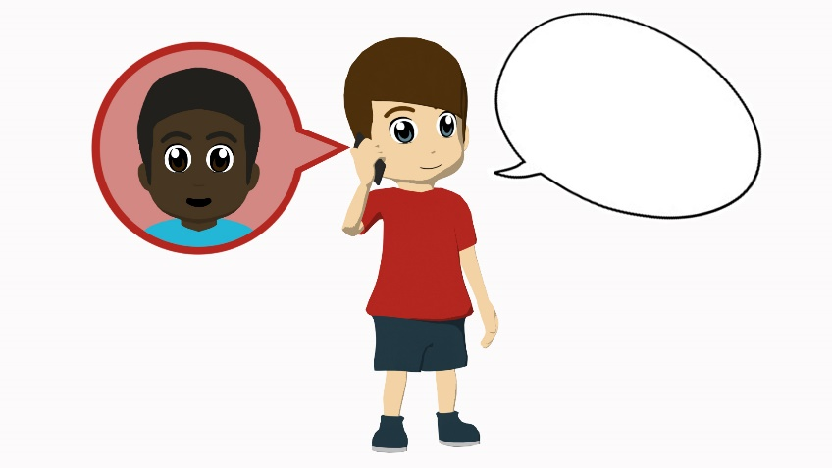
Student A
Daniel does it
It’s important to…
¡Hola!
[arrive early]
[talks with a (male) friend]
[listens to music]
[arrives late]
[dance at home]
at home = en casa
Notes:
Student A speaking cards (these are also available in Word format)
Procedure: 1. Make sure Bs have turned away from the board.
2. Click to bring up A’s prompts.
3. Students complete the speaking activity.
4. Bs turn back to check their answers.
5. As turn away.

Slide 22
Student B
Daniel does it
It’s important to…
[arrives early]
[listen in class]
¡Hola!
[dances with a cat]
[talks with a (female) friend]
[buy a newspaper]
Notes:
Student B speaking cards (these are also available in Word format)
Procedure: 1. Make sure As have turned away from the board.
2. Click to bring up B’s prompts.
3. Students complete the speaking activity.
4. As turn back to check their answers.
5. As turn away.

Slide 23
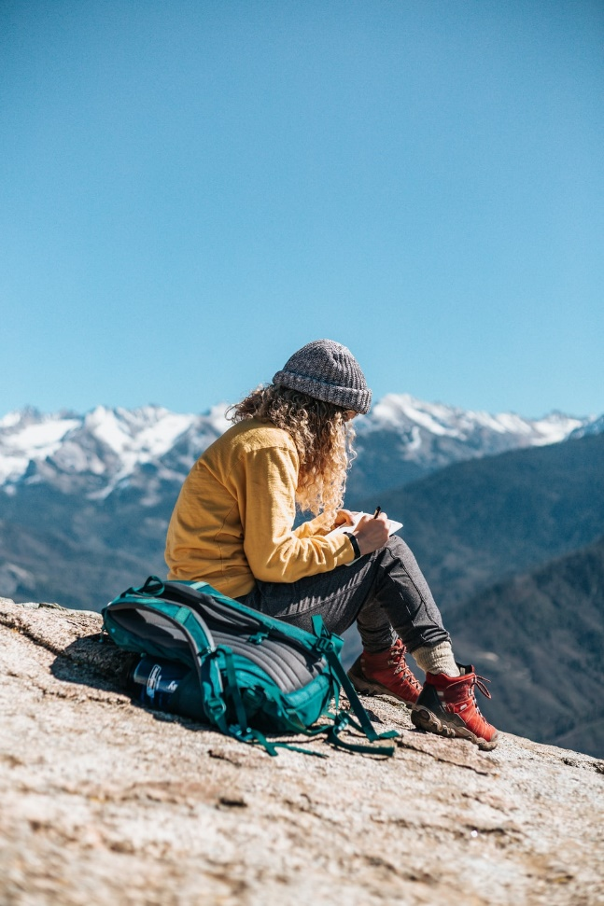
Saying what people do [2]
-ar verbs: infinitive & 3rd person singular (-a)
SSC [cu] + vowel
Y7 Spanish Term 1.1 – Week 6 – Lesson 12 Nick Avery / Rachel Hawkes Artwork: Mark Davies Date updated: 28.07.23
Notes:
Learning outcomes:
Consolidation of SSC [cu] + vowel (cue/cua/cui) Consolidation of -ar verbs; infinitive & 3rd singular (-a)
Word frequency (1 is the most frequent word in Spanish):
7.1.1.6 (introduce) ¿quién? [289]; hablar [90]; comprar [361]; bailar [1323]; llegar [75]; escuchar [281]; amiga [1172]; música [340]; tarde¹ [392]; temprano [1578]; importante [171]; bien [78]; con [14]; otra vez [59-vez]; pareja¹ [892]
7.1.1.3 (revisit) ser [7]; soy; eres; es; alegre [2081]; simpático [3349]; guapo [4192]; alto¹ [231]; bajo¹ [236]; y [4]; marca [marcar-993]; correcto [1467]; opción [1175]
Source: Davies, M. & Davies, K. (2018). A frequency dictionary of Spanish: Core vocabulary for learners (2nd ed.). Routledge: London

Slide 24
Fonética
cui
dar
escuchar / escribir
Make a word.
Translate it!
cui
dado
tro
rpo
dar
es ____ la
dro
dado
cue
rpo
cua
tro
es ____ la
cue
cua
dro
Notes:
Timing: 3 minutes
Aim: to practise saying and spelling words with [cu] + vowel.
Procedure:
1. Students will work in pairs to put the words back together.
2. Working left to right, Student A completes a word.
3. Student B has to listen and write that word, saying the English meaning.
4. They then swap roles to do all 6 words.
5. Click to correct with the class.
Note:
Exclamation marks were not included with ‘cui’ and ‘dado’ to avoid giving away the answer.
Word frequency of unknown words and cognates (1 is the most frequent word in Spanish): cuerpo [232], escuela [424], cuatro [241], cuadro [1017], cuidar [751], cuidado [1822]
Source: Davies, M. & Davies, K. (2018). A frequency dictionary of Spanish: Core vocabulary for learners (2nd ed.). Routledge: London

Slide 25
Vocabulario
leer
comprar
tarde
bien
hablar
con
una amiga
early
to arrive
again
to dance
a partner
late
to listen
to speak
with
a friend (f)
who?
well
to buy
music
temprano
escuchar
otra vez
una pareja
bailar
¿quién?
llegar
música
Notes:
Timing: 2 minutes
Aim: to practise comprehension of of this week’s new vocabulary.
Procedure:
Click for an English prompt.
Students select and read aloud the correct Spanish meaning, chorally.
Continue for all 12 items.

Slide 26
Vocabulario
hablar
bailar
bien
con
hablar
to dance
well
with
to speak
ser
soy
eres
es
to be (trait)
I am
you are
she/he is
escuchar
música
comprar
¿quién?
to listen
music
to buy
who?
llegar
tarde
temprano
una amiga
to arrive
late
early
a friend (f)
alto
guapo
simpática
alegre
good-looking (m)
tall (m)
nice (f)
cheerful (m/f)
Notes:
Timing: 3 minutes
Aim: to practise spoken production of 20 new and revisited words, in a low stakes but time-limited activity.
Procedure:
Work from left to right, top to bottom on the word wall. Ask ‘¿Cómo se dice ‘to dance’ en español?
Click to start the 5-second animation. Pupils say the Spanish word before the animation finishes and reveals the word.
Continue with all words.

Slide 27
escuchar
Lucía is recording her Spanish homework, but her device has problems!
You hear her first word. Which ending must be missing?
Hint: listen for the –a or –ar verb endings.
1
…salsa es fantástico.
…salsa.
…música es importante.
…música.
…con Elena.
…con Elena es maravilloso.
4
…tarde con Pepe es normal.
…tarde con Pepe.
…una casa.
…una casa es importante.
…un periódico es normal.
…un periódico.
2
5
3
6
Notes:
Timing: 8 minutes
Aim: to practise attending to the meanings of infinitives and 3rd person singular forms of verbs
Procedure:
1. Click on the orange action button to hear the first word of the sentence. This will either be an infinitive or 3rd person singular.
2. Decide which sentence ending must be correct (write it OR write A or B)
3. Check answers. While checking answers, ask for the English translation to ensure comprehension of lexical items.
Transcript:
Bailar
Escucha
Hablar
Llega
Comprar
Compra

Slide 28
La gran aventura de Paula
Notes:
Timing: 3 minutes (8 slides)
Aim: to set the context of international travel; to practise read aloud of unknown Spanish words for countries.
Procedure:
Ask the question: Dónde está [Kuala Lumpur]?
Elicit full sentence answers: e.g., Kuala Lumpur está en Malasia.
Note: these three destinations have either previously-taught SSC OR SSC which are similar to English, therefore we can simply ask the question here and students apply their SSC knowledge when reading their answer aloud.
Pictures from https://unsplash.com/ (freely usable images)

Slide 29
Kuala Lumpur
¿Dónde está…?
Tailandia
Malasia
China

Slide 30
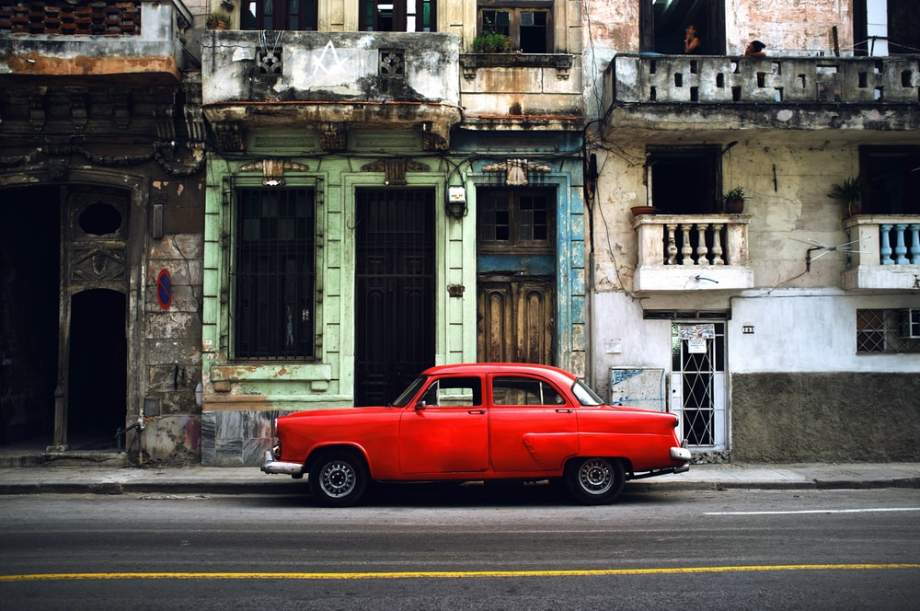
La Habana
La Habana es la capital de Cuba
¿Dónde está…?
El Salvador
Cuba
Guatemala

Slide 31
Oslo
¿Dónde está…?
Noruega
Polonia
Finlandia

Slide 32
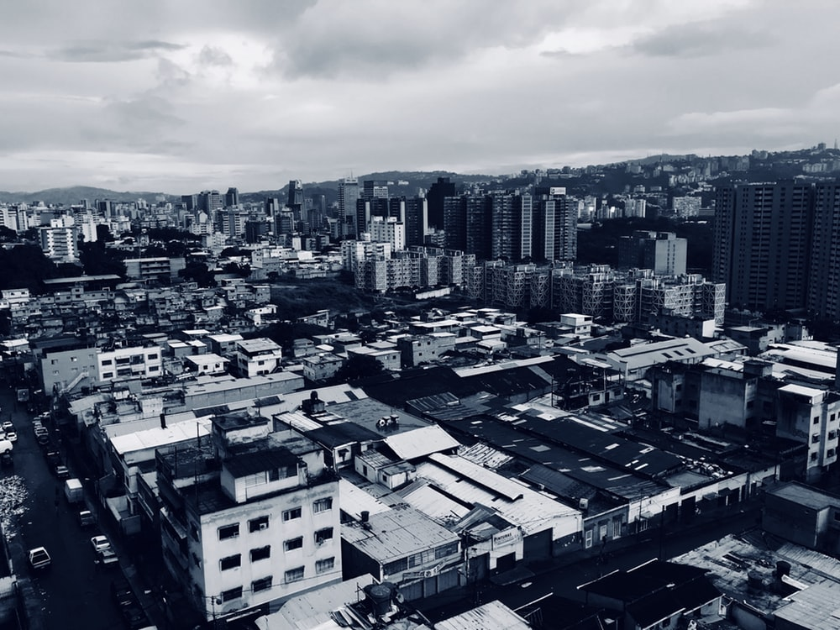
Caracas
Caracas es la capital de Venezuela.
¿Dónde está…?
Brasil
Venezuela
Chile

Slide 33
Estocolmo
¿Dónde está…?
Finlandia
Suecia
Francia

Slide 34
Tokio
¿Dónde está…?
Inglaterra
Francia
Japón

Slide 35
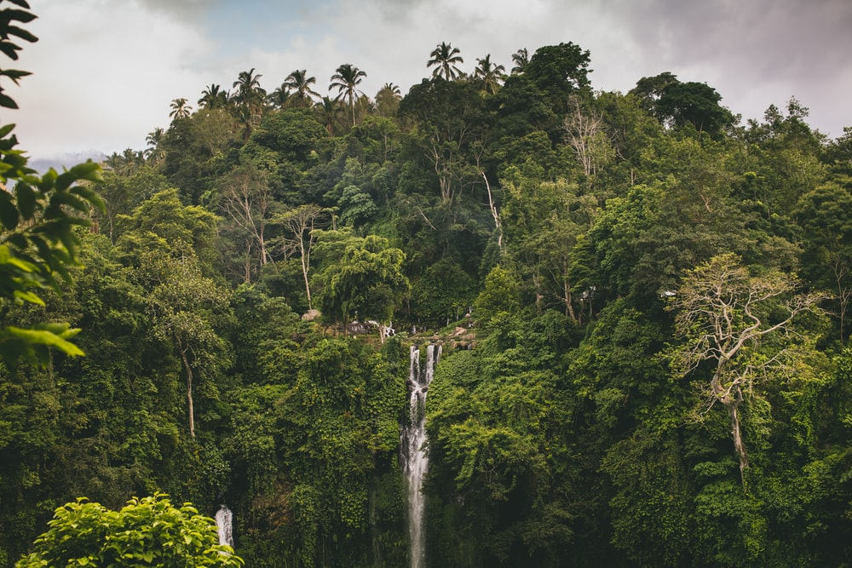
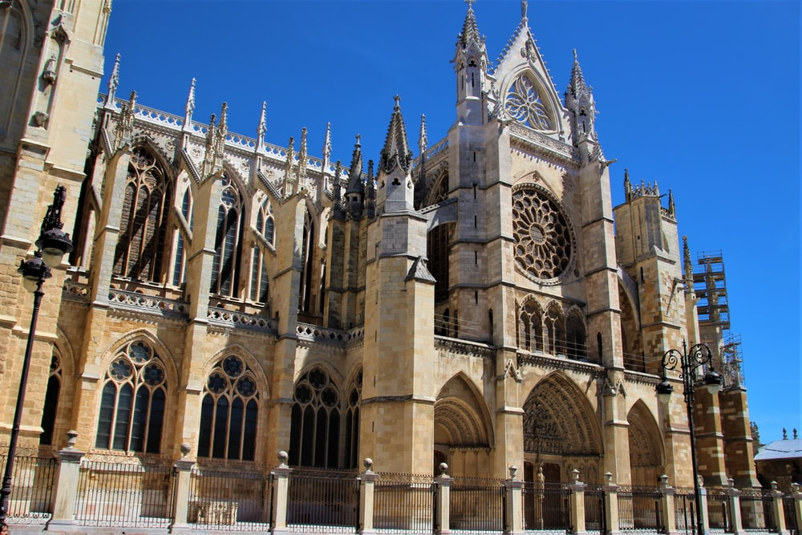
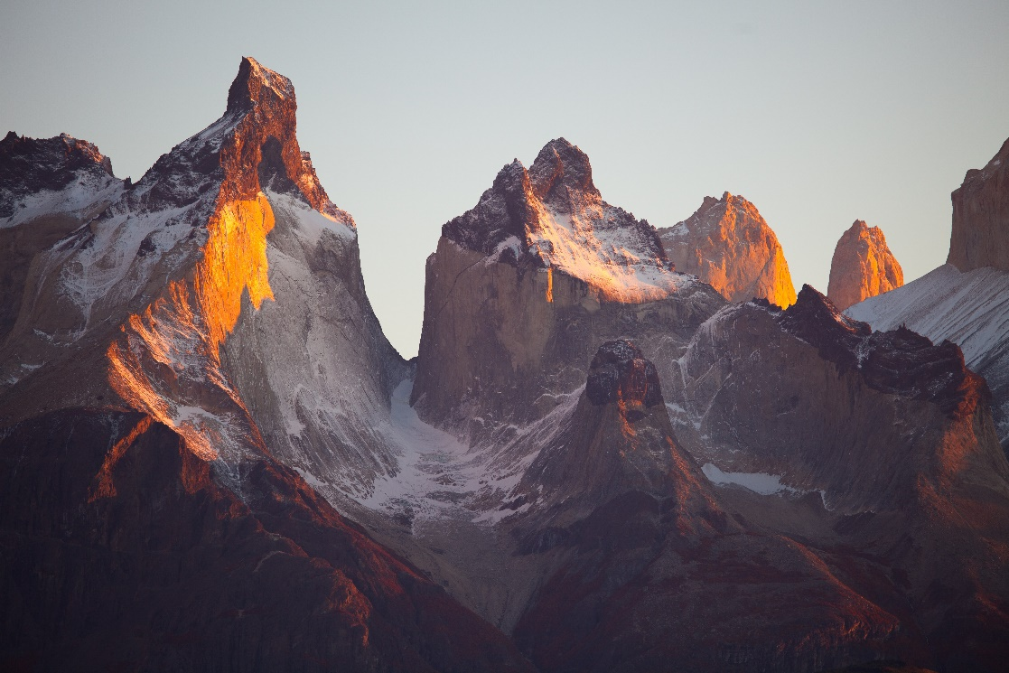
¿León?
B
A
Brasil
C
España
Chile

Slide 36
escuchar
What does she do?
In La Habana she
1
speaks with a (female) friend.
buys a house.
2
In Caracas she
In Stockholm she
3
listens to music.
In Los Llanos she
4
arrives late.
In Tokio she
5
has a party.
In Oslo she
6
forgets a book.
In California she
7
buys a boat.
Notes:
Timing: 10 minutes
Aim: to recognise the meanings of previously taught vocabulary items.
Procedure:
1. Click on each orange button to play audio
2. Complete the sentence in English
3. Multiple repetitions may be needed
Note:
1. Make sure that students are aware that, when referring to a destination, Spanish uses ‘llegar A’ (‘en’ would refer to the means of arriving).
Transcript:
Habla con una amiga en La Habana.
Compra una casa en Caracas.
Escucha música en Estocolmo.
Llega tarde a Los Llanos.
Tiene una fiesta en Toledo.
Olvida un libro en Oslo.
Compra un barco en California.

Slide 37
Paula’s trip was so good that she does it again! This time she goes to the places in a different order.
escuchar / hablar
Student A: 1. Write letters A-F in the order that you want to tell the story. 2. Tell the story in that order.
Student B: 1. Listen and note the correct order A-F.
OR
2. Turn away and make a list of the 6 activities in English.
Then swap roles.
Notes:
Timing: 10-12 mins (3 slides)
Aim: to practise using –ar verbs in 3rd person singular to recount a short narrative.
Procedure:
Click to explain the activity.
Move to the next slide for Student A’s story.
Note: there are 6 activities each round. Over the 2 rounds, all 8 original activities are covered. They are in a different order, with different letters in each round.

Slide 38
Persona A
A
B
C
Forgets a book
Listens to music
Buys a house
Oslo
Estocolmo
Caracas
D
E
F
Arrives late
Speaks with a (female) friend
Has a party
Los Llanos
Tokio
La Habana
Notes:
Student A Round 1 Procedure:
1. Student A recounts 6 actions, in his/her pre-selected order.
2. Student B either a) faces the board and listens, noting the letters in the correct order or b) turns away from the board and takes notes of what happens in English.
3. Student A then checks B’s answers and gives feedback.
4. Move to next slide to swap roles.

Slide 39
Persona B
A
B
C
Dances with a (male) friend
Buys a boat
Has a party
Kuala Lumpur
California
Tokio
D
E
F
Forgets a book
Buys a house
Listens to music
Oslo
Caracas
Estocolmo
Notes:
Student B Round 2 Procedure:
1. Student B recounts 6 actions, in his/her pre-selected order.
2. Student A either a) faces the board and listens, noting the letters in the correct order or b) turns away from the board and takes notes of what happens in English.
3. Student B then checks A’s answers and gives feedback.

Slide 40
Deberes
Vocabulary Learning Homework (Term 1.1, Week 7)
Audio file
Student worksheet
In addition, revisit: Term 1.1 Week 4
Notes:
Use this slide to set the homework.
For Y7, the typical homework will be to pre-learn vocabulary for the next lesson. There is an audio file to accompany the student worksheet.
Notes:
i) Teachers may, in addition, want to recommend use of a particular online app for the pre-learning of each week’s words. ii) Quizlet now requires parental involvement / registration / permissions for users below the age of 13, so it is perhaps most suitable for Y9 – 11 students. iii) Language Nut hosts LDP vocabulary lists and these are free for schools to use, though there is a registration process. One benefit is that all of the student tracking data that Language Nut offers are also available to schools that use the LDP lists for practice. Perhaps this makes it a good option for Y7/8.
iv) There are other free apps, and new ones are always appearing. Teachers have told us that they are currently using: Flippity, Wordwall (where using previously-created activities is free).
v) Gaming Grammar has been acquired by Language Nut. Its original content should still be available to teachers and much of it is appropriate for Y7 learners.

Slide 41
Deberes: una tarea escrita
Write the story of someone’s world trip. Use the present tense.
Use the verbs bailar, comprar, escuchar, estar, hablar, llegar, olvidar, tener.
Remember to use the –a verb ending for s/he.
City and country names are sometimes different in Spanish! Check this in a dictionary.
Notes:
OPTIONAL HOMEWORK TASK

Slide 42
Una gran aventura
Habla con una amiga en La Habana.
Baila con un amigo en Kuala Lumpur.
Compra una casa en Caracas.
Escucha música en Estocolmo.
Llega tarde a Los Llanos.
Tiene una fiesta en Tokio.
Olvida un libro en Oslo.
Compra un barco en California.
Notes:
Full text of Paula’s adventure – for reference only

