Slide 1
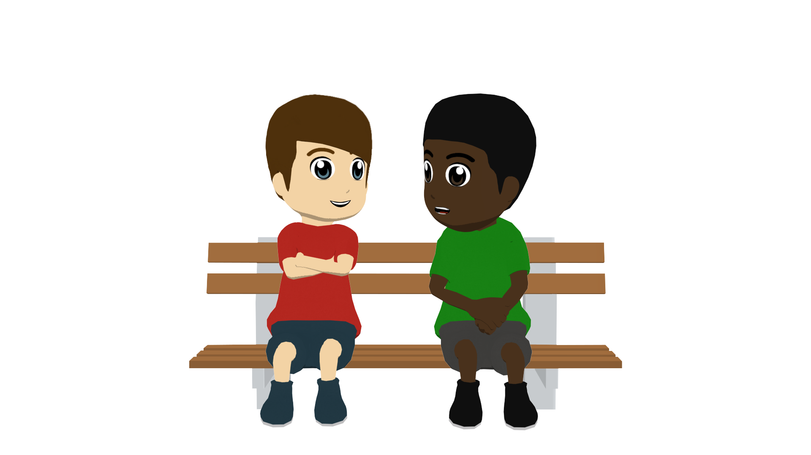
Saying what people have
Singular indefinite article (un/una)
SSCs [l], [ll]
Y7 Spanish Term 1.1 – Week 4 – Lesson 7 Nick Avery / Victoria Hobson Date updated: 28.07.23
Notes:
Note: all words (new and revisited) in this week of the SOW appear on all three GCSE wordlists, with the following exceptions:
AQA list does not have moneda, Inglaterra.
Edexcel list does not have frase.
Learning outcomes:
Introduction of SSC [l] and [ll]
Introduction of [singular indefinite article]
Word frequency (1 is the most frequent word in Spanish):
7.1.1.4 (introduce) tener [19]; tengo; tiene; tienes; moneda [1577]; cama [609]; casa [106]; cámara [903]; bicicleta [3684]; libro [230]; barco [1384]; bolígrafo [>5000]; gato [1728]; ¿qué? [50]; nuevo [94]; un/a [6]; lee [leer-209]; frase [1036]; letra [977]; papel [393]
7.1.1.1 (revisit) estar [21]; estoy; estás; está; norte [624]; sur [661]; Inglaterra [N/A]; España [N/A]; ¿dónde? [161] en [5]; hola [1245]; hasta luego [luego-150]
Source: Davies, M. & Davies, K. (2018). A frequency dictionary of Spanish: Core vocabulary for learners (2nd ed.). Routledge: London

Slide 2
l
libro
Notes:
Timing: 1 minute
Aim: To introduce/consolidate SSC [l]
Procedure: 1. Present the letter(s) and say the [l] sound first, on its own. Students repeat it with you. 2. Bring up the word ”libro” on its own, say it, students repeat it, so that they have the opportunity to focus all of their attention on the connection between the written word and its sound.
3. A possible gesture for this would be to open an imaginary book. 4. Roll back the animations and work through 1-3 again, but this time, dropping your voice completely to listen carefully to the students saying the [l] sound, pronouncing ”libro” and, if using, doing the gesture.
Word frequency (1 is the most frequent word in Spanish):
libro [230] Source: Davies, M. & Davies, K. (2018). A frequency dictionary of Spanish: Core vocabulary for learners (2nd ed.). Routledge: London

Slide 3
l
salir
palabra
lista
libro
luz
luego
[then]
Notes:
Timing: 2 minutes
Aim: To introduce/consolidate SSC [l]
Procedure:
Introduce and elicit the pronunciation of the individual SSC [l] and then the source word again ‘libro’ (with gesture, if using).
Then present and elicit the pronunciation of the five cluster words.
The cluster words have been chosen for their high-frequency, from a range of word classes, with the SSC (where possible) positioned within a variety of syllables within the words (e.g. initial, 2nd, final etc.). Additionally, we have tried to use words that build cumulatively on previously taught SSCs (see the Phonics Teaching Sequence document) and do not include new SSCs. Where new SSCs are used, they are often consonants which have a similar symbol-sound correspondence in English.
Word frequency (1 is the most frequent word in Spanish): libro [230]; salir [114]; lista [1189]; luego [150]; palabra [192]; luz [278] Source: Davies, M. & Davies, K. (2018). A frequency dictionary of Spanish: Core vocabulary for learners (2nd ed.). Routledge: London

Slide 4
l
salir
palabra
lista
libro
luz
luego
Notes:
Without the images, students focus this time again closely on the SSC and the cluster words.

Slide 5
l
salir
palabra
lista
libro
luz
luego
Notes:
Without the images or sound, students have to pronounce the words themselves.

Slide 6
ll
llamar
Notes:
Timing: 1 minute
Aim: To introduce/consolidate SSC [ll]
Procedure: 1. Present the letter(s) and say the [ll] sound first, on its own. Students repeat it with you. 2. Bring up the word ”llamar” on its own, say it, students repeat it, so that they have the opportunity to focus all of their attention on the connection between the written word and its sound.
3. A possible gesture for this would be to bring an imaginary phone to your ear. 4. Roll back the animations and work through 1-3 again, but this time, dropping your voice completely to listen carefully to the students saying the [ll] sound, pronouncing ”llamar” and, if using, doing the gesture.
Word frequency (1 is the most frequent word in Spanish): llamar [122] Source: Davies, M. & Davies, K. (2018). A frequency dictionary of Spanish: Core vocabulary for learners (2nd ed.). Routledge: London

Slide 7
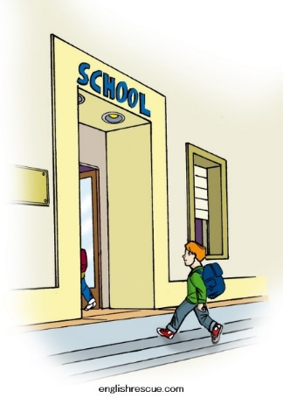
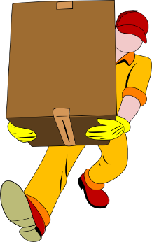
ll
llegar
llave
© www.englishrescue.com
llamar
llevar
amarillo
ella
Notes:
Timing: 2 minutes
Aim: To introduce/consolidate SSC [ll]
Procedure:
Introduce and elicit the pronunciation of the individual SSC [ll] and then the source word again ‘llamar’ (with gesture, if using).
Then present and elicit the pronunciation of the five cluster words.
The cluster words have been chosen for their high-frequency, from a range of word classes, with the SSC (where possible) positioned within a variety of syllables within the words (e.g. initial, 2nd, final etc.). Additionally, we have tried to use words that build cumulatively on previously taught SSCs (see the Phonics Teaching Sequence document) and do not include new SSCs. Where new SSCs are used, they are often consonants which have a similar symbol-sound correspondence in English.
Word frequency (1 is the most frequent word in Spanish): llamar [122]; llegar [75]; llevar [101]; llave [1853]; amarillo [1381] Source: Davies, M. & Davies, K. (2018). A frequency dictionary of Spanish: Core vocabulary for learners (2nd ed.). Routledge: London

Slide 8
ll
llegar
llave
llamar
llevar
amarillo
ella
Notes:
Without the images, students focus this time again closely on the SSC and the cluster words.

Slide 9
ll
llegar
llave
llamar
llevar
amarillo
ella
Notes:
Without the images or sound, students have to pronounce the words themselves.

Slide 10
Fonética
leer / hablar
ella
60
llamar
salir
amarillo
Segundos
llevar
lista
luz
palabra
0
INICIO
Notes:
Timing: 1 minute
Aim: to gain confidence and fluency in saying words with [l] and [ll]
Procedure:
1. Individually (but all at once) pupils read out the words but in alphabetical order. They keep going for one minute.
2. Teacher can circulate to listen into their SSC knowledge.
Word frequency (1 is the most frequent word in Spanish): salir [114]; lista [1189]; palabra [192]; luz [278]; llamar [122]; llevar [101]; ella [72]; amarillo [1381]
Source: Davies, M. & Davies, K. (2018). A frequency dictionary of Spanish: Core vocabulary for learners (2nd ed.). Routledge: London

Slide 11
Gender in Spanish
Things, as well as people, have a gender in Spanish. This means that they are either masculine or feminine:
Masculine
Feminine
un
elefante
an elephant
una
llave
a key
un
lugar
an idea
a place
una
idea
a world
a house
un
mundo
una
casa
To say a (or an) in Spanish before a noun, you use un or una, depending on whether the noun is masculine or feminine.
Notes:
Timing: 2 minutes
Aim: to introduce the concept of grammatical gender of nouns.
Procedure:
Click to present the information.
Elicit the translations of the Spanish from students.
Note: these example nouns are all taken from the SSC source/cluster words from weeks 1-3. Students should already familiar with these from their phonics learning.

Slide 12
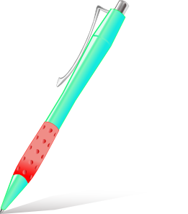
Vocabulario
Masculine nouns (un = a, an)
leer / hablar
un
gato
un
barco
un
bolígrafo
un
libro
Notes:
Timing: 2 minutes (two slides)
Aim: to present/recap new vocabulary for this week. Procedure: 1. Click to bring up each picture and then each written word. Elicit repetition.
2. At the end of the slide rewind the animations a couple of times to repeat the sequence. 3. Then repeat the process with the next slide.
Notes:
Presentation of the active nouns in the tasks that follow. Here, all the masculine nouns are introduced.
All nouns to be taught this week have regular gender marking (i.e. -o ending with masc nouns; -a ending with feminine nouns). This makes the gender recognition easier for students’ first encounter with the concept of gender of nouns. You could point this out to students, but also so that this is not always the case. Some nouns have other endings (e.g. elefante).

Slide 13
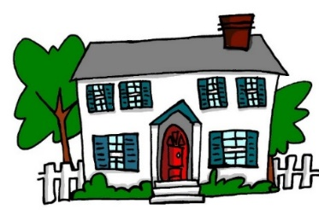
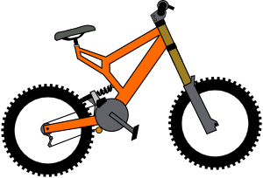
Vocabulario
Feminine nouns (una = a, an)
leer / hablar
una
casa
una
cama
una
cámara
You can also just say ‘bici’!
una
bicicleta
una
moneda
Notes:
[2/2]

Slide 14
Vocabulario
hablar
un
una
Notes:
Timing: 2 minutes
Aim: to practise oral recall of vocabulary and association with the correct indefinite article.
Procedure:
Ask students to predict which pacman will eat the object depending on the noun’s gender.
Students may need to say the word aloud first, then decide if it is ‘un’ or ‘una’. Students are still in early stages of learning this new vocabulary, so teachers may need to prompt with the correct Spanish word.

Slide 15
¡Cluedo!
¿Qué es, y dónde está?
(What is it and where is it?)
escuchar
Lire
Daniel is listening to some clues in a Cluedo game but Hugo is distracting him! Which things are mentioned? Circle the correct ones.
Es un / una | gato / bicicleta. | Está en un / una | barco / casa.
Es un / una | bolígrafo / moneda. | Está en un / una | cama / libro.
Es un / una | libro / cámara. | Está en un / una | barco / bicicleta.
Es un / una | barco / casa. | Está en un / una | libro / moneda.
Es un / una | bolígrafo / casa. | Está en un / una | barco / cama.
1
2
3
4
5
Notes:
Timing: 8 minutes
Aim: to practise focusing on the indefinite article to determine the gender of noun it refers to.
Procedure:
1. Focus students’ attention on the title (¿Qué es, y dónde está?). Some may have heard the word before (‘qué será será’, ‘¿qué pasa?’). Ensure that the meaning of this question word in the title is clear and elicit the translation of title. 2. Students write 1-5.
3. Students listen and write the two correct nouns each time.
4. After finishing, focus on meaning and ask students if any of these sound a bit odd/unexpected!
Note: they may also write the indefinite article, but this isn’t essential; they will have to pay attention to it, in any case, to work out which noun is correct.
Transcript:
Es un [gato]. Está en un [barco]
Es una [moneda]. Está en un [libro]
Es una [cámara]. Está en una [bicicleta]
Es un [barco]. Está en una [moneda]
Es una [casa]. Está en una [cama].

Slide 16
Partner A
Say the start of the sentence in Spanish to your partner.
hablar / escuchar
Choose the word for ‘a’ carefully (either un or una), depending on your choice of picture.
Note: un is for masculine nouns and una is for feminine nouns. Do not say the noun!
E.g. ‘Es una…’
Partner B
Listen carefully to the sentence starter (‘Es un…’ or ‘Es una…’).
Finish the sentence in Spanish. E.g., ‘Es una cámara.’
Partner A
Listen carefully to your partner to make sure they say the noun you were thinking of.
Notes:
Timing: 10-12 mins (both rounds)
Aim: to practise producing and understanding indefinite articles in the oral modality; to practise retrieving nouns and correct indefinite articles from memory
Procedure:
1. Use this slide to give instructions and model the activity
2. Partner A gives their sentence beginning (Es un/una…..without saying the noun!)
3. Partner B says the correct noun, based on the indefinite article they hear.
4. Partner A confirms the answer or corrects their partner.
5. After all 5 items, move to the next slide and swap roles.

Slide 17
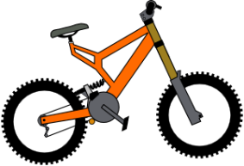
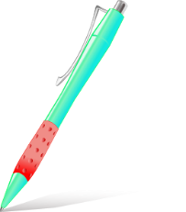
Persona A habla. Persona B escucha.
Partner B
2)
3)
4)
5)
Notes:
DISPLAY DURING ACTIVITY
Student A prompt cards and Student B answer grid.
Procedure:
1. Use this slide to give instructions and model the activity
2. Partner A gives their sentence beginning (Es un/una…..without saying the noun!)
3. Partner B says the correct noun, based on the indefinite article they hear.
4. Partner A confirms the answer or corrects their partner.
5. After all 5 items, move to the next slide and swap roles.
Note: if students need support to recall some/any of the nouns, direct them to their KO or their language guide.

Slide 18
Partner B habla. Persona A escucha.
Partner A
2)
3)
4)
5)
Notes:
DISPLAY DURING ACTIVITY
Note: if students need support to recall some/any of the nouns, direct them to their KO or their language guide.

Slide 19
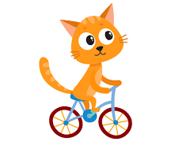
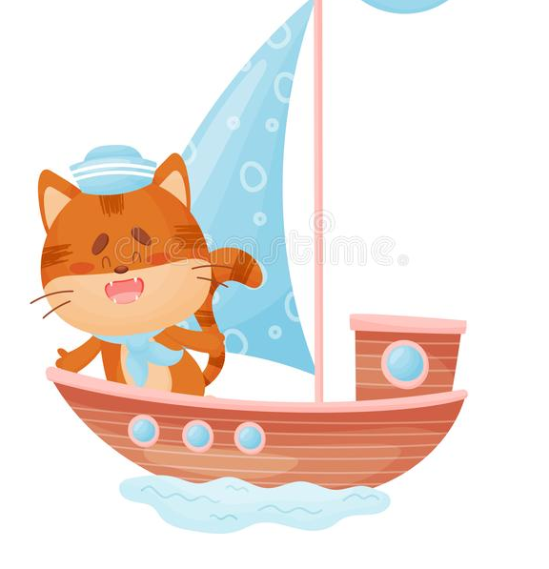
¡A escribir!
escribir
¿Dónde está Snapcat?
Daniel and Hugo see Snapcat everywhere they go! Write descriptions in Spanish of where he is in each picture. Choose the word for a carefully.
Está en una bicicleta.
Está en una cama.
Está en un barco.
Está en una casa.
Está en un libro.
Notes:
OPTIONAL (either class or homework)
Timing: 6 mins
Aim: to practise the use of the singular indefinite article in written production.
Procedure:
1. When giving the instructions, if students need help with the sentence content, give them the English (He is on a bike, He is in a bed, etc.). Remind students that en is for both ‘on’ and ‘in’ and that ‘está’ is used to say ‘it is’ for location.
2. Students write the 5 sentences.

Slide 20
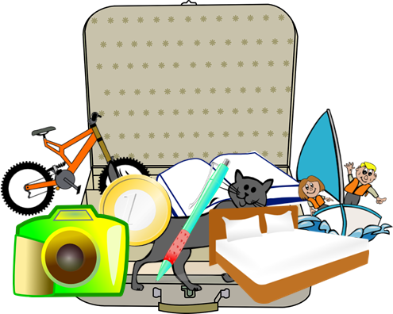
Saying what people have [2]
TENER – tengo / tienes / tiene
yes-no questions [revisited]
Y7 Spanish Term 1.1 – Week 4 – Lesson 7 Nick Avery / Victoria Hobson Date updated: 28.07.23
Notes:
Learning outcomes:
Introduction of TENER – tengo / tienes / tiene Consolidation of yes/no questions with raised intonation
Word frequency (1 is the most frequent word in Spanish):
7.1.1.4 (introduce) tener [19]; tengo; tiene; tienes; moneda [1577]; cama [609]; casa [106]; cámara [903]; bicicleta [3684]; libro [230]; barco [1384]; bolígrafo [>5000]; gato [1728]; ¿qué? [50]; nuevo [94]; un/a [6]; lee [leer-209]; frase [1036]; letra [977]; papel [393]
7.1.1.1 (revisit) estar [21]; estoy; estás; está; norte [624]; sur [661]; Inglaterra [N/A]; España [N/A]; ¿dónde? [161] en [5]; hola [1245]; hasta luego [luego-150]
Source: Davies, M. & Davies, K. (2018). A frequency dictionary of Spanish: Core vocabulary for learners (2nd ed.). Routledge: London

Slide 21
Vocabulario
hablar
un gato
un barco
un bolígrafo
una casa
una cama
una cámara
una moneda
una bicicleta
Notes:
Timing: 5 minutes (two slides)
Aim: to reinforce the nouns taught this week.
Procedure:
Pictures appear in order: teacher says them, students repeat.
Words remain only - students pronounce chorally without teacher support
Question icons elicit the English meanings, one by one.
Move to the next slide to elicit the Spanish words for each odd one out, depending on the noun genders.

Slide 22
Vocabulario
İPilla al intruso!
hablar / escribir
1.
4.
un
un
una
una
una
un
2.
5.
un
una
un
una
un
un
3.
6.
der
una
una
un
una
una
un
Notes:
Aim: to practise vocabulary recall, with a focus on the gender of each noun and correct naming of the article(s).
Procedure: 1. Clarify the meaning of the title of the activity. Pilla al intruso – Find the odd one out.
2. Pupils find the odd one out by identifying the gender of each noun.
3. Elicit the answers and click to confirm them.
Note: students could challenge themselves to complete this activity as a written task, writing the answers, either on mini whiteboards or in their books.
Frequency of unknown words and cognates: intruso [>5000] pillar [4901]

Slide 23
Tener – tengo / tienes
In Spanish, the verb tener means to have.
Tengo
I have
Tienes
you have
Tengo una idea.
I have an idea.
Tienes una casa.
You have a house.
Notes:
Timing: 2 minutes Aim: to present two forms of the verb tener
Procedure:
1. Click to reveal each new part of the explanation.
2. Ask students for the English translation of Spanish sentences (using the orange question mark as a prompt)
Note: this week we introduce the vocabulary item ‘papel’ [393]. This could be used with the new verb ‘tengo’ or ‘tienes’ in class. (¿Tienes papel? Sí/no).

Slide 24
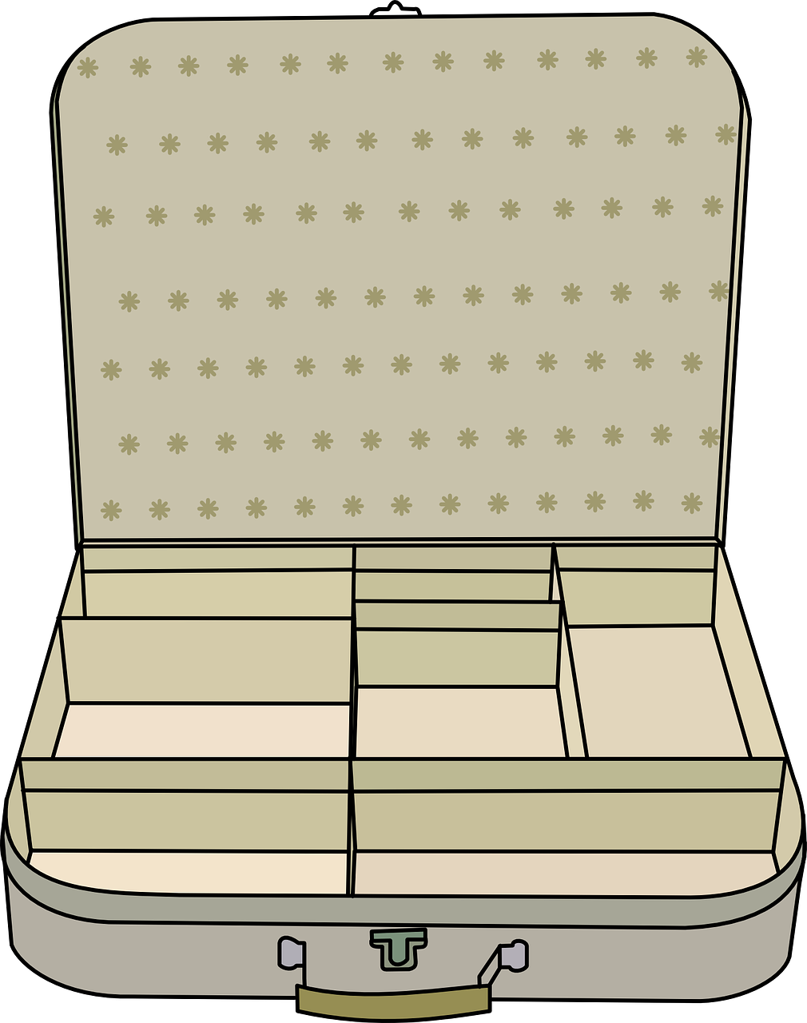
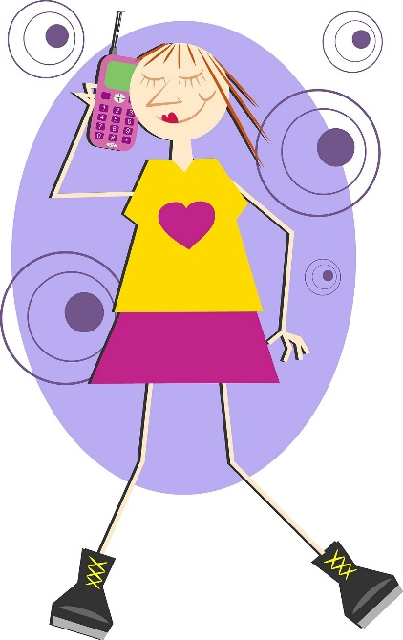
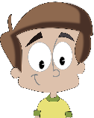
escuchar
En la maleta… Sofía is preparing for a trip. This time she is going with her boyfriend. Who has what in their suitcase ?
Tick ‘I have’ or ‘you have’.
la maleta
I have
you have
 |  | Object | Description
1
boat
fantastic
2
bicycle
white
3
cat
mad (now)
4
book
famous
5
coin
new
6
bed
high
Notes:
Timing: 10 mins
Aim: to practise distinguishing between ‘tengo’ and ‘tienes’ and their meanings; to recall the meanings of the new vocabulary
Procedure:
1. Students write 1-6 and 4-column copy the grid into their books
2. They listen to each item. The first time they only tick ‘I have’ or ‘you have’ (this is the key grammatical information).
3. The second time they listen they focus on the the lexical item and its description, completing this information in English in the right-hand columns.
4. Check answers (these will appear in the order described above)
4. Ask students if there are any surprising items in their suitcases (gato, barco, cama)!
Notes:
1. In checking the descriptions, students might be encouraged to notice adjective agreement (from the previous week). This point may only need to be noted in passing, or teachers may wish to make more of the explanation as a teaching point, depending on the profile of the group.
2. See if students can distinguish the temporary state in item 3 (“está loco”) from the general attributes (‘es famoso’, ‘es blanco’ in the others)
3. To focus on sound-spelling correspondences, students could also listen again and transcribe the sentences.
4. Students have so far seen ‘alto’ as ‘tall’. Here, it refers to an object, so the translation would be ‘high’. Try to elicit this from them.
Transcript:
Tengo un barco. Es fantástico.
Tienes una bicicleta. Es blanca.
Tienes un gato. Está loco.
Tengo un libro. Es famoso.
Tengo una moneda. Es nueva.
Tienes una cama. Es alta.

Slide 25
Tener: I have & s/he has
We have learnt the verb tener means to have.
Tengo
I have
Tienes
you have
Tiene
he / she / it has
Tiene un libro.
S/he has a book.
Tiene una casa.
S/he has a house.
Notes:
Timing: 2 minutes Aim: to present the 3rd person singular of the verb tener
Procedure:
1. Click to reveal each new part of the explanation.
2. Ask students for the English translation of Spanish sentences (using the orange question mark as a prompt)

Slide 26
¿Qué tienes, Daniel?
Daniel is talking to Hugo(‘you’)about what each has. Daniel also mentions what his sister Lucía (‘she’) has.
leer
Write the item in English that each person has.
 |  | Daniel |  | Lucía
1 | Tiene un barco. Tengo una cámara.
2 | Tengo una bicicleta. Tienes un libro.
3 | Tiene una casa. Tengo un barco.
4 | Tengo una moneda. Tiene un bolígrafo.
5 | Tengo un gato. Tienes una cama.
‘she has’
‘I have’
‘you have’
a camera
a boat
a bike
a book
a boat
a house
a coin
a pen
a cat
a bed
Notes:
Timing: 8 mins
Aim: to distinguish between the three previously taught forms of ‘tener’
Procedure:
1. Students write 1-6 on the left-hand margin, with 3 column headers (I have, you have, she has)
2. They read the sentences and write the vocabulary item in English in the correct column.
3. Check answers and give feedback
Notes:
1. By now, students will be very familiar with the vocabulary plus the three singular parts of tener, which have up to now featured in pairs. In this activity, all sentences have ‘tengo’, but not all have ‘tiene’ – some have ‘tienes’ instead. In this way, students have to pay close attention to both the verb form and the item.
Word frequency (1 is the most frequent word in Spanish): moneda [1577]; cama [609]; casa [106]; cámara [903]; bicicleta [3684]; libro [230]; barco [1384]; bolígrafo [>5000]; gato [1728]
Source: Davies, M. & Davies, K. (2018). A frequency dictionary of Spanish: Core vocabulary for learners (2nd ed.). Routledge: London

Slide 27
Alphabet 1
Letras
A
B
C
D
E
F
G
H
I
J
K
L
M
N
Ñ
O
P
Q
R
S
T
U
V
W
X
Y
Z
Notes:
Timing: 5 minutes Aim: to introduce students to the Spanish alphabet. Procedure:
Click on the letter for audio.
Students repeat.
Drill the alphabet with a song/chant of choice. (See below for suggestion).
Notes:
1. This is also an opportunity to teach the new vocabulary item ‘letra’ [977].
2. We usually use the ‘drill instructor’ chant/song to learn the alphabet. Teacher will lead first but after some practice, individuals can take on this role, or class can be split into two halves etc. Have fun with it.

Slide 28
Alphabet 2
 | A | B | C | D | E | F | G | H | I | J | K
P | a | l | x | i | t | e | p | b | m | y | j
Q | b | m | y | j | u | f | q | c | n | z | k
R | c | n | z | k | v | g | r | d | o | a | l
S | d | o | a | l | w | h | s | e | p | b | m
T | e | p | b | m | x | i | t | f | q | c | n
U | f | r | c | n | y | j | u | g | r | d | o
V | g | s | d | o | z | k | v | h | s | e | p
W | h | t | e | p | a | l | w | i | t | f | q
X | i | u | f | q | b | m | x | j | u | g | r
Y | j | v | g | r | c | n | y | k | v | h | s
Z | k | w | h | s | d | o | z | l | w | i | t
Notes:
Timing: 5 minutes Aim: to practise the understanding and producing the Spanish alphabet. Procedure:
Give out small versions of this grid for students to use.
Student A chooses grid coordinates (e.g. C, X) and student B has to say which letter those coordinates meet at (e.g. f).

Slide 29
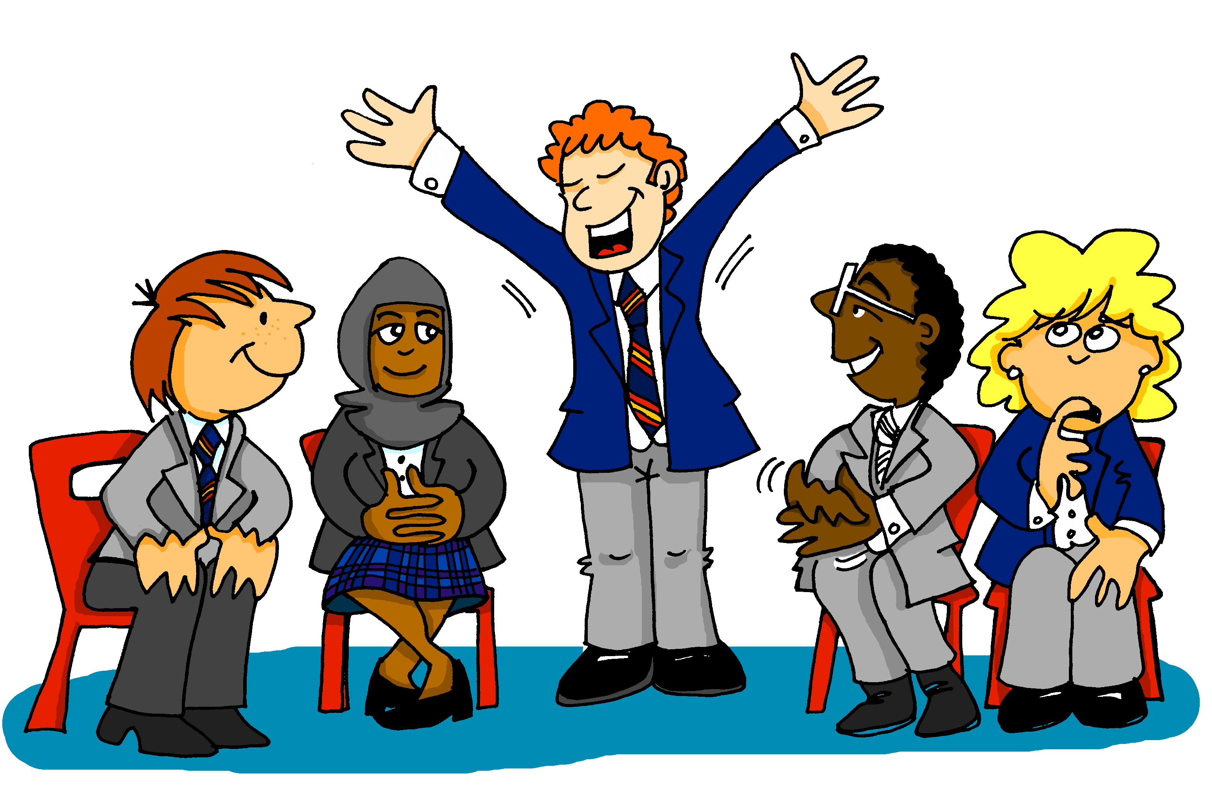
SPELLING BEE
Listen and write!
Notes:
Timing: 5 minutes Aim: to introduce students to the concept of the Spelling Bee.
Procedure:
Explain that the teacher will start a 1 minute timer and say a word in English.
One student has to translate the word into Spanish (including the article, for nouns) and then spell the word using the Spanish alphabet (but they don’t need to spell the article).
The rest of the students have to write down how they think the word is spelled and mark the speller right or wrong.
Use the list of words on the next slide for this activity.
Notes: 1) Time allowing, it would be good to put students into pairs to practise. Student A calls in English, Student B faces away from the board, translates the word into Spanish (saying the article, for nouns, but not spelling the article) and spells the word. Then they swap roles.
2) Pupils may want to put themselves forward for the actual FL Spelling Bee (see https://www.flsb.co.uk/ and email Sarah Schechter (ss2431@cam.ac.uk) where Y7 students have to spell words aloud within a time limit. There are 4 stages to the competition: class, whole school, regional, national.
Alternatively, teachers may simply want to introduce it as a class activity to practise vocabulary every now and then with their classes.

Slide 30
Spelling Bee 2
estar | to be | being [location /state]
está | is [location / state]
¿dónde? | where?
en | in, on
estoy | I am
yo | I
¿cómo? | how?
hoy | today
nervioso | nervous
tranquilo | calm
serio | serious
raro | strange
tonto | silly
blanco | white
muy | very
Notes:
The first 15 words from the Spelling Bee, Stage 1. Students have learnt these words already, but this is the first time they will have practised spelling them out loud using the Spanish alphabet.

Slide 31
Word
 |  | English meaning
1 | tienes | you have (singular)
2 | tiene | s/he has, it has
3 | tener | to have, having
4 | tengo | i have
5 | ¿qué? | what?
6 | un | a (masculine)
7 | una | a (feminine)
8 | una moneda | a coin
9 | una cama | a bed
10 | una casa | a house
11 | una cámara | a camera
12 | una bicicleta | a bicycle
13 | un libro | a book
Notes:
IF YOU PLAN FOR STUDENTS TO PRE-LEARN VOCABULARY USING AN APP THIS WOULD BE A USEFUL OPPORTUNITY TO INTRODUCE IT TO THE CLASS.
See the notes on the next slide.

Slide 32
Deberes
Vocabulary Learning Homework (Term 1.1, Week 5)
Audio file
Student worksheet
In addition, revisit: Term 1.1 Week 2
Notes:
Use this slide to set the homework.
For Y7, the typical homework will be to pre-learn vocabulary for the next lesson. There is an audio file to accompany the student worksheet.
Notes:
i) Teachers may, in addition, want to recommend use of a particular online app for the pre-learning of each week’s words. ii) Quizlet now requires parental involvement / registration / permissions for users below the age of 13, so it is perhaps most suitable for Y9 – 11 students. iii) Language Nut hosts LDP vocabulary lists and these are free for schools to use, though there is a registration process. One benefit is that all of the student tracking data that Language Nut offers are also available to schools that use the LDP lists for practice. Perhaps this makes it a good option for Y7/8.
iv) There are other free apps, and new ones are always appearing. Teachers have told us that they are currently using: Flippity, Wordwall (where using previously-created activities is free).
v) Gaming Grammar has been acquired by Language Nut. Its original content should still be available to teachers and much of it is appropriate for Y7 learners. For example, this lesson students could practise Indefinite articles: gender.

