Slide 1
Saying what someone is like (in general)
SER – soy / eres / es for TRAITS
SSC [u]
¿Cómo es…?
¿Cómo eres…?
Y7 Spanish Term 1.1 – Week 3 – Lesson 5 Victoria Hobson / Nick Avery Date updated: 27.07.23
Notes:
Note: all words (new and revisited) in this week of the SOW appear on all three GCSE wordlists, with the following exceptions:
AQA list does not have marcar.
Edexcel list does not have marcar, correcto, guapo.
Learning outcomes:
Introduction of SSC [u]
Introduction of [ser for traits]
Word frequency (1 is the most frequent word in Spanish):
7.1.1.3 (introduce) ser [7]; soy; eres; es; alegre [2081]; simpático [3349]; guapo [4192]; alto¹ [231]; bajo¹ [236]; y [4]; marca [marcar-993]; correcto [1467]; opción [1175]
Source: Davies, M. & Davies, K. (2018). A frequency dictionary of Spanish: Core vocabulary for learners (2nd ed.). Routledge: London

Slide 2
u
universo
Nick Avery
Notes:
Introduce and elicit the pronunciation of the individual SSC ‘U’ and then present and practise the pronunciation of the source word ‘universo’.
A possible gesture for this source word would be to extend your arms over your head and then out to the sides in a single motion

Slide 3
u
universo
Nick Avery
Notes:
Repeat the sound and elicit the source word.

Slide 4
u
mundo
mucho
un
lugar
universo
[a; an]
[place]
nunca
[never]
Nick Avery
Notes:
Introduce and elicit the pronunciation of the individual SSC ‘u’ and then the source word again (with gesture, if using). Then present and elicit the pronunciation of the five cluster words.
The cluster words have been chosen for their high-frequency, from a range of word classes, with the SSC (where possible) positioned within a variety of syllables within the words(e.g. initial, 2nd, final etc..) and additionally, we have tried to use words that build cumulatively on previously taught SSCs (see the Phonics Teaching Sequence document) and do not include new SSCs. Where new SSCs are used, they are often consonants which have a similar symbol-sound correspondence in English.

Slide 5
u
mundo
mucho
un
lugar
universo
nunca
Nick Avery
Notes:
Without the images, students focus this time again closely on the SSC and the cluster words.

Slide 6
u
mundo
mucho
un
lugar
universo
nunca
Nick Avery
Notes:
Without the images or sound, students have to pronounce the words themselves.

Slide 7
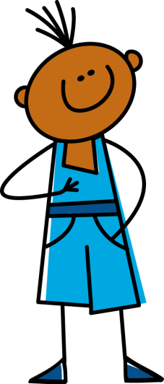
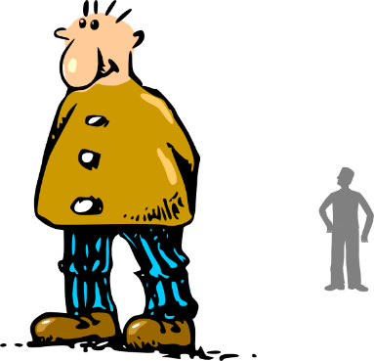
Fonética
leer / hablar
a
e
i
o
u
alto
elefante
idea
yo
universo
Notes:
Recap of SSCs taught so far (1.1.1-1.1.3)
Timing: 2 minutes
Aim: to refresh knowledge of the 5 vowels taught so far
Procedure:
1. Students say the SSC as they appear on each click.
2. Students say the source words as they appear on each click. (Teacher to monitor carefully, particularly ‘idea’)
3. Words disappear. Students say the source words in response to picture prompts

Slide 8
Vocabulario
30
 | Word | English meaning
1 | alto | tall
2 | bajo | short
3 | simpático | nice, friendly
4 | alegre | cheerful
5 | guapo | good-looking
6 | y | and
Some Spanish adjectives don’t end in –o or –a.
You will see more of these.
Segundos
0
INICIO
Notes:
Vocabulario
Timing: 1-3 minutes Aim: To reactivate and strengthen vocabulary knowledge. Note: The verbs will be introduced on other slides.
Procedure: Round 1: Look at the Spanish, recall the English meanings, saying them aloud. [1 minute] Round 2: Look at the English, recall the Spanish meanings, saying them aloud. [1 minute] Repeat for two further minutes, to speed up recall.
Vocabulary for week 3:
ser [7]; soy; eres; es; y [4]; alegre [2081-in AQA]; simpático [3349-in AQA]; guapo [4192-in AQA]; alto [231]; bajo [236]
Note: Students may need support with the pronunciation of 1] ‘j’ in ‘bajo

Slide 9
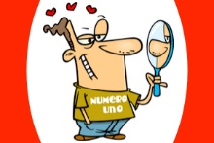
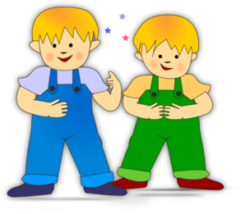
Vocabulario
simpático
alegre
guapo
alto
bajo
Notes:
Vocabulary practice slide
Timing: 3 minutes
Aim: to further reinforce the new adjectives
Procedure:
Pictures and words appear in order: teacher says them, students repeat.
Words remain only - students pronounce chorally without teacher support.
Question icons elicit the English meanings, one by one.
Pictures appear and disappear, out of sequence, eliciting Spanish.
Note: ‘Tranquilo’ (introduced in 1.1.2) will later be recycled as this is an example of an adjective which can be used with both estar and ser and is pertinent to the activity.
Word frequency (1 is the most frequent word in Spanish): simpatico [3350], alegre [2082], guapo [4193], alto [232], bajo [237]
Source: Davies, M. & Davies, K. (2018). A frequency dictionary of Spanish: Core vocabulary for learners (2nd ed.). Routledge: London

Slide 10
Ser: I am & he/she is
In Spanish, the verb ser means to be when describing permanent characteristics (e.g. what someone is like in general).
Soy
I am
Es
it / he / she is
This is different from temporary states (e.g. I am acting strange). We will look at these together later on.
Soy raro
I am strange
Es alegre
He / she / it is cheerful
Notes:
Grammar introduction slide
Timing: 2 minutes
Note: the speech bubble can be used to very briefly refer to the temporary states taught last week (1.1.2) as students may wonder why a verb for ‘to be’ is being introduced again. At this stage, students are not expected to be choose which of the two verbs to use. Indeed, to avoid overload in the early weeks, we teach each verb separately. Later in Y7, once students have had more practice with the separate forms, ser and estar will be juxtaposed in the same activities (see 2.1.5, 2.2.5, 3.1.3).

Slide 11
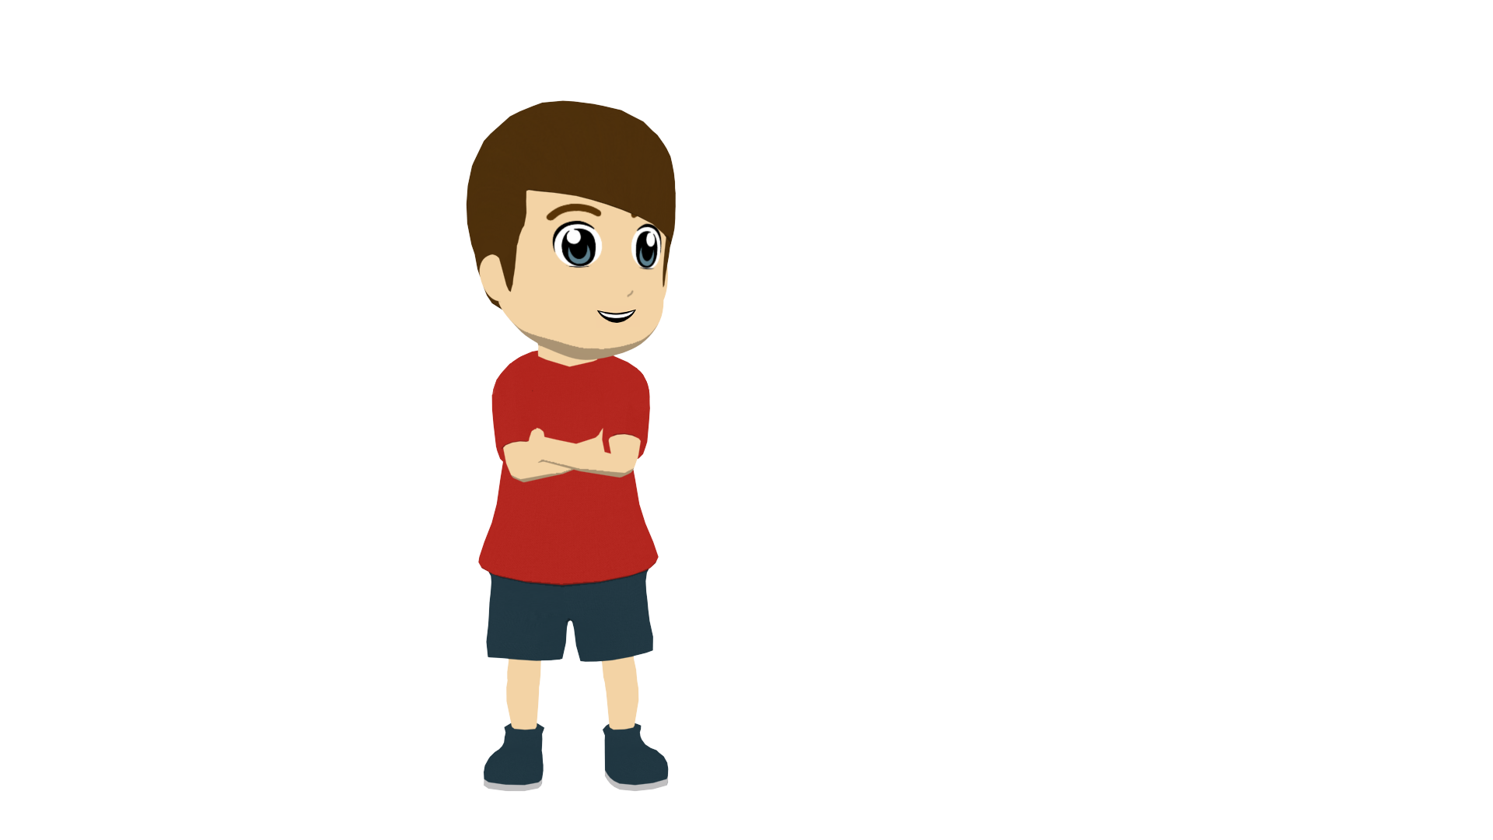
Daniel y* Hugo
y = and
escuchar
Daniel is talking about himself and his best friend Hugo. Who is he describing? Marca la opción correcta.
Daniel
Hugo
‘I am’
‘he is’
1
Soy alto.
2
Es simpático.
3
Es alegre.
4
Soy simpático.
5
Soy tranquilo.
6
Es guapo.
Notes:
Timing: 8 minutes
Aim: to practise distinguishing between ‘soy’ and ‘es’ and their meanings
Procedure:
1. Students write 1-8.
2. They listen and write Paco (‘I am’) or Paulo (‘he is’).
3. Students consider the meanings of the adjectives in the sentences (these are displayed) and decide how similar the twins are - Are they identical twins? Not quite!
4. Students translate the sentences into English (see next slide for answers).
Notes:
1. tranquilo is recycled from week 2 as this is an example of an adjective which can be used with both estar and ser and is pertinent to the activity.
2. Teachers need not print the slide. Students could use their ex books to write their responses. Students do not need to copy out the table.
3. ‘Marca la opción correcta’ is likely to be understood, given that these words are near-cognates, but do draw students attention it. It will frequently be used in task instructions.
Transcript:
Soy alto.
Es simpático.
Es alegre.
Soy simpático.
Soy tranquilo.
Es guapo.

Slide 12
Respuestas
1 | Soy alto.
2 | Es simpático.
3 | Es alegre.
4 | Soy simpático.
5 | Soy tranquilo.
6 | Es guapo.
I am tall.
He is nice.
He is cheerful, happy.
I am nice.
I am calm, quiet.
He is good-looking.
Notes:
TRANSLATION ANSWERS

Slide 13
Ser: I am & you are
We have learnt the verb ser means to be when describing permanent characteristics.
Soy
I am
Es
he / she / it is
Eres
you are
Eres alegre.
You are cheerful.
Eres guapo.
You are good-looking.
Notes:
Grammar introduction slide for ‘eres’
Timing: 2 minutes
Having seen 1st and 3rd person singular, now explain 2nd person singular to students.

Slide 14
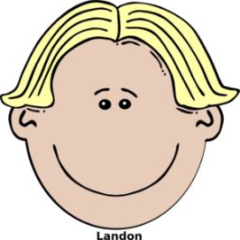
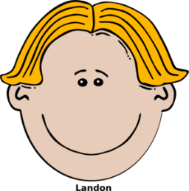
escuchar
Guess who? game 1st time: which cards are ‘I am’ and which are ‘you are’? 2nd time: write the Spanish, then identify the person.
 | quiet |  | good- looking
 | tall |  | quiet
 | short |  | cheerful
 | nice |  | tall
 | short |  | quiet
 | cheerful |  | short
 | nice |  | tall
 | tall |  | good- looking
Note! There are two names too many.
Paco
Raúl
I am
You are
 |  |  |  | Name?
1
2
3
4
5
6
Soy alegre y alto.
Rafa
1
David
David
Rafa
2
Eres bajo y simpático.
3
Eres guapo y tranquilo.
Raúl
4
Soy alto y guapo.
Carlos
Pablo
Pablo
Arturo
5
Soy alegre y bajo.
Eres tranquilo y bajo.
Arturo
6
Juan
Carlos
Notes:
Timing: 8 minutes
Aim: to practise differentiating the verb forms ‘soy’ and ‘eres’ and understanding new vocabulary in the oral modality
Procedure:
1. Students write 1-6.
2. Play each item.
3. Students then look at the profiles on the right and decide who the person must be, based on the description
Transcript:
Soy alegre y alto.
Eres bajo y simpático.
Eres guapo y tranquilo.
Soy alto y guapo.
Soy alegre y bajo.
Eres tranquilo y bajo.
Word frequency (1 is the most frequent word in Spanish): simpatico [3350], alegre [2082], guapo [4193], alto [232], bajo [237], tranquilo [1073]
Source: Davies, M. & Davies, K. (2018). A frequency dictionary of Spanish: Core vocabulary for learners (2nd ed.). Routledge: London

Slide 15
Eres guapo.
escribir
you are (character trait)
good-looking

Slide 16
Es tranquilo.
escribir
He is (character trait)
calm
Notes:
Timing: 5 minutes (4 slides)
Aim: to practise producing verb forms ‘soy’, ‘eres’ and ‘es’; to produce the new vocabulary in the written modality
Procedure:
Students write 1-4 in books or mini whiteboards.
Students look at the picture prompts and write the correct sentence.
Click to correct.
Note: All three forms of SER are included in this task: soy, eres, es, since students have had plenty of practice with these features in pairs.

Slide 17
Soy alegre.
escribir
I am (character trait)
cheerful

Slide 18
Eres simpático.
escribir
you are (character trait)
nice/friendly

Slide 19
Saying what someone is like (in general)
yes-no questions
question vs statement intonation
gender agreement (-o, -a) [revisited]
¿Cómo es…?
¿Cómo eres…?
Y7 Spanish Term 1.1 – Week 3 – Lesson 6 Victoria Hobson / Nick Avery Date updated: 27.07.23
Notes:
Learning outcomes:
Consolidation of SSC [u] and other vowels [a], [e], [i], [o] Consolidation of ‘soy’, ‘eres’, ‘es’
Consolidation of adjective agreement (for biological gender only)
Introduction of yes/no questions with raised intonation
Word frequency (1 is the most frequent word in Spanish):
ser [7]; soy; eres; es; alegre [2081]; simpático [3349]; guapo [4192]; alto¹ [231]; bajo¹ [236]; y [4]; marca [marcar-993]; correcto [1467]; opción [1175]
Source: Davies, M. & Davies, K. (2018). A frequency dictionary of Spanish: Core vocabulary for learners (2nd ed.). Routledge: London

Slide 20
¡A hablar!
hablar
A
[nice, friendly]
[calm]
[you are – character trait]
[cheerful]
[good-looking]
[tall]
[short]
[he is – character trait]
Notes:
Timing: 6 minutes (two slides)
Aim: to practise, in the oral modality, producing ‘eres’ and ‘es’ with the new vocabulary items
Procedure:
1. Group A – (e.g., left-hand side of the class) gives the Spanish.
2. Group B – (e.g., right-hand side) translates into English (facing away from the board)
3. Teacher monitors readiness of responses, verb forms and pronunciation.
4. To be completed before the images stop spinning.
5. After six, players swap roles (see next slide).
Notes:
Speed up timings to increase the challenge.

Slide 21
¡A hablar!
hablar
B
[nice, friendly]
[calm]
[you are – permanent]
[cheerful]
[good-looking]
[tall]
[short]
[he is – permanent]

Slide 22
Adjective agreement
In Spanish, we already know that adjectives ending in ‘o’ change to an ‘a’ when the person being described is female.
Masculine
Es simpático.
He is nice.
Feminine
Es simpática.
She is nice.
When the adjective ends in ‘e’, there is no change.
Es alegre.
He/She is cheerful.
Notes:
Timing: 2 minutes
Aim: to revisit basic adjective agreement.
Procedure:
Click to present the information.
Elicit the translations of the Spanish sentences from students.

Slide 23
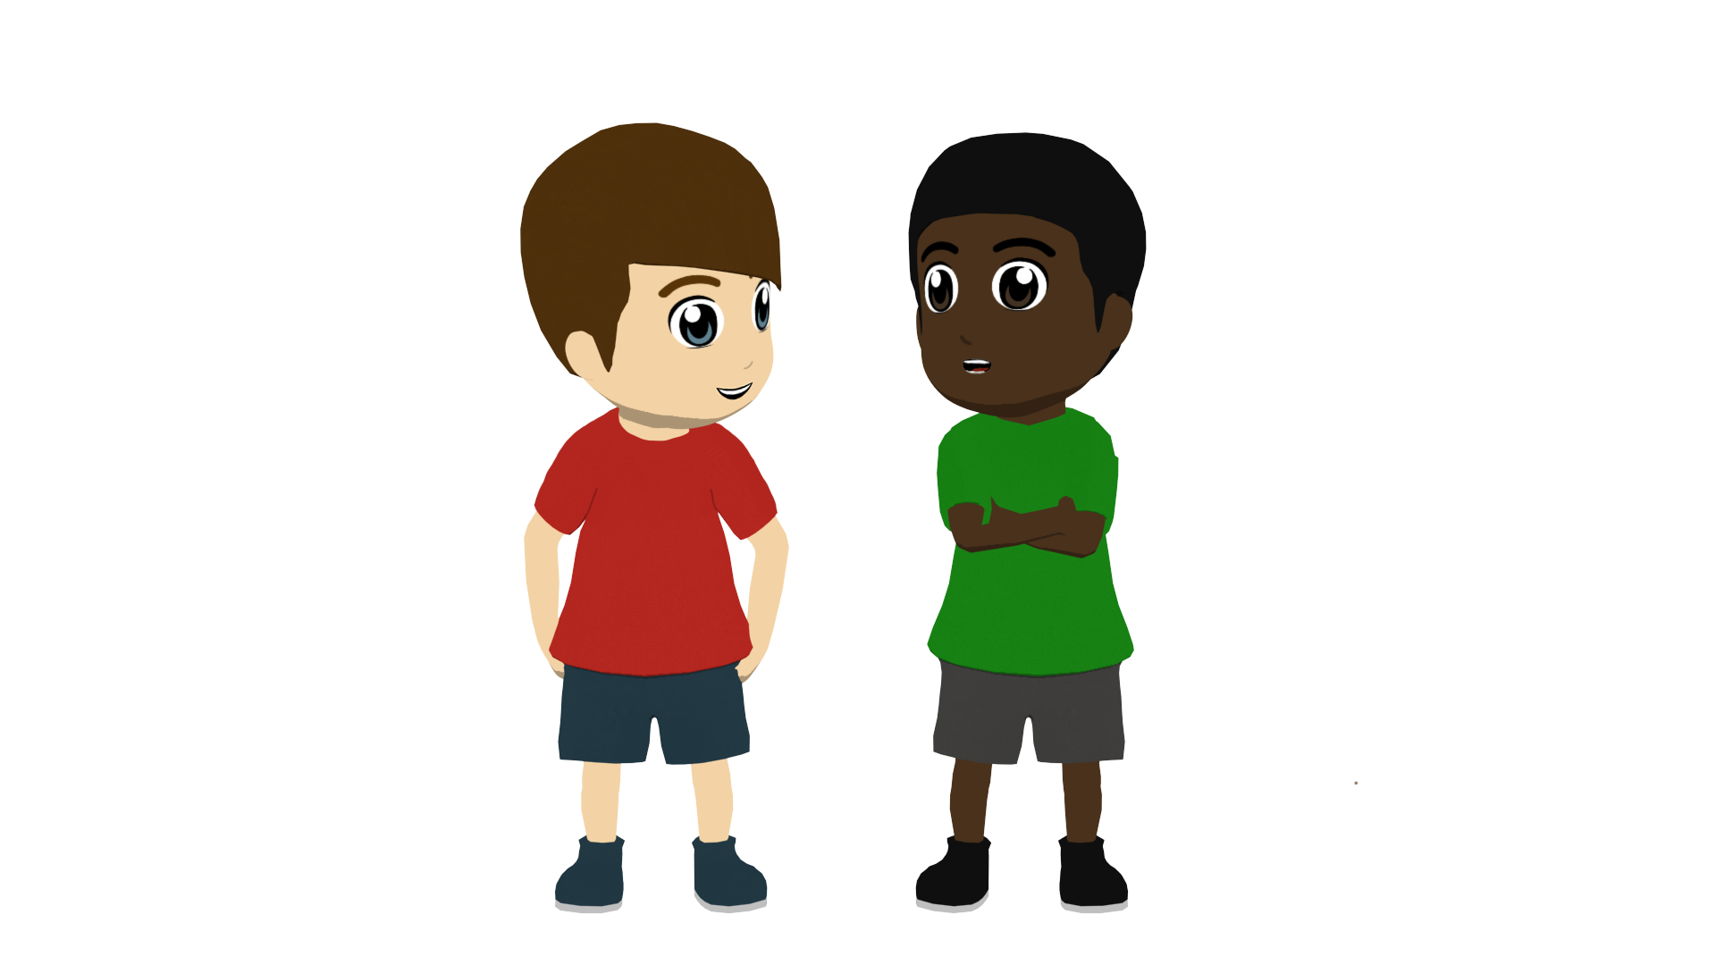
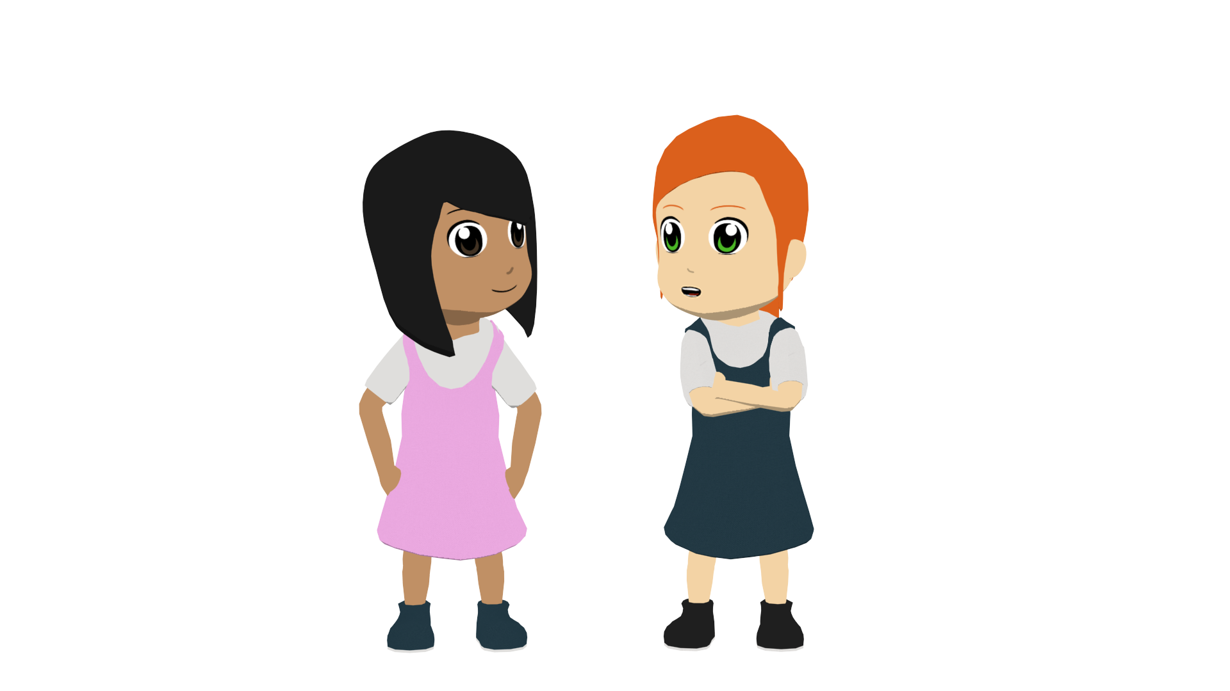
A school play
leer
A poster advertises for the lead roles in a school play, the male lead (Pablo) and female lead (Claudia). The text has been smudged. Is each description for Pablo (P) or Claudia (C)? Or could it be both?
1 | alta |  |  | 4 | alegre
2 | simpático |  |  | 5 | famosa
3 | bajo |  |  | 6 | interesante
P
C
P
C
Notes:
Timing: 7 minutes
Aim: to practise differentiating between adjective endings that mark biological gender
Procedure:
1. Ask students to write 1-8.
2. Students write P for Pablo (i.e. male subject), C for Claudia (female subject) or ‘P & C’ for both
3. Check answers and understanding of the adjectives
Notes:
1. famoso [997] is formally introduced in the second half of the autumn term, and is a cognate. 2. interesante [617] has been encountered in the phonics ‘I’ cluster words and is a cognate. It gives another example of an adjective ending in ‘e’ which doesn’t change for masculine/feminine singular.
Word frequency of unknown words and cognates (1 is the most frequent word in Spanish): famoso [997] interesante [617]
Source: Davies, M. & Davies, K. (2018). A frequency dictionary of Spanish: Core vocabulary for learners (2nd ed.). Routledge: London

Slide 24
escuchar
At lunchtime a tannoy announces 6 more characters for the play. Is it a male or female character? How is each described? Write the English.
1
4
tall, good-looking
cheerful, tall
2
5
short, nice
cheerful, short
3
good-looking, calm
6
calm, short
Notes:
Timing: 8 minutes
Aim: to practise distinguishing between masculine and feminine adjective endings
Procedure:
1. Students write 1-6.
2. Students write [M] male or [F] female for each item, depending on whether they hear a masculine or feminine adjective.
3. Optional: write the character description in English (students might need to take notes in Spanish first, then translate from their notes)
Transcript:
Es alegre y alta.
Es bajo y simpático.
Es guapo y tranquilo.
Es alta y guapa.
Es alegre y baja.
Es tranquilo y bajo.

Slide 25
Yes/no questions
In Spanish, change a statement into a question by raising your voice at the end:
Spanish uses two question marks – the one at the front is upside down!
Statement
Eres alegre.
You are cheerful.
Question
¿Eres alegre?
Are you cheerful?
Notes:
Timing: 2 minutes
Aim: to introduce yes/no questions, including the intonation difference from statements and the use of the upside down question mark.
Procedure:
Click to present the information.
Elicit the translations of the Spanish sentences from students.

Slide 26
¿Quién soy?
hablar / escuchar
Partner A
Partner B
Soy (+ adjective)
¿Eres (+ name)?
Sí / No
Notes:
Timing: 5 minutes
Aim: to work with a partner to identify the characters as quickly as possible; to practise use of adjective agreement and question intonation
Procedure:
1. Explain the title of the slide – who am I? Explain the two component parts of the phrase.
2. Use this slide to model the instructions for the pair work before displaying the master (next slide).
3. Give students 30 seconds to write down 5 names (mixture of boys/girls).
4. Work in pairs. Partners take it in turns to select a name from their own list. They give a sentence to describe themselves (Soy…).
5. The other player has to identify who is being described, using raised question intonation. Are you…?
Explain to the pupils that they have to pronounce the adjective correctly, with the correct ending, otherwise their partner cannot know who they might be.
6. At the end of the game, point out to them that grammar features (in this case masc/fem adjective endings) often help us to pinpoint the correct meaning more quickly, but not always!
Note:
1. Students have been using flat intonation of statements in their speaking tasks so far, for I am, you are and s/he is. Here they use the same word order but raised intonation to turn the statement into a question. Model this with the class a few times, contrasting flat/raised intonation. In subsequent weeks, yes/no questions using intonation will continue to be used.
2. alegre and interesante have been included deliberately here. Students may have to guess twice to get this identity.
3. the pronunciation of names gives an opportunity for phonological decoding. Names have been chosen for revising vowels and a few consonants that students have met in passing, J, R.
Word frequency of unknown words and cognates (1 is the most frequent word in Spanish): famoso [997], interesante [617]
Source: Davies, M. & Davies, K. (2018). A frequency dictionary of Spanish: Core vocabulary for learners (2nd ed.). Routledge: London

Slide 27
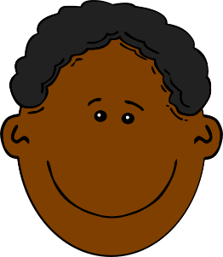
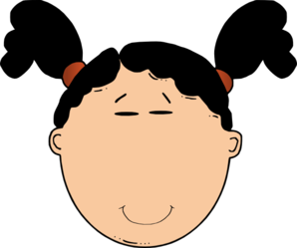
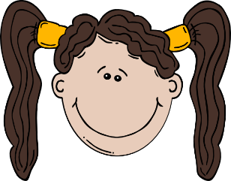
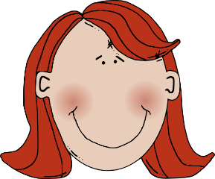
Paco
Elena
Clara
Pablo
(quiet, calm)
(quiet, calm)
(famous)
(interesting)
Irene
David
Serena
Rafa
(tall)
(short)
(tall)
(good-looking)
Juan
Carlos
Arturo
(short)
(cheerful)
(famous)
Clementina
(nice)
Fidelia
Alma
Raúl
Belén
(interesting)
(nice)
(good-looking)
(cheerful)
Notes:
Quién soy? - Who am I?
Display this on the board whilst the speaking activity is taking place.

Slide 28
hablar
¿Cómo eres?
Soy…
¿ayuda? 🆘
¿ayuda? 🆘
alegre
alto¹, alta¹
bajo¹, baja
guapo, guapa
listo, ista
nervioso, nerviosa
raro¹ , rara
serio, seria
simpático, simpática
tonto, tonta
tranquilo, tranquila
¿Cómo es…?
muy
El señor… Roberts
…..
…..
…..
La señora… Cox
……
…..
…..
Notes:
Timing: 4-5 minutes
Aim: to practise this week’s learning in a personal, communicative context.
Procedure: 1. Explain that students will work in pairs to describe themselves, in response to the question ‘cómo eres’ and a teacher they know, in response to their partner’s question: ‘cómo es Señor XXX, Señora XXX’?
2. Click the SOS to reveal written support. Click the text box to hide the support after 2-3 minutes for a 2nd round, with no support.

Slide 29
¡A escribir!
escribir
The following characters will also appear in the school play. You can decide their characters. Write a description of each. Pay attention to adjective spellings.
1 | Señora Fuentes
2 | Señor Gris
3 | Rafaela
4 | Sofía
5 | Diego
6 | Mía
e.g. 1) Es alta y alegre.
Notes:
Note: this writing activity is optional; it could also be used for homework.
Timing: 7 minutes
Aim: to write more freely using adjective agreement.
Procedure:
1. Students write a sentence for each character.
2. They will need to write using the correct form of the adjective, depending on the person (male/female)
3. Ask students to volunteer example sentences for each person

Slide 30
Deberes
Vocabulary Learning Homework (Term 1.1, Week 4)
Audio file
Student worksheet
In addition, revisit: Term 1.1 Week 1
Notes:
Use this slide to set the homework.
For Y7, the typical homework will be to pre-learn vocabulary for the next lesson. There is an audio file to accompany the student worksheet.
Notes:
i) Teachers may, in addition, want to recommend use of a particular online app for the pre-learning of each week’s words. ii) Quizlet now requires parental involvement / registration / permissions for users below the age of 13, so it is perhaps most suitable for Y9 – 11 students. iii) Language Nut hosts LDP vocabulary lists and these are free for schools to use, though there is a registration process. One benefit is that all of the student tracking data that Language Nut offers are also available to schools that use the LDP lists for practice. Perhaps this makes it a good option for Y7/8.
iv) There are other free apps, and new ones are always appearing. Teachers have told us that they are currently using: Flippity, Wordwall (where using previously-created activities is free).
v) Gaming Grammar has been acquired by Language Nut. Its original content should still be available to teachers and much of it is appropriate for Y7 learners.

