Slide 1
Saying what someone is like (at the moment)
ESTAR – estoy / estás / está for STATE/MOOD
SSC [e]
¿Cómo estás…?
Y7 Spanish Term 1.1 – Week 2 – Lesson 3 Victoria Hobson / Nick Avery Date updated: 19.07.23
Notes:
Note: all words (new and revisited) in this week of the SOW appear on all three GCSE wordlists, with the following exceptions:
Edexcel list does not have raro, tonto.
Learning outcomes (lesson 1):
Introduction of SSC [e]
Introduction of ‘estoy’, ‘estás’ and ‘está for state/mood
Note: these three verb forms were seen in 1.1.1 (with ‘estar’ for location)
Word frequency (1 is the most frequent word in Spanish):
1.1.2.3 (introduce) nervioso [1521]; tranquilo [1073]; serio [856]; raro¹ [1005]; tonto [2379]; blanco [372]; ¿cómo? [151]; muy [43]; hoy [167]; ¿Cómo se dice […] en inglés/español?; ¿Cómo se escribe?; seguro [407]; listo [1684]; sí [45]; no [11]
Source: Davies, M. & Davies, K. (2018). A frequency dictionary of Spanish: Core vocabulary for learners (2nd ed.). Routledge: London

Slide 2
e
papel
en
espalda
tener
elefante
[to have]
estar
[to be]
Nick Avery
Notes:
Timing: 3 minutes (3 slides) Aim: to practise the SSC [e]
Procedure:
1. Introduce and elicit the pronunciation of the individual SSC ‘e’ and then the source word (with gesture, if using). 2. Then present and elicit the pronunciation of the five cluster words.
The cluster words have been chosen for their high-frequency, from a range of word classes, with the SSC (where possible) positioned within a variety of syllables within the words(e.g. initial, 2nd, final etc..) and additionally, we have tried to use words that build cumulatively on previously taught SSCs (see the Phonics Teaching Sequence document) and do not include new SSCs. Where new SSCs are used, they are often consonants which have a similar symbol-sound correspondence in English.
Word frequency rankings: elefante [>5000]; papel [393]; espalda [942]; estar [21]; en [5]; tener [19] Source: Davies, M. & Davies, K. (2018). A Frequency Dictionary of Spanish: Core vocabulary for learners (2nd ed.) London: Routledge.

Slide 3
e
papel
en
espalda
tener
elefante
estar
Nick Avery
Notes:
Without the images, students focus this time again closely on the SSC and the cluster words.

Slide 4
e
papel
en
espalda
elefante
tener
estar
Nick Avery
Notes:
Without the images or sound, students have to pronounce the words themselves.

Slide 5
Fonética
escuchar
Listen and write the missing letter(s).
¿Is it [a], [e] or [o]?
e
a
a
_sp_ld_
_l_f_nt_
e
e
a
e
1
6
c_m_
a
a
p_p_l
a
e
2
7
a
a
e
c_s_
t_n_r
e
3
8
_g_st_
a
o
a
o
o
4
_lt_
9
_st_r
e
o
e
a
p_r_
5
10
Notes:
Phonics Timing: 4 minutes Aim: To differentiate between SSC that are similar, phonetically and/or orthographically.
Note: [a] and [o] were introduced in 1.1.1 Procedure: 1. Click to listen. Write the SSC and/or write the whole word. 2. Click to see the answers.
TRANSCRIPT
Espalda
Cama
Tener
Alto
Pero
Elefante
Papel
Casa
Agosto
Estar

Slide 6
hablar
¿Cómo se dice … en español? is how to ask How do you say … in Spanish?
What does ¿Cómo se dice … en inglés? mean?
Sure, certain.
¿Cómo se dice ‘seguro’ en inglés?
¿Estás seguro?
¡Sí!
Notes:
Vocabulario
Timing: 1 minute Aim: To reactivate and strengthen vocabulary knowledge. Note: Students in Y7 pre-learn their vocabulary on Quizlet. This task assists recall of the new vocabulary. Procedure: 1. Present the new language, and elicit repetition.
2. Move to the next slide, where pupils will practise vocabulary in pairs. Teacher will use ‘¿Estás listo/a?’ to check students are ready, ‘¿Cómo se dice en inglés/español?‘ and ‘¿Estás seguro/a?’ to prompt self-correction. Encourage responses ‘sí or ‘no’. Always encourage students to use these phrases in class, too.
Word frequencies:
cómo [151]; hoy [167]; nervioso [1521]; tranquilo [1073]; serio [856]; raro [1005]; tonto [2379]; blanco [372]; muy [43]; seguro [407]; listo [1684]
Note:
Phonics: students will need a little support with the pronunciation of 1] ‘qui’ in ‘tranquilo 2] silent ‘h’ in hoy, and 3] the word-initial ‘r’ in ‘raro’, which is pronounced like a ‘rr’. This can juxtaposed with the ‘r’ in ‘serio’, which is much less pronounced, but still produced with the tongue inside the mouth and no change of shape in the lips (as with English ‘r’). Students will focus on all of these sounds more explicitly, later, so they only need to be addressed briefly here.

Slide 7
Vocabulario
 | Word | English meaning
1 | ¿Cómo? | How? Sorry?
2 | hoy | today
3 | nervioso | nervous
4 | tranquilo | calm
5 | serio | serious
6 | raro | strange
7 | tonto | silly
8 | blanco | white, pale
9 | listo | ready
10 | seguro | sure, certain
11 | muy | very
60
Segundos
0
INICIO
Notes:
Vocabulario
Timing: 2-4 minutes Aim: To reactivate and strengthen vocabulary knowledge. Note: Students in Y7 pre-learn their vocabulary on Quizlet. This task assists recall of the new vocabulary. Procedure: 1. Round 1: Look at the Spanish, recall the English meanings, saying them aloud. [1 minute] 2. Round 2: Look at the English, recall the Spanish meanings, saying them aloud. [1 minute] Repeat for two further minutes, to speed up recall.
3. Teacher then uses ‘¿Estás listo/a?’ to check students are ready, ‘¿Cómo se dice en inglés/español?‘ and ‘¿Estás seguro/a?’ to prompt self-correction. Encourage responses ‘sí or ‘no’. Always encourage students to use these phrases in class, too.
Word frequencies:
cómo [151]; hoy [167]; nervioso [1521]; tranquilo [1073]; serio [856]; raro [1005]; tonto [2379]; blanco [372]; muy [43]; seguro [407]; listo [1684]
Note:
Phonics: students will need a little support with the pronunciation of 1] ‘qui’ in ‘tranquilo 2] silent ‘h’ in hoy, and 3] the word-initial ‘r’ in ‘raro’, which is pronounced like a ‘rr’. This can juxtaposed with the ‘r’ in ‘serio’, which is much less pronounced, but still produced with the tongue inside the mouth and no change of shape in the lips (as with English ‘r’). Students will focus on all of these sounds more explicitly, later, so they only need to be addressed briefly here.

Slide 8
Estar for state/mood
Remember, in Spanish the verb estar means ‘to be’ when describing ___________.
a location
‘Estar’ also means ‘to be’ when describing a mood or temporary state.
In English, we often use a verb with ‘-ing’ to talk about a temporary state (‘right now’).
For example:
I am feeling nervous.
You are being silly.
He is acting strange.
Estoy nervioso.
I am nervous.
Estás tonto.
You are silly.
Está raro.
He is strange.
Notes:
Timing: 2 minutes
Aim: to recap the function of ‘estar’ introduced last week and to introduce a new one (use of estar for state/mood)
Procedure:
Click to reveal each part of the explanation/recap
Where appropriate, elicit rules and translations from students
Note:
We are focusing on masculine forms of adjectives for now and will introduce feminine forms in lesson 2.

Slide 9
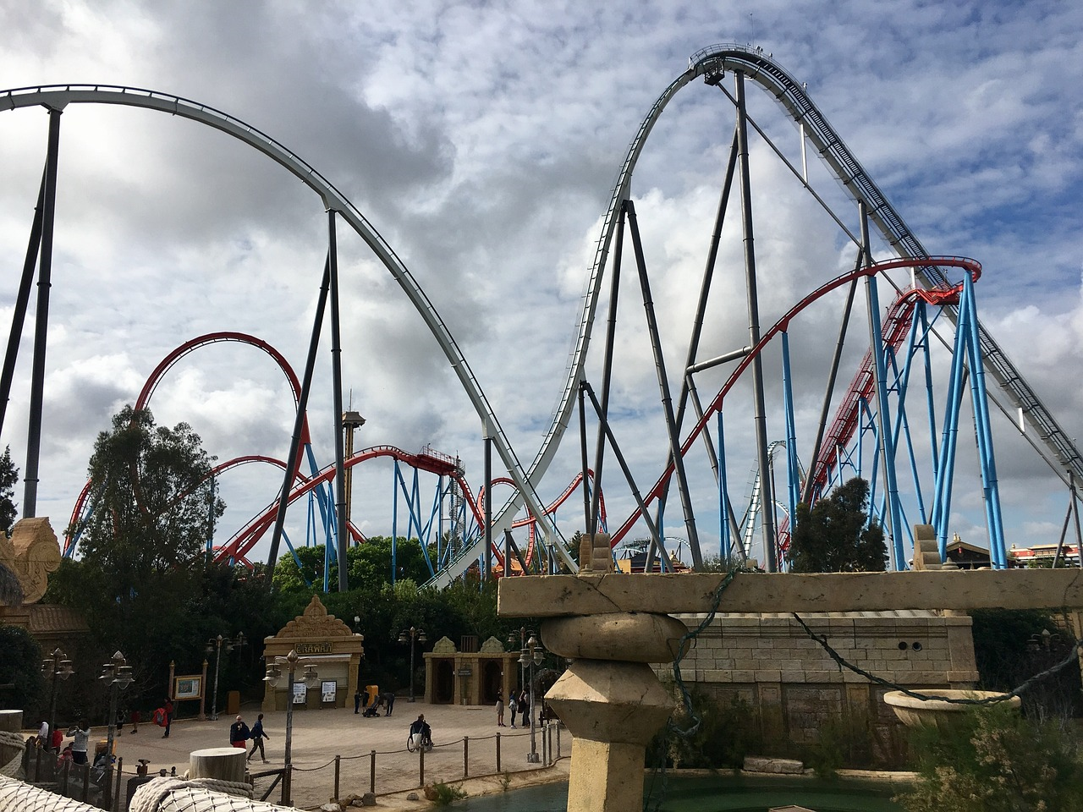
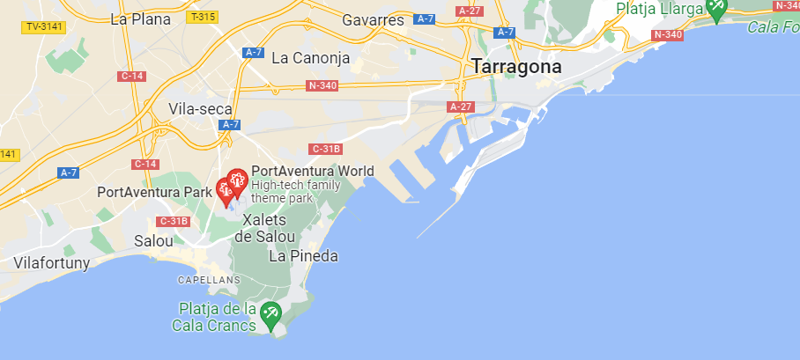
PortAventura World
PortAventura World está en Tarragona, en el norte de España. Es un parque muy famoso.
Notes:
Timing: 2 minutes
Aim: to present information about the most visited theme park in Spain, using mostly previously taught language.
Procedure: 1. Read the text with pupils.
2. Elicit the English meaning. Clarify any unknown words.
Note: both unknown words will be taught in year 7: famoso (7.1.2.4); parque (7.3.1.5)
Frequency of unknown words and cognates: famoso [997] parque [1354]

Slide 10
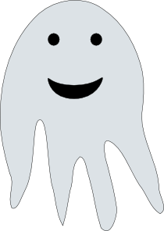
PortAvenura World
escuchar
loco = crazy
Diego and son Daniel are at the Haunted House ride. Is Diego talking about himself (‘I am’) or Daniel (‘you are’). Who is the most scared?
‘I am’
‘You are’
 |  | Diego | Daniel
1
Estás blanco.
✔
2
Estoy tranquilo.
✔
3
Estoy listo.
✔
4
Estás muy nervioso.
✔
5
Estoy serio.
✔
6
Estoy muy tonto.
✔
7
Estás raro.
✔
8
Estás loco.
✔
Notes:
Timing: 8 minutes
Aim: to practice distinguishing between ‘estoy’ and ‘estás’ and their meanings while listening.
Procedure:
1. Students write 1-8.
2. They listen and write ‘Gonzalo’ or ‘Rául’
OR
They first listen and write the sentence before deciding who is referred to. This intermediate step may suit some students as it allows more time for reflection. The full sentences in Spanish appear with the answers.
3. Review the meanings of adjectives with students (ask ‘¿Cómo se dice en inglés?’). This may mean playing the audio once again.
Note: ‘loco’ [846] is not formally included in the set for this week but is a frequent adjective that will be taught later in Year 7. Its meaning is provided in a gloss. Remember the focus here is on the verb. These additional adjectives may be picked up incidentally.
Transcript:
Estás blanco.
Estoy tranquilo.
Estoy listo.
Estás muy nervioso.
Estoy serio.
Estoy muy tonto.
Estás raro.
Estás loco.
Word frequency (1 is the most frequent word in Spanish): nervioso [1521]; tranquilo [1073]; serio [856]; raro [1005]; tonto [2379-in AQA]; blanco [372]; muy [43]
Source: Davies, M. & Davies, K. (2018). A frequency dictionary of Spanish: Core vocabulary for learners (2nd ed.). Routledge: London

Slide 11
¿Cómo está?
You and some friends are there, too. Write how you and others are feeling.
escribir
nervous
today
Está nervioso hoy.
Notes:
Timing: 5 minutes (5 slides)
Aim: to productively use the target vocabulary and grammar in the written modality
Procedure:
In this final activity, students write the sentences generated by the combinations of images and English words.
Note: the first two slides have a prompt question in Spanish, which provides some support. The final three slides have questions in English so that students write the sentences completely independently.

Slide 12
¿Cómo estás?
escribir
calm
today
Estoy tranquilo hoy.

Slide 13
How is he feeling?
escribir
serious
today
Está serio hoy.

Slide 14
How am I feeling?
escribir
very strange
today
Estoy muy raro hoy.

Slide 15
And you? You are…
escribir
pale
today
Estás blanco hoy.

Slide 16
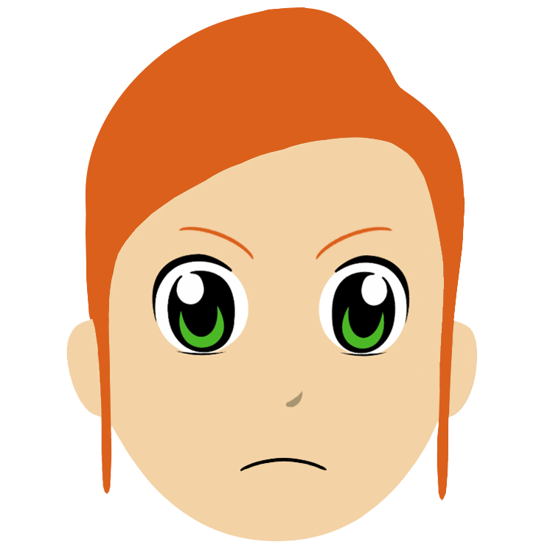
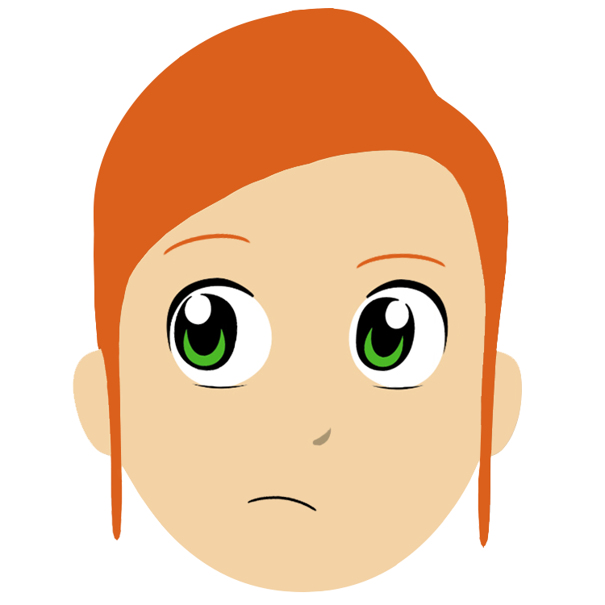
Saying what someone is like (at the moment) [2]
ESTAR – estoy / estás / está for STATE/MOOD
gender agreement on adjectives (-o, -a)
SSC [i]
¿Cómo estás…?
Y7 Spanish Term 1.1 – Week 2 – Lesson 4 Victoria Hobson / Nick Avery Date updated: 19.07.23
Notes:
Learning outcomes:
Introduction of SSC [i] Introduction of gender agreement (-o, -a) where adjectives are a complement to the verb
Note: gender agreement can be a difficult feature to learn. To reduce complexity, it is initially introduced here only for biological gender and in sentences where the adjective is a complement to the verb (e.g. está rara) because this word order is used in both English and Spanish. Later, students will learn about post-nominal adjectives (e.g. un chico serio).
Word frequency (1 is the most frequent word in Spanish):
1.1.2.4 (revisit) nervioso [1521]; tranquilo [1073]; serio [856]; raro¹ [1005]; tonto [2379]; blanco [372]; ¿cómo? [151]; muy [43]; hoy [167]; ¿Cómo se dice […] en inglés/español?; ¿Cómo se escribe?; seguro [407]; listo [1684]; sí [45]; no [11]
Source: Davies, M. & Davies, K. (2018). A frequency dictionary of Spanish: Core vocabulary for learners (2nd ed.). Routledge: London

Slide 17
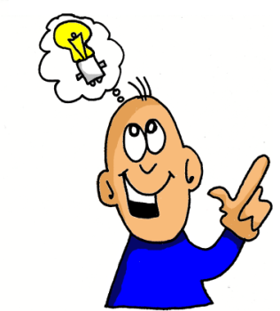
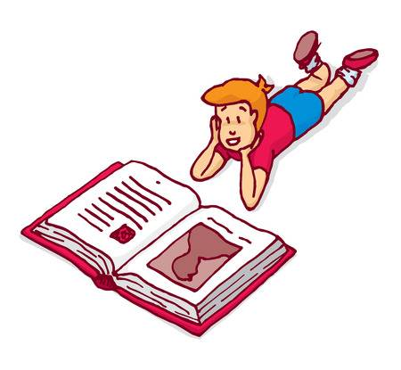
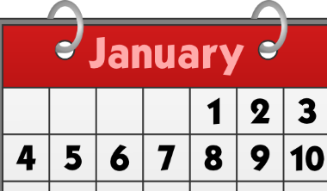
i
i
lista
ir
[to go]
idea
interesante
sin
primero
[without]
Notes:
Timing: 2 minutes
Aim: To introduce SSC [i]
Procedure:
Introduce and elicit the pronunciation of the individual SSC [i] and then the source word again ‘idea’ (with gesture, if using).
Then present and elicit the pronunciation of the five cluster words.
The cluster words have been chosen for their high-frequency, from a range of word classes, with the SSC (where possible) positioned within a variety of syllables within the words (e.g. initial, 2nd, final etc.). Additionally, we have tried to use words that build cumulatively on previously taught SSCs (see the Phonics Teaching Sequence document) and do not include new SSCs. Where new SSCs are used, they are often consonants which have a similar symbol-sound correspondence in English.
Word frequency (1 is the most frequent word in Spanish): idea [248]; lista [1189]; ir [33]; interesante [617]; primero [82]; sin [54] Source: Davies, M. & Davies, K. (2018). A frequency dictionary of Spanish: Core vocabulary for learners (2nd ed.). Routledge: London

Slide 18
i
i
lista
ir
idea
interesante
sin
primero
Notes:
Without the images, students focus this time again closely on the SSC and the cluster words.

Slide 19
i
i
lista
ir
idea
interesante
sin
primero
Notes:
Without the cluster word images or sound, students have to pronounce the words themselves.

Slide 20
escuchar
Listen to the words. Tick the SSCs you hear.
[a] | [e] | [i]
español
inglés
✔
✔
1
lista
list
✔
2
sin
without
✔
✔
✔
interesante
3
interesting
✔
✔
espalda
4
back
✔
✔
primero
first
5
✔
✔
✔
idea
6
idea
Notes:
Phonics – SSC recognition/transcription activity
Timing: 5 minutes Aim: To differentiate between similar SSCs in the oral modality. Procedure: 1. Click 1-6 to listen. Tally each time the SSC is heard. 2. Write the words with the SSC
3. Click for answers.
Note: the Spanish [i] is often confused with the English [e]. This may need attention before/after the activity.
TRANSCRIPT
lista
sin
interesante
espalda
primero
idea

Slide 21
Adjective agreement
In Spanish, adjectives that end in ‘o’ change to an ‘a’ when the person being described is female.
Masculine
Está nervioso.
He is nervous.
Feminine
Está nerviosa.
She is nervous.
Notes:
Grammar introduction slide
Timing: 3 minutes (slides 25-6)
Aim: to introduce gender agreement (for biological gender only and as complement to a verb)
Word frequency:
nervioso [1521]; tranquilo [1073]; serio [856]; raro [1005]; tonto [2379-in AQA]; blanco [372]; muy [43]

Slide 22
Masculine
Feminine
¿Cómo se dice en inglés?
blanco
blanca
white, pale
nervioso
nerviosa
nervous
raro
rara
strange
serio
seria
serious
tonto
tonta
silly
tranquilo
tranquila
calm
seguro
segura
sure, certain
loco
loca
crazy
Notes:
Grammar introduction slide [part 2]
This slide can be used to:
reinforce and practise pronunciation changes for masculine vs feminine forms (e.g. in a listen and repeat style). This will prepare students for the speaking later.
check students’ understanding of the vocab
Whole class – the teacher asks individuals to give the correct answer.
or:
Pairwork: when the adjective disappears in the animation, ask students to turn to their partner and say the adjective out loud. This could be then be practised a few times, with a competition element added by shortening the time sequence on the animation. Challenge pairs to complete within the new speeded up time.
Notes:
1. If desired, the slide could be used as a help-sheet which can be printed out for reference at any point during the activities for those students who need it. (Duplicate the slide and select print 2 to a page for A5 size)
2. although not included for teaching until later in the Y7 scheme of work, loco has been used in some of the listening and reading activities as it supports practice of ‘estar’ and gender agreement. However, if teachers do not wish to practise these words, they can be deleted from the bottom of the list.

Slide 23
Un examen
leer
@ ????????
Read the messages.
It’s an important exam! How are they?
Who is talking? A boy or a girl?
Notes:
Context and instructions for the grammar activity (reading) on the following slide

Slide 24
¿Cómo estás?
leer
1)
estoy muy blanca y nerviosa
@fortnightmegafan
4)
estoy tranquila y rara
@sportster91
María
Paulo
Arturo
Alana
estoy muy tonta y rara
@moviestar
5)
estoy loco y raro
@booboo456
2)
Isabel
Victor
Sara
Hugo
estoy serio y tranquilo @coolkat
estoy loca y muy tonta
@flamencoazul
3)
6)
Diego
Clara
Rebeca
Martín
*enfermo = ill
Notes:
Timing: 7 minutes
Aim: to practise attending to adjective endings in order to determine the gender of the speaker
Procedure:
1. Students write 1-6 in books.
2. They write the correct name (boy or girl)
Note: loco [846] is not from the set for this week but is a frequent adjective that will be taught in the KS3 scheme of work. Remember, here the main focus is the spelling change.

Slide 25
Un examen
escuchar
The exam is tomorrow! Ana is talking to Nadia’s mum about Lucía and Daniel. Who is being talked about? (-o for masculine and –a for feminine). Who seems most worried?
 |  | Lucía | Daniel
1
Está blanco.
✔
2
Está tranquila.
✔
3
Está loca.
✔
4
Está muy nervioso.
✔
5
Está listo.
✔
6
Está muy tonta.
✔
loco = crazy
Notes:
Timing: 8 minutes
Aim: to practise distinguishing between masculine and feminine adjective endings and their meanings
Procedure:
1. Write 1-6.
2. Listen and write María or Paulo, depending on whether the adjective is masculine or feminine.
3. Translate sentences afterwards. This has two benefits: 1) to reinforce the fact that one verb form (está) is used for both ‘he is’ and ‘she is’ and 2) to strengthen understanding of vocabulary.
Transcript:
Está blanco.
Está tranquila.
Está loca.
Está muy nervioso.
Está listo.
Está muy tonta.
Word frequency of unknown words and cognates (1 is the most frequent word in Spanish): loco [846]
Source: Davies, M. & Davies, K. (2018). A frequency dictionary of Spanish: Core vocabulary for learners (2nd ed.). Routledge: London

Slide 26
¿Cómo está?
hablar / escuchar
Partner A
Partner B
Estoy (+ adjective)
(Name!)
İSí! / İNo!
Notes:
Timing: 10-12 mins (2 slides)
Aim: to practise the use of ‘estar’ for temporary states and adjective gender agreement in speaking and listening
Procedure:
Display slide 27 for the whole class.
Give students time to individually choose and write down 8 names. These are the characters that they will then describe.
Players take it in turns describe a person using adjectives, whilst the other player has to identify who is being described from the adjective (-o, -a used)
Note:
1. The person describing who they are must not say the name of the person as this gives away the answer! The idea here is to make the gender agreement on the adjective essential to completion of the task.

Slide 27
Gramática
hablar / escuchar
Marco
Helena
Clara
Felipe
(nervous)
(nervous)
(pale)
(pale)
Lucía
Paulo
Emilio
Ema
(serious)
(serious)
(strange)
(strange)
Chloe
Oscar
Ela
Chloe
Luca
(calm)
(calm)
(silly)
(silly)
Diego
Ana
María
Félix
(ready)
(ready)
(ill)
(ill)
enfermo = ill
Notes:
DISPLAY FOR WHOLE CLASS DURING ACTIVITY

Slide 28
¡Otro* examen!
escribir
The students have two more exams!
Write how they feel now.
1 | Jacinta
2 | Sara
3 | Diego
4 | Hugo
5 | Rebeca
6 | Paulo
e.g. 1) Está muy nerviosa y blanca.
otro = another
Notes:
Timing: 6 minutes
Aim: to practise writing using gender agreement and the new adjectives taught this week
Procedure:
Students imagine how these people are feeling and write ‘Está + adjective’.
Note: there is no correct answer – but encourage them to use a range of adjectives, perhaps set a target of at least 6 different adjectives.

Slide 29
Deberes
Vocabulary Learning Homework (Term 1.1, Week 3)
Audio file
Student worksheet
Notes:
Use this slide to set the homework.
For Y7, the typical homework will be to pre-learn vocabulary for the next lesson. There is an audio file to accompany the student worksheet.
Notes:
i) Teachers may, in addition, want to recommend use of a particular online app for the pre-learning of each week’s words. ii) Quizlet now requires parental involvement / registration / permissions for users below the age of 13, so it is perhaps most suitable for Y9 – 11 students. iii) Language Nut hosts LDP vocabulary lists and these are free for schools to use, though there is a registration process. One benefit is that all of the student tracking data that Language Nut offers are also available to schools that use the LDP lists for practice. Perhaps this makes it a good option for Y7/8.
iv) There are other free apps, and new ones are always appearing. Teachers have told us that they are currently using: Flippity, Wordwall (where using previously-created activities is free).
v) Gaming Grammar has been acquired by Language Nut. Its original content should still be available to teachers and much of it is appropriate for Y7 learners.

