Slide 1
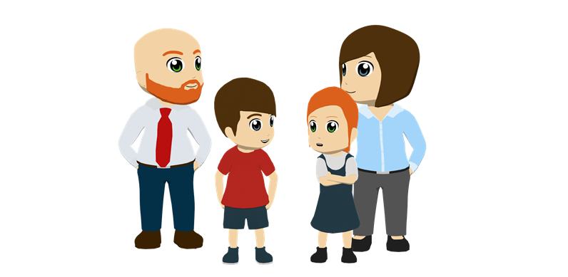
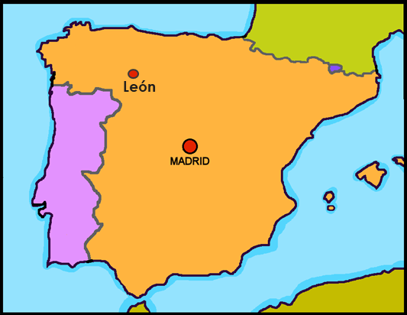
Describing places and locations
ESTAR – estoy, está for location SSC [a]
¿Dónde está…?
Y7 Spanish Term 1.1 – Week 1 – Lesson 1 Victoria Hobson / Nick Avery Date updated: 23.05.23
Notes:
Note: all words (new and revisited) in this week of the SOW appear on all three GCSE wordlists, with the following exceptions:
AQA list does not have Inglaterra.
Learning outcomes:
Introduction of SSC [a]
Introduction of estar, estoy and está (for location)
Note: ‘estás’ will be introduced in the second lesson
Word frequency (1 is the most frequent word in Spanish):
1.1.1 (introduce) estar [21]; estoy; estás; está; norte [624]; sur [661]; Inglaterra [N/A]; España [N/A]; ¿dónde? [161] en [5]; hola [1245]; hasta luego [luego-150]
Source: Davies, M. & Davies, K. (2018). A frequency dictionary of Spanish: Core vocabulary for learners (2nd ed.). Routledge: London

Slide 2
¿Dónde está…?
Where is…?
¡Hola!
¡Hola! (hello) is used in all Spanish-speaking countries to greet someone at all times of day. The ‘h’ is silent!
Notes:
Timing: 7 minutes
Aim: To introduce three new vocabulary items (dónde, está and hola) and identify new students/classmates
Procedure:
Model ‘dónde‘ (with gesture/supported by picture, as preferred) and ‘está’ and the response of raising a hand.
Use “¿Dónde está + name of student?” to identify the new students in the Y7 group.
Say ‘hola’ and wave.
Then, having done the register, the teacher can continue with the next slide, having primed them thoroughly with 'está‘.
Notes:
We envisage that this is the first lesson with a new Y7 class, and that the teacher doesn’t know the students, and the students will likely not all know each other, either.
Teachers may choose to do this after they have got underway with the lesson material OR alternatively they may use this situation to introduce it.
This is an opportunity to use the L2 clearly and successfully for a communicative purpose.

Slide 3
estar
estar
[to be | being] (with location)
está
[is] (with location)
Notes:
Timing: 3 minutes for slides 3-8
Aim: to introduce the verb ‘estar’ more explicitly. ‘Estar’ is one of the 25 most frequently used verbs in Spanish. All 25 most frequent verbs will be introduced early on using the same format. Both long form (infinitive) and short form (3rd person singular) are introduced in order to familiarise students with various forms of the same verb.
Procedure
Bring up the word [estar] on its own, say it, students repeat it, and remind them of the phonics. Draw attention to [a].
Try to elicit the meaning from the students.
Then bring up the English translations. Emphasise the two meanings for the infinitive.
Bring up the short form [está], say it, students repeat it. Draw attention to [a].
Try to elicit the meaning from the students. Emphasise the two meanings for the short form.

Slide 4
estar
estar
[to be | being] (location, state)
está
[is] (location, state)
Notes:
Cycle through the long and short form again.

Slide 5
está
está
[is] (location, state)
Madrid está en España.
[Madrid is in Spain.]
Notes:
Introduce the short form in a sentence.
Note: this is unlikely to cause students any difficulty and is like to be confidence-building for them to translate the meaning so easily. Of course, should learners find it difficult, simply provide the English. The aim here is to provide concrete examples of ESTAR forms in use.

Slide 6
estar
estar
[to be | being] (location, state)
Pablo quiere estar en España.
[Pablo wants to be in Spain.]
Notes:
Introduce the long form in a sentence.
Note: ‘Quiere’ will be introduced in Term 1.2, Week 7. We don’t expect students necessarily to be able to guess its meaning here (though they may well), so continue to provide the English translation, swiftly.

Slide 7
está
está
[is] (location, state)
Madrid ___ en España.
está
[Madrid is in Spain.]
Notes:
Cycle through the short form in context again.
Note: Some students may be able to translate the whole English sentence. However, in case not, a staggered version is provided, whereby the sentence minus the verb is given (a sound effect is heard in place of the verb).

Slide 8
estar
estar
[to be | being] (location, state)
Pablo quiere ____ en España.
estar
[Pablo wants to be in Spain.]
Notes:
Cycle through the long form in context again.

Slide 9
a
nada
amar
∅
casa
alto
agosto
cama
Nick Avery
Notes:
Timing: 3 minutes (3 slides) Aim: to practise the SSC [a]
Procedure:
Introduce the individual SSC ‘a’ with source word and gesture, if using.
Recap individual SSC ‘A’ and then the source word again (with gesture, if using). Then present and elicit the pronunciation of the five cluster words. The cluster words have been chosen for their high-frequency, from a range of word classes, with the SSC (where possible) positioned within a variety of syllables within the words(e.g. initial, 2nd, final etc..) and additionally, we have tried to use words that build cumulatively on previously taught SSCs (see the Phonics Teaching Sequence document) and do not include new SSCs. Where new SSCs are used, they are often consonants which have a similar symbol-sound correspondence in English. Word frequency rankings: alto [231]; nada [87]; casa [106] cama [609]; amar [700]; agosto [931] Source: Davies, M. & Davies, K. (2018). A Frequency Dictionary of Spanish: Core vocabulary for learners (2nd ed.) London: Routledge.
A note on L1:L2 word translations: these are supported in the research literature on vocabulary learning, and should only be avoided where meanings are transparent. If at any point in teaching, pupils are not clear about a meaning, teachers should not hesitate in giving the English meaning.

Slide 10
a
nada
amar
casa
alto
agosto
cama
Nick Avery
Notes:
Without the images, students focus this time again closely on the SSC and the cluster words.

Slide 11
a
nada
amar
casa
alto
agosto
cama
Nick Avery
Notes:
Without the images or sound, students have to pronounce the words themselves.

Slide 12
Fonética
leer / hablar
alto
agosto
60
nada
amar
Segundos
casa
cama
estar
0
INICIO
Notes:
Timing: 1 minute
Aim: To elicit the production of the SSC [a].
Procedure:
1. Click on ‘inicio’ to start the timer
2. Individually (but all at once) pupils read out the words but in alphabetical order.
3. Students keep going for one minute.
3. Teacher can circulate to listen into their SSC knowledge.
Note: the new vocabulary item ‘estar’ [21] is also included.
Word frequency (1 is the most frequent word in Spanish): alto [231]; nada [87]; casa [106] cama [609]; amar [700]; agosto [931]
Source: Davies, M. & Davies, K. (2018). A frequency dictionary of Spanish: Core vocabulary for learners (2nd ed.). Routledge: London

Slide 13
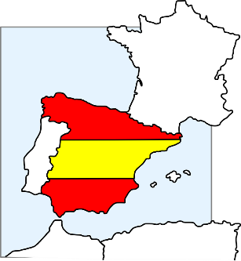
hablar
and está also means ‘it is’!
Notice that está means ‘is’ here…
Está en Inglaterra.
¿Dónde está Granada?
Está en España.
Notes:
Timing: 3 minutes (6 slides)
Aim: 1) To extend practice of SSC [a] to names of cities; 2) to introduce the meaning of ‘está’ as used for ‘it is’ (see note below); 3) to introduce the two new vocabulary items ‘Inglaterra’ and ‘España’
Procedure:
This is a teacher-fronted activity. Teachers can respond chorally.
Ask the group ‘¿Dónde está…?’, with the name of the city. Answer will either be Inglaterra or España.
Teachers may want to insert a 5-second ‘think-pair-share’ turn to your partner and say your answer to them before saying it chorally to the teacher. Done with a swift pace this builds in two repetitions of the new language for each item without noticeably taking up more time.
Note:
You could ask students to pronounce the English towns in a Spanish way - see what they come up with (a good way to assess some prior knowledge of phonics/Spanish).
A couple of the places aren't obvious, so there is genuinely new/surprising info added in here.
We need to deal explicitly with the fact that 'está' stands for two words in English, here - it and is. In the verb slides, we translate 'está' as 'is' and then show it with subjects Madrid and Pablo. Here we see it for the first time meaning 'it is‘.
Note that ‘rr’ and ‘ñ’ are new SSC. Some brief attention will need to be given to RR in Inglaterra and Ñ in España, before they are more formally introduced and practised. It can be quite fun for students to practise rolling the RR! And if students can say ‘lasagne’ they can say ‘España’.

Slide 14
hablar
¿Dónde está Córdoba?
Está en Inglaterra.
Está en España.

Slide 15
hablar
Está en Inglaterra.
¿Dónde está Kendal?
Está en España.

Slide 16
hablar
Está en Inglaterra.
¿Dónde está Salamanca?
Está en España.

Slide 17
hablar
Está en Inglaterra.
¿Dónde está Aspatria?
Está en España.

Slide 18
hablar
Está en Inglaterra.
¿Dónde está Maldon?
Está en España.

Slide 19
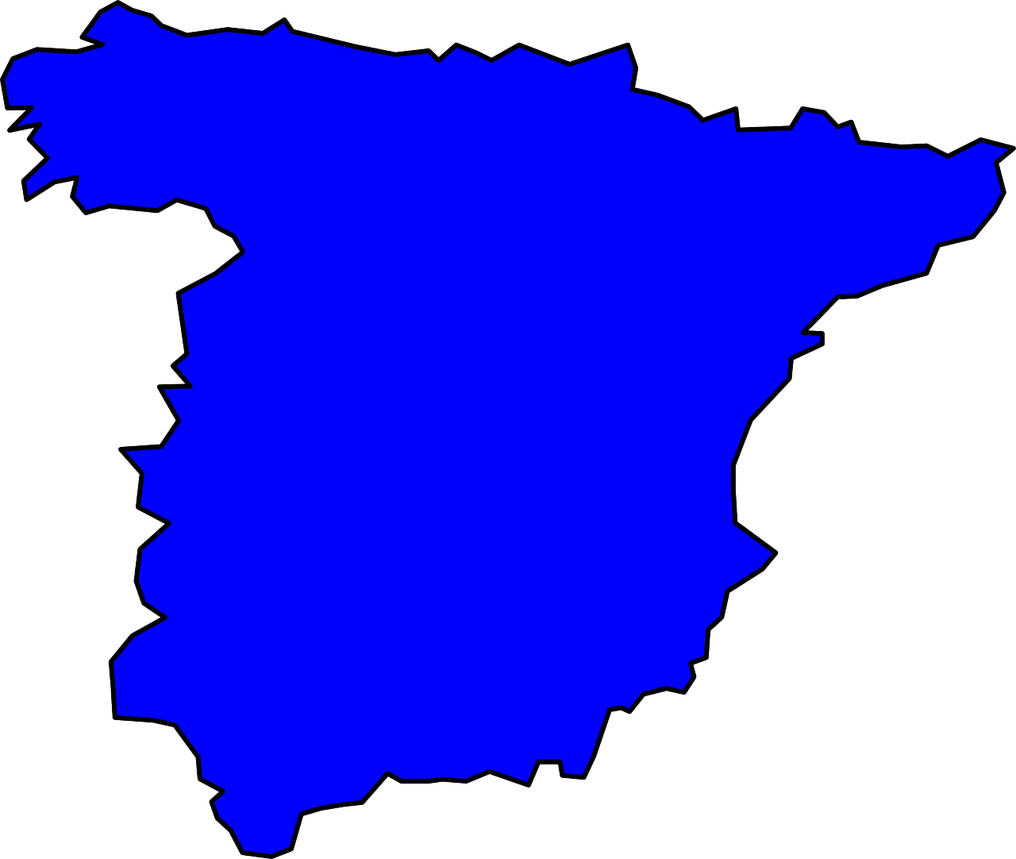
¿Dónde está el palacio Miramar?
Bilbao
San Sebastián
el museo Guggenheim
el palacio Miramar
Barcelona
Madrid
la Sagrada Familia
el Bernabeu
Está en San Sebastián.
Córdoba
la Mezquita-Catedral
Granada
la Alhambra
Notes:
Timing: 5 minutes (6 slides)
Aim: for students to produce sentences with ‘está’ (with the meaning ‘it is’) and to develop further confidence and accuracy in producing [a]
Procedure:
1. Teacher reads aloud the question (which appears on click)
2. Students then have to identify the city and try to pronounce it, focusing on the ‘a’ sound. 3. Elicit choral responses (all students speaking at the same time) to give them more confidence
4. Reinforce the phonic awareness by re-stating the answer yourself when it appears.
Notes:
1. This activity also familiarises students with the landmarks which are referred to in the later listening and reading activities which follow.
2. Students may also want to tell you if they have visited these places and this task offers an independent learning opportunity for students to find out more about these (and other) famous places in Spain after the lesson.

Slide 20
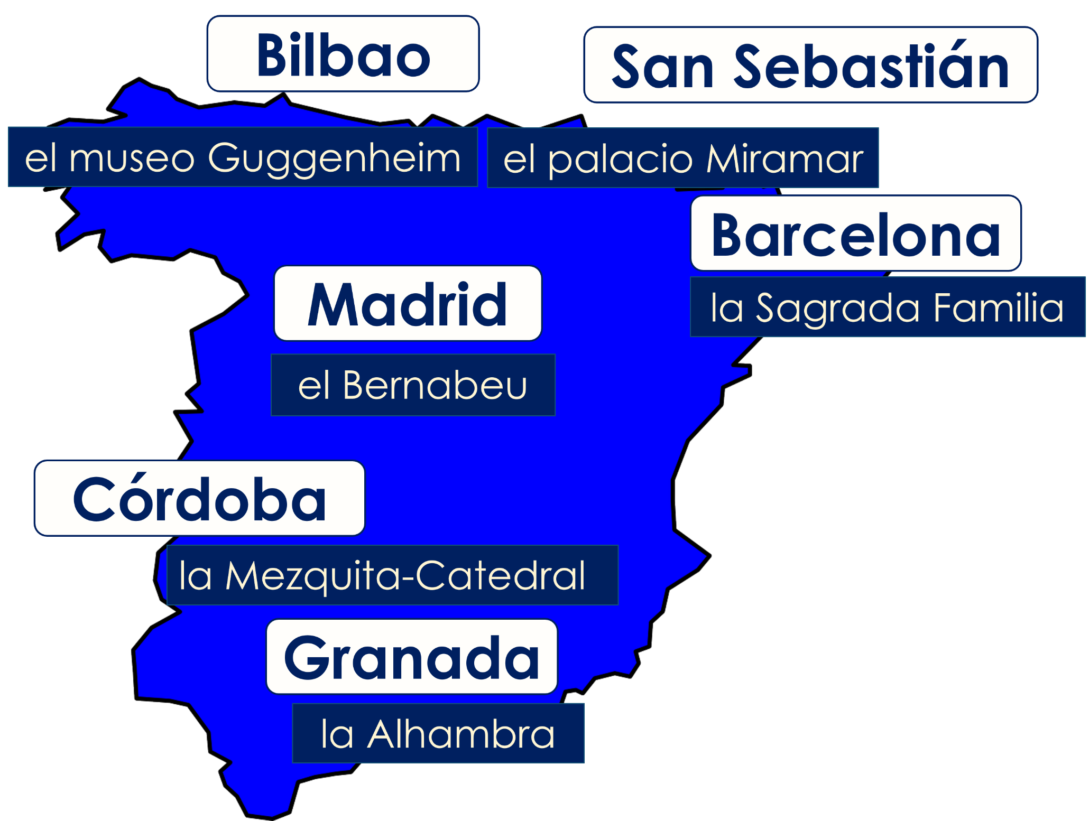
¿Dónde está la Alhambra?
Está en Granada.
Notes:
[2/6]

Slide 21
¿Dónde está el Bernabeu?
Está en Madrid.
Notes:
[3/6]

Slide 22
¿Dónde está el museo Guggenheim?
Está en Bilbao.
Notes:
[4/6]

Slide 23
¿Dónde está la Mezquita-Catedral?
Está en Córdoba.

Slide 24
¿Dónde está la Sagrada Familia?
Está en Barcelona.

Slide 25
Estar: I am & he/she is
gramática
In Spanish, the verb estar means to be when describing location.
Estoy
I am
Está
he / she is
Estoy en España.
I am in Spain.
Está en España.
He / she is in Spain.
Notes:
Timing: 2 minutes
Aim: to highlight the difference in meaning between ‘estoy’ and ‘está’ by juxtaposing the verb forms
Note:
1. Make reference to that fact that está has just been practised to mean ‘is’ and ‘it is’. Now draw students’ attention to its translation as he/she is.
2. This is the first time in this lesson that students need to write. It is probably the best time to hand out exercise books. This may mean that one or two activities move from this lesson into the next.

Slide 26
Cartas postales
leer
Read the postcards from Lucía to her grandma about her and her friend. Who is where? estoy (I am) or está (he/she is).
Write: 1. I am OR he/she is.
Nadia
Notes:
Instruction slide for subsequent grammar (reading) activity

Slide 27
¿Dónde…?
leer
4)
1)
I am
I am
Está en el palacio
Miramar.
Estoy en la Sagrada Familia.
s/he is
s/he is
2)
I am
5)
I am
Estoy en el museo
Guggenheim.
Estoy en el Bernabeu.
s/he is
s/he is
3)
I am
6)
I am
Está en La Alhambra.
Está en la Mezquita-Catedral
s/he is
s/he is
Notes:
Timing: 6 minutes
Aim: to practise attending to the meanings of the verbs ‘estoy’ and ‘está’ in reading comprehension
Procedure:
1. Ask students to write 1-6 in exercise books.
2. Ask them to read the sentence on each postcard and decide which person it must refer to. In their books they should write ‘I am’ or ‘s/he is’
3. Check answers item by item.

Slide 28
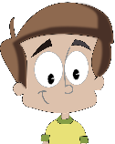
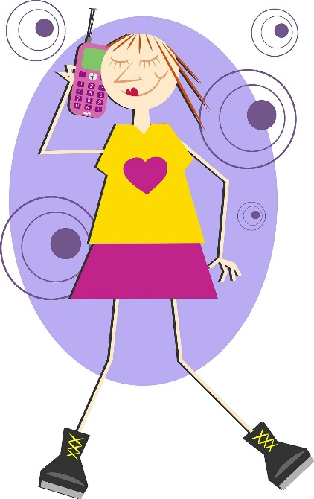
¿Dónde está?
Sofía, Lucía and Daniel’s cousin is missing her boyfriend. She explains why.
escuchar
Listen. Write ‘I am’ or ‘he is’
Listen again and write the city name.
I am | he is | City
1
Granada
2
Bilbao
3
Madrid
4
San Sebastián
5
Córdoba
6
Barcelona
Notes:
Timing: 8 minutes
Aim: to practise attending to the meanings of the verbs ‘estoy’ and ‘está’ in listening comprehension and to practise transcribing city/place names with SSC [a]
Procedure:
1. Ask students to write 1-6 in their books.
2. Tell them that they will sentences using the verbs ‘estoy’ and ‘está’.
3. The first time they listen, they should write ‘I am’ or ‘he is’, depending on the verb.
4. The second time they listen, they should write the city.
Transcript:
Está en la Alhambra. Estoy en el museo Guggenheim.
Estoy en el Bernabeu.
Está en el palacio Miramar.
Está en la Mezquita-Catedral.
Estoy en la Sagrada Familia.

Slide 29
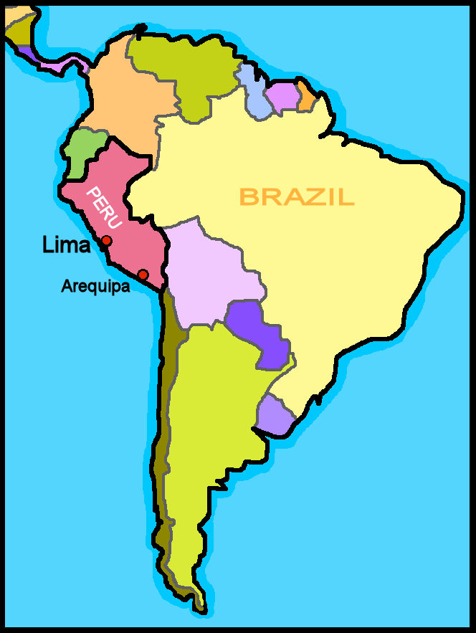
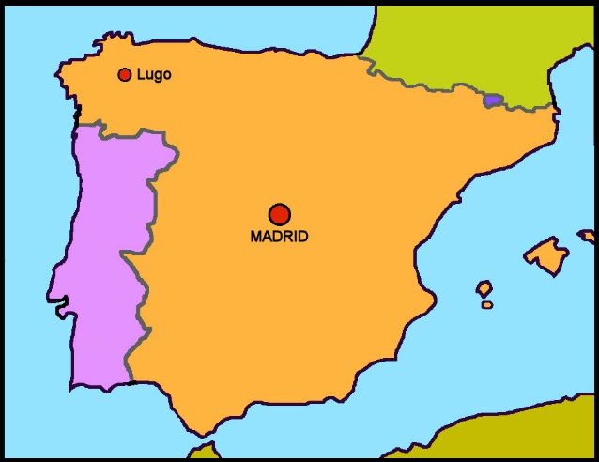
Greetings
¡Hola!
¡Hola!
¡Hola!
¡Hola!
¡Hola!
América Latina
¡Hola! (hello) is used in all Spanish-speaking countries to greet someone at all times of day. The ‘h’ is silent!
¡Hola!
Argentina
Honduras
¡Hola!
¡Hola!
¡Hola!
Bolivia
México
¡Hola!
¡Hola!
Chile
Nicaragua
Colombia
Panamá
¡Hola!
¡Chao, chao!
Costa Rica
Paraguay
¡Hola!
Cuba
Perú
Europa
¡Hola!
¡Hola!
¡Hola!
Ecuador
Puerto Rico
España
¡Chao!
¡Hola!
El Salvador
República Dominicana
¡Chau!
Guatemala
Uruguay
¡Hasta luego!
Guinea Ecuatorial
Venezuela
Spanish is an official language in 20/21 Latin America countries . In Brazil, it’s Portuguese.
In Latin America ¡chao! or ¡chau! is the most common informal ‘bye’.
¡Hasta luego! for ‘bye’ is common in Spain. Again, the ‘h’ is silent!
Notes:
Timing: 2 minutes Aim: to introduce two ways to say informal ‘goodbye’ in different Spanish-speaking parts of the world; to give information about where Spanish is spoken in the world.
Note that ‘chao’ is also used in Spain for goodbye.
Procedure: 1. Click through the animations to present the information. 2. Elicit pronunciation of ‘hola’, ‘hasta luego’, ‘chao’. Note that teachers could spend a minute or so cuing different greetings/farewells by calling out a few of the country names, and a few of the cities in Spain that we have heard this lesson. It would be good to choose in particular the countries/cities with the SSC [a] – there are plenty of them! We can avoid some of the trickier sounds that students haven’t yet met.

Slide 30
¡A hablar!
Caracas
leer / hablar
¡Hola!
Lima
[I am]
¡Hasta luego!
Bilbao
Santiago
¡Chao!
Madrid
[He is]
Granada
Está en Caracas.
Estoy en Madrid.
Está en Lima
Está en Granada.
Estoy en Bilbao.
Estoy en Santiago.
Notes:
Timing: 5 minutes
Aim: to correctly use the verbs ‘estoy’ and ‘está’ in oral production and further practise SSC [a]; to practise greeting ‘hola’ and farewells ‘hasta luego’ and ‘chao’ matching these to places on the two continents where Spanish is spoken.
Procedure:
Explain that partner A says ‘hello’, Partner B responds to the prompts (either I am or He is in) and the name of the city. Partner A says goodbye using the most common form according to the location mentioned.
Word through two examples (one Spain, one Latin America) with As and Bs saying the appropriate sentence/greetings according to the prompts.
Each click brings up a combination of prompts (one for the verb, one for the city)
Click to reveal the correct sentence. Then click to remove the greeting/farewells.
Then students talk to each other (teacher continues clicking to bring up each prompt). Partners swap roles after each item for items 3 – 6.

Slide 31
Deberes
Vocabulary Learning Homework (Term 1.1, Week 1)
Audio file
Student worksheet
Notes:
Take the opportunity to use ‘hasta luego’ at the end of the first class!
Use this slide to set the homework.
For Y7, the typical homework will be to pre-learn vocabulary for the next lesson. There is an audio file to accompany the student worksheet.
This is tricky in this first week, as there has not been the opportunity to pre-learn this week’s vocabulary, but there will be some new vocabulary next week, too., to build up learners’ repertoire. Teachers will decide how best to spread the learning in these first few weeks, but we have put Week 1 vocabulary at the end of lesson 1 and the links to Week 2 vocabulary at the end of lesson 2. All vocabulary is revisited after around 3 weeks, and again after 9 weeks, so students shouldn’t be anxious at this stage, and it may be best to omit Week 1’s audio and worksheet and set it in a few weeks time, when students revisit it.
Notes:
i) Teachers may, in addition, want to recommend use of a particular online app for the pre-learning of each week’s words. ii) Quizlet now requires parental involvement / registration / permissions for users below the age of 13, so it is perhaps most suitable for Y9 – 11 students. iii) Language Nut hosts LDP vocabulary lists and these are free for schools to use, though there is a registration process. One benefit is that all of the student tracking data that Language Nut offers are also available to schools that use the LDP lists for practice. Perhaps this makes it a good option for Y7/8.
iv) There are other free apps, and new ones are always appearing. Teachers have told us that they are currently using: Flippity, Wordwall (where using previously-created activities is free).
v) Gaming Grammar has been acquired by Language Nut. Its original content should still be available to teachers and much of it is appropriate for Y7 learners.

Slide 32
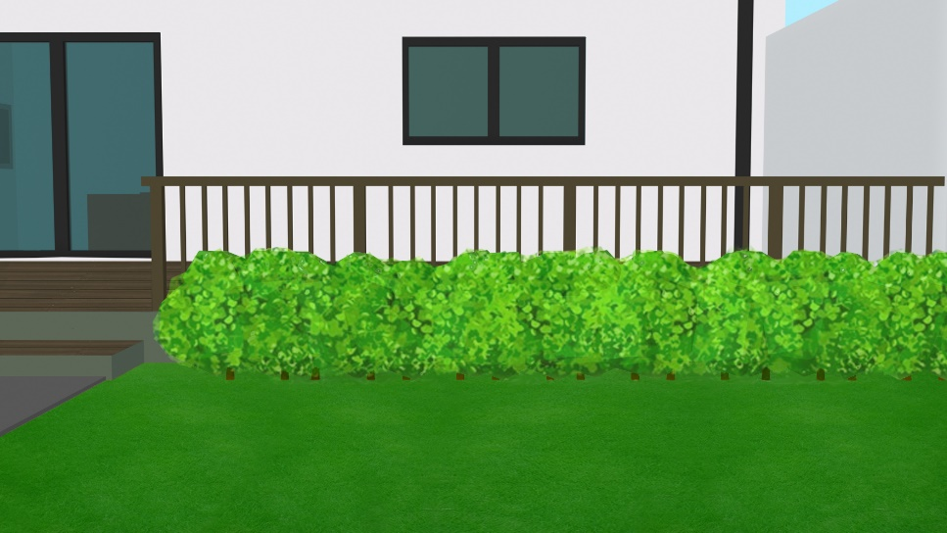
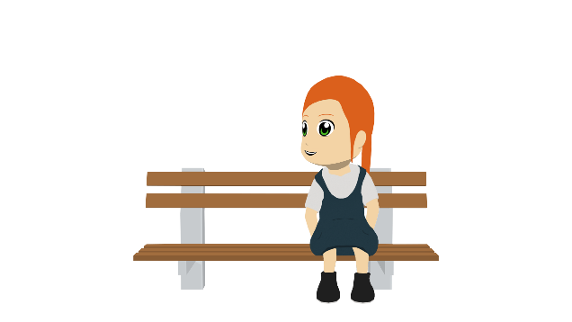
Describing places and locations
ESTAR – estoy, estás, está for location SSC [o], SSC [a]
Estoy en León, en España.
¿Dónde estás…?
Y7 Spanish Term 1.1 – Week 1 – Lesson 2 Victoria Hobson / Nick Avery Date updated: 23.05.23
Notes:
Learning outcomes:
Consolidation of SSC [a]
Introduction of SSC [o] Consolidation of ‘estoy’ and ‘está’
Introduction of ‘estás’ for location
Word frequency (1 is the most frequent word in Spanish):
1.1.1 (introduce) estar [21]; estoy; estás; está; norte [624]; sur [661]; Inglaterra [N/A]; España [N/A]; ¿dónde? [161] en [5]; hola [1245]; hasta luego [luego-150]
Source: Davies, M. & Davies, K. (2018). A frequency dictionary of Spanish: Core vocabulary for learners (2nd ed.). Routledge: London

Slide 33
o
olvidar
dos
solo
yo
con
Con ketchup
poco
[little]
Nick Avery
Notes:
Timing: 2 minutes
Aim: to introduce SSC [o]
Procedure:
1. Introduce and elicit the pronunciation of the individual SSC [o] and then the source word ‘yo’ (with gesture, if using). 2. Then present and elicit the pronunciation of the five cluster words.
The cluster words have been chosen for their high-frequency, from a range of word classes, with the SSC (where possible) positioned within a variety of syllables within the words(e.g. initial, 2nd, final etc..) and additionally, we have tried to use words that build cumulatively on previously taught SSCs (see the Phonics Teaching Sequence document) and do not include new SSCs. Where new SSCs are used, they are often consonants which have a similar symbol-sound correspondence in English.

Slide 34
o
olvidar
dos
solo
yo
con
poco
Nick Avery
Notes:
Without the images, students focus this time again closely on the SSC and the cluster words.

Slide 35
o
olvidar
dos
solo
yo
con
poco
Nick Avery
Notes:
Without the images or sound, students have to pronounce the words themselves.

Slide 36
Fonética
[a]
[o]
leer / hablar
dos
alto
∅
nada
casa
Persona B turns around. Persona A says 6 words with [a] or [o] or both. Persona B points left for [a], right for [o], both for both!
yo
amar
Now swap.
agosto
con
[with]
solo
poco
[little]
cama
olvidar
Notes:
Timing: 2 minutes
Aim: to practise aural distinction between SSC [o] and SSC [a] introduced last lesson.
Procedure:
Ensure Bs turn away from the board, as per the instructions and animations.
Click for A’s words to appear.
Bs listen and respond to the SSC they hear. Students point left for [a] and right for [o].
As give them feedback each time.
Then they swap roles.
Word frequency (1 is the most frequent word in Spanish): alto [231]; nada [87]; casa [106] cama [609]; amar [700]; agosto [931]; yo [28]; olvidar [416]; dos [64]; solo [182] poco [76]; con [14]
Source: Davies, M. & Davies, K. (2018). A frequency dictionary of Spanish: Core vocabulary for learners (2nd ed.). Routledge: London

Slide 37
Vocabulario
60
 | Word | English meaning
1 | dónde | where
2 | estar | to be [location]
3 | estoy | I am
4 | estás | you are
5 | está | he / she / it is
6 | en | in
7 | Inglaterra | England
8 | España | Spain
9 | norte | north
10 | sur | south
Segundos
0
INICIO
Notes:
Timing: 1-4 minutes Aim: to reactivate and strengthen vocabulary knowledge. Procedure: Round 1: Look at the Spanish, recall the English meanings, saying them aloud. [1 minute] Round 2: Look at the English, recall the Spanish meanings, saying them aloud. [1 minute] Repeat for two further minutes, to speed up recall. Word frequencies:
dónde [161]; estar [21]; estoy; estás; está; en [5]; Inglaterra [proper noun - N/A]; España [proper noun - N/A]; el [1]; norte [624]; sur [661]

Slide 38
Estar: I am & you are
Estar means…
to be when describing location.
Está
it / he / she is
Estoy
I am
To say you are, use estás.
Estás
you are
Estás en España.
You are in Spain.
Estás en el norte.
You are in the north.
Notes:
Timing: 2 minutes
Procedure:
The animations here enable teachers to elicit answers from students that revisit last lesson’s learning of ESTAR (
Then present the new verb form ‘estás’.
Elicit the translations of the examples from students.
Notes:
Students will not yet know ‘norte’ but it is a near-cognate and part of this week’s learning.
In this lesson, although 'norte' and sur' require 'el‘ here, try to avoid explaining the use of the definite article. This will be introduced in and practised frequently from term 1.2, week 5.

Slide 39
leer
Diego and Ana (Lucía and Daniel’s parents) have a busy week ahead. Diego writes in his diary. Write where each person is each day in English. Use a ? when no info is given.
2019 | septiembre |  | septiembre
lunes | ……estoy en casa …estás en España… | viernes | …estás en Inglaterra ………………………… ………………………..
martes | .estás en Granada.. .estoy en el norte… | sábado | ………………….…….. ……estoy en Madrid
miércoles | …estoy en Valencia …estás en el sur… | domingo | .estoy en la cama… ………………………………………………
jueves | …estás en casa…… | Notas
You are
I am
6
10
Mon
Tues
Weds
Thurs
Fri
Sat
Sun
at home
in Spain
in the north
in Granada
7
11
in Valencia
in the south
?
at home
?
in England
8
12
in Madrid
?
in bed
?
İFiestas en
octubre!
Fiesta means party or celebration. Fiestas plural can also mean holidays or festivities.
9
Notes:
Timing: 7 minutes
Aim: to practise distinguishing between ‘estoy’ and ‘estás’ and their meanings in reading
Procedure:
1. Students copy the table on the right-hand side into their books
2. They complete the table with the information that corresponds to each form of the verb.
Note:
1. casa and cama are cluster words for SSC [a] and will be known to students from their phonics learning for Week 1.
2. norte has been met on the previous slide. It is likely that students will work out the meaning of ‘sur’ as a result, but as they will need to write the English in this task, it will be apparent if they don’t know it.

Slide 40
escuchar
Sofia compares where she is on holiday and where her friend is. Listen.
Who is it: Sofia (‘I’) or her friend (‘you’)? Tick the person, then write where they are.
‘I am’
‘you are’
Sofia | friend | ¿Dónde?
1
Valencia
2
the north
3
Granada
4
the south
5
England
6
Spain
Notes:
Timing: 8 minutes
Aim: to practise distinguishing between ‘estoy’ and ‘estás’ and their meanings in listening
Procedure:
Ask students to copy the blank table down, with 1-6.
Go through the context, drawing attention to who the verbs are going to refer to (‘I’ and ‘you’)
Ask them to listen and tick the right person.
Listen again and write the place. Tell students that the Spanish cities will be spelt as they hear them (there is no ‘English’ word for them).
Accept answers written in Spanish for north/south/England/Spain.
TRANSCRIPT
Estoy en Valencia
Estás en el norte.
Estoy en Granada.
Estoy en el sur.
Estás en Inglaterra.
Estoy en España.

Slide 41
¿Dónde está(s)?
escribir
1
Estás en España.
Notes:
Timing: 5 minutes (6 slides)
Aim: to use pictures to elicit production of the verbs and vocabulary taught this week
Procedure:
Explain to students that they’ll be using the personal pronoun picture to decide if it’s ‘estoy’, ‘estás’ or ‘está’ and that the picture on the right will show where.
Students write the sentence (in books or on mini-whiteboards) in Spanish.
Note:
1. Because students have now had plenty of receptive (input-based) practice with the three verb forms across the two lessons, we can now bring them together in a final activity

Slide 42
¿Dónde está(s)?
escribir
2
Estás en el norte.

Slide 43
¿Dónde está(s)?
escribir
3
Estoy en Inglaterra.

Slide 44
¿Dónde está(s)?
escribir
4
Madrid
Está en Madrid.

Slide 45
¿Dónde está(s)?
escribir
5
S
Estoy en el sur.

Slide 46
¿Dónde está(s)?
escribir
6
Granada
Estoy en Granada.

Slide 47
Una conversación
hablar
¡Hola!
¡Hola!
¡H_ _ _!
¡Hola!
¡Hola!
¡H_ _ _!
¿Dónde estás?
¿D_ _ _ _ e_ _ _ _?
¿Dónde estás?
Estoy en Caracas.
Costa Rica
Estoy en Granada.
E_ _ _y e_ ________.
Bilbao
Caracas
Madrid
¡_______!
¡Chao!
¡Chao!
Lima
¡_______!
¡Hasta luego!
¡Hasta luego!
Barcelona
Santiago
Córdoba
Bogotá
Granada
Notes:
Timing: 2 minutes Aim: to practise a short dialogue using language from this week. Procedure: 1. Present the example dialogues. 2. Click to bring up the part prompts.
3. Students can select any of the locations in any order. Their partner needs to listen to know which leave taking word to use.

Slide 48
Deberes
Vocabulary Learning Homework (Term 1.1, Week 2)
Audio file
Student worksheet
Notes:
Take the opportunity to use ‘hasta luego’ at the end of the first class!
Use this slide to set the homework.
For Y7, the typical homework will be to pre-learn vocabulary for the next lesson. There is an audio file to accompany the student worksheet.
Notes:
i) Teachers may, in addition, want to recommend use of a particular online app for the pre-learning of each week’s words. ii) Quizlet now requires parental involvement / registration / permissions for users below the age of 13, so it is perhaps most suitable for Y9 – 11 students. iii) Language Nut hosts LDP vocabulary lists and these are free for schools to use, though there is a registration process. One benefit is that all of the student tracking data that Language Nut offers are also available to schools that use the LDP lists for practice. Perhaps this makes it a good option for Y7/8.
iv) There are other free apps, and new ones are always appearing. Teachers have told us that they are currently using: Flippity, Wordwall (where using previously-created activities is free).
v) Gaming Grammar has been acquired by Language Nut. Its original content should still be available to teachers and much of it is appropriate for Y7 learners.

