Slide 1
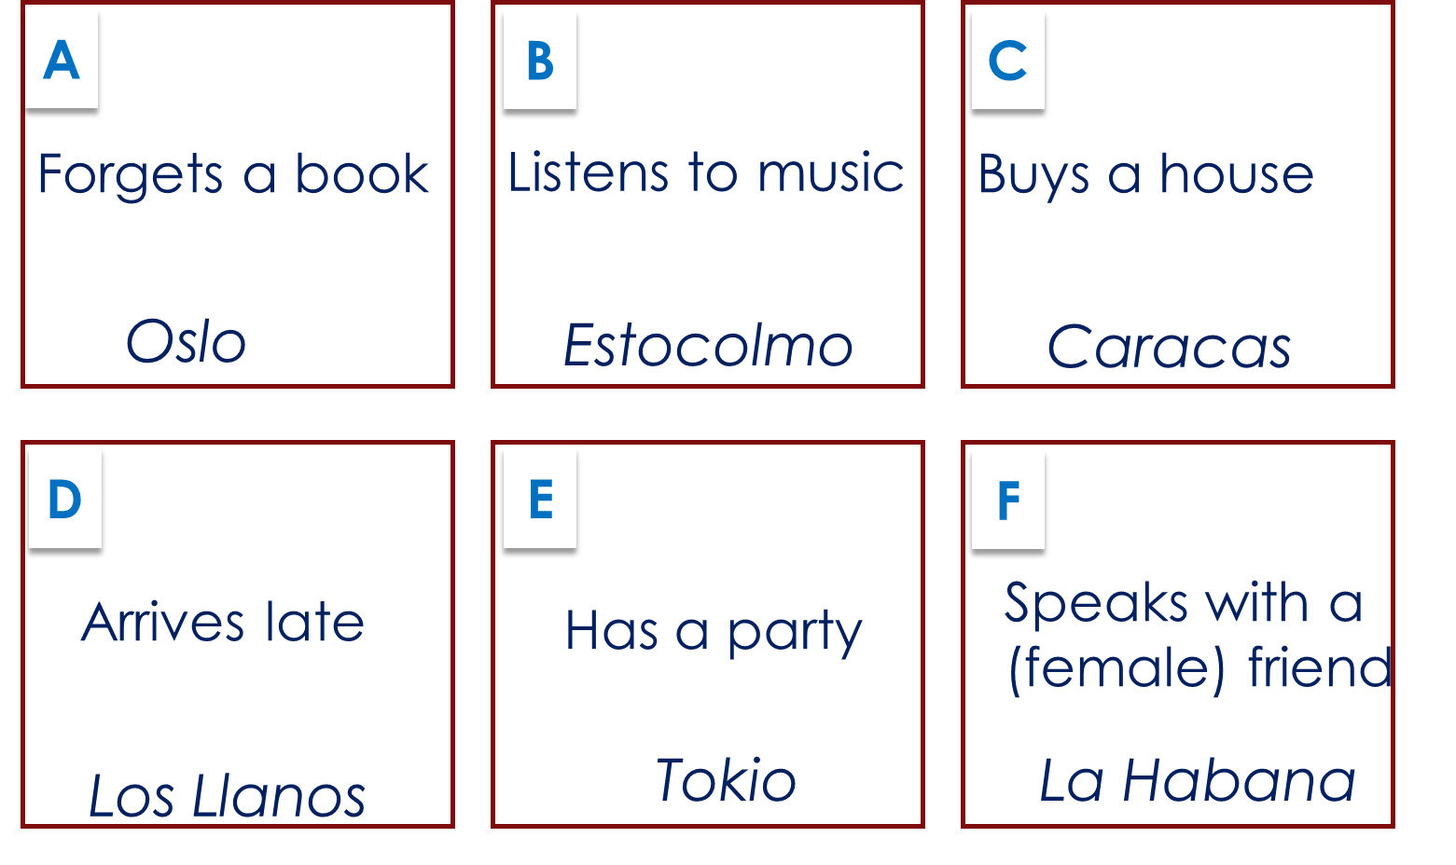
Y7 Spanish
6b
to use she/he verbs to say what someone does
Revisit: Write the words in Spanish. Use the word bank.
to dance __________ | 2. well ____________ | 3. with ____________ | 4. to speak ____________ | 5. to be ____________
6. I am __________ | 7. you are ____________ | 8. s/he, it is ____________ | 9. to listen ___________ | 10. music ___________
11. to buy __________ | 12. who? __________ | 13. to arrive ___________ | 14. late ___________ | 15. early ____________
16. a friend (f) ____________ | 17. tall (m) ___________ | 18. good-looking (m) ____________ | 19. nice (f) | 20. cheerful
bailar
Word Bank guapo | simpática | una amiga | escuchar | ser | llegar | con | hablar | eres |tarde música | comprar | alto | alegre | soy | bien | bailar | ¿quién? | es | temprano
2. Choose the correct sentence ending. Then write the English.
Tip! The clue is the ending on the 1st word!
1. Bailar…
2. Escucha…
3. Hablar…
4. Llega…
5. Comprar…
6. Compra…
…salsa es fantástico.
…salsa.
…música es importante.
…música.
…con Elena.
…con Elena es fantástico.
…tarde con Pepe es normal.
…tarde con Pepe.
…una casa.
…una casa es importante.
…une periódico es normal.
…un periódico.
1.
2.
3.
4.
5.
6.
Dancing salsa is fantastic.
S/he listens to music.
4A. Partner A. Use this side of the sheet. Partner B. Use the other side – 4B. Paula’s trip was so good, she does it again. This time, she visits the places in a different order. Decide the order yourself. Tell your partner the trip in 6 Spanish sentences.
Tip! This is question 4. Turn over to do Q3 first.
Your partner makes notes. in English, without looking at the sheet. Tell your partner if they got them right.

Slide 2
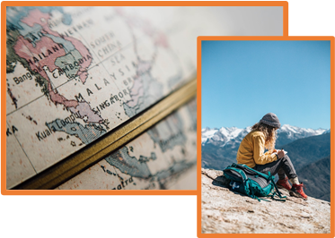
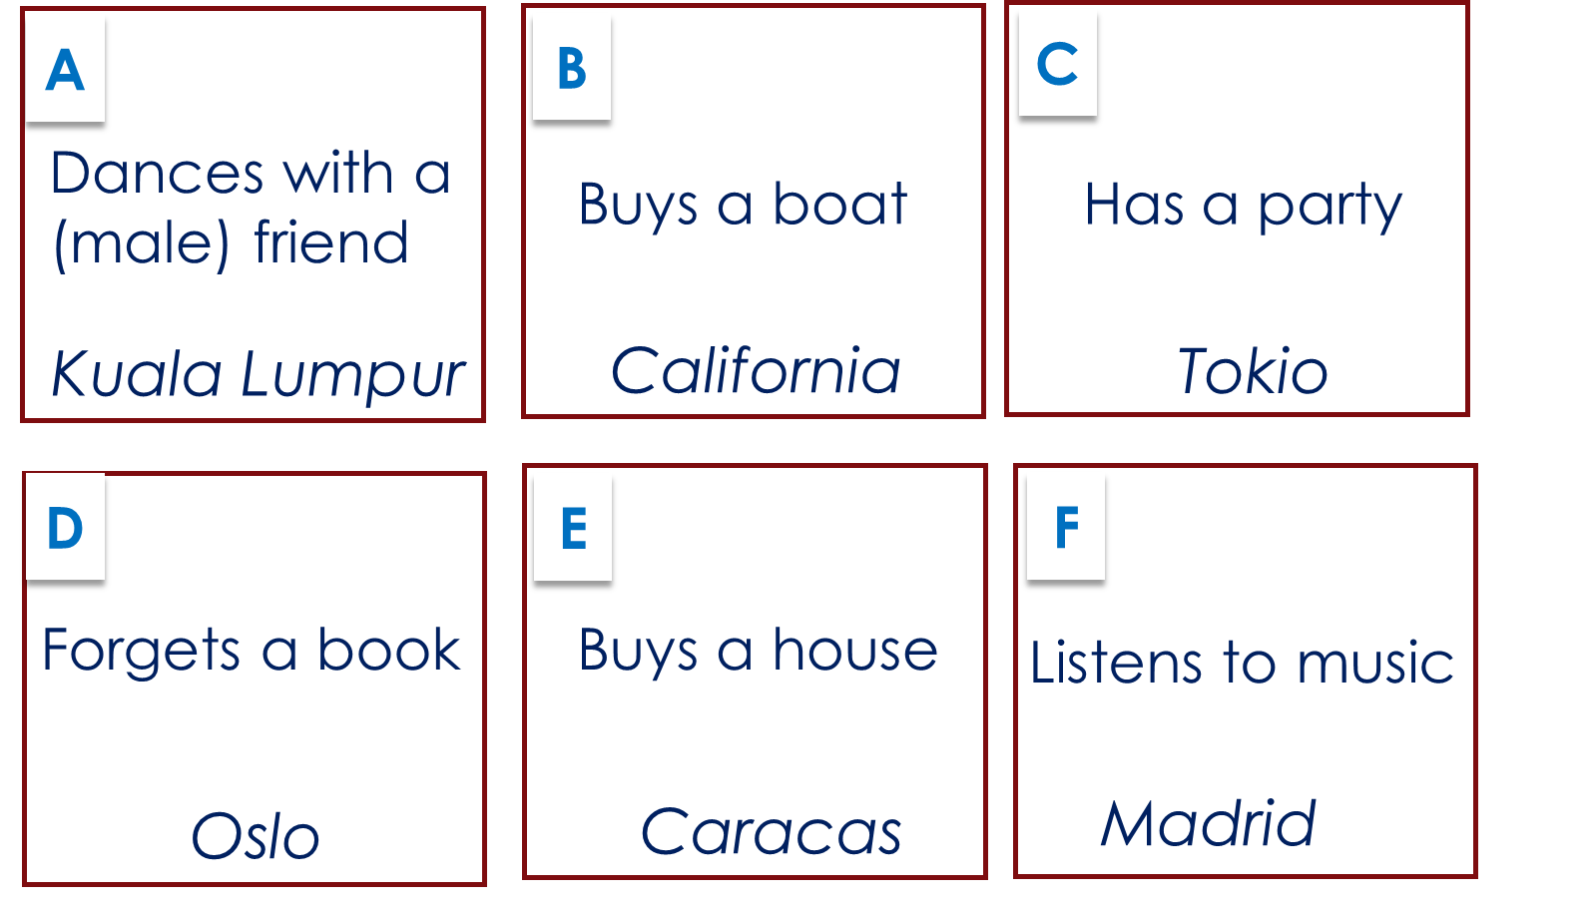
Y7 Spanish
3. Paula’s big adventure. Read the story. What does Paula do in each place?
Habla con una amiga en La Habana.
Compra una casa en Caracas.
Escucha música en Madrid.
Llega tarde a Los Llanos.
Tiene una fiesta en Toledo.
Olvida un libro en Oslo.
Compra un barco en California.
She talks with a friend in La Habana.
4B. Partner B. Use this side of the sheet. Partner A. Use the other side – 4A. Paula’s trip was so good, she does it again. This time, she visits the places in a different order. Listen to your partner and make notes in English about Paula’s trip. Then you decide and tell your partner the trip in 6 Spanish sentences.
5. Write a story of someone’s world trip. Use the ‘a’ verb ending for s/he.
El viaje de ………………….
Use the verbs bailar, comprar, escuchar, estar, hablar, llegar, olvidar, tener.
E.g. El viaje de (Leon)
(Leon’s journey)
Baila en Colombia. … …

