Slide 1
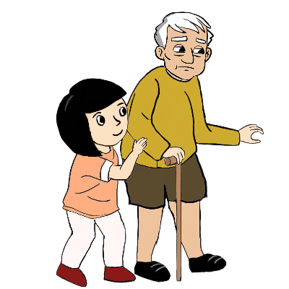
Y7 Spanish
1. Practise saying these words in Spanish. Test your partner on the meanings.
 | Word | English meaning
1 | hablar | to speak, speaking
2 | comprar | to buy, buying
3 | bailar | to dance, dancing
4 | llegar | to arrive, arriving
5 | escuchar | to listen, listening
6a
to use –AR verbs to say what s/he does
Tip! To pronounce the ‘bai’ in ‘bailar’ think
‘buy’ in English (not ‘bay’). It is Spanish ‘a’ + ‘i’ – when you say it quickly it turns into ‘buy’.
6 | ¿quién? | who?
7 | una amiga | a (female) friend
8 | música | music
9 | tarde | late
10 | temprano | early
11 | bien | well
12 | con | with
Infinitive verbs
Tip! Note that the Spanish is the same (escuchar) but the English changes (to listen / listening).
The infinitive verb is the form you find in a dictionary.
In English, we often write ‘to + verb’, e.g., to buy. In Spanish, infinitives often end in –ar, e.g., comprar.
Es importante escuchar. It is important to listen. Note! You can start a sentence with the infinitive, too:
Escuchar es importante. Listening is important.
2. What is Lucía saying here. Write the sentences in English.
1. Es importante llegar temprano.
1.
2.
3.
4.
5.
2. Bailar es interesante.
3. Es correcto escuchar en clase.
4. Llegar tarde es raro.
5. Es importante estar listo.
Say the words. [c] is hard ‘c’. When you say [ue], [ua], [ui] it sounds like you’re saying ‘w’. E.g., [cue] → cooweh.
3. Phonics
[cue]
[body]
[cua]
[cui]
[to look after]
cuerpo
cuatro
cuidar

Slide 2
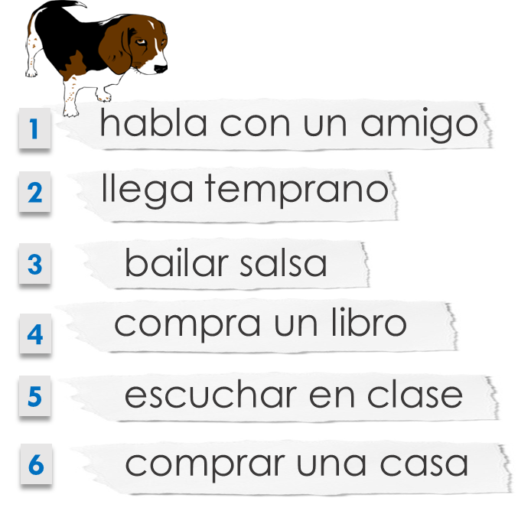
Y7 Spanish
s/he verb forms
To mean ‘s/he’ or ‘it’ with a verb, the verb ending changes to ‘-a’: Escucha música. S/he, it listens to music.
Tip! In English we say ‘she’, ‘he’ or ‘it’ listens. In Spanish, the ‘a’ verb ending tells us this. We don’t have to add a word for ‘she’, ‘he’ or ‘it’.
4. Oh no! The dog ate Lucía’s Spanish homework. What do the text pieces talk about? Write the English meaning in the correct column.
 | the action in general | she/he does the action
1 |  | speaks with a friend
2
3 | to dance/dancing salsa
4
5
6
5. ¿Qué actividad es? Fill in the missing words in Spanish and English.
1. B_ _ la en un barco. | She ________ in __ ________.
2. C_ _ _ ra una revista. | She __________ a _______________.
3. E_ _ _ _ _ a música. | She __________ to _____________.
4. L_ _ _ _ tarde. | She __________ __________.
5. H_ _ _ _ con un amigo. | She __________ with ____ __________.
Try to write all the English meanings of these words from memory, but check back to page 1 if you need to.
5. ¿Cómo se dice en inglés? Write in English. Then test your partner.
1 | música |  | 7 | escuchar
2 | una amiga |  | 8 | bailar
3 | comprar |  | 9 | con
4 | tarde |  | 10 | temprano
5 | hablar |  | 11 | bien
6 | ¿quién? |  | 12 | llegar

