Slide 1
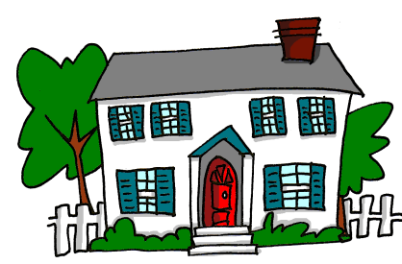
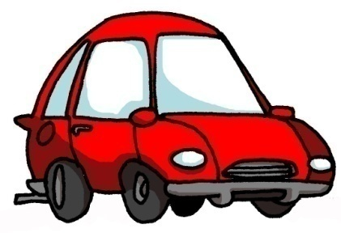
Y7 Spanish
1. Practise saying these words in Spanish. Test your partner on the meanings.
 | Word | English meaning
1 | un amigo | a (male) friend
2 | un periódico | a newspaper
3 | un caballo | a horse
4 | un teléfono | a phone
5a
to make nouns plural and say ‘some’
5 | una planta | a plant
6 | una botella | a bottle
7 | una revista | a magazine
8 | una pregunta | a question
9 | una palabra | a word
10 | una tarea | a task
Tip! To say ‘r’ at the start of a word (or ‘rr’ in the middle) try to roll it, as if you’re imitating a telephone ring: Brrring! Brrrring!
Plural nouns in Spanish
This is similar to English. But there are two words for some: unos for masculine and unas for feminine nouns.
To talk about something in the plural (more than one),
Spanish often adds ‘s’ to the end of the noun:
masculine feminine
un barco → a boat una planta → a plant unos barcos → some boats unas plantas → some plants
2. Matilda is bragging about her belongings. What does she have?
Write a list in English.
1. Tengo unas revistas.
2. Tengo un teléfono.
Tip! Pay attention to whether she has one or some of each thing.
3. Tengo unos caballos y un gato.
4. Tengo un amigo en Inglaterra. ¡Es famoso!
5. ¡Tengo unos amigos en Argentina, también!
6. Tengo una botella de Coca Cola.
también – also, too
1. | 4.
2. | 5.
3. | 6.
The word de in Spanish can mean ‘from’ but also ‘of’:
3. Phonics
Say the words. The c in Spanish is hard c before a, o and u.
[ca]
[co]
[cu]
The ch in Spanish sounds like the ch in English chocolate.
casa
coche
escuchar

Slide 2
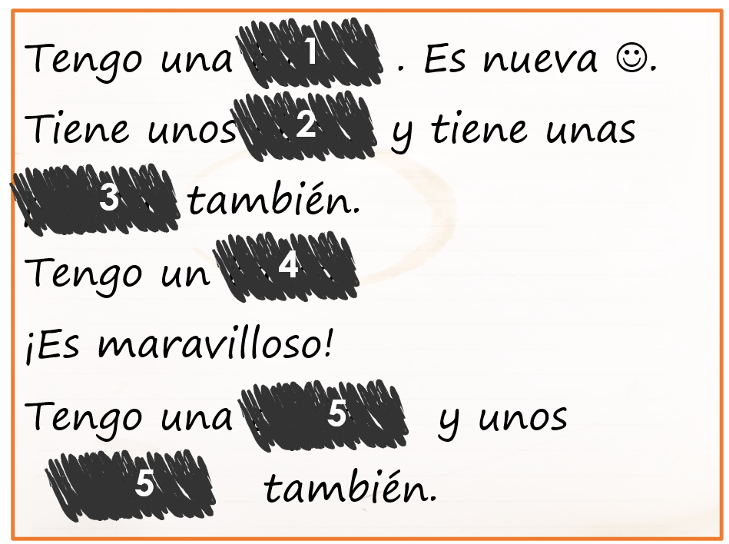
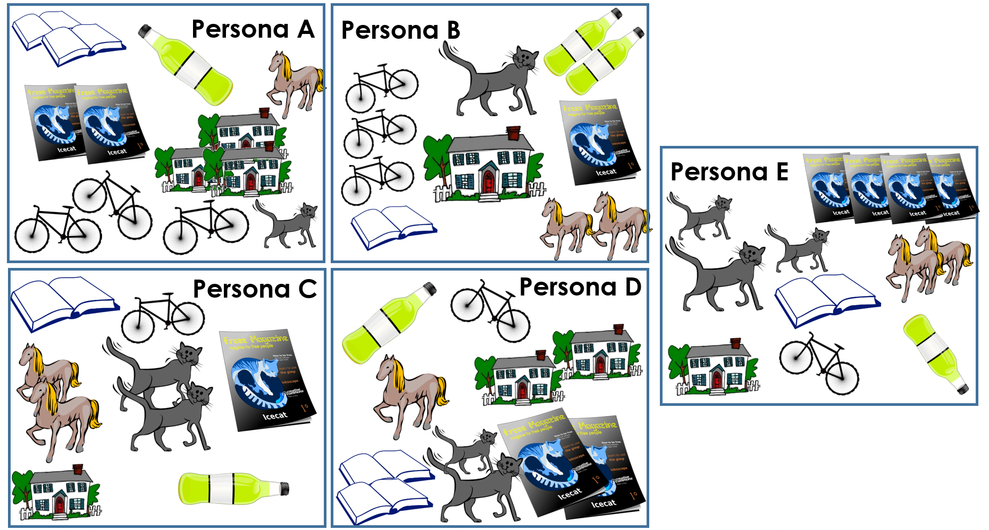
Y7 Spanish
4. ¡A pronunciar! Do a phonics ‘rally’ with a partner. Say these words taking it in turns with a partner to say one word each. Say any word, but don’t repeat a word until you have said them all. Keep going for a whole minute!
calle
cultura
con
documento
street
with
cantar
casa
escuchar
comer
coche
to sing
house
to listen
to eat
car
5. Matilda writes a message about herself and her friend Eva. It got a bit smudged. Work out who has what.
Matilda says ‘I have’, Eva ‘she has’. Look at the word for ‘a’ or ‘some’ and the answer options. Sometimes it could be either.
¿Quién? | ¿Qué?
1 Matilda | bicicleta |periódico | either
2 | libros | casas |either
3 | plantas de Inglaterra | botellas de Pepsi either
4 | revista (de fútbol) | barco | either
5 | plantas de España |cama | either
6 | periódicos |amigos (en Inglaterra) | either
6. Decide (in secret) which person you are. Write 7 statements about your belongings. E.g., Tengo unas bicicletas. (I have some bikes). Read them slowly to your partner, who will make notes and work out which person you are (A, B, C, D or E). Then swap around.
7. Extension: Write 5 sentences in English using ‘have’ and ‘some’ or ‘a’ for your partner to translate into Spanish. E.g., s/he has some newspapers.

