Slide 1
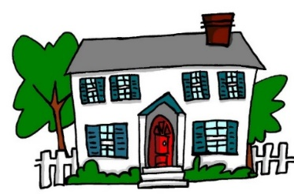
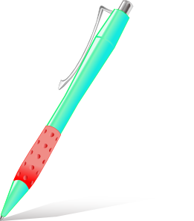
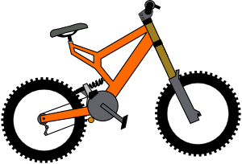
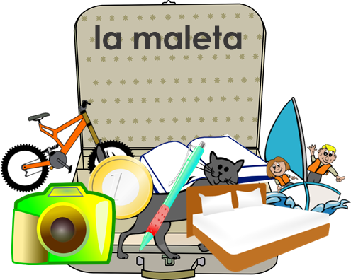
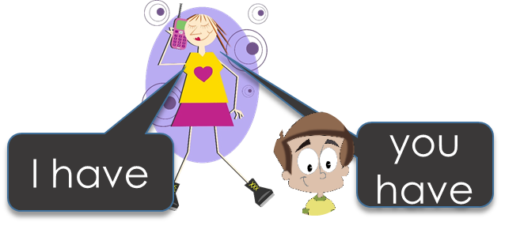
Y7 Spanish
1. In pairs. Person A – say a Spanish word. Person B – translate into English.
4b
to say what you or someone else has
Tip! If you need help remembering the Spanish words, look at last lesson’s work.
2. Odd one out. Which noun has a different gender and word for ‘a’ than the other two?
Tener – to have
In Spanish, the verb tener means to have.
tengo = I have Tengo una idea. I have an idea.
tienes = you have Tienes una casa. You have a house.
3. Sofía is preparing for a trip. She messages her boyfriend. Who has what in their suitcase? Tick ‘I have’ or ‘you have’
1. Tengo un barco. Es fantástico.
3. Tienes un gato. Está loco.
2. Tengo una bici. Es blanca.
4. Tengo un libro. Es famoso.
5. Tengo una moneda. Es nueva.
6. Tienes una cama. Es alta.
 |  |  | Object | Description
1
2
3
4
5
6
a boat
fantastic

Slide 2
Y7 Spanish
Tener – to have
tiene = he/she/it has Tiene un libro. He/She/It has a book.
Tiene una cama. HE/She/It has a bed.
4. Daniel is talking to Hugo about who has what. Write in English what each person has.
‘I have’
‘she has’
‘you have’
1 | Tiene un barco. Tengo una cámara. | a camera |  | a boat
2 | Tengo una bicicleta. Tienes un libro.
3 | Tiene una casa. Tengo un barco.
4 | Tengo una moneda. Tiene un bolígrafo.
5 | Tengo un gato. Tienes una cama.
5. We use the Spanish alphabet to spell out words in Spanish. Practise saying the letter names in Spanish, using the table below.
El alfabeto espanõl
A | ah | J | jota | R | erreh
B | beh | K | ka | S | esseh
C | theh | L | elleh | T | teh
D | deh | M | emeh | U | oo
E | eh | N | eneh | V | oobeh
F | effeh | Ñ | enyeh | W | oobeh dobleh
G | jeh | O | o | X | ekees
H | acheh | P | peh | Y | yeh
I | ee | Q | koo | Z | theta
Tip! These ‘spellings’ just give an idea of how to pronounce the letters. But make sure any ‘-eh’ is pronounced very short. And [j] in Spanish is a rasping sound, like you are clearing your throat!
6. Say a word to your partner. S/he will try to spell it out in Spanish.
estar | to be (location, state) | yo | I | serio | serio
está | is (location, state) | ¿cómo? | how? | raro | strange
¿dónde? | where? | hoy | today | tonto | silly
en | in, on | nervioso | nervous | blanco | white
estoy | I am (location, state) | tranquilo | calm | muy | very

