Slide 1
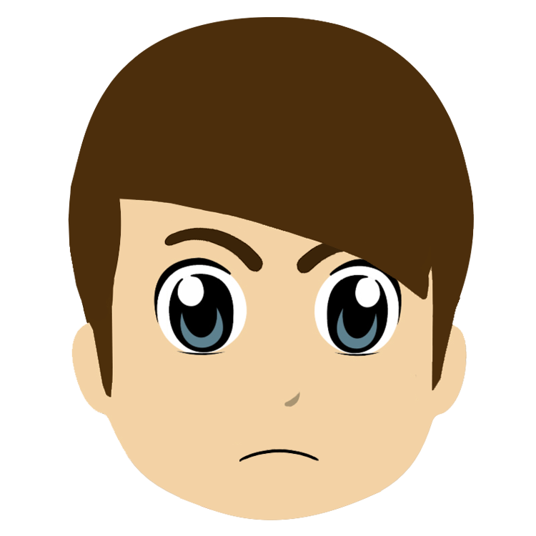
Y7 Spanish
1. Practise saying these words in Spanish. Test your partner on the meanings.
 | Word | English meaning
1 | un gato | a cat
2 | un bolígrafo | a pen
3 | un barco | a boat
4 | un libro | a book
4a
to identify nouns with the correct word for ‘a’
5 | una casa | a house
6 | una cámara | a camera
7 | una bicicleta | a bicycle
8 | una cama | a bed
9 | una moneda | a coin
Tip! Vowels are short and open in Spanish. Open your mouth wide to pronounce them.
Gender of all nouns in Spanish
Things, as well as people, have a gender in Spanish. Each noun is either masculine or feminine: masculine feminine
un elefante → an elephant una llave → a key un lugar → a place una idea → an idea
There is nothing female about a key! This is grammatical not biological gender!
2. ¡Cluedo!
What is it and where is it?
Daniel is listening to clues in a Cluedo game but Hugo distracts him.
What is mentioned and where is it. Circle the correct nouns.
1. Es un gato | bicicleta. Está en una barco | casa.
2. Es una bolígrafo | moneda. Está en un cama | libro.
Tip! The only way you can know is by the word for ‘a’; un (masculine) or una (feminine)?
3. Es una libro | cámara. Está en una barco | bicicleta.
4. Es un barco | casa. Está en una libro | moneda.
5. Es una bolígrafo | casa. Está en un barco | cama.
3. What do these five clues mean? Write the meanings in English. Challenge yourself to do this without looking at the word meanings above.
1. It is a …............. It is in/on a……….
2.
3.
4.
5.
The word en in Spanish can mean ‘in’, ‘on’ or sometimes even ‘at’: Estoy en la escuela. → I am in/at school.

Slide 2
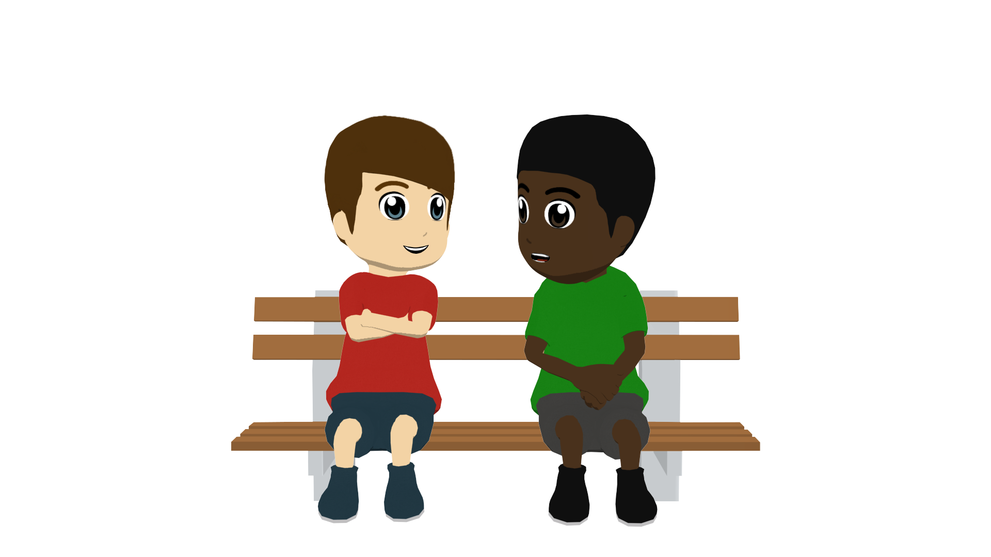
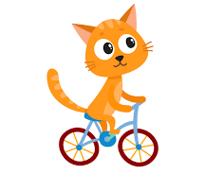
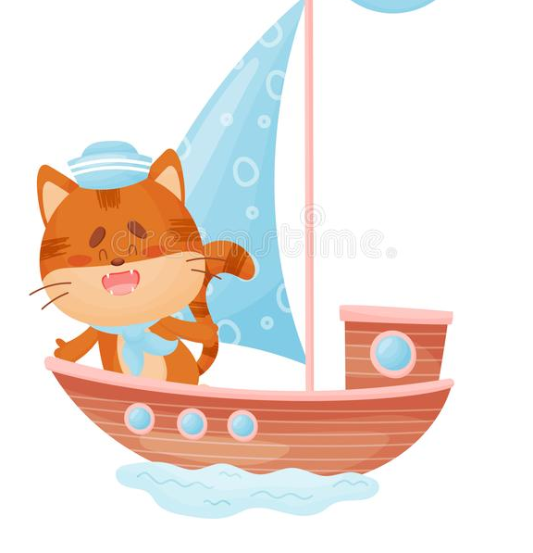
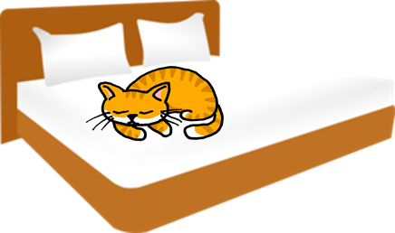
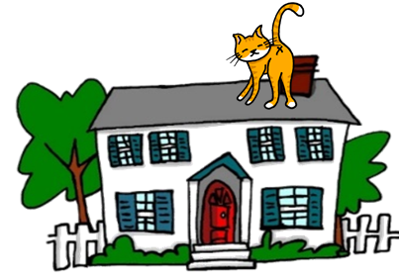
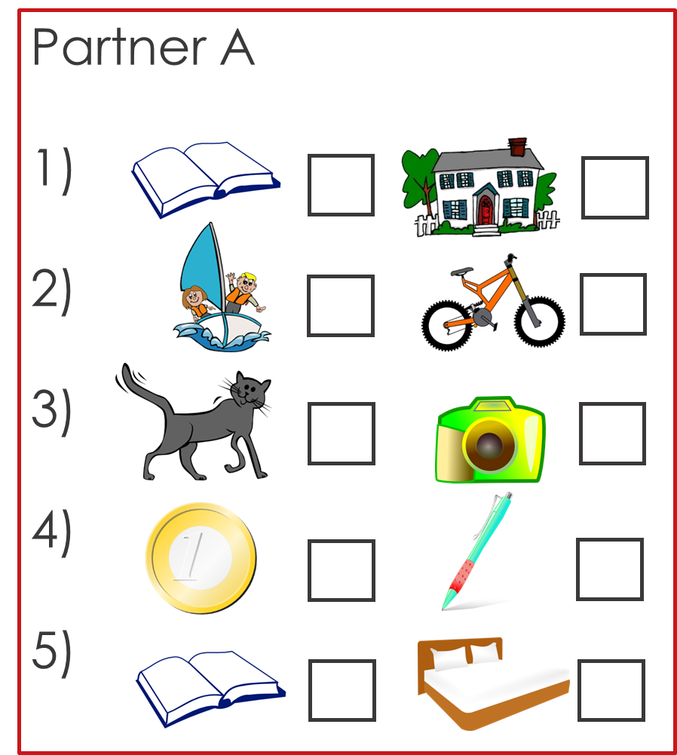
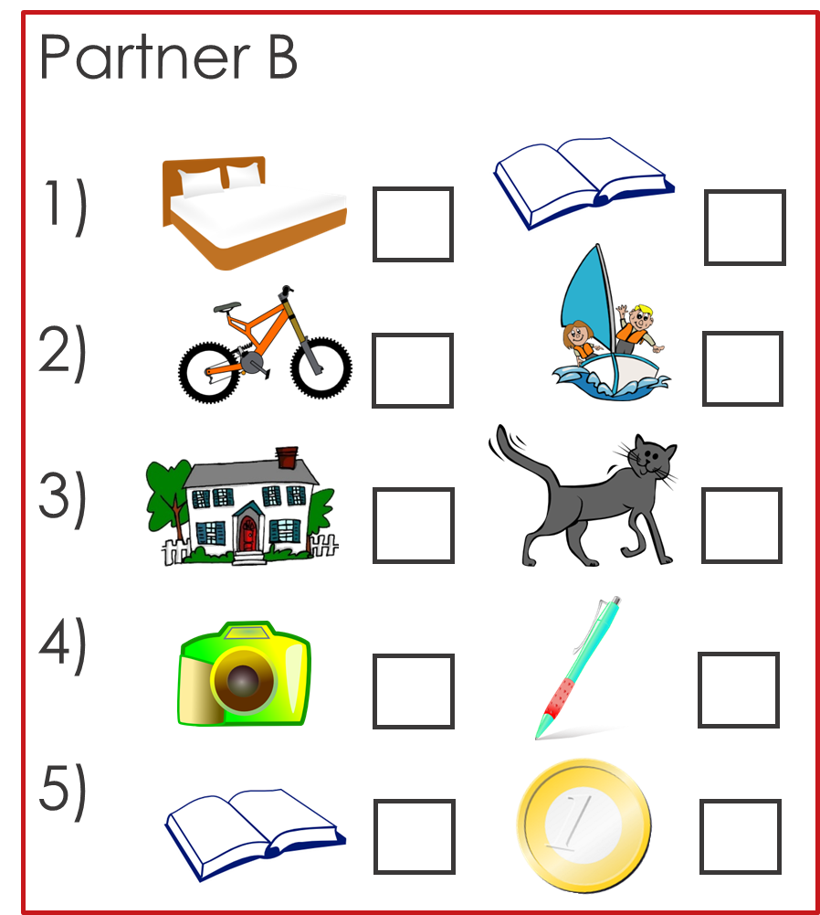
Y7 Spanish
4. ¿Dónde está Snapchat? Daniel and Hugo see Snapcat everywhere! Write a sentence in Spanish about where he is in each picture. Choose the word for a carefully.
1. Está en … ……………..
2.
3.
4.
5.
1
2
3
4
5
5. Partner A. Look at B’s pictures. Decide which one you want to make them say. Start the sentence. Partner B finishes, saying the whole sentence.
If you say ‘una’, your partner has to say ‘Es una cama’.
Example:
Es un…
Then swap. B starts.
A finishes.
¡Es un libro!
¡Sí!
6. Phonics
[l]
This sounds like the ‘l’ in English.
[ll]
The ll in Spanish sounds like y in English.
libro
llamar
Say these words in alphabetical order to your partner. Take care with the [ll] sound. Your partner will listen and check. Then swap.
amarillo
libro
salir
llevar
palabra
yellow
to go out
to wear
word
lista
llegar
llave
ella
llamar
to arrive
key
she
to call

