Slide 1
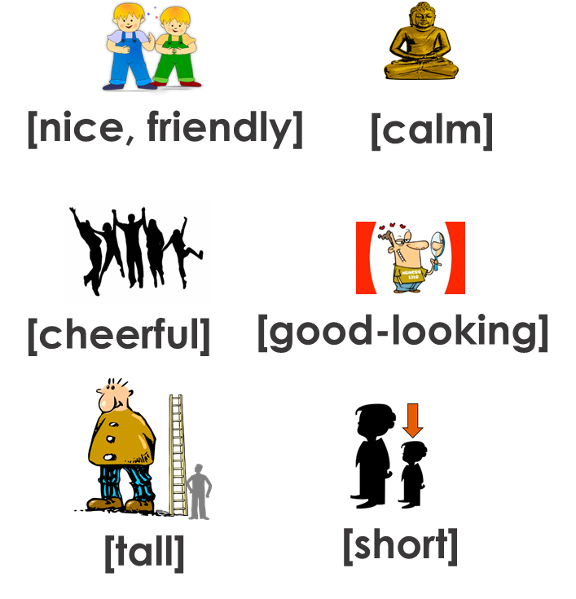
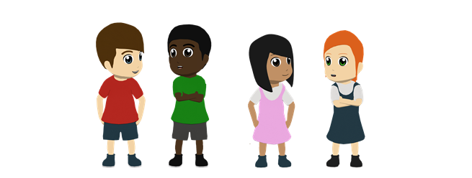
Y7 Spanish
1. In pairs. Person A – say a Spanish sentence. Person B – translate into English.
to say how you or someone else is in general (character traits)
Then swap over. B starts, A translates.
Tip! If you need help remembering the Spanish words, look at last lesson’s work
Adjective agreement
Remember! We change ‘o’ to ‘a’ when the person described is female:
Es simpático. = He is nice.
Es simpática. = She is nice.
When the adjective ends in ‘e’, there is no change.
→ Es alegre. = He / She is cheerful.
2. A school play!
This poster about the lead roles got smudged.
Is each description about Pablo (boy lead) or Claudia (girl lead)? Or both? Write P or C or P/C.
1 | alta.
2 | simpatico.
3 | bajo.
4 | alegre.
5 | famosa.
6 | interesante.
3. Six more characters are announced. Boy or girl? What is he/she like? Write B (boy) or G (girl) and the character in English.
1. Es alegre y alta.
4. Es alto y guapo.
Example:
1. G. She is cheerful and tall.
2. Es bajo y simpatico.
5. Es alegre y bajo.
3. Es guapa y tranquila.
6. Es bajo y nervioso.
4. Invent two more Spanish characters for the play. Write a short sentence with two character traits.
Tip! Remember that if the character is female, you change –o to –a on adjectives.

Slide 2
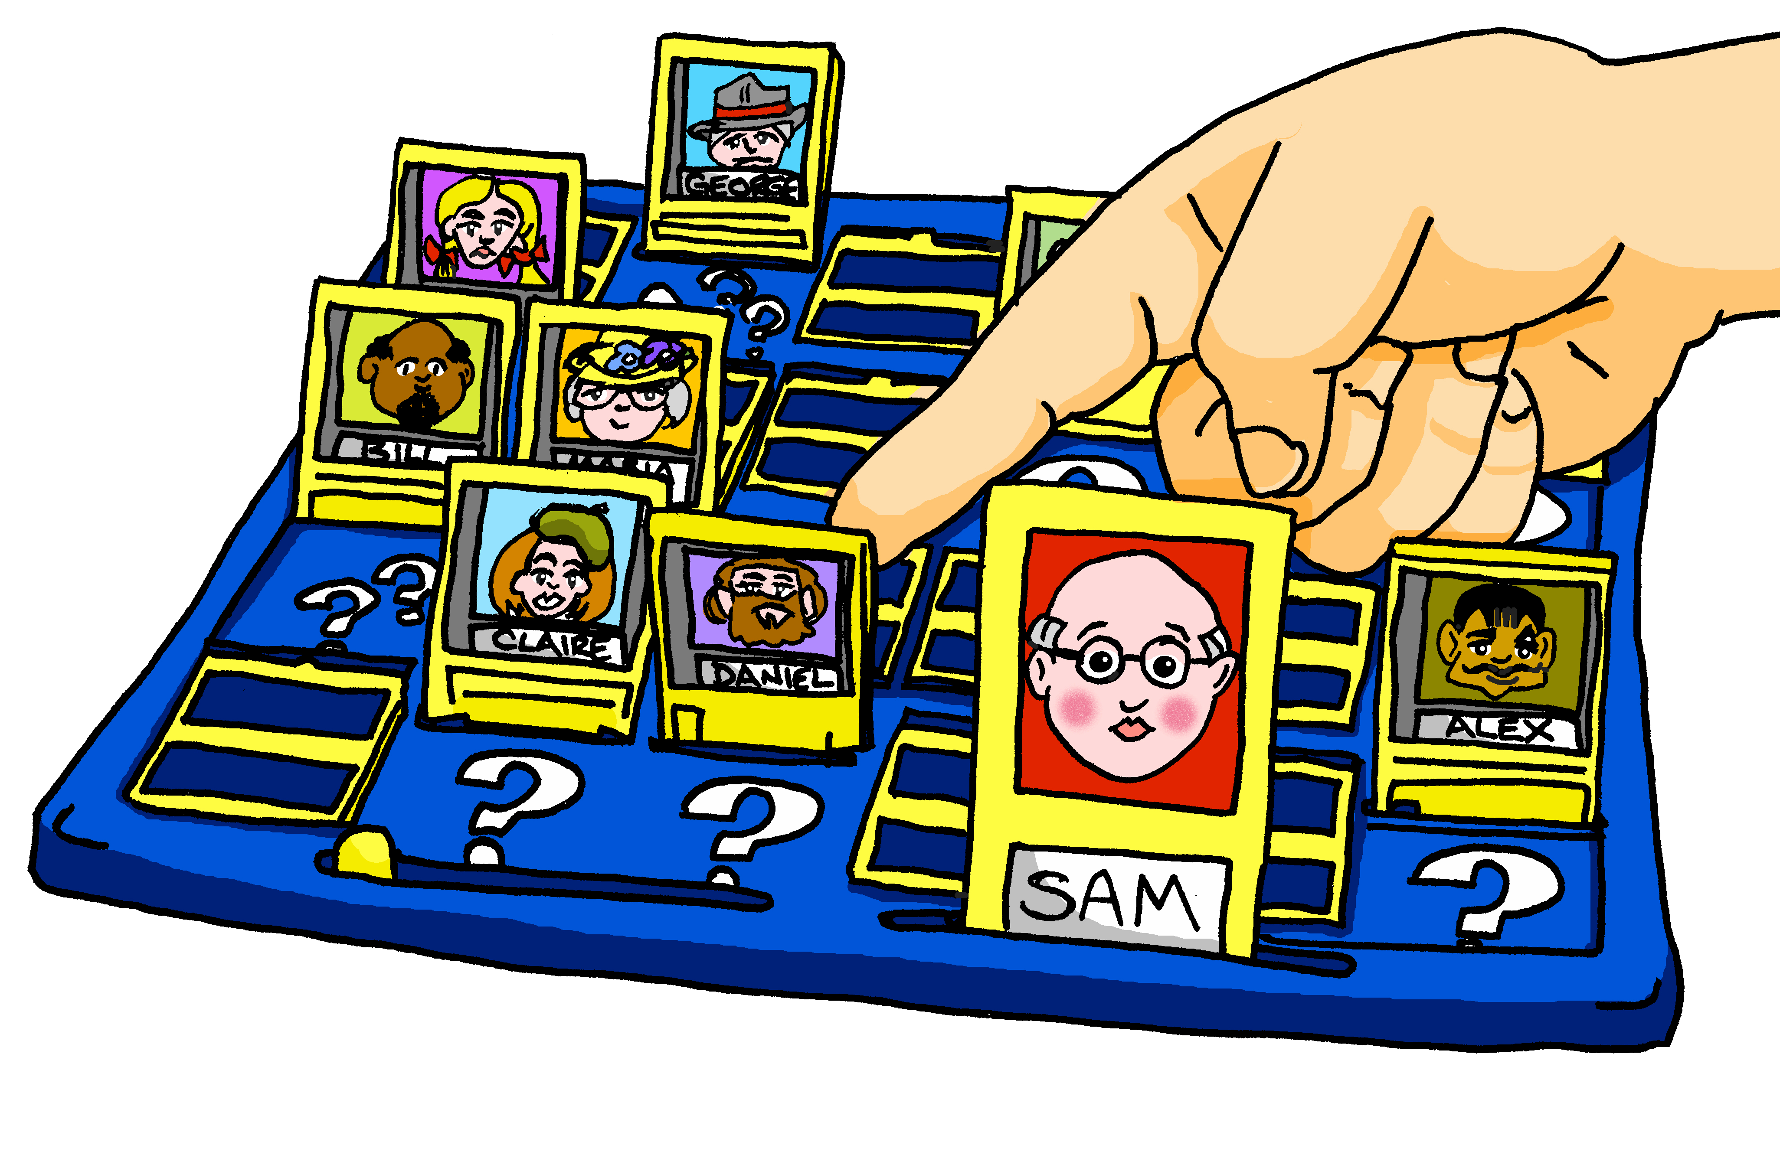
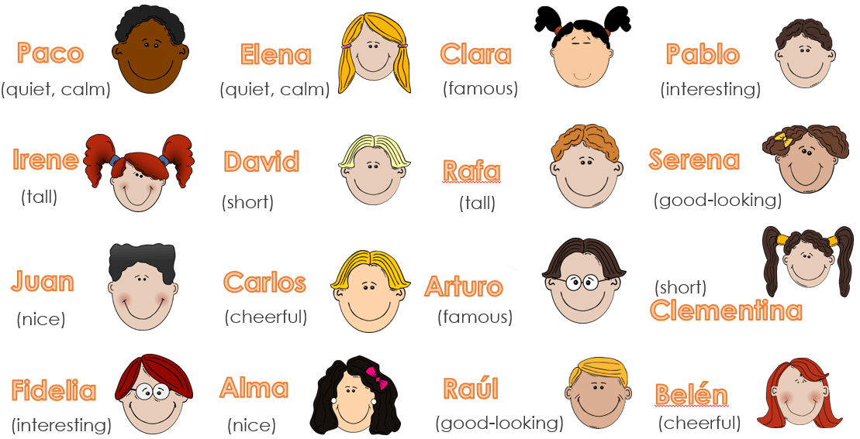
Y7 Spanish
Yes/no questions
Change a Spanish statement into a question by raising your voice at the end:
Eres alegre. = You are cheerful. ¿Eres alegre? = Are you cheerful?
Spanish uses two question marks – the one at the front is upside down. It makes questions very easy to spot!
5. Play ¿Quién soy? (Who am I?) with a partner.
What do you notice about exclamations in Spanish?
Example:
Soy famoso.
¿Eres Arturo?
¡Sí!
Then swap over. B describes. A asks.
6. Here are six more characters for the play. You decide their characters. Write a sentence about each one. Use ‘es’ (he/she is).
 | characters in the play
1 | Señor Fuentes
2 | Señor Gris
3 | Rafaela
4 | Sofía
5 | Diego
6 | Mía
Is the character male or female? Pay attention to the adjective spellings.
Soy tranquila y simpática. Y tú, ¿cómo eres?
¿Cómo eres?
7. To say ‘What are you like?’, ask ‘¿Cómo eres?
Practise with a partner. Describe yourself.

