Slide 1
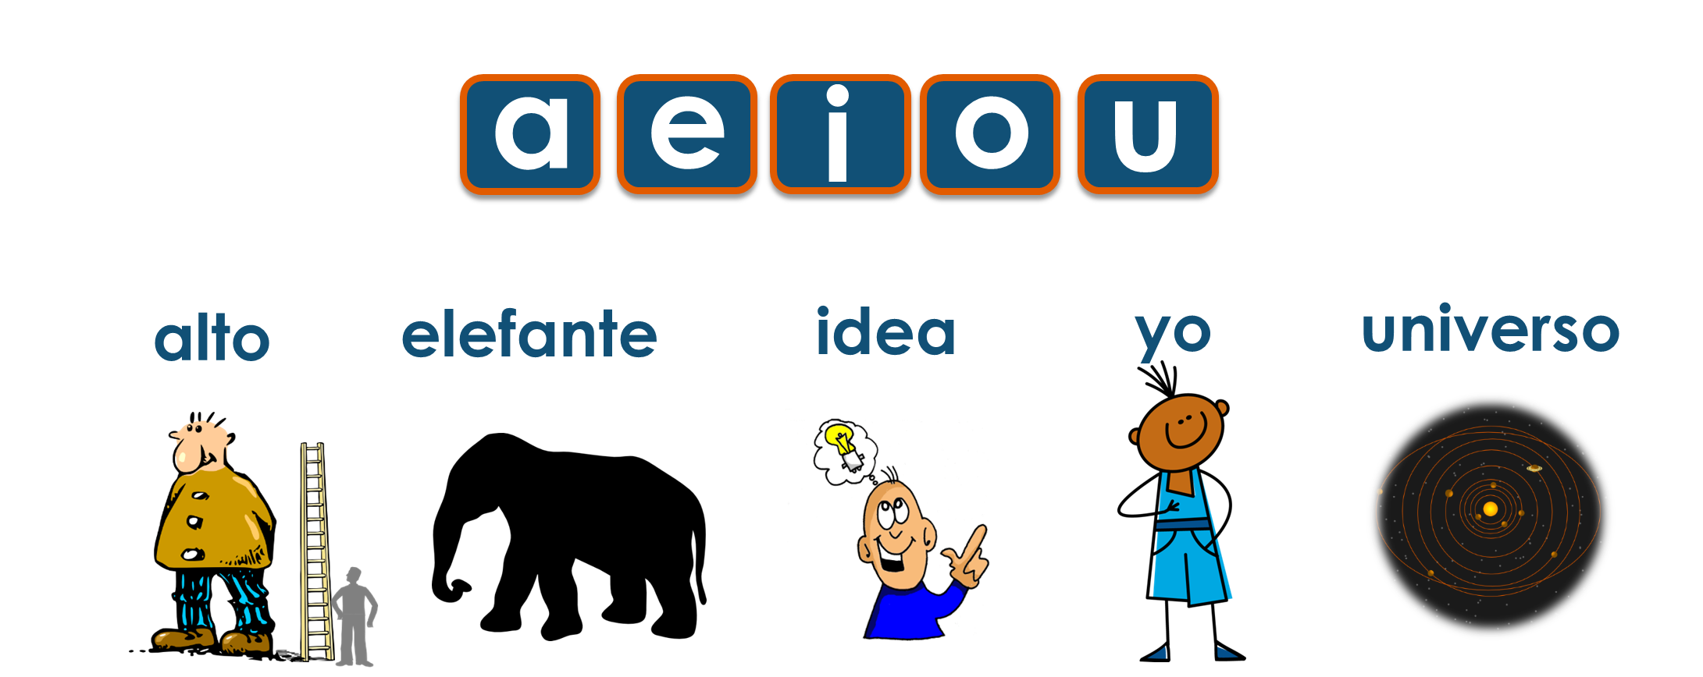
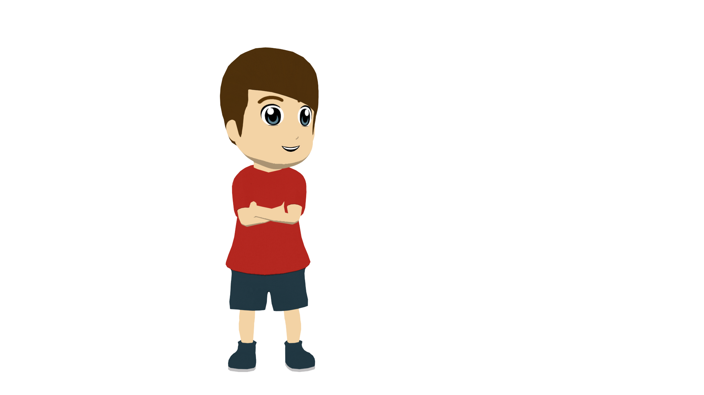
Y7 Spanish
1. Practise saying these words in Spanish. Test your partner on the meanings.
 | Word | English meaning
1 | alto | tall
2 | bajo | short
3 | simpático | nice, friendly
4 | alegre | cheerful
5 | guapo | good-looking
6 | y | and
to say how you or someone else is in general (character traits)
Use these phrases to test your partner. ☺
¿Cómo se dice … en español? → How do you say … in Spanish?
¿Cómo se dice … en inglés? How do you say… in English?
2. Phonics. Spanish vowels are short and open. Practise with the key words.
Tip! Open your mouth wider than we do in English!
ser – to be (general character traits)
This is different from a temporary state: I am feeling strange. Estoy raro.
To say ‘I am’ (generally) use ‘soy’:
→ Soy raro. = I am strange.
To say ‘he / she / it is (generally) use ‘es’:
→ Es alegre. = He / She / It is cheerful.
3. Who is Daniel describing? Himself (I am) or Hugo (he is)? Write 1-6,‘I’ or ‘he’.
1. Soy alto.
4. Soy simpático.
Hugo
2. Es simpático.
5. Soy tranquilo.
‘I am’
‘he is’
3. Es alegre.
6. Es guapo.
4. Write one sentence that describes you generally.
Example:
¡Hola! Soy Lucía. Soy baja y simpática.
Tip! Remember that if you are a girl, you change –o to –a on adjectives.

Slide 2
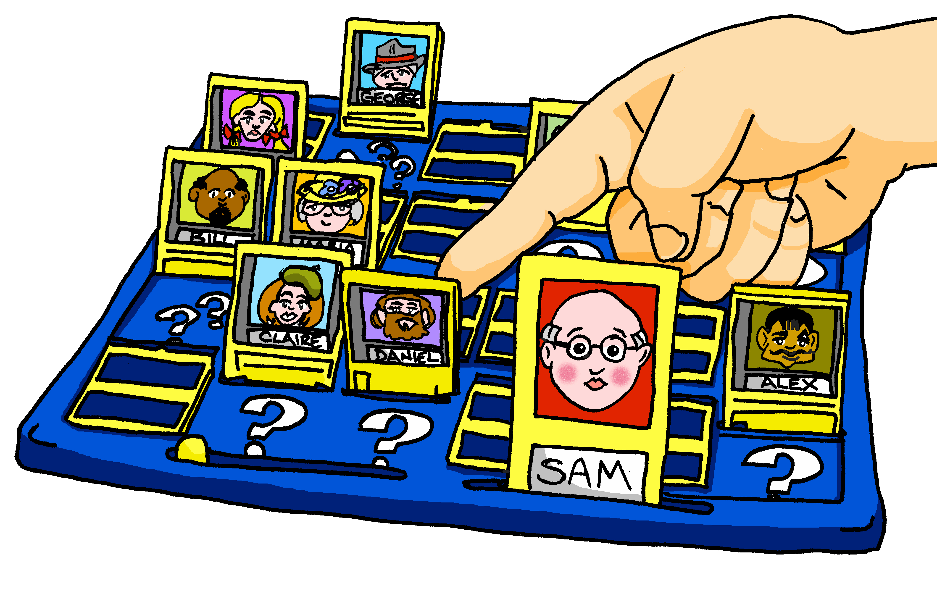
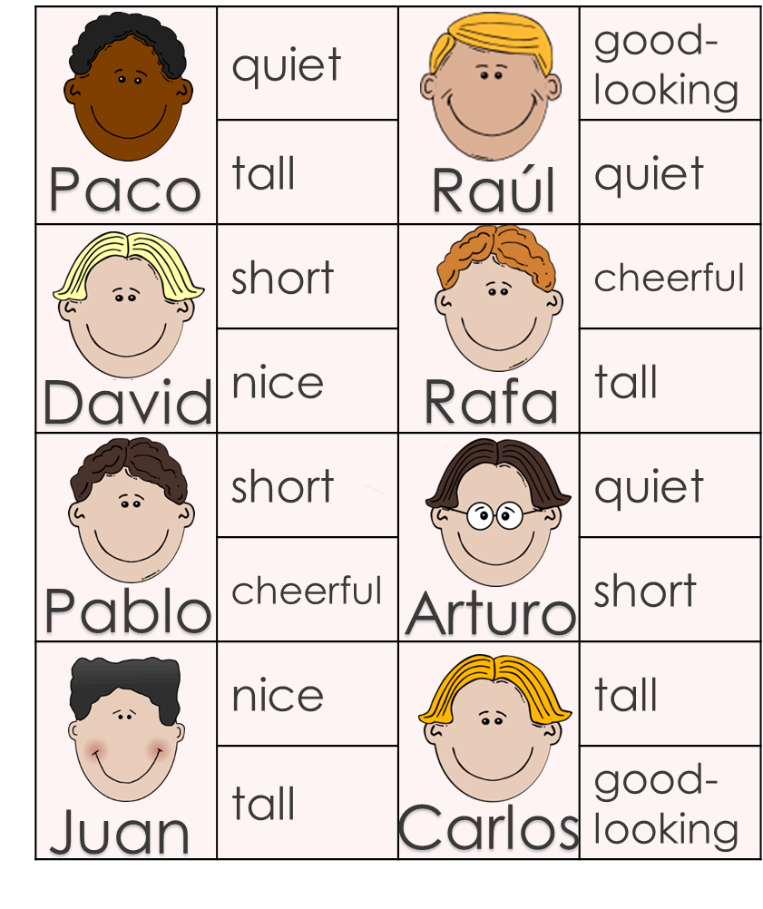
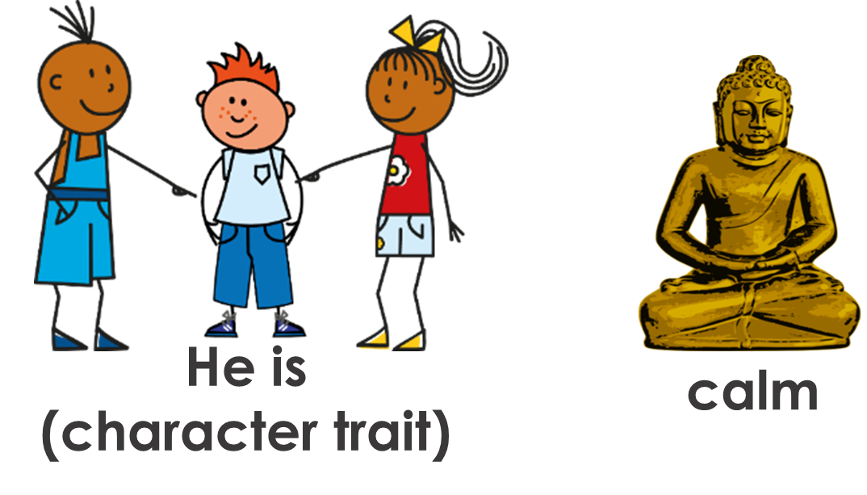
Y7 Spanish
ser – to be (general character traits)
In English we might tend to say: You are a cheerful person to make it clear that it’s what they are like generally, not just today.
To say ‘you are’ (generally) use ‘eres’.
→ Eres alegre. You are cheerful.
5A. Decide which descriptions are ‘I am’ and which are ‘you are.’
I am
you are
1 | Soy alegre y alto.
2 | Eres bajo y simpatico.
3 | Eres guapo y tranquilo.
4 | Soy alto y guapo.
5 | Soy alegre y bajo.
6 | Eres tranquilo y bajo.
Name?
5B. Guess who? game. Identify the person and write the name.
6. Write a sentence in Spanish for each set of pictures.
1
3
2
4
7. Look – cover – say/write – check the vocabulary from this week.
 | say, then cover & write | cover, then write | cover, then write | cover, then write
alto
bajo
simpatico
alegre
guapo
y

