Slide 1
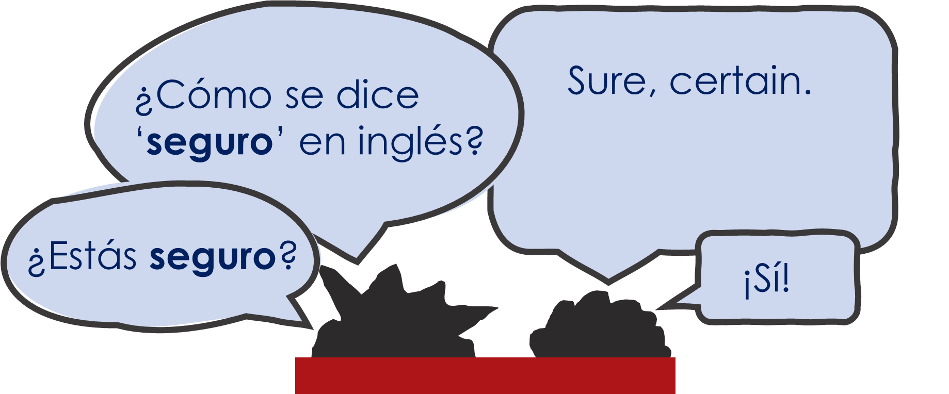
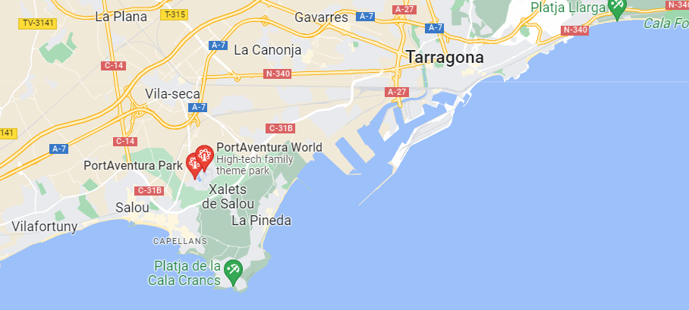
Y7 Spanish
1. Practise saying these words in Spanish. Test your partner on the meanings.
 | Word | English meaning
1 | ¿Cómo? | How? Sorry?
2 | hoy | today
3 | nervioso | nervous
4 | tranquilo | calm
5 | serio | serious
6 | raro | strange
7 | tonto | silly
8 | blanco | white, pale
9 | listo | ready
10 | seguro | sure, certain
11 | muy | very
2b
to say how you or someone else is at the moment
¿Cómo se dice … en español? → How do you say … in Spanish?
What does ¿Cómo se dice … en inglés? mean?
estar – to be (location and state)
In English we might tend to say: I am feeling nervous.
To say ‘I am’ in a location, use ‘estoy’:
→ Estoy en la escuela. = I am in the school.
Also use ‘estoy’ to mean ‘I am’ with a mood or temporary state:
→ Estoy nervioso. = I am nervous.
2. Write how each person is feeling before their exam, in English.
Estoy muy serio, y ¡estoy listo!
E.g. I am very serious and I am readyl
PortAventura World está en Tarragona, en el norte de España. Es un parque muy famoso.
¡Estoy loco y raro hoy!
¡Estoy blanco y muy nervioso!
Estoy seguro y estoy tranquilo.
¡Estoy muy tonto hoy!

Slide 2
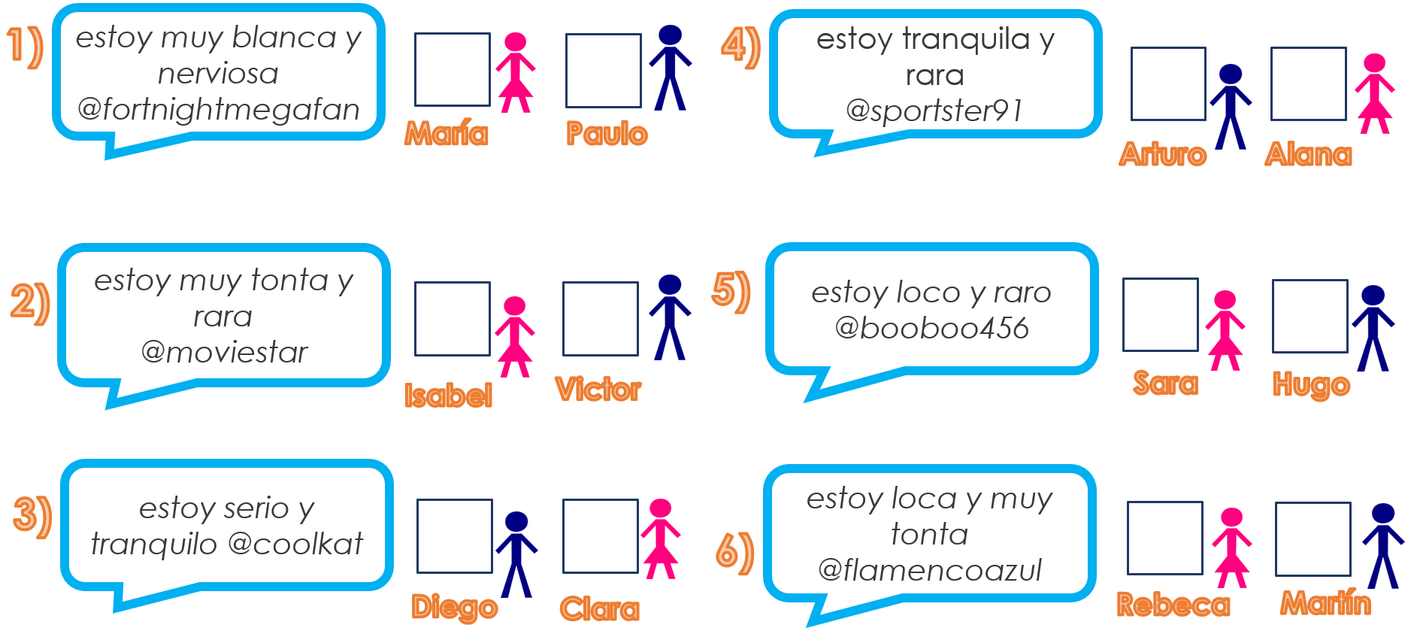
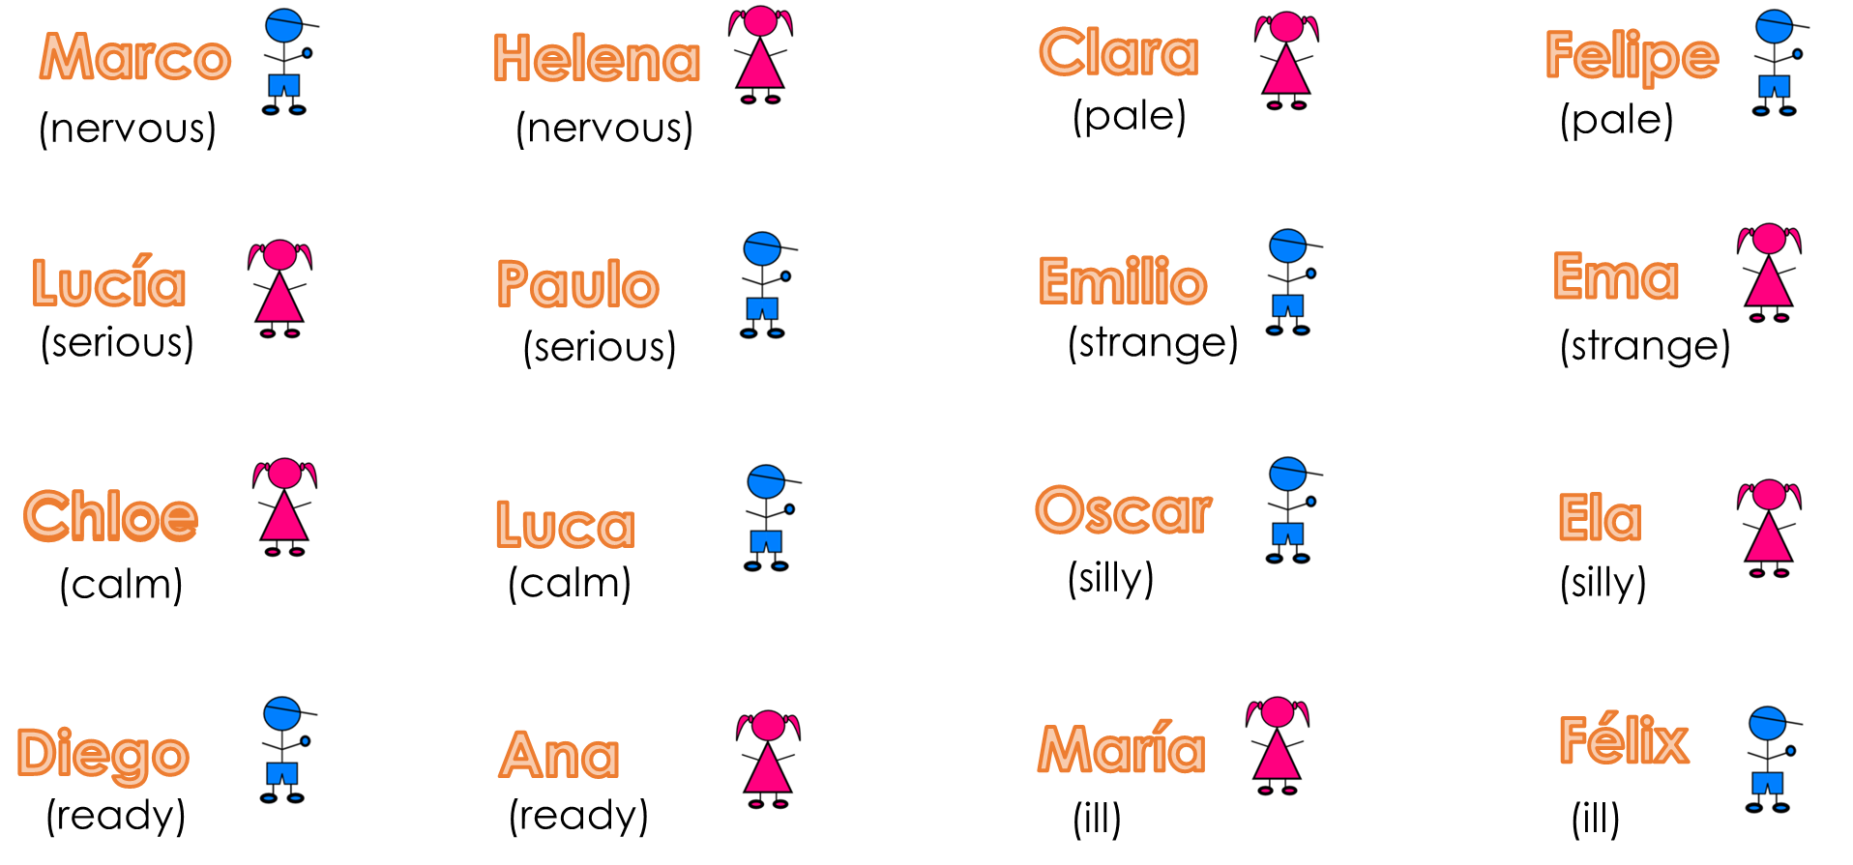
Y7 Spanish
In English we might tend to say: S/he is feeling nervous.
Adjective agreement
Change ‘o’ to ‘a’ when the person described is female:
→ Está nervioso. He is nervous.
→ Está nerviosa. She is nervous.
3. These students also have an exam. Write the name that each message belongs to. (Look at the adjective – boy or girl?)
4. Choose 8 names (write them down in secret). Take it in turns to say a descriptive sentence. Your partner guesses who you are, and vice versa.
Example: A – ‘Estoy serio’ | B – ¡Diego! | A - ¡Sí!

