Slide 1
Y7 Spanish
Write down the key language for this week.
 | Word | English meaning
1 | dónde
2 | estar
3 | estoy
4 | estás
5 | está
6 | en
7 | Inglaterra
8 | España
9 | norte
10 | sur
to revise greetings
to understand and talk about locations
escribir
Write the missing Spanish word. Translate into English.
[she is] en clase.
E
hablar
____________________________
[I am] aquí.
Be ready to respond to the register in Spanish!
1
You can
____________________________
prepare your
answer first, and
practise saying
it aloud a few times.
[He is] ausente.
1 | Hello! I am here.
2 | [Name] is absent.
2
____________________________
3
[She is] allí.
____________________________
[I am] presente.
presente | present
ausente | absent
aquí | here
allí | there
4

Slide 2
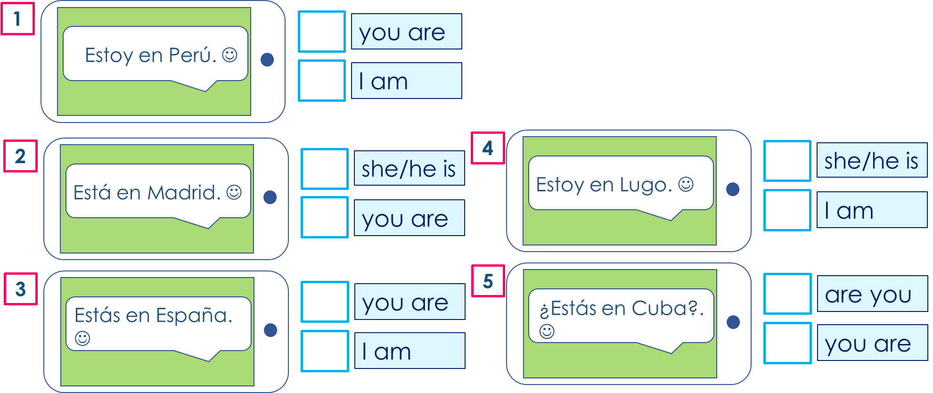
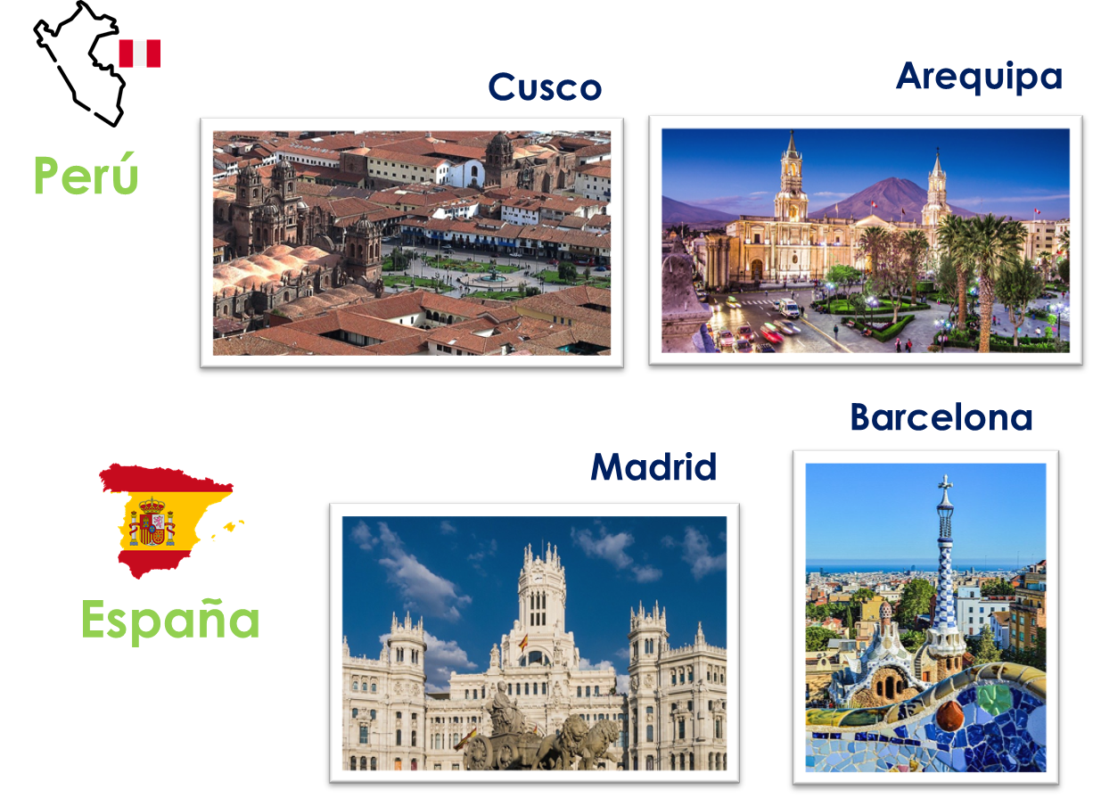
Y7 Spanish
Decide who is in each location. Write 1-5 and I am, you are OR she/he is.
escribir
Write the sentence in Spanish. You choose the city and country.
1 _________________________________.
(You are in____________).
2 _________________________________.
(I am in____________).
3 _________________________________.
(She is in____________).
hablar
Tell a classmate who is in the class.
¡Hola! | Estoy | presente.
 | Está | ausente.
 |  | aquí.
 |  | allí.
Example:
¡Hola! Estoy aquí. Josh está allí. Beth está ausente.
Vocabulario. Try to write the Spanish. Use the language guide, if needed.
to be (location) | Spain | England | I am | she/he/it is
where? | in | you are | north | south
 |  | estás

