Slide 1
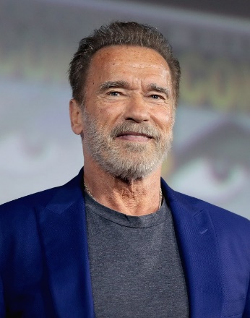
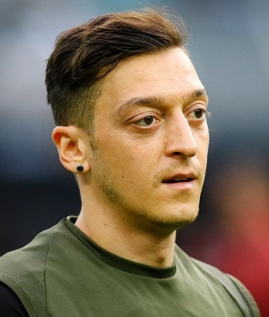
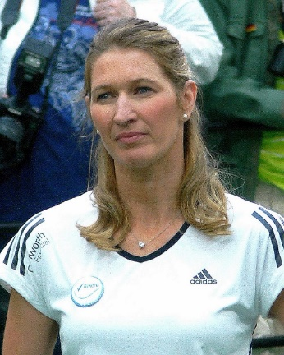
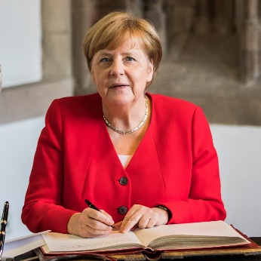
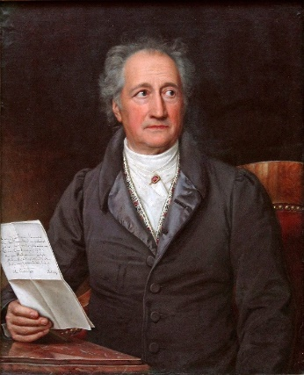
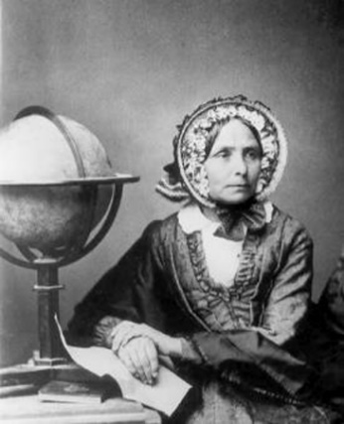
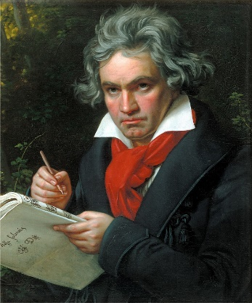
Wer bin ich?
Talking about yourself and someone else Present tense weak verbs: 1st, 2nd, 3rd persons singular
SSC [er], stressed and unstressed
Y7 German
Term 2.1 – Week 5 - Lesson 37 Author name(s): Inge Alferink / Rachel Hawkes
Artwork: Steve Clarke
Date updated: 28.01.24
Notes:
Artwork by Steve Clarke. All additional pictures selected are available under a Creative Commons license; no attribution required.
Note: All words listed below for this week’s learning (new and revisited) appear on all three Awarding Organisations’ word lists, with the following exceptions: i) Edexcel list does not have kaum.
Note that none of the lists has Klassenzimmer but all have Klasse + Zimmer and this would be an acceptable compound.
Learning outcomes (lesson 1):
(Introduction of SSCs [er], stressed and unstressed)
Introduction of present tense weak verbs: 1st, 2nd, 3rd person singular.
Word frequency (1 is the most frequent word in German):
7.2.1.5 (introduce) bleiben [113] brauchen [179] glauben [156] heißen [132] leben [98] liegen [107] reisen [933] verstehen [211] werden1, wird1 [8] Österreich [1511] nach1 [34] nach Hause [n/a] Additional known vocabulary or cognates to recycle: wohnen [560] schreiben [184] spielen [205] reden [368] lernen [288] machen [58]
in der Schule [208] im Klassenzimmer [n/a] im Unterricht [n/a] mit Freunden [n/a]
7.2.1.2 (revisit) null [1680] eins [774] zwei [70] drei [106] vier [200] fünf [274] sechs [428] sieben [611] acht [645] neun [1053] zehn [312] elf [1507] zwölf [1080]
7.1.2.3 (revisit) gehen [66] hören [146] tanzen [1497] kaum [272] manchmal [382] nie [186] oft [223] sehr [81] einmal die Woche [n/a] jeden Tag [n/a]
Source: Jones, R.L & Tschirner, E. (2019). A frequency dictionary of German: Core vocabulary for learners. London: Routledge.
The frequency rankings for words that occur in this PowerPoint which have been previously introduced in LDP resources are given in the LDP SOW and in the resources that first introduced and formally re-visited those words.
For any other words that occur incidentally in this PowerPoint, frequency rankings will be provided in the notes field wherever possible.

Slide 2
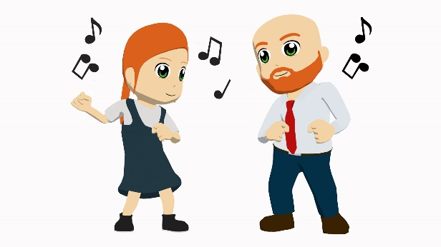
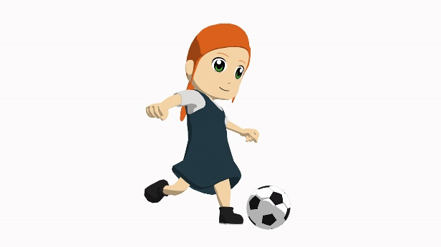
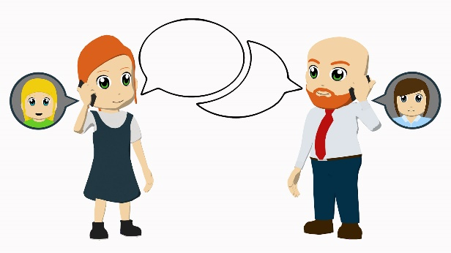
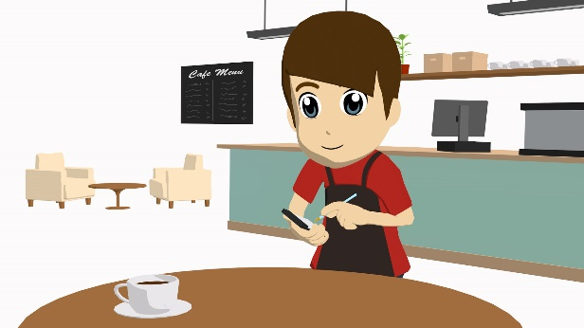
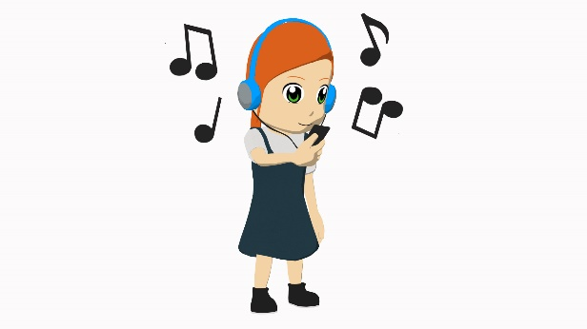
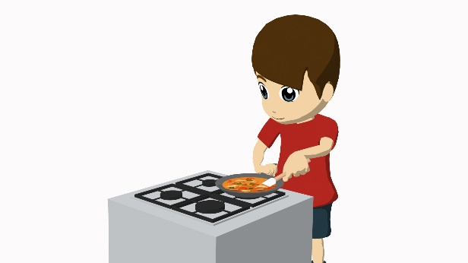
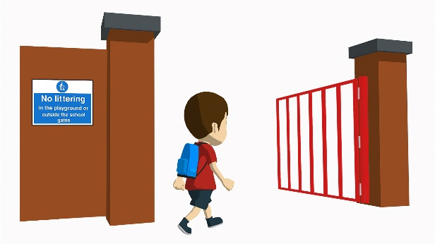
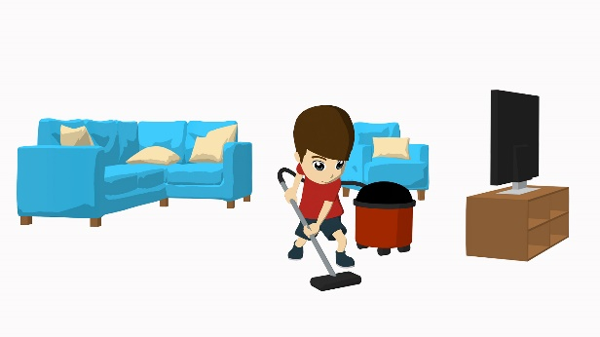
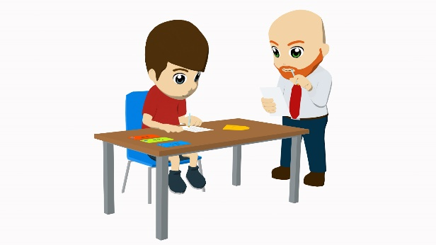
Vokabeln
lesen
hören
tanzen
spielen
arbeiten
schreiben
reden
kochen
putzen
gehen
lernen
Notes:
Timing: 5 minutes
Aim: To revisit weak verbs in first, second, and third person singular.
Note: This starter refreshes 10 of the weak verbs they already know and can be used in the question generating activity in lesson 2.
Procedure: 1. Click to bring up the pictures, one at a time.
2. Students say which verb from the list corresponds to the picture.
3. Click to confirm, by crossing out that verb.
4. Continue until all verbs/pictures have been used.

Slide 3
Vokabeln
lesen
60
nach
zwölf
nach Hause
jeden Tag
einmal die Woche
nie
kaum
elf
manchmal
oft
neun
to, towards
twelve
(to) home
every day
once a week
never
hardly
eleven
sometimes
often
nine
Sekunden
0
LOS!
Notes:
Timing: 3 minutes
Aim: To revisit vocabulary other than verbs.
Procedure: 1. Students have one minute to translate as many words as possible.
2. Click on Los! to start the timer.
3. Answers appear on click.

Slide 4
werden
werden
[to become | becoming]
wird
[becomes | is becoming]
Notes:
Timing: 3 minutes for sequence of six verbs
Aim: To introduce the verb werden more explicitly.
Note: Werden is one of the 25 most frequently used verbs in German. All 25 most frequent verbs will be introduced early on using the same format. Both long form (infinitive) and short form (3rd person singular) are introduced in order to familiarise students with various forms of the same verb.
Procedure:
Bring up the word werden on its own, say it, students repeat it, and remind them of the phonics. Draw attention to the SSC [w] and [er]
Try to elicit the meaning from the students. Students have had explicit teaching that the present tense in German communicates two different present tense meanings in English. This reinforces that learning. Emphasise the two meanings for the short form, reminding students that German only has one form and does not have a direct equivalent of the grammar for ‘is + ing’, the continuous form (as covered in previous weeks).
Bring up the picture, and, if using gestures, a possible gesture would be to mime a seed becoming a plant by starting with fists balled in front of mid-body, and opening them quickly so palms are touching, then raising them in an explosive growth motion.
Then bring up the English translations. Emphasise the two meanings for the infinitive.
Bring up the short form wird, say it, students repeat it. Draw attention to [w] and [i] and [-d].
Try to elicit the meaning from the students. Emphasise the two meanings for the short form.

Slide 5
werden
werden
[to become | becoming]
wird
[becomes | is becoming]
Notes:
Cycle through the long and short form again.

Slide 6
wird
[becomes | is becoming]
Es wird dunkel.
[It becomes | is becoming dark.]
Notes:
Introduce the short form in a sentence.

Slide 7
werden
[to read | reading]
Es kann dunkel werden.
[It can become dark.]
Notes:
Introduce the long form in a sentence.

Slide 8
wird
[becomes | is becoming]
Es wird dunkel.
_________
[It becomes | is becoming dark.]
Notes:
Cycle through the short form in context again.

Slide 9
werden
[to read | reading]
Es kann dunkel werden.
_______________
[It can become dark.]
Notes:
Cycle through the long form in context again.

Slide 10
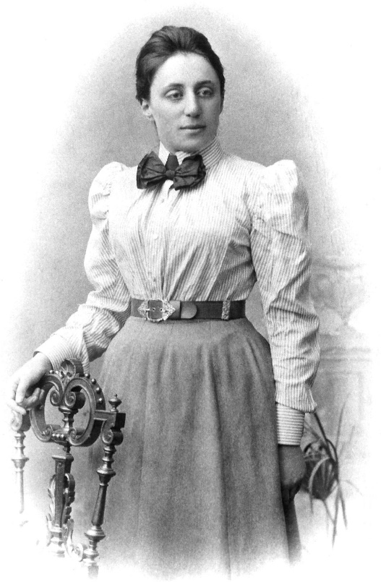
Wer bin ich? Beispiel
lesen / schreiben / sprechen
Ich heiße Emmy Noether und ich komme aus Deutschland. Ich verstehe komplizierte Mathematik. Albert Einstein sagt, ich bin eine wichtige Mathematikerin. Ich arbeite an der Universität Göttingen, aber ich bin eine Frau und bekomme kein Geld!
Ich bin Jüdin. Ich reise 1933 nach Amerika.
Emmy Noether
Notes:
Timing: 15 minutes (or at teacher’s discretion)
Aim: To practise recognition of weak verbs in the present tense.
Note: This task uses 9 short bios of famous people (a combination of historical and current personalities). One is used as an example and the other 8 are for the actual tasks. Because the purpose of this activity is to practise weak verbs in the present, the bios of the historical figures are in the present tense. The task has three parts: running dictation, summary creation, identity guessing game.
Part 1: Wer bin ich? - Running dictation
Procedure: 1. Print the eight bios and put them around the classroom.
2. Introduce the example – play the audio of the example and go through it together for meaning and style and to explain part one of the task.
3. Students work in pairs (or small group depending on the number of students).
4. Give 20 seconds each time. One person runs to his/her allocated text (the teacher will want to allocate the numbered texts to numbered pairs/groups to ensure that all texts are read and there are no ‘bottlenecks’ around one text. The student reads and holds as much information as s/he can in the 20 seconds and when time is up, s/he brings the information back and relays it as oral information in German as per the text (meaning in ich-form, first person). The other person writes down the information, also in German, so this is transcription.
5. This repeats until the bio is complete.
Note: we have recorded audio for all texts. However, audio does not fit into the current three part set up. We will be using these texts and audio recording for some extra revision in week 2.2.1.

Slide 11
Wer bin ich? Beispiel
hören
Ich heiße Emmy Noether und ich komme aus Deutschland. Ich verstehe komplizierte Mathematik. Albert Einstein sagt, ich bin eine wichtige Mathematikerin. Ich arbeite an der Universität Göttingen, aber ich bin eine Frau und bekomme kein Geld!
Ich bin Jüdin. Ich reise 1933 nach Amerika.
Sie kommt aus Deutschland.
Sie reist nach Amerika.
…
…
Sie versteht komplizierte Mathematik.
Emmy Noether
Notes:
Timing: 12 minutes
Part 2: Wer bin ich? - Create a summary
Procedure: 1. Each pair (group) collaboratively writes a 3rd person summary.
2. Students create five 3rd person sentences about their celebrity. In the next part they will be presenting to the other students, who will have to guess which celebrity it is.
Note: Tell students to organise their summary information to make it as challenging as possible for the other teams to guess who it refers to. Make sure they leave out the name! Also tell students not to include any reference to years in their sentences as it may make the clues too easy.

Slide 12
Wer bin ich?
sprechen / hören
© Mark Henckel CC-BY-SA 2.0
© Fars News Agency CC BY 4.0
© Gage Skidmore CC BY-SA 3.0
Steffi Graf
Mesut Özil
Hedy Lamarr
Arnold Schwarzenegger
© Raimond Spekking CC BY-SA 4.0
Ida Pfeiffer
Ludwig von Beethoven
Wolfgang von Goethe
Angela Merkel
Notes:
Timing: 12 minutes (or at teacher’s discretion)
Part 3: Wer bin ich? - listen and identify
Procedure: 1. Have all the pictures and names on the screen.
2. Students present their summary sentence by sentence.
3. After each sentence the other teams can guess who it might be.
Note: If teachers want to run the activity with an element of competition, they can instigate a points system; the sooner the students guess the more points they win, but if they’re wrong they lose points.
Guess correctly after…
… statement 1: 5 points
… statement 2: 4 points, etc.

Slide 13
Steffi Graf
lesen / sprechen
Ich heiße Steffi Graf. Ich komme aus Mannheim, das liegt in Deutschland. Ich wohne aber jetzt mit meiner Familie in den USA. Ich habe einen Mann, André Agassi, und zwei Kinder. Ich spiele Tennis und gewinne Wimbledon oft. Ich bin die erste Tennisspielerin mit einem „Golden Slam“, das heißt vier Grand Slams und einem Goldmedaille bei den Olympischen Spielen in einem Jahr.
© Mark Henckel CC-BY-SA 2.0
Notes:
Steffi Graf - https://en.wikipedia.org/wiki/Steffi_Graf

Slide 14
Ida Pfeiffer
lesen / sprechen
Mein Name ist Ida Pfeiffer und ich komme aus Österreich. Ich lebe im 19. Jahrhundert. Ich reise viel und brauche Geld für meine Weltreisen. Ich schreibe Bücher und bekomme für die Bücher Geld. Ich spreche Deutsch, aber ich lerne Englisch und Dänisch für meine Reise nach Skandinavien.
Notes:
Ida Pfeiffer - https://en.wikipedia.org/wiki/Ida_Laura_Pfeiffer

Slide 15
Hedy Lamarr
lesen / sprechen
Mein Name ist Hedy Lamarr. Ich komme aus Österreich, aber ich lebe in den USA. Ich spiele und tanze in Filmen und habe einen Stern auf dem Hollywood Walk of Fame. 2014 bekomme ich auch einen Platz in der National Inventors Hall of Fame.
Ich mag Technik und man benutzt* meine Technologien im WLan und Bluetooth.
*benutzen - to use
Notes:
Hedy Lamarr - https://en.wikipedia.org/wiki/Hedy_Lamarr
Word frequency (1 is the most frequent word in German):
benutzen [872]
Source: Jones, R.L & Tschirner, E. (2011). A frequency dictionary of German: Core vocabulary for learners. London: Routledge.

Slide 16
Angela Merkel
lesen / sprechen
Mein Name ist Angela Merkel. Ich bin Politikerin. Meine Partei is die Christlich Demokratische Union und ich glaube an Gott. Ich werde 2005 Bundeskanzlerin und bleibe bis 2021 im Amt*. Ich rede mit anderen G7 Politikern über Weltpolitik. Mein Spitzname ist ‘Mutti’. Ich bin auch Physikerin.
© Raimond Spekking CC BY-SA 4.0
*im Amt - in office
Notes:
Angela Merkel - https://de.wikipedia.org/wiki/Angela_Merkel
Word frequency (1 is the most frequent word in German):
das Amt [1114]
Source: Jones, R.L & Tschirner, E. (2011). A frequency dictionary of German: Core vocabulary for learners. London: Routledge.
Note: Glauben is used here in its prototypical meaning ‘believe’. However, it should be noted that the high frequency of the verb is likely due to constructions, such as ‘Ich glaube das…’ (I think that… / I believe that…).

Slide 17
Mesut Özil
lesen / sprechen
Ich heiße Mesut Özil und ich komme aus Gelsenkirchen, das liegt in Deutschland. Ich bin Fußballspieler. Ich spiele in Deutschland, Spanien und England. Ich spiele jetzt für Arsenal und bekome viel Geld. Ich gewinne 2014 mit Deutschland die Weltmeisterschaft. Ich werde fünfmal Deutscher Spieler des Jahres.
© Fars News Agency CC BY 4.0
Notes:
Mesut Özil - https://en.wikipedia.org/wiki/Mesut_Özil

Slide 18
Ludwig von Beethoven
lesen / sprechen
Ich heiße Ludwig von Beethoven und komme aus Bonn, das liegt in Deutschland. Ich lebe im 18. und 19. Jahrhundert. Ich spiele sehr gern Musik und bin Klavierspieler. Ich komponiere 1824 ‘Ode an die Freude’, das Lied der Europaïschen Union, und viele andere Musikstücke. Ich höre leider nicht gut.
Notes:
Beethoven - https://de.wikipedia.org/wiki/Ludwig_van_Beethoven

Slide 19
Wolfgang von Goethe
lesen / sprechen
Ich heiße Wolfgang von Goethe und ich habe viele Jobs. Ich arbeite als Diplomat und mag Naturwissenschaften. Ich schreibe auch Bücher, Theaterstücke, und andere Literatur. Ich schreibe das Stück Doktor Faustus. Ich reise manchmal nach Italien und mag es sehr.
Notes:
Goethe - https://de.wikipedia.org/wiki/Johann_Wolfgang_von_Goethe

Slide 20
Arnold Schwarzenegger
lesen / sprechen
Mein Name ist Arnold Schwarzenegger. Ich bin Österreicher, aber lebe jetzt in den USA. Ich bin Bodybuilder und werde 1984 Mister Universum. Ich spiele auch in Filmen, zum Beispiel in ‘Terminator’. Ich arbeite auch von 2003 bis 2011 als Politiker in Kalifornien.
© Gage Skidmore CC BY-SA 3.0
Notes:
Arnold Schwarzenegger - https://en.wikipedia.org/wiki/Arnold_Schwarzenegger

Slide 21
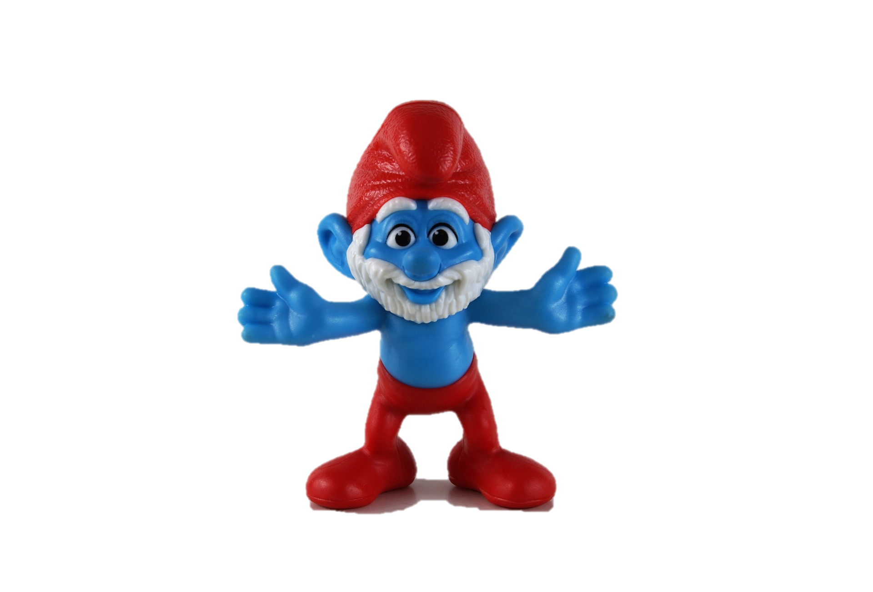
Wer bin ich?
Talking about yourself and someone else Present tense weak verbs: 1st, 2nd, 3rd persons singular
SSC [er], stressed and unstressed
Papa Schlumpf
Y7 German
Term 2.1 – Week 5 - Lesson 38 Author name(s): Inge Alferink / Rachel Hawkes
Artwork: Steve Clarke
Date updated: 28.01.24
Notes:
Artwork by Steve Clarke. All additional pictures selected are available under a Creative Commons license; no attribution required.
Note: All words listed below for this week’s learning (new and revisited) appear on all three Awarding Organisations’ word lists, with the following exceptions: i) Edexcel list does not have kaum.
Note that none of the lists has Klassenzimmer but all have Klasse + Zimmer and this would be an acceptable compound.
Learning outcomes (lesson 2):
Introduction of SSC [er], stressed and unstressed
Consolidation of present tense weak verbs: 1st, 2nd, 3rd person singular.
Word frequency (1 is the most frequent word in German):
7.2.1.5 (introduce) bleiben [113] brauchen [179] glauben [156] heißen [132] leben [98] liegen [107] reisen [933] verstehen [211] werden1, wird1 [8] Österreich [1511] nach1 [34] nach Hause [n/a] Additional known vocabulary or cognates to recycle: wohnen [560] schreiben [184] spielen [205] reden [368] lernen [288] machen [58]
in der Schule [208] im Klassenzimmer [n/a] im Unterricht [n/a] mit Freunden [n/a]
7.2.1.2 (revisit) null [1680] eins [774] zwei [70] drei [106] vier [200] fünf [274] sechs [428] sieben [611] acht [645] neun [1053] zehn [312] elf [1507] zwölf [1080]
7.1.2.3 (revisit) gehen [66] hören [146] tanzen [1497] kaum [272] manchmal [382] nie [186] oft [223] sehr [81] einmal die Woche [n/a] jeden Tag [n/a]
Source: Jones, R.L & Tschirner, E. (2019). A frequency dictionary of German: Core vocabulary for learners. London: Routledge.
The frequency rankings for words that occur in this PowerPoint which have been previously introduced in LDP resources are given in the LDP SOW and in the resources that first introduced and formally re-visited those words.
For any other words that occur incidentally in this PowerPoint, frequency rankings will be provided in the notes field wherever possible.

Slide 22
er
er
Notes:
Timing: 1 minute
Aim: To introduce/consolidate SSC [er]
Procedure: 1. Present the letter(s) and say the [er] sound first, on its own. Students repeat it with you. 2. Bring up the word ”er” on its own, say it, students repeat it, so that they have the opportunity to focus all of their attention on the connection between the written word and its sound.
3. A possible gesture for this would be to point to an imaginary ‘he’, using your index finger, thumb point upwards (to make the gesture more exaggerated), as per the image.
4. Roll back the animations and work through 1-3 again, but this time, dropping your voice completely to listen carefully to the students saying the [er] sound, pronouncing ”er” and, if using, doing the gesture. Word frequency (1 is the most frequent word in German): er [20] Source: Jones, R.L. & Tschirner, E. (2006). A frequency dictionary of German: core vocabulary for learners. Routledge

Slide 23
er
er
Notes:
With sound and no pictures to focus all attention on the sound-symbol correspondence.

Slide 24
er
er
Notes:
Without sound to elicit pronunciation (without first hearing the teacher).
Teacher to elicit pronunciation by asking “Wie sagt man…”

Slide 25
er
schwer
wer?
er
Herz
lernen
erst
st
Notes:
Timing: 2 minutes
Aim: To introduce/consolidate SSC [er]
Procedure:
Introduce and elicit the pronunciation of the individual SSC [er] and then the source word again ‘er’ (with gesture, if using).
Then present and elicit the pronunciation of the five cluster words.
The cluster words have been chosen for their high-frequency, from a range of word classes, with the SSC (where possible) positioned within a variety of syllables within the words (e.g. initial, 2nd, final etc.). Additionally, we have tried to use words that build cumulatively on previously taught SSCs (see the Phonics Teaching Sequence document) and do not include new SSCs. Where new SSCs are used, they are often consonants which have a similar symbol-sound correspondence in English.
Word frequency (1 is the most frequent word in German): er [20]; schwer [256] wer? [173]; Herz [699]; erst [126]; lernen [203].
Source: Jones, R.L. & Tschirner, E. (2006). A frequency dictionary of German: core vocabulary for learners. Routledge

Slide 26
er
schwer
wer?
er
Herz
lernen
erst
Notes:
With sound and no pictures to focus all attention on the sound-symbol correspondence.

Slide 27
er
schwer
wer?
er
Herz
lernen
erst
Notes:
Without sound to elicit pronunciation (without first hearing the teacher).
Teacher to elicit pronunciation by asking “Wie sagt man…”

Slide 28
er
wieder
Notes:
Timing: 1 minute
Aim: To introduce/consolidate SSC [er]
Procedure: 1. Present the letter(s) and say the [er] sound first, on its own. Students repeat it with you. 2. Bring up the word ”wieder” on its own, say it, students repeat it, so that they have the opportunity to focus all of their attention on the connection between the written word and its sound.
3. A possible gesture for this would be to roll your hands over in the air, clockwise. Your hands are in front of your body.
4. Roll back the animations and work through 1-3 again, but this time, dropping your voice completely to listen carefully to the students saying the [er] sound, pronouncing ”wieder” and, if using, doing the gesture. Word frequency (1 is the most frequent word in German): wieder [75] Source: Jones, R.L. & Tschirner, E. (2006). A frequency dictionary of German: core vocabulary for learners. Routledge

Slide 29
er
wieder
Notes:
With sound and no pictures to focus all attention on the sound-symbol correspondence.

Slide 30
er
wieder
Notes:
Without sound to elicit pronunciation (without first hearing the teacher).
Teacher to elicit pronunciation by asking “Wie sagt man…”

Slide 31
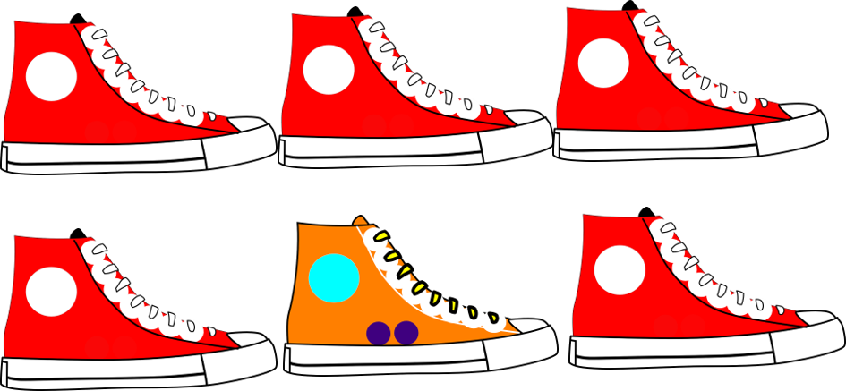
er
Eltern
aber
wieder
anders
oder
?
hundert
Notes:
Timing: 2 minutes
Aim: To introduce/consolidate SSC [er]
Procedure:
Introduce and elicit the pronunciation of the individual SSC [er] and then the source word again ‘wieder’ (with gesture, if using).
Then present and elicit the pronunciation of the five cluster words.
The cluster words have been chosen for their high-frequency, from a range of word classes, with the SSC (where possible) positioned within a variety of syllables within the words (e.g. initial, 2nd, final etc.). Additionally, we have tried to use words that build cumulatively on previously taught SSCs (see the Phonics Teaching Sequence document) and do not include new SSCs. Where new SSCs are used, they are often consonants which have a similar symbol-sound correspondence in English.
Word frequency (1 is the most frequent word in German): wieder [75]; Eltern [351] aber [32]; anders [306]; hundert [945]; oder [30]. Source: Jones, R.L. & Tschirner, E. (2006). A frequency dictionary of German: core vocabulary for learners. Routledge

Slide 32
er
Eltern
aber
wieder
anders
oder
hundert
Notes:
With sound and no pictures to focus all attention on the sound-symbol correspondence.

Slide 33
er
Eltern
aber
wieder
anders
oder
hundert
Notes:
Without sound to elicit pronunciation (without first hearing the teacher).
Teacher to elicit pronunciation by asking “Wie sagt man…”

Slide 34
Wie viele … ?
Wie viele [Stressed and unstressed –er]?
hören
Der Herr versteht kein Deutsch.
1
Der Herr versteht kein Deutsch.
2
Er lernt nichts.
Er lernt nichts.
Die Eltern putzen das Fenster.
3
Die Eltern putzen das Fenster.
4
Die Mutter ist groß, aber das Kind ist klein.
Die Mutter ist groß, aber das Kind ist klein.
5
Wer hat leider kein Herz?
Wer hat leider kein Herz?
6
Der Fußballspieler gewinnt wieder hundert Trophäen.
Der Fußballspieler gewinnt wieder hundert Trophäen.
Notes:
Timing: 6 minutes
Aim: To provide phonics practice - How many stressed and unstressed –er can you hear in the sentences?
Procedure: 1. Click on the numbered buttons to play the audio.
2. Students listen and identify where the two types of –er occur.
3. Answers appear on successive mouse clicks: stressed –er are underlined, unstressed –er are hignlighted in colour only (no underlining).
Note:
Sentences 1 and 2 only contain stressed -er
Sentences 3 and 4 only contain unstressed –er
Sentences 5 and 6 contain both stressed and unstressed –er

Slide 35
Fragen
Grammatik
Closed (yes /no) questions are formed by swapping the verb and subject:
Statement
Du | spielst | oft Tennis.
You often play tennis.
Closed
Spielst | du | oft Tennis?
Do you often play tennis?
To ask an open question, place a question word directly in front of the verb:
Open
Wo
spielst | du oft Tennis?
Where do you often play tennis?
Notes:
Timing: 3 minutes
Aim: To revisit knowledge about open and closed questions that students were taught in 1.1.7 and 1.2.3
Procedure: 1. Cycle through the information on the slide using the animation sequence.
2. Teacher to highlight that German does not have a word for do/does, or the continuous equivalent are/is, and that inversion must be used to translate these. These two concepts will be explained more in week 2.1.6.

Slide 36
Who never dances?
Schreib auf Deutsch.
schreiben
Wer tanzt nie?
1
Wie can mean how:
Wie geht’s? Gut, danke.
Wie can mean what like:
Wie ist der Mann? Er ist groß.
Here we get wie instead of was:
Wie heißt du? (What are you called?)
2
How do you write that?
Wie schreibt man das?
3
Are you going home?
Gehst du nach Hause?
4
What do you cook often?
Was kochst du oft?
5
Do you work every day?
Arbeitest du jeden Tag?
6
Where do you live now?
Wo wohnst du jetzt?
Fill in the correct question word:
Wie heißt du?
7
___
Notes:
Timing: 10 minutes
Aim: To provide translation practice (English to German).
Note: In this activity we revisit asking open and closed questions using the words revisited in the vocab starter. Students translate the English questions into German. They practise question formation as well as producing second person singular (du) verb forms. Du-questions will come back in the dictagloss task that follows. Translation is useful to draw attention to the do-auxiliary in English, which does not exist in German.
Procedure: 1. Click to bring up the English sentences for translation into German, one by one.
2. Students attempt to translate each sentence into German.
3. The second round of clicks brings up a suggested translation for each sentence.
4. The final round of clicks brings up an additional question, eliciting the question word ‘wie?’ – see note below.
Note: heißen – now that we have introduced this verb, it would be usual for students to learn how to use to ask others’ names. They haven’t yet done this, so won’t know that the question is ‘Wie’ not ‘Was’ We flag this explicitly, here, with a note that recaps the prototypical meaning of ‘wie’ and how students have used it, plus the ‘what like’ meaning:
Ie. Wie geht’s ? Gut, danke Wie ist der Mann? Er is groß. Then we add a further meaning – Wie instead of Was, to mean ‘what’. Wie heißt du? What are you called? (literally ‘how (do) you call you?’).

Slide 37
Exklusives Interview!
hören / schreiben / sprechen
PAPA SCHLUMPF: “ICH LERNE JAPANISCH”
Hör jetzt das exklusive Interview an!
Notes:
Timing: 25 minutes
Aim: To provide a dictagloss – Interview mit Papa Schlumpf.
Note: This is a dictagloss activity where students reconstruct a text from notes about an interview they have listened to. The text is designed to practise verbs forms in the first, second, and third person singular beyond sentence level. The vocabulary items have been encountered before or are cognates. The vocab starters and content of lesson one will have refreshed students’ memory. An alternative version using slightly more complex language is available on the LDP Resource Portal.
Procedure:
Students write 1-10 in their notebooks with plenty of space for each point.
Students listen to the interview and take notes about each question and answer.
Play the interview again if necessary. How many times is up depends on the class and ability level and is up to the teacher’s judgment.
Based on the notes students reconstruct the dialogue (could be done in pairs).
In pairs students perform the dialogue, as read aloud from their own script.
A transcript is provided over the next two slides, for checking.

Slide 38
Transcript
hören
Was sind deine Hobbys?
Ich mag reisen und ich reise oft. Ich sitze oder liege auch manchmal im Wald und denke an das Leben.
Hast du Familie?
Ja. Ich habe auch einen Freund. Er heißt Hiro. Er wohnt leider in Japan, aber wir reden oft.
Was ist deine Lieblingsfarbe?
Es gibt viel Blau in meiner Welt. Aber Blau ist langweilig. Ich mag Schwarz sehr!
Wie viele Schlümpfe gibt es?
Ich glaube, es gibt rund eine Million, aber ich weiß es nicht! Ein Schlumpf kocht, ein Schlumpf putzt, ein Schlumpf tanzt...
Arbeitest du jeden Tag?
Ja, ich arbeite viel, aber ich mag das. Es gibt viele Schlümpfe und sie haben viele Fragen.
Notes:
Transcript dictagloss for checking.

Slide 39
Transcript
hören
Was magst du nicht?
Ich mag Hunde nicht.
Was machst du jeden Tag?
Ich gehe jeden Tag in den Wald. Ich mache Yoga, ich tanze, und ich gehe wieder nach Hause.
Verstehst du Fremdsprachen?
Ich spreche Schlümpfisch, aber ich verstehe auch sehr gut Deutsch. Ich lerne jetzt Japanisch und ich gehe einmal die Woche in die Schule.
Hörst du Musik?
Ja, aber ich habe leider kaum Zeit.
Was gibt es auf deiner ‘Bucketliste’?
Ich denke manchmal: “Ich schreibe ein Buch!”, aber ich weiß nicht.
Notes:
Transcript dictagloss for checking.

Slide 40
Hausaufgaben
No new vocabulary for 7.2.1.6
Revisit vocabulary from this term: 7.2.1.1 7.2.1.2 7.2.1.3 7.2.1.4
7.2.1.5
Notes:
Timing: 2 minutes Next week is revision/assessment week. There is no new vocabulary. Direct students instead to revisit vocabulary from this term (and/or last term). The assessments contain vocabulary, grammar and phonics from Term 1 and Term 2.1.

Slide 41
Hausaufgaben
New vocabulary for Term 7.2.2.1
Audio file
Student worksheet
In addition, revisit: Term 2.1 Week 3 | Term 1.2 Week 4
Notes:
NOTE: This is the homework slide for homework to be set at the end of next week’s revision/assessment week 7.2.1.6 Timing: 2 minutes Use this slide to set the homework.
Use this slide to set the homework.
For Y7, the typical homework will be to pre-learn vocabulary for the next lesson. There is an audio file to accompany the student worksheet.
Notes:
i) Teachers may, in addition, want to recommend use of a particular online app for the pre-learning of each week’s words. ii) Quizlet now requires parental involvement / registration / permissions for users below the age of 13, so it is perhaps most suitable for Y9 – 11 students. iii) Language Nut hosts LDP vocabulary lists and these are free for schools to use, though there is a registration process. One benefit is that all of the student tracking data that Language Nut offers are also available to schools that use the LDP lists for practice. Perhaps this makes it a good option for Y7/8.
iv) There are other free apps, and new ones are always appearing. Teachers have told us that they are currently using: Flippity, Wordwall (where using previously-created activities is free).
v) Gaming Grammar has been acquired by Language Nut. Its original content should still be available to teachers and much of it is appropriate for Y7 learners.

