Slide 1
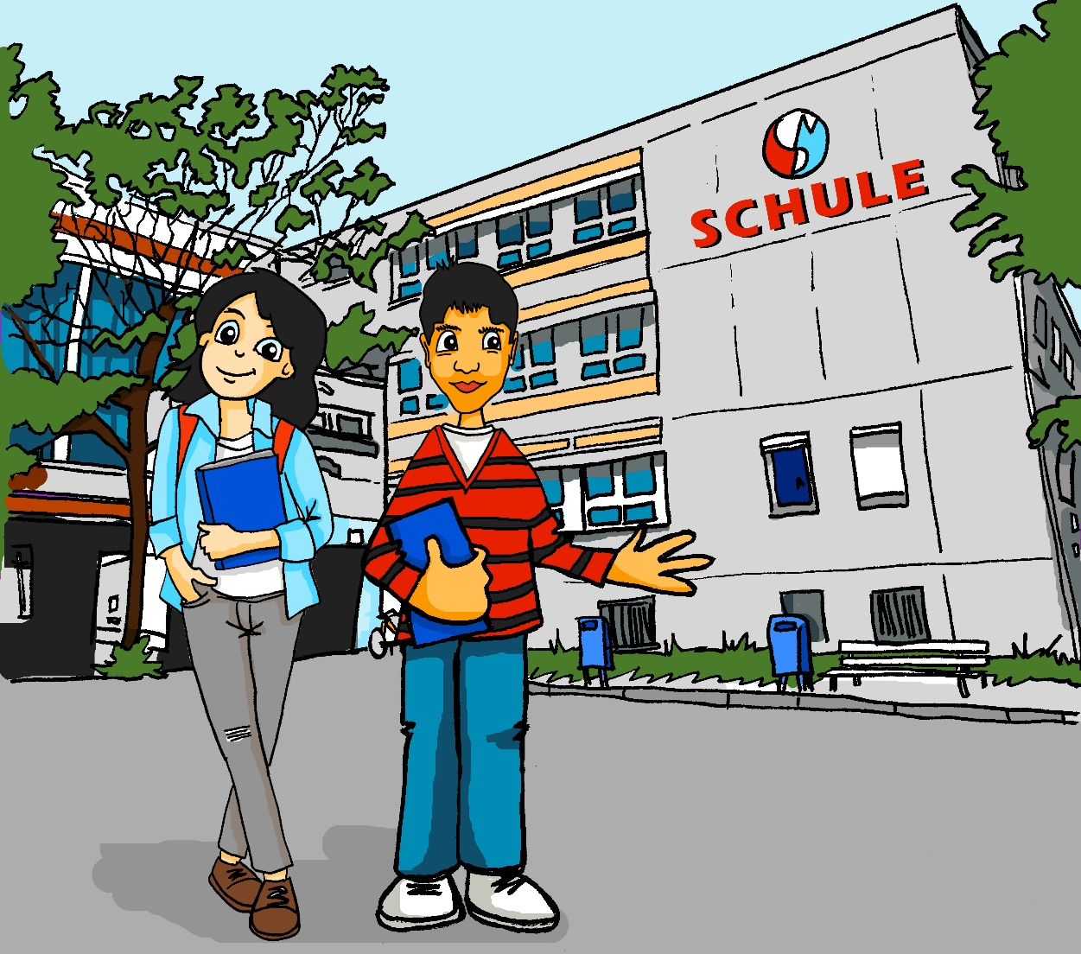
Wie findest du die Schule?
Object pronouns (singular) ihn, sie, es, sie (plural)
FINDEN - ich finde / du findest / er & sie findet
SSC [s like z], [ß]
Y7 German
Term 2.1 – Week 4 - Lesson 35 Author name(s): Leigh McClelland / Rachel Hawkes
Artwork: Steve Clarke
Date updated: 26.01.24
Notes:
Artwork by Steve Clarke. All additional pictures selected are available under a Creative Commons license; no attribution required.
Note: All words listed below for this week’s learning (new and revisited) appear on all three Awarding Organisations’ word lists, with the following exceptions: i) AQA list does not have Gutschein, putzen
ii) Edexcel list does not have Gutschein, hässlich, in Ordnung, putzen. iii) Eduqas list does not have list does not have Gutschein, hässlich.
Learning outcomes (lesson 1):
Introduction of SSCs [s like z], [ß]
Introduction of FINDEN: 1st, 2nd, 3rd person singular. Consolidation of singular object pronouns, and introduction to plural object pronoun.
Word frequency (1 is the most frequent word in German):
7.2.1.4 (introduce) finden [103] Essen1 [323] Uniform [3857] gesund [1275] langweilig [3019] lecker [>5009] leicht [311] nett [1565] praktisch [840] schwierig [580] schlecht [327] streng [1375] wichtig [144] zu1 [21] ein bisschen [n/a] Additional known vocabulary or cognates to recycle: Schule [359] Lehrer [695] (plural) Unterricht [1823] schön [188] hässlich [3542] toll [972] ganz [69] ziemlich [605] jetzt [72] interessant [810] gut [76] super [1772] total [1021] in Ordnung [n/a] 7.2.1.1 (revisit) denken [128] er2 [15] es [12] sie2 [7] Fahrrad / Rad [2138] Geschenk [2595] Gutschein [>5009] Handy [1693] Jacke [3287] hässlich [3542] toll [972] ganz [69] jetzt [72] ziemlich [605] in Ordnung [n/a]
7.1.2.2 (revisit) arbeiten [234] kochen [1481] putzen [3586] sitzen [231] Auto [361] Boden [536] Garten [1158] Liste [1792] Zimmer [665] nochmal [1984] ich verstehe nicht [n/a] zu Hause [n/a]
Note: interessant [531] and gut [78] have been introduced as phonics words and will be re-used in the lessons, here. However, they have not been added to the quizlet list for 7.2.1.4, so as not to overload it.
Source: Jones, R.L & Tschirner, E. (2019). A frequency dictionary of German: Core vocabulary for learners. London: Routledge.
Additional known vocabulary or cognates to recycle:
wohnen [380] schreiben [245] spielen [197] reden [356] lernen [203] machen [49] im Klassenzimmer [609/619] im Unterricht [1107] in der Schule [208] mit Freunden [13/327]
The frequency rankings for words that occur in this PowerPoint which have been previously introduced in LDP resources are given in the LDP SOW and in the resources that first introduced and formally re-visited those words.
For any other words that occur incidentally in this PowerPoint, frequency rankings will be provided in the notes field wherever possible.

Slide 2
s
sollen
Notes:
Timing: 1 minute
Aim: To introduce/consolidate SSC [s]
Procedure: 1. Present the letter(s) and say the [s] sound first, on its own. Students repeat it with you. 2. Bring up the word ”sollen” on its own, say it, students repeat it, so that they have the opportunity to focus all of their attention on the connection between the written word and its sound.
3. A possible gesture for this would be to mime telling someone what s/he should do, by wagging your finger, and looking serious.
4. Roll back the animations and work through 1-3 again, but this time, dropping your voice completely to listen carefully to the students saying the [s] sound, pronouncing ”sollen” and, if using, doing the gesture. Word frequency (1 is the most frequent word in German): sollen [63]
Source: Jones, R.L. & Tschirner, E. (2006). A frequency dictionary of German: core vocabulary for learners. Routledge

Slide 3
s
sollen
Notes:
With sound and no pictures to focus all attention on the sound-symbol correspondence.

Slide 4
s
sollen
Notes:
Without sound to elicit pronunciation (without first hearing the teacher).
Teacher to elicit pronunciation by asking “Wie sagt man…”

Slide 5
s
Gesetz
Seite
sollen
54
reisen
Satz
Subjekt
Verb
Objekt
langsam
Ich habe Hunger.
Notes:
Timing: 2 minutes
Aim: To introduce/consolidate SSC [s]
Procedure:
Introduce and elicit the pronunciation of the individual SSC [s] and then the source word again ‘sollen’ (with gesture, if using).
Then present and elicit the pronunciation of the five cluster words.
The cluster words have been chosen for their high-frequency, from a range of word classes, with the SSC (where possible) positioned within a variety of syllables within the words (e.g. initial, 2nd, final etc.). Additionally, we have tried to use words that build cumulatively on previously taught SSCs (see the Phonics Teaching Sequence document) and do not include new SSCs. Where new SSCs are used, they are often consonants which have a similar symbol-sound correspondence in English.
Word frequency (1 is the most frequent word in German): sollen [63]; Gesetz [552] Seite[217]; reisen [978]; langsam [604]; Satz [582]. Source: Jones, R.L. & Tschirner, E. (2006). A frequency dictionary of German: core vocabulary for learners. Routledge

Slide 6
s
Gesetz
Seite
sollen
reisen
Satz
langsam
Notes:
With sound and no pictures to focus all attention on the sound-symbol correspondence.

Slide 7
s
Gesetz
Seite
sollen
reisen
Satz
langsam
Notes:
Without sound to elicit pronunciation (without first hearing the teacher).
Teacher to elicit pronunciation by asking “Wie sagt man…”

Slide 8
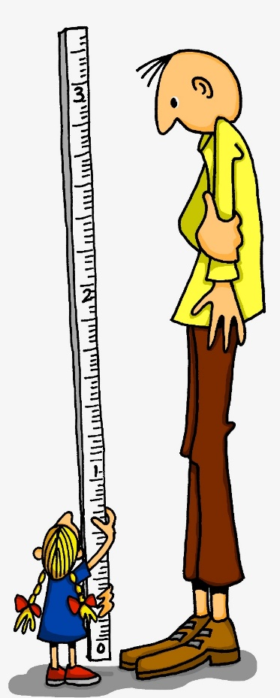
ß
groß
Notes:
Timing: 1 minute
Aim: To introduce/consolidate SSC [ß]
Procedure: 1. Present the letter(s) and say the [ß] sound first, on its own. Students repeat it with you. 2. Bring up the word ”groß” on its own, say it, students repeat it, so that they have the opportunity to focus all of their attention on the connection between the written word and its sound.
3. A possible gesture for this would be to stretch your hand up high above your head, forming your hand into a right angle to indicate that you are measuring something/one very tall.
4. Roll back the animations and work through 1-3 again, but this time, dropping your voice completely to listen carefully to the students saying the [ß] sound, pronouncing ”groß” and, if using, doing the gesture. Word frequency (1 is the most frequent word in German): groß [74] Source: Jones, R.L. & Tschirner, E. (2006). A frequency dictionary of German: core vocabulary for learners. Routledge

Slide 9
ß
groß
Notes:
With sound and no pictures to focus all attention on the sound-symbol correspondence.

Slide 10
ß
groß
Notes:
Without sound to elicit pronunciation (without first hearing the teacher).
Teacher to elicit pronunciation by asking “Wie sagt man…”

Slide 11
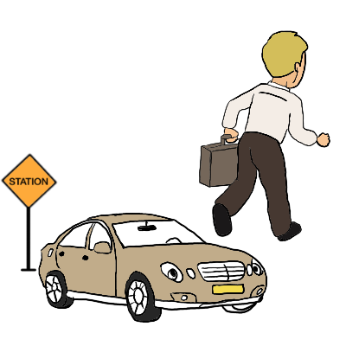
ß
Fußball
ein bisschen
groß
heißen
lassen
Misky
damals
1919
2019
Notes:
Timing: 2 minutes
Aim: To introduce/consolidate SSC [ß]
Procedure:
Introduce and elicit the pronunciation of the individual SSC [ß] and then the source word again ‘groß’ (with gesture, if using).
Then present and elicit the pronunciation of the five cluster words.
The cluster words have been chosen for their high-frequency, from a range of word classes, with the SSC (where possible) positioned within a variety of syllables within the words (e.g. initial, 2nd, final etc.). Additionally, we have tried to use words that build cumulatively on previously taught SSCs (see the Phonics Teaching Sequence document) and do not include new SSCs. Where new SSCs are used, they are often consonants which have a similar symbol-sound correspondence in English.
Word frequency (1 is the most frequent word in German): groß [74]; Fußball [1497] ein bisschen [194]; heißen [123]; damals [271]; lassen [82]. Source: Jones, R.L. & Tschirner, E. (2006). A frequency dictionary of German: core vocabulary for learners. Routledge

Slide 12
ß
Fußball
ein bisschen
groß
heißen
lassen
damals
Notes:
With sound and no pictures to focus all attention on the sound-symbol correspondence.

Slide 13
ß
Fußball
ein bisschen
groß
heißen
lassen
damals
Notes:
Without sound to elicit pronunciation (without first hearing the teacher).
Teacher to elicit pronunciation by asking “Wie sagt man…”

Slide 14
das Essen
gesund
sitzen
zu Hause
hässlich
es
super
interessant
sie
Notes:
Timing: 3 minutes
Aim: To practise distinguishing between [s] or [ss] pronounced as English ‘s’, or [s] pronounced as English ‘z’.
Note: Words for this task are taken from the introduced and revisited vocabulary sets for this week, or previously taught words (es, sie) and two cognates (super, interessant) to challenge decoding skills further.
Procedure: 1. Students must decide whether the sounds in the words match to the bee (buzz) or the snake (hiss). 2. Teachers can elicit the sound [zzzz] or [ssss] first from the students, then the full word. 3. Answers are animated one by one to move to the correct image.
Word frequency (1 is the most frequent word in German): interessant [810] super [1772]
Source: Jones, R.L. & Tschirner, E. (2011). A frequency dictionary of German: core vocabulary for learners. Routledge

Slide 15
Snap?
Ja
oder
nein?
das Essen
Fußball
reisen
Satz
es
heißen
gesund
sie
lassen
super
sitzen
langsam
interessant
Seite
hässlich
zu Hause
Gesetz
Notes:
Timing: 6 minutes
Aim: To practise distinguishing between [s] or [ss] pronounced as English ‘s’, or [s] pronounced as English ‘z’.
Procedure: 1. Students identify if the sounds highlighted in yellow are a match, ‘snap’ (like the card game) by pronouncing the words aloud and comparing them. 2. Play FOUR times with class and give students a few seconds to pronounce in pairs and decide, before taking the class answer each time. The answers are animated. 3. Then pairs can play against each other – one student choosing and pronouncing two words and the other student deciding whether they make a matching snap pair or not.
4. The words have been chosen from the pre-learn and consolidation and cluster lists as well as the vocabulary students are expected to have learnt in advance of this lesson.
Word frequency (1 is the most frequent word in German): essen [323] Fußball [1277] reisen [933] heißen [126] gesund [1275] lassen [83] sitzen [231] langsam [526] Seite [197] hässlich [3542] Gesetz [578] Satz [432] interessant [810] super [1772]
Source: Jones, R.L. & Tschirner, E. (2011). A frequency dictionary of German: core vocabulary for learners. Routledge

Slide 16
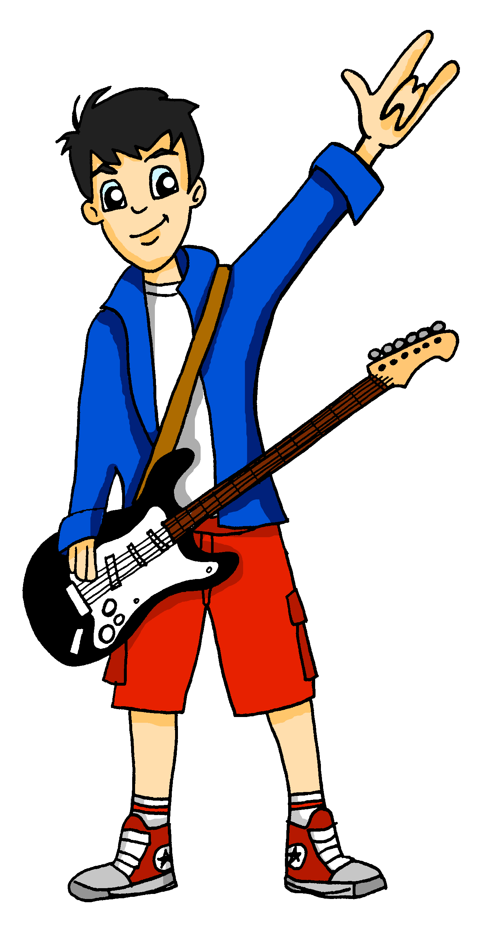
finden – to find
Grammatik
The verb finden is frequently used to seek and express an opinion.
Ich finde sie gut, aber …
Wie findest du die Schule, Mia?
…er findet sie total super!
Notice the extra e before the -st and -t endings.
ich finde I find du findest you find er/sie findet he/she finds
This forms a new syllable, making the endings easier to pronounce and to hear.
Notes:
Timing: 3 minutes
Aim: To introduce the verb FINDEN.
Procedure: 1. Teachers to read the slide with students, drawing attention to the spelling change and explaining it. 2. Elicit the English meaning of each speech bubble from students, both the literal (less frequent) English translation, ‘How do you find…?’ and the more idiomatic ‘What do you think of…?’ 3. Explain to students that FINDEN is often used when they want to say ‘What do you think of?’ Note: The following slides recap singular object pronouns that students were taught last week, alongside MÖGEN, before introducing the plural object pronoun. Pronouns are tricky because they are more numerous in German than English, and rely on students’ secure knowledge of each noun’s gender. There will therefore be sustained practice of these throughout KS3.

Slide 17
Wie findest du…?
lesen / sprechen
Wie findet er es?
Wie findest du das Essen?
Er findet es …
Ich finde es …
(ziemlich / ganz / total / ein bisschen/ zu / nicht) lecker / schlecht / gesund
Notes:
Timing: 5 minutes (4 slides)
Aim: To model all three forms of FINDEN, together with singular object pronouns.
Note: Students are further involved as they are prompted to respond to complete the utterances using a choice of suitable words from this week’s vocabulary sets (both new and revisited), adverbs and adjectives.
Procedure: 1. Cycle through the information on the slide using the animation sequence.
2. Teachers can elicit two or three responses and their translations from other students, to keep all involved, and provide additional practice of the new vocabulary in the oral modality.
Note: These sentences also recycle subject pronouns, that students have now revisited several times.

Slide 18
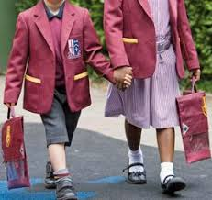
Wie findest du…?
lesen / sprechen
Wie findet er sie?
Wie findest du die Schuluniform?
Er findet sie …
Ich finde sie …
(ziemlich / ganz / total / ein bisschen / zu/nicht) schön / hässlich / praktisch / schlecht / wichtig
Notes:
[2/4]

Slide 19
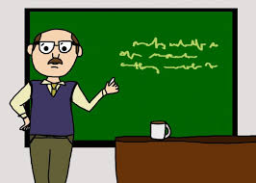
Wie findest du…?
Wie findet sie ihn?
lesen / sprechen
Wie findest du den Lehrer?
Remember!
After a verb, the masculine definite article changes from der to den and the object pronoun changes from er to ihn.
Sie findet ihn …
Ich finde ihn …
(ziemlich / ganz / total / ein bisschen / zu / nicht) langweilig / schlecht / nett / toll / streng / in Ordnung
Notes:
[3/4]

Slide 20
Wie findest du…?
lesen / sprechen
Wie findet sie ihn?
Wie findest du den Unterricht?
______
Sie findet ihn …
_____
Ich finde ihn …
____
(ziemlich / ganz / total / ein bisschen / zu / nicht) schwierig / langweilig / schlecht / wichtig / leicht
Notes:
[4/4]

Slide 21
Wie findest du …?
hören
oder
oder
1
Katze Handy
Ich finde es schlecht.
2
Auto Jacke
Ich finde sie ziemlich schön.
3
Boden Hund
Ich finde ihn hässlich.
4
Gutschein iPad
Ich finde es ganz praktisch.
5
Garten Geschenk
Ich finde ihn ein bisschen langweilig.
Notes:
Timing: 5 minutes
Aim: To focus on the three singular object pronouns. It revises nouns taken from the revisited vocabulary sets, and importantly requires them to know their genders to select the correct answers.
Procedure: 1. Students listen and determine which of the items (or whether both) in each case is/are referred to, ticking those that match the accusative pronoun heard, and crossing those that do not match.
Note: Ensure all students understand that the ticks and crosses do not reflect positive and negative opinions (both of which they will hear) respectively.
2. Click to reveal the answers. Before the answer for each is revealed, the sentence appears, so that students have additional opportunity to connect speech and writing (if they or the teacher reads the sentence aloud).
Note: For lower attaining groups, this task could first be completed as a reading task, by removing the animations on the sentences.

Slide 22
Object pronouns
Grammatik
Singular & plural object pronouns (him, her, it, them)
As you already know, singular subject pronouns (er, sie, es) show the gender of nouns.
Object pronouns come after a verb, and the masculine subject pronoun changes to ihn.
The plural object pronoun is always sie (them), regardless of the gender in the singular.
(singular = der Hund) Wie findest du Hunde? Ich finde sie nett.
(How do you find dogs? I find them nice.)
(singular = die Liste) Wie findest du Listen? Ich finde sie wichtig.
(How do you find lists? I find them important.)
(singular = das Spiel) Wie findest du Spiele? Ich finde sie leicht.
(How do you find games? I find them easy.)
Notes:
Timing: 3 minutes
Aim: To recap singular subject and object pronouns and present the plural object pronoun ‘sie’.
Procedure: 1. Cycle through the information on the slide using the animation sequence.
2. Teachers can prompt students to provide the English before revealing it, compelling them to process vocabulary and grammar from this week.

Slide 23
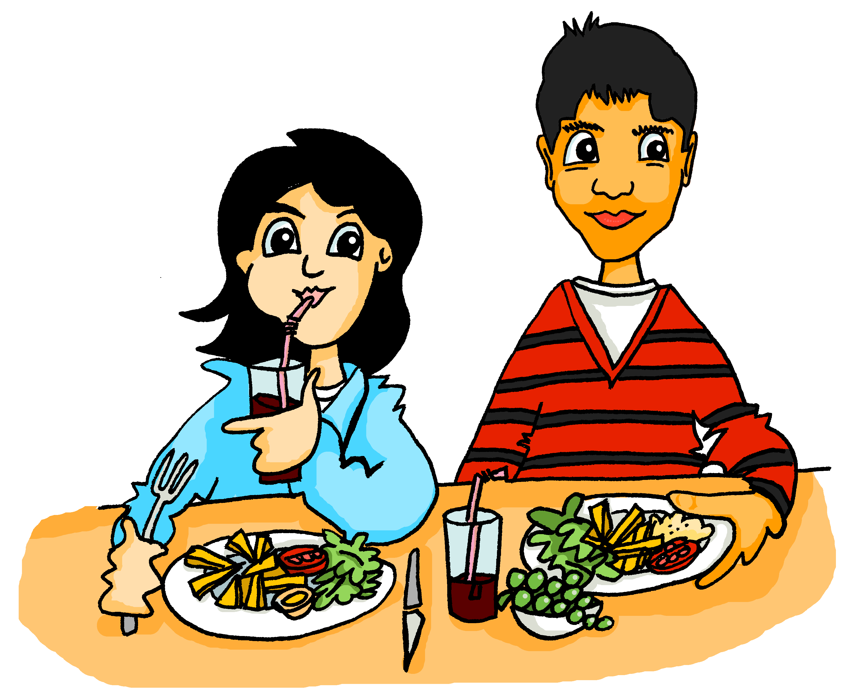
Ich, du oder Wolfgang?
hören
Wie findest du das Essen?
Ich mag das Essen! Wolfgang findet das Essen nicht lecker, aber
----ich---- finde es gesund.
_____________________________________________________________________________
_____________________________________________________________________________
1
Antworten
Notes:
Timing: 9 minutes (for 6 slides)
Aim: To practise distinuishing between the different forms of FINDEN.
Notes: The context is continued from last week. Mehmet is a new arrival at Mia and Wolfgang’s school. Mia and Mehmet are getting to know each other and talking about their views of school, and referring also to Wolfgang’s views.
Procedure:
1. Click number 1 to hear a gapped version of the dialogue. 2. Students focus on the form of FINDEN to decide whether the subject is ‘ich, du oder Wolfgang’. This needs to be very clear to students before they start this set of six short listening passages. 3. To record their answers, they write, for example: 1. Wolfgang, ich 4. Each dialogue is corrected immediately, to provide instant feedback, and monitor understanding. Teachers click the ‘Antwort’ button to hear the full dialogue, with the name / pronouns added in. Then the answers appear in written form. Note: After the listening, the same dialogue is revisited to focus on object pronouns. That might be the best opportunity to elicit English translations, rather than when correcting this listening task.
Transcript:
Mehmet (male voice): Wie findest du das Essen? Mia (Female): Ich mag das Essen! [Wolfgang] findet das Essen nicht lecker, aber [ich] finde es gesund.

Slide 24
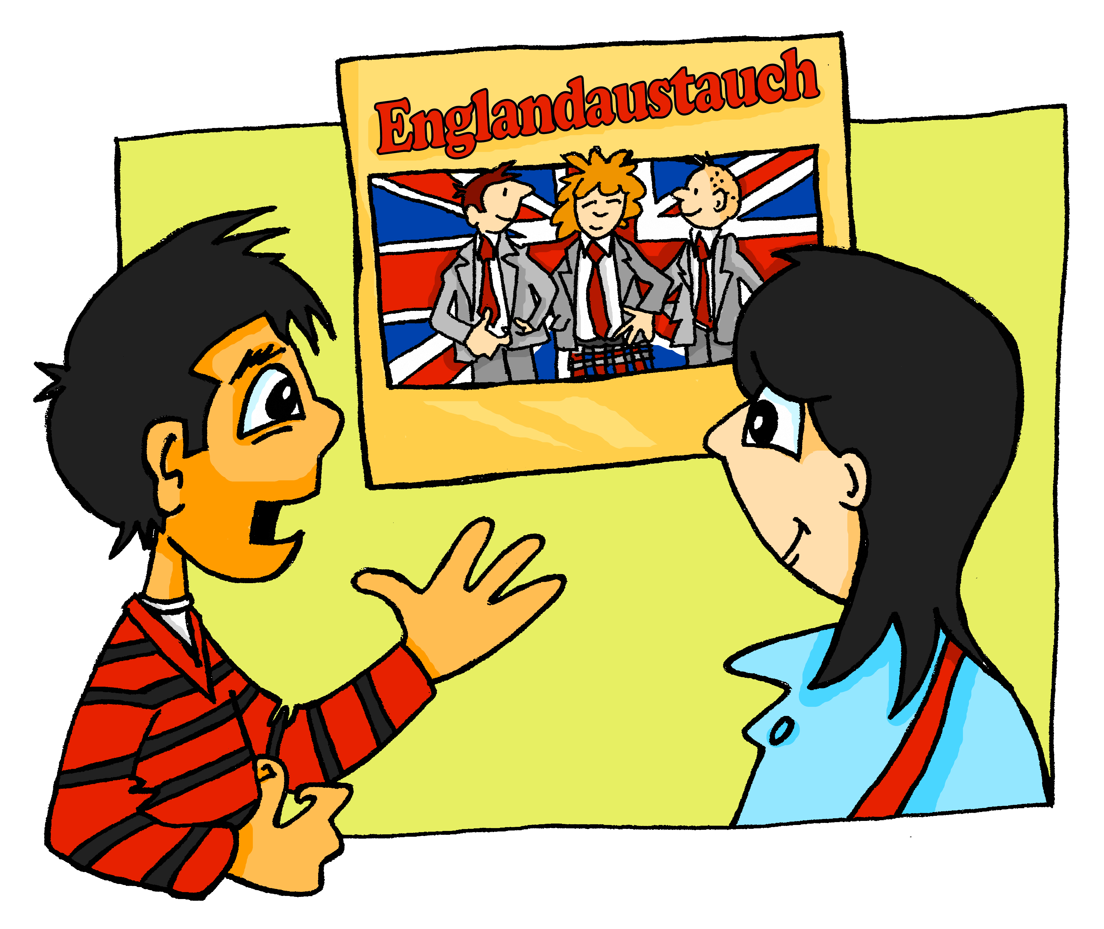
Ich, du oder Wolfgang?
hören
Ich mag die Uniform. Und du?
----Du---- findest die Uniform gut?
----Ich---- finde die Uniform hässlich.
_____________________________________________________________________________
_____________________________________________________________________________
2
Antworten
Notes:
Slide 2 of 6. This is the continuation of the activity on the previous slide.
Note: This slide offers a cultural insight. German state schools students (there are very very few private schools, too) don’t have to wear uniform. They therefore find it strange that English students do. Teachers may also like to prompt students to suggest what the poster is about. Englandaustausch - England exchange. This is another opportunity to remind students that German often puts two nouns together to create compound nouns. They have met several of these already, and will do some further work on this during Y7. With higher attaining students, it may be useful to tell them that, when two nouns of different genders combine, the gender of the new noun is always that of the second/final word. In this case, England is neuter, Austausch [2744] is masculine, so the new noun Englandaustausch is…? → der Englandaustausch.
Transcript:
Mehmet: Ich mag die Uniform. Und du? Mia: [Du] findest die Uniform gut? [Ich] finde die Uniform hässlich.
Answers: 2. du, ich

Slide 25
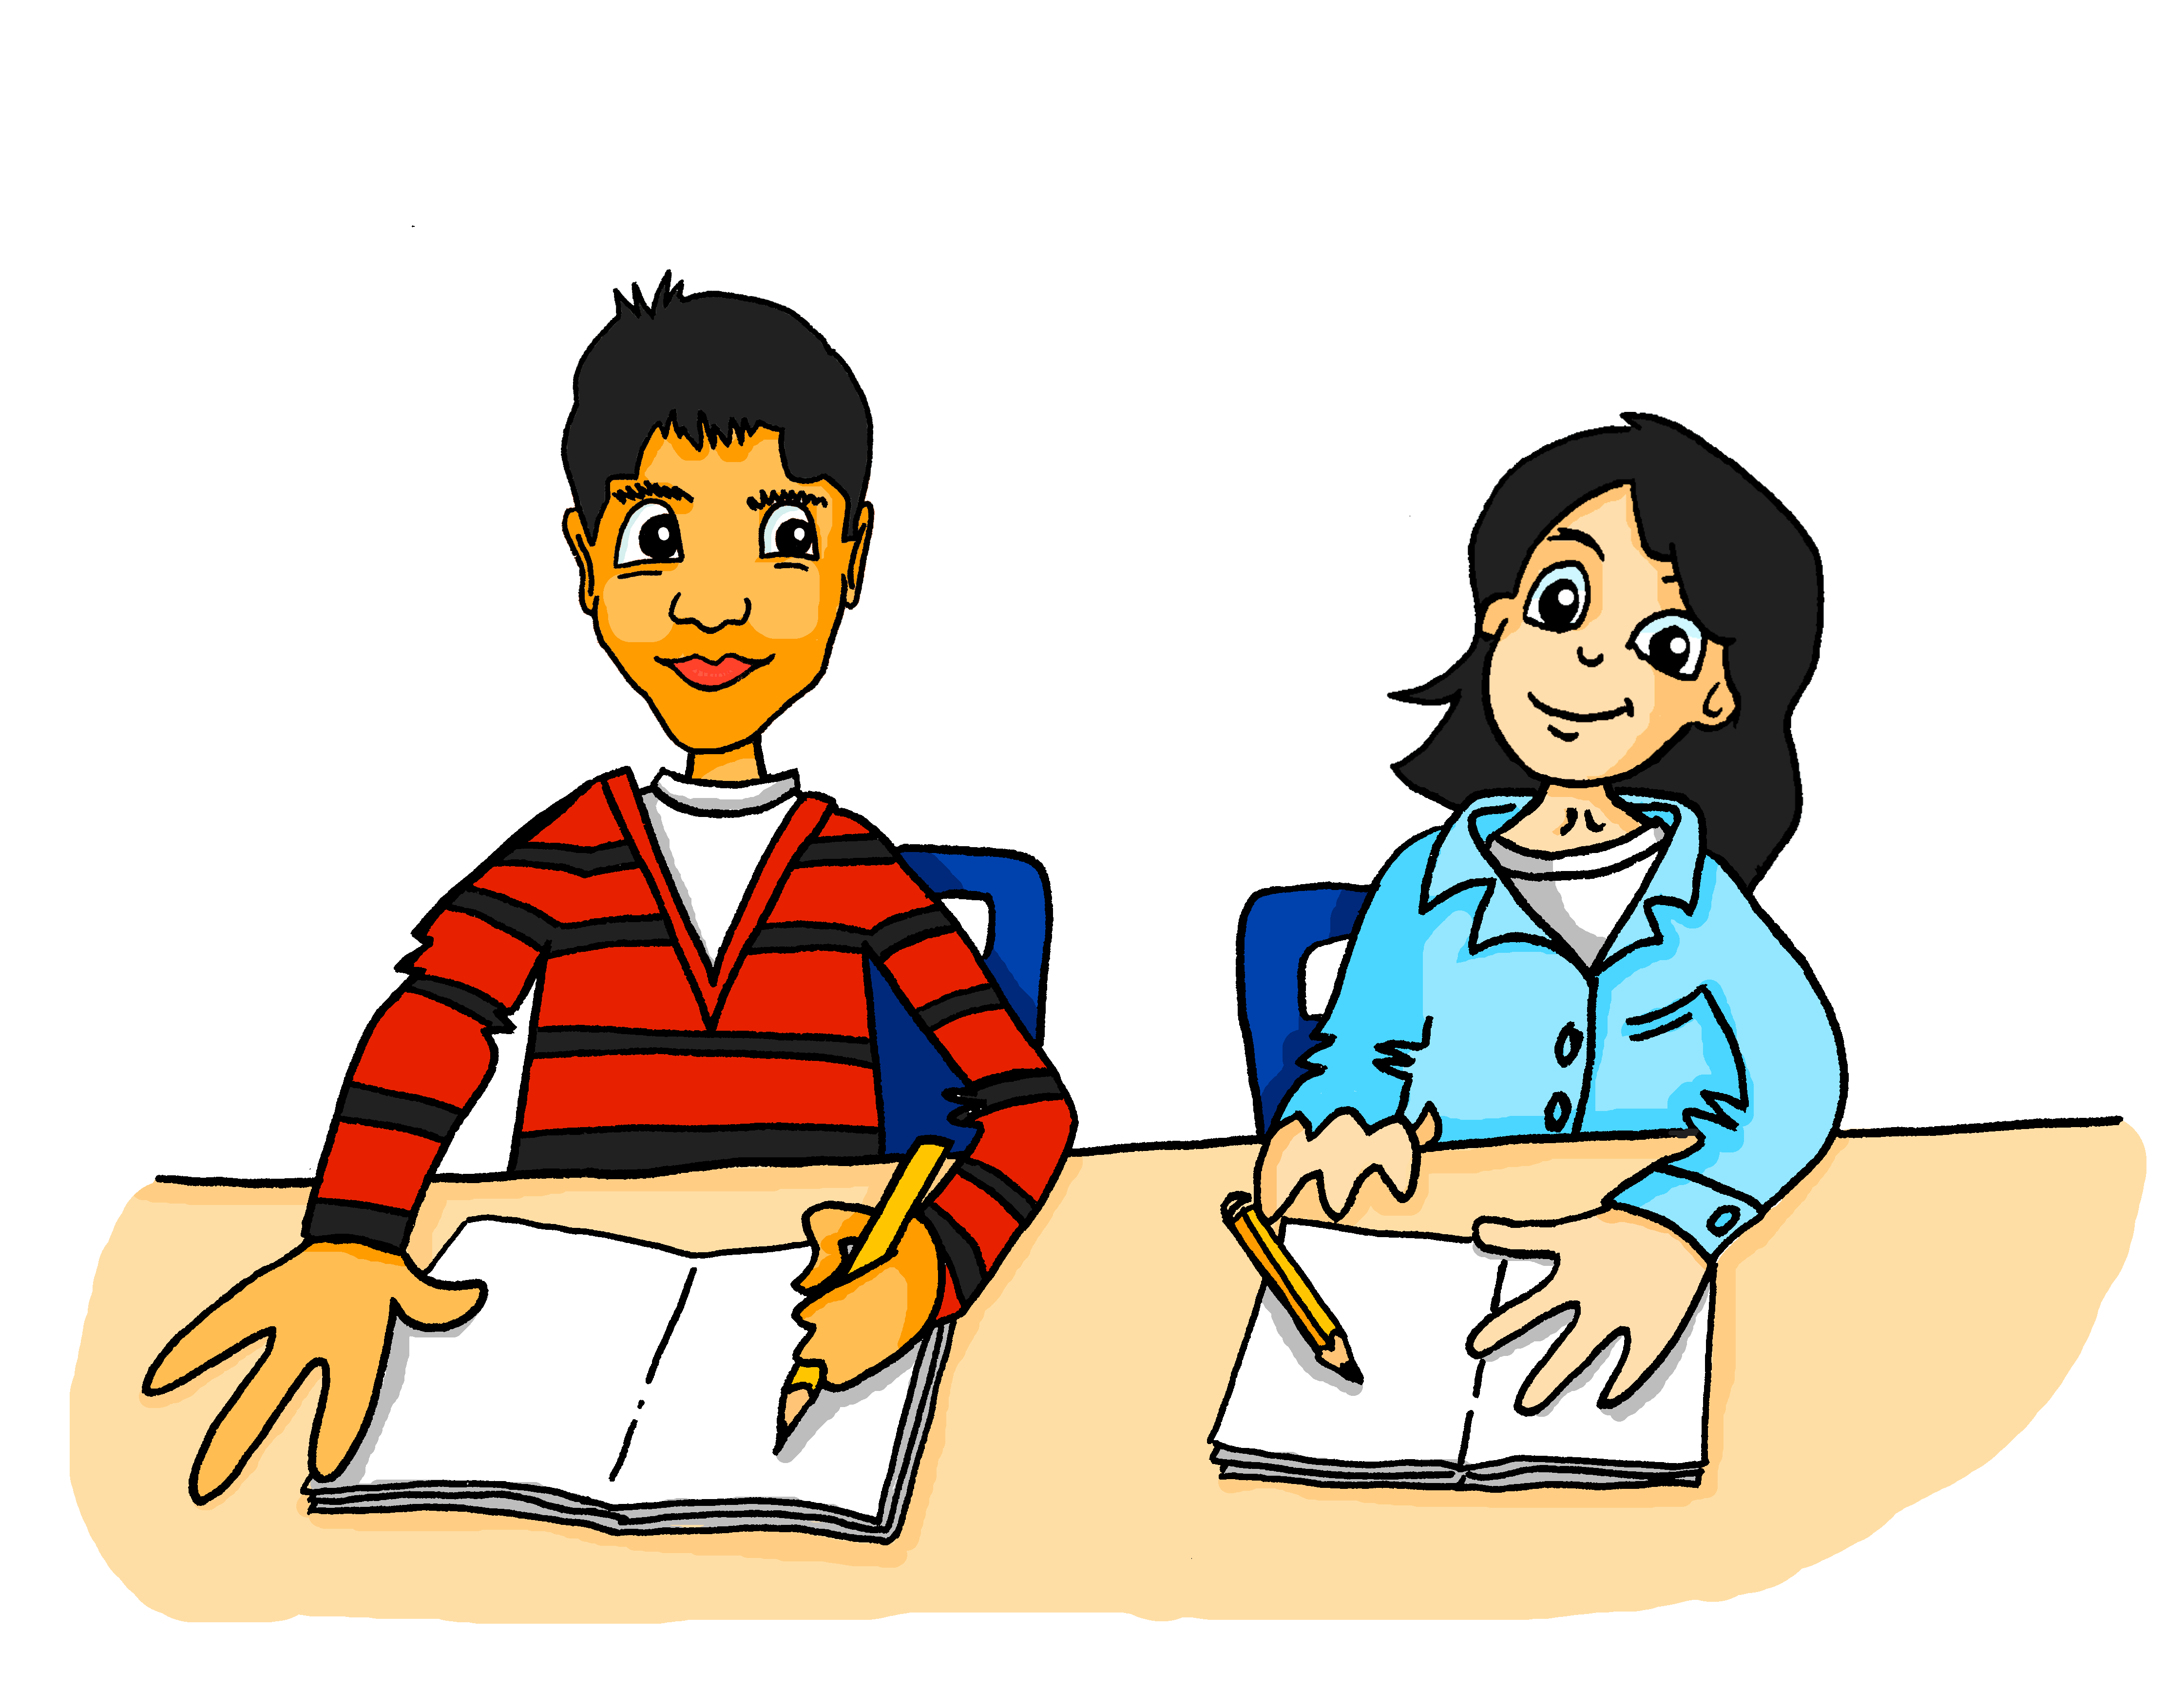
Ich, du oder Wolfgang?
hören
----Ich---- finde Fremdsprachen ziemlich leicht, aber Wolfgang findet Fremdsprachen nicht interessant.
Der Unterricht ist zu schwierig. Mia, wie findest --- du---- den Unterricht?
_____________________________________________________________________________
_____________________________________________________________________________
_____________________________________________________________________________
3
Antworten
Notes:
Slide 3 of 6. This is the continuation of the activity on the previous slide.
Note: Fremdsprache was in last week’s vocabulary set.
Transcript:
Mehmet: Der Unterricht is zu schwierig. Mia, wie findest [du] den Unterricht? Mia: [Ich] finde Fremdsprachen ziemlich leicht, aber [Wolfgang] findet Fremdsprachen nicht interessant.
Answers: 3. du, ich, Wolfgang

Slide 26
Ich, du oder Wolfgang?
hören
----Ich---- finde die iPads ganz praktisch.
Ich mag die iPads nicht.
----Ich---- finde die iPads ein bisschen zu langsam.
_____________________________________________________________________________
_____________________________________________________________________________
4
Antworten
Notes:
Slide 4 of 6. This is the continuation of the activity on the previous slide.
Transcript:
Mehmet: [ich] finde die iPads ganz praktisch. Mia: Ich mag die Ipads nicht. [ich] finde die Ipads ein bisschen zu langsam.
Answers: 4. ich, ich

Slide 27
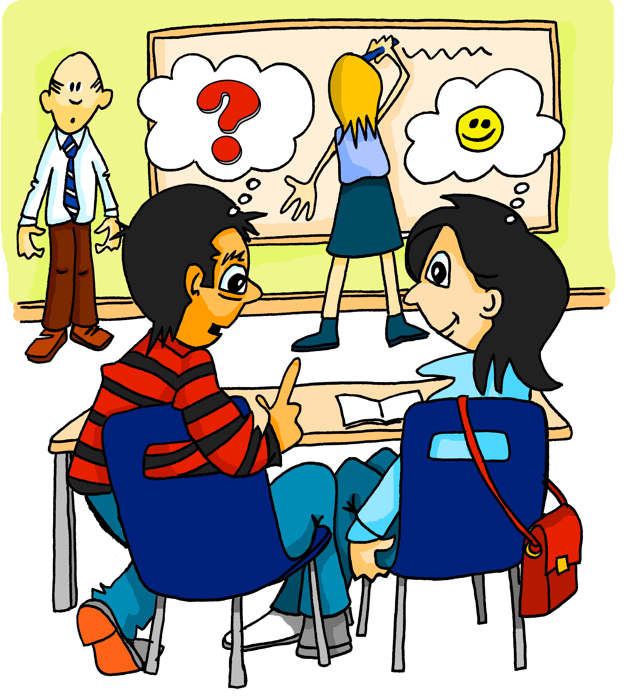
Ich, du oder Wolfgang?
hören
Ach, Wolfgang findet die Lehrer zu streng, aber
----ich---- finde
die Lehrer in Ordnung.
_____________________________________________________________________________
Und wie
findest ----du---- die Lehrer hier?
_____________________________________________________________________________
_____________________________________________________________________________
5
Antworten
Notes:
Slide 5 of 6. This is the continuation of the activity on the previous slide.
Transcript:
Mehmet: Und wie findest [du] die Lehrer hier? Mia: Ach, [Wolfgang] findet die Lehrer zu streng, aber [ich] finde die Lehrer in Ordnung.
Answers: 5. du, Wolfgang, ich

Slide 28
Ich, du oder Wolfgang?
hören
Wolfgang findet Schule in Ordnung, und Mehmet,
----du---- findest Schule wichtig, nicht wahr?
Ja, aber
----ich---- finde die Hausaufgaben schwierig.
_____________________________________________________________________________
_____________________________________________________________________________
6
Antworten
Notes:
Slide 6 of 6. This is the continuation of the activity on the previous slide.
Transcript:
Mia: [Wolfgang] findet die Schule schlecht, aber Mehmet, [du] findest die Schule wichtig, nicht wahr?
Mehmet: Ja, aber [ich] finde die Hausaufgaben schwierig.
Answers:
6. Wolfgang, du, ich

Slide 29
ihn, es, sie oder sie (Pl.)?
lesen
Wie findest du das Essen?
Ich mag das Essen! Wolfgang findet das Essen nicht lecker, aber ich finde es gesund.
Notes:
Timing: 10 minutes (12 slides)
Aim: To focus on object pronouns. Procedure: 1. In this activity, the dialogue is revisited, and students are prompted to replace identified nouns with the appropriate pronoun. This is a scaffolded task, as the gender of each noun is given by the article in the dialogue, but given the number of different German pronouns, structured practice like this is needed. 2. Teachers may want to use this opportunity to elicit English translations of the dialogue from students orally, as this will prompt additional noticing of the target grammar features.

Slide 30
ihn, es, sie oder sie (Pl.)?
lesen
Wie findest du das Essen?
Ich mag das Essen! Wolfgang findet es nicht lecker, aber ich finde es gesund.
Notes:
[2/12]

Slide 31
ihn, es, sie oder sie (Pl.)?
lesen
Ich mag die Uniform. Und du?
Du findest die Uniform gut? Ich finde die Uniform hässlich.
Notes:
[3/12]

Slide 32
ihn, es, sie oder sie (Pl.)?
lesen
Ich mag die Uniform. Und du?
Du findest die Uniform gut? Ich finde sie hässlich.
Notes:
[4/12]

Slide 33
ihn, es, sie oder sie (Pl.)?
lesen
Der Unterricht ist zu schwierig. Mia, wie findest du den Unterricht?
Ich finde Fremdsprachen ziemlich leicht, aber Wolfgang findet Fremdsprachen nicht interessant.
Notes:
[5/12]

Slide 34
ihn, es, sie oder sie (Pl.)?
lesen
Der Unterricht ist zu schwierig. Mia, wie findest du ihn?
Ich finde Fremdsprachen ziemlich leicht, aber Wolfgang findet sie nicht interessant.
Notes:
[6/12]

Slide 35
ihn, es, sie oder sie (Pl.)?
lesen
Ich mag die iPads nicht. Ich finde die iPads ein bisschen zu langsam.
Ich finde die iPads ganz praktisch.
Notes:
[7/12]

Slide 36
ihn, es, sie oder sie (Pl.)?
lesen
Ich mag die iPads nicht. Ich finde sie ein bisschen zu langsam.
Ich finde die iPads ganz praktisch.
Notes:
[8/12]

Slide 37
ihn, es, sie oder sie (Pl.)?
lesen
Ach, Wolfgang findet die Lehrer zu streng, aber ich finde die Lehrer in Ordnung.
Und wie findest du die Lehrer hier?
Notes:
[9/12]

Slide 38
ihn, es, sie oder sie (Pl.)?
lesen
Ach, Wolfgang findet die Lehrer zu streng, aber ich finde sie in Ordnung.
Und wie findest du die Lehrer hier?
Notes:
[10/12]

Slide 39
ihn, es, sie oder sie (Pl.)?
lesen
Wolfgang findet Schule in Ordnung, und Mehmet, du findest Schule wichtig, nicht wahr?
Ja, aber ich finde die Hausaufgaben schwierig.
Notes:
[11/12]

Slide 40
ihn, es, sie oder sie (Pl.)?
lesen
Wolfgang findet Schule in Ordnung, und Mehmet, du findest sie wichtig, nicht wahr?
Ja, aber ich finde die Hausaufgaben schwierig.
Notes:
[12/12]

Slide 41
Wie findest du Schule?
Object pronouns (singular) ihn, sie, es, sie (plural)
FINDEN - ich finde / du findest / er & sie findet
SSC [s like z], [ß]
Hausaufgaben?
Lehrer?
Essen?
Y7 German
Term 2.1 – Week 4 - Lesson 35 Author name(s): Leigh McClelland / Rachel Hawkes
Artwork: Steve Clarke
Date updated: 26.01.24
Uniform?
Unterricht?
Notes:
Artwork by Steve Clarke. All additional pictures selected are available under a Creative Commons license; no attribution required.
Note: All words listed below for this week’s learning (new and revisited) appear on all three Awarding Organisations’ word lists, with the following exceptions: i) AQA list does not have Gutschein, putzen
ii) Edexcel list does not have Gutschein, hässlich, in Ordnung, putzen. iii) Eduqas list does not have list does not have Gutschein, hässlich.
Learning outcomes (lesson 2):
Consolidation of SSCs [s like z], [ß]
Consolidation of FINDEN: 1st, 2nd, 3rd person singular. Consolidation of singular object pronouns, and introduction to plural object pronoun.
Word frequency (1 is the most frequent word in German):
7.2.1.4 (introduce) finden [103] Essen1 [323] Uniform [3857] gesund [1275] langweilig [3019] lecker [>5009] leicht [311] nett [1565] praktisch [840] schwierig [580] schlecht [327] streng [1375] wichtig [144] zu1 [21] ein bisschen [n/a] Additional known vocabulary or cognates to recycle: Schule [359] Lehrer [695] (plural) Unterricht [1823] schön [188] hässlich [3542] toll [972] ganz [69] ziemlich [605] jetzt [72] interessant [810] gut [76] super [1772] total [1021] in Ordnung [n/a] 7.2.1.1 (revisit) denken [128] er2 [15] es [12] sie2 [7] Fahrrad / Rad [2138] Geschenk [2595] Gutschein [>5009] Handy [1693] Jacke [3287] hässlich [3542] toll [972] ganz [69] jetzt [72] ziemlich [605] in Ordnung [n/a]
7.1.2.2 (revisit) arbeiten [234] kochen [1481] putzen [3586] sitzen [231] Auto [361] Boden [536] Garten [1158] Liste [1792] Zimmer [665] nochmal [1984] ich verstehe nicht [n/a] zu Hause [n/a]
Note: interessant [531] and gut [78] have been introduced as phonics words and will be re-used in the lessons, here. However, they have not been added to the quizlet list for 7.2.1.4, so as not to overload it.
Source: Jones, R.L & Tschirner, E. (2019). A frequency dictionary of German: Core vocabulary for learners. London: Routledge.
Additional known vocabulary or cognates to recycle:
wohnen [380] schreiben [245] spielen [197] reden [356] lernen [203] machen [49] im Klassenzimmer [609/619] im Unterricht [1107] in der Schule [208] mit Freunden [13/327]
The frequency rankings for words that occur in this PowerPoint which have been previously introduced in LDP resources are given in the LDP SOW and in the resources that first introduced and formally re-visited those words.
For any other words that occur incidentally in this PowerPoint, frequency rankings will be provided in the notes field wherever possible.

Slide 42
s, ss, ß
Phonetik
When it comes before a vowel, 's' is pronounced like the English ‘z’.
e.g. sagen, sehr, sein, sie, sitzen, sollen, gesund, super, Reise
Elsewhere, the German ‘s’, as well as all instances of ‘ss’ and ‘ß’ are pronounced like an English ‘s’.
e.g. eins, hast, das, dass, groß, lassen, Haus, Wasser, heißen, weiß
'ss’ is used when the preceding vowel in a word is short, but is written 'ß’ after a long vowel e.g. 'Fuß', 'Maß', 'Spaß’
or two vowels together e.g. 'weiß', 'heiß', 'heißt'
Remember: sch-, sp-, st-
are pronounced in their own way at the start of a word!
Notes:
Timing: 3 minutes
Aim: To explain how students will know when to pronounce ‘s’ as a ‘z’ and when as an ‘s’.
Note: This slide also explains the use of the ß (called Eszett or scharfes S) instead of ss.
Procedure:
1. Cycle through the information on the slide using the animation sequence.
2. There is then an odd one out task to practise applying these SSC on the following slide.

Slide 43
Was passt nicht in die Reihe?
Phonetik
1.
weiß
groß
Seite
2.
bisschen
Satz
Fußball
3.
langsam
reisen
heißen
4.
lassen
Gesetz
sollen
5.
damals
findest
gesund
Notes:
Timing: 3 minutes
Aim: To practise distinguishing between ‘s’ as a ‘z’ and when as an ‘s’, and also the ß (called Eszett or scharfes S) instead of ‘ss’.
Procedure: 1. Students have met this task type before and the instruction ‘Was passt nicht?’ Teachers can elicit the instruction meaning from students. 2. Students should be encouraged to practise pronouncing these words out loud, individually or in pairs, to decide which is the odd one out in each row (Reihe). 3. Answers are animated to shade the odd one out. Words are from the cluster words practised last lesson.
4. There is no need to focus on meaning, though teachers might be interested to see which words may have been retained incidentally.
Word frequency (1 is the most frequent word in German): essen [323] Fußball [1277] reisen [933] heißen [126] gesund [1275] lassen [83] sitzen [231] langsam [526] Seite [197] hässlich [3542] Gesetz [578] Satz [432] interessant [810] super [1772]
Source: Jones, R.L. & Tschirner, E. (2011). A frequency dictionary of German: core vocabulary for learners. Routledge

Slide 44
Vokabeln
sprechen
15
difficult
bad
important
practical
boring
easy
nice
strict
healthy
tasty
schwierig
schlecht
wichtig
praktisch
langweilig
Sekunden
leicht
nett
streng
gesund
lecker
0
LOS!
Notes:
Timing: 4 minutes
Aim: To practise recall of adjectives from this week’s vocabulary set.
Procedure: 1. Students work in pairs to produce these words in German orally. 2. Click to bring up the German words one by one.
3. The teacher can decide whether to do further rounds of practice, either whole class or in pairs.

Slide 45
Schreib die Liste!
Schreib die Liste alphabetisch auf Deutsch!
schreiben
1. bad
1. gesund
2. boring
2. langweilig
3. delicious
3. lecker
4. difficult
4. leicht
5. easy
5. nett
6. healthy
6. praktisch
7. important
7. schlecht
8. nice
8. schwierig
9. practical
9. streng
10. strict
10. wichtig
Notes:
Timing: 10 minutes
Aim: To provide practice in recalling the adjectives (new and revisited) from this week’s vocabulary sets. Procedure:
1. Draw students’ attention to the word ‘alphabetisch’.
2. They need to write the words in German, in alphabetical order of the German. The reason for this is that it will essentially require them to give them longer, more sustained attention; it is likely that students will write them twice, once in rough to generate all the German and again to list them in number order.
3. The German answers are provided in alphabetical order, with the English translation of each also animated to appear after each German answer, to maintain the focus on the meaning of the words.
Note: For lower attaining groups, this slide can be modified and the ‘alphabetisch’ removed, so that the German answers match the English words, 1-10. Any higher attaining students who finish quickly can be prompted to do an additional task, e.g. order the words by length, or put the words in a sentence.

Slide 46
Wie findest du das?
sprechen
1
P
P = positiv
N = negativ
2
N
Person A
Person B
auf Englisch
zum Beispiel
subjects, important
Ich finde sie wichtig!
Notes:
Timing: 3 minutes (two example slides)
Aim: To practise eliciting and responding to opinions using finden.
Note: This slide and the next are to model the task.
Procedure:
1. There are two sample items for the teacher to model. This slide demonstrates number 1. 2. Person A speaks. S/he has two decisions to make: whether to use a singular OR plural object pronoun, and which positive adjective to say. 3. Person B writes in English. S/he has two things to understand: whether it is school subject (singular) OR school subjects (plural) and the meaning of the positive adjective, in this case subjects (plural) and important.

Slide 47
Wie findest du das?
sprechen
1
P
P = positiv
N = negativ
2
N
Person A
Person B
auf Englisch
zum Beispiel
present, bad
Ich finde es schlecht!
Notes:
[2/2]

Slide 48
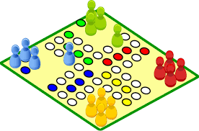
Wie findest du das?
sprechen
P
Person B
N
Person A
auf Englisch
N
P
N
P
Notes:
Timing: 10 minutes (two slides)
Speaking task part one – Partner A. Display this slide. There are no handouts needed for this speaking task.
Procedure:
1. Student A speaks, Student B writes for all six items. 2. Teachers may want to reinforce the need to be sure about the genders of all the nouns, first. S/he could elicit these first, if needed, with the whole class.
3. There are no answers provided as these will vary.
Note: Students do not produce the nouns themselves in this task, only the correct pronouns that go with them.

Slide 49
Wie findest du das?
sprechen
N
Person B
P
Person A
auf Englisch
P
N
P
N
Notes:
Speaking task part two – Partner B. Display this slide. There are no handouts needed for this speaking task.

Slide 50
Wie findest du das?
Schreib die Frage und eine Antwort.
schreiben
Wie findest du die Hausaufgaben? Ich finde sie wichtig.
Beispiel ? __________________________________________________
1. ? __________________________________________________
Wie findest du den Lehrer? Ich finde ihn interessant.
2. ? __________________________________________________
Wie findest du die Schule? Ich finde sie schwierig.
3. ? __________________________________________________
Wie findest du die Uniform? Ich finde sie praktisch.
4. ? __________________________________________________
Wie findest du das Essen? Ich finde es lecker.
5. ? __________________________________________________
Wie findest du den Unterricht? Ich finde ihn leicht.
Notes:
Timing: 10 minutes
Aim: To practise question production (writing) to elicit opinions using finden; to practise answering such questions using direct object pronouns and adjectives learnt.
Note: this task provides the verb structure and keeps it constant to reduce cognitive load and allow students to focus on their independent knowledge of the nouns (including their gender), the object pronouns and the adjectives.
Procedure: 1. Model the task using the example. 2. Students need to write the question to ask ‘What do you think of [noun]?’ and an answer, using the correct object pronoun and their opinion, using an adjective of their choice.
3. Answers are provided on individual mouse clicks.

Slide 51
Ein Dialog
sprechen
Essen?
Aha, interessant!
Toll!
Echt?
Ach so!
Uniform?
Hausaufgaben?
Unterricht?
Lehrer?
Notes:
Timing: 7 minutes (task timing is flexible 2-20 minutes)
Aim: To practise question production (speaking) to elicit opinions using finden; to practise answering such questions using direct object pronouns and adjectives learnt.
Note: this task is open-ended and can last two minutes or 20, depending on how long you have. If you have more than two minutes, it makes sense to move students so that they repeat the task with new partners.
Procedure: 1. Encourage students not to ask about each aspect of school life in order. 2. Remind them that they need to use the correct R2 article after FINDEN, depending on the gender of all these nouns. 3. If necessary, elicit the definite article of each, as follows: das Essen die Uniform die Hausaufgaben (ask if singular or plural) der Unterricht (prompt them for the R2 → den) der / die Lehrer (prompt them to tell you what it would mean if you asked ‘Wie findest du den Lehrer?’ (What do you think of the male teacher (singular) and if you asked ‘Wie findest du die Lehrer?’ (What do you think of the teachers (plural)? Use this as an opportunity to stress the importance of getting the articles correct.
4. The teacher might also want to elicit the words for ‘it’ and ‘them’ that students will need to reply with, if not to need to repeat the noun, e.g.: Wie findest du das Essen? Ich finde das Essen toll. But in order not to repeat ‘das Essen?’ → Ich finde [beep] toll. → Ich finde es toll.

Slide 52
Hausaufgaben
Vocabulary Learning Homework (Term 2.1, Week 5)
Audio file
Student worksheet
In addition, revisit: Term 2.1 Week 2 | Term 1.2 Week 3
Notes:
Timing: 2 minutes Use this slide to set the homework.
Use this slide to set the homework.
For Y7, the typical homework will be to pre-learn vocabulary for the next lesson. There is an audio file to accompany the student worksheet.
Notes:
i) Teachers may, in addition, want to recommend use of a particular online app for the pre-learning of each week’s words. ii) Quizlet now requires parental involvement / registration / permissions for users below the age of 13, so it is perhaps most suitable for Y9 – 11 students. iii) Language Nut hosts LDP vocabulary lists and these are free for schools to use, though there is a registration process. One benefit is that all of the student tracking data that Language Nut offers are also available to schools that use the LDP lists for practice. Perhaps this makes it a good option for Y7/8.
iv) There are other free apps, and new ones are always appearing. Teachers have told us that they are currently using: Flippity, Wordwall (where using previously-created activities is free).
v) Gaming Grammar has been acquired by Language Nut. Its original content should still be available to teachers and much of it is appropriate for Y7 learners. From this lesson, for example, learners could practise

