Slide 1
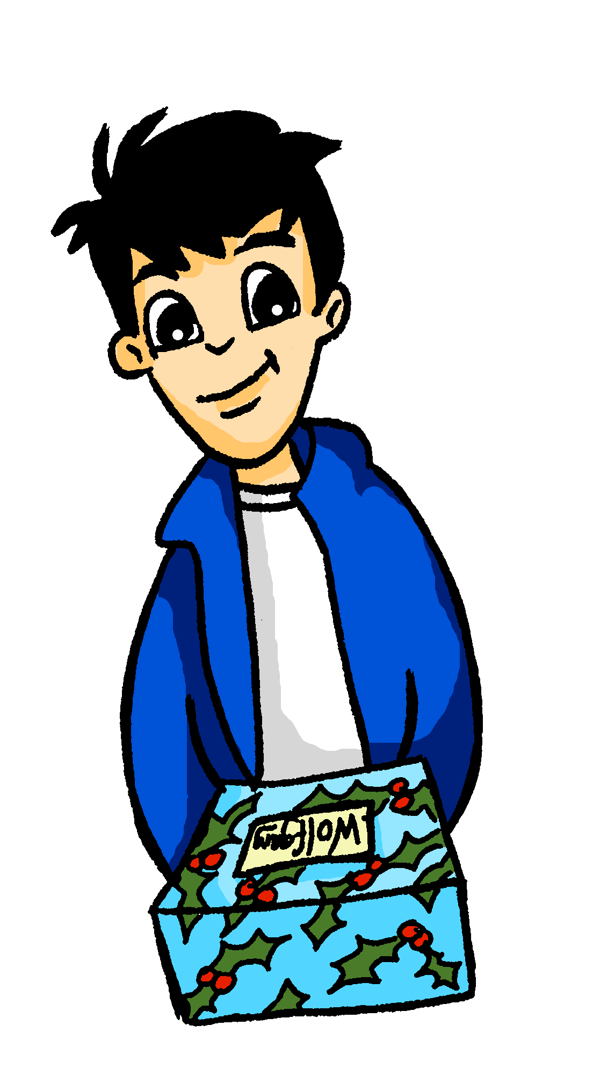
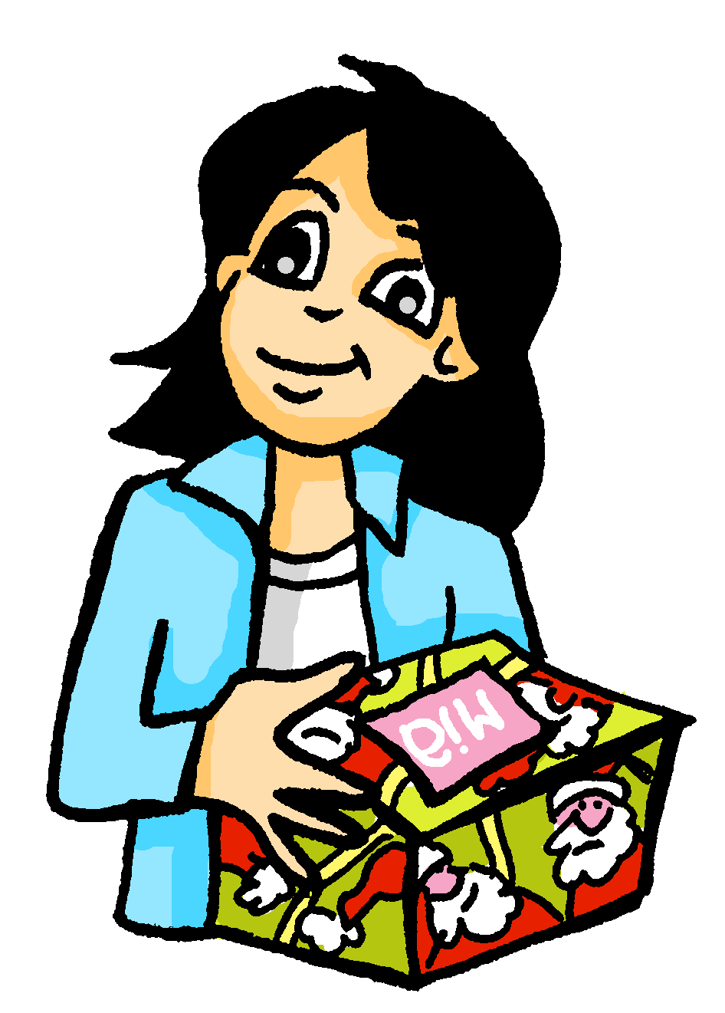
Weihnachten Talking about what you and others have, and what it is like
Subject pronouns er, sie and es meaning ‘it’
SSC [ö]
Y7 German
Term 2.1 – Week 1 - Lesson 29 Author name(s): Natalie Finlayson / Rachel Hawkes
Artwork: Steve Clarke
Date updated: 24.01.24
Notes:
Artwork by Steve Clarke. All additional pictures selected are available under a Creative Commons license; no attribution required.
Note: All words listed below for this week’s learning (new and revisited) appear on all three Awarding Organisations’ word lists, with the following exception:
i) AQA list does not have Gutschein.
ii) Edexcel list does not have Gutschein, hässlich, Ordnung.
iii) Eduqas list does not have Gutschein, hässlich.
Learning outcomes
Presentation of SSC /ö/
Subject pronouns er, sie and es meaning ‘it’
Word frequency (1 is the most frequent word in German):
7.2.1.1 (introduce) - denken [128] er2 [15] es [12] sie2 [7] Fahrrad / Rad [2138] Geschenk [2595] Gutschein [>5009] Handy [1693] Jacke [3287] hässlich [3542] toll [972] ganz [69] jetzt [72] ziemlich [605] in Ordnung [n/a]
1.2.5 (revisit) - kommen [62] stehen [85] Junge [548] Kopf [250] Körper [488] Mädchen [602] Mutter [218] Nacht [325] Tür [375] Vater [232] dunkel [706]
1.1.6 (revisit) - habe, hast [6] Beispiel [94] Erste [95] Frage [157] Frau1 [99] Grund [249] Hand [180] Herr [154] Problem [210] Schule [359]
Source: Jones, R.L & Tschirner, E. (2019). A frequency dictionary of German: Core vocabulary for learners. London: Routledge.
The frequency rankings for words that occur in this PowerPoint which have been previously introduced in LDP resources are given in the LDP SOW and in the resources that first introduced and formally re-visited those words.
For any other words that occur incidentally in this PowerPoint, frequency rankings will be provided in the notes field wherever possible.

Slide 2
ö
schön
Notes:
Timing: 1 minute
Aim: To introduce/consolidate SSC [ö]
Procedure: 1. Present the letter(s) and say the [ö] sound first, on its own. Students repeat it with you. 2. Bring up the word ”schön” on its own, say it, students repeat it, so that they have the opportunity to focus all of their attention on the connection between the written word and its sound.
3. A possible gesture for this would be to mime an exaggerated exclamation of seeing / receiving something beautiful. As you say ‘schön’ with an appropriate sigh, bring your hands to the rest on your cheeks, and smile!
4. Roll back the animations and work through 1-3 again, but this time, dropping your voice completely to listen carefully to the students saying the [ö] sound, pronouncing ” schön” and, if using, doing the gesture. Word frequency (1 is the most frequent word in German): schön [164] Source: Jones, R.L. & Tschirner, E. (2006). A frequency dictionary of German: core vocabulary for learners. Routledge

Slide 3
ö
schön
Notes:
With sound and no pictures to focus all attention on the sound-symbol correspondence.

Slide 4
ö
schön
Notes:
Without sound to elicit pronunciation (without first hearing the teacher).
Teacher to elicit pronunciation by asking “Wie sagt man…”

Slide 5
ö
Lösung
mögen
[solution]
[to like]
schön
französisch
Körper
[body]
möglich
[possible]
Notes:
Timing: 2 minutes
Aim: To introduce/consolidate SSC [ö]
Procedure:
Introduce and elicit the pronunciation of the individual SSC [ö] and then the source word again ‘schön’ (with gesture, if using).
Then present and elicit the pronunciation of the five cluster words.
The cluster words have been chosen for their high-frequency, from a range of word classes, with the SSC (where possible) positioned within a variety of syllables within the words (e.g. initial, 2nd, final etc.). Additionally, we have tried to use words that build cumulatively on previously taught SSCs (see the Phonics Teaching Sequence document) and do not include new SSCs. Where new SSCs are used, they are often consonants which have a similar symbol-sound correspondence in English.
Word frequency (1 is the most frequent word in German): schön [164]; Lösung [620] mögen [151]; französisch [644]; möglich [156]; Körper [617]. Source: Jones, R.L. & Tschirner, E. (2006). A frequency dictionary of German: core vocabulary for learners. Routledge

Slide 6
ö
Lösung
mögen
schön
französisch
Körper
möglich
Notes:
With sound and no pictures to focus all attention on the sound-symbol correspondence.

Slide 7
ö
Lösung
mögen
schön
französisch
Körper
möglich
Notes:
Without sound to elicit pronunciation (without first hearing the teacher).
Teacher to elicit pronunciation by asking “Wie sagt man…”

Slide 8
ö
plötzlich
[suddenly]
Notes:
Timing: 1 minute
Aim: To introduce/consolidate SSC [ö]
Procedure: 1. Present the letter(s) and say the [ö] sound first, on its own. Students repeat it with you. 2. Bring up the word ”plötzlich” on its own, say it, students repeat it, so that they have the opportunity to focus all of their attention on the connection between the written word and its sound.
3. A possible gesture for this would be to mime a sudden shock that makes you jump backwards. Put your hands up and look shocked, as in the picture.
4. Roll back the animations and work through 1-3 again, but this time, dropping your voice completely to listen carefully to the students saying the [ö] sound, pronouncing ”plötzlich” and, if using, doing the gesture. Word frequency (1 is the most frequent word in German): plötzlich [459] Source: Jones, R.L. & Tschirner, E. (2006). A frequency dictionary of German: core vocabulary for learners. Routledge

Slide 9
ö
plötzlich
[suddenly]
Notes:
With sound and no pictures to focus all attention on the sound-symbol correspondence.

Slide 10
ö
plötzlich
[suddenly]
Notes:
Without sound to elicit pronunciation (without first hearing the teacher).
Teacher to elicit pronunciation by asking “Wie sagt man…”

Slide 11
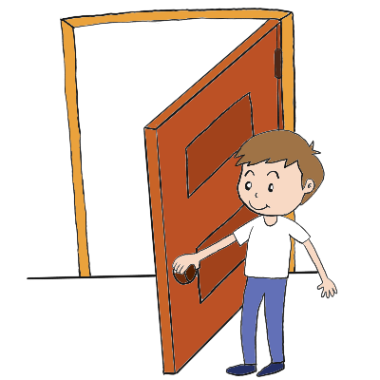
ö
Bevölkerung
zwölf
12
plötzlich
völlig
öffnen
%
öffentlich
[public]
Notes:
Timing: 2 minutes
Aim: To introduce/consolidate SSC [ei]
Procedure:
Introduce and elicit the pronunciation of the individual SSC [ö] and then the source word again ‘plötzlich’ (with gesture, if using).
Then present and elicit the pronunciation of the five cluster words.
The cluster words have been chosen for their high-frequency, from a range of word classes, with the SSC (where possible) positioned within a variety of syllables within the words (e.g. initial, 2nd, final etc.). Additionally, we have tried to use words that build cumulatively on previously taught SSCs (see the Phonics Teaching Sequence document) and do not include new SSCs. Where new SSCs are used, they are often consonants which have a similar symbol-sound correspondence in English.
Word frequency (1 is the most frequent word in German): plötzlich [459]; Bevölkerung [769] völlig [462]; öffentlich [399]; zwölf [882]; öffnen [538]. Source: Jones, R.L. & Tschirner, E. (2006). A frequency dictionary of German: core vocabulary for learners. Routledge

Slide 12
ö
Bevölkerung
zwölf
plötzlich
völlig
öffnen
öffentlich
Notes:
With sound and no pictures to focus all attention on the sound-symbol correspondence.

Slide 13
ö
Bevölkerung
zwölf
plötzlich
völlig
öffnen
öffentlich
Notes:
Without sound to elicit pronunciation (without first hearing the teacher).
Teacher to elicit pronunciation by asking “Wie sagt man…”

Slide 14
denken
[to think | thinking]
denkt
[thinks | is thinking]
Notes:
Timing: 3 minutes for sequence of six verbs
Aim: to introduce the verb denken more explicitly.
Note: Denken is one of the 25 most frequently used verbs in German. All 25 most frequent verbs will be introduced early on using the same format. Both long form (infinitive) and short form (3rd person singular) are introduced in order to familiarise students with various forms of the same verb. Students should know the meaning of this verb already, as it was set as (audio and quizlet) homework. It is re-presented here in the infinitive and short form to deepen students’ knowledge and model the use of both forms in sentences.
Procedure:
Bring up the word denken on its own, say it, students repeat it, and remind them of the phonics. Draw attention to the long and short [e].
Try to elicit the meaning from the students. Students have had explicit teaching that the present tense in German communicates two different present tense meanings in English. This reinforces that learning. Emphasise the two meanings for the short form, reminding students that German only has one form and does not have a direct equivalent of the grammar for ‘is + ing’, the continuous form (as covered in previous weeks).
Bring up the picture, and, if using gestures, a possible gesture would be to bring one’s finger to one’s cheek/lips in a pensive posture.
Then bring up the English translations. Emphasise the two meanings for the infinitive.
Bring up the short form denkt, say it, students repeat it. Draw attention to the long [e].
Try to elicit the meaning from the students. Emphasise the two meanings for the short form.

Slide 15
denken
[to think | thinking]
denkt
[thinks | is thinking]
Notes:
Cycle through the long and short form again.

Slide 16
denkt
[thinks | is thinking]
Einstein denkt viel.
[Einstein thinks a lot.]
Notes:
Introduce the short form in a sentence.
Students have not yet learned ‘viel’ [60] as a target vocabulary item, but they met the countable form ‘viele’ in 1.2.6. Teacher to draw attention to this and elicit meaning from students.

Slide 17
denken
[to think | thinking]
Viel denken ist gut.
[Thinking a lot is good.]
Notes:
Introduce the long form in a sentence.

Slide 18
denkt
[thinks | is thinking]
Einstein denkt viel.
______
[Einstein thinks a lot.]
Notes:
Cycle through the short form in context again.

Slide 19
denken
[to think | thinking]
_______
Viel denken ist gut.
[Thinking a lot is good.]
Notes:
Cycle through the long form in context again.

Slide 20
Was denkst du?
lesen /schreiben
hässlich
Ordne die Wörter.
denken
das Buch, das Fahrrad, der Gutschein, das Geschenk
schön, hässlich, in Ordung, toll
sehr, ziemlich, ganz
jeden Tag, einmal die Woche, jetzt
lernen, schreiben, denken
das Fahrrad
_________________,
_________________,
_________________
in Ordnung
_________________,
_________________,
_________________
der Gutschein
toll
_________________,
_________________
jetzt
_________________
das Geschenk
_________________
ziemlich
ganz
Notes:
Timing: 5 minutes
Aim: To consolidate the definitions of vocabulary items pre-learned as homework, building associations with vocabulary from previous weeks.
Note: Knowing the associations of a word both helps students understand its broader meaning, and to recall it in appropriate contexts. Students have not learnt the verb ‘ordnen’ but it is a near-cognate. We could have used ‘kategorisieren’ or ‘organisieren’ here, but using ‘ordnen’ facilitates a link with ‘in Ordnung’, and these associations strengthen word knowledge. Students have learnt das Wort, and the plural forming pattern +umlaut+e but haven’t yet seen the +umlaut+er pattern. Elicit the meaning from students, here, and the singular form ‘das Wort’. Tell students that when they meet unfamiliar nouns in the plural, they can try to remove the umlaut and +e/+er ending to see if they might recognise the singular form.
Procedure: 1. Students work in pairs to facilitate discussion. They write the words which they consider the best match in the gaps.
2. Teacher elicits answers by pointing at a letter and asking ‘Was ist die Lösung?’ (It is suggested Lösung be used rather than Antwort in this lesson as it is one of this week’s SSC cluster words).
3. Students volunteer answers ‘das Fahrrad, der Gutschein, das Geschenk etc.
4. Teacher reveals the answers by clcking the mouse and pronounces the words again. Students repeat.
5. Optional additional activity: Teacher and students then discuss as a class why e.g. Fahrrad fits here. By explaining and justifying their choices, students engage in creative processing of the vocabulary items, which helps retention.
Suggested justifications:
Christmas presents / objects / things you can buy / nouns
words used to describe things / opinions of things / adjectives
words that express how strongly we feel about something / emphasis / intensifiers
words that express when we do something / adverbs / temporal adverbs
things we do at school / actions / verbs

Slide 21
Wie ist das Geschenk?
lesen
Ordne die Adverbien.
ziemlich
hässlich
ganz
toll
ziemlich toll
ganz hässlich
toll
hässlich
in Ordnung
Notes:
Timing: 5 minutes
Aim: To develop awareness of the semantic relationship between adjectives and adjectives used with intensifiers by ordering these opinions from most to least enthusiastic.
Note: In Ordnung is grammatically a ‘noun phrase’ but it has lots of uses, including functioning as an adjective meaning ‘fine/decent/groovy/hunky-dory/okay/sound/super/ok/’ and an adverb meaning ‘all right/alright’
Procedure: 1. Students order the opinions from most to least enthusiastic.
2. Teacher to emphasise that hässlich and toll are not direct opposites (hässlich is more specific than toll, meaning specifically ‘ugly’ rather than generally ‘bad’)
3. Answers (from left to right on the scale) revealed on clicks.

Slide 22
Geschenke
sprechen
The pronunciation of this word is not as you would expect! The [a] sounds like [ä].
das Handy
der Zug
die Katze
das iPad
This word looks like an English word, but the German [j] is pronounced differently, like ‘y’ in English.
Which German word do you already know that rhymes with this one?
der Hund
die Jacke
[und]
das Spiel
der Fußball
Notes:
Timing: 3 minutes
Aim: To develop awareness of pronunciation only.
Note: Definitions should not be provided at this stage. A meaning-focussed exercise appears on the next slide.
Procedure: 1. The words appear one by one on clicks. Students sound out the words based on their knowledge of previously-studied SSCs, and English.
2. Teacher pronounces the word correctly. Students repeat. Two of the words - das Handy, der Hund - contain pronunciation anomalies. One word – die Jacke – contains SSC [j], which has not yet been encountered. Students will likely pronounce these three words incorrectly during the sounding out phase. Teacher to acknowledge the pronunciation is not as expected. Bubbles containing guidance appear on individual clicks.
3. Students work in pairs to practise pronunciation.

Slide 23
Geschenke
lesen
Masculine | Feminine | Neuter
das Handy
der Zug
die Katze
der Zug
die Jacke
das Handy
Often, nouns which look like English words are neuter.
das iPad
der Hund
der Fußball
die Katze
das Spiel
die Jacke
Often, nouns which end in –e are feminine.
das Spiel
der Hund
das iPad
der Fußball
Notes:
Timing: 5 minutes
Aim: To practise recognition of this week’s vocabulary (reading).
Procedure: 1. Students work in pairs to match the definitions with the pictures, and discuss strategies for a) remembering the meanings, and b) remembering the genders. These could include comparing to English words, and memorising the letters and sounds that change (e.g. cat/Katze, jacket/Jacke), noticing spelling rules (-e ending in feminine), noticing rules about (pseudo-) anglicisms and brand names (neuter for Handy and iPad).
2. Students to share their strategies with the class. Teacher to highlight the importance of spotting patterns and developing strategies to help with vocabulary learning and retention.
3. Click to reveal the answers.

Slide 24
Geschenke
schreiben
der Zug
der Fußball
die Jacke
die Katze
das iPad
das Handy
der Hund
das Spiel
Notes:
Timing: 5 minutes
Aim: To practise writing the new vocabulary items.
Procedure: 1. On the first click, the word appears with its picture.
2. On the second click, the word disappears. Students then have to write the word (only starting to write once the word has disappeared from the screen), so they use working memory to store each word and write from that. Remind students that they will need to write the gender, and begin the noun with a capital letter.
3. On the third click, the word reappears.
4. On the fourth click, the word/picture combination disappears and the cycle begins again with a new word.

Slide 25
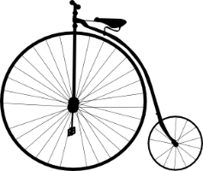
Subject pronouns (1)
Grammatik
The subject of a sentence is the person or thing doing a verb.
Often, the subject of a sentence is a noun:
Sometimes, the noun is replaced by a pronoun:
In English, subject pronouns tell us whether the subject of a sentence is a male person (he), a female person (she) or a thing (it).
In German, subject pronouns tell us the grammatical gender of the subject.
er - masculine: Der Gutschein ist toll! Er ist toll! It is great.
sie - feminine: Die Jacke ist gelb. Sie ist gelb. It is yellow.
es - neuter: Das Fahrrad ist groß. Es ist groß. It is big.
German has three words for ‘it.’ The word for ‘it’ reflects the gender of the noun. The ending of the word for ‘it’ is the same as the ending of the word for ‘the’.
The woman is reading a book.
She is reading a book.
Notes:
Timing: 3 minutes
Aim: To introduce students to the fact that German has three words for ‘it.’
Procedure: 1. Cycle through the information on the slide by clicking the mouse.
2. Teacher to acknowledge that this will be challenging for students as English speakers, as it will feel strange to refer to inanimate objects as ‘he’ and ‘she’ to begin with. Teacher to emphasise that ‘es’ is only for neuter words.
3. Teacher to emphasise that the pronoun endings (er, sie, es) mirror the endings of the definite article (der, die, das). This should help students remember which is needed when. Teacher can demonstrate this by pointing to objects in the classroom and describing them using the subject pronoun, e.g. Er (der Tisch) ist groß. Sie (die Tafel) ist hier/da. Es (das Buch) ist rot.

Slide 26
Was ist das? (1/2)
hören
Schreib A oder B. Schreib auch das Wort.
 | A | B
M
N
O
Notes:
Timing: 6 minutes (both slides)
Aim: To identify which object is being described by listening to the pronoun, and connecting it to the gender of a known noun.
Procedure:
1. Audio (with pronoun obscured) plays on letter clicks.
2. Students identify which item/picture completes the sentence (writing down A / B), and then try to write the missing noun down in German (remembering the capital letter of course!)
Note: There might be some who recognise which item it should be but can't remember the noun / spelling. They are still able to engage in the activity and be rewarded for recognising the gender, even if they can't recall the noun completely correctly.
3. This activity continues on the following slide, Answer slides then follow the slides for this activity.
Transcript:
M) Sie ist ziemlich hässlich.
N) Er ist ganz toll.
O) Sie ist sehr klein.

Slide 27
Was ist das? (2/2)
hören
Schreib A oder B. Schreib auch das Wort.
 | A | B
P
Q
R
Notes:
This is the continuation of the activity on the previous slide.
Transcript:
P) Es ist super!
Q) Es ist sehr interessant.
R) Er ist ganz groß.

Slide 28
Antworten (1/2)
hören
Schreib A oder B. Schreib auch das Wort.
 | A | B
die Jacke
M
der Zug
N
die Katze
O
Notes:
Timing: 2 minutes (both slides)
Aim: To reveal the answers to the activity on the previous slides.
Procedure:
1. Answers revealed on clicks.
Transcript:
M) Sie ist ziemlich hässlich.
N) Er ist ganz toll.
O) Sie ist sehr klein.

Slide 29
Antworten (2/2)
hören
Schreib A oder B. Schreib auch das Wort.
 | A | B
das Handy
P
das Buch
Q
der Tisch
R
Notes:
This is the continuation of the previous slide.
Transcript:
P) Es ist super!
Q) Es ist sehr interessant.
R) Er ist ganz groß.

Slide 30
Wie sind die Dinge? (1/3)
lesen / schreiben
Schreib Sätze! Beispiel: Sie ist groß. Die Flasche ist groß.
 | Die Flasche ist groß. | Der Garten ist klein.
Er ist klein und sie ist groß.
 | Die Band ist ganz toll. | Das iPad ist toll.
Es ist toll und sie ist ganz toll.
Notes:
Timing: 8 minutes (3 slides)
Note: if time is short in the lesson, reduce the number of items in the activity.
Aim: To to practise connecting pronouns with nouns by matching pairs of pronouns with pairs of known nouns.
Procedure:
1. Students read the sentences, which each contain two different pronouns.
2. Students decide to which noun each adjective refers, and write a sentence below each picture using definite article + noun as the subject. This will help students connect pronouns with definite articles, and also provides some written vocabulary revision.
3. Answers revealed on clicks. Teacher elicits responses by asking e.g. ‘Wie ist die Flasche?’

Slide 31
Wie sind die Dinge? (2/3)
lesen / schreiben
 | Das Auto ist rot. | Der Zug ist grün.
Es ist rot und er ist grün.
 | Das Haus ist blau. | Die Tür ist gelb.
Sie ist gelb und es ist blau.
Notes:
This is the continuation of the activity on the previous slide.

Slide 32
Wie sind die Dinge? (3/3)
lesen / schreiben
 | Der Hund spielt im Garten. | Die Katze sitzt im Zimmer.
Er spielt im Garten und sie sitzt im Zimmer.
 | Die Nacht ist schön. | Das Wasser ist dunkel.
Es ist dunkel und sie ist schön.
Notes:
This is the continuation of the activity on the previous slide.

Slide 33
Was passt nicht?
lesen
a) der Körper, der Kopf, die Tür
A) der Körper, der Kopf, die Tür
e) gewinnen, das Problem, der/die/das Erste
F) gewinnen, das Problem, der/die/das Erste
b) dunkel, blau, manchmal
B) dunkel, blau, manchmal
f) die Nacht, der Grund, der Tag,
G) die Nacht, der Grund, der Tag
c) kommen, stehen, gehen,
C) kommen, stehen, gehen,
g) die Frage, die Lösung, die Antwort
H) die Frage, die Lösung, die Antwort
d) der Mann, der Herr, die Mutter
D) der Mann, der Herr, die Mutter
h) der Boden, die Tür, das Fenster
I) der Boden, die Tür, das Fenster
e) die Nacht, die Schule, die Tafel
E) die Nacht, die Schule, die Tafel
i) der Vater, der Junge, das Mädchen
J) der Vater, der Junge, das Mädchen
Notes:
OPTIONAL
Timing: 5 minutes
Aim: To revise this week’s revisited vocabulary.
Note: This semantic categorisation exercise helps students consider the broader definitions of vocabulary items, helping to organise vocabulary knowledge in the memory.
Procedure:
1. Students have had the task instruction ‘Was passt nicht?‘ before. Ensure they are clear about its meaning. They have not formally met the verb ‘passen’ but they have been taught ‘was’ and ‘nicht’. 2. Students work in pairs to facilitate discussion. They identify a category heading which links two of the words, and write down the word which they doesn’t think fit the category.
3. Teacher elicits answers by pointing at a letter and asking e.g. ‘Was ist die Lösung? Der Körper, der Kopf oder die Tür?’ All three options should be read out in the question for additional listening practice.
4. Students volunteer answers, e.g. ‘die Tür’. Teacher and students then discuss as a class why ‘die Tür’ is a poor fit. By explaining and justifying their choices, students engage in creative processing of the vocabulary items, which helps retention.
Suggested justifications are given below, though students may have other justifications and different category headings. They may have different, creative solutions and choose different words – this is fine if a logical justification is given.
die Tür (doesn’t fit the body category)
manchmal (doesn’t fit the colours/shades/descriptions category)
stehen (doesn’t fit the movement category)
die Nacht (doesn’t fit the objects/school category)
das Problem (doesn’t fit the winning/competition category)
der Grund (doesn’t fit the time category)
die Frage (doesn’t fit the solution category)
der Boden (doesn’t fit the entrances/exits category)
der Vater (doesn’t fit the children category) OR das Mädchen (doesn’t fit the male person category)
Note: for a more challenging version of this activity, the teacher can turn this into a hören / schreiben activity by reading out the lists of words, and having students write down the answers, before showing them on the slide.

Slide 34
Weihnachten Talking about what you and others have, and what it is like
Subject pronoun sie meaning ‘they’
SSC [ö]
Was denkst du?
Y7 German
Term 2.1 – Week 1 - Lesson 30 Author name(s): Natalie Finlayson / Rachel Hawkes
Artwork: Steve Clarke
Date updated: 24.01.24
Notes:
Artwork by Steve Clarke. All additional pictures selected are available under a Creative Commons license; no attribution required.
Note: All words listed below for this week’s learning (new and revisited) appear on all three Awarding Organisations’ word lists, with the following exception:
i) AQA list does not have Gutschein.
ii) Edexcel list does not have Gutschein, hässlich, Ordnung.
iii) Eduqas list does not have Gutschein, hässlich.
Learning outcomes
Consolidation of SSC /ö/
Subject pronoun sie meaning ‘they’
Word frequency (1 is the most frequent word in German):
7.2.1.1 (introduce) - denken [128] er2 [15] es [12] sie2 [7] Fahrrad / Rad [2138] Geschenk [2595] Gutschein [>5009] Handy [1693] Jacke [3287] hässlich [3542] toll [972] ganz [69] jetzt [72] ziemlich [605] in Ordnung [n/a]
1.2.5 (revisit) - kommen [62] stehen [85] Junge [548] Kopf [250] Körper [488] Mädchen [602] Mutter [218] Nacht [325] Tür [375] Vater [232] dunkel [706]
1.1.6 (revisit) - habe, hast [6] Beispiel [94] Erste [95] Frage [157] Frau1 [99] Grund [249] Hand [180] Herr [154] Problem [210] Schule [359]
Source: Jones, R.L & Tschirner, E. (2019). A frequency dictionary of German: Core vocabulary for learners. London: Routledge.
The frequency rankings for words that occur in this PowerPoint which have been previously introduced in LDP resources are given in the LDP SOW and in the resources that first introduced and formally re-visited those words.
For any other words that occur incidentally in this PowerPoint, frequency rankings will be provided in the notes field wherever possible.

Slide 35
Weihnachtsgeschenke
lesen / sprechen
Was hat Mia?
Sie hat ein Handy.
_____
Wie ist Mias Handy?
Ich denke, es
ist total gut!
__
Notes:
Timing: 5 minutes (8 slides)
Note: if time is short in the lesson, reduce the number of items in the activity.
Aim: To revise the use of accusative indefinite articles to talk about what someone has, and practise use of subject pronouns to describe it.
Note: Through the activity, students learn to connect gender with articles and pronouns.
Procedure: 1. The teachers asks a question, e.g. Was hat Mia?, to elicit a choral response from the students: Sie hat ein Handy.

Slide 36
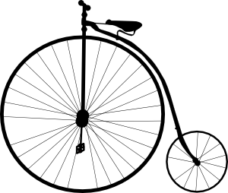
Weihnachtsgeschenke
lesen / sprechen
Was hat Wolfgang?
Er hat ein Fahrrad.
_____
Wie ist Wolfgangs Fahrrad?
Ich denke, es ist ziemlich hässlich!
__
Notes:
This is the continuation of the activity on the previous slide.

Slide 37
Weihnachtsgeschenke
lesen / sprechen
Was hat Mia?
Sie hat einen Gutschein.
_____
Wie ist Mias Gutschein?
Ich denke, er
ist toll!
__
Notes:
This is the continuation of the activity on the previous slide.

Slide 38
Weihnachtsgeschenke
lesen / sprechen
Was hat Wolfgang?
Er hat ein Spiel.
___
Wie ist Wolfgangs Spiel?
Ich denke, es
ist interessant!
__
Notes:
This is the continuation of the activity on the previous slide.

Slide 39
Weihnachtsgeschenke
lesen / sprechen
Was hat Mia?
Sie hat eine Jacke.
_____
Wie ist Mias Jacke?
Ich denke, sie ist hässlich!
__
Notes:
This is the continuation of the activity on the previous slide.

Slide 40
Weihnachtsgeschenke
lesen / sprechen
Was hat Wolfgang?
Er hat ein iPad.
___
Wie ist Wolfgangs iPad?
Ich denke, es
ist perfekt!
__
Notes:
This is the continuation of the activity on the previous slide.

Slide 41
Weihnachtsgeschenke
lesen / sprechen
Was hat Mia?
Sie hat einen
Zug.
_____
Wie ist Mias Zug?
Ich denke, er
ist super!
__
Notes:
This is the continuation of the activity on the previous slide.

Slide 42
Weihnachtsgeschenke
lesen / sprechen
Was hat Wolfgang?
Er hat einen Fußball.
_____
Wie ist Wolfgangs Fußball?
Ich denke, er
ist ganz hässlich!
__
Notes:
This is the continuation of the activity on the previous slide.

Slide 43
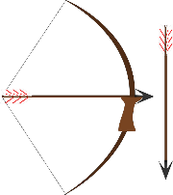
[o] und [ö]
lesen / schreiben
Many words containing /a/, /o/ and /u/ add an umlaut in the plural form. Words ending in –el, en and –er don’t add an ending in the plural form.
What is the plural form of the words below?
der Bogen | der Vogel | der Ofen | der Boden | die Tochter
die Bögen | die Vögel | die Öfen | die Böden | die Töchter
Notes:
Timing: 2 minutes
Aim: To recap the rules about plural formation introduced in 1.2.6, and practise the difference between SSCs /o/ and /ö/.
Note: This exercise also draws attention to the importance of sound in creating meaning by juxtaposing singular and plural forms of words which differ in terms of umlauts only.
Procedure: 1. Teacher elicits answers from students and then clicks to confirm on the slide.
2. Teacher to emphasise to students that mispronouncing the umlaut causes a change in meaning.
Note that the /ch/ becomes soft in Töchter.
Word frequency (1 is the most frequent word in German):
der Bogen [3070]; der Vogel [1878]; der Ofen [3214]; der Boden [445]; die Tochter [514]
Source: Jones, R.L & Tschirner, E. (2011). A frequency dictionary of German: Core vocabulary for learners. London: Routledge.

Slide 44
Gibt es eine, einen oder viele?
hören
 | eine / einen (o) | viele (ö)
A
Bogen
B
Vogel
C
Ofen
D
Boden
E
Tochter
Notes:
Timing: 3 minutes (two slides)
Aim: To practise distinguishing between singular and plural forms of nouns, as incorporating SSCs [o] and [ö] respectively (listening).
Procedure: 1. Audio plays on clicking individual letters. The article/quantifier is obscured in each case so students must listen to the sound.
2. By listening to the [o]/[ö], students determine whether the noun referred to is singular or plural.
3. Answers are revealed on the following slide.
Transcript
a) Es gibt [viele] Bögen im Museum.
b) Es gibt [einen] Vogel im Garten.
c) Herr Martin hat [einen] Ofen zu Hause.
d) Mia putzt jede Woche [die] Böden.
e) Die Frau hat [eine] Tochter.

Slide 45
Antworten
hören
 | eine / einen (o) | viele (ö)
A
Bogen
B
Vogel
C
Ofen
D
Boden
E
Tochter
Notes:
Aim: To reveal the answers to the activity on the previous slide.
Procedure: 1. Full audio (including articles/quantifiers) plays on clicking individual letters.
2. Answers revealed on clicks.
Transcript
a) Es gibt [viele] Bögen im Museum.
b) Es gibt [einen] Vogel im Garten.
c) Herr Martin hat [einen] Ofen zu Hause.
d) Mia putzt jede Woche [die] Böden.
e) Die Frau hat [eine] Tochter.

Slide 46
[o] oder [ö]?
hören / sprechen / schreiben
Wie schreibt man das? Mit /o/ oder mit /ö/? Arbeite mit einem Partner/einer Partnerin.
Beispiel:
Person A
zuhören/schreiben | sprechen
Schottland (kurz) | öffnen (kurz)
Person B
zuhören/schreiben | sprechen
Schottland (kurz) | öffnen (kurz)
Person A fragt: „Wie sagt man Scotland?“
Person B antwortet: „Schottland“.
Person A schreibt „o”.
Person B fragt: „Wie sagt man to open?“
Person A antwortet: „öffnen“.
Person B schreibt „ö”.
Notes:
Timing: 6 minutes
Aim: To work in pairs to complete the spellings of unknown words.
Note: This slide gives an example dialogue to present to students. The resource cards for this activity are found on the portal as a separate document entitled ‘pronunciation role cards’. Unknown words have been chosen (frequency information on next slide), so that students must focus on the sound. These words consist of long and short /ö/, previously studied SSCs and transferable consonants. The only exceptions are the /sch/ in Schottland, which teachers can highlight in the example above, and the /r/ in Butterbrot, with which students might need some extra support. A hint about the pronunciation (long or short) is given.
Procedure: 1. The role cards are printed and distributed amongst students. Each sheet contains two different cards, to be given to partner A and partner B, so must be cut in half.
2. Each student has a list of complete words to read out to their partner, and a list of words with the /o/ or /ö/ missing, which they must complete by listening to their partners pronunciation of the words.
3. Students have met the nouns die Frage and die Antwort, but not the verb forms fragen and antworten. Teacher to highlight that many nouns may be turned into verbs by removing the capital letter and adding –en.

Slide 47
Person A
zuhören/ schreiben | sprechen
Sch___ttland (kurz) | öffnen (kurz)
zw___lf (kurz) | tot (lang)
das Butterbr___t (lang) | unmöglich (kurz)
ich m___chte (kurz) | die Pommes (kurz)
das Kin___ (lang) | können (kurz)
___ffentlich (kurz) | Obst (lang)
das ___l (lang) | gewöhnlich (lang)
Person A
zuhören/ schreiben | sprechen
Sch___ttland (kurz) | öffnen (kurz)
zw___lf (kurz) | tot (lang)
das Butterbr___t (lang) | unmöglich (kurz)
ich m___chte (kurz) | die Pommes (kurz)
das Kin___ (lang) | können (kurz)
___ffentlich (kurz) | Obst (lang)
das ___l (lang) | gewöhnlich (lang)
Person B
sprechen | zuhören/ schreiben
Schottland (kurz) | ___ffnen (kurz)
zwölf (kurz) | t___t (lang)
das Butterbrot (lang) | unm___glich (kurz)
ich möchte (kurz) | die P___mmes (kurz)
das Kino (lang) | k___nnen (kurz)
öffentlich (kurz) | ___bst (lang)
das Öl (lang) | gew___hnlich (lang)
Person B
sprechen | zuhören/ schreiben
Schottland (kurz) | ___ffnen (kurz)
zwölf (kurz) | t___t (lang)
das Butterbrot (lang) | unm___glich (kurz)
ich möchte (kurz) | die P___mmes (kurz)
das Kino (lang) | k___nnen (kurz)
öffentlich (kurz) | ___bst (lang)
das Öl (lang) | gew___hnlich (lang)
12
12
12
12
[impossible]
[impossible]
[impossible]
[impossible]
[I would like]
[I would like]
[I would like]
[I would like]
[public]
[public]
[public]
[public]
[usual]
[usual]
[usual]
[usual]
Notes:
DO NOT DISPLAY These are the role play cards to print, cut up and distribute.

Slide 48
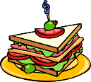
Lösungen - /o/ oder /ö/?
hören / sprechen / schreiben
Schottland
öffnen
12
zwölf
tot
das Butterbrot
[impossible]
unmöglich
[I would like]
ich möchte
die Pommes
das Kino
[to be able to]
können
[public]
öffentlich
das Obst
das Öl
[usual]
gewöhnlich
Notes:
ANSWERS Timing: 5 minutes
Aim: To provide the answers to the activity on the previous slide.
Procedure: 1. ‘Lösung’ is one of this week’s SSC cluster words. Explain that ‘Lösungen’ is the plural form.
2. This slide reveals the complete spellings of each word in the task. Teacher points at a word, asks ‘Wie sagt man Scotland?’ to elicit ‘Schottland’, and then ‘/o/ oder /ö/?’ to elicit ‘/o/’.
3. Teacher then pronounces the word again, and gives English translation. Students repeat. Teachers also focus on the pronunciation of previously encountered SSCs,
e.g. zwölf, unmöglich, ich möchte, öffentlich, gewöhnlich.
4. Teacher to draw attention to capitalisation at the beginning of nouns.
5. Note that Obst is designated ‘lang’ even though the ‘o’ is followed by 3 consonants! It may be considered an exception to the long/short vowel rule, although it is worth noting that there is considerable variability between speakers as to the length of the ‘o’. Listen to the two native speakers, here: https://www.dict.cc/?s=Obst
Word frequency (1 is the most frequent word in German):
Schottland [n/a] zwölf [1080] Butterbrot [>5009] ich möchte (möchten) [>5009] Kino [2020] öffentlich [494] Öl [2135] öffnen [508] tot [513] unmöglich [1879] Pommes [>5009] können [23] Obst [4980] gewöhnlich [2253]
Source: Jones, R.L & Tschirner, E. (2011). A frequency dictionary of German: Core vocabulary for learners. London: Routledge.

Slide 49
Subject pronouns (2)
Grammatik
As we know, subject pronouns tell us the grammatical gender of the subject.
er - masculine Der Gutschein ist toll! Er ist toll! It is great.
sie - feminine Die Jacke ist gelb. Sie ist gelb. It is yellow.
es - neuter Das Fahrrad ist groß. Es ist groß. It is big.
This is not the case in the plural form. To say ‘they,’ ‘sie’ is used for all genders.
Die Gutscheine sind toll! Sie sind toll! They are great!
Die Jacken sind gelb. Sie sind gelb. They are yellow.
Die Fahrräder sind groß. Sie sind groß. They are big.
Note that sie means both ‘it (feminine)’ and ‘they’. The verb form tells you what is being talked about.
Sie ist gelb. It is yellow.
Sie sind gelb. They are yellow.
____
____
____
____
____
____
____
____
____
____
____
____
____
____
Notes:
Timing: 4 minutes
Aim: To introduce the use of the pronoun ‘sie’ to mean ‘they’.
Procedure: 1. Cycle through the information on the slide by clicking the mouse.
2. Teacher to draw attention to the irregular plural formation of Fahrrad (90% rule!).

Slide 50
Wer ist das? Die Katze oder die Hunde?
lesen
F | Sie ist ganz groß.
G | Sie sind sehr schön.
H | Sie ist kaum zu Hause.
I | Sie sind ziemlich klein.
J | Sie sind oft im Garten.
K | Sie ist Mias Haustier.
Notes:
Timing: 3 minutes
Note: if time is short, elicit answers orally from the whole class instead of students doing it as individual comprehension.
Aim: To practise looking at the verb form to describe whether a singular or plural subject is being talked about.
Procedure: 1. Students read the sentences and tck the appropriate column in each case. 2. Teacher to emphasise that in this situation the pronouns (sie - she and sie - they) don’t help with meaning. It is the verb form which is crucial, here.
3. Click to reveal the correct answers.

Slide 51
Weihnachten in Berlin!
lesen, hören und sprechen
Weihnachten in Berlin ist sehr schön! Es gibt einen Weihnachtsmarkt am Marktplatz und einen Weihnachtsbaum mit Kerzen in der Schule. Es gibt Bonbons im Unterricht und keine Hausaufgaben!
Es ist der 24. Dezember und Wolfgang und Mia sind zu Hause. Mia singt Weihnachtslieder und Wolfgang kocht Suppe. Es gibt jetzt Geschenke! Mia bekommt eine Jacke. Die Jacke ist gelb und sehr groß. Mia denkt, die Jacke ist ganz hässlich! Mia bekommt aber auch ein Handy. Mia denkt, das Handy ist toll!
Wolfgang bekommt ein Spiel und ein iPad. Wolfgang denkt, das Spiel und das iPad sind super! Wolfgang bekommt aber auch einen Fußball. Er denkt, der Fußball ist total hässlich. Die Farbe ist nicht schön. Die Katze denkt, der Fußball ist ganz toll. Die Katze spielt sehr oft im Garten Fußball!
Notes:
Timing: 6 minutes
Aim: To provide segmentation practice.
Procedure: 1. Teacher plays the recording whilst students read the text. The audio is paused just before the words in bold.
2. The teacher then asks:
1/ What is the next word? The students then read the next word out loud, practising segmentation skills.
2/ What type of word is it? The students then identify the word as a noun, verb, adjective or adverb, practising grammar knowledge.
3/ What other word could be used instead? The students then offer an alternative word of the same word class that makes sense in context, practising vocabulary and grammar knowledge.
Some suggestions below:
Weihnachten in Berlin ist sehr schön! Es gibt einen Weihnachtsbaum / einen Weihnachstmann / eine Engel / einen Stern am Marktplatz.
Es ist der 24. Dezember und Wolfgang und Mia sind im Zimmer/ im Garten
Wolfgang kocht Nudeln / Spagetti / Pizza
Die Jacke ist rot / blau / grün
Mia denkt, das Handy ist (nicht) gut / super / hässlich
Wolfgang denkt, das Spiel und das iPad sind (nicht) gut / toll / hässlich
Die Katze ist / sitzt sehr oft im Garten

Slide 52
Weihnachten in Berlin!
lesen, hören und sprechen
Replace the repeated subjects with a subject pronoun (er, sie, es or sie).
Weihnachten in Berlin ist sehr schön! Es gibt einen Weihnachtsmarkt am Marktplatz und einen Weihnachtsbaum mit Kerzen in der Schule. Es gibt Bonbons im Unterricht und keine Hausaufgaben!
Es ist der 24. Dezember und Wolfgang und Mia sind zu Hause. Mia singt Weihnachtslieder und Wolfgang kocht Suppe. Es gibt jetzt Geschenke! Mia bekommt eine Jacke. Die Jacke ist gelb und sehr groß. Mia denkt, die Jacke ist ganz hässlich! Mia bekommt aber auch ein Handy. Mia denkt, das Handy ist toll!
Wolfgang bekommt ein Spiel und ein iPad. Er denkt, das Spiel und das iPad sind super! Wolfgang bekommt aber auch einen Fußball. Wolfgang denkt, der Fußball ist total hässlich. Die Farbe ist nicht schön. Die Katze denkt, der Fußball ist ganz toll. Die Katze spielt sehr oft im Garten Fußball!
Sie
Sie
es
sie
er
Sie
Notes:
Timing: 6 minutes
Aim: To practise replacing repeated subjects with appropriate pronouns.
Procedure:
1. Teacher to highlight that one of use of pronouns is to avoid repetition and excessively long sentences. However, that not all repeated subjects are highlighted as sometimes repetition is necessary for clarity, for example when there is a subject change and two feminine nouns are involved: Mia bekommt eine Jacke. Sie ist gelb und sehr groß. Mia denkt, die Jacke ist ganz hässlich.
2. Solutions revealed on clicks.

Slide 53
Weihnachtsgeschenke
schreiben
Und was denkst du? Give opinions on four Christmas presents.
Beispiel: Ich habe jetzt eine Jacke. Ich denke, sie ist super!
1.
2.
3.
4.
Notes:
Note: this activity could be set for homework. Timing: 5 minutes
Aim: To practise sentence production (writing) using pronouns of the appropriate gender for ‘it’.
Procedure:
1. Students work alone to create four sentences about having and thinking.
2. They should be encouraged to use a noun in the first sentence, and a pronoun in the second.
3, The activity is then used as the basis for a transcription exercise on the following slide.

Slide 54
Weihnachtsgeschenke
sprechen, hören, schreiben
Now, read your sentences to a partner.
Was hat dein(e) Partner(in)? Was denkt er/sie? Schreib 4 Sätze.
Beispiel: Mark hat jetzt einen Computer. Er denkt, er ist ganz toll.
1.
2.
3.
4.
Notes:
Timing: 5 minutes
Aim: To practise speaking in sentences using pronouns of the appropriate gender for ‘it’, along with transription in the third person.
Procedure:
1. Students listen to their partner’s sentences about having and thinking in the first person, then transcribe them in the third person.
2. Teacher can elicit answers from pupils in the third person by asking e.g. ‘Was hat Mark? Was denkt Mark?’

Slide 55
Hausaufgaben
Vocabulary Learning Homework (Term 2.1, Week 2)
Audio file
Student worksheet
In addition, revisit: Term 1.2 Week 6 | Term 1.1 Week 7
Notes:
Timing: 2 minutes Use this slide to set the homework.
Use this slide to set the homework.
For Y7, the typical homework will be to pre-learn vocabulary for the next lesson. There is an audio file to accompany the student worksheet.
Notes:
i) Teachers may, in addition, want to recommend use of a particular online app for the pre-learning of each week’s words. ii) Quizlet now requires parental involvement / registration / permissions for users below the age of 13, so it is perhaps most suitable for Y9 – 11 students. iii) Language Nut hosts LDP vocabulary lists and these are free for schools to use, though there is a registration process. One benefit is that all of the student tracking data that Language Nut offers are also available to schools that use the LDP lists for practice. Perhaps this makes it a good option for Y7/8.
iv) There are other free apps, and new ones are always appearing. Teachers have told us that they are currently using: Flippity, Wordwall (where using previously-created activities is free).
v) Gaming Grammar has been acquired by Language Nut. Its original content should still be available to teachers and much of it is appropriate for Y7 learners. From this lesson, for example, learners could practise Article agreement

