Slide 1
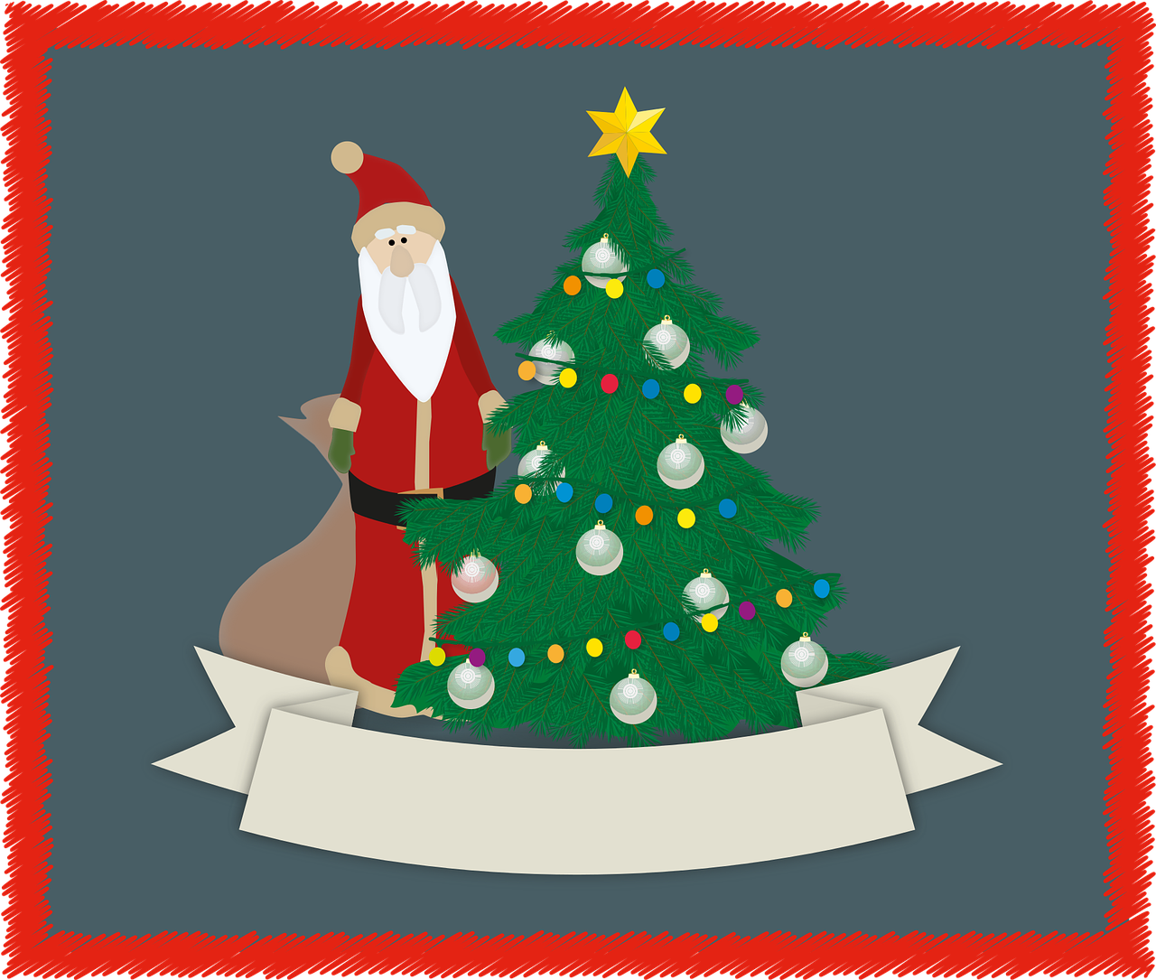
Weihnachtstraditionen
SEIN - ist / sind Plural Rule 3 - +(e)n Plural article = 'die'
Y7 German
Term 1.2 – Week 7 - Lesson 27 Inge Alferink/ Rachel Hawkes
Artwork: Steve Clarke
Date updated: 13/08/2023
Frohe Weihnachten
Notes:
Artwork by Steve Clarke. All additional pictures selected are available under a Creative Commons license; no attribution required. Note: Some schools may want to have end of term assessments. It would be fine for schools to omit either this week (Week 7) or the previous week (Week 6) or both, in favour of assessments. The grammar covered in these two weeks (plural rules 1, 2 and 3) are revisited multiple times over the course of KS3. The only thing teachers will want to ensure is that students learn the new vocabulary and revisit the assigned vocabulary from both weeks, as these words will recur from this week onwards and it will be assumed that students have been taught them.
There are vocabulary practice tasks within these lessons that could be used at some point over these two weeks or the words set as learning ahead of Term 2.
Note: All words listed below for this week’s learning (new and revisited) appear on all three Awarding Organisations’ word lists, with the following exception:
i) AQA list does not have zuhören. (Haustier not listed but Haus + Tier =comprehensible compound).
ii) Edexcel list does not have Kirche, freiwillig.
Learning outcomes (lesson 1):
Introduction of third person plural form of SEIN (ist / sind)
Introduction of plurals Rule 3 - die --> +(e)n; plural article = 'die'
Word frequency (1 is the most frequent word in German):
7.1.2.7 (introduce) bekommen [212] sind [4] Familie [329] Hund [825] Idee [451] Katze [2235] Kirche [892] Woche [219] früh [366] schön [188] spät [169] ich wünsche mir [n/a]
7.1.2.4 (revisit) lesen [305] sprechen [161] wiederholen [988] zeigen [136] zuhören [1629] Antwort [522] freiwillig [1652] (Antworten) zeigen! Zuhören! Sprechen! Lesen! Schreiben! Wiederholen!
7.1.1.5 (revisit) haben, hat [6] er1 [15] sie1 [7] wer? [149] Freund [273] Fußball [1277] Haus [159] Haustier [>5009] Lehrer [695] Wasser [245] Welt [164] Wort [194] wahr [737] nicht wahr? [n/a] Ist es warm/kalt heute?
Source: Jones, R.L. & Tschirner, E. (2019). A frequency dictionary of German: core vocabulary for learners. Routledge

Slide 2
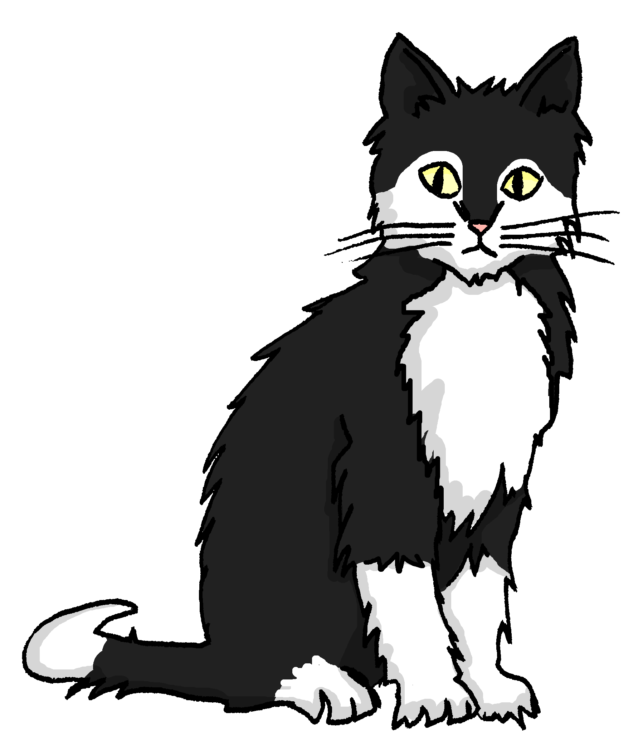
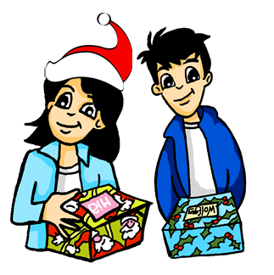
Vokabeln (1/2)
lesen / sprechen
die Idee
die Katze
der Hund
[(they) are]
[to receive, receiving]
[I wish (for)…]
bekommen
Ich wünsche mir…
(sie) sind
Notes:
Timing: 8 minutes (two slides) Aim: to present and practise the new vocabulary for this week. Procedure: 1. Click to bring up the German word. 2. Elicit repetition.
3. Click to bring up the picture/English meaning and elicit a 2nd repetition of the word.
4. Continue with the remaining words on the slide.
5. Ask ‘Wie sagt man XXX auf Deutsch/Englisch’? to provide more practice.
6. Move on to the remaining words on the next slide and repeat the process.

Slide 3
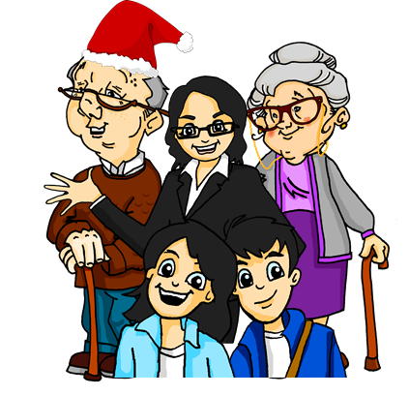
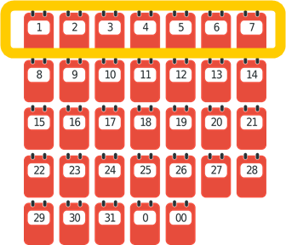
Vokabeln (2/2)
lesen / sprechen
die Kirche
die Familie
die Woche
[beautiful]
[early]
[late]
schön
spät
früh
Notes:
2/2

Slide 4
bekommen
[to get / receive | getting / receiving]
bekommt
[gets / receives | is getting / receiving]
Notes:
Timing: 3 minutes for sequence of six verbs
Aim: To introduce the verb bekommen more explicitly.
Note: Though bekommen is not one of the 25 most frequent verbs in German, kommen is on that list, so bekommen is both useful in the Christmans context of this lesson and as a precursor to kommen, which students will meet later.
Procedure:
Bring up the word bekommen on its own, say it, students repeat it, and remind them of the phonics.
Try to elicit the meaning from the students. Students have had explicit teaching that the present tense in German communicates two different present tense meanings in English. This reinforces that learning. Emphasise the two meanings for the short form, reminding students that German only has one form and does not have a direct equivalent of the grammar for ‘is + ing’, the continuous form (as covered in previous weeks).
Bring up the picture, and, if using gestures, a possible gesture would be mime receiving something in one’s hands from another.
Then bring up the English translations. Emphasise the two meanings for the infinitive.
Bring up the short form bekommt, say it, students repeat it.
Try to elicit the meaning from the students. Emphasise the two meanings for the short form.

Slide 5
bekommen
[to get / receive | getting / receiving]
bekommt
[gets / receives | is getting / receiving]
Notes:
Cycle through the long and short form again.

Slide 6
bekommt
[gets / receives | is getting / receiving]
Die Frau bekommt das Buch.
[The woman gets | is getting the book.]
Notes:
Introduce the short form in a sentence.

Slide 7
bekommen
[to get / receive | getting / receiving]
Die Frau kann das Buch bekommen.
[The woman can get the book.]
Notes:
Introduce the long form in a sentence.

Slide 8
bekommt
[gets / receives | is getting / receiving]
bekommt
Die Frau __________ das Buch.
[The woman gets | is getting the book.]
Notes:
Cycle through the short form in context again.

Slide 9
bekommen
[to get / receive | getting / receiving]
bekommen
Die Frau kann das Buch ___________.
[The woman can get the book.]
Notes:
Cycle through the long form in context again.

Slide 10
sein (to be): ist (is), sind (are)
Grammatik
(he /she) is
(er / sie) ist
(they) are
(sie) sind
Der Hund ist schön.
Die Hunde sind schön.
Die Familie ist zu spät.
Die Familien sind zu spät.
Das Mädchen ist zu früh.
Die Mädchen sind zu früh.
zu - too
Notes:
Timing: 2 minutes Aim: To introduce the third person plural form of SEIN: ‘sind’.
Procedure: 1. Click to animate the explanation.
2. Ensure students’ understanding at each stage, i.e., elicit the English meanings of each German example.
Note: Remind / elicit from students that ist/sind are both part of sein. This is something that is hard to understand and retain, so needs regular reinforcement.

Slide 11
Ist oder sind?
Singular oder Plural? Schreib 1-6 und ‘ist’ oder ‘sind’.
lesen
ist | sind
sind
1. Die Filme _____ wahr.
sind
2. Die Haustiere _____ schön.
ist
3. Das Stück _____ Klein.
sind
4. Die Spiele _____ super.
sind
?
5. Die Fenster _____ grün.
ist
?
6. Der Winter _____ lange.
Notes:
Timing: 7 minutes Aim: to practise distinguishing between the third person singular and plural forms of SEIN: ‘ist’ v. ‘sind’.
Procedure: 1. If needed, work through number one to model an example.
2. Students complete the remaining items, students deciding whether the verb form will be ‘ist’ or ‘sind’, according to whether the noun is singular or plural. Articles are obscured to force students to pay attention to the form.
3. Click to bring up the correct verb form, and uncover the definite articile (of particular importance for the last two questions – see step 5 below). Elicit both from students.
4. Fenster and Winter could be both singular and plural. Teacher can emphasise that the article is a crucial piece of information here.

Slide 12
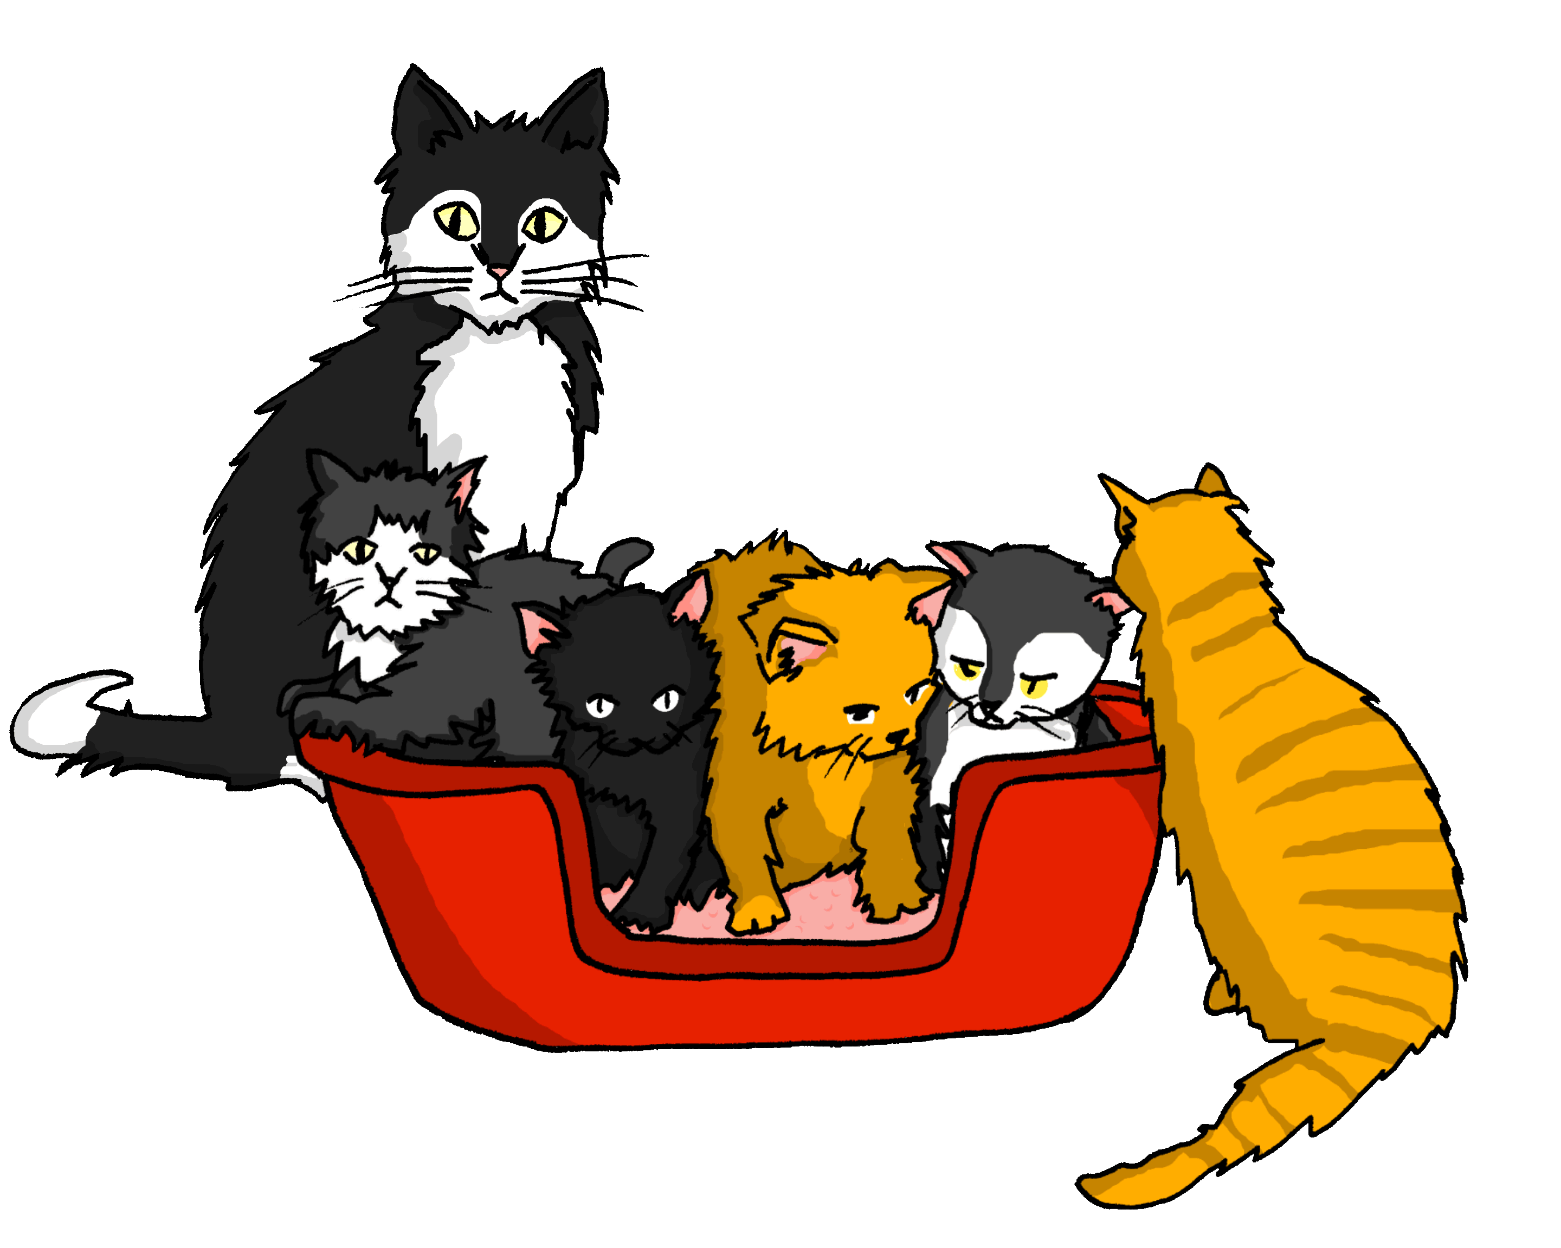
Plurale – weiblich (feminine)
Grammatik
Remember! The plural word for ‘the’ is die for nouns of all genders.
Most feminine nouns make a plural by adding an –n or –en:
die Katze
die Welt
die Kugel
die Katzen
die Welten
die Kugeln
Notes:
Timing: 2 minutes Aim: to introduce plural rule 3 - die --> +(e)n.
Procedure: 1. Click to animate the explanation. The singular forms are provided.
2. Click to provide the plural picture and elicit (or provide, as needed) the German plural form.
2. Ensure students’ understanding at each stage.
Note:
i) Katze and Welt have been taught. We use them to show examples of adding –n to feminine nouns ending in –e (there are lots of these) and –en to feminine nouns ending in a consonant. Kugel is not on any of the word lists, but provided here as an example of feminine noun ending in –el, showing the plural form +-n. This is important since last week students learnt that masculine words ending in –el, -en, -er often have the same plural form. Conversely, feminine nouns ending in –el-en-er almost always take –n or –en. E.g., Tafel → Tafeln, Million → Millionen, Schwester → Schwestern.
ii) The word ‘weiblich’ is in the title [2491]. It’s equivalent ‘männlich’ [3326] hasn’t yet been used with students, but they know ‘Mann’ and the ‘ä’ SSC, so these two adjectives could be used in tasks focused on gender, from now on.

Slide 13
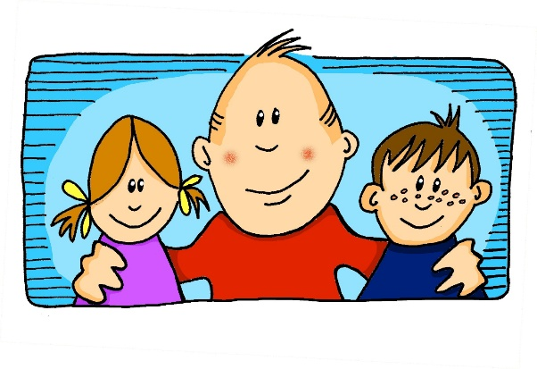
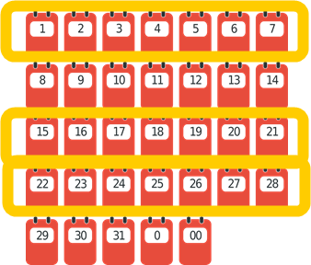
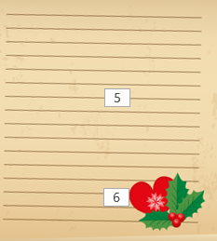
Wie viele gibt es?
Ist es die (Singular) oder die (Plural)?
lesen
4
die Glocken | die Glocke ist laut.
1
die Familie | die Familien ist da.
5
die Wochen | die Woche sind lang.
2
die Kerzen | die Kerze sind schön.
3
6
die Liste | die Listen ist klein.
die Tür | die Türen sind dekoriert.
Notes:
Timing: 5 minutes Aim: to practise differentiating between ist and sind in the written modality again, this time using the understanding of the verb form to connect to the correct singular or plural noun. Procedure: 1. Students read each sentence and decide, based on the verb whether they need a singular or plural noun. They write down the noun and its English meaning.
2. Click to check responses, and elicit the English meanings orally for reinforcement.
Note:
i) pictures are provided in this task to ensure that it is accessible to all students, particularly given Kerze and Glocke are not part of the vocabulary list, but used here for pattern recognition, and of course, some students may pick up vocabulary incidentally. Teachers could remove the pictures to focus students’ attention more acutely on the noun forms, but the listening task that follows does this.
ii) Glocke, Kerze, dekoriert are not formally taught, nor are they on any of the three AO GCSE vocabulary lists. Familie, Tür, Woche, Liste, da, schön, laut, and super are on all three lists.

Slide 14
Eine oder viele?
hören / schreiben
Hör zu. Schreib ‚ist‘ oder ‚sind‘ oder den Satz*.
1
Die Kirchen sind offen.
4
2
Die Wochen sind kurz.
Die Glocke ist laut.
5
3
Die Kugeln sind rot.
Die Idee ist gut.
der Satz - sentence
Notes:
Timing: 6 minutes Aim: to practise aural comprehension of feminine singular and plural nouns; to practise written production of ist and sind.
Note:
i. Students could be challenged to transcribe the whole sentence, adding the missing verb form as well. ii. All nouns are feminine, i.e. the article does not supply any additional information. It is worth reminding students of this. The only way they can distinguish between singular and plural here is the ending on the noun. Kirche, Woche and Idee are on all GCSE word lists. Glocke and Kugel are used as examples of the plural pattern but do not appear on GCSE word lists.
Procedure: 1. Click to the numbered button to play the audio. NB: It plays each one twice after just one click. The verb (ist/sind) is obscured (with a festive jingle!).
2. Students listen to the sentences and write ‘ist’ or ‘sind’ as appropriate, considering the form of the noun heard.
3. Once all questions have been displayed and heard, successive clicks display the correct answers.
Transcript:
1. Die Kirchen [sind] offen.
2. Die Glocke [ist] laut.
3. Die Kugeln [sind] rot.
4. Die Wochen [sind] kurz.
5. Die Idee [ist] gut.

Slide 15
Ein/eine oder viele?
lesen
Antworten
Welt
Wort
Freunde
Fußball
Haus
ein/eine
Lehrer
viele
Familie
Haustiere
Familie
Fußball
Wort
Lehrer
Haus
Welt
Antworten
Lehrer
Ideen
Haustiere
Ideen
Freunde
Notes:
Timing: 6 minutes
Aim: to practise recognising singular and plural forms of nouns.
Procedure: 1. Click to bring up the nouns, one at a time.
2. Students say whether each noun is singular or plural.
3. Click to make the noun ‘fly’ to the appropriate ‘sack’ on the screen.
Note that the final item ‘Lehrer’ is the same form in singular and plural and therefore appears in both ‘sacks’.

Slide 16
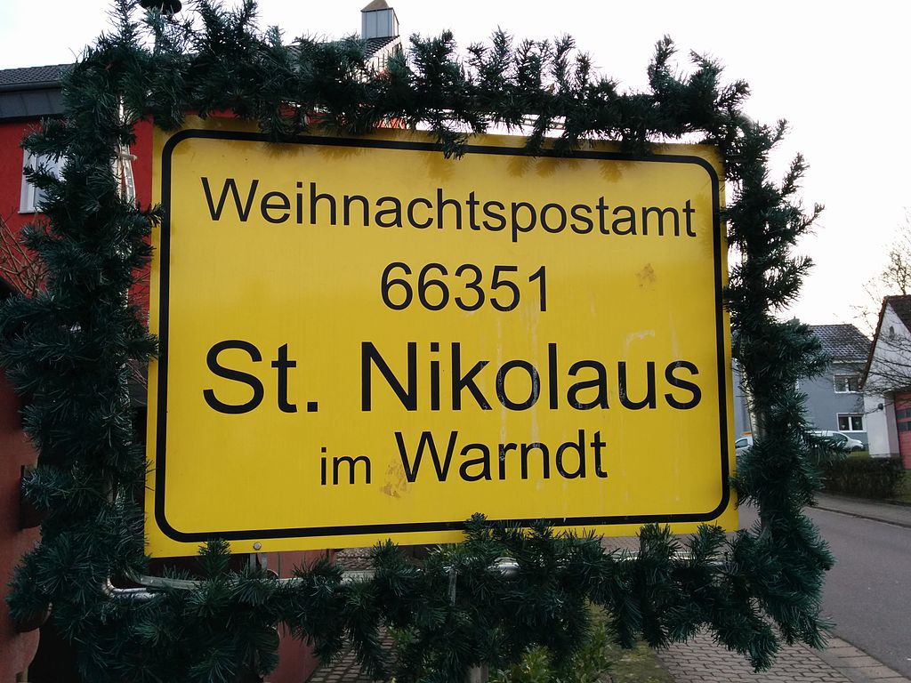
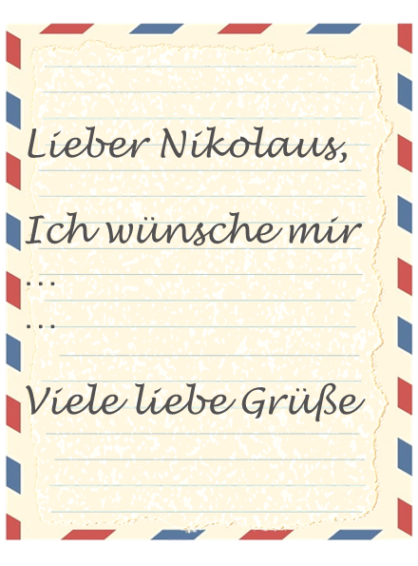
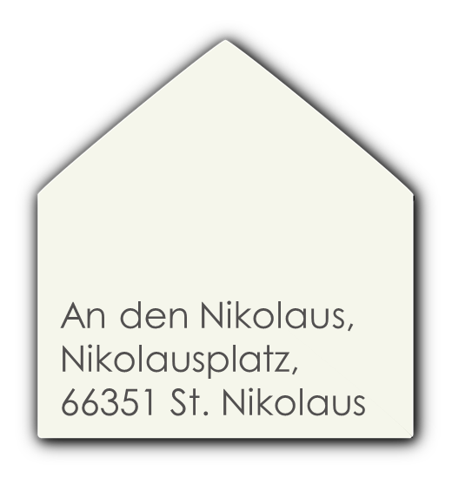
Weihnachtstraditionen
Using singular and plural nouns SSC [ä]
Y7 German
Term 1.2 – Week 7 - Lesson 28 Inge Alferink/ Rachel Hawkes
Artwork: Steve Clarke
Date updated: 13/08/2023
Notes:
Artwork by Steve Clarke. All additional pictures selected are available under a Creative Commons license; no attribution required.
Learning outcomes (lesson 2):
Introduction of SSC [ä]
Consolidation of third person plural form of SEIN (ist / sind)
Consolidation of plurals Rule 3 - die --> +(e)n; plural article = 'die'
Word frequency (1 is the most frequent word in German):
7.1.2.7 (introduce) bekommen [212] sind [4] Familie [329] Hund [825] Idee [451] Katze [2235] Kirche [892] Woche [219] früh [366] schön [188] spät [169] ich wünsche mir [n/a]
7.1.2.4 (revisit) lesen [305] sprechen [161] wiederholen [988] zeigen [136] zuhören [1629] Antwort [522] freiwillig [1652] (Antworten) zeigen! Zuhören! Sprechen! Lesen! Schreiben! Wiederholen!
7.1.1.5 (revisit) haben, hat [6] er1 [15] sie1 [7] wer? [149] Freund [273] Fußball [1277] Haus [159] Haustier [>5009] Lehrer [695] Wasser [245] Welt [164] Wort [194] wahr [737] nicht wahr? [n/a] Ist es warm/kalt heute?
Source: Jones, R.L. & Tschirner, E. (2019). A frequency dictionary of German: core vocabulary for learners. Routledge
Cultural information about Christmas post offices from : https://de.wikipedia.org/wiki/Weihnachtspostamt And also: https://www.dw.com/en/writing-letters-to-the-christkind-or-santa-claus/a-63843130#:~:text=Every%20year%2C%20children%20living%20in,Nicholas%20or%20the%20Christ%20Child.
Image attribution (Weihnachtspostamt, St.Nikolaus): EwSp01, CC BY-SA 4.0 via Wikimedia Commons Deutschland Adresse: An den Nikolaus, Nikolausplatz, 66351 St. Nikolaus
An den Weihnachtsmann Weihnachtspostfiliale 16798 Himmelpfort
An das Christkind 51777 Engelskirchen
Also (Himmelstadt, Nikolausdorf, Himmelsberg, Himmelpforten)
ÖsterreichDas österreichische Weihnachtspostamt befindet sich in dem kleinen Ort Christkindl in Oberösterreich.
Adresse:
Postamt Christkindl Christkindlweg 6 4411 Christkindl
Schweiz
Auch in der Schweiz werden Kinderbriefe an das Christkind oder den Schweizer „Samichlaus“ beantwortet.
Adressen:
An das Christkind 9405 Wienacht-Tobel An das Christkind 3027 Bethlehem Die Weihnachtspostämter von Bern-Bethlehem und Wienacht-Tobel (Lutzenberg) sind allerdings inzwischen geschlossen worden. Die Kinderbriefe landen jetzt bei der zentralen Fundstelle der Schweizerischen Post in Chiasso und werden dort auch bearbeitet.

Slide 17
Vokabeln
sprechen
[to receive, receiving]
d_ _ I_ _ _
d_ _ K_ _ _ _
d_ _ H_ _ _
bekommen
die Idee
die Katze
der Hund
b_ _ _ _ _ _ _ _
[I wish (for)…]
d_ _ K_ _ _ _ _
d_ _ F_ _ _ _ _ _
d_ _ W_ _ _ _
i_ _ w_ _ _ _ _ _ m_ _
die Kirche
die Familie
die Woche
ich wünsche mir
[(they) are]
[beautiful]
[late]
[early]
schön
spät
früh
(sie) sind
s_ _ _ _
s_ _ _
f_ _ _
(sie) _ _ _ _
Notes:
Timing: 5 minutes
Aim: to practise oral production of the new vocabulary from this week, in a time-limited, but low stakes activity. Procedure: 1. Working from left to right, top to bottom, teachers click to start a 4-second animation.
2. Students have to say the right German word aloud before the animation finishes and the word is revealed.
Note: it may be worth doing this activity twice, first without students speaking aloud (they could think, or mouthe, or sub-vocalise the words), and second, with choral elicitation of all the words. Task repetition of a variety of spoken production tasks has been shown to be beneficial for performance. Having two different conditions for the same task adds variety.

Slide 18
ä
spät
Notes:
Timing: 1 minute
Aim: To introduce/consolidate SSC [ä]
Procedure: 1. Present the letter(s) and say the [ä] sound first, on its own. Students repeat it with you. 2. Bring up the word ”spät” on its own, say it, students repeat it, so that they have the opportunity to focus all of their attention on the connection between the written word and its sound.
3. A possible gesture for this would be to bring your left arm up to mime suddenly looking at your watch.
4. Roll back the animations and work through 1-3 again, but this time, dropping your voice completely to listen carefully to the students saying the [ä] sound, pronouncing ”spät’” and, if using, doing the gesture. Word frequency (1 is the most frequent word in German): spät [171]
Source: Jones, R.L. & Tschirner, E. (2006). A frequency dictionary of German: core vocabulary for learners. Routledge

Slide 19
ä
zählen
ähnlich
1, 2, 3, …100
spät
Nähe
wählen
Berlin 1KM
erklären
[to explain]
Notes:
Timing: 1 minute
Aim: To introduce/consolidate SSC [ä]
Procedure:
Introduce and elicit the pronunciation of the individual SSC [ä] and then the source word again ‘spät’ (with gesture, if using).
Then present and elicit the pronunciation of the five cluster words.
The cluster words have been chosen for their high-frequency, from a range of word classes, with the SSC (where possible) positioned within a variety of syllables within the words (e.g. initial, 2nd, final etc.). Additionally, we have tried to use words that build cumulatively on previously taught SSCs (see the Phonics Teaching Sequence document) and do not include new SSCs. Where new SSCs are used, they are often consonants which have a similar symbol-sound correspondence in English.
Word frequency (1 is the most frequent word in German): spät [171]; zählen [680] ähnlich [429]; Nähe [795]; erklären [250]; wählen [64]. Source: Jones, R.L. & Tschirner, E. (2006). A frequency dictionary of German: core vocabulary for learners. Routledge

Slide 20
ä
zählen
ähnlich
spät
Nähe
wählen
erklären
Notes:
With sound and no pictures to focus all attention on the sound-symbol correspondence.

Slide 21
ä
zählen
ähnlich
spät
Nähe
wählen
erklären
Notes:
Without sound to elicit pronunciation (without first hearing the teacher).
Teacher to elicit pronunciation by asking “Wie sagt man…”

Slide 22
ä
lächeln
Notes:
Timing: 1 minute
Aim: To introduce/consolidate SSC [ä]
Procedure: 1. Present the letter(s) and say the [ä] sound first, on its own. Students repeat it with you. 2. Bring up the word ”lächeln” on its own, say it, students repeat it, so that they have the opportunity to focus all of their attention on the connection between the written word and its sound.
3. A possible gesture for this would be to trace a broad smile on your own face, drawing your index fingers away from the middle of your mouth to the outer edges.
4. Roll back the animations and work through 1-3 again, but this time, dropping your voice completely to listen carefully to the students saying the [ä] sound, pronouncing “lächeln” and, if using, doing the gesture. Word frequency (1 is the most frequent word in German): lächeln [793]
Source: Jones, R.L. & Tschirner, E. (2006). A frequency dictionary of German: core vocabulary for learners. Routledge

Slide 23
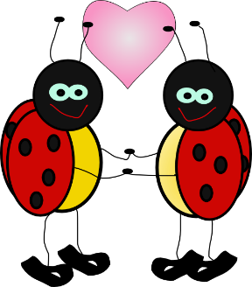
ä
Verhältnis
Mädchen
[relationship]
lächeln
Hälfte
ändern
ständig
[constant(ly)]
Notes:
Timing: 2 minutes
Aim: To introduce/consolidate SSC [ä]
Procedure:
Introduce and elicit the pronunciation of the individual SSC [ä] and then the source word again ‘lächeln’ (with gesture, if using).
Then present and elicit the pronunciation of the five cluster words.
The cluster words have been chosen for their high-frequency, from a range of word classes, with the SSC (where possible) positioned within a variety of syllables within the words (e.g. initial, 2nd, final etc.). Additionally, we have tried to use words that build cumulatively on previously taught SSCs (see the Phonics Teaching Sequence document) and do not include new SSCs. Where new SSCs are used, they are often consonants which have a similar symbol-sound correspondence in English.
Word frequency (1 is the most frequent word in German): lächeln [793]; Verhältnis [517] Mädchen [537]; Hälfte [972]; ständig [612]; ändern [476].
Source: Jones, R.L. & Tschirner, E. (2006). A frequency dictionary of German: core vocabulary for learners. Routledge

Slide 24
ä
Verhältnis
Mädchen
lächeln
Hälfte
ändern
ständig
Notes:
With sound and no pictures to focus all attention on the sound-symbol correspondence.

Slide 25
ä
Verhältnis
Mädchen
lächeln
Hälfte
ändern
ständig
Notes:
Without sound to elicit pronunciation (without first hearing the teacher).
Teacher to elicit pronunciation by asking “Wie sagt man…”

Slide 26
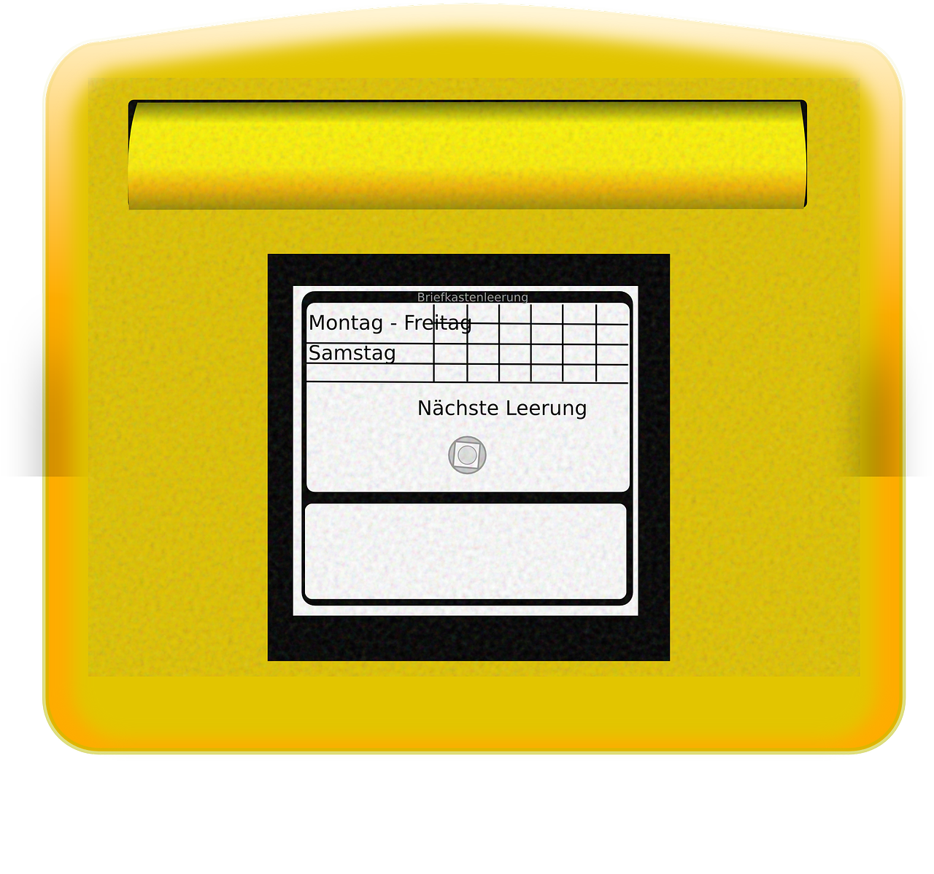
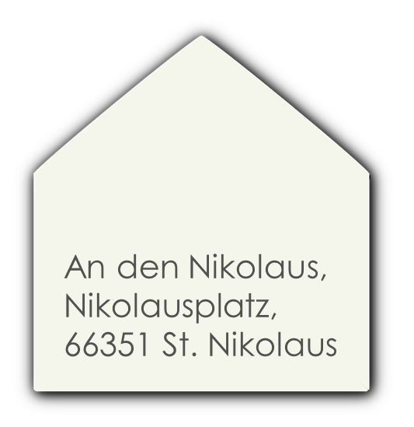
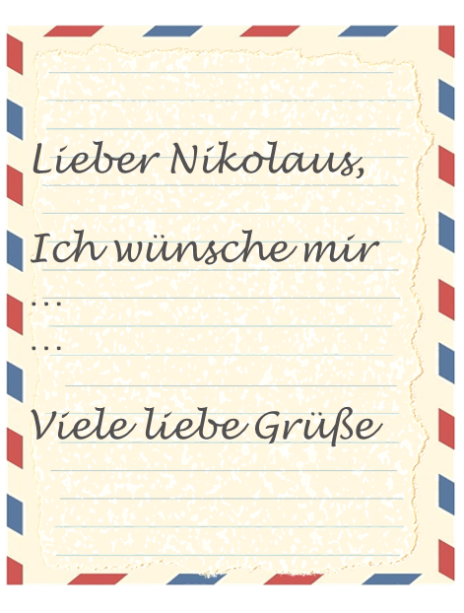
Weihnachtstraditionen
Wie sagt man das auf Englisch?
lesen
Deutschland has several Christmas post offices that Kinder (and adults) send their Weihnachtswunschlisten to.
Around 650, 000 Briefe are received every year.
The post offices are in Städte and villages with Namen such as:
St. Nikolaus, Nikolausdorf, Engelskirchen, Himmelstadt and Himmselsberg.
Everyone bekommt eine Antwort. Die Antworten sind auf Deutsch, auf Englisch and also in many other languages.
das Dorf – village | die Stadt – town | der Himmel – heaven, sky | der Berg - mountain
Notes:
Timing: 25 minutes (3 slides)
Aim: to share some information about a Christmas tradition in Germany; to practise a mixture of low stakes inferencing and some comprehension of previously taught words and cognates.
Procedure:
Give students 2 minutes to read the text with a partner and ask them to come up with plausible meanings in English for each of the words in bold. Reassure them that they haven’t met all of these German words before but that they may be able to infer the meaning from the surrounding English words (and tell them that there are some words they will know).
Then do a choral ‘simultaneous interpreting read aloud’ of the text. Respond to any hesitations by clarifying the meanings.
Ask students for English translations of the place names: St. Nikolaus (St. Nicholas – more about him on the next slide), Nikolasdorf (Nicholas village), Engelskirchen (Angel’s churches), Himmelstadt (heaven/sky town) and Himmelsberg (Heaven’s mountain).
Note: the important words are glossed on the slide. These words all appear on all of the new GCSE wordlists, and will be taught formally at KS3 but some students will pick up vocabulary incidentally, and the words are relevant to our lesson context.
Note:
1. Dictionaries would be useful for this task, since students may wish to use previously untaught vocabulary.
2. This activity could also be given for homework.

Slide 27
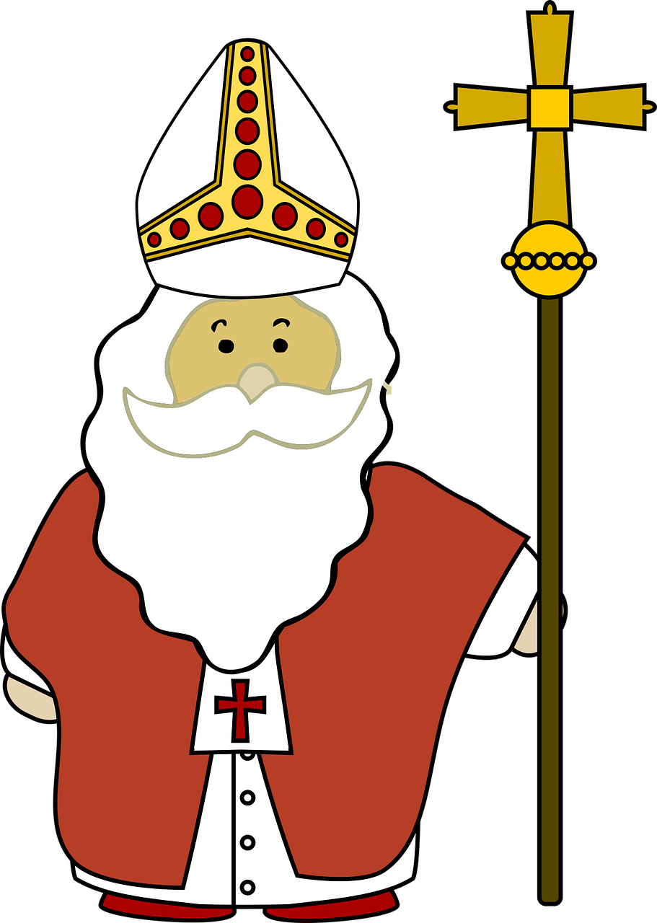
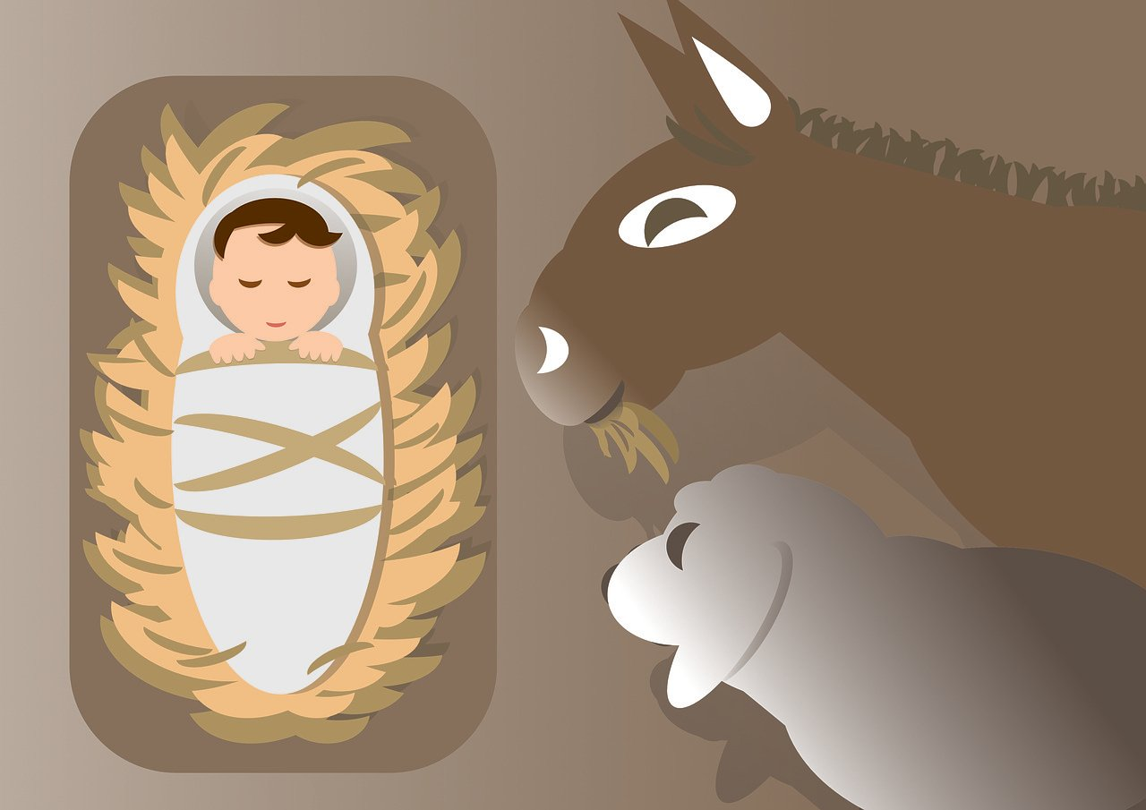
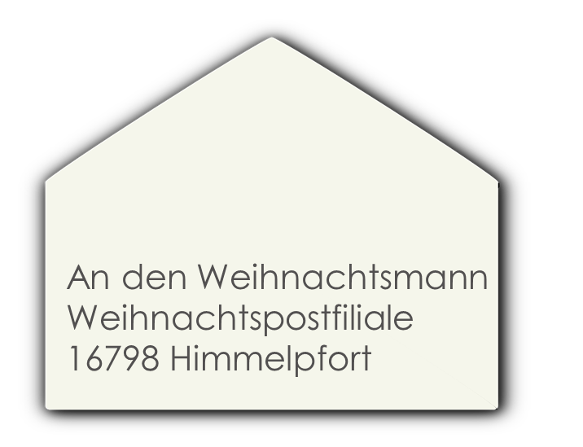
Weihnachtstraditionen
German children choose who to write their Christmas wish lists to. They have three options and a different address for each:
Lieber Nikolaus, …
Lieber Santa Claus, …
Liebes Christkind, …
St. Nikolaus was a bishop in the 4th century. He was known for his charity and giving gifts.
Lieber / Liebes - Dear
Notes:
[2/3] Aim: to find out more about Christmas traditions in Germany.
Procedure:
Present the information. Note: clearly, there is a lot more that could be said about St. Nikolaus and the tradition of celebrating by putting shoes/boots outside bedroom doors on the night of the 5th December when he will visit and fill them with goodies, (as long as children have been good). The timing of this coincides with the death of St.Nikolaus on 6th December 343 AD. Students may ask about the connection between Santa Claus and St. Nikolaus. Essentially the same person, the traditions diverged when Dutch emigrants to the USA took their tradition of celebrating St. Nikolaus, who they call Sinterklaas, which over time became Santa Claus. So St. Nikolaus is essentially the original version of Santa Claus.
Teachers may need to decide how long to spend on this depending on the make up of their classes. They will be students who don’t celebrate Christmas at all, those who do give and receive gifts but for whom the celebrations are 100% secular, those who are practising Christians, and perhaps those who still believe in Father Christmas. Teachers will want to navigate carefully and decide what to share, but St. Nikolaus is a very long-established and widespread tradition in Germany, Austria, Switzerland, and many other European countries so it feels appropriate to know about it.
Information retrieved from Wikipedia:
Adresse: An den Nikolaus, Nikolausplatz, 66351 St. Nikolaus
An den Weihnachtsmann Weihnachtspostfiliale 16798 Himmelpfort
An das Christkind 51777 Engelskirchen
Also (Himmelstadt, Nikolausdorf, Himmelsberg, Himmelpforten)

Slide 28
Ich wünsche mir…
Mia schreibt einen Weihnachtsbrief auf Englisch.
schreiben
Dear… Lieber (m) Liebe (f) Liebes (nt)
Help her translate it into German or write your own letter in German, if you prefer. If you write your own, include:
a greeting
an opinion about Christmas
where you are (at home, different city etc..)
at least one activity that you are doing
at least one present you are wishing for
Dear Santa Claus,
How are you? I’m very well. I’m not in school – hurrah! Christmas is great. I’m playing with Wolf, I’m talking with friends and I’m listening to music.
I’m wishing for a dog! Please! I love dogs!
Best wishes,
Remember! The masculine word for ‘a’ (ein) changes to einen after most verbs.
Best wishes is Viele liebe Grüße in German. It is often abbreviated to VLG in messages.
Use a dictionary to add in words for things on your wish list!
Mia xx
to love, loving - lieben | Hurrah! – Hurra!
Notes:
Aim: to use previously taught language in a new context.
Procedure:
Students respond to the prompts, writing a letter to the wise men about wanting and giving presents.
Note:
1. For those writing their own letter, dictionaries would be useful, since students may wish to use previously untaught vocabulary.
2. It is worth reminding students that in German there is only one present tense – I listen and I’m listening are both ‘ich höre’.
Suggested translation:
Lieber Nikolaus, Wie geht’s dir? Es geht mir sehr gut. Ich bin nicht in der Schule – Hurra!
Weihnachten ist super! Ich spiele mit Wolfgang, ich rede mit Freunden und ich höre Musik. Ich wünsche mir einen Hund, bitte! Ich liebe Hunde! Viele liebe Grüße

Slide 29
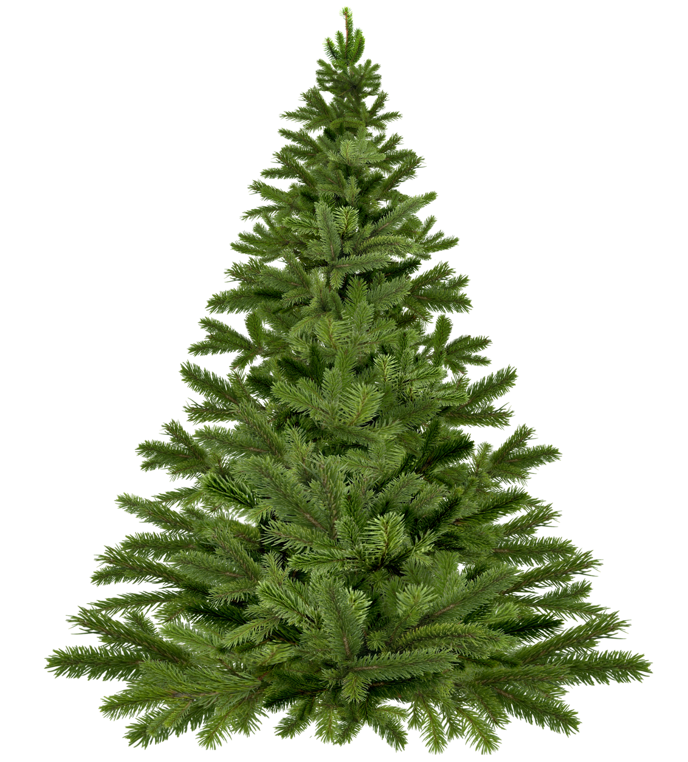
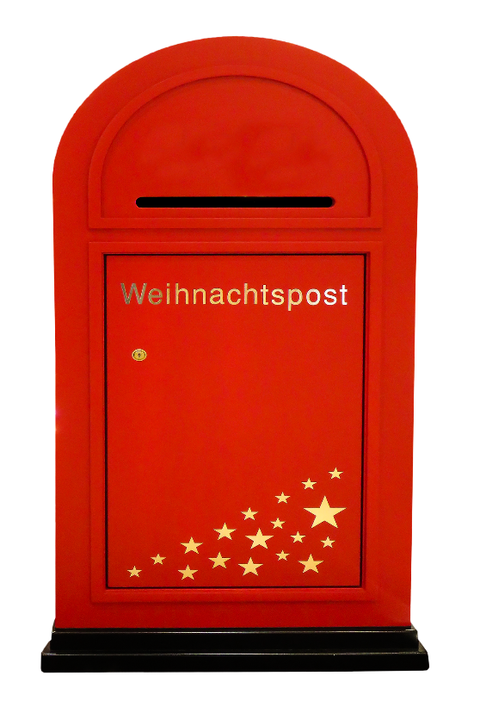
Vokabeln
A
B
A
B
C
C
i
h
3
c
3
D
3
E
F
D
E
F
G
H
I
J
G
J
w
ü
n
h
e
1
3
5
s
c
7
2
1
10
H
I
K
L
M
K
M
L
m
i
r
6
3
3
Notes:
Timing: 10 minutes
Aim: To revisit vocabulary that is not included in the lesson otherwise (includes some items from week 6).
Procedure: 1. Ask students to write down A to M in their notebooks.
2. Click on a bauble to hear the word twice. Repeat if necessary.
3. Students write down the German words they hear.
4. The number on the bauble that appears next to the tree upon subsequent clicks will tell you which letter you need from the word.
5. When all the baubles have appeared, the next sequence of clicks reveals the letters. All the letters together spell ‘ich wünsche mir’, which introduces the theme for the lesson, which we’ll come back to after the phonics introduction.
Transcript/[answers]:
zeigen [→ ich (3)]
nicht wahr [→ ich (3)]
zuhören [→ ich (3)]
wiederholen [→ wünsche (1)]
früh [→ wünsche (3)]
haben [→ wünsche (5)]
hat [→ wünsche (1)]
ich weiß nicht [→ wünsche (10)]
das Wasser [→ wünsche (7)]
wer? [→ wünsche (2)]
manchmal [→ mir (6)]
kein [→ mir (3)]
freiwillig [→ mir (3)]

Slide 30
Frohe Weihnachten!
sprechen
Wir wünschen dir frohe Weihnacht,
wir wünschen dir frohe Weihnacht,
wir wünschen dir frohe Weihnacht
und ein glücklich’ Neujahr!
Notes:
OPTIONAL
Timing: 4 minutes
Aim: to provide a festive end to the final lesson of the term; to appreciate that there are German and English Christmas carol (and Church music in general) traditions are very close, and many of the carols we sing also have German language versions (which in some cases pre-date the English ones – e.g., Silent Night).
Procedure: 1. Students read out loud line by line.
Note: Neu is a new sound and needs to be modelled.
2. Alternatively or additionally, sing to the tune of ‘We wish you a merry Christmas’. Note: versions of the carol can be found on YouTube. Singing along in time to a song is a useful way to speed up spoken production.

Slide 31
Hausaufgaben
Vocabulary Learning Homework (Term 2.1, Week 1)
Audio file
Student worksheet
In addition, revisit: Term 1.2 Week 5 | Term 1.1 Week 6
Notes:
Timing: 2 minutes Use this slide to set the homework.
Use this slide to set the homework.
For Y7, the typical homework will be to pre-learn vocabulary for the next lesson. There is an audio file to accompany the student worksheet.
Notes:
i) Teachers may, in addition, want to recommend use of a particular online app for the pre-learning of each week’s words. ii) Quizlet now requires parental involvement / registration / permissions for users below the age of 13, so it is perhaps most suitable for Y9 – 11 students. iii) Language Nut hosts LDP vocabulary lists and these are free for schools to use, though there is a registration process. One benefit is that all of the student tracking data that Language Nut offers are also available to schools that use the LDP lists for practice. Perhaps this makes it a good option for Y7/8.
iv) There are other free apps, and new ones are always appearing. Teachers have told us that they are currently using: Flippity, Wordwall (where using previously-created activities is free).
v) Gaming Grammar has been acquired by Language Nut. Its original content should still be available to teachers and much of it is appropriate for Y7 learners. From this lesson, for example, learners could practise Article agreement

