Slide 1
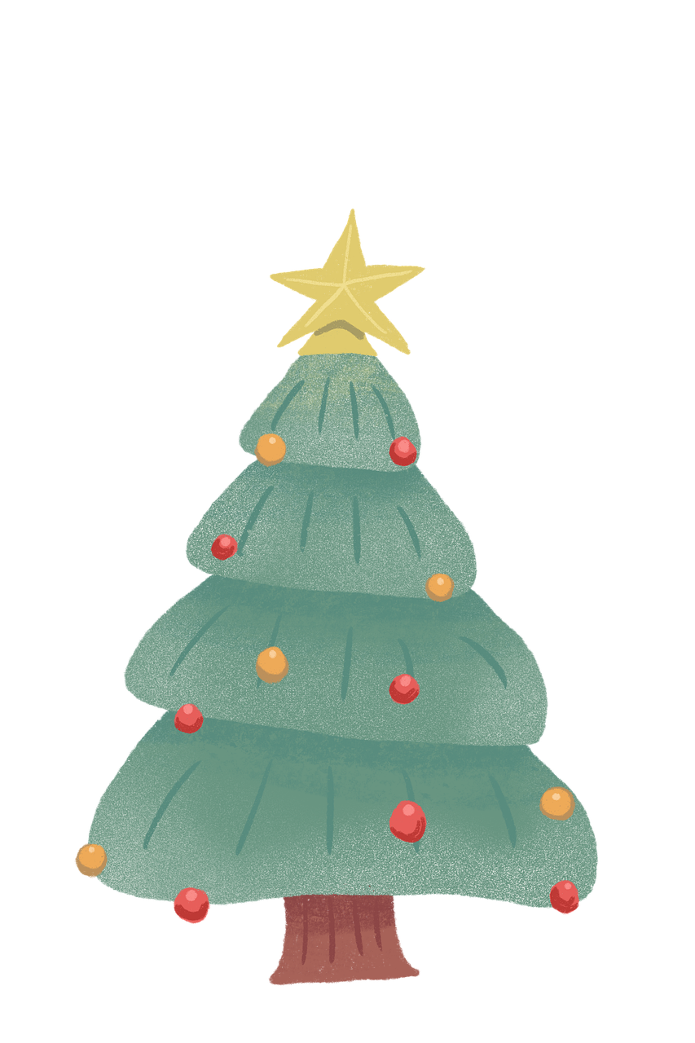
Weihnachten [1]
Number: one or many? Plural Rule 1: add -e or umlaut + -e Plural Rule 2: -el/-en/-er no change Plural article ‘die’ SSC [ü]
Y7 German
Term 1.2 – Week 6 - Lesson 25 Inge Alferink/ Rachel Hawkes
Artwork: Steve Clarke
Date updated: 12/08/2023
Notes:
Artwork by Steve Clarke. All additional pictures selected are available under a Creative Commons license; no attribution required.
Note: All words listed below for this week’s learning (new and revisited) appear on all three Awarding Organisations’ word lists, with the following exception:
i) Edexcel list does not have kaum.
Note: Some schools may want to have end of term assessments. It would be fine for schools to omit either this week (Week 6) or next week (Week 7) or both weeks, in favour of assessments. The grammar covered in these two weeks (plural rules 1, 2 and 3) are revisited multiple times over the course of KS3. The only thing teachers will want to ensure is that students learn the new vocabulary and revisit the assigned vocabulary from both weeks, as these words will recur from this week onwards and it will be assumed that students have been taught them.
There are vocabulary practice tasks within these lessons that could be used at some point over these two weeks or the words set as learning ahead of Term 2.
Learning outcomes (lesson 1):
Introduction of SSC [ü]
Introduction of plurals (der /das) → Rule 1 - umlaut + e, Rule 2 -el/-en/-er NO CHANGE, plural article = 'die’
Word frequency (1 is the most frequent word in German):
7.1.2.6 (introduce) wünschen [630] Arzt [622] Platz1 [326] Spiel [328] Stück [511] Zug [675] grün [682] auch [18] es gibt [n/a] wie viele? [n/a]
7.1.2.3 (revisit) gehen [66] hören [146] tanzen [1497] kaum [272] manchmal [382] nie [186] oft [223] sehr [81] einmal die Woche [n/a] jeden Tag [n/a]
7.1.1.4 (revisit) wissen [78] bist [4] du [54] Farbe [1079] Nummer [806] Ort [341] Tier [614] aber [31] kein [46] ich weiß nicht [n/a] wie sagt man [n/a] wie schreibt man [n/a] das ist (nicht) klar
Source: Jones, R.L. & Tschirner, E. (2019). A frequency dictionary of German: core vocabulary for learners. Routledge

Slide 2
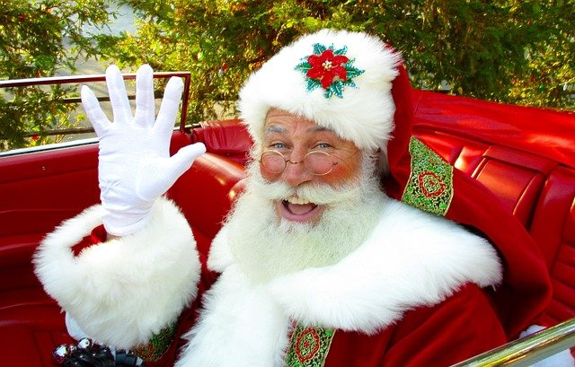
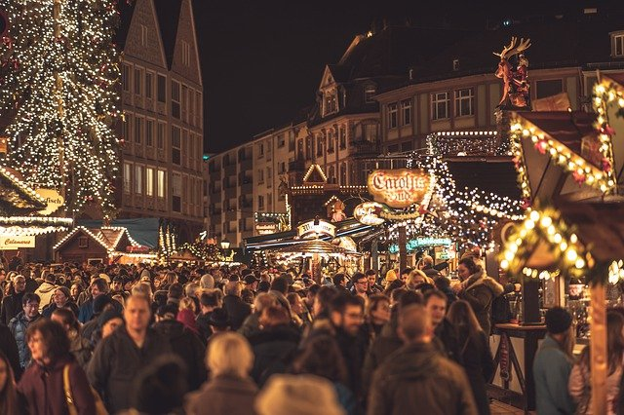
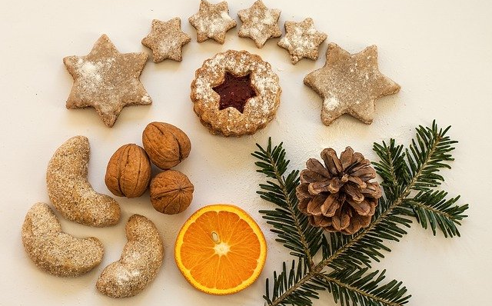
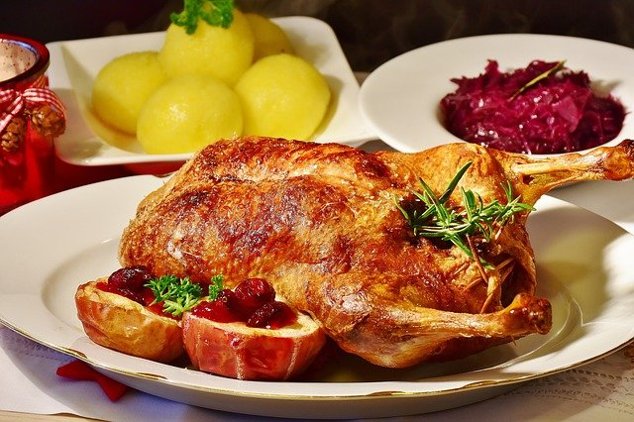
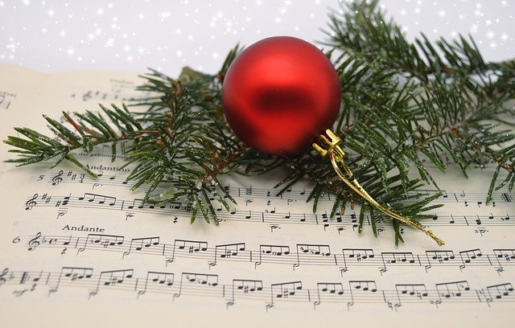
Vokabeln
Two words in English become one word in German.
Weihnachten means Christmas and the prefix Weihnachts- can be added to almost any noun to make a new word.
Wie heißt … auf Englisch?
Weihnachtsmann
Weihnachtsmarkt
Weihnachtsplätzchen
Biscuits that people traditionally make and eat in Germany from November through to advent and Christmas.
Weihnachtstisch
Weihnachtslied
Notes:
Timing: 5 minutes
Aim: to set the scene for the lesson, and to add to students’ knowledge of word formation (derivational morphology) in German with Weihnachts- prefix to create compounds
Procedure: 1. Click to present the new information 2. Elicit English meanings for German compounds.

Slide 3
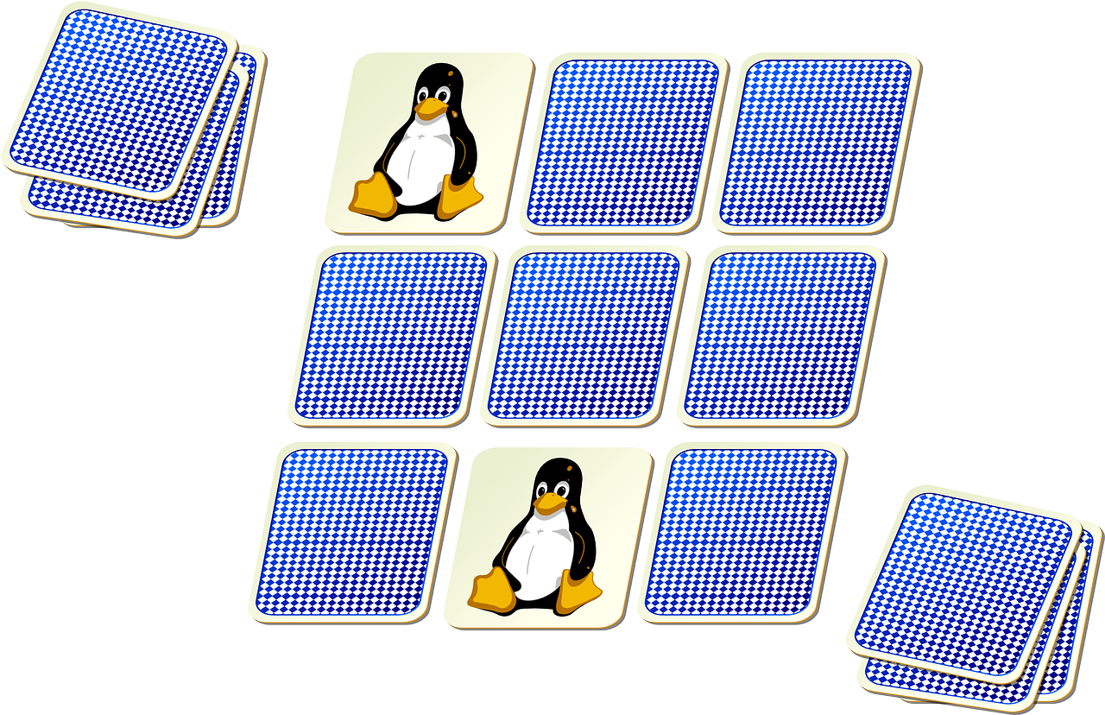
Vokabeln
lesen / sprechen
V
der __ater
w
___issen
i
n__e
i
e
das T__er
s__hr _{[very]}
l
das Spie__
e
tanz__n
e
die Numm__r
W
i
e
v
i
e
l
e
?
Notes:
Timing: 3 minutes (keep this activity brief and pacy) Aim: to share the context for the lesson whilst revisiting previously-met vocabulary.
Procedure: 1. Students work out the missing letters from German (going top to bottom on the left, then on the right).
2. Give them one minute to think-pair-share the words with a partner and work out the phrase at the bottom if they can. Note: These letters spell out ‘Wie viele?’ at the bottom of the slide – this is the context for this lesson.
3. When eliciting each word answer, elicit also the English meaning, to ensure that students remember it.
4. Answers appear on successive mouse clicks.

Slide 4
ü
Tür
Notes:
Timing: 1 minute
Aim: To introduce/consolidate SSC [ü]
Procedure: 1. Present the letter(s) and say the [ü] sound first, on its own. Students repeat it with you. 2. Bring up the word ” Tür” on its own, say it, students repeat it, so that they have the opportunity to focus all of their attention on the connection between the written word and its sound.
3. A possible gesture for this would be to hold both hands touching in front of your body, palms facing inward, thumbs to the ceiling. Then, with the right hand, mime a door opening by drawing it away from the left so that it finishes at a right angle, like a fully open door.
4. Roll back the animations and work through 1-3 again, but this time, dropping your voice completely to listen carefully to the students saying the [ü] sound, pronouncing ”Tür” and, if using, doing the gesture. Word frequency (1 is the most frequent word in German): Tür [400] Source: Jones, R.L. & Tschirner, E. (2006). A frequency dictionary of German: core vocabulary for learners. Routledge

Slide 5
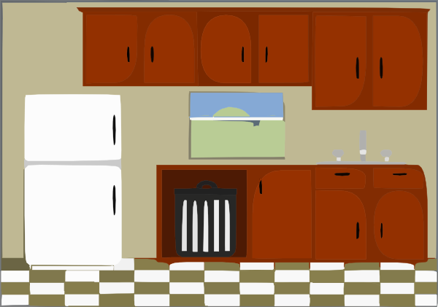
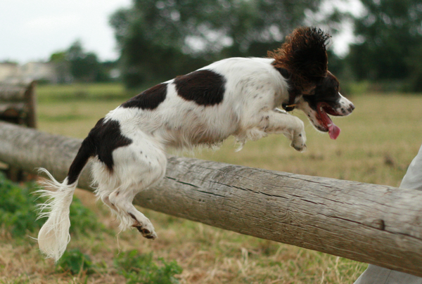
ü
fühlen
grün
Tür
Küche
über
früh
05:30!!!
Notes:
Timing: 2 minutes
Aim: To introduce/consolidate [] SSC [ü]
Procedure:
Introduce and elicit the pronunciation of the individual SSC [ü] and then the source word again ‘Tür’ (with gesture, if using).
Then present and elicit the pronunciation of the five cluster words.
The cluster words have been chosen for their high-frequency, from a range of word classes, with the SSC (where possible) positioned within a variety of syllables within the words (e.g. initial, 2nd, final etc.). Additionally, we have tried to use words that build cumulatively on previously taught SSCs (see the Phonics Teaching Sequence document) and do not include new SSCs. Where new SSCs are used, they are often consonants which have a similar symbol-sound correspondence in English.
Word frequency (1 is the most frequent word in German): Tür [400]; fühlen [419] grün [556]; Küche [960]; früh [322]; über [48]. Source: Jones, R.L. & Tschirner, E. (2006). A frequency dictionary of German: core vocabulary for learners. Routledge

Slide 6
ü
fühlen
grün
Tür
Küche
über
früh
Notes:
With sound and no pictures to focus all attention on the sound-symbol correspondence.

Slide 7
ü
fühlen
grün
Tür
Küche
über
früh
Notes:
Without sound to elicit pronunciation (without first hearing the teacher).
Teacher to elicit pronunciation by asking “Wie sagt man…”

Slide 8
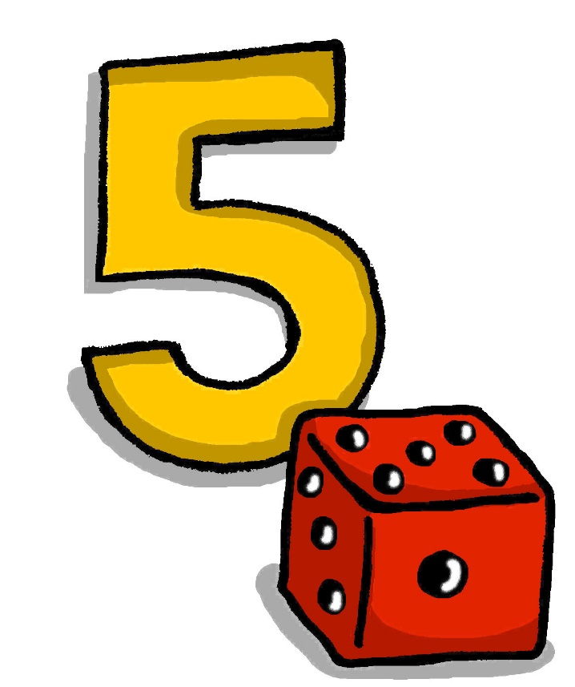
ü
fünf
Notes:
Timing: 1 minute
Aim: To introduce/consolidate SSC [ü]
Procedure: 1. Present the letter(s) and say the [ü] sound first, on its own. Students repeat it with you. 2. Bring up the word “fünf” on its own, say it, students repeat it, so that they have the opportunity to focus all of their attention on the connection between the written word and its sound.
3. A possible gesture for this would be to hold up your right hand, five digits spread apart.
4. Roll back the animations and work through 1-3 again, but this time, dropping your voice completely to listen carefully to the students saying the [ü] sound, pronouncing “fünf” and, if using, doing the gesture. Word frequency (1 is the most frequent word in German): fünf [272]
Source: Jones, R.L. & Tschirner, E. (2006). A frequency dictionary of German: core vocabulary for learners. Routledge

Slide 9
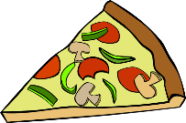
ü
Rücken
wünschen
[to wish]
fünf
Stück
Glück
[luck/happiness]
müssen
[to have to/must]
Notes:
Timing: 2 minutes
Aim: To introduce/consolidate SSC [ü]
Procedure:
Introduce and elicit the pronunciation of the individual SSC [ü] and then the source word again ‘fünf’ (with gesture, if using).
Then present and elicit the pronunciation of the five cluster words.
The cluster words have been chosen for their high-frequency, from a range of word classes, with the SSC (where possible) positioned within a variety of syllables within the words (e.g. initial, 2nd, final etc.). Additionally, we have tried to use words that build cumulatively on previously taught SSCs (see the Phonics Teaching Sequence document) and do not include new SSCs. Where new SSCs are used, they are often consonants which have a similar symbol-sound correspondence in English.
Word frequency (1 is the most frequent word in German): fünf [272]; Rücken [914] wünschen [684]; Glück [763]; müssen [45]; Stück [417].
Source: Jones, R.L. & Tschirner, E. (2006). A frequency dictionary of German: core vocabulary for learners. Routledge

Slide 10
ü
Rücken
wünschen
fünf
Stück
Glück
müssen
Notes:
With sound and no pictures to focus all attention on the sound-symbol correspondence.

Slide 11
ü
Rücken
wünschen
fünf
Stück
Glück
müssen
Notes:
Without sound to elicit pronunciation (without first hearing the teacher).
Teacher to elicit pronunciation by asking “Wie sagt man…”

Slide 12
U oder Ü?
Hör zu. Wie schreibt man das? Ist das [u] oder [ü]?
hören
 | U | Ü
1
2
3
4
5
6
1
der Zug
2
die Nummer
3
die Tür
4
grün
5
putzen
6
wünschen
Notes:
Timing: 6 minutes Aim: to practise distinguishing between [u] and [ü].
Procedure: 1. Click on the numbers to play the audio.
2. Students tick the appropriate column for each word.
3. Click to reveal the correct answers.
Transcript:
1. der Zug
2. die Nummer
3. die Tür
4. grün
5. putzen
6. wünschen

Slide 13
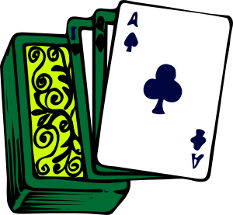
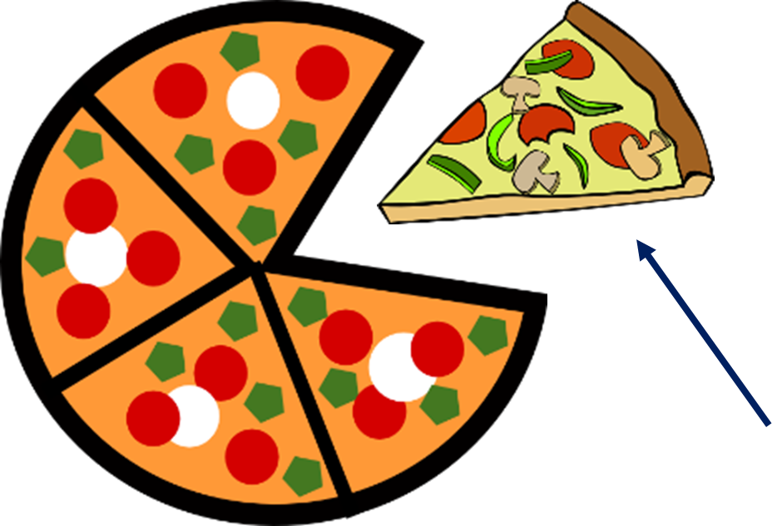
Vokabeln
Wie sagt man das auf Deutsch?
lesen / sprechen
(the) game
[st] sounds like ‘sht’ and [sp] like ‘’shp’.
(the) piece
(the) place, room
there is, there are
also
(the) doctor
how many?
(the) train
green
to wish, wishing
wünschen
wie viele?
wünschen
es gibt
wie viele?
es gibt
der Zug
grün
auch
der Zug
der Arzt
grün
auch
der Arzt
der Platz
das Stück
der Platz
das Spiel
das Stück
das Spiel
Notes:
Timing: 3 minutes Aim: to practise read aloud of this week‘s new vocabulary and association of the written word with its English meaning. Note: students have been taught almost all the vowel SSC represented here, plus [w] and [z] and [ch]. They will need support with [sp] and [st] and probably also [au]
Procedure:
1. Click to bring up the first English prompt.
2. Elicit the German word from students. 3. Click to confirm.
4. Continue with items 2-10.

Slide 14
More than one – rule 1
Grammatik
In German there are several ways to make plural nouns.
Most masculine and neuter words either:
add -e to the end
Note that the word for ‘the’ is ‘die’ for ALL plural nouns!
or:
der Tisch
die Tische
2. add -e to the end and an umlaut on the vowel:
>90% masculine and >75% neuter plurals work like this.
der Zug
die Züge
Notes:
Timing: 3 minutes Aim: to explain plurals rule 1: most masculine words go to -e or +umlaut –e.
Procedure: 1. Click to animate the explanation.
2. Ensure students’ understanding at each stage.
3. Emphasize this covers more than 90% of the masculine plurals and more than 75% neuter plurals.

Slide 15
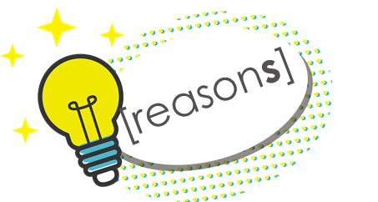
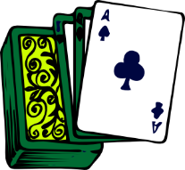
Wie viele gibt es?
hören
Hör zu. Wie viele? Schreib einen/ein oder viele.
1
4
2
5
[reason]
3
6
Notes:
Timing: 7 minutes Aim: to practise distinguishing between the plural and singular forms of nouns (listening).
Procedure: 1. Click to bring up the first prompts for item 1.
2. Click on the numbered button to play the sentence (the articles/’viele’ have been bleeped out).
3. By listening to the form of the noun alone, students determine whether a singular article, or the determiner ‘viele’ is needed before it.
4. Then click to bring up the answer. Remind students that if the noun is plural, they will hear an ‘e’ pronounced at the end, and they may also hear a vowel change in the word.
5. Continue with items 2-6. Then click to check answers for 2-6.
Transcript:
1. es gibt [viele] Köpfe.
2. es gibt [einen] Arzt.
3. es gibt [ein] Spiel.
4. es gibt [viele] Plätze.
5. es gibt [viele] Gründe.
6. es gibt [ein] Stück.

Slide 16
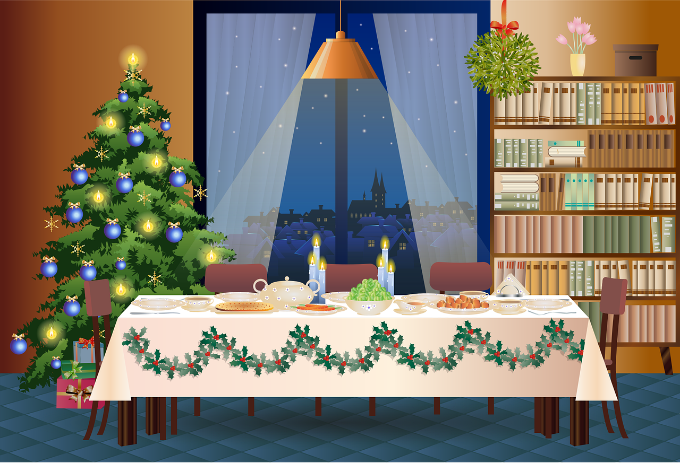
More than one – rule 2
Grammatik
Words ending in -EL or -EN or -ER are often the same in the plural:
Remember the plural word for ‘the’ is ‘die’ for ALL words!
der Engel
das Zimmer
das Mädchen
die Engel
die Zimmer
die Mädchen
Notes:
Timing: 2 minutes Aim: to explain plurals rule 2: words that end in –EL or –EN or -ER typically stay the same.
Procedure: 1. Click to animate the explanation.
2. Ensure students’ understanding at each stage.
3. Remind students that the plural word for ‘the’ is ‘die’, regardless of the singular noun’s gender. They are likely to find this strange (because it really is!)

Slide 17
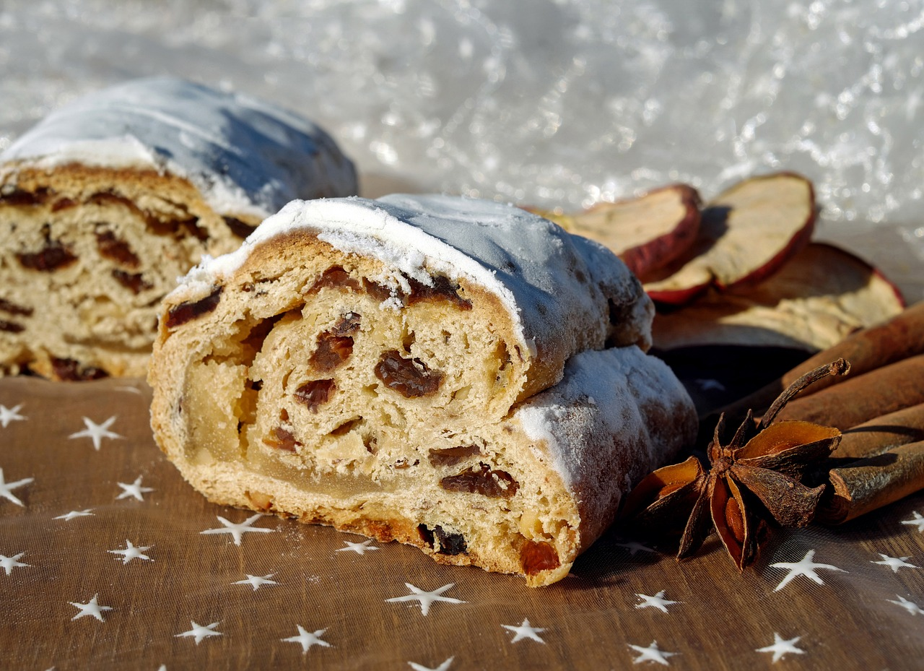
Wie viele gibt es?
Ist es der (Singular) oder die (Plural)?
lesen
Was ist Stollen?
Stollen is a traditional German Christmas fruit bread of nuts, spices, and dried or candied fruit, coated with powdered sugar or icing sugar and often containing marzipan. It is eaten for breakfast around Christmas time, either cold, warmed or toasted, with or without butter, jam or honey.
der | die Stollen
Notes:
Timing: 8 minutes (two slides)
Aim: to encounter some Christmas vocabulary and hear a little about Christmas traditions; differentiate singular and plural nouns in German, paying attention to the definite article, because the noun forms are identical.
Procedure: 1. Tell students that quite a lot of German words associated with Christmas end in –el, -en, -er, and that Stollen is one example they may (or may not) have heard of.
2. Ask students to decide which article is correct, according to the picture which shows two Stollen.
3. Click to reveal the answer.
4. Take the opportunity to ask students if they have tried or would like to try it. (Healthy eating, Health & Safety rules in your schools permitting, it may be a useful lesson in which to have some Stollen, Lebkuchen or Plätzchen available for students to try. Of course, it does involve knowing the ingredients and the food allergies of your class and may therefore not be something you are comfortable doing).

Slide 18
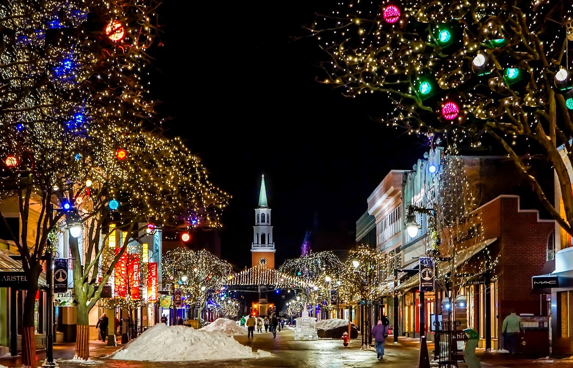
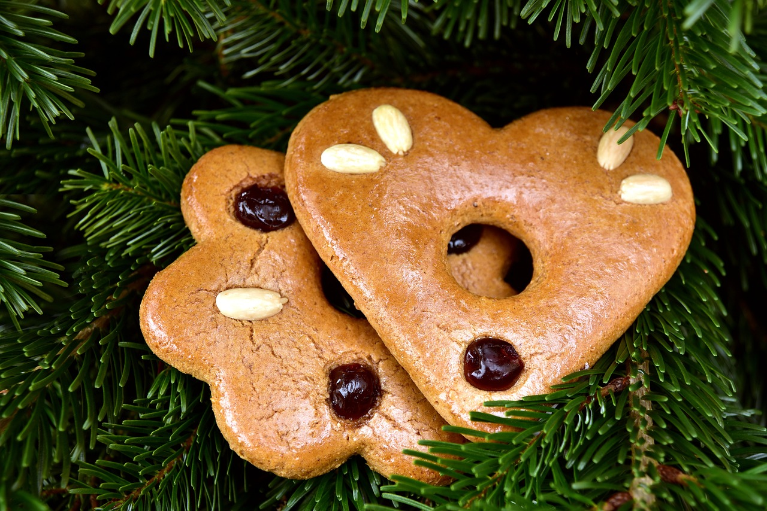
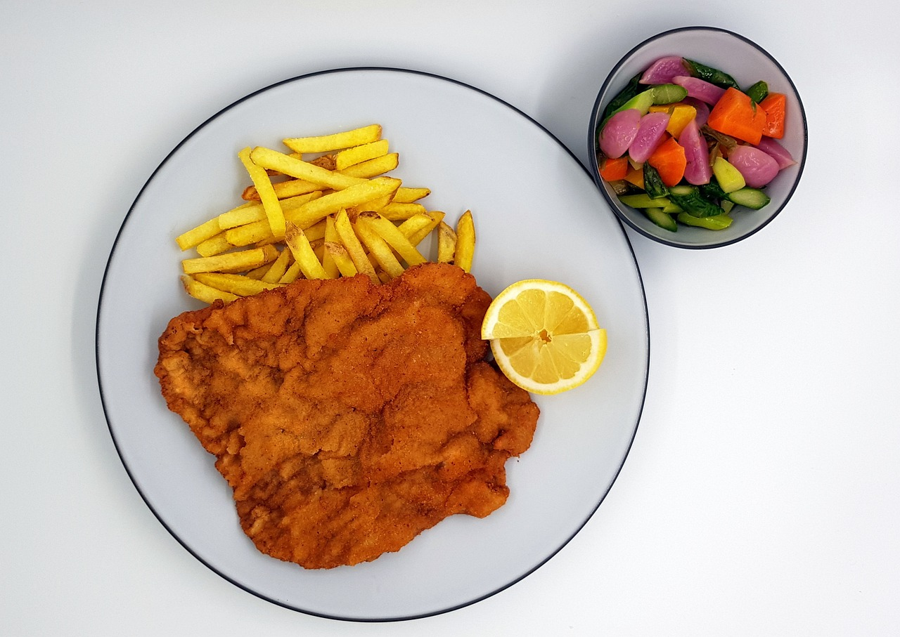
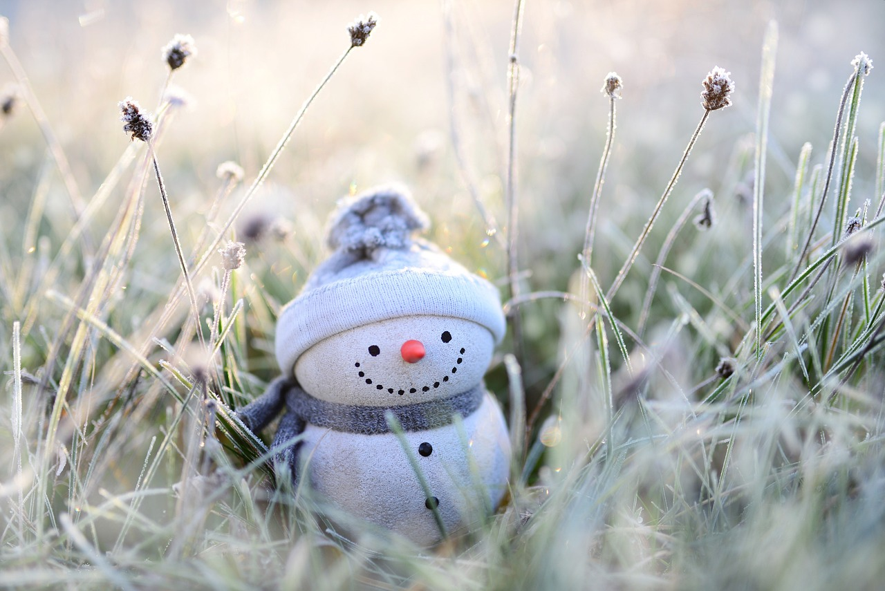
Wie viele gibt es?
Ist es der/das (Singular) oder die (Plural)?
lesen
1
4
das | die Plätzchen
das | die Weihnachten
the Christmas cookies
the Christmases
2
der | die Lebkuchen
5
das | die Schnitzel
the gingerbread cookie
the schnitzel
3
das | die Dezember
6
der/das | die Silvester
the Decembers
the New Year’s Eves
Notes:
Procedure: 1. With these additional Christmas vocabulary items, ask students to decide which article is correct, according to the English meanings of each noun provided.
2. Click to correct.
3. Take the opportunity to ask students if they have any experience of Germany at Christmas time, and/or Lebkuchen or Schnitzel etc..
Note: Weihnachten, Heiliger Abend, and Silvester are on new AQA and Eduqas GCSE wordlists, but only Silvester appears on the Edexcel list. In addition, Eduqas has included Lebkuchen and Schnitzel.

Slide 19
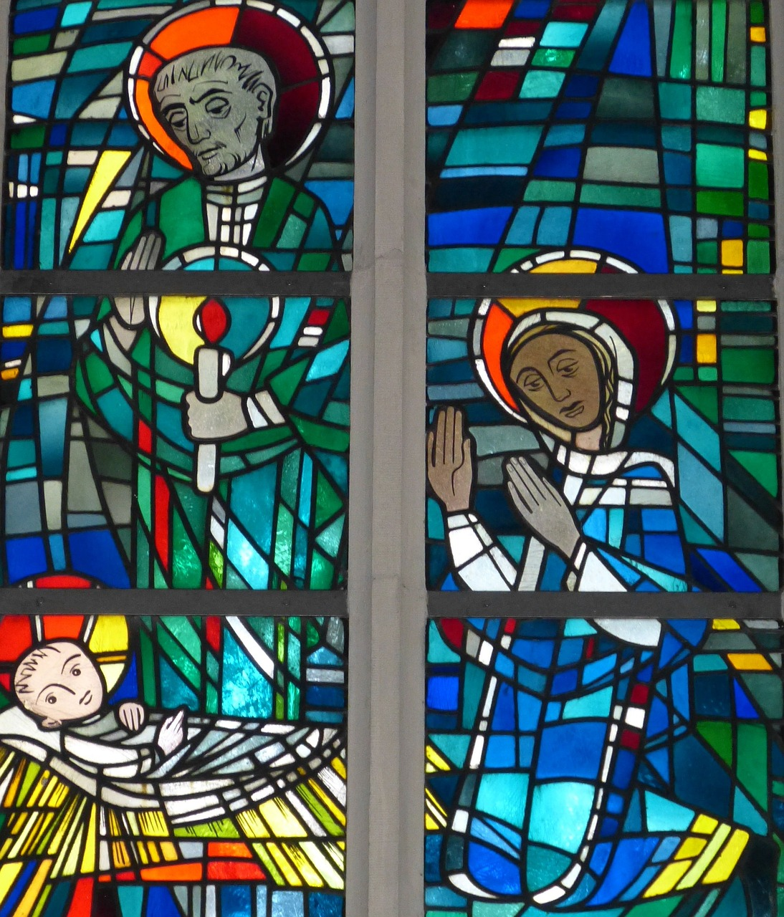
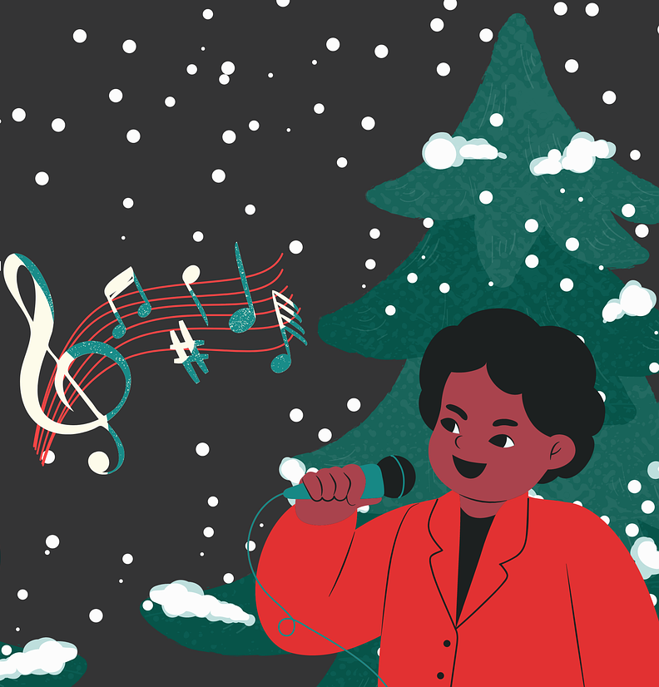
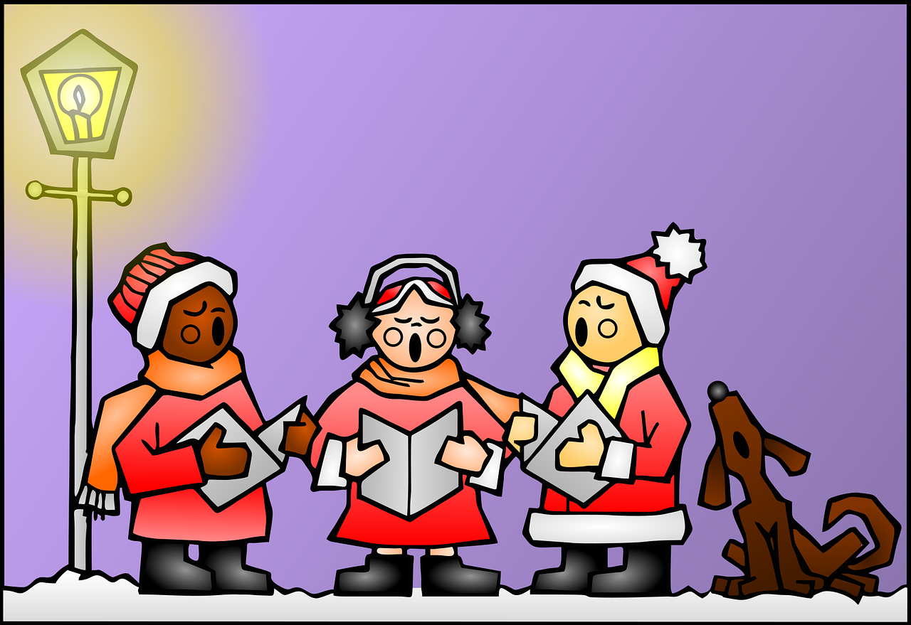
Wie viele gibt es?
Hör zu. Wie viele? Schreib S (Singular) and P (Plural).
hören
1
4
2
5
3
6
Notes:
OPTIONAL (Omit if short of time) Timing: 5 minutes Aim: to practise differentiating plurals by reference to the definite article alone for nouns which do not themselves change in the plural.
Procedure: 1. Teachers may want first to reiterate the fact that with these nouns that don’t change, the change in article is the only clue to whether the noun is singular or plural.
2. Click to bring up the questions one by one.
3. Click on the audio buttons to hear the examples.
4. Students note S for singular and P for plural.
5. When all questions are complete, click to bring up the answers one by one.
Transcript:
1. die Fenster
2. die Winter
3. der Sänger
4. die Mädchen
5. die Zimmer
6. der Engel
All words are on all new GCSE lists for all three Aos, except for Engel, which doesn’t appear, which is not on the Y7 vocabulary list to be learnt but which is included here for the plural –el pattern.

Slide 20
Schmückt den Saal mit grünen Zweigen! Fa-la-la-la-la-la-la-la-la!
sprechen
Tretet an zum bunten Reigen!
Fa-la-la-la-la-la-la-la-la!
Auf und nieder, immer wieder!
Fa-la-la-la-la-la-la-la-la!
Singt die alten Weihnachtslieder!
Fa-la-la-la-la-la-la-la-la!
Notes:
Optional (but include if you like singing). Timing: 5 minutes Aim: Practising phonics [ü] in a real text.
Note: lesson two includes a more detailed Christmas song covering the same SSCs. Depending on available time and how the students are getting on with these particular SSCs this activity could be left out.
Procedure: 1. Speak the first two lines out loud, drawing attention to the [ü] introduced earlier in the lesson.
2. Students repeat out loud. Note: In case students are curious about the meaning of the words to this song, the English translations are below:
Schmückt den Saal mit grünen Zweigen! (Literally - Decorate the hall/room with green boughs/branches. In the English version of the carol – Deck the halls with boughs of holly) Fa-la-la-la-la-la-la-la-la!
Tretet an zum bunten Reigen! (Step up to the varied melodies - i.e. an invitation to dance)
Fa-la-la-la-la-la-la-la-la!
Auf und nieder, immer wieder! (Up and down, over and over again)
Fa-la-la-la-la-la-la-la-la!
Singt die alten Weihnachtslieder! (Sing the old Christmas carols)
Fa-la-la-la-la-la-la-la-la!

Slide 21
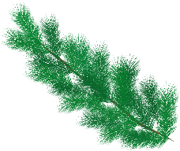
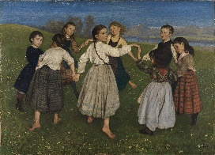
Schmückt den Saal mit grünen Zweigen! Fa-la-la-la-la-la-la-la-la!
sprechen
schmücken – to decorate der Saal – the hall
Tretet an zum bunten Reigen!
Fa-la-la-la-la-la-la-la-la!
Auf und nieder, immer wieder!
Fa-la-la-la-la-la-la-la-la!
Singt die alten Weihnachtslieder!
Fa-la-la-la-la-la-la-la-la!
der Reigen
Was ist das?
Was sind Weihnachtslieder?
Notes:
Timing: 3 minutes Aim: Practising phonics [ei] and [ie] in an authentic text.
Note: lesson two includes a more detailed Christmas song covering the same SSCs. Depending on available time and how the students are getting on with these particular SSCs this activity could be left out.
Procedure: 1. Highlight the 'ei’ / 'ie’ SSCs in the text lines by line.
2. Students repeat out loud. 3. Now sing the song together (Melody is Deck the Halls):
Schmückt den Saal mit grünen Zweigen! Fa-la-la-la-la-la-la-la-la!
Tretet an zum bunten Reigen!
Fa-la-la-la-la-la-la-la-la!
Auf und nieder, immer wieder!
Fa-la-la-la-la-la-la-la-la!
Singt die alten Weihnachtslieder!
Fa-la-la-la-la-la-la-la-la!
4. Provide further cultural and linguistic information about the song. i. Click once to provide the glosses for the first line and elicit the meaning of the first line of the song. Decorate the hall with green branches. Compare briefly with the English original: Deck the halls with boughs of holly. If students know this carol they may never have thought about the meaning of these quite archaic words! ii. Click again to bring up the picture of a Reigen (circle dance) and ask Was ist das? Tanzen is a previously taught word that we are revisiting this week, so if students automatically say ‘dance, or dancing’ then prompt them again to provide the German word. You might want to add that many western cultures (Germany and England, included) have traditional folk circle dances that originate from Greece. iii. Click for the 3rd call out and prompt students to tell you the meaning of Weihnachtslieder. They were introduced to the word Weihnachten, and several Weihnachts- compounds at the start of the lesson. They know Lied from 7.1.1.7. Although –er plurals are not a focus this week, it is likely that students will recognise the singular form and realise that it is plural, here. You can tell them that this is a different plural ending that they will learn later.
Picture attribution: Hans Thoma, Public domain, via Wikimedia Commons
Origin of the song Deck the Halls:
1866. Other “Nos Galan” lyrics were written by John Ceiriog Hughes (1832-1887), ca. 1873. Tune: Nos Galan (“New Year's Eve”) from John Thomas's Welsh Melodies with Welsh and English Poetry; this series by Thomas was a collaboration with John Talhaiarn Jones and Thomas Oliphant.

Slide 22
Weihnachten [2]
Number: one or many? Plural Rules 1 and 2 Plural article ‘die’ Songtext: O Tannenbaum SSC [ü]
Y7 German
Term 1.2 – Week 6 - Lesson 26 Inge Alferink/ Rachel Hawkes
Artwork: Steve Clarke
Date updated: 12/08/2023
O Tannenbaum
Notes:
Artwork by Steve Clarke. All additional pictures selected are available under a Creative Commons license; no attribution required.
Learning outcomes (lesson 2):
Consolidation of SSC [ü]
Consolidation of plurals (der /das) → Rule 1 - umlaut + e, Rule 2 -el/-en/-er NO CHANGE, plural article = 'die’
Authentic text: O Tannenbaum
Word frequency (1 is the most frequent word in German):
7.1.2.6 (introduce) wünschen [630] Arzt [622] Platz1 [326] Spiel [328] Stück [511] Zug [675] grün [682] auch [18] es gibt [n/a] wie viele? [n/a]
7.1.2.3 (revisit) gehen [66] hören [146] tanzen [1497] kaum [272] manchmal [382] nie [186] oft [223] sehr [81] einmal die Woche [n/a] jeden Tag [n/a]
7.1.1.4 (revisit) wissen [78] bist [4] du [54] Farbe [1079] Nummer [806] Ort [341] Tier [614] aber [31] kein [46] ich weiß nicht [n/a] wie sagt man [n/a] wie schreibt man [n/a]
das ist (nicht) klar
Source: Jones, R.L. & Tschirner, E. (2019). A frequency dictionary of German: core vocabulary for learners. Routledge

Slide 23
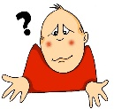
Vokabeln
Lies die Tipps. Wie schreibt man das?
lesen / schreiben
?
A. Nur montags
B. Blau, gelb, rot
C. Übersetze ‘never’
D. oder
E. Am Sonntag, Montag, Dienstag, etc.
F. Übersetze ‘hardly’
G. Übersetze ‘to wish’
H. Schreiben, sprechen, lesen, und …
I. Nicht selten
J. Wo?
K. Ehm?
E | I | N | M | A | L |  | D | I | E |  | W | O | C | H | E
 |  |  | D | I | E |  | F | A | R | B | E | N
 |  |  |  |  |  |  |  |  |  | N | I | E
 |  |  |  |  |  |  | D | A | S |  | H | A | U | S | T | I | E | R
 |  |  |  |  |  |  | J | E | D | E | N |  | T | A | G
 |  |  |  |  |  |  |  |  |  | K | A | U | M
 |  |  |  |  |  |  | W | Ü | N | S | C | H | E | N
 |  |  |  |  |  |  |  |  |  |  | H | Ö | R | E | N
 |  |  |  |  |  |  |  |  | O | F | T
 |  |  |  |  |  |  |  |  |  | D | E | R |  | O | R | T
W | I | E |  | S | A | G | T | - | M | A | N | ?
übersetzen – to translate
Notes:
Timing: 10 minutes Aim: To share the theme for the lesson (‘Weihnachten’), whilst revising previously-met vocabulary.
Note: A more complex version of this task, in which only the first letter of each word is given, can be found on the next slide.
Procedure: 1. Teacher asks question / gives clue in German as per A – L on slide. 2. Student(s) volunteer(s) the answer (e.g. einmal die Woche).
3. Teacher asks ‘wie schreibt man das?’ 4. Students in chorus (slowly and steadily) respond to spell out the answer: E-I-N-M-A-L D-I-E W-O-C-H-E) Note: If students are practising for the Spelling Bee, then they will have learnt the term ‘Abstand’ for indicating a space between words. They could be prompted to use that, here.
5. As students spell the word, teacher reveals each letter on a click.This will enable the teacher to pick up on any of the trickier letters, and do some remedial practice in the moment.

Slide 24
Vokabeln
lesen / schreiben
?
A. Nur montags
B. Blau, gelb, rot
C. Übersetze ‘never’
D. oder
E. Am Sonntag, Montag, Dienstag, etc.
F. Übersetze ‘hardly’
G. Übersetze ‘to wish’
H. Schreiben, sprechen, lesen, und …
I. Nicht selten
J. Wo?
K. Ehm?
E | I | N | M | A | L |  | D | I | E |  | W | O | C | H | E
 |  |  | D | I | E |  | F | A | R | B | E | N
 |  |  |  |  |  |  |  |  |  | N | I | E
 |  |  |  |  |  |  | D | A | S |  | H | A | U | S | T | I | E | R
 |  |  |  |  |  |  | J | E | D | E | N |  | T | A | G
 |  |  |  |  |  |  |  |  |  | K | A | U | M
 |  |  |  |  |  |  | W | Ü | N | S | C | H | E | N
 |  |  |  |  |  |  |  |  |  |  | H | Ö | R | E | N
 |  |  |  |  |  |  |  |  | O | F | T
 |  |  |  |  |  |  |  |  |  | D | E | R |  | O | R | T
W | I | E |  | S | A | G | T | - | M | A | N | ?
übersetzen – to translate
Notes:
MORE CHALLENGING VERSION
Timing: 10 minutes Aim: To share the theme for the lesson (‘Weihnachten’), whilst revising previously-met vocabulary.
Note: This version of this task only gives the first letter of each word. A less complex version, in which more letters of each word are given, can be found on the previous slide.
Procedure: 1. Teacher asks question / gives clue in German as per A – L on slide. 2. Student(s) volunteer(s) the answer (e.g. einmal die Woche).
3. Teacher asks ‘wie schreibt man das?’ 4. Students in chorus (slowly and steadily) respond to spell out the answer: E-I-N-M-A-L D-I-E W-O-C-H-E). Note: If students are practising for the Spelling Bee, then they will have learnt the term ‘Abstand’ for indicating a space between words. They could be prompted to use that here.
5. As students spell the word, the teacher reveals each letter on a click. This will enable the teacher to pick up on any of the trickier letters, and do some remedial practice in the moment.

Slide 25
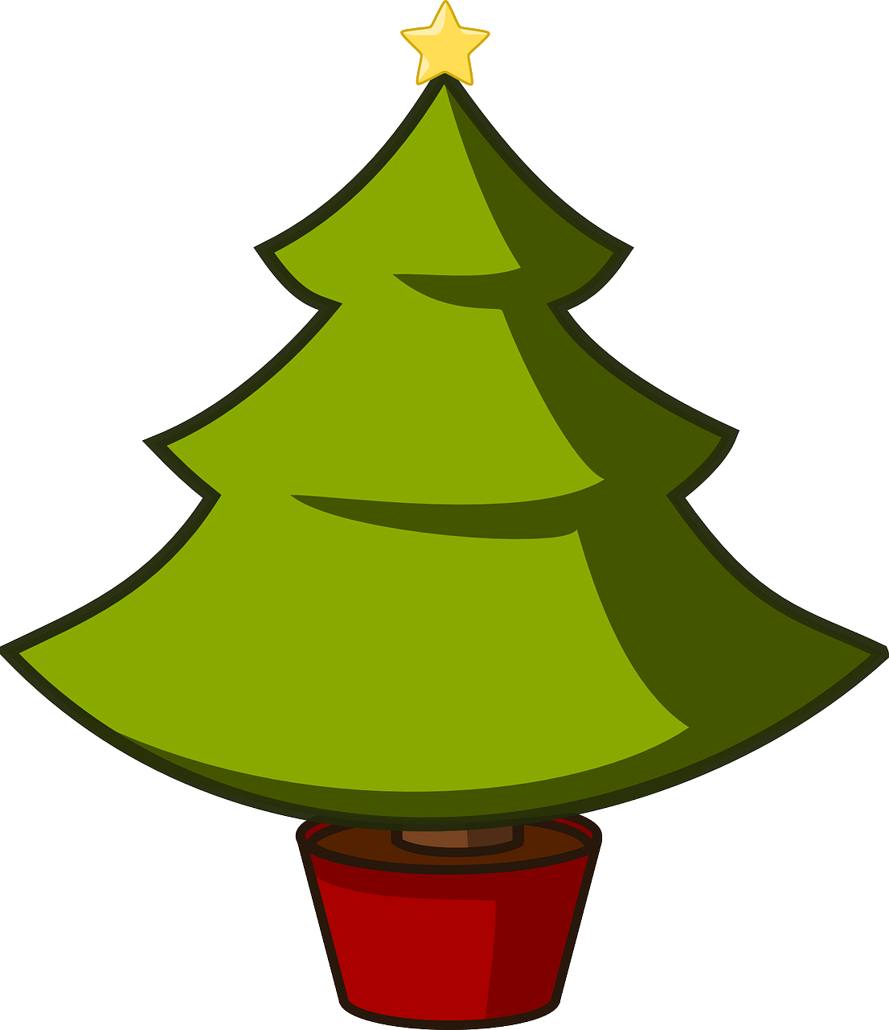
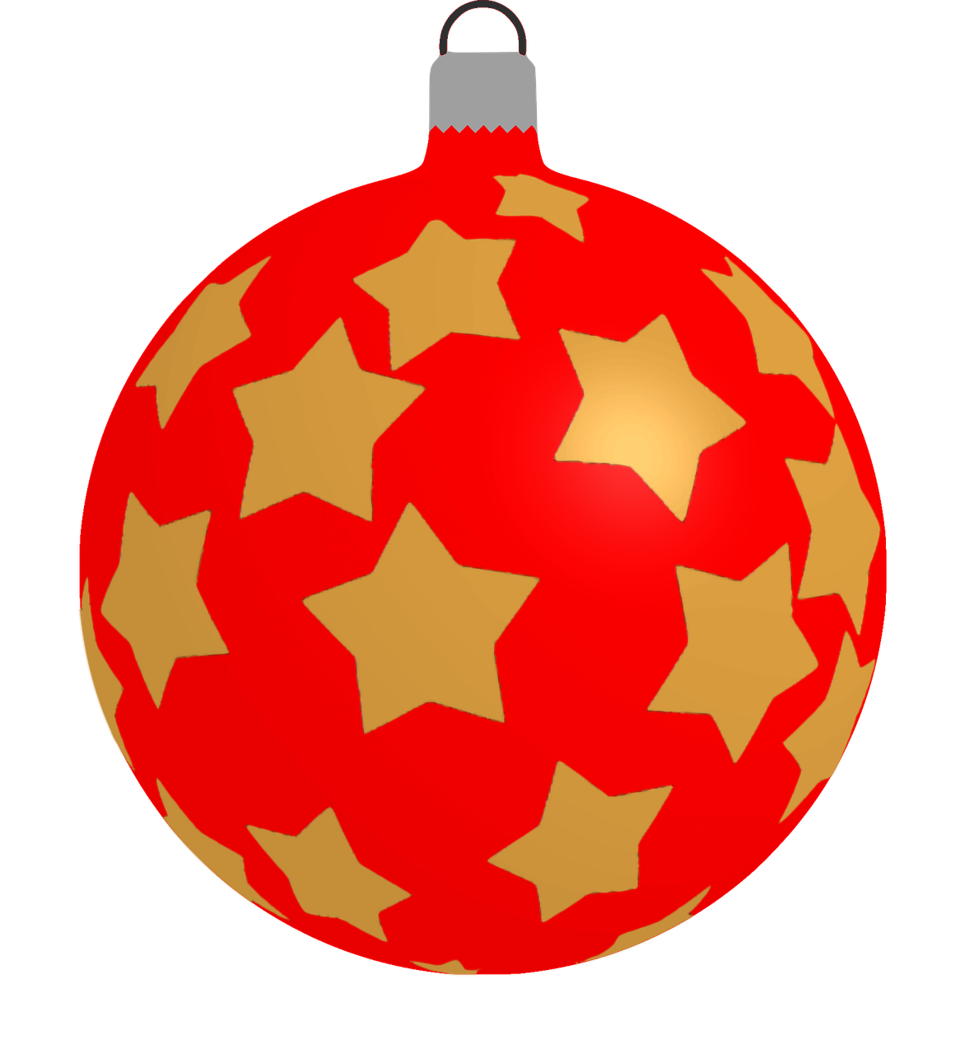
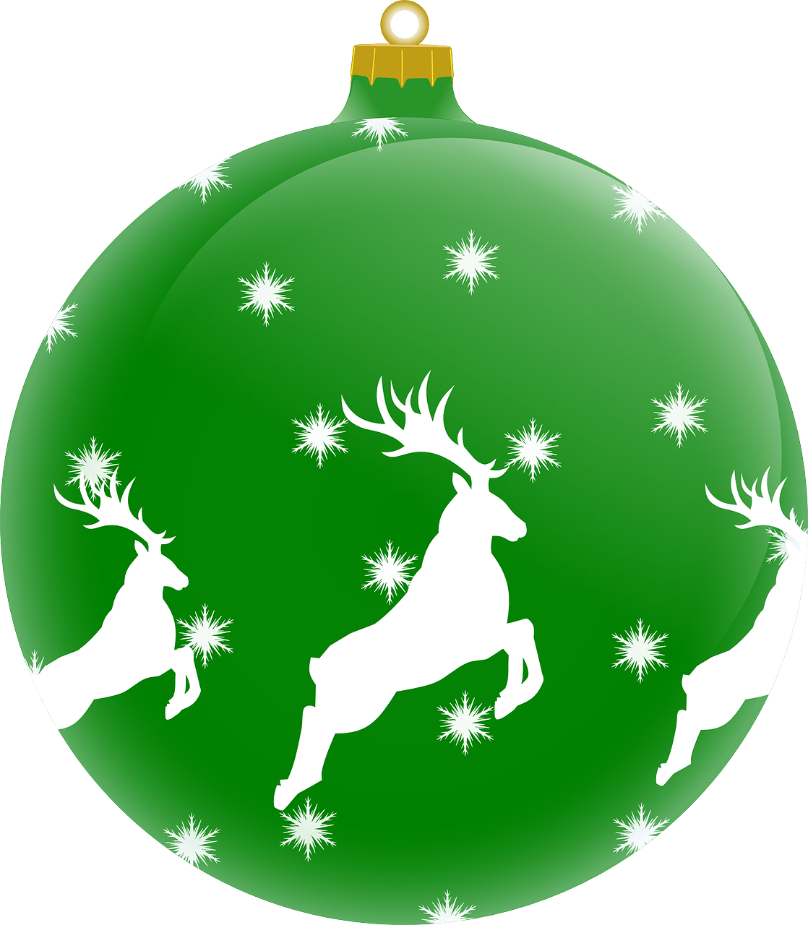
Wie sagt man das?
sprechen
how many?
wie viele?
grün
the doctor
der Arzt
green
der Zug
auch
the train
also, too
das Spiel
the game
es gibt
there is, there are
to wish, wishing
wünschen
the piece
das Spiel
the place
der Platz
Notes:
Timing: 3 minutes
Aim: to practise spoken OR written production of the 10 new words for this week, in a low stakes but time-limited activity.
Procedure:
Work from top to bottom, left to right on the tree. Ask ‘Wie sagt man das auf Deutsch?
Click to start the 5-second animation. Pupils say the German word before the animation finishes and reveals the word.
Continue with all words.
Note: this activity would work as speaking or writing (e.g., on mini whiteboards)

Slide 26
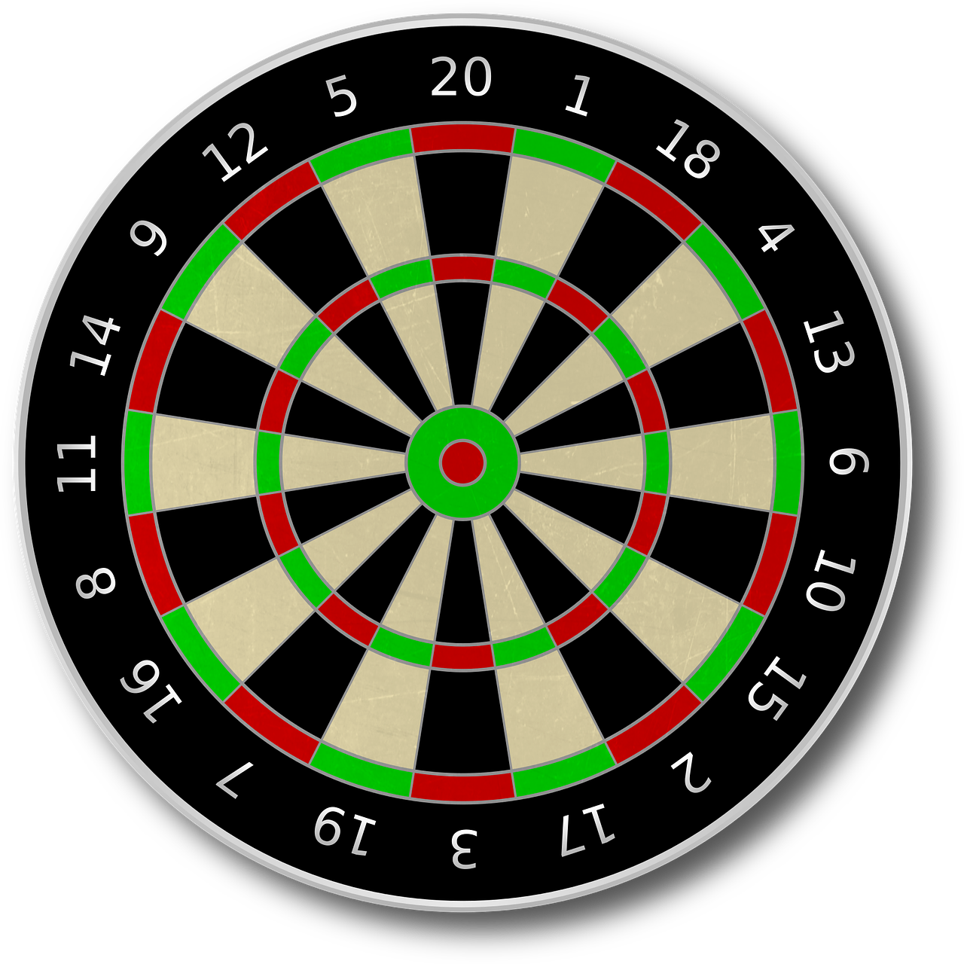
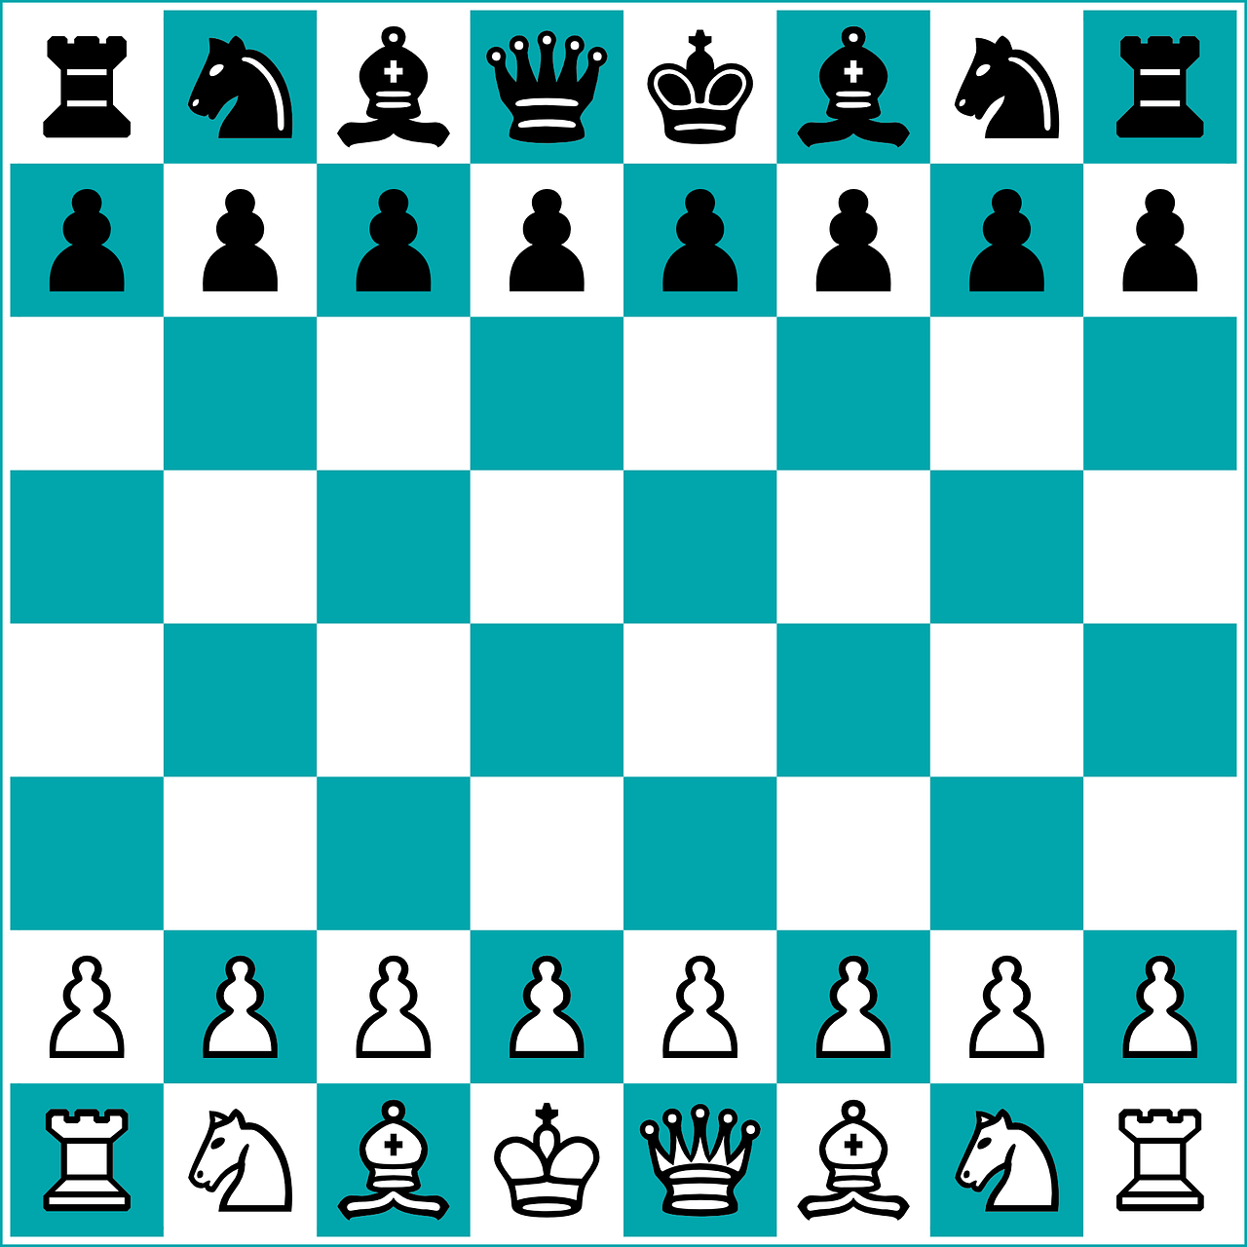
Was gibt es zu Weihnachten?
sprechen
Es gibt viele…
Spiele.
Notes:
Timing: 3 minutes
Aim: to practise spoken application of the two plural rules for this week with revisited vocabulary, and a few cultural items that we saw last lesson.
Procedure:
Ask ‘Was gibt es zu Weihnachten?’
Elicit response orally,.
Click to provide the correct plural.
Continue with the remaining slides.

Slide 27
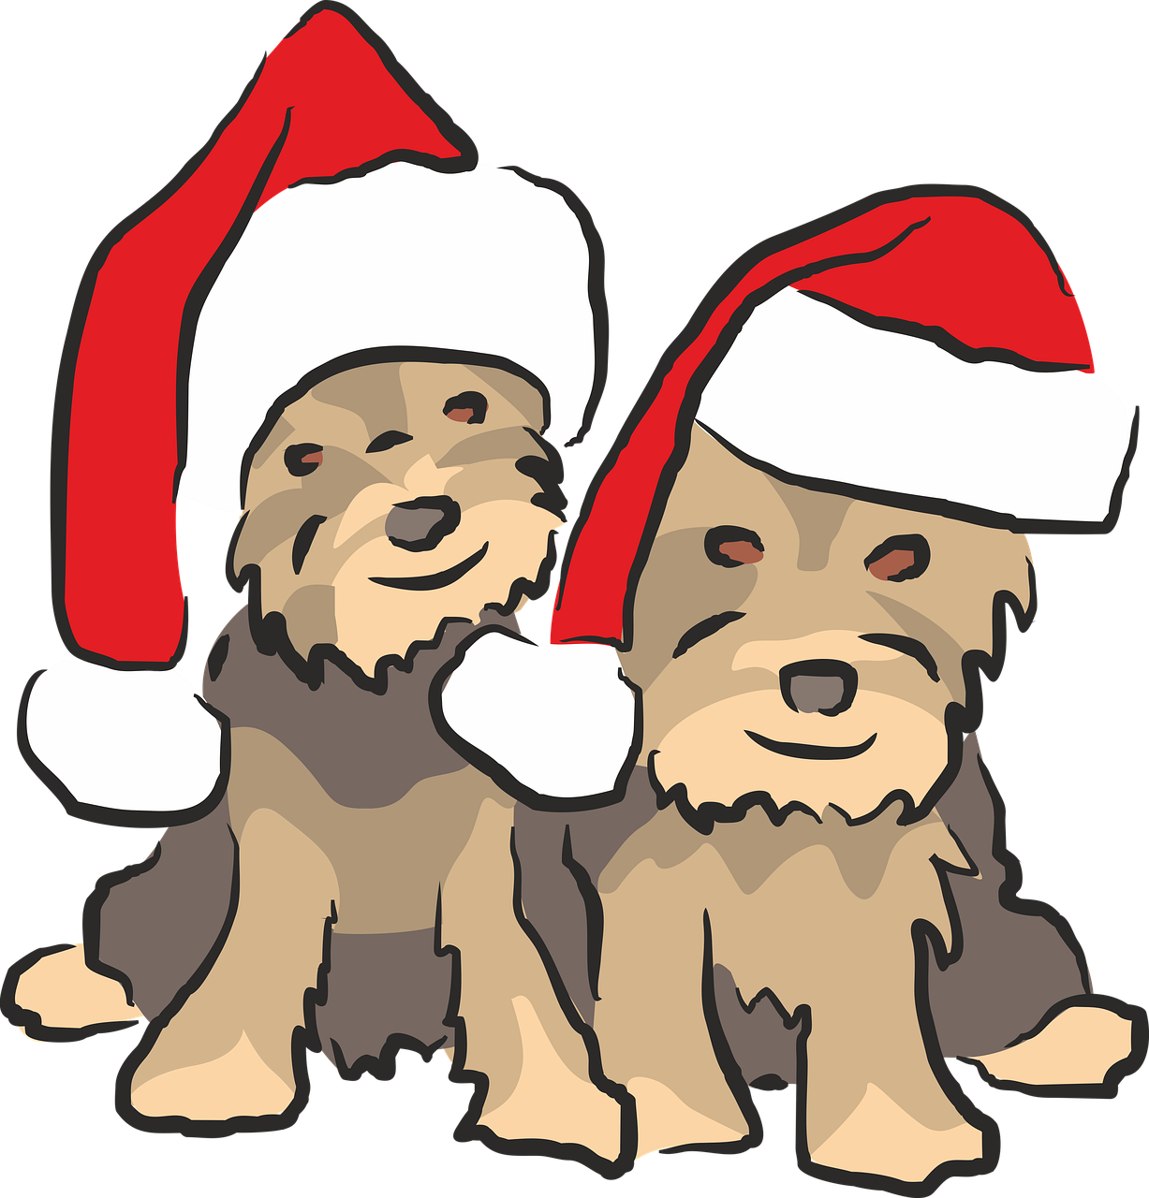
Was gibt es zu Weihnachten?
sprechen
Es gibt viele…
Tiere.
Notes:
Note: Hund is new vocabulary next week, so here we are aiming to revisit ‘Tier’.

Slide 28
Was gibt es zu Weihnachten?
sprechen
Es gibt viele…
Filme.

Slide 29
Was gibt es zu Weihnachten?
sprechen
Es gibt viele…
Orte.

Slide 30
Was gibt es zu Weihnachten?
sprechen
Es gibt viele…
Stücke.

Slide 31
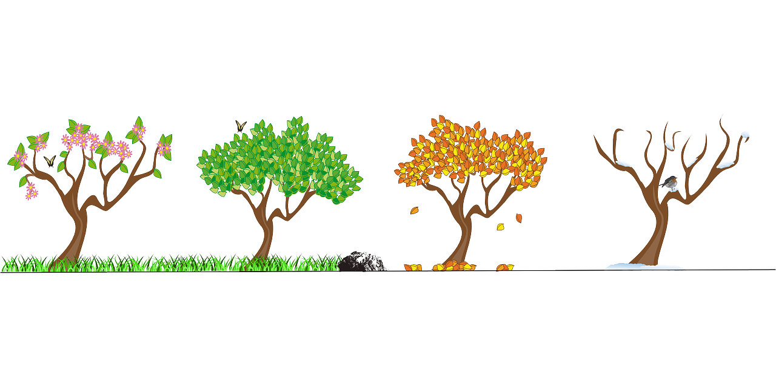
Was gibt es zu Weihnachten?
sprechen
Es gibt viele…
Winter.

Slide 32
Was gibt es zu Weihnachten?
sprechen
E_ g_ _ _ v_ _ _ _…
Engel.
der Engel
der Engel

Slide 33
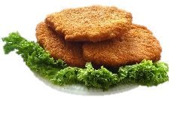
Was gibt es zu Weihnachten?
sprechen
E_ g_ _ _ v_ _ _ _…
Schnitzel.
das Schnitzel

Slide 34
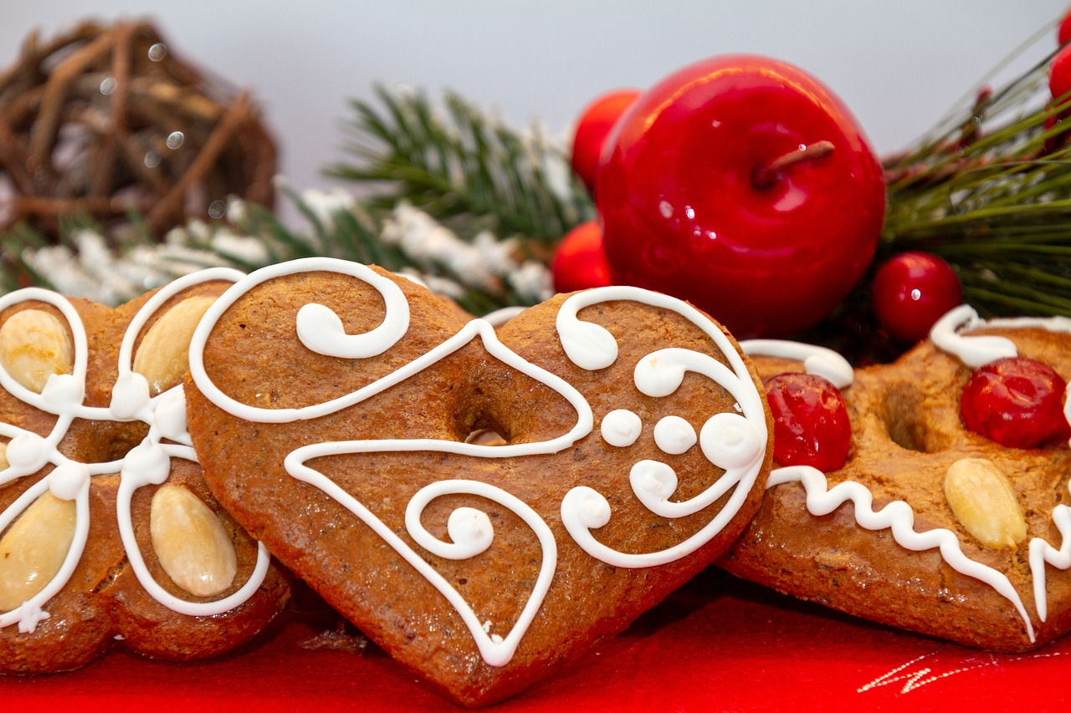
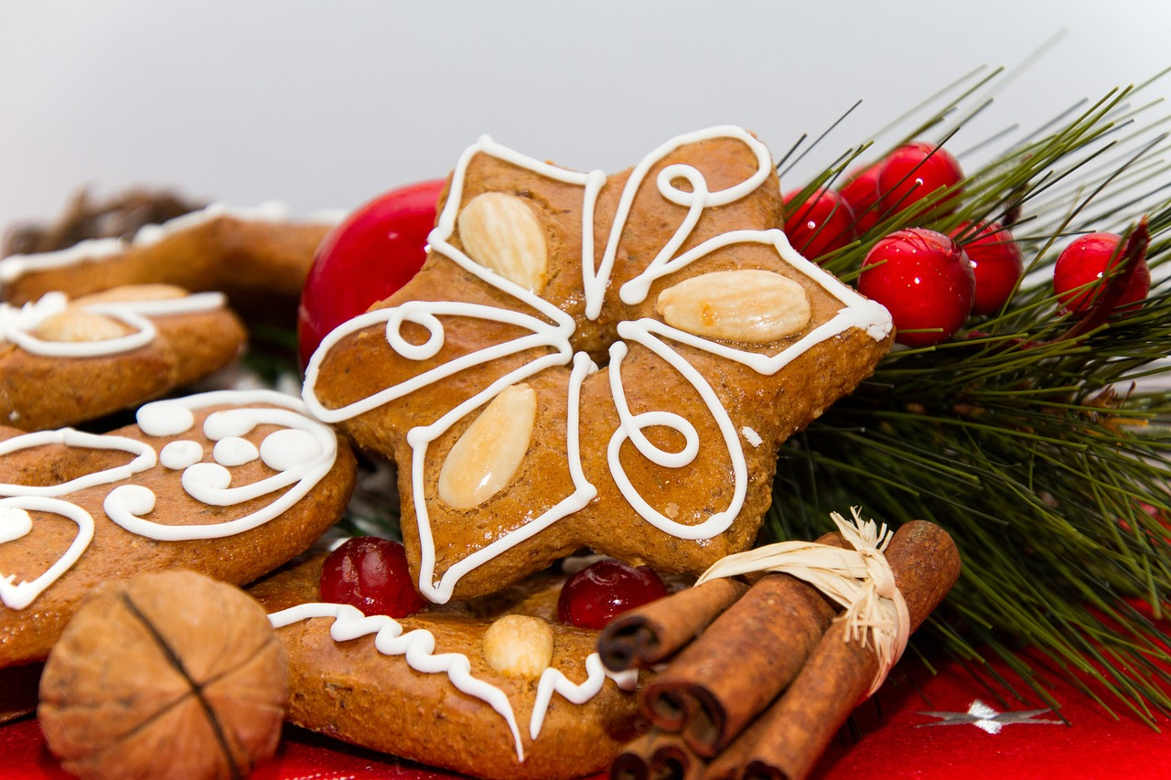
Was gibt es zu Weihnachten?
sprechen
E_ g_ _ _ v_ _ _ _…
Lebkuchen.

Slide 35
Ein Weihnachtslied: O Tannenbaum
Hör die Musik an.
Ist die Musik…
a. Popmusik
b. traditionell
c. klassisch
Was ist das Thema?
a. Liebe
b. Natur
c. Europa
Notes:
Timing: 2 minutes Aim: To introduce a seasonal text.
Procedure: 1. Setting the scene. Just play one verse of an instrumental version. Link to instrumental versions: https://www.youtube.com/watch?v=KurqAmMi-bc (various instruments) https://www.youtube.com/watch?v=nxvJ1SIRdiI (piano only)
2. Alternatively, click on left hand tree, then right hand tree.
Link to versions with lyrics:
https://www.youtube.com/watch?v=OVSoZn66iC4 – a capella version, lyrics are fairly clear, there is only one verse https://www.youtube.com/watch?v=RJauT4IM1Y8 (choral version; pretty, but as there are a lot of voices, the individual sounds are not as clear– 3 verses, only play verse 1) https://www.youtube.com/watch?v=lS4wTuvR7Ik (single voice; quite clear sound – 3 verses, only play verse 1)

Slide 36
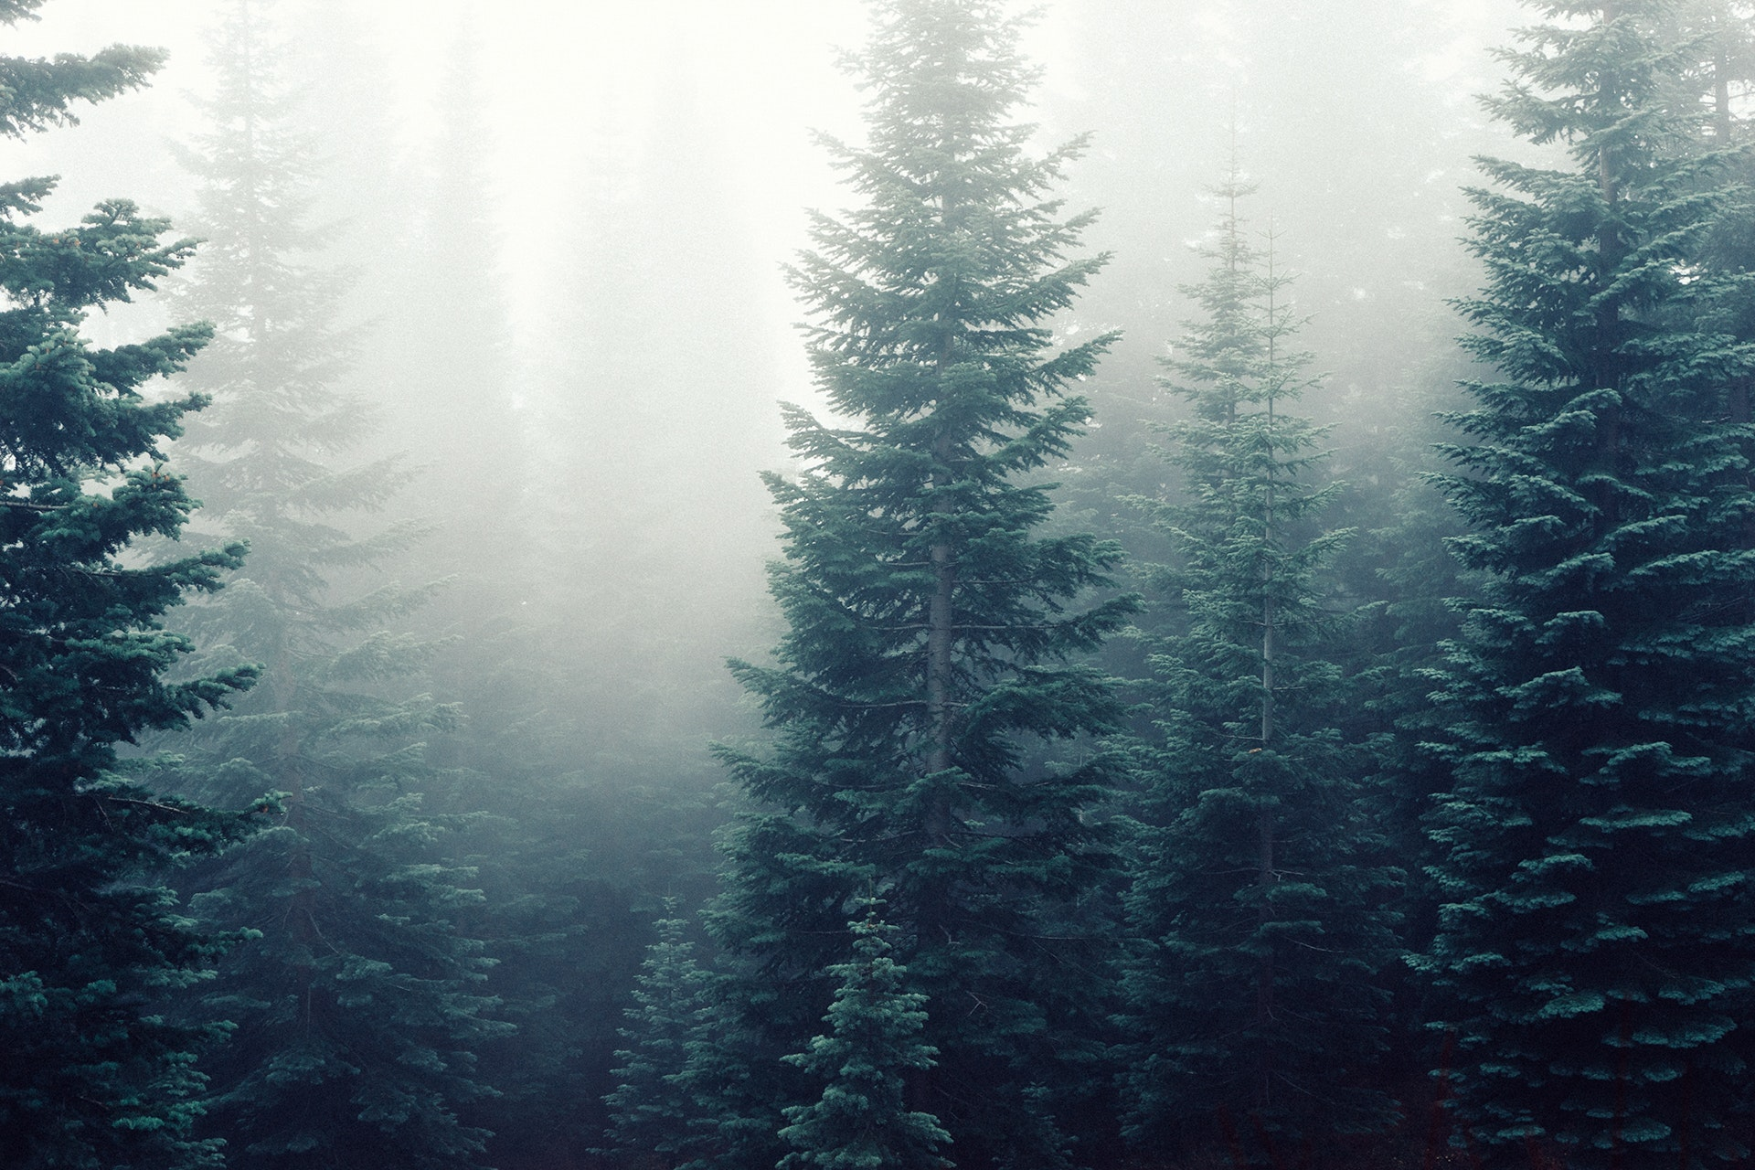
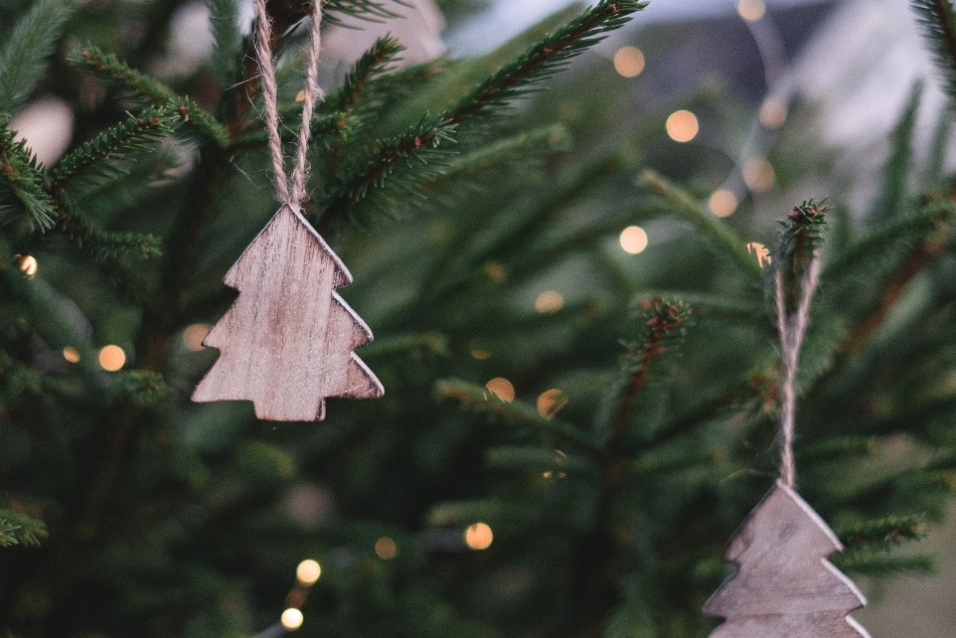
O Tannenbaum
der Baum
O, Tannenbaum
Notes:
Timing: 1 minute Aim: To set the scene further.
Procedure: 1. The pictures emphasise the natural properties of the tree and not the decorative (Christmassy) aspect. The top right picture might prime ‘snowing’ (wenn es schneit).
2. Introduce the noun ‘der Baum’ [996] and invite the students to guess what type of tree a Tannenbaum might be.
Note: Students have not yet learnt the SSC ‘au’, but they have encountered some words with ‘au’ already (for example, das Haus). We return to this later in the lesson.

Slide 37
Vokabelideen
schreiben
Titel: O, Tannenbaum
60 Sekunden.
5 Wörter (Deutsch oder Englisch)
Notes:
Timing: 2 minutes Aim: Helping students to use their real-world knowledge and previous vocabulary knowledge in a new context.
Procedure: 1. Give the instructions in German: Der Titel von diesem Lied /Song ist: O, Tannenbaum. In 60 Sekunden schreib 5 Wörter (Deutsch oder Englisch) für das Lied.
2. Hear some examples.
Some ideas, with their word frequency: der Baum [996]; das Blatt [1330]; der Stamm [3500]; der Zweig/Ast [>4000]; die Wurzel [3047]; wachsen [482]; grün [556]; braun [2178]; die Erde [781]; die Sonne [953]; der Regen [1690]; der Sommer [704]; der Winter [1288]; der Schnee [2203]

Slide 38
[u] oder [ü]?
hören
Hör zu. Ist es [u] oder [ü[?
O Tannenbaum, o Tannenbaum,
wie gr_n sind deine Blätter!
D_ gr_nst nicht n_r z_r Sommerzeit,
Nein auch im Winter, wenn es schneit.
O Tannenbaum, o Tannenbaum,
wie gr_n sind deine Blätter!
Notes:
Timing: 2 minutes Aim: To practise differentiating between ‘u’ and ‘ü’.
Procedure: 1. Click on the fir tree in the top right hand corner to play the song. Students write ‘u’ or ‘ü’ for each missing vowel.
2. Play the song a second time. The text could also be read aloud if the recording seems too fast.
3. Alternatively, here is a link to a commercial version: https://www.youtube.com/watch?v=lS4wTuvR7Ik
(single voice, but quite clear sound – 3 verses, only play verse 1).
4. The answers are provided on the next slide.
Note: We include the source words and pictures as a refresher.
Instructions in German:
Hör zu
Schreib ‘u’ oder ‘ü’

Slide 39
Antworten
lesen/sprechen
O Tannenbaum, o Tannenbaum,
wie gr_n sind deine Blätter!
D_ gr_nst nicht n_r z_r Sommerzeit,
Nein auch im Winter, wenn es schneit.
O Tannenbaum, o Tannenbaum,
wie gr_n sind deine Blätter!
grün
Du
grünst
nur
zur
grün
Notes:
Timing: 1 minute Aim: To provide the answers to the activity on the previous slide.
Procedure: 1. Ask students which SSC is missing each time.c, licking to reveal the answers one by one.

Slide 40
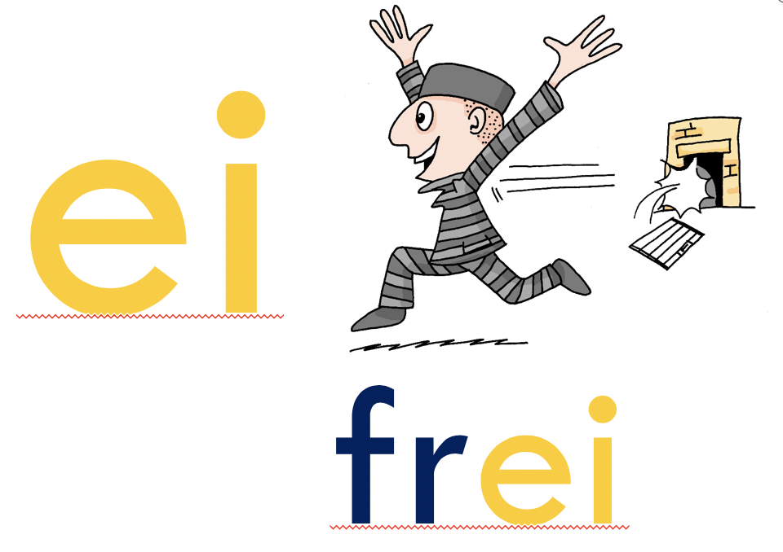
[ie] oder [ei]?
hören
O Tannenbaum, o Tannenbaum,
w__ grün sind d__ne Blätter!
Du grünst nicht nur zur Sommerz__t,
N__n auch im Winter, wenn es schn__t.
O Tannenbaum, o Tannenbaum,
w__ grün sind d__ne Blätter!
Notes:
Timing: 2 minutes Aim: To practise differentiating between ‘ie’ and ‘ei’.
Procedure: 1. Click on the fir tree in the top right hand corner to play the song. Students write ‘ie’ or ei’ for each missing vowel.
2. Play the song a second time. The text could also be read aloud if the recording seems too fast.
3. Alternatively, here is a link to a commercial version: https://www.youtube.com/watch?v=lS4wTuvR7Ik
(single voice, but quite clear sound – 3 verses, only play verse 1).
4. The answers are provided on the next slide.
Note: Revisiting SSCs. In the NCELP SOW these SSCs have been introduced during Term 1.1, Weeks 3 (ei) and 7 (ie). We are using these as a minimal pair because of the spelling similarities. We include the source words and pictures as a refresher.
Instructions:
Hör zu
Schreib ie oder ei

Slide 41
Antworten – [ie] vs [ei]
lesen / sprechen
O Tannenbaum, o Tannenbaum,
w__ grün sind d__ne Blätter!
Du grünst nicht nur zur Sommersz__t,
N__n auch im Winter, wenn es schn__t.
O Tannenbaum, o Tannenbaum,
w__ grün sind d__ne Blätter!
wie
deine
Sommerzeit
Nein
schneit
wie
deine
Notes:
Timing: 1 minute Aim: To provide the answers to the activity on the previous slide.
Procedure: 1. Ask students which SSC is missing each time.c, licking to reveal the answers one by one.

Slide 42
[au] und [sch]
sprechen
[au]
blau
das Haus
kaum
O Tannenbaum, o Tannenbaum,
wie grün sind deine Blätter!
Du grünst nicht nur zur Sommerzeit,
Nein auch im Winter, wenn es schneit.
O Tannenbaum, o Tannenbaum,
wie grün sind deine Blätter!
O Tannenbaum, o Tannenbaum,
wie grün sind deine Blätter!
Du grünst nicht nur zur Sommerzeit,
Nein auch im Winter, wenn es schneit.
O Tannenbaum, o Tannenbaum,
wie grün sind deine Blätter!
[sch]
der Tisch
die Flasche
falsch
schreiben
in der Schule
Notes:
Timing: 2 minutes Aim: To practise two new sounds – [au] and [sch] – before attempting to sing the song.
Note: There are two more sounds that have not been introduced formally (i.e. in a dedicated phonics session), but that pupils will have encountered already in other words: ‘au’ and ‘sch’. The boxes on the right hand side give the sounds in words they have already been introduced to previously in the SOW.
Procedure: 1. Practise these new sounds separately (saying ‘au’ and ‘sch’) and relate them to the sounds in familiar words, before saying them in the new words.

Slide 43
Sprich es aus oder sing mit!
sprechen
O Tannenbaum, o Tannenbaum,
wie grün sind deine Blätter!
Du grünst nicht nur zur Sommerzeit,
Nein auch im Winter, wenn es schneit.
O Tannenbaum, o Tannenbaum,
wie grün sind deine Blätter!
Notes:
Timing: 2 minutes Aim: To practise saying the text/singing the song.
Procedure: 1. Ask your students to practise saying the text. 2. Click on the tree symbol to play the music and ask them to keep in time with the song to help word formation. 3. Alternatively, students could sing the song.
Note: Click tree on left for a slower instrumental version, tree on right for a quicker version.

Slide 44
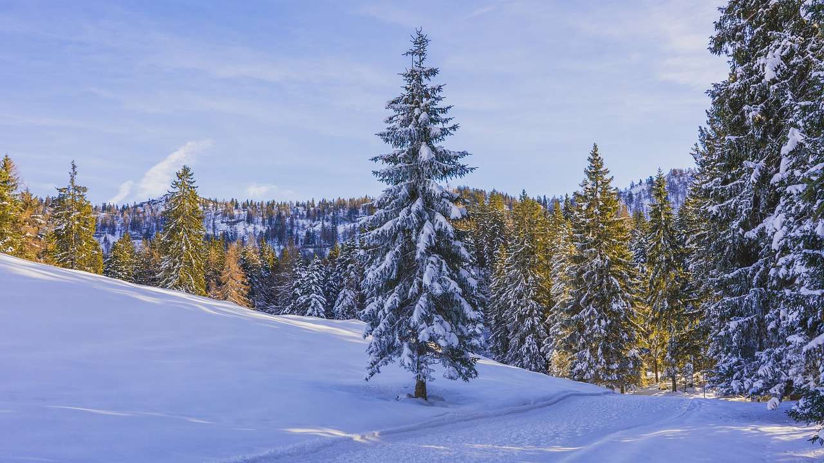
Verbing nouns
Grammatik
Du grünst nicht nur zur Sommerzeit, Nein auch im Winter, wenn es schneit.
Notes:
Timing: 1 minute Aim: To raise awareness of the relationship between certain verbs and adjectives.
Procedure: 1. Ask students what type of word they think ‘grünst’ is. Clues: verb ending; personal pronoun ‘Du’
2. Can they deduce the meaning of ‘grünen’ from the adjective ‘grün’? (to turn green, to be green, to blossom, to flourish).
Link to Calvin & Hobbs carton about ‘verbing nouns’: https://www.gocomics.com/calvinandhobbes/1993/01/25

Slide 45
Übersetzen
lesen
O Tannenbaum, o Tannenbaum, | O fir tree, o fir tree
wie grün sind deine Blätter | how green are your leaves!
Du grünst nicht nur zur Sommerzeit, | You are not just green in summer(time),
Nein auch im Winter, wenn es schneit. | No, also in the winter, when it snows.
O Tannenbaum, o Tannenbaum, | O fir tree, o fir tree
wie grün sind deine Blätter. | How green are your leaves!
übersetzen – to translate
Notes:
Timing: 3 minutes Aim: To practise translation into English.
Procedure: 1. Ask students to translate the verse using:
the words they already know
contextual expectations (Baum / Blätter / Grün )
cognates (Sommer & Winter)
generalisations (grünst)
2. Elicit translations from students line by line.
3. Click to bring up suggested translation, line by line.

Slide 46
Hausaufgaben
Vocabulary Learning Homework (Term 1.2, Week 7)
Audio file
Student worksheet
In addition, revisit: Term 1.2 Week 4 Term 1.1 Week 5
Notes:
Use this slide to set the homework.
For Y7, the typical homework will be to pre-learn vocabulary for the next lesson. There is an audio file to accompany the student worksheet.
Notes:
i) Teachers may, in addition, want to recommend use of a particular online app for the pre-learning of each week’s words. ii) Quizlet now requires parental involvement / registration / permissions for users below the age of 13, so it is perhaps most suitable for Y9 – 11 students. iii) Language Nut hosts LDP vocabulary lists and these are free for schools to use, though there is a registration process. One benefit is that all of the student tracking data that Language Nut offers are also available to schools that use the LDP lists for practice. Perhaps this makes it a good option for Y7/8.
iv) There are other free apps, and new ones are always appearing. Teachers have told us that they are currently using: Flippity, Wordwall (where using previously-created activities is free).
v) Gaming Grammar has been acquired by Language Nut. Its original content should still be available to teachers and much of it is appropriate for Y7 learners. From this lesson, for example, learners could practise Article agreement.

