Slide 1
Wer macht was?
Sentence-building from infinitive verbs Present tense: 1st, 2nd, 3rd persons singular
SSC song and short [u]
Y7 German Term 1.2 – Week 5 – Lesson 23 Leigh McClelland / Rachel Hawkes Artwork: Steve Clarke Date updated: 19.08.23
Notes:
Artwork by Steve Clarke. All additional pictures selected are available under a Creative Common license; no attribution required.
Note: All words listed below for this week’s learning (new and revisited) appear on all three Awarding Organisations’ word lists, with the following exceptions:
i) AQA and Edexcel do not have putzen. ii) Eduqas does not separately list Hausaufgaben but Haus + Aufgabe are both listed, so Hausaufgabe(n) would be permissible as a transparent compound.
Learning outcomes (lesson 1):
Introduction of SSC [u]
Consolidation of singular definite articles
Word frequency (1 is the most frequent word in German):
7.1.2.5 (introduce) kommen [62] stehen [85] Junge [548] Kopf [250] Körper [488] Mädchen [602] Mutter [218] Nacht [325] Tür [375] Vater [232] dunkel [706]
7.1.2.2 (revisit) arbeiten [234] kochen [1481] putzen [3586] sitzen [231] Auto [361] Boden [536] Garten [1158] Liste [1792] Zimmer [665] nochmal [1984] ich verstehe nicht [n/a] zu Hause [n/a] Hausaufgaben [Haus+aufgabe]
7.1.1.3 (revisit) bin [4] ich [10] Ding [370] Form [307] Mensch [90] blau [948] gelb [1446] groß1 [67] gut [76] klein [110] rot [477] wie? [25] und [2] bitte [471] danke [877] ein, eine [5] wie geht's? [n/a]
Source: Jones, R.L. & Tschirner, E. (2019). A frequency dictionary of German: core vocabulary for learners. Routledge

Slide 2
Mensch, Ort, Farbe oder Ding?
sprechen
Person B: Write 5 words in German from the table below. Person A: Ask yes/no questions in German to work out the words.
Ist es ein Ort?
Nein!
Ist es ein Mensch?
Ja!
Person A
Person B
Ist es der Herr?
Nein!
Then swap roles and play again!
Ist es Katrin?
Ja!
hier | das Mädchen | blau | Katrin | der Garten
die Schule | die Form | zu Hause | die Hausaufgabe | der Herr
der Fußball | das Auto | die Hand | das Zimmer | die Liste
gelb | Mia | rot | die Frau | der Mann
Notes:
Timing: 7 minutes
Aim: to practise asking and answering yes/no questions practise 10 items from this week’s revisited vocabulary and additional previously taught words.
Procedure:
Pupil B chooses 5 words and writes them down secretly.
Pupil A asks yes/no questions using the categories Mensch, Ort, Farbe and Ding and then asks ‘Ist es…’ until they work out the 5 words on B’s list.
Then pupils swap roles and play again.
Note: after modelling the task, click again to make the prompts disappear so that students are creating the questions using just the word list as reference, not the speech bubbles.

Slide 3
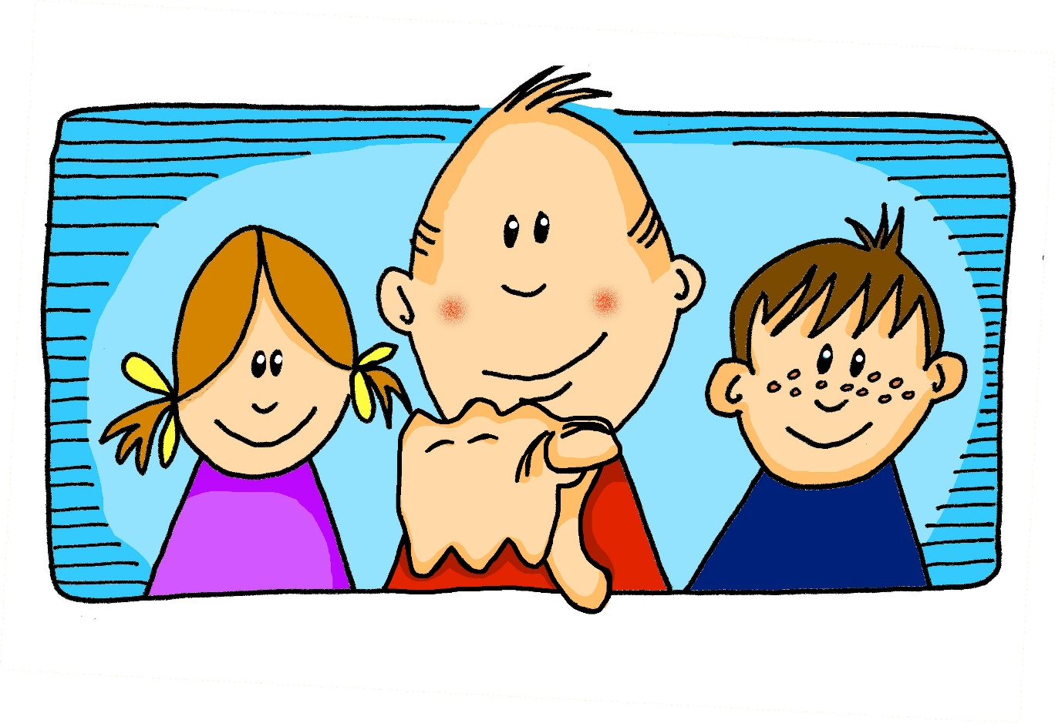
u
du
Notes:
Timing: 1 minute
Aim: To introduce/consolidate SSC [u]
Procedure: 1. Present the letter(s) and say the [u] sound first, on its own. Students repeat it with you. 2. Bring up the word ”du” on its own, say it, students repeat it, so that they have the opportunity to focus all of their attention on the connection between the written word and its sound.
3. A possible gesture for this would be to point out directly in front of you.
4. Roll back the animations and work through 1-3 again, but this time, dropping your voice completely to listen carefully to the students saying the [u] sound, pronouncing ”du” and, if using, doing the gesture. Word frequency (1 is the most frequent word in German): du [52]
Source: Jones, R.L. & Tschirner, E. (2006). A frequency dictionary of German: core vocabulary for learners. Routledge

Slide 4
u
absolut
gut
%
du
Minute
Schule
tun
[to do]
Notes:
Timing: 2 minutes
Aim: To introduce/consolidate SSC [u]
Procedure:
Introduce and elicit the pronunciation of the individual SSC [u] and then the source word again ‘du’ (with gesture, if using).
Then present and elicit the pronunciation of the five cluster words.
The cluster words have been chosen for their high-frequency, from a range of word classes, with the SSC (where possible) positioned within a variety of syllables within the words (e.g. initial, 2nd, final etc.). Additionally, we have tried to use words that build cumulatively on previously taught SSCs (see the Phonics Teaching Sequence document) and do not include new SSCs. Where new SSCs are used, they are often consonants which have a similar symbol-sound correspondence in English.
Word frequency (1 is the most frequent word in German): du [52]; absolut [993] gut [78]; Minute [361]; tun [140]; Schule [208].
Source: Jones, R.L. & Tschirner, E. (2006). A frequency dictionary of German: core vocabulary for learners. Routledge

Slide 5
u
absolut
gut
du
Minute
Schule
tun
Notes:
With sound and no pictures to focus all attention on the sound-symbol correspondence.

Slide 6
u
absolut
gut
du
Minute
Schule
tun
[to do]
Notes:
Without sound to elicit pronunciation (without first hearing the teacher).
Teacher to elicit pronunciation by asking “Wie sagt man…”

Slide 7
Vowels
sprechen
German vowels can be short or long.
Vowels are short when followed by more than one consonant, e.g., hundert, nutzen.
Vowels are long when:
there is a double vowel (no examples of ‘uu’ in German)
or when followed by the letter ‘h’, e.g., Uhr,
or by a single consonant, e.g., absolut.
Notes:
Timing: 2 minutes Aim: To recap what students were taught in Week 1 about the long/short [a] SSC.
Note: Here we include ‘hundert’ and ‘Uhr’, which students will be taught soon when they learn other SSC.
Procedure: 1. Click to animate the explanation.
2. Ensure students’ understanding at each stage.
Word frequency (1 is the most frequent word in German):
hundert [945] and Uhr [349]
Source: Jones, R.L. & Tschirner, E. (2011). A frequency dictionary of German: core vocabulary for learners. Routledge

Slide 8
Phonetik
Long [u] or short [u]? Which word is the odd one out?
hören
Hör zu.
 | A | B | C
 | Hund | Computer | Instrument
 | Punkt | Buch | Musik
 | gut | super | wunderbar
 | jung | du | Bruder
 | Mutter | Uhr | rund
 | Gruppe | Kunst | Minute
Buch is an exception: it has a long [u] which comes before two consonants!
1
2
3
4
5
6
Notes:
Timing: 8 minutes
Aim: to practise long and short [u] in the listening modality.
Procedure:
Click to play the first recording. Pupils decide which of the three words they hear is the odd one out based on a long or short [u].
Differentiation: pupils write all the words down for a higher challenge and then select the odd one out, or just 1.B etc.
Click to reveal answer tick.
Click to reveal written version of the words.
Continue for items 2-6.
Transcript:
Hund | Computer | Instrument
Punkt | Buch | Musik
Gut | super | wunderbar
jung| du | Bruder
Mutter | Uhr | rund
Gruppe | Kunst | Minute
Vocabulary: Gruppe [369] Uhr [348]
Jones, R.L & Tschirner, E. (2019). A frequency dictionary of German: Core vocabulary for learners. London: Routledge.

Slide 9
Ein Email schreiben
Wolf sucht einen Brieffreund in England. Er schreibt auf Englisch.
schreiben
Dear… Lieber (m) Liebe (f)
Dear pen friend,
How are you? I’m very well.
Translate it into German or write your own letter in German, if you prefer. If you write your own:
include a greeting
say where you live
say where you are now (at home, in school, different city etc..)
write at least one activity you do at home
and one activity you do at school every day
ask two questions
I live in Berlin, but I am not at home, I am in school. It is Monday.
also = auch It goes after the verb.
I am learning English at school und I also do sport. Football is really good.
I play guitar at home. How are you? What do you do at home? Do you play football?
Use a dictionary to add in words for things on your wish list!
Best wishes,
Best wishes is Viele (liebe) Grüße in German. It is often abbreviated to VG or VLG in messages.
Wolf
der Brieffreund | die Brieffreundin - penfriend
Notes:
Timing: 30 minutes Aim: to use previously taught language in a new context.
Procedure:
Students respond to the prompts, writing a letter of introduction to a penfriend in German.
Note:
1. For those writing their own letter, dictionaries would be useful, since students may wish to use previously untaught vocabulary.
2. It is worth reminding students that in German there is only one present tense – I learn and I’m learning are both ‘ich lerne’.
3. The task can be further adapted – shortened, the bullets constrained, additional support provided (e.g., from the KO or the vocabulary guide).
Suggested translation:
Lieber Brieffreund, Wie geht’s? Es geht mir sehr gut. Ich wohne in Berlin, aber ich bin nicht zu Hause, ich bin in der Schule. Es ist Montag.
Ich lerne Englisch in der Schule. Ich mache auch Sport. Fußball ist sehr gut. Ich spiele Gitarre zu Hause. Wie geht’s dir? Was machst du zu Hause? Spielst du Fußball? Viele Grüße
Note: auch [] is in next week’s vocabulary set.

Slide 10
Wer macht was?
Narrating with nouns - using gender and words for ‘the’ correctly Definite articles - singular
Y7 German Term 1.2 – Week 5 – Lesson 24 Leigh McClelland / Rachel Hawkes Artwork: Steve Clarke Date updated: 19.08.23
eine Filmszene
Notes:
Artwork by Steve Clarke. All additional pictures selected are available under a Creative Common license; no attribution required.
Learning outcomes (lesson 2):
Consolidation of SSC [u]
Consolidation of singular definite articles
Word frequency (1 is the most frequent word in German):
7.1.2.5 (introduce) kommen [62] stehen [85] Junge [548] Kopf [250] Körper [488] Mädchen [602] Mutter [218] Nacht [325] Tür [375] Vater [232] dunkel [706]
7.1.2.2 (revisit) arbeiten [234] kochen [1481] putzen [3586] sitzen [231] Auto [361] Boden [536] Garten [1158] Liste [1792] Zimmer [665] nochmal [1984] ich verstehe nicht [n/a] zu Hause [n/a] Hausaufgaben [Haus+aufgabe]
7.1.1.3 (revisit) bin [4] ich [10] Ding [370] Form [307] Mensch [90] blau [948] gelb [1446] groß1 [67] gut [76] klein [110] rot [477] wie? [25] und [2] bitte [471] danke [877] ein, eine [5] wie geht's? [n/a]
Source: Jones, R.L. & Tschirner, E. (2019). A frequency dictionary of German: core vocabulary for learners. Routledge

Slide 11
Vokabeln
 |  |  |  |  |  |  |  |  |  |  | d
 |  |  |  |  |  |  |  |  |  | d | i |  |  | W
 |  |  | d |  | d |  |  |  |  | a | e |  |  | i
 |  |  | a |  | e | a |  |  | n | s |  |  |  | e
k |  |  | n |  | r | r |  | k | o |  | N | i | g
l | b | u | k |  |  | b |  | o | c | Z | a | c | u | g
__ | __ | __ | __ |  | __ | __ | __ | __ | __ | __ | __ | __ | __ | __
i | t | d |  |  | a | i | i | h | m | m | h |  |  | h
n | t |  |  |  | r | t | t | e | a | m | t | b |  | t
 | e |  |  |  | t | e | z | n | l | e |  | i |  | ‘
 |  |  |  |  | e | n | e |  |  | r |  | n |  | s
 |  |  |  |  | n |  | n
lesen
e
i
n
e
G
e
s
c
h
i
c
h
t
e
die Geschichte - story
Notes:
Timing: 4 minutes Aim: To share the context for the lesson (i.e. a story), whilst revising almost all of the remaining revisited vocabulary for this week.
Procedure: 1. Students say the German words in turn from left to right, naming the missing letter in each.
These spell out ‘eine Geschichte’ – the theme for this lesson sequence.
2. When eliciting each word answer, elicit also the English meaning, to ensure that students remember it.
3. Answers appear on successive mouse clicks.
4. The final click bring up the meaning of Geschichte, which is a new word, but one that is all on GCSE word lists, and is taught on the LDP SOW later.

Slide 12
Definite articles
Grammatik
German nouns are divided up into two / three / four groups.
gender
the
Each group has a grammatical __________ and a different word for ______.
masculine | der | e.g. der Zug (the train)
feminine | die | e.g. die Familie (the family)
neuter | das | e.g. das Haus (the house)
definite articles
These words for the are called _________ _________.
learn
As you know, when you learn a German noun, you must ________ its grammatical gender.
Notes:
Timing: 2 minutes Aim: To provide an interactive reminder of the three genders in German.
Procedure: 1. Click to animate the explanation.
2. Each sentence (plus answers) is animated separately to allow the teacher to elicit responses from the class, and build the explanation interactively and collaboratively.
3. Ensure students’ understanding at each stage.
Note: Remember that these explanations by themselves do not make a huge impact on learning – it is practice that really has the biggest benefits. So it is not worth spending too much time on these explanations. Also, they are always ‘partial’ – we can’t communicate all the complexity at once.
Word frequency rankings:
Haus [159], Familie [310], Zug [613] Source: Jones, R.L & Tschirner, E. (2011). A frequency dictionary of German: Core vocabulary for learners. London: Routledge.

Slide 13
Vokabeln
Masculine nouns (der …)
sprechen
der
Mann
der
Vater
der
Junge
Why?
der
Fußball
der
Kopf
der
Grund
Notes:
Timing: 2 minutes Aim: To revisit the concept of masculine gender with some known words that are used in the activities which follow.
Procedure: 1. Click to bring up each picture in turn.
2. Elicit the German word from the students.

Slide 14
Vokabeln
Feminine nouns (die …)
sprechen
die
Hand
die
Mutter
die
Familie
die
Nacht
die
Tür
Notes:
Timing: 2 minutes Aim: To revisit the concept of feminine gender with some known words that are used in the activities which follow.
Procedure: 1. Click to bring up each picture in turn.
2. Elicit the German word from the students.

Slide 15
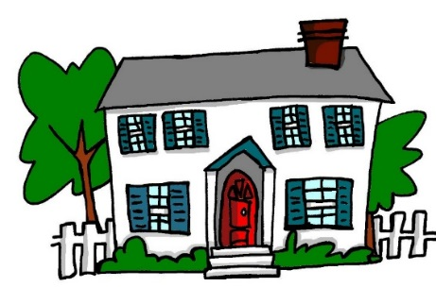
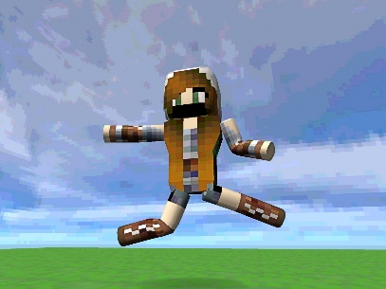
Vokabeln
Neuter nouns (das …)
sprechen
das
Buch
das
Haus
das
Monster
das
Computerspiel
das
Wasser
das
Mädchen
Notes:
Timing: 2 minutes Aim: To revisit the concept of neuter gender with some known words that are used in the activities which follow.
Procedure: 1. Click to bring up each picture in turn.
2. Elicit the German word from the students.
3. You could point out that the noun ‘girl’ has a neuter gender. This just shows that ALL nouns have gender, and in German this is not always in ways that you expect. Gender on nouns is very ‘abstract’! It has to be learnt, and can’t really be guessed or worked out in German.

Slide 16
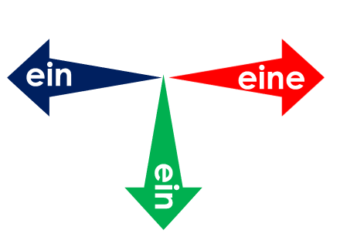
Was ist das?
lesen / sprechen
Fußball
Mutter
Mann
Tür
Buch
Vater
Mädchen
die
der
Grund
Haus
Wasser
Monster
Familie
Junge
Nacht
Kopf
Computerspiel
Hand
das
Notes:
Timing: 3 minutes Aim: To present/introduce the active nouns from the tasks that follow.
Procedure: 1. Students predict to which word for ‘the’ each noun will fly – der, die or das? 2. This slide has the words as text. The next slide has the nouns as pictures to stimulate recall of the words themselves as well as their gender.
3. Click to make each word appear; click again to make it fly to the correct category.
Note: It is anticipated that the meaning of many/most of these nouns will be known as many are included as phonics source/cluster words and will have been encountered and practised for pronunciation, but not with a focus on their gender/matching word for ‘the’.

Slide 17
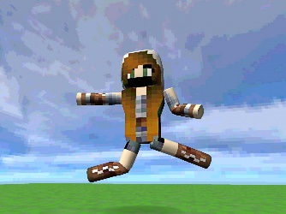
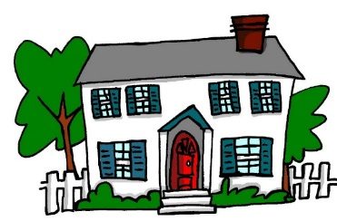
Vokabeln
Was passt nicht?
sprechen
1.
4.
die
die
das
der
die
die
2.
5.
das
die
das
der
das
das
Why?
3.
6.
der
der
das
der
der
die
Notes:
Timing: 3 minutes Aim: To practise recall of nouns and their gender.
Procedure: 1. Students find the odd one out by identifying the gender of each noun, and naming each of the nouns.
2. Click to reveal the answers (confirming the genders at the same time) one by one.

Slide 18
ein Filmprojekt (1/2)
Lies den Text. Was ist richtig? Wie sagt man das auf Englisch?
lesen
Your German friend has a film project homework but has ripped up her notes in frustration. You rescue the scraps of paper and try to reconstruct her ideas for the opening scene.
Familie
Mädchen
Vater
1. Die / / macht ein Picknick im Garten.
The family is having a picnic in the garden.
Mädchen
Junge
Mutter
2. Die / / sitzt auf dem Gras.
The mother is sitting on the grass.
Mutter
Vater
Mädchen
3. Der / / hat ein Buch.
The father has a book.
Junge
Mädchen
Mutter
4. Die / / trinkt Wasser.
The mother is drinking water.
Mädchen
Junge
Familie
5. Das / / spielt Fußball mit einem Freund.
The girl is playing football with a friend.
Notes:
Timing: 10 minutes (two slides) Aim: To practise matching nouns to their gender.
Procedure:
1. Students select the correct word according to the given gender (definite article).
2. Elicit the answers 1-5 (answers are animated to highlight the correct noun when you click on the mouse.)
3. After establishing the correct nouns, elicit the translations for each sentence, giving students 30-60 seconds to ‘think-pair-share’ before taking answers from students, in whole class feedback. 4. Encourage students to consider that this is a written set of ‘scene setting’ instructions. Ask them what sounds most natural as they translate. Note that students may first translate ‘macht’ as ‘does/is doing’ - prompt them to realise that we don’t say ‘does/is doing a picnic’ in English and to select a more natural translation ‘has/is having’. For scene-setting, we usually prefer the present continuous, so 1,2,4 and 5 are likely to be translated with the ‘ing’ form.
5. The most likely translations are animated to appear on each click.
Word frequency (1 is the most frequent word in German):
Picknick [>5009] trinken [608]
Source: Jones, R.L. & Tschirner, E. (2011). A frequency dictionary of German: core vocabulary for learners. Routledge

Slide 19
ein Filmprojekt (2/2)
Lies den Text. Was ist richtig? Wie sagt man das auf Englisch?
lesen
The scene continues and the action starts!
Haus
Fußball
Mädchen
6. Der / / ist klein.
The football is small.
Mädchen
Mutter
Junge
7. Der / / geht ins Haus.
The boy goes into the house.
Mutter
Junge
Tier
8. Der / / kommt wieder aus dem Haus.
The boy comes out of the house again.
Familie
Fußball
Haus
9. Das / / explodiert!
The house explodes!
Notes:
2/2

Slide 20
ein Computerspiel
hören
Your German friend is on the phone describing the story of her new favourite computer game. You can’t hear because of background noise. Choose the correct nouns to make sense of it all.
1
der/die/das | Mann / Nacht / Monster | ist sehr dunkel.
der/die/das | Mann / Familie / Monster | steht in einer Kirche.
der/die/das | Computerspiel / Nacht / Grund | ist nicht klar.
der/die/das | Familie / Mann / Monster | findet einen Körper! Was?!
der/die/das | Kopf / Monster / Hand | ist rot und blutig.
2
3
4
5
Notes:
Timing: 10 minutes (3 slides) Aim: To practise matching nouns to their gender and semantic context.
Procedure:
1. Students listen to the recording (the nouns are obscured) and read the text in the third column; based on the article heard (and considering the meaning) they select the correct noun from the three choices and indicate its gender (selecting the definite article).
2. Click to reveal the answers one by one.
Transcript:
Note: Recordings have blender noises inserted instead of the words in square brackets.
1. Die [Nacht] ist sehr dunkel.
2. Der [Mann] steht in einer Kirche.
3. Der [Grund] ist nicht klar.
4. Der [Mann] findet einen Körper! Was?!
5. Der [Kopf] ist rot und blutig.

Slide 21
ein Computerspiel [2]
hören
You keep listening to your friend, and start to make notes in English to try to make sense of the story.
article | noun | notes
 | Monster / Hand / Mann
 | Familie / Mädchen / Mann
 | Computerspiel / Mann / Tür
 | Familie / Mann / Monster
 | Nacht / Computerspiel / Familie
6
7
8
9
10
Notes:
Timing: 5 minutes Aim: to practise matching nouns to their gender and semantic context (continuation of the activity on the previous slide).
Note: this time the choices of definite article are not visible, forcing recall of these, and neither is the complement of the sentence (forcing students to listen for the semantic context).
Procedure:
1. Students listen to the recording (the nouns are obscured); based on the article heard they select the correct noun from the three choices and indicate its gender (writing in the definite article). They then make notes in English on the full meaning conveyed by each sentence.
2. The answers are revealed one by one on the following slide.
Transcript:
Note: Recordings have blender noises inserted instead of the words in square brackets.
6. Die [Hand] hat keine Finger.
7. Der [Mann] sieht jetzt ein Monster. Hilfe!
8. Die [Tür] ist da.
9. Das [Monster] kommt plötzlich in die Kirche.
10. Das [Computerspiel] endet! O nein!

Slide 22
Antworten
article | noun | notes
 | Monster / Hand / Mann
 | Familie / Mädchen / Mann
 | Computerspiel / Mann / Tür
 | Familie / Mann / Monster
 | Nacht / Computerspiel / Familie
6
die
Hand – no fingers
7
der
Man sees monster
8
die
Door is there
9
das
Monster comes into the church
10
das
Computer game ends
Notes:
This slide provides the animated answers to the activity on the previous slide

Slide 23
Eine Filmszene schreiben
schreiben
Schreib die Filmszene auf Deutsch.
1. The family is at home.
2. The house is small but the garden is big.
3. The father is sitting in the room and he is working.
4. The boy is standing and he is cooking.
5. The girl is writing a list and the mother is coming.
6. The night is dark. One person is not a human being…
Die Familie ist zu Hause.
Das Hause ist klein aber der Garten ist groß.
Der Vater sitzt im Zimmer und er arbeitet.
Der Junge steht und er kocht.
Das Mädchen schreibt eine Liste und die Mutter kommt.
Die Nacht ist dunkel. Eine Person ist kein Mensch…
Notes:
Timing: 12 minutes Aim: To practise writing sentences using the known vocabulary.
Note: this task cues German present tense using predominantly the present continuous in English (which fits the context for a set of stage/film directions describing a scene before the main action starts). This provides another opportunity to practise this important cross-linguistic difference in production, written modality. In the previous lesson we practised comprehension of the same. Students need repeated practice with this language feature. In addition, this task also practises noun gender, definite/indefinite article differentiation and the use of ‘kein’, which was introduced several weeks ago.
Procedure: 1. Students translate the sentences into German.
2. Click to reveal the suggested translations one by one.
Note: this task may be deemed too challenging for some groups. There are several ways to differentiate it to provide scaffolding / reduce the level of challenge. 1] Provide the language as an L2 → L1 translation. Students will still engage in mapping the meaning of English present continuous to German present tense. 2] Restructure the task as a jigsaw translation - Provide English and German versions of the text alongside each other, with different gaps. See the next slide for an example of this. 3] As above, but provide the first letter of each of the German words. This provides only limited support for the vocabulary retrieval but note that it does not allow for such a clear focus on the present continuous / German present tense comparison.
An alternative ‘jigsaw’ translation task format is to be found on the next slide.

Slide 24
Eine Filmszene schreiben
schreiben
Schreib die Filmszene auf Deutsch.
1. ___ ________ is at home.
2. ___ ______ is small ___ the garden ____ big.
3. ____ ______ is sitting ___ ___ _______ and ___ is working.
4. ____ ________ __ __________ and he is cooking.
5. ___ _________ is writing a list ___ ___ _________ is coming.
6. The _______ ___ dark. One ________ _____ not a human being…
1. Die Familie ____ ___ __________.
2. Das Haus ___ ______ aber ____ ________ ist _______.
3. Der Vater _________ im Zimmer ____ er __________.
4. Der Junge steht ___ ___ ___________.
5. Das Mädchen _________ _____ _______ und die Mutter _________.
6. ____ Nacht ist________. _____ Person ist _____ __________...
The family
ist zu Hause
The house
but
ist klein
der
is
Garten
groß
The father
in the room
sitzt
he
und
arbeitet
The boy
is standing
und
er
kocht
The girl
and
the
schreibt
eine
mother
Liste
kommt
night
is
Die
dunkel
Eine
person
is
kein
Mensch
Notes:
Alternative ‘jigsaw’ translation task format

Slide 25
Hausaufgaben
Vocabulary Learning Homework (Term 1.2, Week 6)
Audio file
Student worksheet
In addition, revisit: Term 1.2 Week 3
Term 1.1 Week 4
Notes:
Use this slide to set the homework.
For Y7, the typical homework will be to pre-learn vocabulary for the next lesson. There is an audio file to accompany the student worksheet.
Notes:
i) Teachers may, in addition, want to recommend use of a particular online app for the pre-learning of each week’s words. ii) Quizlet now requires parental involvement / registration / permissions for users below the age of 13, so it is perhaps most suitable for Y9 – 11 students. iii) Language Nut hosts LDP vocabulary lists and these are free for schools to use, though there is a registration process. One benefit is that all of the student tracking data that Language Nut offers are also available to schools that use the LDP lists for practice. Perhaps this makes it a good option for Y7/8.
iv) There are other free apps, and new ones are always appearing. Teachers have told us that they are currently using: Flippity, Wordwall (where using previously-created activities is free).
v) Gaming Grammar has been acquired by Language Nut. Its original content should still be available to teachers and much of it is appropriate for Y7 learners. From this lesson, for example, learners could practise Article agreement.

