Slide 1
Wer macht was?
Sentence-building from infinitive verbs Present tense: 1st, 2nd, 3rd persons singular
SSC hard and soft [ch]
Hallo, Oma! Wie geht’s dir?
Gut! Was machst du? Und was macht Wolf?
Y7 German Term 1.2 – Week 4 – Lesson 21 Natalie Finlayson / Rachel Hawkes Artwork: Steve Clarke Date updated: 19.08.23
Notes:
Artwork by Steve Clarke. All additional pictures selected are available under a Creative Common license; no attribution required.
Note: All words listed below for this week’s learning (new and revisited) appear on all three Awarding Organisations’ word lists, with the following exceptions:
i) AQA and Eduqas do not have zuhören. ii) Edexcel does not have freiwillig.
(Klassenzimmer is also not separately listed on any list but Klasse and Zimmer are on all three lists, so Klassenzimmer would be permissible as a transparent compound).
Learning outcomes (lesson 1):
Introduction of SSC – long and short [ch] (revisited)
Consolidation of present tense weak verbs: 1st, 2nd, 3rd persons singular
Word frequency (1 is the most frequent word in German):
7.1.2.4 (introduce) lesen [305] sprechen [161] wiederholen [988] zeigen [136] zuhören [1629] Antwort [522] freiwillig [1652]
(Antworten) zeigen! Zuhören! Sprechen! Lesen! Schreiben! Wiederholen!
7.1.2.1 (revisit) lernen [288] machen [58] reden [368] schreiben [184] spielen [205] wohnen [560] Aufgabe [256] Klassenzimmer [>5009] Montag [794] Unterricht1 [1823] mit1 [13] im Klassenzimmer [n/a] im Unterricht [n/a] in der Schule [n/a] mit Freunden [n/a]
7.1.1.2 (revisit) sagen, sagt [40] was?[38] Klasse [961] Mann [121] Paar [241] Tag [111] falsch [524] richtig [177] oder [35] ja1 [45] nein [148] nicht [11] Ist das klar? [n/a]
Source: Jones, R.L. & Tschirner, E. (2019). A frequency dictionary of German: core vocabulary for learners. Routledge

Slide 2
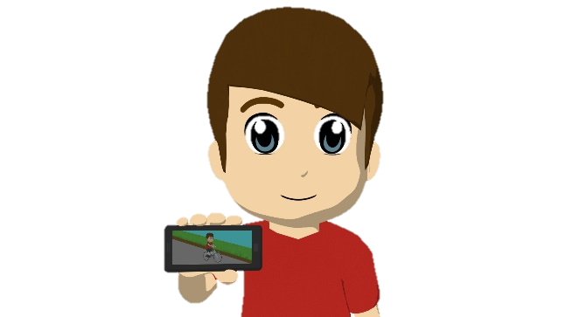
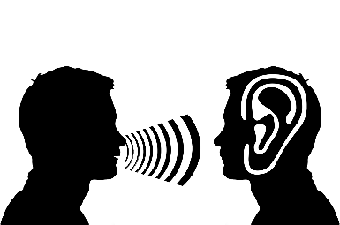
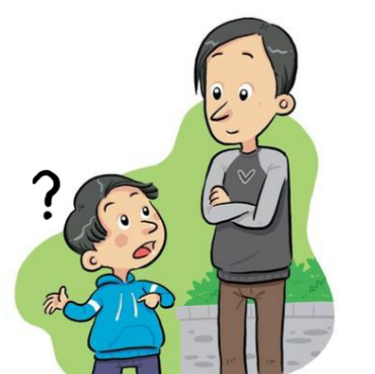
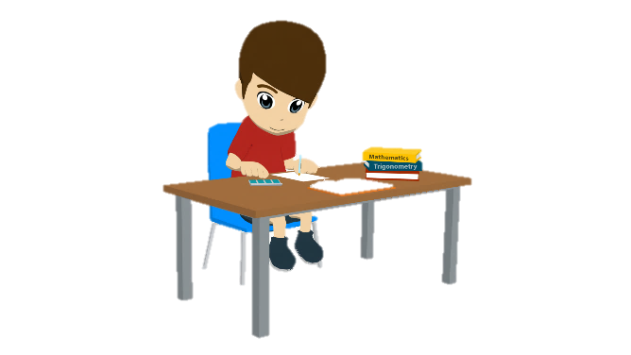
Vokabeln
lesen / schreiben
schreiben
Hallo!
Hallo!
Hallo!
antworten
sprechen
wiederholen
lesen
zeigen
zuhören
wiederholen
zeigen
…
lesen
fragen
sprechen
fragen
schreiben
antworten
zuhören
Notes:
Timing: 5 minutes Aim: To revise the infinitive form of all verbs which can be used to give classroom instructions.
Note: Students have not yet learnt /ö/, /s-/ or /sp-/ as an SSC and may therefore need some help/practice with these.
Procedure: 1. Students read the choices and choose the one that best fits each picture.
2. Teacher elicits answers by pointing at the picture and asking ‘Was ist das?’ to elicit a choral response.
3. Answers appear on your click.
4. Teacher should highlight that these verbs will be used instructions in German from now on, and so it is important that students can understand the meaning in spoken and written form.

Slide 3
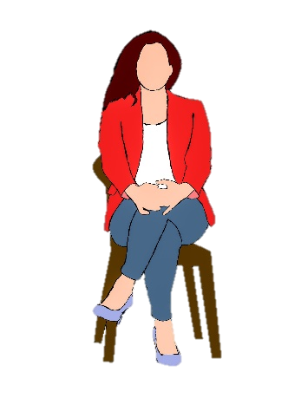
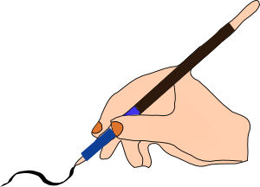
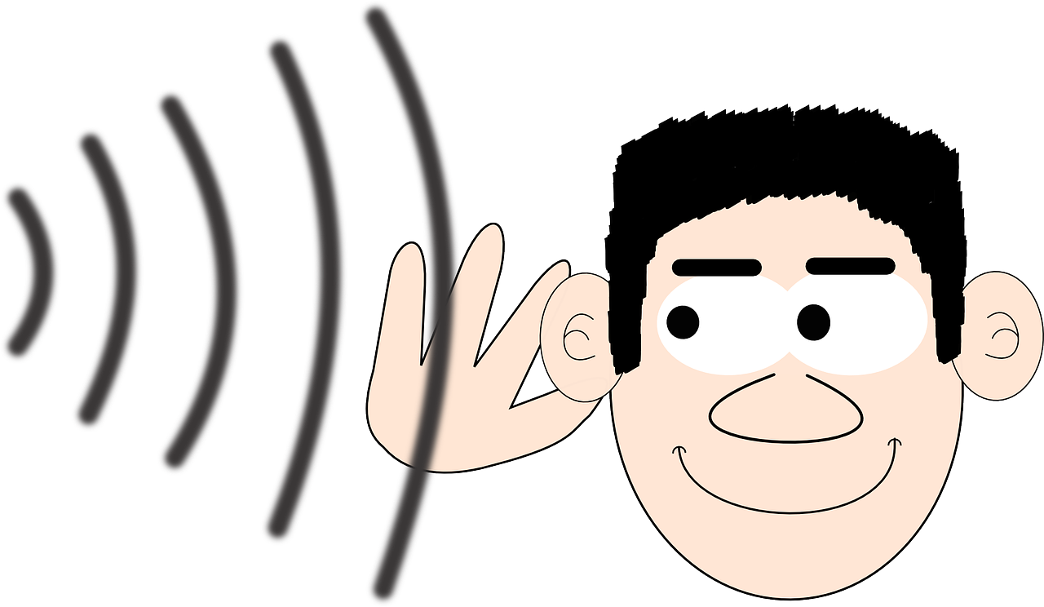
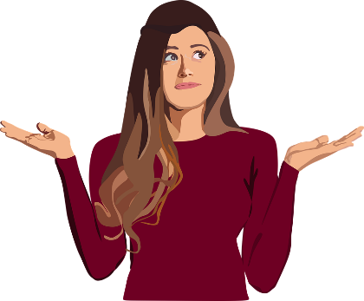
Du bist dran!
hören / sprechen
Schreiben!
Zuhören!
Sitzen!
Lesen!
Zeigen!
Sprechen!
Fragen!
Antworten!
Notes:
Timing: 5 minutes
Aim: To provide additional practice for classroom verbs. Procedure: 1. Teacher first brings up the vocabulary items one by one, and asks students to perform a gesture/mime to represent the meaning. The slide provides example gestures.
2. Once gestures have been agreed, a Simon Says-type game can be played. The students stand up and the teacher hides the slide. The teacher then lists the verbs in a random order. Students must perform the action which corresponds to the word they hear. If they perform the wrong action, or take too long to decide, they are out of the game and must sit down. The last student standing is the winner.

Slide 4
lesen
[to read | reading]
liest
[reads | is reading]
Notes:
Timing: 3 minutes for sequence of six slides
Aim: To introduce the verb lesen more explicitly.
Note: Lesen is one of the LDP 15 prototypical verbs in German. Prototypical verbs are common verbs that illustrate the typical characteristics of a class of verb – the German prototypical verbs contain examples of regular/weak verbs, but also common examples of changes to the stem. All 15 prototypical verbs will be introduced early on using the same format. Both long form (infinitive) and short form (3rd person singular) are introduced in order to familiarise students with various forms of the same verb.
Procedure:
Bring up the word lesen on its own, say it, students repeat it, and remind them of the phonics. Draw attention to long [e]
Try to elicit the meaning from the students. Students have had explicit teaching that the present tense in German communicates two different present tense meanings in English. This reinforces that learning. Emphasise the two meanings for the short form, reminding students that German only has one form and does not have a direct equivalent of the grammar for ‘is + ing’, the continuous form (as covered in previous weeks).
Bring up the picture, and, if using gestures, a possible gesture would be [to mime holding an open book in front of self, and reading it].
Then bring up the English translations. Emphasise the two meanings for the infinitive.
Bring up the short form liest, say it, students repeat it. Draw attention to the stem change to [ie].
Try to elicit the meaning from the students. Emphasise the two meanings for the short form.

Slide 5
lesen
[to read | reading]
liest
[reads | is reading]
Notes:
Cycle through the long and short form again.

Slide 6
liest
[reads | is reading]
Sie liest ein Buch.
[She reads | is reading a book.]
Notes:
Introduce the short form in a sentence.

Slide 7
liest
[reads | is reading]
liest
Sie ____ ein Buch.
[She reads | is reading a book.]
Notes:
Cycle through the short form in context again.

Slide 8
lesen
[to read | reading]
Sie kann ein Buch lesen.
[She can read a book.]
Notes:
Introduce the long form in a sentence.

Slide 9
lesen
[to read | reading]
lesen
Sie kann ein Buch ______.
[She can read a book.]
Notes:
Cycle through the long form in context again.

Slide 10
Order of words in a sentence
Grammatik
A simple German sentence contains a subject and a verb with an ending.
Ich spiele.
Du spielst.
Mia spielt.
I play/am playing.
You play/are playing.
Mia plays/is playing.
We can make the sentence more interesting by adding a noun after the verb.
Ich spiele Fußball.
This word order is the same as in English.
I play/am playing football.
Du spielst Gitarre.
You play/are playing guitar.
Mia spielt Tennis.
Mia plays/is playing Tennis.
Notes:
Timing: 4 minutes (two slides) Aim: To provide a reminder of the order and formation of sentence components.
Procedure: 1. Click to animate the explanation.
2. This part is revisiting. Elicit the English for each German example.
3. Move to the next slide.

Slide 11
Order of words in a sentence
Grammatik
An adverb adds information about when, how or where something happens.
The adverb normally comes after the verb. It splits up the verb and noun.
Ich spiele mit Freunden Fußball.
So, if a sentence contains an adverb, the word order is different from English.
I am playing football with friends.
Du spielst zu Hause Gitarre.
You are playing guitar at home.
Mia spielt manchmal Tennis.
Mia sometimes plays Tennis.
Notes:
Procedure: 1. Click to animate the explanation.
2. Teacher to pay special attention to the word order with adverbs, highlighting that a word-for-word translation from English will result in incorrect word order: if the sentence contains a time, manner or place, this must come after the verb and before the noun.
Note: At this point we are teaching the word order in a sentence with ONE adverb only. We are not aiming to introduce the time, manner, place rule for multiple adverbs.
3. Ensure students’ understanding at each stage.

Slide 12
Sätze bauen (building sentences)
lesen / schreiben
Schreib den Satz.
spielen
nie
Gitarre
er
Er
spielt
nie
Gitarre.
Notes:
Timing: 5 minutes (two slides) Aim: To practise using correct word order in sentence formation (writing).
Procedure: 1. Students rearrange the jigsaw pieces to produce sentences with correct word order. Teacher to remind students to think about word order and verb endings.
2. Click to reveal the answers piece by piece.
Note: teachers may want to model the thinking with this first sentence and hand over to students to work independently on the 2nd.

Slide 13
Sätze bauen (building sentences)
lesen / schreiben
Schreib den Satz.
du
jeden Tag
Mathe
lernen
Du
lernst
jeden Tag
Mathe
Notes:
[2/2]

Slide 14
Order of words in a question
Grammatik
Sentences are turned into questions by swapping the verb and subject.
Du spielst zu Hause Gitarre.
Spielst du zu Hause Gitarre?
You play/are playing guitar at home.
Do you play / Are you playing guitar at home?
To ask an open question, place a question word in front of the verb.
Only the verb and subject swap places. The adverb and noun stay in the same position.
Wie oft spielst du zu Hause Gitarre?
How often do you play guitar at home?
Wer spielt zu Hause Gitarre?
Who plays / is playing guitar at home?
Notes:
Timing: 2 minutes Aim: To revisit the topic of word order in questions.
Procedure: 1. Click to animate the explanation.
2. Draw attention to word order: VSO for closed questions, Question word + VSO or VO for open questions. Teacher to pay special attention to the word order with adverbs, highlighting that a word-for-word translation from English will result in incorrect word order.
3. Ensure students’ understanding at each stage. Animations allow teachers to elicit the du and er/sie forms of the sentences, as well as the English translations.

Slide 15
Sätze bauen (building sentences)
lesen / schreiben
Schreib die Frage.
kochen
du
Suppe
oft
Kochst
du
oft
Suppe?
Notes:
Timing: 5 minutes (two slides) Aim: To practise using correct word order in sentence formation (writing).
Procedure: 1. Students rearrange the jigsaw pieces to produce sentences with correct word order. Teacher to remind students to think about word order and verb endings.
2. Click to reveal the answers piece by piece.
Note: teachers may want to model the thinking with this first sentence and hand over to students to work independently on the 2nd.

Slide 16
Sätze bauen (building sentences)
lesen / schreiben
Schreib die Frage.
sie
putzen
den Boden
zu
Hause
zu
Hause
den Boden?
Putzt
sie
Notes:
[2/2]

Slide 17
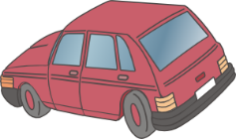
Am Telefon (1/2)
Mia und Oma telefonieren. Oma hat Fragen.
hören
Wer macht was? Schreib M (Mia) oder W (Wolfgang).
1
2
3
4
5
6
7
8
Notes:
Timing: 10 minutes (two slides)
Aim: To practise distinguishing between the first and third person singular forms of verbs (listening).
Procedure: 1. Audio plays on clicking the button on the top right. Students hear a full dialogue rather than individual sentences. Pronouns are obscured so students must listen to the verb ending to decide who is doing what. The dialogue contains negated verbs as well as some red herrings, so students will need to listen carefully to the context to understand the meaning. They may need to hear the audio two or three times.
2. Students can complete the exercise by sketching a 2x4 grid in their workbooks, and writing M or W in each square.
3. Click to advance to the next slide, which displays the answers.
Note: students learned die Frage in 1.1.6 Explain that Fragen is the plural form. Students will learn plural rules in two weeks’ time. Ach so! can be introduced as a conversational filler to mean ‘right!’ ‘okay!’ ‘I see!’
Transcript:
PHONE RINGS
Mia: Hallo?
Oma: Hallo Mia! Hier ist Oma.
Mia: Hallo Oma! Wie gehts?
Oma: Gut, danke! Was machst du? Und was macht Wolfgang?
Mia: [beep] spielt Frisbee und [beep] spiele Computer.
Oma: Was?! Bist du nicht im Garten?
Mia: [beep] ist im Garten. [beep] sitze im Zimmer.
Oma: Du machst Hausaufgaben, nicht wahr? Und Wolfgang?
Mia: [beep] habe eine Matheaufgabe. [beep] hat eine Englischaufgabe.
Oma: Ach so! Putzt Wolfgang den Boden?
Mia: Ich weiß nicht. [beep] putze das Auto. [beep] kocht Spagetti.
Oma: Okay, ich verstehe.

Slide 18
Antworten
Mia und Oma telefonieren. Oma hat Fragen.
hören
Wer macht was? Schreib M (Mia) oder W (Wolfgang).
1
W
2
M
3
W
4
M
5
M
6
W
7
M
8
W
Notes:
Aim: To provide the answers to the exercise on the previous slide.
Procedure: 1. Audio plays on clicking the button on the top right. Students hear the full audio this time (i.e. including pronouns).
2. Teacher uses questions in the third person to elicit answers from students: ‘Wer spielt Tennis? Wolfgang spielt Tennis…’ etc.
3. Click to display the answers one by one.
Transcript:
PHONE RINGS
Mia: Hallo?
Oma: Hallo Mia! Hier ist Oma.
Mia: Hallo Oma! Wie gehts?
Oma: Gut, danke! Was machst du? Und was macht Wolfgang?
Mia: Wolfgang spielt Frisbee und ich spiele Computer.
Oma: Was?! Bist du nicht im Garten?
Mia: Wolfgang ist im Garten. Ich sitze im Zimmer.
Oma: Du machst Hausaufgaben, nicht wahr? Und Wolfgang?
Mia: Ich habe eine Matheaufgabe. Wolfgang hat eine Englischaufgabe.
Oma: Ach so! Putzt Wolfgang den Boden?
Mia: Ich weiß nicht. Ich putze das Auto. Wolfgang kocht Spagetti.
Oma: Okay, ich verstehe.

Slide 19
Am Telefon
schreiben / hören / sprechen
1. Say hello. Ask how your partner is.
3. Say you are in lessons in school and you have a problem.
5. Say you don’t know. He is not there.
7. Say you are doing a task. Ask how you say ‘(e.g. You write’)’ in German
9.Say yes and thank you.
2. Say hello and say ‘not well’ and you are at home.
4. Ask where the teacher is.
6. Ask what the problem is.
8. Tell her what the words are. Ask ‘is that clear’?
10. Respond to the thanks (e.g., ‘no problem!’
Wiederholen!
Notes:
Timing: 13 minutes Aim: to practise productive use of most of this week’s revisited vocabulary in a role play interaction.
Procedure: 1. Give students 8 minutes in pairs to write the dialogue. (Note: these are words and structures we are revisiting from 3 and 9 weeks ago, so it is likely students will need this time).
2. In the remaining 5 minutes, ask students to turn their notes over and carry out the interaction using the English prompts on the board, and glancing at their notes only if they get stuck.
3. Ask them to repeat the task, swapping roles. They should vary items 7 & 8 each time.

Slide 20
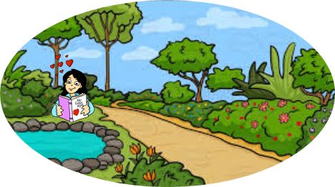
Wer macht was?
Sentence-building from infinitive verbs Present tense: 1st, 2nd, 3rd persons singular
SSC hard and soft [ch]
Y7 German Term 1.2 – Week 4 – Lesson 22 Natalie Finlayson / Rachel Hawkes Artwork: Steve Clarke Date updated: 19.08.23
Meine Traumwoche
Notes:
Artwork by Steve Clarke. All additional pictures selected are available under a Creative Common license; no attribution required.
Learning outcomes (lesson 2):
Consolidation of SSC – long and short [ch] (revisited)
Consolidation of present tense weak verbs: 1st, 2nd, 3rd persons singular
Word frequency (1 is the most frequent word in German):
7.1.2.4 (introduce) lesen [305] sprechen [161] wiederholen [988] zeigen [136] zuhören [1629] Antwort [522] freiwillig [1652]
(Antworten) zeigen! Zuhören! Sprechen! Lesen! Schreiben! Wiederholen!
7.1.2.1 (revisit) lernen [288] machen [58] reden [368] schreiben [184] spielen [205] wohnen [560] Aufgabe [256] Klassenzimmer [>5009] Montag [794] Unterricht1 [1823] mit1 [13] im Klassenzimmer [n/a] im Unterricht [n/a] in der Schule [n/a] mit Freunden [n/a]
7.1.1.2 (revisit) sagen, sagt [40] was?[38] Klasse [961] Mann [121] Paar [241] Tag [111] falsch [524] richtig [177] oder [35] ja1 [45] nein [148] nicht [11] Ist das klar? [n/a]
Source: Jones, R.L. & Tschirner, E. (2019). A frequency dictionary of German: core vocabulary for learners. Routledge

Slide 21
Soft or hard [ch]?
Phonetik
The German /ch/ can be soft or hard.
It is hard after these sounds:
/a/ (machen, acht, Sachen)
/o/ (die Woche, kochen, nochmal)
/u/ (das Buch)
/au/ (auch)
It is soft after other sounds: (manchmal, nicht, richtig).
Notes:
Timing: 10 minutes (two slides) Aim: To provide a reminder of the pronunciation rules for [ch].
Procedure: 1. Click to animate the explanation.
2. Notes: hard and soft here refer to the physiological differences in sound production, i.e. whether the air is forced through the soft palette (‘soft’) or from a place lower in the throat (‘hard’). Students have encountered all words used as examples here with the exception of auch.
3. Ensure students’ understanding at each stage.
Word frequency (1 is the most frequent word in German):
auch [18]
Source: Jones, R.L. & Tschirner, E. (2019). A frequency dictionary of German: core vocabulary for learners. Routledge

Slide 22
Soft or hard [ch]?
lesen / sprechen
Consider the words below. Is the [ch] is soft or hard?
 | soft | hard |  | soft | hard
leicht (light, easy) |  |  | ziemlich (quite, fairly)
brauchen (to need) |  |  | ein bisschen (a bit)
danach (afterwards) |  |  | die Fremdsprache (foreign language)
schlecht (bad) |  |  | lachen (to laugh)
Notes:
Aim: To practise sounding out new words and recognising the different versions of the SSC [ch] that result from the different mouth positions.
Note: Unknown words have been chosen so that students must focus on the sound. The words are all highly frequent and will be introduced over the coming weeks.
Procedure: 1. First, students read the words and decide based on spelling with the [ch] is soft or hard.
2. The teacher then reads the words out loud. Students check their answers based on what they hear.
3. Answers revealed on clicks. Teacher elicits oral pronunciation of the words. The words are comprised of previously studied SSCs and transferable consonants with the exception of [au] brauchen and [sp] in Fremdsprache.
Word frequency (1 is the most frequent word in German):
leicht [285]; danach [437]; brauchen [201]; ziemlich [443]; schlecht [332]; lachen [561]; Fremdsprache [1791]
Source: Jones, R.L. & Tschirner, E. (2019). A frequency dictionary of German: core vocabulary for learners. Routledge

Slide 23
Vokabeln
Was ist die Antwort? Schreib auf Deutsch.
lesen und schreiben
?
A. Was machst du in England?
B. Nicht falsch.
C. Wo bist du?
D. Was ist das? →
E. Was machst du in der Schule?
F. Wo ist das Klassenzimmer?
G. Nicht richtig.
H. Das ist ein Tag.
I. Was machst du mit einer Gitarre?
J. Du redest …
K. Er ist keine Frau.
L. Was machst du im Unterricht?
 |  |  |  |  |  |  |  | W | O | H | N | E | N
 |  |  |  |  |  |  | R | I | C | H | T | I | G
I | M | - | K | L | A | S | S | E | N | Z | I | M | M | E | R
 |  |  |  |  |  |  |  | D | A | S | - | P | A | A | R
 |  |  |  |  |  |  | L | E | R | N | E | N
 |  |  | I | N | - | D | E | R |  | S | C | H | U | L | E
 |  |  | F | A | L | S | C | H
 |  |  |  |  |  |  | M | O | N | T | A | G
 |  |  |  | S | P | I | E | L | E | N
 | M | I | T | - | F | R | E | U | N | D | E | N
 |  | D | E | R | - | M | A | N | N
 | D | I | E | - | A | U | F | G | A | B | E
Notes:
Timing: 10 minutes Aim: To share the grammar learning objective for the lesson, whilst revising all of the rest of this week’s revisited vocabulary.
Note: A more complex version of this task, in which only the first letter of each word is given, can be found on the next slide.
Procedure: 1. Teacher asks question / gives clue in German as per A – L on slide. 2. Student(s) volunteer(s) the answer (e.g. wohnen).
3. Teacher asks ‘wie schreibt man das?’ 4. Students in chorus (slowly and steadily) respond to spell out the answer: W – O – H – N – E – N. 5. As students spell the word, teacher reveals each letter on a click. This will enable the teacher to pick up on any of the trickier letters, and do some remedial practice in the moment.
Note: Students should have pre-learned the verb ‘wiederholen’ as part of their audio homework, so teacher should explain that this is the noun form.

Slide 24
Vokabeln
Was ist die Antwort? Schreib auf Deutsch.
lesen und schreiben
?
A. Was machst du in England?
B. Nicht falsch.
C. Wo bist du?
D. Was ist das? →
E. Was machst du in der Schule?
F. Wo ist das Klassenzimmer?
G. Nicht richtig.
H. Das ist ein Tag.
I. Was machst du mit einer Gitarre?
J. Du redest …
K. Er ist keine Frau.
L. Was machst du im Unterricht?
 |  |  |  |  |  |  |  | W | O | H | N | E | N
 |  |  |  |  |  |  | R | I | C | H | T | I | G
I | M | - | K | L | A | S | S | E | N | Z | I | M | M | E | R
 |  |  |  |  |  |  |  | D | A | S | - | P | A | A | R
 |  |  |  |  |  |  | L | E | R | N | E | N
 |  |  | I | N | - | D | E | R |  | S | C | H | U | L | E
 |  |  | F | A | L | S | C | H
 |  |  |  |  |  |  | M | O | N | T | A | G
 |  |  |  | S | P | I | E | L | E | N
 | M | I | T | - | F | R | E | U | N | D | E | N
 |  | D | E | R | - | M | A | N | N
 | D | I | E | - | A | U | F | G | A | B | E
Notes:
MORE CHALLENGING VERSION
Timing: 10 minutes Aim: To share the grammar learning objective for the lesson, whilst revising all of the rest of this week’s revisited vocabulary.
Note: A less complex version of this task, in which more letters of each word are given, can be found on the previous slide.
Procedure: 1. Teacher asks question / gives clue in German as per A – L on slide. 2. Student(s) volunteer(s) the answer (e.g. wohnen).
3. Teacher asks ‘wie schreibt man das?’ 4. Students in chorus (slowly and steadily) respond to spell out the answer: W – O – H – N – E – N. 5. As students spell the word, teacher reveals each letter on a click. This will enable the teacher to pick up on any of the trickier letters, and do some remedial practice in the moment.
Note: Students should have pre-learned the verb ‘wiederholen’ as part of their audio homework, so teachers should explain that this is the noun form.

Slide 25
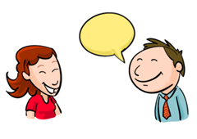
sprechen
[to speak | speaking]
Notice that the vowel in the stem changes from e → i. We will meet more verbs like this later.
spricht
[speaks | is speaking]
Notes:
Timing: 3 minutes for sequence of six slides
Aim: To introduce the verb sprechen more explicitly.
Note: Sprechen is one of the LDP 15 prototypical verbs in German. Prototypical verbs are common verbs that illustrate the typical characteristics of a class of verb – the German prototypical verbs contain examples of regular/weak verbs, but also common examples of changes to the stem. All 15 prototypical verbs will be introduced early on using the same format. Both long form (infinitive) and short form (3rd person singular) are introduced in order to familiarise students with various forms of the same verb.
Procedure:
Bring up the word sprechen on its own, say it, students repeat it, and remind them of the phonics. Draw attention to [ch]
Try to elicit the meaning from the students. Students have had explicit teaching that the present tense in German communicates two different present tense meanings in English. This reinforces that learning. Emphasise the two meanings for the short form, reminding students that German only has one form and does not have a direct equivalent of the grammar for ‘is + ing’, the continuous form (as covered in previous weeks).
Bring up the picture, and, if using gestures, a possible gesture would be [to put hand in front of mouth and make speaking gesture].
Then bring up the English translations. Emphasise the two meanings for the infinitive.
Bring up the short form spricht, say it, students repeat it. Draw attention to [ch].
Try to elicit the meaning from the students. Emphasise the two meanings for the short form.

Slide 26
sprechen
[to speak | speaking]
spricht
[speaks | is speaking]
Notes:
Cycle through the long and short form again.

Slide 27
spricht
[speaks | is speaking]
Er spricht Deutsch.
[He speaks | is speaking German.]
Notes:
Introduce the short form in a sentence.

Slide 28
sprechen
[to speak | speaking]
Er muss Deutsch sprechen.
[He must speak German.]
Notes:
Introduce the long form in a sentence.

Slide 29
spricht
[speaks | is speaking]
spricht
Er ______ Deutsch.
[He speaks | is speaking German.]
Notes:
Cycle through the short form in context again.

Slide 30
sprechen
[to speak | speaking]
sprechen
Er muss Deutsch _________.
[He must speak German.]
Notes:
Cycle through the long form in context again.

Slide 31
Verben
Grammatik
Which word is the verb in the following sentence? How do you know?
Mia kauft oft Bonbons.
‘Bonbons’ cannot be a verb because it does not end in –en, –e, –st or –t. It also begins with a capital letter, which tells you it is a noun.
‘oft’ ends in –t and does not begin with a capital letter. But it cannot be a verb because it does not appear next to the subject. ‘oft’ is an adverb. It usually comes after the verb.
The verb is ‘kauft’. It ends in –t, is not capitalised and appears next to the subject.
To find out the meaning of ‘kauft’, look up the infinitive form in the dictionary.
To form the infinitive, remove –t and add –en:
Mia kauft →
kauf- →
kaufen →
to buy, buying
Notes:
Timing: 3 minutes Aim: To revisit the topic of verbs, to prepare students for the dictionary work in the coming slides.
Procedure: 1. Click to animate the explanation.
2. Remind students how to recognise regular verbs, and how to convert them into infinitive forms to look up in a dictionary
3. Ensure students’ understanding at each stage.

Slide 32
Mias Tagebuch
Finde 28 Verben im Text!
lesen
Mia schreibt ein Tagebuch*.
Wolfgang macht Hausaufgaben, kocht und putzt den Boden. Ich schreibe ein Buch, spiele am Computer oder zeichne. Ich singe oft ein Lied und höre jeden Tag Mark Forster. Mark Forster ist mein
Lieblingssänger. Ich liebe Mark Forster!
Ich putze nicht aber ich arbeite freiwillig im Garten. Ich spiele mit Opa Fußball und zeige Oma Fotos. Und … ja, das ist meine Traumwoche. ☺
Meine Traumwoche 21. November 2022
Ich bleibe jeden Tag zu Hause und gehe nicht in die Schule. Wolfgang hat Unterricht und lernt Englisch aber ich sitze im Garten und rede mit Freunden. Die Sonne scheint jeden Tag und ich trinke Limonade und kaufe im Supermarkt Bonbons. Ich besuche manchmal Nina, meine beste Freundin. Ich gehe mit Nina einkaufen oder schwimmen.
Wolfgang macht Hausaufgaben, kocht und putzt den Boden. Ich schreibe ein Buch, spiele am Computer oder zeichne. Ich singe oft ein Lied und höre jeden Tag Mark Forster. Mark Forster ist mein
Lieblingssänger. Ich liebe Mark Forster!
Ich putze nicht aber ich arbeite freiwillig im Garten. Ich spiele mit Opa Fußball und zeige Oma Fotos.
Und … ja, das ist meine Traumwoche. ☺
Meine Traumwoche 21. November 2019
Ich bleibe jeden Tag zu Hause und gehe nicht in die Schule. Wolfgang hat Unterricht und lernt Englisch aber ich sitze im Garten und rede mit Freunden. Die Sonne scheint jeden Tag und ich trinke Limonade und kaufe im Supermarkt Bonbons. Ich besuche manchmal Nina, meine beste Freundin. Ich gehe mit Nina einkaufen oder schwimmen.
das Tagebuch - diary
Notes:
Timing: 8 minutes Aim: to practise recognising the verbs in a text (reading).
Procedure: 1. Students identify all examples of verbs. They can do this by circling/underlining on a printed copy, or by writing a list in their workbooks.
2. Remind students that the verbs could occur in the short form (ending in –e, -st or –t) or the long form (-en), and that haben and sein are also verbs. All verbs included are regular in the present tense, with the exception of haben and sein which students have learned.
3. All the verbs are highlighted in one go upon clicking the mouse.
Notes:
1) The majority of these verbs have been encountered before, but seven unfamiliar high-frequency verbs are included in preparation for the dictionary work on the next slide:
bleiben [112]; scheinen [276]; besuchen [703]; einkaufen [1789]; schwimmen [1832]; zeichnen [1808]; lieben [816].
Source: Jones, R.L. & Tschirner, E. (2011). A frequency dictionary of German: core vocabulary for learners. Routledge
2) In terms of other unfamiliar items:
a/ Students have not met Tagebuch, but they know ‘Tag’ and ‘Buch’. This is a good opportunity to remind students about compounds. Teacher to explain that as students know the gender of Buch, they also know the gender of any word ending in Buch, as the gender of compound nouns agrees with the final stem. Same with Traumwoche. Teachers to ensure that Tagebuch and Traumwoche are understood by students before starting the task.
b/ Sonne, Limonade, Bonbons, beste and Fotos are all new words, but can be inferred from the English translations.
c/ Teacher to point out the convention for writing dates – with a full stop after the number.
d/ Mark Forster – a German singer/songwriter and TV personality.

Slide 33
Wörterbucharbeit
übersetzen*
Wie ist Mias Traumwoche? Schreib Sätze auf Englisch.
Meine Traumwoche 21. November 2019
Ich bleibe jeden Tag zu Hause und gehe nicht in die Schule. Wolfgang hat Unterricht und lernt Englisch aber ich sitze im Garten und rede mit Freunden. Die Sonne scheint jeden Tag und ich trinke Limonade und kaufe im Supermarkt Bonbons. Ich besuche manchmal Nina, meine beste Freundin. Ich gehe mit Nina einkaufen oder schwimmen.
Wolfgang macht Hausaufgaben, kocht und putzt den Boden. Ich schreibe ein Buch, spiele am Computer oder zeichne. Ich singe oft ein Lied und höre jeden Tag Mark Forster. Mark Forster ist mein
Lieblingssänger. Ich liebe Mark Forster!
Ich putze nicht aber ich arbeite freiwillig im Garten. Ich spiele mit Opa Fußball und zeige Oma Fotos.
Und … ja, das ist meine Traumwoche. ☺
Notes:
Timing: 10 minutes Aim: To provide practice in the use of dictionaries to look up unfamiliar verbs.
Procedure: 1. Tell students that they have already learnt the meanings of 20 of the 28 verbs in this text, but that some new verbs have been included, which they might need to look up.
2. As a reminder, elicit the process that they would need to go to to find the meaning of ‘bleibe’ in the dictionary, i.e. remove the ending –e, add –en, to form the infinitive –bleiben, then look up its meaning in the dictionary.
3. Also remind students of the word order rules discussed in the ‘building blocks’ section of the previous lesson – where does the adverb go?
4. Students can attempt this translation individually at first, and then compare translations with a partner.

Slide 34
Eine Antwort (1/2)
übersetzen
Meine Traumwoche 21. November 2022
Ich bleibe jeden Tag zu Hause und gehe nicht in die Schule. Wolfgang hat Unterricht und lernt Englisch aber ich sitze im Garten und rede mit Freunden. Die Sonne scheint jeden Tag und ich trinke Limonade und kaufe im Supermarkt Bonbons. Ich besuche manchmal Nina, meine beste Freundin. Ich gehe mit Nina einkaufen oder schwimmen.
My dream week 21st November 2019
I stay at home every day and don‘t go to school. Wolfgang has class and learns English but I sit in the garden and chat with friends.
The sun shines every day and I drink lemonade and buy sweets in the supermarket.
I sometimes visit Nina, my best friend.
I go shopping or swimming with Nina.
Notes:
ANSWERS
Timing: 3 minutes Aim: To provide suggested English sentences for the first half of the translation exercise on the previous slide.
Note: This is answer slide 1 of 2.
Procedure: 1. The suggested English sentences appear one by one on clicks.
2. Teacher can present these suggested translations after eliciting suggestions from students.
3. Teacher may wish to collect ideas from the class and come up with a class translation on the board instead.
4. Teacher to stress that there could be several solutions, and to encourage and praise structurally sound alternative suggestions.

Slide 35
Eine Antwort (2/2)
übersetzen
Wolfgang macht Hausaufgaben, kocht und putzt den Boden.
Ich schreibe ein Buch, spiele am Computer oder zeichne.
Ich singe oft ein Lied und höre jeden Tag Mark Forster.
Mark Forster ist mein Lieblingssänger. Ich liebe Mark Forster!
Ich putze nicht aber ich arbeite freiwillig im Garten.
Ich spiele mit Opa Fußball und zeige Oma Fotos.
Und … ja, das ist meine Traumwoche. ☺
Wolfgang does his homework, cooks and cleans the floor.
I write a book, play on the computer or draw.
I often sing a song and I listen to Mark Forster every day.
Mark Forster is my
favourite singer. I love Mark Forster!
I don’t clean, but I work voluntarily in the garden.
I play football with Opa and show Oma photos.
And … yes, that’s my dream week ☺
Notes:
2/2

Slide 36
Hausaufgaben
Vocabulary Learning Homework (Term 1.2, Week 5)
Audio file
Student worksheet
In addition, revisit: Term 1.2 Week 2 Term 1.1 Week 3
Notes:
Use this slide to set the homework.
For Y7, the typical homework will be to pre-learn vocabulary for the next lesson. There is an audio file to accompany the student worksheet.
Notes:
i) Teachers may, in addition, want to recommend use of a particular online app for the pre-learning of each week’s words. ii) Quizlet now requires parental involvement / registration / permissions for users below the age of 13, so it is perhaps most suitable for Y9 – 11 students. iii) Language Nut hosts LDP vocabulary lists and these are free for schools to use, though there is a registration process. One benefit is that all of the student tracking data that Language Nut offers are also available to schools that use the LDP lists for practice. Perhaps this makes it a good option for Y7/8.
iv) There are other free apps, and new ones are always appearing. Teachers have told us that they are currently using: Flippity, Wordwall (where using previously-created activities is free).
v) Gaming Grammar has been acquired by Language Nut. Its original content should still be available to teachers and much of it is appropriate for Y7 learners.

