Slide 1
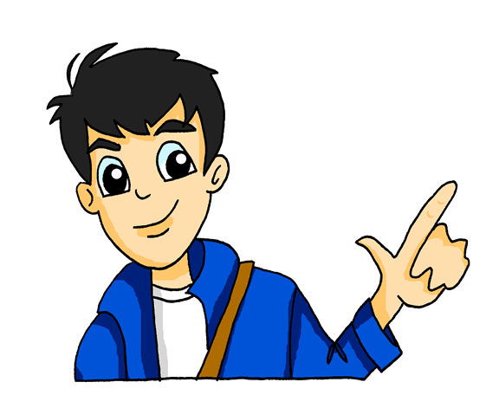
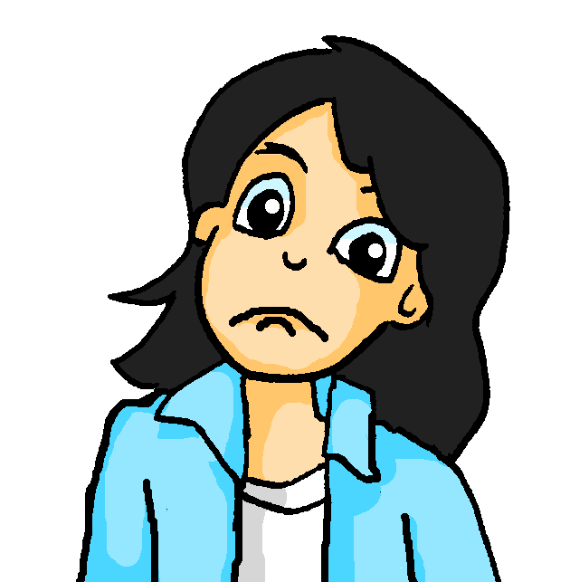
Was machst du zu Hause?
Asking and answering questions about activities at home Present tense (weak) verbs: 1st and 2nd persons singular Wo? was? wer? wie? questions
SSC hard and soft [ch]
@mia2008: Ich koche einmal die Woche und du arbeitest im Garten. OK?
Y7 German Term 1.2 – Week 3 – Lesson 19 Natalie Finlayson / Rachel Hawkes Artwork: Steve Clarke Date updated: 18.08.23
Notes:
Artwork by Steve Clarke. All additional pictures selected are available under a Creative Common license; no attribution required.
Note: All words listed below for this week’s learning (new and revisited) appear on all three Awarding Organisations’ word lists, with the following (previously noted) exception:
i) AQA does not have Tafel, Heft. ii) Edexcel does not have Tafel, Tschüss.
Learning outcomes (lesson 1):
Introduction of SSC – long and short [ch]
Introduction of present tense weak verbs: 1st person singular (juxtaposed with 2nd person singular)
Word frequency (1 is the most frequent word in German):
7.1.2.3 (introduce) gehen [66] hören [146] tanzen [1497] kaum [272] manchmal [382] nie [186] oft [223] sehr [81] einmal die Woche [n/a] jeden Tag [n/a]
7.1.1.7 (revisit) Band [<5009] Buch [300] Film [505] Lehrerin [695] Lied [1733] Sänger [3029] Sängerin [3916] leider [643] Lieblings- [n/a]
7.1.1.1 (revisit) sein¹, ist [4] Fenster [674] Flasche [1602] Heft [3862] Tafel [3855] Tisch [529] da [48] hier [68] wo? [108] der, die, das [1] Hallo! [1077] Tschüs! [3766]
Source: Jones, R.L. & Tschirner, E. (2019). A frequency dictionary of German: core vocabulary for learners. Routledge

Slide 2
ch
ich
Notes:
Timing: 1 minute
Aim: To introduce/consolidate SSC [ch]
Procedure: 1. Present the letter(s) and say the [ch] sound first, on its own. Students repeat it with you. 2. Bring up the word ”ich” on its own, say it, students repeat it, so that they have the opportunity to focus all of their attention on the connection between the written word and its sound.
3. A possible gesture for this would be to do an exaggerated gesture of pointing to yourself.
4. Roll back the animations and work through 1-3 again, but this time, dropping your voice completely to listen carefully to the students saying the [ch] sound, pronouncing ”ich” and, if using, doing the gesture. Word frequency (1 is the most frequent word in German): ich [8]
Source: Jones, R.L. & Tschirner, E. (2006). A frequency dictionary of German: core vocabulary for learners. Routledge

Slide 3
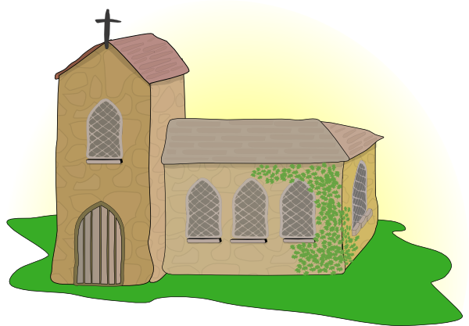
ch
Licht
Kirche
ich
nicht
endlich
[finally]
manchmal
[sometimes]
Notes:
Timing: 2 minutes
Aim: To introduce/consolidate SSC [ch]
Procedure:
Introduce and elicit the pronunciation of the individual SSC [ch] and then the source word again ‘ich’ (with gesture, if using).
Then present and elicit the pronunciation of the five cluster words.
The cluster words have been chosen for their high-frequency, from a range of word classes, with the SSC (where possible) positioned within a variety of syllables within the words (e.g. initial, 2nd, final etc.). Additionally, we have tried to use words that build cumulatively on previously taught SSCs (see the Phonics Teaching Sequence document) and do not include new SSCs. Where new SSCs are used, they are often consonants which have a similar symbol-sound correspondence in English.
Word frequency (1 is the most frequent word in German): ich [8]; Licht [503] Kirche [519]; endlich [496]; manchmal [394]; nicht [12]
Source: Jones, R.L. & Tschirner, E. (2006). A frequency dictionary of German: core vocabulary for learners. Routledge

Slide 4
ch
Licht
Kirche
ich
nicht
endlich
manchmal
Notes:
With sound and no pictures to focus all attention on the sound-symbol correspondence.

Slide 5
ch
Licht
Kirche
ich
nicht
endlich
manchmal
Notes:
Without sound to elicit pronunciation (without first hearing the teacher).
Teacher to elicit pronunciation by asking “Wie sagt man…”

Slide 6
ch
Buch
Notes:
Timing: 1 minute
Aim: To introduce/consolidate SSC [ch]
Procedure: 1. Present the letter(s) and say the [ch] sound first, on its own. Students repeat it with you. 2. Bring up the word ”Buch” on its own, say it, students repeat it, so that they have the opportunity to focus all of their attention on the connection between the written word and its sound.
3. A possible gesture for this would be to mime opening the pages of a book with both hands.
4. Roll back the animations and work through 1-3 again, but this time, dropping your voice completely to listen carefully to the students saying the [ch] sound, pronouncing ”Buch” and, if using, doing the gesture. Word frequency (1 is the most frequent word in German): Buch [195]
Source: Jones, R.L. & Tschirner, E. (2006). A frequency dictionary of German: core vocabulary for learners. Routledge

Slide 7
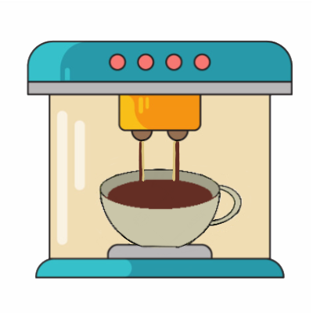
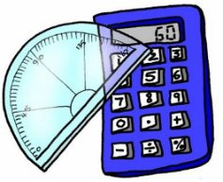
ch
machen
nochmal
Buch
acht
Nacht
Fach
Notes:
Timing: 2 minutes
Aim: To introduce/consolidate SSC [ch]
Procedure:
Introduce and elicit the pronunciation of the individual SSC [ch] and then the source word again ‘Buch’ (with gesture, if using).
Then present and elicit the pronunciation of the five cluster words.
The cluster words have been chosen for their high-frequency, from a range of word classes, with the SSC (where possible) positioned within a variety of syllables within the words (e.g. initial, 2nd, final etc.). Additionally, we have tried to use words that build cumulatively on previously taught SSCs (see the Phonics Teaching Sequence document) and do not include new SSCs. Where new SSCs are used, they are often consonants which have a similar symbol-sound correspondence in English.
Word frequency (1 is the most frequent word in German): Buch [195]; machen [49] nochmal [773]; acht [458]; Fach [698]; Nacht [335]. Source: Jones, R.L. & Tschirner, E. (2006). A frequency dictionary of German: core vocabulary for learners. Routledge

Slide 8
ch
machen
nochmal
Buch
acht
Nacht
Fach
Notes:
With sound and no pictures to focus all attention on the sound-symbol correspondence.

Slide 9
ch
machen
nochmal
Buch
acht
Nacht
Fach
Notes:
Without sound to elicit pronunciation (without first hearing the teacher).
Teacher to elicit pronunciation by asking “Wie sagt man…”

Slide 10
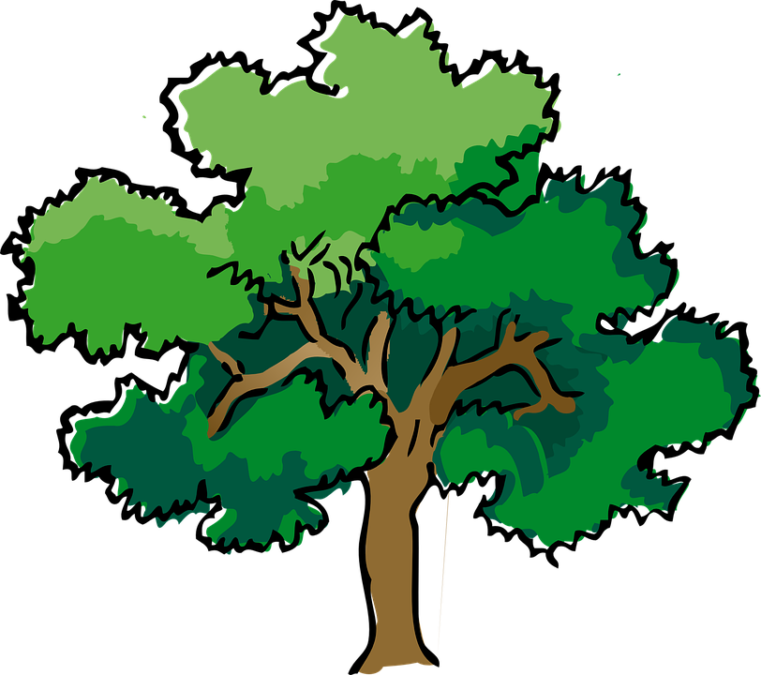
Phonetik
Soft [ch]: ich Hard [ch]: Buch
Hör zu.
hören
soft [ch]
hard [ch]
lachen [to laugh]
einfach
Milch
suchen [to look for]
Every country has a national tree. German has the ‘Eiche’ (oak) and… so does England!
sechzehn
Eiche
Notes:
Timing: 2 minutes
Aim: to distinguish between the SSCs soft [ch] and hard [ch] in the listening modality.
Procedure:
1. Click sound button to play recording for item 1. Pupils decide whether it is soft or hard [ch] and point left for soft and right for hard [ch].
2. Click for answer tick, then for written version, then for picture.
3. Continue for items 2-6.
4. Click to correct and reveal the German written words and their English meanings.
5. Click to bring up the information about Germany’s and England’s national tree.
Transcript:
lachen
einfach
Milch
suchen
sechzehn
Eiche
Note: with the exceptions of Eiche, all of these words are on all three GCSE lists.

Slide 11
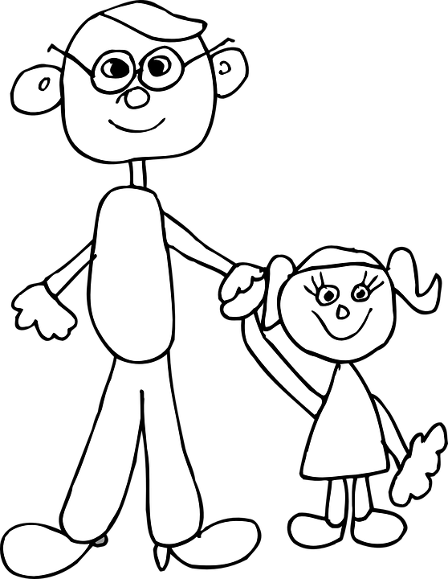
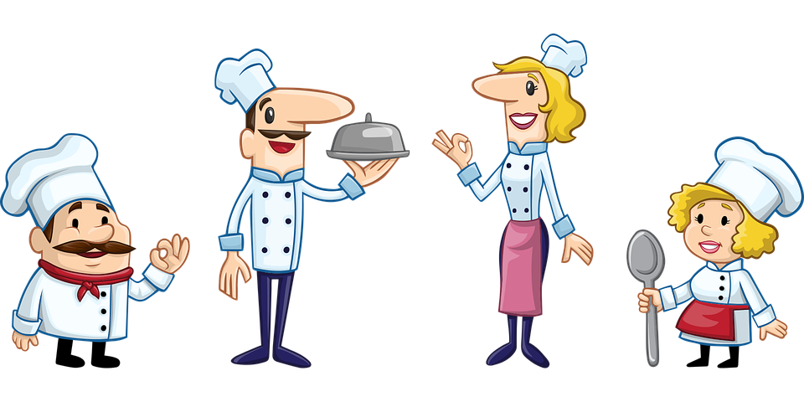
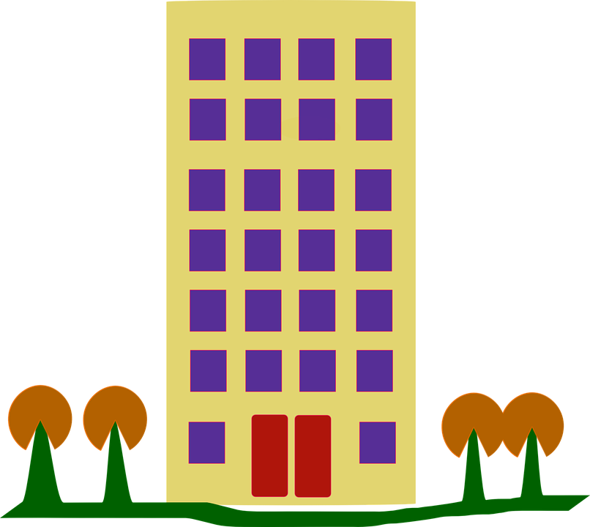
Partnerarbeit
Sag die Wörter.
lesen / sprechen
auch | lachen | acht | suchen | einfach
Tochter | Mittwoch | kochen | weiblich | Buch
nicht | Milch | Kuchen | richtig | sprechen
Eiche | rechts | sechzehn | ich | hoch
60
S
0
START
Notes:
Timing: 5 minutes Aim: To practise the SSC [ch] in a pairwork read aloud and listening task.
Procedure: 1. Pupils work in pairs. Pupil A picks five words from the board, jotting them down, without showing Pupil B.
2. Pupil B has to name the correct five words, by saying each one until s/he has found all five.
3. When all five words have been said students swap roles and repeat. 4. Teachers can click on each picture to check pronunciation with the class, as required.
Frequency of unknown words/cognates:
acht [645] auch [6] Buch [300] Eiche [>5009] einfach [131] hoch [118] kochen [1481] Kuchen [4381] lachen [444] Milch [2276] Mittwoch [1187] nicht [11] rechts [829] richtig [177] sechzehn [4924] sprechen [161] suchen [293] Tochter [694] weiblich [1984] Jones, R.L & Tschirner, E. (2019). A frequency dictionary of German: Core vocabulary for learners. London: Routledge.
Note: with the exceptions of Eiche and weiblich, all of these words are on all three GCSE lists.

Slide 12
Was ist das auf Deutsch?
lesen / sprechen
manchmal
nie
jeden Tag
every day
kaum
sehr
einmal die Woche
Notes:
1/10
Timing: 5 minutes (10 slides)
Aim: to practise written recognition and read aloud of this week’s new vocabulary.
Procedure:
Pupils read the words and decide which word relates to the picture shown.
Teacher asks ‘Was ist das auf Deutsch?’
Click to bring up answer.
If needed, the teacher can prompt for the English meaning ‘Was ist das auf Englisch?’ but it is likely that the meaning is transparently given by the pictures on this occasion.

Slide 13
Was ist das auf Deutsch?
lesen / sprechen
manchmal
nie
jeden Tag
sometimes
kaum
sehr
einmal die Woche
Notes:
2/10

Slide 14
Was ist das auf Deutsch?
lesen / sprechen
einmal die Woche
nie
very
sehr
jeden Tag
kaum
manchmal
Notes:
3/10

Slide 15
Was ist das auf Deutsch?
lesen / sprechen
einmal die Woche
nie
sehr
hardly
jeden Tag
kaum
manchmal
Notes:
4/10

Slide 16
Was ist das auf Deutsch?
lesen / sprechen
oft
sehr
einmal die Woche
never
jeden Tag
nie
manchmal
Notes:
5/10

Slide 17
Was ist das auf Deutsch?
lesen / sprechen
oft
sehr
einmal die Woche
once a week
jeden Tag
nie
manchmal
Notes:
6/10

Slide 18
Was ist das auf Deutsch?
lesen / sprechen
gehen
oft
hören
to go, going
jeden Tag
tanzen
manchmal
Notes:
7/10

Slide 19
Was ist das auf Deutsch?
lesen / sprechen
sein
oft
hören
to hear, listen,
haben
tanzen
gehen
Notes:
8/10

Slide 20
Was ist das auf Deutsch?
lesen / sprechen
machen
tanzen
lernen
often
sehr
oft
gehen
Notes:
9/10

Slide 21
Was ist das auf Deutsch?
lesen / sprechen
machen
gehen
to dance, dancing
spielen
tanzen
lernen
hören
Notes:
10/10

Slide 22
tanzen
[to dance | dancing]
tanzt
[dances | is dancing]
Notes:
Timing: 3 minutes for sequence of six slides
Aim: To introduce the verb tanzen more explicitly.
Note: Tanzen is one of the LDP 15 prototypical verbs in German. Prototypical verbs are common verbs that illustrate the typical characteristics of a class of verb – the German prototypical verbs contain examples of regular/weak verbs, but also common examples of changes to the stem. All 15 prototypical verbs will be introduced early on using the same format. Both long form (infinitive) and short form (3rd person singular) are introduced in order to familiarise students with various forms of the same verb.
Procedure:
Bring up the word tanzen on its own, say it, students repeat it, and remind them of the phonics. Draw attention to the SSC [z].
Try to elicit the meaning from the students. Students have had explicit teaching that the present tense in German communicates two different present tense meanings in English. This reinforces that learning. Emphasise the two meanings for the short form, reminding students that German only has one form and does not have a direct equivalent of the grammar for ‘is + ing’, the continuous form (as covered in previous weeks).
Bring up the picture, and, if using gestures, a possible gesture would be to mime dancing.
Then bring up the English translations. Emphasise the two meanings for the infinitive.
Bring up the short form tanzt, say it, students repeat it. Draw attention to the SSC [z].
Try to elicit the meaning from the students. Emphasise the two meanings for the short form.

Slide 23
tanzen
[to dance | dancing]
tanzt
[dances | is dancing]
Notes:
Cycle through the long and short form again.

Slide 24
tanzt
[dances | is dancing]
Laura tanzt oft.
[Laura often dances.]
Notes:
Introduce the short form in a sentence.

Slide 25
tanzen
[to dance| dancing]
Laura lernt tanzen.
[Laura learns | is learning to dance.]
Notes:
Introduce the long form in a sentence.

Slide 26
tanzt
[dances | is dancing]
Laura _____ oft.
tanzt
[Laura often dances.]
Notes:
Cycle through the short form in context again.

Slide 27
tanzen
[to dance | dancing]
tanzen
Laura lernt _______.
[Laura learns | is learning to dance.]
Notes:
Cycle through the long form in context again.

Slide 28
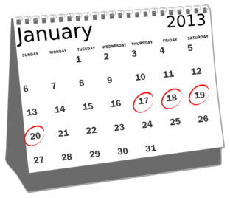
Wie oft?
lesen
Put these adverbs of frequency in order, from most to least frequent.
manchmal
einmal die Woche
nie
jeden Tag
oft
sehr oft
kaum
Notes:
Timing: 5 minutes (two slides) Aim: To consolidate knowledge of the adverbs in this week’s vocabulary set.
Procedure: 1. Explain that adverbs are words that give more information about verbs – here, how often the verb happens.
2. Students write the terms in order.
3. Check meanings are known, and check pronunciation before the main task begins.

Slide 29
Wie oft? Antworten
lesen
Put the adverbs of frequency in order, from most to least frequent.
sehr oft
very often
jeden Tag
every day
oft
often
einmal die Woche
once a week
manchmal
sometimes
kaum
hardly
nie
never
Notes:
Aim: To present the answers to the activity on the previous slide.
Procedure: 1. The correct order appears with the slide.
2. Click to display the English translations of the terms.
3. With the English meanings displayed, try to elicit the German from students, to deepen their knowledge of this week’s vocabulary. This constant repetition of retrieval strengthens the memory of the words, whilst also giving the teacher valuable information as to how well the students know them. i.e. it is a form of ongoing assessment.

Slide 30
Ich oder du?
Grammatik
As we know, the German verb ending tells us who a statement is about:
Ich singe das Lied. Der Sänger singt das Lied.
To talk to or about another person in the du (you) form:
The stem of a verb is what remains when the –en ending is removed from the infinitive, e.g. schreib-, hab-, koch-.
Infinitive
singen
= to sing, singing
you
du singst
= you sing / are singing
Remove –en and add –st.
lernen →
lern- →
du lernst →
you learn / are learning
tanzen →
tanz- →
du tanzt →
you dance / are learning
If the stem ends in –z add only –t.
Notes:
Timing: 2 minutes Aim: To introduce the second person singular form of the verb.
Procedure: 1. Click to animate the explanation.
2. Ensure students’ understanding at each stage.

Slide 31
Ich oder du?
Wer macht was? Schreib ich (I) oder du (you).
lesen
Wolfgang and Mia want to help more often, but they can’t agree!
@mia2008: ___ koche einmal die Woche und ___ arbeitest im Garten.
Du
Ich
b) @der_wolf: Das ist unfair! ___ machst das Bett und ___ putze das Fenster.
du
ich
Du
b) @der_wolf: Nein! ___ putzt jeden Tag den Boden und ___ koche manchmal.
@mia2008: Okay. ___ schreibe eine Liste.
Ich
ich
Ich
Ich
b) @der_wolf: Nein! ___ schreibe die Liste und ___ machst die Arbeit.
@mia2008: Was?! ___ putze manchmal den Boden und ___ machst das Bett.
du
du
Notes:
Timing: 8 minutes Aim: To practise distiguishing between the first and second person singular forms of the verb (reading).
Procedure: 1. Go through question 1 as a whole-class example before giving students time to complete the rest of the activity.
2. Students can complete the activity by writing e.g. a) ich, du in their exercise books.
3. Click to reveal the answers one by one.
4. Remind students of the 3rd person singular form learnt previously by asking ‘Wer kocht? Ich oder du?’ to elicit the response ‘’Ich koche…’ etc.

Slide 32
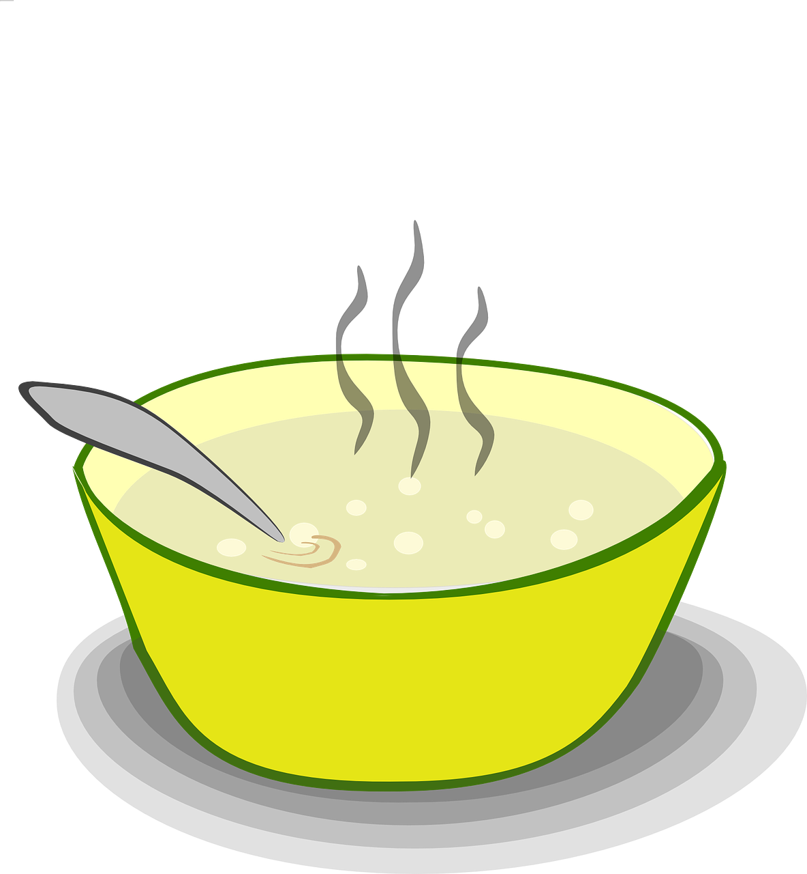
Ich oder du?
Wer macht was? Schreib ich (I) oder du (you).
hören
Mia is reading out a list of what she and Wolfgang do each week.
 | einmal die Woche tanzen gehen |  |  |  | jeden Tag in den Garten gehen
 | kaum Hausaufgaben machen |  |  |  | manchmal Suppe kochen
 | sehr oft Computer spielen |  |  |  | jeden Tag eine Liste schreiben
ich
du
ich
du
A
D
B
E
C
F
Notes:
Timing: 7 minutes Aim: To practise distiguishing between the first and second person singular forms of the verb (listening).
Procedure: 1. Click on the audio buttons to play each recording. Pronouns are obscured by a beep to focus students on the verb ending for meaning.
2. Students can complete the activity by writing e.g. A) ich, du in their exercise books.
3. Click to advance to the next slide to reveal the answers one by one.
Note: All words in this exercise have been encountered previously, with the exception of Suppe which can be inferred from the English soup.
Transcript:
a. _______ gehst einmal die Woche tanzen.
b. _______ machst kaum Hausaufgaben.
c. _______ spielst sehr oft Computer.
d. _______ gehe jeden Tag in den Garten.
e. _______ kochst manchmal Suppe.
f. _______ schreibe jeden Tag eine Liste.
Word frequency (1 is the most frequent word in German):
die Suppe [>5009]
Source: Jones, R.L. & Tschirner, E. (2019). A frequency dictionary of German: core vocabulary for learners. Routledge

Slide 33
Ich oder du?
Wer macht was? Schreib ich (I) oder du (you).
hören
Mia is reading out a list of what she and Wolfgang do each week.
 | einmal die Woche tanzen gehen |  |  |  | jeden Tag in den Garten gehen
 | kaum Hausaufgaben machen |  |  |  | manchmal Suppe kochen
 | sehr oft Computer spielen |  |  |  | jeden Tag eine Liste schreiben
ich
du
ich
du
A
D
B
E
C
F
Notes:
Aim: To present the answers to the activity on the previous slide.
Procedure: 1. Click on the audio buttons to play the full version of each recording (the pronouns were obscured by noises for the acitivity itself).
2. Click to reveal the answers one by one and elicit the English meanings of each sentence, orally. This consolidates knowledge of this week’s and previous weeks’ vocabulary.
Transcript:
a. Du gehst einmal die Woche tanzen.
b. Du machst kaum Hausaufgaben.
c. Du spielst sehr oft Computer.
d. Ich gehe jeden Tag in den Garten.
e. Du kochst manchmal Suppe.
f. Ich schreibe jeden Tag eine Liste.

Slide 34
Fragen
Partnerarbeit. Was ist richtig? Was ist falsch?
lesen / sprechen
1
Hörst du
3
Redest du
Spielst du
dein Lieblingslied?
Verstehst du
dein Lieblingslehrerin?
Gehst du
Spielst du
Singst du
Hörst du
2
Sagst du
4
Kochst du
5
…
Hast du
‘Tschüss’!
Schreibst du
manchmal?
…
das Buch?
Tanzt du
Tanzt du
…
Hörst du
Gehst du
…
Notes:
Timing: 7 minutes
Aim: to practise recognition of verbs and vocabulary from this and previous weeks.
Procedure:
Explain to pupils that they need to decide which verbs could be correct starters to each of the 5 sentences, based on their meaning. Sometimes all verbs might make sense.
Pupils discuss in pairs and write down 1-4 and the verbs they think work for each sentence.
Elicit answers and click for ticks to appear next to correct verbs. Discuss meanings of each question/statement as you correct.
4. For number 5 students come up with their own question starters and volunteer them. Verbs they have learnt that work here are: Hast du, Schreibst du, Verstehst du, Lernst du, Machst du, Putzt du.
Note: Ensure pupils know the meanings of the 5 words in red boxes, as without this knowledge they will struggle to access the task. Also point out the questions and statements. Additional task suggestions: Students make up their own sense and nonsense sentences and questions, and their partner or the class must decide whether or not they make sense.

Slide 35
Wie oft machst du das?
Asking and answering questions about activities at home Present tense (weak) verbs: 1st and 2nd persons singular Wo? was? wer? wie? questions
Y7 German Term 1.2 – Week 3 – Lesson 20 Natalie Finlayson / Rachel Hawkes Artwork: Steve Clarke Date updated: 18.08.23
Notes:
Artwork by Steve Clarke. All additional pictures selected are available under a Creative Common license; no attribution required.
Learning outcomes (lesson 2):
Consolidation of present tense weak verbs: 1st person singular (juxtaposed with 2nd person singular)
Consolidation of VSO questions with question words wo, was, wer, wie
Word frequency (1 is the most frequent word in German):
7.1.2.3 (introduce) gehen [66] hören [146] tanzen [1497] kaum [272] manchmal [382] nie [186] oft [223] sehr [81] einmal die Woche [n/a] jeden Tag [n/a]
7.1.1.7 (revisit) Band [<5009] Buch [300] Film [505] Lehrerin [695] Lied [1733] Sänger [3029] Sängerin [3916] leider [643] Lieblings- [n/a]
7.1.1.1 (revisit) sein¹, ist [4] Fenster [674] Flasche [1602] Heft [3862] Tafel [3855] Tisch [529] da [48] hier [68] wo? [108] der, die, das [1] Hallo! [1077] Tschüs! [3766]
Source: Jones, R.L. & Tschirner, E. (2019). A frequency dictionary of German: core vocabulary for learners. Routledge

Slide 36
Vokabeln
lesen / sprechen
 | Word | English meaning
1 | tanzen | to dance, dancing
2 | gehen | to go, going
3 | hören | to listen/hear
4 | jeden Tag | every day
5 | einmal die Woche | once a week
6 | nie | never
7 | kaum | seldom
8 | manchmal | sometimes
9 | sehr | very
10 | oft | often
Notes:
OPTIONAL ADDITIONAL STARTER SLIDE Timing: 1-4 minutes Aim: To reactivate and strengthen vocabulary knowledge.
Procedure: Round 1: Look at the German, recall the English meanings, saying them aloud. [1 minute] Round 2: Look at the English, recall the German meanings, saying them aloud. [1 minute] Repeat for two further minutes, to speed up recall.

Slide 37
Vokabeln
F
o
s
die __ lasche
w__ ?
der Ti__ch
r
d
a
hie__
die Ban__
der, die, d__s
a
e
die T__fel
s__in
t
das Hef__
g
die Sän__erin
r
Z
leide__
das __immer
e
das F__nster
F
r
a
g
e
o
d
e
r
S
a
t
z
?
Notes:
Timing: 5 minutes Aim: To share the grammar learning objective for the lesson with students, whilst revising previously-learned vocabulary.
Procedure: 1. By working out which letters are missing and putting them in order into the spaces below, students create the question ‘Frage oder Satz?’, which is the grammatical focus for this lesson
2. Elicit the English translation of this question from students to ensure that they are all clear about its meaning. Note: ‘Frage’ is a word students learnt in 1.1.6 but ‘Satz’ is a new, but highly frequent word, which we want to use from now on in classroom language/task instructions. Ensure that the meaning of Satz is clear. Satz appears on both AQA and Eduqas GCSE word lists, but not on Edexcel.
Frequency rankings (1 is the most common word in German):
der Satz [582]
Source: Jones, R.L. & Tschirner, E. (2011). A frequency dictionary of German: core vocabulary for learners. Routledge

Slide 38
Frage oder Satz?
Grammatik
Closed (yes/no) questions
As you know, closed questions are formed by swapping the verb and subject:
Note that when you hear questions, you get an extra clue from the intonation, and when you read, you see the question mark.
Statement
Du | spielst | oft Tennis.
You often play tennis.
Question
Spielst | du | oft Tennis?
Do you often play tennis?
Statement
Du | schreibst | ein Buch.
You are writing a book.
Question
Schreibst | du | ein Buch?
Are you writing a book?
This is how you ask ‘do’ or ‘are’ questions in German.
Notes:
Timing: 3 minutes Aim: To revisit knowledge that students were taught in 1.1.7 on the formation of closed questions.
Procedure: 1. Click to animate the explanation.
2. Highlight that German does not have a word for do/does, or the continuous equivalent are/is, and that inversion must be used to translate these.
3. Ensure students’ understanding at each stage.

Slide 39
Frage oder Satz?
hören
Zorg is making observations about Wolfgang. He can produce a lot of words, but lacks intonation (and manners!)
Is Zorg asking a question or making a statement? Write ? or .
?
.
C
?
A
B
.
.
?
D
E
F
Notes:
Timing: 5 minutes
Aim: To revisit the VSO syntax of questions vs SVO of statements.
Note: This slide is the full task slide.
Procedure: 1. Click on the audio buttons to play each recording. The voice is robotic and has flat intonation, to remove this clue as to whether each sentence is a question or a statement.
2. Students can complete the activity by writing e.g. A) ?/ . in their exercise books.
3. Click to bring up the answers one by one. Teacher elicits responses by asking ‘Ist A eine Frage oder ein Satz?’ (‘A ist eine Frage … B ist ein Satz …’)
Transcript:
a) Hörst du jeden Tag das Lied
b) Du arbeitest kaum im Garten
c) Putzt du manchmal das Auto
d) Du tanzt nicht so gut
e) Du sitzt oft zu Hause am Computer
f) Gehst du nie in den Garten

Slide 40
Open (wh-) questions
Grammatik
Open (wh-) questions
To ask an open question, place a question word directly in front of the verb:
Closed
Schreibst | du | ein Buch?
Are you writing a book?
Open
Wer
Who is writing a book?
Wo
schreibst | du | ein Buch?
Where are you writing a book?
schreibt |  | ein Buch?
Beispiel:
Was hast du am Montag?
What do you have on Monday?
Wo spielst du Tennis?
Where do you play tennis?
Wie oft putzt du dein Zimmer?
How often do you clean your room?
Wer ist dein Lieblingslehrer?
Who is your favourite (male) teacher?
Notes:
Timing: 3 minutes Aim: To revisit knowledge that students were taught in 1.1.7 on the formation of closed questions.
Procedure: 1. Click to animate the explanation.
2. Draw attention to word order: VSO for closed questions, Question word + VSO or VO for open questions.
3. Ensure students’ understanding at each stage.

Slide 41
Open (wh-) questions
lesen / sprechen
- Was ________ du? - Tennis.
- _________? - Im Sportunterricht.
- ______ oft? - ________ die Woche.
- Mit ___________? - Ja!
- _____ ist der Lehrer? - Herr Meier. Er ist super!
wer
spielst
wo
Wo
spielst
Wie
Einmal
wie
Freunden
einmal
Wer
Freunden
Notes:
Timing: 5 minutes Aim: To practise distiguishing between the first and second person singular forms of the verb (reading/speaking).
Procedure: 1. Students write the text, completing the gaps with one of the options. This will help them further practise the 1st & 2nd person singular form of verbs & question words.
2. Click to reveal the answers one by one.
3. Once complete, they can practise reading this conversation in pairs.
After initial practice reading their own (completed) texts, an extra challenge could be to ask them to practise with the incomplete text displayed on the board. This will prompt speeded recall of the words that are missing!

Slide 42
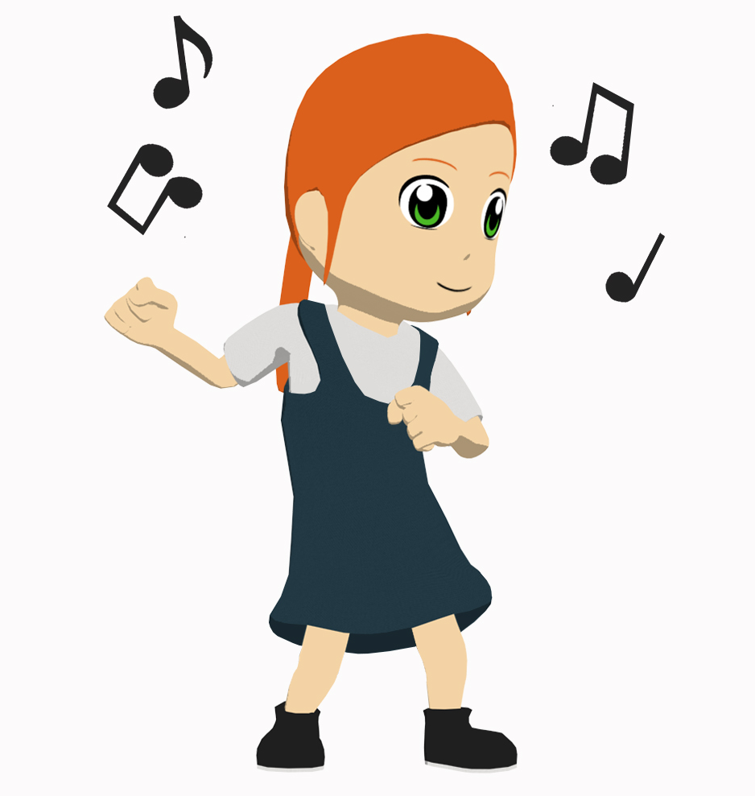
Wie oft machst du das?
Oft, kaum, nicht etc. are adverbs. They come directly after the verb.
sprechen
Frag einen Partner oder eine Partnerin!
Beispiel: “Wie oft spielst du am Computer?” “Ich spiele kaum am Computer.”
oft
manchmal
kaum
nie
einmal die Woche
jeden Tag
Notes:
Timing: 8 minutes Aim: To practise distiguishing between the first and second person singular forms of the verb (speaking).
Note: This version of the speaking task expects students to generate the correct question with no verbal support at all. There is an alternative version on the next slide, which gives the infinitive phrase. That version still requires students to use the correct verb form and question syntax.
Procedure: 1. This slide can be printed and given to pupils, or they can quickly sketch a table in their workbooks.
2. Students know the noun Frage (1.2.6), but have not encountered the verb form, fragen. Teacher to ask students what they think the instruction means and make the connection with Frage.
3. In this oral exercise, students ask a partner how often they do the pictured activities, and tick the appropriate box. 3. On completion, first, second and third person forms can be brought together through teacher elicitation of responses, e.g. ‘Wie oft spielt Mary Computer? Mary spielt kaum Computer’. ‘Wer kocht manchmal?’ ‘Sally kocht manchmal’ etc.

Slide 43
Wie oft machst du das?
Oft, kaum, nicht etc. are adverbs. They come directly after the verb.
sprechen
Frag einen Partner oder eine Partnerin!
Beispiel: “Wie oft spielst du Fußball?” “Ich spiele kaum Fußball.”
 | Fußball spielen | Musik hören | am Computer spielen | kochen | im Garten sitzen | singen | tanzen
oft
manchmal
kaum
nie
einmal die Woche
jeden Tag
Notes:
ALTERNATIVE FORMAT
Timing: 6 minutes Aim: To practise distiguishing between the first and second person singular forms of the verb (speaking).
Note: Alternative format for the speaking activity, giving more support. It is often beneficial to repeat speaking tasks. In this instance, students could first use this supported version of the task, and then repeat the task with a different partner, referring only to the picture table on the previous slide.
Procedure: 1. This slide can be printed and given to pupils, or they can quickly sketch a table in their workbooks.
2. Students know the noun Frage (1.2.6), but have not encountered the verb form, fragen. Teacher to ask students what they think the instruction means and make the connection with Frage.
3. In this oral exercise, students ask a partner how often they do the specified activities, and tick the appropriate box. 3. On completion, first, second and third person forms can be brought together through teacher elicitation of responses, e.g. ‘Wie oft spielt Mary Computer? Mary spielt kaum Computer’. ‘Wer kocht manchmal?’ ‘Sally kocht manchmal’ etc.

Slide 44
Fragen
schreiben
You now know a lot of verbs! Here they are on one slide.
What questions could you ask German students (about home or school) using these verbs? Schreib 5 Fragen.
schreiben
machen
singen
hören
haben
putzen
sein
spielen
gehen
kochen
reden
sitzen
wohnen
sagen
arbeiten
lernen
tanzen
Notes:
Timing: 15 minutes Aim: To revise the infinitive form of all verbs learned so far.
Procedure: 1. Click to bring up the verbs one by one, eliciting the English meaning of each from the students. The final click brings up the main task instruction.
2. Students prepare a survey with questions that they could send to a partner school (where there is a partner school, they should actually do this). First each student writes 5 questions individually.
3. Then they pair up and ensure that they have 10 different ones between them.
4. Then they join with another pair, and decide on the best 10 questions overall, eliminating those they think aren't as interesting.
5. On the slide that follows, the teacher gathers 20 different questions to put as survey to a German class (real or hypothetical).

Slide 45
Fragen
schreiben
Fragen:
Notes:
This is a blank slide for the teacher to use to gather 20 different questions to pose to a German class in a survey (see activity on previous slide).

Slide 46
Hausaufgaben
Vocabulary Learning Homework (Term 1.2, Week 4)
Audio file
Student worksheet
In addition, revisit: Term 1.2 Week 1 | Term 1.1 Week 2
Notes:
Use this slide to set the homework.
For Y7, the typical homework will be to pre-learn vocabulary for the next lesson. There is an audio file to accompany the student worksheet.
Notes:
i) Teachers may, in addition, want to recommend use of a particular online app for the pre-learning of each week’s words. ii) Quizlet now requires parental involvement / registration / permissions for users below the age of 13, so it is perhaps most suitable for Y9 – 11 students. iii) Language Nut hosts LDP vocabulary lists and these are free for schools to use, though there is a registration process. One benefit is that all of the student tracking data that Language Nut offers are also available to schools that use the LDP lists for practice. Perhaps this makes it a good option for Y7/8.
iv) There are other free apps, and new ones are always appearing. Teachers have told us that they are currently using: Flippity, Wordwall (where using previously-created activities is free).
v) Gaming Grammar has been acquired by Language Nut. Its original content should still be available to teachers and much of it is appropriate for Y7 learners. From this lesson, for example, learners could practise Questions: Subject-Verb inversion.

