Slide 1
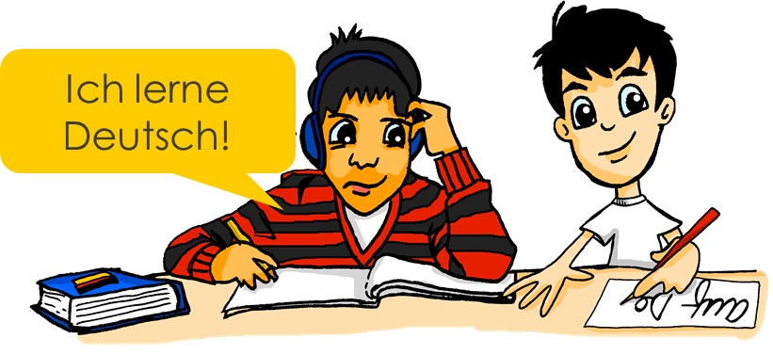
In der Schule und zu Hause
What you do and someone else does in school and at home Present tense (weak) verbs: 1st and 3rd persons singular
SSC long and short [i]
Y7 German Term 1.2 – Week 2 – Lesson 17 Elinor Parks / Rachel Hawkes Artwork: Steve Clarke Date updated: 17.08.23
Notes:
Artwork by Steve Clarke. All additional pictures selected are available under a Creative Common license; no attribution required.
Note: All words listed below for this week’s learning (new and revisited) appear on all three Awarding Organisations’ word lists, with one exception:
AQA and Edexcel do not have putzen.
Learning outcomes (lesson 1):
Introduction of SSC – long and short [i]
Introduction of present tense weak verbs: 1st person singular (juxtaposed with and 3rd person singular)
Word frequency (1 is the most frequent word in German):
7.1.2.2 (introduce) arbeiten [234] kochen [1481] putzen [3586] sitzen [231] Auto [361] Boden [536] Garten [1158] Liste [1792] Zimmer [665] nochmal [1984] ich verstehe nicht [n/a] zu Hause [n/a] Hausaufgaben [Haus+aufgabe]
7.1.1.6 (revisit) habe, hast [6] Beispiel [94] Erste [95] Frage [157] Frau1 [99] Grund [249] Hand [180] Herr [154] Problem [210] Schule [359]
Wer hat einen Grund / eine Frage / ein Beispiel / ein Problem? Wer ist der/die/das Erste?
Source: Jones, R.L. & Tschirner, E. (2019). A frequency dictionary of German: core vocabulary for learners. Routledge

Slide 2
Vokabeln
sprechen
m
das Proble__
W
a
w
das __ asser
ich h__be
nicht __ahr?
c
S__hule
e
a
der H__rr
die Fr__u
H
die __and
r
t
s
die F__age
der, die, das Ers __e
das Bei__piel
W
e
r
m
a
c
h
t
w
a
s
?
Notes:
Timing: 5 minutes Aim: To revise nine items of Week 6 vocabulary and two items from Week 5, also defining the context for this week’s lessons.
Procedure: 1. By working out which letters are missing and putting them in order into the spaces below, students create the question ‘Wer macht was in der Schule und zu Hause?’, which is the context for this week’s lessons.
2. Elicit the English translation of this question from students to ensure that they are all clear about its meaning.

Slide 3
i
wir
Notes:
Timing: 1 minute
Aim: To introduce/consolidate SSC [i]
Procedure: 1. Present the letter(s) and say the [i] sound first, on its own. Students repeat it with you. 2. Bring up the word ”wir” on its own, say it, students repeat it, so that they have the opportunity to focus all of their attention on the connection between the written word and its sound.
3. A possible gesture for this would be to mime putting your arms around two people, one on either side.
4. Roll back the animations and work through 1-3 again, but this time, dropping your voice completely to listen carefully to the students saying the [i] sound, pronouncing ”wir” and, if using, doing the gesture. Word frequency (1 is the most frequent word in German): wir [31]
Source: Jones, R.L. & Tschirner, E. (2006). A frequency dictionary of German: core vocabulary for learners. Routledge

Slide 4
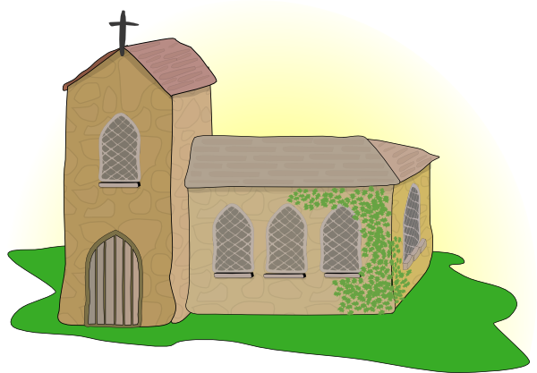
i
Kirche
Familie
wir
Linie
ihr
privat
Notes:
Timing: 2 minutes
Aim: To introduce/consolidate SSC [i]
Procedure:
Introduce and elicit the pronunciation of the individual SSC [i] and then the source word again ‘wir’ (with gesture, if using).
Then present and elicit the pronunciation of the five cluster words.
The cluster words have been chosen for their high-frequency, from a range of word classes, with the SSC (where possible) positioned within a variety of syllables within the words (e.g. initial, 2nd, final etc.). Additionally, we have tried to use words that build cumulatively on previously taught SSCs (see the Phonics Teaching Sequence document) and do not include new SSCs. Where new SSCs are used, they are often consonants which have a similar symbol-sound correspondence in English.
Word frequency (1 is the most frequent word in German): wir [31]; Kirche [519] Familie [310]; Linie [897]; privat [665]; ihr [26]. Source: Jones, R.L. & Tschirner, E. (2006). A frequency dictionary of German: core vocabulary for learners. Routledge

Slide 5
i
Kirche
Familie
wir
Linie
ihr
privat
Notes:
With sound and no pictures to focus all attention on the sound-symbol correspondence.

Slide 6
i
Kirche
Familie
wir
Linie
ihr
privat
Notes:
Without sound to elicit pronunciation (without first hearing the teacher).
Teacher to elicit pronunciation by asking “Wie sagt man…”

Slide 7
i
finden
Notes:
Timing: 1 minute
Aim: To introduce/consolidate SSC [i]
Procedure: 1. Present the letter(s) and say the [i] sound first, on its own. Students repeat it with you. 2. Bring up the word ”finden” on its own, say it, students repeat it, so that they have the opportunity to focus all of their attention on the connection between the written word and its sound.
3. A possible gesture for this would be to mime looking by holding a magnifying glass in your left hand, and pointing to what you’ve found with your right hand.
4. Roll back the animations and work through 1-3 again, but this time, dropping your voice completely to listen carefully to the students saying the [i] sound, pronouncing ”finden” and, if using, doing the gesture. Word frequency (1 is the most frequent word in German): finden [110]
Source: Jones, R.L. & Tschirner, E. (2006). A frequency dictionary of German: core vocabulary for learners. Routledge

Slide 8
i
mit
bitte
finden
Hilfe
wissen
[to know]
interessant
[interesting]
Notes:
Timing: 2 minutes
Aim: To introduce/consolidate SSC [i]
Procedure:
Introduce and elicit the pronunciation of the individual SSC [i] and then the source word again ‘finden’ (with gesture, if using).
Then present and elicit the pronunciation of the five cluster words.
The cluster words have been chosen for their high-frequency, from a range of word classes, with the SSC (where possible) positioned within a variety of syllables within the words (e.g. initial, 2nd, final etc.). Additionally, we have tried to use words that build cumulatively on previously taught SSCs (see the Phonics Teaching Sequence document) and do not include new SSCs. Where new SSCs are used, they are often consonants which have a similar symbol-sound correspondence in English.
Word frequency (1 is the most frequent word in German): finden [110]; mit [13] bitte [547]; wissen [79]; interessant [531]; Hilfe [737]. Source: Jones, R.L. & Tschirner, E. (2006). A frequency dictionary of German: core vocabulary for learners. Routledge

Slide 9
i
mit
bitte
finden
Hilfe
wissen
interessant
Notes:
With sound and no pictures to focus all attention on the sound-symbol correspondence.

Slide 10
i
mit
bitte
finden
Hilfe
wissen
interessant
Notes:
Without sound to elicit pronunciation (without first hearing the teacher).
Teacher to elicit pronunciation by asking “Wie sagt man…”

Slide 11
Phonetik
Some German words look very similar to English words.
hören
However, they may sound different. Is the [i] in the German word the same sound as in English?
Hör zu.
1
2
3
Film
britisch
Triumph
4
5
6
Musik
Tipp
Finger
7
8
9
privat
Berlin
Tennis
Notes:
Timing: 5 minutes
Aim: to practise aural distinction between English and German SSC [i], by listening to cognates.
Procedure:
Do number 1 with pupils to model the task.
Click to hear the German word.
Ask them to tick if they think it is the same [i] sound as in the English word.
Click to reveal the written word and the answer tick or cross.
Repeat steps 2-4 with the remaining eight words.
Transcript:
Film britisch Triumph Musik
Tipp
Finger privat
Berlin
Tennis
Frequency of unknown words and cognates:
Berlin [n/a] britisch [1419] Film [505] Finger [1019] Musik [509] privat [746] Tennis [4671] Tipp [3088] Triumph [4616]
Jones, R.L & Tschirner, E. (2019). A frequency dictionary of German: Core vocabulary for learners. London: Routledge.

Slide 12
Knowing who does what: Weak verbs: ‘I’ versus ‘s/he’
Grammatik
In German, the verb ending often tells us who is doing the action.
Compare:
Remember: the infinitive is the dictionary form. It tells you ‘what’ but not ‘who’.
Infinitive
singen
= to sing
s/he
Sie / er singt
= S/he sings
I
‘Weak’ is another word for ‘regular’.
Ich singe
= I sing
So, for weak German verbs:
For ‘s/he’, remove –en and add –t.
lernen →
lern- →
sie/er lernt →
s/he learns
sagen →
sag- →
ich sage →
I say
For ‘I’, remove –en and add –e.
Notes:
Timing: 4 minutes Aim: To recap verb knowledge introduced so far and introduce the first person singular form. Procedure: 1. Click to animate the explanation.
2. Ensure students’ understanding at all stages.
Note: Teachers may want students to make a brief notes in their exercise books.

Slide 13
Wolfgang und Mia
Wolfgang oder Mia? Schreib W oder M.
lesen
Wolfgang und Mia sind Zwillinge (twins).
Wer macht was in der Schule?
 | Wolfgang sagt:
1
2
3
4
5
6
Wolfgang redet.
W
schreibe ein Lied.
macht Hausaufgaben.
Ich …. aber sie…
sitzt mit Freunden.
sagt viel auf Englisch.
lerne Mathe in der Schule.
spiele Gitarre.
Notes:
Timing: 8 minutes (2 slides) Aim: To practise recognising the first person singular form of the verb, in contrast to the third person singular. Procedure: 1. Emphasize the information in the speech bubble, i.e. that Wolfgang is speaking, so he uses ‘ich’ to talk about himself and ‘sie’ to talk about Mia.
2. Students read the statements and decide whether each applies to Wolfgang, or to Mia.
3. Advance to the next slide to view the animated answers.

Slide 14
Antworten
lesen
Wolfgang
Mia
Ich …. aber sie…
 | Wolfgang sagt:
1
2
3
4
5
6
schreibe ein Lied.
W
M
macht Hausaufgaben.
sitzt mit Freunden.
M
M
sagt viel auf Englisch.
lerne Mathe in der Schule.
W
spiele Gitarre.
W
Notes:
Aim: To provide the answers to the activity on the previous slide.
Procedure: Click to reveal the answers one by one.

Slide 15
Und zu Hause?
hören
Wolfgang oder Mia? Schreib W oder M.
 | Mia redet: = ‘ich’ | Wolfgang = ‘er’
Who makes pizza?
Who plays on the computer?
Who cleans the car?
Who makes the bed?
Who sits in the garden?
Who works in the garden?
Who writes a list?
Ich …. aber er…
1
✔
2
✔
3
✔
4
✔
5
✔
6
✔
7
✔
Notes:
Timing: 7 minutes Aim: To practise distinguishing between first and third person singular forms of the verb. Procedure: 1. Click once to bring up the instructions.
2. Click on the audio buttons to play the sentences. Pronouns are ‘beeped’ out to trap the form, i.e. focus learners only on the verb ending to give the meaning ‘I’ or ‘s/he’.
3. Click again to reveal the answers one by one.
4. Promote global understanding of the main ideas by asking ‘Wer macht mehr, Wolf oder Mia?’ Students have encountered ‘mehr’ in their phonics learning but main need an explanation of the meaning for reinforcement.
Transcript:
1. Er macht Pizza.
2. Ich spiele am Computer.
3. Er putzt das Auto.
4. Er macht das Bett.
5. Ich sitze im Garten.
6. Er arbeitet im Garten.
7. Er schreibt eine Liste.

Slide 16
Wer macht was zu Hause?
sprechen
Tennis
gut
Ich Er / Sie
machen arbeiten reden sitzen
singen spielen wohnen putzen kochen schreiben lernen sagen haben sein
oft
Deutsch
nichts
im Garten
den Boden
Remember: you have to change the verb ending to say ‘who’ does the action.
das Zimmer
in Leipzig
‘Ja!’
Curry
ein Haustier
ein Lied
Notes:
Timing: 10 minutes Aim: To practise sentence formation using the first and third person singular forms of the verb.
Note: Most verb forms can go with more than one option.
Procedure: 1. Partner A: Creates an English sentence that can be made from a combination of the options given (using grammatical knowledge of verb endings, and lexical knowledge of vocabulary provided). S/he tries to use each verb and each item in the circle once. S/he crosses them off on his/her sheet to keep track. When s/he runs out of possible combinations, partners swap roles. 2. Partner B: Translates the sentence into German (developing speed of retrieval and word production / pronunciation). Differentiation: If vocabulary is already well known, Partner B can challenge him/herself to produce the sentences without reference to the sheet.
3. Plenary: Teachers can use this slide to create sentences in English for students to translate into German on mini whiteboards. (Alternatively, students can volunteer English sentences for the class to write in German)
4. Additional, more challenging plenary on the following slide.

Slide 17
Wer macht was?
a football a friend a water bottle a pet
the house the car the floor the list in the classroom in the room in lessons in the garden
in school
with friends at home
schreiben
Articles: ‘the’ or ‘a’? Remember that masculine nouns change their article after these verbs : der → den ein → einen
Schreib auf Deutsch.
I clean
she sits
he cooks
I work
I have
1
2
3
4
5
Notes:
Timing: 8 minutes Aim: to provide an alternative / additional plenary (assessment). Procedure: 1. Students write a sentence, adding one additional element (beyond the pronoun and verb). Remind them of English translations of previously taught nouns, and that any masculine nouns that follow these verbs will change their article (der → den, ein → einen). 2. They write without reference to resources. This assesses retention of key vocabulary from Week 1.1.5 and 1.2.2, as well as grammatical knowledge of verb endings. In addition, the past half-term’s learning of noun gender, definite and indefinite articles, and Row 2 accusative are assessed.
Note: a few multiword phrases are in use at the moment (zu Hause, im Unterricht) because the students have not yet learned about prepositions and their affect on articles. They will learn about the Row 3 (dative) and Row 2 (accusative) use of a few key prepositions in Term 3 of Y7.

Slide 18
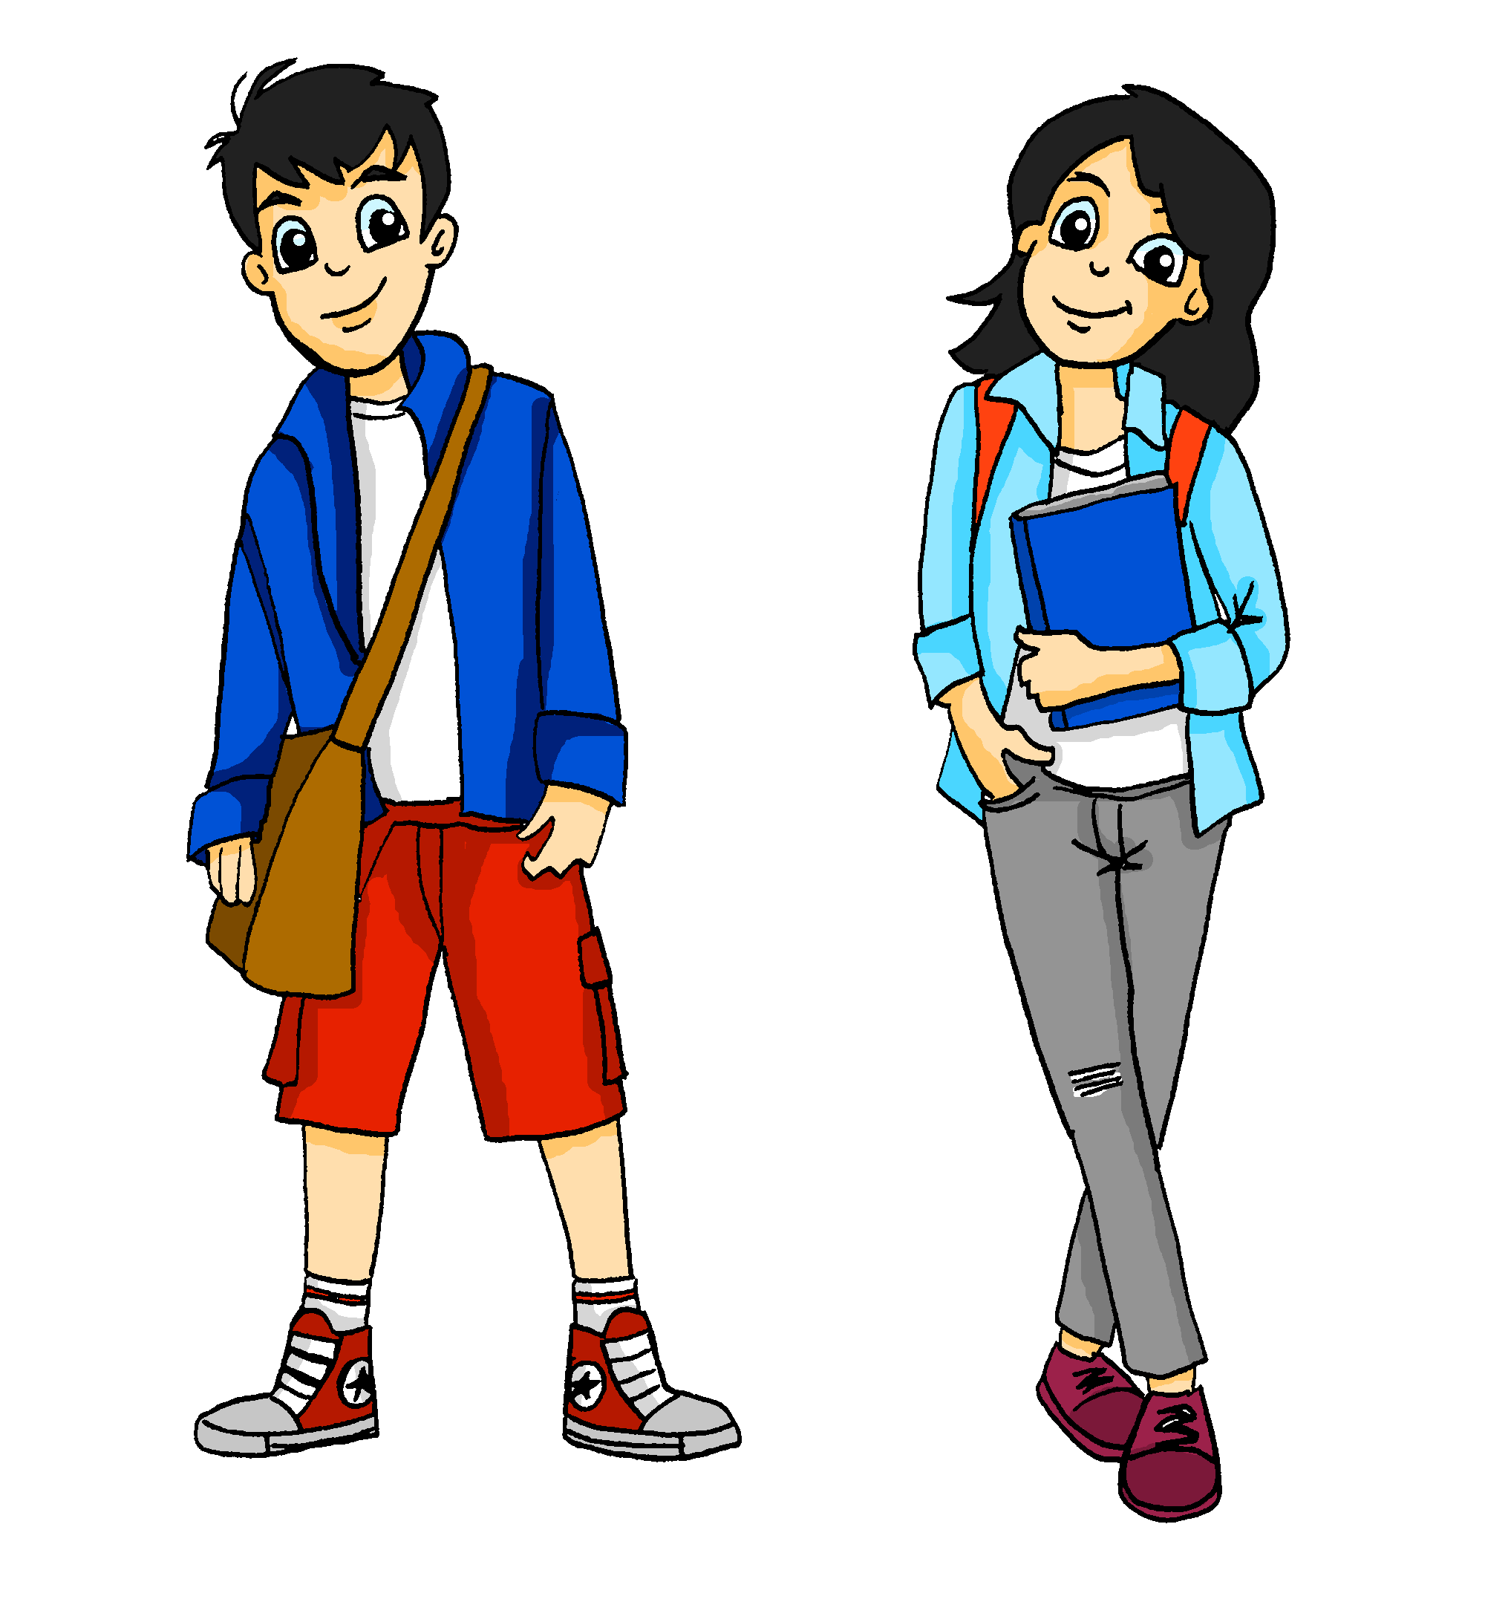
In der Schule und zu Hause
What you do and someone else does in school and at home Present tense (weak) verbs: 1st and 3rd persons singular
SSC long and short [i]
Ich putze den Boden.
Er macht das Bett.
Y7 German Term 1.2 – Week 2 – Lesson 18 Elinor Parks / Rachel Hawkes Artwork: Steve Clarke Date updated: 17.08.23
Notes:
Artwork by Steve Clarke. All additional pictures selected are available under a Creative Common license; no attribution required.
Learning outcomes (lesson 2):
Consolidation of present tense weak verbs: 1st person singular (juxtaposed with and 3rd person singular)
Consolidation of subject prononuns er/sie meaning 'he', 'she'
Word frequency (1 is the most frequent word in German):
7.1.2.2 (introduce) arbeiten [234] kochen [1481] putzen [3586] sitzen [231] Auto [361] Boden [536] Garten [1158] Liste [1792] Zimmer [665] nochmal [1984] ich verstehe nicht [n/a] zu Hause [n/a] Hausaufgaben [Haus+aufgabe]
7.1.1.6 (revisit) habe, hast [6] Beispiel [94] Erste [95] Frage [157] Frau1 [99] Grund [249] Hand [180] Herr [154] Problem [210] Schule [359]
Wer hat einen Grund / eine Frage / ein Beispiel / ein Problem? Wer ist der/die/das Erste?
Source: Jones, R.L. & Tschirner, E. (2019). A frequency dictionary of German: core vocabulary for learners. Routledge

Slide 19
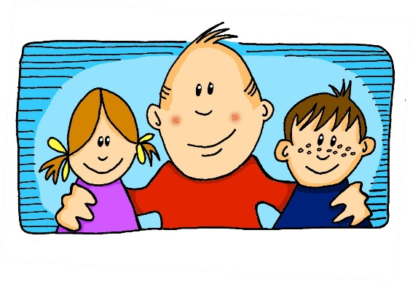
Phonetik
lesen / sprechen
sagen
geben
frei
wir
Welt
kalt
denken
Liebe
finden
Zug
Notes:
Timing: 2 minutes Aim: To recap the 10 SSCs taught so far this year.
Procedure: 1. Click to bring up the SSCs and elicit whole class presentation.
2. Give students a minute to say them again to each other, alternating words.
Note: They are presented in pairs – long/short ‘a’, long/short ‘e’, ei/ie, long/short ‘I’, and finally W and Z (set a little apart on the slide from the others as they are not a pair, as such).

Slide 20
Phonetik
wir
1
Wir sit_en all__n. ☹
Wir sitzen allein. ☹
2
Wir d_nken ‘W_s?!’
Wir denken ‘Was?!’
3
Wir h_ben __n Z_mmer.
Wir haben ein Zimmer.
4
Wir ge_innen __n B_tt.
Wir gewinnen ein Bett.
5
Wir haben einen Gast.
Wir h_ben __n G_st.
6
Wir s_gen ‘Hurr_h’. ☺
Wir sagen ‘Hurra’. ☺
Notes:
Timing: 8 minutes
Aim: to practise transcription and comprehension of cluster word vocabulary.
Note: It’s important to see the source and cluster words as vocabulary, as well. Some students will pick up this language incidentally before it is formally introduced later in the course. The vast majority of phonics and cluster words are in the most frequent 500 words, and almost all appear on all 3 Awarding Organisation word lists, too. For example, in this transcript task the only word that isn’t on the lists is ‘Hurra’ (and Edexcel doesn’t have Gast).
Suggested procedure: 1. Click to play each sentence separately.
2. Students transcribe. 3. Click to play the whole text through for checking. 4. Click to bring up the gapped sentences and elicit student responses orally. 5. Click to provide the full sentence answers.
This slide can be used in a variety of ways:
1) Transcription task. Clicking on the player button top right plays all the sentences in sequence. They can be played individually by clicking on the numbered buttons. Clicking the mouse brings up a gapped version of each sentence in turn, followed by the complete versions.
2) Read aloud task. 3) Translation task. 4) Paired vocabulary tennis task (with gestures for the verbs) 5)Teacher reads aloud (or students do this in pairs), stops on a particular word and students have to say a) the next word b) the word before c) what type of word it is d) give another word that would still make sense in the context.
Transcript:
Wir sitzen allein.
Wir denken ‚was‘?!.
Wir haben ein Zimmer.
Wir gewinnen ein Bett.
Wir haben einen Gast.
Wir sagen ‚Hurra‘.
In the set of 42 words included, there are: 12 verbs (7/25 most common, and classing ‘Danke’ as a verb) 16 nouns (3 genders) 8 adjectives (+ 1 comparative)
2 adverbs (in addition, two adjectives also function as adverbs)
1 indefinite article 1 question word 1 number

Slide 21
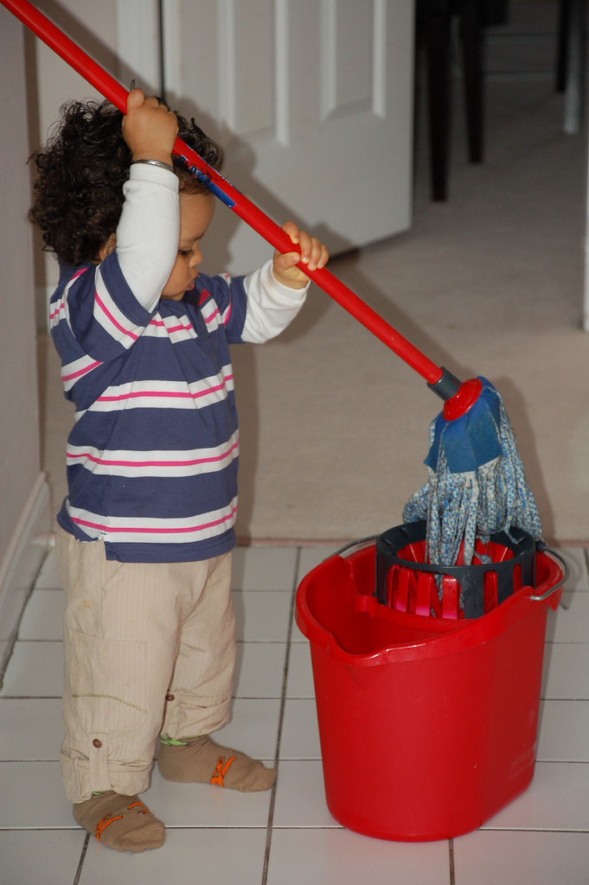
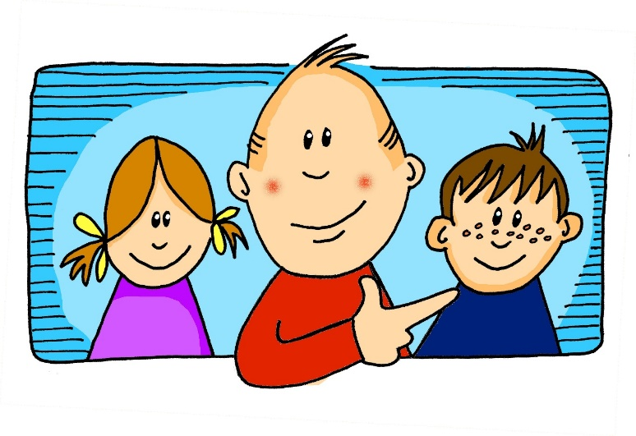
Vokabeln
sprechen
Was macht er?
Er putzt den Boden.
Notes:
Photo: Hardeep Singh from Vancouver, Canada [CC BY 2.0 (https://creativecommons.org/licenses/by/2.0)]
Timing: 10 minutes (10 slides) – but reduce the number of slides, if needed. Aim: To practise the key vocabulary from this week and to prime for the information gap production task that follows.
Procedure: 1. Teacher elicits the language orally from students (or on mini whiteboards, if preferred)

Slide 22
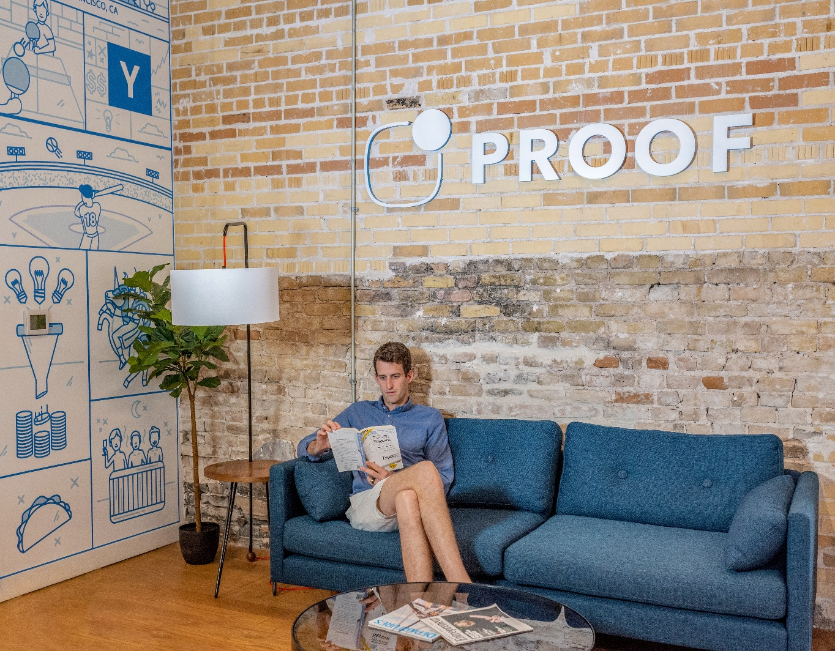
Vokabeln
sprechen
Was machst du?
Ich sitze zu Hause.
Notes:
Photo by Austin Distel on Unsplash
2/10

Slide 23
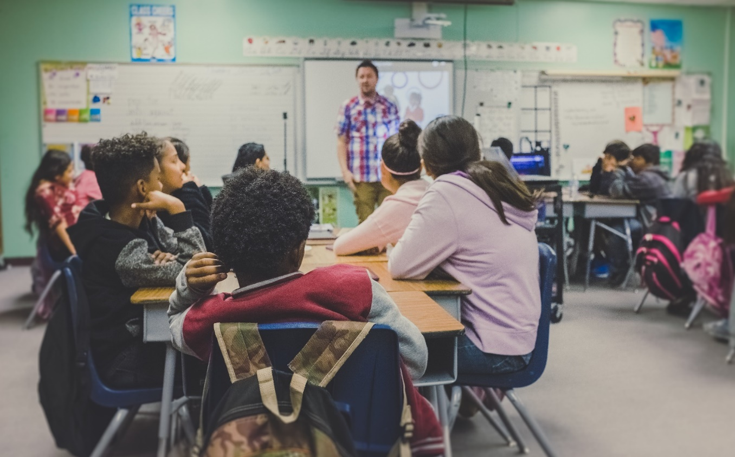
Vokabeln
sprechen
Was macht sie?
Sie sitzt im Klassenzimmer.
Notes:
Photo by Austin Distel on Unsplash
3/10

Slide 24
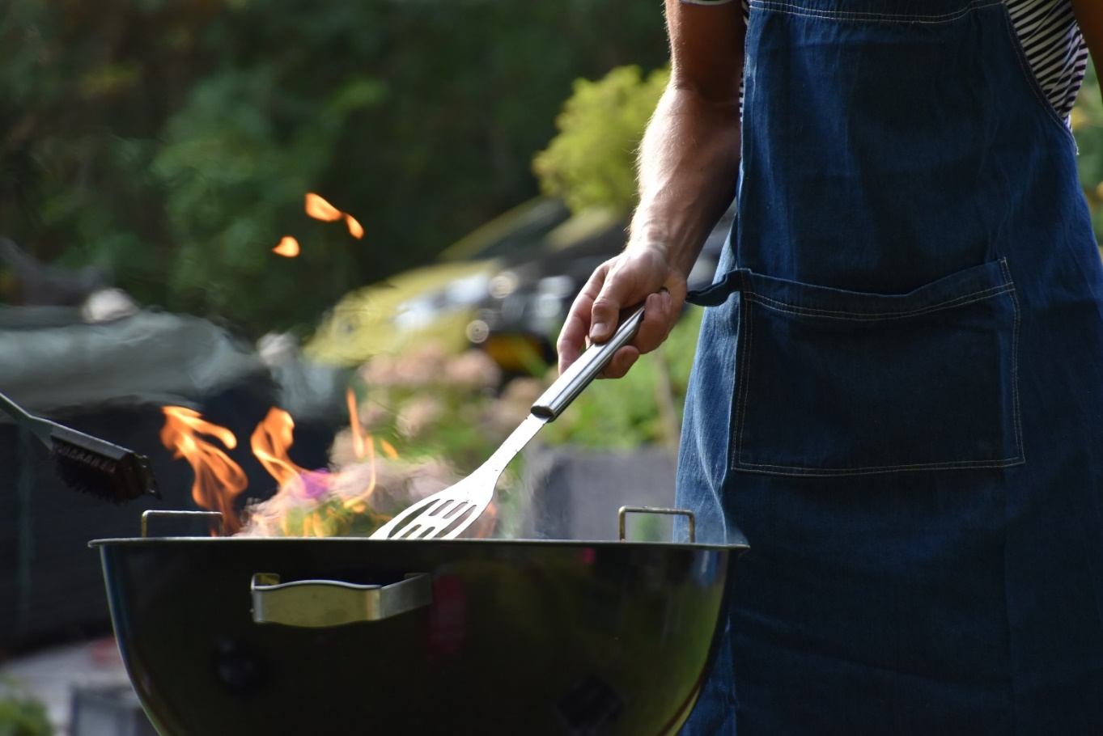
Vokabeln
sprechen
Was macht er?
Er kocht im Garten.
Notes:
Photo by Vincent Keiman on Unsplash
4/10

Slide 25
Vokabeln
sprechen
Was machst du?
Ich arbeite zu Hause.
Notes:
Photo by Thought Catalog on Unsplash
5/10

Slide 26
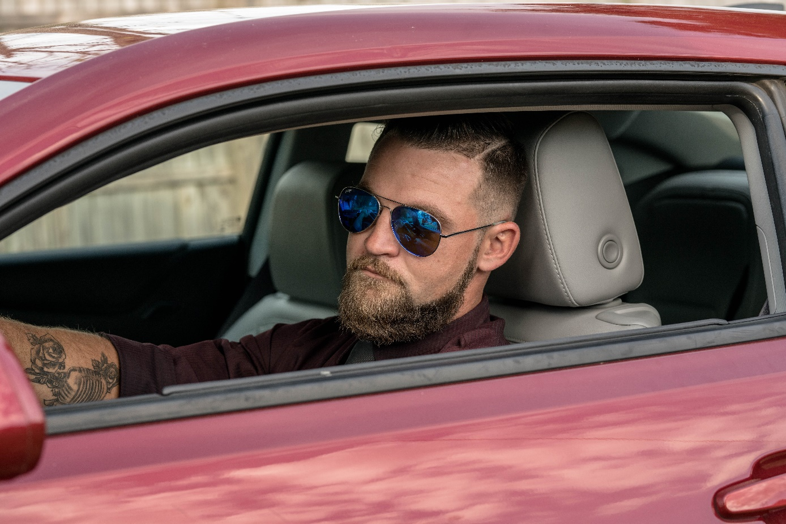
Vokabeln
sprechen
Was macht er?
Er sitzt im Auto.
Notes:
Photo by Blake Barlow on Unsplash
6/10

Slide 27
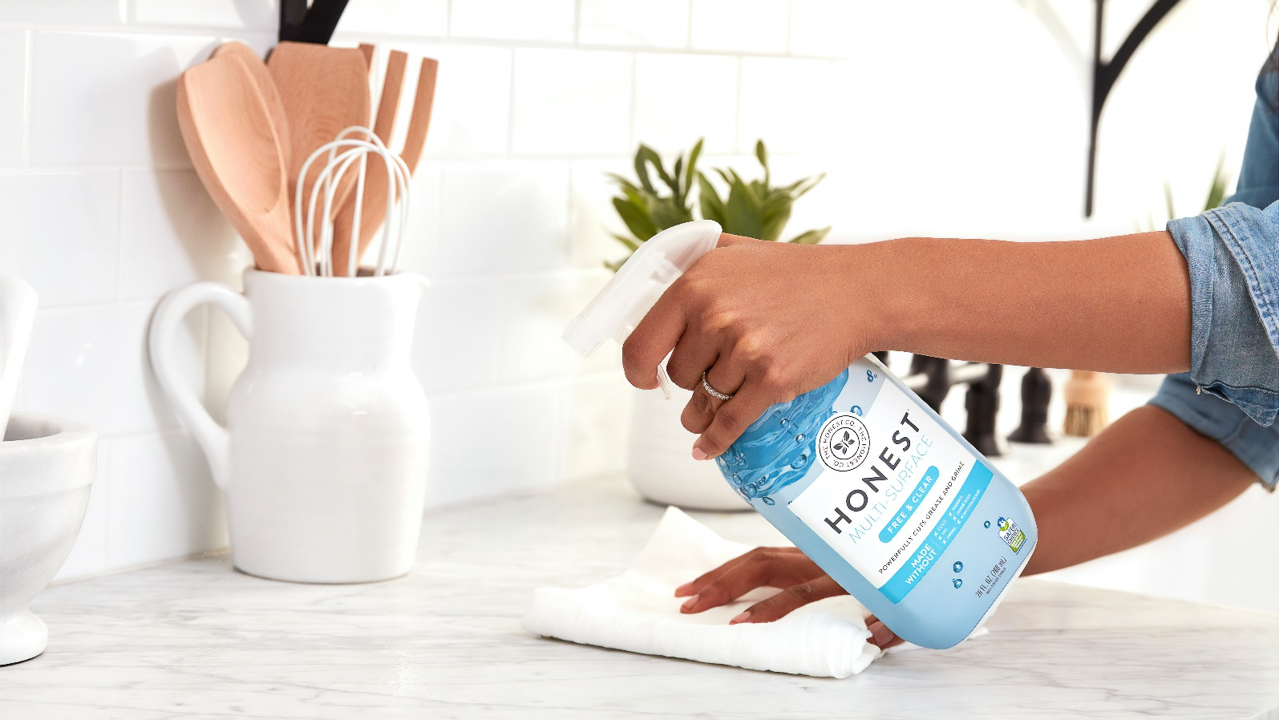
Vokabeln
sprechen
Was macht sie?
Sie putzt das Zimmer.
Notes:
Photo by The Honest Company on Unsplash
7/10

Slide 28
Vokabeln
sprechen
Was machst du?
Ich mache Sport.
Notes:
Photo by Thought Catalog on Unsplash
8/10

Slide 29
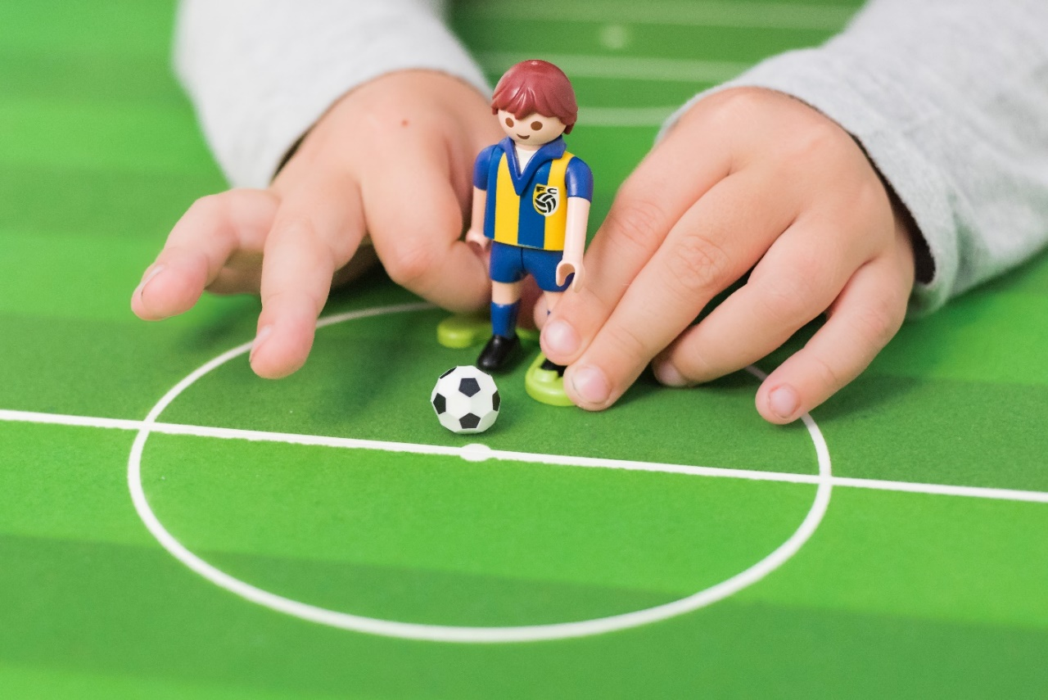
Vokabeln
sprechen
Was machst du?
Ich spiele Fußball.
Notes:
Photo by Click and Boo on Unsplash
9/10

Slide 30
Vokabeln
sprechen
Was macht sie?
Sie schreibt eine Liste.
Notes:
Photo by Plush Design Studio on Unsplash
10/10

Slide 31
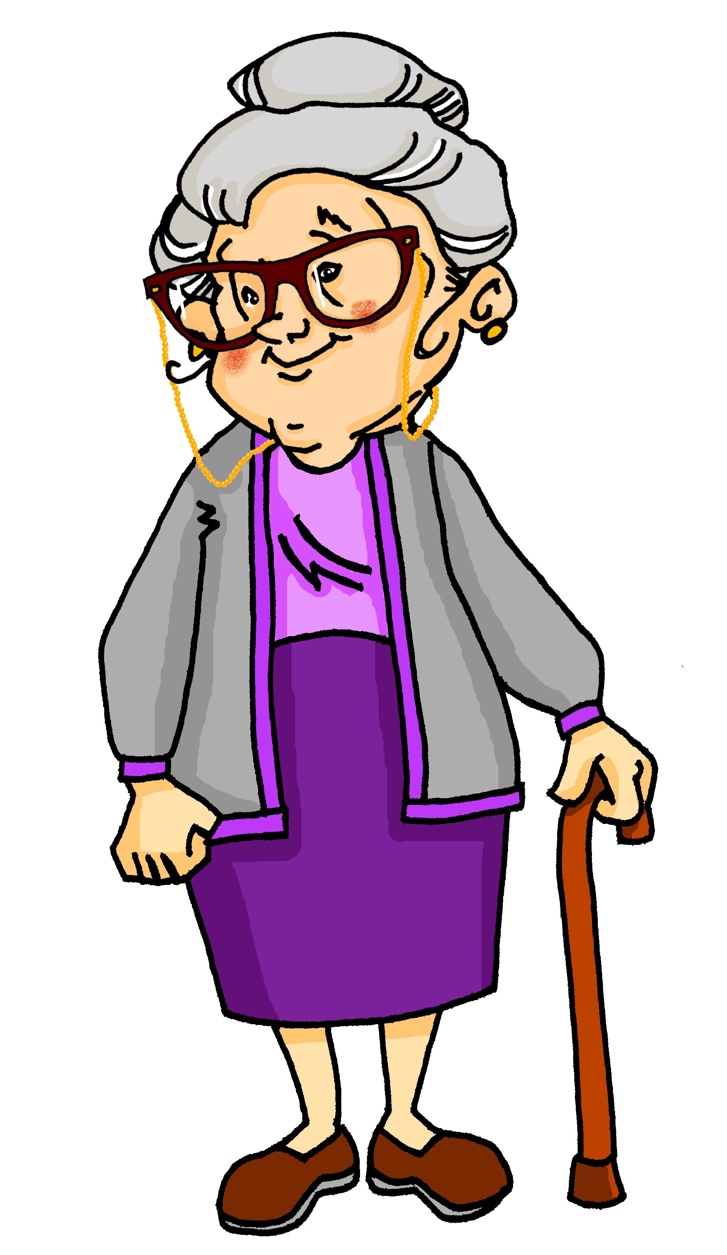
Wer arbeitet zu Hause?
sprechen / hören
Oma says Wolfgang and Mia don’t help enough home.
Partner A: You are Mia. Tell your granny what you (me) and your brother (he) do at home.
Partner B: Make a note of who does what, according to Mia.
Notes:
Timing: 12 minutes (both rounds) Aim: To practise oral sentence production using the first and third person singular forms of the verb Procedure: 1. Elicit the meaning of the TL title. All language has been previously taught.
2. Go through the instructions, which here are given in English, for clarity (information gap tasks can be tricky to explain).

Slide 32
Partner A: Du bist Mia.
Partner B: Turn away from the board.
sprechen / hören
me
work in garden
2. me
clean floor
3. he
play guitar
4. he
sing
5. he
do sport
6. me
make the bed
7. me
clean the room
8. he
sit in the garden
Notes:
This is Partner A’s card.
Procedure: 1. Ensure that Bs turn away from the board before the prompts appear.
2. Click to bring up the prompts. 3. As say all of the sentences in German, and Bs write down 1-8 and the meaning in English.

Slide 33
Antworten
sprechen / hören
1 | Ich arbeite im Garten. | I work in the garden.
2 | Ich putze den Boden. | I clean the floor.
3 | Er spielt Gitarre. | He plays guitar.
4 | Er singt. | He sings.
5 | Er macht Sport. | He does sport.
6 | Ich mache das Bett. | I make the bed.
7 | Ich putze das Zimmer. | I clean the room.
8 | Er sitzt im Garten. | He sits in the garden.
Notes:
ANSWERS – Round 1 A checks what s/he said. B checks what s/he wrote.

Slide 34
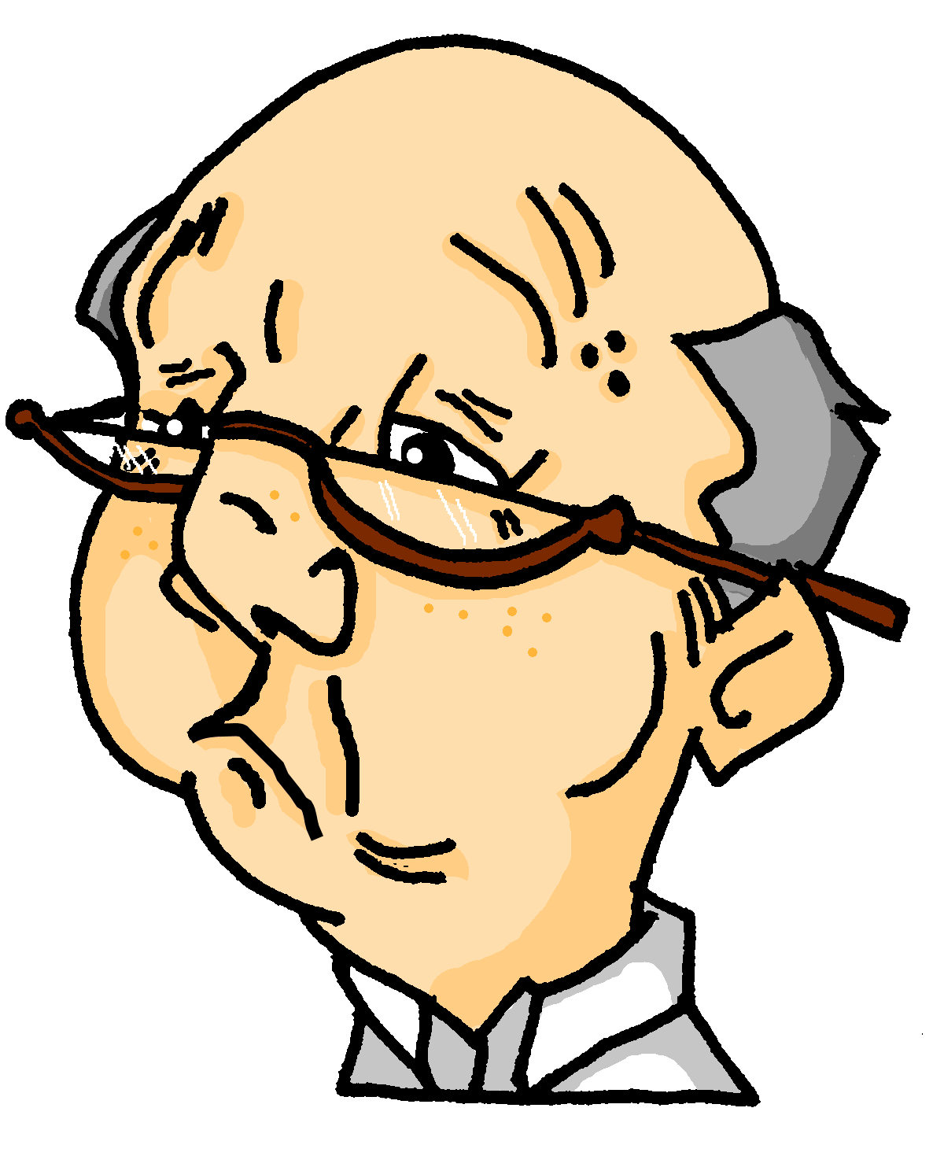
Das ist falsch!
sprechen / hören
Das ist falsch!
Opa (grandpa)arrives.
He says he and Oma do it all.
Partner B: You are Opa. Say what you do (I) and what Oma does (she).
Partner A: Make a note of who does what, according to Opa.
Notes:
This side explains what happens when the partners swap roles.

Slide 35
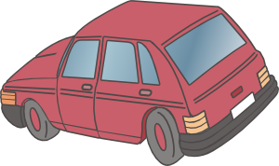
Partner B: Du bist Opa.
Partner A: Turn away from the board.
sprechen / hören
me
clean car
2. she
cook
3. she
clean the floor
4. me
sit in the garden
5. me
write a list
6. me
make the bed
7. she
works in the garden
8. me
work on computer
Notes:
This is Partner B’s card for the second round.
Procedure: 1. Ensure that As turn away from the board before the prompts appear.
2. Click to bring up the prompts. 3. As say all of the sentences in German, and As write down 1-8 and the meaning in English.

Slide 36
Antworten
sprechen / hören
1 | Ich putze das Auto. | I clean the car.
2 | Sie kocht. | She cooks.
3 | Sie putzt den Boden. | She cleans the floor.
4 | Ich sitze im Garten. | I sit in the garden.
5 | Ich schreibe eine Liste. | I write a list.
6 | Ich mache das Bett. | I make the bed.
7 | Sie arbeitet im Garten. | She works in the garden.
8 | Ich arbeite am Computer. | I work on the computer.
Notes:
ANSWERS – Round 2 B checks what s/he said. A checks what s/he wrote.

Slide 37
Wolfgang oder ich (Mia)
Schreib auf Deutsch.
schreiben
Beispiel:
Er macht das Bett.
Er macht
1) ______ ________ das Bett.
2) ______ ________ Nudeln.
3) ______ ________ im Garten
4) ______ ________ am Computer.
5) ______ ________ Sport.
Notes:
(See also the alternative task)
Timing: 5 minutes (two slides) or can be extended so students write their own sentences. Aim: To practise the written form of the first and third person singular forms of the verb.
Procedure: 1. Students write the complete sentence, adding the verb form. 2. The answers are animated on the next slide.

Slide 38
Antworten
Schreib auf Deutsch.
schreiben
Er macht
1) ______ ________ das Bett.
Er kocht
2) ______ ________ Nudeln.
Ich sitze
3) ______ ________ im Garten
Ich arbeite
4) ______ ________ am Computer.
Er macht
5) ______ ________ Sport.
Notes:
ANSWERS

Slide 39
Wer macht was zu Hause?
Use ‘und’, ‘oder’ or ‘aber’ to join ideas together and write longer sentences.
Schreib einen Text auf Deutsch.
Write 6 sentences explaining what you do at home, and what someone else does. You can use their name.
Use at least six different verbs.
arbeiten
sitzen
putzen
kochen
machen
spielen
schreiben
lernen
denken
reden
Notes:
OPTIONAL EXTENSION OR ALTERNATIVE TO PREVIOUS TASK
Timing: 14 minutes
Aim: To provide practice in written production of the verbs covered so far in various persons.
Note: Students should be encouraged to use conjunctions to build longer sentences.
Procedure: 1. Students write 6 sentences in German, as per the prompt.
2. Students can use either their KO or vocabulary guide for support, as needed, particularly as the focus is on the correct use of verb endings, and only the infinitives are listed in these sources.

Slide 40
Hausaufgaben
Vocabulary Learning Homework (Y7, Term 1.2, Week 3)
Audio file
Student worksheet
In addition, revisit: Term1.1 Week 7 Term 1.1 Week 1
Notes:
Use this slide to set the homework.
For Y7, the typical homework will be to pre-learn vocabulary for the next lesson. There is an audio file to accompany the student worksheet.
Notes:
i) Teachers may, in addition, want to recommend use of a particular online app for the pre-learning of each week’s words. ii) Quizlet now requires parental involvement / registration / permissions for users below the age of 13, so it is perhaps most suitable for Y9 – 11 students. iii) Language Nut hosts LDP vocabulary lists and these are free for schools to use, though there is a registration process. One benefit is that all of the student tracking data that Language Nut offers are also available to schools that use the LDP lists for practice. Perhaps this makes it a good option for Y7/8.
iv) There are other free apps, and new ones are always appearing. Teachers have told us that they are currently using: Flippity, Wordwall (where using previously-created activities is free).
v) Gaming Grammar has been acquired by Language Nut. Its original content should still be available to teachers and much of it is appropriate for Y7 learners. From this lesson, for example, learners could practise Definite articles: gender.

