Slide 1
Asking and answering questions
Yes/no questions SSC [ie]
Nein, aber ich habe einen Lieblingsfilm.
Hast du ein Lieblingsbuch?
Y7 German Term 1.1 – Week 7 – Lesson 13 Natalie Finlayson / Rachel Hawkes Artwork: Steve Clarke Date updated: 16.08.23
Notes:
Artwork by Steve Clarke. All additional pictures selected are available under a Creative Common license; no attribution required.
Note: All words listed below for this week’s learning (new and revisited) appear on all three Awarding Organisations’ word lists, with no exceptions.
Learning outcomes (lesson 1):
Introduction of SSC [ie]
Introduction of VSO (verb-subject-object) questions;
Word frequency (1 is the most frequent word in German):
7.1.1.7 (introduce) Band [<5009] Buch [300] Film [505] Lehrerin [695] Lied [1733] Sänger [3029] Sängerin [3916] leider [643] Lieblings- [n/a]
7.1.1.4 (revisit) wissen [78] bist [4] du [54] Farbe [1079] Nummer [806] Ort [341] Tier [614] aber [31] kein [46] ich weiß nicht [n/a] wie sagt man [n/a] wie schreibt man [n/a] das ist (nicht) klar
Source: Jones, R.L. & Tschirner, E. (2019). A frequency dictionary of German: core vocabulary for learners. Routledge

Slide 2
Vokabeln
sprechen
Wie sagt man…?
Notes:
Timing: 10 minutes (11 slides)
Aim: To revise use of ‘wie sagt man...?’ Procedure: 1. Revise use of ‘wie sagt man…’ and responses ‘ich weiß/ich weiß nicht’ in whole class feedback.

Slide 3
Vokabeln
sprechen
die Lehrerin
Notes:
Aim: To introduce the new vocabulary for this week. Procedure: 1. Ask ‘Wie sagt man female teacher auf Deutsch?’
-‘Ich weiß! die Lehrerin’ 2. Ensure that students give the correct definite article as per the homework vocabulary list. 3. Answer revealed on click.
4. Draw attention to the –in suffix. Ask: ‘Und wie sagt man male teacher auf Deutsch?’

Slide 4
Vokabeln
sprechen
der Sänger
Notes:
Procedure: 1. Ask ‘Wie sagt man ... auf Deutsch?’
-‘Ich weiß! ....’ 2. Ensure that students give the correct definite article as per the vocabulary list in the homework. 3. Answer revealed on click.

Slide 5
Vokabeln
sprechen
die Sängerin
Notes:
Procedure: 1. Ask ‘Wie sagt man ... auf Deutsch?’
-‘Ich weiß! ....’ 2. Ensure that students give the correct definite article as per the homework vocabulary list. 3. Answer revealed on click.

Slide 6
Vokabeln
sprechen
der Film
Notes:
Procedure: 1. Ask ‘Wie sagt man ... auf Deutsch?’
-‘Ich weiß! ....’ 2. Ensure that students give the correct definite article as per the homework vocabulary list. 3. Answer revealed on click.

Slide 7
Vokabeln
sprechen
die Band
Notes:
Procedure: 1. Ask ‘Wie sagt man ... auf Deutsch?’
-‘Ich weiß! ....’ 2. Ensure that students give the correct definite article as per the homework vocabulary list. 3. Answer revealed on click.

Slide 8
Vokabeln
sprechen
das Buch
Notes:
Procedure: 1. Ask ‘Wie sagt man ... auf Deutsch?’
-‘Ich weiß! ....’ 2. Ensure that students give the correct definite article as per the homework vocabulary list. 3. Answer revealed on click.

Slide 9
Vokabeln
sprechen
Wie schreibt man…?
Notes:
Procedure: Revise use of ‘wie schreibt man…?’.

Slide 10
Vokabeln
sprechen
das Lied
L – I – E - D
Notes:
Procedure: 1. Ask: ‘Wie schreibt man song auf Deutsch?’
2. Students respond: - ‘Ich weiß – L-I-E-D’, spelling out the word.
3. The contrast between this and the next slide provides a useful introduction to this week’s SSC. Draw attention to the [ie] combination. Take the opportunity to emphasise the SSC ‘ie’ by repeating and eliciting the spelling from students, pointing out each letter. This is one of the trickiest SSCs for students learning German, so it’s worth taking every opportunity to reinforce it.

Slide 11
Vokabeln
sprechen
[unfortunately]
leider
L – E – I – D – E - R
Notes:
Procedure: 1. Ask: ‘Wie schreibt man unfortunately auf Deutsch?’
2. Students respond: - ‘Ich weiß – L-E-I-D-E-R’, spelling out the word.
3. The contrast between this and the next slide provides a useful introduction to this week’s SSC.

Slide 12
Vokabeln
sprechen
Lieblings-
L – I – E – B – L – I – N – G - S
Notes:
Procedure: 1. Ask: ‘Wie schreibt man favourite auf Deutsch?’
2. Students respond: - ‘Ich weiß – L-I-E-B-L-I-N-G-S’, spelling out the word.
3. The contrast between this and the previous slide provides a useful introduction to this week’s SSC. Draw attention to the [ie] combination.

Slide 13
Vokabeln
sprechen
 | Word | English meaning
1 | der Sänger | singer (m)
2 | der Film | film
3 | die Band | band
4 | die Lehrerin | teacher (f)
5 | die Sängerin | singer (f)
6 | das Buch | book
7 | das Lied | song
8 | Lieblings- | favourite
9 | leider | unfortunately
Notes:
Timing: 10 minutes (4 slides) Aim: To consolidate knowledge of this week’s new vocabulary. Procedure: 1. Students spend 2 minutes creating their own paper flashcards with words only (English words on one side German on the other).
Note: We are not expecting at this stage that students can write all of these words accurately in German/English. Therefore provide access to a list of the vocabulary. It does make sense, however, to make this a learning activity, rather than just a copying one. One way to do this is to provide access to the English meanings first, give students 1 minute to write those on each portion of their paper (which they’ve folded into 9 equal rectangular shapes), then to tear them up. Then provide the German list. Students will then need to ensure that they select the correct English piece to write the matching German meaning on the back.
Word frequency (1 is the most frequent word in German): 7.1.1.7 (introduce) Band [<5009] Buch [300] Film [505] Lehrerin [695] Lied [1733] Sänger [3029] Sängerin [3916] leider [643] Lieblings- [n/a]
Source: Jones, R.L. & Tschirner, E. (2019). A frequency dictionary of German: core vocabulary for learners. Routledge

Slide 14
Vokabeln
1
hören
A
B
C
book
singer (m.)
unfortunately
D
E
F
film
favourite
band
G
H
I
song
teacher (f.)
singer (f.)
Notes:
Aim: To provide practice in recognising the new vocabulary in the listening modality. Procedure: 1. Explain to students that they are going to hear nine German words, and that they should arrange their cards in a 3x3 grid as shown (working from A-I), English-side up, in the order they hear the words.
NB: Students don’t add letters to their flashcards, these are just to show the order that they need to place the cards in, according to the order in which the teacher says the words. It’s easier to model this task than explain too much about it. The first time students do it, a few might be unsure, but after the first time, they will immediately know from this slide exactly what they have to do. It’s worth reassuring them of this, the first time you do it!
2. Teacher reads the transcript.
3. Teacher then asks the students ‘Was ist A? Was ist B?’ to elicit the response ‘A ist das Buch, B ist der Sänger etc.. Note: The answers appear in English on the screen under each letter, so all can see/read/check their answers and know if they heard correctly, BUT this task additionally elicits the German from students that can already produce it, so it offers ideal differentiation. On the other hand, if the whole class is already able to produce the language, then the teacher can elicit the answers chorally from the whole class.
4. Answers revealed by clicking the letter.
Transcript:
das Buch, der Sänger, leider, der Film, Lieblings-, die Band, das Lied, die Lehrerin, die Sängerin.

Slide 15
Vokabeln
2
hören
A
B
C
band
song
favourite
D
E
F
film
book
singer (m.)
G
H
I
singer (f.)
unfortunately
teacher (f.)
Notes:
Procedure: As the previous slide or: 1. As an alternative, or additional version, the teacher can give students the transcript to read to a partner, rather than reading it themselves.
2. Students listen to the words and arrange their flashcards in a 3 x 3 grid as shown, in the order they hear the words (from A – I).
3. Teacher then asks the students ‘Was ist A? Was ist B?’ to elicit the response ‘‘A ist die Band, B ist das Lied etc..
4. Answers revealed on clicking the letter.
Transcript:
die Band, das Lied, Lieblings-, der Film, das Buch, der Sänger, die Sängerin, leider, die Lehrerin

Slide 16
Vokabeln
3
hören
A
B
C
singer (m.)
teacher (f.)
band
D
E
F
film
book
singer (f.)
G
H
I
song
unfortunately
favourite
Notes:
Procedure: 1. This third slide could either be a 2nd slide for pairs to swap roles, or the teacher can do a quicker, whole class round, speeding up delivery and reducing the pauses between each vocabulary item to increase the processing challenge for students.
2. Students listen to the words and arrange their flashcards in a 3 x 3 grid as shown, in the order they hear the words (from A – I).
3. Teacher then asks the students ‘Was ist A? Was ist B?’ to elicit the response ‘A ist der Sänger, B ist die Lehrerin’ etc.
4. Answers revealed on clicking the letter.
Transcript:
der Sänger, die Lehrerin, die Band, der Film, das Buch, die Sängerin, das Lied, leider, Lieblings-

Slide 17
Asking questions
Grammatik
Word order
To ask a ‘yes/no’ question in English, ‘do you..’ is followed by a verb.
Statement
Note that when you hear questions, you get an extra clue from the intonation, and when you read, you see the question mark.
You | have | a football.
Question
Do you | have | a football?
In German, just swap the verb and subject (e.g. ‘du’), like this:
Statement
Du | hast | einen Fußball.
Question
Hast | du | einen Fußball?
→
Do you | have | a bottle?
Hast | du | eine Flasche?
Notes:
Timing: 2 minutes Aim: To introduce VSO (verb-subject-object) or yes/no questions. Procedure: 1. Click to animate the explanation.
2. Check students’ understanding at each stage. 3. Tell students that they might find it tricky to remember this because a) the English construction is different, and b) additional clues are provided by intonation in spoken form, and punctuation in written form.

Slide 18
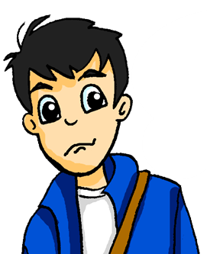
Was schreibt Katrin?
lesen
Mias mum is texting Wolfgang with shopping plans. He is confused as there is no punctuation!
Help Wolfgang. Write "?" after questions and "." after statements.
1. Hast du eine Flasche Cola __
4. Hast du ein Heft __
2. Du hast einen Fußball __
5. Du hast eine Wasserflasche __
3. Hast du ein Buch __
6. Du hast einen Tisch __
Notes:
Timing: 5 minutes (2 slides) Aim: To provide practice in recognising VSO questions (reading modality). Procedure: 1. Students can do the task by writing numbers 1-6 and noting ? or . next to each.
2. Use the next slide to give the answers and ensure comprehension.

Slide 19
Antworten
lesen
1. Hast du eine Flasche Cola __
4. Hast du ein Heft __
?
?
2. Du hast einen Fußball __
5. Du hast eine Wasserflasche __
.
.
3. Hast du ein Buch __
6. Du hast einen Tisch __
?
.
Notes:
Aim: To provide the answers to the task on the previous slide. Procedure: 1. Teacher elicits responses by asking ‘Ist das eine Frage?’ (Ja/nein) and pointing to the item. Students already know ‘Frage’, and the grammatical focus of this week is yes/no questions so the use of those here in input serves to reinforce the pattern. The word for sentence ‘Satz’ [582] is also a high-frequency word, and some teachers might find themselves naturally introducing it here. Note: Students have not yet been taught numbers in the SOW so at this point there is no direction to use them. Depending on the class, some teachers may feel that they can begin to use them in tasks receptively, priming for subsequent teaching.
2. Click to reveal answers one at time.

Slide 20
Ist das eine Frage?
hören
Zorg knows a lot of words but his voice is flat.
Is Zorg asking a question or making a statement? Write ? or .
?
.
A
B
C
D
E
F
Notes:
Timing: 7 minutes (two slides) Aim: To explain the task which follows.
Procedure: 1. NB: This slide is an example to do first with students and correct. It has the answers for A and B.
2. Then go to the next slide for the full exercise. The next slide has the audio and the answers.
3. NB: If it seems strange to students that we have so many appearances from Zorg, the robot, explain that it is important that we remove the audible clues (i.e. raised intonation) that come with questions, so that they only focus on the syntax. Transcript:
a) Hast du ein Haustier
b) Du hast einen Lehrer
c) Hast du eine Hand
d) Hast du einen Tisch
e) Du hast eine Tafel
f) Du hast ein Haus

Slide 21
Ist das eine Frage?
hören
Is Zorg asking a question or making a statement? Write ? or .
?
.
C
?
A
B
?
?
.
D
E
F
Notes:
Procedure: 1. Again, students can do the task by writing numbers 1-6 and noting ? or . next to each.
2. Audio is activated by clicking the individual letters.
3. Answers revealed on clicking the gaps. Teacher elicits responses by asking ‘Ist A eine Frage?’ (Ja/nein)
Transcript:
a) Hast du ein Haustier
b) Du hast einen Lehrer
c) Hast du eine Hand
d) Hast du einen Tisch
e) Hast du eine Tafel
f) Du hast ein Haus.

Slide 22
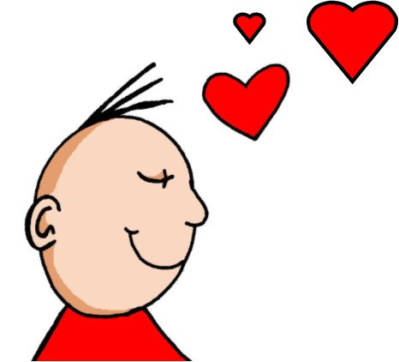
ie
Liebe
Notes:
Timing: 1 minute
Aim: To introduce/consolidate SSC [ie]
Procedure: 1. Present the letter(s) and say the [ie] sound first, on its own. Students repeat it with you. 2. Bring up the word ”Liebe” on its own, say it, students repeat it, so that they have the opportunity to focus all of their attention on the connection between the written word and its sound.
3. A possible gesture for this would be to fold both hands over your heart, and smile!
4. Roll back the animations and work through 1-3 again, but this time, dropping your voice completely to listen carefully to the students saying the [ie] sound, pronouncing ”Liebe” and, if using, doing the gesture. Word frequency (1 is the most frequent word in German): Liebe [843]
Source: Jones, R.L. & Tschirner, E. (2006). A frequency dictionary of German: core vocabulary for learners. Routledge

Slide 23
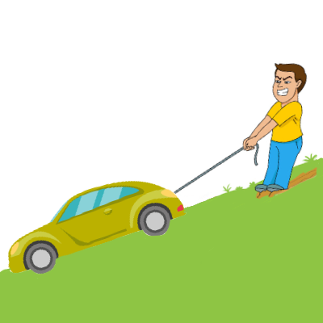
ie
ziehen
sie
Liebe
tief
Brief
liegen
2000 Kilometer
Notes:
Timing: 2 minutes
Aim: To introduce/consolidate SSC [ie]
Procedure:
Introduce and elicit the pronunciation of the individual SSC [ie] and then the source word again ‘Liebe’ (with gesture, if using).
Then present and elicit the pronunciation of the five cluster words.
The cluster words have been chosen for their high-frequency, from a range of word classes, with the SSC (where possible) positioned within a variety of syllables within the words (e.g. initial, 2nd, final etc.). Additionally, we have tried to use words that build cumulatively on previously taught SSCs (see the Phonics Teaching Sequence document) and do not include new SSCs. Where new SSCs are used, they are often consonants which have a similar symbol-sound correspondence in English.
Word frequency (1 is the most frequent word in German): Liebe [843]; ziehen[266] sie [10]; tief [506]; liegen [118]; Brief [813].
Source: Jones, R.L. & Tschirner, E. (2006). A frequency dictionary of German: core vocabulary for learners. Routledge

Slide 24
ie
ziehen
sie
Liebe
tief
Brief
liegen
Notes:
With sound and no pictures to focus all attention on the sound-symbol correspondence.

Slide 25
ie
ziehen
sie
Liebe
tief
Brief
liegen
Notes:
Without sound to elicit pronunciation (without first hearing the teacher).
Teacher to elicit pronunciation by asking “Wie sagt man…”

Slide 26
Phonetik
Hör zu. Ist es [ie] oder [ee]? Schreib das Wort.
hören / schreiben
 | Kaffee |  | Frieden
 | See |  | Tee
 | niemand |  | nee!
1
_ _
4
_ _
[peace]
2
_ _
5
_ _
3
_ _
[no-one]
6
_ _
Notes:
Timing: 5 minutes Aim: To provide aural practice in distinguishing between this week’s SSC [ie] and the previously taught SSC long [e], here represented by the letters ee, specifically because this SSC is pronounced in English in the same way as [ie] in German. Procedure: 1. Students write 1-8, listen to each unknown word and transcribe the missing letters (or the whole word). 2. Click to reveal answers. 3. Pictures and/or words are provided to make meanings clear to students.
Transcript: 1. Kaffee 2. See 3. niemand 4. Frieden 5. Tee 6. Nee!
Word frequency of unknown words (1 is the most frequent word in German): Kaffee [1299] See [1317] niemand [362] Tee [2617] nee [148] Frieden [1696]
Source: Jones, R.L. & Tschirner, E. (2019). A frequency dictionary of German: core vocabulary for learners. Routledge
Note: most of these words are on all 3 GCSE word lists. Exceptions: Tee not on AQA, but on Edexcel and Eduqas. Nee not on Edexcel, but on AQA and Eduqas.

Slide 27
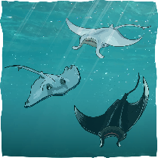
Phonetik
Person A schreibt 5 Wörter. Person B muss alle 5 Wörter sagen.
sprechen
40
[sie]
[Schnee]
[Lied]
[Tee]
[ziehen]
[niemand]
[Nee!]
[Idee]
[Meer]
[Liebe]
Sekunden
[Frieden]
[Kaffee]
[Krieg]
[Brief]
[See]
2000 Kilometer
[Haustier]
0
[liegen]
LOS!
[tief]
[Sieg]
[Wie?]
Notes:
Timing: 5 minutes Aim: To provide spoken production practice of SSC [ie] and [ee] in a range of unknown words and words from this week’s vocabulary list. Procedure: 1. Student A selects five words and writes them down, without Student B’s knowledge. 2. Student B has 40 seconds to pronounce correctly all five words on Student A’s list by saying as many of the words as s/he can as quickly as s/he can.
3. If Student B pronounces a word incorrectly, Student A may interrupt to correct, thereby taking up some of Student B’s task time. 4. The number of words Student B correctly pronounces (from Student A’s selection) is the score to beat. 5. Students then swap roles.
Word frequency (1 is the most frequent word in German): Lied [1726] Liebe [843] liegen [83] Brief [813] sie [10] Haustier [>5000] wie [28] ziehen [266] tief [506] Kaffee [1299] See [1317] Sieg [1040] niemand [362] Krieg [575] Tee [2617] nee [148] Frieden [1696] Armee [2209] Schnee [1761] Meer [852] Idee [451]
Source: Jones, R.L. & Tschirner, E. (2019). A frequency dictionary of German: core vocabulary for learners. Routledge
Note: most words on all 3 GCSE lists. Exceptions: Sieg on Edexcel + Eduqas not AQA; Nee, Krieg on AQA + Eduqas but not Edexcel. Note that Haustier is not an item on any list, but could be tested as a compound, because of the transparency of the individual words Haus + Tier, which are on all 3 GCSE lists.

Slide 28
Asking and answering questions
Yes/no questions Negation with kein + nouns R2 (accusative) Mein/meine/mein R1 (nominative) SSC [ie]
Ja! Mein Lieblingsfilm ist Barbie!
Hast du ein Lieblingsfilm?
Y7 German Term 1.1 – Week 7 – Lesson 14 Natalie Finlayson / Rachel Hawkes Artwork: Steve Clarke Date updated: 16.08.23
Notes:
Artwork by Steve Clarke. All additional pictures selected are available under a Creative Common license; no attribution required.
Learning outcomes (lesson 2):
Consolidation of SSC [ie]
Consolidation of VSO questions
Introduction of negation with kein + nouns R2 (accusative)
Introduction of mein/meine/mein R1 (nominative)
Word frequency (1 is the most frequent word in German):
7.1.1.7 (introduce) Band [<5009] Buch [300] Film [505] Lehrerin [695] Lied [1733] Sänger [3029] Sängerin [3916] leider [643] Lieblings- [n/a]
7.1.1.4 (revisit) wissen [78] bist [4] du [54] Farbe [1079] Nummer [806] Ort [341] Tier [614] aber [31] kein [46] ich weiß nicht [n/a] wie sagt man [n/a] wie schreibt man [n/a] das ist (nicht) klar
Source: Jones, R.L. & Tschirner, E. (2019). A frequency dictionary of German: core vocabulary for learners. Routledge

Slide 29
Vokabeln
sprechen
Wie sagt man…?
Wie sagt man... ?
der Film
leider
How do you say... ?
film
unfortunately
Wie schreibt man das?
die Nummer
How do you write that?
number
der Ort
ich weiß nicht
die Sängerin
kein
Lieblings-
place
I don’t know
female singer
not a
favourite
die Lehrerin
der Sänger
aber
die Band
das Tier
female teacher
male singer
but
band
animal
du bist
wissen
das Buch
you are
to know
book
das Lied
die Farbe
song
colour
Notes:
Timing: 4 minutes
Aim: To revise this week’s vocabulary, new and revisited.
Procedure: 1. Elicit the German for the words shown in turn, working down each column, top to bottom and then left to right.
2. Click to check answers one by one, in the same order.

Slide 30
Using kein after haben
Grammatik
Saying you have a/one thing
As you know, an indefinite article is used after haben to say you have a/one thing.
eine
ein
Hast du … einen Fußball? _____ Flasche? _____ Buch?
einen
eine
ein
Ja. Ich habe … ______ Fußball. _____ Flasche. _____ Buch.
Saying you don’t have a/one thing
Kein is used after haben to say you don’t have a/one thing.
Like ein, it matches the gender of the noun.
Hast du … einen Fußball? eine Flasche? ein Buch?
keinen
keine
kein
Nein. Ich habe … ______ Fußball. _______ Flasche. _____ Buch.
Notes:
Timing: 3 minutes Aim: To introduce the use of kein after haben.
Procedure: 1. Click to animate the explanation.
2. Explain that this happens because of the verb haben, and draw attention to the Row 2 gender pattern, which mirrors that of einen, eine, ein, which they have already encountered.
3. Elicit the missing articles (revealed on click) from the full class in chorus.
4. Draw comparisons between the ‘I have no football’ structure and the English ‘I have no idea’ (see week 5 grammar explanation), while acknowledging that this may be confusing because the typical English construction is ‘I don’t have’.

Slide 31
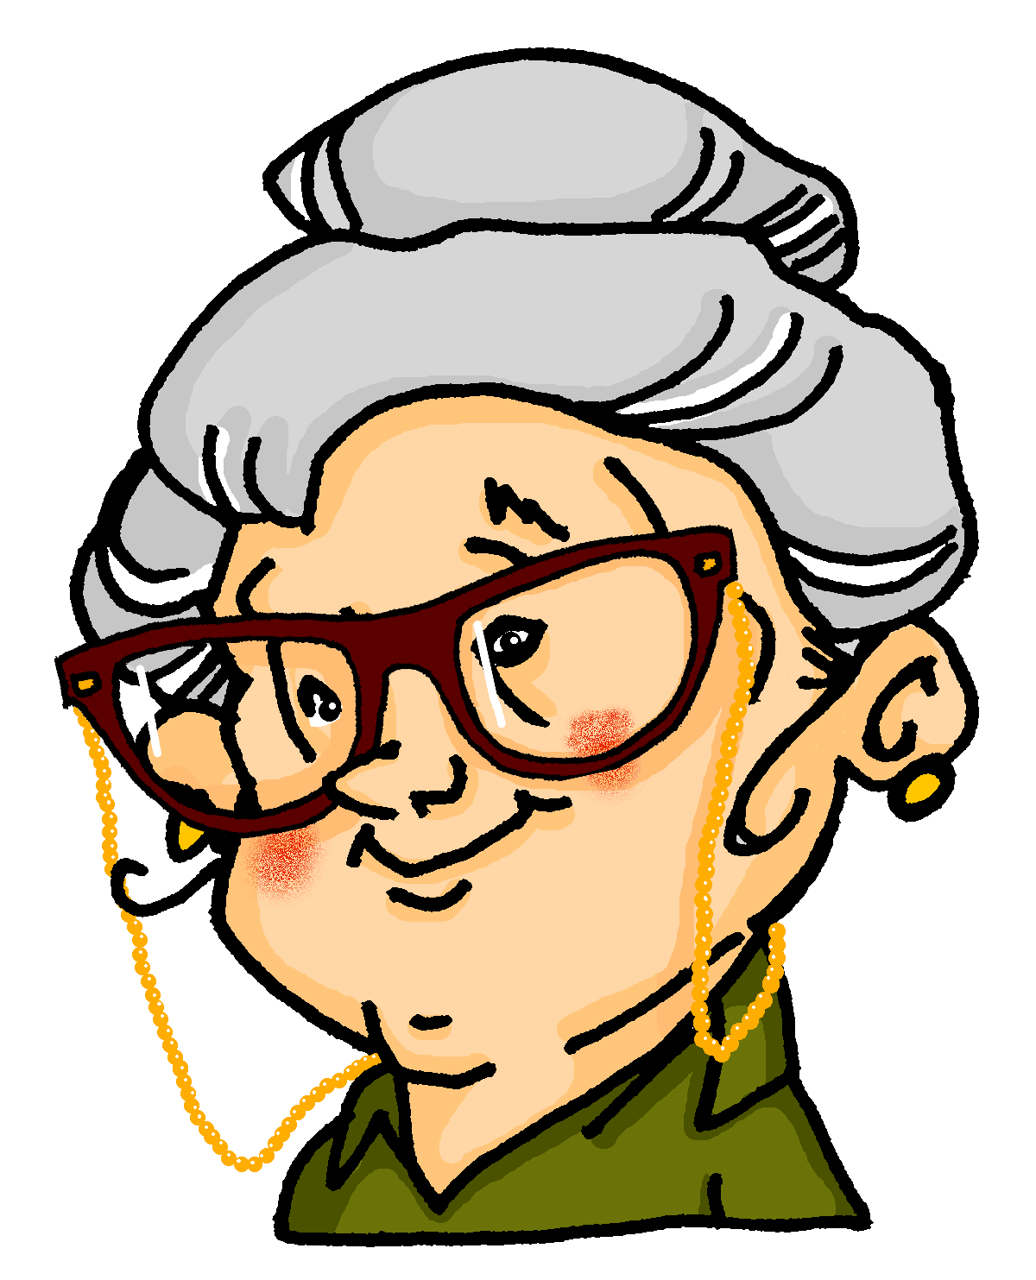
Lieblingsdinge
hören
Oma is talking to granddaughter, Mia, about favourite things. The line is bad. Listen and decide whether Mia does (✔) or does not (✖) have a favourite.
Have you got … ?
A
✖
✔
A
B
✖
✔
B
C
✔
✖
C
I’ve got / I haven’t got …
D
✖
✔
D
E
✖
✔
E
Notes:
Timing: 10 minutes Aim: To provide practice in noticing negation with kein. Procedure: 1. This listening activity and the reading activity that follows focus on connecting articles ein- and kein- to nouns, in order to decide what someone does and doesn’t have. The articles are all in accusative (Row 2).
2. The nouns in the recording are obscured by noises. The students decide based on the article they hear whether Heike has a favourite or not. The objects in each pair have different genders to allow for this.
3. The order in which nouns with ein- and kein- appear varies so that students cannot guess based o:n word order. It is worth telling students this. ie. In the answer the noun on the right could be mentioned first.
4. Recording plays on clicking individual letters.
5. Elicit responses – for this teachers might use ‘Sie hat ein Lieblingsbuch – falsch oder richtig?’ or ‘Hat sie ein Lieblingsbuch?’ Ja, Nein. 6. Full recording (including answers) plays on clicking individual letters of the 2nd set of audio buttons.
Transcript 1:
a. Hast du ein Lieblingsbuch oder einen Lieblingsfilm?
Ich habe einen ____ [Lieblingsfilm] aber ich habe kein ____ [Lieblingsbuch].
b. Hast du einen Lieblingssänger oder eine Lieblingssängerin?
Ich habe keinen ____ [Lieblingssänger ] aber ich habe eine ____ [Lieblingssängerin].
c. Hast du ein Lieblingslied oder eine Lieblingsband?
Ich habe keine [Lieblingsband] aber ich habe ein ____ [Lieblingslied].
d. Hast du eine ____ [Lieblingslehrerin] oder einen ____ [Lieblingslehrer]?
Ich habe keine [Lieblingslehrerin] aber ich habe einen ____ [Lieblingslehrer].
e. Hast du ein _____ [Lieblingstier] oder einen [Lieblingsort]?
Ich habe einen ____ [Lieblingsort] aber kein ___ [Lieblingstier].
Transcript 2:
a. Hast du ein Lieblingsbuch oder einen Lieblingsfilm?
Ich habe einen Lieblingsfilm aber ich habe kein Lieblingsbuch.
b. Hast du einen Lieblingssänger oder eine Lieblingssängerin?
Ich habe keinen Lieblingssänger aber ich habe eine Lieblingssängerin.
c. Hast du ein Lieblingslied oder eine Lieblingsband?
Ich habe keine Lieblingsband aber ich habe ein Lieblingslied.
d. Hast du eine Lieblingslehrerin oder einen Lieblingslehrer?
Ich habe keine Lieblingslehrerin aber ich habe einen Lieblingslehrer.
e. Hast du ein Lieblingstier oder einen Lieblingsort?
Ich habe einen Lieblingsort aber kein Lieblingstier].

Slide 32
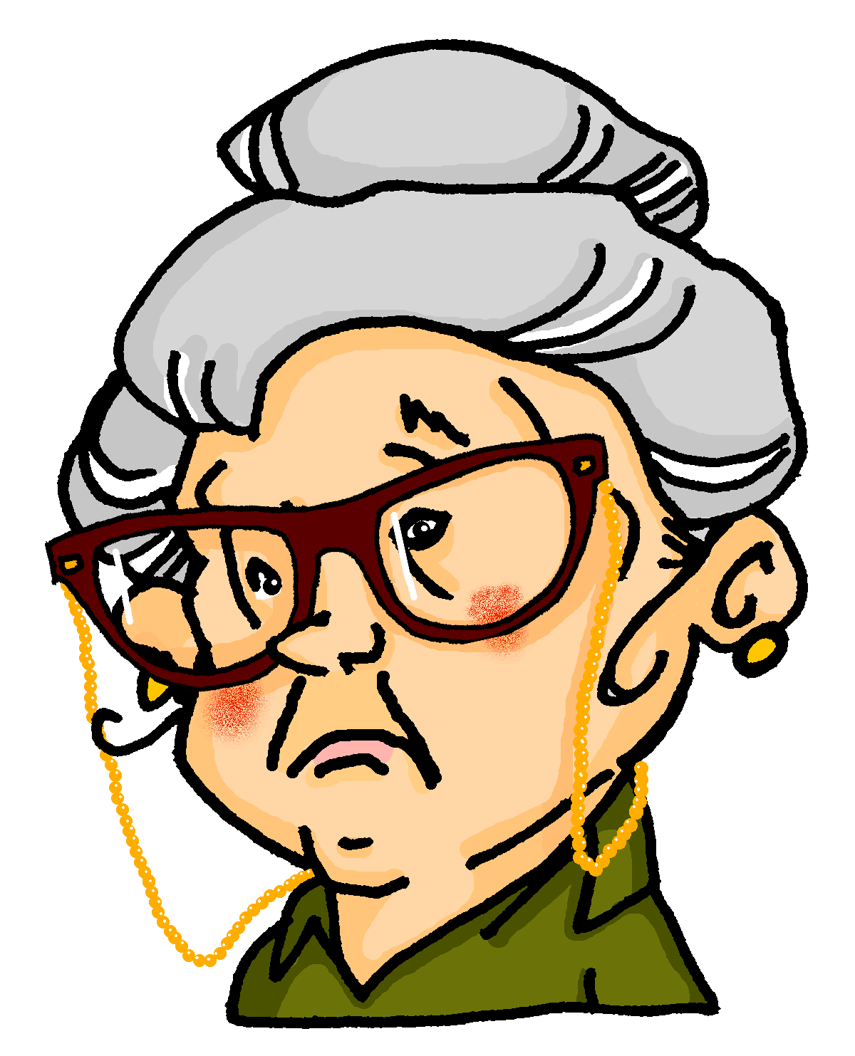
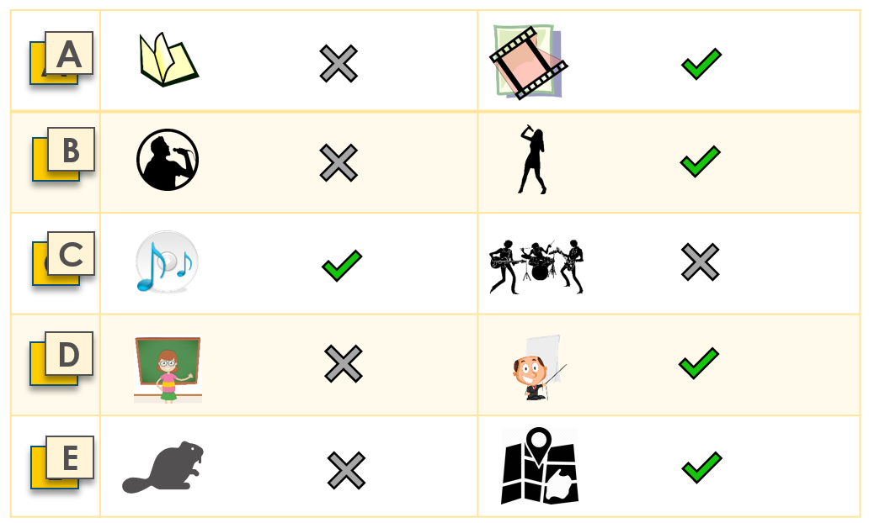
Mias Lieblingsdinge
lesen
Oh je! Oma listed Mia’s favourite things, but smudged the articles! Help her complete the sentences.
Mia hat
Sie hat
Sie hat
Sie hat
Sie hat
kein
keinen
ein
keine
kein
Lieblingsbuch aber
Lieblingssänger aber
Lieblingslied aber
Lieblingslehrerin aber
Lieblingstier aber
einen
eine
keine
einen
einen
Lieblingsfilm.
Lieblingssängerin.
Lieblingsband.
Lieblingslehrer.
Lieblingsort.
Notes:
Timing: 10 minutes Aim: to provide production practice (writing) of the use of kein versus the indefinite article. Procedure: 1. Students need to use their answers to the listening to complete this, by writing ein(e) or kein(e) before each item as appropriate, according to whether Mia does or does not have a favourite.
2. Click to bring up a copy of the answers for students to refer to.
3. Answers revealed on clicks.

Slide 33
My → mein, mein, meine
Grammatik
Ja, m___ L______________ i__ Star Wars.
Ja, mein Lieblingsfilm ist Star Wars.
Add the prefix Lieblings- to a noun to talk about your favourite things. Introduce them using mein/meine.
Mein Lieblingsbuch ist …
Ja, mein Lieblingslied ist Rocket Man.
Ja, m___ L______________ i__ Rocket Man.
Ja, meine Lieblingslehrerin ist Frau Schmidt.
Ja, m___ L______________ i__ Frau Schmidt.
Zorg, hast du eine Lieblingsband?
Zorg, hast du eine Lieblingslehrerin?
Zorg, hast du ein Lieblingslied?
Zorg, hast du einen Lieblingsfilm?
Nein, ich habe keine Lieblingsband!
Notes:
Timing: 3 minutes Aim: To introduce mein/meine.
Note: This is not a full introduction of possessive adjectives here. Mein/meine are introduced here because: a) they are communicatively important and students will often ask how to say ‘my’ now that they know a bank of nouns b) the words themselves are easy to remember and say, as mein sounds like ‘my’ and acts like ‘ein’. c) students have had a thorough grounding in definite and indefinite articles and the implications of noun gender, so that, with some inevitable reminding, they will use them accurately and begin to apply them to the nouns they know well. Procedure: 1. Click to animate the explanation.
2. Check students’ understanding at each stage.

Slide 34
Do you have a favourite...?
Don’t forget to add words that are important to you to your Wortschatz!
sprechen
Ask your partner.
If yes, write (✔) and their answer.
If no, write (✘).
1. Favourite book? (nt)
2. Favourite band? (f)
3. Favourite film? (m)
4. Favourite singer? (m/f)
5. Favourite song? (nt)
6. Favourite place? (m)
7. Favourite teacher? (m/f)
Notes:
Timing: 10 minutes Aim: To provide practice (speaking modality) in asking and answering questions about having (favourite things).
Procedure: 1. Students to ask/answer each other’s questions following the model on the previous slide. 2. Depending on the class, the teacher could choose to prime students for this task by eliciting the questions chorally from students, giving them a drei-zwei-eins countdown to think/construct the question in their heads, then s/he can offer an answer to model the task. Sample dialogue:
Teacher: Ok. Frage eins. Drei-zwei-eins… Students all together: Hast du ein Lieblingsbuch? Teacher: Ja, mein Lieblingsbuch ist Born to run. Also, drei-zwei-eins… Students: Hast du eine Lieblingsband? Teacher: Nein, ich habe leider keine Lieblingsband.
Etc…

Slide 35
Favourite things
schreiben
Write sentences to describe your partner’s favourite things.
1.
2.
3.
4.
5.
6.
Mias Lieblingsbuch ist Harry Potter.
1. Favourite book? | Harry Potter
2. Favourite person? | Silbermond
3. Favourite film? | x
Mias Lieblingsband ist Silbermond.
Mia hat keinen Lieblingsfilm.
Mias Lieblingsbuch [Mia’s favourite book]. No apostrophe in German.
Notes:
Timing: 5-10 minutes Aim: To provide practice (writing modality) in answering questions about having (favourite things). Procedure: 1. This task may be an additional homework task, if lesson time is short. Students write sentences to describe their partner’s favourite things.
2. The first three answers are modelled to give full sentence examples.
3. This can be expanded into a speaking activity in which answers are presented orally. The teacher asks students about their partners’ favourite things. Where the pupil does not have a favourite thing, use this as a chance to practise ‘leider’ e.g. ‘Wolfgang, hat Mia ein Lieblingsbuch?’ ‘Ja, Mias Lieblingsbuch ist …’ / ‘Leider nicht’

Slide 36
Hausaufgaben
Vocabulary Learning Homework (Y7, Term 1.2, Week 1)
Audio file
Student worksheet
In addition, revisit: Term 1.1 Week 5
Notes:
Use this slide to set the homework.
For Y7, the typical homework will be to pre-learn vocabulary for the next lesson. There is an audio file to accompany the student worksheet.
Notes:
i) Teachers may, in addition, want to recommend use of a particular online app for the pre-learning of each week’s words. ii) Quizlet now requires parental involvement / registration / permissions for users below the age of 13, so it is perhaps most suitable for Y9 – 11 students. iii) Language Nut hosts LDP vocabulary lists and these are free for schools to use, though there is a registration process. One benefit is that all of the student tracking data that Language Nut offers are also available to schools that use the LDP lists for practice. Perhaps this makes it a good option for Y7/8.
iv) There are other free apps, and new ones are always appearing. Teachers have told us that they are currently using: Flippity, Wordwall (where using previously-created activities is free).
v) Gaming Grammar has been acquired by Language Nut. Its original content should still be available to teachers and much of it is appropriate for Y7 learners. From this lesson, for example, learners could practise Possessive adjectives agreement; Question formation.

