Slide 1
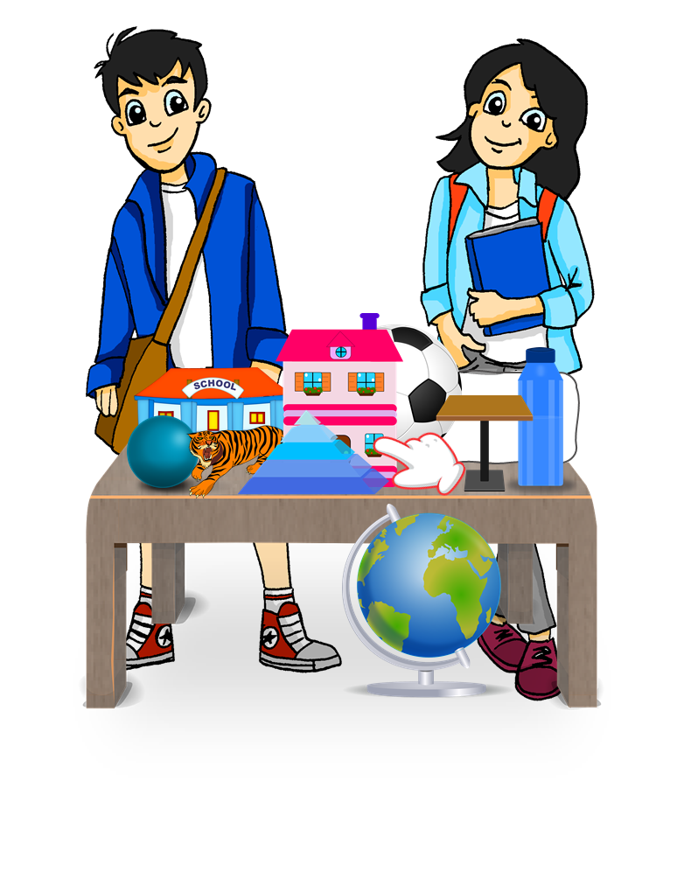
Ich habe einen, eine, ein…
Possessing things: I have ‘the’ or I have ‘a/an’ HABEN (to have, having) ich habe, du hast Indefinite articles (singular), R2 (accusative)
Ich habe eine Hand!
Du hast einen Ball und ein Tier!
Y7 German Term 1.1 – Week 6 – Lesson 11 Inge Alferink / Rachel Hawkes Artwork: Steve Clarke Date updated: 16.08.23
Notes:
Artwork by Steve Clarke. All additional pictures selected are available under a Creative Common license; no attribution required.
Note: All words listed below for this week’s learning (new and revisited) appear on all three Awarding Organisations’ word lists, with no exceptions.
Learning outcomes (lesson 1):
Introduction of HABEN / ich habe, du hast, er/sie hat
Introduction of indefinite articles (singular) – Row 2 (accusative)
SSC Revisit [a] [e] [ei] [z] [w]
Word frequency (1 is the most frequent word in German):
7.1.1.6 (introduce) hast [6] Beispiel [94] Erste [95] Frage [157] Frau1 [99] Grund [249] Hand [180] Herr [154] Problem [210] Schule [359]
Wer hat einen Grund / eine Frage / ein Beispiel / ein Problem? Wer ist der/die/das Erste?
7.1.1.3 (revisit) bin [4] ich [10] Ding [370] Form [307] Mensch [90] blau [948] gelb [1446] groß1 [67] gut [76] klein [110] rot [477] wie? [25] und [2] bitte [471] danke [877] ein, eine [5] wie geht's? [n/a]
Source: Jones, R.L. & Tschirner, E. (2019). A frequency dictionary of German: core vocabulary for learners. Routledge

Slide 2
Vokabeln
Wie sagt man das auf Deutsch?
sprechen
blau
klein
groß
gut
blue
small, little
big, large
good
das Ding
ich bin
die Form
der Mensch
the form, shape
human being, person,
the thing
I am
haben
ich habe
sie hat
er hat
to have, having
I have
she has
he has
gelb
rot
wie?
und
yellow
red
how?
and
bitte
danke
ein, eine, ein
Wie geht’s?
How’s it going?
please
thank you
a/an
Notes:
Timing: 3 minutes
Aim: to practise spoken production of 20 revisited words, in a low stakes but time-limited activity.
Procedure:
Work from left to right, top to bottom on the word wall. Ask ‘¿Wie sagt man das auf Deutsch?
Click to start the 5-second animation. Pupils say the German word before the animation finishes and reveals the word.
Continue with all words.
Note: all of these words appear on all 3 AO GCSE word lists. die Form is not listed separately on the AQA list, but they have ‘in Form sein’ – to be in form, to be in (good) shape’, which is a literal translation of ‘Form’ from the meanings ‘form, shape’ and ‘sein’ (to be, being).

Slide 3
Vokabeln
Wie sagt man das auf Deutsch?
lesen / sprechen
die Schule
das Problem
die Frau
die Schule
das Problem
die Frau
du hast
der Herr
die Hand
das Beispiel
du hast
der Herr
die Hand
das Beispiel
der Grund
die Frage
der, die, das Erste
der Grund
die Frage
der, die, das Erste
(the) question
(the) hand
(the) first (one)
(the) reason
(the) man, Mr.
(the) woman, Mrs.
(the) example
(the) school
you have
(the) problem
Notes:
Timing: 5 minutes
Aim: to practise understanding and pronouncing this week’s new vocabulary.
Procedure: 1. Click to bring up an English prompt.
2. Students say the German word. 3. Click to check answers. 4. As appropriate to the class, continue with some Q&A once all German words are displayed, to elicit comprehension more rapidly, asking for example: Wie sagt man ‘example’ auf Deutsch? 5. Teachers may also want to use the opportunity to practise spelling words out: Wie schreibt man ‘the woman’ auf Deutsch. In this instance, students say the whole word, including the article with nouns, but then just spell out the noun itself (as is the case in the national FL spelling bee).
Words:
1. du hast 2. die Hand 3. die Schule
4. das Beispiel 5. die Frau 6. der Herr
7. das Problem
8. der Grund
9. der, die, das Erste
10. die Frage

Slide 4
ein, eine, ein
Grammatik
As you know, German has three words for a:
masculine
feminine
neuter
Das ist…
ein Tisch
eine Flasche
ein Fenster
After sein, the word for ‘a’ is ein for masculine and neuter words.
It’s important to know the gender of each noun you learn.
Let’s practise!
Notes:
Timing: 1 minute Aim: To recap the words for ‘a’ in the nominative case.
Procedure: 1. Click to animate the explanation.
2. Check students’ understanding at each stage.

Slide 5
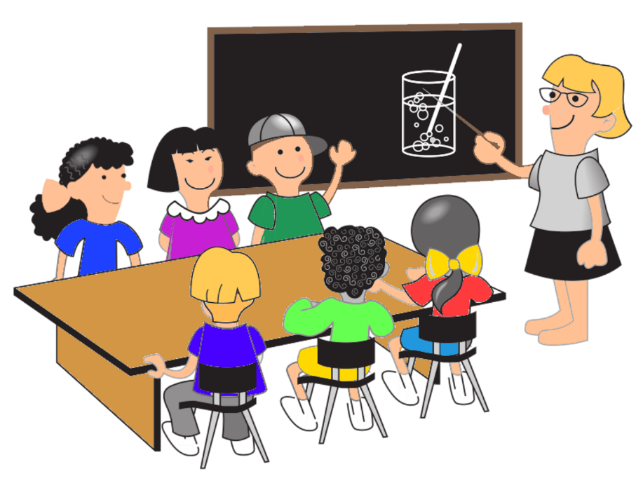
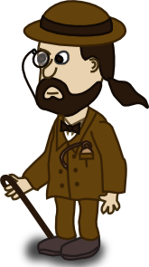
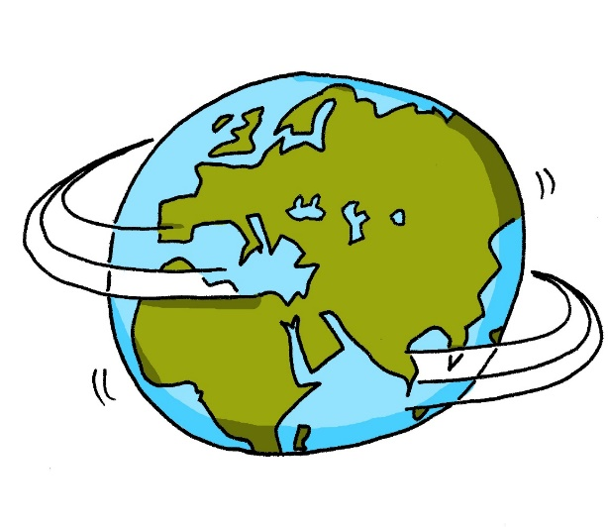
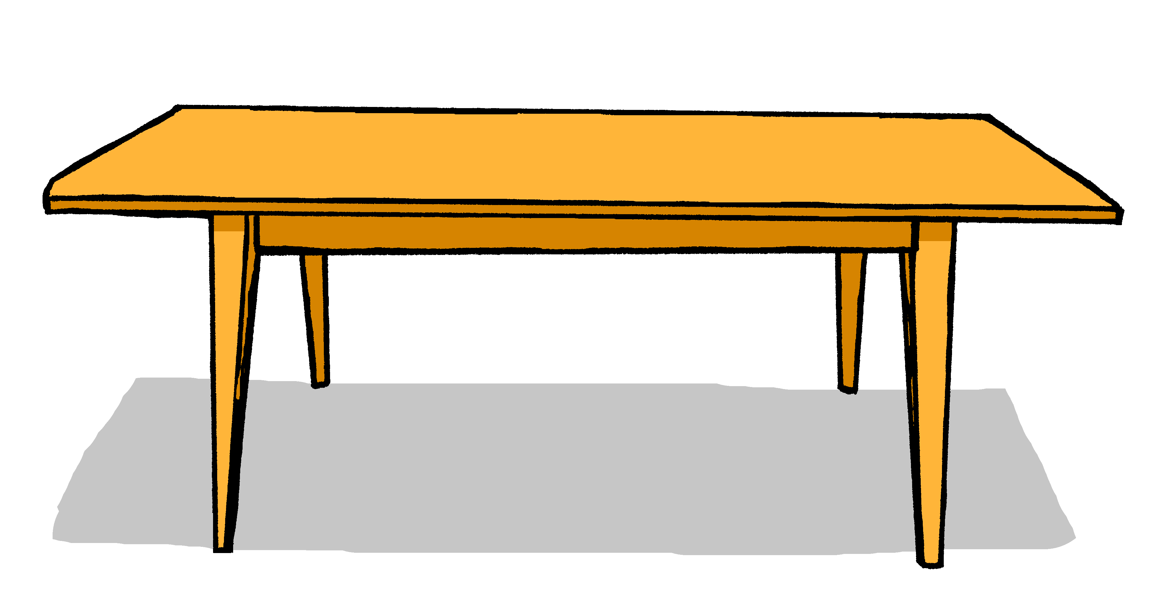
Was ist das?
sprechen
1a | 1b
2a | 2b
3a | 3b
____ Klasse
____ Wort
____ Schule
____ Ding
____ Tag
____ Hand
4a | 4b
5a | 5b
6a | 6b
____ Ort
____ Frage
____ Form
____ Beispiel
____ Haustier
____ Frau
7a | 7b
8a | 8b
9a | 9b
____ Herr
____ Farbe
____ Tafel
____ Tisch
____ Grund
____ Welt
Notes:
Timing: 10 minutes (two slides) Aim: to practise associating and producing the correct indefinite article with 18 new and previously taught nouns.
Procedure: 1. Students note their own set of chosen letters (either A or B) for each item.
2. They then pair up. 3. Round 1 of the activity is for Partner A to say, for example: ‘Nummer eins. Das ist ein…’ for number 1, but not the noun itself. 4. On the basis of the article heard, Partner B writes the correct letter, i.e. 1b.
5. When all 9 items have been asked about, A & B compare their answers. They should match. 6. Students swap roles for Round 2. Partner B uses the original set of letters s/he chose.
7. Go to the next slide to repeat the task without the German words.

Slide 6
Was ist das?
sprechen
1a | 1b
2a | 2b
3a | 3b
4a | 4b
5a | 5b
6a | 6b
7a | 7b
8a | 8b
9a | 9b
Notes:
In this version of the activity, students need to work without the German words to prompt them.
They still only need to say the article, but they will need to think of the German word and its gender to arrive at the correct ein, eine, ein so there is more work to do here.
If teachers prefer, they can use this more challenging version for both rounds or the more supported version for both rounds.

Slide 7
Haben – to have, having
Grammatik
You know that the verb haben means ‘to have’.
You have already seen I have, he has and she has.
After most verbs the masculine word for ‘the’, ein, changes its spelling to einen. It still means ‘the’.
ich habe
I have
er hat
he has
sie hat
she has
You have is du hast.
Du hast einen Grund.
Du hast eine Frage.
Du hast ein Problem.
You have a reason.
You have a question.
You have a problem.
This change happens after most verbs but not SEIN / ist (BE / is).
Notes:
Timing: 3 minutes
Aim: to introduce the verb haben in 1st and 3rd persons singular; to introduce the Row 2 (accusative) form of the definite article (den) that follows most verbs.
Procedure:
Read the grammar explanation about haben. Make sure pupils are clear about the ‘I’, ‘he’ and ‘she’ pictures.
Elicit English translations for the German examples provided.
Draw attention to the den used here after haben for masculine nouns.

Slide 8
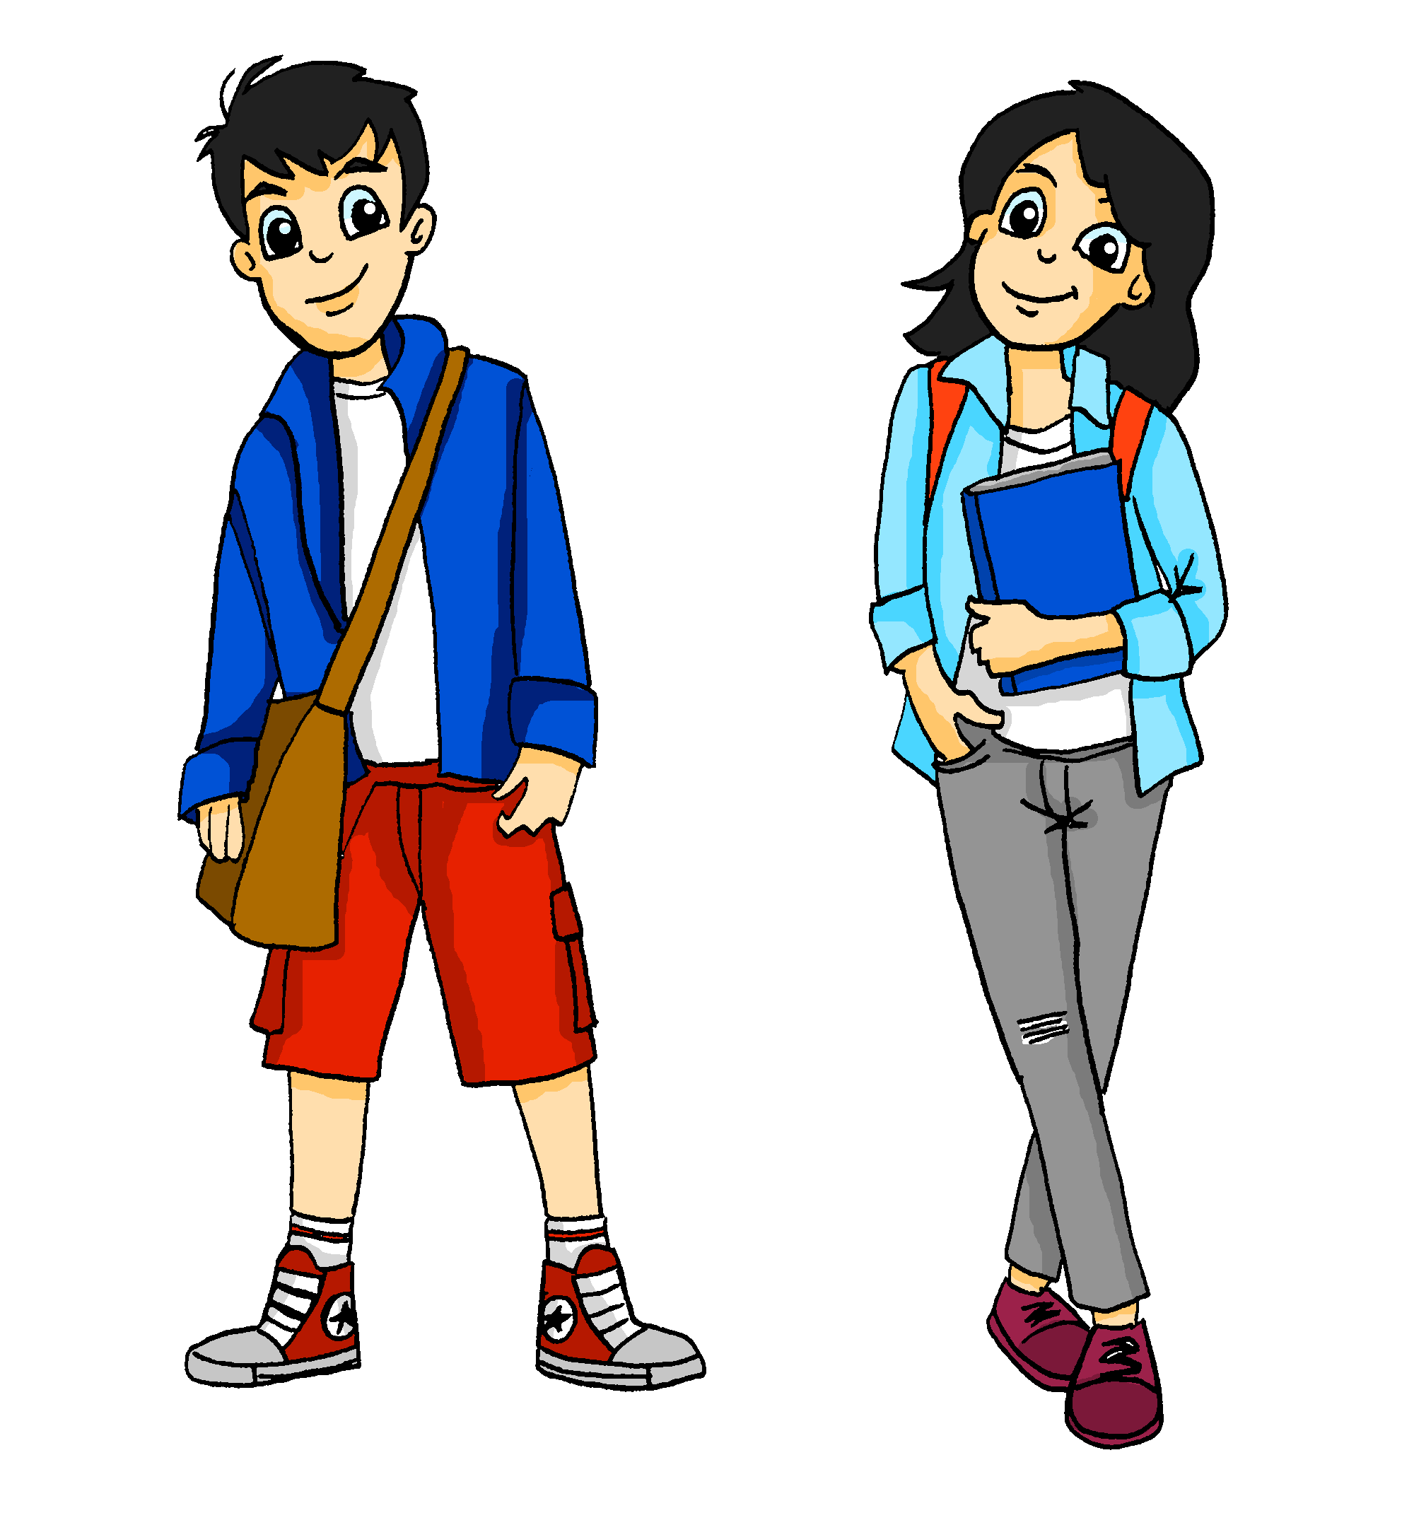
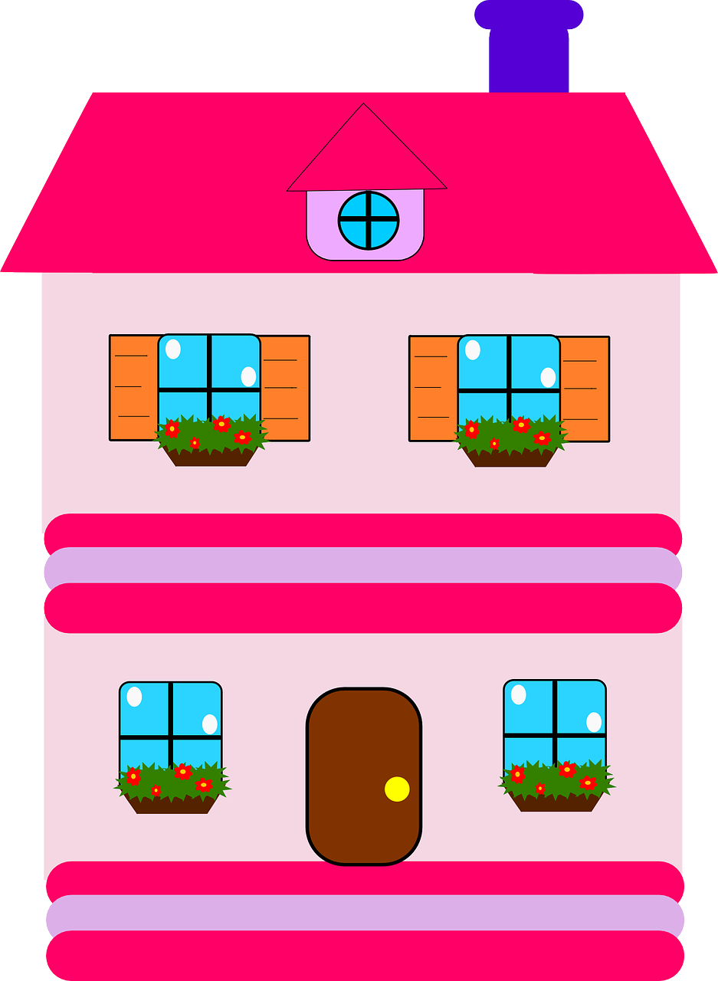
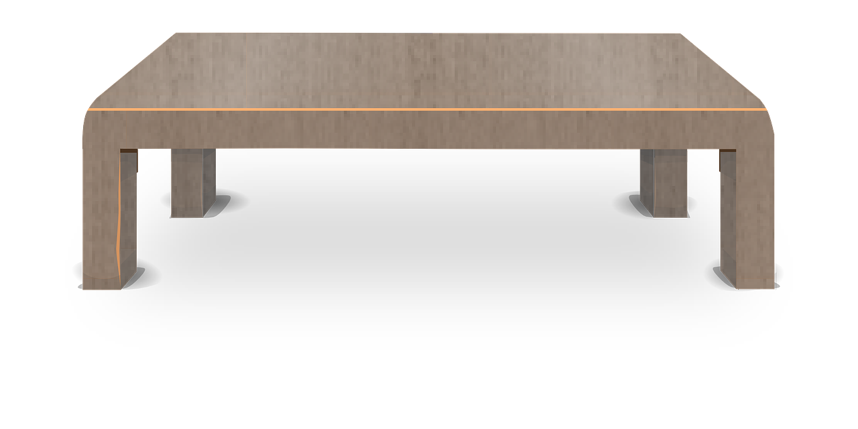
Was hat Mia?
Mia is tidying up to donate items for a sale. She numbers the possible items but spills hot chocolate on her list.
lesen
Schreib 1 – 6 und das Ding auf Deutsch und Englisch.
1. Ich habe einen
Ball | Haus
2. Ich habe eine
Heft | Flasche
3. Ich habe einen
Hand | Tisch
4. Ich habe ein
Tier | Tafel
5. Ich habe ein
Haus | Schule
6. Ich habe eine
Form | Tier
Notes:
Timing: 7 minutes Aim: to practise connecting indefinite articles to the correct nouns in R2 – accusative.
Procedure: 1. Explain the task.
2. Students write 1-6 in their books and using their knowledge of the noun genders decide which noun Mia has on her list. 3. Elicit and confirm the answers. Unpack any misunderstanding.
Extension: Early finishers could be asked to compare what is on the table which the list, and to say if there is anything on the table that isn’t on the list – e.g., Fußball, Schule, Hand, Tafel (it’s a Minitafel – mini(which) board), Welt. Students don’t know the word for globe. They do know Welt and you could offer them either ‘der Erdball’ (earth ball) or ‘die Weltkugel’ (world ball) as two further examples of compounds.
Students could write the missing sentences to complete the list. Of these words, all except ‘Tafel’ (and Erdball/Weltkugel) are on all 3 AO lists. Tafel (board, and bar (of chocolate)) only appears on the Eduqas list.

Slide 9
Was sagt Mia?
Schreib 1 – 6 und das Ding auf Deutsch.
hören
Mia talks to Wolf about items for the sale. Does she say ‘Ich’ (I) or ‘Du’ (you)?
I have
you have
 |  | Ding
1
Fußball
2
Flasche
3
Heft
4
Haus
5
Nummer
6
Fahrrad
das Fahrrad - bicycle
Notes:
Timing: 8 minutes Aim: to practise aural distinction between ich habe and du hast in a listening activity, and their connection with meaning. In addition, to practise transcription.
Procedure: 1. Students write 1-6 in their books.
2. Click on the audio button to play each sentence. The pronouns have been obscured, so students have to pay attention to the verb forms.
3. Students tick the appropriate column, for ‘I have’ or ‘you have’.
4. Click to bring up the answers.
Transcript: 1. Ich [habe] einen Fußball. 2. Du [hast] eine Flasche. 3. Ich [habe] ein Heft.
4. Ich [habe] ein Haus.
5. Ich [habe] eine Nummer.
6. Du [hast] ein Fahrrad.

Slide 10
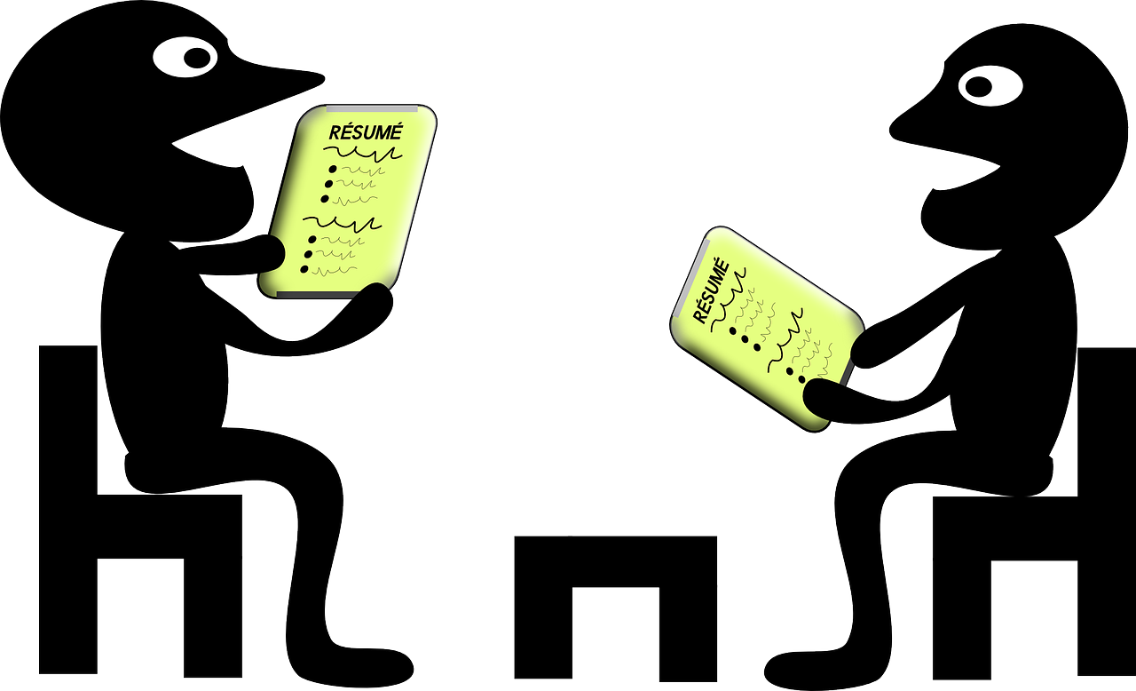
Wie sagt man das auf Deutsch?
Write 5 sentences in English. Your partner says them in German.
lesen / sprechen
Ich Du Er Sie Das | bin habe bist hast ist hat | ein einen eine ___ | Mädchen. Freund. Gast. groß. blau. klein. Beispiel. Problem. Grund. Haustier. Fußball. Frage. Haus.
Notes:
Timing: 8 minutes
Aim: to practise comprehension and read aloud of new and revisited language and grammar from this and previous weeks.
Procedure:
Both pupils write 5 sentences (in English) made up of words from the table.
They swap sentences.
Partner A tries to say all B’s sentences in German as quickly as possible.
Then Partner B tries to say all A’s sentences in German.

Slide 11
Ich habe einen, eine, ein…
Possessing things: I have ‘the’ or I have ‘a/an’ HABEN (to have, having) ich habe, du hast Indefinite articles (singular), R2 (accusative)
SSC Revisit [a] [e] [ei] [z] [w]
Y7 German Term 1.1 – Week 6 – Lesson 12 Inge Alferink / Rachel Hawkes Artwork: Steve Clarke Date updated: 16.08.23
Notes:
Artwork by Steve Clarke. All additional pictures selected are available under a Creative Common license; no attribution required.
Learning outcomes (lesson 2):
Consolidation of HABEN / ich habe, du hast, er/sie hat
Consolidation of indefinite articles (singular) – Row 2 (accusative)SSC Recap [a] [e] [ei] [z ] [w]
SSC - Recap [a] [e] [ei] [z ] [w]
Word frequency (1 is the most frequent word in German):
7.1.1.6 (introduce) habe, hast [6] Beispiel [94] Erste [95] Frage [157] Frau1 [99] Grund [249] Hand [180] Herr [154] Problem [210] Schule [359]
Wer hat einen Grund / eine Frage / ein Beispiel / ein Problem? Wer ist der/die/das Erste?
7.1.1.3 (revisit) bin [4] ich [10] Ding [370] Form [307] Mensch [90] blau [948] gelb [1446] groß1 [67] gut [76] klein [110] rot [477] wie? [25] und [2] bitte [471] danke [877] ein, eine [5] wie geht's? [n/a]
Source: Jones, R.L. & Tschirner, E. (2019). A frequency dictionary of German: core vocabulary for learners. Routledge

Slide 12
Was ist das auf Deutsch?
schreiben
Schreib auf Deutsch.
I You He She That | am are is have has | a/an | girl. male friend. guest (m). big, large. blue. small, little. example. problem. reason. pet. football. question. house.
Du hast einen Grund.
Das ist ein Fußball.
Er ist ein Freund.
Ich habe eine Frage.
Sie hat ein Beispiel.
Notes:
Timing: 10 minutes
Aim: to practise written production of new and revisited language and grammar from this and previous weeks.
Procedure:
Teacher clicks to bring up prompt 1.
Students write the sentence in German.
Teacher clicks to provide feedback.
Continue with items 2-5.
Notes:
1) If there is more time, students can continue the activity in pairs OR the teacher can continue to give prompts for further sentences. 2) If more support is needed, students could use the Knowledge Organiser or their Language Guide, but encourage most students to work from memory. Tell them it is not a test and they will learn more by trying to remember the words, than by copying them across from a written source. 3) This activity could also be completed as a speaking activity.
The five sentences are: 1. You have a reason. Du hast einen Grund. 2. That is a football. Das ist ein Fußball. 3. I have a question. Ich habe eine Frage.
4. She has an example. Sie hat ein Beispiel. 5. He is a friend. Er ist ein Freund.

Slide 13
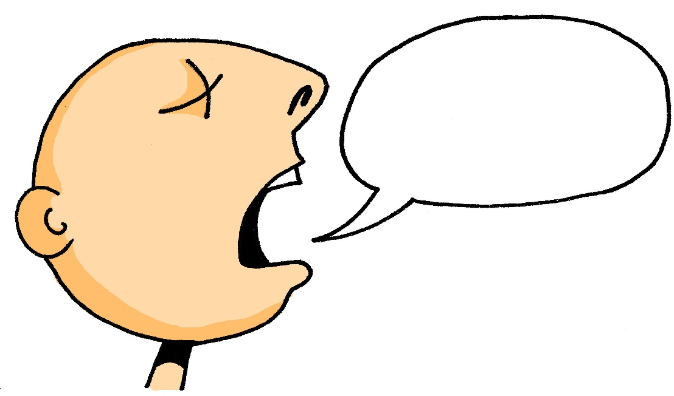
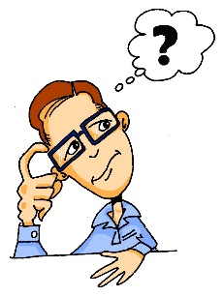
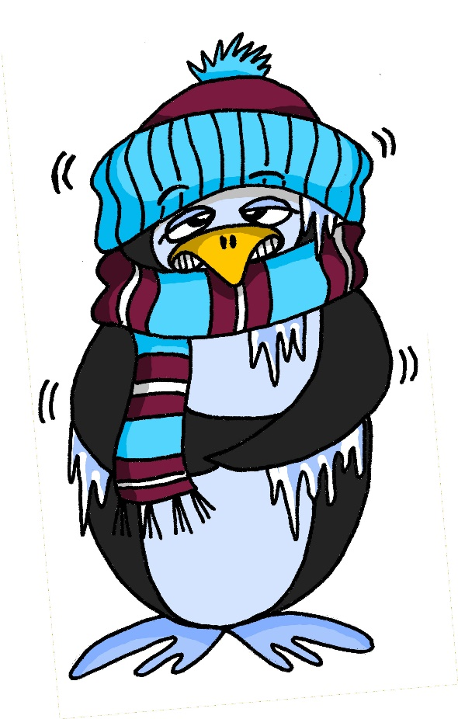
Phonetik
hören / schreiben | lesen / sprechen
Auf Wieder-sehen [goodbye]
60
sagen
[to say, tell]
der Arzt
[doctor(m)]
antworten[to answer]
Welt |  | sagen | Arzt | antworten |  | Auf Wieder-sehen!
frei |  | denken |  | allein |  | klein
Zug | geben | kalt |  | zehn | Wasser | Meer
die Welt
[world]
frei
[free]
denken [to think, thinking]
allein
[alone]
klein [small, little]
S
der Zug
[train]
geben
[to give, giving]
kalt
[cold]
zehn
[ten]
Wasser[water]
das Meer [sea]
0
START
Notes:
Timing: 5 minutes
Aim: to recap knowledge of SSC [a] [e] [ei] [z] [w] in either read aloud or transcription or both.
Note: this slide can be used flexibly. Here are some possibilities:
Procedures: Transcription:
1. Students either turn away or teacher ‘blanks’ the screen. 2. Teacher clicks each picture to play audio (1-14 as 15 is Auf Wiedersehen, and just concludes the exercise and reminds them of this useful phrase). 3. Students transcribe. 4. Elicit responses orally and click to confirm the spelling. (Note that the nouns are provided with definite articles in the answers and teachers could prompt for these, too).
Read aloud: 1. Start the timer. Pupil A tries to read aloud all of the words within the 60 seconds allowed.
2. Pupil B listens. If Pupil A says mistake, Pupil B can direct him/her to start again from the beginning. 3. They swap roles and repeat the task.
4. Click to reveal the words one by one to elicit (and check) choral pronunciation.

Slide 14
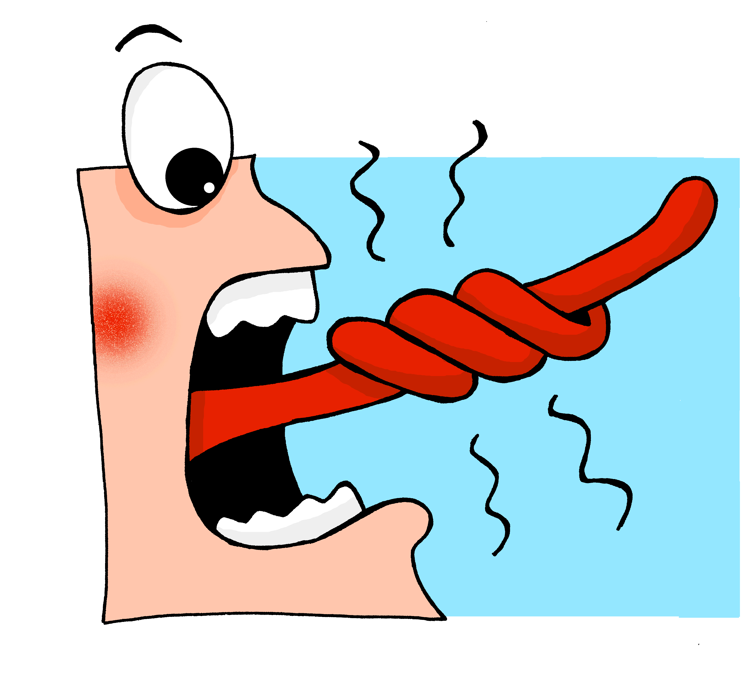
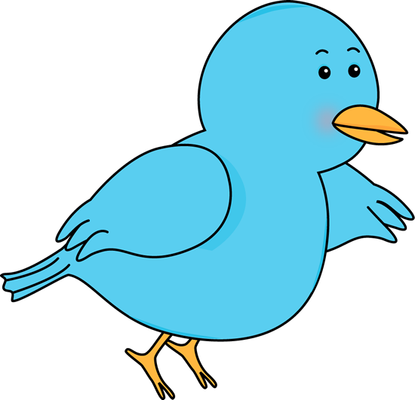
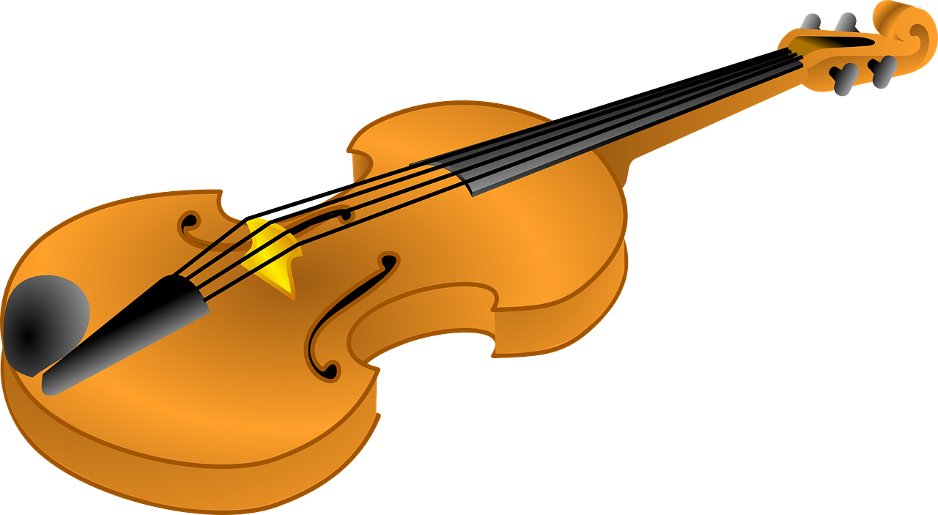
Phonetik
hören / sprechen
Eine kleine Meise geigt allein eine leise Weise, eine zweite schweigt leider.
Notes:
OPTIONAL TASK
Timing: 5 minutes Aim: To provide additional practice of one of the trickiest SSC in the form of a tonguetwister (Zungenbrecher).
Note: The target SSC is ei, but some of the others are covered too: W in Weise, Z in zweite, a in allein. Most of the other sounds that have not been covered so far are similar to English with the exception of sch, which should be pointed out and modelled more carefully.
Procedure: 1. Teacher reads out the whole sentence slowly and then takes the students through it word by word.
2. Teacher models word; students respond with word.
3. Discuss the meaning of the sentence. Students can supply the words they know – A small ___ ___ alone. A small (blue) tit plays a quiet tune/melody on his/her own, a second (blue tit) is unfortunately silent.
4. Students practise saying the sentence individually.
5. They could compete once through to see who can say it the fastest without tripping up.
Word frequency (1 is the most frequent word in German): geigen [>5000] schweigen [863] die Meise [>5000] die Weise [413] leise [1160] leider [642] Source: Jones, R.L. & Tschirner, E. (2011). A frequency dictionary of German: core vocabulary for learners. Routledge

Slide 15
‘a’ (ein, eine, ein) oder ‘the’ (der, die, das)
Grammatik
‘the’ (der, die, das) often refers to the only one:
There is only one ball and you have it!
Du hast den Ball.
You have the Ball.
‘a’ (ein, eine, ein) often identifies one of many:
You have one but there are other exercise books, too.
Du hast ein Heft.
You have an exercise book.
Notes:
Timing: 1 minute Aim: to raise awareness about the contrastive uses / meanings of ‘a/an’ and ‘the, ahead of the next activity. Procedure: 1. Click to present the information.
2. Elicit the translations of the German examples.

Slide 16
Was hat Wolf?
Wolfgang is donating some things. Mia asks him what he has.
Hör zu. Ist es ‘a/an’ oder ‘the’?
hören
one of many | the only one
1
2
3
4
5
Notes:
Timing: 8 minutes Aim: To consolidate knowledge of the meanings of the definite and indefinite articles. Procedure: 1. Click on the audio button to play the question. (Note: we will be teaching yes/no questions formally next week).
3. Students tick whether the item mentioned is the only one, or one of many, by considering whether the definite or indefinite article is used to refer to it.
4. Click a second time to bring up the correct answer.
5. Repeat for the other questions in turn.
Transcript: 1. Hast du eine Flasche?
2. Hast du den Fußball?
3. Hast du einen Tisch?
4. Hast du die Tafel?
5. Hast du das Heft?

Slide 17
Wie ist das auf Deutsch? (1/6)
schreiben
Du hast eine Flasche.
Notes:
Timing: 6 minutes (all 6 slides) Aim: Practising I have / you have, together with the Row 2 (accusative) forms of the definite article, in a writing activity. Procedure: 1. Students consider the picture and write the sentence in German.
2. Click to bring up the answer.
Note: the activity format suggests the use of mini whiteboards, but teachers could of course decide to use a different format.

Slide 18
Wie ist das auf Deutsch? (2/6)
schreiben
Ich habe einen Fußball.
Notes:
[2/6]

Slide 19
Wie ist das auf Deutsch? (3/6)
schreiben
Ich habe ein Haustier.
Notes:
[3/6]

Slide 20
Wie ist das auf Deutsch? (4/6)
schreiben
Ich habe ein Wort.
Notes:
[4/6]

Slide 21
Wie ist das auf Deutsch? (5/6)
schreiben
Du hast einen Freund.
Notes:
[5/6]

Slide 22
Wie ist das auf Deutsch? (6/6)
schreiben
10
Du hast eine Nummer.
Notes:
[6/6]

Slide 23
Wiederholen
lesen /hören
1
sein | bist | hast | ist
5
A
B
C
D
___ Frage | ___ Tisch | ___ Nummer | ___ Farbe
groß | rot | kalt | sagt
2
6
3
A
B
C
D
7
der Lehrer | der Freund |
das Heft | die Frau
4
ein Fenster | ein Wort | ein Paar | ein Freund
8
A
B
C
D
Notes:
Timing: 10 minutes Aim: To revisit some of the grammar, vocab, and phonics introduced over the past few weeks.
Procedure: 1. Students select the odd one out from the options presented.
2. For the audio items click the letter to play the sound.
3. Click to show the correct answers (see below for rationale).
Note: this is revision rather than assessment and students may come up with alternative, plausible answers to the questions.
Transcript/answers: 1. Sein / bist / hast / ist (not a form of sein)
2. die/eine Frage / der/ein Tisch / die/eine Nummer / die/eine Farbe (der/ein Tisch – it’s masculine)
3. frei / allein / Idee / klein (audio – long ‘e’ not ‘ei)
4. Ein Fenster / Ein Wort / Ein Paar / Ein Freund (masculine)
5. Geben / Welt / Leben / sehen (audio – short ‘e’ not long ‘e’)
6. groß / rot / kalt / sagt (verb not adjective)
7. Der Lehrer / Der Freund / Das Heft / Die Frau (thing not person)
8. Wasser / klar / haben / Paar (audio – long ‘a’ not long ‘a’)

Slide 24
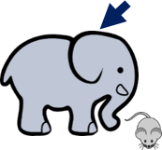
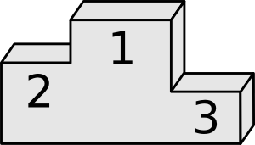
Vokabeln
schreiben
A
B
C
D
E
F
G
H
I
J
K
L
Notes:
Timing: 5 minutes Aim: To recap vocabulary from previous weeks. Procedure: 1. Students write 1-12 in books.
2. Click / press enter to animate a picture. They will be covered over entirely after 5 seconds.
3. Ask students to write down the German word before the picture has faded away. 4. Check answers by eliciting the German from students, with definite article, using the next slide.
Answers: A. die Frage B. die Schule C. groß D. Danke E. der, die, das Erste F. Bitte G. das Beispiel H. die Frau I. der Grund J. der Herr K. das Problem L. die Hand

Slide 25
Vokabeln
schreiben
die Frage
die Schule
groß
danke
das Beispiel
der,die,das Erste
die Frau
bitte
das Problem
die Grund
der Herr
die Hand
Notes:
ANSWERS

Slide 26
Hausaufgaben
Vocabulary Learning Homework (Y7, Term 1.1, Week 7)
Audio file
Student worksheet
In addition, revisit: Term 1.1 Week 4
Notes:
Use this slide to set the homework.
For Y7, the typical homework will be to pre-learn vocabulary for the next lesson. There is an audio file to accompany the student worksheet.
Notes:
i) Teachers may, in addition, want to recommend use of a particular online app for the pre-learning of each week’s words. ii) Quizlet now requires parental involvement / registration / permissions for users below the age of 13, so it is perhaps most suitable for Y9 – 11 students. iii) Language Nut hosts LDP vocabulary lists and these are free for schools to use, though there is a registration process. One benefit is that all of the student tracking data that Language Nut offers are also available to schools that use the LDP lists for practice. Perhaps this makes it a good option for Y7/8.
iv) There are other free apps, and new ones are always appearing. Teachers have told us that they are currently using: Flippity, Wordwall (where using previously-created activities is free).
v) Gaming Grammar has been acquired by Language Nut. Its original content should still be available to teachers and much of it is appropriate for Y7 learners. From this lesson, for example, learners could practise Indefinite articles: gender.

