Slide 1
Wer, was, wie und wo?
Who, what, how and where? SSC [w]
Wer?
Wie?
Wo?
Was?
Y7 German Term 1.1 – Week 5 – Lesson 9 Inge Alferink / Rachel Hawkes Artwork: Steve Clarke Date updated: 14.08.23
Notes:
Artwork by Steve Clarke. All additional pictures selected are available under a Creative Common license; no attribution required.
Note: All words listed below for this week’s learning appear on all three Awarding Organisations’ word lists, with the following exceptions: i) No list has Haustier (but it is an understandable compound made up of ‘Haus (house/home)’ + ‘Tier (animal)’. ii) Eduqas list doesn’t have Fußball for the same reason. Compounds that are a straightforwardly comprehensible sum of their parts, which themselves are listed may be included in assessments.
Learning outcomes (lesson 1):
Introduction of SSC [w]
Consolidation of definite articles (singular) R1(nominative) Consolidation of question words wer, was, wie and wo
Word frequency (1 is the most frequent word in German):
7.1.1.5 (introduce) haben, hat [6] er1 [15] sie1 [7] wer? [149] Freund [273] Fußball [1277] Haus [159] Haustier [>5009] Lehrer [695] Wasser [245] Welt [164] Wort [194] wahr [737] nicht wahr? [n/a] Ist es warm/kalt heute?
7.1.1.2 (revisit) sagen, sagt [40] was?[38] Klasse [961] Mann [121] Paar [241] Tag [111] falsch [524] richtig [177] oder [35] ja1 [45] nein [148] nicht [11] Ist das klar? [n/a]
Source: Jones, R.L. & Tschirner, E. (2019). A frequency dictionary of German: core vocabulary for learners. Routledge

Slide 2
Vokabeln
Was ist das auf Deutsch?
lesen / sprechen
sagen
Tag
richtig
falsch
Mann
Ist das klar?
Paar
man
yes
class
false,
wrong
not
no
pair
day
right, correct
says,
tells
to say, tell
or
Is that clear?
what?
sagt
was?
ja
nein
Klasse
oder
nicht
Notes:
Timing: 4 minutes
Aim: To practise recognition and cued productive oral recall of this week’s REVISITED vocabulary set.
Procedure:
1. Students supply the German for the word which appears in English. Ensure that for nouns students also supply the definite article – der, die, das. The aim is to be able to give the German before the teacher counts drei – zwei – eins.
Notes:
1. The activity can be repeated, clicking faster through the animations to increase speed of recall.
2. Teachers may wish to give students 30 seconds to look at the German words before showing the English prompts.

Slide 3
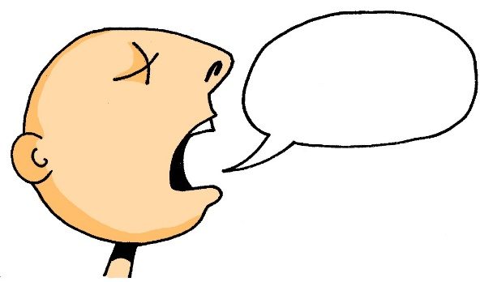
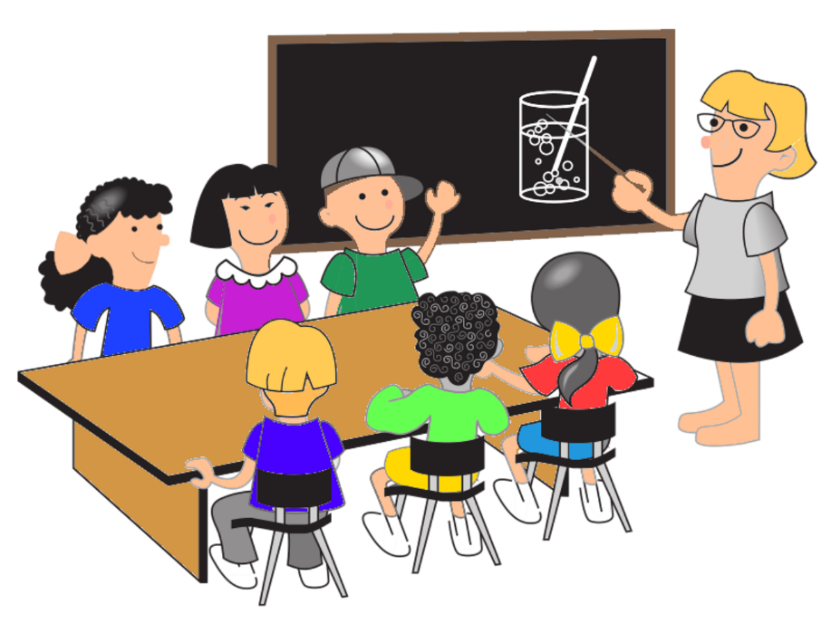
Vokabeln
lesen / sprechen
60
A
d__ P___
E
f_____
r______
B
F
d__ M___
Sekunden
C
s______
G
d__ T__
0
d__ K___
LOS!
D
Notes:
Timing: 5 minutes Aim: To revisit the vocabulary from 7.1.1.2. Procedure: 1. Give students 60 seconds to fill in correct words. This also offers the opportunity for them to re-visit some alphabet letters from last week.
2. The answers are displayed on the next slide.

Slide 4
Vokabeln
lesen / sprechen
A
das Paar
E
falsch
richtig
B
F
der Mann
C
sagen
G
der Tag
die Klasse
D
Notes:
This slide displays the answers to the activity on the previous slide.

Slide 5
Vokabeln
sprechen
Das ist…
Notes:
Timing: 5 minutes Aim: To revise use of indefinite and definite articles in whole-class feedback.
Note: This is a placeholder slide as no slides are needed for this activity. It’s useful to use ‘real world’ referents when possible, and for variety. Use the B key to turn off the powerpoint temporarily if you find the slide distracting.
Procedure:
1.Teacher cues (example): Das ist ein Fenster, nicht wahr? Student reponse: Nein! Das ist ein Heft.
Teacher then prompts for definite article - Ja, aber wie schreibt man ‘the exercise book’?
Students respond with their written answer. 2. Point to: table. Say: Das ist ein Heft, nicht wahr? … 3. Point to bottle: Say: Das ist ein Tier, nicht wahr? … 4. Point to board: Say: Das ist ein Mann, nicht wahr? … 5. Point to window: Say: Das ist eine Flasche, nicht wahr? …
Vocabulary: This revisits the gender and written form of Week 1 and 2 vocabulary, which were not elicited in the previous activity.
This activity introduces ‘nicht wahr’. This is Week 5 vocabulary – students were assigned Week 5 vocabulary as pre-learning, so they may recognise it, but the teacher will want to establish that students know both the literal meaning of each word ‘nicht’ and ‘wahr’ and also the functional meaning as a tag question ‘isn’t it?’ It’s worth pointing out that it can stand for any tag question (don’t you, aren’t they, etc.), so is VERY useful and much easier to use than English tag questions are for learners of English.
This activity also revisits ‘ja’, ‘nein’ (Week 2) ‘aber’ and ‘wie schreibt man’ (Week 4).

Slide 6
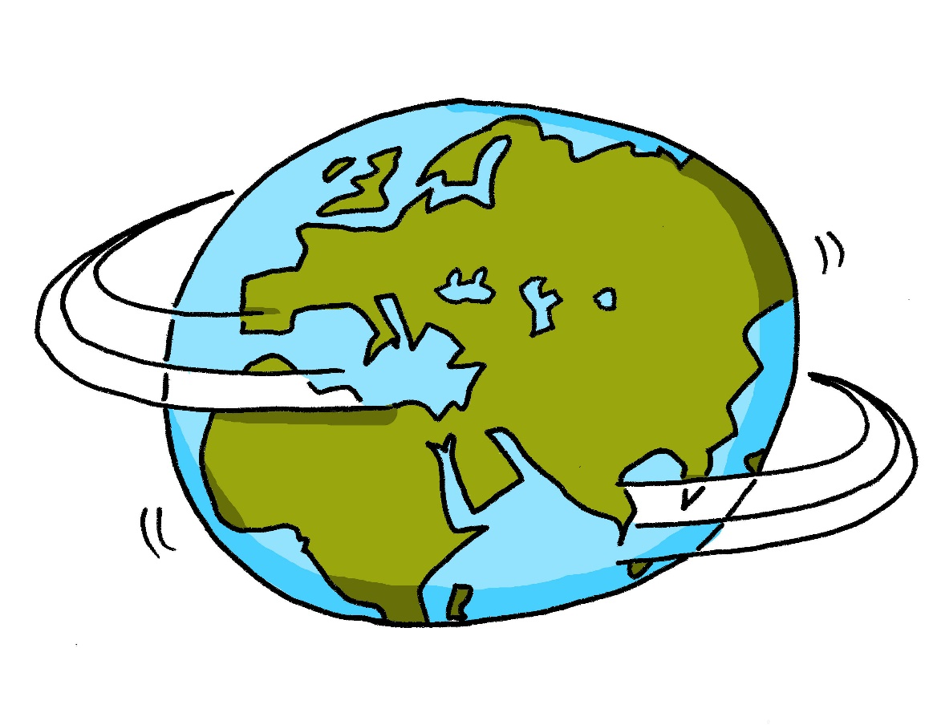
w
Welt
Notes:
Timing: 1 minute
Aim: To introduce/consolidate SSC [w]
Procedure: 1. Present the letter(s) and say the [w] sound first, on its own. Students repeat it with you. 2. Bring up the word ”Welt” on its own, say it, students repeat it, so that they have the opportunity to focus all of their attention on the connection between the written word and its sound.
3. A possible gesture for this would be to start with your hands above your head and draw them down, out and then back into the body, tracing the shape of the world.
4. Roll back the animations and work through 1-3 again, but this time, dropping your voice completely to listen carefully to the students saying the [w] sound, pronouncing ”Welt” and, if using, doing the gesture. Word frequency (1 is the most frequent word in German): Welt [164] Source: Jones, R.L. & Tschirner, E. (2019). A frequency dictionary of German: core vocabulary for learners. Routledge

Slide 7
Vokabeln
sprechen
wer?
who?
Notes:
Timing: 3 minutes (all four slides) Aim: To introduce the 4th Question word: ‘wer’.
Note: Following the introduction of ‘ wer’, we will revisit the question words students have encountered so far.
Procedure: 1. Model pronunciation of the question word.
2. Optional: Note that ‘wer’ might be considered a false friend as it sounds similar to ‘where’ in English.
One useful ‘hook’ for students is to say ‘Who? wer?’ (and mime the action of ‘hoovering’!) This (perhaps bizarrely) has the effect of fixing the association of the English ‘who’ with the German ‘wer’and does help students to map the L1:L2 meaning more securely.

Slide 8
Vokabeln
sprechen
wer?
who?
Notes:
Procedure: 1. Elicit the question word from students.

Slide 9
Vokabeln
sprechen
wer?
who?
Wer ist dein Mathelehrer?
[Who is your maths teacher?]
Notes:
Procedure: Model the question word and the question, and elicit answers as all students will now have a Maths teacher and Y7s like sharing information about school in the first term, when everything is new to them.

Slide 10
Vokabeln
sprechen
wer?
who?
____ ist dein Mathelehrer?
Wer
[Who is your maths teacher?]
Notes:
Procedure: 1. Elicit the the question word and the question from students.

Slide 11
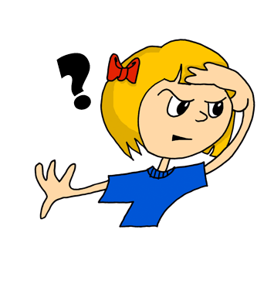
Vokabeln
sprechen
Was
____ denkst du?
__ ist Niko?
Wo
___ schreibt man …?
Wie
Wer
___ ist dein Englischlehrer?
Notes:
Timing: 3 minutes Aim: To revisit the question words learnt so far. Procedure: 1. Use the images to elicit the question words and a whole question. The questions on the slide are examples they have seen before, but other options are possible, of course.
2. Note: remember to revisit both meanings of ‘wie’ (‘how’ and ‘like what’) E.g. Ask: Wie ist das Heft hier? Rot oder blau?

Slide 12
Vokabeln
sprechen
Wie?
Wer?
Was?
Wo?
Notes:
Timing: 3 minutes (both slides) Aim: To revise questions words with their assocoated gestures. Procedure: 1. If teachers have used gestures to teach the questions, it is straightforward here to practise retrieval with students, whilst they show their understanding of each question word’s meaning.
2. Move quickly onto the next slide, where students can be invited to call out a question word and the rest of the class shows their understanding with the appropriate gesture. The teacher can also do the gestures (in jumbled order) and elicit the German from students.

Slide 13
Vokabeln
sprechen
W__?
W__?
W__?
W_?
Notes:
Procedure:
1. Students can now be invited to call out a question word and the rest of the class shows their understanding with the appropriate gesture.
2. The teacher can also do the gestures (in jumbled order) and elicit the German from students.

Slide 14
Vokabeln
sprechen
Wer
der Tag
Was
das Tier
Wo
der Mann
Was
der Gast
Wie
Wer
ist
?
die Farbe
die Flasche
Wo
Wie
der Mensch
das Ding
Notes:
Timing: 10 minutes Aim: To provide production practice (speaking) in question formation with question words. Procedure: 1. In pairs, students take turns to create a question using a question and a noun from each set. Once a word has been used it is crossed out. Note that not all question words can go with all nouns, e.g. ‘wer’ only makes sense with living things.
2. Rather than answering the questions, students translate their partner’s question into English.
They can do this orally or write down their questions.
3. For higher challenge, suggest that only the student creating the questions has sight of the sheet. This ensures that the listener relies only on the aural input for understanding.

Slide 15
Vokabeln
sprechen
der Lehrer
Notes:
Timing: 4 minutes (all six slides) Aim: To present this week’s new vocabulary. Procedure: 1. The words are animated to allow teachers to elicit prior knowledge from students, but there will obviously (as always) be different levels of knowledge in the room, particularly as their first encounters with these words were self-access via Quizlet. Teachers can use these slides flexibly to move students to more secure knowledge of the words.

Slide 16
Vokabeln
sprechen
der Fußball
der Ball
der Fußball
is a compound noun:
der Fuß + der Ball → der Fußball.
Notes:
Procedure: 1. Click to bring up the callout about Fußball as a compound noun. (This is the 2nd time that students encounter a compound). 2. Then click to bring up the image of the other ball.
3. Elicit the German for this from student i.e., der Ball.

Slide 17
Vokabeln
sprechen
der Freund

Slide 18
Vokabeln
sprechen
das Tier
das Haus
das Haustier
das Haustier
is also a compound noun:
das Tier + das Haus → das Haustier (pet).
Notes:
Procedure: 1. Elicit the German for ‘Tier’ (taught last week).
2. Click to bring up the German for house, and then the image.
3. Click to bring up the German for pet and then the image.
4. Elicit the meaning from students then click to bring up the callout about Haustier as a compound noun.

Slide 19
Vokabeln
sprechen
das Wasser

Slide 20
Vokabeln
sprechen
die Welt

Slide 21
Vokabeln
sprechen
das Wort

Slide 22
Vokabeln
sprechen
der Lehrer
die Welt
der Freund
das Wort
der Fußball
das Wasser
N
J
L
I
K
M
Notes:
Timing: 6 minutes Aim: To provide production (speaking) practice with most of the new vocabulary.
Procedure: 1. Elicit the answers using the German letters. Was ist ‘I’ ? etc..
2. Students volunteer the German words.

Slide 23
Vokabeln
lesen / sprechen
6. der Lehrer
1. der Fußball
5. die Welt
4. das Wort
3. das Wasser
2. der Freund
Notes:
Timing: 5 minutes Aim: To provide written comprehension practice (with a time limit to speed up processing) and production (speaking) practice with some of the new vocabulary. Procedure: 1. Students write 1-6 in books.
2. Ask students to write down the English translation before the word has faded away.
3. Click to bring up each option
4. Check answers by eliciting the German from students, with definite article. (i.e. so that they are translating back from their written English into spoken German). Note: Students have not yet done numbers but will be taught them explicitly in Week 9. However, in the next few weeks, certain activities will prime for them. Here the teacher can say the number when eliciting the answers, but support understanding by holding up the appropriate number of fingers each time. Obviously, the items proceed in number order in any case, so the finger gesture is more to draw learners attention to the sound – meaning connection of the number with the German word for that number.
5. Pay particular attention to the pronunciation of ‘W’, our SSC for this week, and also to the correct recall of the genders. It’s all too easy for students to lose the connection between the gender and the noun.
ANSWERS 1. der Fußball 2. der Freund 3. das Wasser 4. das Wort 5. die Welt 6. der Lehrer

Slide 24
Was ist das?
Sag das Wort auf Deutsch.
sprechen
m
m
f
nt
Notes:
Timing: 2 minutes
Aim: To practise gender and word knowledge with this week’s new words, using pictures prompts. Procedure: 1. Pictures representing the 6 nouns from this week appear on separate mouse clicks. Say the word (chorally) with its definite article. 2. On second click, the noun moves into the ‘appropriately gendered’ mouth.

Slide 25
Wer hat was?
Possessing things: who has what? HABEN (to have, having) ich habe, er/sie hat Definite articles (singular), R2 (accusative)
SSC [w]
Y7 German Term 1.1 – Week 5 – Lesson 10 Inge Alferink / Rachel Hawkes Artwork: Steve Clarke Date updated: 14.08.23
Notes:
Artwork by Steve Clarke. All additional pictures selected are available under a Creative Common license; no attribution required.
Learning outcomes (lesson 2):
Introduction of SSC [w]
Introduction of definite articles (singular) - Row 2 (accusative)
Word frequency (1 is the most frequent word in German):
7.1.1.5 (introduce) haben, hat [6] er1 [15] sie1 [7] wer? [149] Freund [273] Fußball [1277] Haus [159] Haustier [>5009] Lehrer [695] Wasser [245] Welt [164] Wort [194] wahr [737] nicht wahr? [n/a] Ist es warm/kalt heute?
7.1.1.2 (revisit) sagen, sagt [40] was?[38] Klasse [961] Mann [121] Paar [241] Tag [111] falsch [524] richtig [177] oder [35] ja1 [45] nein [148] nicht [11] Ist das klar? [n/a]
Source: Jones, R.L. & Tschirner, E. (2019). A frequency dictionary of German: core vocabulary for learners. Routledge

Slide 26
w
Welt
Notes:
Timing: 1 minute
Aim: To introduce/consolidate SSC [w]
Procedure: 1. Present the letter(s) and say the [w] sound first, on its own. Students repeat it with you. 2. Bring up the word ”Welt” on its own, say it, students repeat it, so that they have the opportunity to focus all of their attention on the connection between the written word and its sound.
3. A possible gesture for this would be to start with your hands above your head and draw them down, out and then back into the body, tracing the shape of the world.
4. Roll back the animations and work through 1-3 again, but this time, dropping your voice completely to listen carefully to the students saying the [w] sound, pronouncing ”Welt” and, if using, doing the gesture. Word frequency (1 is the most frequent word in German): Welt [164] Source: Jones, R.L. & Tschirner, E. (2019). A frequency dictionary of German: core vocabulary for learners. Routledge

Slide 27
w
Wasser
wahr
Welt
Was?
gewinnen
antworten
[to answer]
[to win]
Notes:
Timing: 2 minutes
Aim: To introduce/consolidate SSC [w]
Procedure:
Introduce and elicit the pronunciation of the individual SSC [w] and then the source word again ‘Welt’ (with gesture, if using).
Then present and elicit the pronunciation of the five cluster words.
The cluster words have been chosen for their high-frequency, from a range of word classes, with the SSC (where possible) positioned within a variety of syllables within the words (e.g. initial, 2nd, final etc.). Additionally, we have tried to use words that build cumulatively on previously taught SSCs (see the Phonics Teaching Sequence document) and do not include new SSCs. Where new SSCs are used, they are often consonants which have a similar symbol-sound correspondence in English.
Word frequency (1 is the most frequent word in German): Welt [190]; Wasser [297] wahr [662]; Was? [39]; antworten [804]; gewinnen [410]. Source: Jones, R.L. & Tschirner, E. (2006). A frequency dictionary of German: core vocabulary for learners. Routledge

Slide 28
w
Wasser
wahr
Welt
Was?
gewinnen
antworten
Notes:
With sound and no pictures to focus all attention on the sound-symbol correspondence.

Slide 29
w
Wasser
wahr
Welt
Was?
gewinnen
antworten
Notes:
Without sound to elicit pronunciation (without first hearing the teacher).
Teacher to elicit pronunciation by asking “Wie sagt man…”

Slide 30
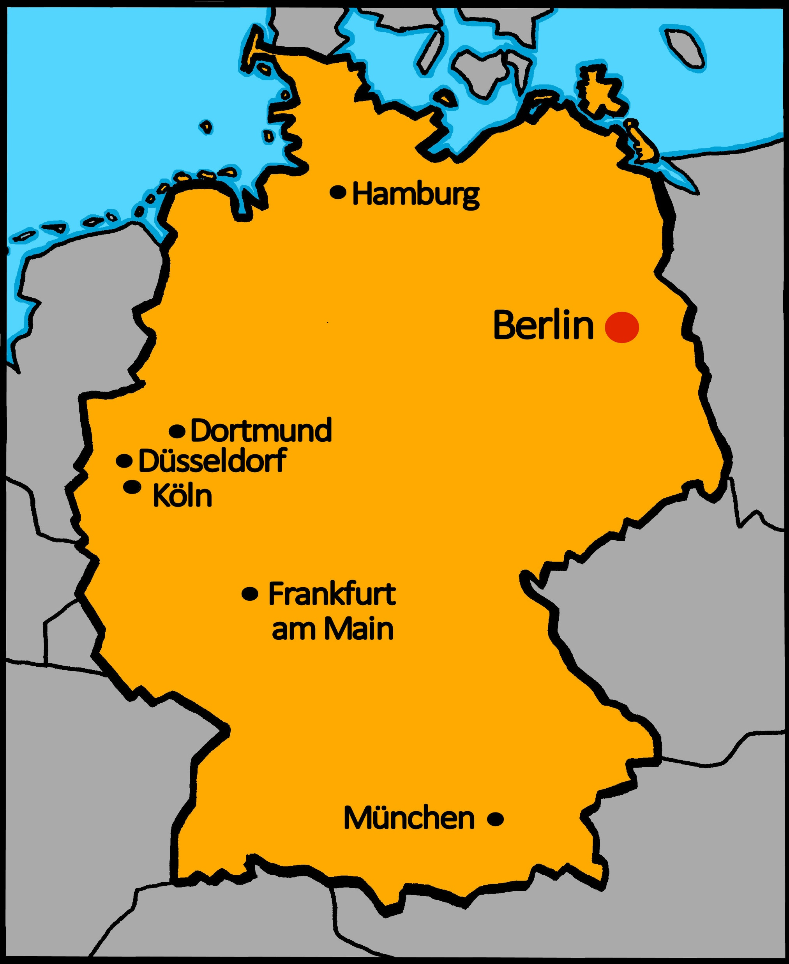
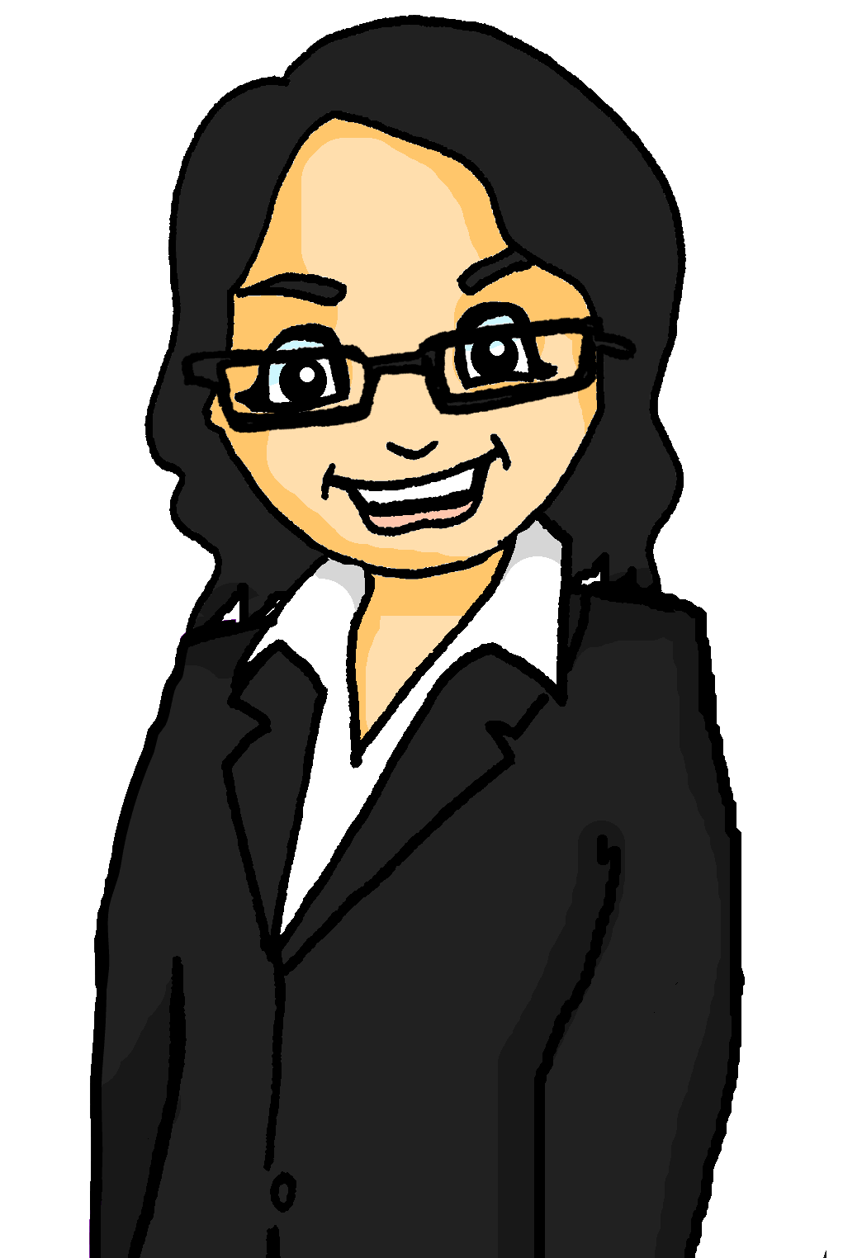
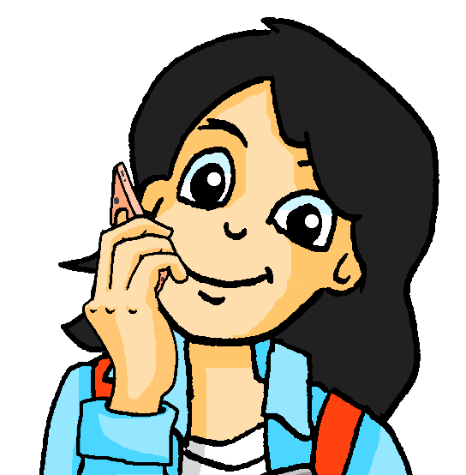
In Weimar
Katrin ist Mias Mutter. Sie ist nicht zu Hause*. Wo ist sie?
lesen / sprechen
Lies den Dialog.
Map of Germany with the cities marked on there.
Hallo, Mia! Wie geht’s?
Gut! Wo bist du?! Ich weiß es nicht!
Ich bin in Weimar. Der Wind hier ist kalt! Wie ist das Wetter da?
Ist das wahr?! Es ist warm hier.
Alles klar.
Auf Wiedersehen.
Tschüss, Mutti!
Alles klar means all clear and can be used as a question and an answer:
Teacher: Alles klar? (Everything clear?)
Pupil: Alles klar! (All clear!)
zu Hause – at home
Notes:
Timing: 6 minutes (two slides)
Aim: to consolidate the SSC [w] by ‘read aloud’ conversation containing known words with [w].
Procedure:
Ensure students understand the context given in the first line of text on the slide.
Give students a minute or so to read aloud the dialogue in pairs. Teacher can circulate to listen in to students’ pronunciation.
3. Click to bring up speech bubble explaining about ‘alles klar’ – they already know ‘Ist das klar?’. Explain that teachers can say this as a question to ask if everything is clear/understood and that they can reply using ‘alles klar’ as a statement. It’s just a small variation on what they already know but something they would/will hear often in German-speaking contexts outside of the classroom, too. 3. Move to the next slide.
Note: All of the words (and grammar features) in this dialogue have been previously taught (or encountered and practised as phonics cluster words – e.g., kalt), with the exception of Wind, Wetter, warm and Auf Wiedersehen. Auf Wiedersehen won’t be formally introduced on the LDP SOW for some time, so it makes sense to introduce it here and use in in classroom interaction as often as possible. All of these words are on all three AO GCSE lists.

Slide 31
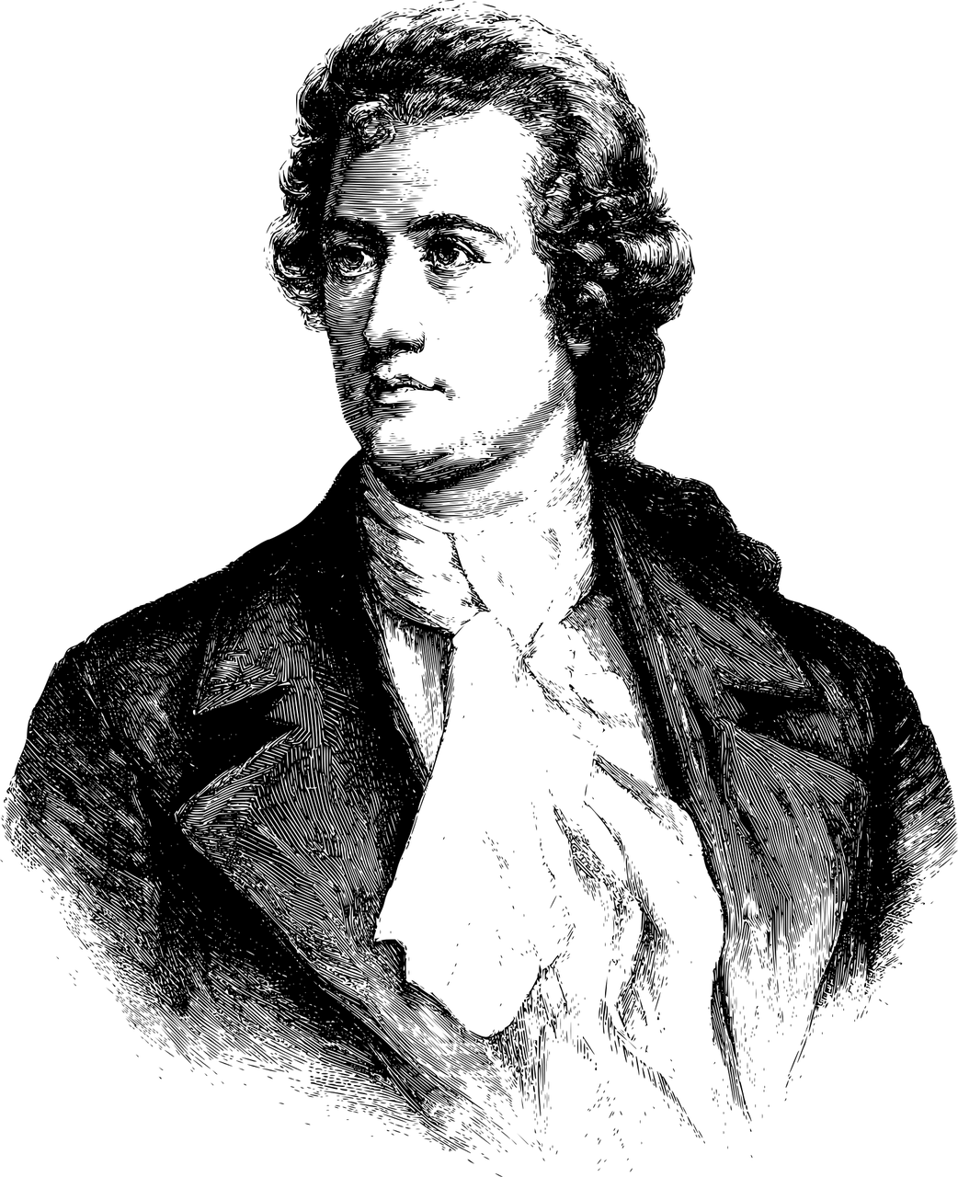
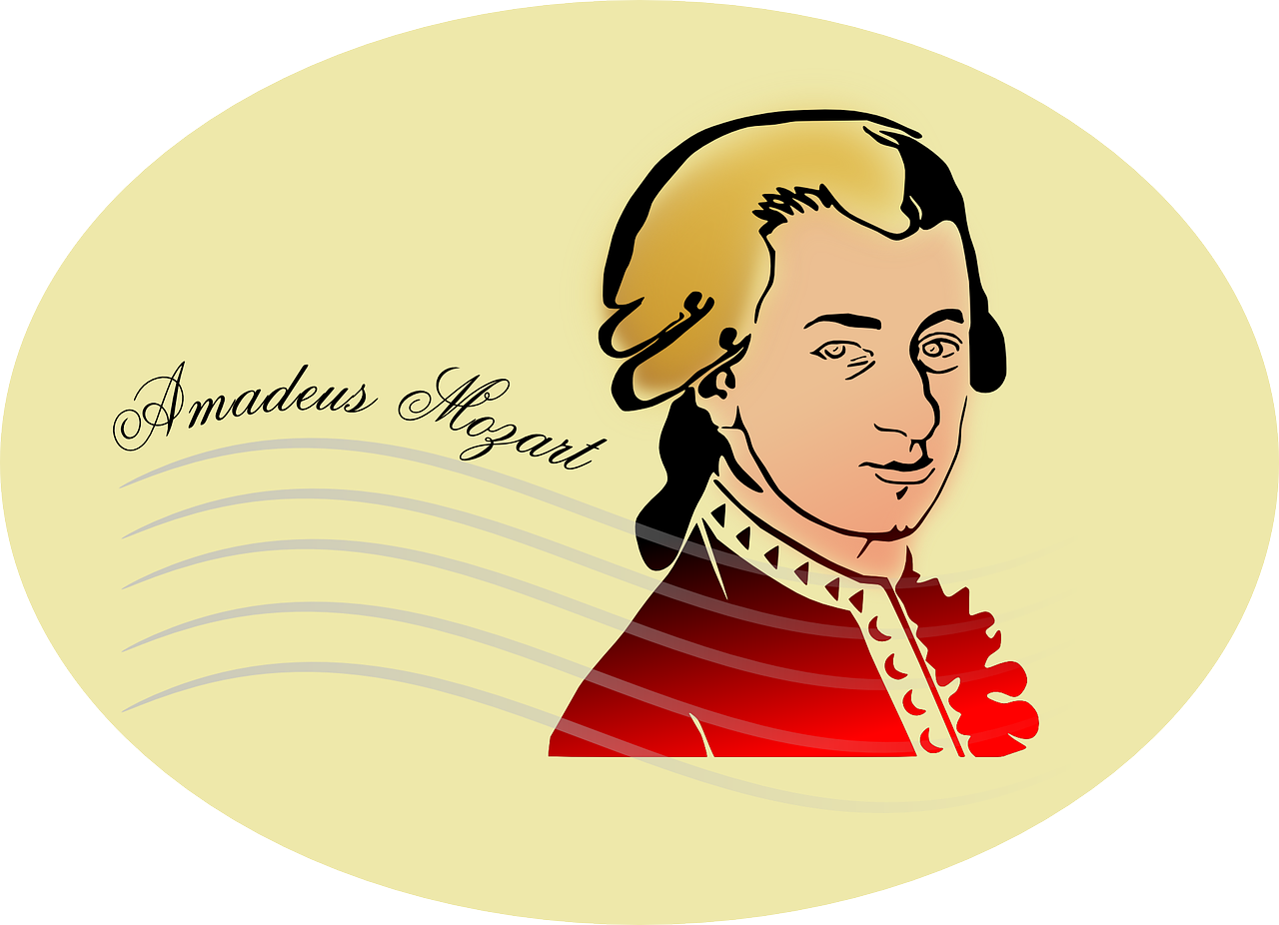
Wo ist Weimar?
Weimar ist in der Mitte von Deutschland.
Johann Wolfgang von Goethe, Germany’s most famous writer, lived there.
Wolfgang used to be a very popular German boy’s name. A very famous Austrian composer has this name, too.
Map of Germany with the cities marked on there.
Wer ist das?
Ja, richtig! Wolfgang Amadeus Mozart.
Ich bin auch Wolfgang, oder Wolf.
Notes:
Aim: to consolidate the SSC [w] providing a focus on more examples of its use; to share a little cultural information (names of two internationally iconic figures from German-speaking culture – Goethe and Mozart); and introduce Wolfgang, a central character in the SOW narrative.
Procedure:
Click to bring up and read about the location of Weimar in German, and the subsequent information in English.
2. Click to bring up Wolfgang asking for the identity of the famous Austrian composer. Elicit suggestions from students and click to bring up the final two callouts.

Slide 32
haben
[to have | having]
hat
[has]
Notes:
Timing: 3 minutes for sequence of six verbs
Aim: To introduce the verb haben more explicitly.
Note: Haben is one of the 25 most frequently used verbs in German. All 25 most frequent verbs will be introduced early on using the same format. Both long form (infinitive) and short form (3rd person singular) are introduced in order to familiarise students with various forms of the same verb.
Procedure
Bring up the word haben on its own, say it, students repeat it, and remind them of the phonics. Draw attention to the long [a].
Try to elicit the meaning from the students. Students have had explicit teaching that the present tense in German communicates two different present tense meanings in English. This reinforces that learning.
Then bring up the English translations. Emphasise the two meanings for the infinitive.
Bring up the short form hat, say it, students repeat it. Draw attention to the short [a].
Try to elicit the meaning from the students.

Slide 33
haben
[to have| having]
hat
[has]
Notes:
Cycle through the long and short form again.

Slide 34
hat
[has]
Markus hat ein Fahrrad.
[Markus has a bike.]
Notes:
Introduce the short form in a sentence.

Slide 35
haben
[to have | having]
Markus muss ein Fahrrad haben.
[Markus must have a bike.]
Notes:
Introduce the long form in a sentence.

Slide 36
hat
[has]
hat
Markus ____ ein Fahrrad.
[Markus has a bike].
Notes:
Cycle through the short form in context again.

Slide 37
haben
[to have | having]
Markus muss ein Fahrrad_______.
haben
[Markus must have a bike.]
Notes:
Cycle through the long form in context again.

Slide 38
Haben – to have, having
Grammatik
In German the verb haben means ‘to have’.
I have, he has and she has are parts of the verb ‘to have’.
After most verbs the masculine word for ‘the’, der, changes its spelling to den. It still means ‘the’.
ich habe
I have
er hat
he has
sie hat
she has
Ich habe den Fußball.
Er hat die Flasche.
Sie hat das Heft.
I have the football.
He has the bottle.
She has the exercise book.
This change happens after most verbs but not SEIN / ist (BE / is).
Notes:
Timing: 3 minutes
Aim: to introduce the verb haben in 1st and 3rd persons singular; to introduce the Row 2 (accusative) form of the definite article (den) that follows most verbs.
Procedure:
Read the grammar explanation about haben. Make sure pupils are clear about the ‘I’, ‘he’ and ‘she’ pictures.
Elicit English translations for the German examples provided.
Draw attention to the den used here after haben for masculine nouns.

Slide 39
Was ist richtig?
lesen
Help Zorg choose the correct verb to start each sentence. Look carefully at the word for ‘the’ in each sentence.
1. Ich habe | Das ist
den Tisch.
Compound noun: das Wasser + die Flasche → die Wasserflasche.
Notice that the gender of the new noun is the gender of the final noun.
2. Das ist | Er hat
der Freund, Wolf.
3. Sie hat | Das ist
der Mann.
4. Ich habe | Das ist
den Fußball.
5. Ich habe | Das ist
die Wasserflasche.
6. Er hat | Das ist
das Tier.
Could be either verb here because die and das don’t change!
Notes:
Timing: 8 minutes Aim: to recognise in written form words for ‘the’, contrasting the masculine form after sein (der) and after most other verbs (den)
Procedure:
Tell pupils they need to decide between haben and sein to start each sentence, remembering that the masculine word for the changes after most verbs, but not sein.
Pupils write down 1-6 and their choice of verb for each sentence.
Elicit answers and ask pupils to explain why they have chosen a particular answer. Click to reveal answers.
Discuss 5 and 6- these nouns are feminine and neuter so we don’t need to worry about the change- this only applies to masculine der changing to den. Can they translate the sentences? E.g. Ich habe den Tisch = I have the table.
Click to bring up the callout about compound nouns. This is the 3rd time that students have encountered one of these this lesson.
Additional task suggestions: 1. Ask pupils to translate each sentence, as well as choosing the correct option. 2. Ask students to write/say the alternative sentences. E.g., Das ist der Tisch. That is the table.

Slide 40
Wer hat …?
hören
Zorg is asking who has what. Listen to Zorg.
What is he asking about? Who has that item, W (Wolfgang) or M (Mia)?
Wer hat die /den /das ________ ?
Wolfgang
Mia
Beispiel:
Beispiel:
Notes:
Timing: 8 minutes (2 slides) Aim: to practise connecting nouns with the correct form of the definite article. Procedure: 1. Use this slide to explain the task. The noun itself is omitted, forcing students to listen for the article and use this to determine the object.
2. Click on Beispiel – tell students its meaning (example). This word will be formally learnt next week so useful to bring in here.
3. Elicit the answer and explanation why – i.e., we hear ‘die’ and this is the word ‘the’ that connects to Flasche, whilst ‘das’ connects to Paar.
4. Click to hear the full question.
5. Move to the questions and answers on the next slide.

Slide 41
Wer hat…?
Zorg is asking who has what.
Listen. Write 1-6 and W (Wolfgang) or M (Mia).
hören
Wolfgang
Mia
Wolfgang
Mia
1
4
1
4
2
5
2
5
3
6
3
6
Notes:
Procedure: 1. Click to play the gapped audio. (Note that for items 2 – 6 you need to click once to bring up the two image options, and then click the audio. This is to avoid too much visual information on the slide all at once).
2. Students write W (Wolfgang) or M (Mia). 3. Click to bring up the 2nd set of audio buttson.
4. Elicit responses orally, and click to confirm by listening to the full sentence.
Transcript:
Wer hat den [Fußball]?
Wer hat die [Tafel]?
Wer hat das [Heft]?
4. Wer hat den [Tisch]?
5. Wer hat das [Paar]?
6. Wer hat das [Tier]?

Slide 42
Was hat er? Was hat sie?
lesen / schreiben
Wolfgang hat ____ Fußball.
Mia hat ____ Tafel.
Wolfgang hat ____ Heft.
Mia hat ____ Tisch.
Wolfgang hat ____ Paar.
Mia hat ____ Tier.
den
die
das
den
das
Wolfgang
Mia
das
Notes:
OMIT THIS ACTIVITY, IF SHORT OF TIME. Timing: 6 minutes Aim: To practise written production of the correct form of the article for nouns. Procedure: 1. Click to display the sentences based on the previous exercise one by one. The definite article is missing from each.
2. Students supply the correct for word for the article in each case.
3. Click to display the answers.

Slide 43
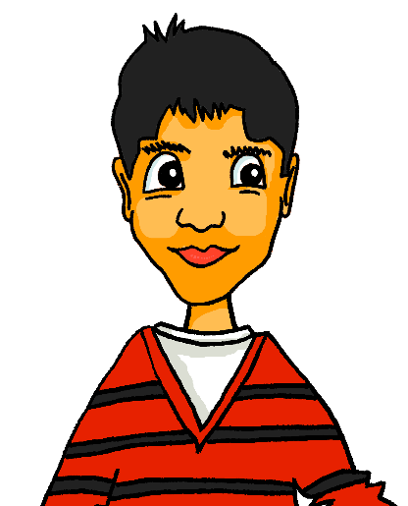
Wer bist du?
Choose a person. Say what you have. Your partner works out who you are. Then swap.
sprechen / hören
Mia
Wolf
Katrin
Ich habe den Ball…
Wer bist du?
Zorg
Mehmet
Du bist Katrin!
Nein, ich habe den Ball, den Fußball, die Wasserflasche, die Tafel, das Haustier und die Flasche.
Du bist Mia!
Richtig! Ich bin Mia.
Notes:
Timing: 8 minutes
Aim: to practise oral production of haben + words for ‘the’ + nouns.
Procedure:
Tell pupils they are going to choose to be one of the characters but must not tell their partner/group who they have chosen.
Click through the speech bubbles to illustrate how the conversation might go. Person A asks ‘Who are you?’. Person B uses ‘ich habe’ + words for the + nouns to describe what he/she has, pretending to be one of the characters. Person A can suggest the identity at any point saying ‘Are you…?’
Pupils have their own dialogues, changing the underlined parts of the speech bubbles.
Repeat, with both pupils having at least 2 goes at each role.
Pupils should then say or write sentences in the he/she form to describe the pictures e.g. Er (Wolf) hat das Heft, die Flasche, das Tier und das Haus. Er hat auch die Tafel und das Haustier.
Note: i) It is tricky to have a communicative speaking activity without separate handouts that makes the articles task essential. The logistics of time make it hard for teachers to fit speaking activities into a lesson if there are handouts, so this activity is a compromise. It is an information gap activity with independent language production (i.e., from memory). It is hoped that the very focused listening and reading input practice on gender and articles in the previous weeks and this week will prompt most students to produce most/all of the correct articles. There will also be many opportunities throughout the course to continue to focus on gender in speaking activities, as it is a difficult one for students to automatise, and requires lots of practice in all modes and modalities, including in listening and reading. ii) It might be helpful/necessary to recap the genders of the nouns before this activity and remind students to differentiate between ball and football, bottle and water bottle, animal and pet. Additional task suggestions: 1. Pupils could join with another pair and report back on what their partner has in the 3rd person e.g. Er hat den Ball, die Wasserflasche, das Heft, das Haustier, das Haus und den Fußball. Wer ist er?

Slide 44
Hausaufgaben
Vocabulary Learning Homework (Y7, Term 1.1, Week 6)
Audio file
Student worksheet
In addition, revisit: Term 1.1 Week 3
Notes:
Use this slide to set the homework.
For Y7, the typical homework will be to pre-learn vocabulary for the next lesson. There is an audio file to accompany the student worksheet.
Notes:
i) Teachers may, in addition, want to recommend use of a particular online app for the pre-learning of each week’s words. ii) Quizlet now requires parental involvement / registration / permissions for users below the age of 13, so it is perhaps most suitable for Y9 – 11 students. iii) Language Nut hosts LDP vocabulary lists and these are free for schools to use, though there is a registration process. One benefit is that all of the student tracking data that Language Nut offers are also available to schools that use the LDP lists for practice. Perhaps this makes it a good option for Y7/8.
iv) There are other free apps, and new ones are always appearing. Teachers have told us that they are currently using: Flippity, Wordwall (where using previously-created activities is free).
v) Gaming Grammar has been acquired by Language Nut. Its original content should still be available to teachers and much of it is appropriate for Y7 learners. From this lesson, for example, learners could practise Definite articles: gender.

Slide 45
Phonetik
hören / schreiben
Wo ist der Lehrer?
Das Ding ist blau.
Du bist klein.
Der Mann hat den Fußball.
Wie schreibt man das?
Ist das Ding rot oder gelb?
1
2
3
4
5
6
Notes:
OPTIONAL ACTIVITY Timing: 10 minutes Aim: to practise the phonics, vocabulary and grammar learnt, via transcription.
Note: A lot of the activities so far have used isolated words. This activity puts the vocabulary they have learnt in context. It also focuses the students’ attention on accurate spelling of the words.
Procedure: 1. Play the audio recording of the sentences. Click the number to repeat the sentence as many times as needed.
2. Students write the sentences down.
3. Discuss the answers. For each item ask a student to read what they have written. Play the recording again and then show the written version.
Transcript: 1. Wo ist der Lehrer?
2. Das Ding ist blau.
3. Du bist klein.
4. Der Mann hat den Fußball.
5. Wie schreibt man das?
6. Ist das Ding rot oder gelb?

Slide 46
Wer hat was?
sprechen
https://www.bensound.com
Notes:
OPTIONAL SPEAKING ACTIVITY (instead of slide 43) Timing: 10 minutes Aim: To practise use of the correct article form with nouns. Procedure: 1. Pass the parcel with cards. To start the music, click the audio player icon, which displays a pause button when the music is playing, allowing full control.
2. Music stops, everyone holds up their cards (we will have 9-10 nouns in play, all the masc. ones). Teacher first asks 'Wer hat den Tisch?' Wer hat den Lehrer?'. After a few more turns, the teacher asks: 'Was hat David?' to elicit the definite article in Row 2.
3. A variation: Teacher has an extra set of the nouns in pictures. After the music stops holds a card up and ask ‘Was ist das?’ (‘Das ist der Tisch’) followed by ‘Wer hat das’? (‘David hat den Tisch’). This emphasises that masculine ‘the’ does not change after ist, but does change after other verbs.
4. The cards themselves are on the next slide.
Masculine words
der Tisch
der Tag
der Mann
der Mensch
der Ort
der Lehrer
der Fußball
der Freund der Gast
Additions
die Welt
das Wort
das Wasser
das Tier
die Sache / das Ding
die Zahl
die Farbe

Slide 47
Karten
Notes:
These are the cards for the game on the previous slide.

