Slide 1
Berlin
Describing things: Was ist das (nicht)? Wie ist das (nicht)?
Negation: nicht + adjective; kein + nouns
SSC [z]
Hallo! Ich bin Mia. Wie geht’s?
Ich bin in Berlin. Wo bist du?
Y7 German Term 1.1 – Week 4 – Lesson 8 Rachel Hawkes Artwork: Steve Clarke Date updated: 25.05.23
Notes:
Artwork by Steve Clarke. All additional pictures selected are available under a Creative Common license; no attribution required.
Note: All words listed below for this week’s learning appear on all three Awarding Organisations’ word lists, with the following exceptions: i) Edexcel list does not have Tafel, Tschüss. ii) AQA list does not have Tafel, Heft.
Learning outcomes (lesson 1):
Introduction of SSC [z]
Introduction of negation: nicht + adjective; kein + nouns (Row 1-Nominative)
Word frequency (1 is the most frequent word in German):
7.1.1.4 (introduce) wissen [78] bist [4] du [54] Farbe [1079] Nummer [806] Ort [341] Tier [614] aber [31] kein [46] ich weiß nicht [n/a] wie sagt man [n/a] wie schreibt man [n/a]
das ist (nicht) klar
7.1.1.1 (revisit) sein¹, ist [4] Fenster [674] Flasche [1602] Heft [3862] Tafel [3855] Tisch [529] da [48] hier [68] wo? [108] der, die, das [1] Hallo! [1077] Tschüs! [3766]
Source: Jones, R.L. & Tschirner, E. (2019). A frequency dictionary of German: core vocabulary for learners. Routledge

Slide 2
wie
sprechen
wie?
how?
Wie sagt man…?
[How do you say…?]
Notes:
Timing: 1 minute
Aim: To introduce and practise the important phrase ‘Wie sagt man’.
Procedure: 1. Model the phrase, and use it to ask students to recall the meanings of some words from previous lessons.
2. Encourage students to realise the importance of the phrase for asking questions whenever meanings are unclear. E.g. Wie sagt man ‘ein Tisch’ auf Englisch? Wie sagt man ‘an exercise book’ auf Deutsch?

Slide 3
z
Zug
Notes:
Timing: 1 minute
Aim: To introduce/consolidate SSC [z]
Procedure: 1. Present the letter(s) and say the [z] sound first, on its own. Students repeat it with you. 2. Bring up the word “Zug” on its own, say it, students repeat it, so that they have the opportunity to focus all of their attention on the connection between the written word and its sound.
3. A possible gesture for this would be to mime wheels, holding your hands at your sides, elbows bent, forearms facing forwards in a right angle, and draw small circles with them, in the air (to denote the wheels of a train going round).
4. Roll back the animations and work through 1-3 again, but this time, dropping your voice completely to listen carefully to the students saying the [z] sound, pronouncing ”Zug” and, if using, doing the gesture. Word frequency (1 is the most frequent word in German): Zug [675] Source: Jones, R.L. & Tschirner, E. (2019). A frequency dictionary of German: core vocabulary for learners. Routledge

Slide 4
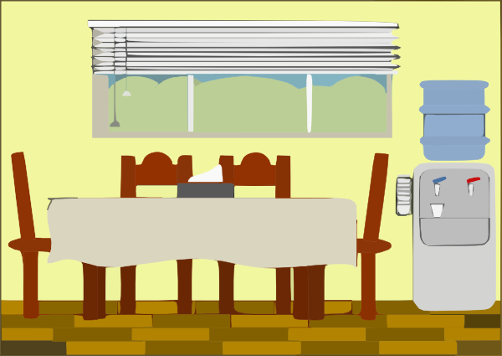
z
Zimmer
zehn
Zug
Arzt
sitzen
Platz
Notes:
Timing: 2 minutes
Aim: To introduce/consolidate SSC [z]
Procedure:
Introduce and elicit the pronunciation of the individual SSC [z] and then the source word again ‘Zug’ (with gesture, if using).
Then present and elicit the pronunciation of the five cluster words.
The cluster words have been chosen for their high-frequency, from a range of word classes, with the SSC (where possible) positioned within a variety of syllables within the words (e.g. initial, 2nd, final etc.). Additionally, we have tried to use words that build cumulatively on previously taught SSCs (see the Phonics Teaching Sequence document) and do not include new SSCs. Where new SSCs are used, they are often consonants which have a similar symbol-sound correspondence in English.
Zug [675] Zimmer [665] zehn [333] Arzt [622] Platz [326] sitzen [231]. Source: Jones, R.L. & Tschirner, E. (2019). A frequency dictionary of German: core vocabulary for learners. Routledge

Slide 5
z
Zimmer
zehn
Zug
Arzt
sitzen
Platz
Notes:
With sound and no pictures to focus all attention on the sound-symbol correspondence.

Slide 6
z
Zimmer
zehn
Zug
Arzt
sitzen
Platz
Notes:
Without sound to elicit pronunciation (without first hearing the teacher).
Teacher to elicit pronunciation by asking “Wie sagt man…”

Slide 7
Negation
Grammatik
In German, to say ‘not’ with adjectives, use ‘nicht’:
Das ist rot.
That is red.
Das ist nicht rot.
That is not red. / That isn’t red.
‘kein’ works like ‘ein’ and matches the gender of the noun.
To say ‘not a/no’ with nouns, use ‘kein’:
Das ist kein Mensch.
That is not a human being.
We sometimes use ‘no’
in English, too: That’s no problem! Das ist kein Problem!
Das ist keine Form.
That is not a shape.
Das ist kein Ding.
That is not a thing.
Notes:
Timing: 2 minutes Aim: To introduce the negative forms of ‘nicht’ with adjectives and ‘kein’ with nouns.
Procedure: 1. Click on the mouse to animate the explanation.
2. Check students’ understanding at each stage.

Slide 8
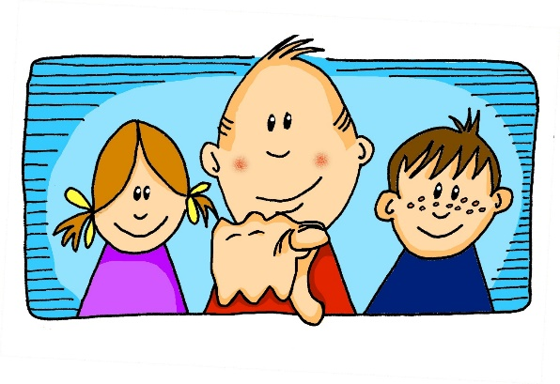
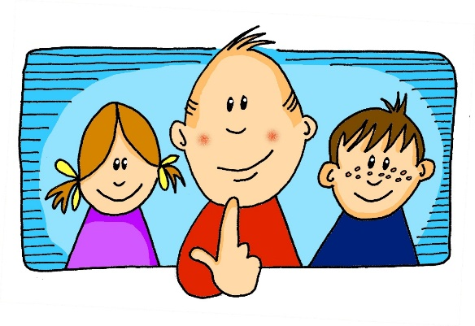
Bist du…?
sprechen
Bist du …?
Ich bin keine Form.
Nein
eine Form
Ja
Notes:
Timing: 8 minutes (all 6 slides) Aim: To practise kein/keine/kein, eliciting the answer ‘Ich bin’ to ensure that these forms and meanings are fully practised, before asking students to actively differentiate between ‘kein’ and ‘nicht’.
Procedure: 1. Teacher asks ‘Bist du ein…?’
2. Students respond ‘Ich bin kein/keine/kein...’ or ‘Ich bin ein/eine/ein...’ when correct.

Slide 9
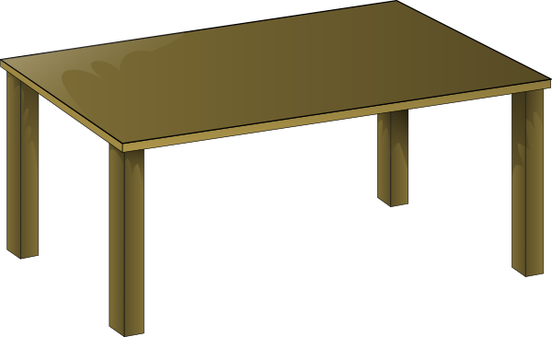
Bist du…?
sprechen
Nein
Ja
Notes:
Bist du ein Tisch? → Ich bin kein Tisch

Slide 10
Bist du…?
sprechen
Nein
Ja
Notes:
Bist du ein Heft? → Ich bin kein Heft.

Slide 11
Bist du…?
sprechen
Nein
Ja
Notes:
Bist du ein Tier? → Ich bin kein Tier.
Note: Make it clear (in case students don’t recall this from their pre-learning) that das Tier is the word for ‘animal’ in general – all types of animal. This image is not meant to represent a specific animal.

Slide 12
Bist du…?
sprechen
Nein
Ja
Notes:
Bist du eine Flasche? → Ich bin keine Flasche.

Slide 13
Bist du…?
sprechen
Nein
Ja
Notes:
Bist du ein Mensch? → Ich bin ein Mensch.

Slide 14
SEIN (to be | being)
Grammatik
Note: ‘bin’ (am), ‘bist’ (are) and ‘ist’ (is) are all forms of the verb
SEIN (to be | being).
Ich bin ein Mensch.
I am a human being.
Du bist ein Mensch.
You are a human being.
Das ist ein Mensch.
That is a human being.
Remember: ‘das’ is ‘the’ for neuter nouns and general word for ‘that’.
Notes:
Timing: 2 minutes
Aim: To remind students that ‘am’, are’ and ‘is’ are all parts of the verb ‘BE’ - this is often something that students are not clear about, without explicit reminders, as the verbs are so irregular in German and English. Procedure: 1. Bring up each German phrase and elicit the English for each.
2. Then bring up the note that reminds students that bin, bist and ist are all part of the same verb SEIN (to be)

Slide 15
Ist das…?
sprechen
Ist das ein Ding?
Das ist kein Ding.
Nein
Ja
Notes:
Timing: 8 minutes (all 6 slides) Aim: To prompt a deeper level of processing of ‘kein/keine/kein’ vs ‘ein/eine/ein’, as more of them are affirmative answers. Procedure: 1. Teacher asks ‘Ist das ein… ?’
2. Students respond ‘Das ist kein/keine/kein...’ or ‘Das ist ein/eine/ein...’ when correct.

Slide 16
Ist das…?
sprechen
Nein
Ja
Notes:
Ist das ein Mensch? → Das ist kein Mensch.

Slide 17
Ist das…?
sprechen
Nein
Ja
Notes:
Ist das eine Form? → Das ist eine Form.

Slide 18
Ist das…?
sprechen
Nein
Ja
Notes:
Ist das ein Mensch? → Das ist ein Mensch.

Slide 19
Ist das…?
sprechen
Nein
Ja
Notes:
Ist das ein Ding? → Das ist kein Ding.

Slide 20
Ist das…?
sprechen
Nein
Ja
Notes:
Ist das eine Form? → Das ist keine Form.

Slide 21
Eine Radioshow
Your boss needs help! The quiz items for a new radio show got corrupted. ☹ Look at the items described and add in the missing words.
lesen
1 | Ich bin _______ rot.
2 | Ich bin _______ Mensch.
3 | Ich bin _______ groß.
4 | Ich bin _______ Ding.
5 | Ich bin ________ Tafel.
6 | Ich bin ________ gelb.
7 | Ich bin ________ Tisch.
8 | Ich bin ________ blau.
nicht
keine
kein
nicht
nicht
kein
kein
nicht
Notes:
EITHER THIS SLIDE OR THE NEXT (MORE CHALLENGING) Timing: 5 minutes (either [1] or [2]) Aim: To practise selecting the correct negative form, according to the meaning.
Note: This is the more straightforward version of the task, in which only ‘nicht’ or ‘kein/keine/kein’ are possible.
A more challenging version, which works in the same way, is to be found on the next slide. Procedure: 1. Students consider each question and decide on the appropriate form to fill each gap.
2. click on the mouse to animate the answers.

Slide 22
Eine Radioshow
Your boss needs help! The quiz items for a new radio show got corrupted. ☹ Look at the items described and, if necessary, add in the missing words.
lesen
1 | Ich bin _______ rot.
2 | Ich bin _______ Mensch.
3 | Ich bin _______ klein.
4 | Ich bin _______ Ding.
5 | Ich bin ________ blau.
6 | Ich bin ________ gelb.
7 | Ich bin ________ Tisch.
8 | Ich bin ________ Heft.
nicht
kein
nicht
kein
kein
ein
Notes:
THIS IS THE MORE CHALLENGING VERSION OF THE PREVIOUS SLIDE
Aim: To practise selecting the correct article or negative form, according to the meaning.
Note: This is the more challenging version of the task on the previous slide, because four answers are possible.
Stress the instruction ‘if necessary’ and reinforce the message that ‘nothing’ is a possible answer, here. The four possibilities are: nicht, kein(e), nothing, ein(e).

Slide 23
Eine Radioshow
The quiz goes live tonight! Listening to a practice session, you notice more corrupted items. Look at the items below and add in the missing words.
hören
1 | Ich bin _______ rot.
2 | Ich bin _______ Form.
3 | Ich bin _______ klein.
4 | Ich bin _______ Tisch.
1 | Ich bin _______ Ding.
2 | Ich bin _______ groß.
3 | Ich bin _______ blau.
4 | Ich bin _______ Orange.
1
1
nicht
ein
2
2
keine
nicht
3
3
nicht
nicht
4
4
kein
keine
Notes:
EITHER THIS SLIDE OR THE NEXT (MORE CHALLENGING) Timing: 5 minutes (either [3] or [4]) Aim: To practise selecting the correct article or negative form based on what is heard.
Note: A more challenging version of this activity is on the next slide. Procedure: 1. Click on the audio buttons to play each item.
2. Students read each sentence and, on the basis of what is heard, select the correct article or negative form to fill each gap.
Transcript:
Eins. [Presenter] Bist du blau?
[Contestant] Ja. Zwei. [Presenter] Bist du eine Form?
[Contestant] Nein.
Drei. [Presenter] Bist du groß?
[Contestant] Ja.
Vier. [Presenter] Bist du ein Zug?
[Contestant] Ja!
Eins. [Presenter] Bist du ein Ding?
[Contestant] Ja. Zwei. [Presenter] Bist du klein?
[Contestant] Ja.
Drei. [Presenter] Bist du gelb?
[Contestant] Ja.
Vier. [Presenter] Bist du eine Banane?
[Contestant] Ja!

Slide 24
Eine Radioshow
The quiz goes live tonight! Listening to a practice session, you notice more corrupted items. Look at the items below and, if necessary, add in the missing words.
hören
1 | Ich bin _______ rot.
2 | Ich bin _______ Form.
3 | Ich bin _______ klein.
4 | Ich bin _______ Tisch.
1 | Ich bin _______ Ding.
2 | Ich bin _______ groß.
3 | Ich bin _______ gelb.
4 | Ich bin _______ Banane.
Note: You may not ALWAYS need nicht or kein(e). Listen carefully. You may need ‘ein’ or nothing.
1
1
nicht
ein
2
2
keine
nicht
3
3
nicht
4
4
kein
eine
Notes:
THIS IS THE MORE CHALLENGING VERSION OF THE PREVIOUS SLIDE
Note: In this more challenging version of the task, students are alerted to the possibility of 4 different answers (as in the reading).
In the 2nd set of 4 questions, these possibilities are used.
Transcript:
Eins. [Presenter] Bist du blau?
[Contestant] Ja. Zwei. [Presenter] Bist du eine Form?
[Contestant] Nein.
Drei. [Presenter] Bist du groß?
[Contestant] Ja.
Vier. [Presenter] Bist du ein Zug?
[Contestant] Ja!
Eins. [Presenter] Bist du ein Ding?
[Contestant] Ja. Zwei. [Presenter] Bist du klein?
[Contestant] Ja.
Drei. [Presenter] Bist du gelb?
[Contestant] Ja.
Vier. [Presenter] Bist du eine Banane?
[Contestant] Ja!

Slide 25
Vokabeln
sprechen
 | Word | English meaning
1 | du | you (singular)
2 | du bist | you are (BE)
3 | kein | not a
4 | die Farbe | colour
5 | die Nummer | number
6 | das Tier | animal
7 | der Ort | place
8 | aber | but
9 | wie sagt man…? | how do you say…?
10 | wie schreibt man…? | how do you write…?
11 | ich weiß nicht | I don’t know
12 | wissen | to know, knowing
60
0
LOS!
Notes:
Timing: 5 minutes Aim: To present the new vocabulary for Week 4.
Note: Given the important of knowing the genders of the nouns (generally, but specifically for the upcoming speaking activity), teachers could pick out place, thing and animal and elicit the German with correct article to conclude this activity and prime for the speaking activity on the following slide.
Procedure: 1. Students first study the list for a minute, with both German and English meanings visible.
2. Then the English is covered, and in pairs, (or individually) students try to recall the English meanings of each word, noting the words that are tricky to retrieve.
3. Then the German meanings are obscured, and students work in pairs to try to recall as many of the German words as they can in one minute.
4. Reassure them that the expectation is not that they know them all at this stage, but that the process of trying to retrieve them is part of the learning itself.
5. Finally, give students a final minute with the full list, German and English, and ask them to focus on the words that were most difficulty to remember.

Slide 26
Ort, Form oder Tier?
sprechen
Bist du ein Ort?
Ich bin kein Ort.
Mia keeps her card and it’s her turn.
Ich bin ein Tier.
Bist du ein Tier?
Wolfgang has to give up his card and it’s still Mia’s turn.
Bist du eine Form?
Ich bin keine Form.
Nein! Ach….!
Wolfgang keeps his card and it’s his turn.
Mia said ‘Nein’ so forfeits her card!
Bist du eine Form?
Notes:
Timing: 10 minutes (5 minutes’ creation + 5 minutes playing the game) Aim: To practise the forms of ‘ein’ and ‘kein’ learned so far, in the speaking modality.
Procedure: Yes/No game (i.e. you are not allowed to say Ja/Nein or you forfeit your card). The aim of the game is to win all of your partner’s cards (or be the one to have the most cards when the time runs out).
Create own set of mini flashcards (1 x piece A4 paper folded into 12 rectangles) drawing any animals, places, shapes. Set time limit for the creation – count down 5-4-3-2-1 for the drawing of each item.. Join own set with another person's. Mix them up and deal them equally.
Note: It’s important to draw students’ attention (again) to the gender of the nouns DER ORT, DIE FORM, DAS TIER, as the focus of this task is to correctly produce either ‘ein/eine’ or ‘kein/keine’ depending on the meaning, but also differentiating for gender. Place, shape or animal are the choices. You ask this of your partner, who either answers affirmatively (without Yes) or negatively (without No). If you guess correctly with your question, you win your partner’s card. If not, s/he keeps the card and play passes. If you say Nein by mistake (instead of ‘Ich bin keine Form’) you also lose your card.
Ask 'Bist du eine Form?'
Answer: Ich bin eine Form (have to give up your card)
Ich bin keine Form (get to keep your card).

Slide 27
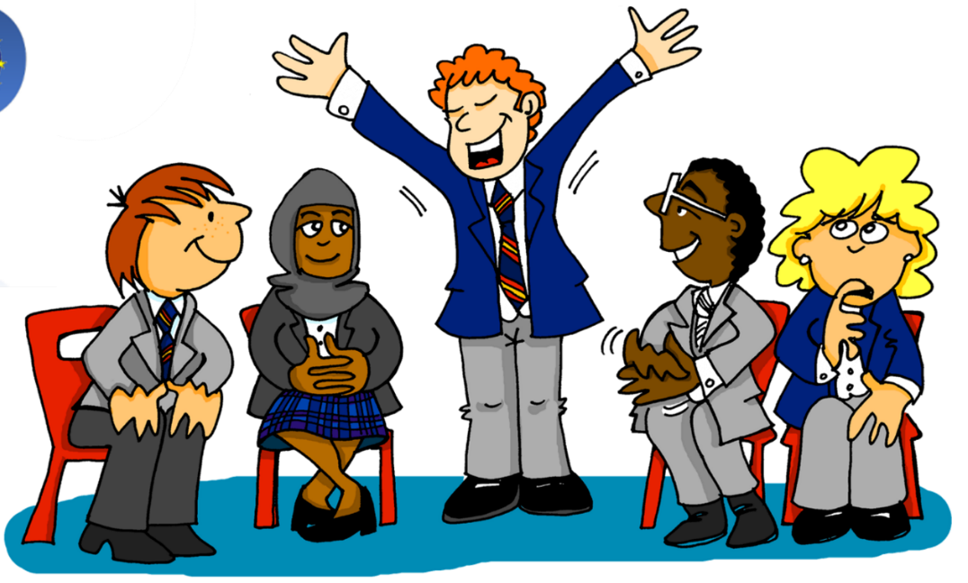
Describing things: Wie sagt man …? Wie schreibt man das?
German alphabet, Spelling Bee, classroom conversations
Wie schreibt man das?
Y7 German Term 1.1 – Week 4 – Lesson 8 Rachel Hawkes Artwork: Steve Clarke Date updated: 25.05.23
Notes:
Artwork by Steve Clarke. All additional pictures selected are available under a Creative Common license; no attribution required.
Learning outcomes (lesson 2):
Introduction of the German alphabet, the Spelling Bee competition and Quizlet
Word frequency (1 is the most frequent word in German):
7.1.1.4 (introduce) wissen [78] bist [4] du [54] Farbe [1079] Nummer [806] Ort [341] Tier [614] aber [31] kein [46] ich weiß nicht [n/a] wie sagt man [n/a] wie schreibt man [n/a]
das ist (nicht) klar
7.1.1.1 (revisit) sein¹, ist [4] Fenster [674] Flasche [1602] Heft [3862] Tafel [3855] Tisch [529] da [48] hier [68] wo? [108] der, die, das [1] Hallo! [1077] Tschüs! [3766]
Source: Jones, R.L. & Tschirner, E. (2019). A frequency dictionary of German: core vocabulary for learners. Routledge

Slide 28
wie
sprechen
wie?
how?
____ geht’s?
Wie
[How’s it going?]
Notes:
Timing: 2 minutes (both slides)
Aim: To recap the important phrase ‘Wie geht’s?’, and the possible answers learnt last week.
Procedure: 1. Recap the phrase, and the possible answers on the next slide.
2. Students can ask 2-3 other students in the class.

Slide 29
Wie geht’s?
sprechen
gut
Ja, es geht.
For‘And you?’ in this context, say: Und dir?
nicht so gut
Notes:
Procedure: 1. Recap the question and answer phrases that students know.
2. Click to introduce ‘Und dir?’ to ask ‘And you?’
3. Students can ask 2-3 other students in the class.

Slide 30
wie
sprechen
wie?
how?
Wie schreibt man…?
[How do you write…?]
Notes:
Timing: 1 minute
Aim: To introduce and practise the important phrase ‘Wie schreibt man’.
Procedure: 1. Model the phrase, and use it to ask students to recall the meanings of some words from previous lessons.
2. Encourage students to realise the importance of the phrase for asking questions whenever spellings are unclear. This language is connected to the learning of the alphabet, and introduction to the spelling bee.

Slide 31
alphabet
hören
Notes:
Timing: 5 minutes
Aim: To introduce the letters of the alphabet.
Procedure: 1. click on the mouse to bring up each letter one at a time, with audio.
2. Students repeat.

Slide 32
alphabet
ABCDEFG
sprechen
HIJKLMN
OPQRSTU
VWXYZ
Notes:
Timing: 3 minutes
Aim: To practise the letters of the alphabet.
Procedure: 1. Use the ‘drill instructor’ chant/song to learn the alphabet. Teacher will lead first but after some practice, individuals can take on this role, or class can be split into two halves etc. Have fun with it.

Slide 33
alphabet
sprechen
 | A | B | C | D | E | F | G | H | I | J | K
P | a | l | x | i | t | e | p | b | m | y | j
Q | b | m | y | j | u | f | q | c | n | z | k
R | c | n | z | k | v | g | r | d | o | a | l
S | d | o | a | l | w | h | s | e | p | b | m
T | e | p | b | m | x | i | t | f | q | c | n
U | f | r | c | n | y | j | u | g | r | d | o
V | g | s | d | o | z | k | v | h | s | e | p
W | h | t | e | p | a | l | w | i | t | f | q
X | i | u | f | q | b | m | x | j | u | g | r
Y | j | v | g | r | c | n | y | k | v | h | s
Z | k | w | h | s | d | o | z | l | w | i | t
Notes:
Timing: 5 minutes
Aim: To practise, in pairs, saying the letters of the alphabet.
Procedure: 1. Make small grids for the pupils to stick into their books.
2. Pupil A chooses grid coordinates (e.g. C, X) and pupil B has to say which letter those coordinates meet at (e.g. f). Obviously the pronunciation of the letters is German!

Slide 34
alphabet
hören
Notes:
Timing: 2 minutes
Aim: To consolidate knowledge of the alphabet in German.
Procedure: 1. Click to play the whole alphabet through for students to listen and join in with.

Slide 35
alphabet
ABCDEFG
sprechen
HIJKLMN
OPQRSTU
VWXYZ
Notes:
Timing: 2 minutes
Aim: To consolidate knowledge of the alphabet further.
Procedure: 1. Revise the alphabet again chorally using the drill instructor’s chant.

Slide 36
SPELLING BEE
Notes:
Timing: 10 minutes
Aim: To introduce the Spelling Bee competition; to practise vocabulary recall and spelling of previously taught words.
Procedure: 1. Explain the Spelling Bee: The Spelling Bee is a national competition for spelling German words aloud within a 1 minute time limit. They are all words that the students will be learning this year (not extra words to learn). Practising for the spelling bee is a very good way to learn and remember vocabulary well, improve your pronunciation and train your memory. Practise makes progress! 2. Move onto the next slide.

Slide 37
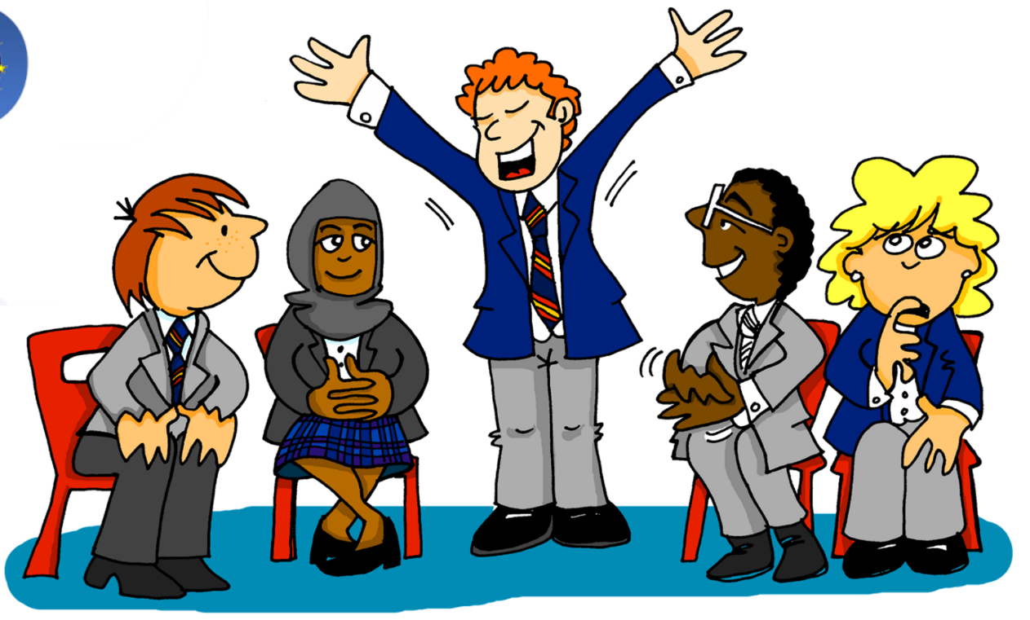
The Spelling Bee
Wie sagt man ‘to be, being’ auf Deutsch?
sein | to be | being
ist | is
wo? | where?
hier | here
da | there
das Heft | exercise book
das Fenster | window
der Tisch | table
die Tafel | board
die Flasche | bottle
und | and
Deutsch | German (noun)
ja | yes
nein | no
sagen | to say, tell
Wie schreibt man das?
sein
Richtig!
S-E-I-N
If you don’t know, say Ich weiß nicht!
Notes:
Procedure: 1. Tell students these are the first 15 words from the Spelling Bee, Stage 1. Stage 1 is the class stage, so everyone can do this. There are 50 words altogether in Stage 1. 2. Model the paired practice which is designed to practise useful classroom language for asking meanings and spellings of words. It’s not an exact replica of the Spelling Bee, for that reason.
3. Give pupils a few minutes in pairs to practise, using these 15 words. One student turns away from the board.
Notes:
i) Students have learnt these words already, but this is the first time they will have practised spelling them out loud using the German alphabet. ii) In the competition itself, the teacher calls the word in English, students say the word (with definite article as well for nouns) and then spell the word out in German (articles do not need to be spelled). iii) in the Spelling Bee proper, if students want to pass when they don’t know, they say ‘ich passe’.

Slide 38
Ein Dialog
Champion translator! Schreib auf Deutsch und Englisch.
schreiben / sprechen
Deutsch
A: [Hello] ¿[How are you?]
B: [Hi! Good, thanks.] Und dir?
A: [Good. What is] das hier?
B: [That is] ein Heft.
A: [How] schreibt man ‘Heft’? B: H-E-F-T.
A: [Where is] mein Heft, [please]?
B: [I don’t know]. A: OK. Und [how do you say] ‚bottle‘ auf Deutsch? B: Die Flasche. Das ist F-L-A-S-C-H-E. [Is that clear?]
A: [Yes, thanks.] Das ist klar!
Englisch
A: Hello! How are you?
B: Hi! Good, thanks. And you?
A: Good. What is that here?
B: That’s an exercise book.
A: How do you spell ‚Heft‘? B: H-E-F-T. A: And where is my exercise book, please?
B: I don’t know.
A. OK. And how do you say ‚bottle‘ in German?
B: Die Flasche. That‘s F-L-A-S-C-H-E. Is that clear?
A: Yes, thanks. That‘s clear!
A: Hallo! Wie geht's?
B: Hallo! Gut, danke. Und dir?
A: Gut. Was ist das hier? B: Das ist ein Heft.
A: Wie schreibt man ‚Heft‘? B: H-E-F-T. A: Und wo ist mein Heft, bitte?
B: Ich weiß nicht.
A. OK. Und wie sagt man ‚bottle‘ auf Deutsch? B: Die Flasche. Das ist F-L-A-S-C-H-E. Ist das klar?
A: Ja, danke! Das ist klar!
Notes:
Timing: 15 minutes Aim: to bring together language taught and practised in weeks 1-4 in an everyday classroom conversational context.
Procedure: 1. Ask students to read and translate the conversation into German and English.
2. There are two unknown elements. This gives a need for students to ask: Wie sagt man ‘mein’? Wie sagt man ‘auf Deutsch’?
Note that all the new elements are high-frequency and will soon appear on the Y7 SOW. 3. Click to reveal both texts. Clarify any misunderstandings.
4. Then click to remove the full English and German versions and students work in pairs to say the whole dialogue, translating the English to German in real time.
5. Extension: if time allows, invite students to change any elements they can. They can either do this in writing, or working it out with a partner, in speaking.

Slide 39
Hausaufgaben
Vocabulary Learning Homework (Y7, Term 1.1, Week 5)
Audio file
Student worksheet
Notes:
Use this slide to set the homework.
For Y7, the typical homework will be to pre-learn vocabulary for the next lesson. There is an audio file to accompany the student worksheet.
Notes:
i) Teachers may, in addition, want to recommend use of a particular online app for the pre-learning of each week’s words. ii) Quizlet now requires parental involvement / registration / permissions for users below the age of 13, so it is perhaps most suitable for Y9 – 11 students. iii) Language Nut hosts LDP vocabulary lists and these are free for schools to use, though there is a registration process. One benefit is that all of the student tracking data that Language Nut offers are also available to schools that use the LDP lists for practice. Perhaps this makes it a good option for Y7/8.
iv) There are other free apps, and new ones are always appearing. Teachers have told us that they are currently using: Flippity, Wordwall (where using previously-created activities is free).
v) Gaming Grammar has been acquired by Language Nut. Its original content should still be available to teachers and much of it is appropriate for Y7 learners. From this lesson, for example, learners could practise Indefinite articles: gender.

