Slide 1
Describing attributes
What is it like? Words for ‘a’ – ein, eine, ein (Indefinite articles – Row 1, nominative)
SSC [ei]
Hallo! Wie geht’s?
Gut, und dir?
Y7 German Term 1.1 – Week 3 – Lesson 5 Rachel Hawkes Artwork: Steve Clarke Date updated: 25.05.23
Notes:
Artwork by Steve Clarke. All additional pictures selected are available under a Creative Common license; no attribution required.
Note: All words listed below for this week’s learning appear on all three Awarding Organisations’ word lists, with no exceptions. Note however that the AQA list has ‘Form’ within the multiword phrase: in Form sein (to be in form, in good shape).
Learning outcomes (lesson 1):
Introduction of SSC [ei]
Introduction of indefinite articles – Row 1 (nominative)
Word frequency (1 is the most frequent word in German):
7.1.1.3 (introduce) bin [4] ich [10] Ding [370] Form [307] Mensch [90] blau [948] gelb [1446] groß1 [67] gut [76] klein [110] rot [477] wie? [25] und [2] bitte [471] danke [877] ein, eine [5] wie geht's? [n/a]
Source: Jones, R.L. & Tschirner, E. (2019). A frequency dictionary of German: core vocabulary for learners. Routledge

Slide 2
wie
sprechen
wie?
how?
Wie sagt man…?
[How do you say…?]
Notes:
Timing: 8 minutes (three slides) Aim: to present the literal word-for-word use of ‘wie’ meaning ‘how’, and combining it here with some classroom language. Procedure: 1. Click to present the new language , say the German, students repeat.
2. Teachers may also want to draw learners attention to a more literal translation of this phrase – How goes it?, which, whilst not idiomatic, does communicate in English and helps learners to unpack the structure word for word.

Slide 3
Vokabeln
sprechen
wie?
how?
____ geht’s?
Wie
[How’s it going?]
Notes:
Procedure: 1. Click through animations.
2. Elicit ‘wie?’ from the students.

Slide 4
Wie geht’s?
sprechen
gut
Ja, es geht.
For ‘And you?’ in this context, say: Und dir?
nicht so gut
Notes:
Aim: to learn some possible answers to the question ‘Wie geht’s?’.
Procedure: 1. Present the three possible answers to the question shown on the slide.
2. Ask students how things are going. They can also turn to their peers and ask them.

Slide 5
ei
frei
Notes:
Timing: 1 minute
Aim: To introduce/consolidate SSC [ei]
Procedure: 1. Present the letter(s) and say the [ei] sound first, on its own. Students repeat it with you. 2. Bring up the word ”frei” on its own, say it, students repeat it, so that they have the opportunity to focus all of their attention on the connection between the written word and its sound.
3. A possible gesture for this would be to stretch both arms up in the air (pointing outwards slightly to make a Y shape with your body), and smile!
4. Roll back the animations and work through 1-3 again, but this time, dropping your voice completely to listen carefully to the students saying the [ei] sound, pronouncing ”frei” and, if using, doing the gesture. Word frequency (1 is the most frequent word in German): frei [289] Source: Jones, R.L. & Tschirner, E. (2019). A frequency dictionary of German: core vocabulary for learners. Routledge

Slide 6
ei
leider
ein
[unfortunately]
/a
frei
klein
allein
sein
[alone]
[to be]
Notes:
Timing: 2 minutes
Aim: To introduce/consolidate SSC [ei]
Procedure:
Introduce and elicit the pronunciation of the individual SSC [ei] and then the source word again ‘frei’ (with gesture, if using).
Then present and elicit the pronunciation of the five cluster words.
The cluster words have been chosen for their high-frequency, from a range of word classes, with the SSC (where possible) positioned within a variety of syllables within the words (e.g. initial, 2nd, final etc.). Additionally, we have tried to use words that build cumulatively on previously taught SSCs (see the Phonics Teaching Sequence document) and do not include new SSCs. Where new SSCs are used, they are often consonants which have a similar symbol-sound correspondence in English.
Word frequency (1 is the most frequent word in German): frei [289] leider [643] ein [5] klein [110] sein [4] allein [267] Source: Jones, R.L. & Tschirner, E. (2019). A frequency dictionary of German: core vocabulary for learners. Routledge

Slide 7
ei
leider
ein
frei
klein
allein
sein
Notes:
With sound and no pictures to focus all attention on the sound-symbol correspondence.

Slide 8
ei
leider
ein
frei
klein
allein
sein
Notes:
Without sound to elicit pronunciation (without first hearing the teacher).
Teacher to elicit pronunciation by asking “Wie sagt man…”

Slide 9
ein, eine, ein = ‘a’
/a
Grammatik
As you know, German has three words for the:
Keep the idea of three genders, even though two of them share the same word for ‘ein’
masculine
feminine
neuter
die Flasche
das Fenster
der
die
das
der Tisch
It also has different words for a:
masculine
feminine
neuter
ein
Tisch
eine
Flasche
ein
Fenster
‘ein’ and ‘eine’ can also mean ‘one’ so ‘ein Tisch’ means ‘a table’ or ‘one table’
Notes:
Timing: 3 minutes Aim: To introduce the three Row 1 (nominative) forms of the indefinite article. Procedure: 1. Click on the mouse to animate the explanation.
2. Check students’ understanding at each stage.

Slide 10
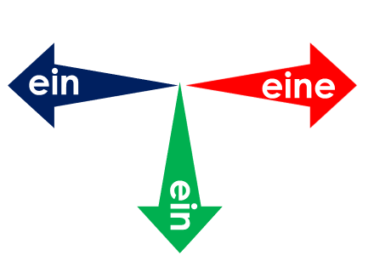
Was ist das?
lesen / sprechen
Klasse
Mann
Heft
eine
ein
Tag
Paar
Fenster
Tafel
Flasche
Tisch
ein
Notes:
Timing: 3 minutes Aim: to practise use of the indefinite article with nouns learnt in Weeks 1 and 2. Procedure: 1. Ask ‘Was ist das?’ and click to bring up the first word. 2. Elicit ‘Das ist ein…’ [Heft].
3. Click again to make the word ‘fly’ into the appropriate gender ‘bin’ area.
4. Continue for items 2-9.

Slide 11
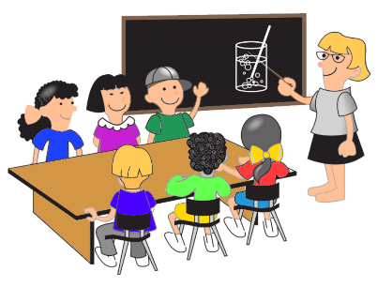
Was ist das?
sprechen
eine
ein
ein
ein
Notes:
Timing: 3 minutes Aim: to practise spoken recall of previously taught nouns and their indefinite articles.
Procedure: 1. Click to ‘star’ a picture.
2. Ask ‘Was ist das?’. Students say the German word with the correct indefinite article. e.g., Das ist ein Tisch. 3. Click to make the word ‘fly’ into the appropriate gender area.

Slide 12
Vokabeln
sprechen
 | Word | English meaning
1 | ich | I
2 | bin | am (BE)
3 | klein | small
4 | groß | big, tall
5 | rot | red
6 | gelb | yellow
7 | blau | blue
8 | wie? | how?
9 | und | and
10 | die Form | shape
11 | der Mensch | human being
12 | das Ding | thing
60
Sekunden
0
LOS!
Notes:
Timing: 5 minutes Aim: to practise recall of the new vocabulary for Week 3. Procedure: 1. Students first study the list for a minute, with both German and English meanings visible.
2. Then the English is covered, and in pairs, (or individually) students try to recall the English meanings of each word, noting the words that are tricky to retrieve.
3. Then the German meanings are obscured, and students work in pairs to try to recall as many of the German words as they can in one minute.
4. Reassure them that the expectation is not that they know them all at this stage, but that the process of trying to retrieve them is part of the learning itself.
5. Finally, give students a final minute with the full list, German and English, and ask them to focus on the words that were most difficulty to remember.

Slide 13
‘a’ or ‘the’?
Grammatik
‘a’ (ein, eine, ein) often introduces new information and identifies something to the listener:
Das ist eine Tafel.
Was ist das?
Ach! Die Tafel ist groß!
‘the’ (der, die, das) refers to something already mentioned or known.
Notes:
Timing: 2 minutes Aim: To introduce the three Row 1 (nominative) forms of the indefinite article. Procedure: 1. Click on the mouse to animate the explanation.
2. Check students’ understanding at each stage.

Slide 14
‘ein(e)’ oder der/die/das?
Robbie der Roboter learns by asking questions.
He has lots of questions! Is he asking ‘a’ or ‘the’?
lesen
Ist est ‘ein/eine’ oder ‘der, die, das?
1 | Ist ______ Mann klein? (ein/der) | Nein, der Mann ist groß.
2 | Was ist das? Ist das _______ Tafel? (die/eine) | Ja, und die Tafel ist klein.
3 | Wo ist ______ Klasse? (eine/die) | Die Klasse ist da.
4 | Ist das _____ Mensch? (der/ein) | Nein, das ist ein Ding.
5 | Was ist das? Ist das _________ Flasche? (die/eine) | Ja, und die Flasche ist blau.
6 | Ist ______ Heft blau? (ein/das) | Nein, rot und gelb.
der
eine
die
ein
eine
das
Notes:
Timing: 8 minutes Aim: to practise selecting between the definite and indefinite article, according to the desired meaning. Procedure: 1. Students read the questions and answers, and decide which of he two articles shown in brackets would best fill the gap (the possible choices reveal the gender of the noun, so that recalling this is not the focus of the activity).
2. Click to provide answers.

Slide 15
‘ein(e)’ oder der/die/das?
lesen
Zorg is new and everything is new to him!
His internal translator keeps cutting out, too. Does he hear/say ‘ein, eine, ein’ or ‘der, die, das’?
Zorg, das hier ist ____ Klasse.
Ach, ____ Klasse ist groß.
Was ist das? Ist das ___ Tisch?
Nein, das ist ______ Fenster.
Ach, _____ Fenster ist klein!
Ja. Und Zorg, das ist ______ Flasche.
Ach, _____ Flasche ist gelb!
Ja, richtig! Und ____ Heft hier ist auch gelb.
Ach, gelb ist gut! Ich bin gelb!
Notes:
Timing: 8 minutes (two slides) Aim: To practise deciding between the definite and indefinite article, recalling the gender of each noun in additiion. Procedure: 1. Let students read the dialogue one line at a time, using the slide animation.
2. Thinking about the meaning, students need to decide whether it is the indefinite or definite article that is needed, and then which gender is required (the nouns are all known). 3. Students can number 1-8 and write their answers in their exercise books. The answers are on the next slide (with audio).

Slide 16
‘ein(e)’ oder der/die/das?
hören / lesen
Hör zu und lies. Ist es ‘ein/eine’ oder ‘der, die, das?
Zorg, das hier ist eine Klasse.
Ach, die Klasse ist groß.
Was ist das? Ist es ein Tisch?
Nein, das ist ein Fenster.
Ach, das Fenster ist klein!
Ja. Und Zorg, das ist eine Flasche.
Ach, die Flasche ist gelb!
Ja, richtig! Und das Heft hier ist auch* gelb.
Ach, gelb ist gut! Ich bin gelb!
*auch = also
Notes:
This slide has the answers (with audio) to the activity on the previous slide.

Slide 17
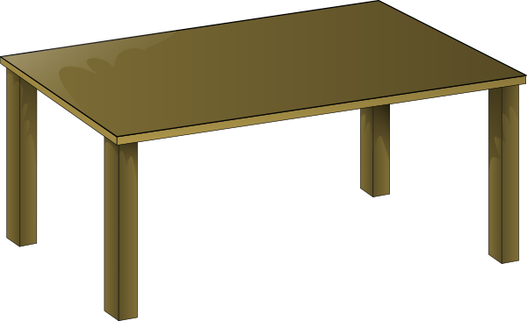
Was ist falsch?
lesen
das
der
ein
das
der
ein
ein
der
eine
ein
der
das
eine
die
ein
eine
ein
das
Notes:
Timing: 5 minutes Aim: to practise matching nouns with possible articles.
Note: This activity requires students to identify which one of the three options is NOT possible, or ‘total falsch’.
It allows them to see clearly that, for one noun, two determiners are possible from the three provided, but one is not because, whether it is definite or indefinite, it denotes a different gender.
Procedure: 1. Bring up the pictures one at a time, with their set of three articles.
2. Students consider which article is not a possible option for the noun depicted.
3. Click on the mouse to reveal the answer.

Slide 18
Describing attributes
What is it like? Words for ‘a’ – ein, eine, ein (Indefinite articles – Row 1, nominative)
Was ist blau?
Das Meer ist blau!
Was ist grün?
Ein Baum ist grün!
Y7 German Term 1.1 – Week 3 – Lesson 6 Rachel Hawkes Artwork: Steve Clarke Date updated: 14.08.23
Notes:
Artwork by Steve Clarke. All additional pictures selected are available under a Creative Common license; no attribution required.
Learning outcomes (lesson 2):
Consolidation of indefinite articles – Row 1 (nominative)
Word frequency (1 is the most frequent word in German):
7.1.1.3 (introduce) bin [4] ich [10] Ding [370] Form [307] Mensch [90] blau [948] gelb [1446] groß1 [67] gut [76] klein [110] rot [477] wie? [25] und [2] bitte [471] danke [877] ein, eine [5] wie geht's? [n/a]
Source: Jones, R.L. & Tschirner, E. (2019). A frequency dictionary of German: core vocabulary for learners. Routledge

Slide 19
Wie geht’s?
sprechen
gut
Ja, es geht.
For‘And you?’ in this context, say: Und dir?
nicht so gut
Notes:
Timing: 1 minute Aim: To recap on the question ‘Wie geht’s?’ and possible answers. Procedure: 1. Recap ‘Wie’ meaning ‘How?’ and the question Wie geht’s? (How’s it going?)
2. Use this to ask students how things are going for them – it is Week 3 at secondary school, so a very valid question!

Slide 20
Wie? What is…like?
Grammatik
Wie? means ‘how’, as in ‘Wie geht’s?’
How’s it going?
Wie? also means ‘how’, as in ‘Wie ist der Mann?’
Was ist das?
How is the man? – description
or What is the man like?
Das ist ein Mann.
Wie ist der Mann?
Der Mann ist klein und rot.
Notes:
Timing: 3 minutes Aim: To introduce the 2nd meaning of ‘wie’ → What … like?
Procedure: 1. Use the slide animation to model the dialogue, one line at a time.
2. Check students’ understanding at each stage.

Slide 21
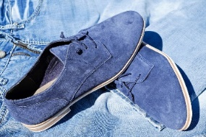
Wie ist das?
schreiben
4
ein
Das ist _______ Mann. _______ Mann ist klein und rot.
1
Der
Das ist ein Fenster. Das Fenster ist klein und blau.
2
5
Das ist ein Paar. Das Paar ist klein und blau.
Das ist eine Flasche. Die Flasche ist groß und gelb.
3
6
Das ist ein Heft. Das Heft ist klein und gelb.
Das ist ein Tisch. Der Tisch ist groß und rot.
Notes:
Timing: 6 minutes Note: Aim: To practise describing things (writing modality) using the adjectives presented this week. Procedure: 1. Model number 1 carefully, eliciting the correct words for ‘a’ and ‘the’ and the translation.
2. Bring up the picture prompts for 2-6. 3. Give students time to write their sentences and correct, whole class, paying particular attention to the articles.
4. Students have met the picture for ‘klein’ with the elephant and arrow to the mouse, but do ensure that the prompt is clear – and that the arrow to the elephant means ‘big’.

Slide 22
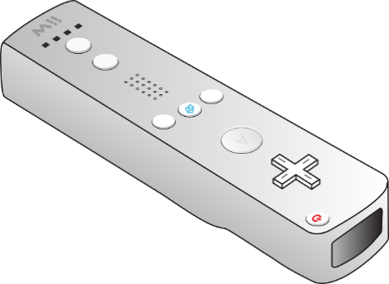
Mensch, Form oder Ding?
sprechen
Was ist das?
Das ist eine Form.
Wie ist die Form?
Die Form ist groß und blau.
Das ist A!
Otto
D
A
Mia
E
B
Notes:
Timing: 5 minutes Aim: To practise describing (speaking modality) how people and things are using the adjectives presented this week. Procedure: 1. Whole class asks teacher: Was ist das?
2. Teacher responds – use example below first time.
3. Then model twice more.
For example: Class: Was ist das?
Teacher: Das ist ein Mensch. Class: Wie ist der Mensch?
Teacher: : Der Mensch ist groß und rot.
Class: Das ist Mia
Class: Was ist das?
Teacher: Das ist ein Ding. Class: Wie ist das Ding?
Teacher: : Das Ding ist groß und gelb.
Class: Das ist E!

Slide 23
Mensch, Form oder Ding?
Was ist das?
sprechen
E
EI
Cola
Hans
Lola
A
Limo
Notes:
Timing: 5 minutes Aim: To practise describing (speaking modality) how people and things are using the adjectives presented this week. Procedure: 1. Paired speaking task. Partners repeat speaking task as modelled with the whole class.
For example: Student A selects an item (in his/her head).
Student B asks: Was ist das? Student A answers: Das ist ein/eine……. Student B asks: Wie ist der/die/das …?
Student A answers: Der/die/das … ist …..und….. Student B says: Das ist (identifier – name or letter)

Slide 24
Ein Gedicht*
*ein Gedicht – a poem
hören
Farben Was ist rot?
Ein Apfel ist rot!
Das Blut ist rot!
Was ist gelb?
Die Sonne ist gelb!
Eine Banane ist gelb!
Was ist blau?
Der Himmel ist blau!
Das Meer ist blau!
Was ist grün?
Das Gras ist grün!
Ein Baum ist grün!
Was ist schwarz?
Die Nacht ist schwarz!
Die Tinte ist schwarz!
Was ist rosa?
Eine Rose ist rosa!
Ein Lippenstift ist rosa!
Was ist orange?
Ein Sonnenuntergang ist orange!
Was ist lila?
Eine Aubergine ist lila!
Was hat alle Farben?
Ein Regenbogen hat alle Farben!
Notes:
Timing: 20 minutes
Aim: to practise/introduce vocabulary in the context of a poem.
Farben
Note: This poem was written by a former Y8 student after 4 weeks of learning German. The structure is simple. 65% words have been learnt previously (if following the LDP SOW and using its resources) 47% words are cognates (some of this category overlap with known words) 74% words are in the 1000 most frequent words, 82% in the most frequent 2000 words. 83% in the LDP/Eduqas GCSE list. [There is an excel frequency sheet for this text, accompanying the lesson resource.] This is the first longer text in German that students have been introduced to. The audio is provided and the text is animated to appear in sync with the audio, to reduce the cognitive load and support understanding. Procedure: The poem can be used for: 1] Dictionary work Students identify 5 unknown words and look them up, trying then to translate the line of the poem with the unknown word Note: Several of the unknown words are a) cognates and b) inferable from the context of the poem (colours of things) and familiar words surrounding. 2] Group translation Students work in small groups to translate the poem into English, paying attention to the use of articles (both definite and indefinite appear in the poem)
3] Adaptation and creation (extension) Students write 6 lines of poem, using the same structure, changing the nouns and colours. Note: this would follow whole class discussion of the group translations, including a focus on the author’s choice of ‘a’ or ‘the’.

Slide 25
Vokabeln
schreiben
 | Word | English meaning
1 | ich | I
2 | bin | am (BE)
3 | klein | small
4 | groß | big, tall
5 | rot | red
6 | gelb | yellow
7 | blau | blue
8 | wie? | how?
9 | und | and
10 | die Form | shape
11 | der Mensch | human being
12 | das Ding | thing
Was denkst du?
1. I have seen this word before.
2. I know what the word means.
3. I can read the word aloud.
4. I can spell the word correctly.
5. I can use the word in a sentence.
6. For nouns, I know the gender and the word for ‘the’ and ‘a’.
Notes:
Timing: 5 minutes Aim: to continue focus with students on what it means to know a word, and to encourage them to reflect on their depth of learning of new vocabulary on a regular basis. Note: this process was introduced last week; it is reinforced here.
Procedure: 1. Elicit meaning of ‘Was denkst du?’ from the students.
2. Teacher talks students through this checklist. Note: Vocabulary learning involves knowing different aspects of a word. Students can use this checklist to check what they know when they are learning new words, or revising ones they already know.
3. Direct pupils to a list of words (from week 1, 2 or this week). Here we bring up the list from this week.
4. For each word the checklist asks students to assess which of the numbered statements apply.
5. Students can then then translate the word and try to use it in a sentence.

Slide 26
Hausaufgaben
Vocabulary Learning Homework (Y7, Term 1.1, Week 4)
Audio file
Student worksheet
Notes:
Use this slide to set the homework.
For Y7, the typical homework will be to pre-learn vocabulary for the next lesson. There is an audio file to accompany the student worksheet.
Notes:
i) Teachers may, in addition, want to recommend use of a particular online app for the pre-learning of each week’s words. ii) Quizlet now requires parental involvement / registration / permissions for users below the age of 13, so it is perhaps most suitable for Y9 – 11 students. iii) Language Nut hosts LDP vocabulary lists and these are free for schools to use, though there is a registration process. One benefit is that all of the student tracking data that Language Nut offers are also available to schools that use the LDP lists for practice. Perhaps this makes it a good option for Y7/8.
iv) There are other free apps, and new ones are always appearing. Teachers have told us that they are currently using: Flippity, Wordwall (where using previously-created activities is free).
v) Gaming Grammar has been acquired by Language Nut. Its original content should still be available to teachers and much of it is appropriate for Y7 learners. From this lesson, for example, learners could practise Indefinite articles: gender.

