Slide 1
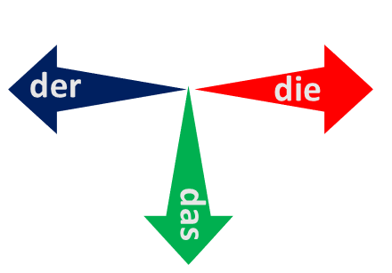
In der Klasse [3]
Identifying things: Was ist das?
Was ist das? Der, die oder das?
Definite articles: the words for ‘the’ long and short [e]
Y7 German Term 1 – Week 2 – Lesson 3
Rachel Hawkes Artwork: Steve Clarke Date updated: 13.08.23
Notes:
Artwork by Steve Clarke. All additional pictures selected are available under a Creative Common license; no attribution required.
Note: All words listed below for this week’s learning appear on all three Awarding Organisations’ word lists, with no exceptions.
Learning outcomes (lesson 1):
Introduction of SSC [e:] and [ɛ] (long and short ‘e’)
Consolidation of definite articles (singular): der, die, das
Word frequency (1 is the most frequent word in German):
7.1.1.2 (introduce) sagen, sagt [40] was? [38] Klasse [961] Mann [121] Paar [241] Tag [111] falsch [524] richtig [177] oder [35] ja1 [45] nein [148] nicht [11] Ist das klar? [n/a]
Source: Jones, R.L. & Tschirner, E. (2019). A frequency dictionary of German: core vocabulary for learners. Routledge

Slide 2
Vokabeln
lesen / sprechen
masculine
feminine
neuter
60
der Gast
die Flasche
das Paar
der Tisch
die Klasse
das Heft
Sekunden
der Mann
die Tafel
das Fenster
0
LOS!
Notes:
Timing: 2 minutes Aim: to practise pronunciation of the new language.
Procedure: 1. Start the timer. Pronounce all the words within one minute, either individually or in pairs, taking turns to say one word each (as in ‘verbal tennis’) 2. Remind that every noun begins with a capital letter in German.
This short activity recaps the nouns that students met last week and will make the more extended speaking activity on the next slide more straightforward.

Slide 3
Ein Dialog
sprechen
H_ _ _ _!
 | H_ _ _ _!
W_ i_ _ [name]?
 | [Name] i_ _ d_.. W_ i_ _ d_ _ [object]?
D_ _ [object] i_ _ h_ _ _.
 | OK. T_ _ _ _ _ _.
T_ _ _ _ _ _!
Notes:
Timing: 5 minutes
Aim: to recap last week’s language in a short, structured dialogue (with room for some variation – names and nouns).
Procedure: Students work in pairs to carry out this short dialogue.
They should be encouraged to repeat it several times, varying the names and nouns each times, and swapping roles A & B.
Note: if additional support is needed, teachers may want to put in a few interim steps, using additional slides. For example: model an example first, taking the role of A and engaging either one student or the whole class to respond as B.
Keep both these activities to time so as not to leave insufficient time for the new learning.

Slide 4
e
geben
Notes:
Timing: 1 minute
Aim: To introduce/consolidate SSC long [e]
Procedure: 1. Present the letter(s) and say the [e] sound first, on its own. Students repeat it with you. 2. Bring up the word ”geben” on its own, say it, students repeat it, so that they have the opportunity to focus all of their attention on the connection between the written word and its sound.
3. A possible gesture for this would be [mime giving a gift to someone]
4. Roll back the animations and work through 1-3 again, but this time, dropping your voice completely to listen carefully to the students saying the [e] sound, pronouncing ”geben” and, if using, doing the gesture. Word frequency (1 is the most frequent word in German): geben [49] Source: Jones, R.L. & Tschirner, E. (2019). A frequency dictionary of German: core vocabulary for learners. Routledge

Slide 5
e
mehr
Leben
geben
sehen
Idee
Meer
Notes:
Timing: 2 minute2
Aim: To introduce/consolidate SSC [e]
Procedure:
Introduce and elicit the pronunciation of the individual SSC [e] and then the source word again ‘geben’ (with gesture, if using).
Then present and elicit the pronunciation of the five cluster words.
The cluster words have been chosen for their high-frequency, from a range of word classes, with the SSC (where possible) positioned within a variety of syllables within the words (e.g. initial, 2nd, final etc.). Additionally, we have tried to use words that build cumulatively on previously taught SSCs (see the Phonics Teaching Sequence document) and do not include new SSCs. Where new SSCs are used, they are often consonants which have a similar symbol-sound correspondence in English.
Word frequency (1 is the most frequent word in German): geben [49]; mehr [52] leben (entry is verb only)[98]; sehen [79]; Meer [852]; Idee [451].
Source: Jones, R.L. & Tschirner, E. (2019). A frequency dictionary of German: core vocabulary for learners. Routledge
Note: all of these phonics words are on all 3 of the AO new GCSE wordlists. In Eduqas and Edexcel, leben is listed as verb only (but the grammar annex includes the nominalisation of infinitive verbs).

Slide 6
e
mehr
Leben
geben
sehen
Idee
Meer
Notes:
With sound and no pictures to focus all attention on the sound-symbol correspondence.

Slide 7
e
mehr
Leben
geben
sehen
Idee
Meer
Notes:
Without sound to elicit pronunciation (without first hearing the teacher).
Teacher to elicit pronunciation by asking “Wie sagt man…”

Slide 8
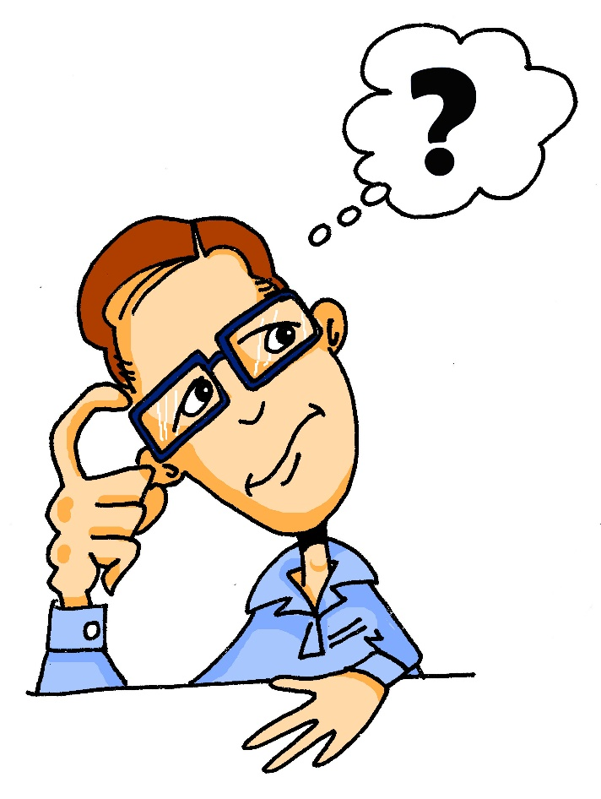
e
denken
Notes:
Timing: 1 minute
Aim: To introduce/consolidate SSC short [e]
Procedure: 1. Present the letter(s) and say the [e] sound first, on its own. Students repeat it with you. 2. Bring up the word ”denken” on its own, say it, students repeat it, so that they have the opportunity to focus all of their attention on the connection between the written word and its sound.
3. A possible gesture for this would be to put your index finger to your temple and look thoughtful!
4. Roll back the animations and work through 1-3 again, but this time, dropping your voice completely to listen carefully to the students saying the [e] sound, pronouncing ”denken” and, if using, doing the gesture. Word frequency (1 is the most frequent word in German): denken [128] Source: Jones, R.L. & Tschirner, E. (2019). A frequency dictionary of German: core vocabulary for learners. Routledge

Slide 9
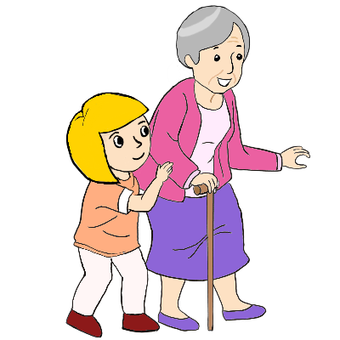
e
besser
Ende
denken
helfen
eng
Bett
Notes:
Timing: 2 minutes
Aim: To introduce/consolidate SSC short [e].
Procedure:
Introduce and elicit the pronunciation of the individual SSC [e] and then the source word again ‘denken’ (with gesture, if using).
Then present and elicit the pronunciation of the five cluster words.
The cluster words have been chosen for their high-frequency, from a range of word classes, with the SSC (where possible) positioned within a variety of syllables within the words (e.g. initial, 2nd, final etc.). Additionally, we have tried to use words that build cumulatively on previously taught SSCs (see the Phonics Teaching Sequence document) and do not include new SSCs. Where new SSCs are used, they are often consonants which have a similar symbol-sound correspondence in English.
Word frequency (1 is the most frequent word in German): denken [128]; besser [201] Ende [183]; helfen [338]; Bett [659]; eng [593].
Source: Jones, R.L. & Tschirner, E. (2019). A frequency dictionary of German: core vocabulary for learners. Routledge
Note: all of these phonics words are on all 3 of the AO new GCSE wordlists.

Slide 10
e
besser
Ende
denken
helfen
eng
Bett
Notes:
With sound and no pictures to focus all attention on the sound-symbol correspondence.

Slide 11
e
besser
Ende
denken
helfen
eng
Bett
Notes:
Without sound to elicit pronunciation (without first hearing the teacher).
Teacher to elicit pronunciation by asking “Wie sagt man…”

Slide 12
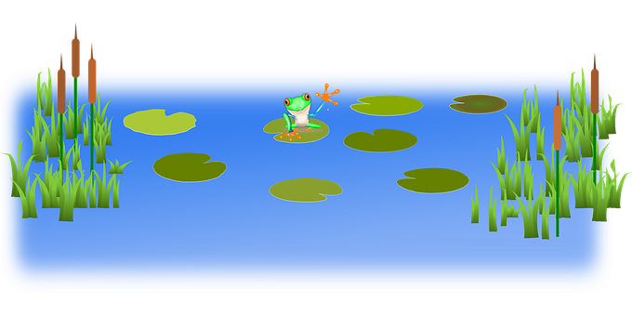
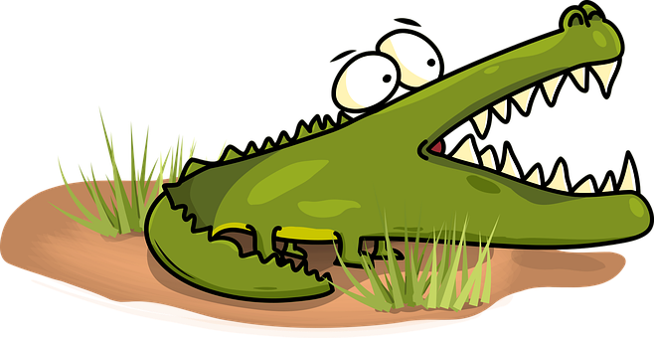
Achtung! Krokodil!
lesen / sprechen
1. Say all the words well in less than 1 minute.
2. Make a safe path across the water by only saying words with long [e].
gelb
Bett
Idee
Ende
Problem
helfen
geben
England
Fenster
Leben
mehr
Meer
Notes:
Timing: 3 minutes
Aim: to practise knowledge of long and short [e] to known and unknown words.
Procedure:
Click to bring up the instructions.
Students work in pairs to practise pronunciation of long and short [e]. For their first go, they can choose where to start and have one minute to pronounce all the words correctly to avoid being eaten by the crocodile. For their second go, students must ONLY pronounce the words with a long [e] to find a safe path across from left to right. If they accidentally say the words with a short [e] they fall into the water.
In their pairs, one student is Person A and one person is Person B. Click to indicate it’s Person A’s turn. Click again to bring up Person B’s turn.

Slide 13
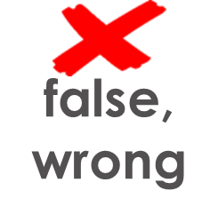
Vokabeln
hören
A | B
C | D
E | F
1
E
falsch
2
A
oder
3
F
ja
4
D
richtig
5
C
nicht
6
B
nein
Notes:
Timing: 8 minutes Aim: to practise aural recognition of this week’s new vocabulary.
Procedure: 1. Click to hear the word in German. 2. Write down the matching letter. 3. Click to check answers.
Note: if students have already managed to start their pre-learning homework they may just be able to listen (without visual and verbal prompts in English) and write the meanings. If there is a mix in the class, challenge students to turn away from the board to complete the activity. Some students may even want to try transcribing the words, especially if they have done some pre-learning. Transcript: 1. falsch
2. oder
3. ja
4. richtig
5. nicht
6. nein

Slide 14
Vokabeln
lesen / sprechen
Wie sagt man das auf Deutsch?
says
(the) class
(the) pair
(the) man
what?
(the) day
to say, saying
sagt
was?
sagt
was?
der Tag
der Tag
der Mann
die Klasse
das Paar
sagen
die Klasse
der Mann
sagen
das Paar
Notes:
Timing: 5 minutes
Aim: to practise understanding and pronouncing the rest of this week’s vocabulary.
Note: students met 4 of these words last week in the phonics sets, and the new words contain the same SSC (long/short [a]) so students will recognise and pronounce these words.
Procedure: 1. Click to bring up an English prompt.
2. Students say the German word. 3. Click to check answers.
Note the target language instruction. Students will learn this formally in week 4, but it’s worth drawing students’ attention to the ‘sagt’ after the final item in the activity.
Words:
1. der Mann 2. die Klasse 3. was?
4. das Paar 5. der Tag 6. sagen
7. sagt

Slide 15
sagen
[to say / tell| saying / telling]
sagt
[says / tells | is saying / telling]
Notes:
Timing: 3 minutes for sequence of six verb slides
Aim: To introduce the verb sagen more explicitly.
Note: Sagen is one of the 25 most frequently used verbs in German. All 25 most frequent verbs will be introduced early on using the same format. Both long form (infinitive) and short form (3rd person singular) are introduced in order to familiarise students with various forms of the same verb.
Procedure:
Bring up the word sagen on its own, say it, students repeat it, and remind them of the phonics. Draw attention to the long ‘a’ sound.
Try to elicit the meaning from the students. Students have had explicit teaching that the present tense in German communicates two different present tense meanings in English. This reinforces that learning. Emphasise the two meanings for the short form, reminding students that German only has one form and does not have a direct equivalent of the grammar for ‘is + ing’, the continuous form (as covered later in the scheme of work).
Bring up the picture, and if using gestures, a possible gesture for this would be to mime speech coming out of your mouth, opening your mouth and drawing your hand away quickly away from you. Then bring up the English translations. Emphasise the two meanings for the infinitive.
Bring up the short form sagt, say it, students repeat it. Draw attention to the long ‘a’ sound.
Try to elicit the meaning from the students. Emphasise the two meanings for the short form.

Slide 16
sagen
[to say / tell| saying / telling]
sagt
[says / tells | is saying / telling]
Notes:
Cycle through the long and short form again.

Slide 17
sagt
[says / tells | is saying / telling]
Der Mann sagt nichts.
[The man says | is saying nothing.]
Notes:
Introduce the short form in a sentence.

Slide 18
sagen
[to say / tell | saying /telling]
Der Mann kann nichts sagen.
[The man can say nothing.]
Notes:
Introduce the long form in a sentence.

Slide 19
sagt
[says / tells| is saying / telling]
sagt
Der Mann ____ nichts.
[The man says | is saying nothing.]
Notes:
Cycle through the short form in context again.

Slide 20
sagen
[to say / tell | saying / telling]
sagen
Der Mann kann nichts_______.
[The man can say nothing.]
Notes:
Cycle through the long form in context again.

Slide 21
Vokabeln
lesen
was?
what?
Notes:
Timing: 2 minutes (three ‘was?’ slides) Aim: To introduce the question word ‘was?’. Procedure: 1. Click on the mouse to bring up the word ‘was?’ – students repeat.
2. Bring up the meaning.

Slide 22
Vokabeln
was?
lesen
what?
Was sagst du?
[What do you say/are you saying?]
Notes:
Procedure: 1. Click on the mouse to bring up the word ‘was?’ – students repeat.
2. Bring up the meaning.
3. Bring up the context sentence, and its meaning.

Slide 23
Vokabeln
sprechen
was?
what?
Was
____ sagst du?
[What do you say/are you saying?]
Notes:
Procedure: 1. Click to bring up the English prompt.
2. Elicit ‘was’.
3. Click to bring up the context sentence.
4. Elicit ‘was’.

Slide 24
Was ist nicht mehr da? (1/4)
lesen
die Flasche
das Fenster
der Tisch
die Tafel
das Heft
der Tag
Notes:
Timing: 5 minutes (all four slides) Aim: To practise recall of the vocabulary introduced last week and this week, using a ‘Kim’s game’ memory activity. Procedure: 1. Allow students to see the words on the slide long enough to attempt to memorise them.
2. Click to make all words disappear and then all but one reappear.
3. Students try to name the missing item.
4. Click to confirm the answer.
Answer: der Tisch

Slide 25
Was ist nicht mehr da? (2/4)
lesen
die Flasche
das Fenster
der Tisch
die Tafel
das Heft
der Tag
Notes:
Answer: das Heft

Slide 26
Was ist nicht mehr da? (3/4)
lesen
die Flasche
das Fenster
der Tisch
die Tafel
das Heft
der Tag
Notes:
Answer: das Fenster

Slide 27
Was ist nicht mehr da? (4/4)
lesen
die Flasche
das Fenster
der Tisch
die Tafel
das Heft
der Tag
Notes:
Answer: die Tafel

Slide 28
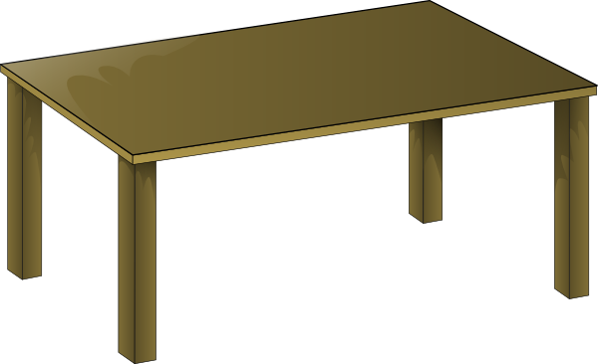
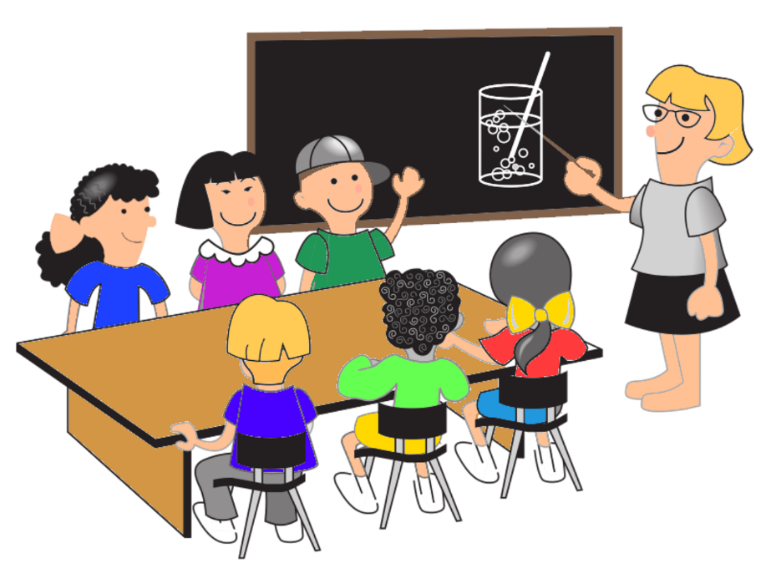
Was ist nicht mehr da? (1/4)
sprechen
Notes:
Timing: 5 minutes (all four slides) Aim: To practise recall of the vocabulary introduced last week and this week, using a variation of ‘Kim’s game’ in which the words are replaced by pictures, and with three additional nouns. Procedure: 1. Allow students to see the pictures on the slide long enough to attempt to memorise them.
2. Click to make all pictures disappear and then all but one reappear.
3. Students try to name the missing item.
4. Click to confirm the answer.
Answer: das Paar

Slide 29
Was ist nicht mehr da? (2/4)
sprechen
Notes:
Answer: die Klasse

Slide 30
Was ist nicht mehr da? (3/4)
sprechen
Notes:
Answer: der Tag

Slide 31
Was ist nicht mehr da? (4/4)
sprechen
Notes:
Answer: die Flasche

Slide 32
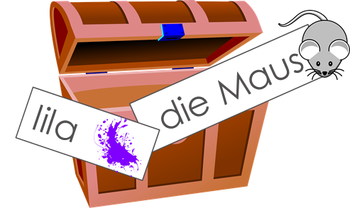
In der Klasse [4]
Was ist das?
Identifying things: Was ist das?
Definite articles: the words for ‘the’ long and short [e]
Das ist mein Wortschatz!
Y7 German Term 1 – Week 2 – Lesson 4
Rachel Hawkes Artwork: Steve Clarke Date updated: 13.08.23
Notes:
Artwork by Steve Clarke. All additional pictures selected are available under a Creative Common license; no attribution required.
Learning outcomes (lesson 2):
Consolidation of SSC [e:] and [ɛ] (long and short ‘e’)
Consolidation of definite articles (singular): der, die, das
Word frequency (1 is the most frequent word in German):
7.1.1.2 (introduce) sagen, sagt [40] was?[38] Klasse [961] Mann [121] Paar [241] Tag [111] falsch [524] richtig [177] oder [35] ja1 [45] nein [148] nicht [11] Ist das klar? [n/a]
Source: Jones, R.L. & Tschirner, E. (2019). A frequency dictionary of German: core vocabulary for learners. Routledge

Slide 33
der, die oder das?
lesen / sprechen
Klasse
Tag
Flasche
Tisch
Mann
Paar
Tafel
Fenster
Heft
m
f
nt
Notes:
Timing: 2 minutes
Aim: To revise gender and definite article connections. Procedure: 1. Click to bring up a German word.
2. Students volunteer the definite article and pronounce the word with its definite article. 2. On second click, the noun moves into the ‘appropriately gendered’ mouth.

Slide 34
Was ist das?
Note that ‘das’ means ‘the’ and also ‘that’.
Was ist das? What is that?
Sag das Wort auf Deutsch.
sprechen
m
f
nt
Notes:
Timing: 2 minutes
Aim: To revise gender and word knowledge, this time the picture prompting recall of the word itself. Procedure: 1. Pictures representing the 9 nouns from Weeks 1 and 2 appear on separate mouse clicks. Say the word (chorally) with its definite article. 2. On second click, the noun moves into the ‘appropriately gendered’ mouth.

Slide 35
sein
[to be| being]
ist
[is]
Notes:
Timing: 3 minutes for sequence of six verbs
Aim: To introduce the verb sein more explicitly.
Note: Sein is one of the 25 most frequently used verbs in German. All 25 most frequent verbs will be introduced early on using the same format. Both long form (infinitive) and short form (3rd person singular) are introduced in order to familiarise students with various forms of the same verb.
Procedure
Bring up the word sein on its own, say it, students repeat it, and remind them of the phonics. Draw attention to the [ei] sound.
Try to elicit the meaning from the students.
2. Bring up the English translations. Emphasise the two meanings for the infinitive.
3. Bring up the short form ist, say it, students repeat it.
4. Try to elicit the meaning from the students. They know ‘ist’ already, but it’s important that they connect ‘is’ and ‘be’, ‘ist’ and ‘sein’. These verbs are so irregular in English and German that many students will not know that ‘is’ and ‘be’ are connected. It’s important to establish and reinforce this, often.

Slide 36
sein
[to be| being]
ist
[is]
Notes:
Cycle through the long and short form again.

Slide 37
ist
[is]
Hannah ist intelligent.
[Hannah is intelligent.]
Notes:
Introduce the long form in a sentence.

Slide 38
sein
[to be| being]
Hannah kann intelligent sein.
[Hannah can be intelligent.]
Notes:
Introduce the short form in a sentence.

Slide 39
ist
[is]
ist
Hannah __ intelligent.
[Hannah is intelligent.]
Notes:
Cycle through the short form in context again.

Slide 40
sein
[to be| being]
Hannah kann intelligent ____.
sein
[Hannah can be intelligent.]
Notes:
Cycle through the long form in context again.

Slide 41
Was ist die Ausnahme ? (1/4)
sprechen
das Heft
die Flasche
das Paar
das Fenster
Notes:
Timing: 4 minutes (4 slides) Aim: To practise recall of the vocabulary introduced this week and last week. Procedure: 1. Students know ‘was’ ‘ist’ and ‘die’. They don’t know ‘Ausnahme’. Ensure the meaning is clear. Tell them the English meaning. Ausnahme is on the Eduqas GCSE list but not formally taught until Y10. Using it here and in other odd one out activities is a useful way to bring its meaning in earlier.
2. Explain that each set of four words has an odd one out. The reasons are mixed bringing together the various things students have learnt so far. For example, the set might be 3 neuter words and one masculine or 3 long vowel words and one short vowel one.
3. Teacher asks 'Was ist die Ausnahme?' Students respond. Teacher models: ‘David sagt, das ist der Tag. Ist das richtig? Ja? Nein?’, and so on, until all answers are checked.
This also revisits richtig / falsch / ja / nein / oder.
Answer: die Flasche (3 neuter nouns + 1 feminine) Frequency of unknown words and cognates: Ausnahme [1404]

Slide 42
Was ist die Ausnahme ? (2/4)
sprechen
der Tisch
der Tag
die Tafel
der Mann
Notes:
As previous slide.
One suggested answer: die Tafel (3 masculine nouns + one feminine)

Slide 43
Was ist die Ausnahme ? (3/4)
sprechen
besser
denken
das Bett
die Idee
Notes:
As previous slide.
One suggested answer: die Idee (2 short e + one long e)
Students may need prompting that this is about Phonetik.

Slide 44
Was ist die Ausnahme ? (4/4)
sprechen
was?
denken
sagen
geben
Notes:
As previous slide.
One suggested answer: was? (3 verbs and a question word)

Slide 45
Partnerarbeit
sprechen / hören
Arbeite mit einem Partner / einer Partnerin.
Person A liest fünf Wörter vor. You can try to read the words fast!
Person B sagt die Wörter auf Englisch.
Beispiel:
Person A sagt:
Person B sagt:
der Tag, richtig, sagt, was?, ja
day, right, correct, says/tells, what?; yes
Notes:
Timing: 3 mins (three slides)
Aim: to gain confidence in reading aloud and practising long and short [a] in particular, whilst the listening student practises aural comprehension of vocabulary from this week’s sets. Note: as far as possible words with the SSCs long and short [a] have been grouped together.
Procedure:
Student B turns away from the board.
Student A reads out five of the words in this week’s vocabulary set.
Student B listens and says the English meanings of the words, in the same order as they were said in German.
Students swap roles.

Slide 46
Partnerarbeit
sprechen / hören
Person A liest fünf Wörter vor. You can try to read the words fast!
Person B sagt die Wörter auf Englisch.
Person A sagt:
Person B sagt:
der Mann, die Klasse, falsch, was?, nicht
man, class, false/wrong, what?, not
Notes:
[1/2] Procedure:
Student B turns away from the board.
Student A reads out five of the words in this week’s vocabulary as they appear on the board, on a click.
Student B listens and says the English meanings of the words, in the same order as they were said in German. 4. Student turns back to the board to check his/her answers.
5. Move to next slide to swap roles.

Slide 47
Partnerarbeit
sprechen / hören
Person B liest fünf Wörter vor. You can try to read the words fast!
Person A sagt die Wörter auf Englisch.
Person A sagt:
to say/tell, day, pair, yes, is that clear?
Person B sagt:
sagen, der Tag, das Paar, ja, ist das klar?
Notes:
[2/2]

Slide 48
In der Klasse
hören / schreiben
Wo ist das Fenster?
4
Das ist falsch.
1
Das ist richtig.
Die Flasche ist da.
2
5
Was denkst du?
Ist die Tafel hier oder da?
3
6
Notes:
Timing: 10 minutes Aim: Transcription exercise bringing together the phonics, vocabulary and grammar taught thus far.
Note: This activity applies the vocabulary they have learnt in some new sentence formulations. It also focuses the students’ attention on spelling of the words. This leads into the next activity where we discuss the various aspects of ‘knowing a word’.
Procedure: 1. Play the audio recording of the sentences. Click the number to repeat the sentence as many times as needed.
2. Students write the sentences down.
3. Discuss the answers. For each item ask a student to read what they have written. Play the recording again and then show the written version.
Transcript: 1. Wo ist das Fenster?
2. Das ist richtig.
3. Was denkst du?
4. Das ist falsch.
5. Die Flasche ist da.
6. Ist die Tafel hier oder da?

Slide 49
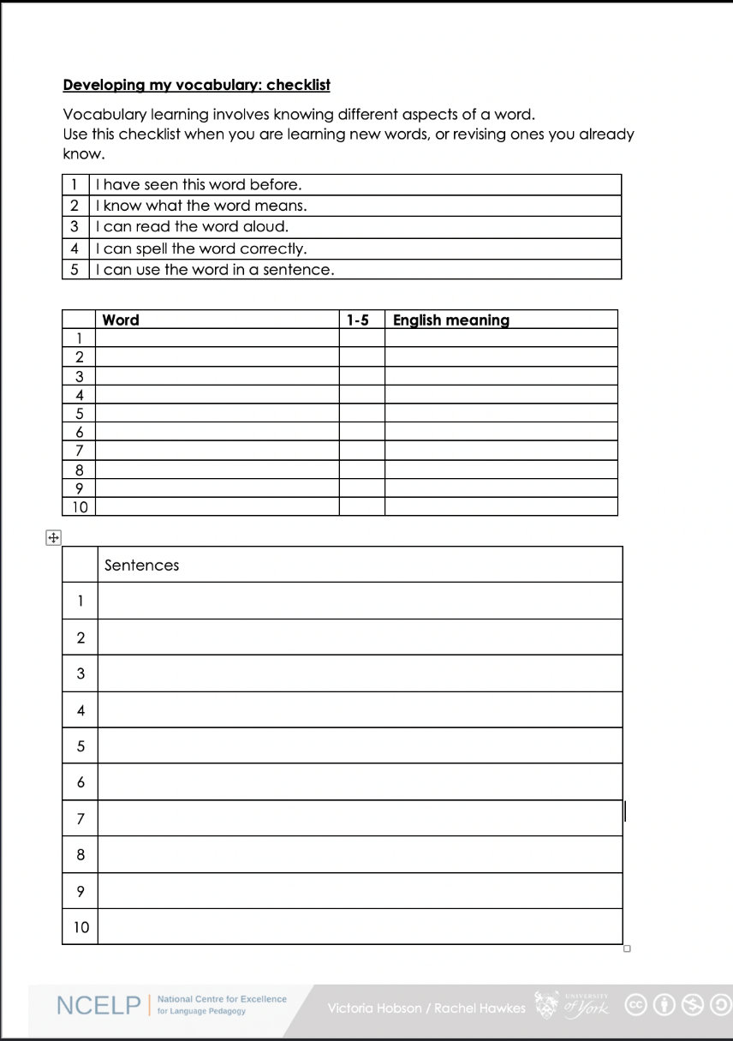
Vokabeln
lesen
Was denkst du?
1. I have seen this word before.
2. I know what the word means.
3. I can read the word aloud.
4. I can spell the word correctly.
5. I can use the word in a sentence.
6. For nouns, I know the gender and the correct word for ‘the’
Notes:
Timing: 12 minutes (two slides) Aim: To discuss with students what it means to know a word, and to encourage them to reflect on their depth of learning of new vocabulary on a regular basis. Procedure: 1. Elicit meaning of ‘Was denkst du?’ from the students.
2. Teacher talks students through the checklist. Vocabulary learning involves knowing different aspects of a word. Students can use this checklist to check what they know when they are learning new words, or revising ones they already know. The next slide presents all the vocabulary for week 1 and 2.
3. For each word the checklist asks students to asses which of the numbered statements apply.
4. Students then translate the word and try to use it in a sentence.
5. We suggest giving students a print out of the template they can refer to throughout the year. A word template is available on the LDP resource portal:
[insert link] Move to the next slide to introduce the idea of personal repertoire.

Slide 50
Vokabeln
Mein Wortschatz
lesen
In German, you can put two or more words together to make one long word! This is called a compound word.
The word ‘Wortschatz’ (vocabulary) is made up of:
das Wort
der Schatz
der Wortschatz
(the) treasure (trove)
(the) treasure trove of words
(the) word
Add words that are important to you to your Wortschatz!
So, mein Wortschatz really means ‘my treasure trove of words’.
Notes:
6. Introduce the idea of personal repertoire to students. Tell them that the words that have been selected to learn in this course are the most frequent, the words used most often by people speaking German, and most used means most useful to them. However, as we are all different people, we will all have words in our own language that are more important to us than others: our favourite animal, a word to describe a good friend, things we most like doing in our free time, a food we detest or can’t eat because of an allergy. As we continue learning we will want to know these words in German, too, and so we should have a place for our personal word repertoire and use every opportunity to search up, use and learn those words, too, so that we can express ourselves.
7. And German has a great word for this: Wortschatz. You can translate it as Vocabulary in English, but it has a much richer meaning than this. One very cool thing about German is its compound words. German adds words together to make new words.
So literally the word vocabulary in German is made up of das Wort + der Schatz, and mein Wortschatz mean ‘my treasure trove of words’. This is more exciting idea than you get from just ‘my vocab’!
So, always add words that are important to you to your Wortschatz. ☺
Note: there will be a more focused introduction to compounds later in Y7 and lots of opportunities to explore these as they are one of the richest features of German (imo!)

Slide 51
Vokabeln
lesen
sein | die Flasche | sagen | das Paar | nicht
das Fenster | wo? | was? | die Klasse | oder
das Heft | hier | sagt | richtig | ja
der Tisch | da | der Tag | falsch | nein
die Tafel | der, die, das | der Mann | ist
Notes:
Timing: 5 minutes Aim: To encourage students to reflect on the depth of their vocabulary learning.
Procedure: Use this slide in conjunction with the previous one to encourage students to reflect on the depth of their vocabulary learning.
Vocabulary for Week 1: sein¹, ist [4] Fenster [674] Flasche [1602] Heft [3862] Tafel [3855] Tisch [529] da [48] hier [68] wo? [108] der, die, das [1] Hallo! [1077] Tschüs(s)! [3766]
Vocabulary for Week 2:
sagen, sagt [40] was? [38] Klasse [961] Mann [121] Paar [241] Tag [111] falsch [524] richtig [177] oder [35] ja1 [45] nein [148] nicht [11] Ist das klar? [n/a]
Source: Jones, R.L. & Tschirner, E. (2019). A frequency dictionary of German: core vocabulary for learners. Routledge

Slide 52
Hausaufgaben
Vocabulary Learning Homework (Y7, Term 1.1, Week 3)
Audio file
Student worksheet
Notes:
Use this slide to set the homework.
For Y7, the typical homework will be to pre-learn vocabulary for the next lesson. There is an audio file to accompany the student worksheet.
Notes:
i) Teachers may, in addition, want to recommend use of a particular online app for the pre-learning of each week’s words. ii) Quizlet now requires parental involvement / registration / permissions for users below the age of 13, so it is perhaps most suitable for Y9 – 11 students. iii) Language Nut hosts LDP vocabulary lists and these are free for schools to use, though there is a registration process. One benefit is that all of the student tracking data that Language Nut offers are also available to schools that use the LDP lists for practice. Perhaps this makes it a good option for Y7/8.
iv) There are other free apps, and new ones are always appearing. Teachers have told us that they are currently using: Flippity, Wordwall (where using previously-created activities is free).
v) Gaming Grammar has been acquired by Language Nut. Its original content should still be available to teachers and much of it is appropriate for Y7 learners. From this lesson, for example, learners could practise Definite articles: gender.

