Slide 1
In the classroom
Locating people and things: Wo ist…?
Definite articles: the words for ‘the’ long and short [a]
Y7 German Term 1 – Week 1 – Lesson 1
Rachel Hawkes Artwork: Steve Clarke Date updated: 13.08.23
Notes:
Artwork by Steve Clarke. All additional pictures selected are available under a Creative Common license, no attribution required.
Note: All words listed below for this week’s learning appear on all three Awarding Organisations’ word lists, with the following exceptions: i) Edexcel list does not have Tafel, Tschüss. ii) AQA list does not have Tafel, Heft.
Learning outcomes (lesson 1):
Introduction of SSC long and short [a]
Introduction of definite articles (singular) der, die, das - Row 1 (nominative); ‚words for ‚the‘ and the concept of grammatical gender Introduction of the verb SEIN and 3rd person singular ‚ist‘, and the question word ‚wo‘ (where?) Introduction of the concept of capital letters for nouns.
Additional notes about the course:
In this introductory lesson, time has deliberately been left to allow for start of the school year ‘setting up’, such as giving out exercise books, implementing a seating plan, etc. Usually one lesson will start with Phonetik, introducing a new SSC (sound-symbol correspondence) and practising it. We then focus on practising the new vocabulary. Grammar is introduced with a brief explanation, and followed with input practice (L & R) that compels students to pay attention to the key form-meaning connection. Productive practice follows, and is designed to make the target language forms task essential. This lesson, the first in the year, instead begins with a way for teachers to learn students’ names, using the new language. See the next four slides. As early as possible there are cultural references. These increase in frequency and become richer as students’ vocabulary builds. There are opportunities to encounter paragraph level reading texts, using mostly previously taught language, with a focus also on recognising and understanding cognates, compound words and using the secure knowledge of surrounding words in a sentence to infer plausible meanings of individual unknown words. There are frequent opportunities in speaking and writing for students to apply their PVG knowledge in more loosely structured, and also more open-ended communication activities.
Word frequency (1 is the most frequent word in German):
sein¹, ist [4] Fenster [674] Flasche [1602] Heft [3862] Tafel [3855] Tisch [529] da [48] hier [68] wo? [108] der, die, das [1] Hallo! [1077] Tschüs(s)! [3766]
Jones, R.L. & Tschirner, E. (2019). A frequency dictionary of German: core vocabulary for learners. Routledge

Slide 2
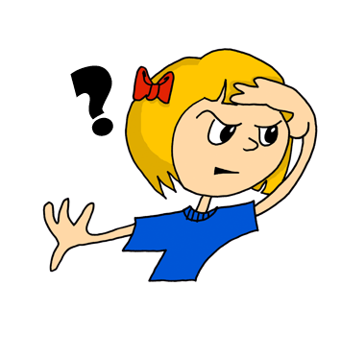
wo?
where?
Notes:
Present this vocabulary on the next three slides as a way in to a routine to find out students’ names and greet them in German (slide 4).
Timing: 1 minute (for three slides)
Aim: To introduce the key vocabulary ‘wo’ (where).
Procedure: 1. Present and say the word. 2. Bring up the question mark, and then straightaway the image and the English translation. 3. Do the gesture for ‘where’ (if desired) and say the word several times. Students say it with the teacher.

Slide 3
wo?
where?
Wo ist Mia?
[Where is Mia?]
Rachel Hawkes
Notes:
Procedure: 1. Repeat the presentation of ‘wo’ 2. Bring up the short German sentence. 3. Elicit the English meaning.

Slide 4
wo?
where?
____ ist Mia?
Wo
[Where is Mia?]
Rachel Hawkes
Notes:
Procedure: 1. Elicit ‘wo’ 2. Elicit ‘wo’ again in the sentence.

Slide 5
Wo ist…?
Guten Tag!
Da!
Hier!
Hallo!
Guten Tag! (hello) is more formal than Hallo! (hello/hi). You would usually say Hallo to a friend and Guten Tag to your teacher.
Notes:
Timing: 10 minutes
Aim: to practise the new language just introduced in context; to teach and practise two greetings. Procedure: 1. Teacher has register but doesn’t know the students – Teachers may find it helpful to ‘mime’ gesture of looking as they say ‘Wo ist [David]?’
2. When [David] puts his hand up, teacher models answer ‘Hier’ and writes it on the board. Ensure all students are clear that ‘hier’ means ‘here’ (seems obvious but it might not be and it’s important that all students understand, so quickly elicit the English, saying ‘’Hier. Auf Englisch?’ and a students will volunteer ‘Here’.
3. The teacher says ‘Guten Tag, [name]’ and ‘Hallo, [name]’ and clicks to bring up both greetings and the callout.
3. Teacher continues to find out where all the other students are – they respond ‘Hier’. It is possible to do this very quickly or elaborate the routine further and introduce ‘da’ – e.g., teacher pretends (may not even be pretence!) that it’s hard to remember where different students are and s/he needs the help of the class. 4. This produces the need for ‘da’ as they will point towards a student in response to the teacher recapping ‘Also, wo ist David?’ and as they point they will naturally want to say ‘Hier’ but realise it doesn’t quite fit, so the teacher provides ‘da’.
5. By the time the attendance of all students has been ascertained, the teacher will know all/almost all of the names of the class, and students will have begun to learn each other’s names, too.
This is an important first step is building the classroom ethos that we need for language learning. In addition, many will now already know the words for ‘where’ and ‘is’ in German – they will often be surprised that they already know this when we go on to present the language more formally in the next slides.

Slide 6
Vokabeln
hören / lesen / sprechen
Wo ist ?
das Fenster
Das Fenster ist da.
Notes:
Timing: 3 minutes (for three slides) or up to 10 minutes, if exercise books are given out after slide 8. Aim: to introduce three classroom nouns. Procedure: 1. Present picture and say the word. (If in a classroom, walk also to the window as you repeat the word)
2. Bring up the question. Wo ist...? and model ‘Das Fenster ist da’, pointing to the real (or picture) window.
3. Elicit the English meaning of ‘da’ again. Show the written version. Additional notes:
The vocabulary in this first lesson is a set of concrete high-frequency nouns that all teachers will be able to point to, as well as show pictures of. Given the importance of grasping that every noun in German has a grammatical gender, that this is not the same as their previous understanding of gender, that it really does apply to every inanimate object around them, and that it’s best to think of it as simply part of the word, it feels useful for students to learn how to name some things that will always be in sight during their lessons, and therefore easily recycled in the few seconds between tasks in future lessons, etc.. The teacher can use this recycling to monitor students’ recall of gender at regular moments during the first half-term, and then periodically during the rest of the first year.

Slide 7
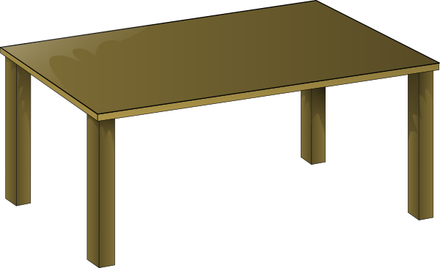
Vokabeln
hören / lesen / sprechen
Wo ist ?
der Tisch
Der Tisch ist hier.
Notes:
As for previous slide.

Slide 8
Vokabeln
hören / lesen / sprechen
Wo ist ?
das Heft
Das Heft ist hier.
Notes:
As for previous slide.
Note: this could be a useful moment to give out exercise books (Hefte) and label them up, before continuing.

Slide 9
Phonetik: Vowels
German vowels can be short or long.
Vowels are short when followed by more than one consonant, e.g., Mann, Gast.
Vowels are long when:
there is a double vowel, e.g. Paar,
or when followed by the letter ‘h’, e.g., fahren,
or by a single consonant, e.g., sagen.
NB: German final ‘e’is not silent, but very short, e.g. danke, Klasse.
Notes:
Timing: 1 minute Aim: to introduce students to key knowledge about German vowels.
Note: It is important to give this explanation, but in the same way as with explicit grammar explanation, it is the practice that counts most. Procedure:
It may be helpful to ensure that ‘vowel’ is 100% understood, eliciting an example in English from students.
Bring up each line of text and read it clearly with appropriate stress and intonation.
3. Proceed to the practice on the next slides.
Note: There are, of course, exceptions to these rules – ‘mit’ has a short vowel sound, and so does ‘das’ which they have just met. It may be helpful to draw attention to the trickiness of English vowel/letter strings and show that there are many exceptions here, too – e.g. the pronunciation of ‘o’ in ‘love’ and ‘move’ and ‘cove’ – different in all three.

Slide 10
a
sagen
Notes:
Timing: 1 minute
Aim: to introduce/consolidate SSC [a]
Procedure: 1. Present the letter(s) and say the [a] sound first, on its own. Students repeat it with you. 2. Bring up the word ”sagen” on its own, say it, students repeat it, so that they have the opportunity to focus all of their attention on the connection between the written word and its sound.
3. A possible gesture for this would be mime speech coming out of your mouth, opening your mouth and drawing your hand away quickly away from you.
4. Roll back the animations and work through 1-3 again, but this time, dropping your voice completely to listen carefully to the students saying the [a] sound, pronouncing ”sagen” and, if using, doing the gesture.

Slide 11
a
sagen
Notes:
With sound and no pictures to focus all attention on the sound-symbol correspondence.

Slide 12
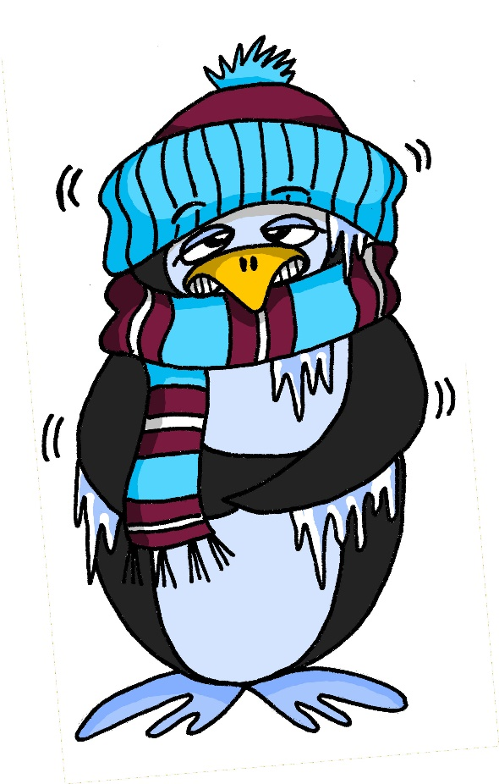
a
kalt
Notes:
Timing: 1 minute
Aim: to introduce/consolidate SSC [a]
Procedure: 1. Present the letter(s) and say the [a] sound first, on its own. Students repeat it with you. 2. Bring up the word ”kalt” on its own, say it, students repeat it, so that they have the opportunity to focus all of their attention on the connection between the written word and its sound.
3. A possible gesture for this would be to mime a shiver, crossing your arms in front of your body.
4. Roll back the animations and work through 1-3 again, but this time, dropping your voice completely to listen carefully to the students saying the [a] sound, pronouncing ”kalt” and, if using, doing the gesture. Word frequency (1 is the most frequent word in German): kalt [887] Source: Jones, R.L. & Tschirner, E. (2019). A frequency dictionary of German: core vocabulary for learners. Routledge

Slide 13
a
kalt
Notes:
With sound and no pictures to focus all attention on the sound-symbol correspondence.

Slide 14
Vokabeln
hören / lesen / sprechen
Wo ist ?
die Tafel
Die Tafel ist hier.
Notes:
Timing: 1 minute
Aim: to introduce further vocabulary, giving students the opportunity to practise their new SSC knowledge. Procedure: 1. Present picture and word and elicit the pronunciation from students (this is an opportunity for them to apply their phonics knowledge and decode the new word)
2. Bring up the question. Wo ist...? and model ‘Die Tafel ist hier’, pointing to the real (or picture) board.
3. Elicit a translation for ‘die Tafel’ and stress ‘die’ to prompt them to notice another word for ‘the’. They have now met the three words for ‘the’ for singular nouns. We will focus explicitly on this soon.

Slide 15
Vokabeln
hören / lesen / sprechen
da
Notes:
As for previous slide.

Slide 16
Vokabeln
hören / lesen / sprechen
Wo ist ?
die Flasche
Die Flasche ist da.
Notes:
Aim: to introduce further vocabulary, giving students the opportunity to practise their new SSC knowledge. Procedure: 1. Present picture and word and elicit the pronunciation from students (this is an opportunity for them to apply their phonics knowledge and decode the new word)
2. Bring up the question. Wo ist...? and model ‘Die Flasche ist da’, pointing to the real (or picture) board.
3. Elicit a translation for ‘die Flasche’ and stress ‘die’ to prompt them to notice another word for ‘the’. They have now met the three words for ‘the’ for singular nouns. We will focus explicitly on this soon.

Slide 17
der, die, das
Grammatik
German has three words for the:
masculine
feminine
neuter
die Flasche
das Fenster
der
die
das
der Tisch
English speakers might find this tricky because English only uses the.
Every noun has a gender, but grammatical gender is not the same as biological gender, as you have seen.
Notes:
Timing: 3 minutes Aim: to introduce the concept of noun gender and the three singular definite articles (words for ‘the’) in German. Procedure: 1. Bring up the text and read it carefully, with helpful intonation.
2. Try to elicit the nouns from students before revealing them. Students have learnt two possible nouns for ‘die’ and ‘das’.
Note: It’s important for teachers to draw out the importance of learning gender. One point of interest is native speaker prediction based on gender. Depending on the class, it might be interesting for students to know that native speakers of languages with gender begin to predict what is going to be talked about as soon as the gender word is said – i.e. if there are two objects in view and just the word for ‘the’ is said, it is already clear what is being talked about. This classification of nouns by gender serves to speed up identification (fractions of a second, but still interesting and important!)
The key point for teachers to emphasise is that students need to learn nouns with their gender from the first encounter and practise recalling them frequently.

Slide 18
Vokabeln
hören / lesen / sprechen
der Tisch
d__ T____h
die Tafel
d__ T___l
d__ F_____e
die Flasche
d__ F_____r
das Fenster
d__ H__t
das Heft
Notes:
Timing: 3 minutes
Aim: to practise the new vocabulary further and to establish the knowledge of gender for the five nouns learnt in this lesson. Procedure: 1. Bring up gapped version of the word. Allow students to recall the word and its article. 2. Reveal the full version of the word. Repeat for other nouns. 3. Bring up the pictures and ask students to say the nouns and their articles.
4. Ask students which is their favourite German word so far, and to think about why. Is it the sound, the meaning, the fact it is easy (or difficult) to remember. Note: This first lesson has been kept deliberately brief to allow for things like giving out exercise books, students finding the right room, etc... Normal lesson length is 50-60 minutes.

Slide 19
Wo ist…?
Tschüss!
Hier!
Tschüss! (Bye) is an informal but very common way to say goodbye.
Notes:
Timing: 2 minutes
Aim: to practise saying ‘bye’ and recap student names, using Wo ist…? Procedure: Note: it might be good for students to have packed away before starting this routine, and then they are ready to say ‘Tschüss’ on the way out of the classroom. 1. Teacher looks for the student saying ‘Wo ist …?’ with the sense that s/he is now checking if s/he has remembered the names of the class.
2. When a student puts his/her hand up, the teacher says ‘Tschüss’ and waves goodbye, eliciting the word in response. 3. Click to bring up the word and callout.
4. Routine continues. Teacher can call several names at once and elicit choral ‘Tschüss’ of course.

Slide 20
Hausaufgaben
Vocabulary Learning Homework (Y7, Term 1.1, Week 1)
Audio file
Worksheet
Notes:
Homework in Y7 involves pre-learning the vocabulary for the following week. This is obviously tricky in Week 1 as they have not had time to pre-learn Week 1 words. Teachers will decide how to spread out the learning, but we have put week 1 words with links on this slide, and week 2 words with links on a slide at the end of lesson 1.
Timing: 5 minutes (could also be left until lesson 2 as Y7 classes will be settling in)
Aim: to explain the homework concept for Y7. Procedure: 1. Explain the to establish the knowledge of new words, practice is extremely important. Perhaps suggest that students think of the memory as a muscle that needs regular training to keep it in good shape. 2. What has happened to day in the lesson has ‘sown the seeds’ of the new words. These words will be re-visited several times more this year. That is built into the lessons. 3. It’s very useful to space the practice of new language, doing little and often. For this reason, the homework this year will usually be to pre-learn the words for the next lesson. This will not mean that students completely know all the words, but that they are part-way there, when they arrive at the lesson. 4. There will be a vocabulary learning homework, with audio and a student worksheet for them to complete each week.
Notes:
i) Teachers may, in addition, want to recommend use of a particular online app for the pre-learning of each week’s words. ii) Quizlet now requires parental involvement / registration / permissions for users below the age of 13, so it is perhaps most suitable for Y9 – 11 students. iii) Language Nut hosts LDP vocabulary lists and these are free for schools to use, though there is a registration process. One benefit is that all of the student tracking data that Language Nut offers are also available to schools that use the LDP lists for practice. Perhaps this makes it a good option for Y7/8.
iv) There are other free apps, and new ones are always appearing. Teachers have told us that they are currently using: Flippity, Wordwall (where using previously-created activities is free).
v) Gaming Grammar has been acquired by Language Nut. Its original content should still be available to teachers and much of it is appropriate for Y7 learners. From this lesson, for example, learners could practise Definite articles: gender.

Slide 21
In the classroom [2] Wo ist der/die/das …?
Definite articles: the words for ‘the’ long and short [a]
c
Y7 German Term 1 – Week 1 – Lesson 2
Rachel Hawkes Artwork: Steve Clarke Date updated: 13.08.23
Notes:
Artwork by Steve Clarke. All additional pictures selected are available under a Creative Common license, no attribution required.
Learning outcomes (lesson 2):
Consolidation of SSC long and short [a]
Introduction of definite articles (singular) der, die, das - Row 1 (nominative); ‚words for ‚the‘ and the concept of grammatical gender Introduction of the verb SEIN and 3rd person singular ‚ist‘, and the question word ‚wo‘ (where?) Introduction of the concept of capital letters for nouns.
Word frequency (1 is the most frequent word in German):
sein¹, ist [4] Fenster [674] Flasche [1602] Heft [3862] Tafel [3855] Tisch [529] da [48] hier [68] wo? [108] der, die, das [1] Hallo! [1077] Tschüs! [3766]
Jones, R.L. & Tschirner, E. (2019). A frequency dictionary of German: core vocabulary for learners. Routledge

Slide 22
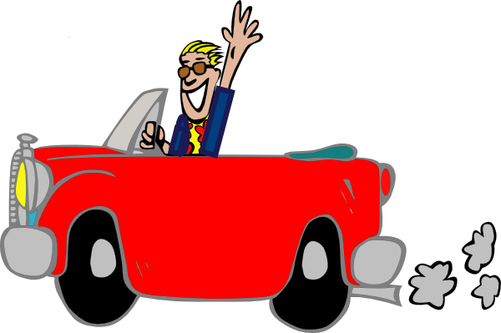
a
Paar
haben
sagen
fahren
Tag
klar
Notes:
Timing: 2 minutes
Aim: to introduce/consolidate SSC [a]
Procedure:
Introduce and elicit the pronunciation of the individual SSC [a] and then the source word again ‘sagen’ (with gesture, if using).
Then present and elicit the pronunciation of the five cluster words.
The cluster words have been chosen for their high-frequency, from a range of word classes, with the SSC (where possible) positioned within a variety of syllables within the words (e.g. initial, 2nd, final etc.). Additionally, we have tried to use words that build cumulatively on previously taught SSCs (see the Phonics Teaching Sequence document) and do not include new SSCs. Where new SSCs are used, they are often consonants which have a similar symbol-sound correspondence in English.
Word frequency (1 is the most frequent word in German): sagen [40] Paar [241] haben [6] fahren [215] klar [239] Tag [111].
Source: Jones, R.L. & Tschirner, E. (2019). A frequency dictionary of German: core vocabulary for learners. Routledge

Slide 23
a
Paar
haben
sagen
fahren
Tag
klar
Notes:
With sound and no pictures to focus all attention on the sound-symbol correspondence.

Slide 24
a
Paar
haben
sagen
fahren
Tag
klar
Notes:
Without sound to elicit pronunciation (without first hearing the teacher).
Teacher to elicit pronunciation by asking “Wie sagt man…”

Slide 25
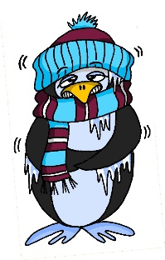
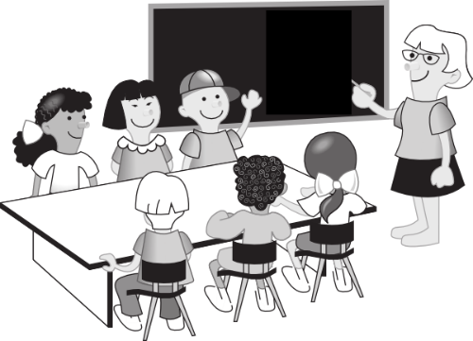
a
lang
Mann
6 Meter
kalt
Klasse
danke
Gast
[guest]
Notes:
Timing: 2 minutes
Aim: to introduce/consolidate SSC [a]
Procedure:
Introduce and elicit the pronunciation of the individual SSC [a] and then the source word again ‘kalt’ (with gesture, if using).
Then present and elicit the pronunciation of the five cluster words.
The cluster words have been chosen for their high-frequency, from a range of word classes, with the SSC (where possible) positioned within a variety of syllables within the words (e.g. initial, 2nd, final etc.). Additionally, we have tried to use words that build cumulatively on previously taught SSCs (see the Phonics Teaching Sequence document) and do not include new SSCs. Where new SSCs are used, they are often consonants which have a similar symbol-sound correspondence in English.
Word frequency (1 is the most frequent word in German): kalt [887] lang [97] Mann [121] Klasse [961] Gast [576] danke [877] Source: Jones, R.L. & Tschirner, E. (2019). A frequency dictionary of German: core vocabulary for learners. Routledge

Slide 26
a
lang
Mann
kalt
Klasse
danke
Gast
Notes:
With sound and no pictures to focus all attention on the sound-symbol correspondence.

Slide 27
a
lang
Mann
kalt
Klasse
danke
Gast
Notes:
Without sound to elicit pronunciation (without first hearing the teacher).
Teacher to elicit pronunciation by asking “Wie sagt man…”

Slide 28
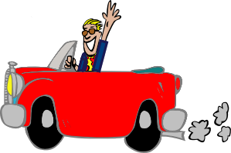
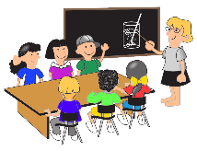
Phonetik
Hör zu. Lang oder kurz*?
hören
 | sagen | kalt
1
Mann
2
Paar
3
fahren
4
Klasse
5
danke
kurz - short
Notes:
Timing: 5 minutes Aim: to focus on differentiating the long and short [a] sounds in German. Procedure: 1. Click to hear the word. Decide if it is long [a] as in ‘sagen’ or short [a] as in ‘kalt’. Students are NOT expected to transcribe the words – there are several ways to write the sound long [a] and these are not words that have yet been taught, merely seen briefly in phonics practice.
2. Bring up the answers and the written word for students’ information. They will be learning these highly frequent words soon.
Transcript:
Mann
Paar
fahren
Klasse
danke

Slide 29
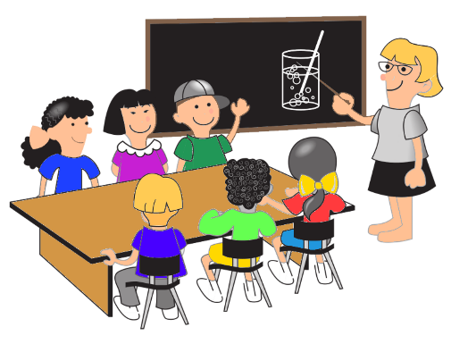
a
lang
der
Mann
kalt
6 Meter
die
Klasse
danke
der
Gast
[guest]
Notes:
Timing: 3 minutes (two slides) Aim: to raise awareness of the properties of nouns in German. Procedure: 1. Ask students to suggest why some of these words have capital letters. 2. Do they know any other German words like this? 3. Click for the definite articles to appear.

Slide 30
Nouns
Grammatik
All German nouns start with a capital letter, wherever they are in the sentence.
For example: Die Klasse ist da. (The class is there.)
Which nouns do this in English?
Proper nouns, e.g. London, September, Monday, Emily.
German proper nouns do this as well.
Notes:
Aim: to introduce the concept of capital letters on German nouns. Procedure: 1. Bring up the text and read it carefully, with helpful intonation.

Slide 31
Nouns
sprechen
Which words need a capital letter in German?
1
The
table
is
there.
1. Der Tisch ist da.
2
Where
is
the
bottle?
2. Wo ist die Flasche?
3
The
exercise book
is
here.
3. Das Heft is hier.
4
Where
is
the
man?
4. Wo ist der Mann?
5
The
man
is
in
London.
5. Der Mann ist in London.
Notes:
Timing: 5 minutes Aim: to practise the concept of capital letters on German nouns. Procedure: 1. Bring up each question.
2. Students identify the words that need capitals. Point out that both German and English always start sentences with a capital letter. 3. Elicit and/or present the German sentence.

Slide 32
der, die, das
Grammatik
Remember! German has three words for the:
masculine
feminine
neuter
der Tisch
die Flasche
das Fenster
der
die
das
Every noun has a gender, but grammatical gender is not the same as biological gender, as you have seen.
Notes:
Timing: 2 minutes Aim: to recap concept of noun gender and the three singular definite articles (words for ‘the’) in German.
Note: This is a repeat of the slide from lesson 1. Procedure: 1. Bring up the text and read it carefully, with helpful intonation.
2. Try to elicit the nouns from students before revealing them. Students have learnt two possible nouns for ‘die’ and ‘das’.

Slide 33
Wo ist...?
hören
Notes:
Timing: 2 minutes (3 slides) Aim: to practise knowledge of noun gender and the three singular definite articles (words for ‘the’) in German. Procedure: 1. Click to bring up both pictures at once. 2. Say the gender of either one and students have to respond by either turning their heads to the left or right or pointing at the correct picture, whichever is clearer. The teacher can frame this as the partially completed question ‘Wo ist die…? OR ‘Wo ist das…?

Slide 34
Wo ist...?
hören
Notes:
As for previous slide.

Slide 35
Wo ist...?
hören
Notes:
As for previous slide.

Slide 36
Vokabeln
der Mann
Notes:
Timing: 5 minutes (all vocabulary presentation slides) Aim: to present and practise the new vocabulary for this week, which includes the nouns from the cluster words. Procedure: 1. Teacher introduces the word and picture and says the word. 2. Teacher brings up the word for ‘the’ separately to focus attention on it.
3. Students say the article and the noun together. 4. Roll back the mouse to repeat these stages a couple of times. 5. Repeat with the remaining nouns on the following slides.

Slide 37
Vokabeln
der Gast
[guest]
Notes:
der Gast

Slide 38
Vokabeln
der Tisch
Notes:
der Tisch

Slide 39
Vokabeln
das Fenster
Notes:
das Fenster

Slide 40
Vokabeln
das Paar
Notes:
das Paar

Slide 41
Vokabeln
das Heft
Notes:
das Heft

Slide 42
Vokabeln
die Tafel
Notes:
die Tafel

Slide 43
Vokabeln
die Flasche
Notes:
die Flasche

Slide 44
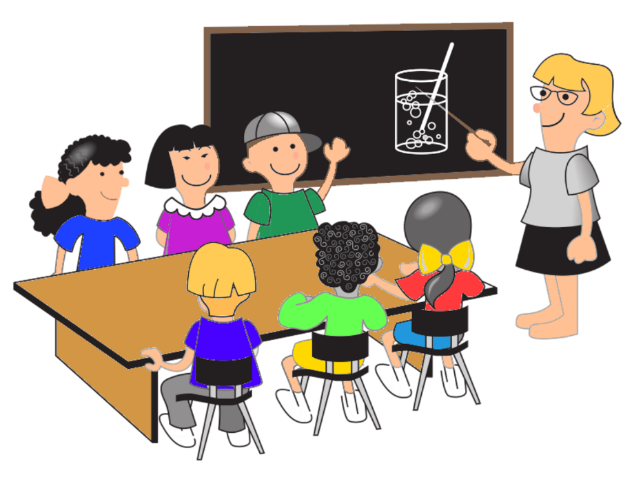
Vokabeln
die Klasse
Notes:
die Klasse

Slide 45
Vokabeln
Fenster
masculine
feminine
neuter
Flasche
Gast
Tisch
Tafel
Klasse
Mann
Paar
Heft
Notes:
Timing: 3 minutes Aim: to reinforce the new knowledge by classifying all nouns by their gender.
Procedure: 1. Teacher clicks and the word ‘masculine’ appears. 2. Students think and identify (written or orally) the masculine nouns. 3. Click to highlight the masculine nouns. 4. Repeat for ‘feminine’ and ‘neuter’ nouns.

Slide 46
Vokabeln
lesen / sprechen
masculine
feminine
neuter
60
der Gast
die Flasche
das Paar
der Tisch
die Klasse
das Heft
Sekunden
der Mann
die Tafel
das Fenster
0
LOS!
Notes:
Timing: 1 minute
Aim: to practise pronunciation of the new language
Procedure: 1. Start the timer. Say all the words, but in alphabetical order this time. This compels learners to slow down a little and they will focus a little more attention on the written word.

Slide 47
Vokabeln
A
B
1. Wo ist die ?
2. Wo ist das ?
Notes:
Timing: 8 minutes (3 slides)
Aim: to practise gender knowledge and written recall of the new vocabulary
Procedure: 1. Students write 1-6 in their books (or on whiteboards). 2. Identify which noun is ‘hidden’ from the definite article. Write A or B. 3. Write the full missing word in German. Note: Reassure students that they are not expected to know these yet, but that trying to write them from memory, trying to remember, is a key part of learning.

Slide 48
Vokabeln
A
B
3. Wo ist der Tisch? ?
4. Wo ist die Tafel? ?
Notes:
As for previous slide.

Slide 49
Vokabeln
A
B
5. Wo ist das ?
6. Wo ist der ?
Notes:
As for previous slide.

Slide 50
Antworten
A
B
1. Wo ist die Flasche ?
2. Wo ist das Fenster ?
Notes:
Timing: 2 minutes (3 slides)
Aim: to review answers to help establish new knowledge.
Procedure: 1. Click to indicate the correct item A or B. 2. Reveal the full spelling of the German word.

Slide 51
Antworten
A
B
3. Wo ist der Tisch?
4. Wo ist die Tafel?
Notes:
As for previous slide.

Slide 52
Antworten
A
B
5. Wo ist das Paar ? ?
6. Wo ist der Mann ?
Notes:
As for previous slide.

Slide 53
der, die oder das?
lesen / sprechen
die Flasche
der Mann
die Tafel
der Tisch
das Fenster
das Heft
die Klasse
das Paar
Notes:
Timing: 3 minutes
Aim: to re-focus on the essential new grammatical knowledge – the definite singular articles der, die, das.
Procedure: 1. Ask ‘Ist es der, die, oder das? (oder will be explicitly taught in a subsequent lesson) 2. Elicit the English meanings.

Slide 54
Ein Dialog
sprechen
Hello!
 | Hello!
Where is [name]?
 | [Name] is there. Where’s [the exercise book]?
[The exercise book] is here.
 | OK. Bye.
Bye.
Notes:
Timing: 7 minutes
Aim: to pull all of this week’s language together in a structured dialogue (with room for some variation – names and nouns).
Procedure: Students work in pairs to carry out this short dialogue.
They should be encouraged to repeat it several times, varying the names and nouns each times, and swapping roles A & B.
Note: if additional support is needed, teachers may want to put in a few interim steps, using additional slides. For example: i) slide with a model dialogue in German ii) slide with gapped dialogue to elicit certain words only iii) slide with first letter prompts only for each of the words iv) this version
This dialogue is repeated at the start of next week’s lesson, to recap learning. Therefore, teachers should not worry unduly if time has not allowed students to practise this thoroughly.

Slide 55
Hausaufgaben
Vocabulary Learning Homework (Y7, Term 1.1, Week 2)
Audio
Worksheet
Notes:
Timing: 5 minutes (could also be left until week 2 as Y7 classes will be settling in)
Aim: to explain the homework concept for Y7. Procedure: 1. Explain the to establish the knowledge of new words, practice is extremely important. Perhaps suggest that students think of the memory as a muscle that needs regular training to keep it in good shape. 2. What has happened to day in the lesson has ‘sown the seeds’ of the new words. These words will be re-visited several times more this year. That is built into the lessons. 3. It’s very useful to space the practice of new language, doing little and often. For this reason, the homework this year will usually be to pre-learn the words for the next lesson. This will not mean that students completely know all the words, but that they are part-way there, when they arrive at the lesson. 4. There will be a vocabulary learning homework, with audio and a student worksheet for them to complete each week.
Notes:
i) Teachers may, in addition, want to recommend use of a particular online app for the pre-learning of each week’s words. ii) Quizlet now requires parental involvement / registration / permissions for users below the age of 13, so it is perhaps most suitable for Y9 – 11 students. iii) Language Nut hosts LDP vocabulary lists and these are free for schools to use, though there is a registration process. One benefit is that all of the student tracking data that Language Nut offers are also available to schools that use the LDP lists for practice. Perhaps this makes it a good option for Y7/8.
iv) There are other free apps, and new ones are always appearing. Teachers have told us that they are currently using: Flippity, Wordwall (where using previously-created activities is free).
v) Gaming Grammar has been acquired by Language Nut. Its original content should still be available to teachers and much of it is appropriate for Y7 learners. From this lesson, for example, learners could practise Definite articles: gender.

