Slide 1
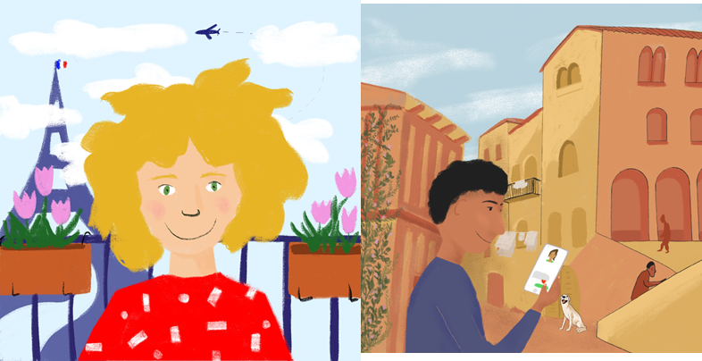
Places to go in town
Singular forms of ALLER (je, il/elle)
Preposition à plus definite article (au, à la)
SSC [ou] revisited
Y7 French
Term 2.2 - Week 1 - Lesson 39 Stephen Owen / Natalie Finlayson / Rachel Hawkes
Artwork by: Chloé Motard
Date updated: 20.02.24
Notes:
Artwork by Chloé Motard. All additional pictures selected are available under a Creative Commons license, no attribution required.
Note: all words appear on all three GCSE wordlists, with this exception:
i) AQA, Edexcel and Eduqas lists do not have sage.
Learning outcomes (lesson 1):
- introduce the first and third person singular forms of aller
- revisit SSC [ou]
- introduce the preposition à as combined with the definite article (au, à la)
Frequency rankings of vocabulary introduced this week (1 is the most common word in French): aller [53], va [53], vais [53], vas [53], caisse [1881], collège [2116], jour [78], parc [1240], poste [489], samedi [1355], train [232], où [48], comment [234], quand [119]
Frequency rankings of vocabulary revisited this week (1 is the most common word in French):
2.1.2 - êtes [5], sommes [5], sont [5], frère [1043], parent [546], sœur [1558], jeune [152], ouvert [897], sage [2643], strict [1859]
1.2.4 - demander [80], montrer [108], parler [106], penser [116], rester [100], école [477], exemple [259], raison [72], normalement [2018], que [9]
Source of frequency information:
Londsale, D., & Le Bras, Y. (2009). A Frequency Dictionary of French: Core vocabulary for learners London: Routledge.

Slide 2
ou
nous
Notes:
Timing: 1 minute
Aim: To introduce SSC [ou]
Procedure: 1. Present the letter(s) and say the [ou] sound first, on its own. Students repeat it with you. 2. Bring up the word ”nous” on its own, say it, students repeat it, so that they have the opportunity to focus all of their attention on the connection between the written word and its sound.
3. A possible gesture for this would be to have both hands draw semi-circles out away from the body. Hands start by the sides of the body, circle swiftly outwards and join up again in front, indicating the inclusion of the self in a larger group. 4. Roll back the animations and work through 1-3 again, but this time, dropping your voice completely to listen carefully to the students saying the [ou] sound, pronouncing ”nous” and, if using, doing the gesture.
Word frequency (1 is the most frequent word in French):
nous [31]
Source: Londsale, D., & Le Bras, Y. (2009). A Frequency Dictionary of French: Core vocabulary for learners London: Routledge.

Slide 3
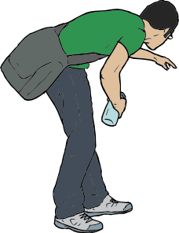
ou
trouver
jouer
Bonjour !
nous
douze
toujours
[always; still]
Notes:
Timing: 2 minutes
Aim: To introduce SSC [ou]
Procedure:
1. Introduce and elicit the pronunciation of the individual SSC [ou] and then the source word again ‘nous’ (with gesture, if using). 2. Then present and elicit the pronunciation of the five cluster words.
The cluster words have been chosen for their high-frequency, from a range of word classes, with the SSC (where possible) positioned within a variety of syllables within the words (e.g. initial, 2nd, final etc.). Additionally, we have tried to use words that build cumulatively on previously taught SSCs (see the Phonics Teaching Sequence document) and do not include new SSCs. Where new SSCs are used, they are often consonants which have a similar symbol-sound correspondence in English.
Word frequency (1 is the most frequent word in French): nous [31]; trouver [83] jouer [219]; bonjour [1972]; toujours [103]; douze [1664].
Source: Londsale, D., & Le Bras, Y. (2009). A Frequency Dictionary of French: Core vocabulary for learners London: Routledge.

Slide 4
[u] ou [ou] ?
lire / parler
route
double
juste
aventure
humain
signature
occupation
publicité
tour
univers
refuser
gouvernement
toucher
courage
ouvrir
situation
jour
souvenir
ou
trouver
urgent
public
calculer
groupe
mouvement
substance
Notes:
Timing: 4 minutes (two slides)
Aim: to practise read aloud of SSC [ou] and [u], building on last week’s awareness-raising exercise on differences in pronunciation between French and English cognates, and consistency of the French spelling rules.
Procedure:
1. Teacher reminds students that their knowledge of English will not help them here. They must look at the spelling [u] or [ou] to find information about pronunciation.
2. Give out one handout (copy of this slide) between two.
3. Students use different colours to play. Student A chooses one of the words and attempts to pronounce it correctly. Student B scrutinises the pronunciation. If Student A pronounces the word correctly, they circle it in their colour (or write it in their books if not printing the slide). If pupil A says [u] instead of [ou] or vice-versa, or pronounces it the ‘English’ way, Student B can steal the word, circling it in their colour.
4. Students alternate turns until all words are circled. 5. Go to the next slide for teacher-led consolidation practice.
Notes: i) The words included in the exercise are either known words or cognates from within the top 5000 words, so students need not focus on meaning and can concentrate fully on decoding.
ii) Clearly, the classroom conditions need to be right with the individual class for friendly competition. If preferred, teachers can use only the following slide for class-led practice.
Frequency of vocabulary:
juste [304], double [574], route [512], occupation [2096], publicité [2110], humain [286], signature [2187], aventure [2090], gouvernement [160], courage [1431], toucher [231], univers [2112], refuser [271], tour [523], jour [78], souvenir [616], ouvrir [257], urgent [2179], ou [33], trouver [83], public [285], situation [223], calculer [2331], groupe [187], substance [2227], movement [485]
Source: Londsale, D., & Le Bras, Y. (2009). A Frequency Dictionary of French: Core vocabulary for learners London: Routledge.

Slide 5
[u] ou [ou] ?
lire / parler
route
double
juste
aventure
humain
signature
occupation
publicité
tour
univers
refuser
gouvernement
toucher
courage
ouvrir
situation
jour
souvenir
ou
trouver
urgent
public
calculer
groupe
mouvement
substance
Notes:
Procedure:
1. Teacher elicits pronunciation by pointing at a word, and asking Comment dit-on? Students answer chorally.
2. Students check their pronunciation by listening to recordings, played on clicking individual words (or provided by the teacher)
3. Students repeat. Note: On this version of the task slide, words containing [ou] are highlighted in orange for clarity.

Slide 6
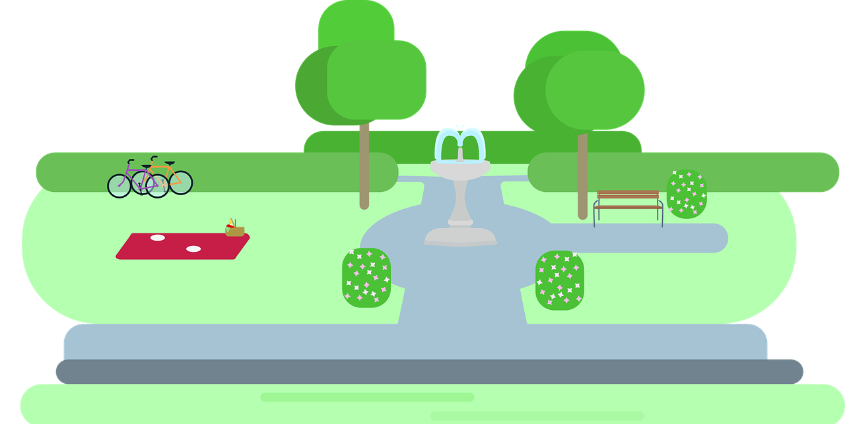
Vocabulaire
Comment dit-on ça en français?
lire / parler
comment?
le train
la poste
où?
le parc
sa.
le jour
le samedi
la caisse
le collège
quand?
checkout
school
park
post office
Saturday
where?
train
day
when?
how?
Notes:
Timing: 3 minutes
Aim: to practise written recognition and read aloud of most of this week’s new vocabulary.
Procedure:
Click for English prompt.
Elicit French from pupils.
Click to confirm.
Repeat with all items.
6

Slide 7
Trouve le mot impossible!
lire / parler
Was ist total falsch?
une
un
le
le
la
un
une
la
le
la
le
une
un
le
une
la
le
un
Notes:
Timing: 2 minutes
Aim: to practise written recognition of determiners and their connection to the nouns in this week’s vocabulary set.
Procedure:
Click for set of French determiners.
Elicit the ‘mot impossible’ from students.
Click to confirm.
Repeat with all items.
Note: teachers can also use the slide to elicit the French for the new nouns.

Slide 8
C’est...
la poste
Notes:
Timing: 2 minutes (five slides) Aim: to practise spoken recall of some of this week’s new vocabulary Procedure:
Click to reveal the first square.
Encourage students to put their hands up if they know, without calling out.
Teacher decides when and how to elicit the answer from students, orally, encouraging pupils to say the full phrase “ c’est … le / la ..” each time
Move to the next slide.
Answer: C’est la poste.

Slide 9
C’est...
le jour
Notes:
C’est le jour.

Slide 10
C’est...
le train
Notes:
C’est le train.

Slide 11
C’est...
le collège
Notes:
C’est le collège

Slide 12
C’est...
la caisse
Notes:
C’est la caisse.

Slide 13
aller
[to go | going]
va
[goes | is going]
Notes:
Timing: 3 minutes (six slides)
Aim: to consolidate knowledge of the verb aller and the short form va.
Procedure:
Bring up the word aller on its own, say it, students repeat it, and remind them of the phonics. Draw attention to SSC [a] and [é/er/et/ez]
Try to elicit the meaning from the students.
Then bring up the English translations. Emphasise the two meanings for the infinitive.
Bring up the short form va, say it, students repeat it. . Draw attention to SSC [a].
Try to elicit the meaning from the students. Emphasise the two meanings for the short form.
Notes:
i) Students should know the meaning of this verb already, as it was set as (audio and Quizlet) homework. It is re-presented here in the infinitive and short form to deepen students’ knowledge and model the use of both forms in sentences.
Introducing the verb aller more explicitly. Aller is one of the 25 most frequently used verbs in French. All 25 most frequent verbs will be introduced early on using the same format. Both long form (infinitive) and short form (3rd person singular) are introduced in order to familiarise students with various forms of the same verb.
ii) Students have had explicit teaching that the present tense in French communicates two different present tense meanings in English. This reinforces that learning. Emphasise the two meanings for the short form, reminding students that French only has one form and does not have a direct equivalent of the grammar for ‘is + ing’, the continuous form (as covered in previous weeks).

Slide 14
aller
[to go| going]
va
[goes | is going]
Notes:
Cycle through the long and short form again.

Slide 15
va
[goes | is going]
Elle va au parc.
[She goes | is going to the park.]
Notes:
Introduce the short form in a sentence.

Slide 16
aller
[to go | going]
Elle aime aller au parc.
[She likes going to the park.]
Notes:
Introduce the long form in a sentence.

Slide 17
va
[goes | is going]
va
Elle au parc.
[She goes | is going to the park.]
Notes:
Cycle through the short form in context again.

Slide 18
aller
[to go | going]
aller
Elle aime au parc.
[She likes going to the park.]
Notes:
Cycle through the long form in context again.

Slide 19
The verb ‘aller’ – to go
grammaire
Aller is an irregular verb, meaning to go, to be going.
je vais
I go / I am going
il va
he goes / he is going
elle va
she goes / she is going
Notes:
Timing: 1 minute Aim: to emphasise that aller is highly irregular.
Procedure: 1. Click to present the information
2. Ask students what other irregular verbs they know, which do not follow regular conjugation patterns.

Slide 20
La liaison
prononcer
Je vais dehors. I go outside.
The final –s in vais is a Silent Final Consonant.
But …
Je vais à Paris. I go to Paris.
Now, the final consonant in vais is not an SFC!
Because the -s is followed by a vowel, it is pronounced like the English ‘z’.
This pronunciation change is an example of liaison.
Notes:
Timing: 3 minutes (4 slides) Aim: to introduce students to a further example of liaison.
Procedure:
1. Click to present the information
2. Elicit pronunciation from pupils.

Slide 21
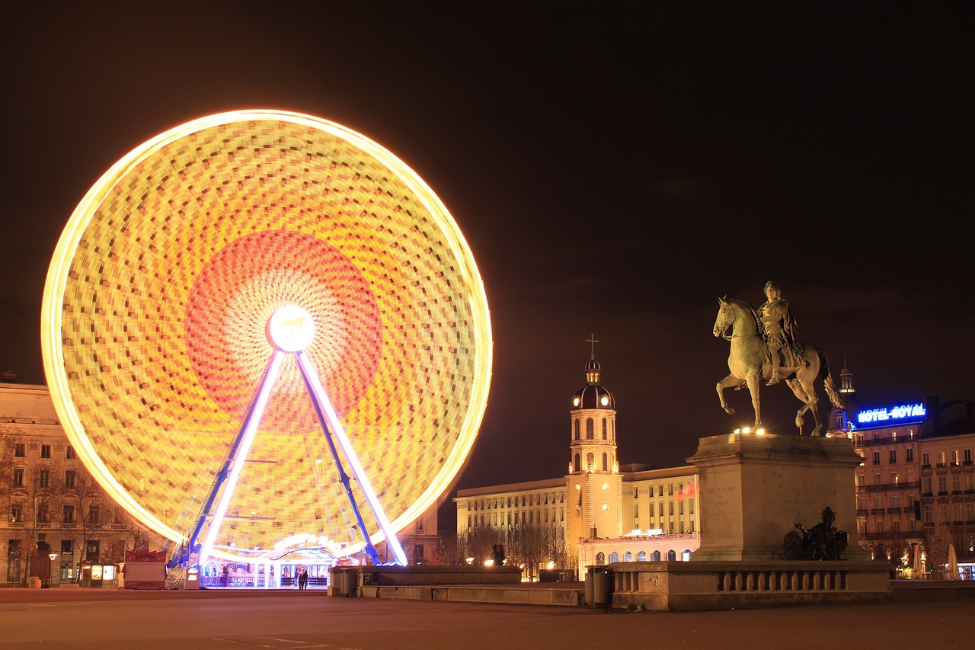
Say where people go: Je vais… (1/3)
prononcer
je vais à Lyon
I go/am going to Lyon
Notes:
Aim: to practise liaison in short sentences.
Procedure:
Click to listen.
Pupils repeat.
3. Highlight that vais à sounds like one word, rather than two.

Slide 22
Say where people go: Je vais… (2/3)
prononcer
je vais au parc
I go/am going to the park
Notes:
2/3

Slide 23
Say where people go: Je vais… (3/3)
prononcer
je vais à la poste
I go/am going to the post office
Notes:
3/3

Slide 24
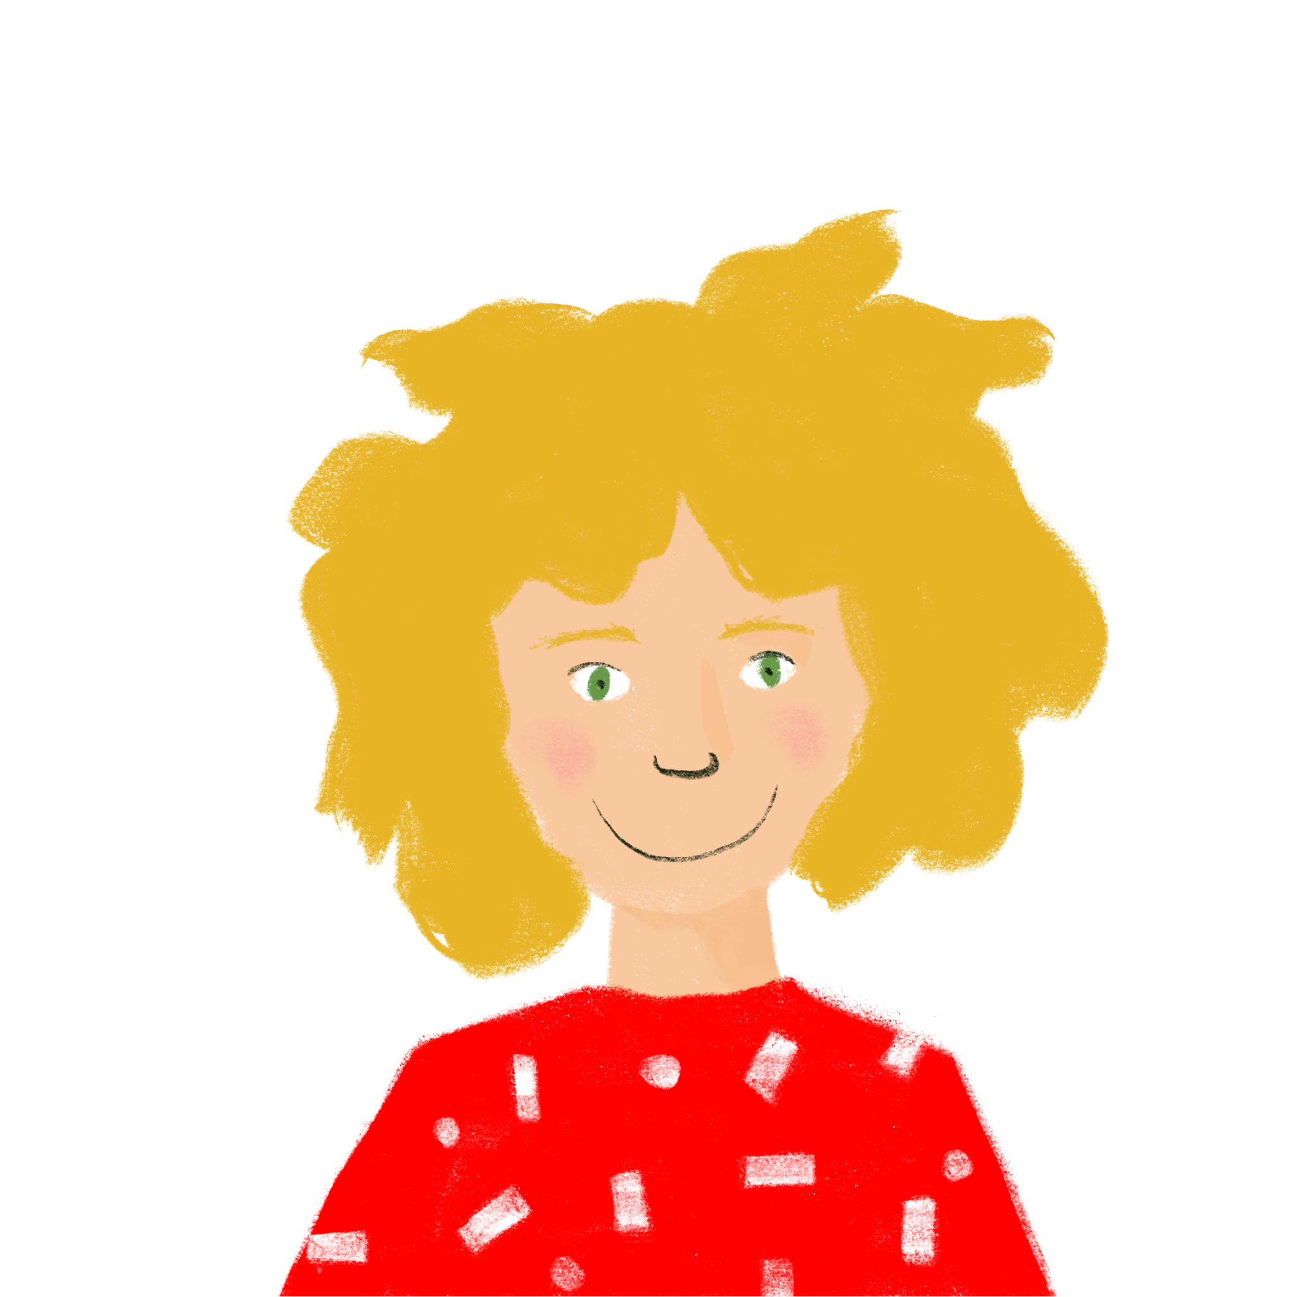
Qui va où ? (je/il)
lire
Léa writes where she is going and where Amir is going.
C’est qui? Léa (je) ou Amir (il)?
 |  | je | il
1.
2.
3.
 |  | je | il
4.
5.
6.
vais à Paris.
va à Poitiers.
vais à Bordeaux.
va à Rouen.
va à Blois.
vais à Lyon.
Notes:
Timing: 7 minutes Aim: to practise written comprehension of two parts of the verb aller. Procedure: 1. Pupils number 1-6 in books and write je or il, paying attention only to the verb form (the pronouns are hidden steer all pupils’ attention to the verb forms.) 2. Elicit responses (in full sentences to practise read aloud) and click to confirm the answers. Notes: i) The use of ‘à’ meaning ‘to’ was introduced in 1.2.3. Check students’ knowledge of the word.

Slide 25
Saying ‘to (the)..’ in French
grammaire
To say ‘to (the)...’ in French before a noun, use au or à la, depending on whether the noun is masculine or feminine:
au and à la can also mean ‘at (the)’, so we can translate ‘au collège’ as ‘to (the) school’ or ‘at (the) school’.
Masculine
Feminine
au parc
to the park
à la caisse
to the checkout
au collège
to (the) school
à la poste
to the post office
to the brother
to the sister
au frère
à la sœur
Sometimes in English we don’t say ‘the’, e.g., ‘I’m going to school’.
à + le = au
Stephen Owen
Notes:
Timing: 2 minutes
Aim: to present two ways to say ‘to (the)’ in French.
Procedure:
Click through the animations to present the information.
Elicit English translations for the French examples provided.

Slide 26
le ou la ?
lire
le
la
salle
poste
parc
travail
fenêtre
porte
caisse
maison
déjeuner
tableau
collège
magasin
Notes:
NB: Higher proficiency students may not need this consolidation but many students find remembering gender difficult, so here we revisit the articles ahead of the targeted practice of au / a la. Timing: 2 minutes
Aim: to consolidate the definite articles for nouns we use in the activity that follows.
Procedure:
Click to reveal a word. Students say the word. Continue until all words are on the slide.
Students predict to which word for ‘the’ each noun will fly to on a click – le or la? The words are animated left to right, top to bottom. They can indicate this with their arms (pointing left for ‘le’ and right for ‘la’ as well as saying the noun with its article.
After pupils say the article and word e.g., la poste, click to animate.
NB: it is anticipated that the meaning of many/most of these nouns will be known, as many are included as from previous vocab sets/for pre-learning for this lesson and will have been encountered and practised for pronunciation, meaning and gender, but not with the matching word for ‘the’.

Slide 27
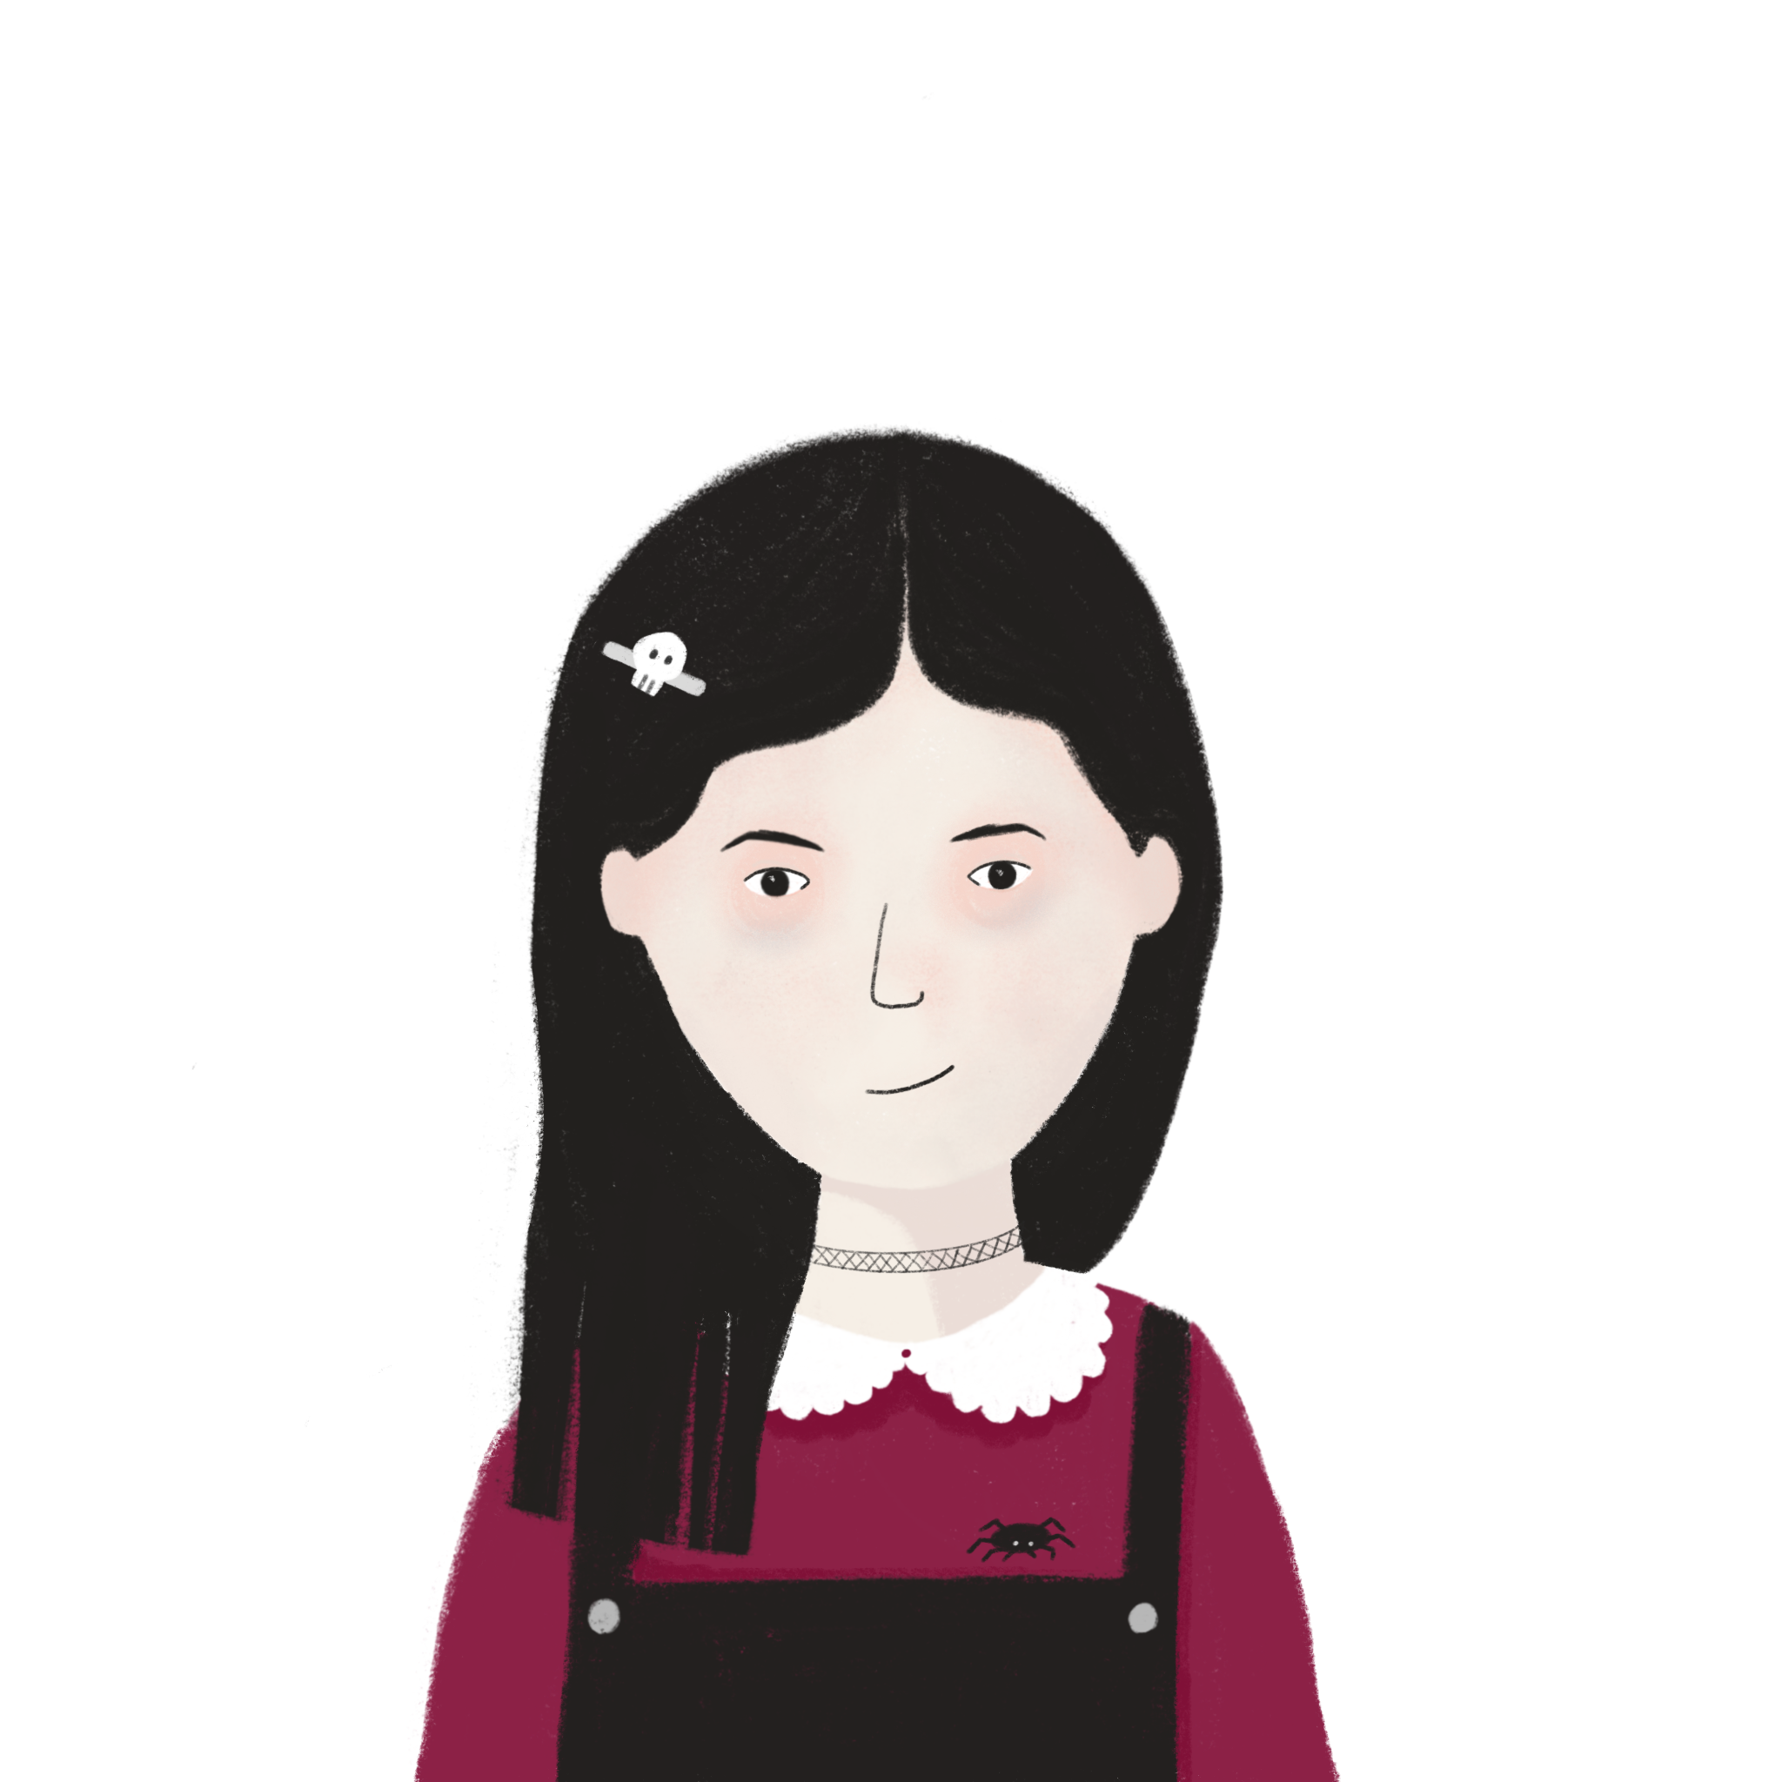
Qui va où ? (au/à la)
écouter
Léa parle. Où va Léa ? (je) Où va Amir ? (il) Où va Sophie ? (elle) C’est au ou à la ?
1
1
Je vais à la ...
poste / parc
2
2
Il va au ...
salle / travail
3
3
Je vais au ...
tableau / porte
4
4
Elle va au ...
fenêtre / déjeuner
5
5
Elle va à la ...
collège / caisse
6
6
Il va à la ...
magasin / maison
Notes:
Timing: 8 minutes Aim: to practise aurally connecting ‘au’ and ‘à la’ with masculine and feminine nouns; to practise written understanding of new and previously taught vocabulary.
Procedure: 1. Pupils write 1-6.
2. Click to listen to number 1.
3. Click to bring up the two destination options.
4. Students write the correct option, based on the article (‘au’ or ‘à la’) they hear. 5. Continue with items 2-6. 6. Click to bring up the 2nd set of audio buttons.
7. First, elicit the full phrase from students. E.g. Je vais à la poste.
8. Click to bring up the sentence beginning and to reveal the sentence ending.
9. If desired, click the red audio button to play the full correct sentence.
10. Continue with feedback for items 2-6.
Transcript:
Je vais à la [poste]
Il va au [travail]
Je vais au [tableau]
Elle va au [déjeuner]
Elle va à la [caisse]
Il va à la [maison]

Slide 28
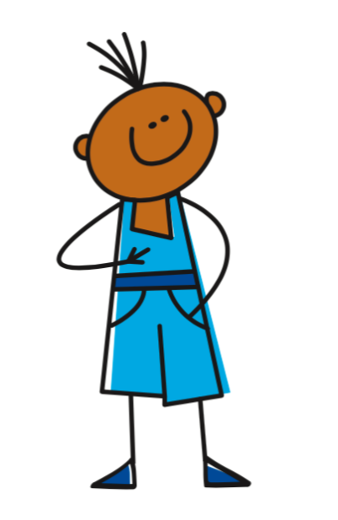
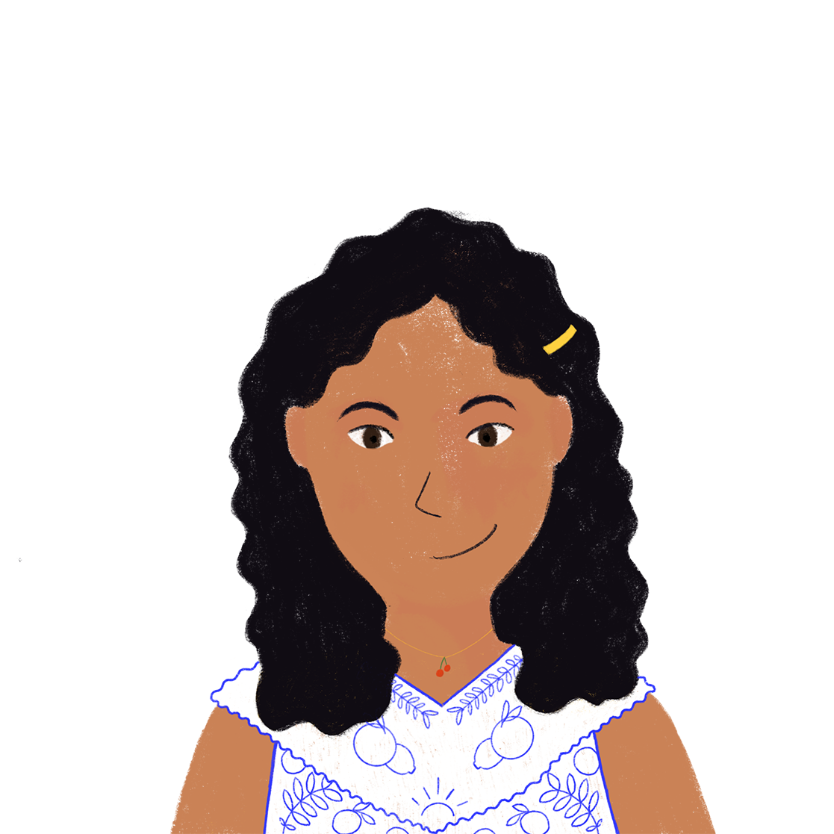
Vocabulaire
parler
L
M
N
O
P
Q
G | H | I | J | K
 | I go |  | to think
(the) reason | how? | to speak | when? | we are
to go, going | parent |  | she goes
to be, being | to stay, remain | sister | to ask, asking | young
 | you go | where? | open | he goes
usually | brother | they are | day | you (all) are
sa.
Notes:
Note: this activity also begins the next lesson, so teachers need not be concerned if they don’t get to it at the end of lesson 1.
Timing: 5 minutes Aim: to reactivate and strengthen vocabulary knowledge of this week’s new and revisited vocabulary; to revisit letters of the alphabet Procedure: 1. Teacher gives co-ordinates using French alphabet letters. E.g., LI – Comment dit-on en français ?
2. Students respond by producing the French word. E.g., la caisse
If not done in the parallel activity last lesson, the teacher can also develop depth of vocabulary knowledge by giving word prompts to trigger word associations.
For example, the teachers says ‘hablar’ and students volunteer any words that have an association with this verb (e.g., inglés, español, palabra, pregunta, teléfono).
Other words the teacher could give are: i) Les questions (comment ?, où ?, quand ? demander
ii) La famille (le parent, la sœur, le frère) iii) Aller (je vais, tu vas, il va, elle va)
iv) Être (nous sommes, vous êtes, ils/elles sont) v) les verbes (penser, parler, aller, être, demander, rester)
vi) Les lieux/les destinations (la poste, le parc, la caisse, le train, le college)
vii) Les descriptions (jeune, ouvert)
viii) quand (normalement, le samedi, le jour) There are no 100% correct / incorrect answers here; it is a matter of students reflecting on the meaning of the words and the contexts in which they could be used, to strengthen word knowledge through the making of semantic connections.

Slide 29
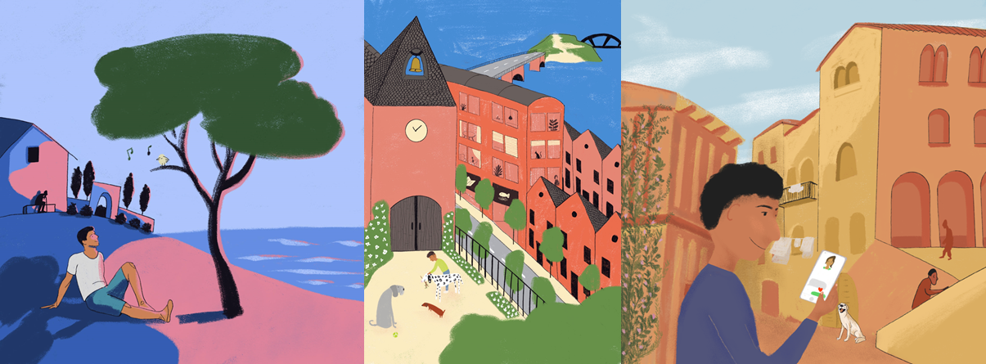
Places to go in town
Singular forms of ALLER (tu)
Preposition à plus definite article (au, à la)
SSC [ou] revisited
Y7 French
Term 2.2 - Week 1 - Lesson 40 Stephen Owen / Natalie Finlayson / Rachel Hawkes
Artwork by: Chloé Motard
Date updated: 21.02.24
Notes:
Artwork by Chloé Motard. All additional pictures selected are available under a Creative Commons license, no attribution required.
Note: all words appear on all three GCSE wordlists, with this exception:
i) AQA, Edexcel and Eduqas lists do not have sage.
Learning outcomes (lesson 1):
- introduce the second person singular forms of aller
Frequency rankings of vocabulary introduced this week (1 is the most common word in French): aller [53], va [53], vais [53], vas [53], caisse [1881], collège [2116], jour [78], parc [1240], poste [489], samedi [1355], train [232], où [48], comment [234], quand [119]
Frequency rankings of vocabulary revisited this week (1 is the most common word in French):
2.1.2 - êtes [5], sommes [5], sont [5], frère [1043], parent [546], sœur [1558], jeune [152], ouvert [897], sage [2643], strict [1859]
1.2.4 - demander [80], montrer [108], parler [106], penser [116], rester [100], école [477], exemple [259], raison [72], normalement [2018], que [9]
Source of frequency information:
Londsale, D., & Le Bras, Y. (2009). A Frequency Dictionary of French: Core vocabulary for learners London: Routledge.

Slide 30
Vocabulaire
parler
L
M
N
O
P
Q
G | H | I | J | K
 | I go |  | to think
(the) reason | how? | to speak | when? | we are
to go, going | parent |  | she goes
to be, being | to stay, remain | sister | to ask, asking | young
 | you go | where? | open | he goes
usually | brother | they are | day | you (all) are
sa.
Notes:
Note: if teachers have already used this activity in lesson 1, they may want to begin the lesson with the phonics ‘pirates’ activity on the next slide. Timing: 5 minutes Aim: to reactivate and strengthen vocabulary knowledge of this week’s new and revisited vocabulary; to revisit letters of the alphabet Procedure: 1. Teacher gives co-ordinates using French alphabet letters. E.g., LI – Comment dit-on en français ?
2. Students respond by producing the French word. E.g., la caisse
If not done in the parallel activity last lesson, the teacher can also develop depth of vocabulary knowledge by giving word prompts to trigger word associations.
For example, the teachers says ‘hablar’ and students volunteer any words that have an association with this verb (e.g., inglés, español, palabra, pregunta, teléfono).
Other words the teacher could give are: i) Les questions (comment ?, où ?, quand ? demander
ii) La famille (le parent, la sœur, le frère) iii) Aller (je vais, tu vas, il va, elle va)
iv) Être (nous sommes, vous êtes, ils/elles sont) v) les verbes (penser, parler, aller, être, demander, rester)
vi) Les lieux/les destinations (la poste, le parc, la caisse, le train, le college)
vii) Les descriptions (jeune, ouvert)
viii) quand (normalement, le samedi, le jour) There are no 100% correct / incorrect answers here; it is a matter of students reflecting on the meaning of the words and the contexts in which they could be used, to strengthen word knowledge through the making of semantic connections.

Slide 31
Les pirates (1/3)
écouter
c
w
pull
nous
pull
One of the chests contains buried treasure. All the others contain poison!
Listen carefully to the secret code and follow the arrows to find the treasure.
poule
nu
poule
h
z
bûche
jus
pouce
v
bouche
joue
puce
pull
k
pull
jus
pouce
nous
i
poule
joue
puce
nu
poule
pulle
nous
pouce
nous
pull
r
poule
nu
puce
nu
poule
pull
y
j
q
poule
Notes:
Timing: 9 minutes (three slides) Aim: to practise aural distinction between [ou] and [u] using a game activity. The game makes use of minimal pairs of unknown words (unknown words are used so that pupils focus on the sound. Definitions are given on a later slide.
Procedure: 1. Tell students the activity starts on the red square and they listen to the words and decide each time whether they hear [u] or [ou]. They will hear 5 words.
2. At each word they make a choice and follow the arrow indicated by that choice. There is only one correct route for each round.
3. Click the green audio button to listen. Students will probably need to hear it at least three times. 4. Then the teacher asks ‘tu es où?’ Pupils respond ‘Z, W’ etc. to practise the alphabet. Teacher clicks on the chests they say to reveal treasure (or not!)
Notes: i) The order of [u] or [ou]. changes (i.e. sometimes [ou] is on the white square and sometimes on the blue) so the pupils must read the spellings.
ii) Students can follow the slide on the projector, or the slide can be printed so they can trace the route with a pen/finger.
iii) Each treasure chest is triggered to reveal what is underneath. You see a hand icon appear when you mouse over it – click and the chest disappears. Each slide only has one treasure chest – the rest reveal skulls.
Transcript:
bûche, jus, pouce, nu, poule
Answer: treasure is located in chest W.

Slide 32
Les pirates (2/3)
écouter
c
w
pull
nous
pull
One of the chests contains buried treasure. All the others contain poison!
Listen carefully to the secret code and follow the arrows to find the treasure.
poule
nu
poule
h
z
bûche
jus
pouce
v
bouche
joue
puce
pull
k
pull
jus
pouce
nous
i
poule
joue
puce
nu
poule
pulle
nous
pouce
nous
pull
r
poule
nu
puce
nu
poule
pull
y
j
q
poule
Notes:
2/3
Transcript:
bouche, joue, puce, nu, poule
Treasure is located in chest Y.

Slide 33
Les pirates (3/3)
écouter
c
w
pull
nous
pull
One of the chests contains buried treasure. All the others contain poison!
Listen carefully to the secret code and follow the arrows to find the treasure.
poule
nu
poule
h
z
bûche
jus
pouce
v
bouche
joue
puce
pull
k
pull
jus
pouce
nous
i
poule
joue
puce
nu
poule
pulle
nous
pouce
nous
pull
r
poule
nu
puce
nu
poule
pull
y
j
q
poule
Notes:
3/3
Transcript:
bouche, jus, pouce, nous, pull
Treasure is located in chest K.

Slide 34
Comment dit-on ça ?
lire / parler
naked
la bûche
la bouche
le jus
la joue
la puce
le pouce
nu
nous
le pull
la poule
Notes:
Timing: 1 minute
Aim: to practise read aloud of unknown words with [ou] and [u]. The words are minimal pairs because they differ in pronunciation by only one phoneme, making them ideal for focusing on the specific difference in sound between these phonemes (which sound similar to many learners of French).
Procedure: 1. Teacher elicits the pronunciation of each pair of words.
2. Pictures appear on each click.
3. Audio plays on clicking the image.
Note: Students may be interested to know that ‘puce’ is actually a term of endearment in French!

Slide 35
The verb ‘aller’ – to go
grammaire
Remember, in French we use the verb aller to say to go.
je vais
I go / I am going
tu vas
you go / you are going
il va
he goes / he is going
elle va
she goes / she is going
Notes:
Timing: 1 minute Aim: to recap parts of aller taught last lesson and introduce ‘tu vas’.
Procedure: 1. First, teachers can elicit the French for the parts of aller that were taught and practised in the previous lesson, one by one. 2. Then the ‘tu’ form of the verb ALLER is introduced.

Slide 36
La liaison
prononcer
Tu vas dehors. You go outside.
The final –s in vas is a Silent Final Consonant.
But …
Tu vas à Londrès. I go to London.
Now, the final consonant in vas is not an SFC!
Because the -s is followed by a vowel, it is pronounced like the English ‘z’.
This is another example of liaison.
Notes:
Timing: 3 minutes (4 slides) Aim: to introduce students to a further example of liaison.
Procedure:
1. Click to present the information
2. Elicit pronunciation from pupils.

Slide 37
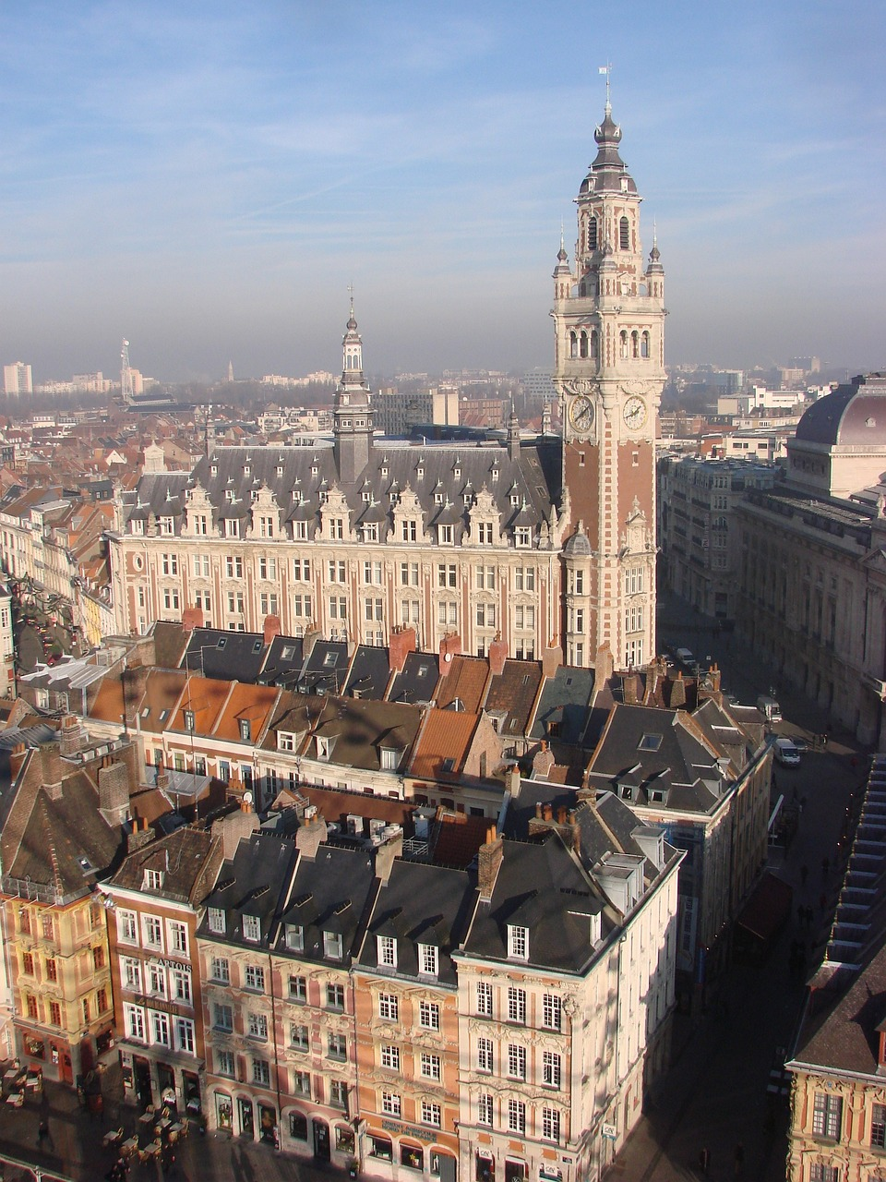
Say where people go: Tu vas… (1/3)
prononcer
tu vas à Lille
You go/are going to Lille
Notes:
Aim: to practise liaison in short sentences.
Procedure:
Click to listen.
Pupils repeat.
3. Highlight that vas à sounds like one word, rather than two.

Slide 38
Say where people go: Tu vas… (2/3)
prononcer
tu vas au collège
You go/are going to school
Notes:
2/3

Slide 39
Say where people go: Tu vas… (3/3)
prononcer
tu vas à la caisse
You go/are going to the checkout
Notes:
3/3

Slide 40
Qui va où ? (je/tu)
écouter
Amir parle. Où va Amir ? (je) Où va Abdel, son frère (tu) ?
 | je | tu
 | je | tu
1
4
1
Tu vas à Paris.
4
Je vais à Rouen.
2
Je vais à Poitiers.
5
2
5
Tu vas à Blois.
3
Je vais à Bordeaux.
6
3
6
Tu vas à Lyon.
Notes:
Timing: 8 minutes Aim: to practise aurally connecting ‘vais’ and ‘vas’ with meaning, without the support of the pronoun.
Procedure: 1. Pupils write 1-6.
2. Click to listen.
3. Pupils note ‘je’ or ‘tu’.
4. Click to correct, ticks first.
5. Then click to bring up a 2nd set of audio buttons, which have full sentence audio.
6. Click to bring up the full sentences. Students can be asked to read each sentence aloud to reinforce pronunciation, including liaison. Click to listen and check, if desired.
Transcript
[Tu] vas à Paris.
2. [Je] vais à Poitiers.
3. [Je] vais à Bordeaux.
4. [Je] vais à Rouen.
5. [Tu] vas à Blois.
6. [Tu] vas à Lyon.

Slide 41
Questions with où
grammaire
Remember, in French we use intonation to form questions.
Tu as un animal ?
Do you have a pet?
Literally: You have an animal?
“Do” is not used in French!
We can add the question word où ? – where?
Je vais où ?
Where am I going?
Tu vas où ?
Where are you going?
The question word goes to the end of the French sentence.
Notes:
Timing: 1 minute Aim: to explain the formation of intonation questions with où . N.B. Intonation questions were introduced in 1.1.2 and students have practised them several times since.
Procedure: 1. Click through the sequence to present the information.
2. Elicit English from students.

Slide 42
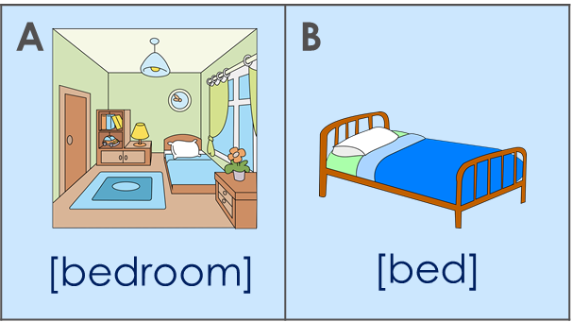
Tu vas où ? Je vais… (1/2)
parler
B: Ask your partner: Where are you going?
Then stop! Don’t say the destination!
Tu vas où ?
A: Tell your partner: I am going to and au… or à la…
Je vais au (lit).
B: Ask for clarification.
You can work out the destination from the au … or à la
Tu vas au lit ?
Oui !
Notes:
Timing: 6 minutes (three slides)
Aim: to practise oral production and comprehension of (Je vais) au / à la, connecting the articles with the correct destination. This slide models the activity.
Procedure:
Click through the sequence to model the activity.
Ensure students’ comprehension at each stage.

Slide 43
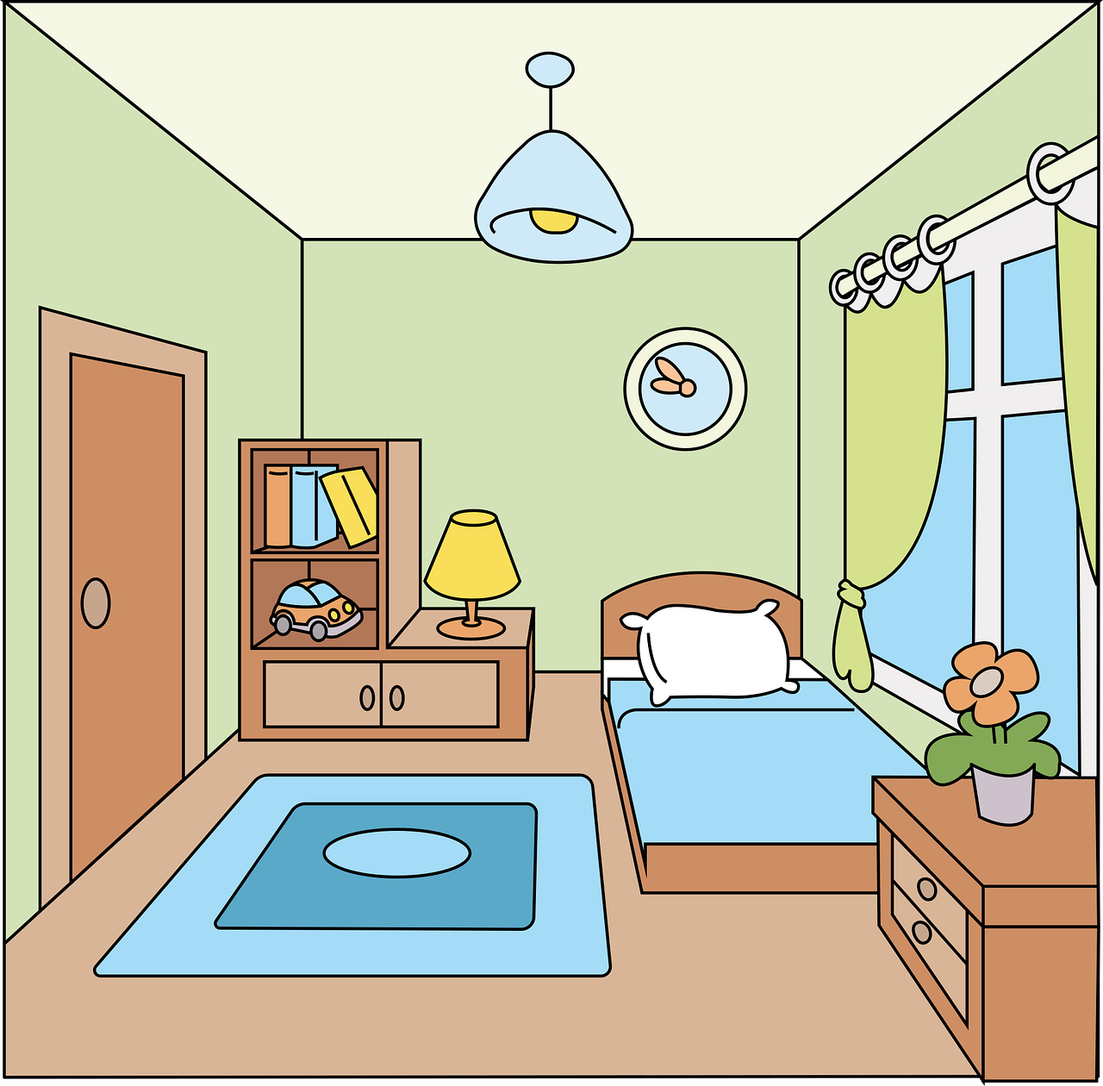
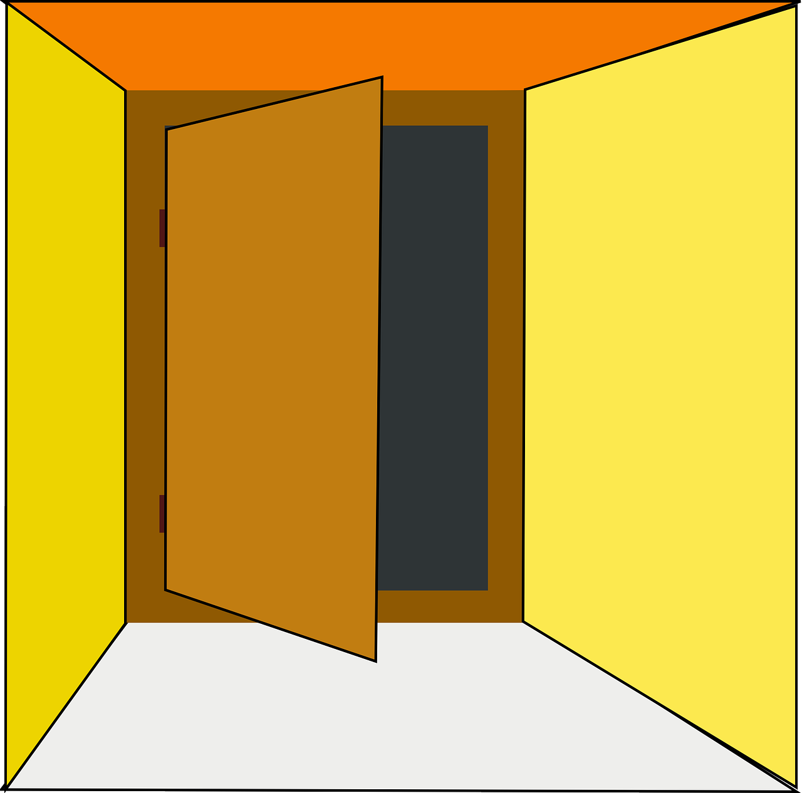
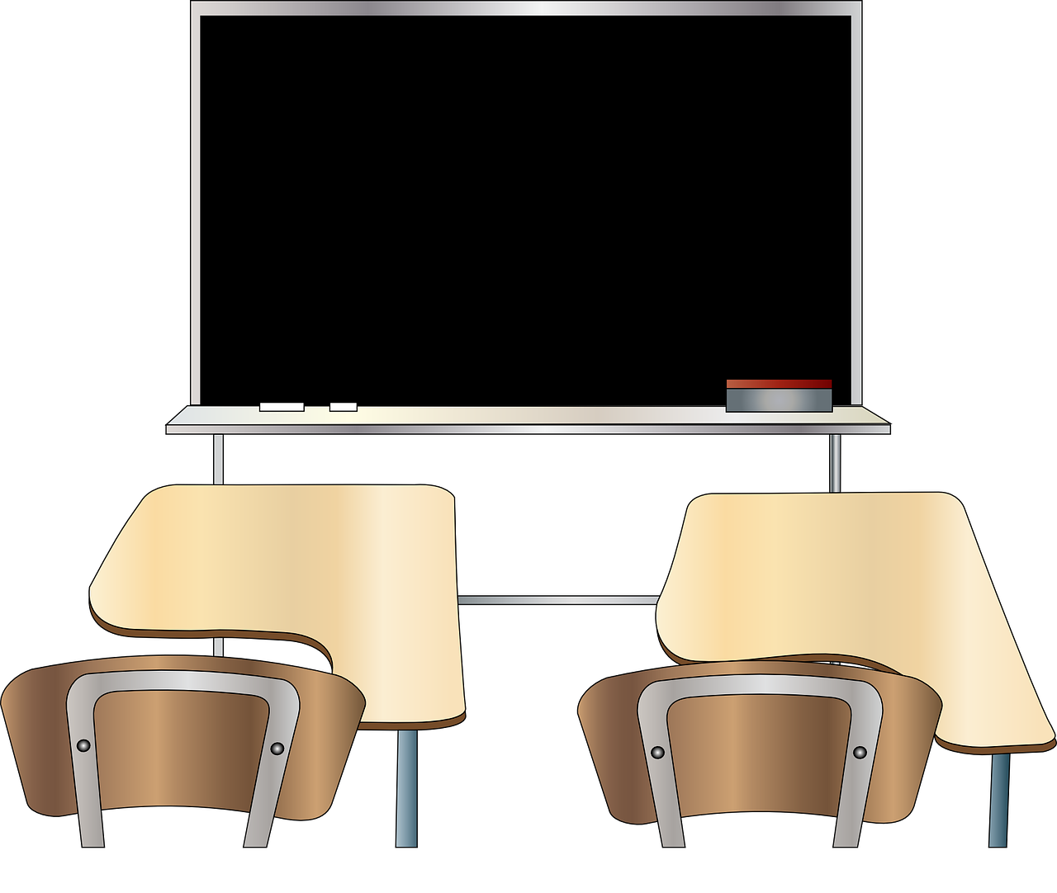
Tu vas où ? Je vais… (1/2)
parler
1
A | B
A | B
A | B
2
3
[bedroom]
[bed]
[shop]
[checkout]
[house]
[work]
4
5
A | B
6
A | B
A | B
[school]
[(class)room]
[post office]
[park]
[door]
[board]
Notes:
Display this slide for Round 1 Procedure:
Student A looks at the item options 1-6 and selects either A or B for each.
S/he then says the sentence beginning Je vais au / à la (depending on the noun selected) without saying the noun.
Student B works out which destination A has chosen and asks for confirmation: e.g. Tu vas au lit ?
A confirms if the response is correct.
The dialogue continues until all 6 destinations have been discussed.
Move to the 2nd slide to swap roles.

Slide 44
Tu vas où ? Je vais… (2/2)
parler
1
A | B
A | B
A | B
2
3
[park]
[post office]
[work]
[home
[board]
[window]
4
5
A | B
6
A | B
A | B
[shop]
[checkout]
[train]
[car]
[(class)room]
[school]
Notes:
Display this slide for Round 2

Slide 45
Other question words
grammaire
Remember to use intonation to ask “Where?” using the question word où ?
Tu vas où ?
Where are you going?
Literally: You are going where?
OR:
Where do you go?
“Do” is not used in French!
Remember: the question word goes after the verb in the French sentence.
We can now ask two more questions:
Tu vas comment ?
How do you go / are you going?
Tu vas quand ?
When do you go / are you going?
Notes:
Timing: 2 minutes
Aim: to explain how to form intonation questions with comment and quand.
Procedure:
Click to present the information.
Elicit English meanings for the examples.

Slide 46
Tu vas comment ?
vocabulaire
Je vais …
en bateau
en train
en bus
en voiture
To say I go by + transport: ‘Je vais en’ + noun
Notes:
Timing: 1minute
Aim: to present the preposition ‘en’ used to mean ‘by’ with transport.
Procedure:
Click to present the information.
Elicit English meanings for the examples.

Slide 47
Comment et quand ?
écouter
Noura demande à Amir. Tu vas comment et quand ? Coche les réponses correctes.
 | by car | by train | every week | today
 | by car | by train | every week | today
1
4
2
5
3
6
Notes:
Timing: 6 minutes Aim: to practise aural comprehension of the new question words and the appropriate information (from vocabulary previously practised) to answer the questions.
Procedure: 1. Do item 1 with students to model the activity.
2. Correct item 1. 3. Click to listen to items 2-6.
4. Elicit responses and click to provide feedback.
Transcript – dialogue between 2 people
1. Tu vas à Paris comment ?
- Je vais à Paris en train.
- Et quand ?
- Aujourd‘hui.
2. Tu vas à Poitiers comment ?
- Je vais à Poitiers en voiture.
- Et quand ?
- Chaque semaine.
3. Tu vas à Bordeaux comment ?
- Je vais à Bordeaux en train.
- Et quand ?
- Aujourd‘hui.
4. Tu vas à Rouen quand ?
- Je vais à Rouen aujourd‘hui.
- Et comment ?
- En voiture.
5. Tu vas à Blois comment ?
- Je vais à Blois en voiture.
- Et quand ?
- Chaque semaine.
6. Tu vas à Lyon quand ?
- Je vais à Lyon chaque semaine.
- Et comment ?
- En train.

Slide 48
Écris en français !
écrire
Translate these questions into French:
1.
How do you go to school?
Tu vas au collège comment ?
2.
When are you going to the shop?
Tu vas au magasin quand ?
3.
How is she going to the post office?
Elle va à la poste comment ?
4.
Where is he going today?
Il va où aujourd’hui ?
5.
Where do you go each week?
Tu vas où chaque semaine ?
6.
When am I going to the park?
Je vais au parc quand ?
Notes:
Note: this activity could be set for additional homework OR as a starter to 7.2.2.2, if desired.
Timing: 10 minutes
Aim: to practise written production of the grammar and vocabulary from this week, in particular forming intonation questions with question words.
Procedure: 1. Model the first item to remind students of the different in word order. Note: Point out that, in French, there is a space before the question mark (and also with exclamation marks), whereas there is no such space in English!
2. Students complete items 2-6. 3. Click to correct.

Slide 49
Devoirs
Vocabulary Learning Homework (Term 2.2, Week 2)
Audio file
Student worksheet
In addition, revisit: Term 2.1 Week 3 Term 1.2 Week 5
Notes:
Timing: 4 minutes Use this slide to set the homework.
For Y7, the typical homework will be to pre-learn vocabulary for the next lesson. There is an audio file to accompany the student worksheet.
Notes:
i) Teachers may, in addition, want to recommend use of a particular online app for the pre-learning of each week’s words. ii) Quizlet now requires parental involvement / registration / permissions for users below the age of 13, so it is perhaps most suitable for Y9 – 11 students. iii) Language Nut hosts LDP vocabulary lists and these are free for schools to use, though there is a registration process. One benefit is that all of the student tracking data that Language Nut offers are also available to schools that use the LDP lists for practice. Perhaps this makes it a good option for Y7/8.
iv) There are other free apps, and new ones are always appearing. Teachers have told us that they are currently using: Flippity, Wordwall (where using previously-created activities is free).
v) Gaming Grammar has been acquired by Language Nut. Its original content should still be available to teachers and much of it is appropriate for Y7 learners. From this lesson, for example, learners could practise:
Verbs (present): 1st person singular/plural (Verb agreement (present))
Verbs (present): 2nd person singular/plural (Verb agreement (present))
Verbs (present): 3rd person singular/plural (Verb agreement (present))
Prepositions (to the): Gender (Prepositions)

Slide 50
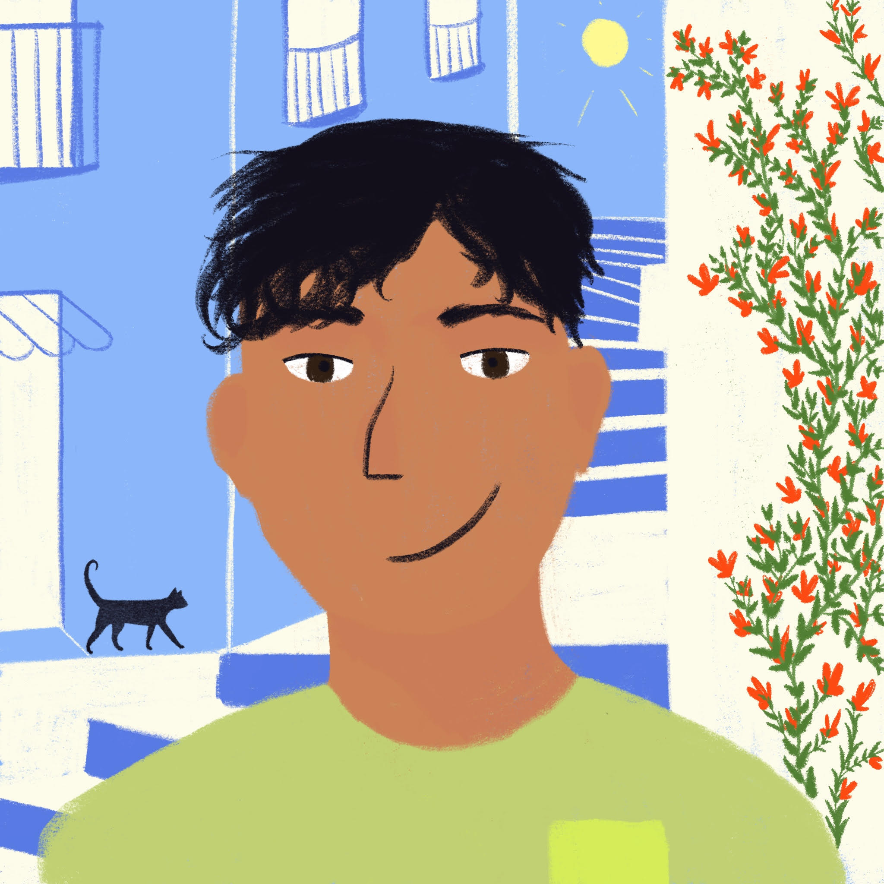
Qui va où ?
lire
Amir écrit un message. Qui va où? Amir (je) ou Abdel (tu) ?
 |  | je | tu
 |  | je | tu
1
vas à la maison.
4
vas au parc.
2
vais au tableau.
5
vas au magasin.
3
vais à la caisse.
6
vais à la poste.
Notes:
Note: For classes requiring more support, this activity may provide useful consolidation before or after the similar listening in lesson 2. Timing: 6 minutes Aim: to practise written comprehension of two parts of the verb aller. Procedure: 1. Pupils number 1-6 in books and write je or il, paying attention only to the verb form (the pronouns are hidden steer all pupils’ attention to the verb forms.) 2. Elicit responses (in full sentences to practise read aloud) and click to confirm the answers. Notes: i) The use of ‘à’ meaning ‘to’ was introduced in 1.2.3. Check students’ knowledge of the word.

