Slide 1
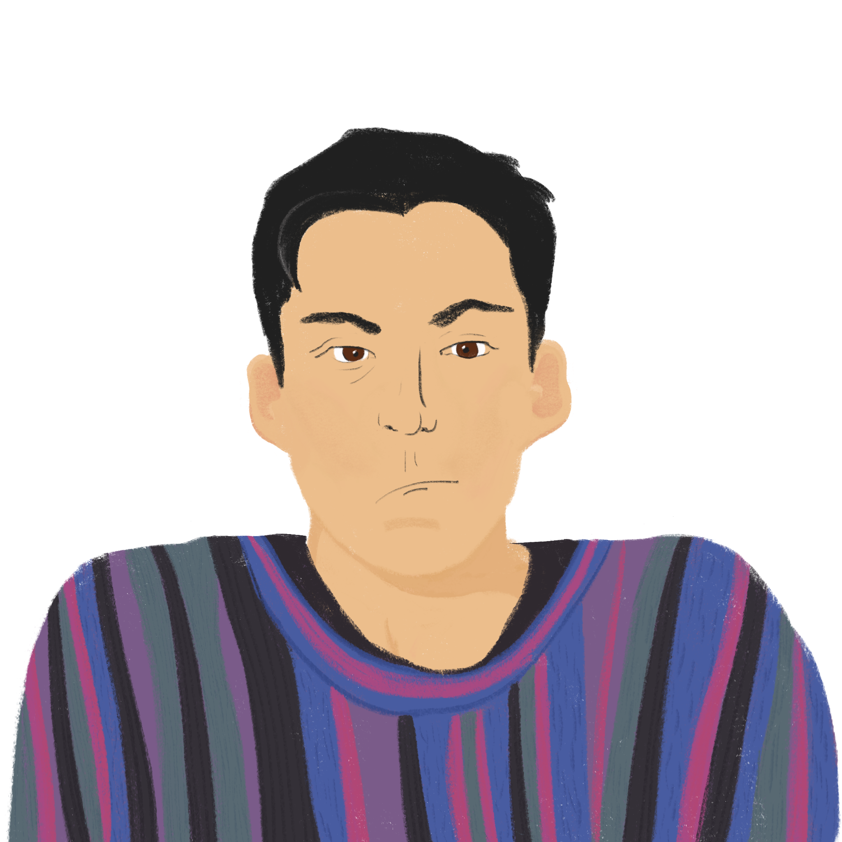
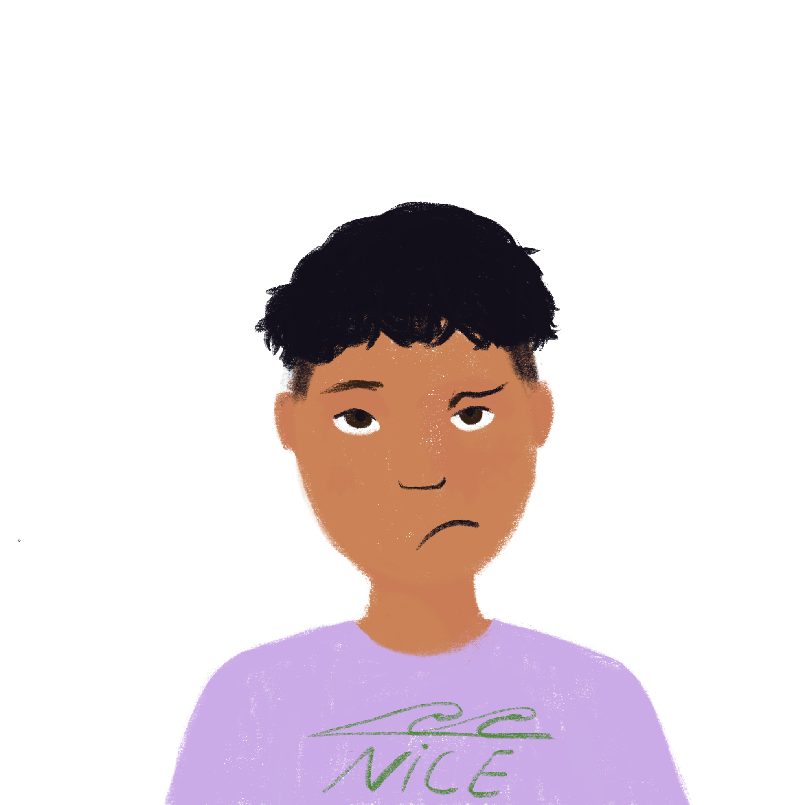
Activities in the holidays
Saying ‘you’ – singular and plural
-ER verbs (tu, vous)
SSC [i] revisited
À l’école
Y7 French
Term 1.2 - Week 7 - Lesson 27 Stephen Owen / Emma Marsden / Kirsten Somerville / Catherine Morris Artwork by: Chloé Motard
Date updated: 08.08.23
Notes:
Artwork by Chloé Motard. All additional pictures selected are available under a Creative Commons license, no attribution required.
Note: all words (new and revisited) in this week of the SOW appear on all three GCSE wordlists, with these exceptions: i) AQA list does not have chemise, phrase (the latter being a cognate that could be used in reading).
ii) Edexcel list does not have phrase (the latter being a cognate that could be used in reading).
iii) Eduqas list does not have chemise.
Learning outcomes (lesson 1):
Revisiting of the SSC [i]
Introduction of the pronoun vous meaning ‘you’ plural (in contrast with English, which has only one word for ‘you’)
Introduction of the plural vous form of regular –ER verbs
Word frequency (1 is the most frequent word in French):
7.1.2.7 (introduce) fermer [757], regarder² [425], vous¹ [50], chemise [3892], classe [778], fenêtre [1604], porte [696], salle [812], silence [1281], tableau [1456], bien [47]
7.1.2.4 (revisit) demander [80], donner [46], montrer [108], cadeau [2298], penser [116], exemple [259], raison [72], aujourd'hui [233], normalement [2018], que¹ [9], à² [4]
7.1.1.6 (revisit) acteur [1152], actrice [1152], anglais² [784], fille¹ [629], français² [251], garçon [1599], médecin [827], mot [220], personne¹ [84], phrase [2074], le [1], la [1], les [1], en¹ [7]
Source: Londsale, D., & Le Bras, Y. (2009). A Frequency Dictionary of French: Core vocabulary for learners London: Routledge.
The frequency rankings for words that occur in this PowerPoint which have been previously introduced in NCELP resources are given in the NCELP SOW and in the resources that first introduced and formally re-visited those words.
For any other words that occur incidentally in this PowerPoint, frequency rankings will be provided in the notes field wherever possible.

Slide 2
i
midi
Notes:
Timing: 1 minute
Aim: To consolidate SSC [i]
Procedure: 1. Present the letter(s) and say the [i] sound first, on its own. Students repeat it with you. 2. Bring up the word ”midi” on its own, say it, students repeat it, so that they have the opportunity to focus all of their attention on the connection between the written word and its sound.
3. A possible gesture for this would be to draw a circle representing a clock face with one hand, with the other arm and hand pointing straight up (representing the hands on 12) within the circle. 4. Roll back the animations and work through 1-3 again, but this time, dropping your voice completely to listen carefully to the students saying the [i] sound, pronouncing ”midi” and, if using, doing the gesture.
Word frequency (1 is the most frequent word in French):
midi [2483].
Source: Londsale, D., & Le Bras, Y. (2009). A Frequency Dictionary of French: Core vocabulary for learners London: Routledge.

Slide 3
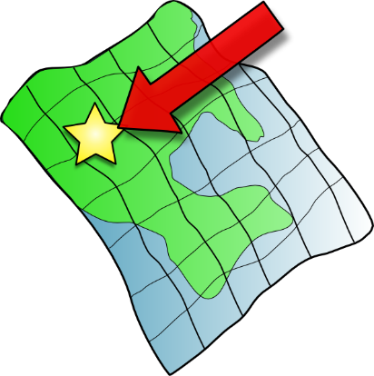
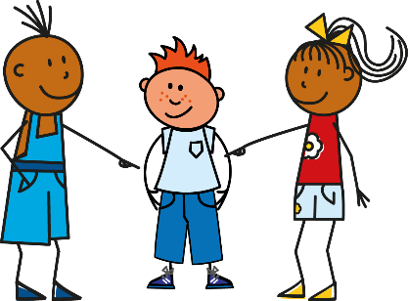
i
petit
lit
midi
ici
qui ?
il
?
Notes:
Timing: 2 minutes
Aim: To consolidate SSC [i]
Procedure:
1. Introduce and elicit the pronunciation of the individual SSC [i] and then the source word again ‘midi’ (with gesture, if using). 2. Then present and elicit the pronunciation of the five cluster words.
The cluster words have been chosen for their high-frequency, from a range of word classes, with the SSC (where possible) positioned within a variety of syllables within the words (e.g. initial, 2nd, final etc.). Additionally, we have tried to use words that build cumulatively on previously taught SSCs (see the Phonics Teaching Sequence document) and do not include new SSCs. Where new SSCs are used, they are often consonants which have a similar symbol-sound correspondence in English.
Word frequency (1 is the most frequent word in French): midi [2483]; petit [138]; lit [1837] ici [167]; il[13]; qui [14]. Source: Londsale, D., & Le Bras, Y. (2009). A Frequency Dictionary of French: Core vocabulary for learners London: Routledge.

Slide 4
[i] ou [e] ?
écouter
Translate the story into English:
 |  | [i] [e] [i] et [e]
 |  | [i] [e] [i] et [e]
Are you having a sad week?
Tu are doing an activity.
1
[i] et [e]
5
[i]
Here’s an idea:
« Goodbye, friends ! »
2
[i]
6
[i] et [e]
You look outside…
« I’m going for a walk. »
3
[e]
7
[e]
It’s nice weather at the moment!
4
[i] et [e]
8
It’s a nice story.
[i]
Notes:
Timing: 10 minutes
Aim: to listen to and translate known vocabulary in a new context; to practise recognition of SSC [i] and [e].
Procedure:
Click to listen.
Students first decide if they hear any examples of [i]or [e] or both.
Then they listen again and translate the sentence into English.
Click to bring up the English.
Notes: i) In the absence of time phrases, students may be able to justify using the present simple or continuous in English. Note the freer translation of passer as ‘have’ in this context.
ii) To provide more support, a word or two from each phrase could be provided.
Transcript:
Tu passes une semaine triste ?
Voici une idée :
Tu regardes dehors…
Il fait beau en ce moment !
Tu fais une activité.
« Au revoir, les amis ! »
« Je fais une promenade. »
C’est une histoire sympathique.

Slide 5
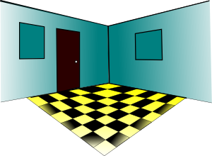
Vocabulaire
lire / parler
la classe
le tableau
la fenêtre
la salle
window
door
you (plural)
to close, closing
good, well
board
silence
shirt
room
to watch, to look at
class
la chemise
le silence
la porte
fermer
regarder
bien
vous
Notes:
Timing: 3 minutes
Aim: to present and practise the words from this week’s new vocab set.
Procedure:
Click to bring up the word in English and elicit the recognition of the equivalent French meaning and read aloud of the word from the class.
Continue with items 2-11.

Slide 6
Vocabulaire
parler
le tableau
board
la classe
class
la porte
door
determiner
+ noun
la salle
room
la chemise
shirt
le silence
silence
la fenêtre
window
fermer
to close, closing
verb
regarder
to watch, to look at
adverb
bien
good, well
pronoun
vous
you (plural)
Notes:
Timing: 3 minutes
Aim: to practise meaning recall (French to English) of the words from this week’s vocabulary set.
Procedure:
Click to bring up the word in French.
With pace, and students have just seen these words, elicit the English meaning from the whole class.
Click to bring up the English translation.
Once all the words are displayed on the screen, with French and English, check the students know what type (part of speech) these words are (this will be useful later and is revision). This is illustrated by the animations.

Slide 7
Talking to others: tu and vous
grammaire
To say ‘you (plural)’ + regular -ER verb in French, the verb is the short form and ends in -ez.
For example:
‘You’ to one person → ‘You’ to more than one person
jouer
tu joues → vous jouez
manger
tu manges → vous mangez
Notes:
Timing: 2 minutes
Aim: to introduce second person singular and second person plural forms of regular –ER verbs in the present tense.
Procedure:
Click to bring up the explanation.
Model the pronunciation of the –ez ending carefully before moving on.

Slide 8
À l’école
It’s nearly the end of term. Amir and his friends are hoping for fun lessons but their teacher has other ideas!
écouter
Is the teacher talking just to Amir (tu) or to Amir and his classmates (vous) ?
Écris tu ou vous.
When you hear ‘-ez' you know it is 'plural you’.
you (all) tu
you (all) vous
you (all) tu
you (all) vous
1
4
2
5
3
6
Notes:
Timing: 8 minutes
Aim: to practise recognising second person singular and plural forms of –ER verbs when listening. The lesson buzzer (beep) in the audio recording stops students hearing the pronoun, so students’ only clue is the verb ending -e/-ez.
Procedure:
Click on the number trigger to play the audio.
Students listen to the verb and decide if the teacher is talking to several pupils (‘vous’) or just one (‘tu’).
3. Click to elicit and confirm the answers.
Transcript:
[…] regardez le problème.
[…] restes en silence.
[…] trouves la solution ?
[…] cochez la réponse.
[…] manges en classe.
[…] parlez en anglais.

Slide 9
Dans la salle de classe de Léa
lire
Léa’s teacher is looking forward to the holidays!
She is happy to ask questions about their holidays activities.
La professeure parle à Léa (tu) ou à la classe (vous) ?
 | you (tu) | you all (vous)
1
2
3
4
5
6
... mangez quoi à Noël ?
... célébrez Noël ? ... écoutes la radio ?
... regardes les films ?
... aimez chanter ? ... demandes quoi comme cadeau ?
Noël - Christmas
Notes:
Note: if teachers require another activity to finish this lesson, they could use the vocabulary crossword from the start of next lesson. Timing: 7 minutes
Aim: to practise recognising second person singular and plural forms of –ER verbs when reading.
Procedure:
Students read each sentence and decide who is being asked a question: ‘tu – you singular’ or ‘vous – you plural’.
Click to bring up the answers 1-6.
Teachers may want to elicit translations of each question in English before moving on.
Frequency of unknown words and cognates: célébrer [2170]
Source: Londsale, D., & Le Bras, Y. (2009). A Frequency Dictionary of French: Core vocabulary for learners London: Routledge.
Note: célébrer and Noël are on both the AQA and Eduqas GCSE lists.

Slide 10
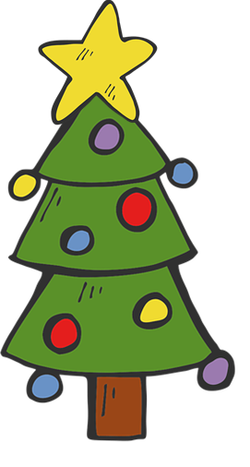
Activities in the holidays
Saying ‘you’ – singular and plural
-ER verbs (vous)
À la maison
Y7 French
Term 1.2 - Week 7 - Lesson 28 Stephen Owen / Emma Marsden / Kirsten Somerville / Catherine Morris Artwork by: Chloé Motard
Artwork by: Chloé Motard
Date updated: 08.08.23
Notes:
Artwork by Chloé Motard. All additional pictures selected are available under a Creative Commons license, no attribution required.
Learning outcomes (lesson 2):
Consolidation of the pronoun vous, meaning ‘you’ plural (in contrast with English, which has only one word for ‘you’)
Consolidation of the plural vous form of regular –ER verbs
Word frequency (1 is the most frequent word in French):
7.1.2.7 (introduce) fermer [757], regarder² [425], vous¹ [50], chemise [3892], classe [778], fenêtre [1604], porte [696], salle [812], silence [1281], tableau [1456], bien [47]
7.1.2.4 (revisit) demander [80], donner [46], montrer [108], cadeau [2298], penser [116], exemple [259], raison [72], aujourd'hui [233], normalement [2018], que¹ [9], à² [4]
7.1.1.6 (revisit) acteur [1152], actrice [1152], anglais² [784], fille¹ [629], français² [251], garçon [1599], médecin [827], mot [220], personne¹ [84], phrase [2074], le [1], la [1], les [1], en¹ [7]
Source: Londsale, D., & Le Bras, Y. (2009). A Frequency Dictionary of French: Core vocabulary for learners London: Routledge.
The frequency rankings for words that occur in this PowerPoint which have been previously introduced in NCELP resources are given in the NCELP SOW and in the resources that first introduced and formally re-visited those words.
For any other words that occur incidentally in this PowerPoint, frequency rankings will be provided in the notes field wherever possible.

Slide 11
Vocabulaire
écrire
1 | C’est habituel.
2 | avoir une opinion
3 | la justification
4 | Je trouve ___ c’est bien !
5 | Il fait un film.
6 | Elle fait un film.
7 | un être humain
8 | Le dictionnaire a ça.
9 | Tu es malade ? Écoute le…
10 | la date présente
11 | femme/fille, homme/______
12 | Un paragraphe a ça.
 | N | O | R | M | A | L | E | M | E | N | T
 |  |  |  |  | P | E | N | S | E | R
 |  |  | R | A | I | S | O | N
 |  |  |  |  |  | Q | U | E
 |  | A | C | T | E | U | R
A | C | T | R | I | C | E
 |  |  | P | E | R | S | O | N | N | E
 |  |  |  | M | O | T
 | M | É | D | E | C | I | N
 |  |  | A | U | J | O | U | R | D’ | H | U | I
 | G | A | R | Ç | O | N
 |  | P | H | R | A | S | E
Notes:
Timing: 10 minutes
Aim: to revise the meaning and spelling of some of this week’s revisited vocabulary
Procedure:
Students write 1-12 and try to spell out the words that match the clue in French.
Click to reveal the missing letters (covered by white boxes, which disappear one by one on successive clicks).
The letters in the orange box spell out ‘les questions’, which sets up for the question-based speaking activities that follow.
Word frequency of near-cognates used: (1 is the most frequent word in French):
habituel [1347], opinion [777], justification [3846], humain [286], dictionnaire [4094], date [660], present [216], paragraphe [2126]
Source: Londsale, D., & Le Bras, Y. (2009). A Frequency Dictionary of French: Core vocabulary for learners London: Routledge.

Slide 12
chanter
[to sing | singing]
chante
[sings | is singing]
Notes:
Timing: 3 minutes for sequence of six verbs
Aim: to revisit a prototypical verb from last week’s list.
Procedure
Bring up the word [chanter] on its own, say it, students repeat it, and remind them of the phonics.
Elicit the meaning from the students. Students have had explicit teaching that the present tense in French communicates two different present tense meanings in English. This reinforces that learning. Emphasise the two meanings for the short form, reminding students that French only has one form and does not have a direct equivalent of the grammar for ‘is + ing’, the continuous form (as covered in previous weeks).
Bring up the picture using gestures if desired.
Then bring up the English translations. Emphasise the two meanings for the infinitive.
Bring up the short form [chante], say it, students repeat it.
Try to elicit the meaning from the students. Emphasise the two meanings for the short form.

Slide 13
chanter
[to sing | singing]
chante
[sings | is singing]
Notes:
Cycle through the long and short form again.

Slide 14
chante
[sings | is singing]
Elle chante à la radio.
[She sings | is singing on the radio.]
Notes:
Introduce the short form in a sentence.

Slide 15
chanter
[to sing | singing]
Elle aime chanter à la radio.
[She likes singing on the radio.]
Notes:
Introduce the long form in a sentence.

Slide 16
chante
[sings | is singing]
Elle chante à la radio.
[She sings | is singing on the radio.]
Notes:
Cycle through the short form in context again.

Slide 17
chanter
[to sing | singing]
Elle aime chanter à la radio.
[She likes singing on the radio.]
Notes:
Cycle through the long form in context again.

Slide 18
Talking to others: tu and vous
grammaire
To say ‘you (plural)’ + regular -ER verb in French, the verb is the short form and ends in -ez.
For example:
‘You’ to one person → ‘You’ to more than one person
jouer
tu joues → vous jouez
manger
tu manges → vous mangez
The following speaking and writing activities will allow you to practise these verb forms!
Notes:
Timing: 1 minute
Aim: to recap second person singular and second person plural forms of regular –ER verbs in the present tense ahead of the production activities.
Procedure:
Click to bring up the explanation.
Draw attention to the pronunciation of the –ez ending once again.

Slide 19
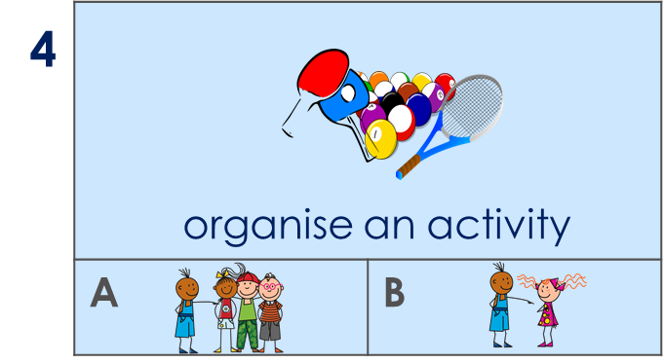
C’est qui ? L’activité c’est quoi ?
Ask your partner about what they usually do in the winter holidays. Ask either ‘do you’? or ‘do you (all)?
Chut !
Partner A
Partner B
(organise an activity)
_____________________
Chut
Vous organisez une activité ?
 4A
______________
organiser – to organise
Notes:
Timing: 10 minutes (3 slides) Note: the timing equates to 5 minutes per round.
Aim: to practise producing and understanding verbs in 2nd persons singular and plural with a range of vocabulary.
Procedure:
1. Use this slide to model the activity. It’s called ‘chut’. ‘chut’ (=shhhhh!) – don’t give away the pronoun.
The activity is this: students must listen carefully to the verb and tick under the correct picture whether ‘tu’ or ‘vous’ is needed to complete their partner’s sentence.
2. First, students A and B try to write 6 sentences using the English/picture prompts but NOT IN ORDER. They write them in any order. Each must choose whether to write an ‘you’ or ‘you (all)’ sentence.
3. When both students have completed their sentences, partner A says one sentence (6 in total) at a time to their partner without using the subject pronoun.
Partner Bs must listen carefully to the verb and write the number of the image and A or B depending on the ‘you’ or ‘you (all)’ form they hear in French. Note: the fact that they have practised writing 6 sentences this time around, too, means they should understand more readily what Partner A says.
Example:
Partner A writes: Vous préparez une activité.
Partner A says to B: chut préparez une activité.
Partner B finds the correct pair of images and writes the number of the image and A or B depending on the ‘you’ or ‘you (all)’ form they hear in French.
Once they have said all 6 sentences to their partner, students then recreate, in speaking, the sentences that their partners must have written. They use the pictures and their note of the number + A/B for each one. As they speak, the partner who wrote the sentences confirms if they are correct – the sentence read out loud should be exactly the same as the sentence they themselves had written earlier.
Then they swap roles and do the same again for the next slide.

Slide 20
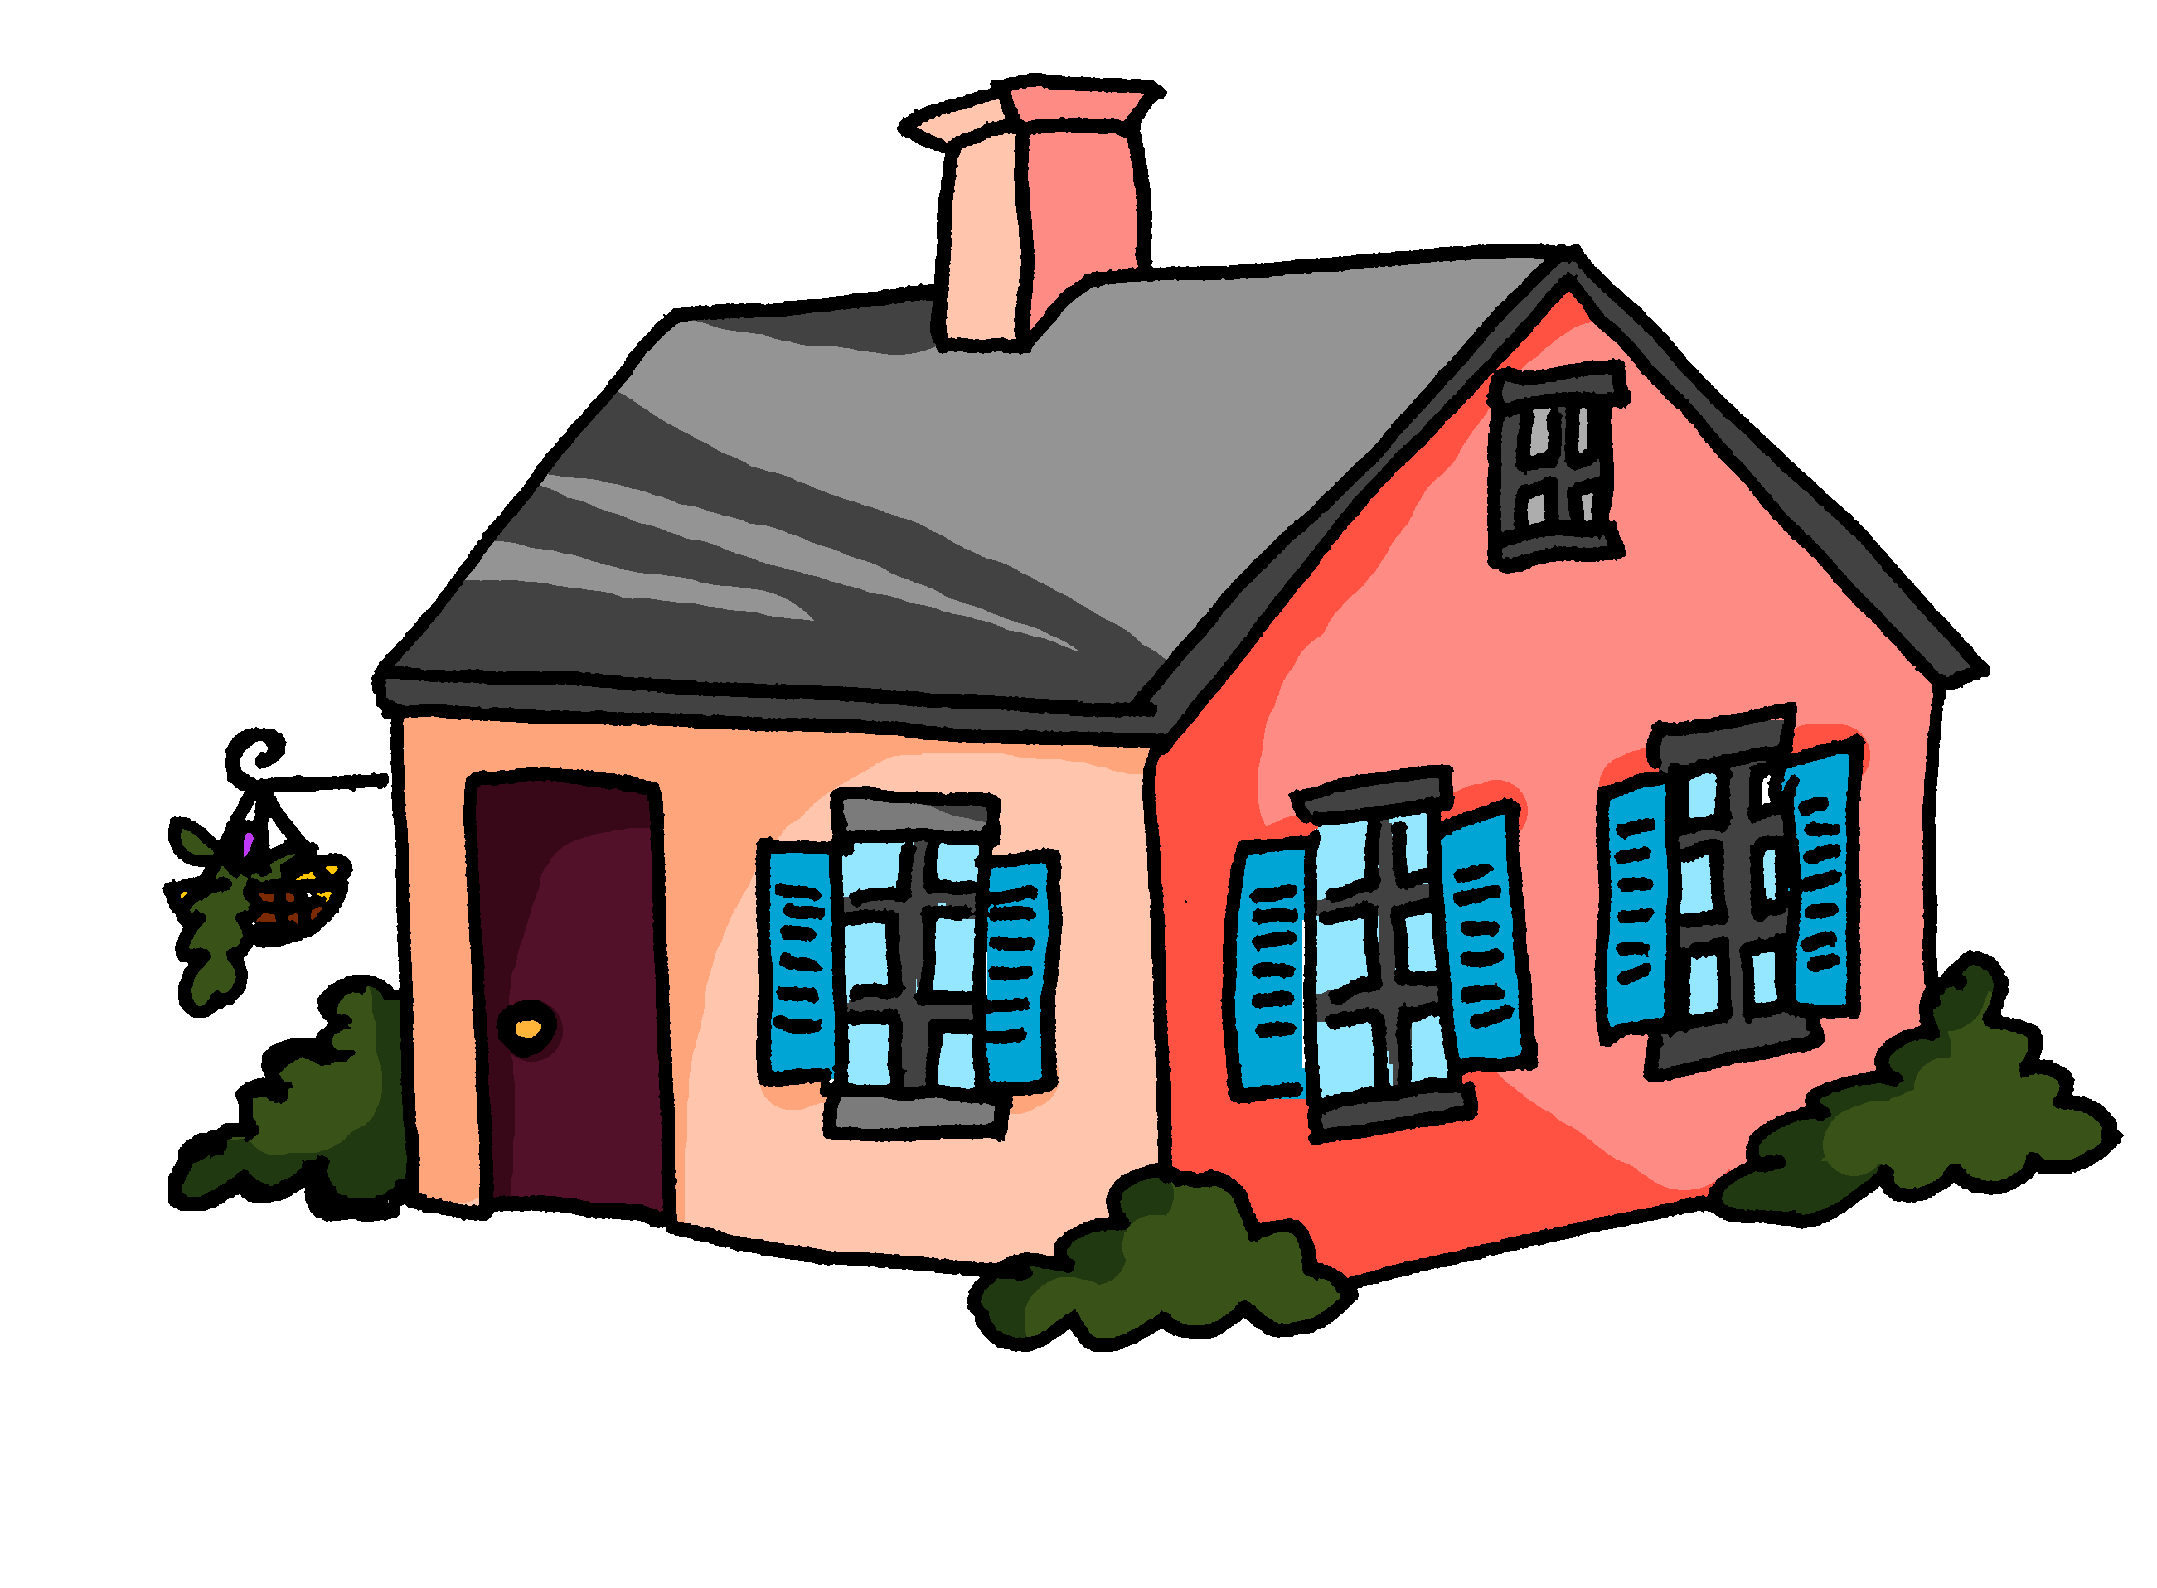
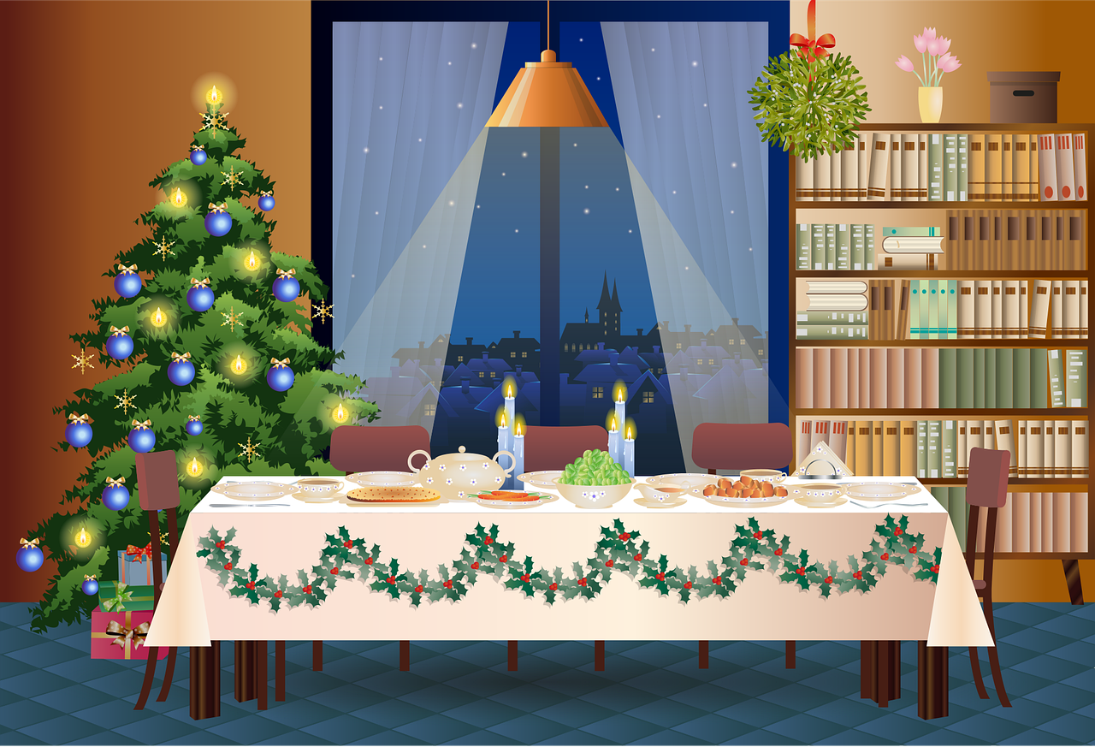
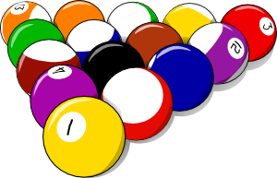
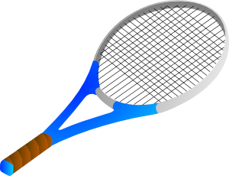
C’est qui ? L’activité c’est quoi ? [1/2]
écrire / parler
A | B
A | B
A | B
1
2
3
give a present to […]
watch a film
study at home
4
A | B
5
A | B
6
A | B
organise an activity
sing
prepare the lunch
Notes:
Display this slide for Round 1
Frequency of unknown words and cognates: organiser [701]
Source: Londsale, D., & Le Bras, Y. (2009). A Frequency Dictionary of French: Core vocabulary for learners London: Routledge.
Note: Organiser is on all three GCSE lists.

Slide 21
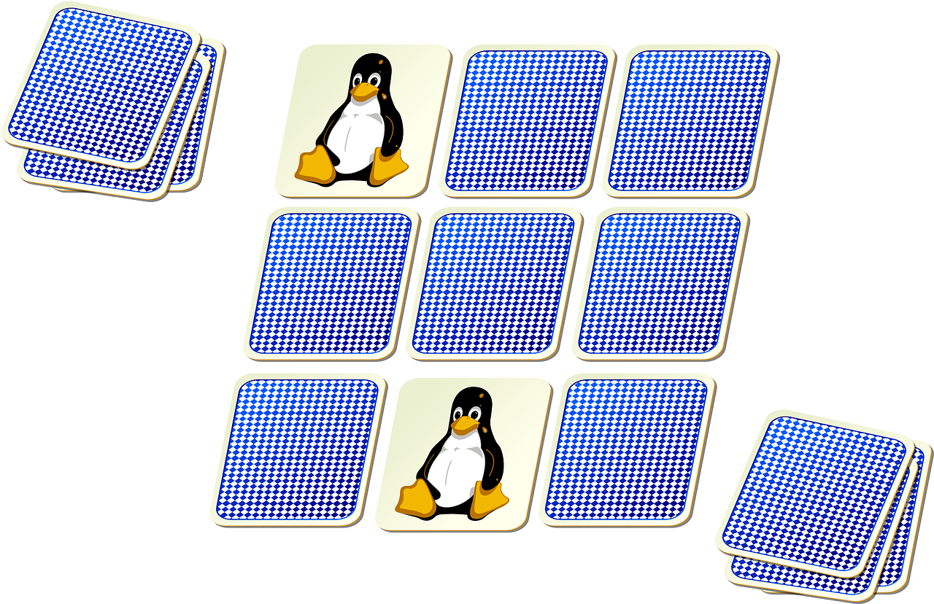
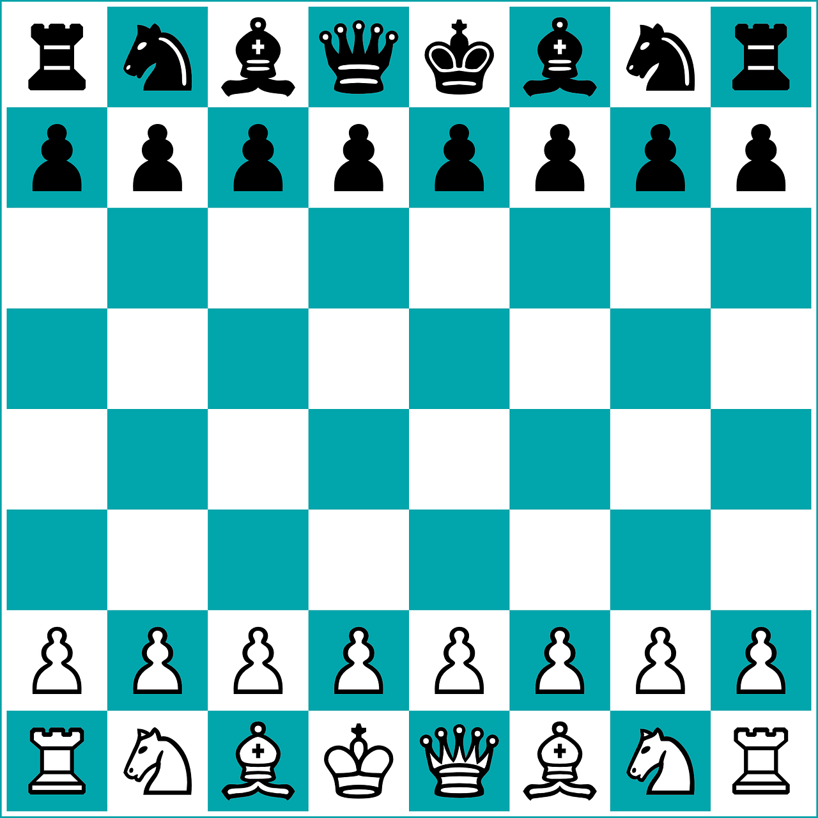
C’est qui ? L’activité c’est quoi ? [1/2]
écrire / parler
A | B
A | B
A | B
1
2
3
walk outside
listen to the radio
find a present for […]?
4
A | B
5
A | B
6
A | B
ask for a phone as a present
play a game
organise a party
un jeu – a game | une fête – a party
Notes:
Display this slide for Round 2
Frequency of unknown words and cognates: fête [1490] jeu [291]
Source: Londsale, D., & Le Bras, Y. (2009). A Frequency Dictionary of French: Core vocabulary for learners London: Routledge.
Note: fête and jeu have already been introduced as phonics words and they are on all three GCSE lists.

Slide 22
Answering others: je and nous
écrire
Oui, je regarde un film.
__
__
Tu regardes la télé ?
Non, j’ écoute la radio.
__
__
Oui, nous jouons à la maison.
____
_____
Vous jouez à la maison ?
Non, nous jouons dehors.
____
_____
Notes:
Timing: 2 minutes
Aim: to recap first person singular and first person plural forms of regular –ER verbs, ahead of the final written production activity.
Procedure:
1. Click to bring up the first question (in second person singular).
2. Click to bring up the first model answer. Elicit responses from students (subject of the verb with correct ending).
3. Click to reveal the answers.
4. Click to bring up a second model answer, again eliciting responses from students to highlight correct subject and verb form. This examples models a negative response to the question, without the need to use ne…pas, which students are yet to learn.
5. Repeat as above to model questions and answers using ‘vous’ and ‘nous’.

Slide 23
Tu fais quoi, normalement ?
You can choose what other vocabulary to use!
écrire
Write an answer to each question about what you do during the Christmas holidays.
 | Question | Réponse
1 | Vous jouez un jeu à la maison ?
2 | Tu prépares le déjeuner ?
3 | Vous chantez ?
4 | Vous organisez une fête dehors ?
5 | Tu restes à la maison ?
6 | Tu regardes un film ?
un jeu – a game | une fête – a party
Notes:
OPTIONAL Timing: 15 minutes
Aim: to practise choosing the correct verb form in response to questions asked in second person singular and second person plural, thereby combining learning from 7.1.2.5 (‘je’/’nous’ forms of –ER verbs in the present tense).
Procedure:
Students write an answer to each question.
Students’ creativity can be encouraged here by advising them to review previously learnt vocabulary from across the series of lessons with –ER verbs and, if appropriate, to consult a dictionary to search for any new vocabulary items needed.
Frequency of unknown words and cognates: fête [1490] jeu [291] organiser [701]
Source: Londsale, D., & Le Bras, Y. (2009). A Frequency Dictionary of French: Core vocabulary for learners London: Routledge.
Note: fête and jeu have already been introduced as phonics words and with organiser, they are on all three GCSE lists.

Slide 24
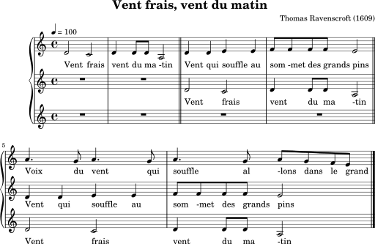
Une chanson
Vent frais, vent du matin
chanter
People think the words for this song were written around 1965. It is sung as a round.
You may have heard this tune. It was written in 1609 by Thomas Ravenscroft and is also sung with the words: ‘Hey ho, noboby at home…’
Look at the words. Which word means ‘wind’ do you think?
Vent frais, vent du matin Vent qui souffle… aux sommets des grands pins Joie du vent qui souffle Allons dans le grand Vent frais, vent du matin
Cool wind, morning wind Wind that blows...
on the tops of the tall pines
Joy of the blowing wind
Let's go into the big
Cool wind, morning wind…
Notes:
OPTIONAL Teachers usually have their own favourite French songs for the end of the Autumn Term but this is a short song that is simple to pick up, and enjoyable to sing, as it is a round. It contains many of the SSC we have focused on this term: SFC, [en/an], [ai], [in], [qu], [ou]. Timing: flexible
Aim: to enjoy a traditional French song.
Procedure: 1. Click to bring up the information about the song.
2. Click to prompt pupils to tell you which word is ‘wind’ in French.
3. Ask pupils to tell you any words that end in a SFC (Silent Final Consonant), any words with an ‘en/an’ sound and with an ‘in’ sound.
4. Click to listen to the short music file and/or visit the YouTube page. Pupils can join in with the words several times. It is a very short song and they will soon be able to sing along.
5. Teachers may then like to divide the class into two or three and try to sing it as a round.
Song lyrics: Vent frais, vent du matin Vent qui souffle aux sommets des grands pins Joie du vent qui souffle Allons dans le grand Vent frais, vent du matin
Information about Vent frais, vent du matin: https://fr.wikipedia.org/wiki/Vent_frais,_vent_du_matin
Sheet music image: Cdang, CC0, via Wikimedia Commons
Video of the song: https://youtu.be/x7Vj8zUmN1I
More information about the choir Les Petits Chanteurs: https://fr.wikipedia.org/wiki/Petits_Chanteurs_d%27Asni%C3%A8res
Midi music file: https://commons.wikimedia.org/wiki/File:Vent_frais_vent_du_matin.midi?uselang=fr

Slide 25
Devoirs
Vocabulary Learning Homework (Term 2.1, Week 1)
Audio file
Student worksheet
In addition, revisit: Term 1.2 Week 5 Term 1.1 Week 7
Notes:
Use this slide to set the homework.
For Y7, the typical homework will be to pre-learn vocabulary for the next lesson. There is an audio file to accompany the student worksheet.
Notes:
i) Teachers may, in addition, want to recommend use of a particular online app for the pre-learning of each week’s words. ii) Quizlet now requires parental involvement / registration / permissions for users below the age of 13, so it is perhaps most suitable for Y9 – 11 students. iii) Language Nut hosts LDP vocabulary lists and these are free for schools to use, though there is a registration process. One benefit is that all of the student tracking data that Language Nut offers are also available to schools that use the LDP lists for practice. Perhaps this makes it a good option for Y7/8.
iv) There are other free apps, and new ones are always appearing. Teachers have told us that they are currently using: Flippity, Wordwall (where using previously-created activities is free).
v) Gaming Grammar has been acquired by Language Nut. Its original content should still be available to teachers and much of it is appropriate for Y7 learners. From this lesson, for example, learners could practise:
Verbs (present): 1st person singular/plural (Verb agreement (present))
Verbs (present): 2nd person singular/plural (Verb agreement (present))
Verbs (present): 3rd person singular/plural (Verb agreement (present))

