Slide 1
Activities in and out of school Saying what others do
-ER verbs (il/elle, ils/elles)
SSC [a] revisited
Activités
Y7 French
Term 1.2 - Week 6 - Lesson 25 Victoria Hobson / Emma Marsden / Rachel Hawkes
Artwork by: Chloé Motard
Date updated: 08.08.23
Notes:
Artwork by Chloé Motard. All additional pictures selected are available under a Creative Commons license, no attribution required.
Note: all words (new and revisited) in this week of the SOW appear on all three GCSE wordlists, with these exceptions: i) No list has cocher.
ii) Edexcel list does not have radio (though radio may be used as a cognate in the reading).
Learning outcomes (lesson 1):
Consolidation of SSC [a]
Introduction of (third person plural forms of –ER verbs]
Consolidation of [third person singular and first person plural forms of –ER verbs]
Word frequency (1 is the most frequent word in French):
7.1.2.6 (introduce) chanter [1820], étudier [960], jouer [219], ils [13], elles [38], élève [1068], fruit [896], histoire¹ [263], radio [1526], ensemble [124]
7.1.2.3 (revisit) aimer [242], cocher [>5000], passer¹ [90], porter¹ [105], rester [100], trouver [83], école [477], moment [148], semaine [245], solution [608], uniforme [1801], chaque [151], à1 [4], avec [23]
7.1.1.5 (revisit) il² [13], elle² [38], ami [467], amie [467], chanteur [3251], chanteuse [3251], femme [154], homme [136], professeur [1150], professeure [1150], drôle [2166], intéressant [1244], faux [555], sympa(thique) [4164], vrai [292]
Source: Londsale, D., & Le Bras, Y. (2009). A Frequency Dictionary of French: Core vocabulary for learners London: Routledge.
The frequency rankings for words that occur in this PowerPoint which have been previously introduced in NCELP resources are given in the NCELP SOW and in the resources that first introduced and formally re-visited those words.
For any other words that occur incidentally in this PowerPoint, frequency rankings will be provided in the notes field wherever possible.

Slide 2
a
animal
Notes:
Timing: 1 minute
Aim: To consolidate SSC [a]
Procedure: 1. Present the letter(s) and say the [a] sound first, on its own. Students repeat it with you. 2. Bring up the word ”animal” on its own, say it, students repeat it, so that they have the opportunity to focus all of their attention on the connection between the written word and its sound.
3. A possible gesture for this would be to mimic an animal’s motion, perhaps holding ones arms and hands close to the chest as ‘paws’. 4. Roll back the animations and work through 1-3 again, but this time, dropping your voice completely to listen carefully to the students saying the [a] sound, pronouncing ”animal” and, if using, doing the gesture.
Word frequency (1 is the most frequent word in French):
animal [1002]
Source: Londsale, D., & Le Bras, Y. (2009). A Frequency Dictionary of French: Core vocabulary for learners London: Routledge.

Slide 3
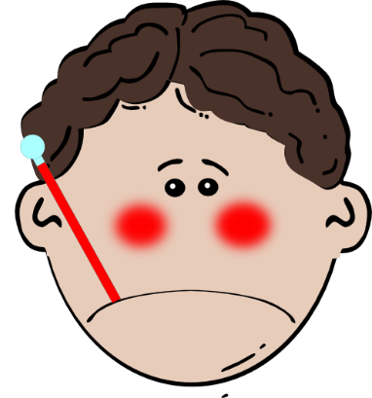
a
ça va ?
table
animal
malade
sac
mal
[badly]
Notes:
Timing: 2 minutes
Aim: To consolidate SSC [a]
Procedure:
1. Introduce and elicit the pronunciation of the individual SSC [a] and then the source word again ‘animal’ (with gesture, if using). 2. Then present and elicit the pronunciation of the five cluster words.
The cluster words have been chosen for their high-frequency, from a range of word classes, with the SSC (where possible) positioned within a variety of syllables within the words (e.g. initial, 2nd, final etc.). Additionally, we have tried to use words that build cumulatively on previously taught SSCs (see the Phonics Teaching Sequence document) and do not include new SSCs. Where new SSCs are used, they are often consonants which have a similar symbol-sound correspondence in English.
Word frequency (1 is the most frequent word in French): animal [1002]; ça va? [54 (cela), 53 (aller)]; malade [1066] mal [277]; table [1019]; sac [2343] Source: Londsale, D., & Le Bras, Y. (2009). A Frequency Dictionary of French: Core vocabulary for learners London: Routledge.

Slide 4
Phonétique
écouter / écrire / parler
1
You have a pet.
Tu as un animal.
2
She has a present.
Elle a un cadeau.
3
He has a sick animal.
Il a un animal malade.
4
You have a nice friend (m).
Tu as un ami sympa.
5
The actor has a calm class.
L’acteur a une classe calme.
Notes:
Timing: 10 minutes
Aim: to further practise applying knowledge of the target SSC [a] at sentence level; to practise sentence level transcription with previously taught words, and with the support of the English sentence.
Note: there are several ways to use this slide, set out below. The procedure sets out how we are using it in it current format.
Procedure:
1. Tell students they need to listen and write in French, but that the English meaning of the sentence will be provided after the 1st time of listening, so they can consider any additional details, for example, silent final consonant ‘s’ on ‘tu as’. 2. Click to model this with number 1. Play audio first time. Giving time for writing. Click to reveal the English meaning and to listen again. Finally, click to provide feedback.
3. Repeat this process with items 2-5.
Transcript:
1. Tu as un animal.
2. Elle a un cadeau.
3. Il a un animal malade.
4. Tu as un ami sympa.
5. L’acteur a une classe calme.
Other transcription
Click the number trigger to play the audio.
Students transcribe what is heard.
Click to reveal the French sentence in full.
Read aloud sentences
Click to bring up the French.
Students read out the sentence either as choral class work or pairs reading to each other.
Click the number trigger to play the audio to reinforce correct pronunciation.
Bi-modal input
The teacher reads out the sentence, pausing at the end of one of the words, just before one begins.
Students read the sentence as they are listening and say aloud the next word after the teacher’s pause.
The teacher can then choose to play the recording in full.
This helps students to link the sound to the written form and helps them “segment” the input into words. When listening gets faster, students need to be really good at this – chopping up the input into words from one continuous stream.
Teachers may wish to elicit translations in English before moving on.

Slide 5
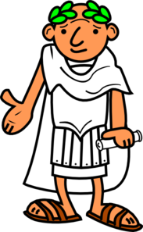
Vocabulaire
lire / parler
chanter
?
[to sing, singing]
?
l’histoire
?
jouer
la radio
étudier
?
?
?
un élève
[to study, studying]
[to play, playing]
[student]
ils
?
elles
?
le fruit
?
[they
(mpl)]
ensemble
?
[they
(fpl)]
[together]
Notes:
Timing: 5 minutes
Aim: to practise the words from this week’s new vocabulary set.
Procedure 1. Students either work by themselves or in pairs, reading out the words and recapping their English meaning (1 minute). 2. The teacher then removes the English words/pictures (one by one) and students try to recall the English orally (chorally), looking at the French (1 minute). 3. Then the French meanings are removed (one by one) and they to recall them orally (again, chorally), looking at the English/image (1 minute). Draw students’ attention to the SFC of ils and elles and reinforce pronunciation of the words if necessary. 4. Further rounds of learning can be facilitated by one student turning away from the board, and his/her partner asking him/her the meanings (‘X, c’est quoi en français ?’). This activity can work from L2 → L1 or L1 → L2.

Slide 6
étudier
[to study | studying]
étudie
[studies | is studying]
Notes:
Timing: 3 minutes for sequence of six verbs
Aim:
To introduce the verb [étudier] more explicitly. [étudier] is one of the NCELP 15 prototypical verbs in French. Prototypical verbs are common verbs that illustrate the typical characteristics of a class of verb – the French prototypical verbs contain examples of regular/weak verbs, but also common examples of changes to the stem. All 15 prototypical verbs will be introduced early on using the same format. Both long form (infinitive) and short form (3rd person singular) are introduced in order to familiarise students with various forms of the same verb.
Procedure
Bring up the word [étudier] on its own, say it, students repeat it, and remind them of the phonics.
Try to elicit the meaning from the students. Students have had explicit teaching that the present tense in French communicates two different present tense meanings in English. This reinforces that learning. Emphasise the two meanings for the short form, reminding students that French only has one form and does not have a direct equivalent of the grammar for ‘is + ing’, the continuous form (as covered in previous weeks).
Bring up the picture using gestures if desired.
Then bring up the English translations. Emphasise the two meanings for the infinitive.
Bring up the short form [étudie], say it, students repeat it.
Try to elicit the meaning from the students. Emphasise the two meanings for the short form.

Slide 7
étudier
[to study | studying]
étudie
[studies | is studying]
Notes:
Cycle through the long and short form again.

Slide 8
étudie
[studies | is studying]
Il étudie le français.
[He studies | is studying French.]
Notes:
Introduce the short form in a sentence.

Slide 9
étudier
[to study | studying]
Il aime étudier le français.
[He likes studying French.]
Notes:
Introduce the long form in a sentence.

Slide 10
étudie
[studies | is studying]
Il étudie le français.
[He studies | is studying French.]
Notes:
Cycle through the short form in context again.

Slide 11
étudier
[to study | studying]
Elle aime étudier le français.
[He likes studying French.]
Notes:
Cycle through the long form in context again.

Slide 12
Regular –ER verbs
grammaire
To say ‘s/he’ + verb in French, the verb is in the short form, often ending in -e.
Il joue.
He plays.
NB! These endings are all silent – they all sound the same!
Elle joue.
She plays.
NB! These endings are all silent – so all these words sound the same!
To say ‘they’ + verb, the verb ends with -ent.
For either a group of boys or a mixed group.
Ils jouent.
They play.
For a group of girls only.
Elles jouent.
They play.
Stephen Owen
Notes:
Timing: 2 minutes
Aim: to introduce third person plural of –er verbs
Procedure:
1. Click to bring up the explanation
2. Model the sound of ‘joue’ and ‘jouent’.
3. Say ‘il joue’ and ‘ils jouent’, then ask the students if they can tell whether you are talking about one person or more than one. The answer is ‘no’!

Slide 13
C’est qui ?
lire
You are reading about a band. Some members (they) talk about themselves and the singer (he). Some words are missing. |  | ils (they) | il (he)
1 | ….joue de la guitare.
2 | ….chantent.
3 | ….écoutent la radio.
4 | ….parle anglais.
5 | ….étudient l’histoire et l’anglais.
6 | …..regardent les films.
7 | ….aime les voyages.
NB! These verb endings all sound the same!
Notes:
Timing: 8 minutes
Aim: to practise understanding third person singular and third person plural endings of –er verbs when reading.
Procedure:
1. Students read the sentence in French and, using the verb ending, tick whether ‘he’ is the subject of the verb or if it is ‘they’.
2. Click to bring up the answers.
3. Click to bring up the pronunciation callout.
4. Elicit pronunciation of the sentences, chorally, with pronouns, il joue de la guitare, ils chantent etc.. to demonstrate this.
5. Teachers could elicit translations into English of the sentences in desired before moving on.
Word frequency of cognate used (1 is the most frequent word in French): guitare [>5000]
Source: Londsale, D., & Le Bras, Y. (2009). A Frequency Dictionary of French: Core vocabulary for learners London: Routledge.

Slide 14
L’activité, c’est quoi ?
parler
mangent
chantent
ils
elles
jouent
Notes:
Timing: 2 minutes
Aim: to reinforce the specific pronunciation of third person plural, along with the subject pronouns ils and elles.
Procedure:
Click to bring up the verb form, model its pronunciation and elicit the pronunciation from students.
Elicit choral responses from students of the third person plural from by clicking to disappear the five verbs at random.
Repeat but this time have students practise with ‘ils’ + verb
Repeat to practise with ‘elles’ + verb.
Note: the liaison between the ‘s’ on the end of ’ils/elles’ and the initial vowel of the next word is not addressed here. Therefore, in this activity and in this week we avoid plural verbs that begin with vowels (e.g., ils écoutent, elles étudient) as liaison is obligatory, here.

Slide 15
C’est qui ?
écouter / écrire
il ou ils ?
elle ou elles ?
Écoute, regarde et écris en français.
Exemple
ils regardent
Notes:
Timing: 7 minutes for the next six slides
Aim: This is an example of a bimodal task which connects the spoken form with the written form simultaneously, as in this case listening alone does not indicate singular or plural. It is useful to practise bimodal tasks in this case because students practise the idea that you can only tell which verb ending to use in writing when you know whether the person is singular or plural – so, here the students get a visual cue (the picture) and this tells them what the written verb ending would be (the oral verb ending doesn’t help!). This teaches students about ‘ambiguity’ in language, and how sentences fit together. In this case, to know ‘who did the verb’ for 3rd person verbs (il and ils), you usually need other prompts to know whether singular or plural is being referred to.
Procedure:
1. Use this slide to model the task instructions.
2. Click to bring up the image and again for the audio. Students will hear a verb (e.g., ils regardent). At the same time a circle will appear around the picture to indicate whether it is 3rd person singular or 3rd person plural.
3. Once they have heard the audio and seen whether it is singular or plural, students write the correct form.
4. Click to reveal the correct written form.
Transcript:
ils regardent
Note: Teachers need to mouse click on the ‘Exemple’ box, which triggers the audio to play the word ‘exemple’
If this step is missed, the first verb may not play in full.

Slide 16
écouter / écrire
C’est qui ?
écouter / écrire
ils chantent
Notes:
Transcript:
ils chantent

Slide 17
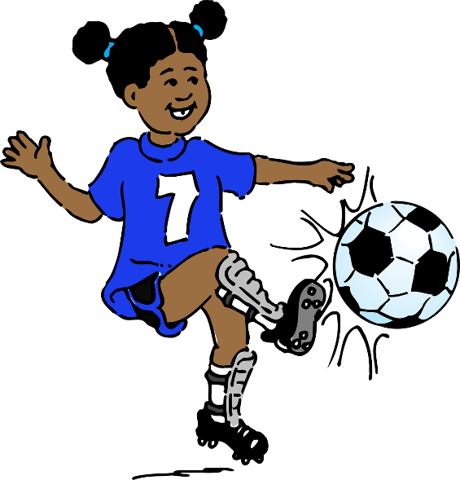
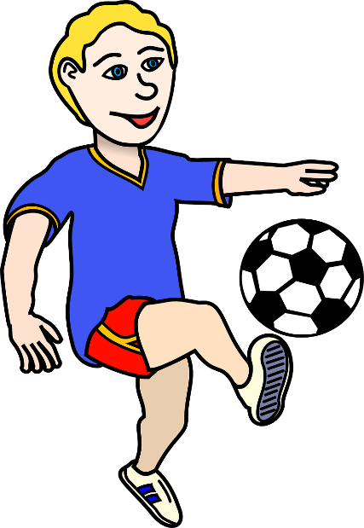
écouter / écrire
C’est qui ?
écouter / écrire
il joue
Notes:
Transcript:
il joue

Slide 18
écouter / écrire
C’est qui ?
écouter / écrire
il trouve
Notes:
Transcript:
il trouve

Slide 19
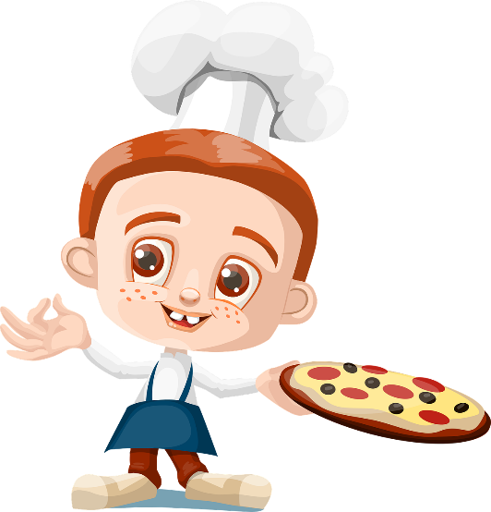
écouter / écrire
C’est qui ?
écouter / écrire
ils préparent
Notes:
Transcript:
ils préparent

Slide 20
écouter / écrire
C’est qui ?
écouter / écrire
elle mange
Notes:
Transcript:
elle mange

Slide 21
écouter / écrire
C’est qui ?
écouter / écrire
elle écoute

Slide 22
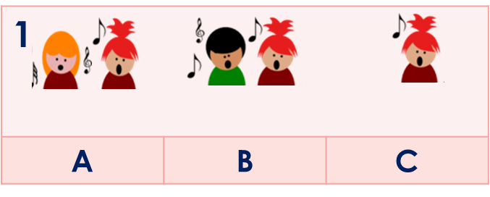
la télépathie
parler / écrire
A + B: Try to predict what your partner will say. Write A,B,or C and the sentence in French. A: Say your sentences.
B: Listen and write. Then compare in writing with your partner. Swap roles for Round 2.
 A…..
 B…..
 elles chantent
Ils chantent
 B ils chantent
 B ils chantent
Notes:
Timing: 10 minutes Aim: to practise oral and written production of 3rd person singular and plural verbs with a variety of vocabulary. Procedure: 1. Students A and B write their own choice of sentence (A, B, or C options) without their partner seeing.
2. In Round 1, A says their 6 sentences. B listens, identifies and write the sentence.
3. They compare A’s written sentence and sentence letter with B’s transcription. Note: it is coincidence if A and B happen to have written the same original sentence, and it’s not really important. The reason that B writes sentences as well as A in Round 1 is to increase the practice opportunities for both, and to ensure that B has engaged with the three sentence options before listening to A.
After Round 1 they swap roles and B is the one to speak.

Slide 23
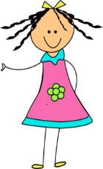
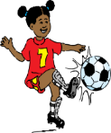
Qui fait quoi ?
écouter / écrire
Parle en français.
lire
Écoute ton/ta partenaire. Identifie (A, B, ou C). Écris en français et compare.
1
A | B | C
4
A | B | C
2
A | B | C
5
A | B | C
3
A | B | C
6
A | B | C
Notes:
Round 1

Slide 24
Qui fait quoi ?
écouter / écrire
Parle en français.
lire
Écoute ton/ta partenaire. Identifie (A, B, ou C). Écris en français et compare.
1
A | B | C
4
A | B | C
2
A | B | C
5
A | B | C
3
A | B | C
6
A | B | C
Notes:
Round 2

Slide 25
Activities in and out of school Saying what others do
-ER verbs (il/elle, ils/elles)
À la maison
Y7 French
Term 1.2 - Week 6 - Lesson 26 Victoria Hobson / Emma Marsden / Rachel Hawkes
Artwork by: Chloé Motard
Date updated: 08.08.23
Notes:
Learning outcomes (lesson 2):
Consolidation of [third person singular and third person plural forms of –ER verbs]
Word frequency (1 is the most frequent word in French):
7.1.2.6 (introduce) chanter [1820], étudier [960], jouer [219], ils [13], elles [38], élève [1068], fruit [896], histoire¹ [263], radio [1526], ensemble [124]
7.1.2.3 (revisit) aimer [242], cocher [>5000], passer¹ [90], porter¹ [105], rester [100], trouver [83], école [477], moment [148], semaine [245], solution [608], uniforme [1801], chaque [151], à1 [4], avec [23]
7.1.1.5 (revisit) il² [13], elle² [38], ami [467], amie [467], chanteur [3251], chanteuse [3251], femme [154], homme [136], professeur [1150], professeure [1150], drôle [2166], intéressant [1244], faux [555], sympa(thique) [4164], vrai [292]
Source: Londsale, D., & Le Bras, Y. (2009). A Frequency Dictionary of French: Core vocabulary for learners London: Routledge.

Slide 26
Qui fait quoi ?
Travaille avec ton/ta partenaire.
lire / parler
Écris 5 phrases en anglais.
Parle en français.
il elle nous | écoute écoutons chante chantons étudie étudions joue jouons porte portons trouve trouvons aime aimons passe passons | le fruit le chanteur la chanteuse l’histoire la solution un uniforme ensemble en français | à l’école à la maison avec un ami avec une amie chaque semaine en ce moment
Notes:
Timing: 8 minutes
Aim: to practise comprehension and read aloud of new and revisited language and grammar from this and previous weeks.
Procedure:
Both pupils write 5 sentences (in English) made up of words from the table.
They swap sentences.
Partner A tries to say all B’s sentences in French as quickly as possible.
Then Partner B tries to say all A’s sentences in French.

Slide 27
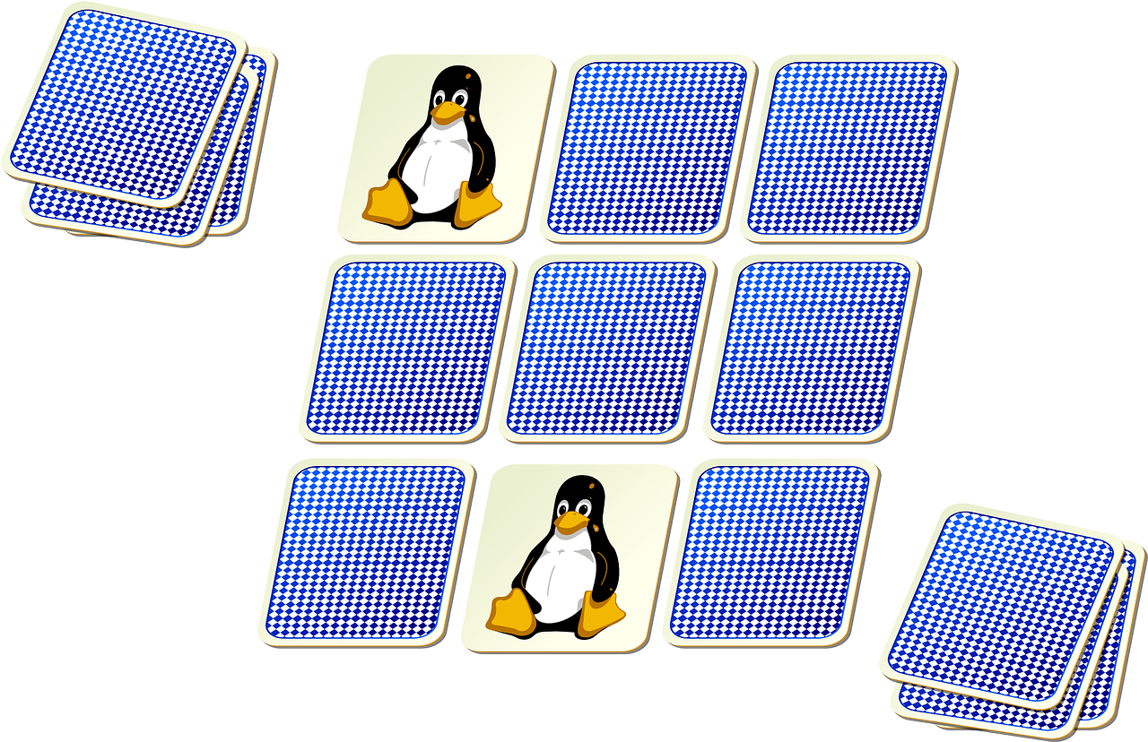
jouer
[to play | playing]
joue
[plays | is playing]
Notes:
Timing: 3 minutes for sequence of six verbs
Aim:
To introduce the verb [jouer] more explicitly. [jouer] is one of the NCELP 15 prototypical verbs in French. Prototypical verbs are common verbs that illustrate the typical characteristics of a class of verb – the French prototypical verbs contain examples of regular/weak verbs, but also common examples of changes to the stem. All 15 prototypical verbs will be introduced early on using the same format. Both long form (infinitive) and short form (3rd person singular) are introduced in order to familiarise students with various forms of the same verb.
Procedure
Bring up the word [jouer] on its own, say it, students repeat it, and remind them of the phonics.
Try to elicit the meaning from the students. Students have had explicit teaching that the present tense in French communicates two different present tense meanings in English. This reinforces that learning. Emphasise the two meanings for the short form, reminding students that French only has one form and does not have a direct equivalent of the grammar for ‘is + ing’, the continuous form (as covered in previous weeks).
Bring up the picture using gestures if desired.
Then bring up the English translations. Emphasise the two meanings for the infinitive.
Bring up the short form [joue], say it, students repeat it.
Try to elicit the meaning from the students. Emphasise the two meanings for the short form.

Slide 28
jouer
[to play | playing]
joue
[plays | is playing]
Notes:
Cycle through the long and short form again.

Slide 29
joue
[speaks | is speaking]
Louise joue au tennis.
[Louise plays | is playing tennis.]
Notes:
Introduce the short form in a sentence.

Slide 30
jouer
[to play | playing]
Louise aime jouer au tennis.
[Louise likes playing tennis.]
Notes:
Introduce the long form in a sentence.

Slide 31
joue
[plays | is playing]
Louise joue au tennis.
[Louise plays | is playing tennis.]
Notes:
Cycle through the short form in context again.

Slide 32
jouer
[to play | playing]
Louise aime jouer au tennis.
[Louise likes playing tennis.]
Notes:
Cycle through the long form in context again.

Slide 33
Qui fait quoi ?
Lis la phrase. Le verbe, c’est quoi ? Complète la phrase. C’est quoi en anglais ?
lire / écrire
trouvent l’histoire intéressante aussi.
1 | Les filles | aime | le français et…
 |  | aiment
2 | Les hommes | étudient | l’anglais et…
 |  | étudie
3 | La femme | parlent | français et…
 |  | parle
4 | Le médecin | travaillent | en France et…
 |  | travaille
The girls like French and find history interesting as well.
The girls like French and speak Spanish.
parlent espagnol.
trouvent l’histoire intéressante aussi.
The men study English and find history interesting as well.
The men study English and speak Spanish.
parlent espagnol.
étudie l’anglais aussi.
The woman speaks French and also studies English.
The doctor works in France and speaks French. The doctor works in France and studies English, too.
parle français.
étudie l’anglais aussi.
trouvent l’histoire intéressante aussi.
étudie l’anglais aussi.
parle français.
parlent espagnol.
Notes:
Timing: 8 minutes
Aim: to focus on verb form by having to choose between 3rd person singular or plural, depending on the subject of the verb but by using full nouns, rather than the subject pronoun (il/ils elle/elles) as in the previous lesson when reading.
Procedure:
1. Students read the first part of the sentence.
2. They then have to choose the correct accompanying verb to form the second part of the sentence successfully. Tell them that more than one answer could be possible.
3. Click to bring up the answers, item by item, followed by the translation into English.
Note: The context for all four sentences is similar which reduces the reliance on vocabulary to work out the answers; students will have to look carefully at verb form.
There are two possible versions for the plural forms, but not for the singular. This adds a level of complexity to the task, in that students will not only have to focus on verb form but meaning as well. Teachers could let the students realise this for themselves, or you could tell them up front.
Some regular –er verbs from previous weeks are revisted here (parler/aimer/trouver/travailler).

Slide 34
Qui fait quoi ?
Écoute la phrase.
écouter / écrire
Use the start of the sentence to work out how to complete the end of the sentence.
Identify the correct one.
Write the correct ending.
Write the correct subject pronoun.
Write the correct verb.
Exemple:
1 | Le garçon | aim_____ | le sport; |  |  | au foot.
 | Les garçons
e
il
joue
Exemple:
2 | La fille | rest_____ | à la maison; |  |  | la télé.
 | Les filles
ent
elles
regardent
Notes:
Timing: 8 minutes (two slides)
Aim: to focus on verb form by having to choose between 3rd person singular or plural, depending on the subject of the verb by using full nouns when listening. Note that this is excellent transcription practice; it really focuses on the decision-making processes that are in play in French when not every letter string is pronounced, and how the grammatical decisions carry across a two-clause sentence.
Procedure:
1. Use this slide to model the requirements of the task. Really emphasise the importance of listening carefully to the subject of the verb – is it singular or plural? Elicit from students what will be heard when the subject is singular and what is heard when it is plural – the subtle difference between ’le’ and ‘les’ (or ‘la’ and ‘les’) really makes a difference to meaning. This is key to students succeeding in the task.
2. Click the exemple to play the audio.
3. Students tick the subject of the verb then use this to help write the correct verb ending (3rd person singular or third person plural).
4. Students continue to transcribe the verb from the second part of the sentence, focusing on the achieving the correct subject pronoun and verb form.
5. On completion of the task, teachers could take the opportunity to do some further sentence level comprehension by asking students to give the meanings in English of the complete sentences.
Transcript:
Exemple: Le garçon aime le sport; il joue au foot.
Exemple: Les filles restent à la maison; elles regardent la télé.
Note: The two part nature of the task sets up differentiation. All students should be able to complete the first part of the sentence at least – hearing the difference between ‘le’ and ‘les’; and the difference between ‘la’ and ‘les’ and then writing the verb ending accordingly: ‘e’ or ‘ent’.
The second part offers a greater level of challenge. Teachers could consider asking students to mark their work in two sets, to allow students to feel successful and give the teacher an indication of how students did with the two aspects of the task.

Slide 35
Qui fait quoi ?
écouter / écrire
Tick the correct one
Write the ending
Write the pronoun
Write the correct verb
1 | Le garçon | aim_____ | la télé; |  |  | les films.
 | Les garçons
1
e
il
regarde
2 | La fille | aim_____ | la musique; |  |  | avec la radio.
 | Les filles
2
ent
elles
chantent
3 | Les médecins | travaill____ | en Angleterre; |  |  | anglais.
 | Le médecin
3
ent
ils
parlent
4 | Le chanteur | aim_____ | la musique; |  |  | la radio.
 | Les chanteurs
4
e
il
écoute
Notes:
Transcript
1) Le garçon aime la télé; il regarde des films.
2) Les filles aiment la musique; elles chantent avec la radio.
3) Les médecins travaillent en Angleterre; ils parlent anglais.
4) Le chanteur aime la musique; il écoute la radio.

Slide 36
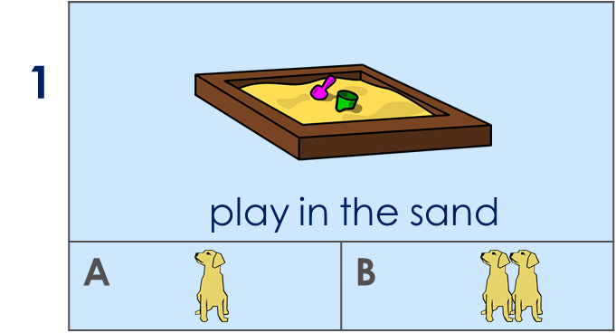
C’est qui ? L’activité c’est quoi ?
Partenaire A
Say your choice of sentence (A or B) in French.
Partenaire B
Listen and write A or B and the full sentence in French.
 1B
Les chiens jouent dans le sable.
____________
les chiens jouent dans le sable.
__________________________
(the dog|the dogs play in the sand)
Notes:
Timing: 10 - 15 minutes (3 slides) Note: the timing equates to 5 minutes per round. Here there should be time for both rounds and it’s important to do them because almost all of this week’s new and revisited vocabulary is used across the two rounds.
Aim: to practise producing and understanding plural nouns and verbs with a range of vocabulary. Procedure:
1. Use this slide to model the activity.
2. If students need to write first, then ensure that both students A & B write all the sentences, even though in Round 1, it is A who speaks. They write them in any order. If they don’t need to write first then student A can start speaking straight away using the English/picture prompts but NOT IN ORDER. Each must choose whether to write/say a singular or plural sentence. They write with the full noun + article (not pronouns) e.g., the dog OR the dogs | the teacher OR the teachers. It is the article difference (le/les, la/les) that will tell the listening student the meaning of the sentence, and therefore what to write down. 3. Partner A says one sentence (6 in total) at a time to their partner using the singular or plural noun.
Partner Bs must listen carefully to the article and write the number of the image and A or B depending on the le/les or la/les they hear in French. Note: the fact that they have practised writing 6 sentences this time around, too, means they should understand more readily what Partner A says.
Example:
Partner A writes/says: Les chiens jouent dans le sable.
Partner B finds the correct pair of images and writes the number of the image and A or B depending on the ‘you’ or ‘you (all)’ form they hear in French. B then also writes the full sentence and checks it with student A.
Then they swap roles and do the same again for the next slide.

Slide 37
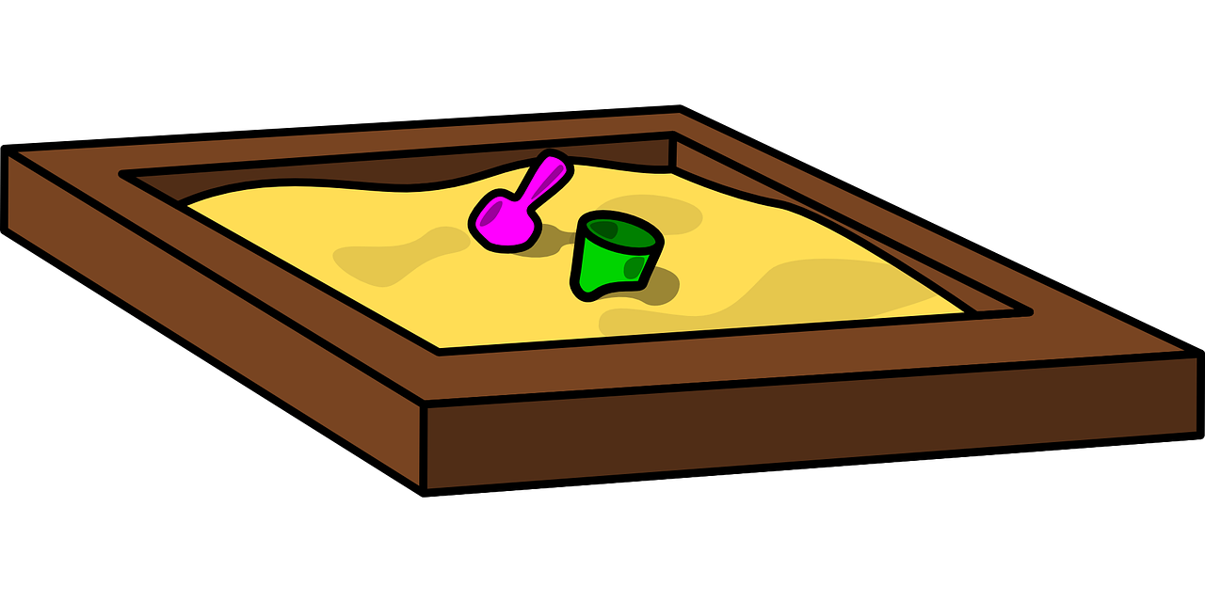
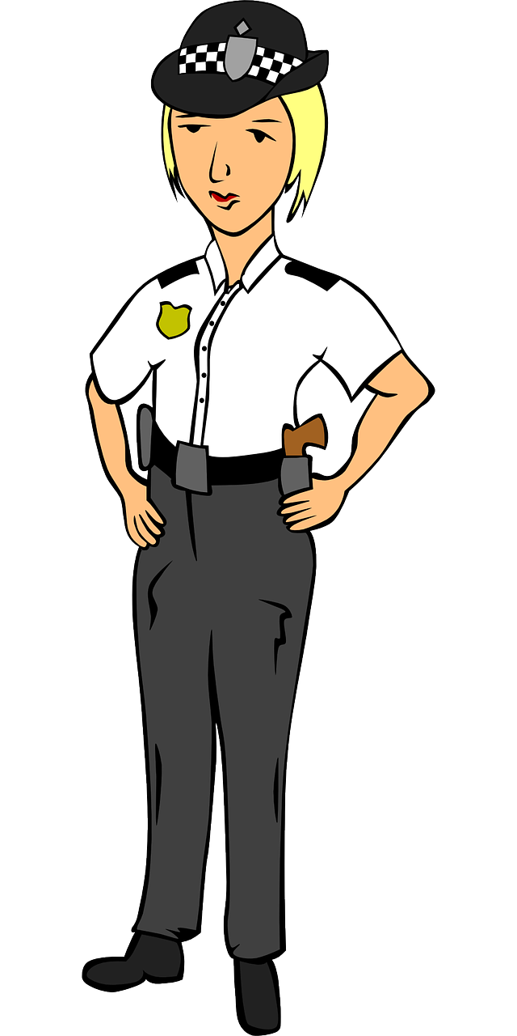
C’est qui ? L’activité c’est quoi ? [1/2]
écrire / parler
A | B
A | B
A | B
1
2
3
play in the sand
stay at school
sing in French
4
A | B
5
A | B
6
A | B
tick the answers
wear a uniform
prepare the fruit
le sable – sand
Notes:
Display this slide for Round 1
Note: sable [3263] was learnt in 7.1.2.1 and is on the Edexcel GCSE wordlist. Source: Londsale, D., & Le Bras, Y. (2009). A Frequency Dictionary of French: Core vocabulary for learners London: Routledge.

Slide 38
C’est qui ? L’activité c’est quoi ? [1/2]
écrire / parler
A | B
A | B
A | B
1
2
3
study history
listen to the radio
spend a week with a friend
4
A | B
5
A | B
6
A | B
find the solution
play every week
like the funny teacher
un jeu – a game | une fête – a party
Notes:
Display this slide for Round 2

Slide 39
Qui fait quoi ?
parler / écrire
Now write two sentences about what your friend does - use ‘he’ or ‘she’ - and write two sentences about what you think your teachers do – use ‘they’ (it doesn’t have to be true!).
L’amie
Les professeurs
Elle écoute le chanteur.
Ils préparent le déjeuner.
Elle étudie l’histoire.
Ils chantent avec la radio.
Say your sentences to your partner who will translate them into English.
Notes:
Timing: 5 minutes
Aim: to practise creative written production at sentence level of regular –er verbs in third person singular and plural.
Procedure:
Students write (then say) two sentences describing what one friend does (it doesn't have to be true!) 'use she or he';
They then write (then say) two sentences that you think all your teachers do - use 'they'.
Note: this exercise offers an opportunity to try to get students to write and say something creative, producing their own language to express their own meanings (rather than translations as previously practised in this sequence).

Slide 40
Devoirs
Vocabulary Learning Homework (Term 1.2, Week 7)
Audio file
Student worksheet
In addition, revisit: Term 1.2 Week 4 Term 1.1 Week 6
Notes:
Use this slide to set the homework.
For Y7, the typical homework will be to pre-learn vocabulary for the next lesson. There is an audio file to accompany the student worksheet.
Notes:
i) Teachers may, in addition, want to recommend use of a particular online app for the pre-learning of each week’s words. ii) Quizlet now requires parental involvement / registration / permissions for users below the age of 13, so it is perhaps most suitable for Y9 – 11 students. iii) Language Nut hosts LDP vocabulary lists and these are free for schools to use, though there is a registration process. One benefit is that all of the student tracking data that Language Nut offers are also available to schools that use the LDP lists for practice. Perhaps this makes it a good option for Y7/8.
iv) There are other free apps, and new ones are always appearing. Teachers have told us that they are currently using: Flippity, Wordwall (where using previously-created activities is free).
v) Gaming Grammar has been acquired by Language Nut. Its original content should still be available to teachers and much of it is appropriate for Y7 learners. From this lesson, for example, learners could practise: Verbs (present): 1st person singular/plural (Verb agreement (present))
Verbs (present): 2nd person singular/plural (Verb agreement (present))
Verbs (present): 3rd person singular/plural (Verb agreement (present))

