Slide 1
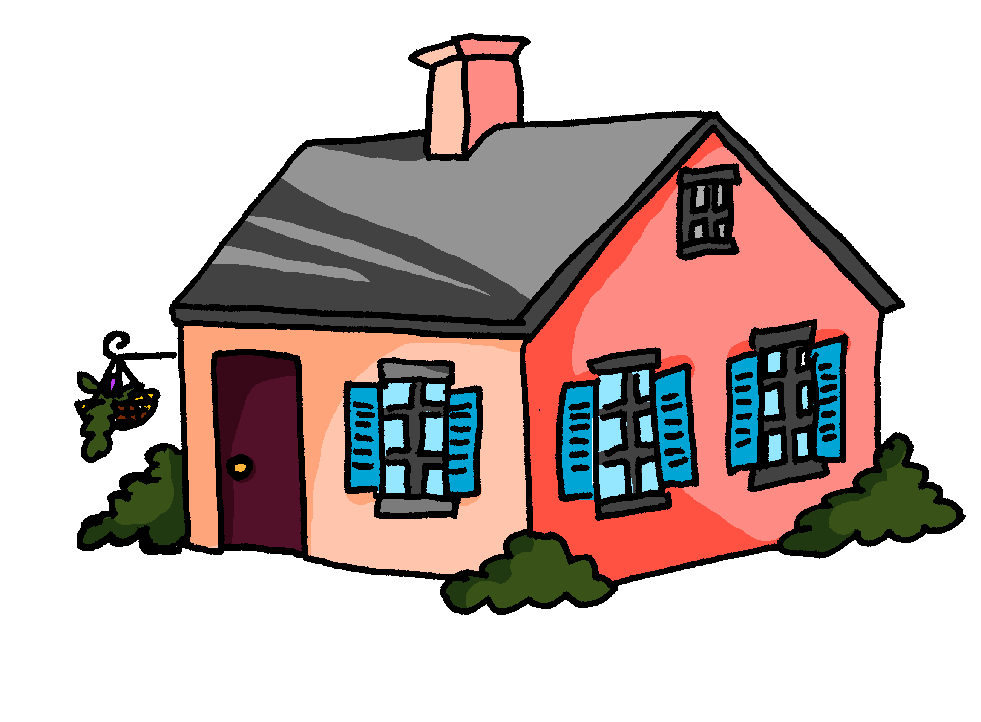
Activities at home
Saying what you do with others
-ER verbs (je & nous)
Present continuous meaning
SFC revisited
À la maison
Y7 French
Term 1.2 - Week 5 - Lesson 23
Victoria Hobson / Emma Marsden / Catherine Morris
Artwork by: Chloé Motard
Date updated: 08.08.23
Notes:
Artwork by Chloé Motard. All additional pictures selected are available under a Creative Commons license, no attribution required.
Note: all words (new and revisited) in this week of the SOW appear on all three GCSE wordlists, with these exceptions: i) Edexcel list does not have promenade, Londres.
Learning outcomes (lesson 1):
Consolidation of SFC
Consolidation of -ER verbs in first three persons singular
Introduction of -ER verbs in first person plural
Word frequency (1 is the most frequent word in French):
7.1.2.5 (introduce) marcher [1532], manger [1338], préparer [368], regarder¹ [425], travailler [290], nous¹ [31], déjeuner [2724], film [848], maison [325], partenaire [1077], télé [2746], dehors [1217], préféré [préférer 597]
7.1.2.2 (revisit) bateau [1287], magasin [1736], numéro [766], promenade [>5000], question [144], réponse [456], visite [1072], voyage [904], beau [393], mauvais¹ [274], de¹ [2], en² [7], Paris [n/a], Londres [n/a]
7.1.1.4 (revisit) as [8], livre [358], ordinateur [2201], vélo [4594], voiture [881], cher [803], chère [803], moderne [1239], rapide [672], voici [1103], oui [284], non [75], comment ça s'écrit?
Source: Londsale, D., & Le Bras, Y. (2009). A Frequency Dictionary of French: Core vocabulary for learners London: Routledge.

Slide 2
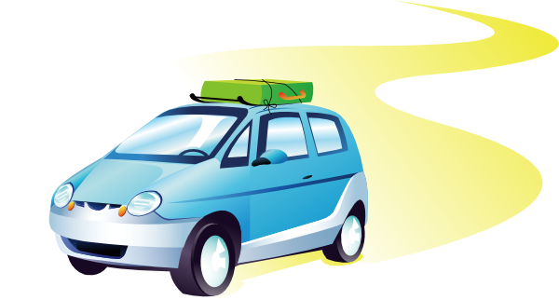
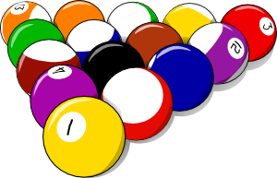
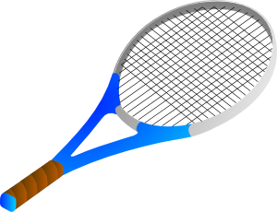
Écris en français
écrire
Use the pictures below to write short sentences in FRENCH to describe what you normally do i) on a summer holiday and ii) at a weekend in winter.
Notes:
Timing: 10 minutes (this task will differentiate by outcome – teachers will set a time limit and students will write as many sentences as they can in the time).
Aim: to practise written production of first person singular of ‘faire’ along with this week’s revisited vocabulary (plus a few additional items from two weeks before that).
Procedure:
Students write sentences using the first person singular form of ‘faire’ in response to the pictures, in order to describe things they might typically do in the summer or at the weekend in winter.
Remind learners that the weather expressions are always used impersonally – i.e. with ‘il’.
Draw students’ attention to the fact that the English meaning here is present simple (what usually happens, what we usually do).
4. Elicit a few suggestions orally to cue learners back into this language (met in 7.1.2.2 and 7.1.1.7). Differentiate the support in the class, as needed, e.g., by allowing students access (after 3-4 minutes) to their KO (KOs do not have set phrases, they continue the phonics, vocabulary and grammar features for each half-term on one A4 page) and/or Language Guide.

Slide 3
SFC
Silent final consonant
dans
X
Notes:
Timing: 1 minute
Aim: To consolidate SSC [SFC]
Explanation in English, if desired: Something that makes French sounds very different from English is that some consonants at the ends of words are silent. This means you don’t pronounce/sound them out at all. As in the word ‘dans’ in French.
Procedure: 1. Present the letter(s) and say the [SFC] sound first, on its own. Students repeat it with you. 2. Bring up the word ”dans” on its own, say it, students repeat it, so that they have the opportunity to focus all of their attention on the connection between the written word and its sound.
3. A possible gesture for this would be to hold ones finger to ones lips to indicate ‘Shhhh!’. 4. Roll back the animations and work through 1-3 again, but this time, dropping your voice completely to listen carefully to the students saying the [SFC] sound, pronouncing ”dans” and, if using, doing the gesture.
Word frequency (1 is the most frequent word in French):
dans [11] Source: Londsale, D., & Le Bras, Y. (2009). A Frequency Dictionary of French: Core vocabulary for learners London: Routledge.

Slide 4
SFC
petit
prix
€15.95
grand
mot
dans
X
mais
[but]
Notes:
Timing: 2 minutes
Aim: To consolidate SSC [SFC]
Procedure:
1. Introduce and elicit the pronunciation of the individual SSC [SFC] (in this case is SFC – silent final consonant so nothing to pronounce as an individual sound!) and then the source word again ‘dans’ (with gesture, if using). 2. Then present and elicit the pronunciation of the five cluster words.
The cluster words have been chosen for their high-frequency, from a range of word classes, with the SSC (where possible) positioned within a variety of syllables within the words (e.g. initial, 2nd, final etc.). Additionally, we have tried to use words that build cumulatively on previously taught SSCs (see the Phonics Teaching Sequence document) and do not include new SSCs. Where new SSCs are used, they are often consonants which have a similar symbol-sound correspondence in English.
Word frequency (1 is the most frequent word in French): dans [11]; petit [138] prix [310]; mot [220]; mais [30]; grand [59]. Source: Londsale, D., & Le Bras, Y. (2009). A Frequency Dictionary of French: Core vocabulary for learners London: Routledge.

Slide 5
… except for
c r f l
Be c a r e f u l with these!

Slide 6
Phonétique
écouter
[SFe] ou [SFC] ?
[lawn]
pelouse
Notes:
Timing: 4 minutes for 6 slides
Aim: aural recognition of SSC [SFe] and [SFC]
Procedure:
1. Click the word to play the audio.
2. Students choose if the word ends in SFe or SFC.
Word frequency (1 is the most frequent word in French): pelouse [>5000]
Source: Londsale, D., & Le Bras, Y. (2009). A Frequency Dictionary of French: Core vocabulary for learners London: Routledge.

Slide 7
Phonétique
écouter
[SFe] ou [SFC] ?
froid
[cold]
Notes:
Word frequency (1 is the most frequent word in French): froid [1307]
Source: Londsale, D., & Le Bras, Y. (2009). A Frequency Dictionary of French: Core vocabulary for learners London: Routledge.

Slide 8
Phonétique
écouter
[SFe] ou [SFC] ?
trente
Notes:
Word frequency (1 is the most frequent word in French): trente [1646]
Source: Londsale, D., & Le Bras, Y. (2009). A Frequency Dictionary of French: Core vocabulary for learners London: Routledge.

Slide 9
Phonétique
écouter
[SFe] ou [SFC] ?
[shy]
timide
Notes:
Word frequency (1 is the most frequent word in French): timide [3835]
Source: Londsale, D., & Le Bras, Y. (2009). A Frequency Dictionary of French: Core vocabulary for learners London: Routledge.

Slide 10
Phonétique
écouter
[SFe] ou [SFC] ?
soupe
Notes:
Word frequency (1 is the most frequent word in French): soupe [4563]
Source: Londsale, D., & Le Bras, Y. (2009). A Frequency Dictionary of French: Core vocabulary for learners London: Routledge.

Slide 11
Phonétique
écouter
[SFe] ou [SFC] ?
[prize]
prix
Notes:
Word frequency (1 is the most frequent word in French): prix [310]
Source: Londsale, D., & Le Bras, Y. (2009). A Frequency Dictionary of French: Core vocabulary for learners London: Routledge.

Slide 12
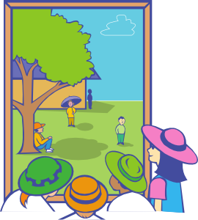
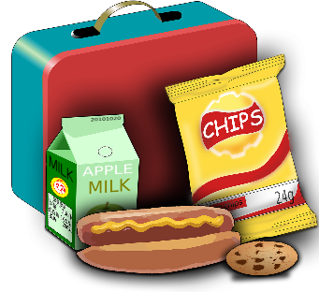
Vocabulaire
1
2
3
4
5
6
écouter
7
8
9
10
11
12
13
b
d
c
travailler
a
marcher
regarder
préparer
g
dehors
manger
le déjeuner
f
e
préféré
le film
j
h
i
nous
m
k
la télé
l
la maison
le/la partenaire
Notes:
Timing: 8 minutes
Aim: Aural recognition of words in this week’s vocabulary set in isolation.
Procedure:
1. Students write 1-13 in their books.
2. Click on a number to hear a word said aloud.
3. Students decide which of the pictures a-l the words best represent and write the letter in their books.
4. On clicks, the words appear next to the letters in the order they were said. Teachers can therefore ask: numéro 1, c’est quoi ? to elicit i) the French letter of the alphabet and ii) a read aloud of the French word and iii) an English translation. Whilst the pictures prompt students to connect the French they hear with an idea, it will still be helpful for students to provide the English equivalent during the feedback, to make sure for example that they are correctly identifying the infinitive meanings of the verbs. For additional challenge, teacher may wish to elicit words in French before click to reveal, e.g., by asking ‘c’est quoi, A?’ and then eliciting the English meaning after that.
Transcript:
1. regarder
2. nous
3. marcher
4. la télé
5. la maison
6. préparer
7. le film
8. travailler
9. dehors
10. préféré
11. manger
12. le déjeuner
13. le partenaire

Slide 13
Regular –er verbs
grammaire
To say ‘I’ + verb in French, the verb is in the short form, often ending in -e.
Je regarde.
I watch (or I am watching).
Je travaille.
I work (or I am working).
To say ‘we’ + verb, the verb ends with -ons.
Nous regardons.
We watch (or we are watching).
Nous travaillons.
We work (or we are working).
Stephen Owen
Notes:
Timing: 2 minutes
Aim: to introduce the first person plural form of regular –ER verbs.

Slide 14
manger
[to eat | eating]
mange
[eats | is eating]
We keep the ‘e’ in the nous form so that the [g] is still soft.
mangeons
[eat | are eating]
Notes:
Timing: 4 minutes for eight slides
Aim: to introduce the verb manger more explicitly. Both long form (infinitive) and short form (3rd person singular) are introduced in order to familiarise students with various forms of the same verb.
Procedure
Bring up the word manger on its own, say it, students repeat it, and remind them of the phonics.
Try to elicit the meaning from the students. Students have had explicit teaching that the present tense in French communicates two different present tense meanings in English. This reinforces that learning. Emphasise the two meanings for the short form, reminding students that French only has one form and does not have a direct equivalent of the grammar for ‘is + ing’, the continuous form (as covered in previous weeks).
Bring up the picture, and, if using gestures, a possible gesture would be to mime eating a sandwich.
Then bring up the English translations. Emphasise the two meanings for the infinitive.
Bring up the first short form mange, say it, students repeat it.
Bring up the second short form mangeons, say it, students repeat it. Draw attention to spelling with [e] added onto the stem. As students how the word would be pronounced if conjugated as normal, i.e. no ‘e’ added (‘mangons’ – hard [g])
Try to elicit the meaning from the students. Emphasise the two meanings for the short forms.
Bring up the info bubble to introduce the stem-change. NB: This is not a grammar point that students are expected to produce at this stage and will not feature in any NCELP tests. It is showcased here for awareness and passive understanding only.

Slide 15
manger
[to eat | eating]
mange
[eats | is eating]
mangeons
[eat | are eating]
Notes:
Cycle through the long and short forms again.

Slide 16
mange
[eats | is eating]
Elle mange des fruits.
[She eats | is eating fruit.]
Notes:
Introduce the first short form in a sentence.

Slide 17
mangeons
[eat | are eating]
Nous mangeons des fruits.
[We eat | are eating fruit.]
Notes:
Introduce the second short form in a sentence.

Slide 18
manger
[to eat | eating]
Elle aime manger des fruits.
[She likes eating fruit.]
Notes:
Introduce the long form in a sentence.

Slide 19
mange
[eats | is eating]
mange
Elle des fruits.
[She eats | is eating fruit.]
Notes:
Cycle through the first short form in context again.

Slide 20
mangeons
[eat | are eating]
mangeons
Nous des fruits.
[We eat | are eating fruit.]
Notes:
Cycle through the second short form in context again.

Slide 21
manger
[to eat | eating]
manger
Elle aime des fruits.
[She likes eating fruit.]
Notes:
Cycle through the long form in context again.

Slide 22
Le journal intime* de Léa
This week, is Léa doing these activities by herself (‘I’) or with Sophie (‘we’)?
lire
nous
Écris 1-6 et nous (we) ou je (I).
je
lundi
jeudi
1
... prépare le déjeuner.
... marche dehors mais il fait mauvais.
2
3
mardi
vendredi
4
... travaillons avec un ordinateur.
... demandons un vélo rapide.
5
6
mercredi
samedi / dimanche
... restons à la maison.
... montre un exemple à la professeure.
le journal intime – diary/journal
Notes:
Timing: 8 minutes
Aim: to practise differentiating in the written modality between 1st persons singular and plural (I/we); to practise aural comprehension of key vocabulary from this and previous weeks.
Procedure:
Students read the diary extracts and note answers 1-6 nous or je in their exercise books.
Elicit answers and provide feedback.
T

Slide 23
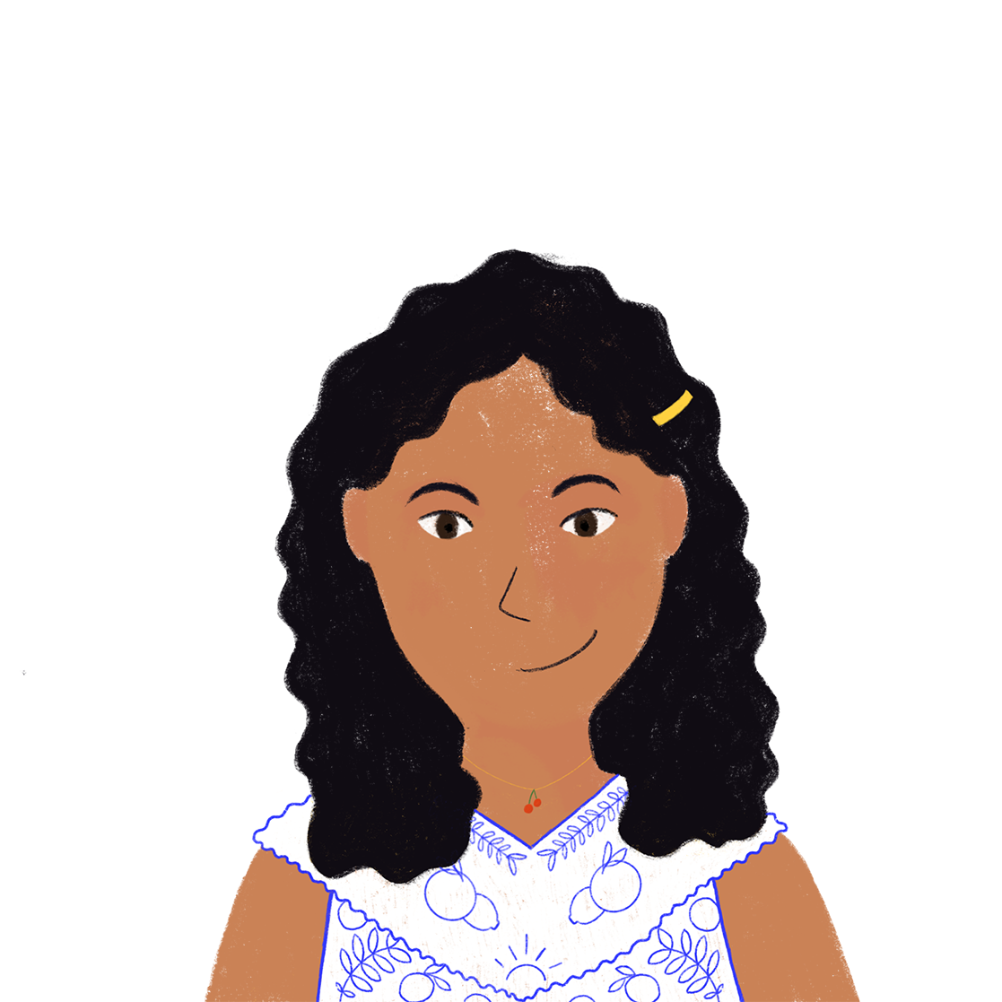
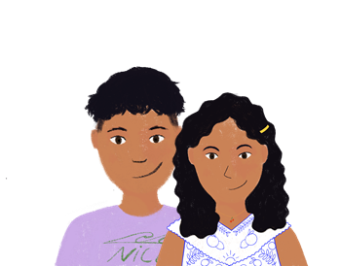
À la maison
écouter
Écris 1-6 ‘I’ ou ‘we’ et l’activité en anglais.
I (je) | We (nous) | activité – écris en anglais
Noura parle. C’est ‘je’ (I) ou ‘nous’ (we) ?
1
work in the house
2
find a present
3
watch a film
4
like the dog
5
give the solution
6
stay outside
Notes:
Timing: 8 minutes
Aim: to practise differentiating aurally between 1st persons singular and plural (I/we); to practise aural comprehension of key vocabulary from this and previous weeks.
Procedure:
Students listen to the audio and write answers in their exercise books.
The sequencing of the answers is such that the verb is addressed first (as this is the element all students should be able to access) allowing teachers to take feedback on scores out of 6.
Then the comprehension of the vocabulary is checked. (Teachers could re-order the custom animation if they wish the activity to follow immediately after the tick. )
To note: the vocabulary chosen for this activity has all been previously seen by students (either as identified vocab for a particular week or as source/cluster words).
Transcript:
[beep] travaillons dans la maison
[beep] trouvons un cadeau
[beep] regarde un film
[beep] aimons le chien
[beep] donne la solution
[beep] reste dehors

Slide 24
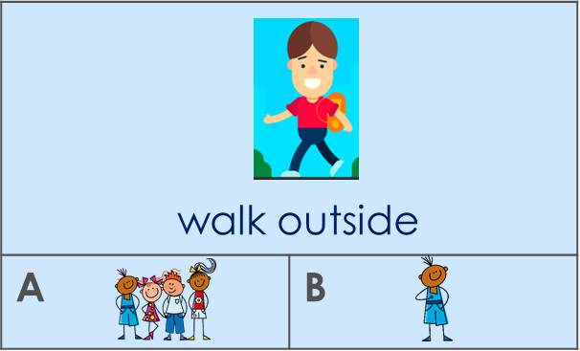
C’est qui ? L’activité c’est quoi ?
Chut !
Partner A
Partner B
(walk outside)
_____________________
Chut
Nous marchons dehors.
 1A
______________
Notes:
Timing: 10 minutes (3 slides) Note: the timing equates to 5 minutes per round. It would be fine to do just one round.
Aim: to practise producing and understanding verbs in 1st person singular and plural with a range of vocabulary.
Procedure:
1. Use this slide to model the activity. It’s called ‘chut’. ‘chut’ (=shhhhh!) – don’t give away the pronoun.
The activity is this: students must listen carefully to the verb and tick under the correct picture whether ‘Je’ or ‘Nous’ is needed to complete their partner’s sentence.
2. First, students A and B try to write 6 sentences using the English/picture prompts but NOT IN ORDER. They write them in any order. Each must choose whether to write an ‘I’ or ‘we’ sentence.
3. When both students have completed their sentences, partner A says one sentence (6 in total) at a time to their partner without using the subject pronoun.
Partner Bs must listen carefully to the verb and write the number of the image and A or B depending on the ‘i’ or ‘we’ form they hear in French. Note: the fact that they have practised writing 6 sentences this time around, too, means they should understand more readily what Partner A says.
Example:
Partner A writes: Nous marchons dehors.
Partner A says to B: chut marchons dehors
Partner B finds the correct pair of images and writes the number of the image and A or B depending on the ‘i’ or ‘we’ form they hear in French.
Once they have said all 6 sentences to their partner, students then recreate, in speaking, the sentences that their partners must have written. They use the pictures and their note of the number + A/B for each one. As they speak, the partner who wrote the sentences confirms if they are correct – the sentence read out loud should be exactly the same as the sentence they themselves had written earlier.
Then they swap roles and do the same again for the next slide.

Slide 25
C’est qui ? L’activité c’est quoi ? [1/2]
écrire / parler
A | B
A | B
A | B
1
2
3
work in house
watch a film
speak French
4
A | B
5
A | B
6
A | B
walk outside
like the dog
prepare lunch
Notes:
Display this slide for Round 1

Slide 26
C’est qui ? L’activité c’est quoi ? [2/2]
écrire / parler
A | B
A | B
A | B
1
2
3
prepare a presentation
like the film
walk in the house
4
A | B
5
A | B
6
A | B
speak English
watch the tv
work outside
Notes:
Display this slide for Round 2

Slide 27
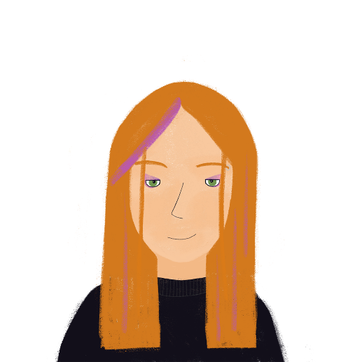
Activities on an exchange Saying what you do with others
-ER verbs (je, tu, il/elle & nous)
SFC revisited
Un échange scolaire
Y7 French
Term 1.2 - Week 5 - Lesson 24
Victoria Hobson / Emma Marsden / Catherine Morris
Artwork by: Chloé Motard
Date updated: 08.08.23
Notes:
Artwork by Chloé Motard. All additional pictures selected are available under a Creative Commons license, no attribution required.
Learning outcomes (lesson 2):
Consolidation of SFC
Consolidation of -ER verbs in first three persons singular
Consolidation of -ER verbs in first person plural
Word frequency (1 is the most frequent word in French):
7.1.2.5 (introduce) marcher [1532], manger [1338], préparer [368], regarder¹ [425], travailler [290], nous¹ [31], déjeuner [2724], film [848], maison [325], partenaire [1077], télé [2746], dehors [1217], préféré [préférer 597]
7.1.2.2 (revisit) bateau [1287], magasin [1736], numéro [766], promenade [>5000], question [144], réponse [456], visite [1072], voyage [904], beau [393], mauvais¹ [274], de¹ [2], en² [7], Paris [n/a], Londres [n/a]
7.1.1.4 (revisit) as [8], livre [358], ordinateur [2201], vélo [4594], voiture [881], cher [803], chère [803], moderne [1239], rapide [672], voici [1103], oui [284], non [75], comment ça s'écrit?
Source: Londsale, D., & Le Bras, Y. (2009). A Frequency Dictionary of French: Core vocabulary for learners London: Routledge.

Slide 28
Phonétique
*le chat = cat
*dans = in
*retourner = to return
lire / parler
1
Le chat* est méchant.
2
Nous trouvons le professeur amusant.
3
Je suis petit mais Nicolas, mon frère, est grand.
4
Il fait les courses et je fais les magasins.
5
Gaspard fait du sport et Clément regarde les films.
6
Nous restons à Paris mais dans* deux semaines
nous retournons* à Londres.
Notes:
Timing: 5 minutes
Aim: Oral production of SFC.
Procedure:
1. Students read sentences aloud to practise SFC
2. Including a few words that are unfamiliar, is the way to assess if pupils are applying their SSC knowledge, as opposed to recalling the pronunciations of whole words that they already know. A way to include unknown words without affecting pupils’ ability to understand the language is to use proper nouns, place or people names, as done here.
3. Sentence six offers an opportunity to stretch students with a sentence that includes a verb they have not previously met [retourner 999]. Teachers should use their judgement as to whether they wish to include this in the SFC practice here.
Word frequency of unknown words and cognates used (1 is the most frequent word in French): chat [3138], retourner [999], sport [2011], dans [11],
Source: Londsale, D., & Le Bras, Y. (2009). A Frequency Dictionary of French: Core vocabulary for learners London: Routledge.

Slide 29
Vocabulaire
Écris en français !
écrire
b
d
c
travailler
a
marcher
regarder
préparer
g
dehors
manger
le déjeuner
f
e
préféré
le film
j
h
i
nous
m
k
la télé
l
la maison
le/la partenaire
Notes:
Timing: 5 minutes
Aim: to produce this week’s vocabulary in writing (note: this activity is essentially a written vocabulary test). Note: if time is short, and it is appropriate for the class, the sentences on the following slide could be set as a written test, instead.
Procedure:
1. Students write a-m in their books and write the French word for each picture prompts. Be strict with the time limit here, to compel speedy retrieval. Make it low stakes by either using whiteboards or by encouraging students to have a go (quickly) at any words they can. This lets students know that it’s not a high stakes assessment and that they can attempt the words in any order.
2. Students swap books for feedback. On clicks, the words appear in letter order.

Slide 30
C’est quoi en français?
parler
60
Français | Anglais
Tu aimes la maison moderne. | You like the modern house.
J’aime travailler avec un partenaire. | I like working with a partner.
Il aime manger dehors. | He likes to eat outside.
C’est la chose préférée de Léa. | It’s Léa’s favourite thing.
Elle aime regarder la télé. | She likes to watch TV.
Il aime préparer le déjeuner. | He likes to prepare lunch.
secondes
0
DÉBUT
Notes:
Timing: 5 minutes
Aim: Spoken production of words in this week’s vocabulary set in sentences.
Procedure:
Pairs work in pairs.
Partner B sits with their back to the board. Partner A says the English. If partner B translates the sentence successfully they get the point, if not partner A gives the translation and keeps the point. Pairs can ask in any order.
After a minute pairs swap round.

Slide 31
Le préféré
lire
Amir pense à Léa et Sophie. Il demande quoi ?
a. C’est quoi, la chose préférée de Sophie ?
a. C’est quoi, [le voyage / la chose] préférée de Sophie ?
b. C’est quoi, l’activité préférée de Léa ?
b. C’est quoi, [le numéro / l’animal] préférée de Léa ?
c. C’est qui, [l’acteur / l’actrice] préféré de Sophie?
c. C’est qui, l’acteur préférée de Sophie ?
d. C’est qui, [le professeur / la professeure] préféré de Léa ?
d. C’est qui, la professeure préférée de Léa ?
e. C’est quoi, [la couleur / le livre] préférée de Sophie ?
e. C’est quoi, la couleur préférée de Sophie ?
f. C’est quoi, [la voiture / le film] préféré de Léa ?
f. C’est quoi, le film préféré de Léa ?
Notes:
Timing: 5 minutes
Aim: Written recognition of préféré and préférée and connecting these with meaning.
Procedure:
1. Students write a-f and the correct form of préféré, using their knowledge of noun gender to help them.
2. Answers revealed on clicks.
3. If time permits, students should read the sentences aloud, thereby practising pronunciation of SSC [é] and drawing attention to the fact that the two forms of préféré sound identical.

Slide 32
Tu as un film préféré ?
parler
Talk about your favourite things with your partner.
Here are some example questions to get you started.
Tu as un livre préféré ?
Tu as un professeur préféré ou une professeure préférée ?
Tu as une couleur préférée ?
Tu as un chanteur préféré ou une chanteuse préférée ?
Tu as un film préféré ?
Les réponses :
Non / oui, c’est … Comment ça s'écrit ?
Notes:
Timing: 8 minutes
Aim: Students use cues on slide to ask and answer questions about their favourite things.
Procedure:
1. Allow up to 3 minutes’ preparation time. The questions suggested use known vocabulary and are designed to elicit answers that take the form of names or titles. However, at advanced levels, students could be encouraged to use dictionaries to ask about other things (animals, food, sports …)
2. Students use cues on slide to ask and answer questions about their favourite things. Draw attention to the fact that the masculine and feminine forms of préféré are identical in the oral form.
3. Encourage students to use Comment ça s'écrit ? to request clarification and spell answers. Students should be encouraged not to respond with non more than once!

Slide 33
Regular –er verbs
grammaire
To say ‘s/he’ + verb in French, the verb is in the short form, often ending in -e.
Il regarde.
He watches (or he is watching).
Elle regarde.
She watches (or he is watching).
To say ‘we’ + verb, the verb ends with -ons.
Nous regardons.
We watch (or we are watching).
Stephen Owen
Notes:
Timing: 2 minutes
Aim: to revise regular –ER verb forms in the third person singular, and contrast these with the first person plural forms introduced this week.
Procedure:
Here, first person singular and plural plus third person singular are recapped ahead of the production activities to follow.
Now that students are familiar with the pair ‘je’ and ‘nous’, we add third person singular which was learnt in the previous week to offer a greater level of challenge and extend students’ competency with these regular –ER verbs.

Slide 34
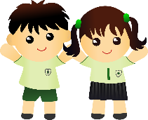
Un échange scolaire*
écrire
Élodie fait un échange scolaire à Londres. Elle parle de la visite. Écris le français.
 | Élodie (I) | Peter (he)
1)
2)
3)
4)
5)
6)
Nous aimons le français.
Il marche à l’école.
Nous portons un uniforme.
Nous parlons anglais.
Il aime le cadeau.
J’aime Londres.
Notes:
Timing: 5 minutes
Aim: Written production of verbs in the 1st/3rd person singular and 1st person plural at sentence level. Revision of regular –ER verbs introduced in previous weeks.
Procedure:
1. Check students understand the context. Encourage them to use their knowledge of English to interpret the meaning of échange scolaire.
2. Explain to students that Élodie will require a ‘je’ sentence to talk about what she does, Peter an ‘il’ sentence to talk about what he does, and both a ‘nous’ sentence to talk about what they do.
3. Students may make some error relating to structures others than the verb form; e.g. students may miss the definite article in nous aimons français. Correct this but do not penalise.
4. NB. Use the opportunity to remind students of the contraction in j’aime. Ask where else they have seen this before (students should say j’ai!) You may wish to exemplify further with other verbs such as adorer, étudier, admirer etc. These verbs will not be known to students but teachers can write them up on the board and ask students how they would say ‘I…’
5. Use the opportunity to highlight the cultural difference –wearing a uniform will be new to Élodie!
Word frequency of cognates used (1 is the most frequent word in French): échange [785], scolaire [1993]
Source: Londsale, D., & Le Bras, Y. (2009). A Frequency Dictionary of French: Core vocabulary for learners London: Routledge.

Slide 35
Dictogloss
écouter / écrire
You are going to hear Élodie talking about her exchange trip to London. Make notes in French (or English if you need to). It will be too fast for you to write every word!
Then, work with a partner to write it up in good French, as if you were Élodie. Keep the meaning the same as what you heard.
Stephen Owen
Notes:
Timing: 15-20 minutes
Aim: Reformulate auditory information into a text. The focus is regular verbs in 1st person singular and plural. All verbs and associated items of vocab are taken from the SoW and as such, should be known by the students. This activity does, however, represent a greater level of challenge and teachers may wish to scaffold this with the help tool (provided on the next slide). This then doubles as a scaffold for the write-up.
Procedure:
1. Click audio button to play passage.
2. Students listen to the passage and write notes in French/English.
3. They should then pair up to write a text that matches the information they heard.
Transcript:
Je passe une semaine à Londres. Je reste avec un ami, Peter. À la maison nous parlons français. C’est intéressant ! Nous regardons la télé, nous aimons les films. À l’école, je parle anglais. Nous portons un uniforme. C’est drôle ! Aujourd’hui, je prépare le déjeuner. Il fait beau et je fais une promenade dehors. Je donne un cadeau à Peter.

Slide 36
Dictogloss
lire / écrire
 |  | I | We | Additional info (in French or English)
to spend a week | passer une semaine
to stay with a friend | rester avec un ami
to speak French | parler français
to watch tv | regarder la télé
to like films | aimer les films
to speak English | parler anglais
to wear a uniform | porter un uniforme
to prepare lunch | préparer le déjeuner
to give a present to | donner un cadeau à
Stephen Owen
Notes:
Teachers could use this as a scaffold.
During the listening, students tick whether it is je or nous they hear associated with the activity, plus write any additional information that they hear such as ‘in the house’ or ‘at school’. This then helps students with the write up, as a record of which person to put the infinitive into.
Or it could be used as a stand alone vocab list if the teachers remove the final three columns.

Slide 37
Dictogloss
écouter / écrire
Je passe une semaine à Londres. Je reste avec un ami, Peter. À la maison nous parlons français. C’est intéressant ! Nous regardons la télé, nous aimons les films. À l’école, je parle anglais. Nous portons un uniforme. C’est drôle ! Aujourd’hui, je prépare le déjeuner. Il fait beau et je fais une promenade dehors. Je donne un cadeau à Peter.
Stephen Owen
Notes:
Here is the transcript. This can either be read by the teacher, or teachers can use the audio recording.

Slide 38
Devoirs
Vocabulary Learning Homework (Term 1.2, Week 6)
Audio file
Student worksheet
In addition, revisit: Term 1.2 Week 2
Term 1.1 Week 4
Notes:
Use this slide to set the homework.
For Y7, the typical homework will be to pre-learn vocabulary for the next lesson. There is an audio file to accompany the student worksheet.
Notes:
i) Teachers may, in addition, want to recommend use of a particular online app for the pre-learning of each week’s words. ii) Quizlet now requires parental involvement / registration / permissions for users below the age of 13, so it is perhaps most suitable for Y9 – 11 students. iii) Language Nut hosts LDP vocabulary lists and these are free for schools to use, though there is a registration process. One benefit is that all of the student tracking data that Language Nut offers are also available to schools that use the LDP lists for practice. Perhaps this makes it a good option for Y7/8.
iv) There are other free apps, and new ones are always appearing. Teachers have told us that they are currently using: Flippity, Wordwall (where using previously-created activities is free).
v) Gaming Grammar has been acquired by Language Nut. Its original content should still be available to teachers and much of it is appropriate for Y7 learners. From this lesson, for example, learners could practise:
Verbs (present): 1st person singular/plural (Verb agreement (present))
Verbs (present): 2nd person singular/plural (Verb agreement (present))
Verbs (present): 3rd person singular/plural (Verb agreement (present))

Slide 39
Vocabulaire
lire
Elle aime regarder la télé.
C’est le film préféré de Léa.
Il aime manger à la maison.
Elle aime marcher dehors.
Elle aime travailler avec un/une partenaire.
Il aime préparer le déjeuner.
She likes working with a partner.
He likes preparing lunch.
She likes walking outside.
It’s Léa’s favourite film.
She likes watching TV.
He likes eating at home.
Notes:
ALTERNATIVE PRACTICE ACTIVITIES IF TEACHERS PREFER NOT TO DO THE DICTOGLOSS.
Timing: 5 minutes (for 6 sentences)
Aim: Written recognition of words in this week’s vocabulary set in context.
Procedure:
1. Click to reveal sentences constructed from words in this week’s vocabulary set and known vocabulary. Sentences containing new verbs begin with il/elle aime so that the verbs are seen in the familiar infinitive form.
2. Students translate the sentences orally (could use think-pair-share) or in writing (e.g., using mini whiteboards).
3. Click to reveal an answer.
4. Click again to reveal a new sentence.
The sentences are as follows: 1. C’est le film préféré de Léa. 2. Elle aime regarder la télé.
3. Elle aime marcher dehors. 4. Il aime preparer le déjeuner. 5. Elle aime travailler avec un/une partenaire. 6. Il aime manger à la maison.

Slide 40
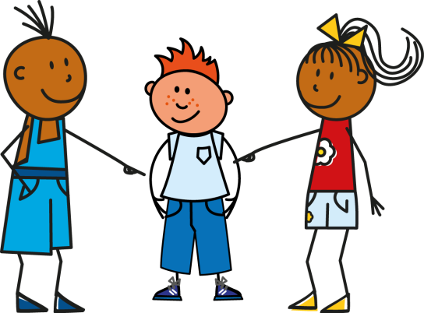
Qui fait quoi ?
écrire / parler
Notes:
ALTERNATIVE PRACTICE ACTIVITIES IF TEACHERS PREFER NOT TO DO THE DICTOGLOSS.
Timing: 6 minutes
Aim: written or oral production of first person singular, third person singular and first person plural forms of regular -ER verbs. The activity could be done as a mini-whiteboard / exercise book activity, as a paired oral activity or as a choral response.
Procedure:
1. Click to reveal a pair of circles. The circle in the top line represents who is doing the action, the second line represents the verb that should be used.
2. Students say or write pronoun/verb pairs.
3. Repeat for 12 total combinations.
Sequence:
1. il travaille
2. nous marchons
3. je prépare
4. nous regardons
5. elle marche
6. nous travaillons

Slide 41
Écris en anglais
écrire / parler
Je passe une semaine à Londres.
Je reste avec un ami, Peter.
À la maison nous parlons français.
C’est intéressant !
Nous regardons la télé,
nous aimons les films.
À l’école, je parle anglaise.
Nous portons un uniforme. C’est drôle!
Aujourd’hui, je prépare le déjeuner.
Il fait beau et je fais une promenade dehors.
Je donne un cadeau à Peter.
I’m spending a week in London.
I’m staying with a friend, Peter.
In the house we speak French.
It’s interesting!
We watch tv,
we like films.
At school I speak English.
We wear a uniform. It’s funny!
Today, I’m preparing lunch.
The weather is nice and I’m going for a walk outside.
I’m giving a present to Peter.
Notes:
ALTERNATIVE PRACTICE ACTIVITIES IF TEACHERS PREFER NOT TO DO THE DICTOGLOSS.
Timing: 8 minutes
Aim: L2 – L1 translation activity that allows teachers to check students’ understanding of the whole text.
Procedure:
1. Students could attempt this is pairs or groups of four. Remind students of the two English present tenses and encourage them to think about which they are using in their translations and why.
2. Suggested translations are provided, but appropriate alternatives should be encouraged and praised (e.g. at home rather than in the house, translations in the present simple rather than continuous, etc)

