Slide 1
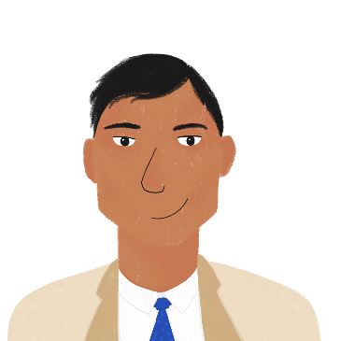
Activities in class [2]
Talking about actions to others
–ER verbs (je, tu, il/elle) Present simple vs continuous
Preposition à with certain verbs: at vs to
SSCs [-tion]
Y7 French
Term 1.2 - Week 4 - Lesson 21
Natalie Finlayson / Emma Marsden
Artwork by: Chloé Motard
Date updated: 06.08.23
Notes:
Artwork by Chloé Motard. All additional pictures selected are available under a Creative Commons license, no attribution required.
Note: all words (new and revisited) in this week of the SOW appear on all three GCSE wordlists, with these exceptions: i) AQA list does not have jaune, poète.
ii) Edexcel list does not have poème, poète (both cognates).
iii) Eduqas list does not have poème, poète (both cognates).
Learning outcomes (lesson 1)
Introducing SSC [-tion]
Consolidating -ER verbs with je, tu il/elle
Introducing present simple vs present continuous
Frequency rankings of vocabulary introduced this week (1 is the most common word in French):
1.2.4 - demander [80], donner [46], montrer [108], penser [116], cadeau [2298], exemple [259], raison [72], aujourd'hui [233], normalement [2018], que¹ [9], à² [4]
Frequency rankings of vocabulary revisited this week (1 is the most common word in French):
1.2.1 - ciel [1538], couleur [1211], poème [3031], poète [2307], rêve [1313], vague [1493], bleu [1216], jaune [2585], rouge [987], vert [1060], comme¹ [32]
1.1.3 - a [8], ai [8], avoir [8], ce (c') [12], animal [1002], chambre [633], chien [1744], chose [125], idée [239], portable [4002], règle1 [488], bon [94], un¹ [3], qui ?[14]
Source: Londsale, D., & Le Bras, Y. (2009). A Frequency Dictionary of French: Core vocabulary for learners London: Routledge.

Slide 2
-tion
Attention!
Notes:
Timing: 1 minute
Aim: To introduce SSC [-tion]
Procedure: 1. Present the letter(s) and say the [-tion] sound first, on its own. Students repeat it with you. 2. Bring up the word ”attention” on its own, say it, students repeat it, so that they have the opportunity to focus all of their attention on the connection between the written word and its sound.
3. A possible gesture for this would be to wave one’s hand in front of oneself to indicate not to proceed. 4. Roll back the animations and work through 1-3 again, but this time, dropping your voice completely to listen carefully to the students saying the [-tion] sound, pronouncing ”attention” and, if using, doing the gesture.
Word frequency (1 is the most frequent word in French):
attention [482].
Source: Londsale, D., & Le Bras, Y. (2009). A Frequency Dictionary of French: Core vocabulary for learners London: Routledge.

Slide 3
-tion
Attention!
Notes:
With sound and no pictures to focus all attention on the sound-symbol correspondence.

Slide 4
-tion
Attention!
Notes:
Without sound to elicit pronunciation (without first hearing the teacher).
Teacher to elicit pronunciation by asking “Comment dit-on …"

Slide 5
-tion
population
situation
attention!
action
solution
international
Notes:
Timing: 2 minutes
Aim: To introduce SSC [-tion]
Procedure:
1. Introduce and elicit the pronunciation of the individual SSC [-tion] and then the source word again ‘attention’ (with gesture, if using). 2. Then present and elicit the pronunciation of the five cluster words.
The cluster words have been chosen for their high-frequency, from a range of word classes, with the SSC (where possible) positioned within a variety of syllables within the words (e.g. initial, 2nd, final etc.). Additionally, we have tried to use words that build cumulatively on previously taught SSCs (see the Phonics Teaching Sequence document) and do not include new SSCs. Where new SSCs are used, they are often consonants which have a similar symbol-sound correspondence in English.
Word frequency (1 is the most frequent word in French): population [509]; action [355] situation [223]; international [282]; solution [608]; attention [482]. Source: Londsale, D., & Le Bras, Y. (2009). A Frequency Dictionary of French: Core vocabulary for learners London: Routledge.

Slide 6
-tion
population
situation
attention!
action
solution
international
Notes:
With sound and no pictures to focus all attention on the sound-symbol correspondence.

Slide 7
-tion
population
situation
attention!
action
solution
international
Notes:
Without sound to elicit pronunciation (without first hearing the teacher).
Teacher to elicit pronunciation by asking “Comment dit-on …"

Slide 8
Phonétique
lire / parler
occupation
évaluation
30
collaboration
national
question
interprétation
constitutionnel
secondes
promotion
section
option
conviction
satisfaction
orientation
0
ambition
DÉBUT
Notes:
Timing: 30 seconds (click début to begin timer)
Aim: Practise pronunciation of SSC [tion]
Procedure:
1. Click ‘début’ to start timer
2. Students have 30 seconds to accurately pronounce as many words as possible
3. Students can do this in pairs to check each others pronunciation
Word frequency (1 is the most frequent word in French): interprétation [2005], orientation [2025], collaboration [2037], conviction [2054], évaluation [2057], occupation [2096], satisfaction [2108], promotion [2139], section [2141], question [144], option [2156], national [227], constitutionnel [2249], ambition [2280]
Source: Londsale, D., & Le Bras, Y. (2009). A Frequency Dictionary of French: Core vocabulary for learners London: Routledge.

Slide 9
Vocabulaire A
lire
demander
donner
aujourd’hui
1. normally
3. to ask for, asking for
5. present, gift
le cadeau
penser
normalement
2. to give, giving
4. today
6. to think, thinking
Notes:
Timing: 10 minutes (four slides)
Aim: Written recognition of words in this week’s vocabulary set.
Procedure:
1. Explain the task to learners as follows: Here is a “bridge” built of hexagonal blocks. But it is weak at the moment, because the blocks are not in the right order! Rearrange the yellow blocks so that they show the English meaning of the French word to their left. When the blocks are in the correct position, the bridge will be strong!
2. Demonstrate to learners by filling in the first example on this slide (e.g. overwrite ‘normally’ with ‘to ask for’.
3. Students write 1-6 and the English words in the correct order.
4. Answers appear on the next slide.
5. Move on to slide 10 and repeat steps 1-4 for the remaining words in the set.

Slide 10
Réponses A
lire
demander
donner
aujourd’hui
1. to ask, asking
3. to give, giving
5. today
le cadeau
penser
normalement
2. present, gift
4. to think, thinking
6. normally
Notes:
This is the solution to the exercise. Answers appear animated one by one (in the sequence top to bottom for each column, from left to right) upon successive mouse clicks.

Slide 11
Vocabulaire B
lire
la raison
l’exemple (m)
1. that
3. to show, showing
montrer
que
à
2. at, to
4. reason
5. example
Notes:
Slide B: remaining vocabulary in the set.

Slide 12
Réponses B
lire
la raison
l’exemple (m)
1. reason
3. example
montrer
que
à
2. to show, showing
4. that
5. at, to
Notes:
As per slide A

Slide 13
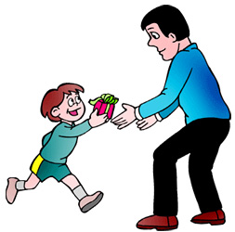
donner
[to give | giving]
donne
[gives | is giving]
Notes:
Timing: 3 minutes (6 slides)
NB: depending on the needs of the class and the time available, you may wish to choose just one or two verbs to focus on.
Aim: Introducing the verb donner more explicitly. Donner is one of the 25 most frequently used verbs in French. All 25 most frequent verbs will be introduced early on using the same format. Both long form (infinitive) and short form (3rd person singular) are introduced in order to familiarise students with the various forms of the same verb.
Procedure
1. Bring up the word donner on its own, say it, students repeat it, and remind them of the phonics.
2. Try to elicit the meaning from the students.
3. Bring up the picture, and establish the meaning of the word in English, clearly, i.e., ‘to give’. 4. Bring up the short form donne, say it, students repeat it. Try to elicit the meaning from the students.

Slide 14
donner
[to give | giving]
donne
[gives | is giving]
Notes:
Cycle through the long and short form again.

Slide 15
donne
[gives | is giving]
Il donne un cadeau à un ami.
[He gives | is giving a present to a friend.]
Notes:
Introduce the short form in a sentence.

Slide 16
donner
[to give | giving]
Il aime donner un cadeau à un ami.
[He likes to give | giving a present to a friend.]
Notes:
Introduce the long form in a sentence.

Slide 17
donne
[gives | is giving]
Il donne un cadeau à un ami.
[He gives | is giving a present to a friend.]
Notes:
Cycle through the short form in context again.

Slide 18
donner
[to give| giving]
Il aime donner un cadeau à un ami.
[He likes to give | giving a present to a friend.]
Notes:
Cycle through the long form in context again.

Slide 19
Present simple or continuous?
grammaire
English has two present tense forms.
I make the bed every week. I am making the bed at the moment.
French has one present tense only. The BE + -ing form does not exist.
Je fais le lit chaque semaine. Je fais le lit en ce moment.
Present simple - normally; routine
Present continuous (BE + -ing) - ongoing; current
Adverbs of time tell us which English tense to choose.
Je fais = I make AND
I’m making
In French, the present simple is used with all adverbs.
Notes:
Timing: 3 minutes
Aim: to describe and explain the metalanguage (present simple, present continuous and adverbs) used to talk about verbs in this and subsequent sequences.
Procedure:
Click to bring up the explanation
Highlight the distinction between present simple for routine actions and present continuous for current/ongoing actions.
Stress the fact that the BE + -ing form is an English construction only. ‘Être’ cannot be used with a verb this way.

Slide 20
Present simple or continuous?
lire
Nick, an exchange student, is babysitting for the Petit family. He makes notes about the children, Julien and Géraldine.
Choose present simple (normally; routine) or continuous (ongoing; current).
A
Julien washes/is washing up at the moment.
B
Géraldine learns/is learning English every week.
C
Géraldine plays/is playing with her friends at the moment.
D
Julien reads/is reading a book at the moment.
E
Géraldine sings/is singing every week.
Notes:
Timing: 3 minutes
Aim: Awareness-raising exercise in English to teach students to connect temporal adverbs with tense.
Procedure:
Students read the sentences and choose the correct tense (present simple or continuous) according to the temporal adverb.
Note: there is no need for writing in this activity; take responses orally as it is preparation for the target language activities that follow.

Slide 21
Adverbs of time
grammaire
[every week]
chaque semaine
[usually]
normalement
en ce moment
[at the moment]
aujourd’hui
[today]
Notes:
Timing: 1 minute
Aim: To clarify which form of the English present tense is indicated by ‘chaque semaine’ and ‘en ce moment’, then ‘normalement’ and ‘aujourd’hui’.
Procedure:
Elicit pronunciation and English meaning from students of ‘chaque semaine’ and ‘en ce moment’, then ‘normalement’ and ‘aujourd’hui’.
Clarify that ‘chaque semaine’ and ‘normalement’ indicates routine action and require present simple in English and ‘en ce moment’ and ‘aujourd’hui’ indicate current/ongoing actions or plans and require present continuous in English.

Slide 22
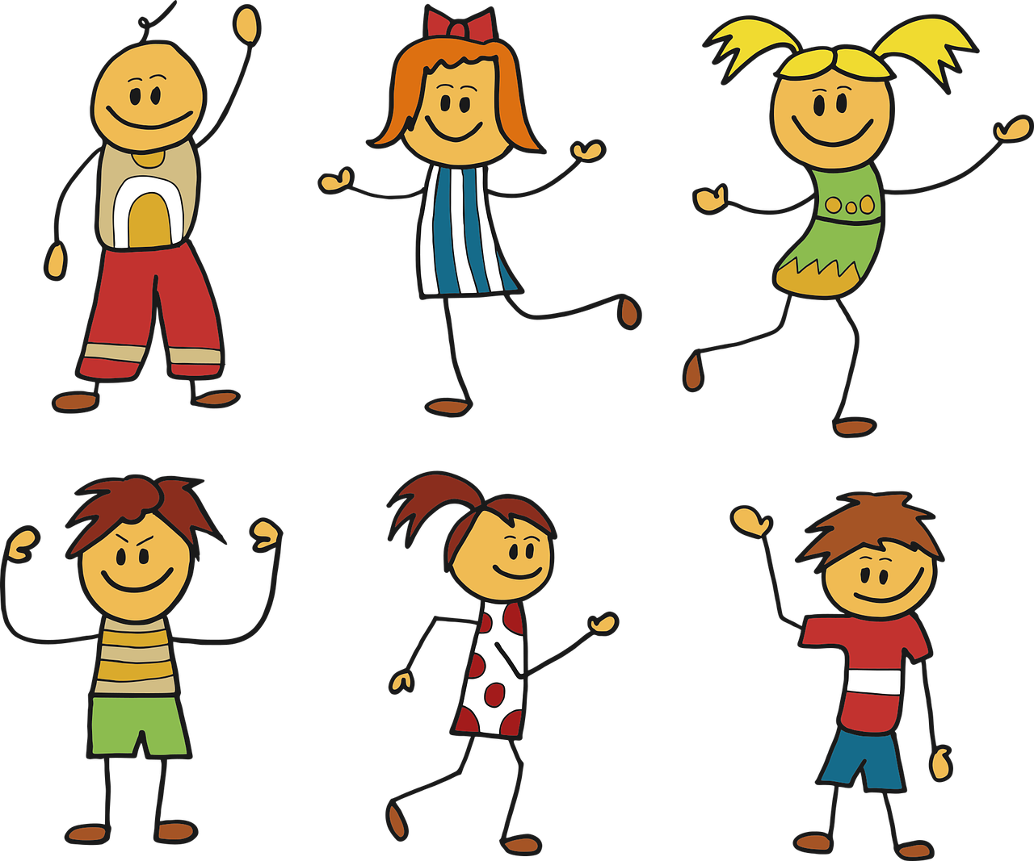
La classe d’Amir
Le verbe en anglais, c’est quoi ?
Present simple / continuous
Present simple / continuous
lire
 | continuous | simple
1. Claude aime le football, normalement. | is liking | likes
2. Il passe le week-end en France en ce moment. | is spending | spends
3. Paul fait la cuisine aujourd’hui. | is doing | does
4. Aujourd’hui, Jean donne un cadeau à un ami. | is giving | gives
5. Gaëlle reste à l’école, normalement . | is staying | stays
6. Zoë parle à une amie chaque semaine. | is talking | talks
Notes:
Timing: 8 minutes
Aim: to raise students’ awareness about the ambiguity of the French present tense. This activity should give rise to lots of talk about the two English forms.
1. Ask learners to consider whether they would translate the French present tense verb in each sentence with the simple present or the present continuous meaning.
2. Students write 1-6 and the translations they think ‘feel right’.
3. Answers are provided via animated ovals which appear upon clicking the mouse. In each case, discuss the reason behind the answer. It is the adverb meaning that will prompt students to select the most natural present tense translation.
Word frequency of cognates used (1 is the most frequent word in French): football [2602]
Source: Londsale, D., & Le Bras, Y. (2009). A Frequency Dictionary of French: Core vocabulary for learners London: Routledge.

Slide 23
Amir et Bilal
Present simple / continuous
écouter
Le verbe en anglais, c’est quoi ?
Amir is making birthday plans with his dad, Bilal. What do they normally do, and what are they doing today? Choose present simple or continuous.
 |  | simple | continuous
 | Amir | asks for | is asking for | a present.
 | Bilal | thinks | is thinking | that it’s good.
 | Amir | gives | is giving | an example.
 | Bilal | gives | is giving | a reason.
 | Amir | asks for | is asking for | a boat.
 | Bilal | shows | is showing | a model to Amir.
1
2
3
4
5
6
Notes:
Timing: 8 minutes
Aim: Basic translation exercise to practise present tenses, using vocabulary from this week’s new and revisited sets.
1. Students write 1-8 and decide whether the simple or continuous translation is needed based on the use of normalement or aujourd’hui. Teacher reminds students that the French tense is the same throughout, and that students will have to listen out for the time phrases in French to find out this information.
2. Answers are revealed on clicks. Teacher explains that the time phrases are not given in the English because the verb tense provides information about whether things happen routinely, or are ongoing right now.
Transcript:
Amir demande un cadeau, normalement.
Bilal pense que c’est bon, normalement.
Amir donne un exemple à Bilal, normalement.
Bilal donne une raison à Amandine aujourd’hui.
Amir demande un bateau aujourd’hui.
Bilal montre un modèle à Amir aujourd’hui.

Slide 24
The preposition à
grammaire
As we have learnt, the preposition à can mean ‘at’:
Il reste à l’école.
The preposition à can also mean ‘to’ when used with certain verbs:
Bilal parle à Amir.
Sometimes, we leave out the ‘to’ in English. This cannot happen in French.
Bilal donne un cadeau à Amir.
Elle demande la raison à Julien.
He stays / is staying at school.
Bilal speaks / is speaking to Amir.
In French, you ask something ‘to’ someone, just like you say something to someone.
Bilal gives / is giving a present to Amir.
OR Bilal gives / is giving Amir a present.
She asks Julien for the reason.
Notes:
Timing: 3 minutes
Aim: Introducing the different meanings of à with certain verbs. Teacher to stress the fact that the à cannot be dropped in French, and highlight the need for à in constructions with demander.

Slide 25
À l’école
lire
What is happening at school? Choose the correct meaning of à.
 | à = at / to
Léa parle à une amie.
Sophie fait une activité à l’école.
Le gouvernement donne €5000 à l’école.
Sophie montre la question à Léa.
Sophie est une fille intelligente à l’école.
Sophie demande la réponse à la professeure.
to
Léa
at
to
to
at
Sophie
[-]
Notes:
Timing: 5 minutes
Aim: Practise different translations of preposition à. Written recognition of some of the vocabulary in this week’s new and revisited sets.
Procedure:
Students read the sentences and tick the relevant translation of à based on context.
Before revealing answers revealed on clicks, elicit full oral translations of each sentence.
Attention should be drawn to the fact that the same preposition can be translated differently depending on the context, and highlight that in number 8, à implies the meaning ‘to’, although it does not translate directly into English.
Word frequency of cognates used (1 is the most frequent word in French): gouvernement [160]
Source: Londsale, D., & Le Bras, Y. (2009). A Frequency Dictionary of French: Core vocabulary for learners London: Routledge.

Slide 26
Activities in class [2]
Talking about actions to others
–ER verbs (je, tu, il/elle)
Preposition à with certain verbs: at vs to
SSCs [-ien]
Y7 French
Term 1.2 - Week 4 - Lesson 22
Stephen Owen / Emma Marsden / Kirsten Somerville / Catherine Morris
Artwork by: Chloé Motard
Date updated: 06.08.23
Notes:
Artwork by Chloé Motard. All additional pictures selected are available under a Creative Commons license, no attribution required.
Learning outcomes (lesson 2):
Introducing SSC [-ien]
Consolidating -ER verbs with je, tu il/elle
Consolidating present simple vs present continuous
Frequency rankings of vocabulary introduced this week (1 is the most common word in French):
1.2.4 - demander [80], donner [46], montrer [108], penser [116], cadeau [2298], exemple [259], raison [72], aujourd'hui [233], normalement [2018], que¹ [9], à² [4]
Frequency rankings of vocabulary revisited this week (1 is the most common word in French):
1.2.1 - ciel [1538], couleur [1211], poème [3031], poète [2307], rêve [1313], vague [1493], bleu [1216], jaune [2585], rouge [987], vert [1060], comme¹ [32]
1.1.3 - a [8], ai [8], avoir [8], ce (c') [12], animal [1002], chambre [633], chien [1744], chose [125], idée [239], portable [4002], règle1 [488], bon [94], un¹ [3], qui ?[14]
Source: Londsale, D., & Le Bras, Y. (2009). A Frequency Dictionary of French: Core vocabulary for learners London: Routledge.

Slide 27
Vocabulaire
Le mur* de mots
parler
avoir
j’ai
un, une
un rêve
to have
I have
a/an (m, f)
dream
rouge
bleu
vert
jaune
red
blue
green
yellow
le ciel
la vague
la chose
le chien
the sky
the wave
the thing
the dog
qui ?
la règle
le portable
la couleur
who?
the ruler
the phone
the colour
comme
ce, c’
bon
la chambre
like, as
this, that
good
the bedroom
le mur - wall
Notes:
Timing: 5 minutes
Aim: to practise spoken production of 20 new and revisited words, in a low stakes but time-limited activity. Note: some words also appear elsewhere in this week’s activities, but this activity ensures that all words from this week’s revisited sets and not in other activities are practised.
Procedure:
Work from left to right, top to bottom on the word wall. Ask ‘blue’ c’est quoi en anglais ?
Click to start the 5-second animation. Pupils say the French word before the animation finishes and reveals the word.
Continue with all words.

Slide 28
ien
bien
Notes:
Timing: 1 minute
Aim: To introduce SSC [ien]
Procedure: 1. Present the letter(s) and say the [ien] sound first, on its own. Students repeat it with you. 2. Bring up the word ”bien” on its own, say it, students repeat it, so that they have the opportunity to focus all of their attention on the connection between the written word and its sound.
3. A possible gesture for this would be to give a thumbs up sign. 4. Roll back the animations and work through 1-3 again, but this time, dropping your voice completely to listen carefully to the students saying the [ien] sound, pronouncing ”bien” and, if using, doing the gesture.
Word frequency (1 is the most frequent word in French):
bien [47]
Source: Londsale, D., & Le Bras, Y. (2009). A Frequency Dictionary of French: Core vocabulary for learners London: Routledge.

Slide 29
ien
bien
Notes:
With sound and no pictures to focus all attention on the sound-symbol correspondence.

Slide 30
ien
bien
Notes:
Without sound to elicit pronunciation (without first hearing the teacher).
Teacher to elicit pronunciation by asking “Comment dit-on …"

Slide 31
ien
ancien
chien
rien
bien
combien ?
[nothing]
bientôt
€ ?
[soon]
Notes:
Timing: 2 minutes
Aim: To introduce SSC [ien]
Procedure:
1. Introduce and elicit the pronunciation of the individual SSC [ien] and then the source word again ‘bien’ (with gesture, if using). 2. Then present and elicit the pronunciation of the five cluster words.
The cluster words have been chosen for their high-frequency, from a range of word classes, with the SSC (where possible) positioned within a variety of syllables within the words (e.g. initial, 2nd, final etc.). Additionally, we have tried to use words that build cumulatively on previously taught SSCs (see the Phonics Teaching Sequence document) and do not include new SSCs. Where new SSCs are used, they are often consonants which have a similar symbol-sound correspondence in English.
Word frequency (1 is the most frequent word in French): chien [1744]; rien [168] bientôt [1208]; ancien [392]; combien? [800]; bien [47]. Source: Londsale, D., & Le Bras, Y. (2009). A Frequency Dictionary of French: Core vocabulary for learners London: Routledge.

Slide 32
ien
ancien
chien
rien
bien
combien ?
bientôt
Notes:
With sound and no pictures to focus all attention on the sound-symbol correspondence.

Slide 33
ien
ancien
chien
rien
bien
combien ?
bientôt
Notes:
Without sound to elicit pronunciation (without first hearing the teacher).
Teacher to elicit pronunciation by asking “Comment dit-on …"

Slide 34
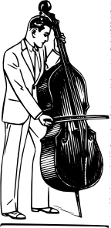
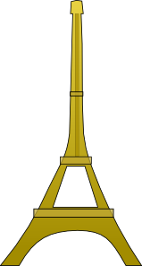
Phonétique
politicien
lire / parler
30
maintien
technicien
comédien
[maintenance]
comédien
entretien
chrétien
[interview]
secondes
musicien
bienvenu
[welcome]
gardien
[guardian]
chirurgien
égyptien
0
parisien
[surgeon]
DÉBUT
Notes:
Timing: 30 seconds (click début to begin timer)
Aim: Practise pronunciation of SSC [tion]
Procedure:
1. Click ‘début’ to start timer
2. Students have 30 seconds to accurately pronounce as many words as possible
3. Students can do this in pairs to check each others pronunciation
Word frequency (1 is the most frequent word in French): maintien [1819], technicien [2461], comédien [4253], chrétien [1895], gardien [1924], musicien [3100], politicien [3371], parisien [2549], entretien [1433], bienvenu [3714], égyptien [4137], comédien [4253], chirurgien [4787]
Source: Londsale, D., & Le Bras, Y. (2009). A Frequency Dictionary of French: Core vocabulary for learners London: Routledge.

Slide 35
Penser à / penser que
grammaire
We can also use the preposition à with penser to mean ‘about’:
Bilal pense à Amandine.
Another word that often follows penser is que, meaning ‘that’.
Sometimes, we leave out ‘that’ in English. This cannot happen in French.
Bilal pense que c’est vrai.
When we use que before a word beginning with a vowel, it becomes qu’:
Bilal pense qu’elle est drôle.
Bilal thinks / is thinking about Amandine.
Similar to:
le / la → l’
ce → c’
Bilal thinks that it’s true.
OR Bilal thinks it’s true.
Bilal thinks that she’s funny.
OR Bilal thinks she’s funny.
Notes:
Timing: 3 minutes
Aim: Introducing the use of different prepositions with penser (penser à vs penser que). Teacher to stress that the que cannot be dropped in French.

Slide 36
C’est quoi ? C’est qui ?
lire
Léa and Sophie are playing a guessing game. Complete the questions.
 |  | A | B
1 | Tu penses à | un poème triste ? | c’est triste ?
2 | Tu penses à | elle est française ? | une poète française ?
3 | Tu penses qu’ | un homme anglais ? | il est anglais ?
4 | Tu penses qu’ | Un chanteur excellent ? | il est excellent ?
5 | Tu penses à | c’est jaune ? | un portable jaune?
6 | Tu penses qu’ | il est méchant ? | un acteur méchant ?
Notes:
Timing: 5 minutes
Aim: to practise the meanings and structures associated with penser à and penser que.
1. Teacher to remind students that the preposition à is used before a noun phrase, while the conjuncton que is used before a subject + verb phrase.
2. Students write 1-8 and A or B.
3. Answers appear on clicks.
All vocabulary has been taught previously.

Slide 37
La présentation de Léa [1/3]
lire
a dream
example
who
like, as
the reason
today
is thinking of
is listening to
the idea
to do/make
a poet
to find
un rêve
exemple
Aujourd’hui, Léa écoute la professeure à l’école. L’idée est de trouver des informations sur une personne importante. C’est un rêve pour Léa. Elle aime faire les présentations ! Mais qui, par exemple ? Sophie pense à un poète comme Paul Éluard mais Léa pense à Malala Yousafzai. La raison ? Malala est un modèle pour beaucoup de* personnes.
qui
comme
la raison
aujourd’hui
pense à
écoute
l’idée
faire
un poète
trouver
beaucoup de – a lot of
Notes:
Timing: 15 minutes (3 slides)
Aim: to set the scene for this week’s lesson; to practise written comprehension of some of this week’s revisited vocabulary.
Procedure:
1. Pupils read the text aloud with teacher support, as needed. Almost all words have been previously taught or are cognates. Two cognates practise one of this week’s SSC [-tion].
2. Pupils focus on the English words and identify the French words from the bold words in the text. Pupils volunteer answers in order.
3. Teachers elicit an oral translation of the text from the class to establish the context of the next few activities and to consolidate vocabulary knowledge.
Note: increase the challenge by removing the table and simply eliciting the meanings of the words in bold.
Frequency of unknown words and cognates:
présentation [1723] important [215] information [317]
Londsale, D., & Le Bras, Y. (2009). A Frequency Dictionary of French: Core vocabulary for learners London: Routledge.

Slide 38
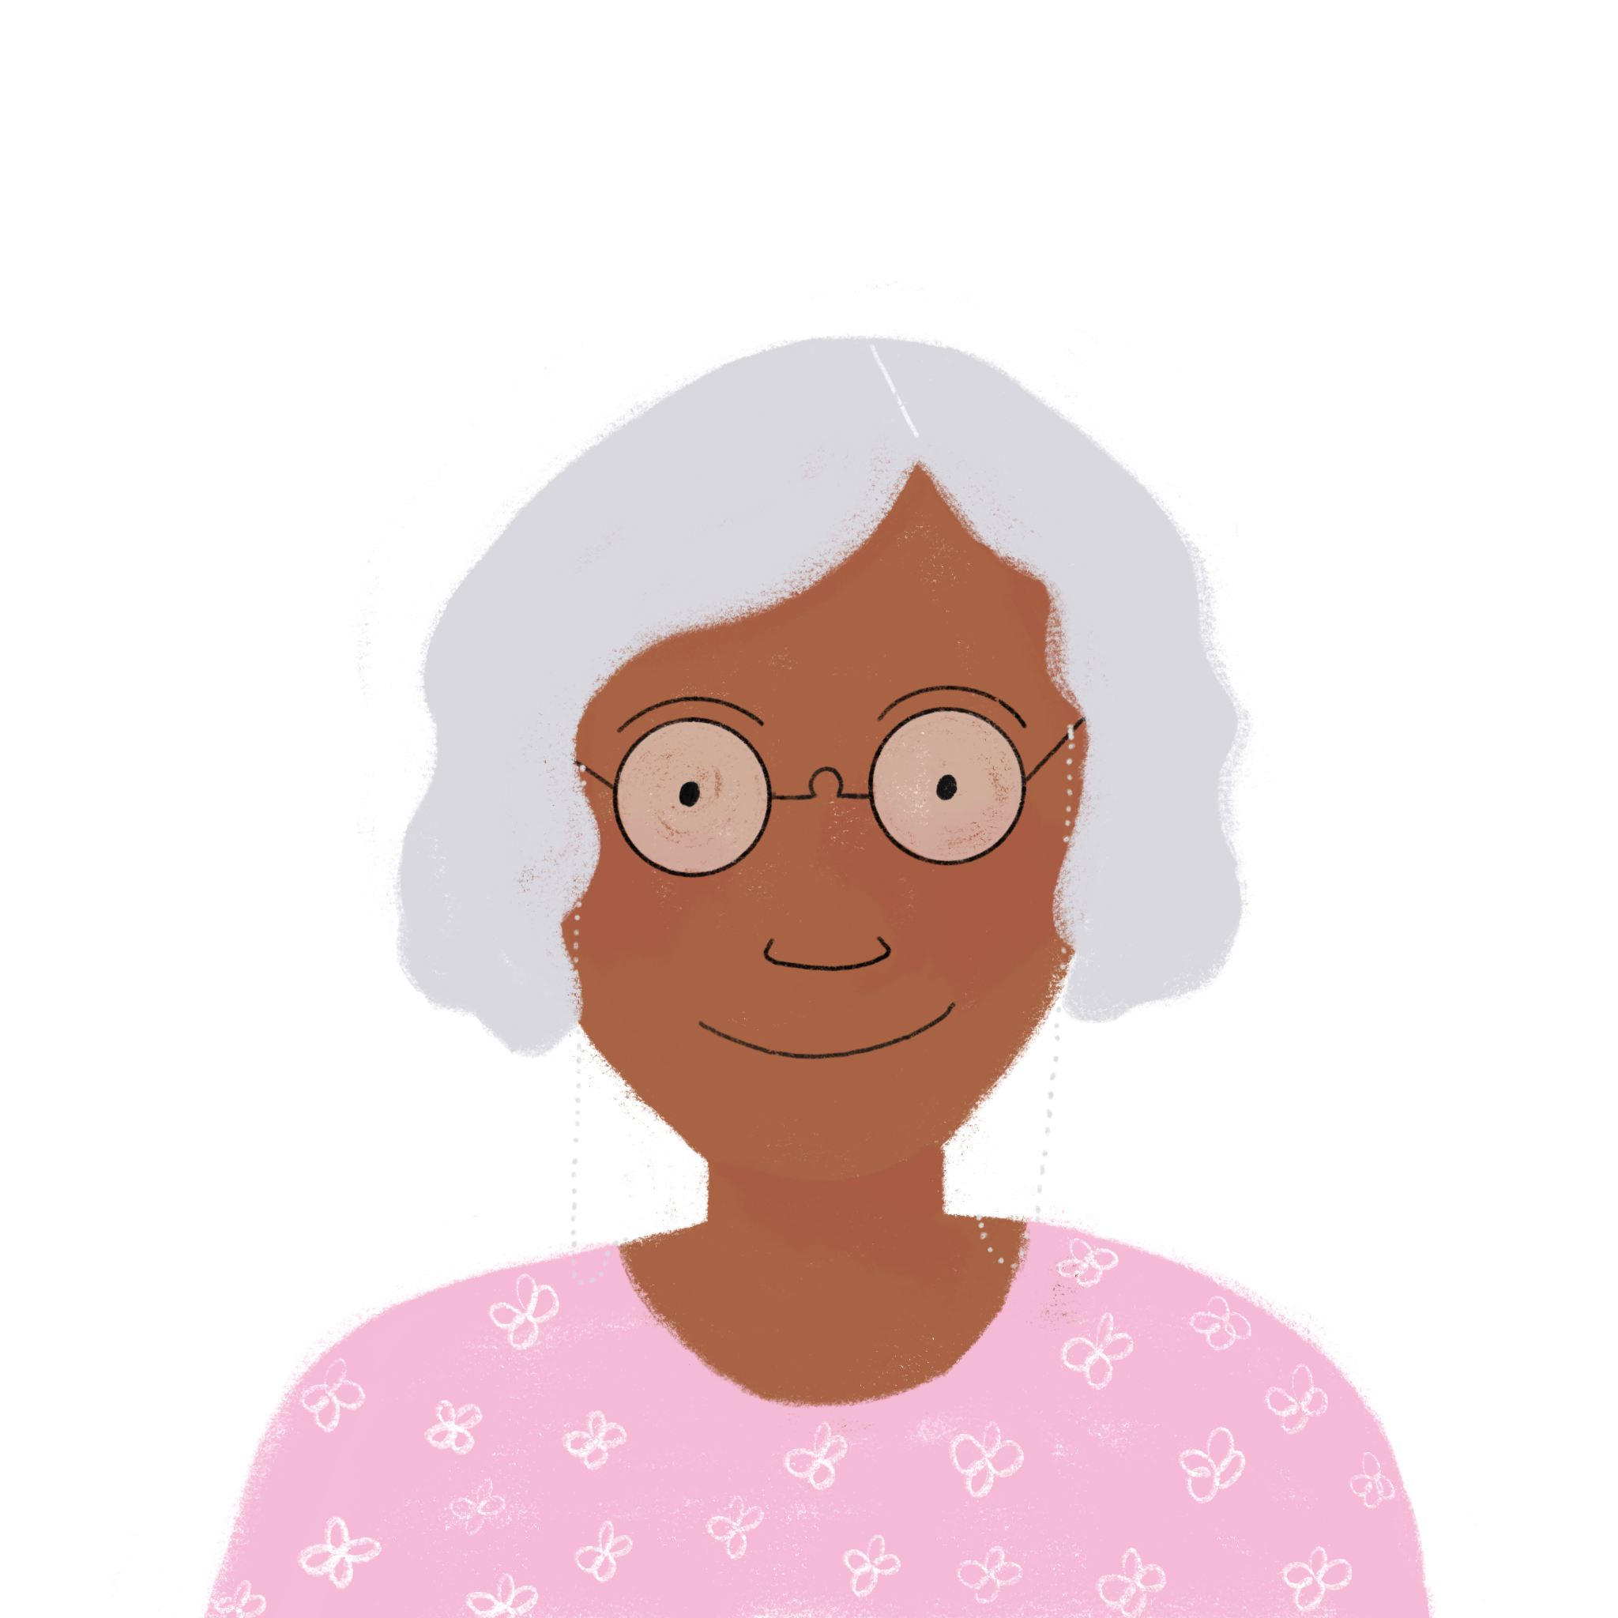
La présentation de Léa [2/3]
La professeure parle à Léa. C’est ‘je’ ou ‘tu’ ?
lire
 |  | I (je) | you (tu)
1 | ... demande un texte intéressant, aujourd’hui.
2 | En ce moment ... penses à un exemple.
3 | ... as une idée intéressante.
4 | ... montre la présentation à la classe, aujourd’hui ?
5 | ... donne un cadeau rouge, chaque semaine.
6 | ... montres l’idée à une amie en ce moment ?
Notes:
[2/2] Aim: to practise distinguishing between the first and second person singular forms of regular –ER verbs (introduced in the previous week).
Procedure:
1. Students write 1-6 and ‘je’ or ‘tu’, using their knowledge of verb endings to help them.
2. Answers revealed on clicks.
3. Students are then asked to translate each complete sentence into English (this can be elicited orally). Do they need to use the present simple or continuous in their translations?
N.B. Listening activities of this type are not possible for the first and second person singular forms of regular –ER verbs, since the two forms are orally indistinguishable. Only the written form differs, hence the reading activity.
Frequency of unknown words and cognates:
présentation [1723] important [215] information [317]
Londsale, D., & Le Bras, Y. (2009). A Frequency Dictionary of French: Core vocabulary for learners London: Routledge.

Slide 39
La présentation de Léa [3/3]
La professeure parle à Léa (tu). Elle parle aussi de Sophie (elle).
lire
Does the teacher ask Léa (tu) or about Sophie (elle) ?
... demandes un ordinateur ?
... a un portable en classe, aujourd’hui ?
... aimes les poèmes ?
... penses à un homme ou à une femme ? ... aime faire les présentations ?
... pense que c’est une bonne idée ? ... trouves une personne intéressante ?
 | you (tu) | she (elle)
1
2
3
4
5
6
Notes:
[3/3]
Aim: to practise distinguishing between the 2nd and 3rd person singular forms of regular –ER verbs (introduced in the previous week); to practise understanding previously taught vocabulary.
Procedure:
1. Students write 1-6 and ‘je’ or ‘tu’, using their knowledge of verb endings to help them.
2. Answers revealed on clicks.
3. Students are then asked to translate each complete sentence into English (this can be elicited orally).
N.B. Listening activities of this type are not possible for the first and second person singular forms of regular –ER verbs, since the two forms are orally indistinguishable. Only the written form differs, hence the reading activity.
Frequency of unknown words and cognates:
présentation [1723]
Londsale, D., & Le Bras, Y. (2009). A Frequency Dictionary of French: Core vocabulary for learners London: Routledge.

Slide 40
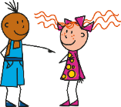
Un dialogue en classe
A: You are Léa and you are talking to Sophie. B: You are another student in Léa’s class.
parler
A: Decide on an order for your sentences and note the letter sequence. Don’t show your partner. Say all your sentences/questions in your order. B: Listen and note the letters down in order. Then check together.
A | B | C | D
E | F | G | H
donner – un cadeau – un ami
parler – la professeure
montrer – un exemple
aimer – l’idée
donner – un cadeau – un ami
aimer – l’idée
montrer – un exemple
parler – la professeure
Notes:
(OR SEE THE ALTERNATIVE SPEAKING ACTIVITY AT THE END OF THE SLIDE DECK) Timing: 5 minutes (two slides) Aim: to practise production of 1 and 2nd person present tense sentences, using previously taught vocabulary and the new vocabulary from this week. Procedure: 1. Tell students they are taking the roles of Sophie and Léa who are in class working on their presentations. 2. They need to translate the prompts into French in their chosen order.
3. The listening student notes the order.
Note: ensure that students recognise the pronoun images for ‘je’ and ‘tu’.

Slide 41
Un dialogue en classe
B: You are Sophie and you are talking to Léa. A: You are another student in Léa’s class.
parler
B: Decide on an order for your sentences and note the letter sequence. Don’t show your partner. Say all your sentences/questions. A: Listen and note the letters down in order. Then check together.
A | B | C | D
E | F | G | H
trouver – une solution
aimer – l’école
trouver – une solution
rester – calme
aimer –
l’école
rester – calme
porter –
un uniforme
porter – un uniforme
Notes:
[2/2]
Note: ensure that students recognise the pronoun images for ‘je’ and ‘tu’.

Slide 42
Malala Yousafzai
Jigsaw translation [1/2] Écris en anglais et en français.
lire / écrire
français
anglais
elle
I admire
1. J'admire Malala Yousafzai car* _______ ______ courageuse _____ modeste.
2. Elle lutte* contre l'injustice _____ pour l’éducation des _________.
3. ______ ____________ _____ _____________ ___ __________ _______une solution, _______________.
4. Malala _____ ____ _______ calme ____ ________________.
1. ___ _________ Malala Yousafzai because* she is ___________ and _________.
2. ____ _________ __________ _____________ and _______ _____ _______________ ____ girls.
3. She asks for the reasons and she finds ____ _________, usually.
4. Malala is a ________ and intelligent woman.
est
et
brave
modest
et
She fights against injustice
filles
for the education of
Elle demande les raisins et
a
elle trouve
solution
normalement
est une femme
et
intelligente
calm
lutter – to fight
Notes:
Timing: 10 minutes (2 slides) Aim: to practise written production of previously taught vocabulary and structures, and comprehension of cognates. Procedure: 1. Students work to complete English and French versions of the text.
2. Elicit answers and click to being up (French, then English, for each sentence) answers.
Note: there are quite a few cognates in this text. These have deliberately not been glossed to provide the opportunity for i) practising their recognition and/or ii) practising inference. As in Week 5 of Term 1, we can prompt students again here to use the surrounding words they know to work out a plausible meaning of, for example, words like: contre, pour (in sentence 2), and quatre languages (in sentence 5). Image attribution: 内閣官房内閣広報室, CC BY 4.0 via Wikimedia Commons

Slide 43
Malala Yousafzai
Jigsaw translation [2/2] Écris en anglais et en français.
lire / écrire
français
anglais
lire
écouter
She likes
écrire
5. ___ _________ reading, writing, listening and speaking _____ ______________: Pashto, Urdu, English and French.
6. She is ___ model ________ lots of* people.
7. I am pleased ____ ___________ her* _______________. Goodbye and thank you, Malala!
5. Elle aime _______, ___________, ____________ ____ ______________ quatre langues : le pachto, l’ourdou, __ _________ _____ ____ _____________.
6. _____ __________ un __________ pour beaucoup de* ____________________.
7. _____ __________ ____________ de lire son* histoire. ____ ___________ _____ ____________, Malala !
et parler
four languages
l’anglais et le
français
Elle est
modèle
a
for
personnes
to read
Je suis content(e)
story
Au revoir et merci
l’ourdu (Urdu) and le pachto (Pashto) are Indo-Iranian languages.

Slide 44
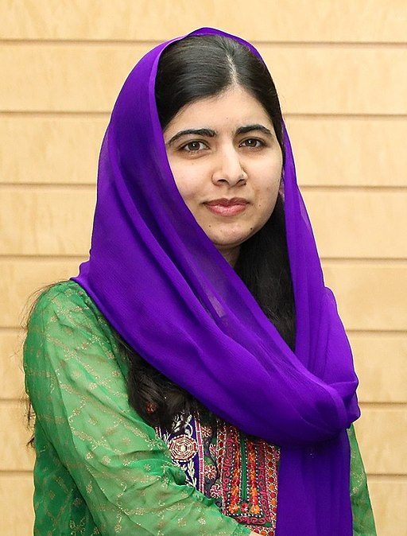
Malala Yousafzai
Give Léa’s presentation in French.
parler
J'admire Malala Yousafzai car* [she is] courageuse [and] modeste.
Elle lutte* contre l'injustice et pour l’éducation des [girls].
[She asks for the reasons] et [she finds] une solution, [usually].
Malala est [a woman] calme et intelligente.
[She likes reading, writing, listening and speaking] quatre langues : le pachto, l’ourdou, [English and French].
[She is a model] pour beaucoup de* [people].
[I am pleased] de lire son* histoire. [Goodbye and thank you], Malala !
l’ourdu (Urdu) and le pachto (Pashto) are Indo-Iranian languages.
car – because|lutter – to fight|beaucoup de – a lot of
Notes:
Timing: 2 minutes Aim: to practise spoken production of previously taught vocabulary and structures in the format of an oral translation task, using the same text that has just been used for written translation; to practise read aloud of familiar and unfamiliar language. Procedure: 1. Students work in pairs, taking it in turns to read aloud each sentence, translating each English word/phrase into French as they go. 2. When they finish, they should repeat the task, so that each gets the opportunity to say each of the sentences. Image attribution: 内閣官房内閣広報室, CC BY 4.0 via Wikimedia Commons

Slide 45
Malala Yousafzai
lire
J'admire Malala Yousafzai car* elle est courageuse et modeste.
Elle lutte* contre l'injustice et pour l’éducation des filles.
Elle demande les raisons et
elle trouve une solution, normalement.
Malala est une femme calme et intelligente.
Elle aime lire, écrire, écouter et parler quatre langues, le pachto, l’ourdou, l'anglais et le français.
Elle est un modèle pour beaucoup de* personnes.
Je suis contente de lire son* histoire. Au revoir et merci, Malala !
l’ourdu (Urdu) and le pachto (Pashto) are Indo-Iranian languages.
car – because|lutter – to fight|beaucoup de – a lot of
Notes:
Full version of the text for reference. Image attribution: 内閣官房内閣広報室, CC BY 4.0 via Wikimedia Commons

Slide 46
Devoirs
Vocabulary Learning Homework (Term 1.2, Week 5)
Audio file
Student worksheet
In addition, revisit: Term 1.2 Week 2 Term 1.1 Week 4
Notes:
Use this slide to set the homework.
For Y7, the typical homework will be to pre-learn vocabulary for the next lesson. There is an audio file to accompany the student worksheet.
Notes:
i) Teachers may, in addition, want to recommend use of a particular online app for the pre-learning of each week’s words. ii) Quizlet now requires parental involvement / registration / permissions for users below the age of 13, so it is perhaps most suitable for Y9 – 11 students. iii) Language Nut hosts LDP vocabulary lists and these are free for schools to use, though there is a registration process. One benefit is that all of the student tracking data that Language Nut offers are also available to schools that use the LDP lists for practice. Perhaps this makes it a good option for Y7/8.
iv) There are other free apps, and new ones are always appearing. Teachers have told us that they are currently using: Flippity, Wordwall (where using previously-created activities is free).
v) Gaming Grammar has been acquired by Language Nut. Its original content should still be available to teachers and much of it is appropriate for Y7 learners. From this lesson, for example, learners could practise:
Prepositions (to the): Gender (Prepositions)
Verbs (present): 1st person singular/plural (Verb agreement (present))
Verbs (present): 2nd person singular/plural (Verb agreement (present))
Verbs (present): 3rd person singular/plural (Verb agreement (present))

Slide 47
Un dialogue en classe
parler
Are you thinking about a an actor or a singer?
No, I’m thinking about a poet.
[penser à|acteur | chanteur]
[penser à|poète]
The teacher is asking for an interesting text, today!
Yes. I am very glad. I like doing the presentations every week.
[demander | un texte]
[faire | les presentations]
Am I showing the presentation to the class?
Yes. It’s normal! You talk to the class every week !
[montrer | la présentation]
[normal | parler]
The teacher is giving a present for the presentations, today! Good luck!
It’s true. I like talking but I also like listening!
[vrai | parler | écouter]
[donner |un cadeau | Bonne chance !]
Notes:
ALTERNATIVE SPEAKING OR WRITING ACTIVITY WITH MORE CHALLENGE Timing: 5 minutes Aim: to practise production of 1 and 2nd person present tense sentences, using previously taught vocabulary and the new vocabulary from this week. Procedure: 1. Tell students they are taking the roles of Sophie and Léa who are in class working on their presentations. 2. They need to translate the prompts into French to conduct the dialogue.

Slide 48
Malala Yousafzai
lire
J'admire Malala Yousafzai car* elle est courageuse et modeste. Comme jeune pakistanaise, elle lutte* contre le racisme et l'injustice et pour l’éducation des filles. Elle demande les raisons et elle trouve une solution, normalement.
Elle est calme et forte*. Elle aime lire, écrire, écouter et parler quatre langues, le pachto, l’ourdou, l'anglais et le français.
Malala est une femme intelligente et intéressante. Elle est un modèle pour beaucoup de* personnes. Je suis contente de lire son histoire. Au revoir et merci, Malala !
l’ourdu (Urdu) and le pachto (Pashto) are Indo-Iranian languages.
car – because | lutter – to fight | fort(e) – strong | beaucoup de – a lot of
Notes:
This is a longer, slightly more developed version of the same text. Image attribution: 内閣官房内閣広報室, CC BY 4.0 via Wikimedia Commons

