Slide 1
Activities in class
Saying what people do
What is a verb?
-ER verbs (je, tu, il/elle) in the present tense
SSC [ai]
Y7 French
Term 1.2 - Week 3 - Lesson 19
Natalie Finlayson / Emma Marsden
Artwork by: Chloé Motard
Date updated: 06.08.23
Notes:
Artwork by Chloé Motard. All additional pictures selected are available under a Creative Commons license, no attribution required.
Note: all words (new and revisited) in this week of the SOW appear on all three GCSE wordlists, with these exceptions: i) AQA list does not have cocher, ménage, modèle.
ii) Edexcel list does not have cocher, intelligent, méchant, ménage.
iii) Eduqas list does not have cocher, intelligent, méchant, modèle.
Learning outcomes (lesson 1)
Introduction of SSC [ai]
Introduction of the present tense used with its simple meaning
Word frequency (1 is the most frequent word in French):
7.1.2.3 (introduce) aimer [242], cocher [>5000], passer¹ [90], porter [105], rester [100], trouver [83], école [477], moment [148], semaine [245], solution [608], uniforme [1801], chaque [151], à¹ [4], avec [23]
7.1.1.7 (revisit) faire [25], fais [25], fait [25], ça [54], activité [452], courses [1289], cuisine [2618], devoirs [39], lit [1837], ménage [2326], modèle [958], d'accord [736], quoi ? [297]
7.1.1.2 (revisit) est [5], il [13], elle [38], amusant [4695], calme [1731], content [1841], excellent [1225], intelligent [2509], malade [1066], méchant [3184], triste [1843], mais [30], ou [33], merci [1070]
Source: Londsale, D., & Le Bras, Y. (2009). A Frequency Dictionary of French: Core vocabulary for learners London: Routledge.
The frequency rankings for words that occur in this PowerPoint which have been previously introduced in NCELP resources are given in the NCELP SOW and in the resources that first introduced and formally re-visited those words.
For any other words that occur incidentally in this PowerPoint, frequency rankings will be provided in the notes field wherever possible.
The additional English meanings of the following words have been added to Quizlet since the creation of this resource: rester: to stay, staying; to remain, remaining

Slide 2
ai
vrai
Notes:
Timing: 1 minute
Aim: To introduce SSC [ai]
Procedure: 1. Present the letter(s) and say the [ai] sound first, on its own. Students repeat it with you. 2. Bring up the word ”vrai” on its own, say it, students repeat it, so that they have the opportunity to focus all of their attention on the connection between the written word and its sound.
3. A possible gesture for this would be to mime a ‘tick’.
4. Roll back the animations and work through 1-3 again, but this time, dropping your voice completely to listen carefully to the students saying the [ai] sound, pronouncing ”vrai” and, if using, doing the gesture.
Word frequency (1 is the most frequent word in French):
vrai [292].
Source: Londsale, D., & Le Bras, Y. (2009). A Frequency Dictionary of French: Core vocabulary for learners London: Routledge.

Slide 3
ai
vrai
Notes:
With sound and no pictures to focus all attention on the sound-symbol correspondence.

Slide 4
ai
vrai
Notes:
Without sound to elicit pronunciation (without first hearing the teacher).
Teacher to elicit pronunciation by asking “Comment dit-on …"

Slide 5
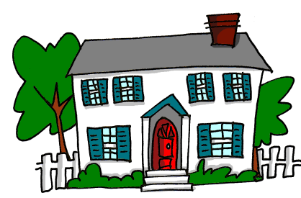
ai
maison
raison
[reason]
mauvais
vrai
faire
[bad]
semaine
[to do]
[week]
Notes:
Timing: 2 minutes
Aim: To introduce SSC [ai]
Procedure:
1. Introduce and elicit the pronunciation of the individual SSC [ai] and then the source word again ‘vrai’ (with gesture, if using). 2. Then present and elicit the pronunciation of the five cluster words.
The cluster words have been chosen for their high-frequency, from a range of word classes, with the SSC (where possible) positioned within a variety of syllables within the words (e.g. initial, 2nd, final etc.). Additionally, we have tried to use words that build cumulatively on previously taught SSCs (see the Phonics Teaching Sequence document) and do not include new SSCs. Where new SSCs are used, they are often consonants which have a similar symbol-sound correspondence in English.
Word frequency (1 is the most frequent word in French): maison [325]; raison [72] mauvais [274]; faire [25]; semaine [245]; vrai [292]. Source: Londsale, D., & Le Bras, Y. (2009). A Frequency Dictionary of French: Core vocabulary for learners London: Routledge.

Slide 6
ai
maison
raison
mauvais
vrai
faire
semaine
Notes:
With sound and no pictures to focus all attention on the sound-symbol correspondence.

Slide 7
ai
maison
raison
mauvais
vrai
faire
semaine
Notes:
Without sound to elicit pronunciation (without first hearing the teacher).
Teacher to elicit pronunciation by asking “Comment dit-on …"

Slide 8
Phonétique
écouter
C’est la SSC [ai] ?
ou
__
le combat
portugais
__
Notes:
Timing: 5 minutes for 5 slides
Aim: Aural recognition of SSC [ai]
Procedure:
1. Click the images to play the audio.
2. Students choose which word has [ai],
3. Students could also complete the word with the correct spelling
4. Answers revealed on a click.
Word frequency (1 is the most frequent word in French): portugais [3684], combat [1062]
Source: Londsale, D., & Le Bras, Y. (2009). A Frequency Dictionary of French: Core vocabulary for learners London: Routledge.

Slide 9
Phonétique
écouter
C’est la SSC [ai] ?
ou
[she knows how to]
__
le camp
elle sait
__
Notes:
Word frequency (1 is the most frequent word in French): camp [1084], savoir [67]
Source: Londsale, D., & Le Bras, Y. (2009). A Frequency Dictionary of French: Core vocabulary for learners London: Routledge.

Slide 10
Phonétique
écouter
C’est la SSC [ai] ?
ou
[why]
pourquoi
__
[why?]
l’essai
__
Notes:
Word frequency (1 is the most frequent word in French): pourquoi [193], essai [1475]
Source: Londsale, D., & Le Bras, Y. (2009). A Frequency Dictionary of French: Core vocabulary for learners London: Routledge.

Slide 11
Phonétique
écouter
C’est la SSC [ai] ?
ou
[perfect]
parfait
__
__
la médaille
Notes:
Word frequency (1 is the most frequent word in French): parfait [1600], médaille [3361]
Source: Londsale, D., & Le Bras, Y. (2009). A Frequency Dictionary of French: Core vocabulary for learners London: Routledge.

Slide 12
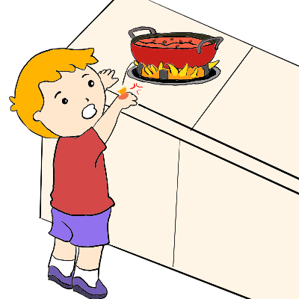
Phonétique
écouter
C’est la SSC [ai] ?
ou
l’oraison
__
__
il brûle
Notes:
Word frequency (1 is the most frequent word in French): oraison [>5000], brûler [1930]
Source: Londsale, D., & Le Bras, Y. (2009). A Frequency Dictionary of French: Core vocabulary for learners London: Routledge.

Slide 13
Vocabulaire 1
écouter
A
B
C
D
E
week
to like, liking
at
to find, finding
school
F
G
H
I
to wear, wearing
to tick, ticking
solution
uniform
K
to spend (time), spending (time)
J
K
L
M
N
every
moment
to stay, staying
with
Notes:
Timing: 5 minutes
Aim: oral recognition of words in this weeks’ vocabulary set.
Procedure:
Students write the letters A-N.
Click to listen.
Students write the English for as many of the words as they can.
Click to reveal the answers. Answers appear in English on the screen under each letter, so all can see/read/check their answers and know if they heard correctly.
Additionally, elicit the French from students, either individually or as a whole class choral response.
Transcript:
la semaine, aimer, à, trouver, lécole, porter, la solution, l’uniforme, cocher, chaque, en ce moment, rester, passer, avec

Slide 14
Le verbe
grammaire
Le verbe
Verbs tell you how two nouns relate to each other.
Verbs are not just action words! They can mean things we can’t see or hear:
In English, you can add ‘-ed’ or ‘-ing’ to the end of verbs and put ‘to’ in front of them.
Verbs can have other verbs in front of them, e.g., ‘do’, ‘was’, ‘is’, ‘likes’ or ‘has’.
studies
likes
The girl ___ French.
loves
speaks
be
have
want
get
become
happen
Notes:
Timing: 2 minutes
Aim: to check that students are familiar with verb vocabulary.
Procedure:
1. Before clicking on the explanation, ask students to define a verb and give some examples.
2. Click to bring up the explanation.
Note:
Robust knowledge of verb vocabulary is absolutely critical for learning a language. That is, the meaning of verbs – ‘go’, ‘eat’, ‘be’, ‘play’, ‘love’ – not the grammar of verbs in their different tenses and forms. It would be useful to explain this to students. It is something that we take for granted in our own language.
Students in year 7 should all know what a verb is, from their primary school lessons. It might, however, be worth checking this in the initial stages.

Slide 15
Trouve le verbe !
Identify the verb or verbs in these sentences.
grammaire
1. George plays computer games for three hours every day. 2. Helen loves detective stories. 3. Everyone thinks that it is great. 4. He never really liked fizzy drinks. 5. What kind of taste do you detect? 6. Making myself do sport is my ambition this year!
1. George plays computer games for three hours every day. [to play]
2. Helen loves detective stories. [to love]
3. Everyone thinks that it is great. [to think, to be]
4. He never really liked fizzy drinks. [to like]
5. What kind of taste do you detect? [to do, to detect]
6. Making myself do sport is my ambition this year! [to make, to do, to be]
Notes:
Timing: 5 minutes
Aim: Awareness-raising exercise in English to teach students to recognise different forms of verbs.
(This is in preparation for a lot of work with verbs and, in particular, the two forms of the present in English with the one equivalent form in French.)
Procedure:
Students do ‘think-pair-share’ for one minute with a partner, reading the sentences and identifying the verbs.
Teacher elicits answers orally.
Answers revealed on clicks.
Optional extension:
To go further you could ask students to:
tell you what the ‘infinitive’, the dictionary form, of each verb is in English (shown in square brackets above)
- change the ‘dictionary’ form into as many different versions of the same VERB as they can, without turning it into a different word class (part of speech)! e.g. think, thinks, thinking, thought are all forms of the same verb; BUT…. thoughtful, thoughtless, thinker are NOT verbs, but they come from the same word family.
- give you some words that can be both a noun and a verb (e.g., head; captain; chair; cook).

Slide 16
aimer
[to like | liking]
aime
[likes | is liking]
Notes:
Timing: 3 minutes (six slides)
Aim: to introduce the verb aimer more explicitly. Aimer is one of the NCELP 15 prototypical verbs in French. Prototypical verbs are common verbs that illustrate the typical characteristics of a class of verb – the French prototypical verbs contain examples of regular/weak verbs, but also common examples of changes to the stem. Both long form (infinitive) and short form (3rd person singular) are introduced in order to familiarise students with various forms of the same verb.
Procedure
Bring up the word aimer on its own, say it, students repeat it, and remind them of the phonics. Draw attention to [ai].
Try to elicit the meaning from the students. Students have had explicit teaching that the present tense in French communicates two different present tense meanings in English. This reinforces that learning. Emphasise the two meanings for the short form, reminding students that French only has one form and does not have a direct equivalent of the grammar for ‘is + ing’, the continuous form (as covered in this week).
Bring up the picture, and, if using gestures, a possible gesture would be [to give the thumbs up sign].
Then bring up the English translations. Emphasise the two meanings for the infinitive.
Bring up the short form [aime], say it, students repeat it. Draw attention to [ai]
Try to elicit the meaning from the students. Emphasise the two meanings for the short form.

Slide 17
aimer
[to like | liking]
aime
[likes | is liking]
Notes:
Cycle through the long and short form again.

Slide 18
aime
[likes | is liking]
Il aime le professeur.
[He likes | is liking the teacher.]
Notes:
Introduce the short form in a sentence.

Slide 19
aimer
[to like | liking]
Aimer le professeur est bon.
[Liking the teacher is good.]
Notes:
Introduce the long form in a sentence. Draw attention to the fact that aimer can mean both ‘to like’ and ‘liking’ but that when it is at the start of a sentence like this, in English we use the –ing form.

Slide 20
aime
[likes | is liking]
Il le professeur.
aime
[He likes | is liking the teacher.]
Notes:
Cycle through the short form in context again.

Slide 21
aimer
[to like | liking]
Aimer
le professeur est bon.
[Liking the teacher is good.]
Notes:
Cycle through the long form in context again.

Slide 22
Regular –ER verbs
grammaire
In French, regular verb endings change to match pronouns.
Sometimes, this happens in English too.
Je porte un uniforme.
Tu portes un uniforme.
Elle porte un uniforme.
I wear a uniform.
You wear a uniform.
She wears a uniform.
Notes:
Timing: 3 minutes (2 slides)
Aim: to introduce students to first and second person singular of regular –er verbs in the present tense.
Procedure:
Click to bring up the explanation
Highlight the fact the verb is never in the long (infinitive) form when used with a pronoun.
Explain that the infinitive gives information about the ‘what’, but not about the ‘who’. The information about who comes from the verb ending.

Slide 23
Regular –ER verbs
grammaire
To say ‘I’ + -ER verb in French, the verb is in the short form and ends in -e.
aimer
To say ‘you’ + –ER verb in French, the verb is in the short form and ends in -es.
J’aime = Je + aime Je contracts to j’ before a vowel
J’aime le professeur.
I like the teacher.
aime and aimes sound the same because of SFC.
Tu aimes le professeur.
You like the teacher.
Notes:
[2/2]

Slide 24
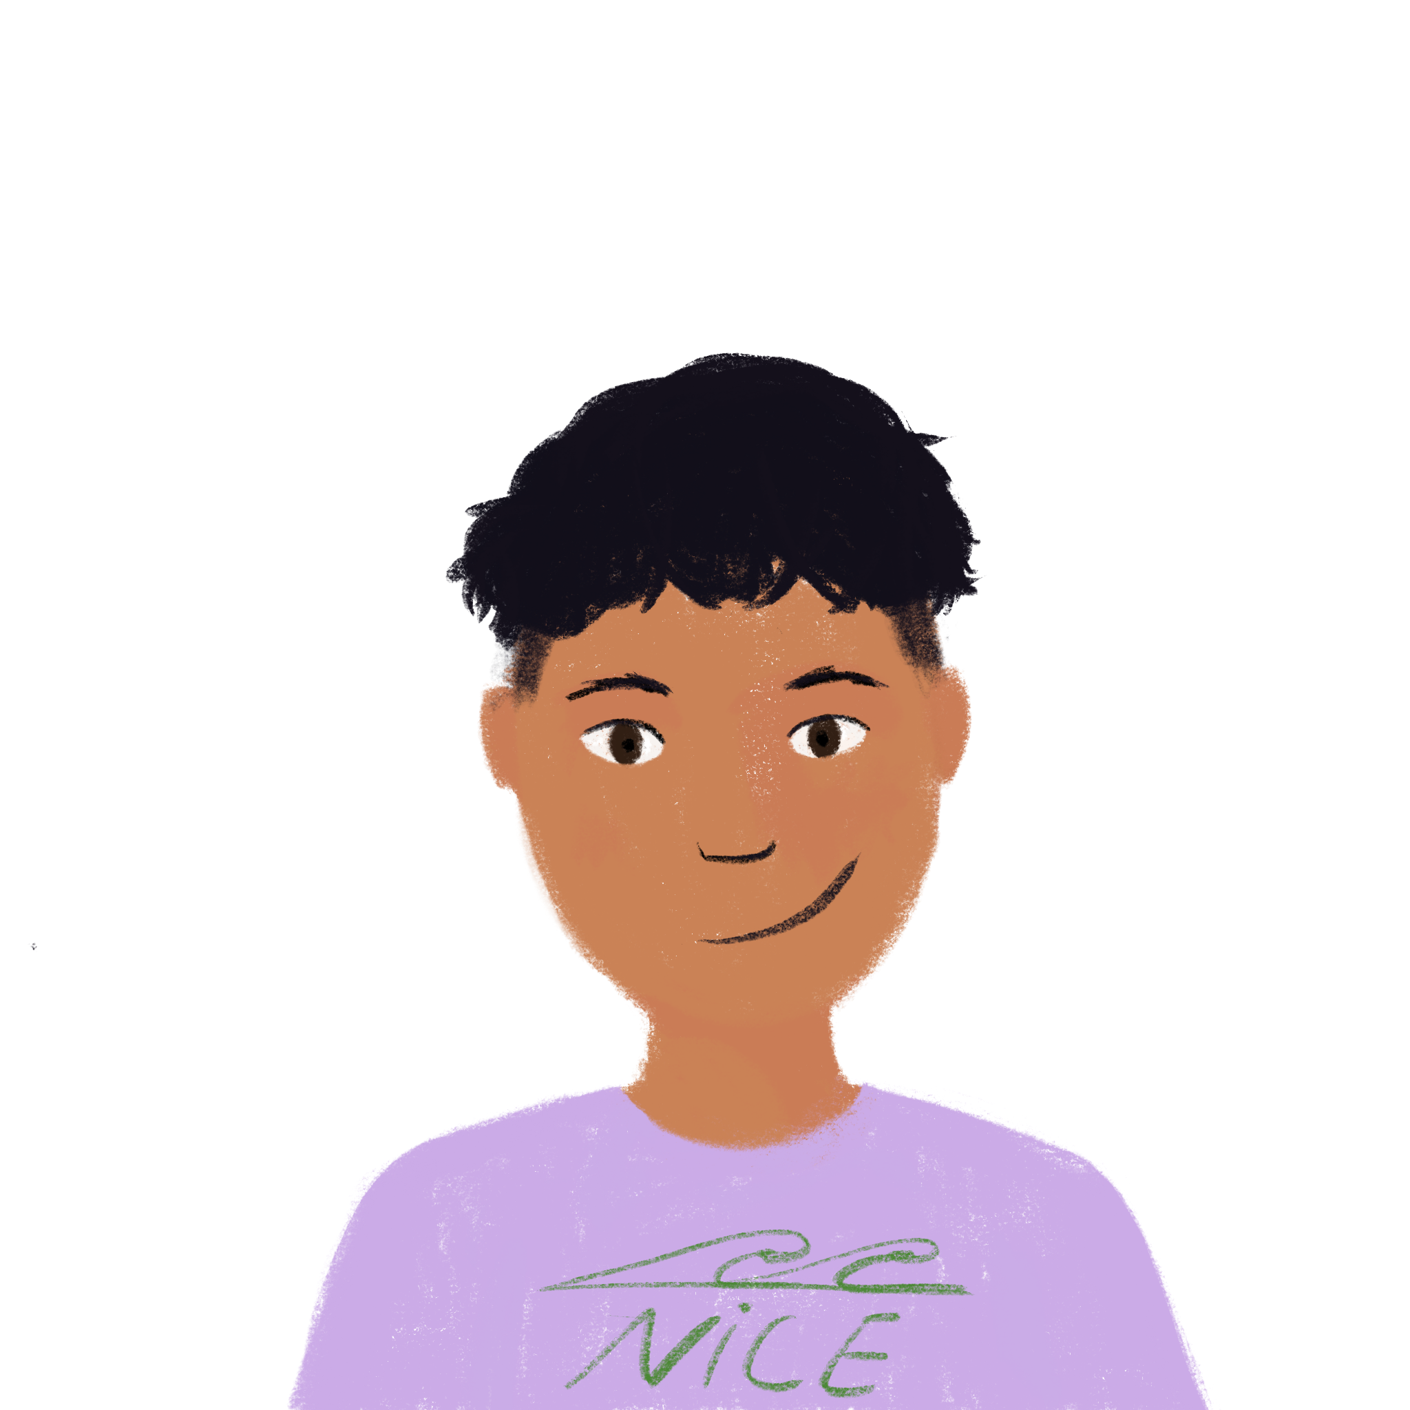
À l’école
lire
Amir is talking to Noura, his sister. Is he speaking about himself (je) or about Noura (tu)?
1 | … coche la réponse. |  |  | 4 | … trouve ça excellent.
2 | … passe une semaine intéressante. |  |  | 5 | … restes calme.
3 | … portes un uniforme bleu. |  |  | 6 | ... aimes l’anglais.
I
you
I
you
Notes:
Timing: 5 minutes
Aim: to practise associating the verb ending –e with ‘I’ and –es with ‘you’ for present tense regular –er verbs. Subject pronouns are removed so as to focus students’ attention on the verb endings only to arrive at the answers.
Procedure:
1. Students read the sentences and decide if ‘I’ or ‘you’ is the subject of the verb.
2. Answers are revealed on a click.

Slide 25
Regular –ER verbs
grammaire
To say ‘s/he’ + regular –ER verb in French, the verb is in the short form, and ends in -e.
aimer
porter
Il aime le professeur.
Elle porte un uniforme.
Notes:
Timing: 1 minute
Aim: to introduce students to third person singular of regular –er verbs in the present tense.
Procedure:
Click to bring up the explanation
Highlight the fact the verb is never in the long (infinitive) form when used with a pronoun.
Explain that the infinitive gives information about the ‘what’, but not about the ‘who’. The information about who comes from the verb ending.

Slide 26
Regular –ER verbs
Léa is messaging her cousin Amir. Is she asking him directly (you) - tu or about Noura (she) – elle?
lire
1
you
4
… trouves une solution ?
… aime quoi ?
she
… restes content ?
…coches le mot, ou le numéro ?
2
5
3
… porte un uniforme rouge ?
6
… passe une semaine amusante ?
Notes:
Timing: 5 minutes
Aim: to practise associating the verb ending –e with ‘he’ and –es with ‘you’ for present tense regular –er verbs. Subject pronouns are removed so as to focus students’ attention on the verb endings only to arrive at the answers.
Procedure:
1. Students read the sentences and decide if ‘he’ or ‘you’ is the subject of the verb.
2. Answers are revealed on a click.

Slide 27
Avec un/une partenaire
Écris 5 phrases en anglais. Parle en français.
lire/parler
Je/J’ tu il elle | aime aimes coche coches passe passes porte portes reste restes trouve trouves | le/l’ la/l’ les un une | ménage modèle mot moment numéro uniforme cuisine école phrase questions réponse semaine devoirs courses | à l’école à la maison en classe en France avec un ami avec une amie
 |  | quoi ? | quoi ?
Remember! You can ask ‘yes/no’ and ‘what’ questions, too.
Exemple: She finds the answer with a (female) friend.
Elle trouve la réponse avec une amie.
Notes:
Timing: 10 minutes
Aim: to practise comprehension and read aloud of new and revisited language and grammar from this and previous weeks.
Procedure:
Both pupils write 5 sentences (in English) made up of words from the table.
They swap sentences.
Partner A tries to say all B’s sentences in French as quickly as possible.
Then Partner B tries to say all A’s sentences in French.

Slide 28
Activities in class
Saying what people like doing
Two-verb structures: aimer + infinitive
Intonation questions (two-verb structures)
SSC [oi]
Y7 French
Term 1.2 - Week 3 - Lesson 20
Natalie Finlayson / Emma Marsden
Artwork by: Chloé Motard
Date updated: 06.08.23
Notes:
Artwork by Chloé Motard. All additional pictures selected are available under a Creative Commons license, no attribution required.
Learning outcomes (lesson 2)
Introduction of SSC [oi]
Consolidation of the present tense –er verbs with je,tu, il/elle
Introduction of double-verb structures with ‘aimer’+ infinitive Introduction of intonation questions (two-verb structures
Word frequency (1 is the most frequent word in French):
7.1.2.3 (introduce) aimer [242], cocher [>5000], passer¹ [90], porter [105], rester [100], trouver [83], école [477], moment [148], semaine [245], solution [608], uniforme [1801], chaque [151], à¹ [4], avec [23]
7.1.1.7 (revisit) faire [25], fais [25], fait [25], ça [54], activité [452], courses [1289], cuisine [2618], devoirs [39], lit [1837], ménage [2326], modèle [958], d'accord [736], quoi ? [297]
7.1.1.2 (revisit) est [5], il [13], elle [38], amusant [4695], calme [1731], content [1841], excellent [1225], intelligent [2509], malade [1066], méchant [3184], triste [1843], mais [30], ou [33], merci [1070]
Source: Londsale, D., & Le Bras, Y. (2009). A Frequency Dictionary of French: Core vocabulary for learners London: Routledge.
The additional English meanings of the following words have been added to Quizlet since the creation of this resource: rester: to stay, staying; to remain, remaining

Slide 29
Avec un/une partenaire
aimer
to like
parler
cocher
to tick
rester
to stay
porter
to wear
passer
to spend (time)
trouver
to find
parler
to speak
écouter
to listen
Notes:
Timing: 2 minutes
Aim: to practise spoken production of 6 previously taught verbs (plus parler and écouter, which students have seen on multiple slides this term).
Procedure:
Give students a minute to work with a partner to try to recall orally each of the 8 verbs in French.
Elicit responses chorally and click to reveal the answers.

Slide 30
oi
[to see]
voir
Notes:
Timing: 1 minute
Aim: To introduce/consolidate SSC [oi]
Procedure: 1. Present the letter(s) and say the [oi] sound first, on its own. Students repeat it with you. 2. Bring up the word ”voir” on its own, say it, students repeat it, so that they have the opportunity to focus all of their attention on the connection between the written word and its sound.
3. A possible gesture for this would be to put one’s hand above one’s brow (as if to shade one’s view) and pretend to be seeing something far off. 4. Roll back the animations and work through 1-3 again, but this time, dropping your voice completely to listen carefully to the students saying the [oi] sound, pronouncing ”voir” and, if using, doing the gesture.
Word frequency (1 is the most frequent word in French):
voir [69].
Source: Londsale, D., & Le Bras, Y. (2009). A Frequency Dictionary of French: Core vocabulary for learners London: Routledge.

Slide 31
oi
voir
Notes:
With sound and no pictures to focus all attention on the sound-symbol correspondence.

Slide 32
oi
[to see]
voir
Notes:
Without sound to elicit pronunciation (without first hearing the teacher).
Teacher to elicit pronunciation by asking “Comment dit-on …"

Slide 33
oi
droite
avoir
[to have]
to see
voir
Au revoir !
trois
Pourquoi ?
[why?]
Notes:
Timing: 2 minutes
Aim: To introduce/consolidate SSC [oi]
Procedure:
1. Introduce and elicit the pronunciation of the individual SSC [oi] and then the source word again ‘voir’ (with gesture, if using). 2. Then present and elicit the pronunciation of the five cluster words.
The cluster words have been chosen for their high-frequency, from a range of word classes, with the SSC (where possible) positioned within a variety of syllables within the words (e.g. initial, 2nd, final etc.). Additionally, we have tried to use words that build cumulatively on previously taught SSCs (see the Phonics Teaching Sequence document) and do not include new SSCs. Where new SSCs are used, they are often consonants which have a similar symbol-sound correspondence in English.
Word frequency (1 is the most frequent word in French): droite [1293]; avoir [8] au revoir [n/a]; pourquoi[193]; trois[115]; voir [69]. Source: Londsale, D., & Le Bras, Y. (2009). A Frequency Dictionary of French: Core vocabulary for learners London: Routledge.

Slide 34
oi
droite
avoir
voir
Au revoir !
trois
Pourquoi ?
Notes:
With sound and no pictures to focus all attention on the sound-symbol correspondence.

Slide 35
oi
droite
avoir
voir
Au revoir !
trois
Pourquoi ?
Notes:
Without sound to elicit pronunciation (without first hearing the teacher).
Teacher to elicit pronunciation by asking “Comment dit-on …"

Slide 36
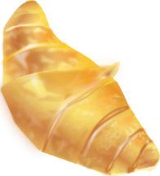
Phonétique
Round 1:
Round 2: shortest → longest
lire / parler
soi
60
bois
[self]
étoile
espoir
voisin
[hope]
croissant
secondes
[neighbour]
victoire
laboratoire
accessoire
0
[accessory]
DÉBUT
Notes:
Timing: 2-3 minutes
Aim: Oral production of SSC [oi] in words of varying degrees of complexity in alphabetical order for one minute, helping automisation of production.
Procedure:
Round 1: Students say the words in alphabetical order, taking it in turns to say a word each, building up speed over 1 minute’s intensive practice.
Round 2: Students say the words in order of length out loud with a partner, building up speed, over 1 minute’s intensive practice.
Teachers circulate during this activity to listen into learners’ SSC knowledge, giving feedback where necessary.
4. If the listening student notices a mistake in the pronunciation of [oi], their partner must go back to the first word and start again! Mispronunciations of SSCs other than [oi] should be noted and fed back to partners after the minute is up.
Word frequency (1 is the most frequent word in French): soi [1365], bois [1425], étoile [2776], espoir [717], voisin [979], croissant [2069], victoire [1373], laboratoire [2158], accessoire [2689]
Source: Londsale, D., & Le Bras, Y. (2009). A Frequency Dictionary of French: Core vocabulary for learners London: Routledge.

Slide 37
En français, c’est quoi ?
lire/parler
He spends a week in France.
You wear a uniform at school.
Je/J’ tu il elle | aime aimes coche coches passe passes porte portes reste restes trouve trouves | le/l’ la/l’ les un une | ménage modèle mot moment numéro uniforme cuisine école phrase questions réponse semaine devoirs courses | à l’école à la maison en classe en France avec un ami avec une amie
 |  | quoi ? | quoi ?
Il passe une semaine en France.
Tu portes un uniforme à l’école.
Do you stay (for) a week at home?
I find the questions with a (female) friend.
Tu restes une semaine à la maison ?
Je trouve les questions avec une amie.
What do I like? I like school!
J’aime quoi ? J’aime l’école !
Notes:
Timing: 4 minutes
Aim: to practise comprehension and read aloud of new and revisited language and grammar from this and previous weeks; to provide a supportive lead up to the production activity that follows.
Procedure:
Teacher clicks to bring up an English prompt.
Students produce the sentence, chorally.
Teacher clicks to provide feedback.
Continue with items 2-5.
Move to the next slide.
Note: Draw students’ attention to 2-part punctuation in French (? and ! - also : and ;), which always needs a space before it, unlike in English). You could mention word order –it sounds more natural in English to put the time at the end (Do you stay at home for a week?) whilst in French the time tends to come after the verb.

Slide 38
En français, c’est quoi ?
Écris en français.
écrire
I you he she | like likes tick ticks spend spends wear wears stay stays find finds | the a | solution uniform week (food) shopping cooking homework housework model moment phrase question | at school at home/the house in class in France with a (male) friend with a (female) friend in French
 |  | what? | what?
How would we usually ask this?
We usually say: What does she wear at home?
Il passe un moment avec un ami.
Je trouve une phrase en français.
Elle porte quoi à la maison ?
Tu coches la solution en classe.
Tu aimes quoi à l’lécole ?
Notes:
Timing: 10 minutes
Aim: to practise written production of new and revisited language and grammar from this and previous weeks.
Procedure:
Teacher clicks to bring up prompt 1.
Students write the sentence in French.
Teacher clicks to provide feedback.
Continue with items 2-5.
Notes:
1) If there is more time, students can continue the activity in pairs OR the teacher can continue to give prompts for further sentences. 2) If more support is needed, students could use the Knowledge Organiser or their Language Guide, but encourage most students to work from memory. Tell them it is not a test and they will learn more by trying to remember the words, than by copying them across from a written source. 3) This activity could also be completed as a speaking activity.

Slide 39
trouver
[to find | finding]
trouve
[finds | is finding]
Notes:
Timing: 3 minutes (6 slides)
NB: depending on the needs of the class and the time available, you may wish to choose just one or two verbs to focus on.
Aim: to introduce the verb trouver more explicitly. Trouver is one of the 25 most frequently used verbs in French. All 25 most frequent verbs will be introduced early on using the same format. Both long form (infinitive) and short form (3rd person singular) are introduced in order to familiarise students with various forms of the same verb.
Procedure
Bring up the word trouver on its own, say it, students repeat it, and remind them of the phonics. Draw attention to [ou]
Try to elicit the meaning from the students. Students have had explicit teaching that the present tense in French communicates two different present tense meanings in English. This reinforces that learning. Emphasise the two meanings for the short form, reminding students that French only has one form and does not have a direct equivalent of the grammar for ‘is + ing’, the continuous form (as covered in previous weeks).
Bring up the picture, and, if using gestures, a possible gesture would be [to bring an imaginary magnifying glass up to one eye].
Then bring up the English translations. Emphasise the two meanings for the infinitive.
Bring up the short form trouve, say it, students repeat it. Draw attention to [ou]
Try to elicit the meaning from the students. Emphasise the two meanings for the short form.

Slide 40
trouver
[to find | finding]
trouve
[finds | is finding]
Notes:
Cycle through the long and short form again.

Slide 41
trouve
[finds | is finding]
Amélie trouve une solution.
[Amélie finds | is finding a solution.]
Notes:
Introduce the short form in a sentence.

Slide 42
trouver
[to find | finding]
Amélie aime trouver une solution.
[Amélie likes to find | finding a solution.]
Notes:
Introduce the long form in a sentence.

Slide 43
trouve
[finds | is finding]
trouve
Amélie une solution.
[Amélie finds | is finding a solution.]
Notes:
Cycle through the short form in context again.

Slide 44
trouver
[to find | finding]
trouver
Amélie aime une solution.
[Amélie likes to find |finding a solution.]
Notes:
Cycle through the long form in context again.

Slide 45
Using two verbs in a sentence
grammaire
As we have learnt, when we use a verb in a sentence with je, tu, il or elle, we use the short form of the verb, with an ending that matches the pronoun:
J’aime le professeur.
Tu aimes le professeur.
Il aime le professeur.
If the sentence has two verbs, the second verb is in the long form (infinitive):
écouter = to listen to AND listening to
J’aime écouter le professeur.
Tu aimes écouter le professeur.
Il aime écouter le professeur.
In English, the second verb can be in the ‘to’ infinitive or the –ing form:
I like to listen to the teacher.
J’aime écouter le professeur.
I like listening to the teacher.
Notes:
Timing: 3 minutes
Aim: to introduce double-verb structures using aimer
Procedure:
Click to bring up the explanation
Highlight that there is no French equivalent for the –ing form in English – there is only one long form in French.

Slide 46
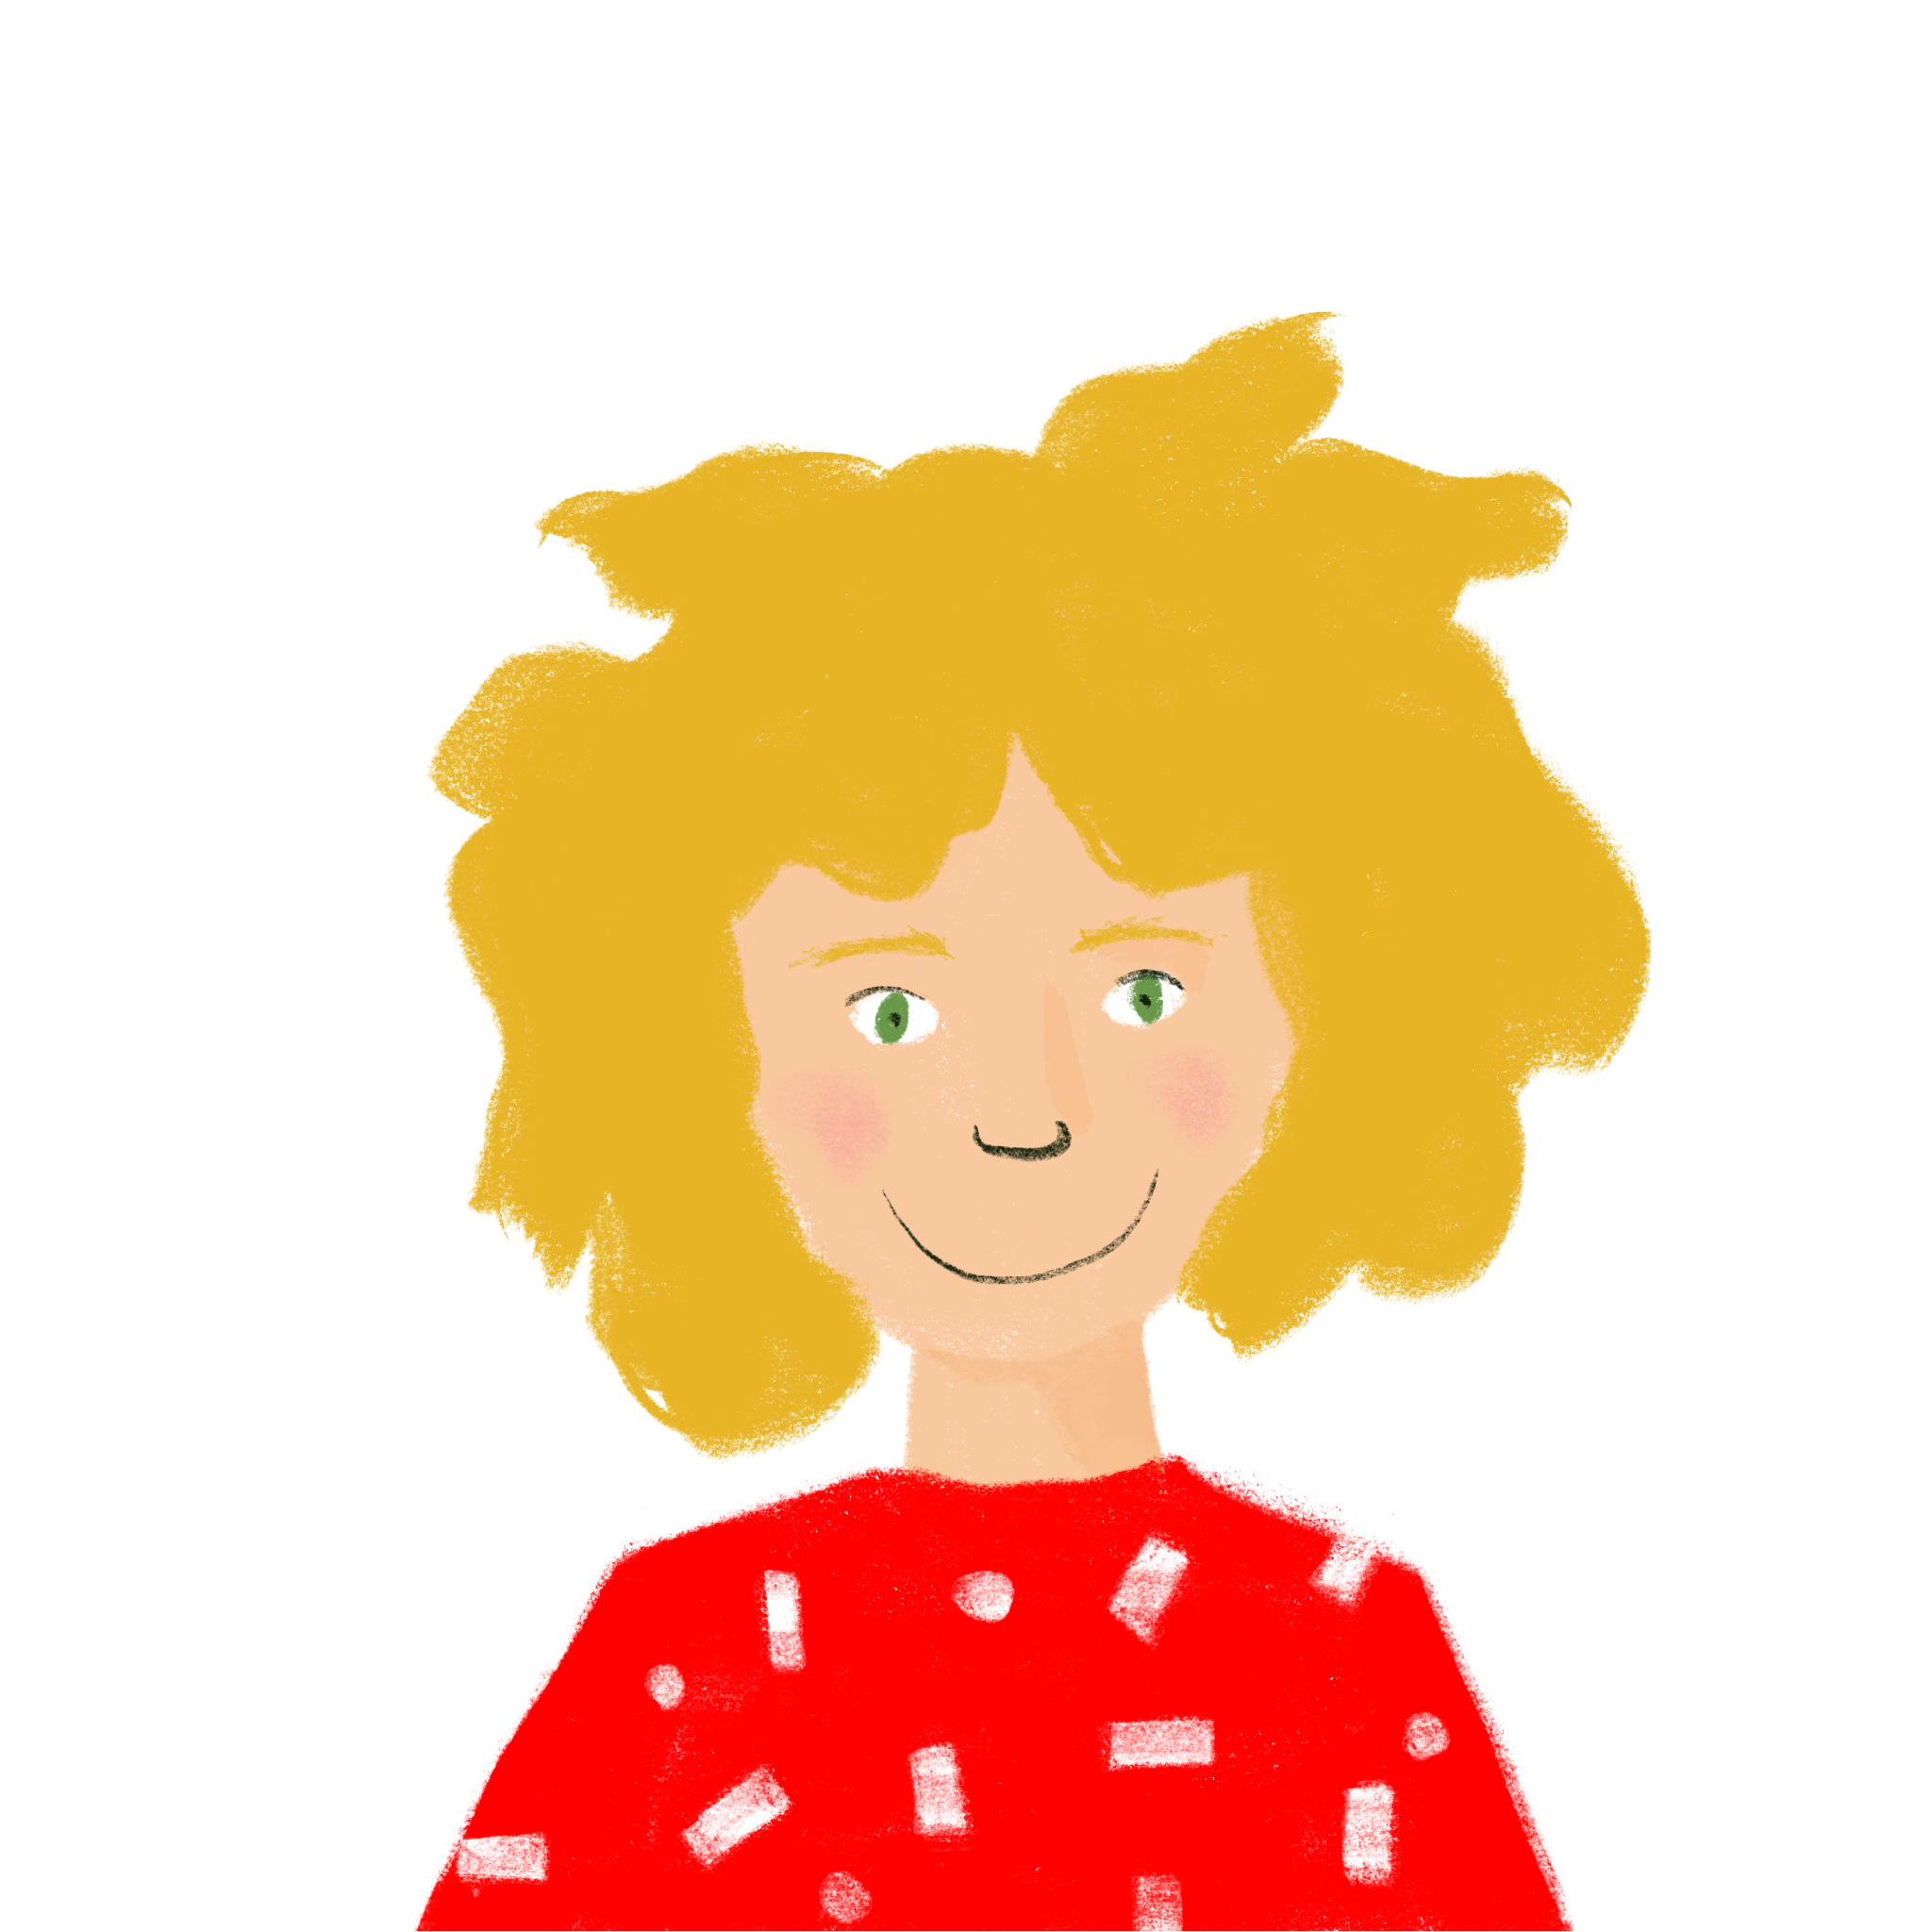
En classe
Remember! In sentences with two verbs, the second verb is in the long form.
lire
Léa describes some of the people in her class. Is she describing what each person does, or what they like doing?
 |  | does it | likes doing it |  |  | does it | likes doing it
1 | Je fais une activité. |  |  | 4 | Monsieur Petit passe une semaine triste. Il est malade !
2 | Sophie coche les réponses. |  |  | 5 | Pierre porte un T-shirt.
3 | Elle aime rester à l’école. |  |  | 6 | J’aime trouver les solutions.
Notes:
Timing: 5 minutes
Aim: written recognition of single vs. double-verb structures with appropriate translations into English.
Procedure:
Students look at the verb form to decide if it is the only verb in the sentence (short form), or the second one after aimer (long form) to decide whther the answer is ‘does it’ or ‘likes doing it’. Explain that only some sentences have words missing.
Answers are revealed on clicks.
Elicit English meanings of the sentences, orally to consolidate understanding.

Slide 47
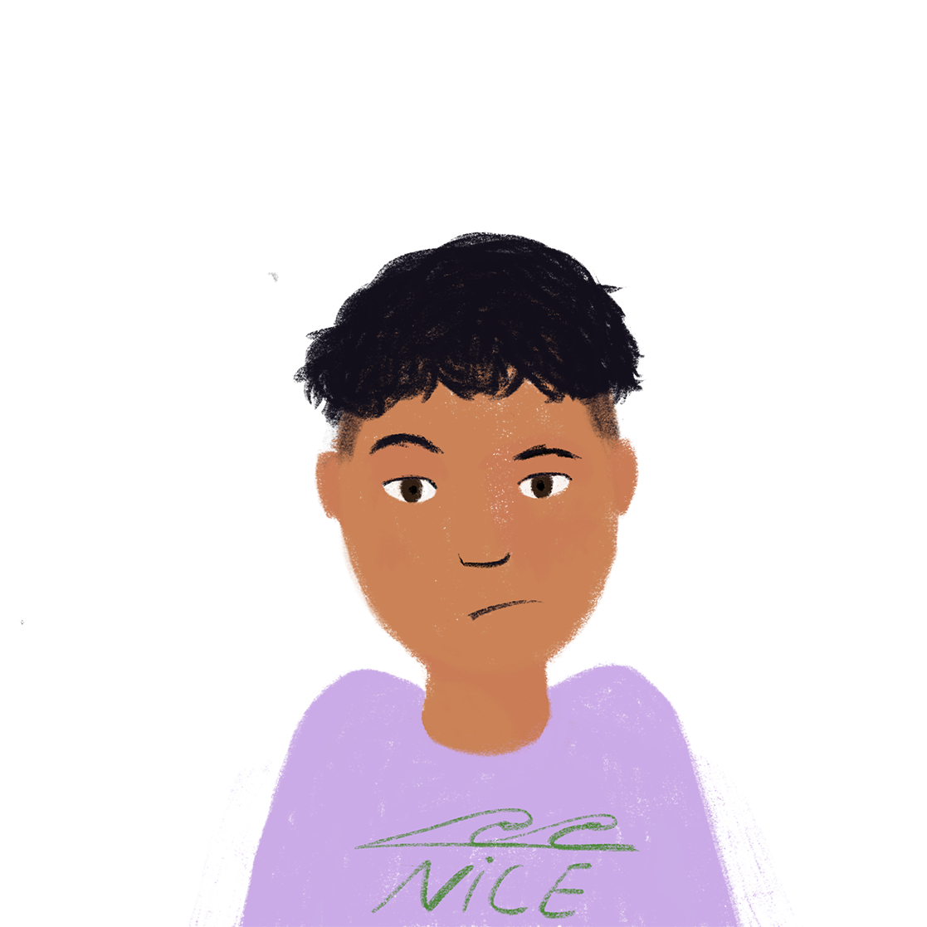
Léa a une liste de questions !
Remember! In sentences with two verbs, the second verb is in the long form.
écouter
Léa calls Amir to ask him some questions. Is she asking if he does it, or if he likes doing it?
 |  | does it? | likes doing it? |  |  | does it? | likes doing it?
1
4
2
5
3
6
Notes:
Timing: 5 minutes
Aim: oral recognition of single vs. double-verb structures with appropriate translations into English.
Procedure:
1. Students listen to the verb form to decide if it is the only verb in the sentence (short form), or the second one after aimer (long form) – explain that only some questions have words missing.
2. Click the number to play the audio. Answers and the full audio (including the first verb where relevant) are provided on the next slide.
Students will be familiar with all vocabulary from this week and previous weeks.
Transcript:
Tu [aimes] parler avec Jacques ?
Tu [-] trouves Géraldine intelligente ?
Tu [-] restes à l’école ?
Tu [aimes] porter un uniforme ?
Tu [aimes] écrire en français ?
Tu [aimes] avoir un chien ?

Slide 48
Léa a une liste de questions !
écouter
For a ‘do you like’ 2-verb question, just make your voice go up at the end.
Later, Léa calls Amir to ask him some questions. Is she asking if he does it, or if he likes doing it?
 |  | does it? | likes doing it? |  |  | does it? | likes doing it?
1
Tu aimes parler avec Jacques ?
4
Tu aimes porter un uniforme ?
2
Tu trouves Géraldine intelligente ?
5
Tu aimes écrire en français ?
3
Tu restes à l’école ?
6
Tu aimes avoir un chien ?
Notes:
Answers are revealed on clicks. The written sentences are revealed on clicks after the answers, for optional simultaneous listening/reading practise to reinforce the structure.
TRANSCRIPT:
Tu aimes parler avec Jacques ?
Tu trouves Géraldine intelligente ?
Tu restes à l’école ?
Tu aimes porter un uniforme ?
Tu aimes écrire en français ?
Tu aimes avoir un chien ?

Slide 49
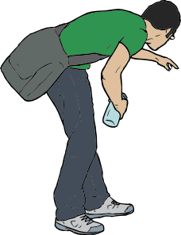
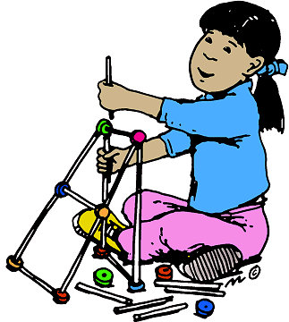
Qui fait quoi ?
parler / écrire
Partenaire A
Who does what? What likes doing what ? Describe the situations below to a partner. Parle en français!
A
B
C
D
e.g. Say:
“He wears a blue uniform.”
elle …
tu …
je …
Notes:
Timing: 10 minutes
Aim: oral production of regular –ER verbs in the short and long form; recognition and transcription of previously taught vocabulary and structures.
Procedure:
Draw students’ attention to the title question, which contains words students have learnt before, but they haven’t seen them in this question. Ensure understanding.
Students work creatively to form and say sentences from prompts. The cards can be printed, or simply displayed on the screen.
Here, Partner A describes the situation, and Partner B writes what s/he hears. Use of adjectives will allow for the creation of sentences of varying complexity, allowing for differentiation.
Suggested solutions to the above:
Il porte un uniforme bleu.
Elle aime faire le modèle.
Tu aimes faire la cuisine.
Je trouve un vélo jaune.

Slide 50
Qui fait quoi ?
parler / écrire
Partenaire B Task 1.
Who does what? Who likes doing what? Write what you hear. Écris en français!
A
Il porte un uniforme bleu.
B
Elle aime faire le modèle.
C
Tu aimes faire la cuisine.
D
Je trouve un vélo jaune.

Slide 51
Qui fait quoi ?
parler / écrire
Regular –ER verbs
Partenaire B Task 2.
Who does what? Describe the situations below to a partner. Parle en français!
A
B
C
D
il …
je …
elle …
tu …
e.g. he likes doing the shopping.
Notes:
Here, Partner B describes the situation, and Partner A writes what s/he hears.
Suggested solutions to the above:
A) Il aime faire les courses.
B) J’aime faire le ménage.
C) Elle porte un uniforme vert.
D) Tu trouves un bateau rouge.

Slide 52
Qui fait quoi ?
parler / écrire
Partenaire A Task 2.
Who does what? Write what you hear. Écris en français!
A
Il aime faire les courses.
B
J’aime faire le ménage.
C
Elle porte un uniforme vert.
D
Tu trouves un bateau rouge.

Slide 53
Devoirs
Vocabulary Learning Homework (Term 1.2, Week 4)
Audio file
Student worksheet
In addition, revisit: Term 1.2 Week 1 Term 1.1 Week 3
Notes:
Use this slide to set the homework.
For Y7, the typical homework will be to pre-learn vocabulary for the next lesson. There is an audio file to accompany the student worksheet.
Notes:
i) Teachers may, in addition, want to recommend use of a particular online app for the pre-learning of each week’s words. ii) Quizlet now requires parental involvement / registration / permissions for users below the age of 13, so it is perhaps most suitable for Y9 – 11 students. iii) Language Nut hosts LDP vocabulary lists and these are free for schools to use, though there is a registration process. One benefit is that all of the student tracking data that Language Nut offers are also available to schools that use the LDP lists for practice. Perhaps this makes it a good option for Y7/8.
iv) There are other free apps, and new ones are always appearing. Teachers have told us that they are currently using: Flippity, Wordwall (where using previously-created activities is free).
v) Gaming Grammar has been acquired by Language Nut. Its original content should still be available to teachers and much of it is appropriate for Y7 learners.

