Slide 1
Activities on trips
Saying what people do
Faire with equivalents in English other than 'do/make’
SSC [ch]
Y7 French
Term 1.2 - Week 2 - Lesson 17
Stephen Owen / Emma Marsden / Ciarán Morris
Artwork by: Chloé Motard
Date updated: 05.08.23
Notes:
Artwork by Chloé Motard. All additional pictures selected are available under a Creative Commons license, no attribution required.
Note: all words (new and revisited) in this week of the SOW appear on all three GCSE wordlists, with these exceptions: i) AQA list does not have phrase.
ii) Edexcel list does not have promenade, Londres, phrase.
Learning outcomes (lesson 1):
Introduction of SSC [ch]
Introduction of faire with equivalents in English other than 'do/make'
Word frequency (1 is the most frequent word in French):
7.1.2.2 (introduce) bateau [1287], magasin [1736], numéro [766], promenade [>5000], question [144], réponse [456], visite [1072], voyage [904], beau [393], mauvais [274], de¹ [2], en² [7], Paris [n/a], Londres [n/a]
7.1.1.6 (revisit) acteur [1152], actrice [1152], anglais² [784], fille¹ [629], français² [251], garçon [1599], médecin [827], mot [220], personne¹ [84], phrase [2074], le [1], la [1], les [1], en¹ [7]
7.1.1.1 (revisit) être [5], es [5], suis [5], lire [278], écrire [382], écouter [429], parler [429], je [22], tu [112], anglais¹ [784], anglaise¹ [784], français¹ [251], française¹ [251], grand¹ [59], petit¹ [138], grande¹ [59], petite¹ [138], et [6], au revoir [1274], bonjour [1972]
Source: Londsale, D., & Le Bras, Y. (2009). A Frequency Dictionary of French: Core vocabulary for learners London: Routledge.
The frequency rankings for words that occur in this PowerPoint which have been previously introduced in NCELP resources are given in the NCELP SOW and in the resources that first introduced and formally re-visited those words.
For any other words that occur incidentally in this PowerPoint, frequency rankings will be provided in the notes field wherever possible.

Slide 2
ch
chercher
Notes:
Timing: 1 minute
Aim: To introduce SSC [ch]
Procedure: 1. Present the letter(s) and say the [ch] sound first, on its own. Students repeat it with you. 2. Bring up the word ”chercher” on its own, say it, students repeat it, so that they have the opportunity to focus all of their attention on the connection between the written word and its sound.
3. A possible gesture for this would be to mime looking for something everywhere. 4. Roll back the animations and work through 1-3 again, but this time, dropping your voice completely to listen carefully to the students saying the [ch] sound, pronouncing ”chercher” and, if using, doing the gesture.
Word frequency (1 is the most frequent word in French):
chercher [336]. Source: Londsale, D., & Le Bras, Y. (2009). A Frequency Dictionary of French: Core vocabulary for learners London: Routledge.

Slide 3
ch
chercher
Notes:
With sound and no pictures to focus all attention on the sound-symbol correspondence.

Slide 4
ch
chercher
Notes:
Without sound to elicit pronunciation (without first hearing the teacher).
Teacher to elicit pronunciation by asking “Comment dit-on …"

Slide 5
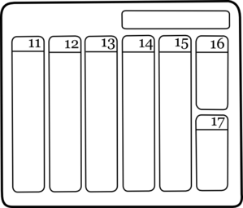
ch
dimanche
chanter
chercher
bouche
chat
champ
[field]
Notes:
Timing: 2 minutes
Aim: To introduce SSC [ch]
Procedure:
1. Introduce and elicit the pronunciation of the individual SSC [ch] and then the source word again ‘chercher’ (with gesture, if using). 2. Then present and elicit the pronunciation of the five cluster words.
The cluster words have been chosen for their high-frequency, from a range of word classes, with the SSC (where possible) positioned within a variety of syllables within the words (e.g. initial, 2nd, final etc.). Additionally, we have tried to use words that build cumulatively on previously taught SSCs (see the Phonics Teaching Sequence document) and do not include new SSCs. Where new SSCs are used, they are often consonants which have a similar symbol-sound correspondence in English.
Word frequency (1 is the most frequent word in French): dimanche [1235]; chanter [1820] bouche [1838]; champ [847]; chat [3138]; chercher [336]. Source: Londsale, D., & Le Bras, Y. (2009). A Frequency Dictionary of French: Core vocabulary for learners London: Routledge.

Slide 6
ch
dimanche
chanter
chercher
bouche
chat
champ
Notes:
With sound and no pictures to focus all attention on the sound-symbol correspondence.

Slide 7
ch
dimanche
chanter
chercher
bouche
chat
champ
Notes:
Without sound to elicit pronunciation (without first hearing the teacher).
Teacher to elicit pronunciation by asking “Comment dit-on …"

Slide 8
Phonétique
écouter / écrire
C’est [ch] ou [s(s)] ?
broche brooch
brosse brush
1
2
3
4
5
6
a
b
a
mâche chews, is chewing
b
masse mass
a
sot silly
b
chaud hot
a
crasse grime
b
crache spits, is spitting
a
sait knows, is knowing
b
chez at
chut hush
su knew
a
b
Notes:
Timing: 5 minutes Aim: To differentiate between pairs of words that differ by one phoneme (one SSC that changes the meaning). These words are called minimal pairs. Procedure: 1. Click on the letter triggers (a then b for numbers 1-6) to play the audio. 2. Students write [ch] or [s(s)] for each pair.
3. Click to see the answers.
Transcript:
1a. broche - b. brosse
2a. mâche - b. masse
3a. sot - b. chaud
4a. crasse - b. crache
5a. sait - b. chez
6a. chut - b. su
Word frequency of unknown vocabulary (1 is the most frequent word in French): broche [>5000], brosse [>5000], mâcher [>5000], masse [1826], sot [>5000], chaud [1852], crasse [>5000], cracher [>5000], savoir [67], chez [206]
Source: Londsale, D., & Le Bras, Y. (2009). A Frequency Dictionary of French: Core vocabulary for learners London: Routledge.

Slide 9
The verb ‘faire’ – to do/make
grammaire
Phonétique
Reminder: in French we use the verb faire to say to do and to make.
je fais
I do / I make
tu fais
you do / you make
il fait
he does / he makes
elle fait
she does / she makes
Stephen Owen
Notes:
Timing: 2 minutes
Aim: to recap singular persons of the verb ‘faire’.
Procedure:
1.Read through the explanation
2.Highlight the spelling difference in the third person singular form

Slide 10
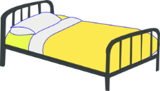
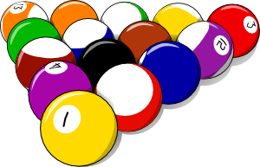
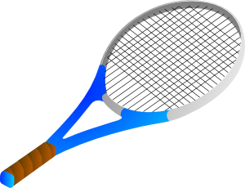
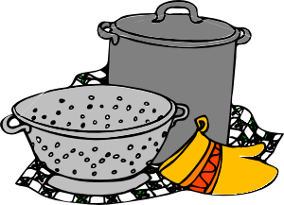
faire… (to do, make)
écrire
1
2
faire u_ m_ _ _ _ _
faire un modèle
3
faire l_ l_ _
faire le lit
faire une activité
faire u_ _ a_ _ _ _ _ _ _
5
4
faire l_ c_ _ _ _ _ _
faire la cuisine
faire l_ m_ _ _ _ _
faire le ménage
7
faire l_ _ d_ _ _ _ _ _
faire les devoirs
6
faire l_ _ c_ _ _ _ _ _
faire les courses
Notes:
Timing: 5 minutes
Aim: to revise the previously-presented, prototypical meanings of ‘faire’ (as equivalents of ‘do’ and ‘make’), before introducing some alternative uses.
Procedure:
1. Students complete the words in written modality.
2. Elicit translations into English to clarify the activity and in each instance whether ‘faire’ is translated as ‘do’ or ‘make’

Slide 11
The verb ‘faire’ – other meanings
The verb faire has meanings other than ‘to do, to make’.
Faire le pont literally means ‘to make the bridge’.
But French people say this to mean ‘to take a long weekend’.
When a national holiday day falls on a Tuesday or Thursday, many people will ‘faire le pont’ to make a four-day weekend.
Mai 2022
Lu. | Ma. | Me. | Je. | Ve. | Sa. | Di.
23 | 24 | 25 | 26 | 27 | 28 | 29
Ascension
Notes:
OPTIONAL Timing: 2 minutes
Aim: to introduce students to the idea that ‘faire’ doesn’t always translate as do/make; to introduce an idiomatic expression with ‘faire’.
Procedure:
Click through the animations to present the information.
Explain that Ascension day is a national holiday in France and falls on a Thursday this year, so many people will take Friday off work and create a bridge from jeudi (Thursday) to dimanche (Sunday).

Slide 12
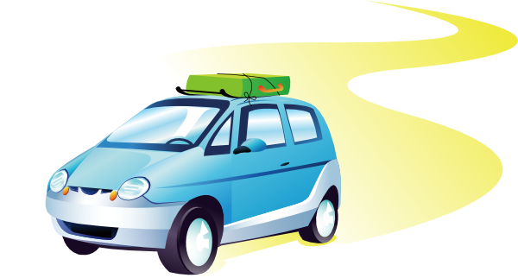
Faire – new meanings
C’est quoi en anglais ?
lire
faire les courses = to go food shopping (a chore)
faire les magasins = to go shopping (for fun)
to visit / go on a tour of
to be bad weather
to go on a journey/trip
to go /do the (food) shopping
to go shopping
to be nice weather
to go for a walk
to go for a boat ride
faire une promenade
faire les magasins
faire beau
faire les courses
faire un voyage
faire une promenade en bateau
faire mauvais
faire une visite de
Notes:
Timing: 3 minutes
Aim: to introduce some alternative meanings of ‘faire’ where it often means ‘go (on/for)’ and two weather expressions.
Procedure:
Click to bring up the French infinitive phrase.
Elicit the English meaning (or provide it, if students don’t quickly arrive at the correct meaning).
Point out that the verb can variously be rendered as ‘go (on/for)’ and ‘be’ across these examples, the verb ‘faire’ in French covering all of these different meanings in these common collocations.
Note: The weather terms are covered with the infinitive for now, as they can of course be encountered in this form in natural language: e.g., ‘il va faire beau’. The impersonal use of ‘faire’ in these expressions will be discussed later.
12

Slide 13
The verb ‘faire’ – other meanings
vocabulaire
faire un voyage
faire une promenade
Here, en means ‘by’
(a trip by boat).
As you know, it can also mean ‘in’ (écris en anglais/write in English).
faire beau
faire les magasins
faire une visite de
faire mauvais
faire une promenade en bateau
Notes:
Timing: 3 minutes
Aim: to embed correct pronunciation of the newly learnt expressions with ‘faire’ and promote recall of meanings in English.
Procedure:
1. Present the image and either elicit the French phrase or model the pronunciation (as necessary), asking students to listen and repeat.
2. Click to bring up the French.
3. Elicit meanings in English.

Slide 14
Londres et Paris
écouter
French has its own word for London. Paris has an SFC in French.
To say you went on a tourist visit or tour of a city, use ‘faire une visite de’ (a visit of) + name of city.
Londres
Paris
Je fais une visite de Londres.
Tu fais une visite de Paris.
Notes:
Timing: 3 minutes
Aim: to introduce the French words for ‘London’ and ‘Paris’
Procedure:
Click to see and hear the French names of the cities.
Students repeat.
Students alternate between saying the English and French city names as many times as necessary.
Click to reveal the constructions with ‘de’.
Students repeat.

Slide 15
C’est quoi ?
vocabulaire
faire une visite de
Notes:
Timing: 4 minutes for the next 7 slides
Aim: to promote oral recall of the newly learnt expressions with ‘faire’.
Procedure:
1. Slowly reveal the image of one of the items of vocabulary just introduced one click at a time.
2. Challenge students to guess the item (in French) at the earliest opportunity, gaining more ‘points’, for example, the earlier they do so.
3. Refer to the notes for the vocabulary item sought, e.g. (for this slide):
faire une visite.

Slide 16
C’est quoi ?
vocabulaire
faire une promenade
Notes:
faire une promenade.

Slide 17
C’est quoi ?
vocabulaire
faire beau
Notes:
faire beau.

Slide 18
C’est quoi ?
vocabulaire
faire mauvais
Notes:
faire mauvais.

Slide 19
C’est quoi ?
vocabulaire
faire une promenade en bateau
Notes:
faire une promenade en bateau.

Slide 20
C’est quoi ?
vocabulaire
faire les magasins
Notes:
faire les magasins.

Slide 21
Talking about the weather
grammaire
Faire is used with il (meaning ‘it’) with weather expressions:
il fait beau
it is nice weather
il fait mauvais
it is bad weather
Stephen Owen
Notes:
Timing: 1 minute
Aim: to explain the impersonal use of ‘faire’ in weather expressions.
Procedure:
1. Click to bring up the explanation.

Slide 22
Écris le numéro !
écouter
Number the pictures below in the order that you hear them mentioned.
a |  |  | d
b |  |  | e
c |  |  | f
1
2
3
4
5
6
Notes:
Timing: 5 minutes
Aim: to practise recognition of the newly learnt expressions with ‘faire’ in the oral modality.
Procedure:
Click on the number trigger to play the audio.
Students write in the number next to the correct image.
See the next slide for the answers.
Transcript:
Je fais les magasins.
Elle fait le ménage.
Je fais un voyage.
Il fait une promenade.
Il fait mauvais.
Il fait beau.

Slide 23
Écris le numéro !
écouter/ parler /écrire
Réponses :
a |  |  | d
b |  |  | e
c |  |  | f
6
Il fait beau.
5
Il fait mauvais.
4
Il fait une promenade.
3
Je fais un voyage.
1
Je fais les magasins.
2
Elle fait le ménage.
Notes:
Timing: 8 minutes
Aim: to practise written production of the newly learnt expressions with ‘faire’ and singular persons of the verb ‘faire’.
Procedure:
Reveal the answers on a mouse click to the previous activity.
Tell students they are now going to write what they heard.
Play the audio again.
Students reconstruct the sentence as heard in the transcript.
Ask student to then create a similar sentence which could fit the picture. They could do either of these first orally, then in writing (i.e. transcribe or adapt what they hear).

Slide 24
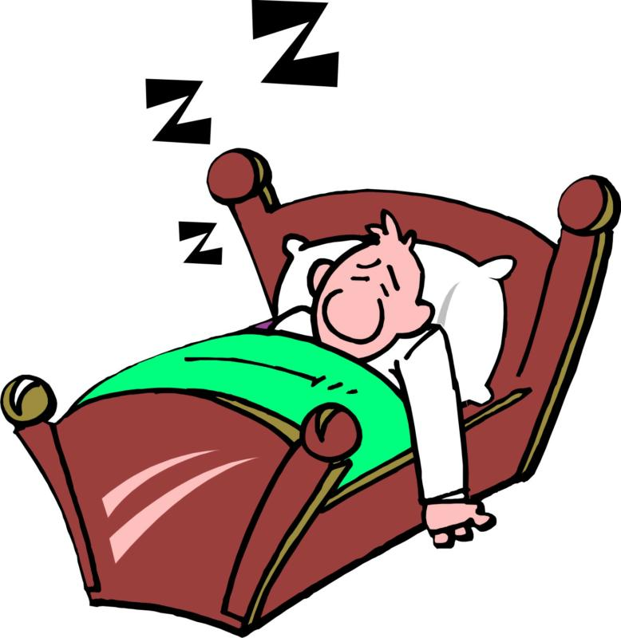
Activities on trips
Saying what people do
Faire with equivalents in English other than 'do/make’
SSC [ç/c]
Y7 French
Term 1.2 - Week 2 - Lesson 18
Stephen Owen / Emma Marsden / Ciarán Morris
Artwork by: Chloé Motard
Date updated: 05.08.23
Notes:
Artwork by Chloé Motard. All additional pictures selected are available under a Creative Commons license, no attribution required.
Learning outcomes (lesson 2):
Introduction of SSC [ç/c]
Consolidation of [faire with equivalents in English other than 'do/make']
Word frequency (1 is the most frequent word in French):
7.1.2.2 (introduce) bateau [1287], magasin [1736], numéro [766], promenade [>5000], question [144], réponse [456], visite [1072], voyage [904], beau [393], mauvais [274], de¹ [2], en² [7], Paris [n/a], Londres [n/a]
7.1.1.6 (revisit) acteur [1152], actrice [1152], anglais² [784], fille¹ [629], français² [251], garçon [1599], médecin [827], mot [220], personne¹ [84], phrase [2074], le [1], la [1], les [1], en¹ [7]
7.1.1.1 (revisit) être [5], es [5], suis [5], lire [278], écrire [382], écouter [429], parler [429], je [22], tu [112], anglais¹ [784], anglaise¹ [784], français¹ [251], française¹ [251], grand¹ [59], petit¹ [138], grande¹ [59], petite¹ [138], et [6], au revoir [1274], bonjour [1972]
Source: Londsale, D., & Le Bras, Y. (2009). A Frequency Dictionary of French: Core vocabulary for learners London: Routledge.

Slide 25
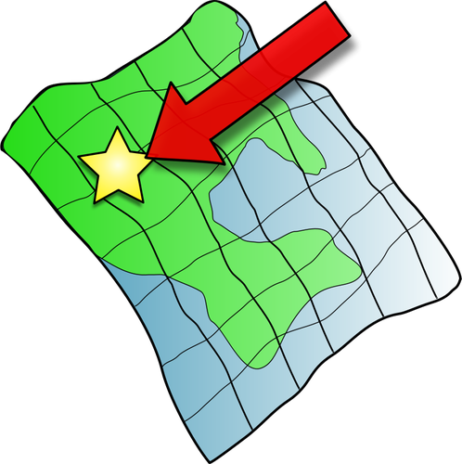
ç/c
ici
Notes:
Timing: 1 minute
Aim: To introduce SSC [ç/c]
Procedure: 1. Present the letter(s) and say the [ç/c] sound first, on its own. Students repeat it with you. 2. Bring up the word ”ici” on its own, say it, students repeat it, so that they have the opportunity to focus all of their attention on the connection between the written word and its sound.
3. A possible gesture for this would be to point to the spot on which one is standing / indicate the room in which the lesson is taking place with a sweeping motion of one’s index finger. 4. Roll back the animations and work through 1-3 again, but this time, dropping your voice completely to listen carefully to the students saying the [ç/c] sound, pronouncing ”ici” and, if using, doing the gesture.
Word frequency (1 is the most frequent word in French):
ici [167]. Source: Londsale, D., & Le Bras, Y. (2009). A Frequency Dictionary of French: Core vocabulary for learners London: Routledge.

Slide 26
ç/c
ici
Notes:
With sound and no pictures to focus all attention on the sound-symbol correspondence.

Slide 27
ç/c
ici
Notes:
Without sound to elicit pronunciation (without first hearing the teacher).
Teacher to elicit pronunciation by asking “Comment dit-on …"

Slide 28
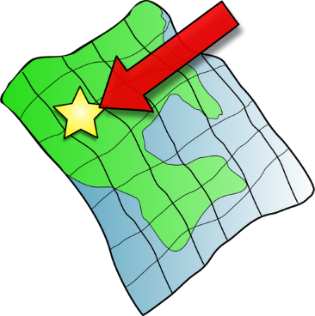
ç/c
français
garçon
ici
cinéma
cinq
décider
[to decide]
Notes:
Timing: 2 minutes
Aim: To introduce SSC [ç/c]
Procedure:
1. Introduce and elicit the pronunciation of the individual SSC [ç/c] and then the source word again ‘ici’ (with gesture, if using). 2. Then present and elicit the pronunciation of the five cluster words.
The cluster words have been chosen for their high-frequency, from a range of word classes, with the SSC (where possible) positioned within a variety of syllables within the words (e.g. initial, 2nd, final etc.). Additionally, we have tried to use words that build cumulatively on previously taught SSCs (see the Phonics Teaching Sequence document) and do not include new SSCs. Where new SSCs are used, they are often consonants which have a similar symbol-sound correspondence in English.
Word frequency (1 is the most frequent word in French): français [251]; garçon [1599]; cinéma [1623]; décider [165]; cinq [288]; ici [167]. Source: Londsale, D., & Le Bras, Y. (2009). A Frequency Dictionary of French: Core vocabulary for learners London: Routledge.

Slide 29
ç/c
français
garçon
ici
cinéma
cinq
décider
Notes:
With sound and no pictures to focus all attention on the sound-symbol correspondence.

Slide 30
ç/c
français
garçon
ici
cinéma
cinq
décider
Notes:
Without sound to elicit pronunciation (without first hearing the teacher).
Teacher to elicit pronunciation by asking “Comment dit-on …"

Slide 31
Phonétique
parler
déçevoir
ceci
45
cinq
cependant
ancien
secondes
façon
ici
commerçant
spécial
0
insouciant
DÉBUT
Notes:
Timing: 5 minutes for three slides.
Aim: automatisation of oral production of SSCs soft [c] and [ç] at word level.
Procedure:
Tell students that they are going to take turns to say all the words within a given time, building up speed. They call in any order they like but are not allowed to repeat the one they said in their last turn.
Click on début to start the timer on the screen.
The listening students checks that the speaking student does not produce a hard [c]. If they do, they must repeat the words correctly three times.
Students swap roles. Restart the timer.
Click to check pronunciation of the words.
Word frequency (1 is the most frequent word in French):
ici [167], décevoir [1302], ceci [732], cinq [288], cependant [352], façon [248], ancien [392], commerçant [4167], spécial [726], insouciant [>5000] Source: Londsale, D., & Le Bras, Y. (2009). A Frequency Dictionary of French: Core vocabulary for learners London: Routledge.
Ask students what they notice about the vowels which follow soft [c] (always ‘i’ or ‘e’). This primes for the explanation on slide 36.

Slide 32
Phonétique
parler
déçevoir
ceci
30
cinq
cependant
ancien
secondes
façon
ici
commerçant
spécial
0
insouciant
DÉBUT
Notes:
As previous, but with 15 fewer seconds on the timer.

Slide 33
Phonétique
parler
déçevoir
ceci
15
cinq
cependant
ancien
secondes
façon
ici
commerçant
spécial
0
insouciant
DÉBUT
Notes:
As previous, but with 15 fewer seconds on the timer still.

Slide 34
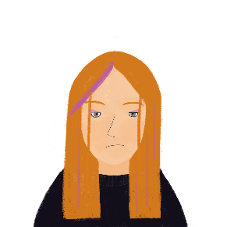
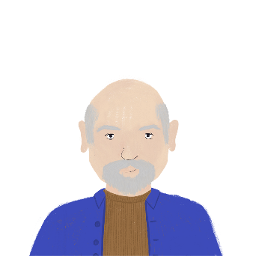
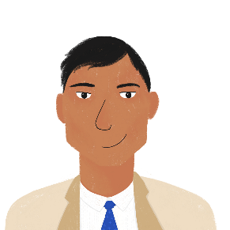
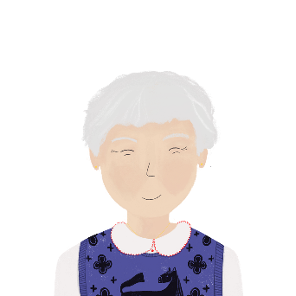
La personne est …
écrire
1. Je suis française.
5. Je suis français.
[French]
[French]
2. Je suis grand.
6. Je suis petit.
[tall]
[short]
3. Je suis anglaise.
7. Je suis grande.
[English]
[tall]
4. Je suis anglais.
8. Je suis petite.
[English]
[short]
Notes:
Timing: 3 minutes
Aim: Written production of some of the words form this week’s revisited set. Revision of adjective agreement.
Procedure
Students read the sentences and decide which form of the French adjective is needed based on the gender of the speaker.
Students write 1-8 and the adjective with the correct ending.
Answers revealed on clicks.

Slide 35
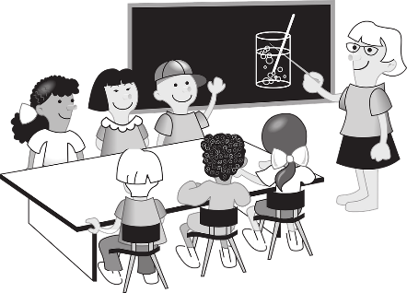
Words with more than one meaning
lire
Many words in English have more than one meaning. What does the word ‘pupil’ mean in these sentences? How do you know?
Your pupils get bigger in the dark. The pupils are working hard.
The other words in the sentence tell you the meaning.
Notes:
Timing: 3 minutes for two slides.
Aim: To introduce the concept of words with multiple meanings, and to explain how these will be taught.

Slide 36
Words with more than one meaning
lire
The same thing happens in French. What does the word ‘en’ mean here?
L’acteur parle en anglais. Je fais un voyage en voiture.
The actor speaks in English. I’m going on a journey by car.
You will learn the meanings of words like this one by one.

Slide 37
Saying ‘in’ and ‘by’ in French
Remember!
‘en’ has more than one meaning in French. The other words in the sentence tell us the meaning.
lire
Lis les phrases. C’est ‘in’ ou ‘by’ ?
 |  | ‘in’ | ‘by’
1. | Le médecin parle en anglais.
2. | Il fait une promenade en bateau.
3. | Le garçon est actif en classe.
 |  | ‘in’ | ‘by’
4. | L’actrice fait un voyage en bateau.
5. | La fille fait des courses en voiture.
6. | Tu es en France ?
Notes:
Timing: 6 minutes (2 slides)
Aim: Practise different translations of preposition en. Written recognition of some of the vocabulary in this week’s revisited set.
Procedure:
Students read the sentences and note ‘in’ or ‘by’ for 1-6.
Answers revealed on clicks.
Attention should be drawn to the fact that the same preposition can be translated differently depending on the context.
Move to the next slide, inviting students to translate the full sentences, orally in a think-pair-share.
Suggested translations can be found on the next slide.

Slide 38
Saying ‘in’ and ‘by’
parler
Parle en anglais !
1. | Le médecin parle en anglais. | The doctor speaks in English.
2. | Il fait une promenade en bateau. | He’s taking a trip by boat / a boat trip.
3. | Le garçon est actif en classe. | The boy is active in class.
4. | L’actrice fait un voyage en bateau. | The actress is going on a journey by boat.
5. | La fille fait des courses en voiture. | The girl is going food shopping by car.
6. | Tu es en France ? | Are you in France?
Notes:
Procedure:
Students work in pairs to translate the sentences orally.
Elicit responses and click to reveal the English translations.

Slide 39
Écris en anglais
lire
He does the housework.
1. Il fait le ménage.
2. Il fait mauvais.
3. Elle fait une visite de Londres.
4. Je fais une promenade en bateau.
5. Tu fais les magasins.
6. Il fait beau.
It is bad weather.
She goes on a tour/visit of London.
I go on a boat ride.
You go shopping.
It is nice weather.
Notes:
Timing: 10 minutes
Aim: to check understanding of the new vocabulary and of the person of the verb used in each sentence, engaging the students again with the grammar feature.
Procedure:
1. Students translate each sentence into English.
2. Answers are revealed on a mouse click.
Note – it might be useful to do this activity as an individual writing task, so that students work on their own retrieval of the language and structure for this week.

Slide 40
Parle en français
parler
1 |  | I go for a walk. | 4 |  | She goes on a journey.
2 |  | He goes shopping. | 5 |  | I go on a boat ride.
3 |  | You go on a tour of Paris. | 6 |  | Do you do the housework?
Je fais une promenade.
Elle fait un voyage.
Il fait les magasins.
Je fais une promenade en bateau.
Tu fais une visite de Paris.
Tu fais les devoirs ?
Notes:
Timing: 3 minutes
Aim: to practise oral production of singular persons of the verb ‘faire’ along with most this week’s target vocabulary, priming for the oral production task on the following slides.
Procedure:
Ask students to translate the sentences into French orally (either as whole-class choral response or in pairs). The sentence are variations of those students have seen, rather than all being identical, to keep students focused on the singular parts of faire and singular pronouns.
Answers are provided, in case they are needed for feedback.
Note:
We need to bear in mind that learners are not at the moment ‘actively’ choosing to use (produce) faire for all these different English meaning. Because this task focusses only on faire, this is a ‘given’ in this series of activities! In a later series of activities in the Scheme of Work, we will provide opportunities for students to actively ‘choose’ to produce ‘faire’ for this set of activities (versus ‘aller’ or ‘être’).

Slide 41
le verbe ‘faire’ – other meanings
Faire la grasse matinée literally means ‘to do/make the fat morning’.
But French people say this to mean ‘to have a lie-in’.
Tu fais la grasse matinée ?
Tu fais quoi le week-end ?
Notes:
OPTIONAL Timing: 2 minutes
Aim: to introduce another idiomatic expression with ‘faire’; to give the opportunity for students to use this and last week’s new language to respond to open and/or closed questions with faire about the weekend.
Procedure:
Click through the animations to present the information.
Ask pupils if they have a lie-in at the weekend? Elicit any other sentences / activities that students can recall to say what they do (from this lesson and the previously one on faire from two weeks ago). We can prompt students with direct questions to support their understanding, as needed. Even if students answer ‘oui’ or ‘non’, they are still speeding up their oral comprehension of the new language. Possible questions: Tu fais une promenade? Tu fais les magasins ou les courses? Tu fais le ménage/le lit/une activité en famille/la cuisine?

Slide 42
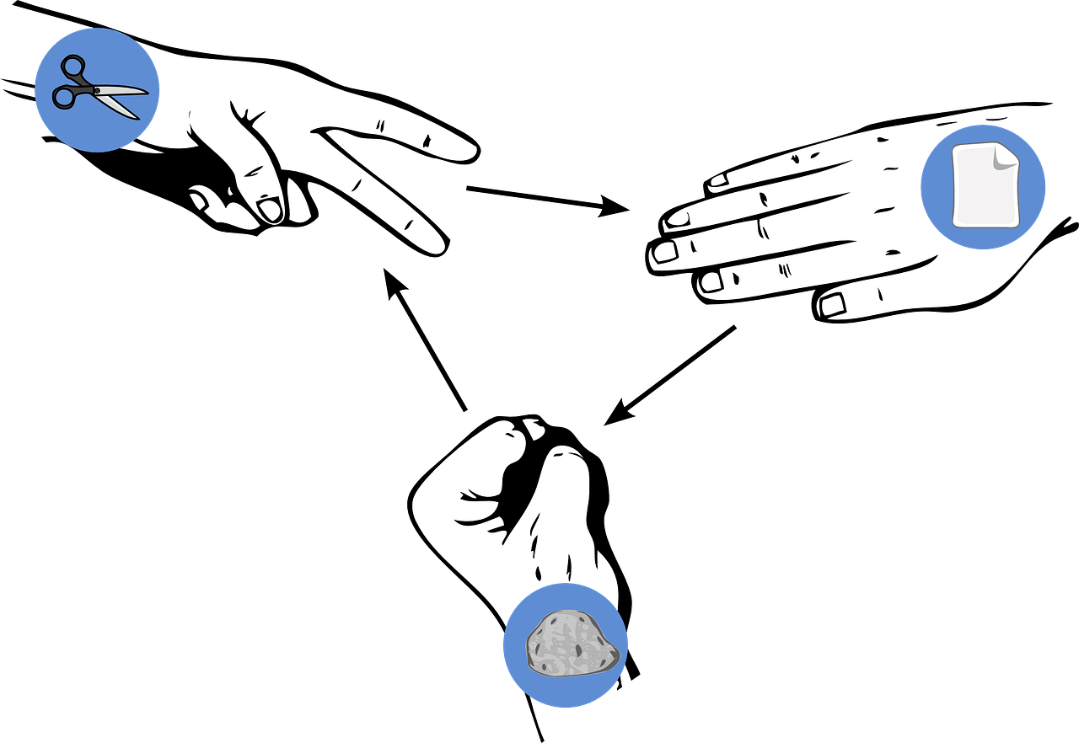
Pierre-papier-ciseaux*
écrire / parler / écouter
From the pictures, choose four activities and write four sentences in French saying ‘I do’ one of the activities (or it is nice/bad weather).
Read your sentences. If your partner has exactly the same sentence as you, play rock-paper-scissors. The loser must write/say a different sentence. Play until you have successfully said all your sentences.
Je fais les magasins, aussi !
Exemple:
Je fais les magasins.
Je fais une visite de Londres.
Partenaire A
Partenaire B
*Rock-paper-scissors
Notes:
Timing: 10 minutes (two rounds of speaking activity)
Aim: to practise oral production and comprehension of negative sentences with 1st person of faire, and vocabulary from this week.
Note: This slide shows how the speaking task is intended to work. The stages are animated to support the teacher in modelling the task.
Procedure:
After modelling this example, display the next slide with 9 item choices (or an alternative with 15).
Partner As read first and Bs answer.
Then swap roles for Round 2. To provide some progression, teachers might like to use the slide of 9 with Round 1 and the slide of 15 with Round 2.
Note: to increase the challenge, open up the choice of sentences to other singular persons of faire (e.g., je + il (or je + il + tu + elle). This makes it less likely that students will coincide with their options as there will be 36 possible sentences if all four pronouns are in the activity. Alternatively, teachers may want to add other activities from last week’s lesson – activité, cuisine, devoirs, lit, modèle. This would give 14 different options (or 15, with faire un effort).

Slide 43
Pierre-papier-ciseaux
écrire / parler / écouter
Notes:
DISPLAY THIS SLIDE OR THE NEXT FOR PUPILS DURING THE TASK.

Slide 44
Pierre-papier-ciseaux
écrire / parler / écouter
un effort
Notes:
DISPLAY THIS SLIDE OR THE PREVIOUS FOR PUPILS DURING THE TASK.

Slide 45
Devoirs
Vocabulary Learning Homework (Term 1.2, Week 3)
Audio file
Student worksheet
In addition, revisit: Term 1.1 Week 7 Term 1.1 Week 2
Notes:
Use this slide to set the homework.
For Y7, the typical homework will be to pre-learn vocabulary for the next lesson. There is an audio file to accompany the student worksheet.
Notes:
i) Teachers may, in addition, want to recommend use of a particular online app for the pre-learning of each week’s words. ii) Quizlet now requires parental involvement / registration / permissions for users below the age of 13, so it is perhaps most suitable for Y9 – 11 students. iii) Language Nut hosts LDP vocabulary lists and these are free for schools to use, though there is a registration process. One benefit is that all of the student tracking data that Language Nut offers are also available to schools that use the LDP lists for practice. Perhaps this makes it a good option for Y7/8.
iv) There are other free apps, and new ones are always appearing. Teachers have told us that they are currently using: Flippity, Wordwall (where using previously-created activities is free).
v) Gaming Grammar has been acquired by Language Nut. Its original content should still be available to teachers and much of it is appropriate for Y7 learners. From this lesson, for example, learners could practise:
Verbs (present): 1st person singular/plural (Verb agreement (present))
Verbs (present): 2nd person singular/plural (Verb agreement (present))
Verbs (present): 3rd person singular/plural (Verb agreement (present))

