Slide 1
Un poème
Sept Couleurs Magiques
SSC [qu]
Y7 French
Term 1.2 - Week 1 - Lesson 15
Nick Avery / Rachel Hawkes / Ciarán Morris
Artwork by: Chloé Motard
Date updated: 05.08.23
Notes:
Note: all words (new and revisited) in this week of the SOW appear on all three GCSE wordlists, with these exceptions: i) AQA list does not have jaune, poète.
ii) Edexcel list does not have drôle, poème, poète.
iii) Eduqas list does not have poème, poète.
Artwork by Chloé Motard. All additional pictures selected are available under a Creative Commons license, no attribution required.
Learning outcomes (lesson 1):
Introduction of SSC [qu]
Deepening vocabulary knowledge through work with a challenging text.
Word frequency (1 is the most frequent word in French):
7.1.2.1 (introduce): ciel [1538], couleur [1211], poème [3031], poète [2307], rêve [1313], vague [1493], bleu [1216], jaune [2585], rouge [987], vert [1060], comme¹ [32]
7.1.1.5 (revisit): il² [13], elle² [38], ami [467], amie [467], chanteur [3251], chanteuse [3251], femme [154], homme [136], professeur [1150], professeure [1150], drôle [2166], intéressant [1244], faux [555], sympa(thique) [4164], vrai [292]
Source: Londsale, D., & Le Bras, Y. (2009). A Frequency Dictionary of French: Core vocabulary for learners London: Routledge.
The frequency rankings for words that occur in this PowerPoint which have been previously introduced in NCELP resources are given in the NCELP SOW and in the resources that first introduced and formally re-visited those words.
For any other words that occur incidentally in this PowerPoint, frequency rankings will be provided in the notes field wherever possible.

Slide 2
qu
?
question
Notes:
Timing: 1 minute
Aim: To introduce SSC [qu]
Procedure: 1. Present the letter(s) and say the [qu] sound first, on its own. Students repeat it with you. 2. Bring up the word ”question” on its own, say it, students repeat it, so that they have the opportunity to focus all of their attention on the connection between the written word and its sound.
3. A possible gesture for this would be to raise one’s eyebrows and look intently, as if querying something. 4. Roll back the animations and work through 1-3 again, but this time, dropping your voice completely to listen carefully to the students saying the [qu] sound, pronouncing ”question” and, if using, doing the gesture.
Word frequency (1 is the most frequent word in French):
question [144].
Source: Londsale, D., & Le Bras, Y. (2009). A Frequency Dictionary of French: Core vocabulary for learners London: Routledge.

Slide 3
qu
question
Notes:
With sound and no pictures to focus all attention on the sound-symbol correspondence.

Slide 4
qu
?
question
Notes:
Without sound to elicit pronunciation (without first hearing the teacher).
Teacher to elicit pronunciation by asking “Comment dit-on …"

Slide 5
qu
quatre
musique
?
question
expliquer
unique
[to explain]
manquer
[unique; only]
[to miss/be missing]
Notes:
Timing: 2 minutes
Aim: To introduce SSC [qu]
Procedure:
1. Introduce and elicit the pronunciation of the individual SSC [qu] and then the source word again ‘question’ (with gesture, if using). 2. Then present and elicit the pronunciation of the five cluster words.
The cluster words have been chosen for their high-frequency, from a range of word classes, with the SSC (where possible) positioned within a variety of syllables within the words (e.g. initial, 2nd, final etc.). Additionally, we have tried to use words that build cumulatively on previously taught SSCs (see the Phonics Teaching Sequence document) and do not include new SSCs. Where new SSCs are used, they are often consonants which have a similar symbol-sound correspondence in English.
Word frequency (1 is the most frequent word in French): quarte [283]; musique [1139] expliquer [252]; manquer [583]; unique [402]; question [144]. Source: Londsale, D., & Le Bras, Y. (2009). A Frequency Dictionary of French: Core vocabulary for learners London: Routledge.

Slide 6
qu
quatre
musique
?
question
expliquer
unique
manquer
Notes:
With sound and no pictures to focus all attention on the sound-symbol correspondence.

Slide 7
qu
quatre
musique
?
question
expliquer
unique
manquer
Notes:
Without sound to elicit pronunciation (without first hearing the teacher).
Teacher to elicit pronunciation by asking “Comment dit-on …"

Slide 8
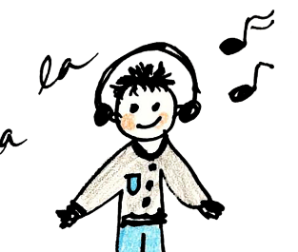
Phonétique
lire / parler
équipe
60
musique
quantité
équipement
[quantity]
Secondes
requête
manquer
[request]
[to miss]
4
expliquer
quatre
0
DÉBUT
Notes:
Timing: 5 minutes for three slides
Aim: automatisation of oral production of SSC [qu] at word level.
Procedure:
Tell students that they are going to take turns to say all the words within a given time, building up speed. They call in any order they like but are not allowed to repeat the one they said in their last turn.
Click on début to start the timer on the screen.
The listening students checks that the speaking student does not pronounce [qu] the English way. If they do, they must repeat the word correctly three times.
Students swap roles. Restart the timer.
Click to check pronunciation of the words.
Word frequency (1 is the most frequent word in French): musique [1139], équipe [814], équipement [1704], quantité [1680], requête [3750], manquer [583], expliquer [252], quatre [253] Source: Londsale, D., & Le Bras, Y. (2009). A Frequency Dictionary of French: Core vocabulary for learners London: Routledge.

Slide 9
Phonétique
lire / parler
équipe
45
musique
quantité
équipement
[quantity]
Secondes
requête
manquer
[request]
[to miss]
4
expliquer
quatre
0
DÉBUT
Notes:
As previous but with 15 fewer seconds on the timer.

Slide 10
Phonétique
lire / parler
équipe
30
musique
quantité
équipement
[quantity]
Secondes
requête
manquer
[request]
[to miss]
4
expliquer
quatre
0
DÉBUT
Notes:
As previous but with 15 fewer seconds on the timer still.

Slide 11
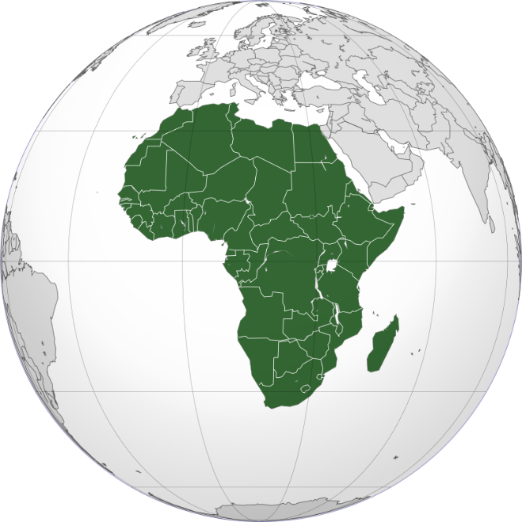
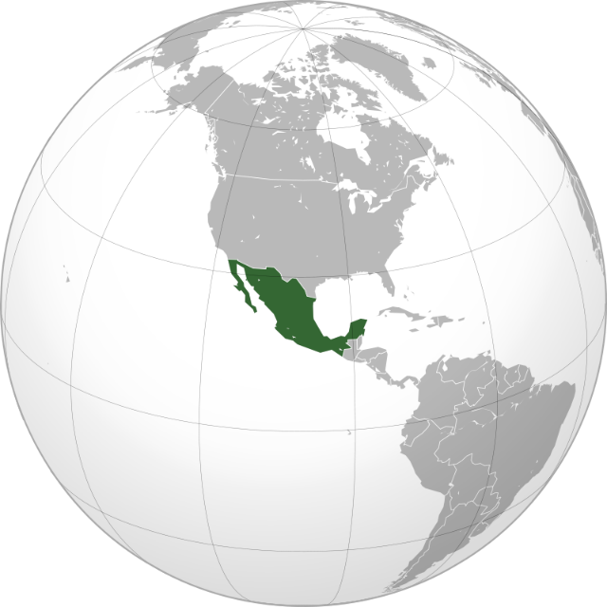
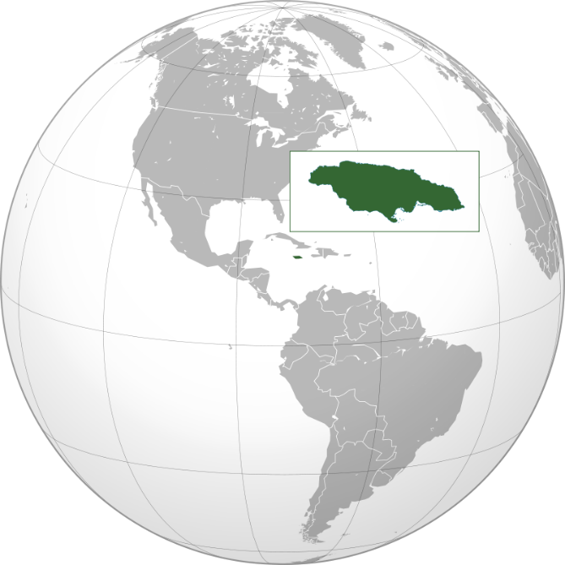
Un texte français
lire
Today we are going to read a short text in French. What kind of text is it?
C’est Afrique
C’est Mexique
C’est Jamaïque
Rouge comme un fruit du Mexique
Orange comme le sable d’Afrique…
C’est un poème !
Notes:
Timing: 3 minutes
Aim: To introduce the task and the text, and to engage students.
Procedure:
Ask students to look at the three globes and decide what the green areas are.
Give the French translation of the first area (Afrique), and ask students to guess what the translations of the two others may be, giving the hint that they rhyme with the first (Mexique, Jamaïque)
Then, present the first two lines of the poem and ask them to guess what sort of text it could be. Why do they think it’s a poem? (A rhyming couplet, repetition of ‘comme’ and of colours)
Word frequencies of unknown words used (1 is the most frequent word in French): texte [631], de [2], sable [3263]
Source: Londsale, D., & Le Bras, Y. (2009). A Frequency Dictionary of French: Core vocabulary for learners London: Routledge.

Slide 12
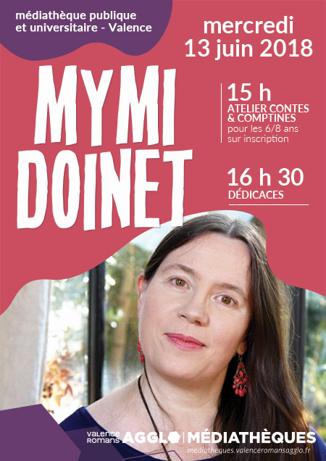
Mymi Doinet (1958-)
La poète: Mymi Doinet
Pays d’origine: France
Ville: Paris
Elle aime écrire pour les enfants
Elle est blogueuse depuis 2010
Notes:
Timing: 5 minutes
Aim: Information gathering exercise using a short text composed of known and unknown words.
Suggested procedures:
Students could take notes in English based on the biographical information that is presented here.
It could be read aloud by the teacher simultaneously to present sound-spelling connections. In context, students should be able to guess the meaning of ‘ville’, ‘pays d’origine’, ‘depuis’ and ‘pour’.
Students could be asked how they think she feels in the photo (elle est calme/contente/indifférente)
Word frequencies of unknown words used (1 is the most frequent word in French): pays [114], de [2], origine [709], ville [260], aimer [242], pour [10], enfant [213], blogeuse [>5000], depuis [96]
Source: Londsale, D., & Le Bras, Y. (2009). A Frequency Dictionary of French: Core vocabulary for learners London: Routledge.
Advertisement featuring Mymi Doinet by Valences Romans Mediathiques is in the public domain.

Slide 13
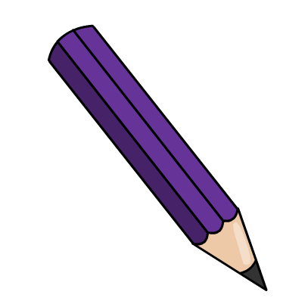
Les couleurs
parler
You don’t know the French words for some of these colours, but they look similar to English!
E
D
F
B
A
violet
G
C
orange
indigo
Notes:
Timing: 5 minutes
Aim: to recall of some words in this week’s vocabulary set.
Procedure
On clicks, the names of the three cognate colours appear for A-C. Have students sound them out using their SSC knowledge ([SFC], soft and gard [g], [an])
Then, students say the names of remaining colours, which they have pre-learned, aloud.
Word frequencies: orange [3912]; indigo [>5000]; violet [>5000]
Source: Londsale, D., & Le Bras, Y. (2009). A Frequency Dictionary of French: Core vocabulary for learners London: Routledge.

Slide 14
Les couleurs
lire
Colours can be used as adjectives. They agree with the noun they are describing.
What is being described below?
1. | ___________ est vert. | la chambre | le portable | could be either
2. | ___________ est bleue. | le lit | la voiture | could be either
3. | ___________ est jaune. | l’ordinateur | la chose | could be either
4. | ___________ est rouge. | la voiture | le modèle | could be either
5. | ___________ est bleu. | le ciel | la vague | could be either
6. | ___________ est verte. | le livre | la règle | could be either
7. | ___________ est orange. | la voiture | l’animal | could be either
8. | ___________ est violet. | le vélo | la chambre | could be either
Notes:
Timing: 5 minutes
Aim: To use knowledge of gender and adjective agreement to choose from pairs of masculine or feminine nouns.
Procedure
Remind students of adjective agreement rules learned so far (where possible, add an –e in feminine form).
Students write 1-8 and decide which noun is being described based on the form of the colour adjective. Remind them to watch out for the colours which end in –e in the masculine form.
Answers revealed on clicks.
Word frequencies: orange [3912]; violet [>5000]
Source: Londsale, D., & Le Bras, Y. (2009). A Frequency Dictionary of French: Core vocabulary for learners London: Routledge.

Slide 15
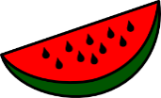
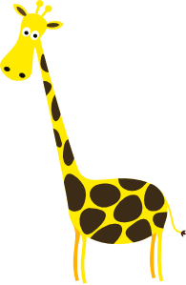
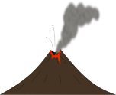
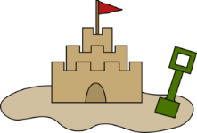
Vocabulaire
Écoute. Le mot, c’est quoi ?
écouter
1
e
a
papillon
2
g
b
vague
3
d
c
arc aux sept couleurs
4
f
fruit
d
5
c
e
sorbet
6
h
girafe chic
f
7
a
g
volcan
8
b
sable
h
Notes:
Timing: 5 minutes
Aim: Practice in connecting the spoken and written forms of unknown words.
Procedure:
1. Tell students that they will hear and read a number of words that will appear in Doinet’s poem. 2. They need to listen and match the letter of the written word to the number of the word heard.
3. Note: where the words are not cognates, pictures are provided to give the meaning. Students will need a bit of help understanding the function of ‘aux’. 4. Answers appear on click.
Transcript:
1. sorbet
2. volcan
3. fruit
4. girafe chic
5. arc aux sept couleurs
6. sable
7. papillon
8. vague
Word frequency (1 is the most frequent word in French):
sorbet [>5000]; volcan [>5000]; fruit [896]; girafe [>5000], chic [>5000]; arc [>5000]; à [4], sept [905], couleur [1211] sable [3263]; papillon [>5000]; vague [1493].
Source: Londsale, D., & Le Bras, Y. (2009). A Frequency Dictionary of French: Core vocabulary for learners London: Routledge.

Slide 16
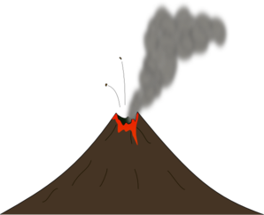
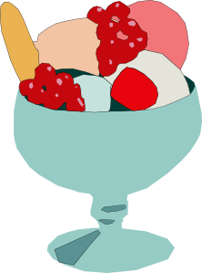
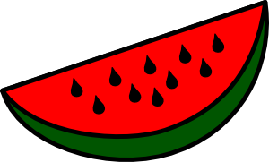
Vocabulaire
Écoute. L’image correcte, c’est quoi ?
écouter
1
D
2
A
C
3
H
B
A
4
B
D
5
E
6
G
7
F
H
8
C
E
F
G
Notes:
Timing: 5 minutes
Aim: Recall of the spoken forms of words introduced on previous slide. The written forms are removed so that students must try to recall the meaning, rather than looking at the form.
Procedure:
Tell students that they will hear a number of words that will appear in Doinet’s poem. These are depicted in Pictures A-H.
Listen and match the letter of the picture to the word heard.
Transcript:
1. sorbet
2. volcan
3. fruit
4. girafe chic
5. arc aux sept couleurs
6. sable
7. papillon
8. vague
Word frequency (1 is the most frequent word in French):
sorbet [>5000]; volcan [>5000]; fruit [896]; girafe [>5000], chic [>5000]; arc [>5000]; à [4], sept [905], couleur [1211] sable [3263]; papillon [>5000]; vague [1493].
Source: Londsale, D., & Le Bras, Y. (2009). A Frequency Dictionary of French: Core vocabulary for learners London: Routledge.

Slide 17
Phonétique
écouter / écrire
g_r_f_ ch_c
p_p_ll_n
v_g_ _
fr_ _t
v_lc_n
_rc _ _x s_pt
c_ _l_ _rs
s_bl_
s_rb_t
Notes:
Timing: 3 minutes
Aim: Practice in connecting the spoken and written forms of unknown words, with particular emphasis on reinforcing the sound and spelling of the vowels within each word.
Procedure:
Tell students that they will hear a number of words that will appear in Doinet’s poem. These are depicted in the pictures.
Click on the image to play the audio.
Students listen and complete the words with the correct vowels.
Note: See next slide for the answers

Slide 18
Les réponses
écouter / écrire
girafe chic
papillon
vague
fruit
volcan
arc aux sept
couleurs
sable
sorbet
Notes:
Answer slide.

Slide 19
Où … ?
écouter
C
1
B
Mexique
H
Afrique
D
D
E
Jamaïque
F
Pacifique
G
Tropique
C
H
Martinique
B
F
G
2
Notes:
Timing: 5 minutes
Aim: To practise listening to the target words now at sentence level within the full poem.
Note:
Play button 1 - top left: audio with full text
Play button 2 - bottom left: audio with text in which colours are obscured with wave sounds. This may be preferable to hearing the full text because students don’t listen out for the colour (they should be listening for the place name and noun).
Procedure:
Decide which version of the text to play (see above).
Click on the appropriate play button.
Students listen and decide which picture represents the noun associated with each place in the poem by writing the correct letter by the place.
Transcript:
Rouge comme un fruit du Mexique
Orange comme le sable d’Afrique
Jaune comme les girafes chics
Vert comme un sorbet Jamaïque
Bleu comme les vagues de Pacifique
Indigo comme un papillon de tropiques
Violet comme les volcans de Martinique
Qui donc est aussi fantastique?
Est-ce un rêve ou est-ce véridique?
C’est dans le ciel mangnifique
L’arc aux sept couleurs magique

Slide 20
Texte complet
lire
Rouge comme un fruit du Mexique C’est dans le ciel magnifique
Orange comme le sable d’Afrique L’arc aux sept couleurs magique
Jaune comme les girafes chics
Vert comme un sorbet Jamaïque
Bleu comme les vagues de Pacifique
Indigo comme un papillon de tropiques
Violet comme les volcans de Martinique
Qui donc est aussi fantastique?
Est-ce un rêve ou est-ce véridique?
Notes:
Full text for reference.

Slide 21
Un poème
Sept Couleurs Magiques
SSC [j/soft g]
Y7 French
Term 1.2 - Week 1 - Lesson 16
Nick Avery / Rachel Hawkes / Ciarán Morris
Artwork by: Chloé Motard
Date updated: 05.08.23
Notes:
Learning outcomes (lesson 2):
Introduction of SSC [j/soft g]
Deepening vocabulary knowledge through work with a challenging text
Word frequency (1 is the most frequent word in French):
7.1.2.1 (introduce): ciel [1538], couleur [1211], poème [3031], poète [2307], rêve [1313], vague [1493], bleu [1216], jaune [2585], rouge [987], vert [1060], comme1 [32]
7.1.1.5 (revisit): il² [13], elle² [38], ami [467], amie [467], chanteur [3251], chanteuse [3251], femme [154], homme [136], professeur [1150], professeure [1150], drôle [2166], intéressant [1244], faux [555], sympa(thique) [4164], vrai [292]
Source: Londsale, D., & Le Bras, Y. (2009). A Frequency Dictionary of French: Core vocabulary for learners London: Routledge.

Slide 22
j/soft g
X
jour
Notes:
Timing: 1 minute
Aim: To introduce SSC [j/soft g]
Procedure: 1. Present the letter(s) and say the [j/soft g] sound first, on its own. Students repeat it with you. 2. Bring up the word ”jour” on its own, say it, students repeat it, so that they have the opportunity to focus all of their attention on the connection between the written word and its sound.
3. A possible gesture for this would be to mime waking up at daybreak, by stretching out ones arms and yawning. 4. Roll back the animations and work through 1-3 again, but this time, dropping your voice completely to listen carefully to the students saying the [j/soft g] sound, pronouncing ”jour” and, if using, doing the gesture.
Word frequency (1 is the most frequent word in French):
jour [78].
Source: Londsale, D., & Le Bras, Y. (2009). A Frequency Dictionary of French: Core vocabulary for learners London: Routledge.

Slide 23
j/soft g
jour
Notes:
With sound and no pictures to focus all attention on the sound-symbol correspondence.

Slide 24
j/soft g
X
jour
Notes:
Without sound to elicit pronunciation (without first hearing the teacher).
Teacher to elicit pronunciation by asking “Comment dit-on …"

Slide 25
j/soft g
j’ai
génial
[I have]
X
jour
sujet
jamais
[subject]
[never]
déjà
[already]
Notes:
Timing: 2 minutes
Aim: To introduce SSC [j/soft g]
Procedure:
1. Introduce and elicit the pronunciation of the individual SSC [j/soft g] and then the source word again ‘jour’ (with gesture, if using). 2. Then present and elicit the pronunciation of the five cluster words.
The cluster words have been chosen for their high-frequency, from a range of word classes, with the SSC (where possible) positioned within a variety of syllables within the words (e.g. initial, 2nd, final etc.). Additionally, we have tried to use words that build cumulatively on previously taught SSCs (see the Phonics Teaching Sequence document) and do not include new SSCs. Where new SSCs are used, they are often consonants which have a similar symbol-sound correspondence in English.
Word frequency (1 is the most frequent word in French): j’ai [8 - avoir]; génial [3872] sujet [353]; déjà [58]; jamais [179]; jour [78]. Source: Londsale, D., & Le Bras, Y. (2009). A Frequency Dictionary of French: Core vocabulary for learners London: Routledge.

Slide 26
j/soft g
j’ai
génial
jour
sujet
jamais
déjà
Notes:
With sound and no pictures to focus all attention on the sound-symbol correspondence.

Slide 27
j/soft g
j’ai
génial
jour
sujet
jamais
déjà
Notes:
Without sound to elicit pronunciation (without first hearing the teacher).
Teacher to elicit pronunciation by asking “Comment dit-on …"

Slide 28
Soft or hard g- ?
phonétique
The French g- can be soft or hard.
It is soft in front of these sounds:
e (génial, intelligent, rouge, le ménage)
i (la girafe)
y (la gymnastique)
It is hard in front of other sounds:
la vague, grand, le magasin
You will meet lots of examples of soft g followed by e.
Notes:
Timing: 2 minutes
Aim: to explain spelling rules governing the pronunciation of soft and hard ‘[g]’.
Procedure:
Click to bring up the explanation.
Draw attention to the fact that students will not encounter ‘soft g’ followed by ‘i’ or ‘y’ very often, whereas ‘soft g’ followed by ‘e’ is very common.
Note: Students have encountered all words used as examples here with the exception of ‘gymnastique’. As no words containing ‘soft g’ followed by ‘y’ feature in the SOW for Year 7, a cognate is used as an example here.
Word frequency (1 is the most frequent word in French):
gymnastique [>5000].
Source: Londsale, D., & Le Bras, Y. (2009). A Frequency Dictionary of French: Core vocabulary for learners London: Routledge.

Slide 29
Soft or hard g- ?
lire / parler
Consider the words below.
Do you think the g- is soft or hard?
 | soft | hard
progrès (progress)
nager (to swim)
gare (station)
étranger (abroad)
Angleterre (England)
boulangerie (bakery)
French g is soft when followed by: e, i, y.
It is hard in front of other sounds.
a
b
c
d
e
f
Notes:
Timing: 5 minutes
Aim: to identify whether ‘g’ is soft or hard by putting into practise the rules on the previous slide.
Procedure:
Students read the word and decide based on spelling whether they think [g] is soft or hard.
Listen to check. Answers revealed on clicks.
Students try to pronounce the words.
Listen again to check pronunciation. Elicit whole class choral pronunciation. (Choral pronunciation practice is recommended as the words contain SSCs which have not yet been focussed on explicitly.)
Note: Unknown words have been chosen so that students must focus on the sound.
Word frequency (1 is the most frequent word in French):
progrès [919]; nager [>5000]; gare [2581]; étranger [305]; Angleterre [n/a]; boulangerie [>5000]; corriger [1639]; plage [2693]; argent [472]; agréable [2841]
Source: Londsale, D., & Le Bras, Y. (2009). A Frequency Dictionary of French: Core vocabulary for learners London: Routledge.

Slide 30
Phonétique
lire / parler
Prononce et organise les mots.
è/ê
SFC
an/en
rêve
violet
fruit
dans
orange
est
chics
volcans
fantastique
sorbet
fruit
orange
dans
rêve
violet
fantastique
est
volcans
sorbet
chics
Notes:
Timing: 5 minutes
Aim: To consolidate SSC knowledge of selected key words from the poem.
Procedure:
Students say out loud the word.
Students classify the word according to the categories within the Venn diagram.
Click on the words to reveal their position within the Venn diagram.

Slide 31
Phonétique
Prononce les mots.
lire / parler
 | I (and ‘QU’)
 | Mexique, Afrique, Pacifique, Tropique
 | OU
 | rouge, ou , couleurs
 | J (and GI)
 | rouge, orange, girafe , magique
Notes:
Timing: 2 minutes
Aim: To practise key sounds within target words from the poem and linking these to the spellings.
Procedure:
Elicit the SSCs [i] and [qu] from students.
Click to reveal the word containing the target SSCs and elicit the pronunciation from students, reinforcing correct pronunciation where necessary.
Repeat for SSCs: [ou], then [j] and [gi].

Slide 32
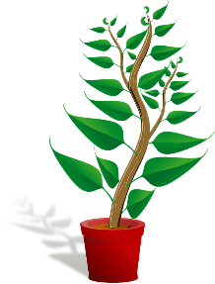
Vrai ou faux ?
Careful! What adjective ending do you need?
lire / écrire
1. Une rose est indigo. | C’est vrai / faux ! Une rose est rouge.
2. Une vague est violette. | C’est vrai / faux ! Une vague est bleue.
3. Une banane est jaune. | C’est vrai / faux ! Une banane est jaune.
4. Un concombre est violet. | C’est vrai / faux ! Un concombre est vert.
5. Une plante est indigo. | C’est vrai / faux ! Une plante est verte.
6. Une carotte est orange. | C’est vrai / faux ! Une carotte est orange.
_________
_________
_________
_________
_________
_________
Notes:
Timing: 5 minutes
Aim: Written recognition and production of the colour terms which form part of this week’s vocabulary set. Revision of ‘vrai’ and ‘faux’ which feature in this week’s revisited vocabulary set.
Procedure:
Students write 1-6 in their books.
They read the sentences and write vrai or faux in their books.
They then fill the gaps with the correct colour. Remind students that colours are adjectives, and they need to add an –e to the feminine form where necessary.
Answers appear on clicks.
Word frequency (1 is the most frequent word in French): rose [2671], banane [>5000], concombre [>5000], plante [2702], carotte [>5000]
Source: Londsale, D., & Le Bras, Y. (2009). A Frequency Dictionary of French: Core vocabulary for learners London: Routledge.

Slide 33
Les couleurs
parler
vert
F
E
indigo
C
jaune
A
violet
B
bleu
G
D
orange
rouge
Notes:
Timing: 2 minutes
Aim: To recap the pronunciation of colours ahead of the speaking activity.
Procedure:
1. In pairs students name the colours.
2. Elicit answers from students to clarify.

Slide 34
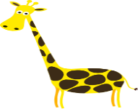
Vocabulaire
parler / lire
_______ comme un ________ du Mexique
_______ comme le __________ d’Afrique
_______ comme les __________ ______
_______ comme un __________ jamaïque
_______ comme les __________ de Pacifique
_______ comme un __________ de tropiques
_______ comme les _____________ de Martinique
Notes:
Timing: 3 minutes
Aim: To promote recall of key vocabulary from the poem in the oral modality plus meanings in English of the full sentences.
Procedure:
Use the pictures in the gaps to elicit the missing words.
A mixed word/picture-based read aloud task could then be done in pairs.
Ask students for the translations of the sentences into English.

Slide 35
‘Un’ ou ‘le’ ?
grammaire
Rouge comme un / le fruit du Mexique
Orange comme un / le sable d’Afrique
Vert comme un / le sorbet Jamaïque
Indigo comme un / le papillon de tropique
Notes:
Timing: 2 minutes
Aim: To clarify the difference between the use of the definite and indefinite article.
Procedure:
1. Elicit the correct word from students, offering additional explanations as necessary.

Slide 36
Les émotions
Ça va comment ?
parler
Je suis…
heureux (-euse)
calme
content(e)
intéressé(e)
triste
fâché(e)
intéressé(e)
indifférent(e)
Notes:
Timing: 2 minutes
Aim: To encourage further engagement with the text by asking students for their emotional response after they have finished reading the poem.
Procedure:
Use the French prompt to ask students how they feel.
Ask students to report back on how their partner feels (il est/elle est…)
Word frequency (1 is the most frequent word in French):
hereux(-euse) [764]; calme [1731]; content(e) [1841]; indifférent(e) [4151]; triste [1843]; fâché(e) [4413]; intéressé(e) [559].
Source: Londsale, D., & Le Bras, Y. (2009). A Frequency Dictionary of French: Core vocabulary for learners London: Routledge.

Slide 37
Écris un poème!
écrire
Now create your own poem!
Try to re-use the colours in the poem with ‘comme’
Remember to use un/une/le/la correctly
Notes:
Timing: 15-20 minutes
Aim: To practise correct use of the article according to intended meaning within a creative written production task.
Procedure:
1. Tell student their task is to research and writing their own poem.
2. Allow use of dictionaries for this, especially as they may want to include words that haven’t yet been taught.
3. Offer students feedback on their use of articles
Note:
This task can be given with or without the concrete/abstract nouns focus on the previous slide. Even without an explicit focus on the previous slide, it's possible that students will mix/match concrete and abstract e.g. Rouge comme l’amour
Bleu comme une voiture

Slide 38
Vocabulaire
lire / écrire
Voici les formes masculines.
Match them with the English words / pictures!
C’est quoi la forme féminine ?
Écris en français.
[he, it]
[kind]
[she, it]
[kind]
le
chanteur
la
chanteuse
l’ami
il
sympa
l’amie
elle
sympa
[funny]
[interesting]
[funny]
[interesting]
le professeur
intéressante
la professeure
drôle
l’homme
intéressant
drôle
la femme
le professeur il le chanteur l’homme l’ami intéressant drôle sympa
Notes:
Timing: 7 minutes
Aim: Written recognition and production of this week’s revisited vocabulary.
Procedure:
1. Students sketch the fist grid and match the words to the pictures.
2. Answers revealed on clicks. As the words are revealed, teacher pronounces them. Students repeat.
3. Students sketch the second grid and write the feminine forms of the words.
4. Answers revealed on clicks. As the words are revealed, teacher pronounces them. Students repeat. Why do some words stay the same? Remind students of adjective agreement rules.
5. Now practice saying pairs of words, focusing on pronunciation changes if relevant.
Word frequency of cognates used (1 is the most frequent word in French):
forme [369], masculin [3714], féminin [2381]
Source: Londsale, D., & Le Bras, Y. (2009). A Frequency Dictionary of French: Core vocabulary for learners London: Routledge.

Slide 39
Devoirs
Vocabulary Learning Homework (Term 1.2, Week 2)
Audio file
Student worksheet
In addition, revisit: Term 1.1.5
Notes:
Use this slide to set the homework.
For Y7, the typical homework will be to pre-learn vocabulary for the next lesson. There is an audio file to accompany the student worksheet.
Notes:
i) Teachers may, in addition, want to recommend use of a particular online app for the pre-learning of each week’s words. ii) Quizlet now requires parental involvement / registration / permissions for users below the age of 13, so it is perhaps most suitable for Y9 – 11 students. iii) Language Nut hosts LDP vocabulary lists and these are free for schools to use, though there is a registration process. One benefit is that all of the student tracking data that Language Nut offers are also available to schools that use the LDP lists for practice. Perhaps this makes it a good option for Y7/8.
iv) There are other free apps, and new ones are always appearing. Teachers have told us that they are currently using: Flippity, Wordwall (where using previously-created activities is free).
v) Gaming Grammar has been acquired by Language Nut. Its original content should still be available to teachers and much of it is appropriate for Y7 learners.

