Slide 1
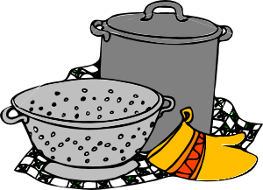
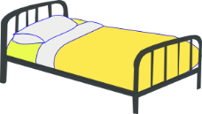
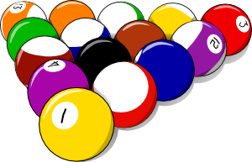
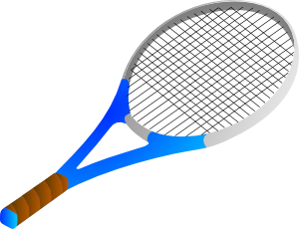
Activities at home
Talking about doing and making things
faire (‘do’ and ‘make’) with le/la/l’/les
intonation questions with question words
SSC [ain/in]
Y7 French
Term 1.1 - Week 7 - Lesson 13
Victoria Hobson / Stephen Owen / Catherine Morris
Artwork by: Chloé Motard
Date updated: 05.08.23
Notes:
Note: all words (new and revisited) in this week of the SOW appear on all three GCSE wordlists, with these exceptions: i) AQA list does not have ménage, modèle.
ii) Edexcel list does not have ménage.
iii) Eduqas list does not have modèle.
Learning outcomes (lesson 1):
Introduction of SSC [ain/in]
Introduction of first and third person singular forms of faire
Word frequency (1 is the most frequent word in French):
7.1.1.7 (introduce) faire [25], fais [25], fait [25], ça [54], activité [452], courses [1289], cuisine [2618], devoirs [39], lit [1837], ménage [2326], modèle [958], d'accord [736], quoi [297]
7.1.1.4 (revisit) as [8], livre [358], ordinateur [2201], vélo [4594], voiture [881], cher [803], chère [803], moderne [1239], rapide [672], voici [1103], oui [284], non [75], comment ça s'écrit?
Source: Londsale, D., & Le Bras, Y. (2009). A Frequency Dictionary of French: Core vocabulary for learners London: Routledge.

Slide 2
ain/in
train
Notes:
Timing: 3 minutes (6 slides)
Aim: To introduce SSC [ain/in]
Procedure: 1. Present the letter(s) and say the [ain/in] sound first, on its own. Students repeat it with you. 2. Bring up the word ”train” on its own, say it, students repeat it, so that they have the opportunity to focus all of their attention on the connection between the written word and its sound.
3. A possible gesture for this would be to move both arms simultaneously forwards and back in a circular motion, simulating the motion of train wheel connecting rods.
4. Roll back the animations and work through 1-3 again, but this time, dropping your voice completely to listen carefully to the students saying the [ain/in] sound, pronouncing ”train” and, if using, doing the gesture.
Word frequency (1 is the most frequent word in French):
train [232]. Source: Londsale, D., & Le Bras, Y. (2009). A Frequency Dictionary of French: Core vocabulary for learners London: Routledge.

Slide 3
ain/in
train
Notes:
With sound and no pictures to focus all attention on the sound-symbol correspondence.

Slide 4
ain/in
train
Notes:
Without sound to elicit pronunciation (without first hearing the teacher).
Teacher to elicit pronunciation by asking “Comment dit-on …"

Slide 5
ain/in
fin
matin
[end]
vingt
train
main
maintenant
[now]
Notes:
Aim: To introduce SSC [ain/in]
Procedure:
1. Introduce and elicit the pronunciation of the individual SSC [ain/in] and then the source word again ‘train’ (with gesture, if using). 2. Then present and elicit the pronunciation of the five cluster words.
The cluster words have been chosen for their high-frequency, from a range of word classes, with the SSC (where possible) positioned within a variety of syllables within the words (e.g. initial, 2nd, final etc.). Additionally, we have tried to use words that build cumulatively on previously taught SSCs (see the Phonics Teaching Sequence document) and do not include new SSCs. Where new SSCs are used, they are often consonants which have a similar symbol-sound correspondence in English.
Word frequency (1 is the most frequent word in French): fin [111]; matin [442] vingt[1273]; maintenant [192]; main [418]; train [232]. Source: Londsale, D., & Le Bras, Y. (2009). A Frequency Dictionary of French: Core vocabulary for learners London: Routledge.

Slide 6
ain/in
fin
matin
vingt
train
main
maintenant
Notes:
With sound and no pictures to focus all attention on the sound-symbol correspondence.

Slide 7
ain/in
fin
matin
vingt
train
main
maintenant
Notes:
Without sound to elicit pronunciation (without first hearing the teacher).
Teacher to elicit pronunciation by asking “Comment dit-on …"

Slide 8
Phonétique
écouter
Listen carefully and find the words you hear in this sea of vocabulary.
1
2
3
4
5
6
A) certain
D) simple
B) cercle
C) certes
E) couronne
J) magasin
H) magistrat
F) cousin
[crown]
[shop]
G) niveau
I) magazine
L) latin
O) gant
[level]
[glove]
N) prince
K) gain
Q) prends
M) éclat
P) latte
[take]
[flash]
[board]
Notes:
Timing: 5 minutes
Aim: Aural recognition of words containing SSC [ain/in] from a pool of distractors. This trains students to associate the process of looking for a certain letter combination when they hear a sound.
Procedure: 1. Click on boxes to play the words.
2. Students note down the letter next to the word they hear. Tell students that to find the word quickly they should focus on the position of [ain/in] in the word they hear, and look for words with the letters in the same position. Time limits or a competitive element could be added to speed this up, helping automisation of the sound-symbol connection.
3. Elicit answers for some alphabet practice by asking ‘c’est quoi?’
4. Answers revealed on clicks.
Transcript:
prince (N)
cousin (F)
certain (A)
latin (L)
magasin (J)
gain (K)
Word frequency (1 is the most frequent word in French): certain [110], cercle [2258], certes [1021], simple [212], cousin [3387], couronne [3700] éclat [3515], latin [1844], prince [2610], gant [>5000], magasin [1736], magistrat [4282], vain [2971], niveau [328], magazine [2033], latte [>5000], prendre [43]
Source: Londsale, D., & Le Bras, Y. (2009). A Frequency Dictionary of French: Core vocabulary for learners London: Routledge.

Slide 9
faire
faire
[to do, make | doing, making]
fait
[does, makes | is doing, making]
Notes:
Timing: 3 minutes for sequence of six verbs
Aim: to introduce the verb faire more explicitly. Faire is one of the 25 most frequently used verbs in French. All 25 most frequent verbs will be introduced early on using the same format. Both long form (infinitive) and short form (3rd person singular) are introduced in order to familiarise students with various forms of the same verb.
Procedure
Bring up the word faire on its own, say it, students repeat it, and remind them of the phonics.
Try to elicit the meaning from the students. Students have had explicit teaching that the present tense in French communicates two different present tense meaning in English. This reinforces that learning. Emphasise the two meanings for the short form, reminding students that French only has one form and does not have a direct equivalent of the grammar for ‘is + ing’, the continuous form (as covered in previous weeks).
Then bring up the English translations. Emphasise the two meanings for the infinitive.
Bring up the short form fait, say it, students repeat it. Draw attention to SFC.
Try to elicit the meaning from the students. Emphasise the two meanings for the short form.

Slide 10
faire
faire
[to do, make | doing, making]
fait
[does, makes | is doing, making]
Notes:
Cycle through the long and short form again.

Slide 11
fait
faire
[to do, make | doing, making]
Léa fait la cuisine.
[Léa does | is doing the cooking.]
Notes:
Introduce the short form in a sentence.

Slide 12
faire
faire
[to do, make | doing, making]
Léa aime faire la cuisine.
[Léa likes doing the cooking.]
Notes:
Introduce the long form in a sentence.

Slide 13
fait
fait
[does, makes | is doing, making]
fait
Léa la cuisine.
[Léa does the cooking.]
Notes:
Cycle through the short form in context again.

Slide 14
faire
faire
[to do, make | doing, making]
faire
Léa aime la cuisine.
[Léa likes doing the cooking.]
Notes:
Cycle through the long form in context again.

Slide 15
Vocabulaire
faire means ‘to do, doing’ AND ‘to make, making’.
parler
faire le lit
faire le ménage
faire la cuisine
faire le modèle
faire une activité
faire les courses
faire les devoirs
Notes:
Timing: 3 minutes
Aim: To draw students’ attention to the two translations of ‘make’ and ‘do’.
Procedure:
To ensure that English meanings are transparent and that students are fully aware of when they use ‘do’ and ‘make’ in English, it is worth eliciting English translations explicitly, here.
Teachers can then use this slide to introduce the vocabulary in a listen and repeat style, if not already pre-learnt.
Reading and writing activities follow which practise the verb faire in first and third person singular. NB this teaching point does not offer a listening and speaking opportunity because of the same pronunciation of the forms for both meanings.

Slide 16
Qui fait quoi?
Écoute. Écris en anglais.
écouter
 | She/He does/makes... | Extra info
Romain | the housework (le ménage) | he’s reading an interesting book (Il lit un livre intéressant)
Léa | the bed, homework, the cooking (le lit, les devoirs, la cuisine) | She has a computer, cooks at the weekend (Elle a un ordinateur, elle fait la cuisine le week-end)
Amandine | the shopping, the cooking (les courses, la cuisine) | She has a car, she usually does the shopping (Elle a une voiture Normalement elle fait la cuisine)
sur – on | normalement - usually
Notes:
Timing: 7 minutes
Aim: to practise comprehension of this week’s vocabulary.
Procedure:
Students listen to the audio for each person. Audio can be paused after each phrase and replayed if needed. Romain’s audio is particularly slow, to allow students a very accessible way in.
Students should note what each person does in English as well as any extra information they hear. The extra information contains some unknown vocabulary (glossed on slide).
Click first to reveal what they do and then to reveal the extra information. Explain any unknown vocabulary. The French also appears on slide, for transparency.
Transcript:
Romain: Je fais le ménage et je lis un livre intéressant.
Léa: Je fais le lit chaque matin et je fais les devoirs sur l’ordinateur. C’est très modern. Le week-end, je fais la cuisine.
Amandine: J’ai une voiture et je fais les courses. Normalement, je fais la cuisine.
Word frequency of unknown vocabulary used (1 is the most frequent word in French): sur [16], week-end [2475], normalement [2018]
Source: Londsale, D., & Le Bras, Y. (2009). A Frequency Dictionary of French: Core vocabulary for learners London: Routledge.

Slide 17
The verb ‘faire’ – to do/make
grammaire
SFC
In French we use the verb faire to say to do and to make.
je fais
I do / I make
il fait
he does / makes
elle fait
she does / makes
Stephen Owen
Notes:
Timing: 2 minutes
Aim: This week we are focussing initially on the first and third person singular forms of ‘faire’, and these are presented here.
Procedure:
Click to reveal the conjugations and meanings of the verb.

Slide 18
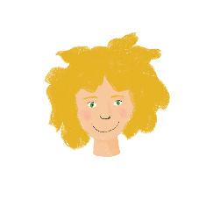
Qui fait quoi ?
lire
Léa writes what she does at home and what her mum does. Who does what? Léa (I…) or her mum (she…).
1 | fais la cuisine. |  |  | 4 | fait un effort.
2 | fais le modèle. |  |  | 5 | fais les devoirs.
3 | fait le ménage. |  |  | 6 | fait une activité.
je
elle
je
elle
Notes:
Timing: 7 minutes
Aim: to recognize the first and third person singular forms of ‘faire’, and connecting these with meaning.
Procedure:
1. Students read the parts of sentences they can see and tick who they think it applies to. They should use their knowledge of verb forms to decide.
2. Answers revealed on clicks.
Word frequency of unknow near-cognates used (1 is the most frequent word in French): effort [388]
Source: Londsale, D., & Le Bras, Y. (2009). A Frequency Dictionary of French: Core vocabulary for learners London: Routledge.

Slide 19
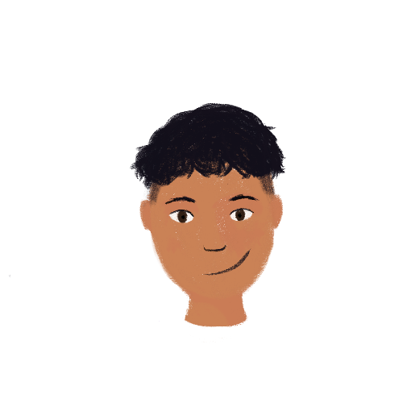
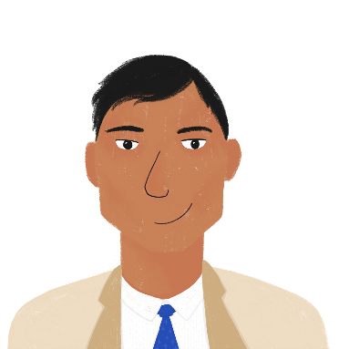
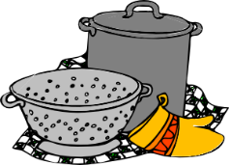
Qui fait quoi ?
écrire
Tu es Amir. Tu écris un e-mail. Écris 5 phrases avec ‘je’ (Amir) ou ‘il’ (papa).
1)
2)
5)
3)
4)
Je fais le lit.
1
2
3
4
5
Il fait le ménage.
Je fais la cuisine.
Je fais les devoirs.
Il fait les courses.
Notes:
Timing: 7 minutes
Aim: written production of vocabulary and the first and third person singular forms of faire.
Procedure:
Check understanding of the rubric, given in French. Students know these words from previous learning.
Use stressed intonation and strategic pointing (i.e. at Amir or his dad) to ensure that the instruction for the task is understood.
Do the first one together as an example, ensuring students focus on the verb ending as well as the pronoun, when feedback on the first answer is given.
Then give students time to do questions 2-5, before checking them together.
Word frequency of unknow near-cognates used in task instructions (1 is the most frequent word in French): e-mail [>388], papa [2458],
Source: Londsale, D., & Le Bras, Y. (2009). A Frequency Dictionary of French: Core vocabulary for learners London: Routledge.

Slide 20
Questions with quoi
parler
As you know, you can turn a statement into a question by raising your pitch:
Statement: Il fait le lit. He’s making the bed.
He makes the bed.
Question: Il fait le lit ? Is he making the bed?
Does he make the bed?
This type of question is a yes/no question.
To get more information about a situation, we need to add a question word.
In French, the question word comes at the end of intonation questions:
Il fait quoi ? What is he doing/making?
__________
Remember!
There is no word for ‘do’ in French.
__________
Notes:
Timing: 3 minutes
Aim: To revise intonation questions (yes/no) and to learn positioning of quoi in an intonation question to elicit more information.

Slide 21
Questions with quoi
parler
Léa is asking Amir about his sister Noura. What is she asking? Form questions with quoi.
Elle a quoi ?
Elle fait quoi ?
Elle écoute quoi ?
________________
Elle a un livre !
Elle fait le modèle!
Elle écoute la radio.
________________
________________
Notes:
Timing: 5 minutes
Aim: Oral production of information questions with raised intonation and quoi. Revision of 3rd person singular form of verbs encountered so far.
Procedure:
Students pair up and take it in turns to play the role of Léa (asking questions) and Amir (answering questions). Remind students that the question word is the last word in the sentence, which is different to English. Remind students to pay attention to their intonation.
Click to reveal solutions.

Slide 22
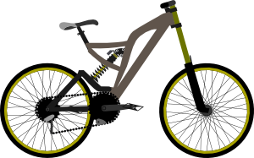
C’est quoi ?
lire
Some people are boasting about what they have. What is being described?
Tu as quoi ?
J’ai un ordinateur moderne et cher.
J’ai un vélo. C’est cool et rapide.
Oui, mais j’ai une voiture.
C’est plus rapide et plus cher qu’un vélo !
plus…. que – more…than
Notes:
OPTIONAL Timing: 5 minutes
Aim: Revision of some of this week’s revisited vocabulary.
Procedure:
1. Students read the sentences and decide what is being described. They should use their knowledge of grammar to help them (masculine and feminine adjectives and determiners)
2. Click to reveal the answers.
Word frequency of unknown cognates used (1 is the most frequent word in French): cool [>5000]
Source: Londsale, D., & Le Bras, Y. (2009). A Frequency Dictionary of French: Core vocabulary for learners London: Routledge.

Slide 23
Activities at home
Talking about doing and making things
faire (‘do’ and ‘make’) with le/la/l’/les
SSC [è/ê]
Y7 French
Term 1.1 - Week 7 - Lesson 14
Victoria Hobson / Stephen Owen / Catherine Morris
Artwork by: Chloé Motard
Date updated: 05.08.23
Notes:
Learning outcomes (lesson 2):
Introduction of SSC [è/ê]
Introduction of first and second person singular forms of faire
Word frequency (1 is the most frequent word in French):
7.1.1.7 (introduce) faire [25], fais [25], fait [25], ça [54], activité [452], courses [1289], cuisine [2618], devoirs [39], lit [1837], ménage [2326], modèle [958], d'accord [736], quoi [297]
7.1.1.4 (revisit) as [8], livre [358], ordinateur [2201], vélo [4594], voiture [881], cher [803], chère [803], moderne [1239], rapide [672], voici [1103], oui [284], non [75], comment ça s'écrit?
Source: Londsale, D., & Le Bras, Y. (2009). A Frequency Dictionary of French: Core vocabulary for learners London: Routledge.

Slide 24
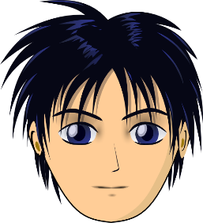
ê/è
[head]
tête
Notes:
Timing: 1 minute
Aim: To introduce SSC [ê/è]
Procedure: 1. Present the letter(s) and say the [ê/è] sound first, on its own. Students repeat it with you. 2. Bring up the word ”tête” on its own, say it, students repeat it, so that they have the opportunity to focus all of their attention on the connection between the written word and its sound.
3. A possible gesture for this would be to point to one’s head.
4. Roll back the animations and work through 1-3 again, but this time, dropping your voice completely to listen carefully to the students saying the [ê/è] sound, pronouncing ” tête” and, if using, doing the gesture.
Word frequency (1 is the most frequent word in French):
tête [343]. Source: Londsale, D., & Le Bras, Y. (2009). A Frequency Dictionary of French: Core vocabulary for learners London: Routledge.

Slide 25
ê/è
tête
Notes:
With sound and no pictures to focus all attention on the sound-symbol correspondence.

Slide 26
ê/è
[head]
tête
Notes:
Without sound to elicit pronunciation (without first hearing the teacher).
Teacher to elicit pronunciation by asking “Comment dit-on …"

Slide 27
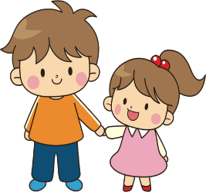
ê/è
fête
frère
[head]
collège
tête
être
[to be]
problème
Notes:
Timing: 2 minutes
Aim: To introduce SSC [ê/è]
Procedure:
1. Introduce and elicit the pronunciation of the individual SSC [ê/è] and then the source word again ‘tête’ (with gesture, if using). 2. Then present and elicit the pronunciation of the five cluster words.
The cluster words have been chosen for their high-frequency, from a range of word classes, with the SSC (where possible) positioned within a variety of syllables within the words (e.g. initial, 2nd, final etc.). Additionally, we have tried to use words that build cumulatively on previously taught SSCs (see the Phonics Teaching Sequence document) and do not include new SSCs. Where new SSCs are used, they are often consonants which have a similar symbol-sound correspondence in English.
Word frequency (1 is the most frequent word in French): fête [1490]; frère [1043] collège [2116]; problème [188]; être[5]; tête [343]. Source: Londsale, D., & Le Bras, Y. (2009). A Frequency Dictionary of French: Core vocabulary for learners London: Routledge.

Slide 28
ê/è
fête
frère
collège
tête
être
problème
Notes:
With sound and no pictures to focus all attention on the sound-symbol correspondence.

Slide 29
ê/è
fête
frère
collège
tête
être
problème
Notes:
Without sound to elicit pronunciation (without first hearing the teacher).
Teacher to elicit pronunciation by asking “Comment dit-on …"

Slide 30
Phonétique
parler
Say only the words containing SSC [è/ê].
A | honnête | théorie | système | émotion | créature
B | céréale | extrême | sincère | helicoptère | poète
A | égyptien | thé | mystère | épidémie | caractère
B | planète | créature | barrière | crème | émotion
A | helicoptère | sincère | kilomètre | carrière | céréale
B | épidémie | sphère | carrière | émotion | atmosphère
A | honnête | théorie | système | émotion | créature
B | céréale | extrême | sincère | hélicoptère | poète
A | égyptien | thé | mystère | épidémie | caractère
B | planète | créature | barrière | crème | émotion
A | hélicoptère | sincère | kilomètre | carrière | céréale
B | épidémie | sphère | carrière | émotion | atmosphère
Notes:
Timing: 5 minutes
Aim: to recognise and correctly pronounce unknown words containing [è/ê]. Awareness-raising of the difference in pronunciation between various accents on the letter ‘e’. Awareness raising of cross-linguistic pronunciation differences in near-cognate words. The words chosen contain sounds that are equivalent (or very similar) to English SSCs, as well as known SSCs, so that students can focus fully on [è/ê] (allowances are made for English pronunciation of [r], which is covered in year 8).
Procedure:
1. Students partner up and label themselves A and B.
2. They then treat the table as a script, but have to make sure they only pronounce the words containing SSC [è/ê]. By skipping over the words containing an [é], students learn to associate the grave accent and circumflex with a different set of sounds from the acute accent.
3. A challenge could be to get through the table as fast as possible without making a mistake.
4. Click to reveal the words students should have said in bold.
5. Click on the words with an [è/ê] to hear them pronounced by a native speaker. Students repeat.
6. Clarify meanings.
Transcript and word frequency (1 is the most frequent word in French): honnête [2405], théorie [1773], système [289], émotion [1854], créature [4407], céréale [4983], extrême [1270], sincère [3180], helicoptère [n/a], poète [2307], égyptien [4137], thé [3517], mystère [2777], épidémie [4203], caractère [927], planète [1875], barrière [2438], crème [4748], kilomètre [1435], carrière [1247], sphere [4209], atmosphère [2493]
Source: Londsale, D., & Le Bras, Y. (2009). A Frequency Dictionary of French: Core vocabulary for learners London: Routledge.

Slide 31
The verb ‘faire’ – to do/make
grammaire
SFC
To say you do / you make we use tu fais:
We have already learnt the following forms of the verbs faire:
je fais
tu fais
you do / make
I do / I make
il fait
he does / makes
elle fait
she does / makes
Stephen Owen
Notes:
Timing: 3 minutes
Aim: Introduction of second person singular form of ‘faire’.

Slide 32
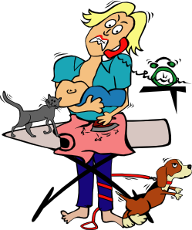
Qui fait quoi ?
lire
Léa’s mum writes a ‘to do’ list for Léa’s dad, with tasks for him and for Léa. The list got torn.
Qui fait quoi ? Tu (papa) ou elle (Léa)?
tu (you)
elle (she)
fais les devoirs
A
B
C
D
E
F
G
H
fais le modèle
fait le ménage
fais la cuisine
fais un effort
fait le lit
fait une activité
fait les courses
Notes:
Timing: 5 minutes
Aim: Written recognition of second and third person forms of ‘faire’. Connecting these with meaning.
Procedure:
Students write A - H and tu or elle. Remind them it is the form of faire that gives them this information.
2. Answers revealed on clicks.
3. Check meanings.
Word frequency of unknown near-cognates used in task activity (1 is the most frequent word in French): effort [388]
Source: Londsale, D., & Le Bras, Y. (2009). A Frequency Dictionary of French: Core vocabulary for learners London: Routledge.

Slide 33
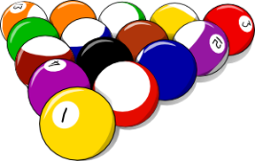
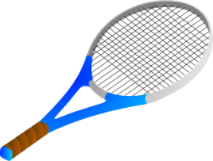
C’est une question ?
écouter
Léa’s dad is a bit confused! He checks his understanding of the to-do list.
Is he making a statement about these things, or asking a question? Write ‘?’ or ‘.’
.
?
?
.
?
.
1
2
3
4
5
6
Notes:
Timing: 5 minutes
Aim: To differentiate aurally between statements and intonation questions. Aural vocabulary recognition.
Procedure:
1. Click on a number to hear a question or statement. The sentences do not match the picture order, so students must use their vocabulary knowledge to decide where to write their answer. In their books, they can just write e.g. ‘1. bed, statement’
2. Elicit answers by pointing to a picture and asking ‘C’est une question ?’
3. Students reply with ‘oui’ or ‘non’.
Transcript:
1. Elle fait le lit.
2. Tu fais une activité ?
3. Tu fais les devoirs ?
4. Tu fais le ménage.
5. Elle fait la cuisine ?
6. Elle fait les courses.
Word frequency of unknown near-cognates used in task activity (1 is the most frequent word in French):
papa [2458], question [144]
Source: Londsale, D., & Le Bras, Y. (2009). A Frequency Dictionary of French: Core vocabulary for learners London: Routledge.

Slide 34
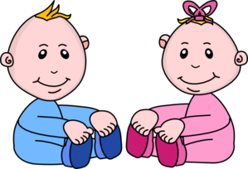
Qui fait quoi ?
écrire
Use the picture prompts to write four questions and four answers.
If mum does the task, write ‘elle…+ verb’. For dad, write ‘il…+ verb’.
1
?
2
?
Tu fais le lit?
Non! Il fait le lit.
Non! Elle fait la cuisine.
Tu fais la cuisine?
?
?
3
4
Non! Elle fait les devoirs.
Tu fais les devoirs?
Tu fais le ménage?
Non! Il fait le ménage.
Notes:
Timing: 5 minutes
Aim: Written production of the second and third person singular forms of ‘faire’ together with this week’s vocabulary.
Procedure:
Students write the correct questions and answers into the speech bubbles to practise 2nd and 3rd person singular of faire.
Do the first one with students as a worked example to model the task.
Students have been taught yes/no questions. Elicit the meaning of the first question, if needed, as a reminder.

Slide 35
C’est qui ? C’est quoi ?
parler
Je fais les courses.
Notes:
Timing: 5 minutes (seven slides)
Aim: Written or spoken consolidation of vocabulary and grammar learned this week.
Procedure:
Click to reveal an image representing a pronoun and an imagine representing an activity.
Students write or say the French.

Slide 36
C’est qui ? C’est quoi ?
parler
Elle fait les devoirs.

Slide 37
C’est qui ? C’est quoi ?
parler
Tu fais le ménage.

Slide 38
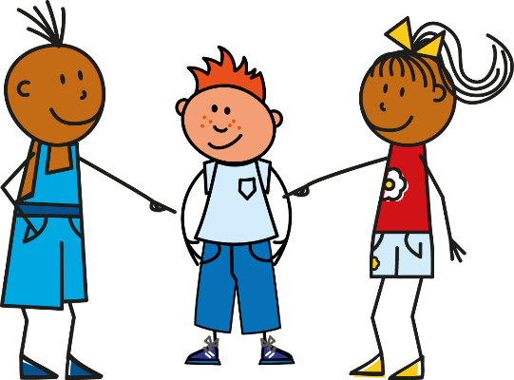
C’est qui ? C’est quoi ?
parler
Il fait une activité.

Slide 39
C’est qui ? C’est quoi ?
parler
Je fais la cuisine.

Slide 40
C’est qui ? C’est quoi ?
parler
Tu fais le modèle.

Slide 41
C’est qui ? C’est quoi ?
parler
Je fais le lit.

Slide 42
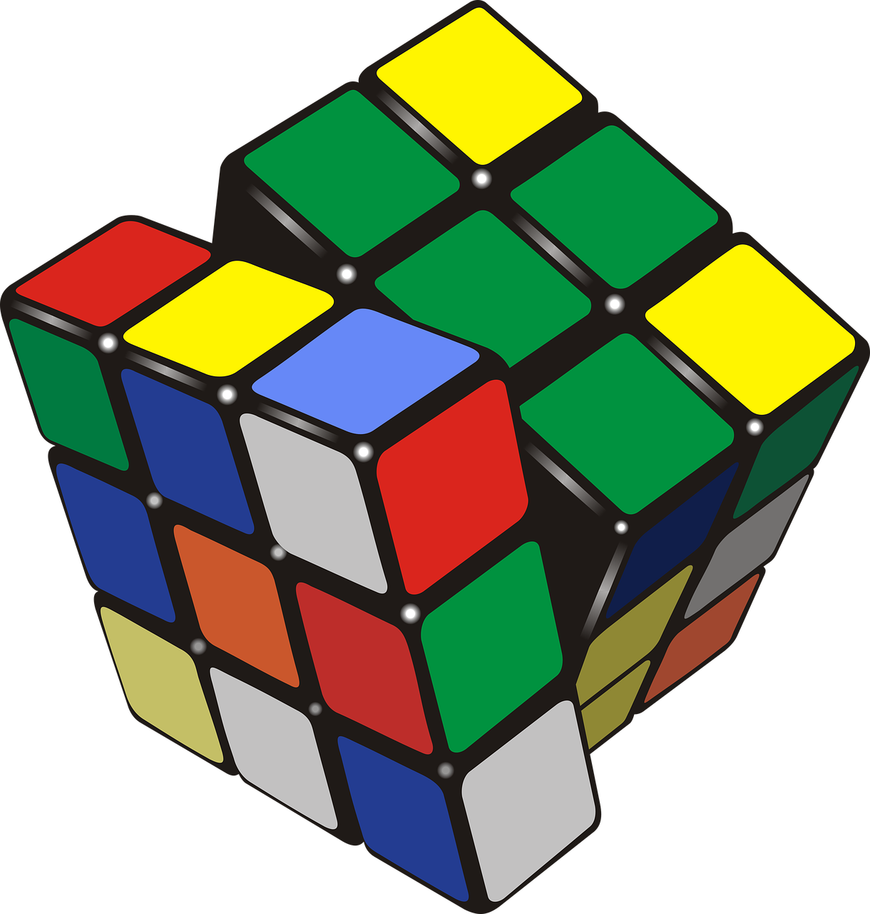
Tu fais…?
Choose an identity A-H. Your partner asks you questions to work out who you are. Then swap roles.
parler
A | B | C | D
E | F | G | H
[activity]
[effort]
[activity]
[effort]
[activity]
[effort]
[activity]
[effort]
[activity]
[effort]
[activity]
Notes:
Timing: 5 minutes Aim: to practise spoken production and comprehension of grammar and vocabulary learned this week.
Procedure:
Display this slide. Both partners select an identity.
They ask each other yes/no questions (e.g., Tu fais les courses?) to determine the identity of their partner.
They could either take it in turns asking and answering and see who finds out the identity of the other in the fewest number of questions OR they could play round by round.
Note: there may be time for multiple rounds, depending on how long they take!

Slide 43
Devoirs
Vocabulary Learning Homework (Y7, Term 1.2, Week 1)
Audio file
Student worksheet
In addition, revisit: Term 1.1 Week 5
Notes:
Use this slide to set the homework.
For Y7, the typical homework will be to pre-learn vocabulary for the next lesson. There is an audio file to accompany the student worksheet.
Notes:
i) Teachers may, in addition, want to recommend use of a particular online app for the pre-learning of each week’s words. ii) Quizlet now requires parental involvement / registration / permissions for users below the age of 13, so it is perhaps most suitable for Y9 – 11 students. iii) Language Nut hosts LDP vocabulary lists and these are free for schools to use, though there is a registration process. One benefit is that all of the student tracking data that Language Nut offers are also available to schools that use the LDP lists for practice. Perhaps this makes it a good option for Y7/8.
iv) There are other free apps, and new ones are always appearing. Teachers have told us that they are currently using: Flippity, Wordwall (where using previously-created activities is free).
v) Gaming Grammar has been acquired by Language Nut. Its original content should still be available to teachers and much of it is appropriate for Y7 learners. From this lesson, for example, learners could practise: Definite articles: Gender (Article Agreement)
Verbs (present): 1st person singular/plural (Verb agreement (present))
Verbs (present): 2nd person singular/plural (Verb agreement (present))
Verbs (present): 3rd person singular/plural (Verb agreement (present))

