Slide 1
Identity: others
Talking about a specific person or thing [1]
definite article (le, la) s-liaison SSC [en/an]
Y7 French
Term 1.1 - Week 6 - Lesson 11
Victoria Hobson / Rachel Hawkes / Catherine Morris
Artwork by: Chloé Motard
Date updated: 20.05.23
Notes:
Note: all words (new and revisited) in this week of the SOW appear on all three GCSE wordlists, with this exception: AQA and Edexcel lists do not have phrase, (which may be used as a cognate in the reading paper).
Learning outcomes (lesson 1):
Introduction of SSC [en/an]
Introduction of definite articles le and la
Introduction of s-liaison
Word frequency (1 is the most frequent word in French):
7.1.1.6 (introduce) acteur [1152], actrice [1152], anglais² [784], fille¹ [629], français² [251], garçon [1599], médecin [827], mot [220], personne¹ [84], phrase [2074], le [1], la [1], les [1], en¹ [7]
7.1.1.3 (revisit) a [8], ai [8], avoir [8], ce (c') [12], animal [1002], chambre [633], chien [1744], chose [125], idée [239], portable [4002], règle1 [488], bon [94], un1 [3], une [3], qui? [14]
Source: Londsale, D., & Le Bras, Y. (2009). A Frequency Dictionary of French: Core vocabulary for learners London: Routledge.

Slide 2
en/an
enfant
Notes:
Timing: 1 minute
Aim: To introduce SSC [en/an]
Procedure: 1. Present the letter(s) and say the [en/an] sound first, on its own. Students repeat it with you. 2. Bring up the word ”enfant” on its own, say it, students repeat it, so that they have the opportunity to focus all of their attention on the connection between the written word and its sound.
3. A possible gesture for this would be to mime patting a child on the head/back 4. Roll back the animations and work through 1-3 again, but this time, dropping your voice completely to listen carefully to the students saying the [en/an] sound, pronouncing ”enfant” and, if using, doing the gesture.
Word frequency (1 is the most frequent word in French):
enfant [126]. Source: Londsale, D., & Le Bras, Y. (2009). A Frequency Dictionary of French: Core vocabulary for learners London: Routledge.

Slide 3
en/an
enfant
Notes:
With sound and no pictures to focus all attention on the sound-symbol correspondence.

Slide 4
en/an
enfant
Notes:
Without sound to elicit pronunciation (without first hearing the teacher).
Teacher to elicit pronunciation by asking “Comment dit-on …"

Slide 5
en/an
grand
quand ?
?
enfant
penser
encore
prendre
[to take]
Notes:
Timing: 2 minutes
Aim: To introduce SSC [en/an]
Procedure:
1. Introduce and elicit the pronunciation of the individual SSC [en/an] and then the source word again ‘enfant’ (with gesture, if using). 2. Then present and elicit the pronunciation of the five cluster words.
The cluster words have been chosen for their high-frequency, from a range of word classes, with the SSC (where possible) positioned within a variety of syllables within the words (e.g. initial, 2nd, final etc.). Additionally, we have tried to use words that build cumulatively on previously taught SSCs (see the Phonics Teaching Sequence document) and do not include new SSCs. Where new SSCs are used, they are often consonants which have a similar symbol-sound correspondence in English.
Word frequency (1 is the most frequent word in French): grand [59]; quand [119] penser [116]; prendre[43]; encore [51]; enfant [126]. Source: Londsale, D., & Le Bras, Y. (2009). A Frequency Dictionary of French: Core vocabulary for learners London: Routledge.

Slide 6
en/an
grand
quand ?
enfant
penser
encore
prendre
Notes:
With sound and no pictures to focus all attention on the sound-symbol correspondence.

Slide 7
en/an
grand
quand ?
enfant
penser
encore
prendre
Notes:
Without sound to elicit pronunciation (without first hearing the teacher).
Teacher to elicit pronunciation by asking “Comment dit-on …"

Slide 8
Phonétique
SFC
lire / parler
30
sentiment
dangereux
client
existence
probablement
performance
parent
tendance
défense
plan
central
document
influence
0
DÉBUT
transparent
danse
Notes:
Timing: 2 minutes Aim: to practise spoken production (read aloud) of words containing the SSC [an/en]
Procedure:
Pupils apply their phonics knowledge to read aloud these words, a mixture of known words and unknown cognates.
Each pupil has 30 seconds to pronounce as many of the words as possible.
The listening partner can send his/her partner back to the start if s/he hears the [an/en] pronounced with English pronunciation or the ‘t’ sounded when it should be silent.
Teacher circulates to listen and support, as needed.
Pupils swap roles. Teacher resets the timer again.

Slide 9
Vocabulaire
The word for actor has a different feminine form:
un acteur, une actrice
The word for doctor doesn’t change:
un médecin, une médecin
écouter
Lis les phrases en anglais. Écoute. Écris A, B ou C.
A | B | C
The male actor speaks English. | The female actor speaks English. | She is an English actor.
The word ‘girl’ is feminine. | The word ‘person’ is feminine. | The word ‘sentence’ is feminine.
The female doctor listens to the boy. | The male doctor listens to the boy. | The girl listens to the boy.
The girl is speaking in English. | The girl speaks English. | The person is speaking in English.
1
2
3
4
Notes:
Timing: 3 minutes
Aim: To aurally identify sentences containing words from this week’s vocabulary set.
Procedure:
1. Click on a number to hear a French sentence read out. They have seen the short forms of parler and écouter in the written form in previous task instructions but have not yet encountered the spoken form. You may wish to present these before beginning the exercise.
2. Students write 1-4 and A, B, or C.
3. Ask: ‘C’est phrase A, B ou C?’
4. Click to reveal answers.
5. Click to display an info bubble drawing attention to the male and female forms of job titles introduced this week.
6. Optional extension for advanced levels: translated some of the distractor sentences into English. Students will need some extra help with the short forms of verbs, and with the near cognate féminin.
Transcript:
1. L’actrice parle anglais.
2. Le mot 'phrase' est féminin.
3. La médecin écoute le garçon.
4. La fille parle en anglais.
Word frequency of unknown near-cognates used (1 is the most frequent word in French): féminin [2381]
Source: Londsale, D., & Le Bras, Y. (2009). A Frequency Dictionary of French: Core vocabulary for learners London: Routledge.

Slide 10
Gender in French
grammaire
We already know that all nouns (e.g., words for things, people, countries) have a gender in French. All nouns are either masculine or feminine.
Masculine
Feminine
a dog
la
chambre
un
chien
the dog
une
a bedroom
le
the bedroom
un
a book
la
the thing
le
chose
the book
a thing
livre
une
un
le
portable
the mobile
a mobile
une
the ruler
règle
la
a ruler
To say a or an in French before a noun, you use un or une, according to whether the noun is masculine or feminine.
To say the in French before a noun, you use le or la, according to whether the noun is masculine or feminine.
Stephen Owen
Notes:
Timing: 2 minutes
Aim: To introduce the definite articles alongside the indefinite forms, and to understand the usage of each.
Click to present the revisited and new information.
Where appropriate, elicit the English for the French examples given.

Slide 11
le ou la ?
lire
le
la
voiture
fille
professeur
médecin (m)
règle
chose
chambre
chanteur
médecin (f)
livre
personne
femme
vélo
garçon
Notes:
Timing: 3 minutes
Aim: Presentation/introduction to the definite articles for nouns we use in the tasks that follow.
Procedure:
Click to reveal a word. Read it aloud. Students repeat.
Students predict to which word for ‘the’ each noun will fly to on a click – le or la? The words are animated left to right, top to bottom.
NB: it is anticipated that the meaning of many/most of these nouns will be known, as many are included as from previous vocab sets/for pre-learning for this lesson and will have been encountered and practised for pronunciation, meaning and gender, but not with the matching word for ‘the’.

Slide 12
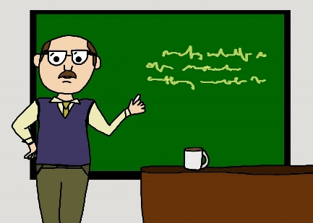
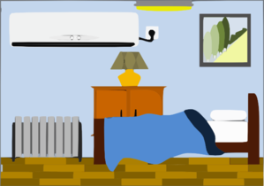
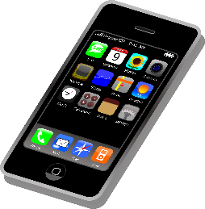
le ou la ?
parler
le
la
Notes:
Timing: 3 minutes
Aim: Recall of vocabulary for the active nouns in the tasks that follow, revision of their definite articles.
Procedure:
Click to spin a picture. Students say the French aloud with the correct article.
Teacher clicks to send the picture to the right gender.
NB: it is anticipated that the meaning of many/most of these nouns will be known, as many are included as from previous vocab sets/for pre-learning for this lesson and will have been encountered and practised for pronunciation, meaning and gender, but not with the matching word for ‘the’.

Slide 13
Trouve l’intrus !
parler
A
D
le
le
la
le
la
la
B
E
le
la
le
la
le
le
C
F
la
la
le
la
la
le
Notes:
Timing: 3 minutes
Aim: To identify the odd one out by identifying the gender of each noun.
Procedure:
See if students can infer what to do from the near cognate intrus in the task instructions.
Call letters A-E and ask ‘C’est qui, l’intrus ?’
Students answer with the French word.
Click to reveal answers and articles.
Word frequency of unknown words used in title (1 is the most frequent word in French): trouver [83], intrus [>5000]
Source: Londsale, D., & Le Bras, Y. (2009). A Frequency Dictionary of French: Core vocabulary for learners London: Routledge.

Slide 14
Langue ou adjectif ?
grammaire
You know the adjectives anglais and français, used to describe people:
J’ai un ami anglais.
I have an English (male) friend.
anglais and français are also nouns, meaning languages:
L’anglais, c’est difficile !
English is difficult!
We usually use an article with languages in French but not in English:
Exception! no article after parler and en:
Elle parle anglais.
She speaks English.
J’ai une amie française.
I have a French (female) friend.
Le français, c’est intéressant!
French is interesting!
Écris en français.
Write in French.
Notes:
Note: this slide could be omitted with some classes at this stage. This is awareness raising and the learning will be reinforced later.
Timing: 2 minutes
Aim: To raise awareness of differences in the forms as uses of vocabulary items l’anglais, anglais(e), le français and française.
Word frequency of unknown near-cognates used (1 is the most frequent word in French): langue [712], adjectif [>5000], difficile [296]
Source: Londsale, D., & Le Bras, Y. (2009). A Frequency Dictionary of French: Core vocabulary for learners London: Routledge.

Slide 15
Masculin ou féminin ?
The cast and crew on a film set receive a jumbled checklist from the French film director.
lire
Lis les phrases et choisis le mot correct. Look carefully at the word for ‘the’!
 |  | A | B
1 | La | chanteur | fille | parle français.
2 | Le | français | chose | , c’est intéressant !
3 | Le | vélo | voiture | est rapide.
4 | La | professeur | personne | a un chien
5 | La | chambre | chien | est calme.
6 | Le | fille | médecin | a une idée.
Notes:
Timing: 5 minutes
Aim: Written recognition of definite articles. Connecting written form with meaning.
Procedure:
1. Students write 1-6 in their books.
2. Students read the sentences and decide whether which noun is being described. Tell them they need to look at the definite article to get this information. As only adjectives which are identical in the masculine and feminine forms are included, they will not find any clues in the second half of the sentence!
3. Click to reveal answers.
4. Ask students for the meanings of the sentences in English.
Word frequency of unknown cognates used in task instructions (1 is the most frequent word in French): choisir [226], correct [2617], masculine [3741], féminin [2381]
Source: Londsale, D., & Le Bras, Y. (2009). A Frequency Dictionary of French: Core vocabulary for learners London: Routledge.

Slide 16
Masculin ou féminin ?
The director gives further information to the cast and crew but his megaphone keeps cutting out!
écouter
Écoute. Choisis le mot correct.
Le / La ? |  | Extra details
le / la | femme / professeur
le / la | chien /voiture
le / la | fille / médecin
le / la | fille / chien
le / la | garçon / fille
le / la | professeur / femme
1
is nice
2
is fast
3
speaks French
4
is ill
5
has a pet / animal
6
is English
Notes:
Timing: 5 minutes
Aim: Aural recognition of definite articles. Connecting written form with meaning.
Procedure:
Click on a number to hear a sentence with the noun obscured.
Students write 1-6 and the word to which the article refers, along with any additional information they hear.
Click to reveal answers.
Transcript
1) La [femme] est sympa.
2) Le [chien] est rapide.
3) Le [médecin] parle français.
4) La [fille] est malade.
5) Le [garçon] a un animal.
6) Le [professeur] est anglaise.
7) La [chambre] a un ordinateur.
8) La [voiture] est rapide.
Word frequency of unknown cognates used in task instructions (1 is the most frequent word in French): choisir [226], correct [2617], masculine [3741], féminin [2381]
Source: Londsale, D., & Le Bras, Y. (2009). A Frequency Dictionary of French: Core vocabulary for learners London: Routledge.

Slide 17
Partenaire A - script
parler / écrire
[ The boy ] a un animal.
[ The woman ] parle anglais.
[ The bedroom ] est moderne.
[ The car ] est rapide.
[ The doctor ] est calme.
Notes:
Timing: 10 minutes
Aim: Oral production and aural recognition of definite articles.
Procedure:
1. Students pair up.
2. Click to show Partner B turning away from the board. They have a copy of their role card on paper (see following slide).
Partner A faces the board,
Click to bring up Partner As’ sentences.
Partner A reads each sentence to their partner but does not say out loud the word that is crossed out.
6. Partner B ticks the noun that matches the word for the that partner A said. They then write the rest of the sentence in the appropriate gaps.
4. Partner B turns back and checks their solution against the answer slide (slide 19).
5. Students swap roles.

Slide 18
Partenaire B
parler / écrire
1.
2.
3.
4.
5.

Slide 19
Partenaire B - réponses
parler / écrire
1.
Le
garçon
a
un
animal.
2.
La
femme
parle
anglais.
3.
La
chambre
est
moderne.
4.
La
voiture
est
rapide.
5.
Le
médecin
est
calme.

Slide 20
Partenaire B - script
parler / écrire
[ The woman ] a un chien.
[ The boy ] est drôle.
[ The singer ] est sympa.
[ The girl ] parle français.
[ The dog ] est calme.

Slide 21
Partenaire A
parler / écrire
1.
2.
3.
4.
5.

Slide 22
Partenaire A - réponses
parler / écrire
1.
La
femme
a
un
chien.
2.
Le
garçon
est
drôle.
3.
Le
chanteur
est
sympa.
4.
La
fille
parle
français.
5.
Le
chien
est
calme.

Slide 23
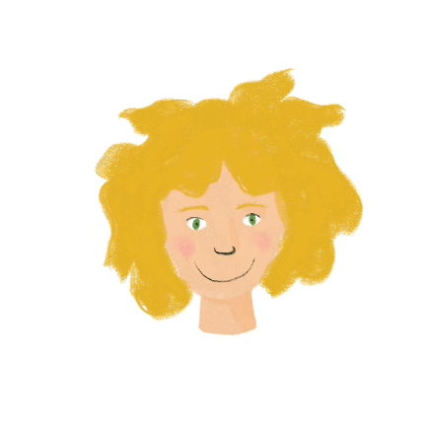
Identity: others
Talking about a specific person or thing [2[
definite article (l’, les) plural marking on nouns (-s) SSC [on]
Y7 French
Term 1.1 - Week 6 - Lesson 12
Victoria Hobson / Rachel Hawkes / Catherine Morris
Artwork by: Chloé Motard
Date updated: 20.05.23
Notes:
Learning outcomes (lesson 2):
Introduction of SSC [on]
Introduction of definite articles les and l’
Introduction of plural noun forms (-s)
Word frequency (1 is the most frequent word in French):
7.1.1.6 (introduce) acteur [1152], actrice [1152], anglais² [784], fille¹ [629], français² [251], garçon [1599], médecin [827], mot [220], personne¹ [84], phrase [2074], le [1], la [1], les [1], en¹ [7]
7.1.1.2 (revisit) est [5], il1 [13], elle1 [38], amusant [4695], calme [1731], content [1841], intelligent [2509], malade [1066], méchant [3184], triste [1843], mais [30], ou [33], merci [1070]
Source: Londsale, D., & Le Bras, Y. (2009). A Frequency Dictionary of French: Core vocabulary for learners London: Routledge.

Slide 24
on
non!
Notes:
Timing: 1 minute
Aim: To introduce SSC [on]
Procedure: 1. Present the letter(s) and say the [on] sound first, on its own. Students repeat it with you. 2. Bring up the word ”non” on its own, say it, students repeat it, so that they have the opportunity to focus all of their attention on the connection between the written word and its sound.
3. A possible gesture for this would be to shake ones head whilst waggling one’s index finger, to indicate ‘no!’ 4. Roll back the animations and work through 1-3 again, but this time, dropping your voice completely to listen carefully to the students saying the [on] sound, pronouncing ”non” and, if using, doing the gesture.
Word frequency (1 is the most frequent word in French):
onze [2447]
Source: Londsale, D., & Le Bras, Y. (2009). A Frequency Dictionary of French: Core vocabulary for learners London: Routledge.

Slide 25
on
non!
Notes:
With sound and no pictures to focus all attention on the sound-symbol correspondence.

Slide 26
on
non!
Notes:
Without sound to elicit pronunciation (without first hearing the teacher).
Teacher to elicit pronunciation by asking “Comment dit-on …"

Slide 27
on
onze
continuer
[to continue]
non!
monde
au fond
montrer
[at the back]
[to show]
Notes:
Timing: 2 minutes
Aim: To introduce SSC [on]
Procedure:
1. Introduce and elicit the pronunciation of the individual SSC [on] and then the source word again ‘non’ (with gesture, if using). 2. Then present and elicit the pronunciation of the five cluster words.
The cluster words have been chosen for their high-frequency, from a range of word classes, with the SSC (where possible) positioned within a variety of syllables within the words (e.g. initial, 2nd, final etc.). Additionally, we have tried to use words that build cumulatively on previously taught SSCs (see the Phonics Teaching Sequence document) and do not include new SSCs. Where new SSCs are used, they are often consonants which have a similar symbol-sound correspondence in English.
Word frequency (1 is the most frequent word in French): onze [2447]; continuer [113] monde [77]; montrer [108]; au fond [553]; non [72]. Source: Londsale, D., & Le Bras, Y. (2009). A Frequency Dictionary of French: Core vocabulary for learners London: Routledge.

Slide 28
on
onze
continuer
non!
monde
au fond
montrer
Notes:
With sound and no pictures to focus all attention on the sound-symbol correspondence.

Slide 29
on
onze
continuer
non!
monde
au fond
montrer
Notes:
Without sound to elicit pronunciation (without first hearing the teacher).
Teacher to elicit pronunciation by asking “Comment dit-on …"

Slide 30
Phonétique
écouter
In which order do you hear the words? Écris ‘1’ ou ‘2’.
e/an
on
__ cent 100
__ son sound
a
1
2
__ en in/by/to
__ on we/one
b
2
1
__ dans in
__ don gift
c
2
1
__ pan part
__ pont bridge
d
1
2
__ sans without
__ sont (they) are
e
1
2
Notes:
Timing: 5 minutes Aim: To differentiate between pairs of words that differ by one phoneme (one SSC that changes the meaning). These words are called minimal pairs. Procedure: 1. Click to listen. 2. Write 1 2 or 2 1 depending on the order in which the words are spoken. 3. Click to see the answers.
Transcript
cent...son
on...en
don...dans
pan...pont
sans...sont

Slide 31
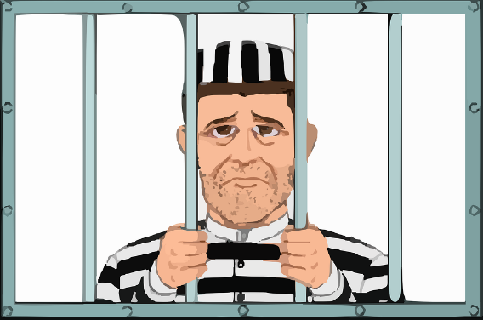
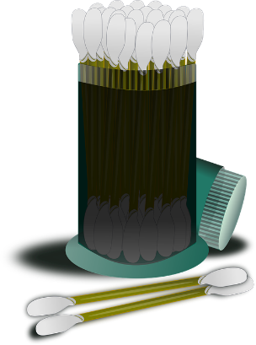
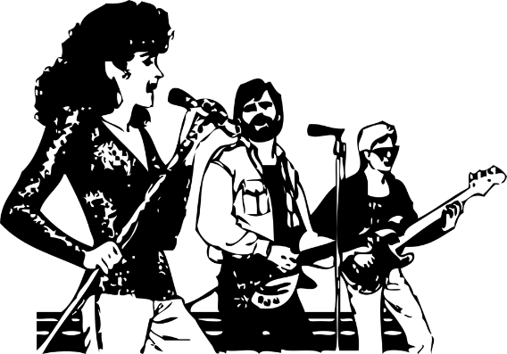
Phonétique
parler
30
These words look like English, but have SSC [on] in French. How do they sound?
prison
blond
contact
opinion
secondes
0
coton
concert
salon
révision
DÉBUT
Notes:
Timing: 2 minutes
Aim: To correctly pronounce cognates and near-cognates containing [on] in decreasing amounts of time, helping automisation of SSC production. Raising awareness of the difference in the English and French pronunciation of this SSC.
Procedure:
Students pair up, and take turns trying to say all the words in 30 seconds (run the timer twice).
Click on the pictures to hear the words pronounced by a native speaker. Students repeat.
Move on to the next slide.
Word frequency (1 is the most frequent word in French): prison [1010], blond [4585], contact [894], opinion [777], coton [4516], concert [1697], salon [2729], revision [2748]
Source: Londsale, D., & Le Bras, Y. (2009). A Frequency Dictionary of French:], Core vocabulary for learners London: Routledge.

Slide 32
Vocabulaire
lire / parler
 | Word | English meaning
1 | le | the (m)
2 | la | the (f)
3 | les | the (pl)
4 | l’anglais | English language
5 | le français | French language
6 | en | in
7 | la personne | person
8 | la médecin | female doctor
9 | l’acteur | male actor
10 | la phrase | sentence
11 | le mot | word
12 | l’actrice | female actor
Notes:
Timing: 4 minutes Aim: To recall this week’s new vocabulary. Procedure: 1. Click to show the French, recall the English meanings, say them aloud. [1 minute] 2. Click to show the English, recall the French meanings, saying them aloud. [1 minute] 3. Repeat for two further minutes, to speed up recall. Note: either add rounds of disappear/appear animations OR have students support each other with one facing away from the board (i.e., tandem testing).

Slide 33
Making nouns and articles plural
grammaire
To make a noun plural when we are talking about more than one thing, we normally add an -s, like in English:
‘The’ changes to ‘les’, to match the plural noun. This is not like English. ‘Les’(the) is the same for both masculine and feminine nouns.
Masculine
Feminine
les
the
s
chien
s
dog
chambre
s
les
s
the
bedroom
the
livre
les
s
book
s
s
les
chose
s
the
thing
the
s
s
mobile
les
portable
ruler
les
the
s
règle
s
Stephen Owen
Notes:
Timing: 2 minutes
Aim: To highlight similarities and differences in plural noun formation between French and English.
Procedure: 1. Click to present the new information.
2. Elicit English for French examples.

Slide 34
Léa en Angleterre*
lire
Here is Léa’s diary entry about her school trip to England.
What does she say? Look carefully at the word for ‘the’.
Le / est confortable.
Les / sont sympas.
Les / sont intéressants.
La / est calme.
Le / parle anglais.
Les / sont modernes.
lit
lits
professeurs
professeur
livres
livre
femmes
femme
médecin
médecins
chambres
chambre
*Angleterre - England
Notes:
Timing: 5 minutes
Aim: Written recognition of the singular and plural forms of definite articles and connecting form with meaning.
Procedure:
1. Students write 1-8 in their books.
2. Students read the sentences and decide whether which noun is being described. Tell them they need to look at the definite article to get this information. NB: It is recognised that the students could, if they notice, use the singular and plural forms of the verb or the plural adjectival agreement to decide which word would be missing (rather than the singular/plural marking on the article). However, as the article comes first and is the focus of the task, it is unlikely that they will attend to the verbs or adjectives or learn them. Some learners may ‘pick them up’ to some limited extent if they happen to notice them, but incidental exposure like this has been found to be largely ineffective for many learners. We do not recommend that teachers draw attention to these other features unless a student spontaneously notices it and mentions it.
3. Click to reveal answers.
4. Ask students for the meanings of the sentences in English.
Word frequency of unknown cognates used in task instructions (1 is the most frequent word in French): confortable [3964], Source: Londsale, D., & Le Bras, Y. (2009). A Frequency Dictionary of French: Core vocabulary for learners London: Routledge.

Slide 35
Singular or plural ?
écouter / écrire
1
4
personne
médecins
2
5
chanteurs
chien
3
6
vélo
chambres
Notes:
Timing: 5 minutes
Aim: Aural recognition of the singular and plural forms of definite articles and connecting form with meaning.
Procedure:
Click on a number to hear an article said aloud.
Students write 1-6 and the word for what the article refers to in French (or if too challenging, they write S (singular), P (plural).
Click to reveal answers and spelling.
Transcript:
la
les
le
les
le
les

Slide 36
When a singular noun begins with a vowel or h-
grammaire
When a singular noun begins with a vowel or a h, the word for the (le or la) shortens to l’ (for both masculine and feminine):
Masculine
Feminine
l’
the
actor
acteur
l’
idée
the
idea
l’
enfant
the
child
amie
l’
the
friend
l’
homme
the
man
You don’t say the ‘h-’ at the start of words. It is silent.
So, you only hear the vowel ‘o’.
Stephen Owen
Notes:
Timing: 2 minutes

Slide 37
Prononcer !
parler
animal, pet
idea
actor
child
l’animal
l’acteur
l’enfant
l’idée
computer
man
friend(m)
friend(f)
l’ami
l’amie
l’ordinateur
l’homme
Notes:
Timing: 2 minutes
Aim: To practise the pronunciation of nouns students know so far where l’ is needed, in ‘think-pair-share’ then teacher-led feedback.
Procedure: 1. Click to bring up all the words.
2. Model an example. C’est un animal, oui ? Comment dit-on ‘the animal/pet’ en français ? L’animal. Oui, c’est ça. Répète alors, l’animal.
3. Give pupils 1 minute or so (think-pair-share) to try to come up with the French for the remaining six nouns and pronounce them together in pairs out loud.
4. Elicit responses to confirm and elicit repetition, as necessary.
Word frequency of unknown cognates used in title (1 is the most frequent word in French): prononciation [>5000]
Source: Londsale, D., & Le Bras, Y. (2009). A Frequency Dictionary of French: Core vocabulary for learners London: Routledge.

Slide 38
Léa en Angleterre
Léa writes more in her diary. What does she say?
lire
Lis les phrases et choisis le mot correct. Look carefully at the word for ‘the’!
 |  | A | B | C
1 | L’ | français | anglais | livre | est intéressant!
2 | Le | homme | femme | garçon | a une idée.
3 | La | amie | médecin | fille | est sympa.
4 | Le | chambre | portable | ordinateur | est moderne.
5 | L’ | professeur | acteur | femme | parle anglais.
6 | L’ | enfant | fille | garçon | a un vélo.
Notes:
Timing: 5 minutes
Aim: Written recognition of definite articles and connecting form with meaning.
Procedure:
1. Students write 1-8 in their books.
2. Students read the sentences and decide whether which noun is being described. Tell them they need to look at the definite article to get this information. As only adjectives which are identical in the masculine and feminine forms are included, they will not find any clues in the second half of the sentence!
3. Click to reveal answers.
4. Aske students for the meanings of the sentences in English.
Word frequency of unknown cognates used in task instructions (1 is the most frequent word in French): choisir [226], correct [2617]
Source: Londsale, D., & Le Bras, Y. (2009). A Frequency Dictionary of French: Core vocabulary for learners London: Routledge.

Slide 39
Écris en français !
écrire
Write six sentences in French using these words.
Choose the words for the carefully.
médecin / est
enfant / a
voiture / est
homme / est
ami / a
femme / parle
Le médecin est calme.
L’enfant a un vélo.
La voiture est chère.
L’homme est sympa.
L’ami a une idée.
La femme parle français.
Notes:
Timing: 5 minutes
Aim: Structured writing exercise requiring written production of the definite article.
Procedure:
1. Students write sentences with the nouns and verbs given. At more advanced levels, encourage use of additional adjectives to add flavour (this will require a reminder of agreement rules).
2. Click to reveal a suggested solution.
3. Collect further solutions from students and add them to this slide.

Slide 40
La liaison
écouter
You have met liaison before, with c’est
C’est un ordinateur.
Voici les règles. Here are the rulers.
The final –s in les is a Silent Final Consonant.
But …
Voici les ordinateurs. Here are the computers.
This time, the final consonant in les is not an SFC!
Because the -s is followed by a vowel, it is pronounced.
This pronunciation change is known as liaison.
Notes:
Timing: 5 minutes (5 slides)
Aim: Introduction to the –s liaison.
You may wish to ask students where they have seen this phenomenon before, before revealing the final info bubble on a click.

Slide 41
La liaison
écouter
les garçons
the boys
Notes:
Listen and repeat.

Slide 42
La liaison
écouter
les actrices
the female actors
Notes:
Timing: 3 minutes for 10 slides [audio missing]
Aim: to introduce the concept of s-liaison before a vowel after les.
Procedure:
Listen and repeat.
Highlight that this sounds like one word, rather than two

Slide 43
La liaison
La liaison
écouter
Voici les médecins.
Here are the doctors.
Notes:
1. Listen and repeat.
2. Ask students to translate the sentence.
3. Reveal picture on a click, ask students to check their translations.
4. Reveal English translation on click.

Slide 44
La liaison
La liaison
La liaison
écouter
Voici les ordinateurs.
Here are the computers.
Notes:
1. Listen and repeat.
2. Ask students to translate the sentence.
3. Reveal picture on a click, ask students to check their translations.
4. Reveal English translation on click.

Slide 45
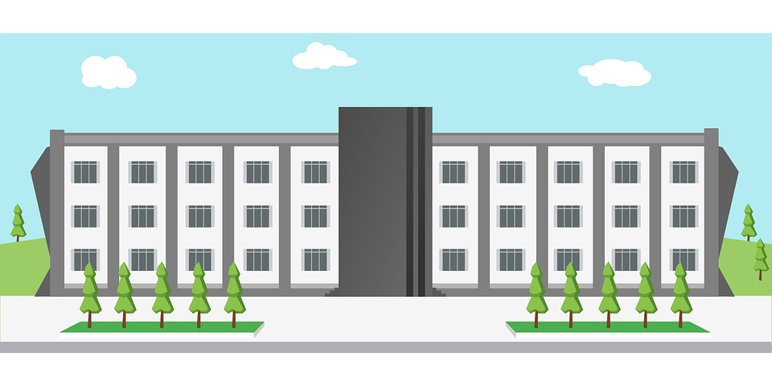
La liaison
écouter
Léa is giving you a tour of her school.
What is she showing you?
Écoute!
1
Voici les … garçons / ordinateurs.
2
Voici les … filles / acteurs.
3
Voici les … professeurs / actrices.
4
Voici les … ordinateurs / vélos.
5
Voici les … personnes / amies.
6
Voici les … livres / amis.
Notes:
OPTIONAL additional practice (OR alternative to the previous 4 slides) Timing: 5 minutes
Aim: To detect the presence or absence of an s-liaison with les, and connect this with meaning.
Procedure:
Students write 1-6.
Click on a button to hear a form of ‘voici les’, followed by a beep.
Based on the presence or absence of a liaison, students decide what comes next. Remind them it is the presence or absence of a -s- sound that will give them this information.
Click to check.
Full audio can be found on the next slide.
Transcript
1. Voici les [garçons].
2. Voici les [acteurs].
3. Voici les [professeurs].
4. Voici les [ordinateurs].
5. Voici les [amies].
6. Voici les [livres].
7. Voici les [actrices].
8. Voici les [règles].

Slide 46
La liaison
écouter
Léa is giving you a tour of her school.
What is she showing you?
Écoute!
1
Voici les … garçons / ordinateurs.
2
Voici les … filles / acteurs.
3
Voici les … professeurs / actrices.
4
Voici les … ordinateurs / vélos.
5
Voici les … personnes / amies.
6
Voici les … livres / amis.
Notes:
Full audio for the exercise on the previous slide.
Transcript
1. Voici les garçons.
2. Voici les acteurs.
3. Voici les professeurs.
4. Voici les ordinateurs.
5. Voici les amies.
6. Voici les livres.
7. Voici les actrices.
8. Voici les règles.

Slide 47
Devoirs
Vocabulary Learning Homework (Y7, Term 1.1, Week 7)
Audio file
Student worksheet
In addition, revisit: Term 1.1 Week 4
Notes:
Use this slide to set the homework.
For Y7, the typical homework will be to pre-learn vocabulary for the next lesson. There is an audio file to accompany the student worksheet.
Notes:
i) Teachers may, in addition, want to recommend use of a particular online app for the pre-learning of each week’s words. ii) Quizlet now requires parental involvement / registration / permissions for users below the age of 13, so it is perhaps most suitable for Y9 – 11 students. iii) Language Nut hosts LDP vocabulary lists and these are free for schools to use, though there is a registration process. One benefit is that all of the student tracking data that Language Nut offers are also available to schools that use the LDP lists for practice. Perhaps this makes it a good option for Y7/8.
iv) There are other free apps, and new ones are always appearing. Teachers have told us that they are currently using: Flippity, Wordwall (where using previously-created activities is free).
v) Gaming Grammar has been acquired by Language Nut. Its original content should still be available to teachers and much of it is appropriate for Y7 learners. From this lesson, for example, learners could practise Definite articles: Gender (Article Agreement), Articles: Number (Article Agreement) and To have and to be: 1st person and 3rd person singular.

