Slide 1
Identity: describing a friend
Distinguishing between having and being [1]
être & avoir (je, tu, il/elle)
feminisation of agent nouns and job titles (-e)
[SFe]
Y7 French
Term 1.1 - Week 5 - Lesson 9 Stephen Owen / Kirsten Somerville / Catherine Morris
Artwork by: Chloé Motard
Date updated: 20.05.23
Notes:
Note: all words (new and revisited) in this week of the SOW appear on all three GCSE wordlists, with this exception: i) Edexcel list does not have drôle, intelligent, méchant. iii) Eduqas list does not have intelligent, méchant.
Learning outcomes (lesson 1):
Introduction of SSC [SFe]
Introduction of feminisation of agent nouns and job titles (-e)
Consolidaton of être and avoir (je, tu, il/elle)
Word frequency (1 is the most frequent word in French):
Introduce: il² [13], elle² [38], ami [467], amie [467], chanteur [3251], chanteuse [3251], femme [154], homme [136], professeur [1150], professeure [1150], drôle [2166], intéressant [1244], faux [555], sympa(thique) [4164], vrai [292]
Revisit: est [5], il [13], elle [38], amusant [4695], calme [1731], content [1841], excellent [1225], intelligent [2509], malade [1066], méchant [3184], triste [1843], mais [30], ou [33], merci [1070]
Source: Londsale, D., & Le Bras, Y. (2009). A Frequency Dictionary of French: Core vocabulary for learners London: Routledge.

Slide 2
SFE
Silent final -e
[shy]
timide
Notes:
Timing: 1 minute
Aim: To introduce SSC [SFE]
Procedure: 1. Present the letter(s) and say the [SFE] sound first, on its own. Students repeat it with you. 2. Bring up the word ”timide” on its own, say it, students repeat it, so that they have the opportunity to focus all of their attention on the connection between the written word and its sound.
3. A possible gesture for this would be to cower and cover one’s face slightly, simulating shyness. 4. Roll back the animations and work through 1-3 again, but this time, dropping your voice completely to listen carefully to the students saying the [SFE] sound, pronouncing ”timide” and, if using, doing the gesture.
Word frequency (1 is the most frequent word in French):
timide [3835]
Source: Londsale, D., & Le Bras, Y. (2009). A Frequency Dictionary of French: Core vocabulary for learners London: Routledge.

Slide 3
SFE
Silent final -e
timide
Notes:
With sound and no pictures to focus all attention on the sound-symbol correspondence.

Slide 4
SFE
Silent final -e
[shy]
timide
Notes:
Without sound to elicit pronunciation (without first hearing the teacher).
Teacher to elicit pronunciation by asking “Comment dit-on …"

Slide 5
SFE
monde
moderne
[silent final –e]
[shy]
centre
timide
douze
vie
[life]
Notes:
Timing: 2 minutes
Aim: To introduce SSC [SFE]
Procedure:
1. Introduce and elicit the pronunciation of the individual SSC [SFE] and then the source word again ‘timide’ (with gesture, if using). 2. Then present and elicit the pronunciation of the five cluster words.
The cluster words have been chosen for their high-frequency, from a range of word classes, with the SSC (where possible) positioned within a variety of syllables within the words (e.g. initial, 2nd, final etc.). Additionally, we have tried to use words that build cumulatively on previously taught SSCs (see the Phonics Teaching Sequence document) and do not include new SSCs. Where new SSCs are used, they are often consonants which have a similar symbol-sound correspondence in English.
Word frequency (1 is the most frequent word in French): monde [77]; moderne [1239] centre [491]; vie [132]; douze [1664]; timide [3835]. Source: Londsale, D., & Le Bras, Y. (2009). A Frequency Dictionary of French: Core vocabulary for learners London: Routledge.

Slide 6
SFE
monde
moderne
[silent final –e]
[shy]
centre
timide
douze
vie
Notes:
With sound and no pictures to focus all attention on the sound-symbol correspondence.

Slide 7
SFE
monde
moderne
[silent final –e]
[shy]
centre
timide
douze
vie
Notes:
Without sound to elicit pronunciation (without first hearing the teacher).
Teacher to elicit pronunciation by asking “Comment dit-on …"

Slide 8
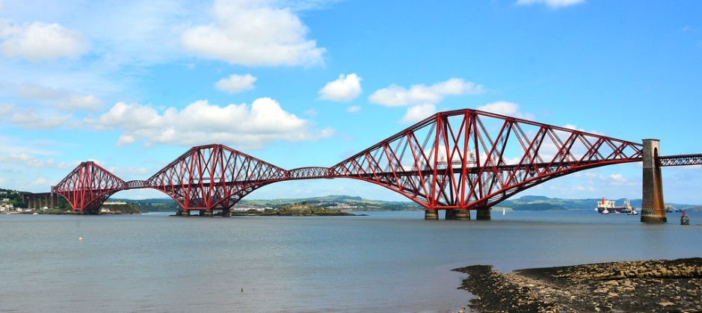
Phonétique
écouter
C’est la SSC [SFe] ?
[lawn]
[bridge]
pelouse
pont
Notes:
Timing: 3 minutes for 6 slides
Aim: aural recognition of SSC [SFe]
Procedure:
1. Click the words to play the audio.
2. Students choose which word has an SFe.
Word frequency (1 is the most frequent word in French): pelouse [>5000], pont [1889]
Source: Londsale, D., & Le Bras, Y. (2009). A Frequency Dictionary of French: Core vocabulary for learners London: Routledge.

Slide 9
Phonétique
écouter
C’est la SSC [SFe] ?
[cooking]
[wolf]
cuisine
loup
Notes:
Word frequency (1 is the most frequent word in French): cuisine [2618], loup [3927]
Source: Londsale, D., & Le Bras, Y. (2009). A Frequency Dictionary of French: Core vocabulary for learners London: Routledge.

Slide 10
Phonétique
écouter
C’est la SSC [SFe] ?
froid
[cold]
trente
Notes:
Word frequency (1 is the most frequent word in French): trente [1646], froid [1307]
Source: Londsale, D., & Le Bras, Y. (2009). A Frequency Dictionary of French: Core vocabulary for learners London: Routledge.

Slide 11
Phonétique
écouter
C’est la SSC [SFe] ?
[hand]
[shy]
main
timide
Notes:
Word frequency (1 is the most frequent word in French): main [418], timide [3835]
Source: Londsale, D., & Le Bras, Y. (2009). A Frequency Dictionary of French: Core vocabulary for learners London: Routledge.

Slide 12
Phonétique
écouter
C’est la SSC [SFe] ?
riz
soupe
Notes:
Word frequency (1 is the most frequent word in French): riz [>5000], soupe [4563]
Source: Londsale, D., & Le Bras, Y. (2009). A Frequency Dictionary of French: Core vocabulary for learners London: Routledge.

Slide 13
Phonétique
écouter
C’est la SSC [SFe] ?
[dawn]
prix
[prize]
aube
Notes:
Word frequency (1 is the most frequent word in French): aube [2728], prix [310]
Source: Londsale, D., & Le Bras, Y. (2009). A Frequency Dictionary of French: Core vocabulary for learners London: Routledge.

Slide 14
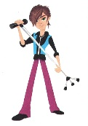
Vocabulaire
These words are all _________.
These words are all nouns.
lire
un professeur
un chanteur
un ami
a teacher (m)
a singer (m)
a friend (m)
un homme
une femme
a man
a woman
drôle
intéressant
sympa(thique)
funny
interesting
nice, pleasant
vrai
faux
These words are all adjectives.
These words are all ____________.
true
false
Notes:
Timing: 5 minutes
Aim: written comprehension of the vocabulary introduced this week
Procedure:
1. Class repetition of the French modelled by the teacher, each French word followed by the teacher showing the written English equivalent.
2. Bring up animated callouts to elicit recognition of the two words classes (nouns and adjectives) represented here.
3. Click to ‘disappear’ the English meanings to elicit student read aloud/pronunciation of the French word followed by the English definition.
4. Move to next slide for written production practice of the new vocabulary.
Word frequency (1 is the most frequent word in French): ami [467] chanteur [3251], femme [154], homme [136], professeur [1150], drôle [2166], intéressant [1244], faux [555], sympa(thique) [4164], vrai [292]
Source: Londsale, D., & Le Bras, Y. (2009). A Frequency Dictionary of French: Core vocabulary for learners London: Routledge.

Slide 15
Vocabulaire
parler
[funny, strange]
[true]
[interesting]
[friend]
[nice, pleasant]
[false]
Notes:
Timing: 3 minutes
Aim: to practise spoken recall of the vocabulary introduced this week
Procedure:
1. Click to ‘star’ a picture. It will face after 3 seconds. Note that the pictures do not appear in alphabetical order.
2. Students say the word in French (and continue repeating it) until the star has disappeared.
3. Ensure that students say the indefinite articles with all of the nouns.
Answers:
A. drôle
B. un chanteur
C. une femme
D. intéressant
E. vrai
F. un ami
G. un professeur
H. sympa(thique)
I. faux
J. un homme
Word frequency (1 is the most frequent word in French): ami [467] chanteur [3251], femme [154], homme [136], professeur [1150], drôle [2166], intéressant [1244], faux [555], sympa(thique) [4164], vrai [292]
Source: Londsale, D., & Le Bras, Y. (2009). A Frequency Dictionary of French: Core vocabulary for learners London: Routledge.

Slide 16
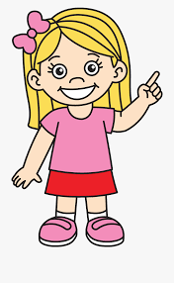
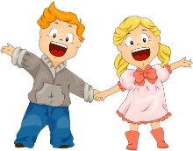
Feminine noun forms
grammaire
We know that we add an ‘e’ to an adjective when it refers to a feminine noun:
Il est anglais.
Elle est anglaise.
We can also add an ‘e’ to some nouns when they refer to a female person:
un ami
une amie
Chanteur is an exception – we also replace the ‘r’ with an ‘s’ before adding the ‘e’.
un professeur
un chanteur
une professeure
une chanteuse
The pronunciation stays the same – Silent Final e !
Note that the word for ‘a’ also changes.
Notes:
Timing: 2 minutes
Aim: introducing the feminisation of agent nouns by adding ‘e’ Procedure: 1. Click to present the new information. 2. Elicit English meanings of the French examples.

Slide 17
C’est qui ?
lire
C’est un homme ou une femme ? Tick the appropriate column for each.
 |  | un homme | une femme
1 | un professeur
2 | une chanteuse
3 | une amie
4 | un chanteur
5 | une professeure
6 | un ami
___
___
___
___
___
___
Notes:
Note: this activity could be omitted, if short of time. Timing: 3 minutes
Aim: written recognition of masculine and feminine forms of agent nouns
Procedure:
1. Students write 1-6 and choose ‘un homme’ or ‘une femme’ for each.
2. Click to reveal the answers. The correct article appears with the answer.

Slide 18
Having and being (avoir et être)
grammaire
Remember, to talk about having something, use the verb avoir.
avoir to have/having
e.g. il a he has
elle a she has
Remember, to talk about being something, use the verb être.
être to be/being
e.g. il est he is
elle est she is
Elle a un chien. She has a dog.
Elle est grande. She is tall.
Notes:
Timing: 3 minutes
Aim: re-cap of the use of être and avoir, which have both previously been introduced and practised (in the 1st, 2nd and 3rd person singular)
Procedure:
Present the previously taught information.
Elicit the English meanings from students after each French example.
Elicit repetition of the French, practising the difference in sound – il a | il est, elle a | elle est.

Slide 19
Avoir ou être ?
Écoute. Écris en anglais.
écouter
 | having | being
1
He is a nice teacher.
2
He has an interesting teacher.
3
She has a funny friend.
4
I am French.
5
Do you have an English friend?
6
She is a nice woman.
Notes:
Timing: 5 minutes
Aim: aural recognition of forms of avoir and être in all three persons (singular), and connecting them to meaning in context.
Procedure:
1. Before the task begins, explain to learners that ‘C’est’ is used with people as well as things, when saying who/what they are. ‘C’est’ (a contraction of ‘ce est’) literally means ‘this is’, but when referring to people can be taken to mean ‘s/he is’.
2. Each item could be played twice, to break it down for the students.
3. The first time, learners could just put a tick in the correct column (having or being).
4. On the second hearing of each item, learners could then provide the (oral) translation.
Transcript
1) C’est un professeur sympathique.
2) Il a un professeur intéressant.
3) Elle a une amie drôle.
4) Je suis française.
5) Tu as un ami anglais ?
6) C’est une femme sympathique.

Slide 20
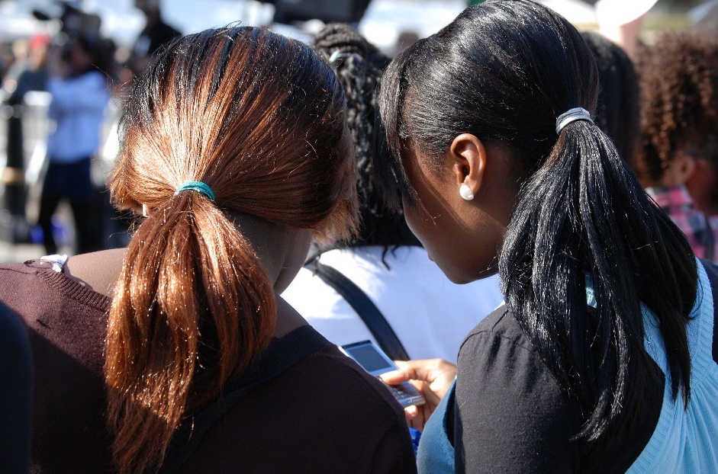
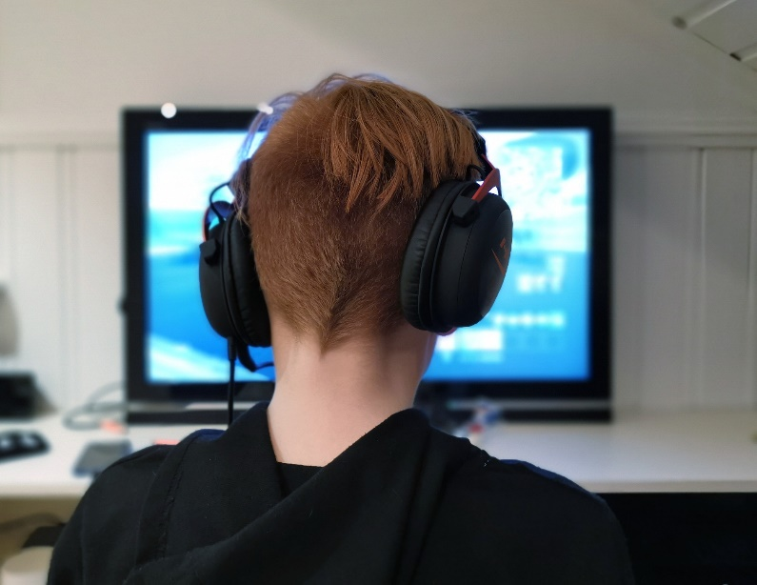
J’ai un ami/une amie (1/3)
lire
C’est qui ? Écris 1-6 et C (Cécile) ou É (Éric) ou C/É.
Éric
When c’est refers to people it can mean s/he is.
Cécile
often
1 | … est souvent amusante.
2 | C’est une amie unique.
3 | ... est parfois timide.
É
C
4 | C’est un ami sympa.
5 | C’est une personne intelligente.
6 | ... est aussi très grande.
C
C/É
C/É
C
sometimes
also
very
Notes:
Timing: 10 minutes (3 slides) Aim: to revisit previously taught vocabulary and grammar in the context of a longer text; to provide a model to scaffold a short piece of writing next lesson; to practise recognition of cognates; to draw attention to some high frequency adverbs that will be taught formally later in the SOW.
Procedure: 1. As a way into the longer texts, pupils first read these extracts and work out who they apply to.
2. Click to correct and clarify any misunderstandings (e.g., intelligente describes ‘une personne’ which could be a male or female person. The noun ‘personne’ is feminine and students will learn this word next week). 3. Highlight the unknown words. Tell students they will be learning them a little later in the course, but that they may find them useful to note down for describing people as the adverbs (souvent, parfois, très) add precision and the conjunction helps to link the meaning of sentences together, like ‘et’ and ‘mais’.
4. Finally, ask if they have spotted any cognates – words they can recognise the meaning of because of their similarity to English - but haven’t learnt yet. There are 3 here. Clarify meanings with students and again, you can suggest that these words make good additions to their personal repertoire as they are often easier to remember, though not always easier to say, than other words.
5. Tell them to look out for these words again when they read the full descriptions of each friend, now.

Slide 21
J’ai un ami/une amie (2/3)
lire
very
J'ai un ami, Éric. Il est très sympa. C’est une personne intelligente et intéressante et il aime lire et écrire. Il est parfois timide mais c’est un ami super. Je suis content d’avoir un ami comme Éric.
Éric
sometimes
Words you may have met before
Cognates
New words we just met
Words to work out
“He is an intelligent and interesting person and he ____ reading and writing.”
like
“I am pleased _____ have a friend _____ Éric.
to
likes
Notes:
Procedure:
If possible give students a copy of both texts to work with.
Ask them to highlight (or underline) any words they already know. Tell them they know 80% of the words already. Celebrate this!
Ask them to highlight in a different colour (or circle) any cognates they find. With the cognates they know 88% words.
Elicit / provide the meanings of two of the new words we just met on the previous slide. Suggest students annotate their text. This makes 93% coverage. This is getting towards a ‘comfortable’ coverage for comprehension.
Click to bring up the ‘Words to work out’ prompt and tell students that sometimes when we know all of most of the rest of the words in a sentence, we can work out a plausible meaning of an unknown word.
Suggest they share a ‘working spoken/oral translation of the two sentences with unknown words and try to work out what could usefully fill the gap.
Elicit this from students and click to bring up - i.e., He is an intelligent and interesting person and he ____ reading and writing.
Do the same with the 2nd sentence: | I am happy/pleased __ have a friend ___ Eric.

Slide 22
J’ai un ami/une amie (3/3)
lire
J'ai une amie, Cécile. Elle est souvent amusante. Elle parle anglais et français et elle aime parler ! Cécile est aussi très grande et elle a un sens de l’humour très drôle. Merci, Cécile ! Tu es une amie unique !
Cécile
Words you may have met before
Cognates
New words
Words to work out
Notes:
Procedure:
Repeat the task, but give the students more of an opportunity to work through the stages independently.
After 5 minutes click to give feedback and answer any questions.
Note: This 3rd slide of the activity can be kept for next lesson, either as it is, or just to serve as a useful example ahead of the writing activity.

Slide 23
Identity: describing a friend
Distinguishing between having and being [2]
subject pronoun ‘it’ SSC [é|-er|-ez]
Y7 French
Term 1.1 - Week 5 - Lesson 10 Stephen Owen / Kirsten Somerville / Catherine Morris
Artwork by: Chloé Motard
Date updated: 20.05.23
Notes:
Learning outcomes (lesson 2):
Introduction of SSC [é / -er / -ez]
Consolidation of indefinite articles
Introduction of subject pronoun ‘it’
Word frequency (1 is the most frequent word in French):
1.1.5 (introduce) il² [13], elle² [38], ami [467], amie [467], chanteur [3251], chanteuse [3251], femme [154], homme [136], professeur [1150], professeure [1150], drôle [2166], intéressant [1244], faux [555], sympa(thique) [4164], vrai [292]
1.1.2 (revisit) est [5], il [13], elle [38], amusant [4695], calme [1731], content [1841], excellent [1225], intelligent [2509], malade [1066], méchant [3184], triste [1843], mais [30], ou [33], merci [1070]
Source: Londsale, D., & Le Bras, Y. (2009). A Frequency Dictionary of French: Core vocabulary for learners London: Routledge.

Slide 24
é/-er/-ez
écrire
Notes:
Timing: 1 minute
Aim: To introduce SSC [é]
Procedure: 1. Present the letter(s) and say the [é] sound first, on its own. Students repeat it with you. 2. Bring up the word ”écrire” on its own, say it, students repeat it, so that they have the opportunity to focus all of their attention on the connection between the written word and its sound.
3. A possible gesture for this would be to mime the act of writing (onto the palm of the other hand perhaps). 4. Roll back the animations and work through 1-3 again, but this time, dropping your voice completely to listen carefully to the students saying the [é] sound, pronouncing ”écrire” and, if using, doing the gesture.
Word frequency (1 is the most frequent word in French):
écrire [382] Source: Londsale, D., & Le Bras, Y. (2009). A Frequency Dictionary of French: Core vocabulary for learners London: Routledge.

Slide 25
é/-er/-ez
écrire
Notes:
With sound and no pictures to focus all attention on the sound-symbol correspondence.

Slide 26
é/-er/-ez
écrire
Notes:
Without sound to elicit pronunciation (without first hearing the teacher).
Teacher to elicit pronunciation by asking “Comment dit-on …"

Slide 27
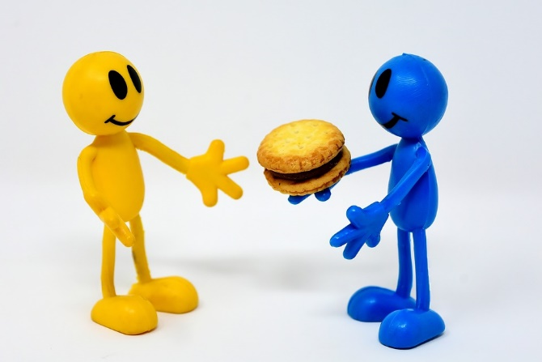
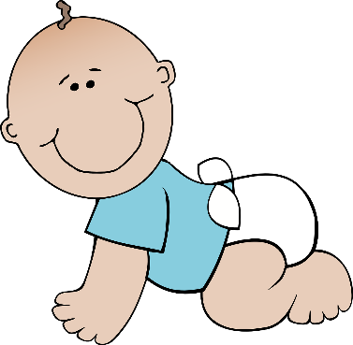
é/-er/-ez
bébé
donner
nez
parler
écrire
aller
[to go]
Notes:
Timing: 2 minutes
Aim: To introduce SSC [é]
Procedure:
1. Introduce and elicit the pronunciation of the individual SSC [é] and then the source word again ‘écrire’ (with gesture, if using). 2. Then present and elicit the pronunciation of the five cluster words.
The cluster words have been chosen for their high-frequency, from a range of word classes, with the SSC (where possible) positioned within a variety of syllables within the words (e.g. initial, 2nd, final etc.). Additionally, we have tried to use words that build cumulatively on previously taught SSCs (see the Phonics Teaching Sequence document) and do not include new SSCs. Where new SSCs are used, they are often consonants which have a similar symbol-sound correspondence in English.
Word frequency (1 is the most frequent word in French): écrire [382]; bébé [>5000]; aller [55] donner [46]; nez [2661]; parler [106]. Source: Londsale, D., & Le Bras, Y. (2009). A Frequency Dictionary of French: Core vocabulary for learners London: Routledge.

Slide 28
é/-er-ez
donner
bébé
nez
parler
écrire
aller
Notes:
With sound and no pictures to focus all attention on the sound-symbol correspondence.

Slide 29
é/-er/-ez
donner
bébé
nez
parler
écrire
aller
Notes:
Without sound to elicit pronunciation (without first hearing the teacher).
Teacher to elicit pronunciation by asking “Comment dit-on …"

Slide 30
Phonétique
assez
parler
papier
quite
60
voler
réalité
bébé
to fly
secondes
éviter
médias
to avoid
médical
février
0
DÉBUT
February
Notes:
Timing: 1 minute
Aim: oral production of SSC [é / -er / -ez]
Procedure:
1. Students say the words alternately out loud with a partner, building up speed, over 1 minute’s intensive practice. They call in any order they like, students are not allowed to repeat the one they said in their last turn.
2. Teacher can circulate to listen into their SSC knowledge.
3. Click on début to start a one-minute timer on the screen.
4. Click on the words to hear them said by a native speaker. Students repeat.
Word frequency (1 is the most frequent word in French): assez [321], papier [951], réalité [532], bébé [2271], voler [1610], médical [1566], médias [1585], éviter [396], février [1136]
Source: Londsale, D., & Le Bras, Y. (2009). A Frequency Dictionary of French: Core vocabulary for learners London: Routledge.

Slide 31
Phonétique
assez
parler
quite
papier
60
voler
réalité
bébé
to fly
secondes
éviter
médias
to avoid
médical
février
0
DÉBUT
February
Notes:
Timing: 1 minute
Aim: oral production of SSC [é / -er / -ez]
Procedure:
1. Individually, students read out the words but in alphabetical order. They keep going for one minute.
2. Teacher can circulate to listen into their SSC knowledge.
Word frequency (1 is the most frequent word in French): assez [321], papier [951], réalité [532], bébé [2271], voler [1610], médical [1566], médias [1585], éviter [396], février [1136]
Source: Londsale, D., & Le Bras, Y. (2009). A Frequency Dictionary of French: Core vocabulary for learners London: Routledge.

Slide 32
C’est un / une
grammaire
Remember, use c’est... to mean it is... (it’s...) in French.
Use the indefinite article un (a) for masculine and une (a) for feminine nouns.
e.g. C’est un livre. It’s a book. (masculine)
C’est une règle. It’s a ruler.
(feminine)
C’est un livre. It’s a book. (masculine)
C’est une règle. It’s a ruler.
(feminine)
➜
liaison
➜
Notes:
Timing: 3 minutes
Aim: revising two things introduced previously: the construction ‘c’est’, and the use of the indefinite article, taking account of the gender of nouns.
Procedure: 1. Click to present the revisited information.
2. Elicit the English for each French example given.

Slide 33
C’est… (1/5)
parler
un ordinateur
Notes:
Timing: 2 minutes for 5 slides
Aim: oral recall of previously taught vocabulary
Procedure:
1. This slide, along with the six slides which follow it, slowly reveal the image of one of the items of vocabulary just introduced.
2. Learners can be challenged to guess the item (in French) at the earliest opportunity, gaining more ‘points’, for example, the earlier they do so.
3. Encourage the pupils to say the full phrase “ c’est … un / une ..” each time, with liaison if possible.
4. The notes for each slide state the vocabulary item sought, e.g. (for this slide):
C’est un ordinateur.

Slide 34
C’est… (2/5)
parler
une voiture
Notes:
C’est une voiture.

Slide 35
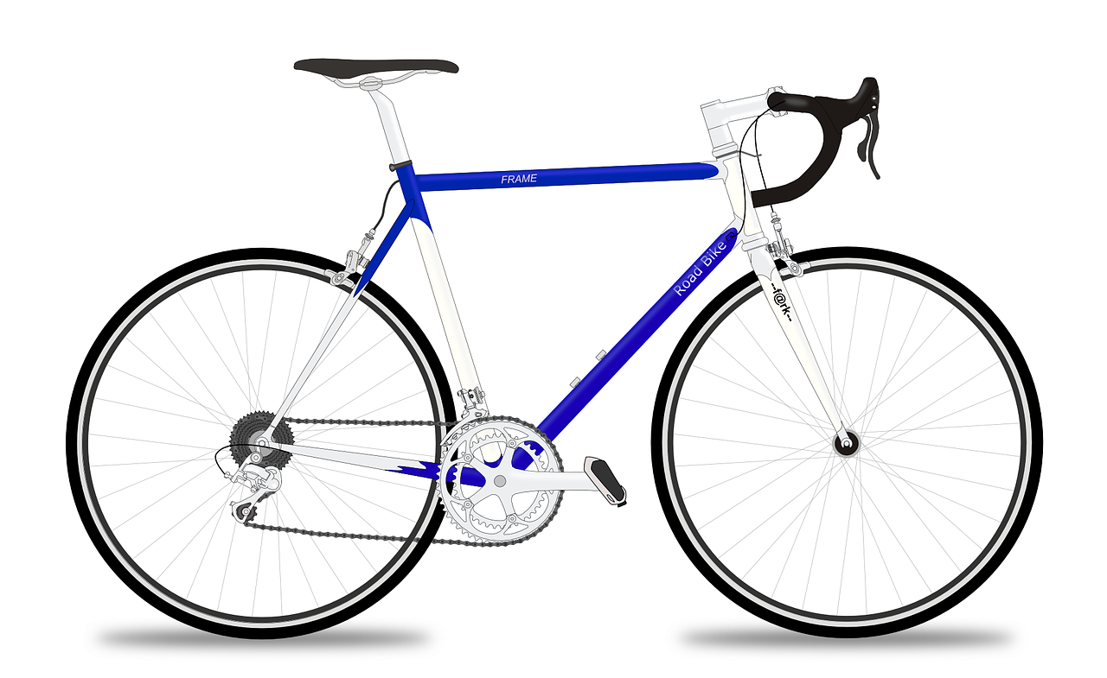
… (3/5)
parler
un vélo
Notes:
C’est un vélo.

Slide 36
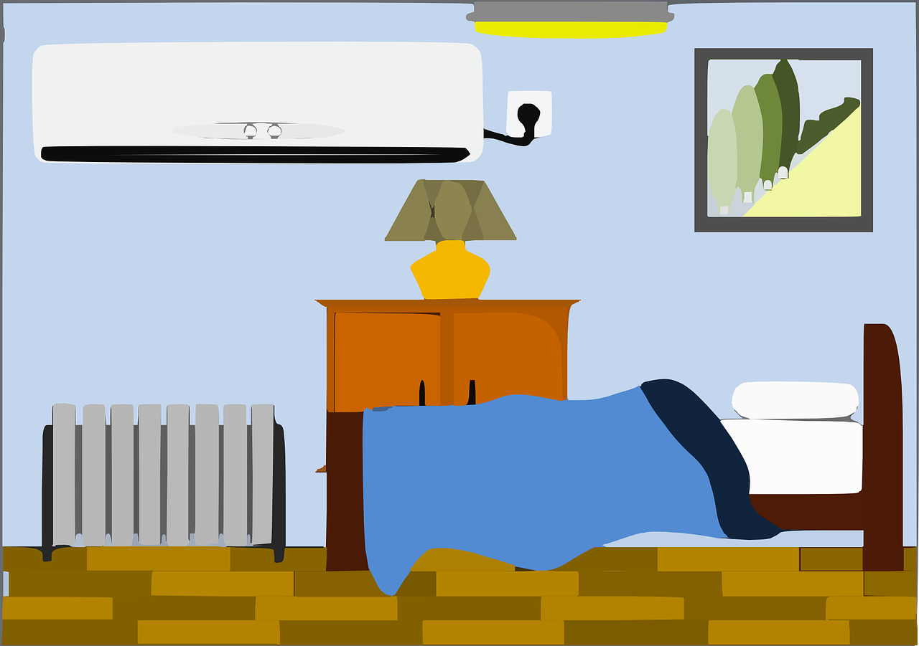
… (4/5)
parler
une chambre
Notes:
C’est une chambre.

Slide 37
… (5/5)
parler
un portable
Notes:
C’est un portable.

Slide 38
Saying ‘it’ in French
grammaire
The word ‘it’ is a pronoun. This means it replaces a noun:
In English, there is only one word for ‘it’, no matter what noun it replaces.
 |  |  | what is ‘it’ ?
1 | A computer is modern. | It is modern. | a computer
2 | A car is expensive. | It is expensive. | a car
3 | A bike is fast. | It is fast. | a bike
4 | A bedroom is quiet. | It is quiet. | a bedroom
In French, we need to know the gender of the noun that the pronoun replaces:
 |  |  | what is ‘it’ ?
1 | Un ordinateur est moderne. | Il est moderne. | un ordinateur
2 | Une voiture est chère. | Elle est chère. | une voiture
3 | Un vélo est rapide. | Il est rapide. | un vélo
4 | Une chambre est calme. | Elle est calme. | une chambre
In French, the word for ‘it’ changes if the noun it replaces is masculine or feminine.
→ il = he, it → elle = she, it
Notes:
Timing: 5 minutes
Aim: raising awareness that the word for ‘it’ in French varies depending on the noun it replaces, while in English it does not
Procedure:
1. Students identify the noun that ‘it’ replaces in each of the English sentences.
2. Do the same for the French sentences.
3. Teacher highlights the difference between the two languages and emphasises the need to think about the gender of the noun being replaced in French.

Slide 39
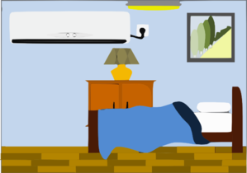
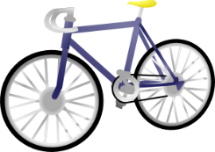
Il ou elle ?
lire
Amir is describing some of his things. What is he talking about? Write a or b.
 |  | a | b
1 | Elle est calme.
2 | Il est triste.
3 | Il est moderne.
 |  | a | b
4 | Elle est rapide.
5 | Il est drôle.
6 | Elle est sympa.
Notes:
Timing: 5 minutes
Aim: written recognition of gender agreement with il and elle meaning ‘it’.
Procedure:
1. Teacher to check students know the gender of nouns before students do the task.
2. Write 1-6 and choose if the pronoun refers to the noun in picture ‘a’ or ‘b’.
3. Click to reveal the answers.

Slide 40
J’ai un ami/une amie
écrire
Add words you want to your repertoire!
Écris un texte sur un ami/une amie.
Cécile
Introduce your friend (I have…)
Write what s/he is like (s/he is… (nationality, size))
Write about what s/he is like as a person
Mention something s/he has
Write something about yourself either a contrast: (s/he is… but I am) OR a similarity: (s/he is.. and I am also…)
Éric
Write 4 sentences Use 2 different verbs Accurate spellings Use 1 conjunction | Write 5-8 sentences Use 2 different conjunctions Use at least 2 adverbs (frequency – always, often, sometimes, or intensity – very, quite, a bit) Use a range of different adjectives accurately
Remember: to say S/He is a [nice] person. → C’est une personne [sympa].
et – and | mais – but | aussi – also
très – very | assez – quite | un peu – a litte (bit)
toujours – always | souvent – often | parfois - sometimes
Notes:
Timing: 20 minutes Aim: to revisit previously taught vocabulary and grammar in the context of a short piece of writing, bringing together language from Y7 Term 1.1 so far.
Procedure: 1. Clarify the activity with students.
2. Suggest they build their text by writing one sentence for each bullet first, and if they have time they could add another one.
3. Suggest that students read through the texts from last lesson and note any vocabulary they want to use, but then put them out of sight to write the full sentences. 4. Teachers may want to give students 10 minutes to plan the task out, and then ask them to put their notes away and write the text without referring. Clearly teachers may want to differentiate the level of challenge for different students within their classes. All levels of adaption are possible, here, including for example just asking pupils to make a list of words that they would need to do this task, but not asking them to do it.
5. Tell students that: “we are all individuals and our language repertoire (the words we learn, store and use) will be individual, too. Whilst there are lots of essential words that everyone will need (and those are the ones I’m teaching you), you will also want to add in words that are important to you to express your meanings, so start on that repertoire-building now. Look up words you need to describe your friend or you and record them in the space we’ve left for that in your exercise book.” (e.g., back pages).

Slide 41
Devoirs
Vocabulary Learning Homework (Term 1.1, Week 6)
Audio file
Student worksheet
In addition, revisit: Term 1.1.3
Notes:
Use this slide to set the homework.
For Y7, the typical homework will be to pre-learn vocabulary for the next lesson. There is an audio file to accompany the student worksheet.
Notes:
i) Teachers may, in addition, want to recommend use of a particular online app for the pre-learning of each week’s words. ii) Quizlet now requires parental involvement / registration / permissions for users below the age of 13, so it is perhaps most suitable for Y9 – 11 students. iii) Language Nut hosts LDP vocabulary lists and these are free for schools to use, though there is a registration process. One benefit is that all of the student tracking data that Language Nut offers are also available to schools that use the LDP lists for practice. Perhaps this makes it a good option for Y7/8.
iv) There are other free apps, and new ones are always appearing. Teachers have told us that they are currently using: Flippity, Wordwall (where using previously-created activities is free).
v) Gaming Grammar has been acquired by Language Nut. Its original content should still be available to teachers and much of it is appropriate for Y7 learners. From this lesson, for example, learners could practise Indefinite articles: Gender (Article Agreement) and To have and to be: 1st person and 3rd person singular.

